Slide 1

Toxic Tandem:
AKI in Liver Disease
Jacob Nysather DO

Slide 2

Disclosures
No financial disclosures

Slide 3
Objectives
Review frame-work for acute kidney injury
Understand pathophysiology of hepato-renal syndrome
Physiologic approach to AKI treatment in liver disease

Slide 4

Case
54 year old male with PMH of Cirrhosis due to Hepatitis C (post-treatment) complicated by esophageal varices, hepatic encephalopathy, and ascites requiring paracentesis. Other PMH includes: diabetes type 2, alcohol dependence, tobacco use. He presents to the ED for worsening abdominal pain for the last 3 days.
NKDA
Meds: Propranolol 10mg BID, furosemide 40mg, spironolactone 100mg, lactulose, metformin 500mg BID

Slide 5
Case
Vitals:
  HR 92, BP 92/54, RR 20, SpO2 96% on RA
Physical:
  Chronically ill
  Jaundice
  Pulm/CV: WNL
  Abd: Distended with +fluid wave, mild tenderness
  Ext: 1-2+ BLE edema

Slide 6
Case
CMP: Na 129, K 3.6, Cl 94, CO2 20, Cr 1
LFT: T. Bili 10, ALT 10, AST 12, Alb 2.7, T.Prot 5.6
CBC: WBC 12, Hgb 11.2, PLT 112
INR 1.6
UA: 2+ urobilogen
Urine Studies: Una <10, Ucr 60

Slide 7
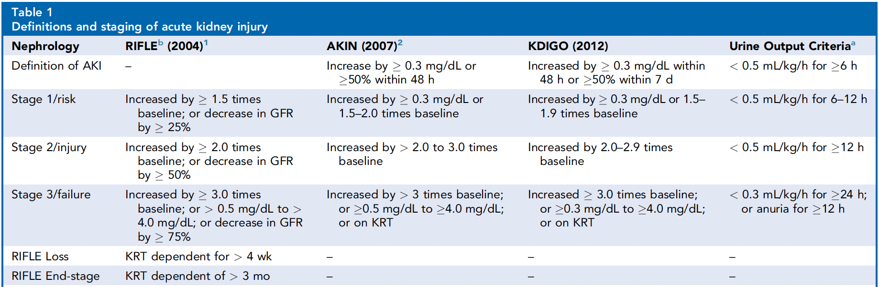
Definition of AKI
Intervent Card Clin. 2023

Slide 8
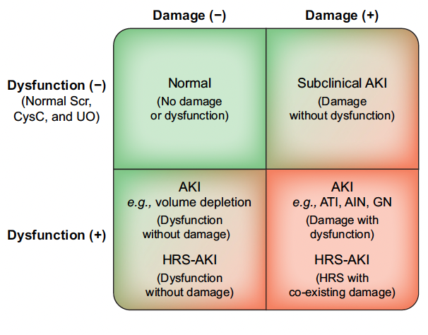
Nadim, MK. et al. J Hepatol. 2024

Slide 9
What are some causes of AKI?

Slide 10
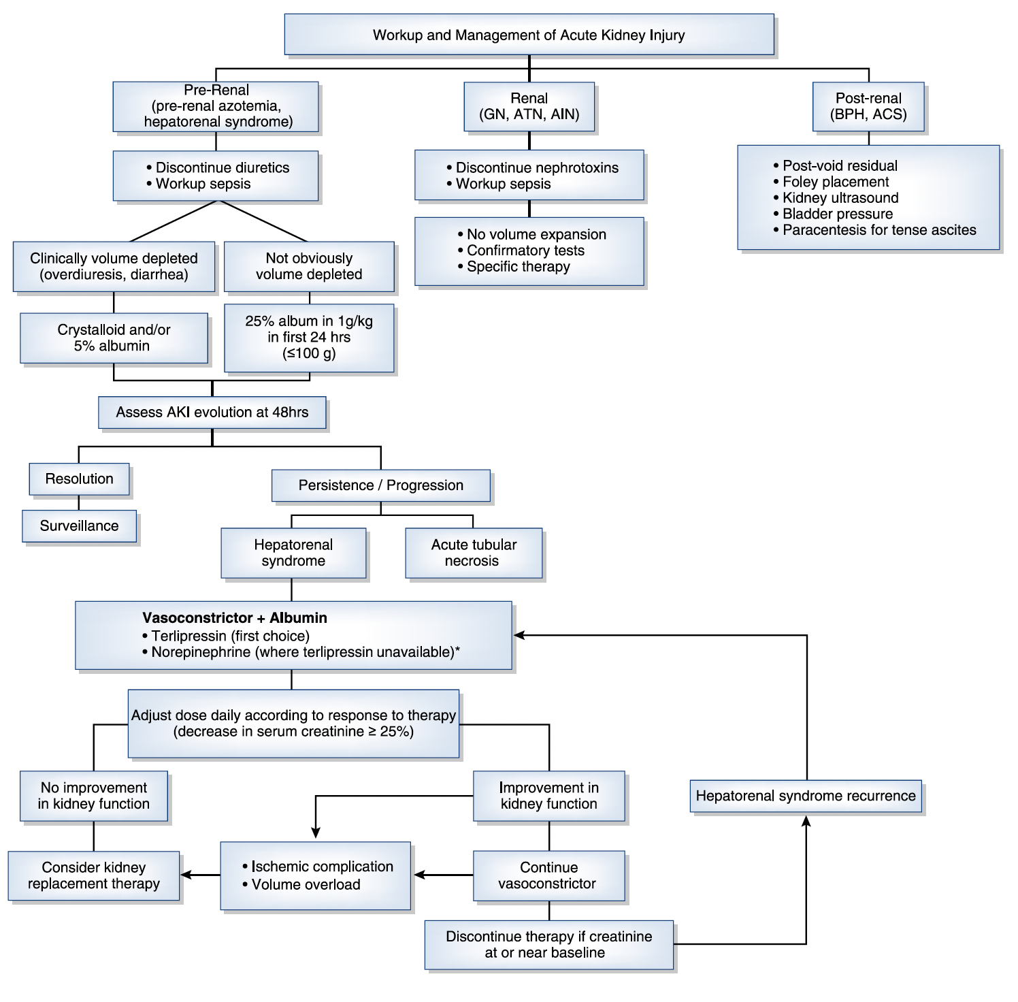
Francoz, C. et al. CJASN 2019

Slide 11
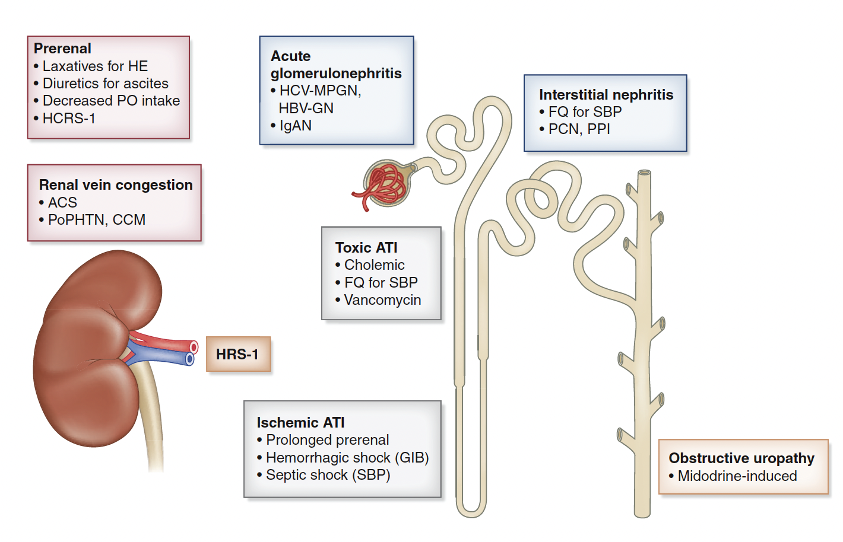
Cullaro, G. et al. CJASN 2022

Slide 12
Francoz, C. et al. CJASN 2019

Slide 13
What is your leading diagnosis?

Slide 14
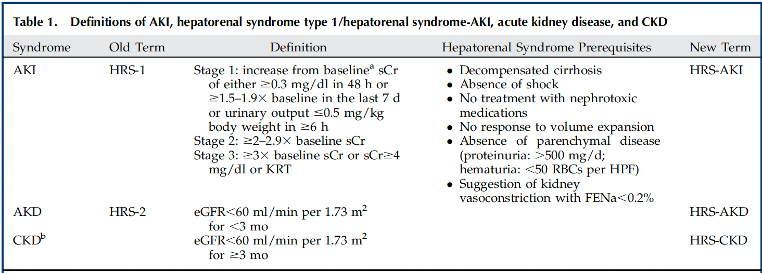
Hepato-Renal Syndrome
Cullaro, G. et al. CJASN 2022

Slide 16
Pathophysiology of HRS
Cirrhosis
Portal Hypertension
Splanchnic/Systemic Vasodilation
  Activation of neurohormonal
Decreased EABV
Cardiac Compensation
  MAP = CO x SVR
Renal Perfusion
Inflammation

Slide 17
Cirrhosis -> Portal Hypertension
Patients with cirrhosis, particularly those with ascites, have an increased susceptibility to AKI because of the hemodynamic alterations that result from portal hypertension
The initial mechanism in the pathogenesis of portal hypertension is increased intrahepatic resistance due to distortion of the liver architecture (fibrosis and nodules) and an increase in intrahepatic vascular tone
Portal Vein Thrombosis

Slide 18
Portal Hypertension -> Vasodilation, SVR
Subsequent activation of vasodilators in the splanchnic circulation (the most important being nitric oxide) leads to progressive splanchnic and systemic vasodilatation
Increased translocation of bacteria and bacterial products due to intestinal dysbiosis, bacterial overgrowth, and altered tight-junction proteins contributes further to vasodilatation (inflammation – PAMP/DAMP)
Resulting in a reduction in the Effective Arterial Blood Volume (EABV)
30% of patients with hepatorenal syndrome have systemic inflammatory response syndrome without documented bacterial infection
Vasodilatory meds: RAASi, NSBB
Infection/Sepsis

Slide 19
Decrease in EABV
This will activate the neurohumoral systems (the renin– angiotensin–aldosterone, sympathetic, and arginine–vasopressin systems) leading to sodium and water retention and ascites formation
In advanced stages of cirrhosis, progressive vasodilatation leads to more avid retention of sodium and water, resulting in refractory ascites and dilutional hyponatremia, respectively
Diuretics
Diarrhea
LVP
Bleeding

Slide 20
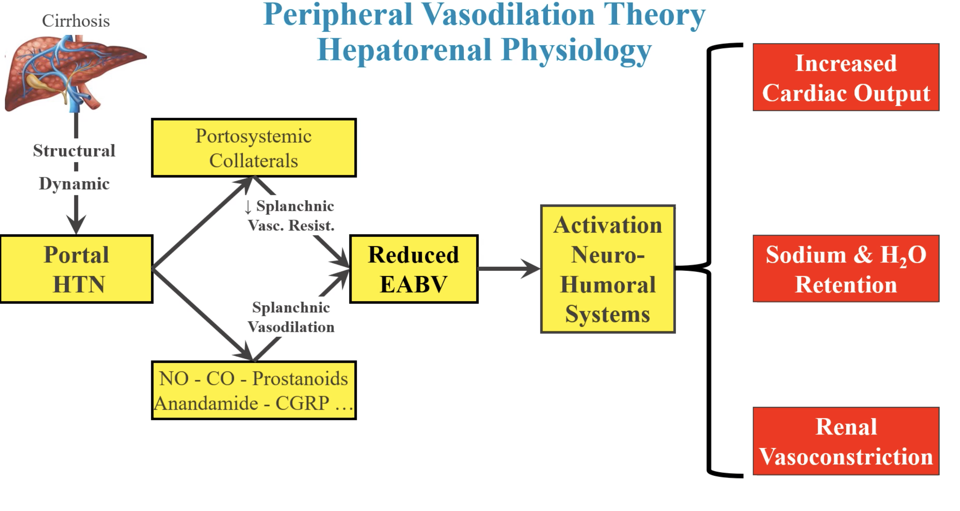
Dr. Juancos. ASN 2022

Slide 21
Cardiac Effects
Initially there is compensation for decreased systemic vascular resistance (SVR) by increasing cardiac output (CO) and hypertrophy/fibrosis (high-output heart failure)
  Vasodilator mediators
  Inflammation leading to vasodilation
Over time cardiac compensation will weaken causing ventricular dilation and relative decrease in cardiac output response (cirrhotic cardiomyopathy)
Further decompensation of the heart will contribute to decreased renal perfusion
Volume Overload
Meds decreasing CO (NSBB)

Slide 22
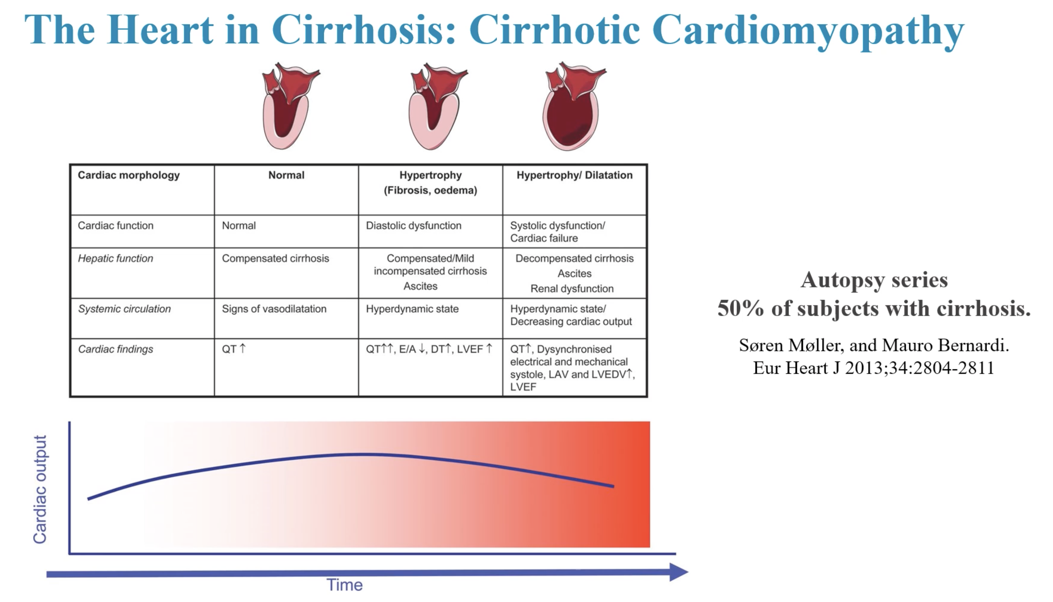
Dr. Juancos. ASN 2022

Slide 23
Renal Effects
With progressive vasodilatation, vasoconstrictive systems (mainly renin and angiotensin) are activated, resulting in renal vasoconstriction and decreased renal blood flow
The reduced renal blood flow results in a decrease in the glomerular filtration rate (GFR) and a prerenal type of kidney injury that does not respond to volume expansion — that is, HRS-AKI
Renal vasoconstriction in patients with cirrhosis is not countered by the release of vasodilatory substances (e.g., prostaglandins) because of a decrease in their production and local release of vasoconstrictors such as endothelin.
Further alteration in renal perfusion pressures
Volume Overload, RAASi, NSAIDs

Slide 24
Sodium Retention -> Ascites
Pathogenesis of renal vasoconstriction and decreased renal blood flow in cirrhosis (“hepatorenal physiology”) represents a continuum of the mechanisms that initially lead to ascites.
Thus, patients with cirrhosis who have ascites, particularly those with refractory ascites, are at the highest risk not only for the development of AKI but also for its most severe clinical form, HRS-AKI

Slide 25
Although HRS-AKI can occur in the absence of a precipitating factor, it is more commonly precipitated by factors that cause a decrease in effective arterial blood volume
These factors include rapid fluid loss (e.g., excessive diuresis or gastrointestinal bleeding), worsening vasodilatation induced by drugs (e.g., angiotensin converting– enzyme inhibitors), and a systemic inflammatory response (e.g., infection)
Not all cases of AKI in patients with cirrhosis result from renal hypoperfusion; some cases may result from structural kidney injury. However, renal hypoperfusion may lead to structural kidney injury when prolonged or when coupled with a “second hit,” such as exposure to nephrotoxic medications, resulting in a delay in renal recovery.

Slide 26
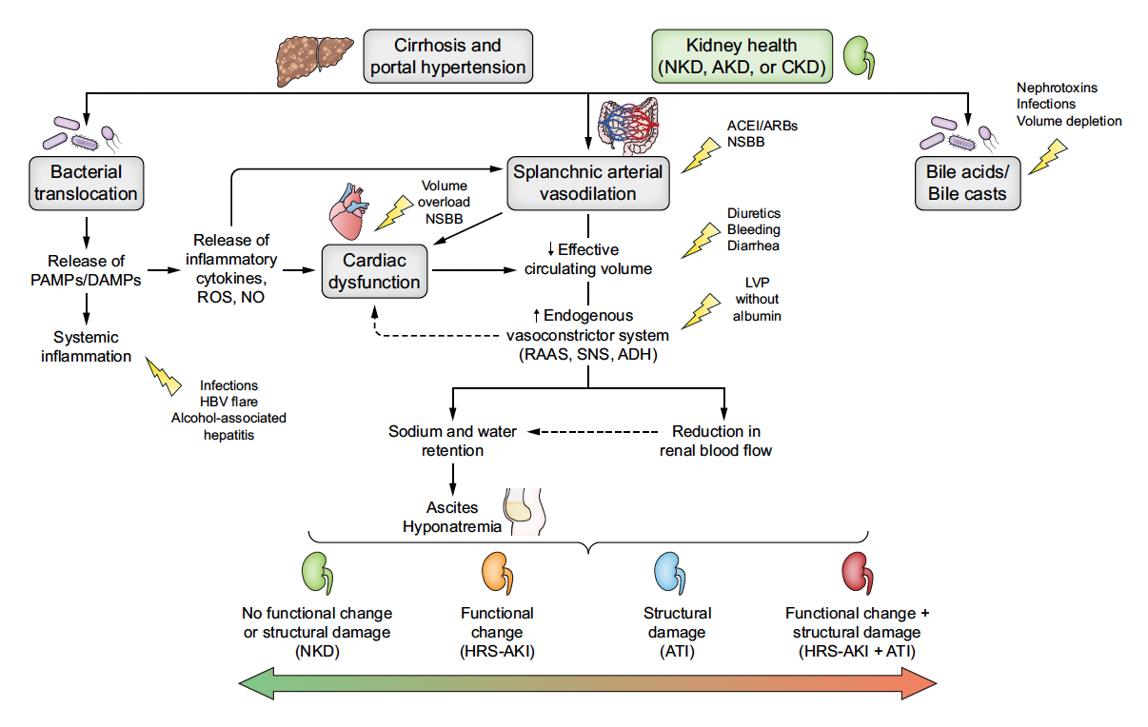
Nadim, MK. et al. J Hepatol. 2024

Slide 27
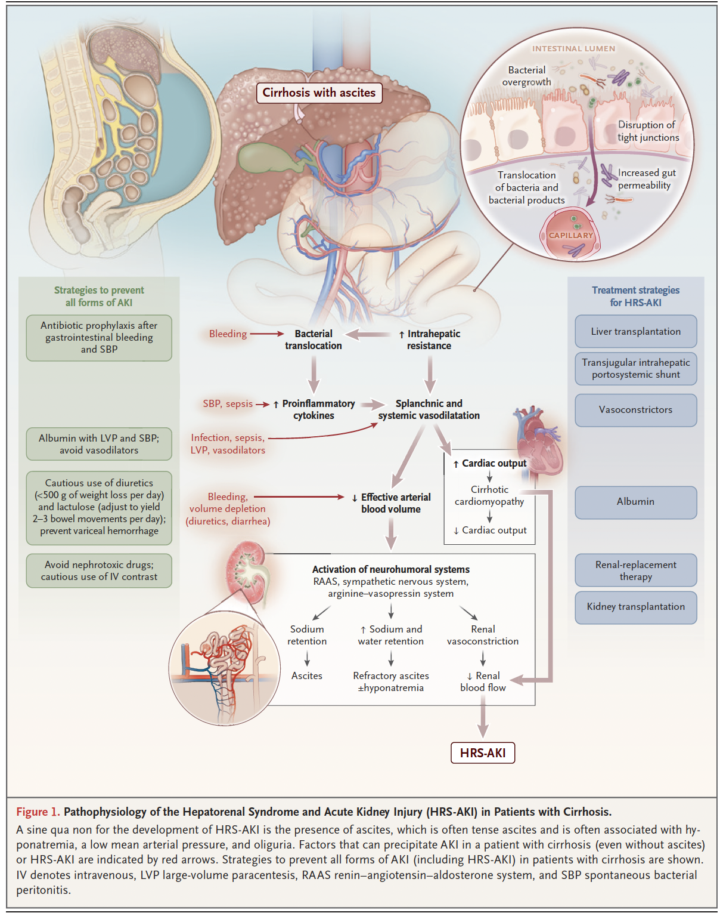
Nadim, MK. et al. NEJM. 2023

Slide 28
You are concerned the patient has HRS-AKI. What are you going to do?

Slide 29
Treatment
Withdrawal of Offending Agents
Volume Assessment
Renal Perfusion

Slide 30
Treatment
Withdrawal of Offending Agents
Volume Assessment
Renal Perfusion

Slide 31
Withdrawal of Offending Agents
In the purest sense, as with any other complex condition, reversing/removing inciting cause will give the best chance at response
  Removing contributing medications
  Targeted treatment of infection
  Reversing triggers (hypovolemia)

Slide 32
Withdrawal of Offending Agents
Hold diuretics (initially)
Stop RAAS or Sympathetic Blockers (BB)
Identify any nephrotoxins (NSAIDs, Antibiotics)
Laxatives?

Slide 33
Treatment
Withdrawal of Offending Agents
Volume Assessment
Renal Perfusion

Slide 34
Volume Assessment
Intravascular volume assessment
  POCUS, ECHO
Hypovolemic/Euvolemic
Hypervolemic

Slide 35
Volume Assessment – Hypo/Euvolemia
Hypovolemic/Euvolemic
  Albumin is fluid of choice for volume replacement in cirrhotics
  Albumin 1g/kg/d for 48hr (max 100g/d)*
    Followed by 20-40g/d
Hemorrhage
  Blood products
  Source Control

Slide 36
Volume Assessment - Albumin
Increased oncotic pressure leading to restoration of EABV
Treatment of HRS-AKI with albumin alone does not appear to be effective
Despite its lack of efficacy as monotherapy for HRS-1, albumin may augment the efficacy of vasoconstrictor therapy
May cause or exacerbate extracellular volume overload and pulmonary edema and that these effects may be potentiated by concomitant use of a vasoconstrictor

Slide 37
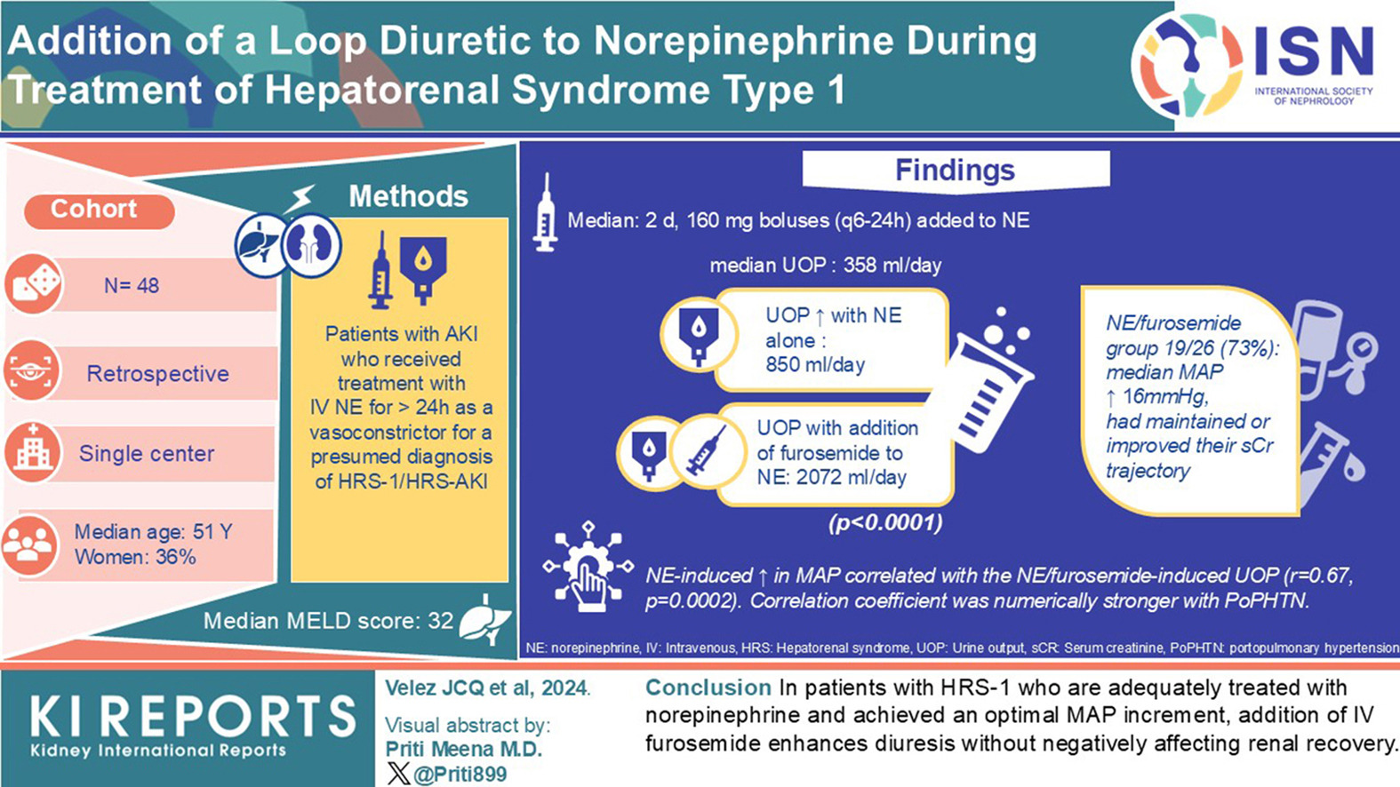
Volume Assessment - Hypervolemia

Slide 38
Treatment
Withdrawal of Offending Agents
Volume Assessment
Renal Perfusion

Slide 39
Renal Perfusion
Vasoconstriction
Intra-abdominal hypertension (IAH)
Improved hepatic flow
Target MAP = 10-15mmHg higher (or MAP >75mmHg)

Slide 40
Renal Perfusion - Vasoconstriction
Terlipressin
  Synthetic vasopressin analog with preferential affinity for the V1 receptor
  First-line therapy where the drug is approved
  1–2-mg IV bolus every 4–12 h and can also be administered via continuous infusion
  Does not require administration by a central venous line or intensive care unit monitoring
  CONFIRM trial, the largest RCT of any vasoconstrictor agent for treatment of HRS-1
  Respiratory failure may relate to simultaneous increases in venous return and afterload that exceed the cardiac reserve

Slide 41
Renal Perfusion - Vasoconstriction
Norepinephrine
systemic vasoconstriction through stimulation of α-adrenergic receptors in the radial smooth muscle of arteries and arterioles and by increasing myocardial contractility through stimulation of the β-1 adrenergic receptors
continuous infusion via central venous access starting at 0.5 mg/h

Slide 42
Renal Perfusion - Vasoconstriction
Midodrine and Octreotide
Midodrine produces systemic vasoconstriction via selective α-1 adrenergic agonism
  2.5-15mg TID
Octreotide is a somatostatin analog that causes splanchnic vasoconstriction by inhibiting the release of endogenous vasodilators (e.g., glucagon)
  100–200 μg every 8 h
dose-escalated based on changes in MAP or sCr
Midodrine and octreotide were dosed to achieve an increase in MAP ≥ 15 mmHg and resulted in improved renal plasma flow, GFR, and urine sodium excretion.
Mortality was 1 of 5 patients in the midodrine and octreotide group compared to 7 of 8 patients receiving low-dose dopamine

Slide 43
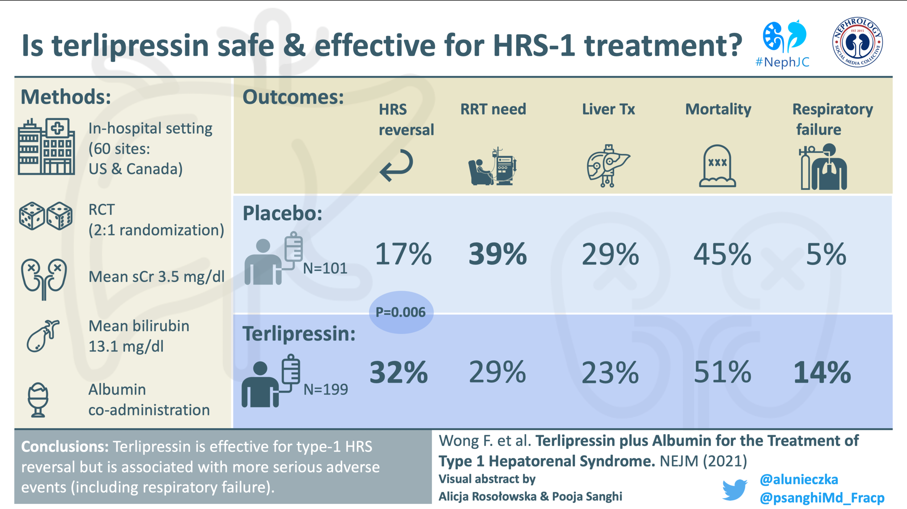
Renal Perfusion - Vasoconstriction

Slide 44
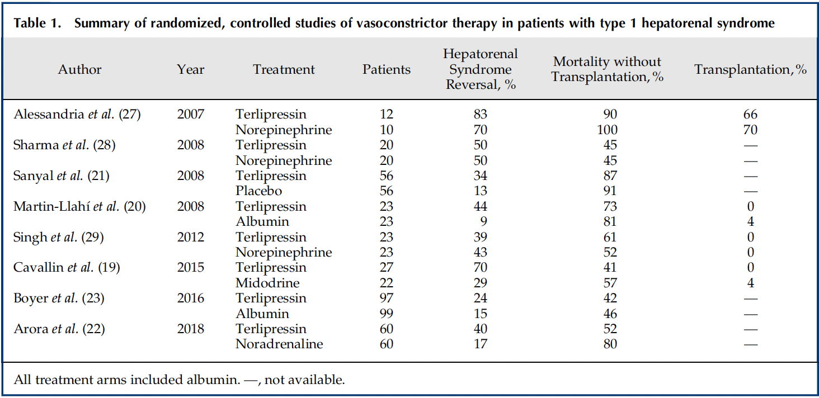
Renal Perfusion - Vasoconstriction
Francoz, C. et al. CJASN 2019

Slide 45
Renal Perfusion – IAH
Abdominal Compartment Syndrome
  20mmHg + New Organ Dysfunction
Intra-abdominal Hypertension
  Normal: 4-7mmHg, Obese 8-12mmHg
  IAH: >12 mmHg
MAP – IAP = RP

Slide 46
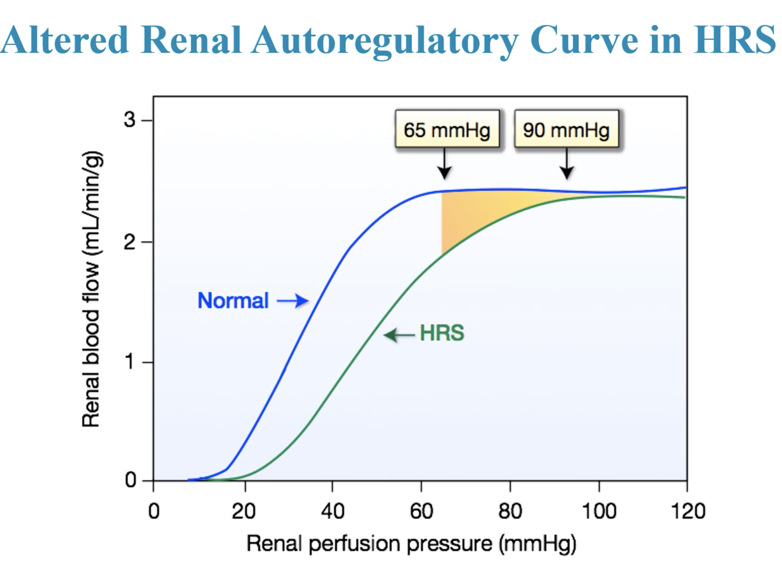
Dr. Juancos. ASN 2022

Slide 47
Renal Perfusion – Hepatic Flow
Transjugular intrahepatic portosystemic shunt (TIPS)
  Refractory ascites and recurrent esophageal bleeding
  In patients without AKI, TIPS has been associated with improvement in kidney function and it has been suggested that TIPS could be used to reverse HRS-1
  128 patients with HRS across 9 studies demonstrated a 93% rate of kidney function improvement in patients with HRS-1
Not sufficient evidence
TIPS was associated with an increased risk for HE

Slide 48
Treatment
Withdrawal of Offending Agents
  Target underlying trigger
  Stop RAASi, BB, Volume depleting agents, Nephrotoxins
Volume Assessment
  POCUS/ECHO
  Hypo-Euvolemic: Albumin
  Hypervolemic: Diuresis
Renal Perfusion
  Vasoconstrictors: Terlipressin > Norepinephrine > Midodrine/Octreotide
  IAH: Paracentesis

Slide 49
Treatment
Withdrawal of Offending Agents
Volume Assessment
Renal Perfusion
Definitive treatment of HRS is a liver transplant

Slide 50
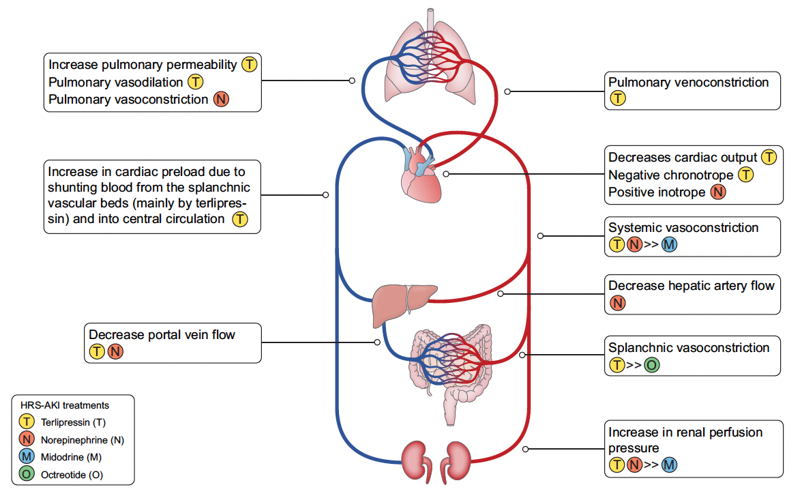
Nadim, MK. et al. J Hepatol. 2024

Slide 51
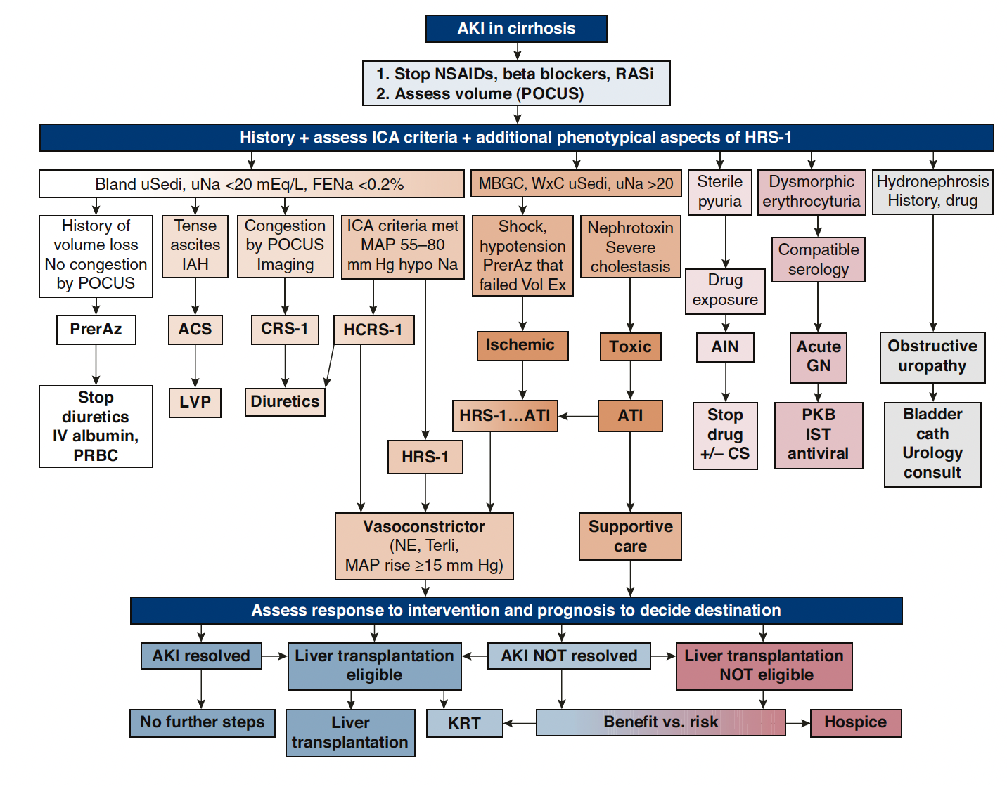
Cullaro, G. et al. CJASN 2022

Slide 52
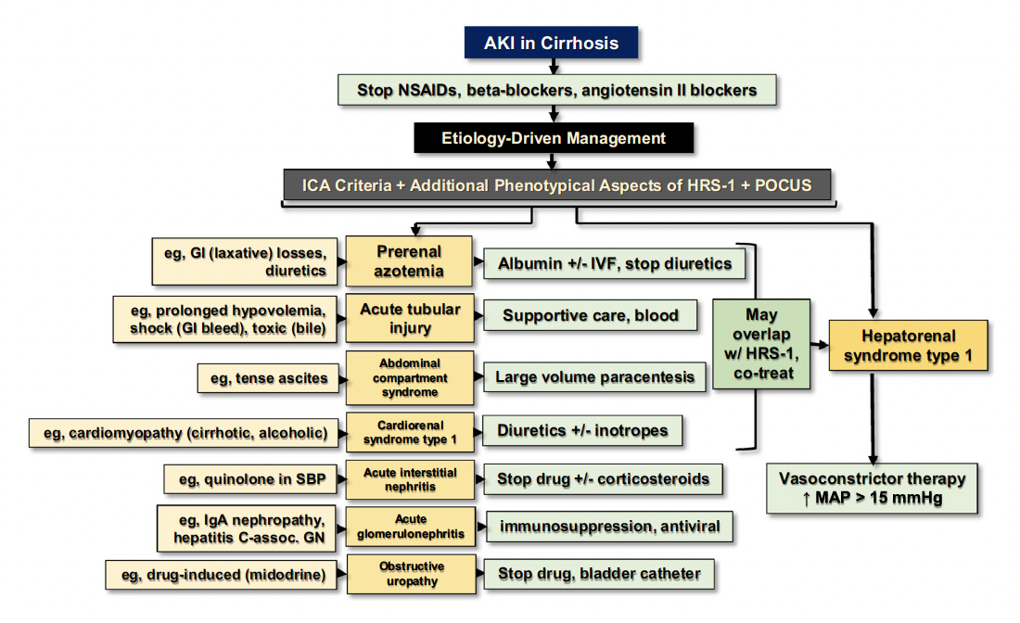

Slide 53
Survival

Slide 54
Despite our best efforts, our patient continues to decompensate to requiring transfer to ICU. Developing respiratory failure and now not responding to therapy with worsening AKI and now anuric
His family asks what are the likely outcomes

Slide 55
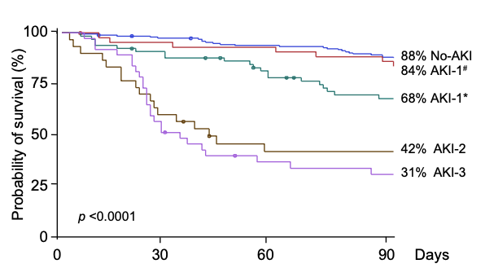
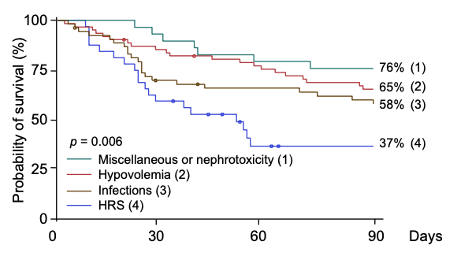
Survival
Fagundes. et al. J Hepatol 2013

Slide 56
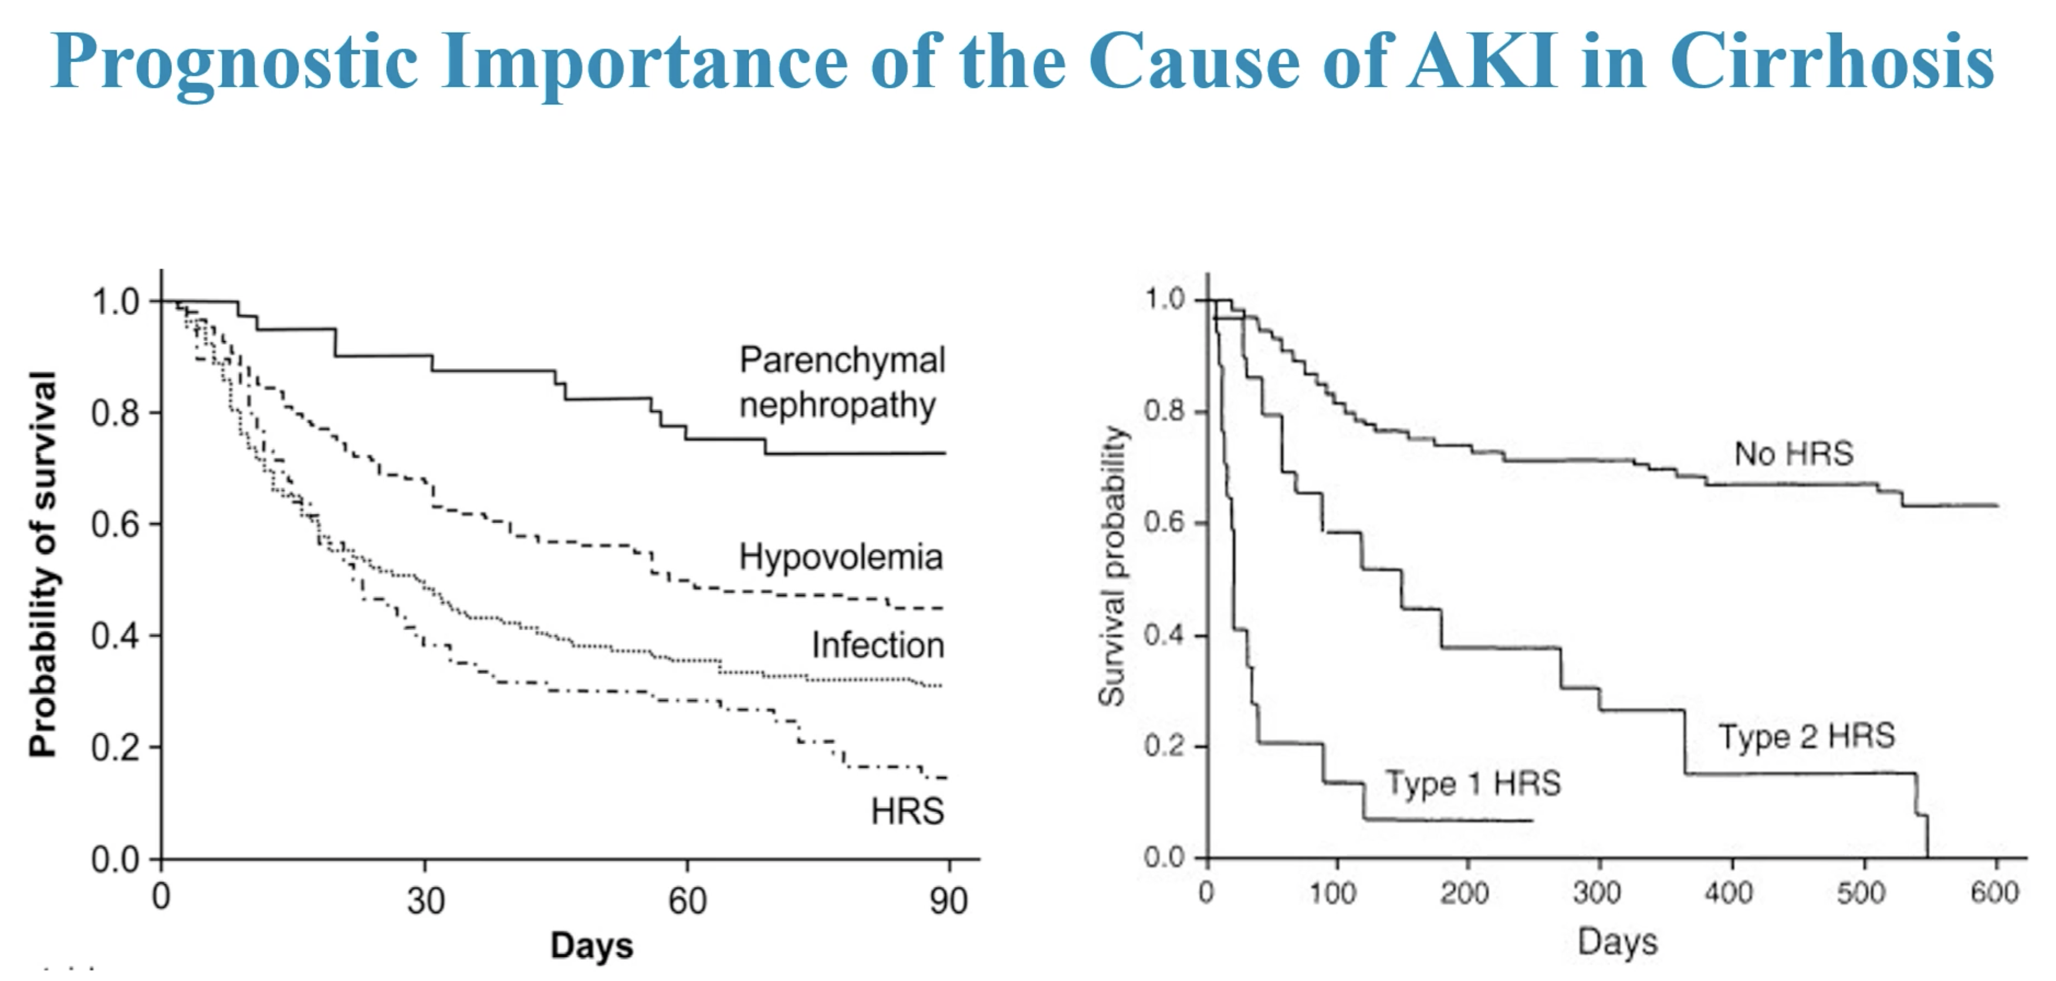
Dr. Juancos. ASN 2022

Slide 57
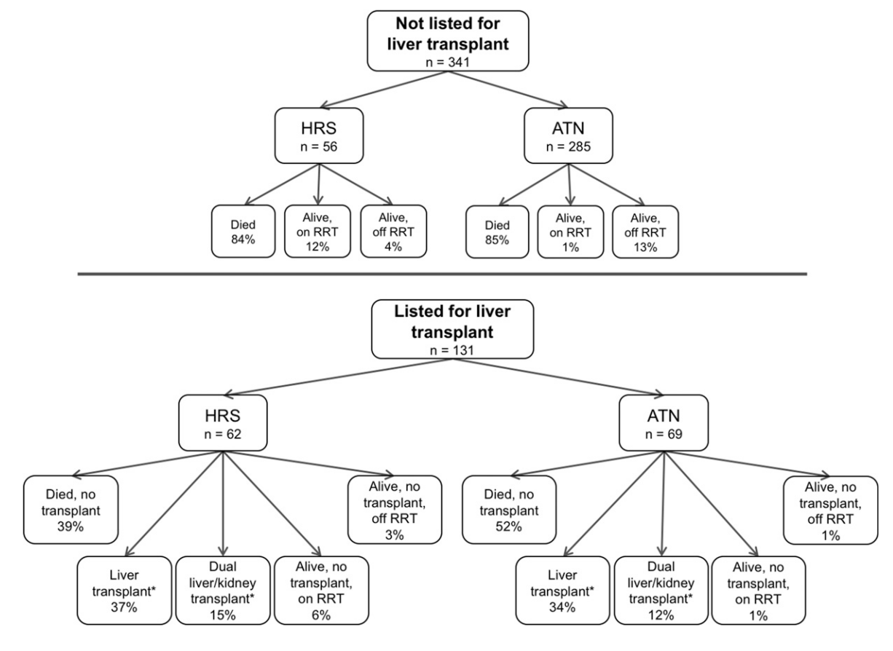
Allegretti, et al. CJASN. 2018

Slide 58
Treatment
Ultimately after discussion, was not a candidate for KRT due to exclusion from liver transplantation. Family proceeded with comfort care.

Slide 59
Summary
Remember the basics of AKI evaluation
Not all Liver AKIs are HRS
  Misdiagnosis is common
  There can be overlapping etiologies
Fluid is a medication, assess patient’s needs daily
After reversal of triggering event, target the physiology for best opportunity of success in HRS reversal

Slide 60
Thank you

Slide 61
Allegretti AS, Parada XV, Eneanya ND, Gilligan H, Xu D, Zhao S, Dienstag JL, Chung RT, Thadhani RI. Prognosis of Patients with Cirrhosis and AKI Who Initiate RRT. Clin J Am Soc Nephrol. 2018 Jan 6;13(1):16-25. doi: 10.2215/CJN.03610417. Epub 2017 Nov 9. PMID: 29122911; PMCID: PMC5753306.
Birkelo BC, Pannu N, Siew ED. Overview of Diagnostic Criteria and Epidemiology of Acute Kidney Injury and Acute Kidney Disease in the Critically Ill Patient. Clin J Am Soc Nephrol. 2022 May;17(5):717-735. doi: 10.2215/CJN.14181021. Epub 2022 Mar 15. PMID: 35292532; PMCID: PMC9269585.
Cullaro G, Kanduri SR, Velez JCQ. Acute Kidney Injury in Patients with Liver Disease. Clin J Am Soc Nephrol. 2022 Nov;17(11):1674-1684. doi: 10.2215/CJN.03040322. Epub 2022 Jul 28. PMID: 35902128; PMCID: PMC9718035.
Fagundes C, Barreto R, Guevara M, Garcia E, Solà E, Rodríguez E, Graupera I, Ariza X, Pereira G, Alfaro I, Cárdenas A, Fernández J, Poch E, Ginès P. A modified acute kidney injury classification for diagnosis and risk stratification of impairment of kidney function in cirrhosis. J Hepatol. 2013 Sep;59(3):474-81. doi: 10.1016/j.jhep.2013.04.036. Epub 2013 May 10. PMID: 23669284.
Francoz C, Durand F, Kahn JA, Genyk YS, Nadim MK. Hepatorenal Syndrome. Clin J Am Soc Nephrol. 2019 May 7;14(5):774-781. doi: 10.2215/CJN.12451018. Epub 2019 Apr 17. PMID: 30996046; PMCID: PMC6500947.
Gudsoorkar PS, Nysather J, Thakar CV. Definition, Staging, and Role of Biomarkers in Acute Kidney Injury in the Context of Cardiovascular Interventions. Interv Cardiol Clin. 2023 Oct;12(4):469-487. doi: 10.1016/j.iccl.2023.06.004. PMID: 37673492.
Nadim MK, Kellum JA, Forni L, Francoz C, Asrani SK, Ostermann M, Allegretti AS, Neyra JA, Olson JC, Piano S, VanWagner LB, Verna EC, Akcan-Arikan A, Angeli P, Belcher JM, Biggins SW, Deep A, Garcia-Tsao G, Genyk YS, Gines P, Kamath PS, Kane-Gill SL, Kaushik M, Lumlertgul N, Macedo E, Maiwall R, Marciano S, Pichler RH, Ronco C, Tandon P, Velez JQ, Mehta RL, Durand F. Acute kidney injury in patients with cirrhosis: Acute Disease Quality Initiative (ADQI) and International Club of Ascites (ICA) joint multidisciplinary consensus meeting. J Hepatol. 2024 Jul;81(1):163-183. doi: 10.1016/j.jhep.2024.03.031. Epub 2024 Mar 26. PMID: 38527522; PMCID: PMC11193657.
Nadim MK, Garcia-Tsao G. Acute Kidney Injury in Patients with Cirrhosis. N Engl J Med. 2023 Feb 23;388(8):733-745. doi: 10.1056/NEJMra2215289. PMID: 36812435.

Slide 62
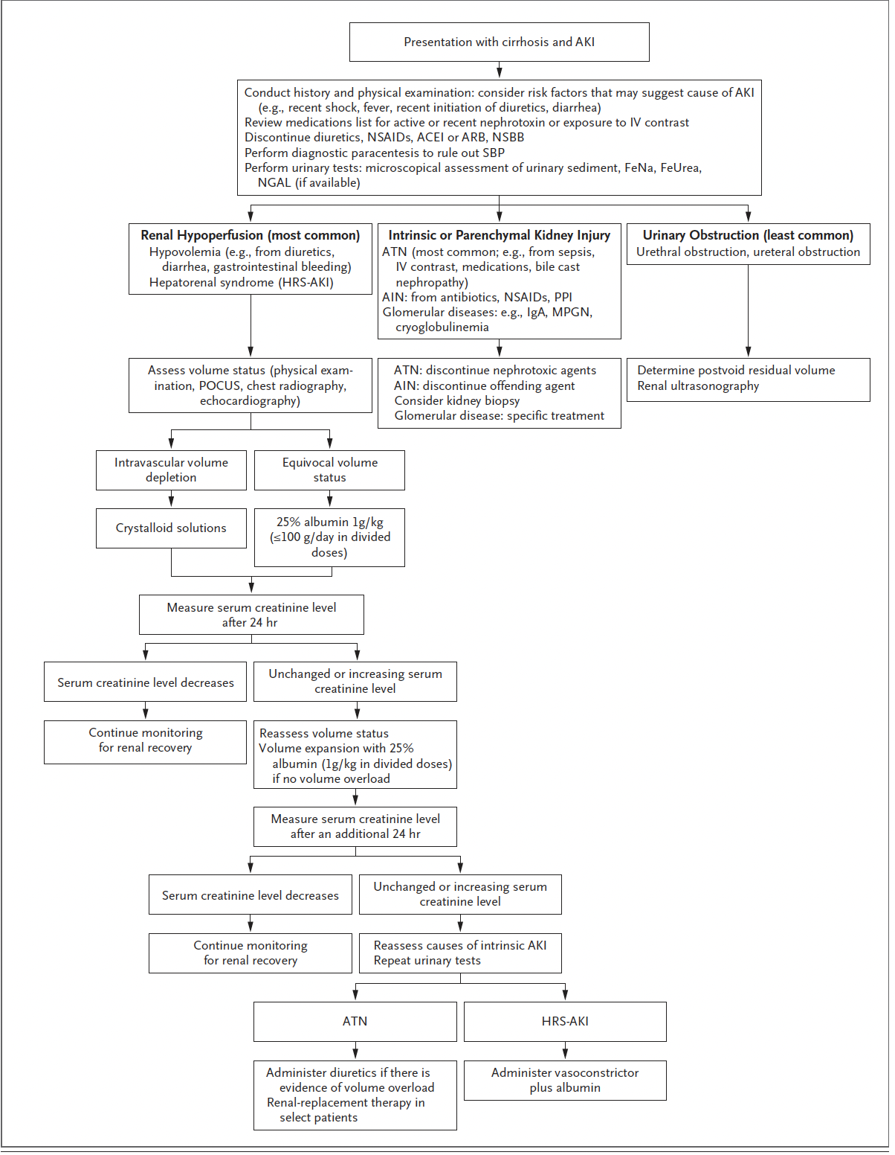
Nadim, MK. et al. NEJM. 2023

Slide 63
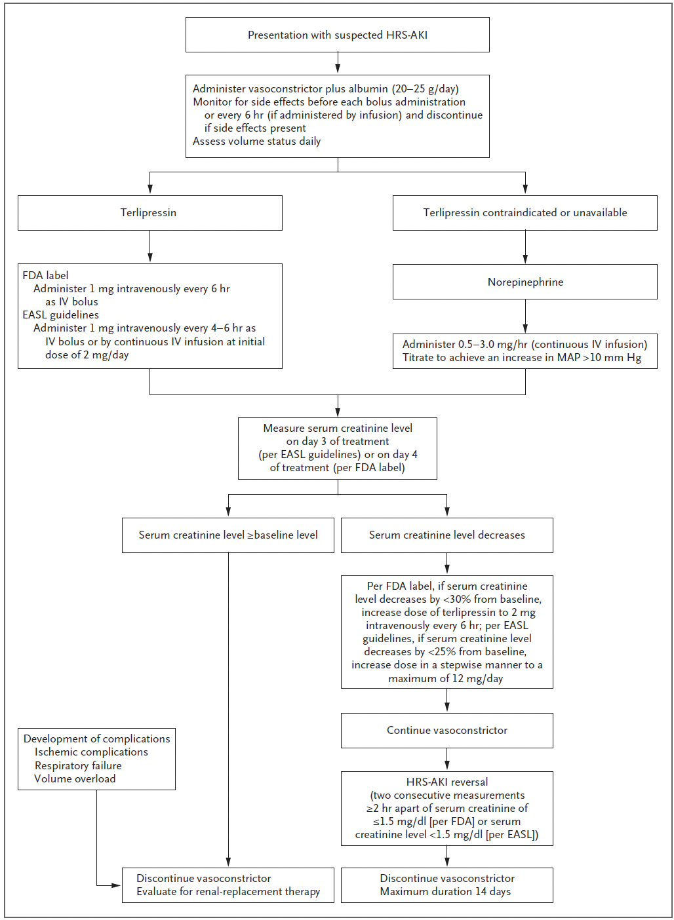
Nadim, MK. et al. NEJM. 2023

Slide 64
Francoz, C. et al. CJASN 2019

Slide 65
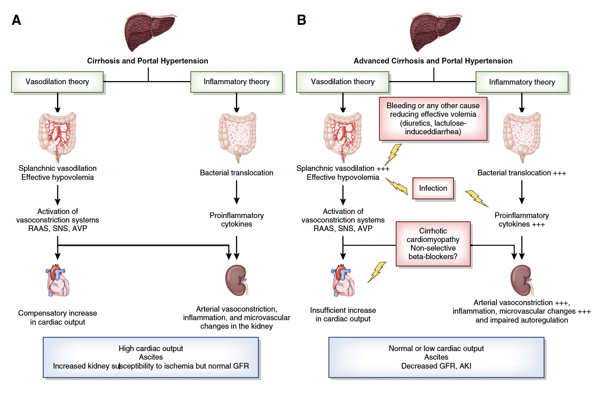
Francoz, C. et al. CJASN 2019

Slide 66
Francoz, C. et al. CJASN 2019

