Slide 1

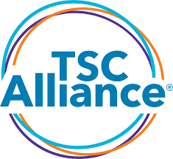
Tuberous Sclerosis Complex
The Kidney
Model for Oncogenesis
Jacob Nysather D.O.
Twitter/X: @drjakenysather
Assistant Professor of Medicine, Division of Nephrology, University of Cincinnati
Adult Nephrology Care – TSC Clinic, Cincinnati Children’s Hospital
Assistant Program Director, Nephrology Fellowship, University of Cincinnati

Slide 2

Disclosures
No financial disclosures

Slide 3
Objectives
Identify common clinical and genetic characteristics of TSC
Identify kidney manifestations associated with TSC
Treatment options available for aforementioned kidney disease
Recognize mTORC1 pathway of TSC as a potential model for oncogenesis

Slide 4
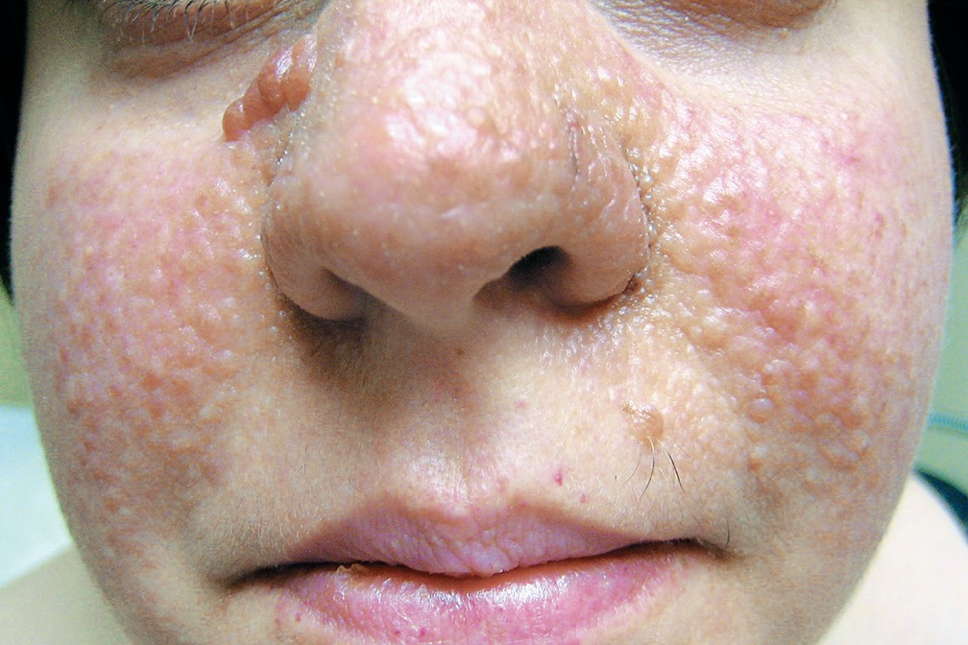
Case 1
A 14 year old girl was evaluated in the ED after a motor vehicle accident. CT imaging revealed a total of 5 simple cysts (2 left and 3 right) with a solid mass noted on each kidney (Right 7mm -7HU and Left 4mm -5HU). Her lab work was unremarkable and after observation was discharged with follow-up recommended to nephrology for incidental kidney lesions/cysts.
Upon further history in your clinic you find 3 hypopigmented macules and skin colored telangectatic papules of varying size over the face that she calls acne. She reports a history of seizures, last at age 5. She has no family history of any kidney or neurologic diseases.
You suspect that she has tuberous sclerosis complex, but are unsure if she meets criteria for diagnosis.
Images used from google search

Slide 5
What is Tuberous Sclerosis Complex
Monogenic multisystem disorder characterized by benign tumor formation in multiple organ systems (brain, skin, lungs, heart, and kidney).
  Despite a common genetic etiology, composition and timing of lesion formation varies widely across affected tissues
Inheritance Pattern:
  Autosomal dominant disorder (1/3)
    50/50 chance of passing along to child if 1 parent is affected.
  Sporadic (2/3)
Incidence: 1:6,000-10,000 births
Prevalence: >1 million worldwide
Across all racial and ethnic groups

Slide 6
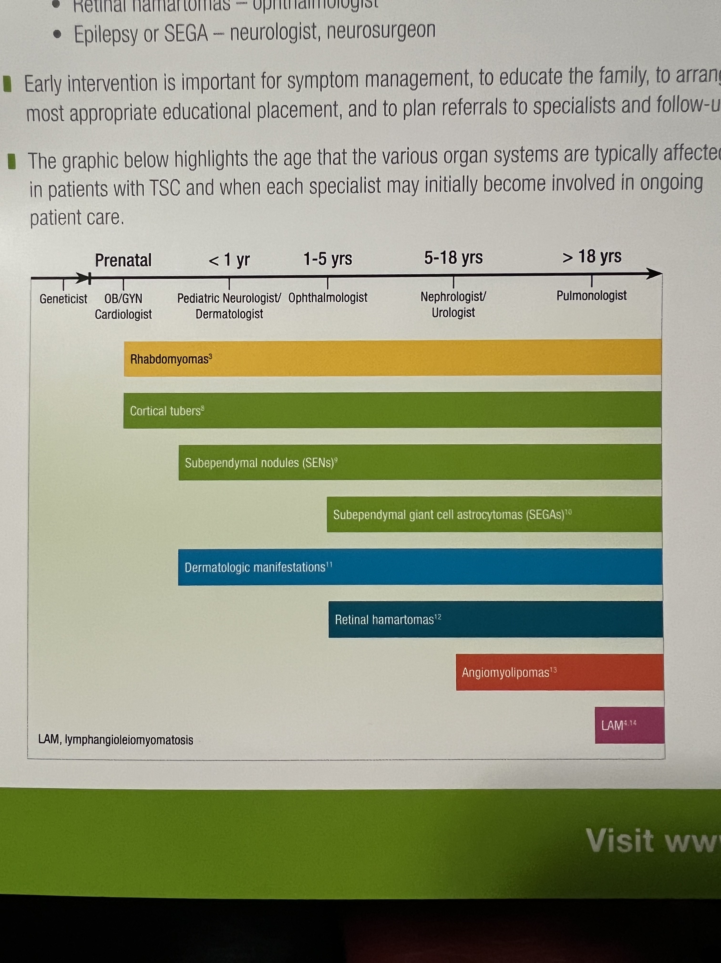
Clinical Presentation
Classic (Vogt’s) triad of facial angiofibromata, developmental delay, and intractable epilepsy occurs in < 40%
www.facingTSC.com

Slide 7
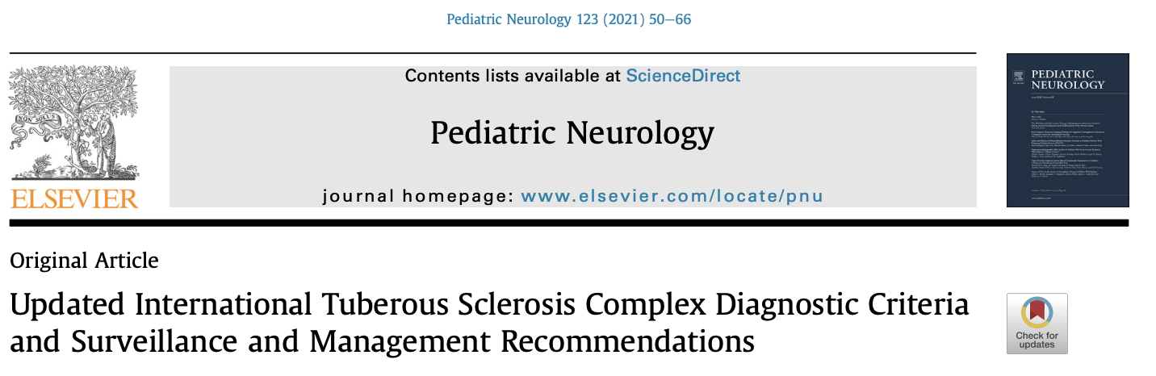
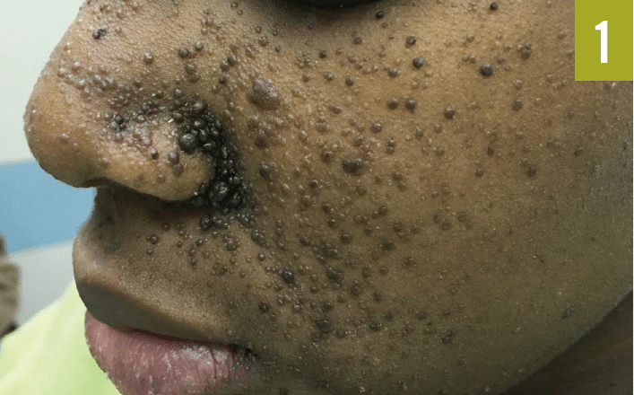
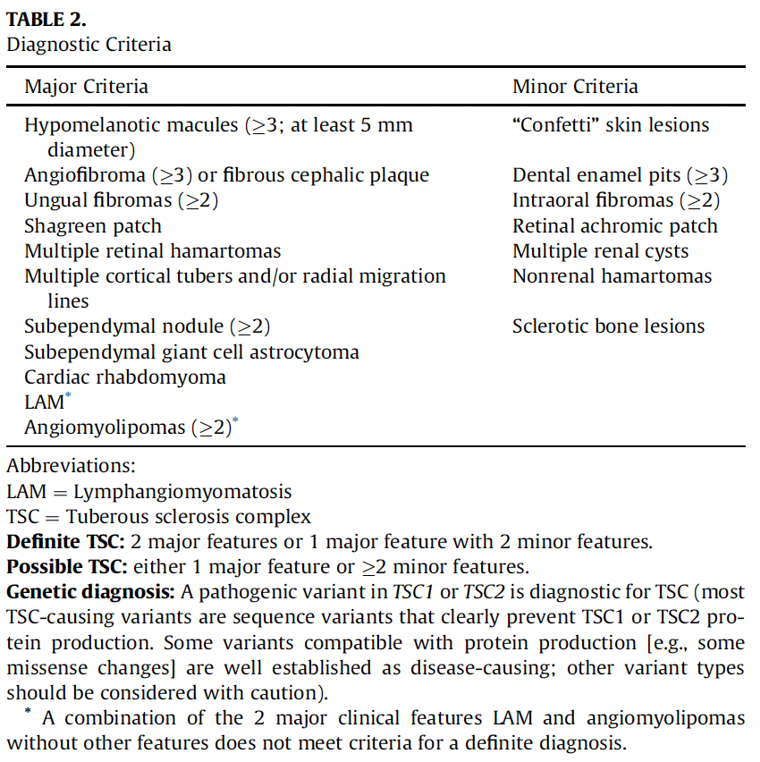
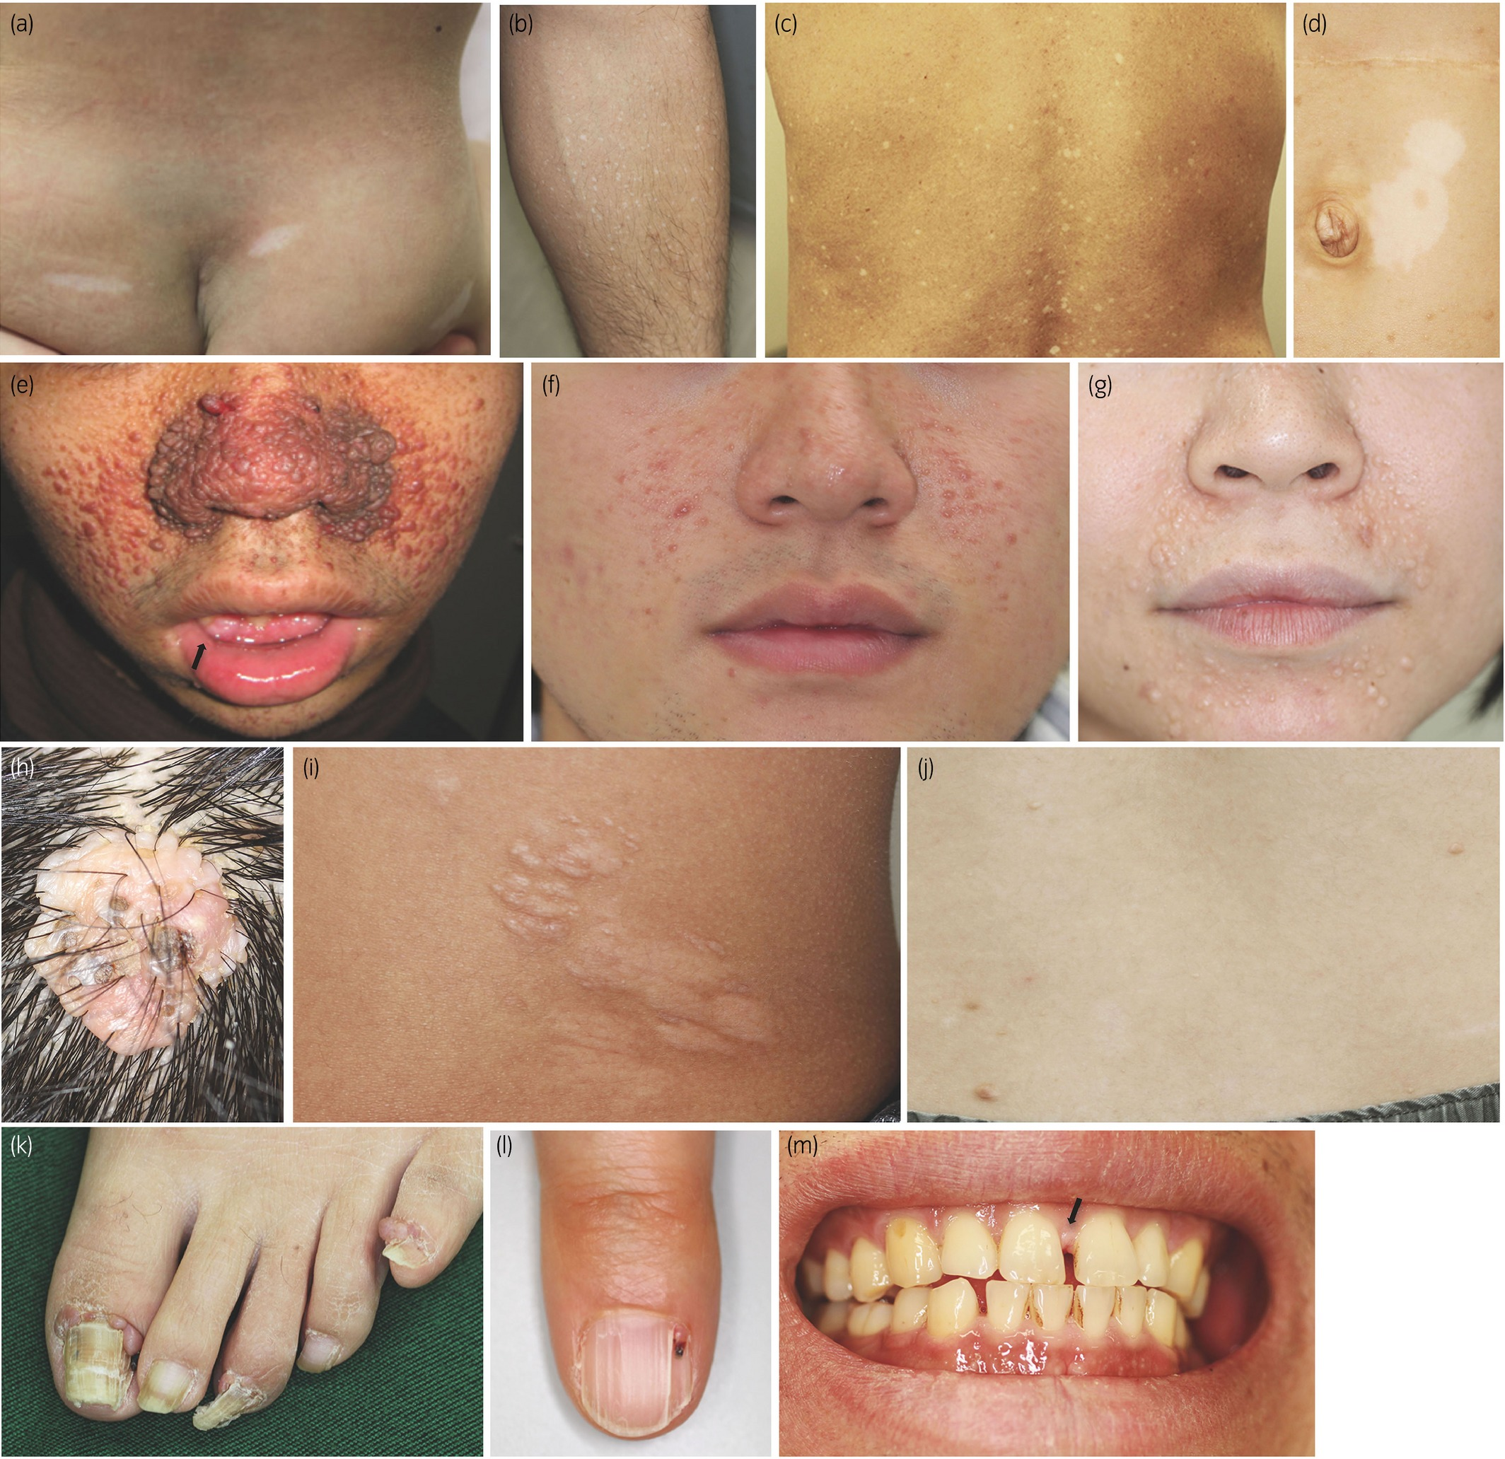
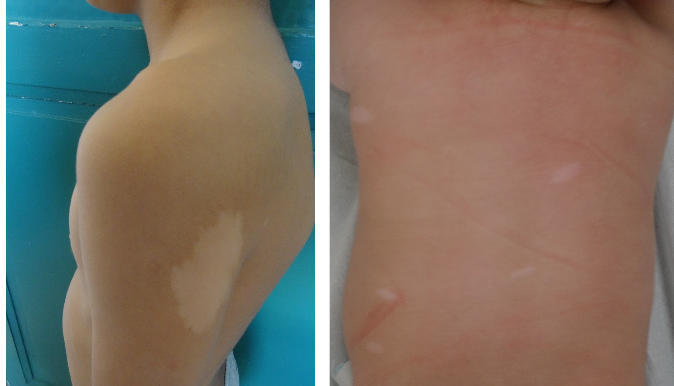
TSC Alliance
for Healthcare
Professionals
Images used from google search

Slide 8
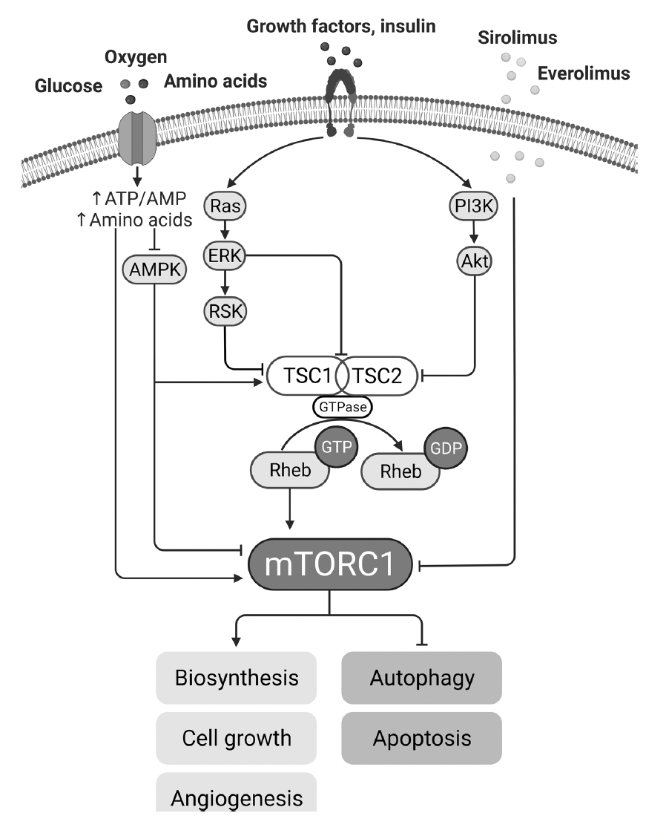
Genetic and Physiologic Basics
Autosomal dominance, loss of function mutation of TSC1 9q34 (hamartin) and TSC2 16p13 (tuberin)
  More than 1800 mutations identified
  Up to 90% of mutations are noted within these 2 genes
  10% are negative for mutations but present with clinical features or have specific tissue markers consistent with TSC1/TSC2 (Mosaicism)
  TSC2 has a 3 times more common than TSC1
TSC2 is adjacent to PKD1 and can have a mixed phenotypical pattern with ADPKD (2-3%) “Contiguous Gene Syndrome”
Tuberin and Hamartin are 2 proteins that along with TBC1D7 form a functional heterotrimeric complex (TS Complex)
  responds to physiological stress (hypoxia, energy depletion, and growth factor deficiency)
TS Complex, during normal function, dephosphorylates Rheb which prevents activation of mTORC1 (Mechanistic Target of Rapamycin Complex 1)
When mTOR is active, it inhibits autophagy/apoptosis and stimulates biosynthesis, angiogenesis, and cell growth
Gallo-Bernal S et al, Cystic kidney disease in TSC, Ped Nephrology 2023

Slide 9
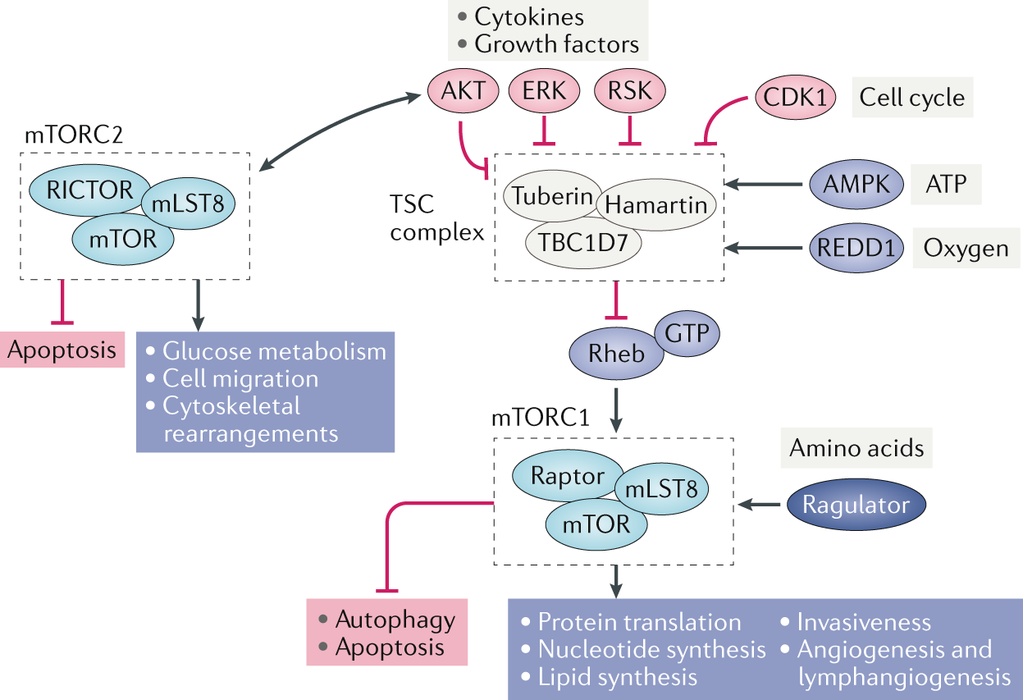
Lam HC et al, Renal disease in TSC, Nature Nephrology 2018

Slide 10
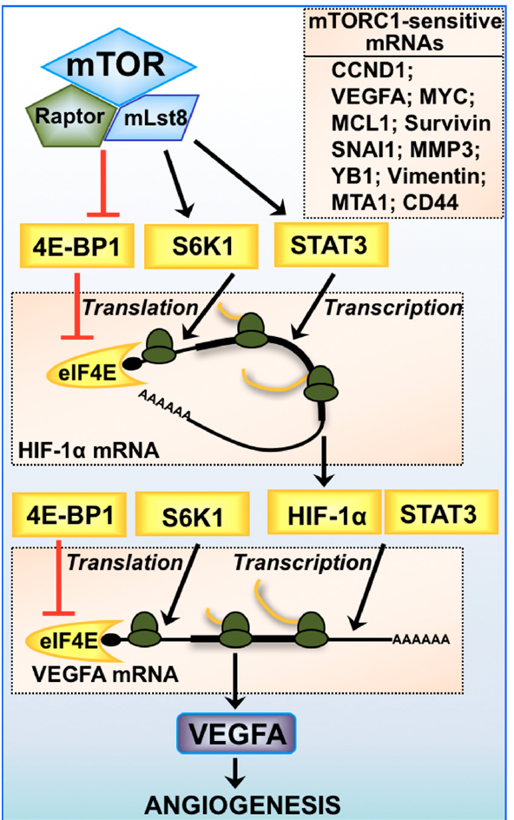
Angiogenesis
HIF Activation
  Promote cell survival
  Promotes glucose uptake, angiogenesis, proliferation and metastasis.
  High levels of HIF protein expression often correlates with an increased risk of mortality in many cancer types
Loss of TSC2 was found to induce a 7-fold increase in HIF-1 transcriptional activity in conditions of hypoxia, which was partially restored upon treatment with rapamycin
Several different anti-cancer therapeutics available targeting VEGF
Rad E., et al, Oncogenetic Signaling in mTOR, Cancers 2018
Dodd KM., et al, Tuberous Sclerosis model for Tumor Growth, Semin Cell Dev Biol 2016

Slide 11
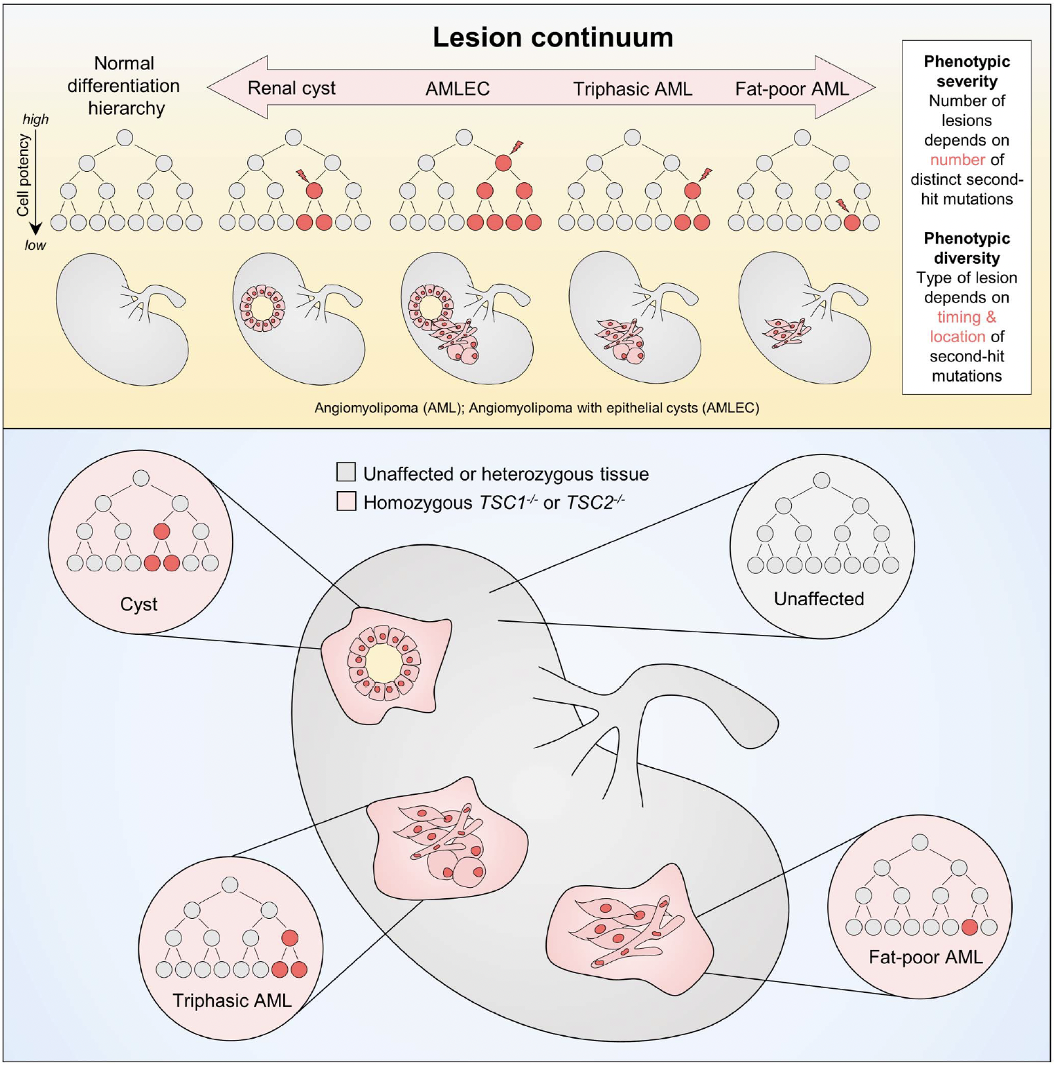
Second Hit Hypothesis
While initial germline inactivation of single TSC1 or TSC2 alleles may be sufficient to cause some syndrome features, tumor growth requires additional somatic mutation of the remaining normal allele (second hit). The loss of this heterozygosity via gene conversion or acquisition of compound heterozygous gene mutations has been identified in a wide variety of TSC associated tumors – Kidney lesions
Pietrobon A et al, TSC Kidney Lesion Pathogenesis, JASN 2023

Slide 12
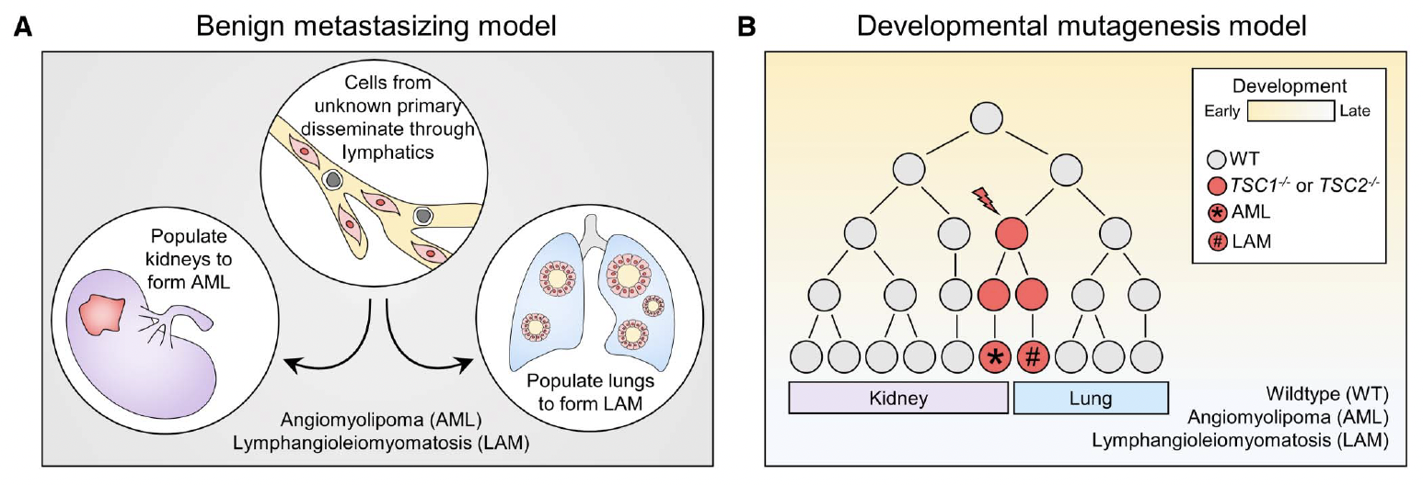
Pietrobon A et al, TSC Kidney Lesion Pathogenesis, JASN 2023

Slide 13
Case 2
A 26 year old female was recently diagnosed with sporatic lymphangiomyomatosis (LAM) after a spontaneous pneumothorax 1 month post partum of the birth of her second child requiring talc pleuridesis. As part of her evaluation she was diagnosed with TSC 2 mutation with bilateral AMLs, largest of which is 32mm on the right. A few simple kidney cysts are noted as well, all of which are 6mm or less.
Is this cancer since they are tumors?

Slide 14
Kidney Manifestations
Kidney contributes to one of the leading causes of mortality
Renal manifestations more prominent in TSC2

Slide 15
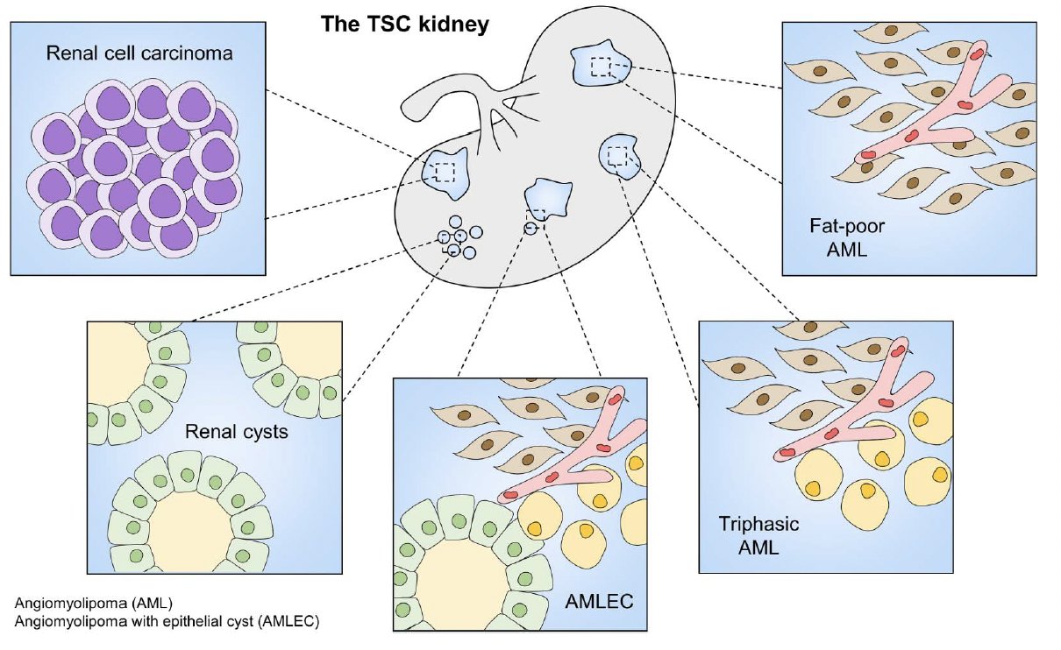
Kidney Manifestations
Kidney contributes to one of the leading causes of mortality
Renal manifestations more prominent in TSC2
Types
  Angiomyolipoma
Pietrobon A et al, TSC Kidney Lesion Pathogenesis, JASN 2023

Slide 16
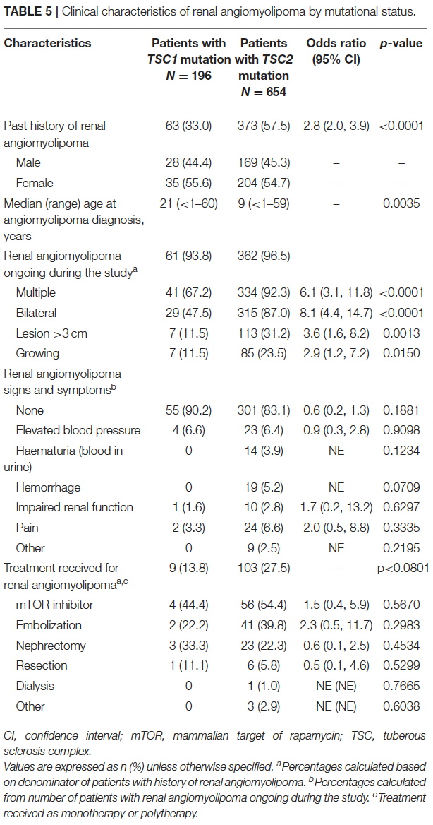
Angiomyolipoma (AML)
Prevalence is > 10 million people world-wide
  Approximately 1/10th are associated with TSC or Lymphangioleiomyomatosis (LAM)
  Affects up to 80% in TSC and 60% of Sporadic LAM
  Genetic associations: Multiple, bilateral, younger age of onset (~10 years old), size
    Not usually detectable prior to school age. Rapid growth during pre-adolescence and adolescence
    Increasing incidence with age
    Female favored, estrogen sensitive*
Kingswood JC et al, Renal Manifestations TSC TOSCA, Front Neuro 2020

Slide 17
Angiomyolipoma (AML)
Perivascular Epithelioid Cell tumor (PEComas) family that exhibit both smooth muscle and melanocytic differentiation
  Imaging: Solid masses
  Histologically contain abnormal blood vessel wall architecture surrounded by smooth muscle-like perivascular cells and adipocyte-like cells
Classic, Typical, or “Triphasic” Variant
  Contain all 3 components are various degrees. Such lesions typically do not behave as a malignant lesion
  Predominant type
  Skew toward 1-2/3 lineage
Atypical, Fat-poor/invisible, or Epithelioid
  Exhibit significant mitotic activity with few or no abnormal vessels or fat cells.
  Potential to show aggressive behavior, lesion recurrence after resection.
  Sometimes may be difficult to differentiate from RCC

Slide 18
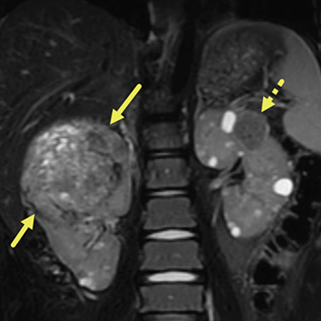
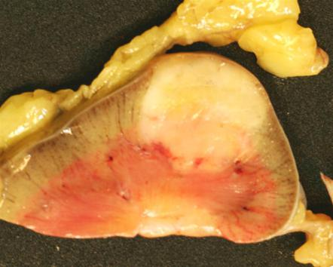
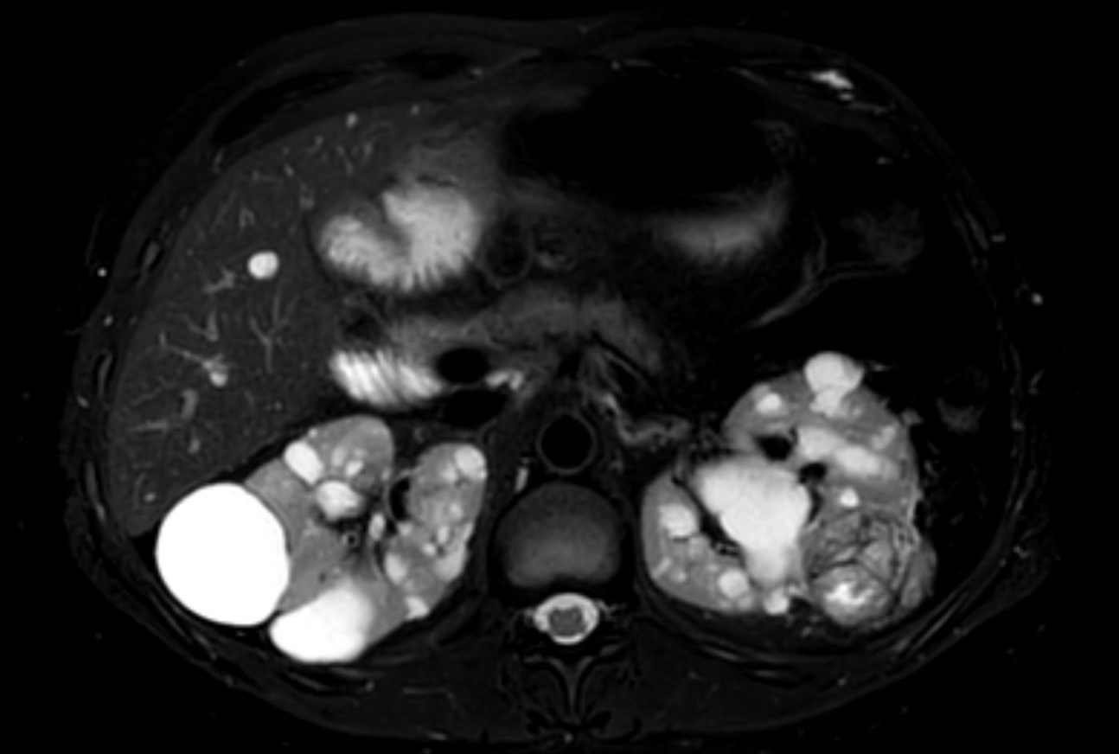
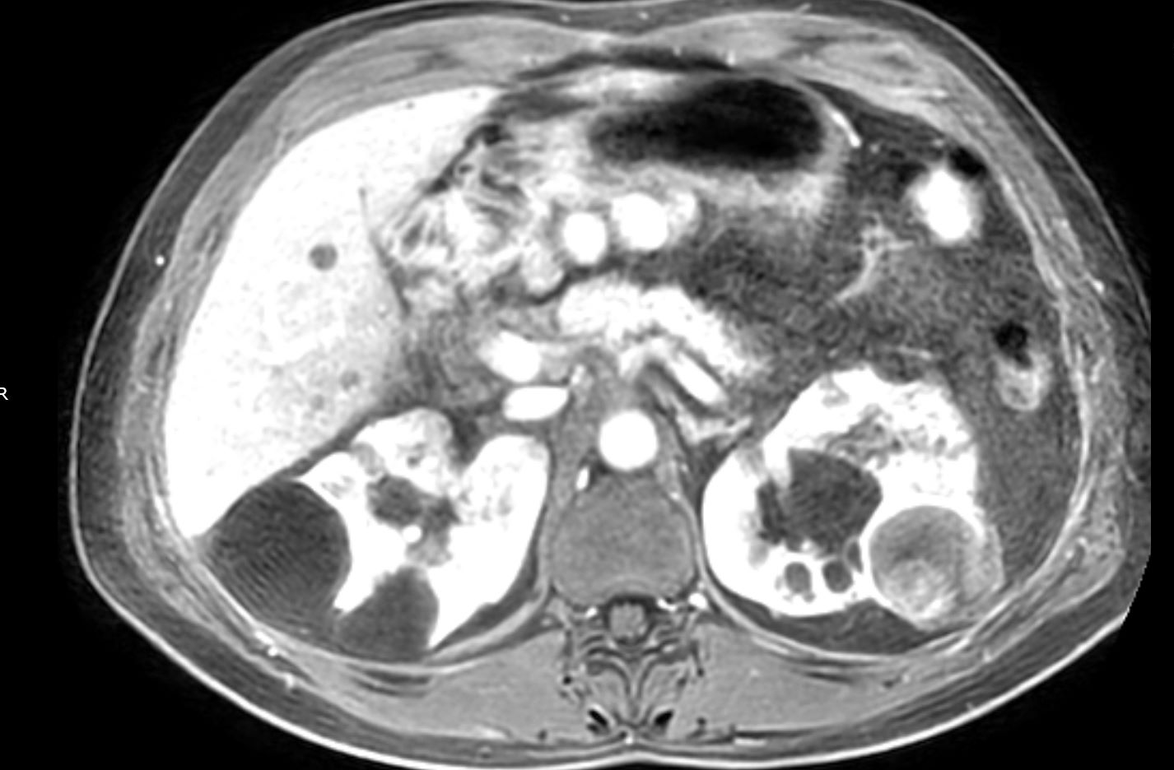
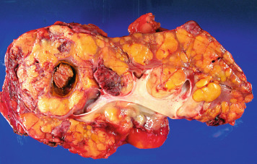
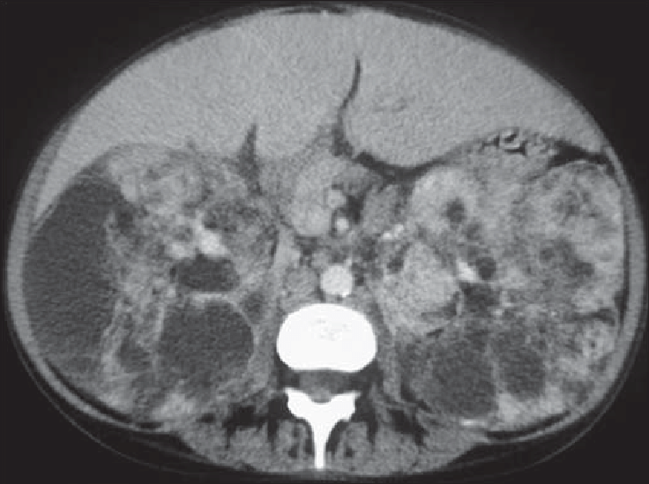
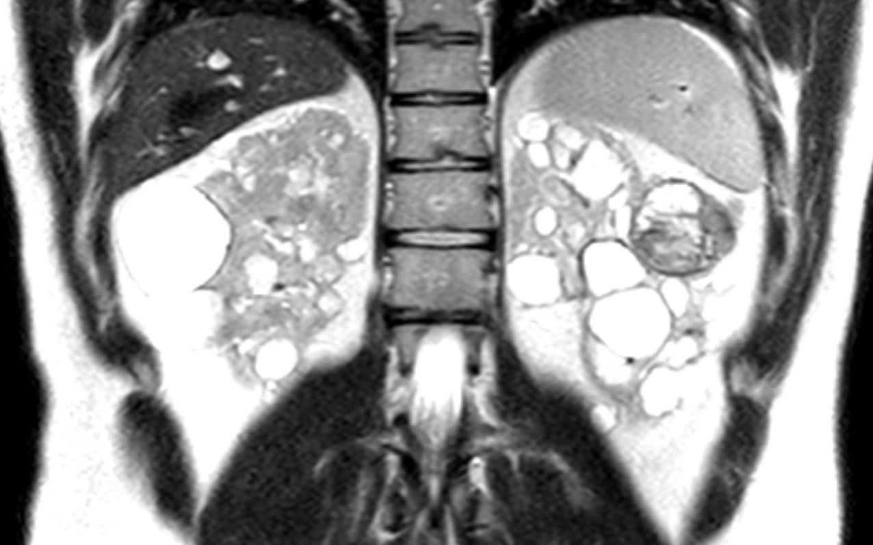

Slide 19
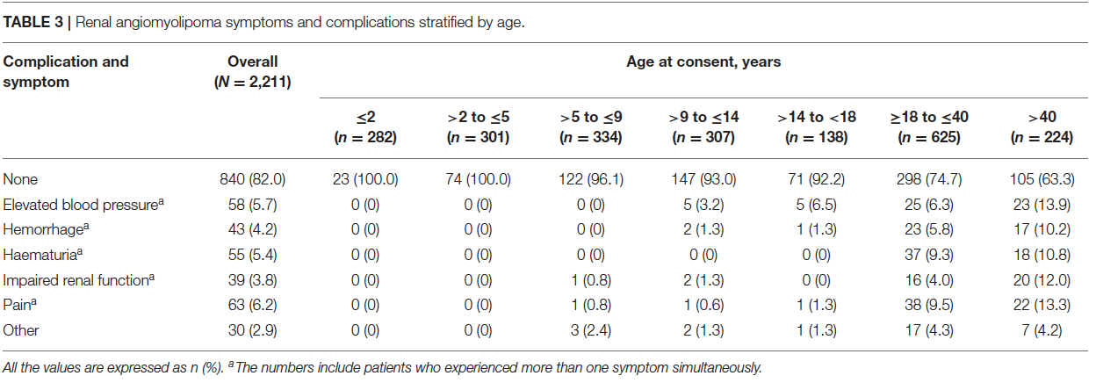
Angiomyolipoma (AML)
Complications
  Increased risk of bleeding:
    Hypervascular types
    >4cm lesions
    aneurysms >5mm
  Invading adjacent renal parenchyma
Kingswood JC et al, Renal Manifestations TSC TOSCA, Front Neuro 2020

Slide 20
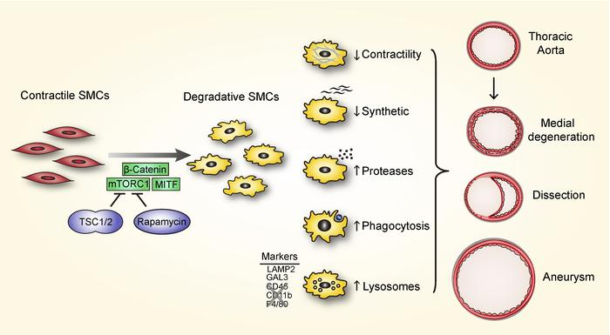
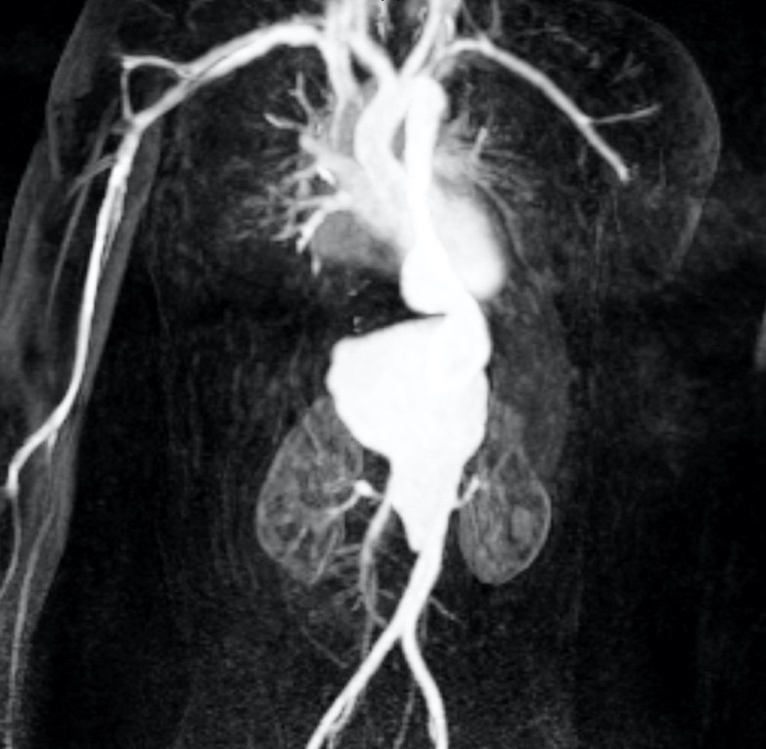
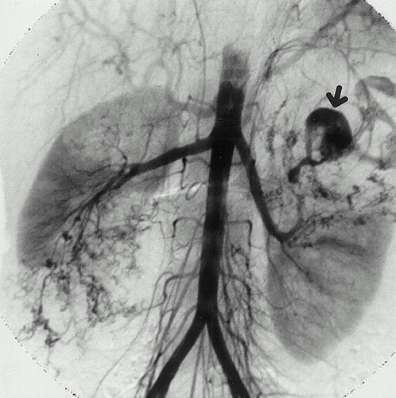
Vascular Abnormalities with TSC
Chronic mTOR hyperactivity in smooth muscle cells can lead to the development of aneurysms by typical TSC pathologic features such as aortic wall thickening, SMC proliferation, and loss of elastin fibers.¹
  Specific deletion of TSC1 in mice¹
  Individual reports in patients²
Vascular phenotype that could be rescued by treating the mice with rapamycin
Similar mechanisms thought to contribute to microaneurysms of AMLs with response to mTOR
1
¹Li G., et al, Chronic mTOR Activation in SMC phenotype, JCI 2020
²Hedin U., et al, Resolving Biologic Paradox, JVS Vasc Sci 2021
Yamakado K., et al, Renal AML: Relationships, Radiology 2002

Slide 21
Kidney Manifestations
Kidney contributes to one of the leading causes of mortality
Renal manifestations more prominent in TSC2
Types
  Angiomyolipoma
  Cystic Diseases
Pietrobon A et al, TSC Kidney Lesion Pathogenesis, JASN 2023

Slide 22
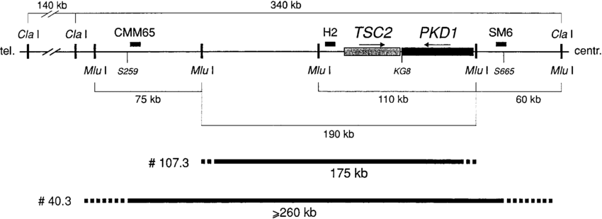
Renal Cysts
Prevalence up to 50% of patients
Predominant kidney finding in early pediatric population
More prominent in TSC2 mutations
Contiguous Gene Syndrome
  Deletions encompassing portions of adjacent TSC2 and PKD1 (2-3% of patients)
  Severe, progressive cystic disease with ADPKD in addition to TSC
Longa L, et al, A Large TSC2 and PKD1 Gene Deletion, Nephrology Dialysis Transplantation 1997

Slide 23
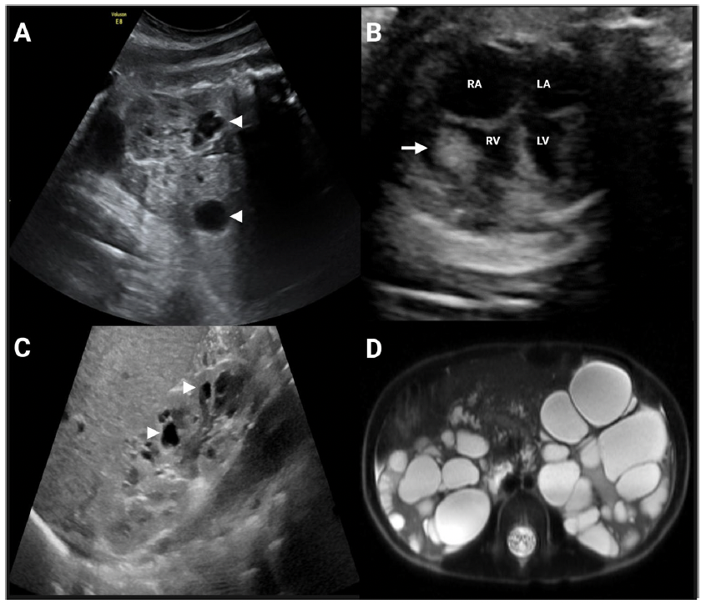
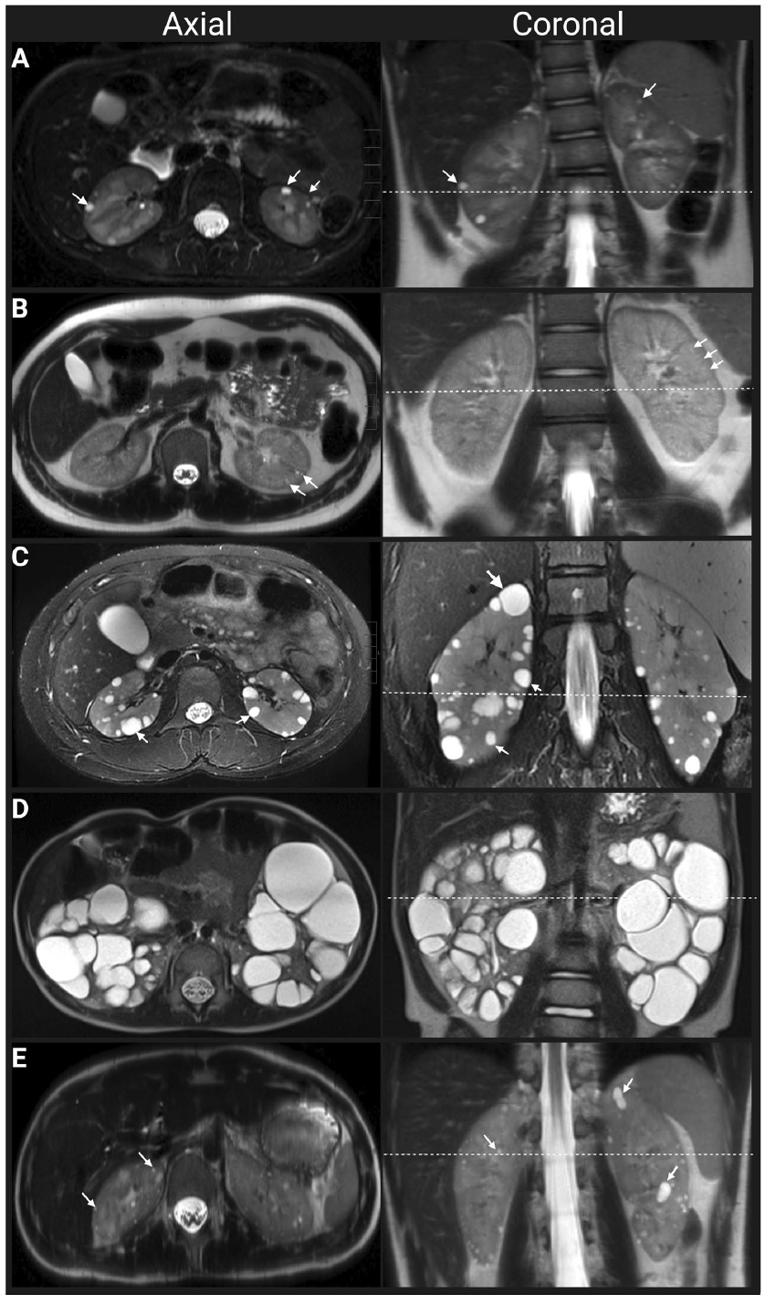
Gallo-Bernal S et al, Cystic kidney disease in TSC, Ped Nephrology 2023

Slide 24
Kidney Manifestations
Kidney contributes to one of the leading causes of mortality
Renal manifestations more prominent in TSC2
Types
  Angiomyolipoma
  Cystic Diseases
  Renal Cell Carcinoma
Pietrobon A et al, TSC Kidney Lesion Pathogenesis, JASN 2023

Slide 25
Renal Cell Carcinoma
Prevalence 2-4%, similar to that of the general population
Median age of onset: 37.5 years old vs 66 years old
  As young as 7 years old
TSC1 mutations are over-represented in this population
Careful evaluation in radiologic features should be taken
  Atypical (fat poor-invisible) AMLs can often be mistaken as RCC
  Rate of growth <5mm/year for AMLs
  May require tissue sample to help differentiate prior to aggressive interventions (nephrectomy). Using a HMB-45 stain to help distinguish (fat-poor AML)

Slide 26
Renal Cell Carcinoma
TSC Associated Papillary RCC, Renal Angiomyo-adenomatous Tumor (RAT), or RCC with smooth muscle stroma (30-50%)
Hybrid Oncocytic Chromophobe Tumor (HOCT) (30-50%)
Unclassified, Granular Eosinophil Macrocystic (10-15%)
  Contain both solid and cystic foci
These tumors are HMB-45-negative (rule-out AMLs)
TSC1 and TSC2 mutations occur in sporadic RCC in general population
  clear cell RCC (2-5%)
  Chromophobe RCC (4-10%)
Henske EP, et al, RCC in TSC, Genes 2021

Slide 27
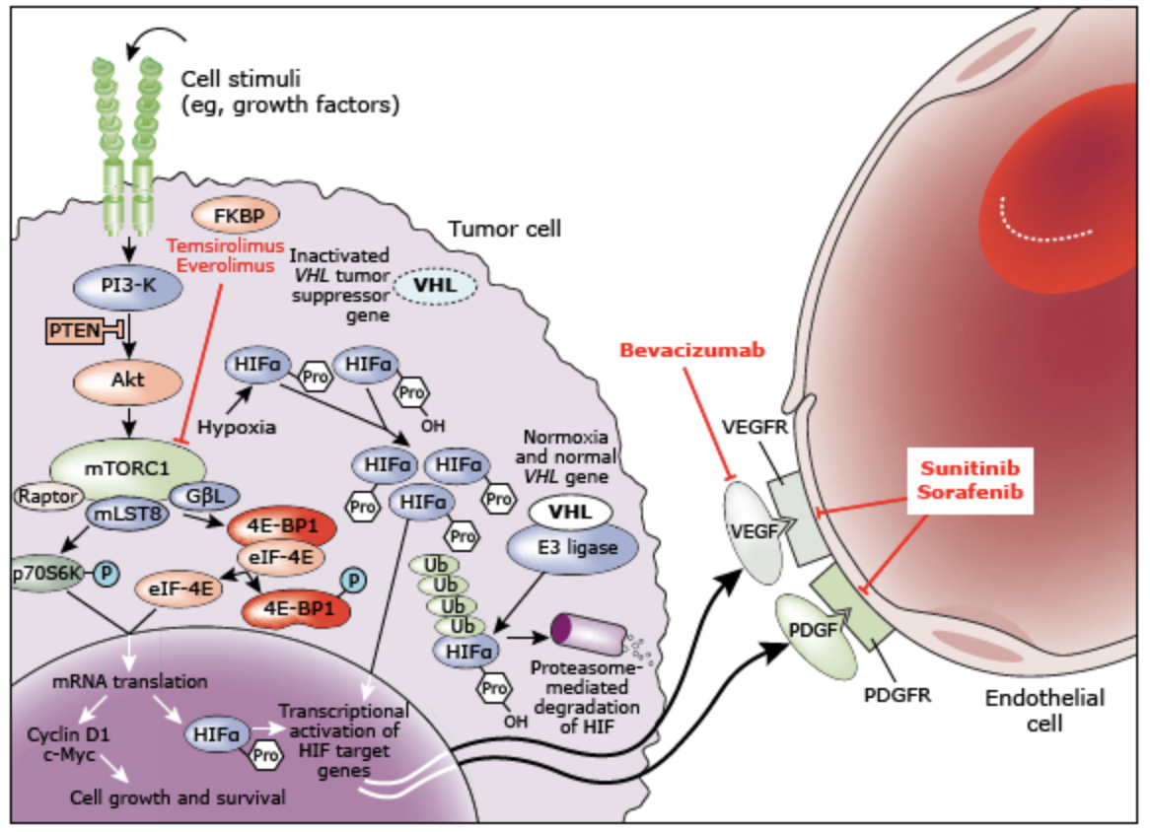
Biological pathways and the resulting therapeutic targets in RCC
Up-To-Date: Reproduced from: Rini BI, Campbell SC, Escudier B. Renal cell carcinoma. Lancet 2009

Slide 28
Kidney Manifestations
Kidney contributes to one of the leading causes of mortality
Renal manifestations more prominent in TSC2
Types
  Angiomyolipoma
  Cystic Diseases
  Renal Cell Carcinoma
  Chronic Kidney Disease
Pietrobon A et al, TSC Kidney Lesion Pathogenesis, JASN 2023

Slide 29
Chronic Kidney Disease
Approximately 40% will have premature loss of kidney function with a eGFR <60 ml/min by the 5th decade
Functional decline is likely multifactorial due to mass effects by tissue-distorting lesions, consequences of hemorrhage, potential nephron loss from interventions, and hypertension
Reported percentage of those requiring kidney replacement therapy (1-3%) is relatively low, there are multiple factors

Slide 30
Kidney Manifestations
Kidney contributes to one of the leading causes of mortality
Renal manifestations more prominent in TSC2
Types
  Angiomyolipoma (80%)
  Cystic Diseases (50%)
  Renal Cell Carcinoma (2-4%)
  Chronic Kidney Disease (>40%)
Can be a combination
Pietrobon A et al, TSC Kidney Lesion Pathogenesis, JASN 2023

Slide 31
Case 2 Continued
The same 26 year old patient asks about what is needed for follow-up

Slide 32
Nephrology Follow-up
Imaging of choice: MRI > CT > US
  MRI has a higher yield for fat-poor AMLs and smaller lesions
  CT favored in VNS or other indications MRI cannot be performed
  US favored as alternatives in pediatric population for more frequent follow-up
Serial Imaging Exams: 1-3 years, throughout life-time
  Based on a case-by-case basis given progression vs stability
Other: Renal function, proteinuria, blood pressure at least annually
Northrup H et al, Updated International TSC Guidelines, Ped Neurology 2021

Slide 33
Case 3
A 32 year old male with significant developmental delay was diagnosed with TSC1 at the age of 3 due to epilepsy. He is accompanied by his parents who are the primary decision makers for him. They have been reluctant to see a nephrologist, but due to increasing size of his AMLs (largest now 53mm) are agreeable.
What are the options for treatment of his kidney tumors?

Slide 34
Treatment Options
Goal of Treatment:
  Preserve normal renal architecture
  Decrease risk of spontaneous hemorrhage
AMLs
  mTOR inhibitors

Slide 35
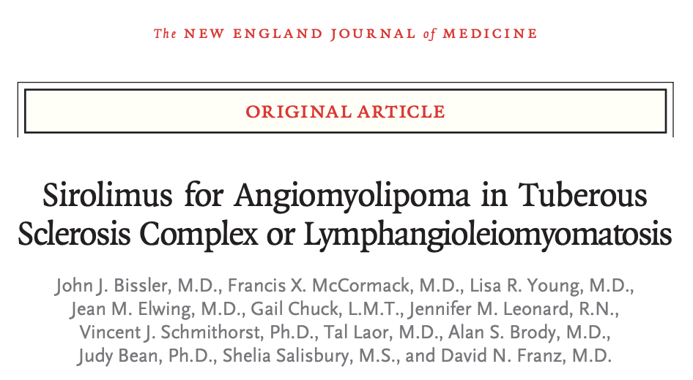
24 month, nonrandomized, open-label trial, Phase 1-2
Sirolimus reduction of AML volume in TSC and Sporadic LAM
Sirolimus for 1 year then discontinuation follow-up
  Dose adjustment for 10% reduction by targeting troughs 1-5, 5-10, 10-15
  Nearly 50% reduction
AML regressed during therapy, but increase in volume after therapy was stopped

Slide 36
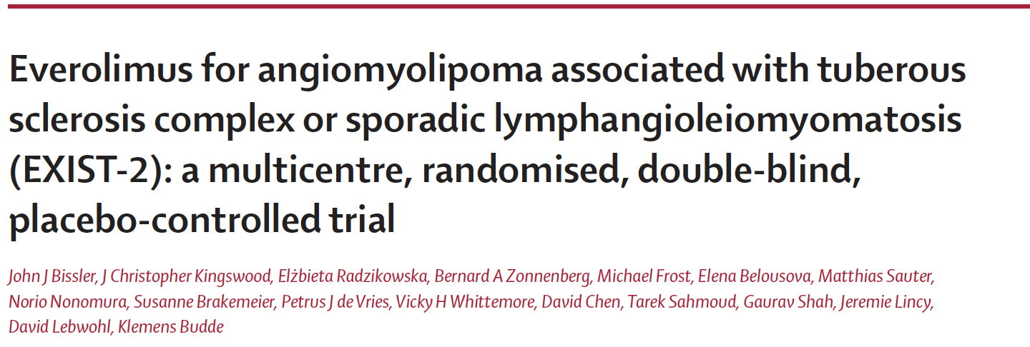
Double-blind, placebo-controlled, phase 3 trial
>18 years old, at least 1 AML >3cm and definite diagnosis of TSC or LAM
2:1 randomization (118 patients)
Everolimus 10mg per day
Primary Efficacy Endpoint: at least 50% reduction in total volume of target AML relative to baseline
  Response Rate: 42% vs 0% (median time 2.9months)
  24 weeks: 55% reach primary endpoint
  At least 30% reduction seen in 80% of Treatment arm vs 3% in placebo
Secondary Endpoint: Progression free rate 98% vs 83% (6 months) and 92% and 25% (at 12 months)
  >25% increase, new AML of at least 1cm, increase in 20% of kidney volume, AML related bleeding

Slide 37
mTOR inhibitors
First line therapy in asymptomatic patients
  Significant reduction in risk of renal hemorrhage
  Tissue/Renal function sparing compared to other therapies
  Decreased renal adverse events compared to use within transplant (mild proteinuria)
Trough goals (3-15) vs daily dosing
  Slow progression with increasing dose based upon response
ADE: Stomatitis, nasopharyngitis, acne-like skin lesions, hyperlipidemia, proteinuria

Slide 38
Treatment Options
Goal of Treatment:
  Preserve normal renal architecture
  Decrease risk of spontaneous hemorrhage
AMLs
  mTOR inhibitors
  Embolization
  Nephrectomy

Slide 39
Embolization and Nephrectomy
One lesion at a time
Not all lesions are amendable to intravascular intervention (location, vascularity)
Post-Embolization Syndrome
  Significantly reduced with steroids¹
Collateral damage to surrounding normal renal parenchyma
Best size reduction of up to 50%²
First line – Acute/active hemorrhage³
¹Bissler JJJ et al, Reduction of PES, AJKD 2002
²Williams JM et al, Embolization of renal AML in TSC, AJKD 2006
³Northrup H et al, Updated International TSC Guidelines, Ped Neurology 2021

Slide 40
Treatment Options
Goal of Treatment:
  Preserve normal renal architecture
  Decrease risk of spontaneous hemorrhage
AMLs
  mTOR inhibitors
    1st line treatment in asymptomatic patients
    Well tolerated
  Embolization
  Nephrectomy
    Emergent/Acute bleed.
    2nd line for non-responsive or progressive lesions at risk of hemorrhage
Renal Cysts

Slide 41
Treatment of Cysts
No FDA approved treatments for TSC-related cystic disease
Risk factor optimization/consequences of cystic disease
  Blood pressure control
    RAAS blockade (HALT-PKD)
  CKD targeted therapies
mTOR?
  Multiple preclinical studies demonstrated effect on cystic disease
  Clinical trials for ADPKD failed to demonstrate benefit^{1,2}
  Size of cysts/timing of initiation/detachment
¹Serra AL et al, Sirolimus in ADPKD, NEJM 2010
²Walz G et al, Everolimus in ADPKD, NEJM 2010

Slide 42
Treatment Options
Goal of Treatment:
  Preserve normal renal architecture
  Decrease risk of spontaneous hemorrhage
AMLs
  mTOR inhibitors
    1st line treatment in asymptomatic patients
    Well tolerated
  Embolization
  Nephrectomy
    Emergent/Acute bleed.
    2nd line for non-responsive or progressive lesions at risk of hemorrhage
Renal Cysts
  Risk factor optimization, management of consequences of disease (RAASi, HTN)

Slide 43
Primary Oncologic Treatment using mTOR/VEGF
mTOR Inhibitors
Anti-VEGF
Renal cell carcinoma
Breast cancer
Neuroendocrine tumors
Pancreatic cancer
Breast cancer
Colorectal cancer
Non-small cell lung cancer (NSCLC)
Renal cell carcinoma (RCC)
Anaplastic lymphoma (AL)
Glioblastoma (GBM)
Cervical cancer (CC)
Fallopian tube cancer (FTC)

Slide 44
End Stage Renal Disease
Dialysis
  Risk vs Benefits
Transplantation
  TSC is NOT a generalized contra-indication
  Follow local guidelines/clinical criteria
  Would favor transitioning to mTOR based regiment when able
  ?Nephrectomy, ?Serial imaging

Slide 45
Objectives Reviewed
Identify common clinical and genetic characteristics of TSC
  Autosomal Dominant and sporadic disease affecting TSC1 (9q34) and TSC2 (16p13) which prevent inhibition of mTORC1 leading to multi-organ system benign tumor growths
  Affects 1:6,000-10,000 live births across all racial and ethnic groups
Identify kidney manifestations associated with TSC
  AMLs (80%), Cysts (50%), RCC (2-4%), CKD (>40% after 5th decade)
  Kidney disease is top 3 in causes in patient’s with TSC
Treatment options available for aforementioned kidney disease
  Goals: preserve normal renal architecture and prevent complications (bleeding)
  mTOR (EXIST-2 trial), Arterial Embolization vs Nephrectomy
Recognize mTORC1 pathway of TSC as a potential model for oncogenesis

Slide 46

Thank you
ASON
Cincinnati Children’s Hospital Medical Center – TSC Clinic
Patients and their families

Slide 47
Questions

Slide 48
Resources
Bissler JJ, Nonomura N, Budde K, Zonnenberg BA, Fischereder M, Voi M, Louveau AL, Herbst F, Bebin EM, Curatolo P, Zonta A, Belousova E. Angiomyolipoma rebound tumor growth after discontinuation of everolimus in patients with tuberous sclerosis complex or sporadic lymphangioleiomyomatosis. PLoS One. 2018;13. doi: 10.1371/journal.pone.0201005
Bissler JJ, Kingswood JC, Radzikowska E, et al. Everolimus for angiomyolipoma associated with tuberous sclerosis complex or sporadic lymphangioleiomyomatosis (EXIST-2): a multicentre, randomised, double-blind, placebo-controlled trial. Lancet. 2013;381(9869):817-824. doi:10.1016/S0140-6736(12)61767-X
Bissler JJ, Batchelor D, Kingswood JC. Progress in Tuberous Sclerosis Complex Renal Disease. Crit Rev Oncog. 2022;27(2):35-49. doi:10.1615/CritRevOncog.2022042857.
Bissler JJJ, Racadio J, Donnelly LFLF, Johnson NDND. Reduction of postembolization syndrome after ablation of renal angiomyolipoma. Am J Kidney Dis. 2002;39:966– 71. doi: 10.1053/ajkd.2002.32770.
Bissler JJ, McCormack FX, Young LR, et al. Sirolimus for angiomyolipoma in tuberous sclerosis complex or lymphangioleiomyomatosis. N Engl J Med. 2008;358(2):140-151. doi:10.1056/NEJMoa063564
Dodd KM, Dunlop EA. Tuberous sclerosis--A model for tumour growth. Semin Cell Dev Biol. 2016;52:3-11. doi:10.1016/j.semcdb.2016.01.025
Gallo-Bernal S, Kilcoyne A, Gee MS, Paul E. Cystic kidney disease in tuberous sclerosis complex: current knowledge and unresolved questions. Pediatr Nephrol. 2023;38(10):3253-3264. doi:10.1007/s00467-022-05820-x
Hedin U, Brunnström H, Dahlin M, Backman T, Perez de Sa V, Tran PK. Resolving the biological paradox of aneurysm formation in children with tuberous sclerosis complex. JVS Vasc Sci. 2021;2:72-78. Published 2021 May 24. doi:10.1016/j.jvssci.2021.05.003
Henske EP, Cornejo KM, Wu CL. Renal Cell Carcinoma in Tuberous Sclerosis Complex. Genes (Basel). 2021;12(10):1585. Published 2021 Oct 8. doi:10.3390/genes12101585
Kingswood JC, Belousova E, Benedik MP, et al. Renal Manifestations of Tuberous Sclerosis Complex: Key Findings From the Final Analysis of the TOSCA Study Focussing Mainly on Renal Angiomyolipomas. Front Neurol. 2020;11:972. Published 2020 Sep 16. doi:10.3389/fneur.2020.00972
Lam, H.C., Siroky, B.J. & Henske, E.P. Renal disease in tuberous sclerosis complex: pathogenesis and therapy. Nat Rev Nephrol 14, 704–716 (2018). https://doi.org/10.1038/s41581-018-0059-6
Li G, Wang M, Caulk AW, et al. Chronic mTOR activation induces a degradative smooth muscle cell phenotype. J Clin Invest. 2020;130(3):1233-1251. doi:10.1172/JCI131048
Northrup H, Aronow ME, Bebin EM, et al. Updated International Tuberous Sclerosis Complex Diagnostic Criteria and Surveillance and Management Recommendations. Pediatr Neurol. 2021;123:50-66. doi:10.1016/j.pediatrneurol.2021.07.011
Pietrobon A, Stanford WL. Tuberous Sclerosis Complex Kidney Lesion Pathogenesis: A Developmental Perspective. J Am Soc Nephrol. 2023;34(7):1135-1149. doi:10.1681/ASN.0000000000000146
Rad E, Murray JT, Tee AR. Oncogenic Signalling through Mechanistic Target of Rapamycin (mTOR): A Driver of Metabolic Transformation and Cancer Progression. Cancers (Basel). 2018 Jan 3;10(1):5. doi: 10.3390/cancers10010005. PMID: 29301334; PMCID: PMC5789355.
Williams JM, Racadio JM, Johnson ND, Donnelly LF, Bissler JJ. Embolization of renal angiomyolipomata in patients with tuberous sclerosis complex. Am J Kidney Dis. 2006;47:95–102. doi: 10.1053/j.ajkd.2005.09.028.
Yamakado K, Tanaka N, Nakagawa T, Kobayashi S, Yanagawa M, Takeda K. Renal angiomyolipoma: relationships between tumor size, aneurysm formation, and rupture. Radiology. 2002;225(1):78-82. doi:10.1148/radiol.2251011477

