Slide 1

HYPERTENSION –
Is It Really Getting on Our NERVES !!
Kidney C.A.R.E. Grand Rounds
Division of Nephrology and Kidney C.A.R.E. Program
University of Cincinnati
Presenters
Dr Jacob Nysather. MD
Dr Prakash Gudsoorkar. MD,FASN,FNKF

Slide 2

Disclosures
Dr Nysather: none
Dr Gudsoorkar: none

Slide 3

At the end of this talk participants should be able to
Review and discuss pre-clinical and early clinical studies in renal denervation (RDN) – walk down memory lane !
Basics of technical aspects involved in RDN
Understand the BP response to RDN in controlled studies
Critically analyze the data from SYMPLICITY HTN & SPYRAL-HTN ON Trial
What does the future behold?

Slide 4

Hypertension is leading cause of CV morbidity and mortality
Nonadherence is 30-50% and a leading cause of apparent Rx resistant HTN

Slide 5
Nervous system control of BP
Autonomic NS
Sympathetic NS
Regulates rapid changes in BP
Short term
Via baroreceptor reflex
Long term control (days, months, years) and regulation

Slide 6
Sympathetically driven clinical hypertension?
Obesity
Weight gain
Metabolic syndrome
Obstructive sleep apnea

Slide 7
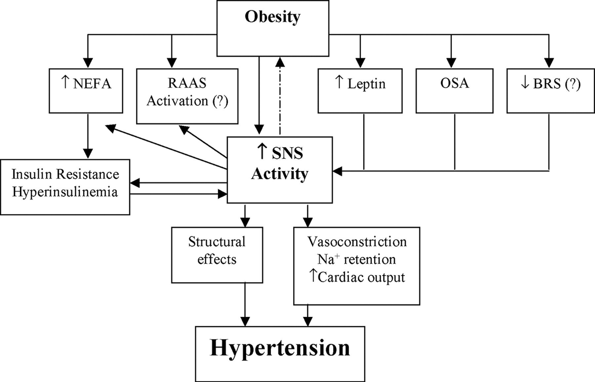
Pathophysiological mechanisms- Obesity & HTN
Esler et al. Hypertension. 2006;48:787–796

Slide 8
Antihypertensive Drugs and the Sympathetic Nervous System
Del Colle S et al. Antihypertensive drugs and the SNS. J Cardiovasc Pharmacol. 2007;50:487–96.

Slide 9
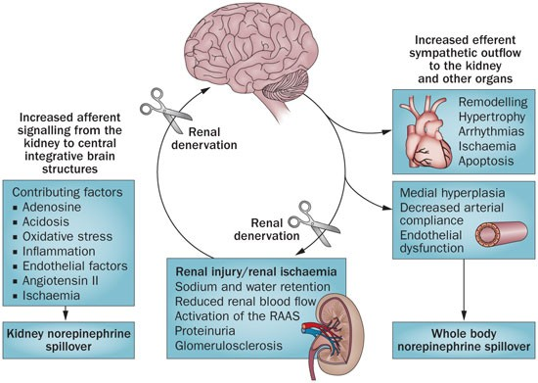
Esler et al. Hypertension. 2006;48:787–796

Slide 10

Recap
We looked at the NS control of HTN
How Sympathetic NS is involved in pathogenesis of HTN and EOD

Slide 11

Renal Denervation Studies

Slide 12

Animal Studies

Slide 13
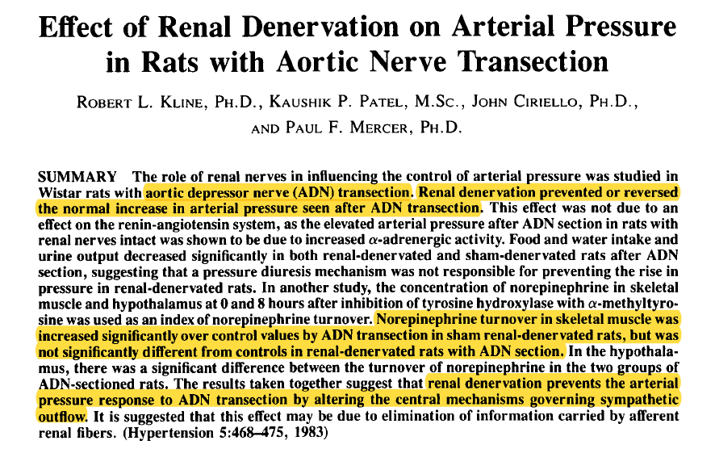
Kline R et al.Hypertension 5:468-475, 1983)
Notes:
Rational behind RDN comes from studies in mouse model.
Similar results have been obtained in canine models as well. Where RDN abolished the hypertension

Slide 14
Sympathoinhibitory Effect of Radiofrequency Renal Denervation in Spontaneously Hypertensive Rats (SHR) With Established Hypertension
Robust sham – controlled trial in SHR
Sustained decrease in both SBP/DBP in RF-ABL vs. Sham-ABL SHR
Kidney norepinephrine levels markedly decreased at 8 weeks in RF-ABL vs. Sham-ABL SHR
No group difference was seen in 24-hr urine Na or urine angiotensin excretion rate
No group difference between plasma renin activity or kidney renin content
Gao J et al. Am J Hypertens. 2016;29:1394–401
Notes:
The spontaneously hypertensive rat (SHR) is the most commonly used model of hypertension and cardiovascular disease.

Slide 15

Recap
Original proof of concept comes from animal studies

Slide 16

Procedure

Slide 17
Renal denervation
Renal sympathetic denervation is a minimally invasive, endovascular catheter-based procedure using radiofrequency ablation or ultrasound ablation aimed at treating resistant hypertension

Slide 18
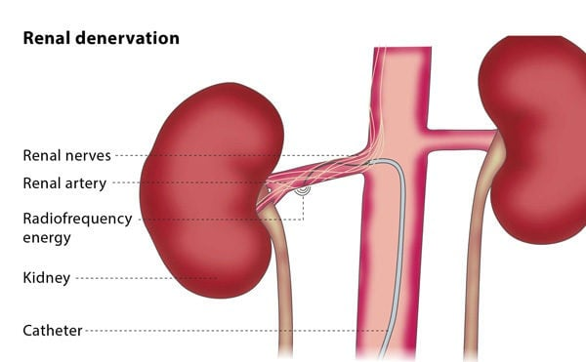

Slide 19
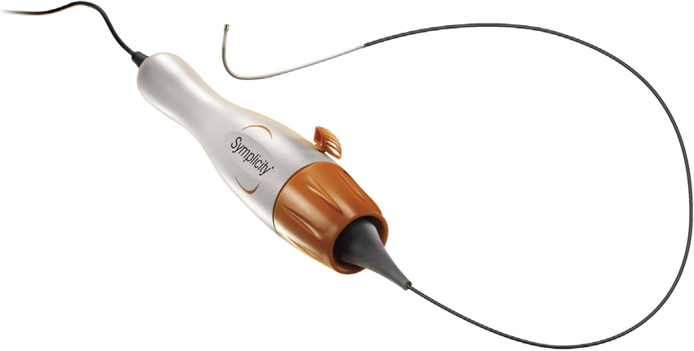
SYMPLICITY FLEX catheter (Medtronic)
Mono electrode radiofrequency

Slide 20
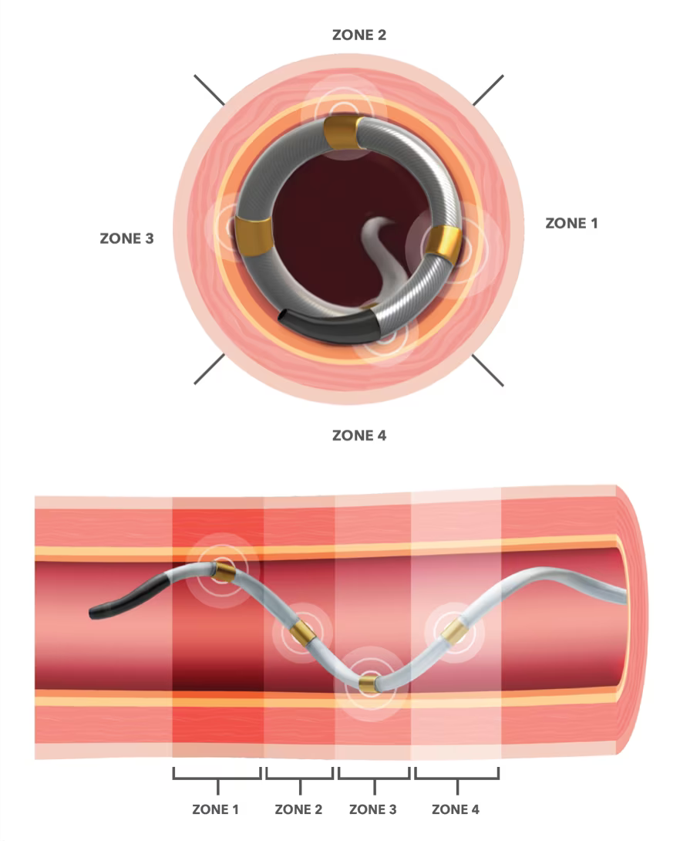
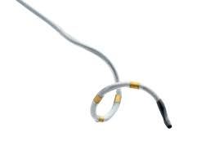
4-electrode SYMPLICITY SPYRAL catheter
(Medtronic; Galway, Ireland)
Multielectrode radiofrequency

Slide 21
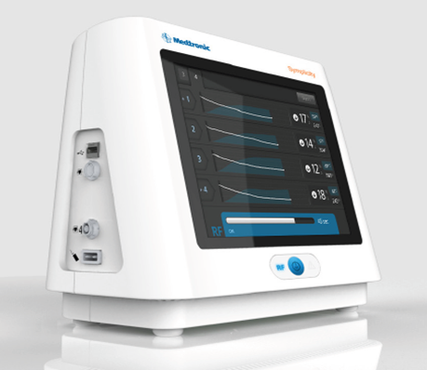
Simplicity G3 radio frequency generator
(Medtronic; Minneapolis, MN, USA)

Slide 22
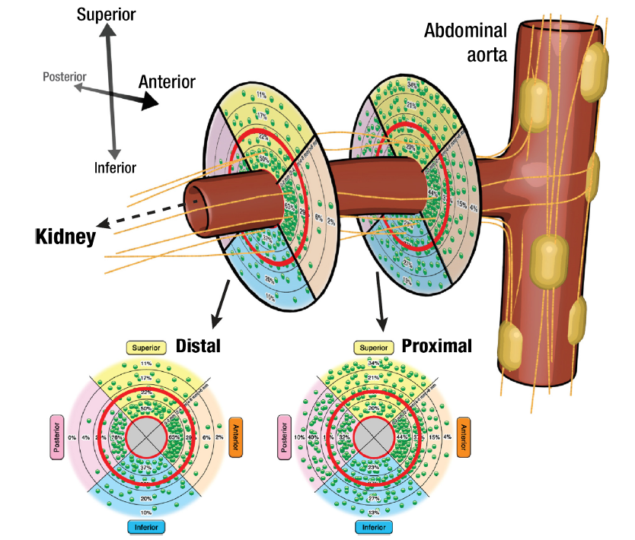
Current Cardiology Reports (2019) 21: 80

Slide 23
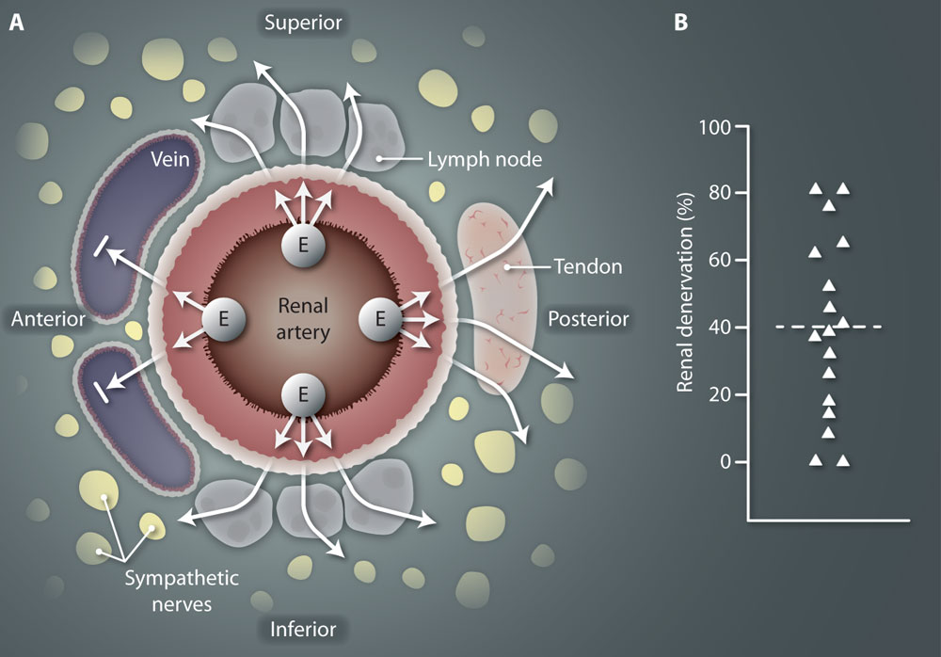

Slide 24

Human Studies
Landmark Trials

Slide 25
Our understanding of RDN comes for 2 major study cohorts
The SYMPLICITY
&
The SPYRAL
Notes:
In the next few slides, I will give you a run down of the major studies

Slide 26

Phase 1
The Advent of Catheter-Directed
Radiofrequency Ablation Techniques

Slide 27
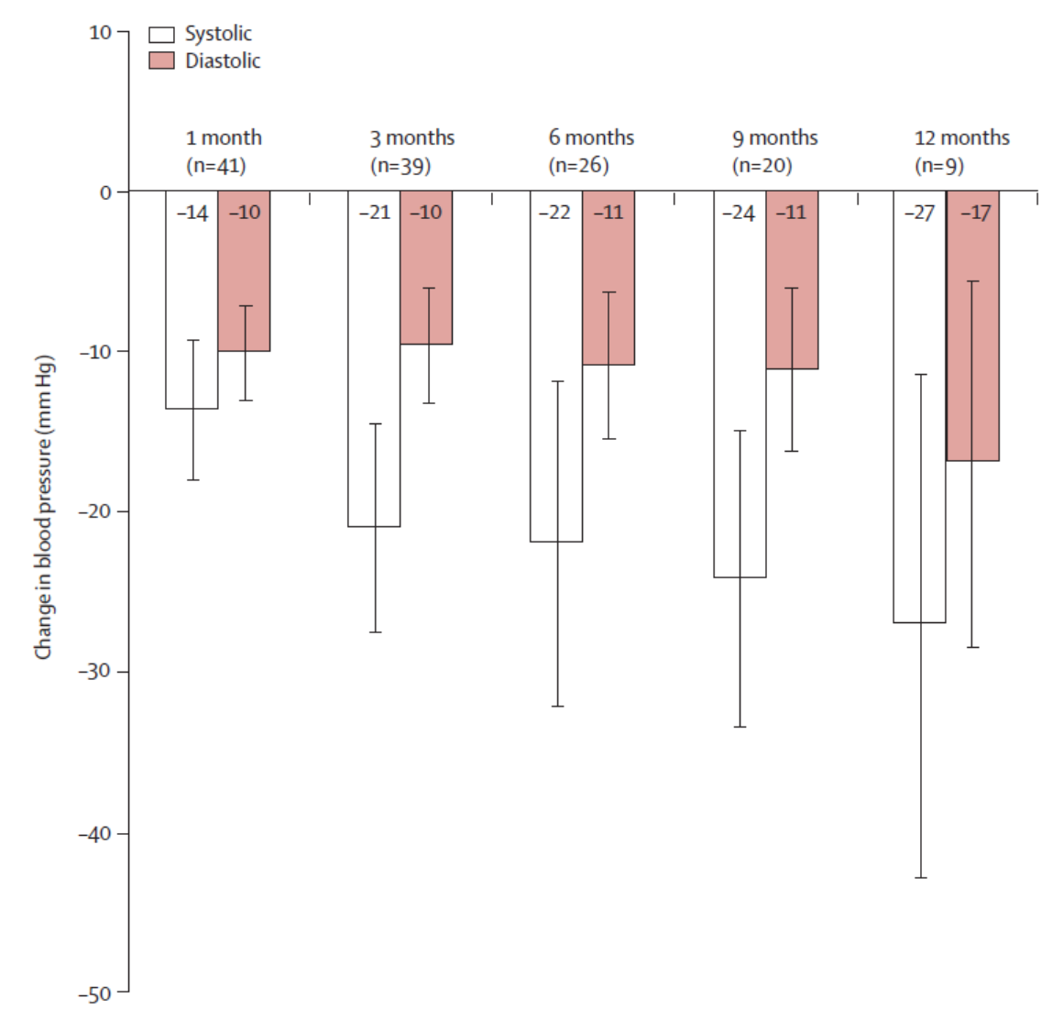
Catheter-based RDN causes substantial and sustained BP reduction, without serious adverse events, in patients with resistant hypertension. Prospective RCT are needed to investigate the usefulness of this procedure in the management resistant hypertension
45 pts RDN – 5 Australian and European centers
Proof of concept study
Follow up for 1 year
Primary endpoints: OBP and safety data before and at 1, 3, 6, 9, and 12 months after procedure
Funding Ardian Inc.
Krum et al. Lancet 2009; 373: 1275–81

Slide 28
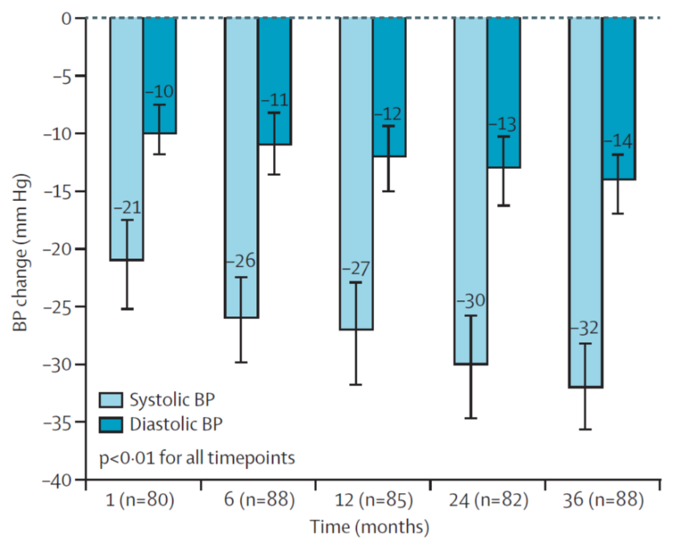
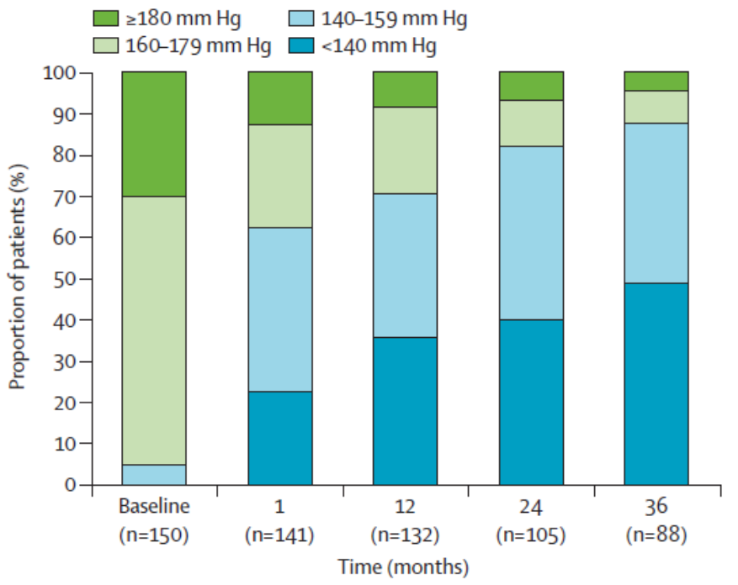
Open label
Resistant HTN
111 participants consented for f/u till 36 months, 88 completed it
Avg. 4.0 ablations per artery
Office BP measured
Funding Ardian LLC/Medtronic Inc.
Changes in blood pressure after RDN persist long term in patients with treatment-resistant hypertension, with good safety
Henry Krum et al. Lancet 2014;383:622-29. SYMPLICITY HTN1-Study

Slide 29
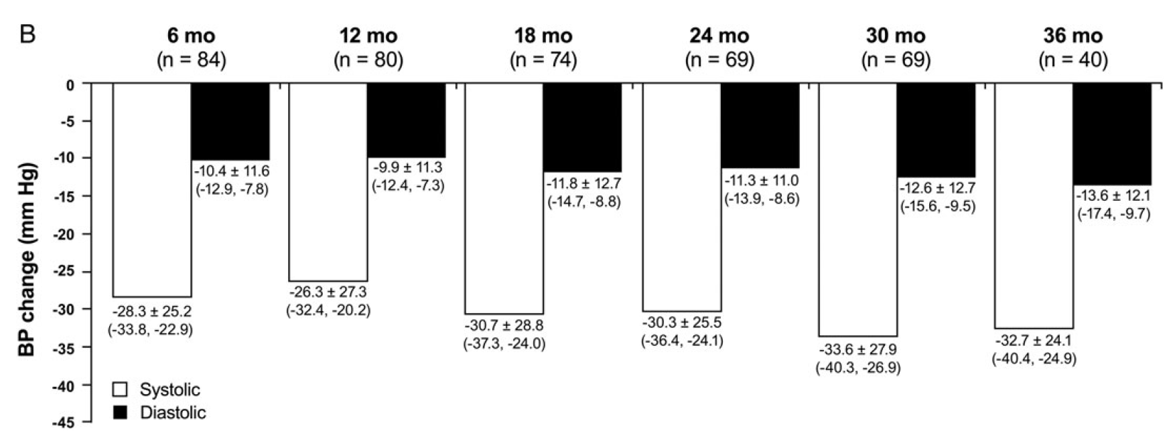
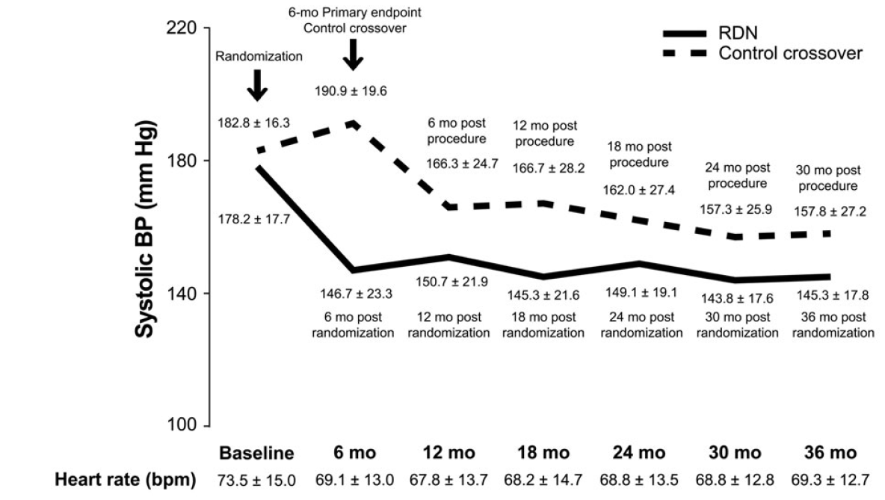
Catheter-based renal denervation for treatment of patients with treatment-resistant hypertension: 36-month results from the SYMPLICITY HTN-2 RCT
RDN resulted in sustained lowering of BP at 3 years in a selected population of subjects with severe, treatment-resistant hypertension without serious safety concerns
The systolic and diastolic BP reduction at 36 months for the RDN group was -33 mmHg (95% CI: -40, -25, P<0.01) and -14 mmHg (95% CI: -17, -10, P<0.01), respectively
Randomized 106 subjects with Rx resistant HTN RDN vs medical Rx alone
Primary Endpoints: Change in office systolic blood pressure at 6 months
Trial allowed control subjects to crossover to receive RDN after the initial 6-month primary endpoint evaluation. (N=37)
Esler MD et al.European Heart Journal (2014) 35, 1752–1759
Notes:
The goal of the trial was to compare a strategy of renal sympathetic denervation with standard therapy among patients with treatment-resistant hypertension.
Secondary Endpoints:
Acute procedural safety
Chronic procedural safety defined as a reduction in eGFR >25% or a new renal stenosis >60%
Composite of sudden death, death from heart failure, death from aortic or peripheral arterial disease, death from renal failure, myocardial infarction, heart failure, stroke, aortic or lower extremity revascularization procedure, lower limb amputation, dialysis, hospital admission for hypertensive crisis, or hospital admission for atrial fibrillation

Slide 30
Phase 1A
Sham-Controlled Catheter-Directed
Radiofrequency Ablation - SYMPLICITY HTN-3

Slide 31
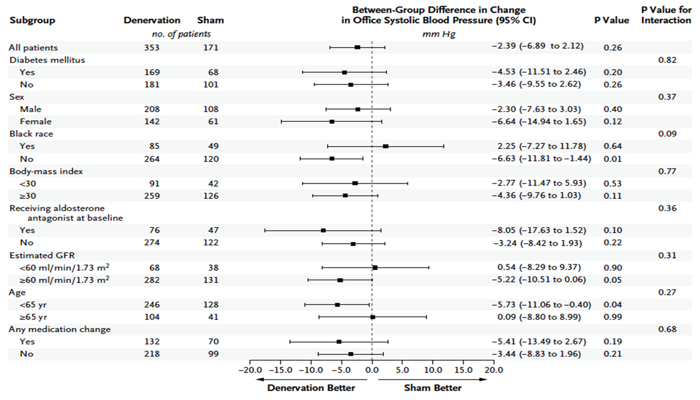

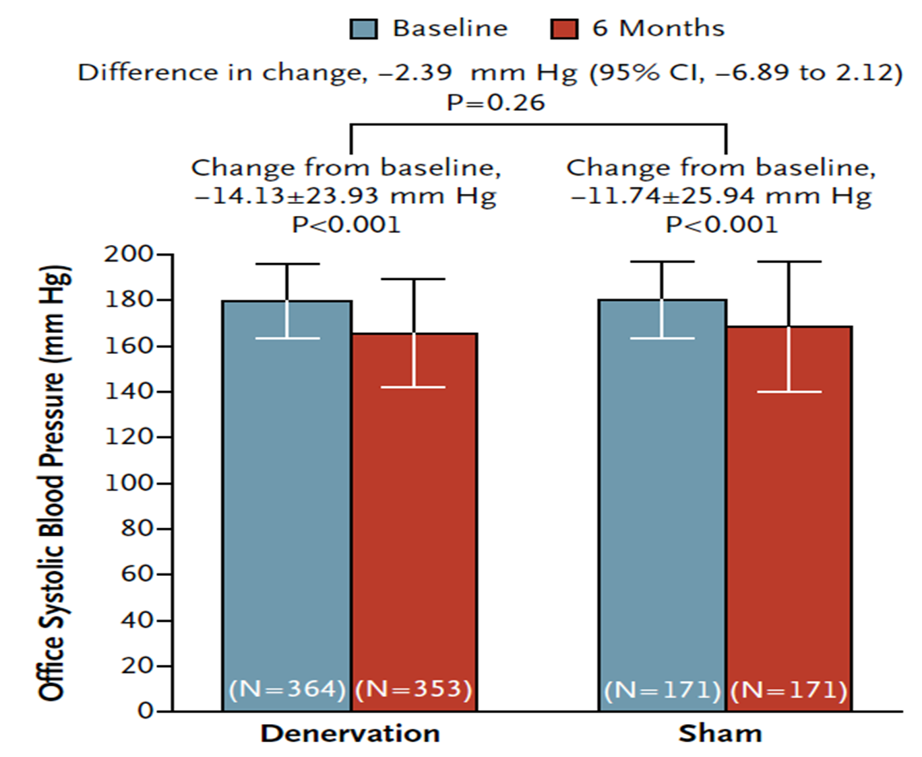
This blinded trial did not show a significant reduction of systolic blood pressure in patients with resistant hypertension 6 months after RDN as compared with a sham control
Prospective, single blind, sham controlled RCT
Resistant HTN
2:1 assignment : RDN vs. sham procedure
Primary efficacy end point: change in office SBP at 6 mo.
Primary safety endpoints: composite of death, ESKD, embolic events resulting EOD, renovascular complications / HTN crisis
Bhatt et al. NEJM 370;15. 2014. SYMPLICITY HTN-3 Investigators

Slide 32
Phase 2
New Ablation Techniques, New Patient Populations

Slide 33
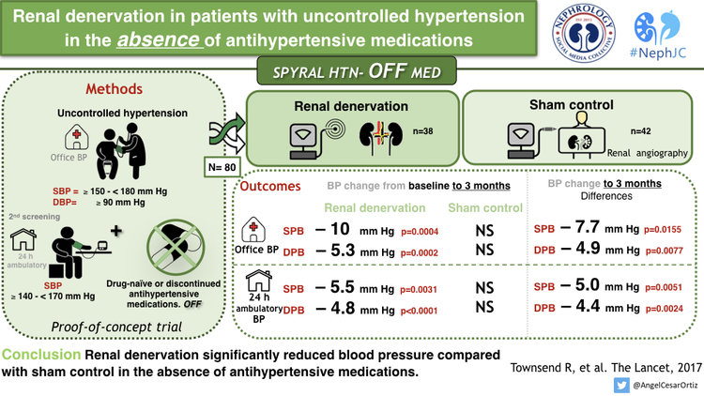
Notes:
This is the. Spiral hypertension off. Trial.
This was a proof of concept study. Which utilized. The simplicity spiral catheter.
It was a sham, controlled. Trial.
The normal patients were either anti hypertensive drug naive. Or. Their antihypertensive medications were discontinued.
At a three month follow up after RDN Blood pressure was significantly reduced. In the study group compared to the sham group.

Slide 34
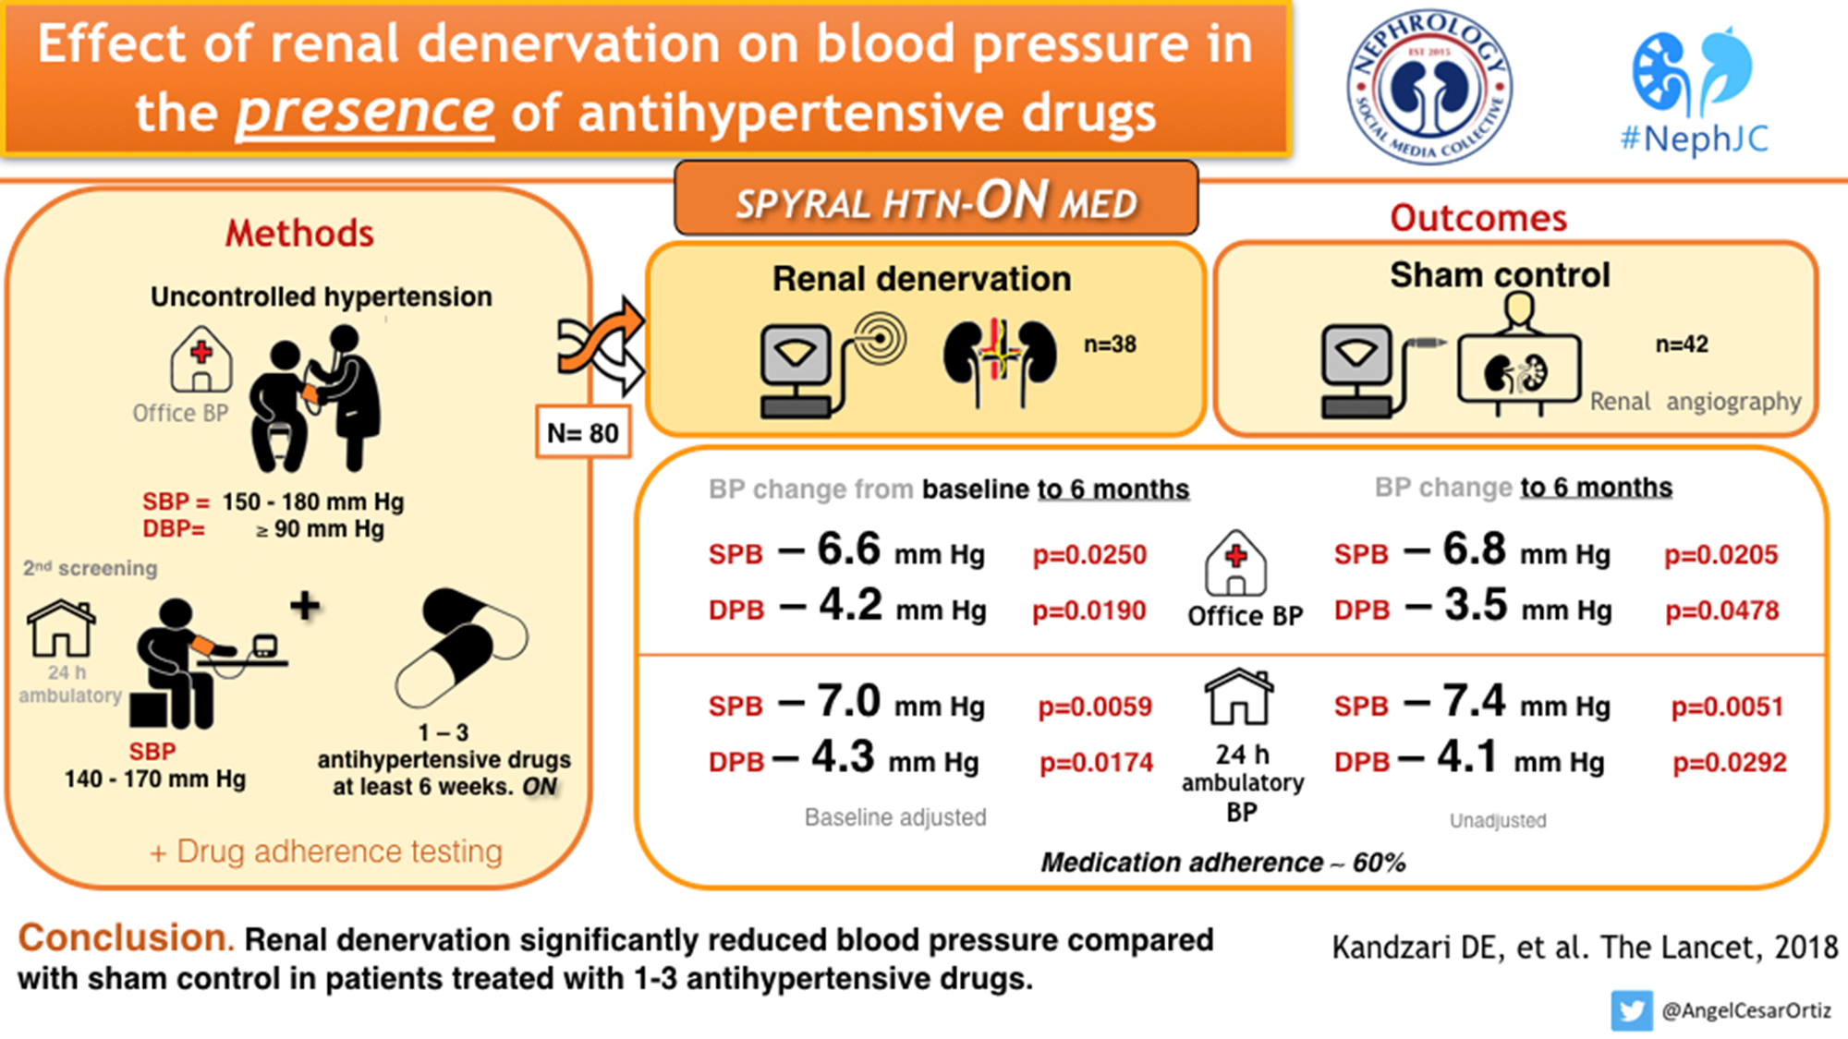
Notes:
This study was subsequently followed by. The spiral hypertension on medication trial.
Again, this was also a. Sham controlled trial.
Then study group had uncontrolled But. They were on at least one to two anti hypertensive medications for at least. Six weeks. And that's why. The trials name is called a spiral hypertension on medication.
A follow-up of six month after the procedure showed that. Renal denervation. Significantly reduced blood pressure. Compared to the sham control.

Slide 35
Phase 2A
Endovascular Ultrasound-Based Renal Denervation Therapy

Slide 36
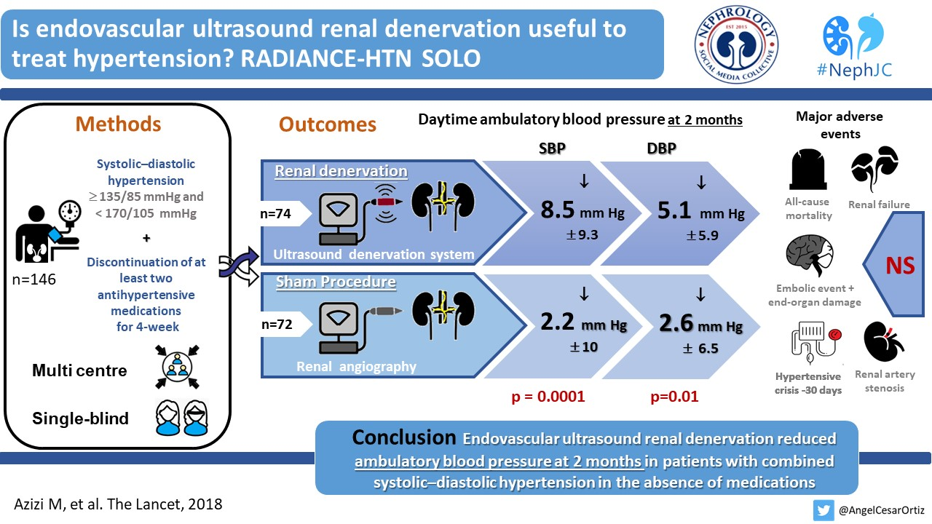

Slide 37
Phase 2B
Endovascular Pharmacological Ablation Therapy

Slide 38
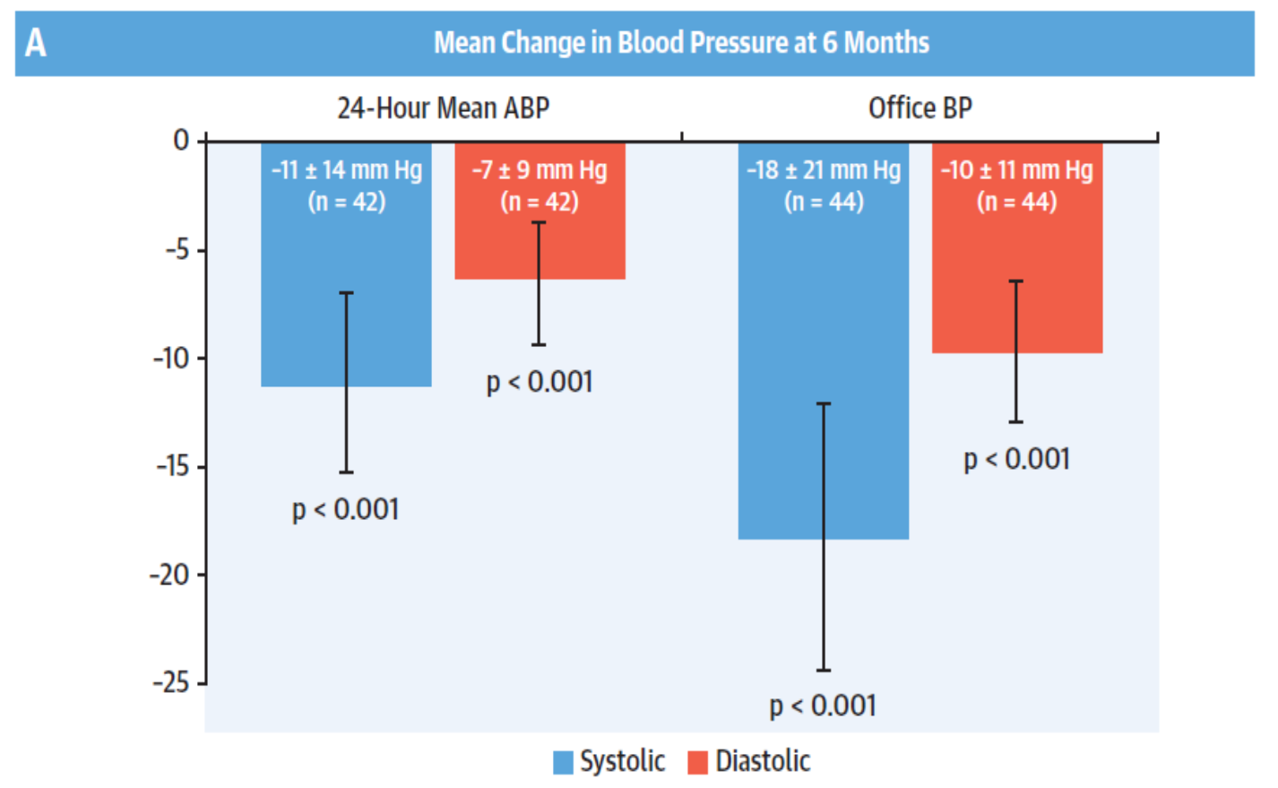
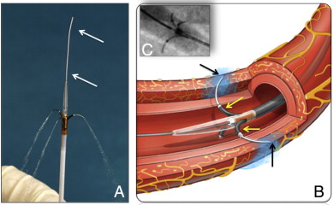
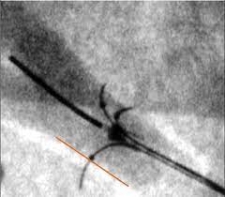
Alcohol-Mediated RDN Using the Peregrine System Infusion Catheter for Rx of HTN
Prospective, single arm, open label, multicenter (9 European centers)
Alcohol mediated RDN
45 pts. with RH
Primary efficacy end point: reduction of 24-h mean
ambulatory systolic BP at 6 months versus baseline
Primary safety endpoints: procedural complications, major bleeding, AKI, ESKD, death within 1 month
Primary results from suggest that alcohol-mediated renal denervation using the Peregrine Catheter safely reduces blood pressure and as such may represent a novel approach for the treatment of hypertension
Mahfoud et al. J Am Coll Cardiol Intv 2020;13:471–84

Slide 39
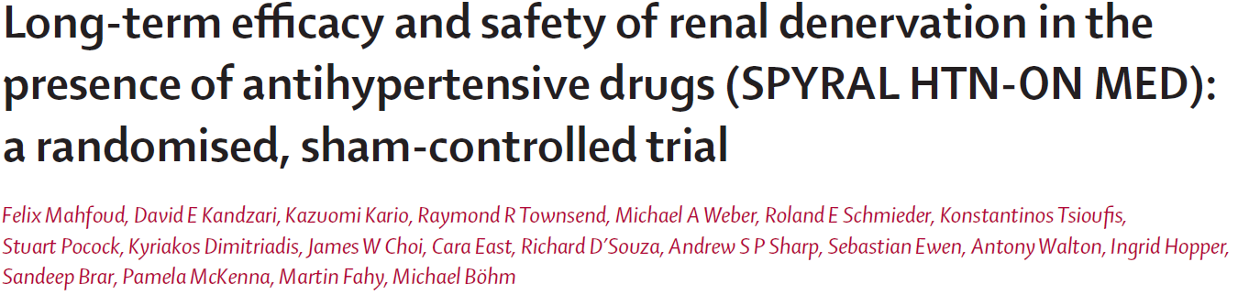
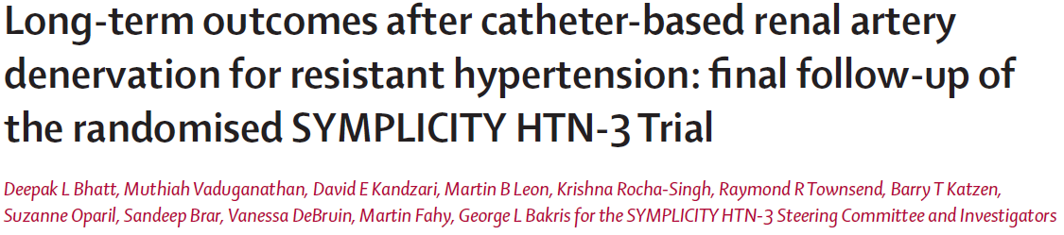
Lancet. Vol 399 April 9, 2022
Lancet. Vol 400 October 22, 2022

Slide 40
Designs
SPYRAL ON
SYMPLICITY
Sites: 25 centers (USA, Germany, Japan, UK, Australia, Austria, and Greece)
Prospective, single-blind, sham-control, RCT
1:1 (38:42)
End Point of this study: Safety and follow-up over 3 years
Catheter: Symplicity Spyral and Symplicity G3
Sites: 88 centers in US
Prospective, single-blind, sham-control, RCT
2:1 Randomization (364:171)
End Point of this study: Safety and follow-up over 3 years
Catheter: Symplicity Flex

Slide 41
Inclusion Criteria
SPYRAL ON
SYMPLICITY
Age: 20 – 80 y
Office: SBP 150-180mmHg, DBP >90mmHg, at 2 screening visits (6 weeks apart)
24hr ABPM: 140-170mmHg (after witnessed drug ingestion)
Meds: 1-3 classes at least 50% maximum dose
Age: 18-80 y
Office: SBP >160mmHg
24h ABPM: >135mmHg
Meds: 3 or more (including diuretic) max tolerated dose (treatment resistant)

Slide 42
Exclusion
SPYRAL ON
SYMPLICITY
Prior renal denervation
Presence of FMD, contains atheroma, calcification, aneurysm, or stent within 5mm of segment
Lack of main renal artery vessel (3-8mm diameter) that does not allow catheter, >50% stenosis, or stent placed <3 months prior
eGFR <45, PCKD, unilateral kidney, Hx of transplant
Type 1 DM or poorly controlled Type 2 (A1c >8% or taking SGLT2 or GLP-1)
Orthostatic hypotension not related to med change within 1 year
Chronic O2 of mechanical ventilation (not including PAP), Primary pulmonary HTN
Known secondary causes (pheo, Cushin, hyperaldo, coartation, untreated thyroid, primary hyperparathyroidism)
Currently taking MRA
MACE within 3 months of screening, wide-spread atherosclerosis, intravascular thrombosis, unstable plaques. Severe Valve Stenosis
Planned surgery or medical condition, in opinion of Investigator, that may affect endpoints
Documented condition that prohibits/interferes with ability to take automated BP
Known unresolved drug or alcohol dependency/use or inability to comprehend/follow instructions
Active PUD/GIB within 6 months prior, Hx Bleeding diathesis/coagulopathy, refuses blood transfusion
Chronic NSAID use, Pregnant, works night shift
Secondary cause of hypertension
Recurrent hospitalizations for HTN emergency in year preceding
Anatomical features (>50% stenosis, renal aneurysm, prior renal artery intervention, multiple renal arteries, renal art <4mm or treatable segment <20mm
Notes:
It’s a busy slide.
Just want to point out the exclusions in the SPYRAL cohort,

Slide 43
Baseline Characteristics – SPYRAL ON Cohort

Slide 44
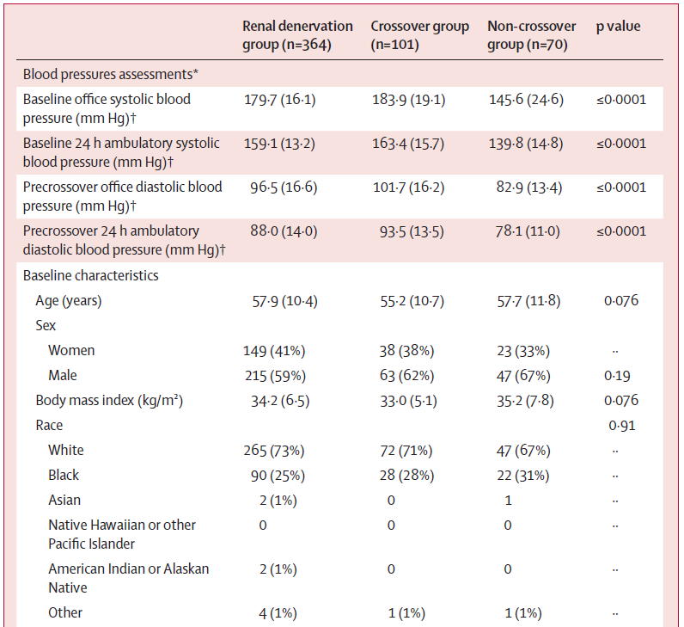
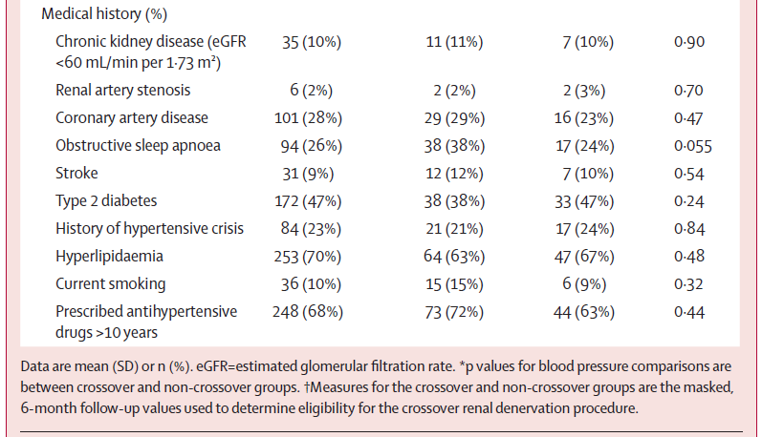
Baseline Characteristics – SYMPLICITY Cohort

Slide 45
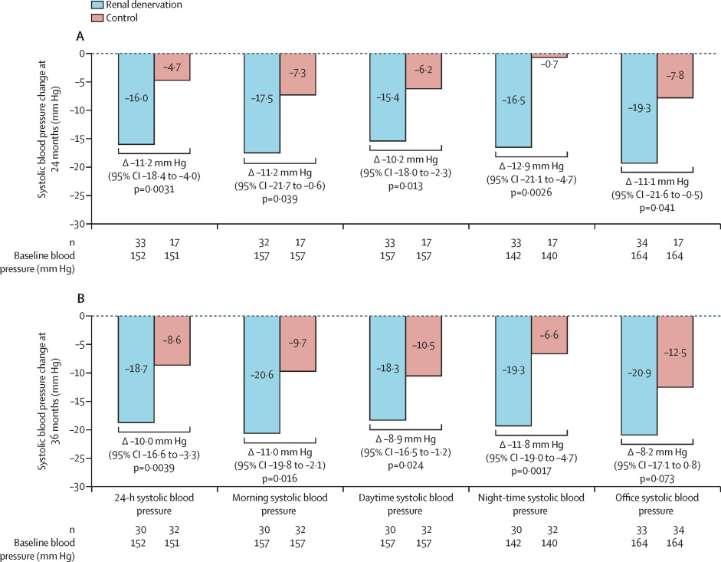
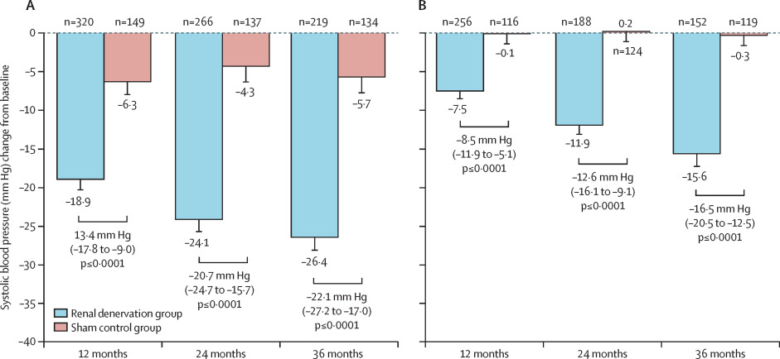
24-Hour Ambulatory Monitor
SYMPLICITY
SPYRAL ON
Figure 2
Figure 2
Notes:
Figure 2. Reduction in mean systolic blood pressure at (A) 24 months and (B) 36 months for renal denervation compared with sham control for 24-h, morning, daytime, night-time, and office systolic blood pressure
Only safety event follow-up was originally required for patients in the sham control group after 12 months, and not all patients reconsented before 24-month follow-up. 36-month sham control blood pressure measurements include 13 imputed values from crossover patients.
Figure 2. Reduction in mean office (A) and 24 h ambulatory (B) systolic blood pressure at 12 months, 24 months, and 36 months
Blood pressure values for the sham control group include last observation carried forward imputed for patients in the crossover group from when they were masked to intervention. Treatment differences and p values in this post-hoc analysis were analyses of covariance adjusted for baseline blood pressure. Error bars are SE.

Slide 46
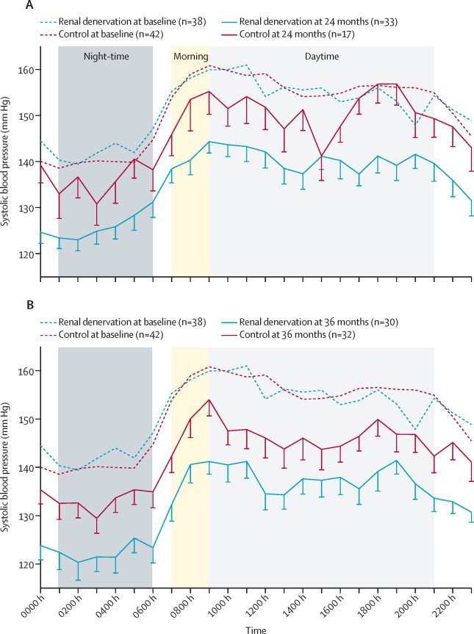
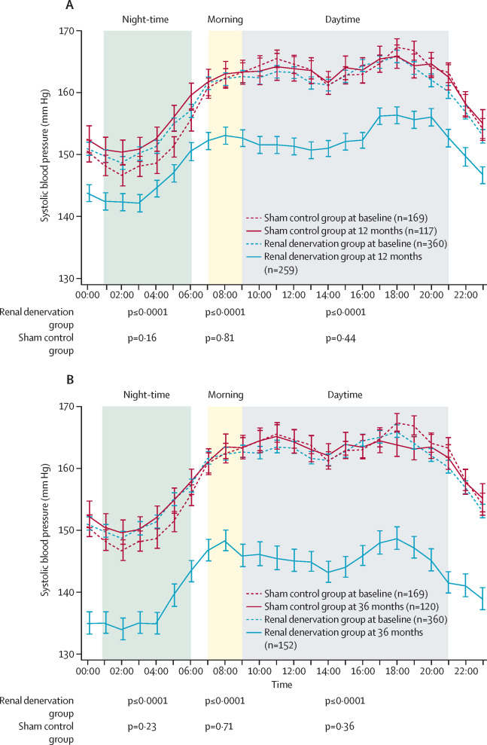
24-Hour Ambulatory Monitor
SPYRAL ON
SYMPLICITY
Figure 3
Figure 3
Notes:
Figure 3. Hourly plots comparing 24-h systolic blood pressures at baseline and (A) 24 months and (B) 36 months post-procedure
Night-time is 0100 h to 0600 h, morning is 0700 h to 0900 h, daytime is 0900 h to 2100 h. Only safety event follow-up was originally required for patients in the sham control group after 12 months, and not all patients reconsented before 24-month follow-up. Mean sham control measurements at 36 months include 13 imputed crossover patients' blood pressure values from their most recent measurements before the renal denervation procedure. Error bars represent the SE.
Figure 3. Hourly comparison of 24 h systolic blood pressures between sham control and renal denervation groups at baseline and 12 months (A) and at baseline and 36 months (B) after procedure
Night-time was defined as 01:00–06:00 h, morning was defined as 07:00–09:00 h, and daytime was defined as 09:00–21:00 h (appendix p 13). Mean measurements in the sham control group at 12 months and 36 months include 97 imputed blood pressure values from patients in the crossover group from their most recent measurements before the renal artery denervation procedure. Error bars represent are SE in this post-hoc analysis. p values are from paired t-tests comparing baseline and follow-up blood pressures within each group for each time range.

Slide 47
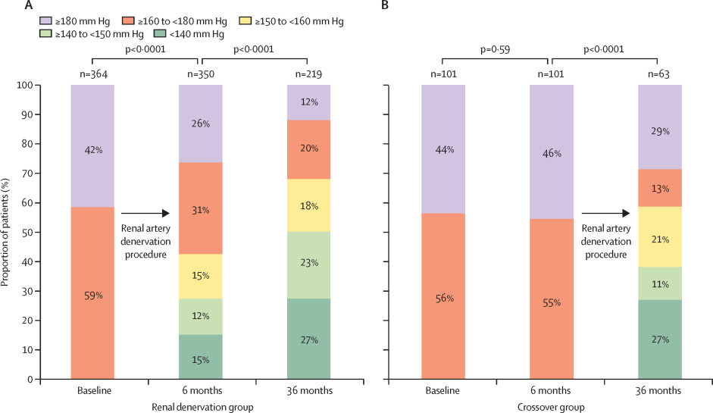
SYMPLICITY Cross-Over
Figure 4
Notes:
Figure 4. Distribution of office systolic blood pressure in patients the renal artery denervation group (A) and patients in the crossover group (B) at baseline, 6 months, and 36 months
Proportion of patients in the indicated office systolic blood pressure ranges at baseline, 6 months, and 36 months.

Slide 48
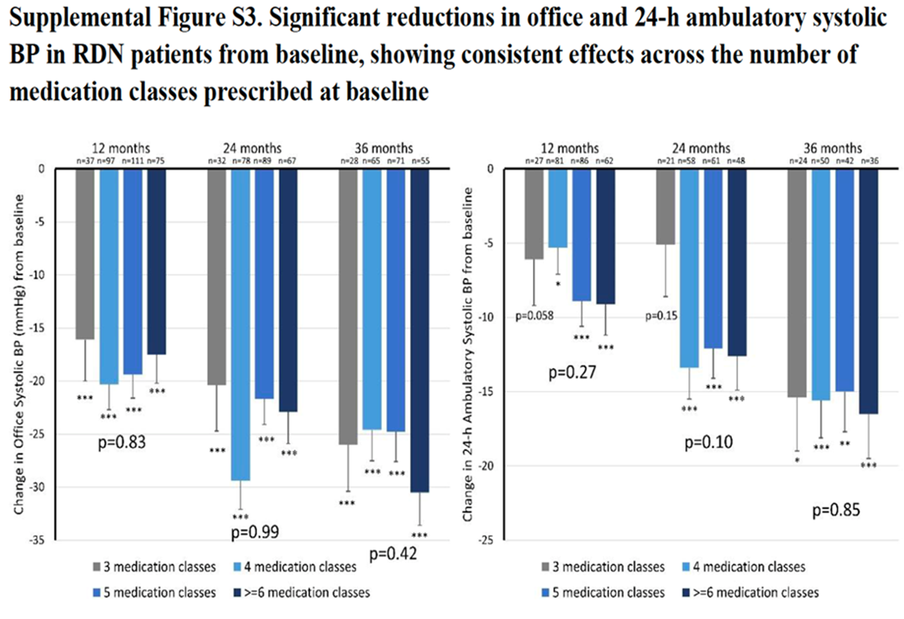
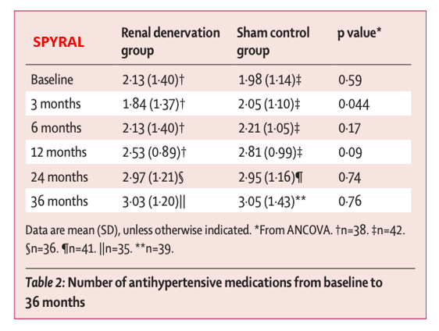
Medication Differences
Notes:
1 = JNC 7 Max dose
2 = #1 x no. of meds
3 = #2 but different weight per class of medication
4 = #1 but using a different denominator for assumed average maintenance vs standard dose

Slide 49
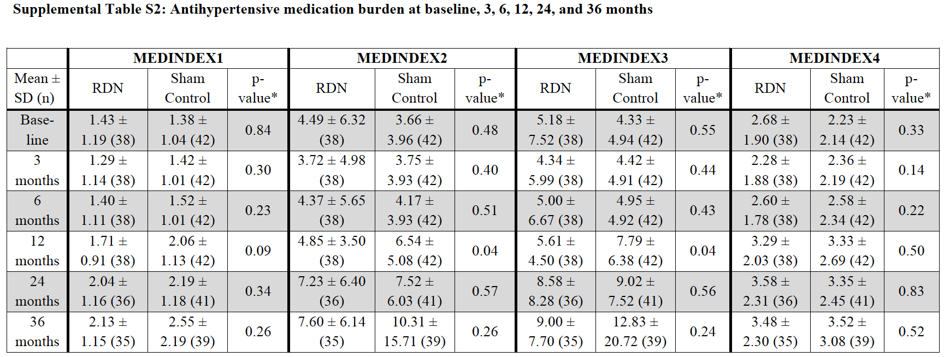
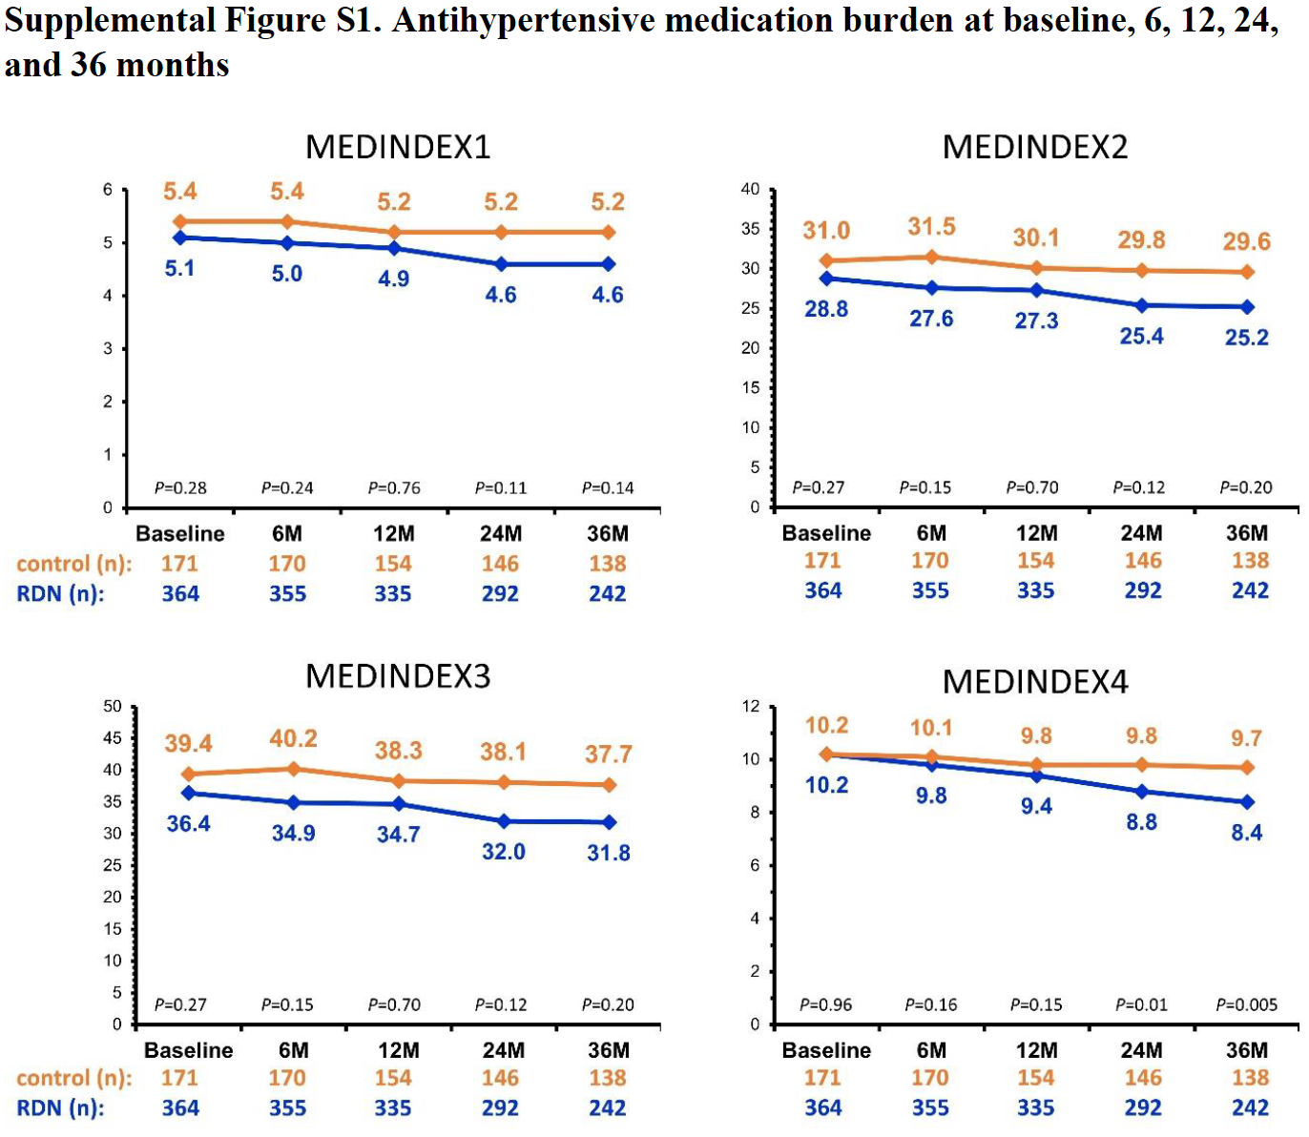
MEDINDEX
SPYRAL ON
SYMPLICITY
Notes:
1 = JNC 7 Max dose
2 = #1 x no. of meds
3 = #2 but different weight per class of medication
4 = #1 but using a different denominator for assumed average maintenance vs standard dose

Slide 50
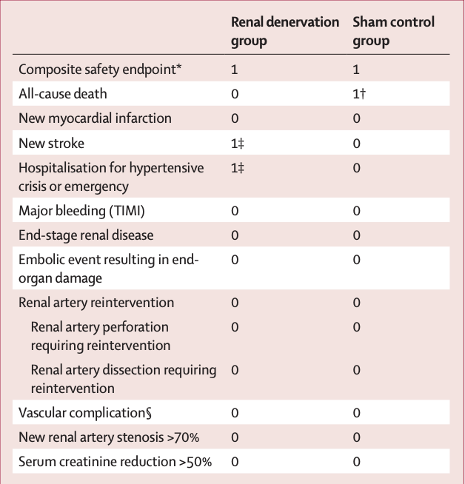
Long-Term Safety - SPYRAL ON
Table 3

Slide 51
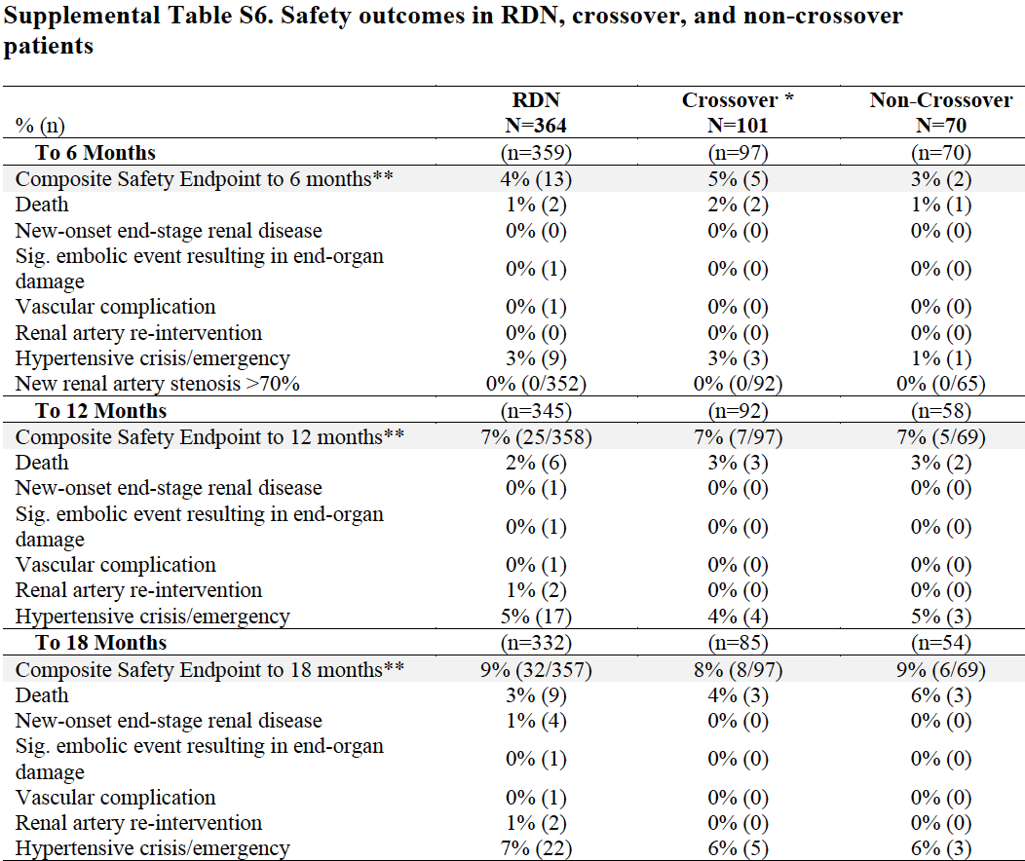
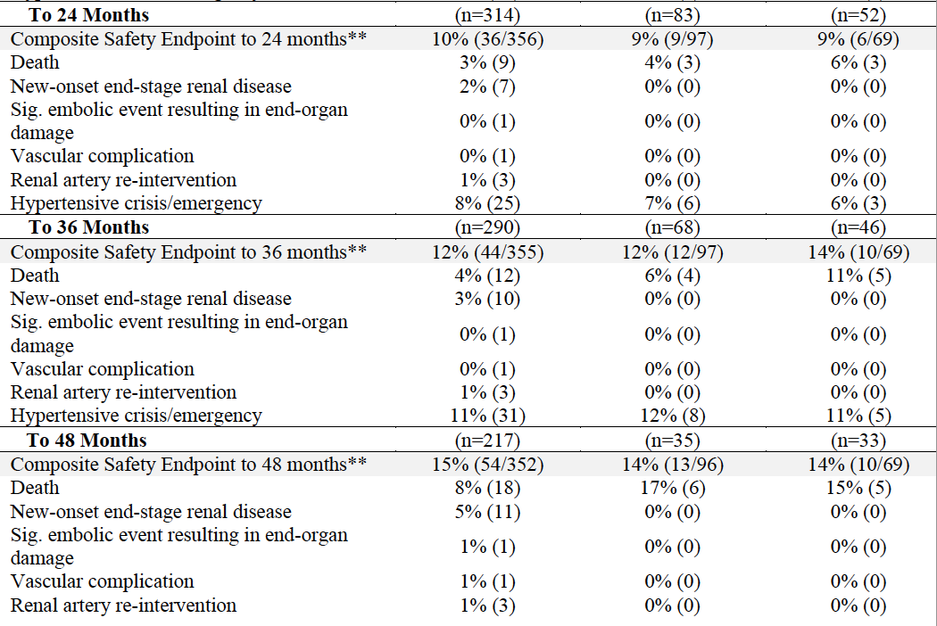
Long-Term Safety-SYMPLICITY

Slide 52
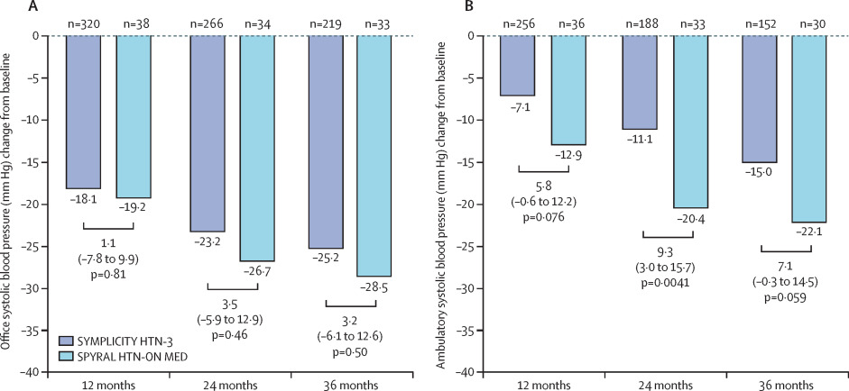
Comparing both head-to-head
Figure 5
Notes:
Figure 5. Office (A) and 24 h ambulatory (B) systolic blood pressure reductions in patients in the renal artery denervation groups of the HTN-3 and the SPYRAL HTN-ON MED Pilot studies
Data from the SPYRAL HTN-ON MED Pilot study are from Mahfoud and colleagues.²¹ Blood pressure values and treatment differences were analyses of covariance adjusted in this post-hoc analysis for baseline blood pressure and the number of prescribed antihypertensive drugs at each timepoint.

Slide 53
Expansion of SPYRAL-ON
Population: renal denervation (n = 206) vs. sham control (n = 131)
  Pilot cohort (n = 80 patients)
  Expansion cohort (n = 257 patients)
MAE at 1 month:
  1% renal denervation group (compared with prior data)
Mean # of anti-hypertensives at 6 months
  1.9 (RDN) vs 2.1 (sham)
Medication Burden at 6 months:
  2.9 (RDN) vs 3.5 (sham)
24-hour ambulatory systolic blood pressure:
  -6.5 mmHg (RDN) vs. -4.5 mmHg (sham)
Office systolic blood pressure:
  -9.9 mmHg (RDN) vs. -5.1 mmHg (sham)
*Presented by Kandzari D.E. at the AHA Scientific Sessions, Chicago, IL, November 7, 2022

Slide 54


Slide 55
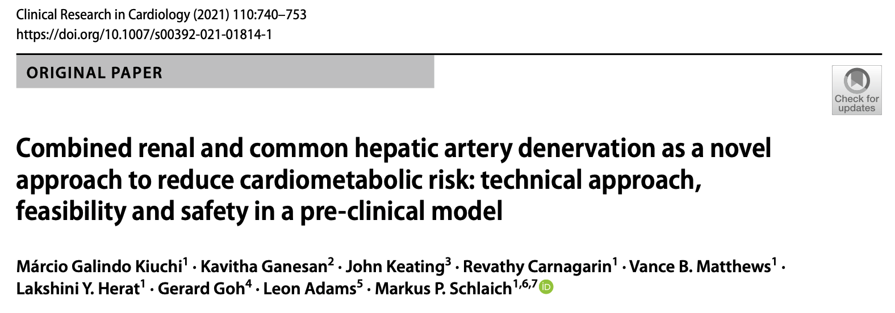
Porcine model
Proof of concept study
BP or cardiometabolic profile was not assessed
NorEpi concentrations were significantly reduced in the liver (− 88%, p = 0.005), kidneys (− 78%, p < 0.001), pancreas (− 78%, p = 0.018) and duodenum (− 95%, p = 0.028) following multi-organ denervation treatment compared to control animals

Slide 56


Slide 57
Take home points …
Initial failure of SYMPLICITY-3 – RDN is not approved as a Rx in US yet …
Hopefully 2022 SYMPLICITY-3 and SPYRAL ON results will change the course
Effective RDN can spare some patients pharmaceutical costs and/or adverse experiences
How to identify those individuals who are likely to have clinically important benefits remains uncertain
Renal artery reinnervation after RDN ? concern
No safety concerns observed at 36 months, need more data beyond 36 months
Important critique of SYMPLICITY HTN-3 trial : RDN pts over a span of 36 months may have received better care compared to sham control

Slide 58
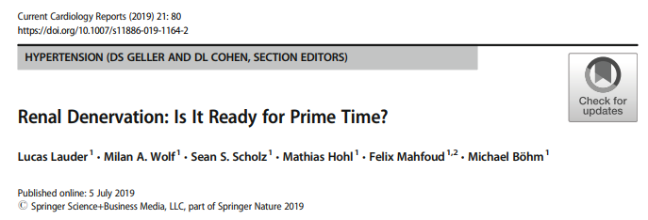

Slide 59

Thank you…

