Slide 1

Nephronomics
Introduction to Healthcare and Policy
Jacob Nysather DO
2-4-2026

Slide 2
Disclosures
No financial disclosures

Slide 3
Lecture Series Overview
Part 1: Introduction to Healthcare and Policy
Part 2: Billing, Coding, and Documentation
Part 3: Insurers and Payers, Dialysis Specifics
Part 4: Specific Policies and Governmental Involvement
Part 5: Contracts and Incentives Benefits
*Part 6: Medical Directorship

Slide 4
Why Does It Matter?

Slide 5
Why Does it Matter
History of Dialysis or Cost of Dialysis
Cost to Healthcare of ESRD
Financial Burder on Patients in Kidney Care
Understanding Health Insurance
Organizations with key impact (CMS, CMMI, AMA)
Policies
Billing, Coding, and Documentation
Reimbursement Models
Know your value from a business perspective, what you bring to the table
Medical Directorships (Acute and Chronic)

Slide 6
Origin Story and a walk down memory lane
Correlate to Nephrology
How the practice gets paid
How the Provider gets paid
Practice Revenue Streams
Payors*
Nephrology and ESRD
Quality Programs

Slide 7
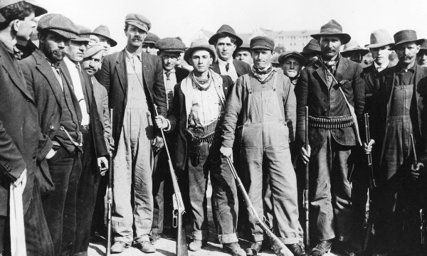

Slide 8

The Knick
Cinemax Original Series

Slide 9
Interweave/influenced by the likes of social events and conflict

Slide 10
Early Times: 1900-1920. WW1 (1914-1918). Women's Suffrage
Turn of the 20th century: Second Industrial Revolution (Gilded Age)
1912: President Teddy Roosevelt as part of his platform endorsed having social insurance (which included health insurance)
  In same year National Convention of Insurance Commissioners developed its first model of state law to regulate health insurance.
1915: American Association for Labor Legislation drafted a bill requiring health insurance. US entered WW1 and bill not enacted
  Bill was not enacted as the United States entered WW1

Slide 11
1920s: Interwar Period, Roaring 20s
1921: Sheppard-Towner Act - providing matching funds to states for prenatal and child health centers (expire 1929 without reauthorization).
1927: Committee on the Costs of Medical Care was formed to study the economics of medical care (physicians, public health specialists, and others).
1932: Published its findings and majority endorsed medical group practice and voluntary health insurance.
1929: Baylor Hospital had introduced a pre-paid hospital insurance plan (Blue Cross plans)

Slide 12
1930s: Interwar Period, Great Depression (1929-1939)
1930: Franklin D Roosevelt appointed the Committee on Economic Security
Social Security Act 1935: included grants for Maternal and Child Health which restored many programs within the Sheppard-Towner Act and expanded role of Children’s Bureau to include welfare services
1938: National Health Conference - recommendations to incorporate into the National Health Bill (died in committee in 1939).
1939: Physician Reimbursement Reform (Blue Shield)
Notes:
social policies to secure employment, retirement, and medical care
National Health Survery conducted by US Public Health Service to assess the Nation’s Health including underlying social and economic factors (National Health Interview Survey)

Slide 13
1940s: WW2 (1939-1945) and Cold War
1943: Wagner-Murray-Dingell Bill – legislation introduced to operate health insurance as part of social security changes with provisions for universal comprehensive health insurance and life long long social insurance
1944: President Roosevelt included right to adequate medical care and the opportunity to achieve and enjoy good health in his Economic Bill of Rights Sate of the Union address.
1944: Social Security Board called for required national health insurance as part of the social security system
1946: Hill-Burton Act (passed) – funded construction of hospitals and prohibited discrimination of medical services on the basis of race, religion, or national origin. Required hospitals to provide a ”reasonable volume” of charitable care and allowed for “separate but equal” facilities.
1947: President Harry S. Truman revived the idea of a national health program after WW2 and the Wagner-Murray-Dingell bill was re-introduced along with Taft-Smith Ball bill authorizing grants to states for medical care of the poor. (neither bill passed)
1948: National Health Assembly by the Federal Security Agency. Called for voluntary health insurance but stated need for universal coverage. The same year the American Medical Association would launch a national campaign against national health insurance

Slide 14
1950s: Civil Rights Movement and Korean War
1951: Joint Commission on Accreditation of Hospitals (JCAHO) formed to improved quality of hospital care.
1952: FSA proposed the enactment of health insurance for those receiving Social Security benefits.
1956: Military program was enacted to provided government health insurance for dependents of those serving in Armed Forces.
1956 and 1959: Forand Bill - provide health insurance for social security beneficiaries
1957 AMA continued to oppose national health insurance with the National Health Interview Survey first conducted and continuously since.
Employer based health coverage grew (and were found to be excluded from an employee’s taxable income). Private plans began to set premiums based on their experiences with various health costs. Those who were retired or were living with disability found it harder to get affordable coverage.

Slide 15
1960s: Civil Rights Movement and Vietnam War
1960: Federal Employees Health Benefit Plan was begun to provide health insurance to federal workers.
Kerr-Mills Act passed which used federal funds to support state programs providing medical care to the poor and elderly (precursor to Medicaid). The WH conference on Aging task force recommended health insurance for the elderly under Social Security.
King-Anderson bill introduced to create a government health insurance program for the aged, drew support from organized labor and intense opposition from the AMA and commercial health insurance carriers.
President Kennedy addressed the nation 1962 on the topic of Medicare and President Johnson would continue to advocate for Medicare when he succeeded President Kennedy
1965: Medicare and Medicaid programs were incorporated into the Social Security Act and signed into law by President Lyndon Johnson.
  A year after passing the Civil Rights Act
  Massive public approval, support of hospital and insurance industries
  No cost controls or fee schedules

Slide 16
1970s
1970s inflation and health care costs were both growing. President Nixon put forth the Comprehensive Health Insurance Plan (CHIP) and other congressmen put forth others splitting support for any one reform.
1972: Supplemental Security Income (SSI) began providing cash assistance to the elderly and disabled. Social Security amendments allowed under 65 with long-term disabilities and or ESRD to qualify for Medicare coverage.
1974: Hawaii Prepaid Health Care Act required employers to provide insurance for any employee working more than 20 hours per week while Employee Retirement Income Security Act (ERISA) exempted self-insured employers from state health insurance regulations. The enactment of Health Planning Resources Development Act in the same year required states to develop health planning programs to prevent the duplication of services (widespread use of Certificate of Need programs)
1977 Health Care Financing Administration was established within the Deport of Health Education and Welfare (DHHS in 1980). National Medical Care Expenditure Survey (NMCES) of that year provided detailed data on how much individuals were spending on health care

Slide 17
1980s
1981: Federal budget reconciliation required states to make additional Medicaid payments to hospitals serving a disproportionate share of Medicaid and low-income patients. Repealed the requirement that Medicaid programs pay hospital rates equal to those paid by Medicare and required states to pay nursing homes at “reasonable and adequate” rates. 2 types of Medicaid wavers were established allowing states to mandate managed care enrollment of certain groups to cover home and community based long-term care.
1982: States allowed a Medicaid expansion to children who require institutional care but could be cared for at home.
1983: Medicare introduced Diagnostic Related Groups (DRG) as a potential payment system for hospital payment.
1986: Emergency Medical Treatment and Active Labor Act (EMTALA) requiring any hospital participating in Medicare to screen and stabilize all individuals presenting to emergency departments regardless of their ability to pay. 1986 federal budget reconciliation gave the option for Medicaid to cover infants, young children, and pregnant women up to 100% of the poverty level regardless of receipt of public assistance
1987: 81 million (13%) of population are uninsured

Slide 18
1990s:
1990: OBRA 90 required Medicaid coverage of children aged 6-18 who were living under the poverty level
President Bill Clinton upon assuming office in 1993 convened a WH Task Force on Health Reform, appoint Hillary Clinton as the chair. The Health Security Act was introduced to both and gained little support and saw push back from the Health Insurance Association of America. Other health reform proposals introduced (McDermott/Wellstone single payer, Cooper’s proposal for managed competition). The administration began approving Medicaid waivers, allowing statewide expansion and many states moved toward managed care for service delivery. They used the cost savings to expand coverage for those previously uninsured. Vaccines floor Children Program was established and federally purchased vaccines to states.
HIPAA passed in 1996 restricting the use of pre-existing conditions in health insurance coverage determinations, setting standards for the privacy of medical records, and favorably taxed long-term care insurance. Personal Responsibility and Work Opportunity Act removed the link between Medicaid and cash assistance eligibility and allowed states to parents and children at higher rates. Banned Medicaid coverage of legal immigrants in their first five years of living in the country with an exemption for emergency care. Mental Health Parity Act of 1996 prohibited group health plans from having lower yearly or lifetime limits for mental health benefits than medical or surgical benefits
1997: Approximately 42.4 (15.7%) are uninsured
1997 Balanced Budget Act – Changes in provider payments to slow Medicare spending and to establish Medicare + Choice (renamed Medicare Advantage in 2003). Enactment of State-CHIP to provide block grants to states allowing for health insurance coverage of children who are low income but whose household is not eligible for Medicaid. Supplying health insurance for employed individuals with a disability and income of up to 250% of poverty. Permission for mandatory Medicaid enrollment in managed care
1999 Ticket to Work Incentives Improvement Act extended states’ ability to cover working disabled to individuals with incomes above 25% of poverty and gave states ability impose income-related premiums

Slide 19
2000s
2000s Breast Cancer Treatment and Prevention Act allowed states to provide Medicaid coverage to uninsured women for treatment of BC cancer provided they are diagnosed through CDC screening program regardless of income. 2002 Bush expanded the number of community health centers serving underserved populations with the Health Center Growth Initiative.
Medicare Drug Improvement and Modernization Act (MMA) was passed and created a (voluntary) subsidized prescription drug benefit under Medicare. Medicare legislation also created HAS allowing users to set aside pre-tax dollars to for current and future medical expenses.
2005 Deficit Reduction Act made changes to Medicaid related premiums, cost sharing, benefits, and asset transfers. Medicare Part D (drug benefits) went into effect followed by the State of Massachusetts implementing legislation to provide health care coverage for nearly all state residents. 1 month later Vermont passed health reform aiming for near universal coverage. San Fan provided universal access to health services within the city for its residents in the same year.
2007: 45.6 million (15.3%) uninsured

Slide 20
2000s
2007 Wyden-Bennet introduced Health Americans Act which would require individuals to obtain private health insurance through a state pool, thus eliminating employer-sponsored insurance programs (did not pass). Bush announced a similar health reform plan replacing employer-sponsored insurance with a standard health care deduction (did not go)
2 versions of a bill to reauthorize S-CHIP but Bush vetoes both. A temporary extension passed. California fails to pass a health reform plan with an individual mandate and shared financing responsibility
2008 Mental Health Parity Act amended to include substance use disorders, SUD on equal basis with physical conditions when health policies cover both. Economic downturn. Senator Baucus (chairman of Senate Finance Committee) released a White Paper outlining a national plan based on Massachusetts model.
2009 Obama established Office of Health Reform to coordinate administrative efforts on a national health reform. CHIP reauthorized and provides states with additional funding, tools, and fiscal incentives to help reach an estimated 4.1 million children who would otherwise uninsured by Medicaid and CHIP. Obama’s budget for 2010 included principles for health reform and proposes 634 billion to be placed in a health reform reserve fund.

Slide 21
2010s
2010 Obama’s proposal for health reform - passed the Patient Protection and Affordable Care Act. The Health Care and Education Reconciliation Act of 2010 was also passed, reflecting amendments and including a reform of national student loan system. Historic reform required that all individuals have health insurance by 2014. The poorest individuals will be covered under a Medicaid expansion, and with incomes to low to mid-range who do not have access through their jobs will be able to purchase with the help of federal subsidies through insurance exchanges. Large businesses who do not provide their employees with health insurance or subsidies will face penalties and no insurance plan will be allowed to deny coverage for any reason, nor will they be able to charge more due to health status or gender. Young adults will be able to stay on parents health plans until age 26.
2016: Trump eliminated the individual mandate section of the ACA removing monetary penalties for not having health insurance. Added pooled health plans, short-term/limited-duration plans, and new Medicare Advantage plans to the marketplace; lowered Medicare Advantage premiums; and improved access to HSAs. Also took action to end surprise medical billing and increase price transparency

Slide 22
2020s
COVID19 required legislators and policy makers to take a hard look at health care access and utilization. Access to telemedicine expansion. DHHS and Department of Defense partered to speed up development of COVID19 vaccines: Operation Warp Speed (OWS). Played key part in selecting vaccine candidates studying safety and efficacy of overlapping clinical trial phases to accelerate developmate and mitigate manufacturing challenges (cost manufacturing, distribution)
Bidne took action to lower cost and increase enrollment in health care marketplace
August 2023: 7.7% of US population is uninsured
American Rescue Plan Act (ARPA) enhanded ACA subsidies and the Inflation Reduction Act extended them

Slide 23
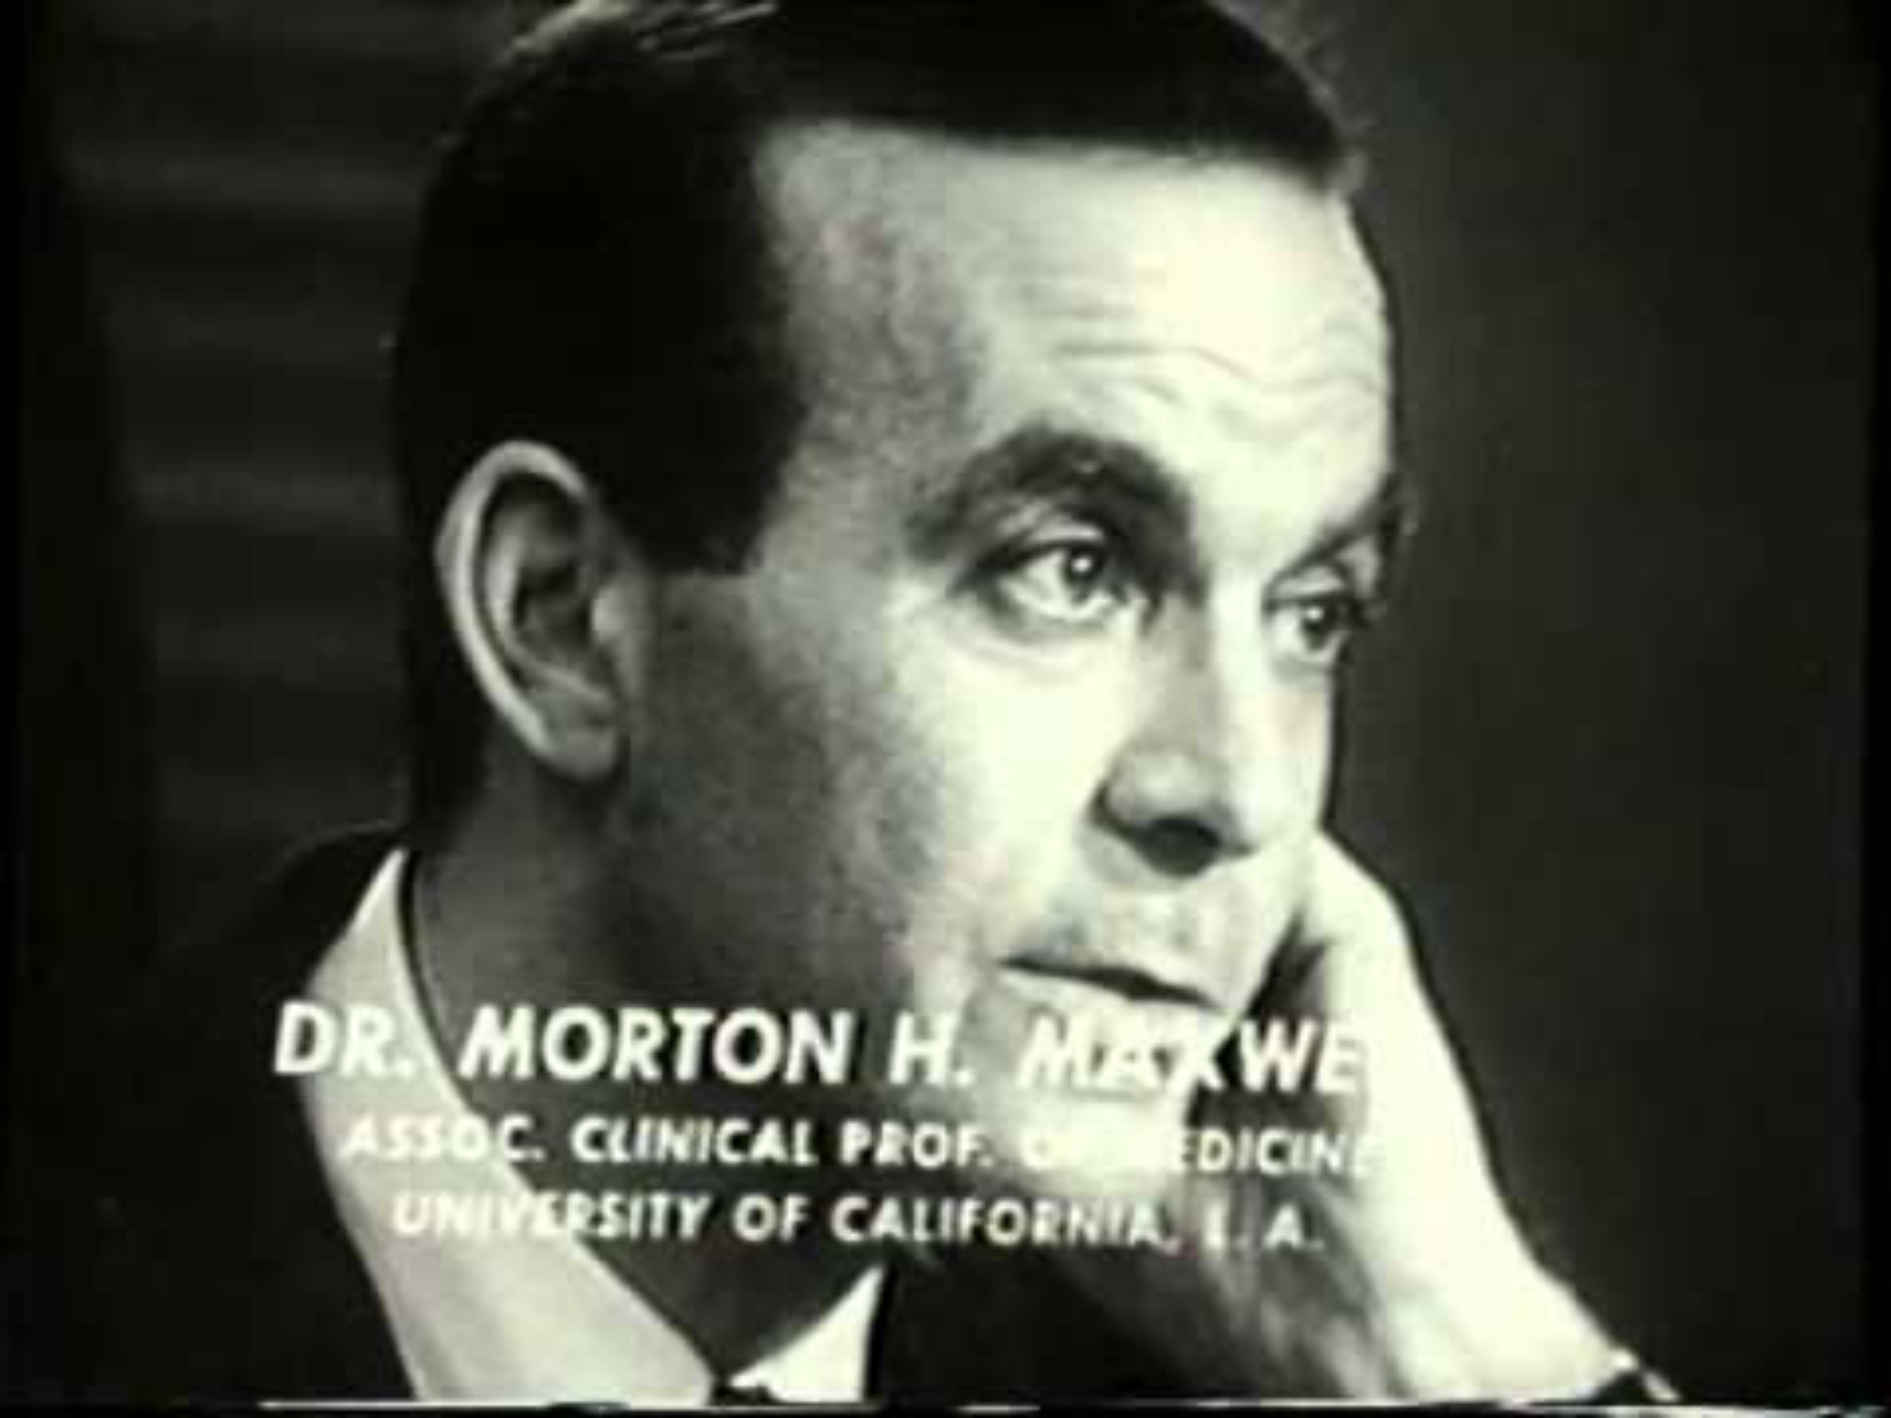
Who Shall Live

Slide 24
Structure and Order
*Billing and Coding
  CPT
  ICD10
  EM
*RVUs
*DRGs

Slide 25
How a Practice gets Paid
Fee For Service (FFS)
Dialysis
Value Based Care (VBC)

Slide 26
How a Practice gets Paid: FFS
Fee For Service (FFS)
  Simplest billing model, Bill for each service provided, volume of services and coding/documentation level are incentivized, bonuses for seeing complex patients, /rural practice or working weekends/evenings
See patient and code encounter -> Biller Submits Charges -> Health Plan determines how much they will pay for each charge -> patient receives bill

Slide 27
How a Practice gets Paid: Dialysis
Monthly Capitation Payment (MCP) for each patient; intent is to cover the usual outpatient care you would provide to a dialysis patient
Amount varies according to # of times patient is seen
NPs can perform some or all of the monthly visits (paid at 80%)

Slide 28
How a Practice gets Paid: VBC
Value Based Care (VBC models)
Nephrology-specific: Comprehensive Kidney CareChoices (CKCC) Program through CMS
Providers belong to KCE (Kidney Contract Entity)
Patients are aligned to a provider based on geographical location, diagnosis codes (ICD-10), and number of claims (E&M codes that were billed) associated with a particular provider (NPI) or practice (TIN)

Slide 29
How a Practice gets Paid: CKCC
Participants receive payments based on risk assumed
1) Capitation Revenue and Quality Bonuses
  Fixed prospective monthly payments, replaces historical FFS revenue. Paid regardless of how often you see patients
2) Quality Based Payments
  CMS takes a 5% quality withhold but allows practices to earn it back by performing well on things like treating depression and optimal starts. Additional bonuses for successful transplantation and home dialysis
3) Shared Savings (global risk)
  Based on actual total cost of care expenditures compared to prospective benchmarks set by CMS
Largest Opportunity = Taking Highest Risk (Bar Graph example)

Slide 30
How a Practice Pay Providers
Associates: Typically Salaried
Partnership (after defined timeframe)
  Buy-in
  Hard Assets (owning building, dialysis, etc)

Slide 31
Practice Revenue Streams
FFS
VBC Arrangements (important to be taking risk)
Medical Directorships
  Every outpatient dialysis unit must have a MD
  Typically need 2-3 years of experience post-fellowship
  Terms can be long (5-10 years)
  Non-competes and limitations; a lot of responsibility
JV Ownership of Dialysis Units
  Usually minority share
  Capital calls a possibility
  Buying into existing units often expensive; de novo less expensive
  Difficult financial times for in-center units
Ancillary Services
  Vascular access center
  Imaging
  Laboratory
  Transplant program management
Real Estate
  Practice locations
  Dialysis Units/ASC
Research

Slide 32
Medicare
Care for Elderly
Qualified by age (65+) or diagnosis (ESKD, ALS, Disability)
Three Parts:
  A: Inpatient, SNF, Hospice
  B: Outpatient Services, Medical Supplies
  C: Medicare Advantage*
  D: RX Coverage
Notable Exclusions: Dental, Vision, Hearing, routine foot care

Slide 33
Medicaid
Aid for the poor, funded by both federal and state governments
Administered at the state level; coverage and exclusion criteria vary widely between states
“Dual Eligibles” = Seniors with both Medicare and Medicaid
Several groups must be covered by states to receive federal funding: demographic + income requirements

Slide 34
Medicaid continued
Expansion under the Affordable Care Act: includes nondisabled adults without dependents with income <138% of federal poverty line
Non-expansion states: no coverage for lawful noncitizen residents

Slide 35
Medicare Advantage
Administered by a private company that contracts with Medicare; these companies get a set amount of $ from Medicare per member
Elusive “Part C” (bundles parts A, B, and usually D)
Must use MDs and hospitals in-network (HMO) or have hiverer OOP costs if going out of network (PPO plans)
Make $ by assuming risk, limiting care
  Aim to outperform benchmark spend
  Accurate coding helps set benchmarks

Slide 36
Leaving Medicare Advantage
Open enrollment twice a year
Access to MediGap a real barrier: Medical Underwriting

Slide 37
Commercial Insurance
Most are provided through employers
Individual policies can be purchases through ACA marketplace
Type of plan depends on deductible, coinsurance, and out-of-pocket maximums (these variables also heavily influence monthly premiums)
Limitations on doctors/hospitals patients can use based on plan type

Slide 38

Next Steps

Slide 39
Organizations with Focus on Business and Policy
ASN
NKF
RPA www.renalmd.org
NBLU www.NBLuniv.org

