Slide 1
Nephron Review
Jacob Nysather PGY-3

Slide 2

Disclosures
None

Slide 3
Objectives
Review the nephron and generalized units of the tubular structure with relevant anatomy.
Common testable subjects based on tubular physiology
Review over areas of a Urinalysis

Slide 4
(56) A 70 year old man is evaluated for new-onset swelling and fatigue for several weeks’ duration, as well as right knee pain occurring during the same time period. History is significant for stage G3a chronic kidney disease and knee osteoarthritis. Medications are lisinopril and OTC naproxen.
On physical examination, blood pressure is 150/80 mmHg, and pulse rate is 70/min; other vital signs are normal. BMI is 30. There are no lung crackles or jugular venous distension. The bladder is not palpable. There is no abdominal bruit. Examination of the right knee reveals crepitus and pain at extremes of flexion and extension. There is 1+ pedal edema.
Laboratory studies:
Bicarbonate 23
Creatinine 2.4 (baseline 1.8)
Potassium 5.6
UA No blood; trace protein
Which of the following is the most appropriate management?
A) Discontinue naproxen
B) Obtain CT angiography of the renal arteries
C) Obtain kidney biopsy
D) Start furosemide

Slide 5
(56) A

Slide 6
(80) A 38 year old man is evaluated during a follow-up visit for elevated blood pressure found for the first time during his last visit. He reports back pain and several weeks’ duration after an episode of heavy lifting at work. History is also notable for seasonal allergies. He currently takes ibuprofen daily for the back pain and loratadine as needed for allergies.
On physical examination, the patient is well developed and muscular, and in no apparent distress. The average of three blood pressure measurements is 139/84 mmHg, and pulse rate is 52/min; other vital signs are normal. BMI is 26. The remainder of the examination is normal. EKG in office is normal.
In addition to follow-up in 1 month, which of the following is the most appropriate management?
A) Begin amlodipine
B) Begin hydrochlorothiazide
C) Discontinue ibuprofen
D) Discontinue loratadine

Slide 7
(80) C
Sodium retention

Slide 8
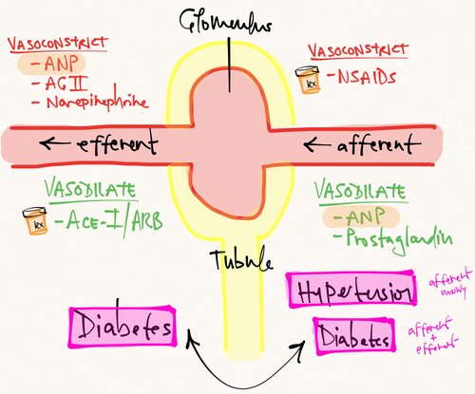
Afferent and Efferent Arterioles

Slide 9
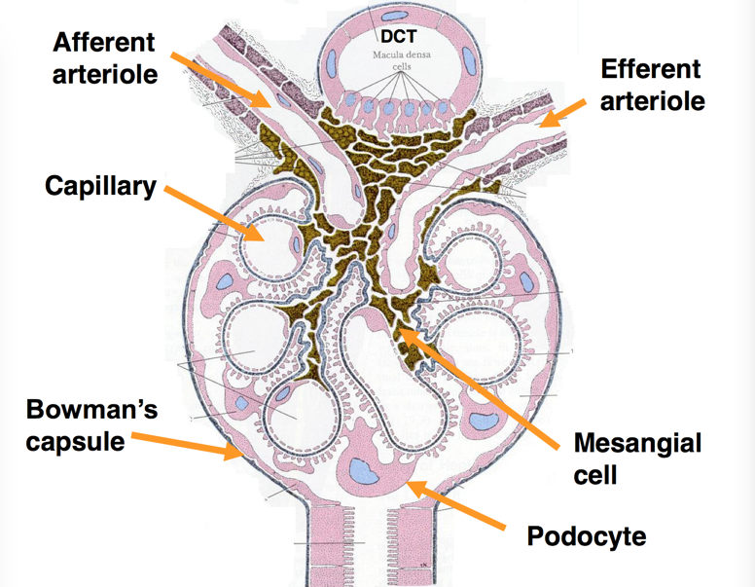
Juxta-glomerulus Apparatus with Macula Densa
Increased flow rate (high Na) causes afferent vasoconstriction
Reduced flow rate (low Na) causes Renin release causing efferent vasoconstriction

Slide 10
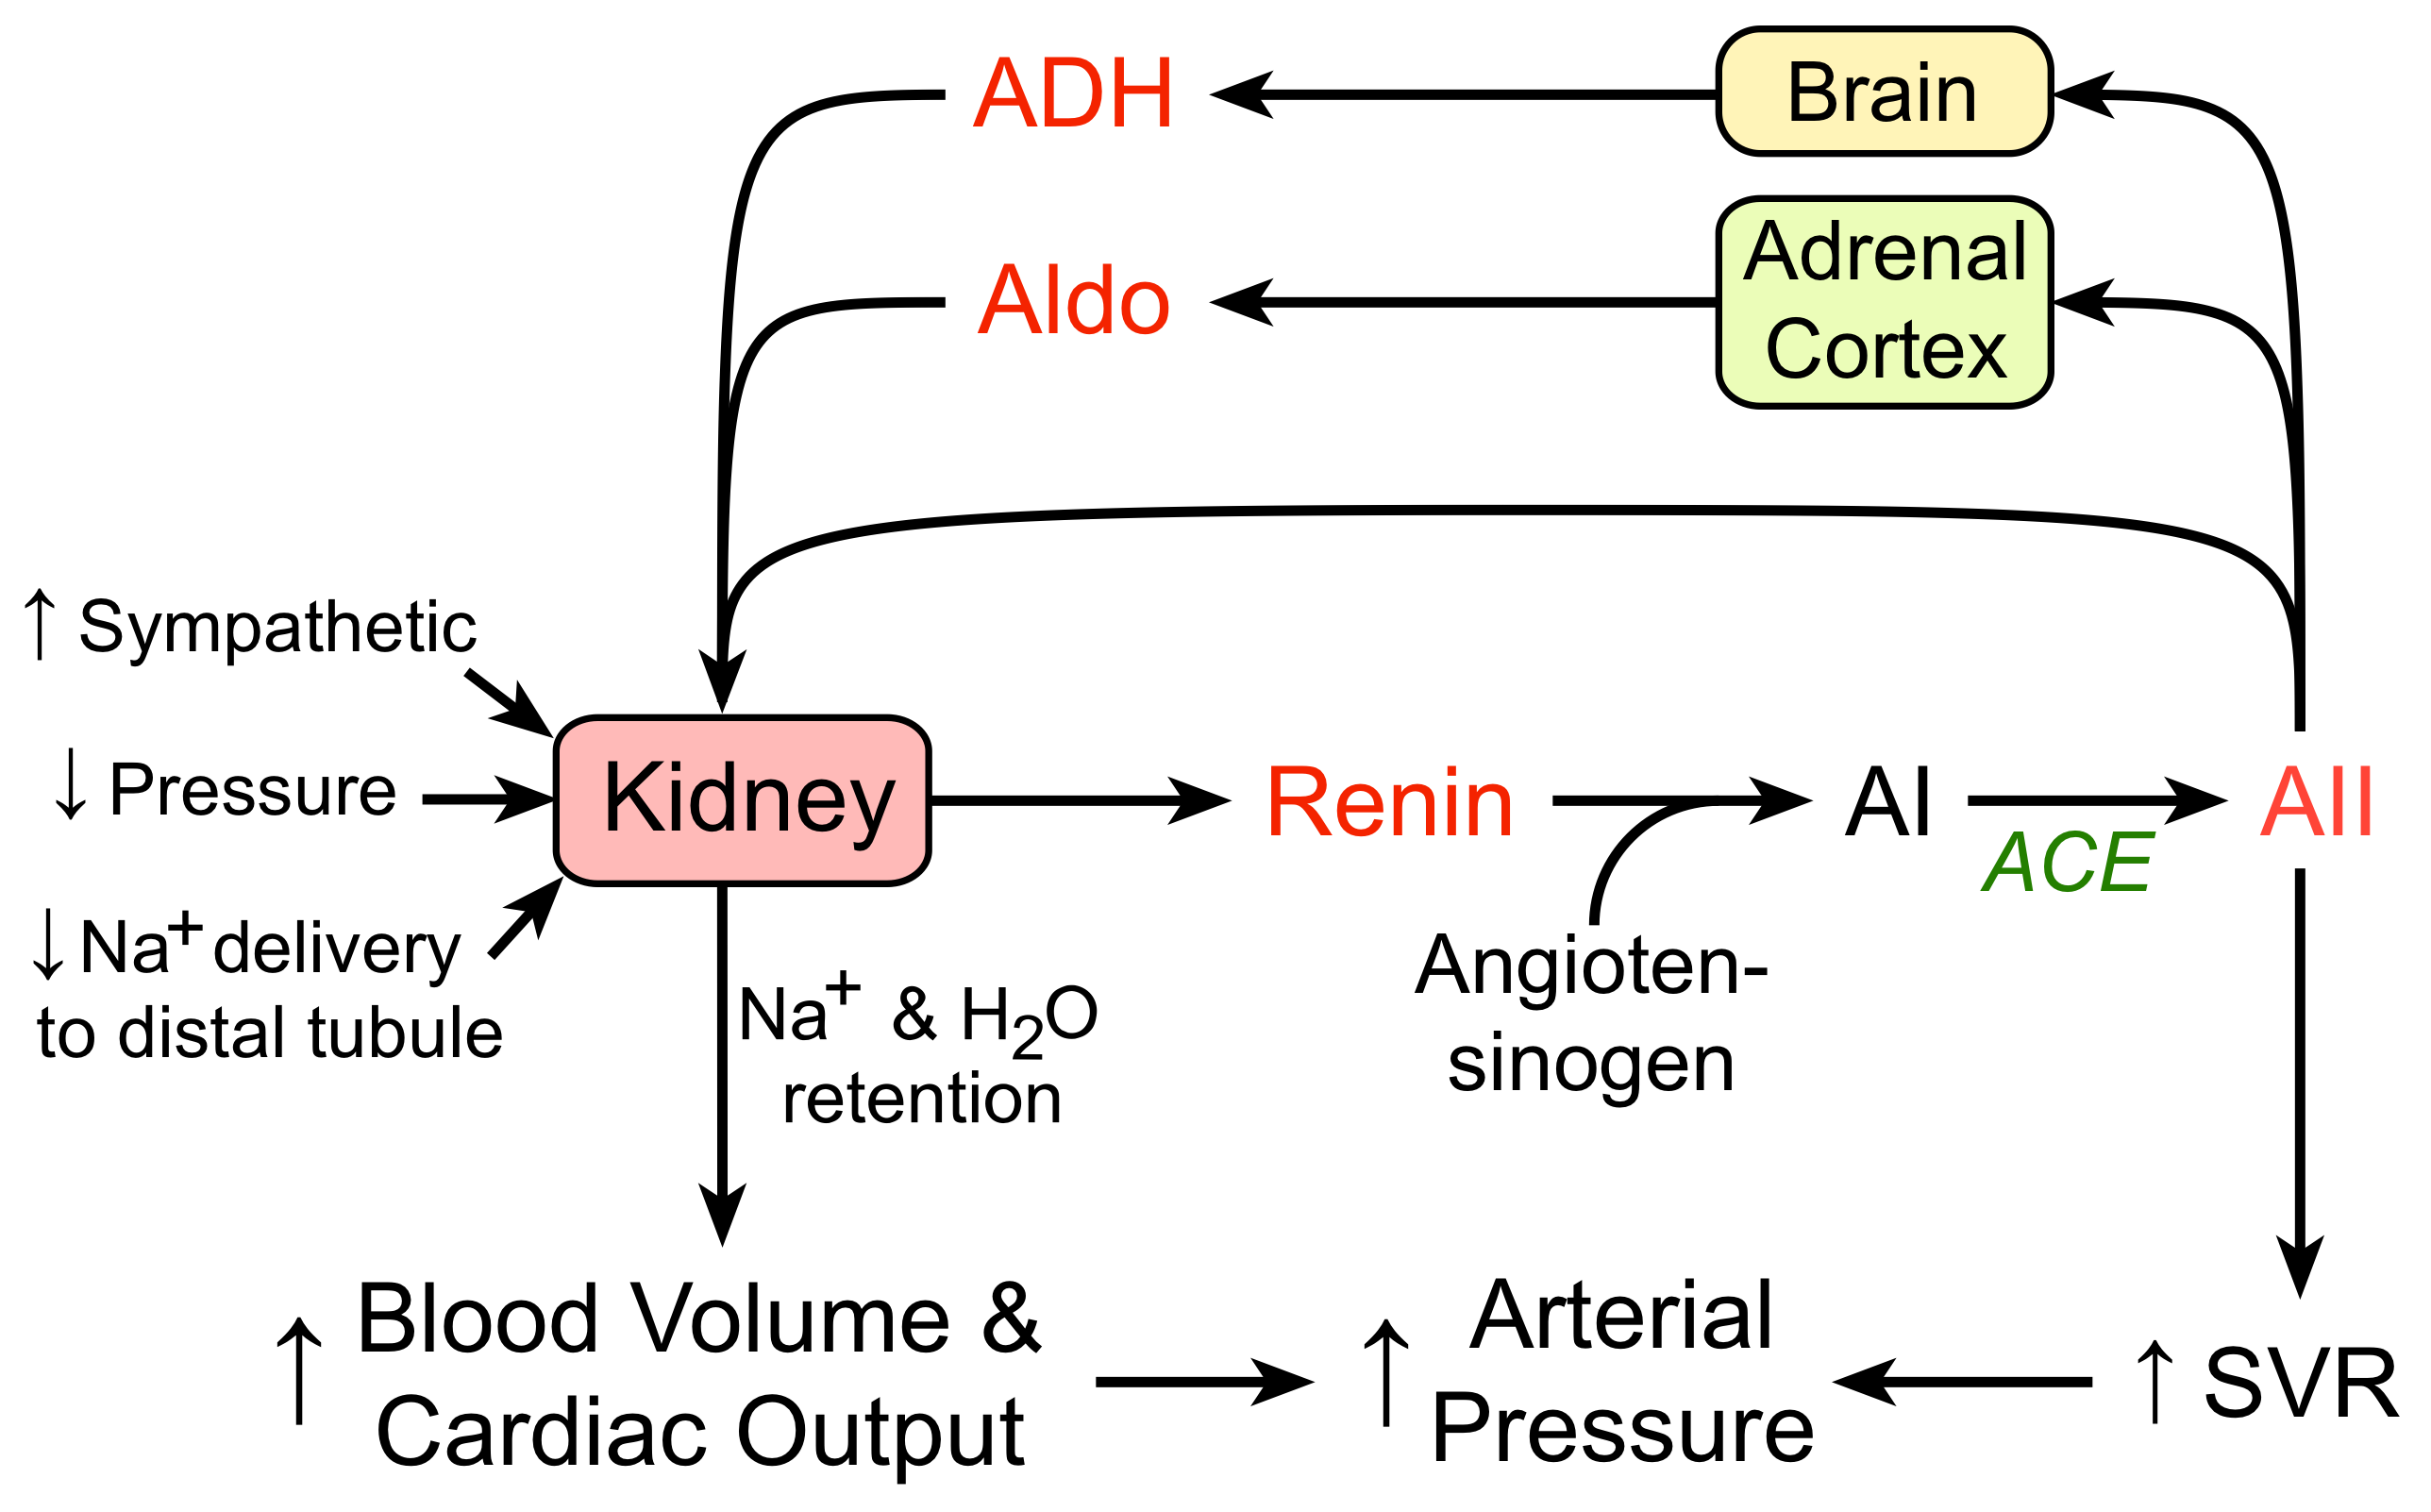

Slide 11
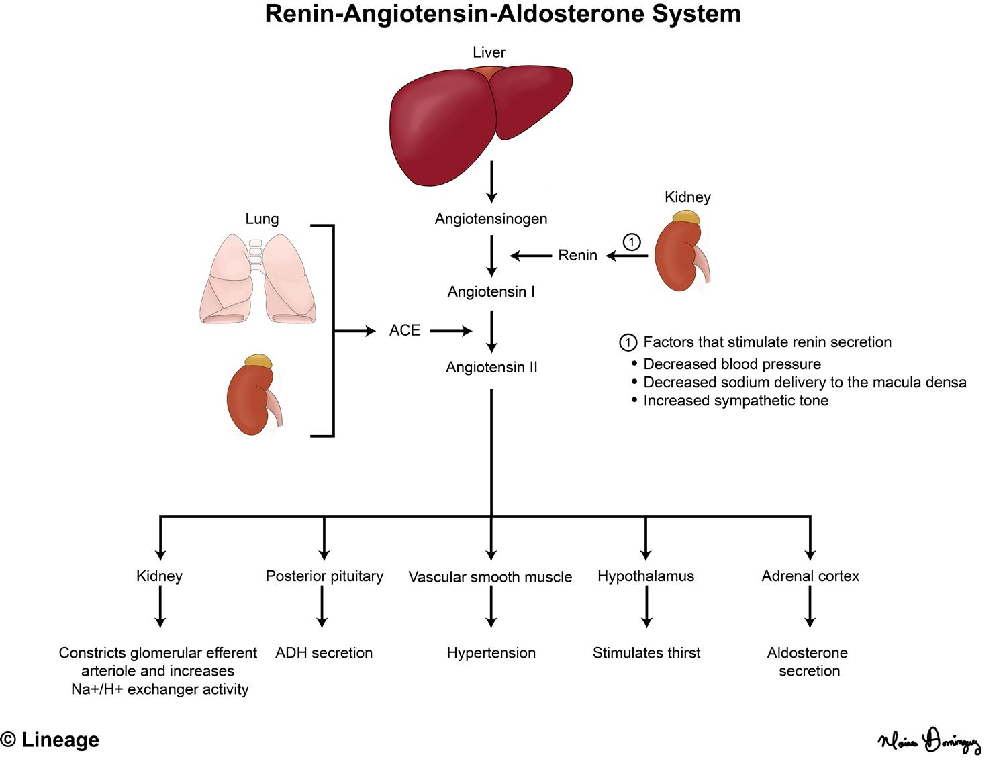

Slide 13
Nephron

Slide 14
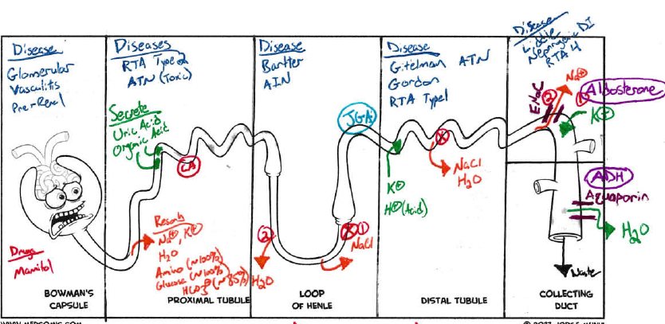
Filter/Secrete = Green Resorb = Orange Disease = Blue
Drugs = Red Hormone= Purple Channels = Maroon

Slide 15
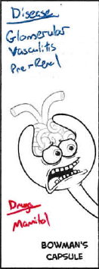
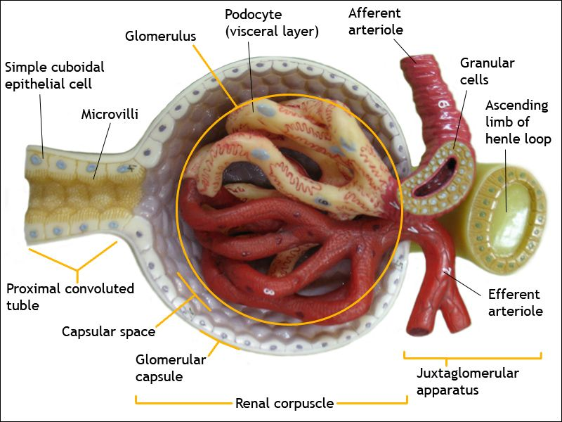
Glomerulus
Filter
H20
NaCl
Potassium
Bicarb
Glucose
Amino Acids
Creatinine
Urea
Albumin/Protein
Drugs
Mannitol

Slide 16
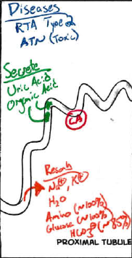
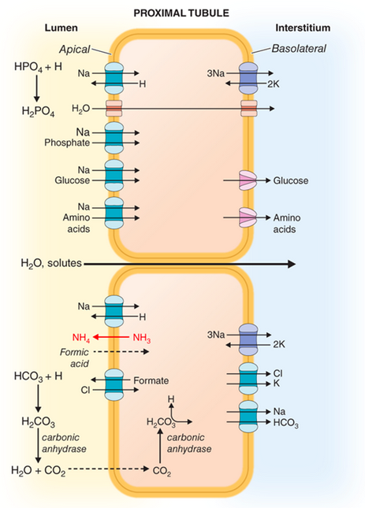
Proximal Tubule
Drugs
Acetazolimide (CA inhibitor)
SGLT-2

Slide 17
Proximal Tubule
~60% of filtered NaCl and water
Na/K-ATPase (active transport) - keeping Na gradient and intracellular Na concentrations low.
Water Reabsorption - Paracellular, Aquaporin-1 (active)
Cl- is poorly reabsorbed (counter balances bicarb reabsorption)
~90% of filtered Bicarb, Glucose, and AA
Carbonic Anhydrase - Exits by Na+/HCO3- cotransporter
Acid Secretion Ammonia (NH4+) and Phosphate
NA/Glucose - when glucose is high (>200) will be unable to re-absorb

Slide 19
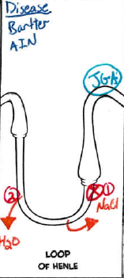
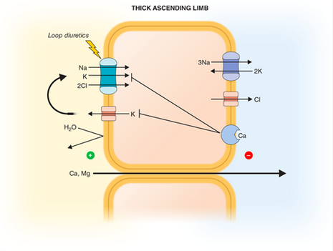
Loop of Henle
Drugs
Loop Diuretics
Mannitol
3 parts - thin descending, thin ascending, thick ascending
15-25% of filtered NaCl is reabsorbed in loop of Henle (mainly thick ascend)
Thick Ascending - Na/K/2Cl (Loop Diuretics) - K is the limiting substrate
Cotransporter enables reabsorption of NH4+ or K+ - leading to accumulation of Ammonia in medullary interstitium

Slide 20
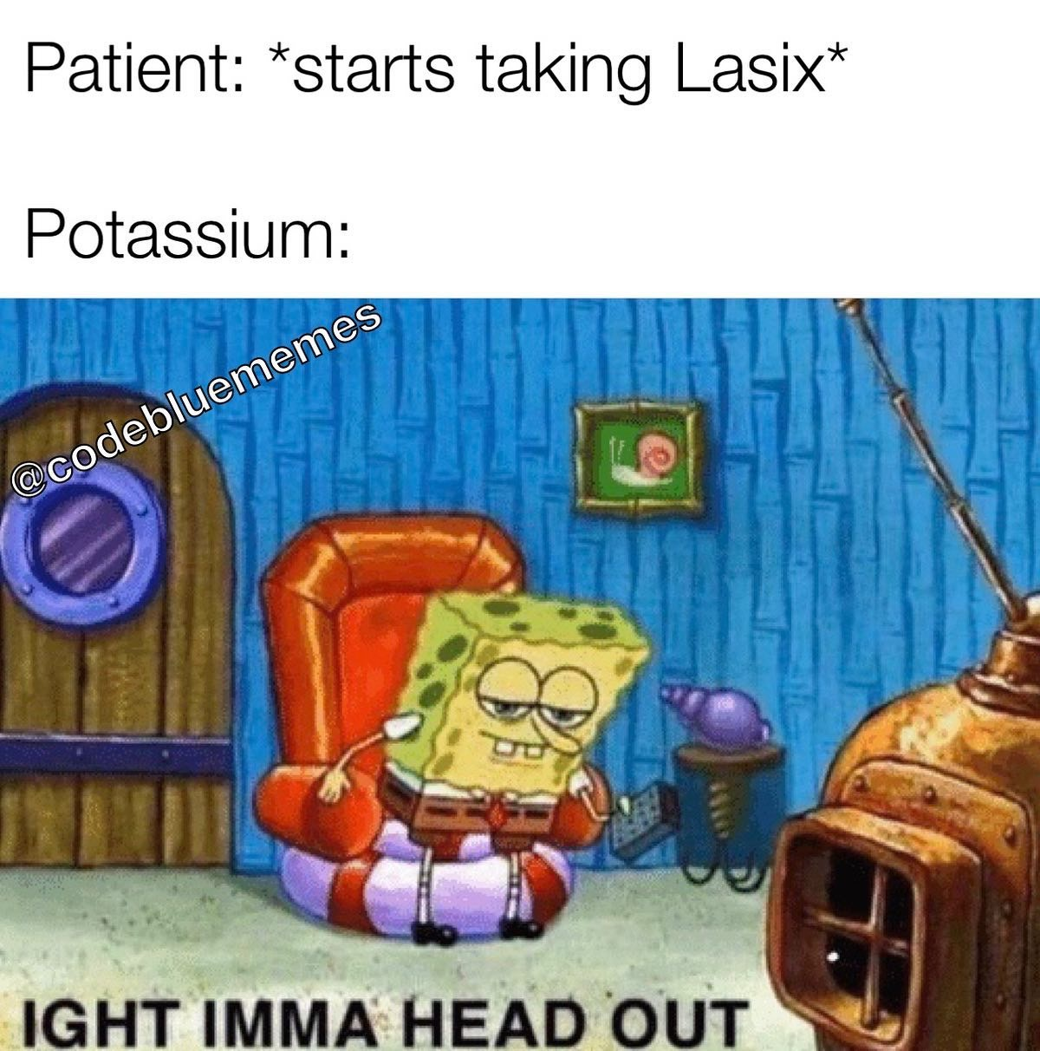

Slide 22
A 40 year old male with a pertinent medical history for muscle cramps. Presents to the office for follow-up on fatigue and polyuria. Per chart review, patient has been dealing with severe muscle cramps for > 5 years. You note patient has had hypokalemia, hypomagnesemia, and hypocalcemia in the past with multiple rounds of supplementation. Patient’s only medication is cyclobenzaprine. Patient is very compliant and forthcoming with history. No other pertinent past medical, social, or family history.
On physical exam vital signs are stable and afebrile. Cardiopulmonary exam is unremarkable. Neuro exam unremarkable except for lower extremity muscle cramping with ROM testing. Peripheral pulses intact and extremities are without any edema.
Creatinine 0.8
Na/K/Cl 138/2.8/104
Bicarb 34
Corrected Calcium 9.4
Magnesium 1.3
Urine Chloride 60
EKG shows sinus rhythm.
What is the most likely diagnosis?
A) Diuretic Abuse
B) Gitelman Syndrome
Type 4 Renal Tubular Acidosis
Laboratory Error

Slide 23
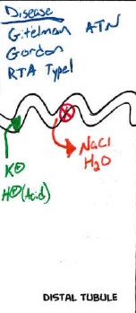
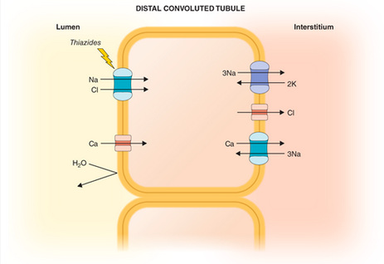
Distal Convoluted Tubule
Drug
Thiazide
Reabsorbs ~5% of filtered NaCl
Tight Epithelium - little water permeability
Na/Cl cotransporter with Na/K-ATPase (Thiazides)
Calcium Reabsorption - inversely related to Na reabsorption and stimulated by PTH
Gitelman and Gordon

Slide 24
Gitelmans Syndrome
Genetic condition that is autosomal recessive that presents commonly with severe cramps, fatigue, polyuria
Barter (Loop, earlier onset)
Labs: hypokalemia, hypomagnesemia, hypocalciuria, metabolic alkalosis
Rule out – diuretic abuse
Dx – rule out other causes such as vomiting and diuretic use
Hold medications, Urine Cl (normal <25, Gitelman >40)
Genetic testing
Tx – electrolyte replacement, NSAID use, ACE/ARB

Slide 25
Gordon Syndrome
Pseudohypoaldosteronism
Familial hyperkalemic hypertension
HTN, hyperkalemia, metabolic acidosis with normal renal function and reduced renin/aldosterone
Appears like RTA type 4 but local on effect is in DCT

Slide 27
(53) A 45 year old woman is evaluated for recent onset of resistant hypertension. During her last visit, chlorthalidone was added to her medication regimen. She reports no symptoms, and review of the systems is otherwise unremarkable. Current medications are metoprolol, amlodipine, hydralazine, and chlorthalidone.
On Physical Exam, blood pressure is 160/96 mmHg, and pulse rate is 65/min; other vital signs are normal. BMI is 24. There is no proptosis. The thyroid gland is not enlarged. The remainder of the examination is unremarkable.
Laboratory studies:
Bicarbonate 34
Creatinine 0.8
Potassium 2.9
Urine Albumin-Cr Ratio 10
Which of the following is the most appropriate diagnostic test to perform next?
A) Kidney ultrasonography with Doppler
B) Plasma aldosterone concertation/plasma renin activity ratio
C) Plasma fractionated metanephrines
D) Polysomnography

Slide 28
(53) B

Slide 29
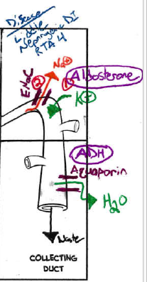
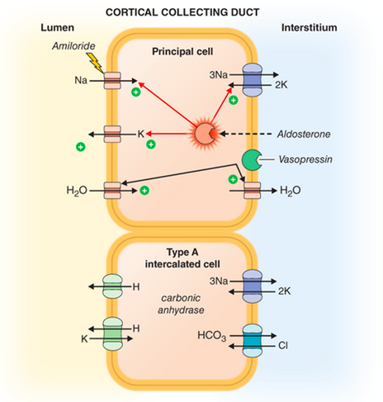
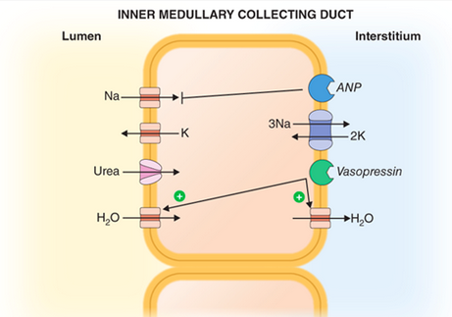
Collecting Duct
Drugs
Aldosterone Antagonist
  Spironolactone
  Eplerenone
Direct ENaC
  Amiloride
  Triamterene

Slide 30
Collecting Duct
2 major parts - Cortical Collecting Duct and Inner Medullary Collecting Duct
4-5% of filtered Na reabsorption
hormonal regulation of salt/water balance
Vasopressin (Anti-Diuretic Hormone) regulation water channels (Aquaporin 2-4) - increases permeability that enables water reabsorption that concentrates urine
Cortical Collecting
  Principal Cells - water, Na-reabsorbing and K-secreting (site of Aldosterone and Mineralocorticoid Receptor Antagonist). Water Reabsorption by Aquaporin (ADH)
  Type A Cells - Acid Secretion and Bicarb Reabsorption under influence of Aldosterone
  Type B Cells - Bicarb Secretion and Acid Reabsoprtion
ENaC - epithelial sodium channel, Na reabsorption and K secretion (aldosterone)
Liddle Syndrome - Na reclamation, hypokalemia, hypertension, and metabolic alkalosis (increase in ENaC).
HyperAldosteroinism contributes to Metabolic Alkalosis

Slide 31
Conn Syndrome
Primary Hyperaldosteronism
Resistant Hypertension with Hypokalemia (but could be low/normal)
Dx: Plasma Aldosterone (high) and Plasma Renin (low)
Tx: Surgery vs. Medical

Slide 32
SIADH, Diabetes Insipidus
SIADH
Hyponatremia with inappropriate ADH secretions
Diabetes Insipidus
Polyuria (>3L/day) with eunatremia to hypernatremia
Central
  Inability of the hypothalamus to create ADH
Nephrogenic
  CCD with appropriate ADH response, kidney not receptive

Slide 34
(41) A 40 year old woman is evaluated for arthralgia, dry eyes, and dry mouth for several weeks’ duration. She has been taking naproxen and acetaminophen daily for about 1 week. She has no pertinent personal or family history.
On physical exam, vital signs are normal. Mucous membranes and conjunctivae are dry. Bilateral parotid gland enlargement is present.
Laboratory Studies:
Creatinine 0.9
Sodium 138
Potassium 3.1
Chloride 118
Bicarbonate 12
Glucose 74
Urinalysis pH 7.0, no blood/protein/glucose/RBC/WBC
Kidney Ultrasound shows echogenic normal-sized kidneys
Which of the following is the most likely cause of the patient’s laboratory findings?
A) Naproxen
B) Type 1 (hypokalemic distal) renal tubular acidosis
C) Type 2 (proximal) renal tubular acidosis
D) Type 4 (hyperkalemic distal) renal tubular acidosis

Slide 35
(41) B

Slide 36
(66) A 55 year old man is evaluated for a 4 month history of persistent hyperkalemia. He also has long-standing type 2 diabetes mellitus complicated by retinopathy and nephropathy. Medications are basal and prandial insulin, atorvastatin, and aspirin.
On physical exam, vital signs are normal. Non-proliferative retinopathy is noted on funduscopic exam. The remainder of the physical exam in noncontributory.
Laboratory Studies:
Creatinine 1.9
Sodium 138
Potassium 5.1
Chloride 112
Bicarbonate 18
Estimated GFR 48
Urinalysis pH 5.0, no blood/protein/glucose/RBC/WBC
Urine Anion Gap Positive
Which of the following is the most likely cause of the patient’s acid-base disorder?
A) Chronic Kidney Disease
B) Type 1 (hypokalemic distal) renal tubular acidosis
C) Type 2 (proximal) renal tubular acidosis
D) Type 4 (hyperkalemic distal) renal tubular acidosis

Slide 37
(66) D

Slide 38
What is a Urine Anion Gap
[U(Na) + U(K)] – U(Cl)
POSITIVE = > decreased ability to excrete acid in the form of Ammonium chloride (RTA)
NEGATIVE = Increased urinary excretion of ammonium (diarrhea)
Use for Non-gap metabolic acidosis

Slide 39
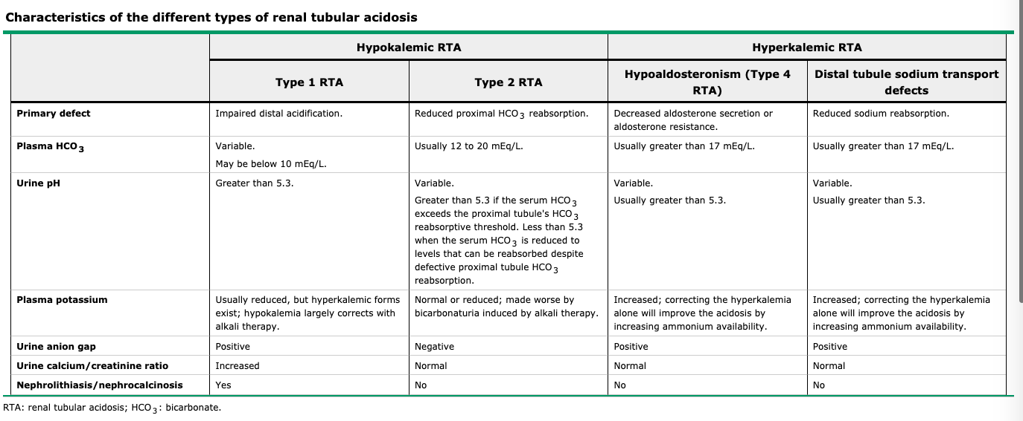
Renal Tubular Acidosis

Slide 40
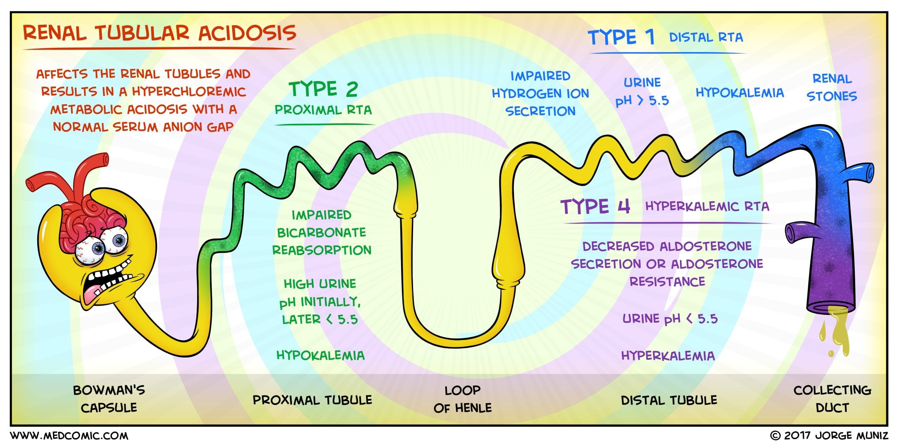

Slide 42
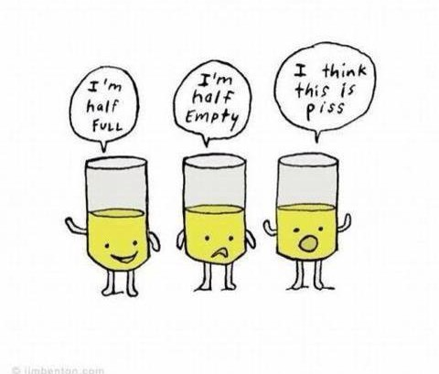
Urinalysis

Slide 43
Urinalysis
pH 6.0
Specific Gravity >1.030
Glucose >300
Ketone Positive
Protein 1+
RBC Negative
Leukocyte Esterase Negative
Nitrite Negative
What is the cause for the elevated specific gravity?
A) Glucosuria
B) UTI
C) Nephrotic Syndrome
D) What is Specific Gravity

Slide 44
Specific Gravity
Measures hydration status and reflects the kidney’s ability to concentrate urine.
Low (< 1.005) = dilute urine or excess hydration
Ex: Diabetes insipidus, ATN
High (>1.030) – volume depletion, renal hypoperfusion, excretion of hypertonic solute
Ex: Glycosuria, Contrast dye

Slide 45
Urinalysis
pH 9.0
Specific Gravity >1.020
Glucose 100
Ketone Negative
Protein 1+
RBC Negative
Leukocyte Esterase Moderate
Nitrite Positive
What is the cause of the elevated pH?
A) Staph Aureus UTI
B) High protein diet
C) Nephrotic Syndrome
D) Proteus Mirabilus UTI

Slide 46
pH
Low urine pH occur eating high-protein diet
Alkaline strict vegetarians
Alkaline infection – urea-splitting organisms
RTA type 1 (distal) inappropriately high
RTA type 4 (distal) appropriately low
Low/acidic (<5.5) = high protein diet, uric acid and cystine stones, RTA type 4
High/alkaline (>7) = urease splitting organisms (Proteus, e. coli, pseudomonas, klebsiella, staphyloccal), low acid (vegetarian), RTA Type 1, Struvite and Calcium phosphate calculi

Slide 47
Blood
Dipstick detects peroxidase activity = blood and free heme (hemo/myo)
>3 = 1+
A positive test in the absence of erythrocytes in urine sediment may indicate myoglobinuria or hemoglobinuria (hemolysis)
False positive tests may occur with other substances with peroxidase activity (peroxidase expressing bacteria) and Rifampin or chloroquine. Alkaline urine (pH >9)
Ascorbic acid can falsely-negative
Rifampin, phenytoin or beets can cause re colored urine that is heme negative

Slide 48
Protein
Dipstick preferentially detects albumin
False negatives may be from dilute urine
Flase positive from high concentrated
Microalbuminuria may go undetected by dipstick
Spot collection or 24hr urine is required for high risk patients
Trace (<30)
1+ (30)
2+ (100)
3+ (300)
4+ (1000)

Slide 49
Glucose
Glucosuria typically occurs when plasma glucose > 180mg/dL
Glucosuria in the absence of hyperglycemia suggest proximal tubular dysfunction (myeloma, tenofovir, disoproxil, SGLT-2 inhibitors)
Glucosuria may be present in normal pregnancy
Fanconi Syndrome

Slide 50
Ketones
Ketonuria commonly seen in starvation, diabetic ketoacidosis, alcoholic ketoacidosis
Salicylate toxicity
Isopropyl alcohol poisoning
Urine dipstick detects acetone and acetoacetate but not Beta-hydroxybutyrate (DKA and alcoholic keto are then underestimated)
False-positive any drugs with sulfhydryl (captopril)

Slide 51
Leukocyte Esterase and Nitrites
Leukocyte esterase is an enzyme present in leukocytes
Positive test suggest pyuria (>5 leukocytes/hpf)
Positive nitrite signifies presence of Gram Negative bacteria (E. coli, klebsiella, Enterobacter, Citrobacter, proteus)
Converting urine nitrates into nitrites
False negative if there is inadequate contact time for bacteria
Negative nitrites (enterococcus, staphylococcus, streptococcus, haemophilus)
Presence of both and abscense of both can correlate to UTI

Slide 52
Bilirubin
Bilirubin should be absent from the urine when serum levels are normal
Conjugated (water soluble) excreted with severe liver disease or obstructive hepatobiliary disease

Slide 53
Urobilinogen
Gut bacteria produce
Urobilinogen is then absorbed via portal circulation and excreted in urine
Increased urobilinogen is associated hemolytic anemia or parenchymal liver disease
Decreased levels are seen with severe cholestasis or obstructive disease

Slide 55
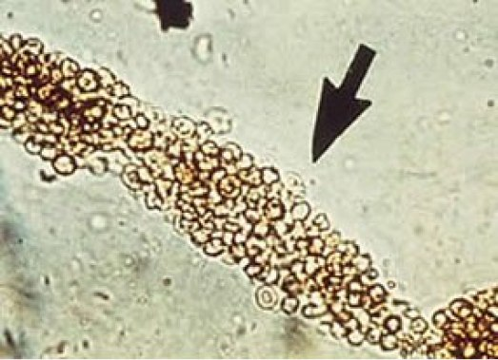
(25) A 27 year old woman is evaluated for a 6 month history of fatigue, arthralgia, and myalgia. She has a history of urinary tract infections. Medications are an oral contraceptive pill and as-needed naproxen for pain.
On physical exam, temperature is 38.2C, blood pressure is 142/90 mmHg, and pulse rate is 90/min. Cardiac, lung, and abdominal examinations are normal.
Laboratory studies show a serum creatinine level of 1.4; urinalysis shows 2+ blood, 3+ protein, positive leukocyte esterase, no nitrites, 10-15 erythrocytes/hpf, 5-10 leukocytes/hpf, and no crystals. Urine microscopy shown:
Which of the following is the most likely diagnosis:
A) Bladder Cancer
B) Glomerulonephritis
C) Tubulointerstial Nephritis
D) Urinary Tract Infection

Slide 56
(25) B

Slide 57
Microscopy

Slide 58
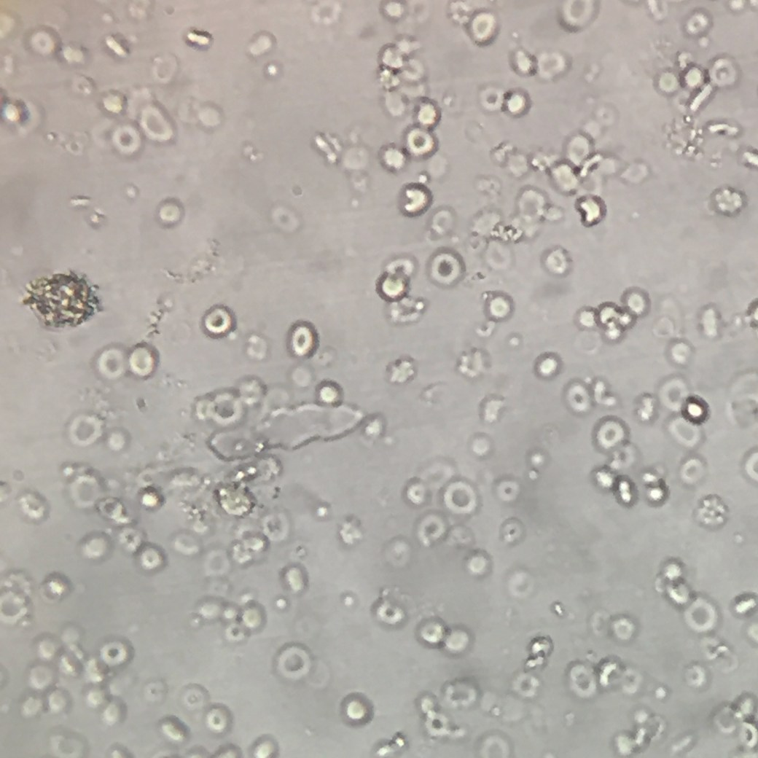
Erythrocytes
Isomorphic (round) suggest nonglomerular origin (infection, mass, cyst, stone)
Glomerular bleeding often associated with fragmentation and dysmorphic
Acanthocytes – vesicle shaped protrusions
Glomerular pattern should prompt evaluation for glomerulonephritis
(normal <2/hpf)

Slide 59
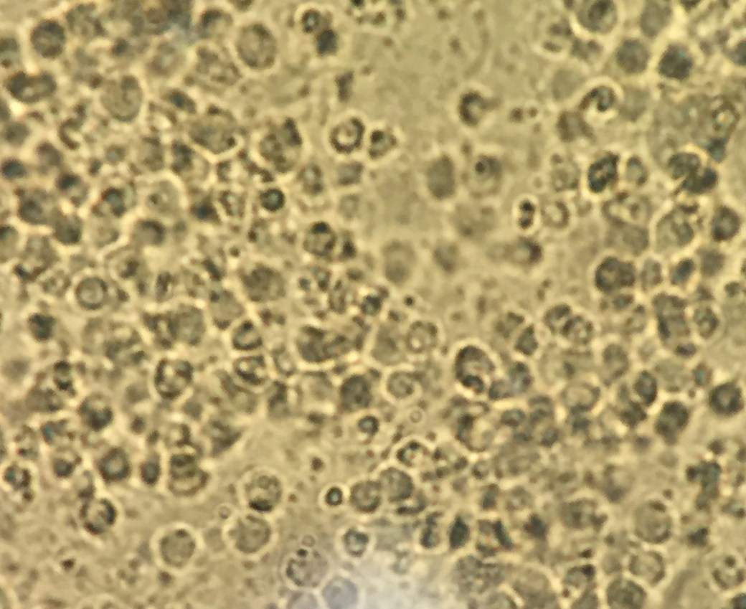
leukocytes
>5 leukocytes indicates pyuria
Sterile pyuria can include vaginitis, cervicitis, prostatitis, AIN, kidney stones, transplant rejection
Absence does NOT rule out AIN

Slide 60
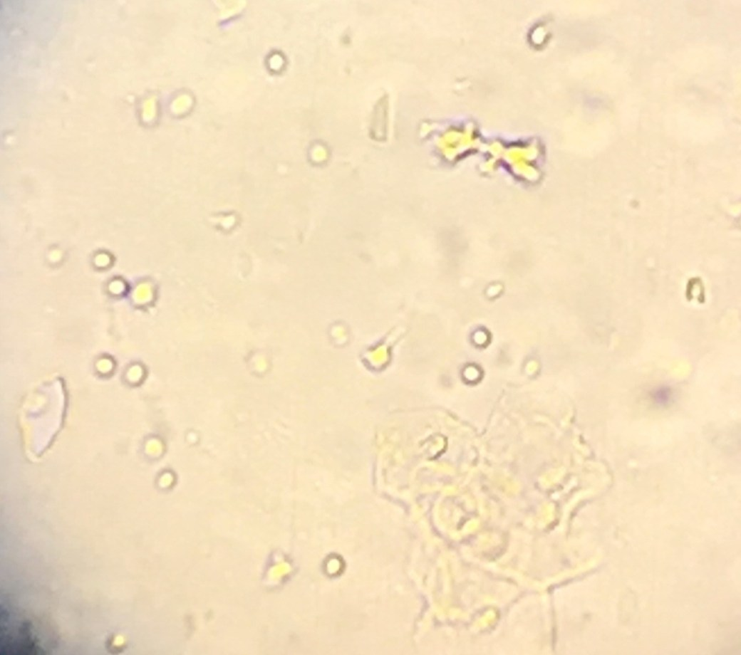
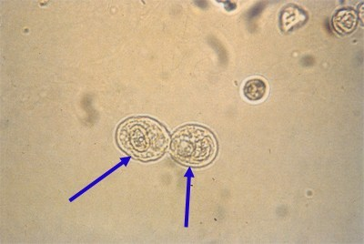
Epithelial Cells
Renal tubular, transitional, squamous epithelial may all be seen
Renal tubular epithelial cells are round with central nuclei and seen 1.5-3x larger than leukocytes
Presence in the context of granular casts suggests acute tubular necrosis
Transitional epithelial – slightly larger and may be binucleated. Renal pelvis to proximal urethra
Squamous epithelial cells are the largest cells and flat/irregular with small central nuclei – distal urethra or external genitalia
Large number of squamous epithelial suggest contamination

Slide 61
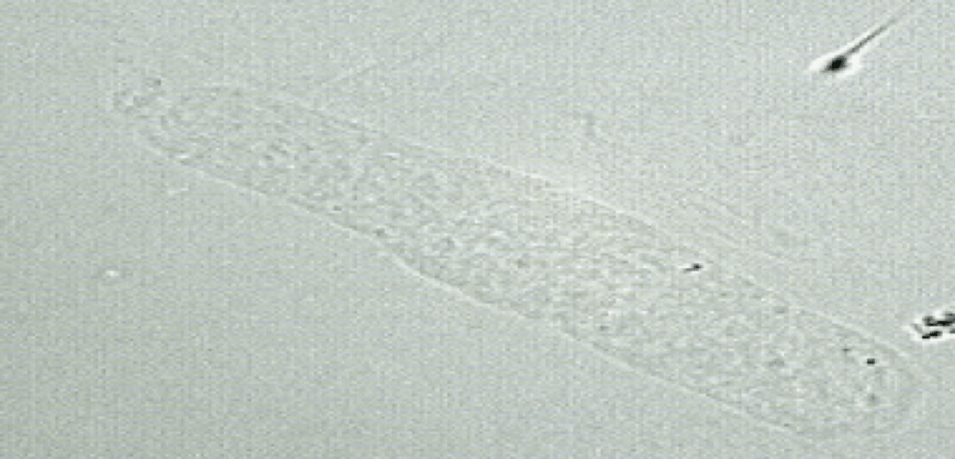
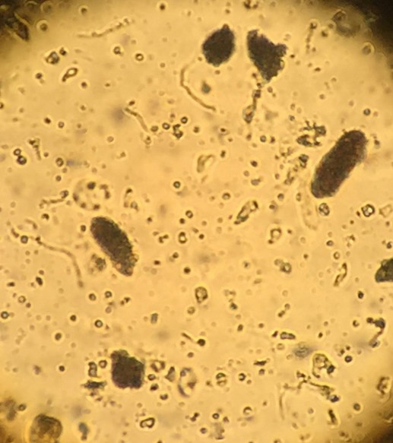
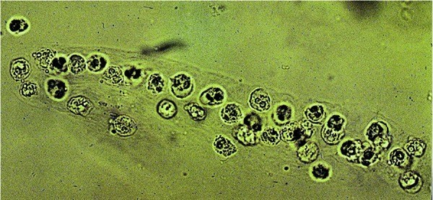
Casts
Backbone of all urine casts is Tamm-Horsfall protein (uromodulin)
Cylindrical casts form in distal tubular lumen
Any cell or debris in casts suggest tubule pathology
Erythrocyte casts are highly suggestive of glomerulonephritis
Leukocyte casts may suggest AIN or pyelonephritis
Pigmented/granular (muddy brown) suggest tubular cell debris

Slide 62
Resources
Harrison’s Principles of Internal Medicine (20th edition)
MKSAP18 Nephrology
NephroSIM
Renal Fellow Network (RFN)
Up-to-date
Urine Sediment Examination, AJKD Vol 73, Issue 2, February 2019

