Slide 1

Metabolic Alkalosis and
Respiratory Acid-Base Disorders
Jacob Nysather D.O.

Slide 2
Lecture Series Overview
Renalism Approach
Lecture 1: Approach to acid-base problems and an overview of physiologic mechanisms at work. Focus on intro to acidosis. 9/3
Lecture 2: Continue the journey of mastering acidosis with a physiologic approach in dissecting and understanding acid-base problems 9/17
Lecture 3: Flip the script and become basic. Touch “base” on the less complex regulator of acid-base. (Have to give credit that it is a faster worker than the kidneys). 10/1
  If time will review other approaches

Slide 3



Objectives
Recognize primary metabolic alkalosis
Review pathogenesis that are involved in metabolic alkalosis
Physiological approach to metabolic alkalosis
Recognize treatments for specific conditions with metabolic alkalosis
Recognize primary respiratory acid-base disturbances

Slide 4

pH Panorama

Slide 5

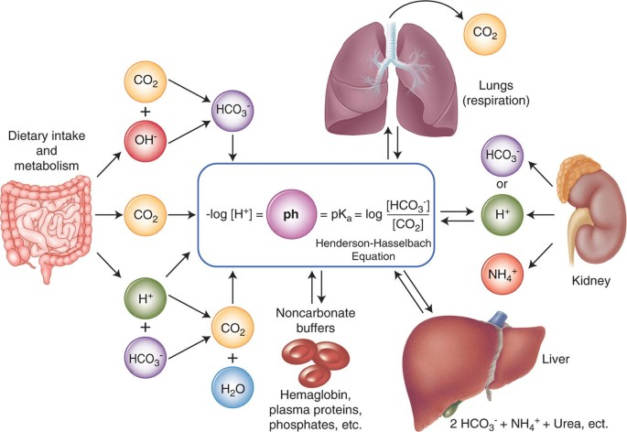
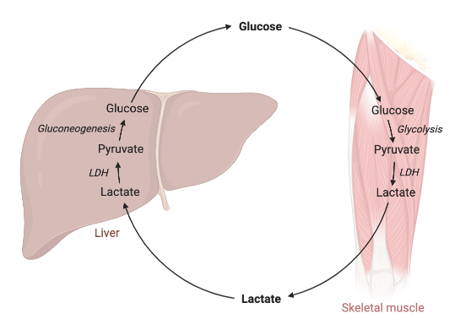
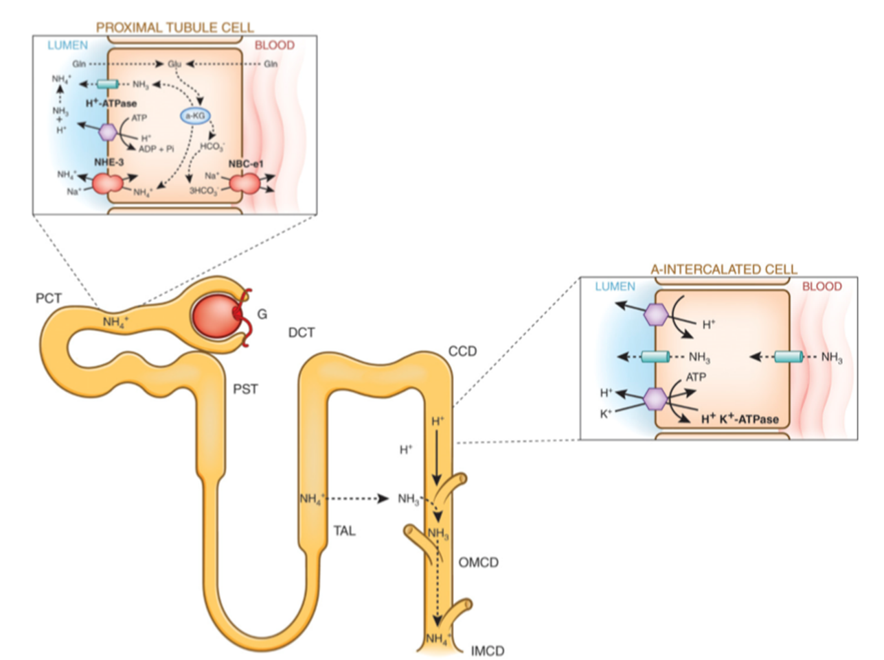
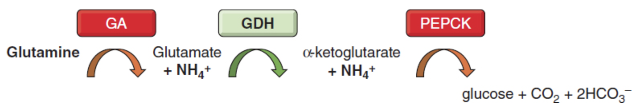
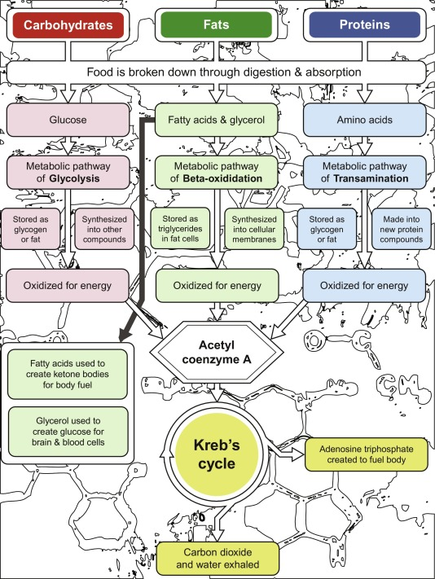
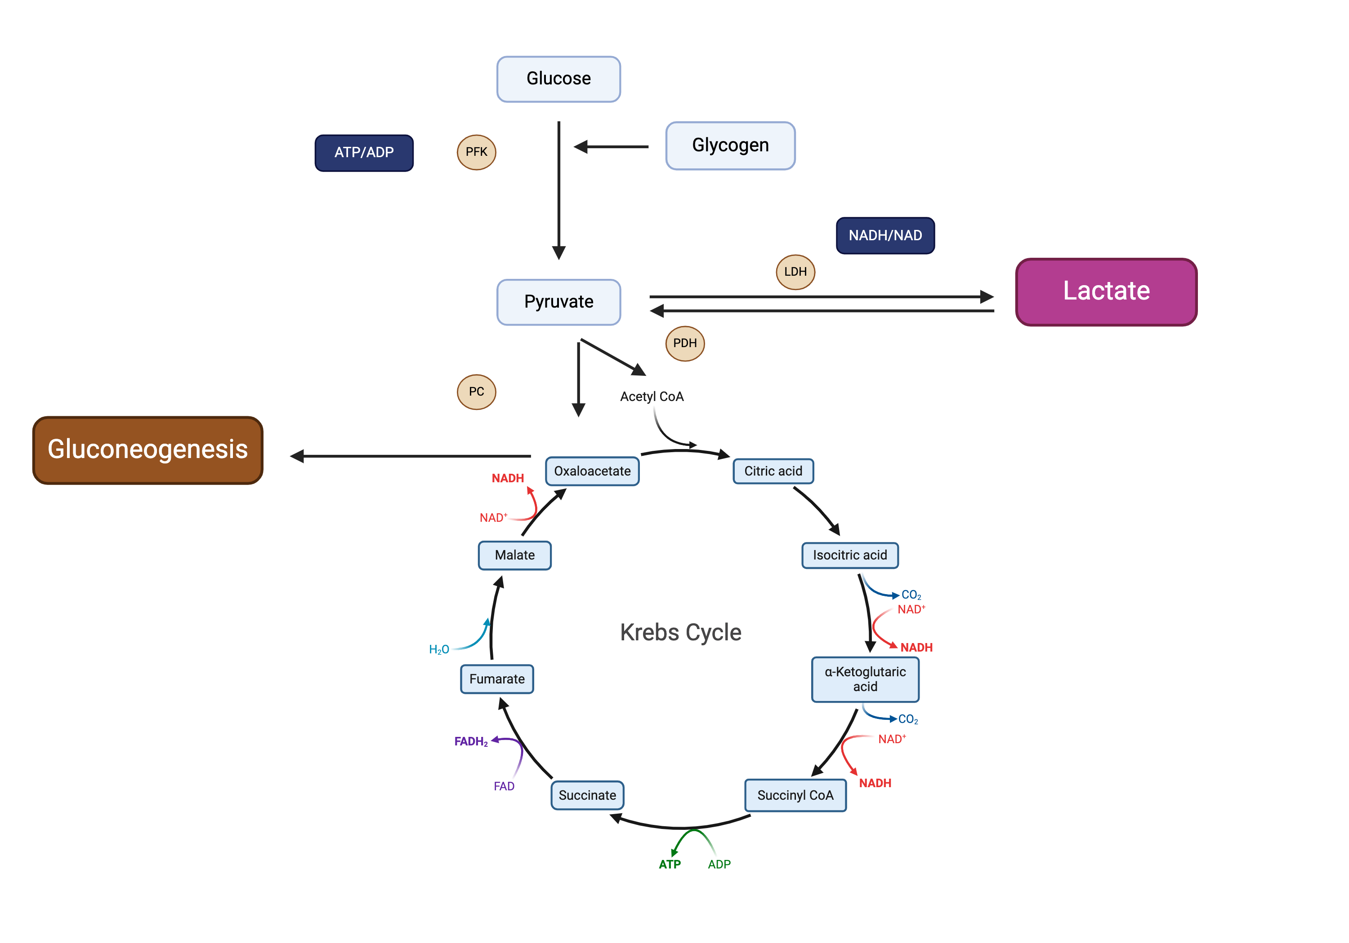
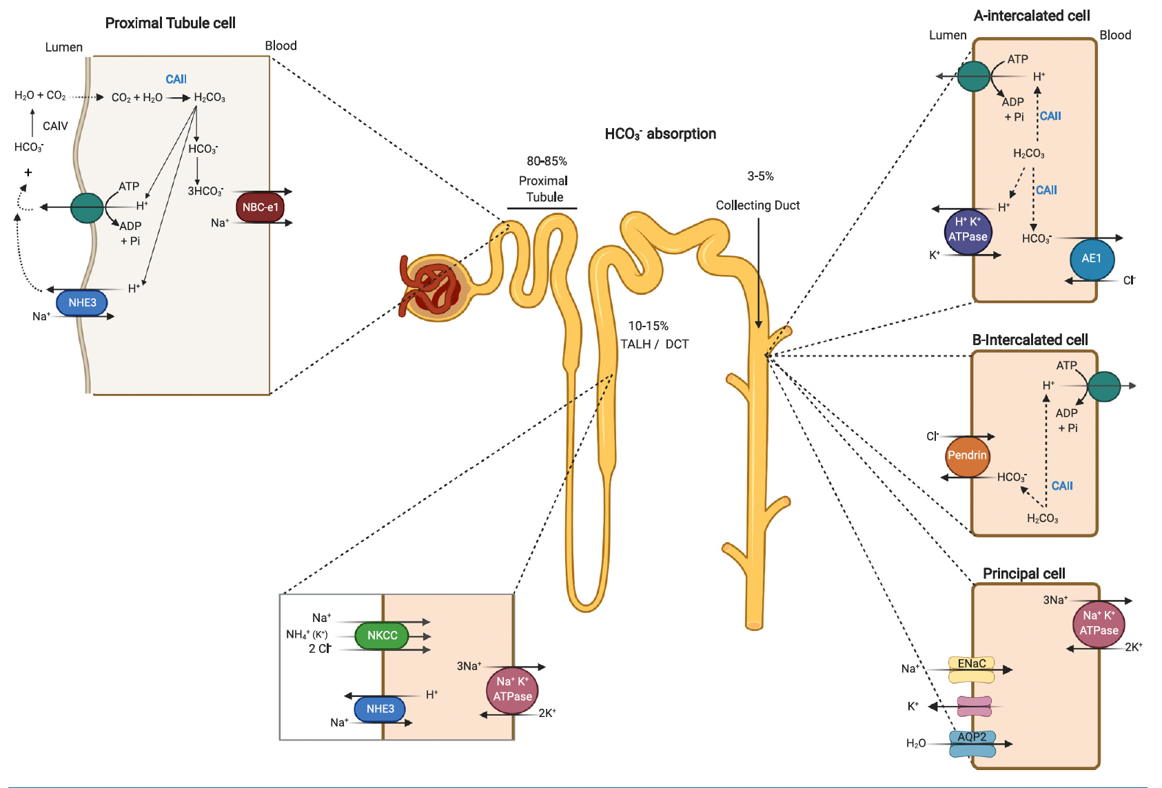
Notes:
H+ donors (acid) and H+ receivers (base)

Slide 6
Overview of Disturbances

Slide 7
Approach to Acid-Base Disorders
Establish the Primary Disturbance
Is there Appropriate Compensation?
The Gaps (Metabolic Acidosis)
Delta/Delta (HAGMA)
Don’t forget the history as it gives important clues!!

Slide 8
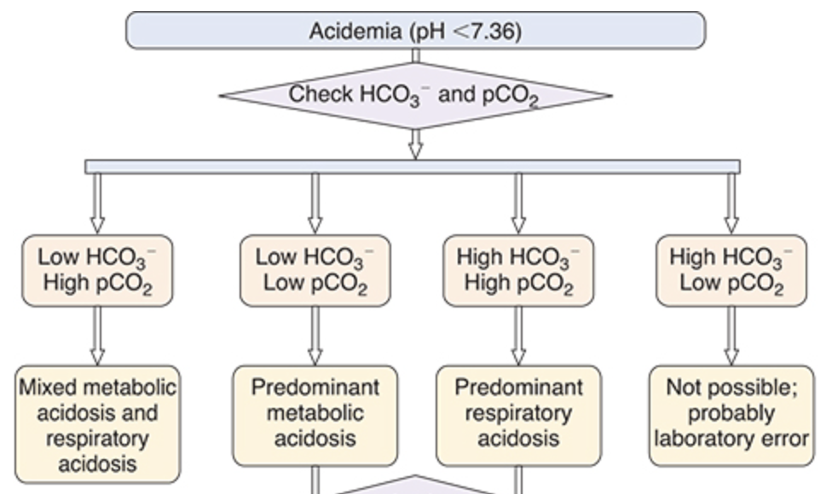
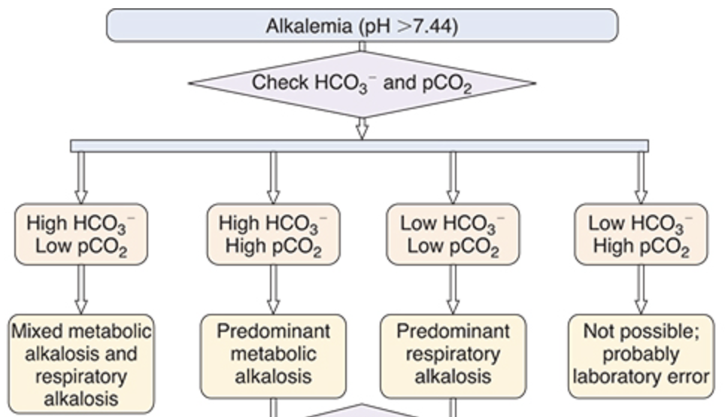
Primary Disturbances
Fig 12.5 (left) and 12.6 (right) Primer 8th ed

Slide 9
Appropriate Compensation

Slide 10
Primary Disorder | pH | Initial Chemical Change | Compensatory Response | Expected Compensation | Complete Adaptive Response
Metabolic Acidosis | Low | ↓ HCO₃- | ↓ pCO₂ | pCO₂ = (1.5 × HCO₃-) + 8 ± 2 pCO₂ = HCO₃- + 15 pCO₂ = decimal digits of pH | 12-24 hrs
Metabolic Alkalosis | High | ↑ HCO₃- | ↑ pCO₂ | pCO₂ = 40 + 0.7x([HCO_{3 measure}] – [HCO_{3 normal}]) pCO₂ = (0.9 × HCO₃-) + 9 pCO₂ = (0.7 × HCO₃-) + 20 | 24-36 hrs
Respiratory Acidosis
Acute | Low | ↑ pCO₂ | ↑ HCO₃- | HCO₃- increases 1 mEq/L for every 10 mm Hg increase in pCO₂ | 2-5 days
Chronic | Low | ↑ pCO₂ | ↑↑ HCO₃- | HCO₃- increases 3 to 4 mEq/L for every 10 mm Hg increase in pCO₂
Respiratory Alkalosis
Acute | High | ↓ pCO₂ | ↓ HCO₃- | HCO₃- decreases 2 mEq/L for every 10 mm Hg decrease in pCO₂ | 2-5 days
Chronic | High | ↓ pCO₂ | ↓ HCO₃- | HCO₃- decreases 5 mEq/L for every 10 mm Hg decrease in pCO₂
Table 12.1: Acid-Base Rules: Changes in pH, pCO₂, and [HCO₃⁻] and Expected Compensatory Responses in Simple Disturbances

Slide 11
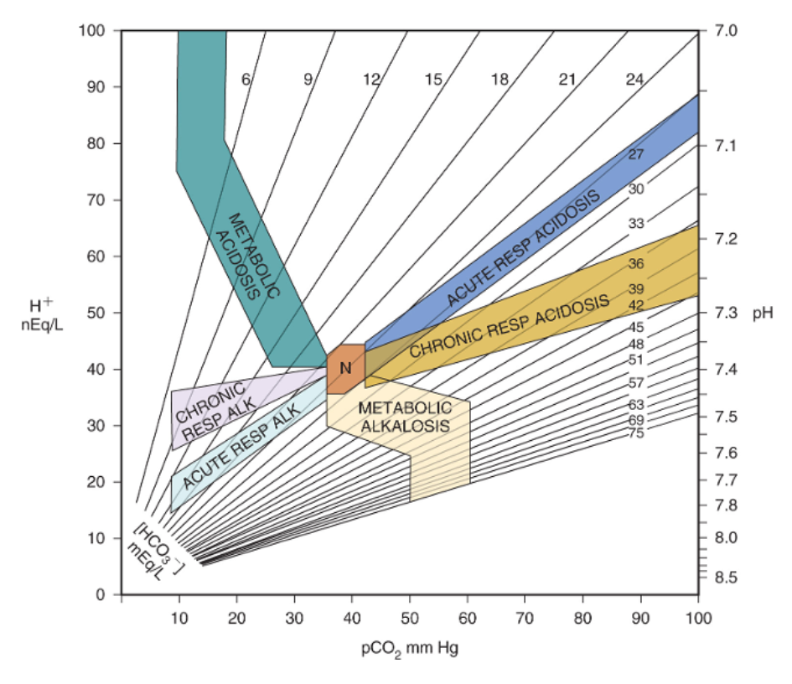
Notes:
The shaded areas represent the 95% confidence limits for zones of compensation for simple acid base disorders. If it falls outside of the shaded areas it is likely a mixed acid base disorder.

Slide 12
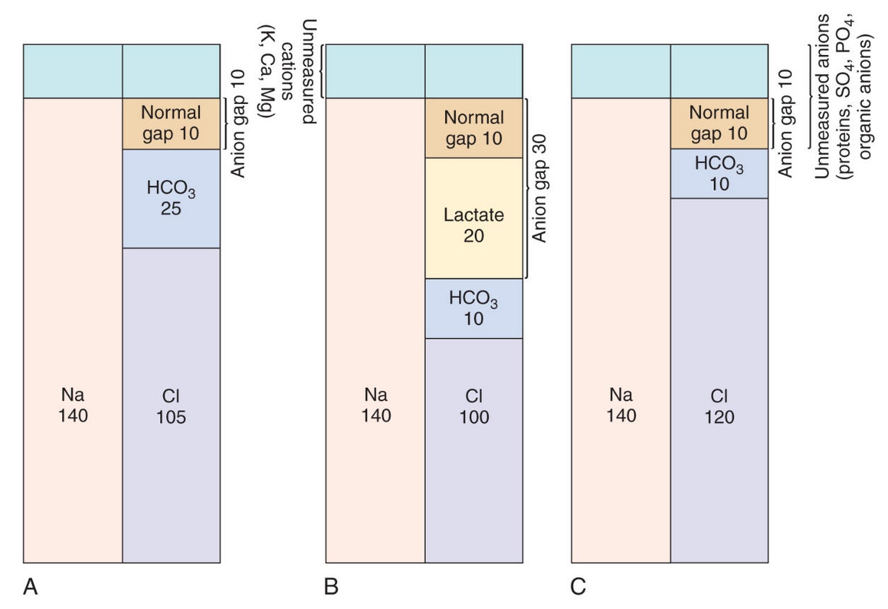
Primer 8th edition

Slide 13
High Anion Gap Pneumonics
CUTE DIMPLES
• Cyanide, Citrate (citric acid)
• Uremia
• Toluene (hippuric acid)
• Ethylene Glycol (oxalic acid)
• Diabetic Ketoacidosis
• INH, Iron
• Methanol, Metformin (lactate)
• Pyroglutamic Acid (oxoproline), Propylene Glycol (lactate), Paraldehyde, Propofol (lactate)
• Lactic Acidosis, Linezolid (lactate)
• Ethanol Ketoacidosis
• Salicylates (lactate + ketones), Starvation Ketoacidosis, Sodium Thiosulfate (?)
GOLD MARK
• Glycols – ethylene (oxalic acid), propylene (lactate)
• Oxoproline (pyroglutamic acid)
• L-lactate (lactic acid)
• D-lactate (lactic acid)
• Methanol (formic acid)
• Aspirin (lactate + ketones)
• Renal failure
• Ketoacidosis – diabetes, starvation, alcohol
MUDPILES
• Methanol (formic acid)
• Uremia (Renal failure)
• Diabetic Ketoacidosis (starvation, alcohol)
• Phenformin, Paraldehyde, Pyroglutamic acid (Oxoproline)
• Lactic Acidosis (D and L)
• Ethanol, Ethylene Glycol
• Salicylates

Slide 14

Metabolic Alkalosis
Represents the inability of the kidney to excrete an excessive amount of bicarbonate present in extracellular fluid (ECF) due to factors that generate the net gain of bicarbonate and secondary factors that maintain the alkalosis
Common causes:
  Vomiting
  Diuretics
  Chloride and volume depletion
  Hypokalemia
  Hyperaldosteronism

Slide 15
Potassium Depletion
Pure K⁺ depletion causes metabolic alkalosis although usually of only modest severity.
Hypokalemia independently enhances renal ammoniagenesis, which increases net acid excretion and thereby the return of “new” bicarbonate to the systemic circulation.
Activation of the H⁺/K⁺-ATPase in the collecting duct by chronic hypokalemia probably plays a major role in maintenance of the alkalosis.
Alkalosis associated with severe K⁺ depletion is resistant to salt administration, with repair of the K⁺ deficiency necessary to correct the alkalosis.

Slide 16
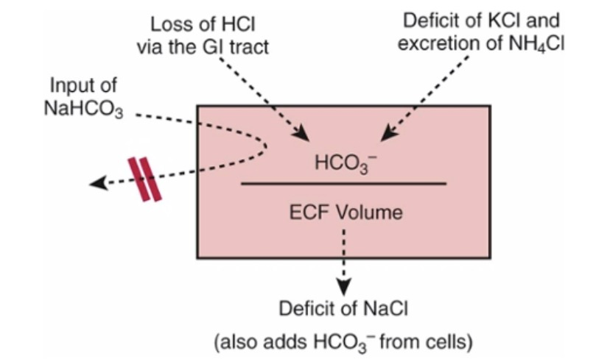
Brenner & Rector's The Kidney

Slide 17
Metabolic Alkalosis
pH >7.44
Renin
Yes
Hypertension
>20
Urine Chloride
<20
Low
High
No
Kidney
Renal Artery Stenosis
Aortic Coarctation
Reninoma
Diuretic Use?
Remote Diuretic
Cystic Fibrosis*
Post hypercapnic state
Aldosterone
GI
No
Low
Bartter
Gitelman
Calcium (Milk)-Alkali
Beta-Lactams
Aminoglycosides
Cystic Fibrosis/Pendrid*
High
Cushing Syndrome
Ectopic Corticotropin
Drugs (carbenoxolone)
Licorice (Glycyrrhetic Acid)
Liddle Syndrome
Apparent Mineralocorticoid Excess
Vomit
NGT Suction
Laxative overuse
Chloride losing diarrhea (congenital)
Villous Adenoma
High volume ileostomy output
Primary Hyperaldosteronism
Glucocorticoid-remediable Aldosteronism

Slide 18
Symptoms of Alkalemia
Patients with metabolic alkalosis experience changes in central and peripheral nervous system function similar to those of hypocalcemia.
This results from the binding of free calcium to anionic protein sites exposed in alkalemia, lowering the ionized calcium concentration.
Symptoms
Confusion
Obtundation
Seizures
Paresthesia
Muscular cramping
Tetany
Aggravation of arrhythmias
Hypoxemia in chronic obstructive pulmonary disease
Related electrolyte abnormalities include hypokalemia and hypophosphatemia.

Slide 19
Pathogenesis
Generation
  Net gain of HCO3
  Net loss of nonvolatile acid (ie HCl by vomiting)
Maintenance
  Volume contraction
  Low GFR
  Cl or K depletion
  Hyperaldosteronism

Slide 20
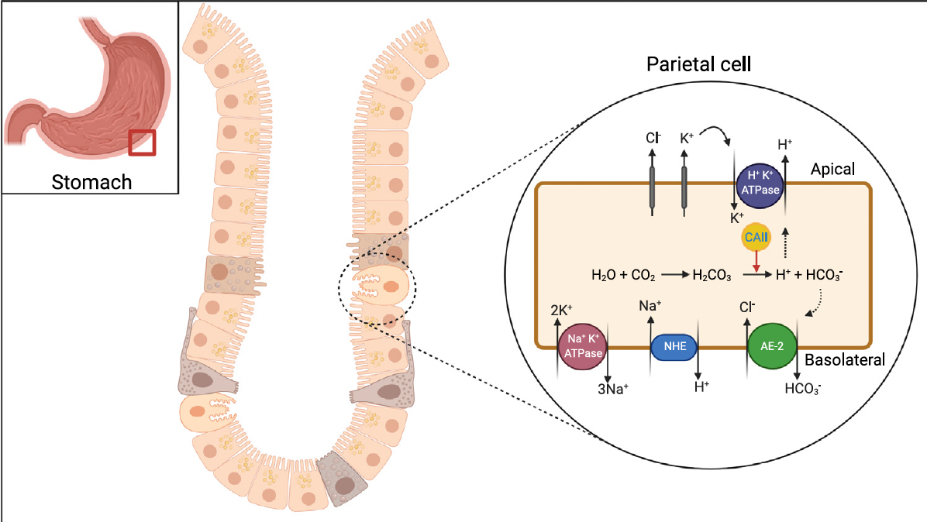
Figure 3: AJKD Met Alk 2022
Notes:
Schematic depiction of the localization and role of apical gastric H+/K+-ATPase, cytoplasmic CAII, and the basolateral Cl−/HCO3− anion exchange protein 2 (AE2; encoded by SLC4A2) in acid secretion and bicarbonate absorption in gastric parietal cells. Excessive gastric loss of HCl results in the addition of new HCO3− to the blood. Abbreviations: AE-2, anion exchange protein 2; CAII, carbonic anhydrase; NHE, Na+/H+ exchanger

Slide 22
Figure 1: AJKD Met Alk 2022
Notes:
Schematic depiction of the localization and role of acid-base transporters and carbonic anhydrases in acid (H+) and bicarbonate (HCO3−) transport in kidney tubules. The majority of filtered HCO3
− is reabsorbed in the proximal tubule via the coordinated actions of Na+/H+ exchanger 3 (NHE3; encoded by SLC9A3) and H+-transporting adenosine triphosphatase (H+-ATPase) on the apical membrane working in tandem with the Na+/HCO3 − cotransporter (NBCe1; encoded by SLC4A4) on the basolateral membrane. This process is facilitated by the actions of carbonic anhydrases IV and II (CAIV and CAII) on the apical membrane and in the cytoplasm, respectively. In the cortical collecting duct (CCD), H+-ATPase and H+/K+-ATPase on the apical membrane of A-intercalated cells mediate H+ secretion into the lumen, resulting in the generation of intracellular HCO3− that is transported to the blood via the basolateral Cl−/HCO3− AE1 (encoded by SLC4A1). The Cl−/HCO3− exchanger pendrin (encoded by SLC26A4) on the apical membrane of non–A-intercalated cells mediates HCO3− secretion into the lumen of the CCD in exchange for Cl− absorption. Sodium (Na+) and H2O are absorbed by the epithelial sodium channel (ENaC) and aquaporin 2 (AQP2), respectively, in principal cells. Abbreviations: ADP, adenosine diphosphate; AE1, anion exchange protein 1; AQP2, aquaporin 2; ATP, adenosine triphosphate; CAII, carbonic anhydrase; CCD, cortical collecting duct; DCT, distal convoluted tubule; ENaC, epithelial sodium channel; NBCe1, basolateral Na+/HCO3− cotransporter; NHE3, Na+/H+ exchanger 3; NKCC, Na+/K+/2Cl− cotransporter; PCT, proximal convoluted tubule; Pi, inorganic phosphate; TALH, thick ascending limb of Henle.

Slide 23
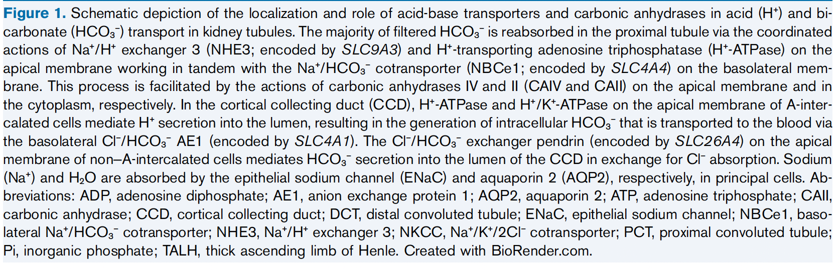

Slide 24
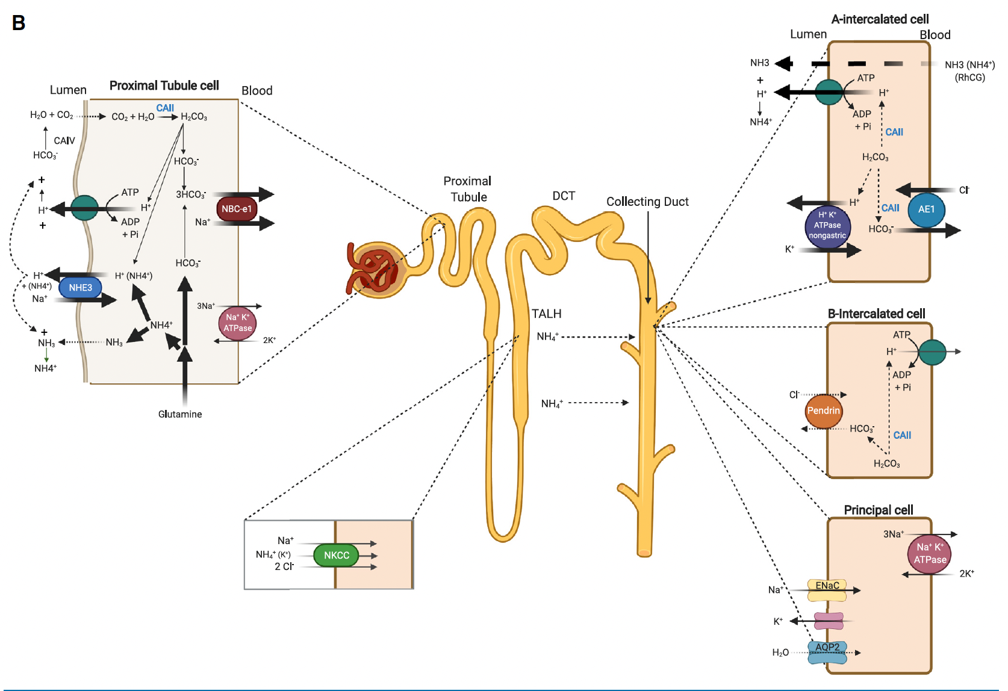
Figure 2: AJKD Met Alk 2022
Notes:
Schematic depiction of the mechanisms and nephron segments responsible for ammoniagenesis and ammonium/ ammonia transport. Ammonium (NH4 +) is generated from glutamine in the proximal tubule. Glutamine is converted to α-ketoglutarate (and eventually HCO3−) and NH4+ by glutaminase and glutamate dehydrogenase. NH4+ is transported into the lumen via the luminal NHE3 as well as being trapped by H+-ATPase-mediated H+ secretion. The NH4+ is reabsorbed in the TAL via the apical Na+/K+/2Cl− cotransporter (NKCC2; encoded by SLC12A1) and secreted into the lumen of the collecting duct predominantly in the form of NH3, which is then trapped by the H+ secreted via H+-ATPase to form NH4+. NH4+ is then excreted into the urine with filtered Cl− as its anion. This generates new HCO3− (via glutamine metabolism), while excreting an acid (ammonium chloride). The HCO3− is returned to the blood via NBCe1. Compared with the baseline state (A), hypokalemia (B) enhances ammoniagenesis in the proximal tubule, stimulates H+ secretion and HCO3− reabsorption in the proximal tubule, activates H+-ATPase and Cl−/HCO3− AE1 in A-intercalated cells, induces the expression and activity of the nongastric H+/K+-ATPase in the collecting duct, and downregulates the expression of the HCO3−-secreting transporter pendrin in B-intercalated cells. Bold arrows indicate activated pathways and molecules; thin arrows denote inactive processes and molecules in hypokalemia. Abbreviations: ADP, adenosine diphosphate; AE1, anion exchange protein 1; AQP2, aquaporin 2; ATP, adenosine triphosphate; CAII, carbonic anhydrase; CCD, cortical collecting duct; DCT, distal convoluted tubule; ENaC, epithelial sodium channel; NBCe1, basolateral Na+/HCO3− cotransporter; NHE3, Na+/H+ exchanger 3; NKCC, Na+/K+/2Cl− cotransporter; PCT, proximal convoluted tubule; Pi, inorganic phosphate; TALH, thick ascending limb of Henle.

Slide 25
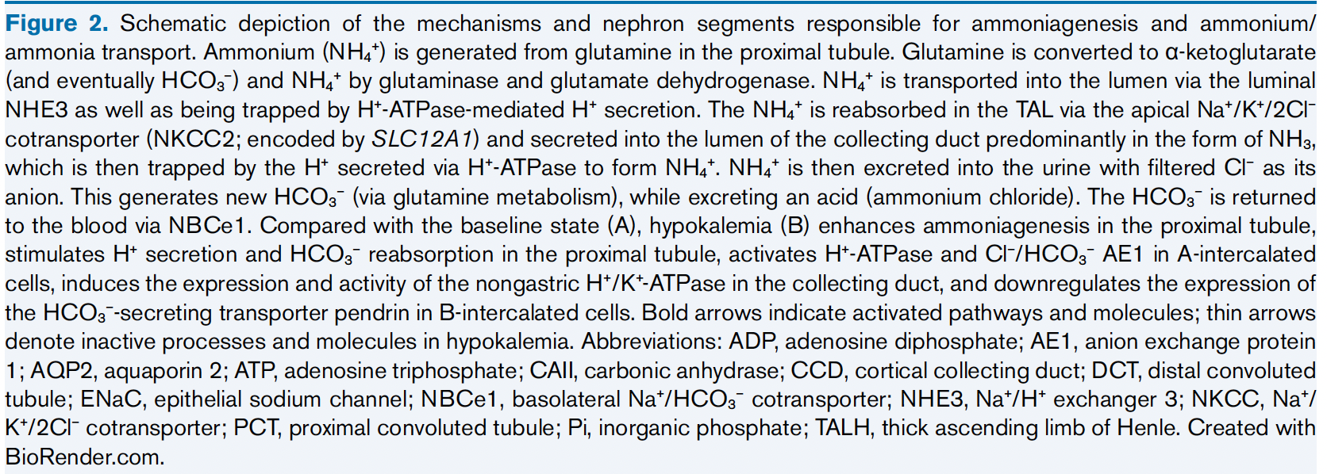

Slide 26
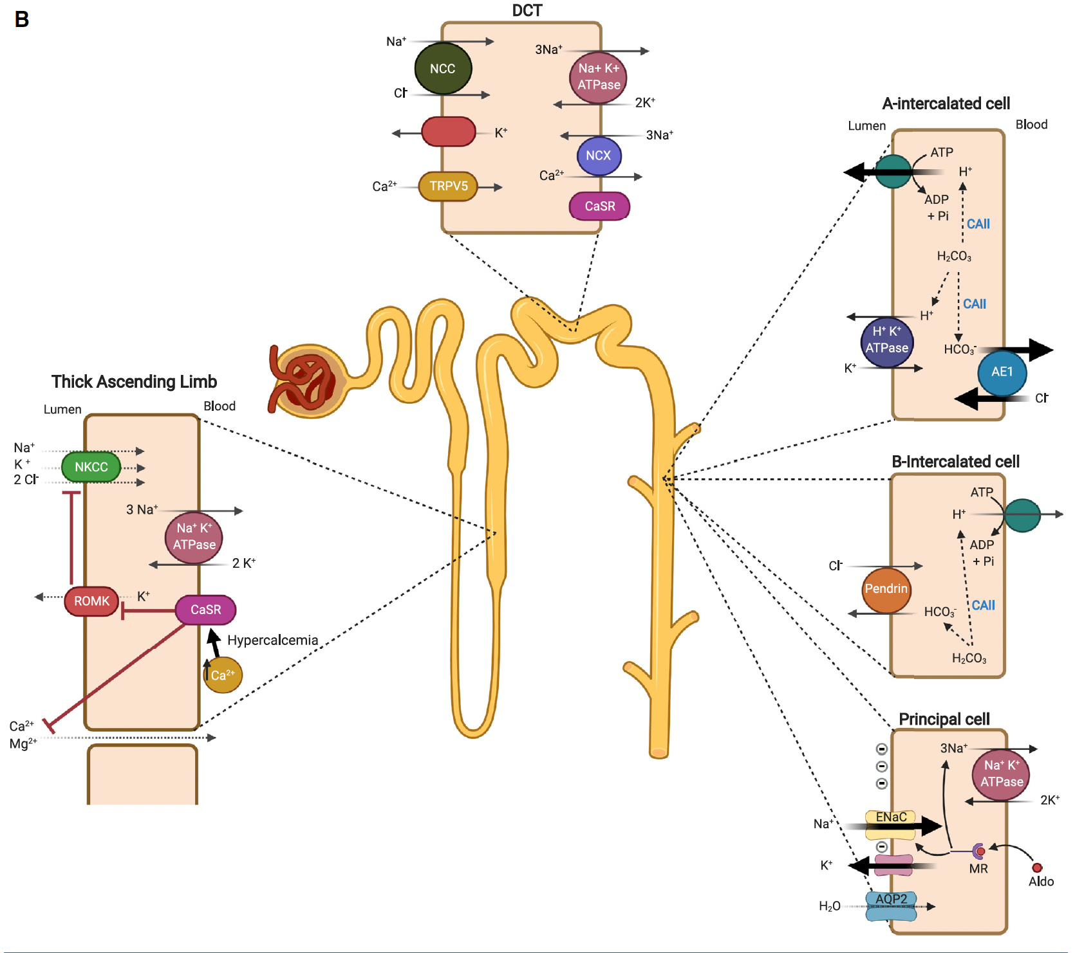
Figure 4: AJKD Met Alk 2022
Notes:
Schematic depiction of the mechanism of salt absorption in the thick ascending limb of Henle and salt absorption and acid secretion in the collecting duct. (A) With normal vascular volume, the inhibition of NKCC will increase the delivery of salt to the distal segments such as the collecting duct, where Na+ is absorbed via ENaC in exchange for K+ (via ROMK) and H+ secretion (via H+- ATPase and in part H+/K+-ATPase). The increase in bicarbonate absorption will be offset by enhanced HCO3 − secretion via pendrin, mitigating the impact of acid secretion on systemic acid-base homeostasis. (B)When loop diuretic use causes volume depletion, the RAAS is activated. Na+ absorption and K+ and H+ secretion processes in the collecting duct are significantly amplified in the presence of aldosterone. The resulting volume depletion and hypochloremia as well as RAAS activation and hypokalemia will enhance bicarbonate absorption and inhibit bicarbonate secretion in the collecting duct cells. Bold arrows indicate activated pathways and molecules. Abbreviations: ADP, adenosine diphosphate; AE1, anion exchange protein 1; Aldo, aldosterone; AQP2, aquaporin2; ATP, adenosine triphosphate; CAII, carbonic anhydrase; CaSR, calcium-sensing receptor; CCD, cortical collecting duct; CFTR, cystic fibrosis transmembrane conductance regulator; DCT, distal convoluted tubule; ENaC, epithelial sodium channel; K+, potassium ion; MR, mineralocorticoid receptor; NCC, Na+/Cl− cotransporter; NCX, sodium-calcium exchanger; NKCC, Na+/K+/ 2Cl− cotransporter; PCT, proximal convoluted tubule; Pi, inorganic phosphate; RAAS, renin-angiotensin-aldosterone system; ROMK, renal outer medullary K+ channel; TAL, thick ascending limb; TRPV5, transient receptor potential vanilloid member 5.

Slide 27
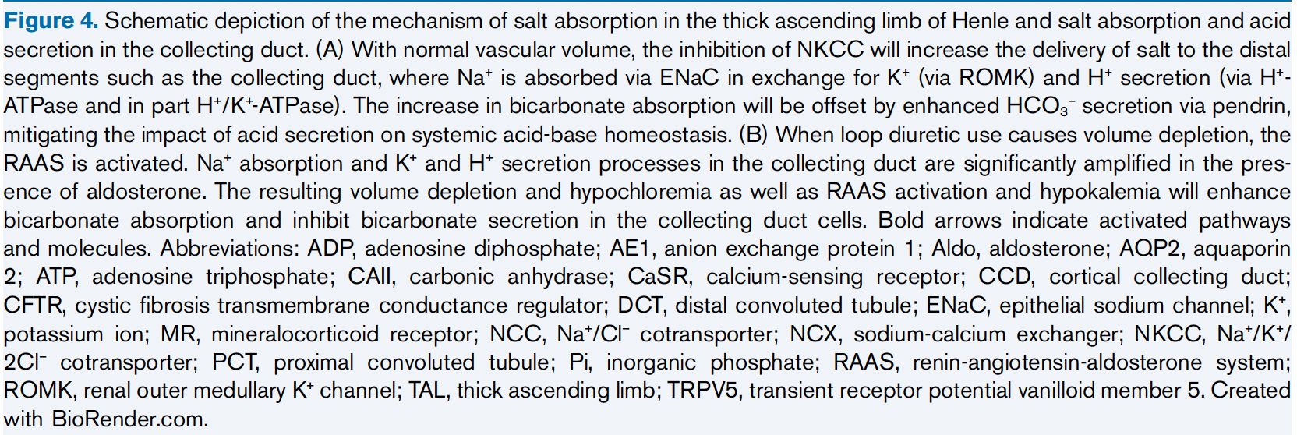

Slide 28
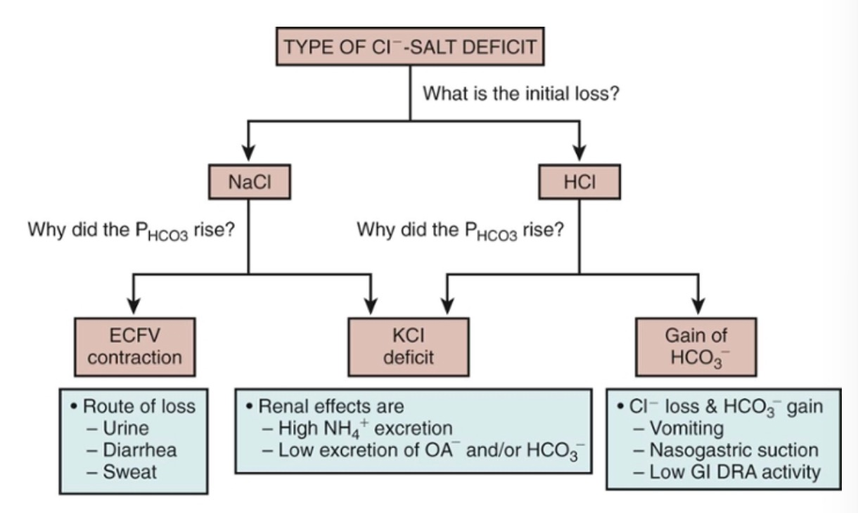
Electroneutrality must be present in every body compartment and in the urine.
Brenner & Rector's The Kidney
Notes:
Terms such as “Cl⁻-depletion alkalosis” do not take into account the need for electroneutrality.
Knowing the balances for Na⁺, K⁺, and Cl⁻ would make it possible for one to decide why the P_{HCO3} is higher than normal and what changes have occurred in the composition of the ECF and ICF compartments.
This segment of the bowel both absorbs and secretes fluid, but absorption normally predominates, reducing the total gut fluid content to approximately 1 L/d by the time it enters the colon. Absorption is driven by sodium and chloride uptake (driving water uptake) and occurs via two linked transporters, the Na⁺/H⁺exchanger and the Cl⁻/HCO₃⁻ exchanger . These two transporters take up Na⁺ and Cl⁻ from the gut lumen and secrete H⁺ and HCO₃⁻ into it. The latter two ions combine, forming H₂CO₃, which dehydrates to form CO₂ in the intestinal lumen. The Cl⁻/HCO₃⁻ exchanger in the small intestine is the “downregulated in adenoma” (DRA) gene product, also named CLD (for chloride diarrhea). By the end of the ileum, Cl⁻/HCO₃⁻exchange predominates, resulting in an alkaline solution.
https://cjasn.asnjournals.org/content/3/6/1861

Slide 29
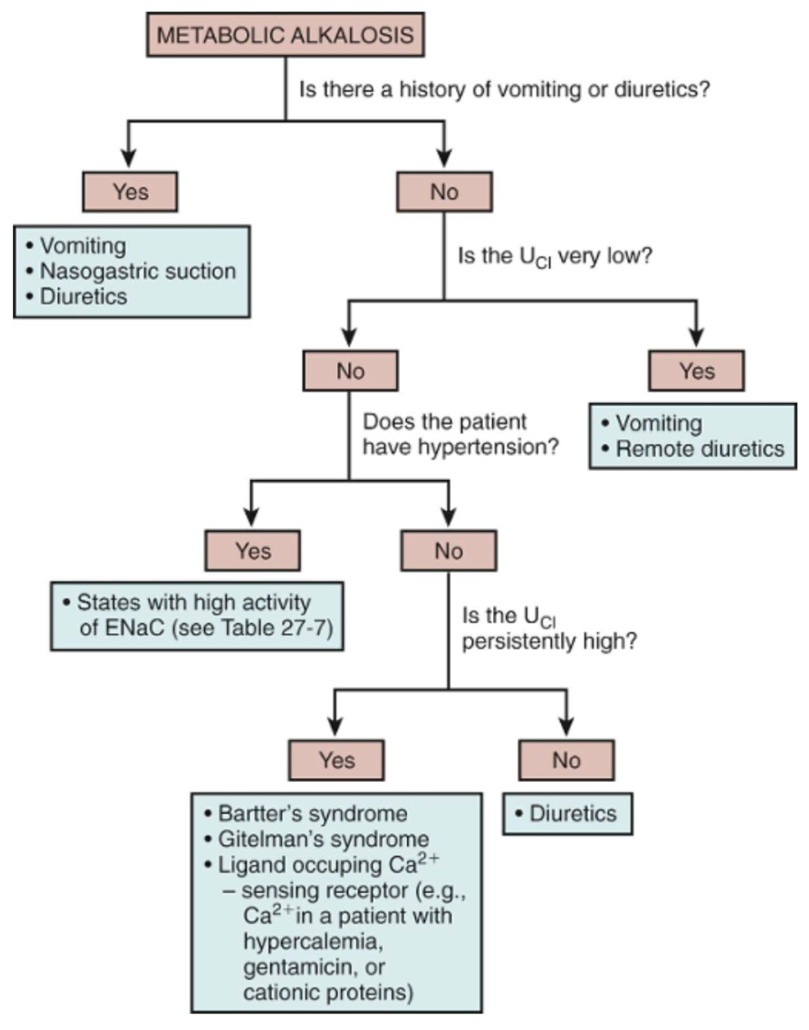
Brenner & Rector's The Kidney
Notes:
Causes associated with an expanded EABV and hypertension
Disorders with enhanced mineralocorticoid activity causing hypokalemia
Primary hyperaldosteronism
Primary hyperreninemic hyperaldosteronism (renal artery stenosis, renin tumor)
Disorders with cortisol (apparent mineralocorticoid excess, inhibition of 11beta-hydroxysteroid dehydrogenase, tumor)
Disorders w/ active amiloride sensitive Na channels (Liddles)
Decrease in GFR and high bicarb load
Causes associated with a contracted effective arterial blood volume (EABV)
Low urine chloride concentration
Gastric
Remote use of diuretics
Post hypercapnic states
Loss of NaCl via lower GI tract
High urine chloride concentration
Diuretic use
Stimulation of the calcium sensing receptor (hypercalcemia, gentamicin, cisplatin, MM)
Inborn error affecting NaCl transporters (Bartter’s, Gitelman’s)

Slide 30
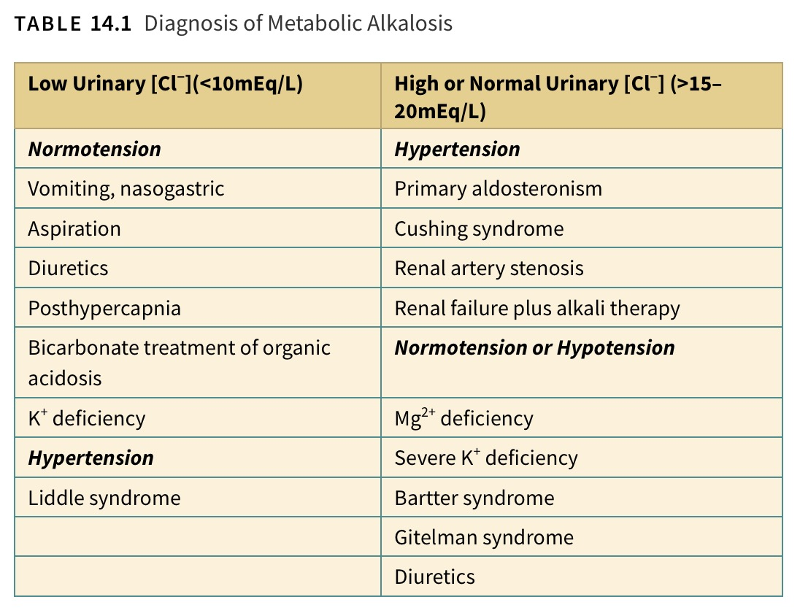
Differential Diagnosis
ASN Primer

Slide 31
A 47-year-old man is brought to the emergency department with altered mental state after being found unresponsive at home by his neighbors. Little is known about his medical history except for a few medications found in his home, including over-the-counter antacids and ibuprofen. His neighbors indicated the patient had a history of heavy smoking and noticed some weight loss over the last 6 months. On arrival, his blood pressure was 95/57 mm Hg, pulse rate was 96 beats/min, and he was afebrile. The oxygen saturation by pulse oximetry was 92%. Basic chemistry laboratory testing showed Na+, 142 mEq/L; K+, 2.9 mEq/L; Cl−, 90 mEq/L; HCO3−, 45 mEq/L; total calcium, 9.1 mg/dL; serum urea nitrogen (SUN), 38 mg/dL; and serum creatinine (Scr), 1.7 mg/dL. An arterial blood gas (ABG) revealed pH, 7.48; PaCO2, 52 mm Hg; and PaO2, 70 mm Hg. The nephrology service was consulted for the workup and management of the acid-base and electrolyte abnormalities.
The differential diagnosis of metabolic alkalosis and hypokalemia in this patient should include (select the best answer):
a) Excessive use of the carbonic anhydrase inhibitor acetazolamide
b) Ectopic corticotropin production due to possible lung malignancy
c) Intake of HCO3−-containing antacid for heartburn in the setting of pre-existing chronic kidney disease (CKD)
d) Gastric outlet obstruction with vomiting

Slide 32
A 47-year-old man is brought to the emergency department with altered mental state after being found unresponsive at home by his neighbors. Little is known about his medical history except for a few medications found in his home, including over-the-counter antacids and ibuprofen. His neighbors indicated the patient had a history of heavy smoking and noticed some weight loss over the last 6 months. On arrival, his blood pressure was 95/57 mm Hg, pulse rate was 96 beats/min, and he was afebrile. The oxygen saturation by pulse oximetry was 92%. Basic chemistry laboratory testing showed Na+, 142 mEq/L; K+, 2.9 mEq/L; Cl−, 90 mEq/L; HCO3−, 45 mEq/L; total calcium, 9.1 mg/dL; serum urea nitrogen (SUN), 38 mg/dL; and serum creatinine (Scr), 1.7 mg/dL. An arterial blood gas (ABG) revealed pH, 7.48; PaCO2, 52 mm Hg; and PaO2, 70 mm Hg. The nephrology service was consulted for the workup and management of the acid-base and electrolyte abnormalities.
The differential diagnosis of metabolic alkalosis and hypokalemia in this patient should include (select the best answer):
a) Excessive use of the carbonic anhydrase inhibitor acetazolamide
b) Ectopic corticotropin production due to possible lung malignancy
c) Intake of HCO3−-containing antacid for heartburn in the setting of pre-existing chronic kidney disease (CKD)
d) Gastric outlet obstruction with vomiting

Slide 33
Metabolic Alkalosis
pH >7.44
Renin
Yes
Hypertension
>20
Urine Chloride
<20
Low
High
No
Kidney
Renal Artery Stenosis
Aortic Coarctation
Reninoma
Diuretic Use?
Remote Diuretic
Cystic Fibrosis*
Post hypercapnic state
Aldosterone
GI
No
Low
Bartter
Gitelman
Calcium (Milk)-Alkali
Beta-Lactams
Aminoglycosides
Cystic Fibrosis/Pendrid*
High
Cushing Syndrome
Ectopic Corticotropin
Drugs (carbenoxolone)
Licorice (Glycyrrhetic Acid)
Liddle Syndrome
Apparent Mineralocorticoid Excess
Vomit
NGT Suction
Laxative overuse
Chloride losing diarrhea (congenital)
Villous Adenoma
High volume ileostomy output
Primary Hyperaldosteronism
Glucocorticoid-remediable Aldosteronism

Slide 34
Gastrointestinal
Vomiting → Cl- loss → increase Cl- secretion → increase HCO3 absorption to replace lost SCl-
Hypovolemia - there is no increase in the ECF volume with this rise in HCO3 → release of angiotensin II → reabsorption of HCO3 ions by the PCT -→ decrease GFR → HCO3 retention
https://cjasn.asnjournals.org/content/3/6/1861#F1
Notes:
Hypokalemia also increases ammonium production independently of acid-base status, which, in the face of enhanced H⁺ secretion, results in increased ammonium production and excretion; this in turn adds new bicarbonate to the systemic circulation (increase in net acid excretion). Therefore hypokalemia plays an important role in the seemingly maladaptive response of the kidney to maintain the alkalosis.

Slide 35
GI: Volume Contraction
Vomiting or Gastric aspiration leads to GI loss of electrolytes: H, Cl, Na, K
Volume Contraction decreases GFR and increases HCO3 reabsorption
RAAS system stimulated leading to high renin and aldosterone
Angiotensin II stimulated Na+/H+ exchange in proximal tubule
Addition of HCO3 to plasma in exchange for Cl

Slide 36
Congenital Chloridorrhea
Rare autosomal-recessive disorder, causes metabolic alkalosis by an extrarenal mechanism of severe diarrhea, fecal acid loss, and HCO3 retention
Mutation is in the SLC26A3 gene that disrupts the HCO3/Cl- anion exchange in the ileum and colon so Cl- is not reabsorbed
The alkalosis is sustained by concomitant ECV contraction, hyperaldosteronism, and K⁺ deficiency
Therapy:
  oral supplementation of sodium and potassium chloride
  proton pump inhibitors may reduce chloride secretion by the parietal cells and improve the diarrhea
The long-term outcome is good with daily supplementation of NaCl and KCl
ASN Primer

Slide 37
Villous Adenoma
Metabolic alkalosis has been described in cases of villous adenoma. K⁺ depletion probably induces the alkalosis since colonic secretion is alkaline.
ASN Primer

Slide 38
Gastrocystoplasty
Augmentation of the bladder by gastrocystoplasty, although uncommon, has been used as an alternative to enterocystoplasty.
Implantation of a segment of vascularized stomach into the bladder in children with reduced bladder capacity has been associated with hypokalemia, hypochloremia, and metabolic alkalosis.
Gastrointestinal complications have also been reported.
Treatment: Oral potassium chloride should be administered chronically.
ASN Primer

Slide 39
Notes:
https://www.sciencedirect.com/topics/biochemistry-genetics-and-molecular-biology/alkaline-tide

Slide 40
Metabolic Alkalosis
pH >7.44
Renin
Yes
Hypertension
>20
Urine Chloride
<20
Low
High
No
Kidney
Renal Artery Stenosis
Aortic Coarctation
Reninoma
Diuretic Use?
Remote Diuretic
Cystic Fibrosis*
Post hypercapnic state
Aldosterone
GI
No
Low
Bartter
Gitelman
Calcium (Milk)-Alkali
Beta-Lactams
Aminoglycosides
Cystic Fibrosis/Pendrid*
High
Cushing Syndrome
Ectopic Corticotropin
Drugs (carbenoxolone)
Licorice (Glycyrrhetic Acid)
Liddle Syndrome
Apparent Mineralocorticoid Excess
Vomit
NGT Suction
Laxative overuse
Chloride losing diarrhea (congenital)
Villous Adenoma
High volume ileostomy output
Primary Hyperaldosteronism
Glucocorticoid-remediable Aldosteronism

Slide 41
Metabolic Alkalosis
There is no tubular maximum for renal HCO₃⁻ reabsorption
Filtered HCO₃⁻ ions are reabsorbed and retained in the ECF compartment unless their reabsorption in the PCT is inhibited.
Angiotensin II and the usual pH in PCT cells are the two major physiologic stimuli for NaHCO₃ reabsorption in the PCT
For Example
  Ingesting a large amount of NaHCO₃ will not cause chronic metabolic alkalosis because it results in expansion of the EABV, which lowers Ang II, and raises the pH in cells of the PCT.
  On the other hand, NaHCO₃ may be retained when there is a large decrease in its filtered load owing to a marked reduction in the GFR.
Notes:
A deficit of NaCl or HCl may cause a higher P_{HCO3} and may also lead to a secondary deficit of K⁺ and hypokalemia. A deficit of K⁺ may be associated with an acidified PCT cell pH, which can then both initiate and sustain a high P_{HCO3} as a result of renal new HCO₃⁻ generation (higher excretion of NH₄⁺) and enhanced reabsorption of HCO₃⁻ and organic anions (potential HCO₃⁻) in the PCT

Slide 42
Exogenous HCO3 Loads
Normal kidney function rarely leads to alkalosis as it has a high capacity to excrete HCO3 except in cases of hemodynamic disturbances and high HCO3 loads
  Intravenous HCO3 administration
  Hyperalimentation (high acetate loads)
  High citrate loads (massive transfusions)
In setting of kidney impairment
  Crack cocaine in hemodialysis patients – freebasing (NaOH)
  Baking soda
ASN Primer

Slide 43
Exogenous HCO3 Loads
Milk-Alkali Syndrome
  Long standing ingestion of milk and antacids
  Increased use of calcium carbonate and vit D
  Majority of cases are in asymptomatic women with high Ca++, hypophosphatemia and CKD
  At risk: older women on ACEi and diuretics
  Can lead to nephrocalcinosis
  Discontinuation of supplements usually suffice to reverse alkalosis
ASN Primer

Slide 44
Exogenous HCO3 Loads
Citrate – Based CRRT
  Leads to metabolism of citrate by the liver and skeletal muscle causing a met gain of HCO3
  Metabolic Alkalosis, Hypocalcemia, Hyponatremia
Citrate based anticoagulation for centrifuge plasmapheresis
ASN Primer

Slide 45
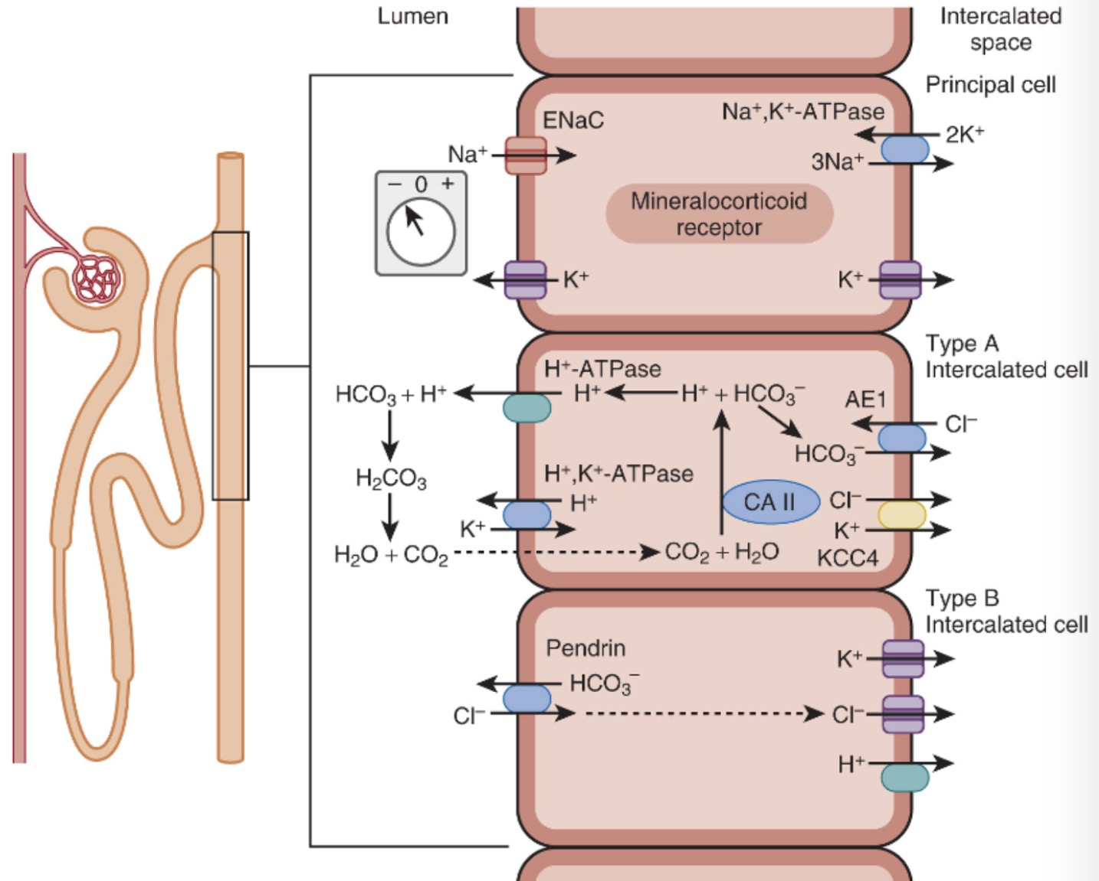
Renal
(1) high delivery of Na⁺ salts to the distal nephron
(2) excessive elaboration of mineralocorticoids
(3) K⁺ deficiency
Continuous Cycle
Brenner & Rector's The Kidney

Slide 46
Diuretics
Induce distal delivery of sodium salts, such as thiazide and loop diuretics, diminish ECV without altering total body bicarbonate content.
Hypokalemia also enhances ammonium production and excretion.
Repair of the alkalosis is achieved by withholding the diuretic, providing isotonic saline to correct the ECV deficit, and repleting potassium/chloride.
ASN Primer

Slide 47
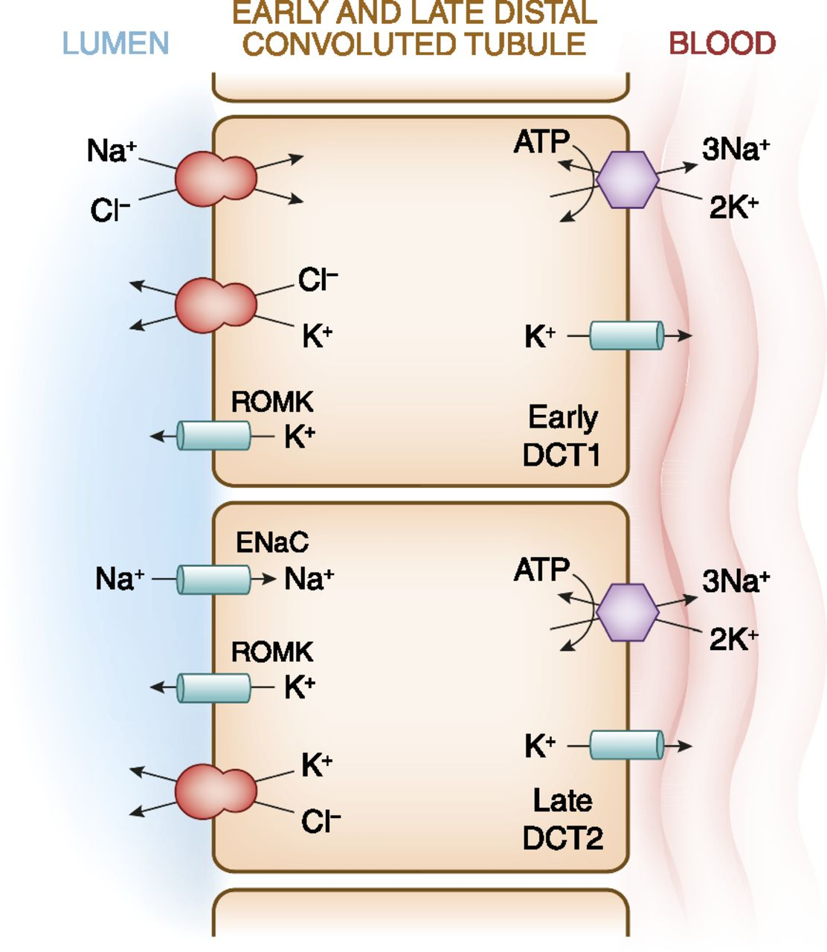

Thiazide sensitive
Amiloride sensitive
Aldosterone-sensitive distal nephron
Biff F. Palmer CJASN doi:10.2215/CJN.08580813
©2014 by American Society of Nephrology
Notes:
A cell model for K⁺transport in the distal convoluted tubule (DCT). In the early DCT, luminal Na⁺ uptake is mediated by the apically located thiazide-sensitive Na⁺-Cl⁻ cotransporter. The transporter is energized by the basolateral Na⁺-K⁺-ATPase, which maintains intracellular Na⁺ concentration low, thus providing a favorable gradient for Na⁺ entry into the cell through secondary active transport. The cotransporter is abundantly expressed in the DCT1 but progressively declines along the DCT2. ROMK is expressed throughout the DCT and into the cortical collecting duct. Expression of the epithelial Na⁺ channel (ENaC), which mediates amiloride-sensitive Na⁺ absorption, begins in the DCT2 and is robustly expressed throughout the downstream connecting tubule and cortical collecting duct. The DCT2 is the beginning of the aldosterone-sensitive distal nephron (ASDN) as identified by the presence of both the mineralocorticoid receptor and the enzyme 11β-hydroxysteroid dehydrogenase II. This enzyme maintains the mineralocorticoid receptor free to only bind aldosterone by metabolizing cortisol to cortisone, the latter of which has no affinity for the receptor. Electrogenic-mediated K⁺ transport begins in the DCT2 with the combined presence of ROMK, ENaC, and aldosterone sensitivity. Electroneutral K⁺-Cl⁻ cotransport is present in the DCT and collecting duct. Conditions that cause a low luminal Cl⁻ concentration increase K⁺ secretion through this mechanism, which occurs with delivery of poorly reabsorbable anions, such as sulfate, phosphate, or bicarbonate.

Slide 48
Loop Diuretics | Bartter’s Syndrome
Both entities impair NaCl reabsorption in the TALH
1 in 1 million
Impaired sodium chloride reabsorption leads to mild volume depletion and activation of the renin-angiotensin-aldosterone system.
The combination of secondary hyperaldosteronism and increased distal flow of Na+ delivery enhances K+ and H+ secretion, leading to hypokalemia and metabolic alkalosis.
Lower blood pressure than the general population

Slide 49
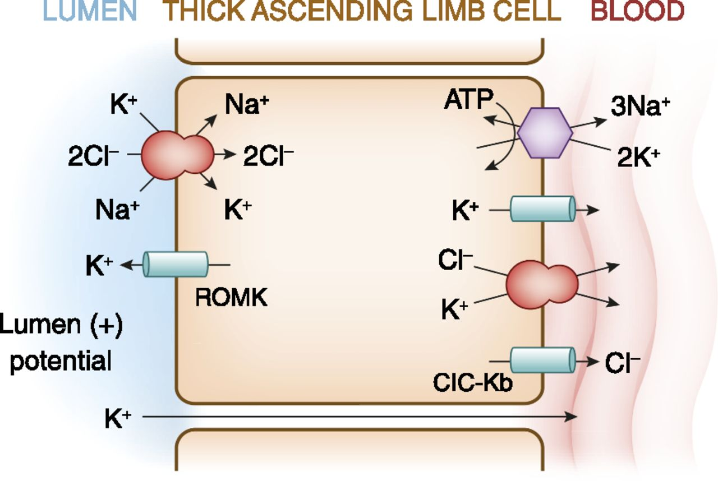
Bartter Syndrome
CaS
Bartter type 5
Bartter type 1
Bartter type 2
Mg
Bartter type 3
Barttin
Bartter type 4
©2015 by American Society of Nephrology
American Society of Nephrology CJASN 2015;10:1886-1887

Slide 50
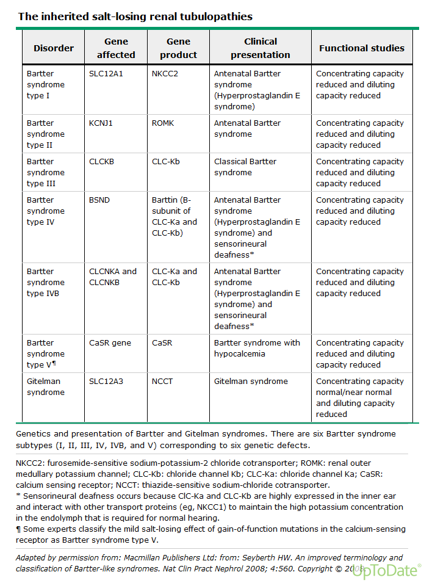
Loss of function
NSAIDs decrease PGE2
Develops nephrocalcinosis due to decreased Ca absorption
NSAIDs decrease PGE2
Loss of function
Affects both TALH & Parathyroid gland → hypocalcemia. AminoGly → similar presentation
Gain of function
Notes:
Table from UpToDate.
Aminoglycosides are polycations, which act as calcimimetics and can activate the CaSR

Slide 51
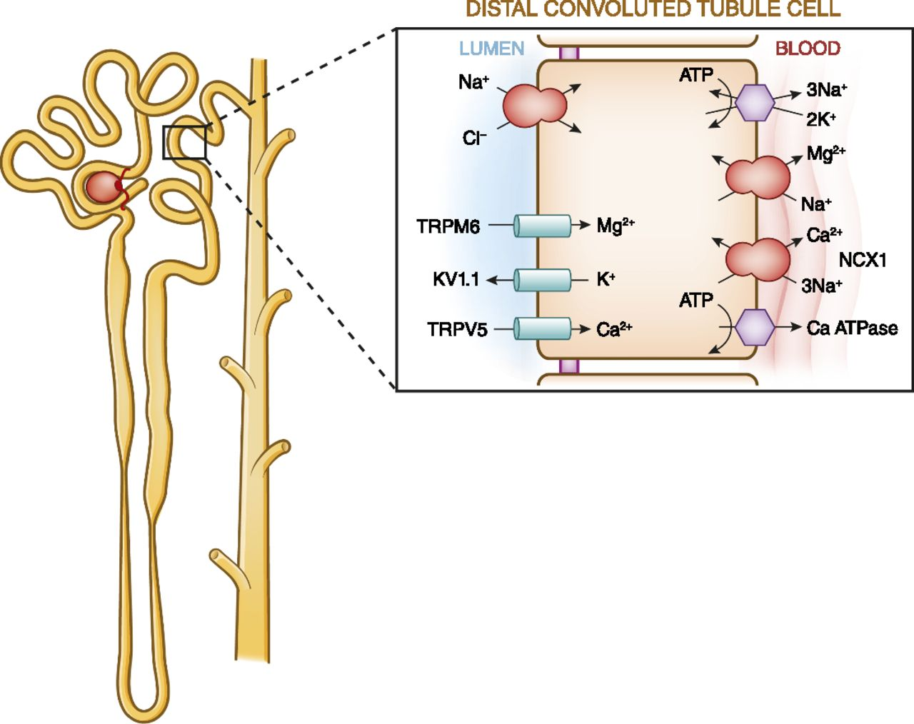
Thiazide and Gitelman Syndrome
x
Gitelman syndrome
  Autosomal Recessive Disorder (1:40,000)
  Not usually diagnosed until late childhood or adulthood
Presents with hypokalemia, metabolic alkalosis, hypomagnesemia, hypocalciuria, polyuria, chondrocalcinosis and normal to elevated blood pressure
  Decreases amount of cations (Na+) in the cell which increases the Ca++ gradient
  Increased distal Na+ delivery → K+ secretion
Calbidin
NSAIDs
Amiloride
Eplerenone
Notes:
UpToDate.com
Model of calcium and magnesium absorption by distal convoluted tubules. Calcium entry across the plasma membrane proceeds through calcium channels with basolateral exit occurring through a combination of the plasma membrane ATPase and Na⁺-Ca⁺ exchanger. Calcium absorption is entirely transcellular. Calciotropic hormones such as parathyroid hormone and calcitonin stimulate calcium absorption. Calcitriol [1,25(OH)₂D] stimulates calcium absorption through the activation of nuclear transcription factors. Inhibition of the apical NaCl cotransporter by thiazide diuretics or in Gitelman’s syndrome indirectly stimulates calcium absorption. It decreases the amt of Na in the cell which increases the gradient needed to have the calcium go through the Na Ca exchanger.

Slide 52
Pendred Syndrome
Pendred syndrome consists of sensorineural deafness and goiter caused by impaired iodide uptake, and it is ascribed to a defect in the pendrin co-transporter (encoded by SLC26A4).
Pendrin is expressed on the apical membrane of type B intercalated cells of the collecting tubule and mediates the secretion of bicarbonate and the reabsorption of chloride.’
Pendrin and the Na–Cl cotransporter (NCC; SLC12A3) cross compensate for the loss of each other
Although these patients typically do not have acid-base disorders they at increased risk when exposed to thiazide diuretic.
These patients are susceptible because of the inability of type B intercalated cells to secrete bicarbonate.
https://www.ncbi.nlm.nih.gov/pmc/articles/PMC4513892/

Slide 53
https://www.ncbi.nlm.nih.gov/pmc/articles/PMC3269186/
Notes:
In the CCD during reduced Cl⁻ delivery to that segment in CDA, pendrin activity is increased but secretion of HCO₃⁻ is inhibited by insufficient Cl⁻ for anion exchange. HCO₃⁻ reabsorption may be partly maintained by Na⁺/H⁺ exchange by the electrical coupling between the principal cell and the H⁺-secreting A cell (although it is morphologically less active than normal) and by the remainder of the collecting duct in the medulla. Coupled Na⁺/K⁺ exchange causes kaliuresis. After Cl⁻ delivery to the cortical collecting ducts increases, HCO₃⁻ secretion occurs and medullary HCO₃⁻reabsorption diminishes, allowing correction of the hypochloremic alkalosis. In our rat studies, bicarbonaturia occurred within minutes of Cl⁻ administration intravenously and Cl⁻ did not increase in the urine until correction of serum [Cl⁻] was nearly complete. (Both H⁺and HCO₃⁻ are produced in the A- and B-type cells by carbonic anhydrase, and during acute acid-base changes, pendrin and H⁺ATPase shuttle back and forth from cytosol to the luminal or basolateral membrane).

Slide 54
Metabolic Alkalosis
pH >7.44
Renin
Yes
Hypertension
>20
Urine Chloride
<20
Low
High
No
Kidney
Renal Artery Stenosis
Aortic Coarctation
Reninoma
Diuretic Use?
Remote Diuretic
Cystic Fibrosis*
Post hypercapnic state
Aldosterone
GI
No
Low
Bartter
Gitelman
Calcium (Milk)-Alkali
Beta-Lactams
Aminoglycosides
Cystic Fibrosis/Pendrid*
High
Cushing Syndrome
Ectopic Corticotropin
Drugs (carbenoxolone)
Licorice (Glycyrrhetic Acid)
Liddle Syndrome
Apparent Mineralocorticoid Excess
Vomit
NGT Suction
Laxative overuse
Chloride losing diarrhea (congenital)
Villous Adenoma
High volume ileostomy output
Primary Hyperaldosteronism
Glucocorticoid-remediable Aldosteronism

Slide 55
Elevated Aldosterone
Low Aldosterone
Primary Hyperaldosteronism
Glucocorticoid Remediable Aldosteronism
Renal Artery Stenosis
Aortic Coarctation
Reninoma
Cushing Syndrome
Ectopic Corticotropin
Congenital Adrenal Hyperplasia
Drugs (carbenoxolone)
Licorice (Glycyrrhetic Acid)
Liddle Syndrome
Apparent Mineralocorticoid Excess (AME)

Slide 56
Metabolic Alkalosis Associated with Hyperaldosteronism and Hypertension
Hyperreninemia promotes conversion of angiotensin I to angiotensin II, causing severe vasoconstriction and aldosterone release
  Seen in renal artery stenosis
    16% present with hypokalemia and alkalosis
  Diuretics
Low renin with high aldosterone
  Adenoma 65%
  Idiopathic hyperaldosteronism 34%
  Glucocorticoid remediable <1%
    Autosomal dominant (CYP11B1/CYP11B2 chimeric gene)
    Aldosterone synthase is attached to ACTH regulatory gene
    Giving glucocorticoid will decrease production of aldosterone
  Carcinoma <1%

Slide 57
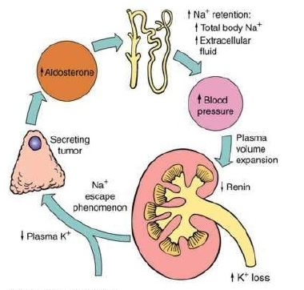
Hyperaldosteronism
Increased salt retention and delivery to distal tubule
Increased ENaC and ROMK
Increased activity of Na K ATPase
Na is reabsorbed faster than Cl-
Leading to negative luminal charge
Increased electrochemical gradient for K and H secretion
Leading to hypokalemia and metabolic alkalosis

Slide 58
Hyperaldosteronism-Like
Low renin and Low aldosterone
  Cushings syndrome
  Congenital Adrenal Hyperplasia/Apparent Mineralocorticoid Excess (AME)
    11 beta hydroxylase deficiency – virilization
    17 alpha hydroxylase deficiency – decreased sex hormones
  Licorice ingestion (acquired inhibition of 11 hydroxysteroid dehydrogenase)
  Liddles syndrome
    Gain of function for ENaC
    Hypertensive
    No response to aldactone
    Response to amiloride and triamterene
    Transplant would cure dz

Slide 59
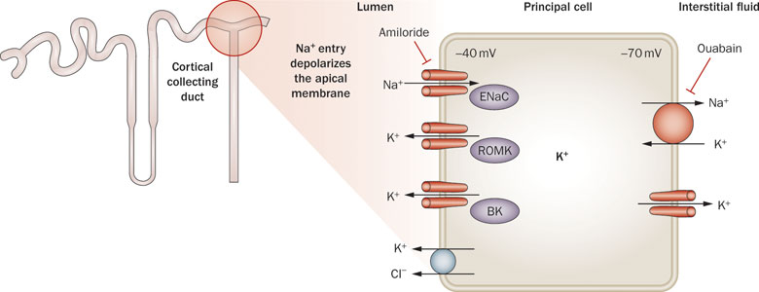
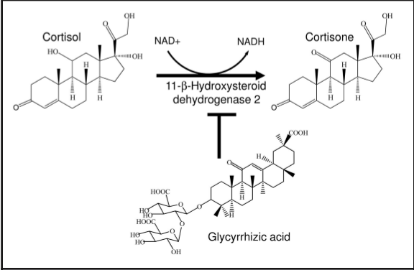
Liddles
Aldo-Receptor
Aldosterone
Adrenal Gland
(Licorice)
Notes:
Liddles --- gain-of-function mutation in ENaC leads to hereditary hypokalemia and hypertension, mimicking the syndrome of mineralocorticoid excess.
11-beta-hydroxylase deficiency --- present with features of androgen excess, including masculinization of female newborns and precocious puberty in male children. Approximately two thirds of patients also have hypertension, which may or may not be associated with mineralocorticoid excess, hypokalemia, and metabolic alkalosis. Seen in Congenital adrenal hyperplasia
Licorice is inhibiting 11-bbeta hydroxylase deficiency

Slide 60
Metabolic Alkalosis
pH >7.44
Renin
Yes
Hypertension
>20
Urine Chloride
<20
Low
High
No
Kidney
Renal Artery Stenosis
Aortic Coarctation
Reninoma
Diuretic Use?
Remote Diuretic
Cystic Fibrosis*
Post hypercapnic state
Aldosterone
GI
No
Low
Bartter
Gitelman
Calcium (Milk)-Alkali
Beta-Lactams
Aminoglycosides
Cystic Fibrosis/Pendrid*
High
Cushing Syndrome
Ectopic Corticotropin
Drugs (carbenoxolone)
Licorice (Glycyrrhetic Acid)
Liddle Syndrome
Apparent Mineralocorticoid Excess
Vomit
NGT Suction
Laxative overuse
Chloride losing diarrhea (congenital)
Villous Adenoma
High volume ileostomy output
Primary Hyperaldosteronism
Glucocorticoid-remediable Aldosteronism

Slide 61
Acid/Base on Calcium
Ultrafiltratable calcium = ionized and complexed fractions
  Ionized = not bound
  Complexed = bound to phosphate and citrate
Acute alkalosis = decreased ionized Ca
Acute or chronic acidosis = increased ionized Ca
  Every 0.1 change in pH, ionized calcium changes by 0.12mg/dL
H
H
Ca
Albumin
H
Ca
Ca
Notes:
For every 0.1 change in pH, ionized calcium changes by 0.12mg/dL
Acute or chronic acidosis = increased ionized Ca but leaching bone to buffer and directly decreases calcium absorption

Slide 62
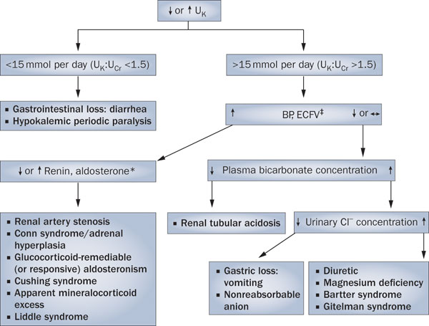
Notes:
Bartter (loop) --- The combination of secondary hyperaldosteronism and increased distal flow of Na+ delivery enhances K+ and H+ secretion, leading to hypokalemia and metabolic alkalosis but usually has low BP
Gitelmans (thiazide) --- presents with hypokalemia, metabolic alkalosis, hypomagnesemia, hypocalciuria, polyuria, chondrocalcinosis and normal to elevated blood pressure
Liddles --- gain-of-function mutation in ENaC leads to hereditary hypokalemia and hypertension, mimicking the syndrome of mineralocorticoid excess.
11-beta-hydroxylase deficiency present with features of androgen excess, including masculinization of female newborns and precocious puberty in male children. Approximately two thirds of patients also have hypertension, which may or may not be associated with mineralocorticoid excess, hypokalemia, and metabolic alkalosis. Seen in Congenital adrenal hyperplasia
Proximal RTA hypokalemia mediated through high aldosterone
Distal RTA hypokalemia mediated through inability to acidify urine
H secretion is needed fo K reabsorption in the alpha intercalated cells

Slide 63
Treatment
Treatment depends on the cause of the metabolic alkalosis
A history of vomiting, diuretic use, or alkali therapy and assessment of the urine chloride concentration, arterial blood pressure, and volume status (particularly the presence or absence of orthostasis will help guide treatment
Acetazolamide is usually effective in patients with adequate kidney function but can exacerbate urinary K⁺ losses and cause hypokalemia.
Dilute hydrochloric acid (0.1 N HCl) infused into a central vein is sometimes recommended.
  Complications include: hemolysis, venous sclerosis, and imprecise dosing
  It is not recommended except in extreme metabolic alkalosis (pH >7.6) in patients unresponsive to or intolerant of isotonic saline infusion, acetazolamide, or ammonium chloride administration
  Oral NH₄Cl is preferable to intravenous 0.1 N HCl, except in patients with liver disease

Slide 64
Metabolic Alkalosis
pH >7.44
Renin
Yes
Hypertension
>20
Urine Chloride
<20
Low
High
No
Kidney
Renal Artery Stenosis
Aortic Coarctation
Reninoma
Diuretic Use?
Remote Diuretic
Cystic Fibrosis*
Post hypercapnic state
Aldosterone
GI
No
Low
Bartter
Gitelman
Calcium (Milk)-Alkali
Beta-Lactams
Aminoglycosides
Cystic Fibrosis/Pendrid*
High
Cushing Syndrome
Ectopic Corticotropin
Drugs (carbenoxolone)
Licorice (Glycyrrhetic Acid)
Liddle Syndrome
Apparent Mineralocorticoid Excess
Vomit
NGT Suction
Laxative overuse
Chloride losing diarrhea (congenital)
Villous Adenoma
High volume ileostomy output
Primary Hyperaldosteronism
Glucocorticoid-remediable Aldosteronism

Slide 65
Match each diagnosis with the correct clinical and laboratory presentation:
Clinical diagnosis:
a) Overuse of the loop diuretic furosemide
b) Ectopic corticotropin due to a lung malignancy
c) Gastric outlet obstruction with vomiting
Presentation:
1) Blood pressure, 160/100 mm Hg; serum K+, 2.9 mEq/L; serum HCO3−, 45 mEq/L; urine Na+, 40 mEq/L; Cl−, 45 mEq/L; and urine K+, 38 mEq/L
2) Blood pressure, 95/57 mm Hg; serum K+, 2.9 mEq/L;serum HCO3−, 45 mEq/L; urine Na+, 40 mEq/L; urine Cl−, 45 mEq/L; and urine K+, 38 mEq/L
3) Blood pressure, 95/57 mm Hg; serum K+, 2.9 mEq/L;serum HCO3−, 45 mEq/L; urine Na+, <10 mEq/L; urine Cl−, <20 mEq/L; and urine K+, 23 mEq/L

Slide 66
A = 2
B = 1
C =3

Slide 67
A 71-year-old woman who has had nocturia for several years is admitted to the hospital secondary to increasing weakness and frequency of urination. She has been well until 2 days ago, when she felt weak and could not climb the stairs to her apartment. She has a history of duodenal ulcer many years ago that responded to intensive antacid therapy. She currently takes calcium carbonate for treatment of osteoarthritis, and she takes bicarbonate of soda for heartburn. She has a 40 pack-year history of smoking.
On physical examination, she is frail and oriented only to person. Pulse is 106/min, and BP is 110/80 supine and 90/70 mmHg sitting. The remainder of the examination is normal.
Laboratory studies reveal the following: Hematocrit 41, Na 152 mmol/L, K 3.0 mmol/L, Cl 100 mmol/L, HCO3 39 mEq/L, BUN 98 mg/dl, creatinine 7.1 mg/dl, Ca 14.4 mg/dl, phosphate 6.3 mg/dl, serum 1,25-dihydroxyvitamin D 30 pg/ml (35 to 85 pg/ml), parathyroid hormone 16 pg/ml (30 to 50 pg/ml). Urinalysis shows specific gravity of 1.007, trace protein, Na of 49 mmol/L, creatinine of 70 mg/dl, and urine osmolality of 260 mOsm/kgH2O. Renal ultrasound shows normal-sized kidneys and no hydronephrosis.
The clinical and laboratory findings are MOST consistent with which ONE of the following?
Vitamin D intoxication.
Chronic kidney disease as a result of longstanding hypertension.
Multiple myeloma.
Milk-alkali syndrome.
Primary hyperparathyroidism.

Slide 68
A 71-year-old woman who has had nocturia for several years is admitted to the hospital secondary to increasing weakness and frequency of urination. She has been well until 2 days ago, when she felt weak and could not climb the stairs to her apartment. She has a history of duodenal ulcer many years ago that responded to intensive antacid therapy. She currently takes calcium carbonate for treatment of osteoarthritis, and she takes bicarbonate of soda for heartburn. She has a 40 pack-year history of smoking.
On physical examination, she is frail and oriented only to person. Pulse is 106/min, and BP is 110/80 supine and 90/70 mmHg sitting. The remainder of the examination is normal.
Laboratory studies reveal the following: Hematocrit 41, Na 152 mmol/L, K 3.0 mmol/L, Cl 100 mmol/L, HCO3 39 mEq/L, BUN 98 mg/dl, creatinine 7.1 mg/dl, Ca 14.4 mg/dl, phosphate 6.3 mg/dl, serum 1,25-dihydroxyvitamin D 30 pg/ml (35 to 85 pg/ml), parathyroid hormone 16 pg/ml (30 to 50 pg/ml). Urinalysis shows specific gravity of 1.007, trace protein, Na of 49 mmol/L, creatinine of 70 mg/dl, and urine osmolality of 260 mOsm/kgH2O. Renal ultrasound shows normal-sized kidneys and no hydronephrosis.
The clinical and laboratory findings are MOST consistent with which ONE of the following?
Vitamin D intoxication.
Chronic kidney disease as a result of longstanding hypertension.
Multiple myeloma.
Milk-alkali syndrome.
Primary hyperparathyroidism.

Slide 69
D) Milk-alkali syndrome
The patient presents with metabolic alkalosis, acute renal failure, and hypercalcemia.
The history describes a patient who likely is taking large quantities of antacids for treatment of dyspepsia. ‘
These features strongly suggest a diagnosis of milk-alkali syndrome. The increased frequency of urination may be the result of a renal concentrating defect caused by hypercalcemia.
Vitamin D intoxication (choice A) can be a cause of hypercalcemia but is excluded by the low levels of active vitamin D. A patient with chronic kidney disease as a result of hypertension (choice B) would be expected to present with small kidneys. A serum calcium concentration of 14.4 would not be expected in such a patient.
Multiple myeloma (choice C) is a consideration but is not the best answer given the clinical features in this case.
Anemia and a low anion gap are often present in patients with myeloma. Primary hyperparathyroidism is excluded by the suppressed parathyroid hormone levels, making choice E incorrect.

Slide 70
A 9-yr-old girl complains of profound weakness, dizziness, and polyuria. She is taking no medications and has no gastrointestinal complaints. Pertinent clinical finding is BP of 90/50 mmHg with orthostatic dizziness. Laboratory data reveal the following: Na 140 mEq/L, K 2.5 mEq/L, Cl 100 mEq/L, CO2 33 mEq/L, blood urea nitrogen 25 mg/dl, and creatinine 0.7 mg/dl. A 24-h urine collection reveals the following: Sodium 90 mEq, potassium 60 mEq, Cl 110 mEq, and calcium 280 mg. Plasma renin and aldosterone are elevated.
These findings are MOST suggestive of which ONE of the following?
Adrenal adenoma
Gitelman syndrome
Bartter syndrome
Licorice ingestion
Hemangiopericytoma

Slide 71
C) Bartter syndrome
The term Bartter syndrome denotes a group of renal diseases that share a common denominator of metabolic alkalosis and renal potassium wasting without hypertension. Bartter syndrome falls into four subgroups: (1) Antenatal Bartter syndrome (hyperprostaglandin E2 syndrome), (2) the Gitelman variety of Bartter syndrome (Gitelman syndrome), (3) classical Bartter syndrome, and (4) pseudo-Bartter syndrome. This patient is an example of classical Bartter syndrome, characterized by early childhood onset. Symptoms may include polyuria, polydipsia, vomiting, constipation, salt craving, and a tendency to volume depletion. Growth retardation follows if treatment is not initiated. Affected patients have hypokalemic metabolic alkalosis and, unlike patients with Gitelman syndrome, their urinary calcium excretion is elevated. Adrenal adenoma, licorice ingestion, and hemangiopericytoma (choices A, D, and E) all are causes of hypokalemia, but these disorders are associated with hypertension.

Slide 72
A 32-year-old woman presents to the hospital with generalized fatigue. She has no known diarrhea and denies taking any medications. Physical examination reveals a thin woman, otherwise unremarkable. Blood pressure 95/57 mm Hg, heart rate 55 beats/min, respiratory rate 12 breaths/min.
Laboratory findings:
Arterial blood gas: pH 7.49, Pco2 50 mm Hg, HCO3− 38 mmol/L
Urine sodium 12 mmol/L, chloride 16 mmol/L, potassium 37 mmol/L
Which one of the following is the most likely diagnosis?
A. Bartter syndrome
B. Gitelman syndrome
C. Surreptitious diuretic use
D. Congenital chloridorrhea
Sodium 132 mmol/L
Potassium 3.3 mmol/L
Chloride 80 mmol/L
Total CO2 39 mmol/L
Blood urea nitrogen 5 mg/dL
Creatinine 0.5 mg/dL
Calcium 7.8 mg/dL
Magnesium 1.6 mg/dL
Albumin 3.8 g/dL
Pham and Pham

Slide 73
A 32-year-old woman presents to the hospital with generalized fatigue. She has no known diarrhea and denies taking any medications. Physical examination reveals a thin woman, otherwise unremarkable. Blood pressure 95/57 mm Hg, heart rate 55 beats/min, respiratory rate 12 breaths/min.
Laboratory findings:
Arterial blood gas: pH 7.49, Pco2 50 mm Hg, HCO3− 38 mmol/L
Urine sodium 12 mmol/L, chloride 16 mmol/L, potassium 37 mmol/L
Which one of the following is the most likely diagnosis?
A. Bartter syndrome
B. Gitelman syndrome
C. Surreptitious diuretic use
D. Congenital chloridorrhea
Sodium 132 mmol/L
Potassium 3.3 mmol/L
Chloride 80 mmol/L
Total CO2 39 mmol/L
Blood urea nitrogen 5 mg/dL
Creatinine 0.5 mg/dL
Calcium 7.8 mg/dL
Magnesium 1.6 mg/dL
Albumin 3.8 g/dL
Pham and Pham

Slide 74
C. Surreptitious diuretic use

Slide 75
Which one of the following conditions with metabolic alkalosis may be easily corrected with chloride infusion?
A. Cushing disease
B. Liddle syndrome
C. Posthypercapnia (i.e., resolution of chronic respiratory acidosis with mechanical ventilation)
D. Severe hypokalemia
Pham and Pham

Slide 76
Which one of the following conditions with metabolic alkalosis may be easily corrected with chloride infusion?
A. Cushing disease
B. Liddle syndrome
C. Posthypercapnia (i.e., resolution of chronic respiratory acidosis with mechanical ventilation)
D. Severe hypokalemia
Pham and Pham

Slide 77
C. Posthypercapnia (i.e., resolution of chronic respiratory acidosis with mechanical ventilation)
Metabolic alkalosis in choices A, B, and D is driven by the hypersecretion of H+ at the collecting duct, not by the retention of HCO3− due to limited intraluminal Cl− for HCO3−-Cl− exchange. Choice A: The high cortisol level in Cushing disease provides high mineralocorticoid activity that drives H+ secretion at the collecting duct and results in metabolic alkalosis. Choice B: Liddle syndrome is associated with increased activity of the epithelial sodium channel (ENaC) in the collecting duct (due to reduced internalization and degradation of ENaC), which can effectively increase H+ secretion to cause metabolic alkalosis. Choice D: Severe hypokalemia is associated with increased H+ secretion at both proximal tubules and collecting duct and increased ammoniagenesis, hence facilitated H+ secretion. Choice C: In chronic respiratory acidosis, the kidneys compensate by holding on to HCO3− at the expense of Cl− excretion. In the acute hyperventilated state of a patient with chronic respiratory acidosis (i.e., posthypercapnia or resolution of chronic respiratory acidosis with mechanical ventilation), the compensatory metabolic alkalosis is left behind as the sole acid–base disturbance. This is referred to as posthypercapnia metabolic alkalosis. The remaining metabolic alkalosis in this case may be corrected with chloride infusion where Cl− is reabsorbed in exchange for an excreted HCO3− via the apical HCO3−-Cl− exchanger.

Slide 78
A 26-year-old woman with no known past medical history is referred to you for persistent hypokalemia. She denies taking any medications or herbs. Vital signs: height 160 cm, weight 48 kg, blood pressure 96/61 mm Hg, pulse 72 beats/min, respiratory rate 14 breaths/min. Patient is nonorthostatic. Physical examination is benign.
Laboratory findings:
Arterial blood gas: pH 7.43, Pco2 45 mm Hg. Both plasma renin activity (PRA) and aldosterone level are slightly elevated.
Urine electrolytes: sodium 52 mmol/L, potassium 37 mmol/L, chloride 92 mmol/L, creatinine 92 mg/dL, calcium 35 mg/dL
Urinalysis: specific gravity 1.009, pH 6.0, no protein, blood, cells, or casts
Which one of the following is the most likely diagnosis?
A. Acute vomiting
B. Bartter syndrome
C. Liddle syndrome
D. Gitelman syndrome
Sodium 134 mmol/L
Potassium 3.1 mmol/L
Chloride 92 mmol/L
Total CO2 30 mmol/L
Blood urea nitrogen 5 mmol/L
Creatinine 0.6 mg/dL
Calcium 9.2 mg/dL
Magnesium 1.7 mg/dL
Pham and Pham

Slide 79
A 26-year-old woman with no known past medical history is referred to you for persistent hypokalemia. She denies taking any medications or herbs. Vital signs: height 160 cm, weight 48 kg, blood pressure 96/61 mm Hg, pulse 72 beats/min, respiratory rate 14 breaths/min. Patient is nonorthostatic. Physical examination is benign.
Laboratory findings:
Arterial blood gas: pH 7.43, Pco2 45 mm Hg. Both plasma renin activity (PRA) and aldosterone level are slightly elevated.
Urine electrolytes: sodium 52 mmol/L, potassium 37 mmol/L, chloride 92 mmol/L, creatinine 92 mg/dL, calcium 35 mg/dL
Urinalysis: specific gravity 1.009, pH 6.0, no protein, blood, cells, or casts
Which one of the following is the most likely diagnosis?
A. Acute vomiting
B. Bartter syndrome
C. Liddle syndrome
D. Gitelman syndrome
Sodium 134 mmol/L
Potassium 3.1 mmol/L
Chloride 92 mmol/L
Total CO2 30 mmol/L
Blood urea nitrogen 5 mmol/L
Creatinine 0.6 mg/dL
Calcium 9.2 mg/dL
Magnesium 1.7 mg/dL
Pham and Pham

Slide 80
D. Gitelman syndrome
The current patient has metabolic alkalosis, given the elevated total CO2 level and pH > 7.4. Any of the four choices would fit. The increased PRA and aldosterone level may be seen in volume depleted state, such as acute vomiting and Bartter and Gitelman syndromes. Choice C: In Liddle syndrome, the primary defect is increased activity of the epithelial sodium channel (ENaC) at the collecting duct. The associated increase in sodium reabsorption leads to volume expansion and hypertension. PRA and aldosterone level in Liddle syndrome are normal or reduced due to the increased sodium reabsorption. Liddle syndrome is, therefore, ruled out. Choice A: Urine electrolytes reveal high sodium and chloride. Although urine sodium may be high in acute vomiting due to the filtration of the high HCO3− load, urine chloride should accurately reflect the low-volume state and remain low (e.g., < 20 mmol/L). The high urine chloride makes acute vomiting less likely. Choices B versus D: Bartter syndrome is typically likened to the equivalent of taking loop diuretics. This is associated with hypercalciuria, hence nephrocalcinosis in this condition. In contrast, Gitelman syndrome is likened to the equivalent of taking thiazide diuretics and is associated with enhanced tubular calcium reabsorption, thus hypocalciuria. Hypomagnesemia is also characteristic of Gitelman, which may manifest as severe hypomagnesemia later in life.

Slide 82
Primary Disorder | pH | Initial Chemical Change | Compensatory Response | Expected Compensation | Complete Adaptive Response
Metabolic Acidosis | Low | ↓ HCO₃- | ↓ pCO₂ | pCO₂ = (1.5 × HCO₃-) + 8 ± 2 pCO₂ = HCO₃- + 15 pCO₂ = decimal digits of pH | 12-24 hrs
Metabolic Alkalosis | High | ↑ HCO₃- | ↑ pCO₂ | pCO₂ = 40 + 0.7x([HCO_{3 measure}] – [HCO_{3 normal}]) pCO₂ = (0.9 × HCO₃-) + 9 pCO₂ = (0.7 × HCO₃-) + 20 | 24-36 hrs
Respiratory Acidosis
Acute | Low | ↑ pCO₂ | ↑ HCO₃- | HCO₃- increases 1 mEq/L for every 10 mm Hg increase in pCO₂ | 2-5 days
Chronic | Low | ↑ pCO₂ | ↑↑ HCO₃- | HCO₃- increases 3 to 4 mEq/L for every 10 mm Hg increase in pCO₂
Respiratory Alkalosis
Acute | High | ↓ pCO₂ | ↓ HCO₃- | HCO₃- decreases 2 mEq/L for every 10 mm Hg decrease in pCO₂ | 2-5 days
Chronic | High | ↓ pCO₂ | ↓ HCO₃- | HCO₃- decreases 5 mEq/L for every 10 mm Hg decrease in pCO₂
Table 12.1: Acid-Base Rules: Changes in pH, pCO₂, and [HCO₃⁻] and Expected Compensatory Responses in Simple Disturbances

Slide 83
Respiratory Acidosis & Alkalosis
Respiratory acidosis, or primary hypercapnia, is the acid-base disturbance initiated by an increase in the carbon dioxide tension of body fluids and in whole-body CO₂stores.
Hypercapnia acidifies body fluids and elicits an adaptive increment in the plasma bicarbonate concentration

Slide 84
Pathophysiology
The ventilatory system is responsible for maintaining PCO₂ within normal limits by adjusting minute ventilation (V̇_{E}) to match the rate of CO₂ production.
V̇_{E} consists of two components:
  ventilation distributed in the gas-exchange units of the lungs (alveolar ventilation, V̇_{A})
  ventilation wasted in dead space (V̇_{D})
Hypercapnia can result from increased CO₂ production, decreased V̇_{A}, or both. Decreased V̇_{A} can occur from a reduction in V̇_{E}, an increase in V̇_{D}, or a combination of the two.

Slide 85
An immediate rise in plasma HCO3 owing to titration of nonbicarbonate body buffers occurs in response to acute hypercapnia.
This adaptation is complete within 5 to 10 minutes after the increase in PCO₂.
On average, plasma HCO3 increases by about 0.1 mEq/L for each 1 mm Hg acute increment in PCO₂

Slide 86
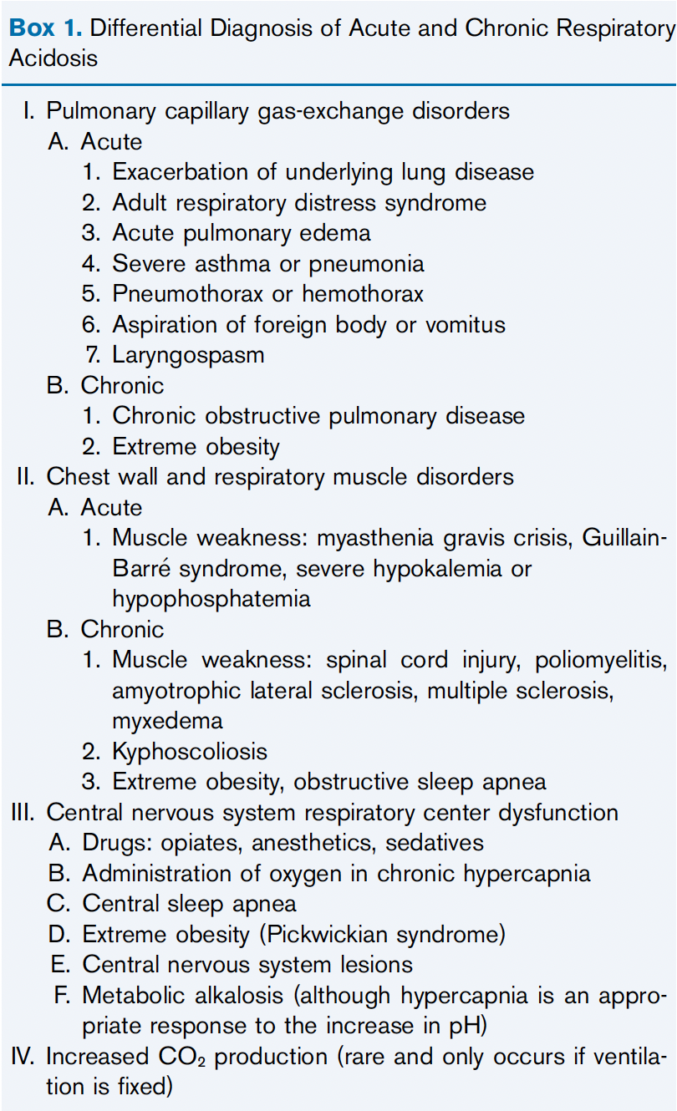
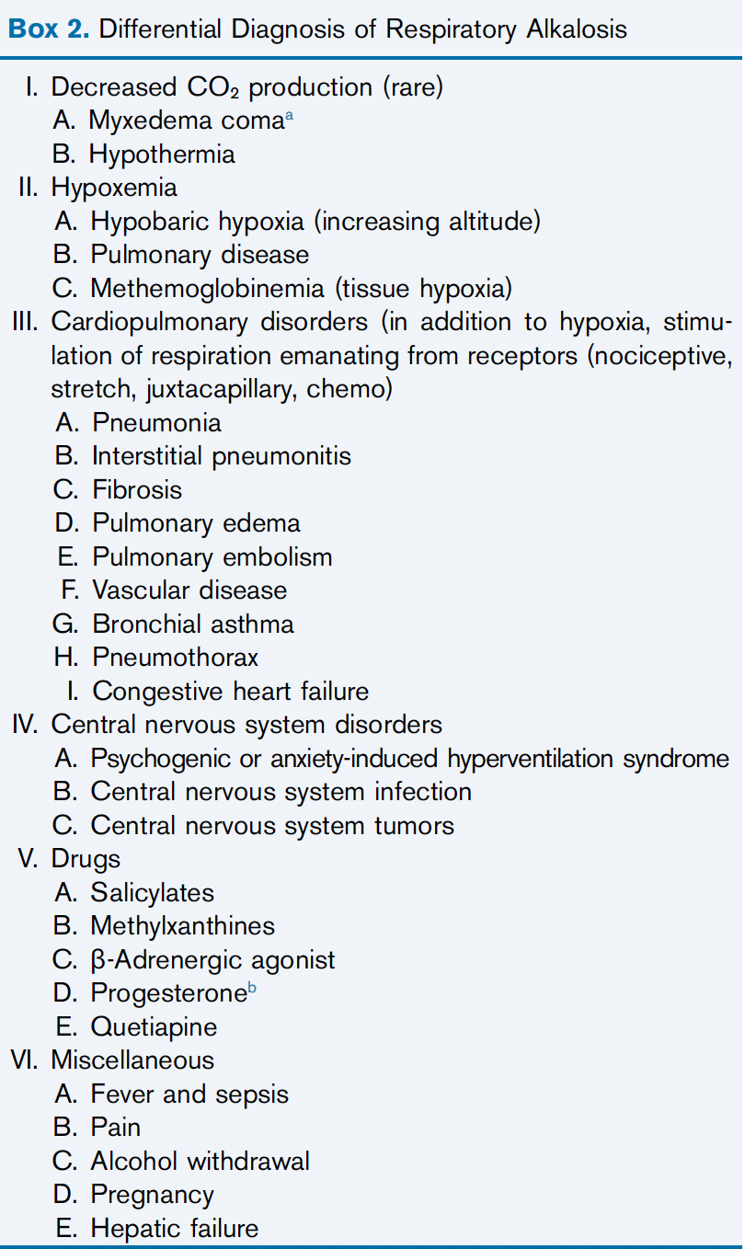
Etiology
AJKD: CC Resp Acid-Base 2023

Slide 87


Thank You
NKF Primer 8th ed
Burton Rose – Clinical Physiology of Acid-Base and Electrolyte
Pham and Pham Nephrology and Hypertension Board Review
Physiologic approach to Acid-Base (NEJM 2014)
AJKD Core Curriculum: Metabolic Alkalosis 2022
AJKD Core Curriculum: Respiratory Acid-Base 2023

Slide 88
Question
After a forced 6-hour intense training exercise in the desert in the heat of the day, an elite corps soldier was the only one in his squad who collapsed. He perspired profusely during the training exercise and drank a large volume of water and glucose-containing fluids. He did not vomit and reported he did not take any medications. Physical examination revealed a markedly contracted EABV. Initial laboratory data are shown in the table. The pH and PCO₂ values are from an arterial blood sample, whereas all other data are from a venous blood sample.
P_{Na}, mmol/L | 125
P_{K}, mmol/L | 2.7
P_{Cl}, mmol/L | 70
Hematocrit | 0.50
pH | 7.50
P_{HCO3}, mmol/L | 38
PCO₂, mm Hg | 47

Slide 89
Question
What are the major threats to the patient and how should they dictate therapy?
  Acute Hyponatremia: The danger is brain herniation due to increased intracranial pressure from swelling of brain cells.
  Hemodynamic Instability: An infusion of isotonic saline was started in the field, and the patient was hemodynamically stable on arrival at the emergency department. Then changed to hypertonic saline due to the acute nature of the drop.
What is the basis for metabolic alkalosis?
  Volume depletion: hematocrit of 0.50, this patient’s ECFV was decreased by a third, from its normal value of 15 L to about 10 L, so he had lost 5 L of ECFV.
  Deficit of NaCl: The decrease in his ECF volume was about 5 L. One can now calculate how much this degree of ECFV contraction would raise the P_{HCO3} (divide the normal content of HCO₃⁻ in the ECF compartment (15 L × 25 mmol/L, or 375 mmol) by the new ECFV (10 L) and the result is 37.5 mmol/L. This value is remarkably close to the measured P_{HCO3,} 38 mmol/L, suggesting that a major reason for the rise in the P_{HCO3} is the fall in his ECFV.
What is the therapy for metabolic alkalosis in this patient?
  Replace NaCl

Slide 90
Question
A 19-year-old man is referred for management of his difficult-to-control hypertension. His brother has difficult- to-control hypertension, and his father had severe hypertension and died of a stroke at age 33 years. The patient seems healthy but has a BP of 180/110 mmHg. Grade 2 hypertensive retinopathy is present on funduscopic examination.
Laboratory studies reveal the following: Na, 140 mmol/L; K, 2.2 mmol/L; Cl, 90 mmol/L; HCO3, 36 mEq/L; plasma renin activity, 0.2 ng/ml per hour (3–9 ng/ml per hour), and aldosterone, 18 ng/dl (nl ,10). Plasma 18-OH cortisol is markedly elevated. High-resolution tomography of the abdomen is negative for adrenal masses.
Which ONE of the following is the MOST specific treatment of the patient’s condition?
A. Spironolactone
B. Dexamethasone
C. Amiloride
D. Angiotensin converting enzyme inhibitor
E. Calcium channel blocker

Slide 91
Answer
Answer B: Dexamethasone.
The patient presents with hypokalemic metabolic alkalosis and hypertension in the setting of having similarly affected family members.
The work-up of the patient is positive for increased plasma aldosterone and suppressed plasma renin activity.
An adrenal adenoma, bilateral adrenal hyperplasia, and dexamethasone suppressible hyperaldosteronism are considerations in this case.
The positive family history and increased plasma 18-OH cortisol confirms the diagnosis of dexamethasone suppressible hyperaldosteronism, making choice B the correct answer.
Choice A would be an effective therapy by blocking the effects of increased aldosterone but unlike dexamethasone, spironolactone is not the most specific therapy. For similar reasons, amiloride (choice C) is also not the correct answer. An angiotensin converting enzyme inhibitor or a calcium channel blocker (choices D and E) would help treat the hypertension but would not be specific therapies of the underlying disorder.

Slide 92
Question
A 16-year-old girl is referred with a provisional diagnosis of primary aldosteronism. Her BP is consistently elevated at 180/120 mmHg, serum K is 2.6 mmol/L, and serum HCO3 is 30 mmol/L. The patient’s younger brother has a BP of 200/110 mmHg, serum K of 2.7 mmol/L, and serum HCO3 of 29 mmol/L. During the next several years, the patient develops renal failure as a result of poorly controlled BP. The patient receives a successful renal allograft from a nonrelated deceased donor. After the transplant, the patient is no longer hypertensive and electrolytes are normal.
Which ONE of the following is the MOST likely cause of the patient’s original disease?
  Activating mutation in the WNK4 kinase
  Inactivating mutation of WNK1 kinase
  Inactivating mutation in the mineralocorticoid receptor
  Truncating mutation causing deletion of the carboxy tail of the b subunit of the epithelial Na channel
  Mutation in the Na1-K1-2Cl2 cotransporter

Slide 93
Answer
Answer D: Truncating mutation causing deletion of the carboxy tail of the b subunit of the epithelial Na channel.
The hypokalemic metabolic alkalosis accompanied by hypertension and the positive family history are consistent with Liddle’s syndrome.
This disorder is caused by mutations that present as if there is constitutive activation of the epithelial Na channel.
Mutations in the carboxy tail of either the b or g subunit of the channel are known to cause the syndrome.
Renal transplantation in the index case of Liddle’s syndrome was curative of the electrolyte disorders.
WNK4 or WNK1 mutation does not cause Liddle’s syndrome. Inactivating mutations in WNK4 or activating mutations in WNK1 have been described as a cause of Gordon’s syndrome, making choices A and B incorrect. Gordon’s syndrome presents with hyperkalemia, normal gap acidosis, and hypertension. Inactivating mutations in the mineralocorticoid receptor present with hyperkalemia, normal gap acidosis, and normal or low BP, making choice C incorrect. Choice E is incorrect because mutations in the Na-K-2Cl cotransporter give rise to Bartter’s syndrome. Hypertension is not a feature of Bartter’s syndrome.

Slide 94
79. A 22-year-old woman is being evaluated for resistant hypertension and hypokalemia despite therapy with amlodipine, labetalol, losartan, and spironolactone. Within the last 4 years, she has experienced three episodes of pregnancy-associated severe hypertension and hypokalemia in her late third trimester requiring a caesarean section. There were no other features of eclampsia or renal disease. Her younger sister had experienced a similarly complicated pregnancy last month.
Labs: 139 | 98 / 9 PRA, 1.1 (normal <4)
3.1 | 28 \ 0.6 Plasma aldosterone, -3.1 (normal 4–15): urinalysis normal
What is the MOST appropriate diagnosis and management for her current resistant hypertension and hypokalemia?
Diagnosis of primary aldosteronism exacerbated by pregnancy requiring increased spironolactone therapy
Diagnosis of renal artery stenosis due to fibromuscular dysplasia exacerbated by pregnancy requiring
percutaneous renal angioplasty
Diagnosis of glucocorticoid remediable aldosteronism (GRA) exacerbated by pregnancy requiring the addition of
dexamethasone to her spironolactone
Diagnosis of mineralocorticoid corticoid receptor mutation (Geller’s syndrome) exacerbated by pregnancy
requiring discontinuation of spironolactone
Answer: D
Explanation:
The mineralocorticoid corticoid receptor mutation (Geller’s syndrome) is a rare disorder that presents as severe hypertension with metabolic alkalosis and hypokalemia in young women during the second and third trimester of pregnancy. The mutation is transmitted by an autosomal dominant inheritance, and the MR 810 mutation is activated by progesterone (which blocks the normal aldosterone receptor but has the opposite effect in Geller syndrome), and thus the pregnant woman with this mutation will present like other causes of “apparent mineralocorticoid excess”: hypertension, hypokalemic metabolic alkalosis with suppressed renin, and alodosterone. Spironolactone (also normally an aldosterone receptor blocker) acts like progesterone in this condition thereby worsening hypertension and hypokalemia when administered. Urgent management during the third trimester of pregnancy often requires delivery, and subsequent management includes avoidance of spironolactone. The low PRA and primary aldosteronism exclude the other diagnoses listed including primary aldosteronism, GRA, and renal artery stenosis (RAS).

