Slide 1
Approach to Acid-Base
Jacob Nysather D.O.

Slide 2

Disclosures
None

Slide 3
Lecture Series Overview
Renalism Approach
Lecture 1: Approach to acid-base problems and an overview of physiologic mechanisms at work. Focus on intro to acidosis. 9/3
Lecture 2: Continue the journey of mastering acidosis with a physiologic approach in dissecting and understanding acid-base problems 9/17
Lecture 3: Flip the script and become basic. Touch “base” on the less complex regulator of acid-base. (Have to give credit that it is a faster worker than the kidneys). 10/1
  If time will review other approaches

Slide 4
Objectives
Understand the importance of acid-base control in the human body
Understand the physiologic approach to diagnosing acid-base disturbances
Identify what constitutes the anion gap and it’s clinical implication in acidosis.
Recognize hyperchloremic metabolic acidosis and it’s primary clinical etiologies

Slide 5
A 63-year-old man with T2DM, stage 3 CKD creatinine 1.6 mg/dl, and COPD was brought to the ED for confusion and poor appetite. He was working on his car in the garage prior to this episode.
Medications: glipizide, lisinopril, metformin, thiazide.
Exam: BP=104/58, P=112, R=18, T=97. The patient was confused, lungs had wheezes, heart was tachycardic.
Labs: Na+ 128; K+ 6.1; Cl- 105; HCO3 6; BUN 43 mg/dl; Cr 3.1 mg/dl; glucose 298 mg/dl; albumin 3.6 g/dl.
ABG - pH 7.06 / pCO2 22 / PO2 86 / [HCO3] 6
Ketones neg
Tox screen (pending)

Slide 6
Which is the most likely cause of this clinical and laboratory presentation?
A. Salicylate ingestion
B. Metformin
C. Toluene ingestion
D. Diethylene glycol ingestion
E. d-lactic acidosis

Slide 7
What is the acid-base disturbance in this case?
A. High-anion gap metabolic acidosis and respiratory alkalosis
B. High-anion gap metabolic acidosis and respiratory acidosis
C. Mixed (AG&NAG) metabolic acidosis and respiratory acidosis
D. High-anion gap metabolic acidosis with metabolic alkalosis and respiratory acidosis
E. Mixed (AG&NAG) metabolic acidosis and respiratory alkalosis

Slide 8
Why is Acid-Base Important
Tertiary structure of proteins is altered by extreme pH conditions, potentially affecting the activity of enzymes and ion transport systems
Acidemia: depress cardiac function, impair the vascular response to catecholamines, and cause arteriolar vasodilation and venoconstriction, with resultant systemic hypotension and pulmonary edema, insulin resistance, reduced hepatic lactate uptake, and accelerated protein catabolism
Alkalemia: generate cardiac arrhythmias, produce neuromuscular irritability, and contribute to tissue hypoxemia, cerebral and myocardial blood flow falls and respiratory depression occurs
Electrolyte disorders (potassium) a common accompaniment of acid-base perturbations, also contribute to the morbidity

Slide 9
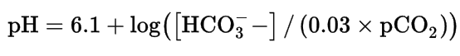
Defining Acid-Base
The normal arterial blood pH range is between 7.36 and 7.44
  Acidemia: arterial pH <7.36
  Alkalemia: arterial pH >7.44
  Acidosis and Alkalosis are pathophysiologic processes that, if unopposed by therapy or complicating disorders, would cause acidemia or alkalemia.
The relationship among pH, pCO2, and HCO3- concentrations is described by the familiar Henderson-Hasselbalch equation
Primer 8th edition
Notes:
H+ donors (acid) and H+ receivers (base)

Slide 10
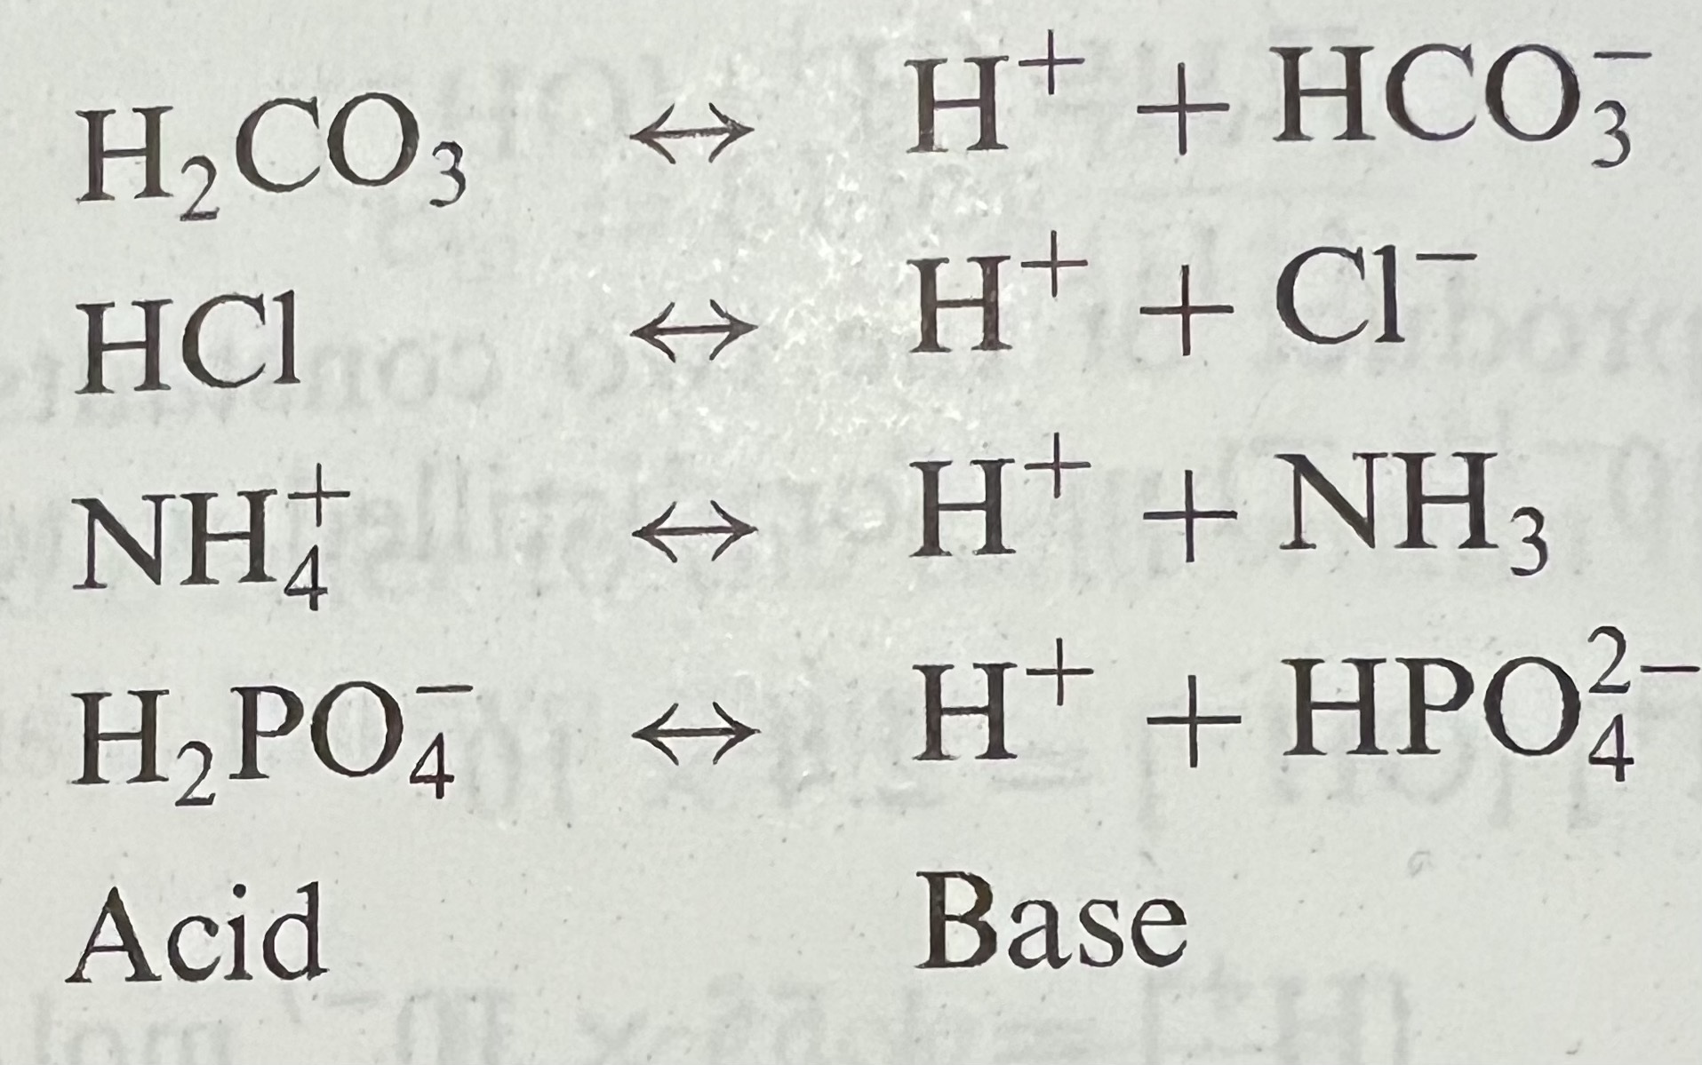
Acid | Base
pH is stabilized by multiple buffers in the ECF, cells, and bone.
  Cellular uptake of some excess H⁺ accompanied by K⁺ & Na⁺ extrusion maintains ECF electroneutrality
  Carbonic Acid (H₂CO₃) - Volatile Acid
  Non-Carbonic Acids - Nonvolatile or Fixed Acids
pCO2 and HCO3 are the most important variables in the buffering system
Primer 8th edition
Notes:
3 different methodologic approaches
Physiologic method uses arterial pH, pCO2, HCO3, anion gap and compensation rules
Base excess method uses arterial pH, pCO2 and calculations of base excess/ anion gap
Physiochemical method uses arterial pH, pCO2 and calculation of strong ion difference, strong ion gap and total concentration of plasma weak acids

Slide 11

pH Panorama

Slide 12
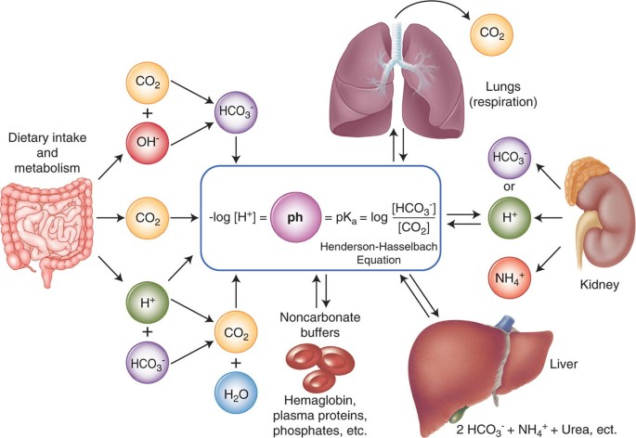
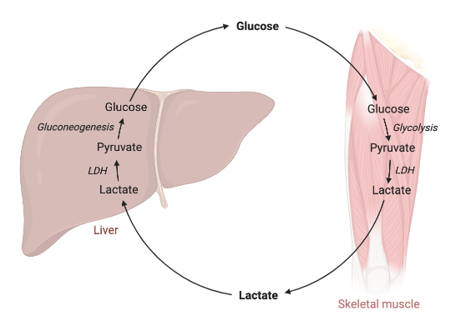
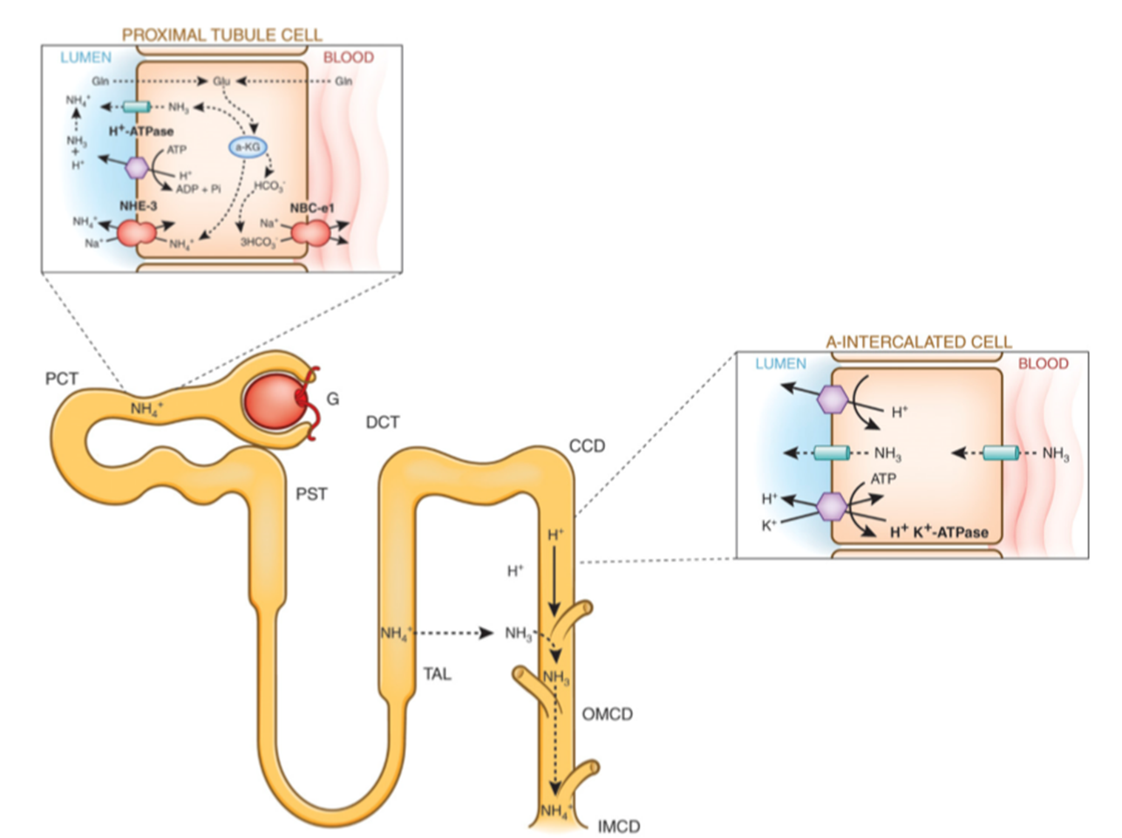
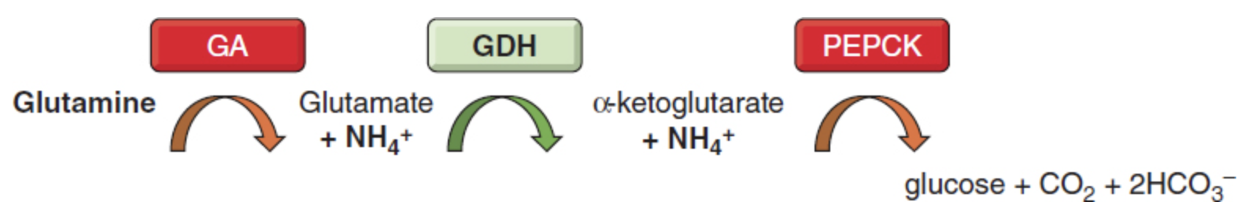
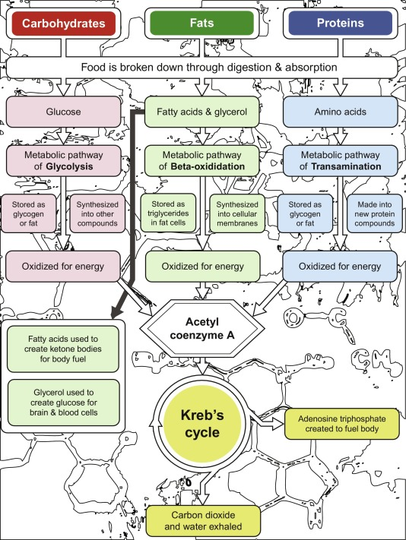
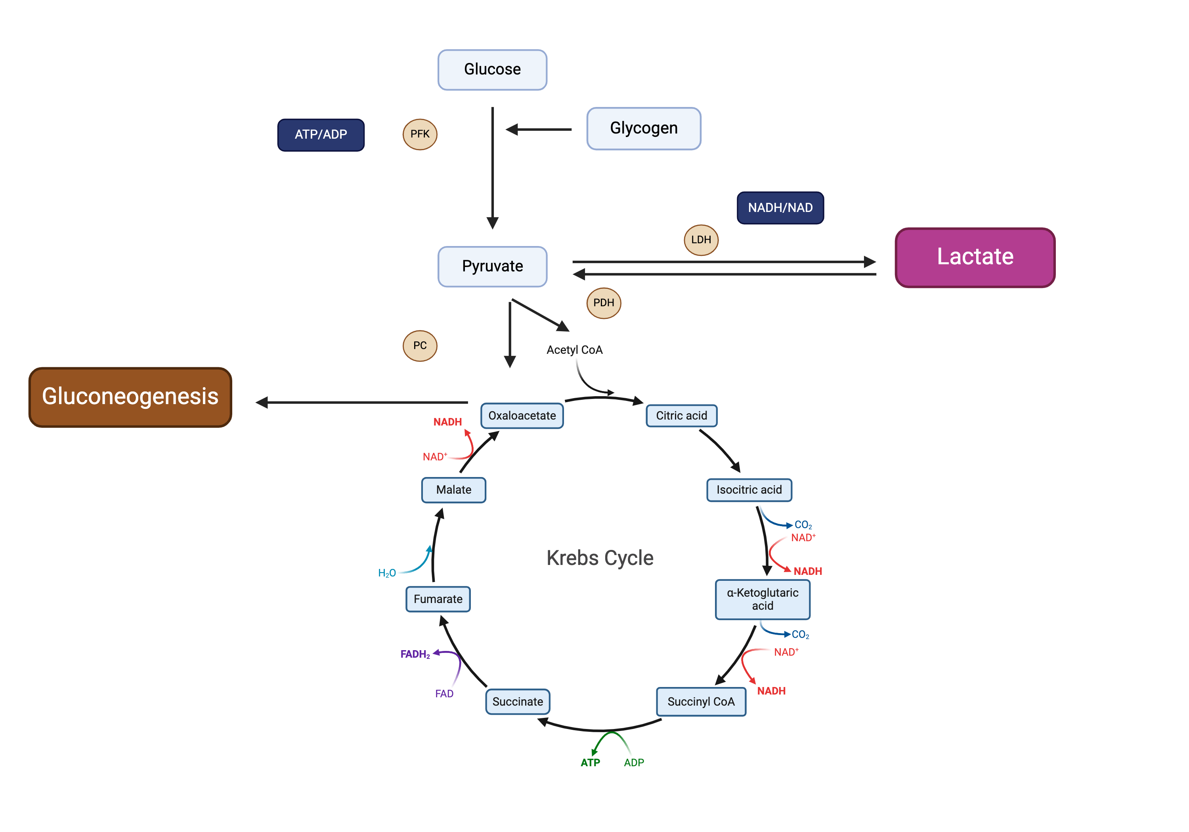
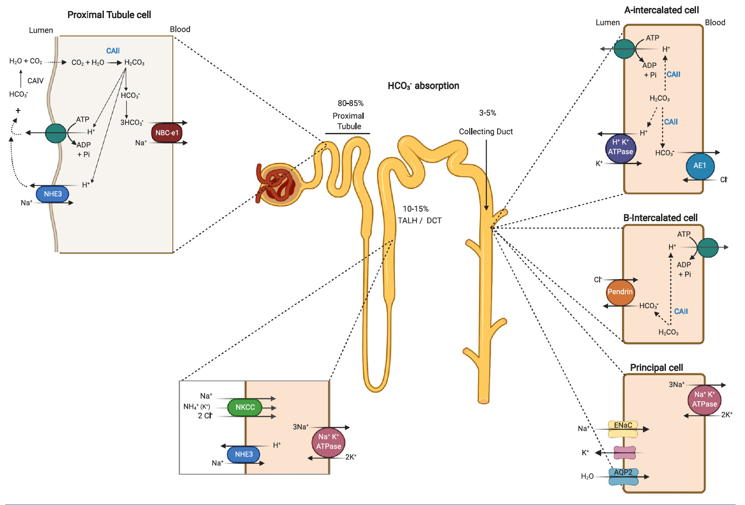
Notes:
H+ donors (acid) and H+ receivers (base)

Slide 13
Overview of Kidney’s Role in Acid-Base

Slide 14
Acid Control
Volatile acids – Removed by lungs
  CO2: ~15 M of CO2 removed by alveolar ventilation
    “Open” system
Nonvolatile acids – Removed by kidneys
  70-100 mM of nonvolatile acids need to be excreted (Western diet) “Fixed” acids, “closed” system
  From sulfur amino acids (AA, methionine, cysteine), phosphoric acid,
  Organic acids (uric, oxalic)
Sources of base: organic anions (citrate, acetate, lactate, ketones), Anionic AA (glutamate, aspartate)

Slide 15
Urinary H+ ”Scavengers”
Ammonium
  NH3/NH4+ (pKa = 9.2)
Titratable Acids (TA)
  Phosphate (HPO4,2- H2PO4-, pKa = 6.8)
  Creatinine (pKa = 5.0)
  Uric Acid (pKa = 5.8)
Free H+ (pH 5=1 x10-5M = 10micromol/L)

Slide 16
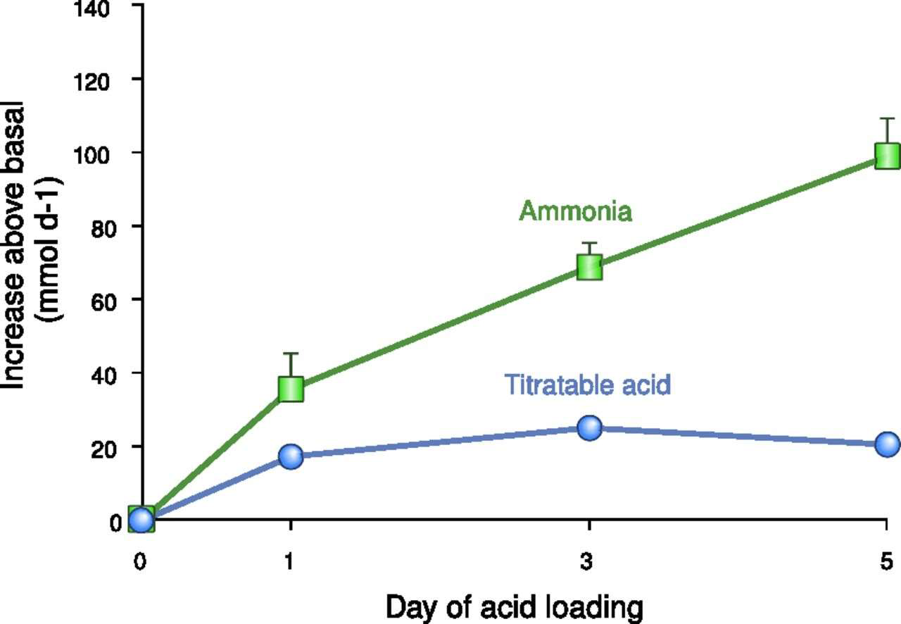
I. David Weiner et al. CJASN doi:10.2215/CJN.1031101312

Slide 17
Renal Ammonium Production
Enhancer
Acidemia
Hypokalemia
Gluconeogenesis
Inhibitors
Alkalemia
Hyperkalemia
Angiotensin Blockers

Slide 18
The Acid Problem
Net H+ Excretion = NH4+ + Titratable Acids - HCO3-
THREE MAIN PROCESSES
1. Proximal acidification
2. Distal acidification
3. Bicarbonate reabsorption/generation
More during NAGMA

Slide 19
Overview of Disturbances

Slide 20
Simple |Single Acid-Base Disturbances
There are four primary simple acid-base disturbances
  Metabolic acidosis
    Define: reduction in serum bicarbonate concentration which includes bicarbonate (HCO₃), carbonic acid (H₂CO₃) and dissolved CO₂
    Causes: metabolic acids, excessive exogenous acid intake, reduced kidney excretion of acid, or excessive exogenous loss of (usually in stool or urine)
    Compensation: hyperventilatory compensatory response which reduces the arterial pCO₂ and blunts the degree of acidemia
  Metabolic Alkalosis
    Define: increase in serum bicarbonate concentration
    Causes: increase in exogenous intake or endogenous generation of bicarbonate w/ reduced or impaired renal excretion
    Compensation: hypoventilatory compensatory response, which increases the arterial pCO₂ and blunts the degree of alkalemia
Primer 8th edition

Slide 21
Simple |Single Acid-Base Disturbances
  Respiratory acidosis
    Define: increase in arterial pCO₂
    Cause: pCO₂ retention
    Compensation: increase in serum bicarbonate concentration due to rapid generation from buffers and, over a period of days, renal generation and retention
  Respiratory alkalosis
    Define: decrease the arterial pCO₂
    Cause: hyperventilation
    Compensation: H+ is released from buffers acutely and chronically, over a period of days, as the kidneys excrete and/or retain acid
Primer 8th edition

Slide 22
Mixed Acid-Base Disorders
Is the occurrence of 2 or more simple acid base disturbances
  They can be divergent or have a similar effect on pH
  To identify these mixed disorders the delta/delta should be calculated

Slide 23
Approach to Acid-Base Disorders
Establish the Primary Disturbance
Is there Appropriate Compensation?
The Gaps (Metabolic Acidosis)
Delta/Delta (HAGMA)
Don’t forget the history as it gives important clues!!

Slide 24
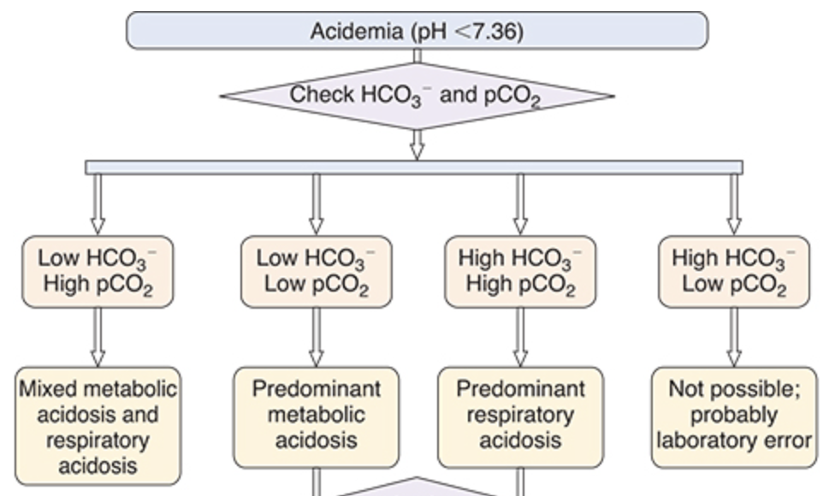
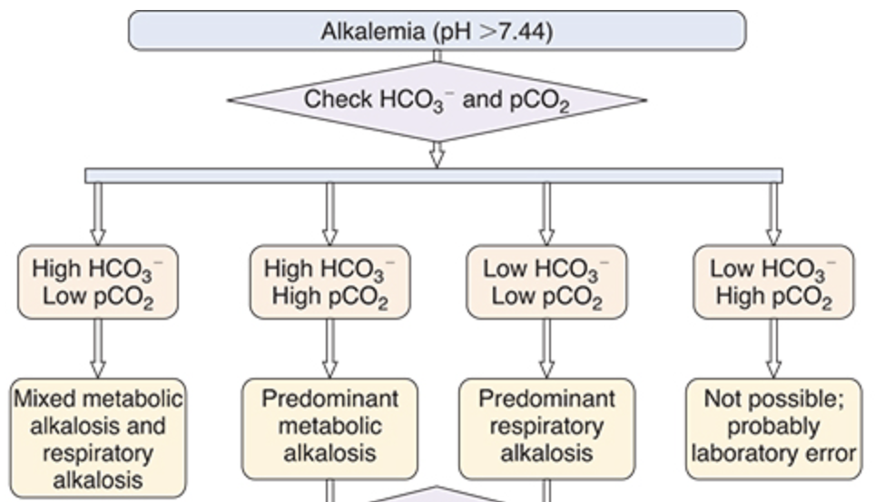
Primary Disturbances
Fig 12.5 (left) and 12.6 (right) Primer 8th ed

Slide 25
Appropriate Compensation

Slide 26
Primary Disorder | pH | Initial Chemical Change | Compensatory Response | Expected Compensation | Complete Adaptive Response
Metabolic Acidosis | Low | ↓ HCO₃- | ↓ pCO₂ | pCO₂ = (1.5 × HCO₃-) + 8 ± 2 pCO₂ = HCO₃- + 15 pCO₂ = decimal digits of pH | 12-24 hrs
Metabolic Alkalosis | High | ↑ HCO₃- | ↑ pCO₂ | pCO₂ = 40 + 0.7x([HCO_{3 measure}] – [HCO_{3 normal}]) pCO₂ = (0.9 × HCO₃-) + 9 pCO₂ = (0.7 × HCO₃-) + 20 | 24-36 hrs
Respiratory Acidosis
Acute | Low | ↑ pCO₂ | ↑ HCO₃- | HCO₃- increases 1 mEq/L for every 10 mm Hg increase in pCO₂ | 2-5 days
Chronic | Low | ↑ pCO₂ | ↑↑ HCO₃- | HCO₃- increases 3 to 4 mEq/L for every 10 mm Hg increase in pCO₂
Respiratory Alkalosis
Acute | High | ↓ pCO₂ | ↓ HCO₃- | HCO₃- decreases 2 mEq/L for every 10 mm Hg decrease in pCO₂ | 2-5 days
Chronic | High | ↓ pCO₂ | ↓ HCO₃- | HCO₃- decreases 5 mEq/L for every 10 mm Hg decrease in pCO₂
Table 12.1: Acid-Base Rules: Changes in pH, pCO₂, and [HCO₃⁻] and Expected Compensatory Responses in Simple Disturbances

Slide 27
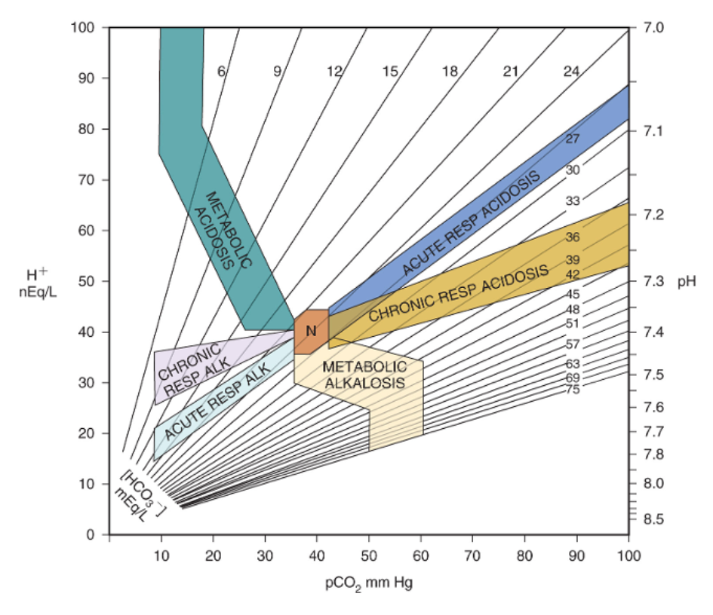
Notes:
The shaded areas represent the 95% confidence limits for zones of compensation for simple acid base disorders. If it falls outside of the shaded areas it is likely a mixed acid base disorder.

Slide 28
The Gaps
Anion Gap
  [Na⁺] – ([Cl⁻] + [HCO₃⁻])
  Normal ~12
  For each 1 g/dL decrease in the serum albumin, the calculated AG should be increased by 2.5 mEq/L
Osmolar Gap
  Measured Serum Osm – Calculate Osmolality
  Calc Osm = 2[Na⁺] + [glucose]/18 + [BUN]/2.8
  Normal < 10

Slide 29
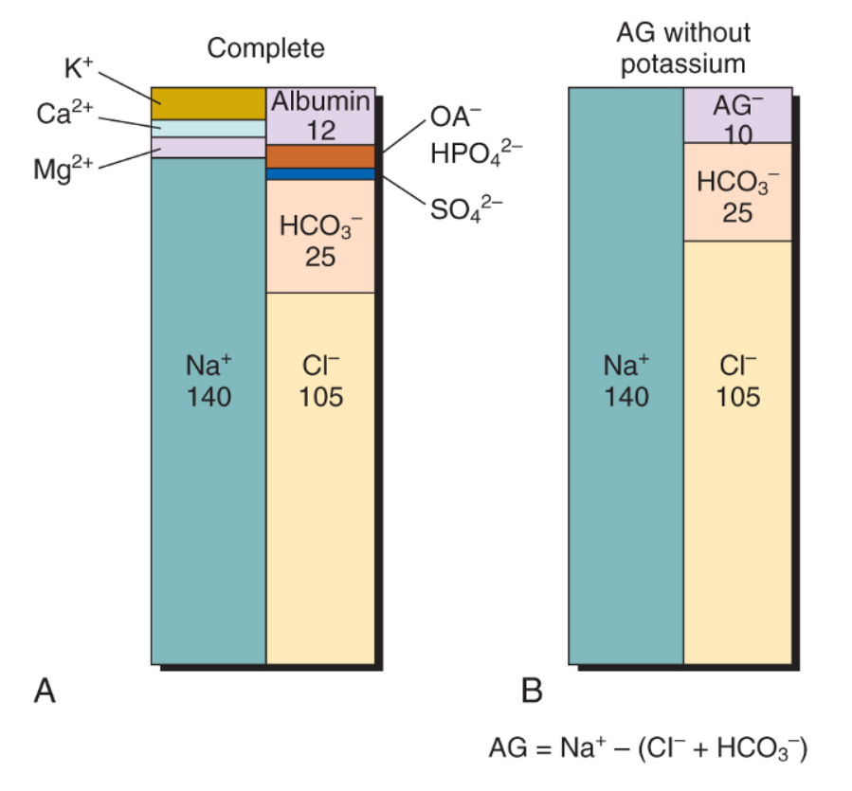
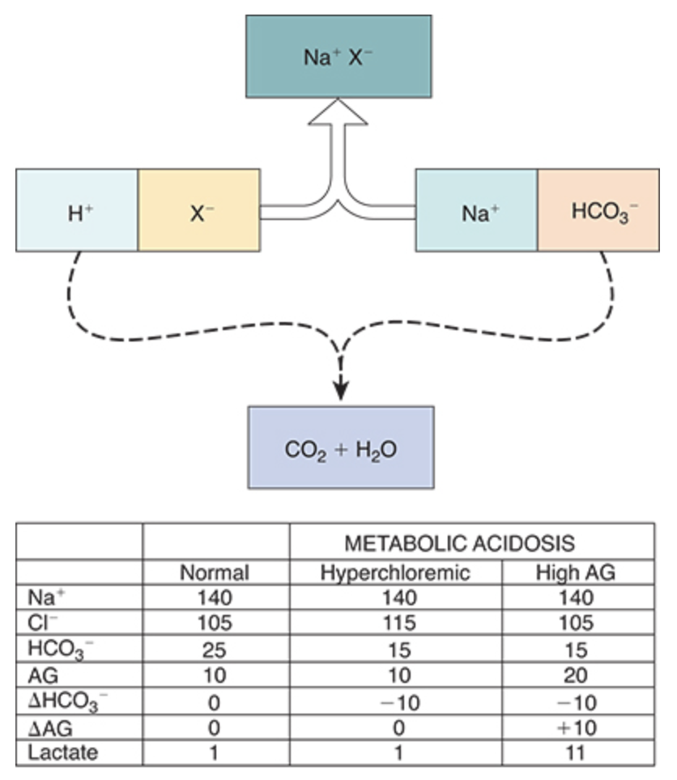
Primer 8th edition
Notes:
Normal AG is primary composed of anionic albumin. To a lesser extent other proteins sulfates phosphates urate and various organic acid anion like lactate. If the concentration of these unmeasured anions increase a rise in anionic gap occurs. The same goes for reduction of albumin leads to a decrease in AG. AG falls about 2.5mEq/L for each 1g/dL reduction of albumin below the normal range.

Slide 30
The Delta/Delta (Δ/Δ)
Δ[AG] = Δ[HCO₃⁻] – pure anion gap acidosis
ΔAG exceeds the fall in [HCO₃⁻]
  Ratio >1
    Lactic Acidosis 1.5, Ketoacidosis 1, All other AGMA – variable
  Presence of an additional disorder that is causing an elevated HCO₃⁻ is suggested:
    Metabolic Alkalosis or Chronic Respiratory Acidosis with compensation
ΔAG less than the fall in [HCO₃⁻]
  Ratio <1
  [Cl⁻] must increase relative to the [Na⁺]
  Presence of an additional disorder that is causing an elevated HCO₃⁻ is suggested:
    NAGMA or Chronic Respiratory Alkalosis with compensation
Primer 8th edition

Slide 31
A 32-year-old man is brought in by paramedics after being found unconscious in the garage at home. Patient is unarousable upon arrival to the emergency department.
Laboratory findings:
Serum chemistry:
Sodium 144 mmol/L
Potassium 3.1 mmol/L
Chloride 101 mmol/L
Total CO2 12 mmol/L
Blood urea nitrogen 9 mg/dL
Creatinine 1.5 mg/dL
Calcium 7.8 mg/dL
Magnesium 1.5 mg/dL
Phosphorus 2.1 mg/dL
Arterial blood gas: pH 7.10, pCO2 40 mm Hg
What acid–base disorders does this patient have?
A. High anion gap metabolic acidosis, metabolic alkalosis, respiratory acidosis
B. High anion gap metabolic acidosis, respiratory acidosis
C. Respiratory alkalosis, high anion gap metabolic acidosis
D. Respiratory alkalosis, high anion gap metabolic acidosis, metabolic alkalosis
Pham and Pham

Slide 32
A 32-year-old man is brought in by paramedics after being found unconscious in the garage at home. Patient is unarousable upon arrival to the emergency department.
Laboratory findings:
Serum chemistry:
Sodium 144 mmol/L
Potassium 3.1 mmol/L
Chloride 101 mmol/L
Total CO2 12 mmol/L
Blood urea nitrogen 9 mg/dL
Creatinine 1.5 mg/dL
Calcium 7.8 mg/dL
Magnesium 1.5 mg/dL
Phosphorus 2.1 mg/dL
Arterial blood gas: pH 7.10, pCO2 40 mm Hg
What acid–base disorders does this patient have?
A. High anion gap metabolic acidosis, metabolic alkalosis, respiratory acidosis
B. High anion gap metabolic acidosis, respiratory acidosis
C. Respiratory alkalosis, high anion gap metabolic acidosis
D. Respiratory alkalosis, high anion gap metabolic acidosis, metabolic alkalosis
Pham and Pham

Slide 33
A. High anion gap metabolic acidosis, metabolic alkalosis, respiratory acidosis
Acid–base disorder determination:
Step 1: Low total CO2 (HCO3−): metabolic acidosis or respiratory alkalosis
Step 2: pH < 7.4 → Metabolic acidosis is more likely.
Step 3: Compensation for metabolic acidosis: For every 1 ↓ in HCO3−, Pco2 ↓ by 1. Since HCO3− ↓ by 12, Pco2 is expected to ↓ by 12 → expected Pco2 = 40 − 12 = 28 ± 3. Since the actual Pco2 is 40, which is much higher than expected, there is also a respiratory acidosis.
Step 4: Check anion gap: 144 − (101 + 12) = 31 (increased anion gap) → 12 normal anion gap + 19 anions → 19 H+, which will consume 19 HCO3−. Expected HCO3− is thus 24 − 19 = 5 ± 2. The actual HCO3− is 12, which is higher than the expected value. There is also a metabolic alkalosis.
Pham and Pham

Slide 34
A 68-year-old man with a history of well-controlled hypertension and benign prostatic hypertrophy presents to the emergency department (ED) with 3 days of fever, dysuria, and weakness and 1 day of rigors. His vital signs are temperature 38.6 C; blood pressure, 90/70 mm Hg; and pulse, 110/min and regular. The physical examination is notable for dry mucous membranes and lethargy. His laboratory values are [Na+], 138 mEq/L; potassium ([K+]), 3.1 mEq/L; [Cl−], 111 mEq/L; [HCO3−], 17 mEq/L; serum urea nitrogen (SUN), 26 mg/dL; creatinine, 1.1 mg/dL; glucose, 126 mg/ 100 mL; albumin, 2.0 g/dL. His arterial blood gas (ABG) values are pH 7.30; pCO2, 32mm Hg; [HCO3−], 15 mEq/L; and pO2, 72mm Hg.
Which of the following acid-base abnormalities exist in this patient?
A. HAGMA with appropriate respiratory compensation
B. Hyperchloremic (normal AG) metabolic acidosis
C. Mixed metabolic acidosis and respiratory alkalosis
D. Metabolic alkalosis and metabolic acidosis
AJKD HAGMA 2021

Slide 35
A 68-year-old man with a history of well-controlled hypertension and benign prostatic hypertrophy presents to the emergency department (ED) with 3 days of fever, dysuria, and weakness and 1 day of rigors. His vital signs are temperature 38.6 C; blood pressure, 90/70 mm Hg; and pulse, 110/min and regular. The physical examination is notable for dry mucous membranes and lethargy. His laboratory values are [Na+], 138 mEq/L; potassium ([K+]), 3.1 mEq/L; [Cl−], 111 mEq/L; [HCO3−], 17 mEq/L; serum urea nitrogen (SUN), 26 mg/dL; creatinine, 1.1 mg/dL; glucose, 126 mg/ 100 mL; albumin, 2.0 g/dL. His arterial blood gas (ABG) values are pH 7.30; pCO2, 32mm Hg; [HCO3−], 15 mEq/L; and pO2, 72mm Hg.
Which of the following acid-base abnormalities exist in this patient?
A. HAGMA with appropriate respiratory compensation
B. Hyperchloremic (normal AG) metabolic acidosis
C. Mixed metabolic acidosis and respiratory alkalosis
D. Metabolic alkalosis and metabolic acidosis
AJKD HAGMA 2021

Slide 36
Metabolic Acidosis

Slide 37
Metabolic Acidosis
Net renal acid excretion is equal to the sum of titratable acid and NH4 minus any secreted HCO3 as a result once kidney function is normal the kidney can accommodate varying levels of acidosis
Thus the etiology of a metabolic acidosis can be divided into four broad categories:
  overproduction of fixed acids
  increased extrarenal loss of base
  decrease in the kidney’s ability to secrete hydrogen ions
  inability of the kidney to reclaim the filtered bicarbonate
Primer 8th edition
Notes:
A high AG can be caused by other things not associated with MA:
Dehydration – leads to increase in albumin and all other fixed acids
Infusion of metabolizable sodium salts like citrate w/o conversion to bicarb by the liver
Infusion of nonmetabolizable sodium salts like in penG
Metabolic acidosis causes an increase in AG in setting of dehydration due to increase in albumin or increase in lactate which can happen in alkalosis
Lab error

Slide 38
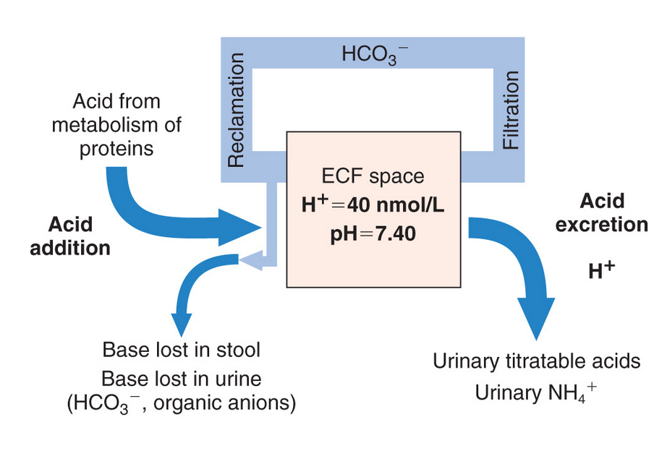
Primer 8th edition
Notes:
Lowest urine pH is 4.5 which is equal to 32mmol/L. Without buffers the patient will need to urinate 3L to get rid of a daily avg acid load.
Urinary phosphate and creatinine help to buffer. This allows the kidney to excrete 40-50% of daily fixed acid load as titratable acids.
The rest is helped by urine acidification.
Net acid excretion = (TA + urine acidification (NH4) – HCO3

Slide 39
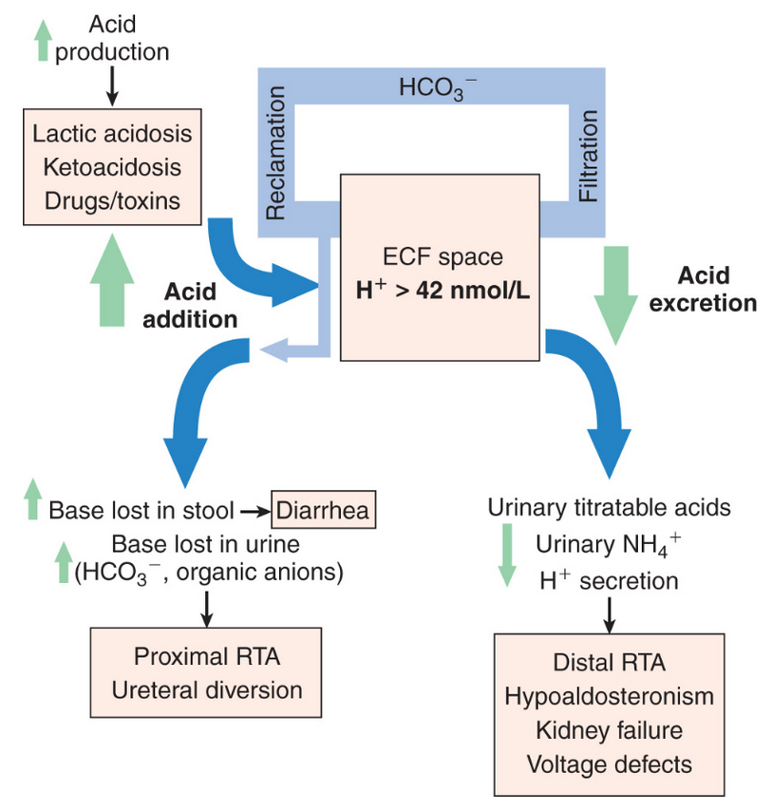
Primer 8th edition

Slide 40
Anion Gap Metabolic Acidosis
M: Methanol
U: Uremia
D: DKA
P: Phenformin, Paraldehyde
I: INH, Iron
L: Lactic Acid
E: Ethanol, Ethylene Glycol
S: Salicylates
G: Glycols
O: Oxoproline (Acetaminophen)
L: L-lactate
D: D-lactate
M: Methanol
A: Aspirin
R: Renal Failure
K: Ketoacidosis

Slide 41
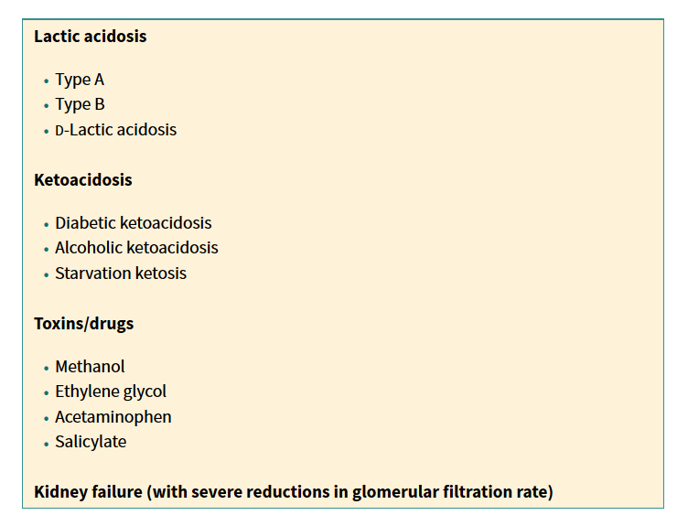
Anion Gap Metabolic Acidosis
Primer 8th edition

Slide 42
Non-Acidotic Rise in Anion Gap
A high AG can be caused by other things not associated with MA:
  Dehydration – leads to increase in albumin and all other fixed acids
  Infusion of metabolizable sodium salts like citrate w/o conversion to bicarb by the liver
  Infusion of nonmetabolizable sodium salts like in PenG
  Metabolic acidosis causes an increase in AG in setting of dehydration due to increase in albumin or increase in lactate which can happen in alkalosis
  Lab error

Slide 43
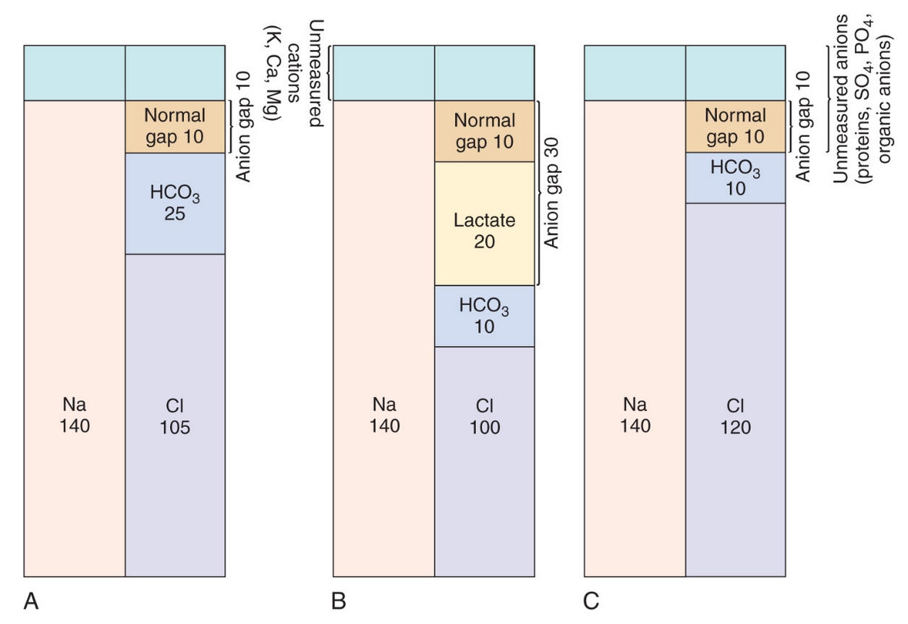
Primer 8th edition

Slide 44
Lactic Acidosis
Anaerobic metabolism of glucose (glycolysis) occurs in the extra-mitochondrial cytoplasm and produces pyruvate as an intermediary.
Pyruvate rapidly undergoes one of two metabolic fates:
  Under anaerobic conditions, because of the high NADH/NAD ratio, pyruvate is quickly reduced by lactate dehydrogenase to lactate, releasing energy, consuming a proton, and decreasing the NADH/NAD ratio, thus allowing for continued glycolysis
  In the presence of oxygen, pyruvate diffuses into the mitochondria and, after oxidation by the pyruvate dehydrogenase (PDH) complex, enters the tricarboxylic acid cycle, where it is completely oxidized to CO₂ and water. Neither of these pathways results in the production of H⁺.
Primer 8th edition

Slide 45
Lactic Acidosis
During glycolysis, glucose metabolism produces two molecules of lactate and two molecules of adenosine triphosphate (ATP). It is the hydrolysis of ATP (ATP = ADP + H⁺ + Pi) that releases protons.
Therefore the acidosis does not occur because of the production of lactate but because under hypoxic conditions the hydrolysis of ATP is greater than ATP production.
Thus the buildup of lactate is a surrogate marker for ATP consumption during hypoxic states.
Primer 8th edition

Slide 46
Lactate A and B
Type A / hypoxic lactic acidosis results from an imbalance between oxygen supply and oxygen demand.
  Low cardiac output, hypotension, severe anemia, carbon monoxide poisoning
Type B lactic acidosis, oxygen delivery is normal but oxidative phosphorylation is impaired.
  This is seen in patients who have inborn errors of metabolism or who have ingested drugs (NRTIs, salicylates, linezolid), toxins (propylene glycol), sepsis, glucose derangements.
Primer 8th edition

Slide 47
Cori Cycle

Slide 48
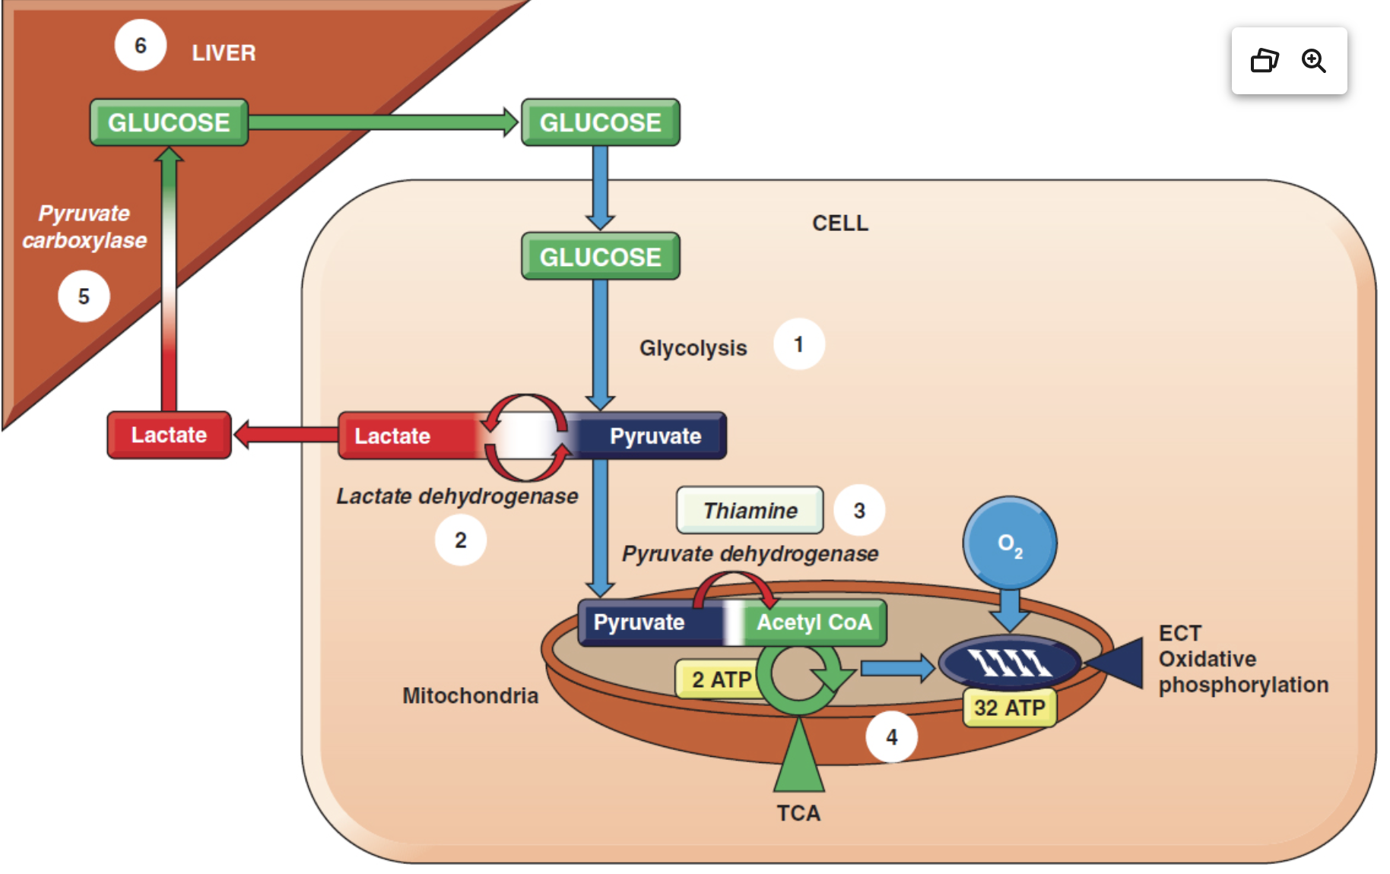
Fig 2.5: Pham, Pham
Notes:
1. Excessive glycolysis (seen in caffeine intoxication with overactive sympathetic nervous system stimulation, high-dose β2-agonist used in the treatment of asthma, pheochromocytoma, metabolically active malignant cells)
2. Lactate dehydrogenase inhibition in the conversion of lactate to pyruvate (isoniazid)
3. Inadequate thiamine (metabolically active malignant cells or severe alcoholism in combination with malnutrition)
4. Drugs/toxins leading to mitochondrial injury and/or oxidative phosphorylation (methanol, propofol, linezolid, salicylate, cyanide, mangostin)
5. Inhibition of pyruvate carboxylase: Metformin is thought to cause lactic acidosis by inhibiting oxidative phosphorylation and pyruvate carboxylase, with the latter blocking the first step of gluconeogenesis.
6. Liver failure can limit gluconeogenesis and cause accumulation of lactic acid (nucleoside reverse transcriptase inhibitors didanosine, stavudine, acute fulminant liver failure).
Abbreviations: ATP, adenosine triphosphate; ECT, electron chain transport; TCA, tricarboxylic acid cycle.

Slide 50
Type A
Anaerobic

Slide 51
Hyperdynamic Stage Sepsis
B Agonist
Pheochromocytoma
Type B
Aerobic
Isoniazid
Metformin
Thiamine
NRTI
Metformin
Linezolid
Propofol

Slide 52
D- Lactate
Unlike the lactate produced by glycolysis in animals, which is the L-isomer, colonic bacteria produce both the L-isomer and the D-isomer.
Risk factors: short-bowel syndrome, high carbohydrate intake and bacterial overgrowth
Mammalian clearance of D-lactate is far less efficient than that of L-lactate
Presentation: mental status changes, ataxia, and nystagmus
Treatment: IV nutrition (bowel rest) and abx to clear GI bacterial overgrowth
Primer 8th edition

Slide 53
Treatment of Lactic Acidosis with Bicarbonate
Increasing pH may actually increase lactic acid production.
The administration of HCO3 can cause a paradoxic decrease in intracellular pH despite an increase in extracellular pH. Bicarbonate combines with hydrogen, forming carbonic acid, which is then converted to CO2 and water.
  pCO2 increases with the titration of acid by bicarbonate and rapidly diffuses into cells, causing acidification, while bicarbonate remains extracellular.
Bicarbonate therapy has been associated with an increase in mortality in treating lactic acidosis w/o resuscitation
Primer 8th edition

Slide 54
Diabetic Ketoacidosis
The lack of insulin leads to an inability of cells to use glucose, causing them to oxidize fatty acids as fuel, producing large amounts of keto acids.
To diagnose DKA
  pH less than 7.35
  elevated AG
  positive serum ketones of at least 1 : 2 dilutions
  decreased serum bicarbonate
Vomiting / dehydration can cause a rise in HCO3 and give a complex acid base status
You may not be able to meet these criteria in our ESRD population
Primer 8th edition

Slide 55
Alcoholic Ketoacidosis
Positive AGMA
Positive osmolar gap
Tx Fomepizole a competitive inhibitor for ADH
Ethylene glycol
  alcohol dehydrogenase into glycolic acid, oxalic acid and lactic acid
  renal failure and AMS
Methanol
  metabolized by alcohol dehydrogenase to formaldehyde and formic acid
  blurry vision to blindness due to optic nerve involvement and pancreatitis
Primer 8th edition
Notes:
Isopropyl alcohol does not cause an elevated anion gap acidosis, retinal toxicity (as does methanol), or renal failure (as does ethylene glycol), although it does increase the osmol gap
It does not cause an anion gap because the active metabolite, acetone, is a terminal ketone in the metabolic pathway and is an uncharged molecule, unlike the active metabolites in other toxic alcohol ingestions
2 to 3 times more potent a central nervous system (CNS) depressant than ethanol leading to prolong sedation or coma. Large ingestions may lead to respiratory arrest, hypotension due to vasodilation, and myocardial suppression

Slide 56
Alcoholic Ketoacidosis
Next lecture
Primer 8th edition
Notes:
Isopropyl alcohol does not cause an elevated anion gap acidosis, retinal toxicity (as does methanol), or renal failure (as does ethylene glycol), although it does increase the osmol gap
It does not cause an anion gap because the active metabolite, acetone, is a terminal ketone in the metabolic pathway and is an uncharged molecule, unlike the active metabolites in other toxic alcohol ingestions
2 to 3 times more potent a central nervous system (CNS) depressant than ethanol leading to prolong sedation or coma. Large ingestions may lead to respiratory arrest, hypotension due to vasodilation, and myocardial suppression

Slide 57
Alcoholic Ketoacidosis
Positive AGMA
Positive osmolar gap
Tx Fomepizole a competitive inhibitor for ADH
Ethylene glycol
  alcohol dehydrogenase into glycolic acid, oxalic acid and lactic acid
  renal failure and AMS
Methanol
  metabolized by alcohol dehydrogenase to formaldehyde and formic acid
  blurry vision to blindness due to optic nerve involvement and pancreatitis
Primer 8th edition
Notes:
Isopropyl alcohol does not cause an elevated anion gap acidosis, retinal toxicity (as does methanol), or renal failure (as does ethylene glycol), although it does increase the osmol gap
It does not cause an anion gap because the active metabolite, acetone, is a terminal ketone in the metabolic pathway and is an uncharged molecule, unlike the active metabolites in other toxic alcohol ingestions
2 to 3 times more potent a central nervous system (CNS) depressant than ethanol leading to prolong sedation or coma. Large ingestions may lead to respiratory arrest, hypotension due to vasodilation, and myocardial suppression

Slide 58
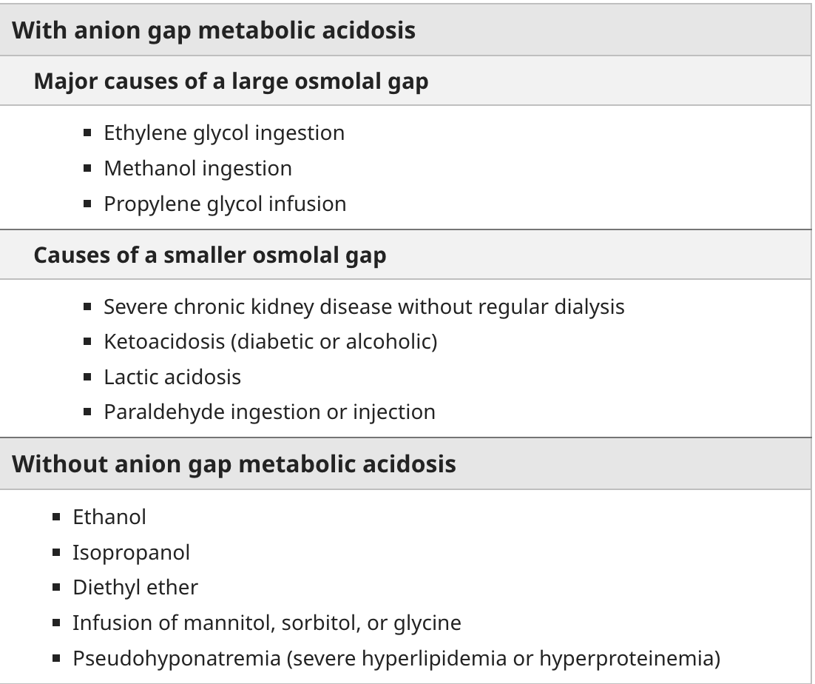
Up-to-date

Slide 59
Salicylate toxicity
Presentation: respiratory alkalosis and metabolic acidosis, agitation, seizures, and even coma
Salicylate is a direct respiratory stimulant
Metabolic acidosis results from the accumulation of both lactic and keto acids.
Primer 8th edition
Notes:
Lactic acidosis type B by impairing oxidative phosphorylation

Slide 60
Pyroglutamic Acidosis
Can occur when underlying infections are treated with acetaminophen, even at therapeutic doses.
Risk factors: malnutrition, renal failure, female sex, sepsis and antibiotic therapy
Glutathione depletion decreases the negative feedback inhibition on γ-glutamylcysteine synthetase, resulting in an increase in pyroglutamic acid (5-oxoproline).
Measurement of urine 5-oxoproline levels will confirm the diagnosis.
Primer 8th edition

Slide 61
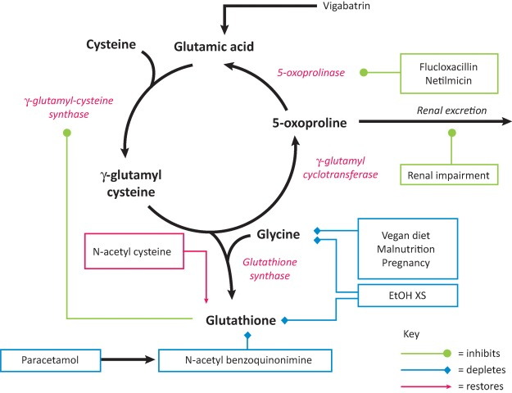
https://www.ncbi.nlm.nih.gov/pmc/articles/PMC6297337/
Notes:
Fig 1. The γ-glutamyl cycle . 5-oxoprolinase operates at low capacity and, therefore, 5-oxoproline will accumulate in the plasma when its rate of production is high. Various factors act to cause accumulation of 5-oxoproline, either by depleting glutathione (blue boxes) or by inhibiting the clearance of 5-oxoproline by 5-oxoprolinase or its renal excretion (green boxes). Enzymes are shown in red italics. EtOH XS = excessive intake of ethanol. Adapted from Humphreys et al . 9

Slide 62
A 47-year-old man with a history of metastatic colorectal carcinoma and alcohol abuse was admitted to the emergency department following a fall. Fourteen hours following admission, he developed a generalized tonic–clonic seizure requiring the administration of lorazepam bolus followed by a continuous infusion of 2 mg/h. He was intubated and required continuing lorazepam support up to 50 mg/h over the next 3 days. Over this time period, he became more and more hypotensive requiring the addition of two vasopressors. Laboratory findings revealed worsening metabolic acidosis with pH and lactic acid level at 7.0 and 14.7 mmol/L respectively. His liver function test was notable for marked transaminitis. He was placed on linezolid and ertapenem pending full infectious evaluation.
Which one(s) of the following may contribute to this patient’s lactic acidosis?
A. Metastatic colorectal carcinoma
B. Propylene glycol mixed in lorazepam
C. Liver failure
D. Linezolid
E. All of the above
Pham and Pham

Slide 63
A 47-year-old man with a history of metastatic colorectal carcinoma and alcohol abuse was admitted to the emergency department following a fall. Fourteen hours following admission, he developed a generalized tonic–clonic seizure requiring the administration of lorazepam bolus followed by a continuous infusion of 2 mg/h. He was intubated and required continuing lorazepam support up to 50 mg/h over the next 3 days. Over this time period, he became more and more hypotensive requiring the addition of two vasopressors. Laboratory findings revealed worsening metabolic acidosis with pH and lactic acid level at 7.0 and 14.7 mmol/L respectively. His liver function test was notable for marked transaminitis. He was placed on linezolid and ertapenem pending full infectious evaluation.
Which one(s) of the following may contribute to this patient’s lactic acidosis?
A. Metastatic colorectal carcinoma
B. Propylene glycol mixed in lorazepam
C. Liver failure
D. Linezolid
E. All of the above
Pham and Pham

Slide 64
E. All of the above
Patient likely has both types A and B lactic acidosis. All of the conditions listed may contribute to type B lactic acidosis. Recall etiologies of type B lactic acidosis include:
Excessive glycolysis (seen in caffeine intoxication with overactive sympathetic nervous system stimulation, high-dose β2-agonist used in the treatment of asthma, pheochromocytoma, metabolically active malignant cells)
Lactate dehydrogenase inhibition in the conversion of lactate to pyruvate (isoniazid)
Inadequate thiamine (metabolically active malignant cells or severe alcoholism in combination with malnutrition)
Drugs/toxins leading to mitochondrial injury and/or oxidative phosphorylation (methanol, propofol, linezolid, salicylate, cyanide, mangostin)
Inhibition of pyruvate carboxylase: Metformin is thought to cause lactic acidosis by inhibiting oxidative phosphorylation and pyruvate carboxylase, which blocks the first step of gluconeogenesis.
Liver failure can limit gluconeogenesis and cause accumulation of lactic acid (nucleoside reverse transcriptase inhibitors didanosine, stavudine, acute fulminant liver failure).
Propylene glycol may be converted to lactic acid in a multistep process involving alcohol dehydrogenase and aldehyde dehydrogenase.

Slide 65
A 25-year-old man with a 10-year history of type 1 diabetes mellitus becomes anorexic after developing gastroenteritis and reducing his insulin dose. He then develops nausea, vomiting, polyuria, and dyspnea and presents to the ED. The patient also has a long history of depression and is taking fluoxetine. He has orthostatic hypotension. His breath has a fruity odor. The initial laboratory studies reveal SUN, 40 mg/dL; creatinine, 1.5 mg/dL; glucose, 800 mg/100 mL; [Na+], 120 mEq/L; [Cl−], 75 mEq/L; [HCO3−], 12mEq/L; K+, 3.0 mEq/L; ([AG], 32 mEq/L); and albumin, 4.0 g/100 mL. The measured osmolality is 330 mOsm/L; serum β-hydroxybutyrate, >8 mEq/L; and urine ketones, 3+ by dipstick. Blood ethanol level is nondetectable. ABG values are pH 7.16; PO2, 90 mm Hg; pCO2, 35 mm Hg; and [HCO3−], 12 mEq/L.
What is his acid-base disorder?
A. HAGMA due to diabetic ketoacidosis (DKA)
B. HAGMA due to DKA and metabolic alkalosis
C. HAGMA due to DKA, metabolic alkalosis, and respiratory acidosis
D. HAGMA due to DKA and hyperchloremic acidosis
AJKD HAGMA 2021

Slide 66
A 25-year-old man with a 10-year history of type 1 diabetes mellitus becomes anorexic after developing gastroenteritis and reducing his insulin dose. He then develops nausea, vomiting, polyuria, and dyspnea and presents to the ED. The patient also has a long history of depression and is taking fluoxetine. He has orthostatic hypotension. His breath has a fruity odor. The initial laboratory studies reveal SUN, 40 mg/dL; creatinine, 1.5 mg/dL; glucose, 800 mg/100 mL; [Na+], 120 mEq/L; [Cl−], 75 mEq/L; [HCO3−], 12mEq/L; K+, 3.0 mEq/L; ([AG], 32 mEq/L); and albumin, 4.0 g/100 mL. The measured osmolality is 330 mOsm/L; serum β-hydroxybutyrate, >8 mEq/L; and urine ketones, 3+ by dipstick. Blood ethanol level is nondetectable. ABG values are pH 7.16; PO2, 90 mm Hg; pCO2, 35 mm Hg; and [HCO3−], 12 mEq/L.
What is his acid-base disorder?
A. HAGMA due to diabetic ketoacidosis (DKA)
B. HAGMA due to DKA and metabolic alkalosis
C. HAGMA due to DKA, metabolic alkalosis, and respiratory acidosis
D. HAGMA due to DKA and hyperchloremic acidosis
AJKD HAGMA 2021

Slide 67
A 63-year-old man with T2DM, stage 3 CKD creatinine 1.6 mg/dl, and COPD was brought to the ED for confusion and poor appetite. He was working on his car in the garage prior to this episode.
Medications: glipizide, lisinopril, metformin, thiazide.
Exam: BP=104/58, P=112, R=18, T=97. The patient was confused, lungs had wheezes, heart was tachycardic.
Labs: Na+ 128; K+ 6.1; Cl- 105; HCO3 6; BUN 43 mg/dl; Cr 3.1 mg/dl; glucose 298 mg/dl; albumin 3.6 g/dl.
ABG - pH 7.06 / pCO2 22 / PO2 86 / [HCO3] 6
Ketones neg
Tox screen (pending)

Slide 68
Which is the most likely cause of this clinical and laboratory presentation?
A. Salicylate ingestion
B. Metformin
C. Toluene ingestion
D. Diethylene glycol ingestion
E. d-lactic acidosis

Slide 69
What is the acid-base disturbance in this case?
A. High-anion gap metabolic acidosis and respiratory alkalosis
B. High-anion gap metabolic acidosis and respiratory acidosis
C. Mixed (AG&NAG) metabolic acidosis and respiratory acidosis
D. High-anion gap metabolic acidosis with metabolic alkalosis and respiratory acidosis
E. Mixed (AG&NAG) metabolic acidosis and respiratory alkalosis

Slide 70
Resources
NKF Primer 8th ed
Burton Rose – Clinical Physiology of Acid-Base and Electrolyte
Pham and Pham Nephrology and Hypertension Board Review
Physiologic approach to Acid-Base (NEJM 2014)
AJKD Core Curriculum: HAGMA
BRCU

Slide 71
To Be Continued

