Slide 1

If You In-Cyst
Jacob Nysather D.O.

Slide 2

Disclosures
No disclosures

Slide 3
Objectives
Review historical progression of ADPKD
Examine current therapeutic options and their impact on disease progression
Analyze active trials and future direction of ADPKD management.

Slide 4
NOT included
Extra-renal manifestations

Slide 5
53 year old male of Slavic origin with no known past medical history. He presents with fatigue and general weakness of 2 days duration. Of note he had a sudden onset of fatigue and severe chest pain that spontaneously resolves after a hunting trip 2 days ago.
He has a family history of a father and 2 brothers with significant gout. Both brother died before the age of 50.

Slide 6
His symptoms continued to progress in severity over the next few days. With generalized weakness, falling down, and transient loss of consciousness. Subsequently developing shortness of breath, general shivering, pale facial color with diaphoresis and weak/irregular heart beats.
He ultimately passed away 9 days after symptom onset

Slide 7


Stefan Bathory
King of Poland, prince of Transylvania
Passed away in 1586
Discrasia frigate – hypothermia, overexposure to cold
Meningeal abscess - cooling agents to treat
“large like those of a bull, with an uneven and bumpy surface”
Scholars revisit cause of death 347 years later in 1933 PKD and uremia
First known patient suspected of PCKD

Slide 8
Era of Medicine
Early descriptions of polycystic kidney disease are difficult to trace with confidence.
Theories of the origin of human disease which were prevalent in antiquity and in the middle ages, reluctance to perform autopsies for social and religious reasons and to the inability to tell the condition apart from the common cystic hydatid disease.
Ancient Greek concepts dominated for nearly 18 centuries with disease explained through humours.
Disease resulted from disturbed proportions or qualities of the fluid components of the body. Solid organs and anatomical structures were not thought to play an important role.

Slide 9
Era of Medicine
Hydatid disease was commonly prevalent in the middle ages of liver and kidneys in medical work and non-medical of the 12th century
The humoral theory of disease continued to influence scholars well into the 16th - 17th century but concept of illness gradually changed with direct changes in the structure of solid organs primarily in Italy which began to change the attitude of church toward autopsies.
Large compilation of anatomy and pathology published in 1679 showing examples of cystic kidney disease.
Despite autopsies showing, it was not recognized as a clinicopathological entity.

Slide 10
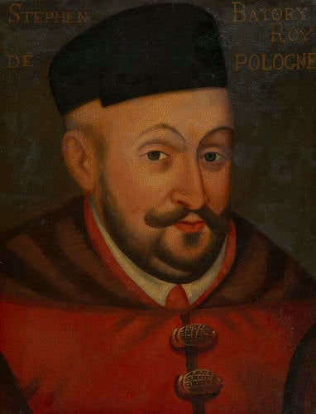
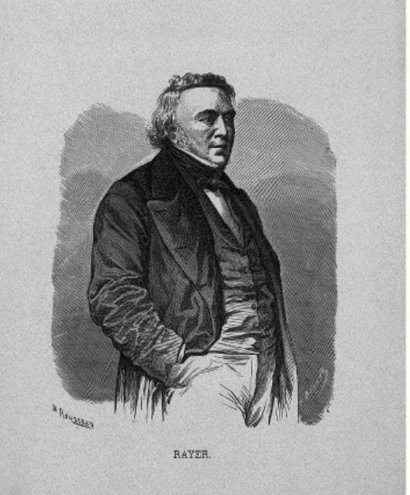
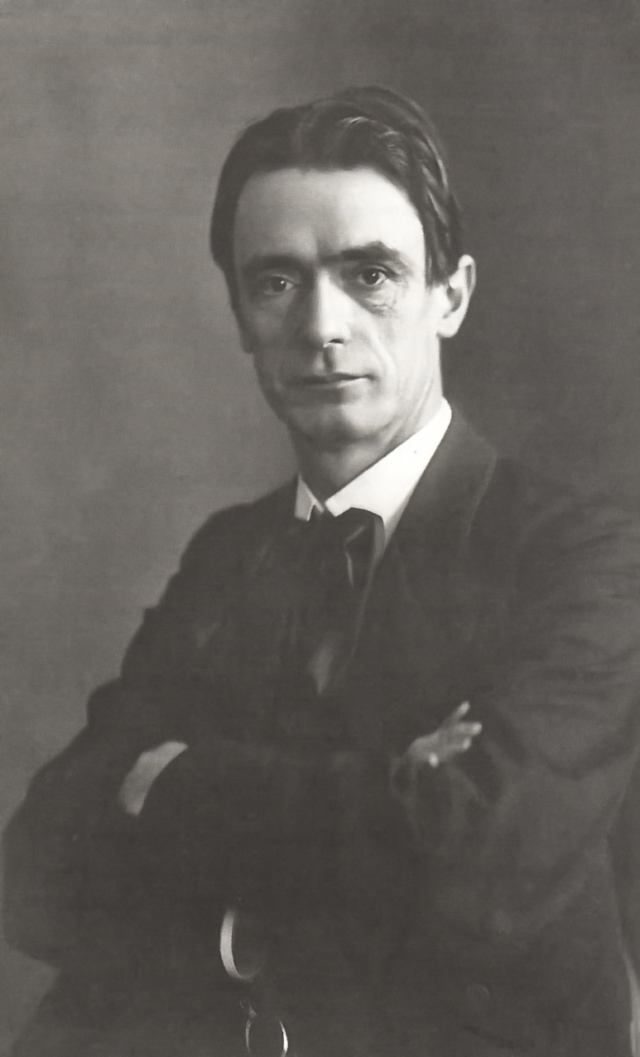
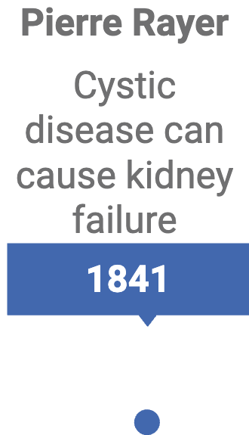
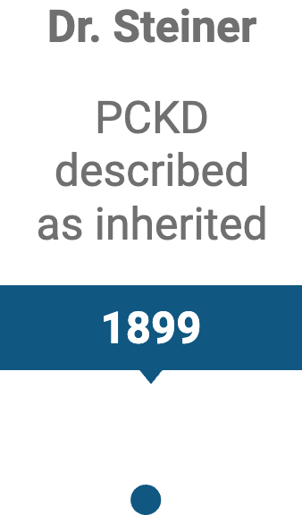






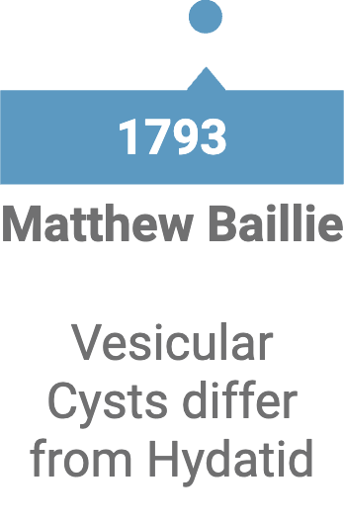
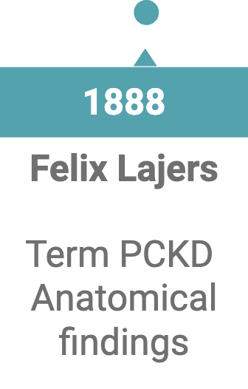
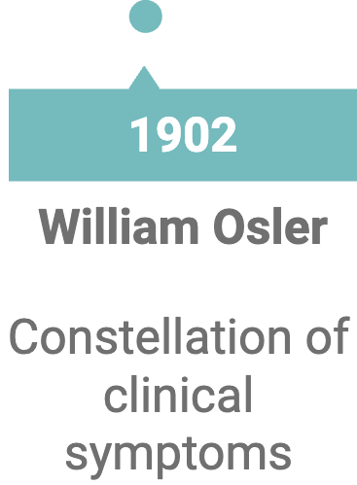


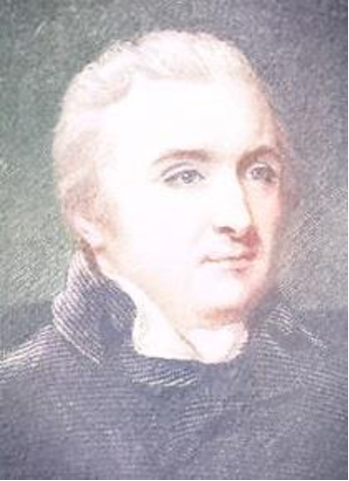

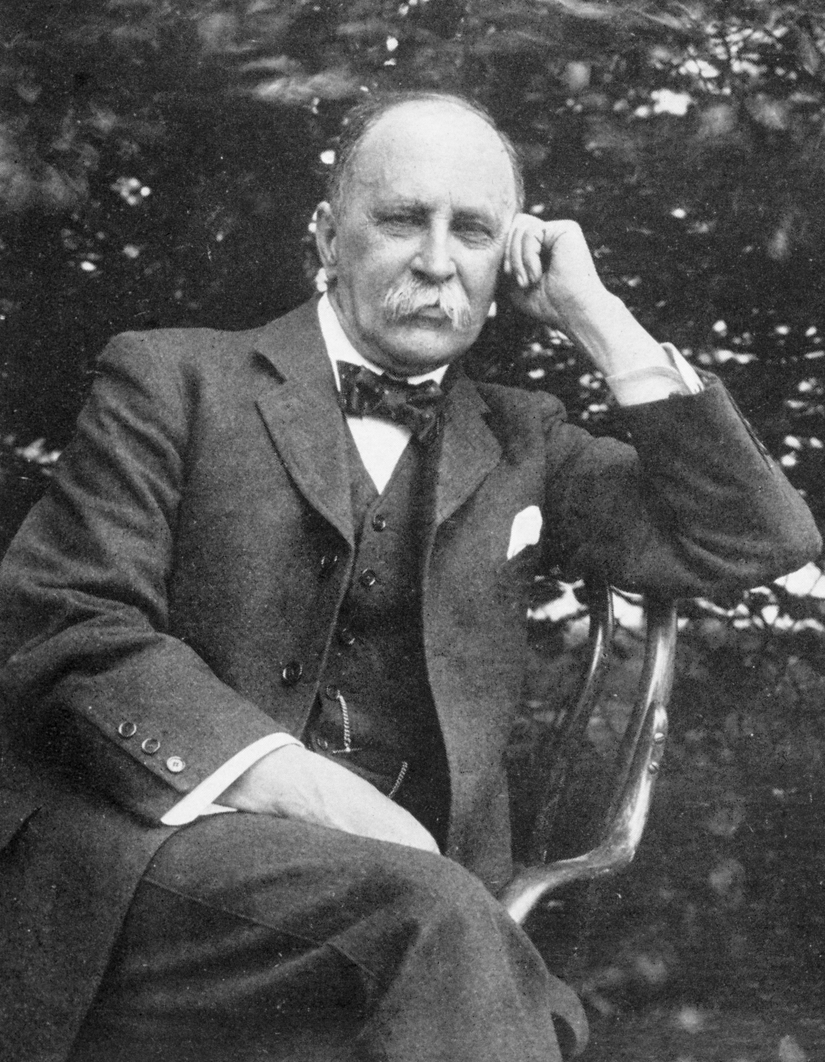
Historical Discovery of ADPKD
Concepts of disease: obstruction, neoplasia, or developmental abnormality
Stefan Bathory
1st PKD Case
Dr. Hughes
Dr. Mochizuki
PKD1/PKD2 genes

Slide 11
18th Century
1793 - Dr. Matthew Baillie
  Distinction between Vesicular cysts in the kidney different from hydatid cysts and described as “false hydatids of the kidney:

Slide 12
19th Century
1841 - Pierre Rayer
  Teardrops of the kidney, cystic degeneration of the kidneys as a cuase of renal failure
  “there are cases where both kidneys are affected by a true generalized cyst degeneration of the cortical substance, which in some cases may be of such a degree that only trances of renal substances are left”
1888 – Felix Lejars
  Doctoral thesis who formally coined the term polycystic kidneys with stress on these cysts were bilateral in nature
  Not just an anatomo-pathological condition but clinical identifiable symptoms and suspected to be clinically diagnosed
1899 – Dr. Rudolf Steiner
  Concept that cystic kidney disease can be inherited

Slide 13
20th Century
1902 - William Osler
  Bilateral tumours in the flanks, cardiovascular changes of interstitial nephritis, condition of the urine, and haematuria
1957 – Dr. Dalgaard
  AD inheritance pattern
  Epidemiology of disease
1994-96 – Dr. Hughes and Dr. Mochizuki
  PKD1/PKD2 genes

Slide 14
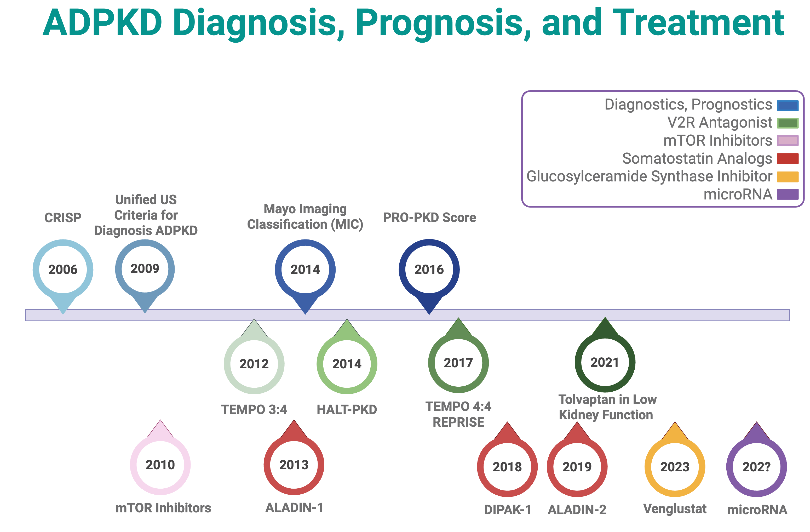

Slide 15
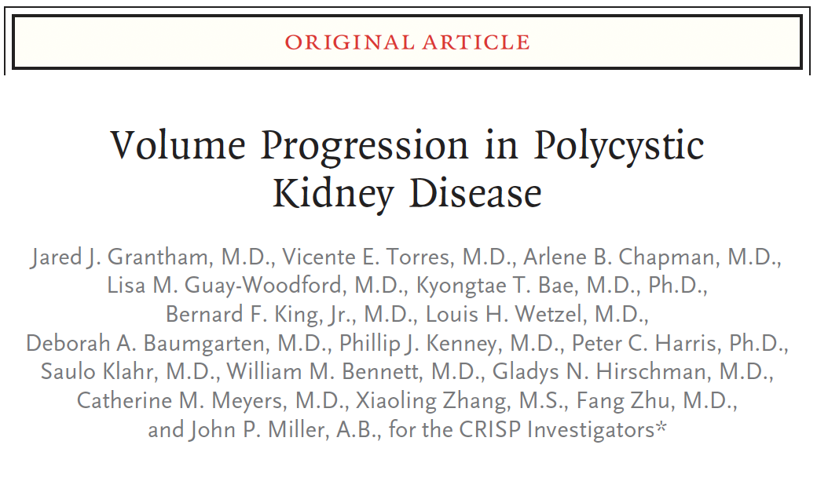
CRISP
15-45 y/o old (145 women, 96 men)
Creatinine clearance >70 ml/min
Creatinine <1.6 men, or <1.4 women
2/3 of patients were considered high risk for progression: HTN before age 35, ADPKD dx <1yr old, proteinuria >300 mg/day, gross hematuria in man <30 y/o
Low risk: >35 yr, no risk factors
135 patients with PKD1, 28 patients with PKD2 variants
Notes:
Total kidney volume (TKV) incorporates all of the aforementioned clinical and genetic risk factors and is the strongest predictor of future GFR loss.
In the Consortium for Radiologic Imaging in the Study of Polycystic Kidney Disease (CRISP), a large multicenter study of 241 ADPKD patients with intact kidney function, patients were followed prospectively with serial MRIs and demonstrated a 5.2%/year increase in TKV.
More recently, data from the CRISP study showed that height-adjusted total kidney volume (HtTKV) of greater than 600 mL/m accurately predicts progression to CKD stage 3 within 8 years. For each 100 mL/m change in HtTKV, there was a 48% relative risk of reaching CKD stage 3. Therefore, TKV is a good predictive biomarker for the development of future GFR loss, with potential application for risk stratification in clinical practice.

Slide 16
CRISP
Kidney Volumes correlate with disease progression
In the Consortium for Radiologic Imaging in the Study of Polycystic Kidney Disease (CRISP), a large multicenter study of 241 ADPKD patients with intact kidney function, patients were followed prospectively with serial MRIs and demonstrated a 5.2%/year increase in TKV.
More recently, data from the CRISP study showed that height-adjusted total kidney volume (HtTKV) of greater than 600 mL/m accurately predicts progression to CKD stage 3 within 8 years. For each 100 mL/m change in HtTKV, there was a 48% relative risk of reaching CKD stage 3. Therefore, TKV is a good predictive biomarker for the development of future GFR loss, with potential application for risk stratification in clinical practice.
Notes:
Total kidney volume (TKV) incorporates all of the aforementioned clinical and genetic risk factors and is the strongest predictor of future GFR loss.
In the Consortium for Radiologic Imaging in the Study of Polycystic Kidney Disease (CRISP), a large multicenter study of 241 ADPKD patients with intact kidney function, patients were followed prospectively with serial MRIs and demonstrated a 5.2%/year increase in TKV.
More recently, data from the CRISP study showed that height-adjusted total kidney volume (HtTKV) of greater than 600 mL/m accurately predicts progression to CKD stage 3 within 8 years. For each 100 mL/m change in HtTKV, there was a 48% relative risk of reaching CKD stage 3. Therefore, TKV is a good predictive biomarker for the development of future GFR loss, with potential application for risk stratification in clinical practice.

Slide 17
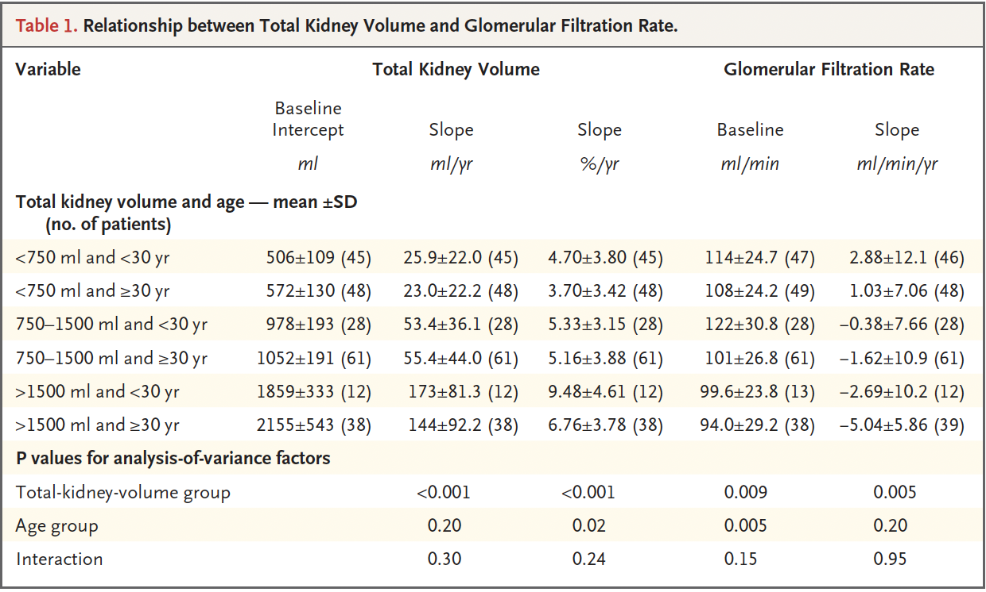
CRISP
Grantham, Jj. et al., CJASN 2006
Notes:
Total kidney volume (TKV) incorporates all of the aforementioned clinical and genetic risk factors and is the strongest predictor of future GFR loss.
In the Consortium for Radiologic Imaging in the Study of Polycystic Kidney Disease (CRISP), a large multicenter study of 241 ADPKD patients with intact kidney function, patients were followed prospectively with serial MRIs and demonstrated a 5.2%/year increase in TKV.
More recently, data from the CRISP study showed that height-adjusted total kidney volume (HtTKV) of greater than 600 mL/m accurately predicts progression to CKD stage 3 within 8 years. For each 100 mL/m change in HtTKV, there was a 48% relative risk of reaching CKD stage 3. Therefore, TKV is a good predictive biomarker for the development of future GFR loss, with potential application for risk stratification in clinical practice.

Slide 18
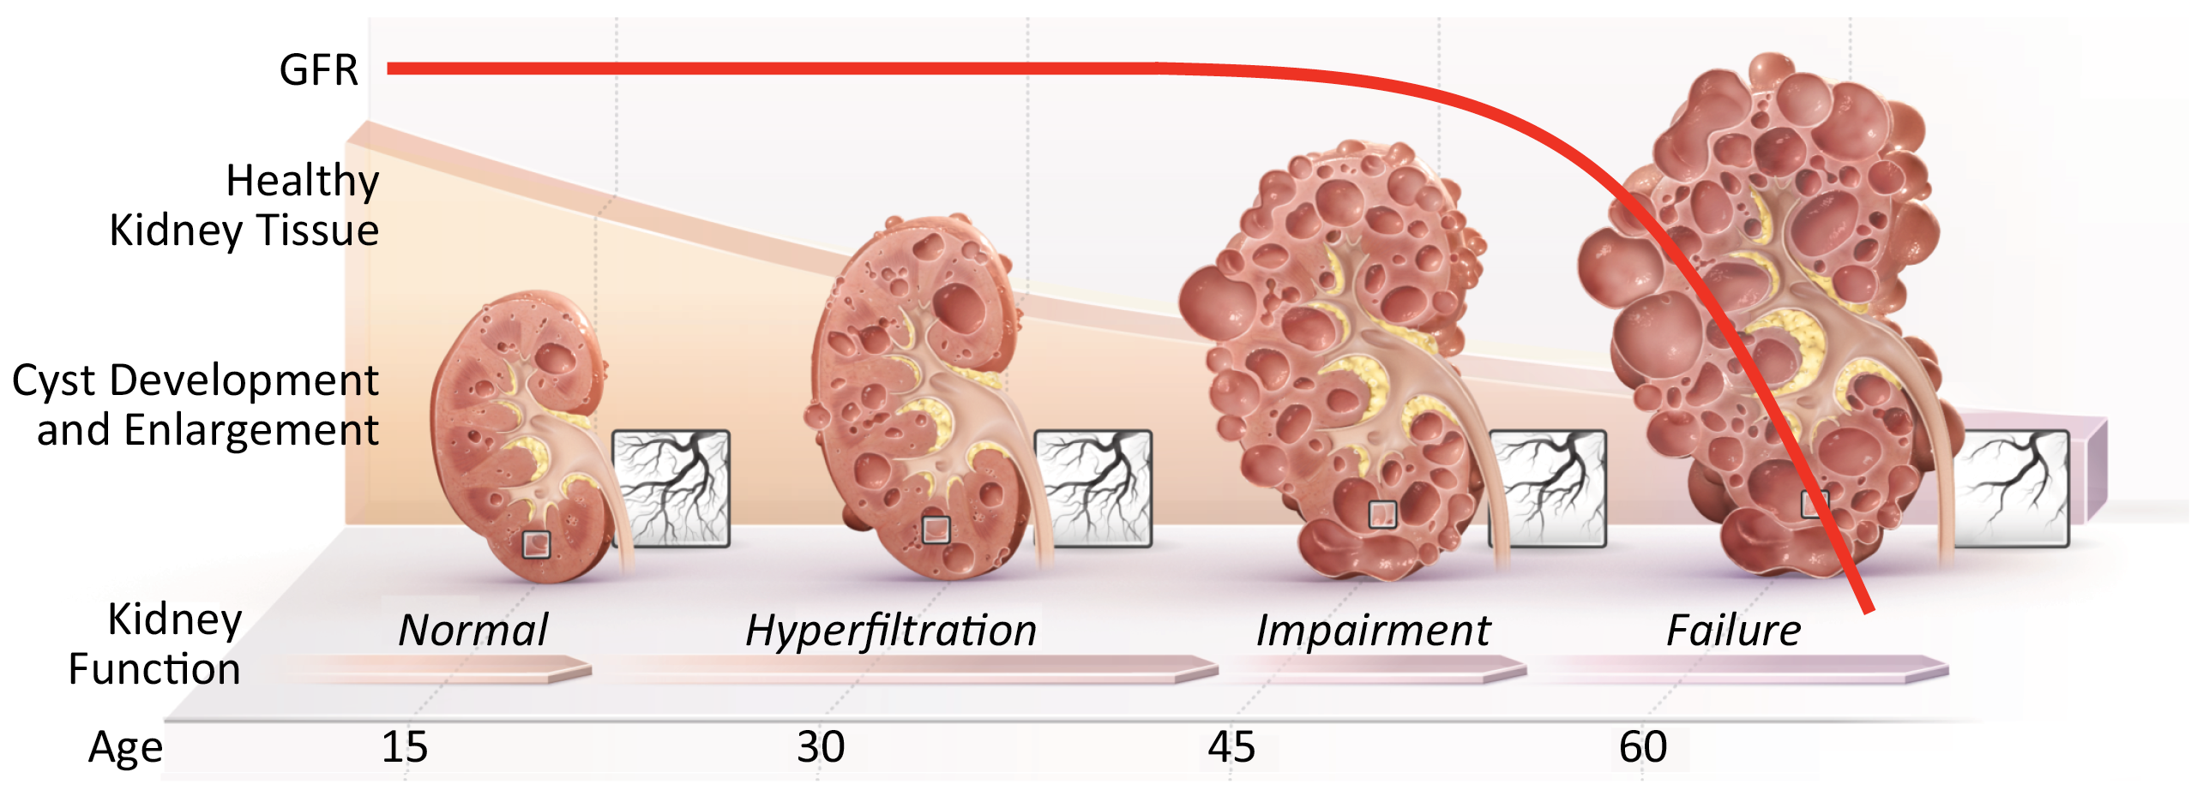
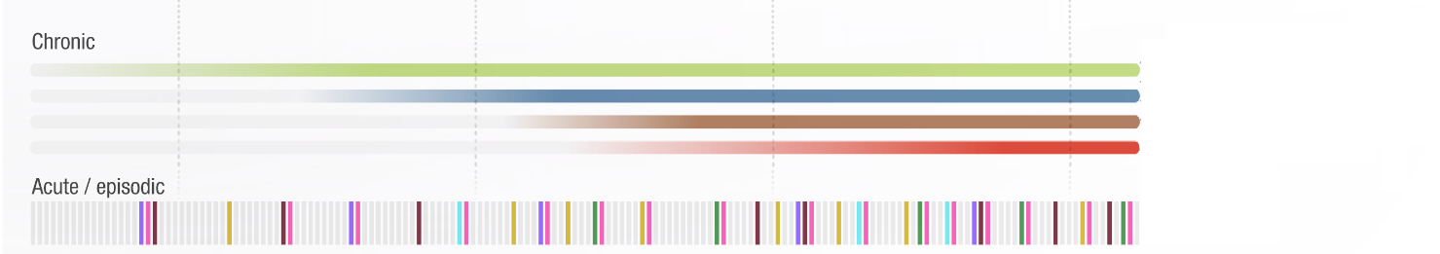
CRISP
Concentrating Defects
Hypertension
Dull Pain & Discomfort
Proteinuria
Adapted from Grantham JJ, et al. N Eng J Med 2006; 354(20):2122-30.

Slide 20
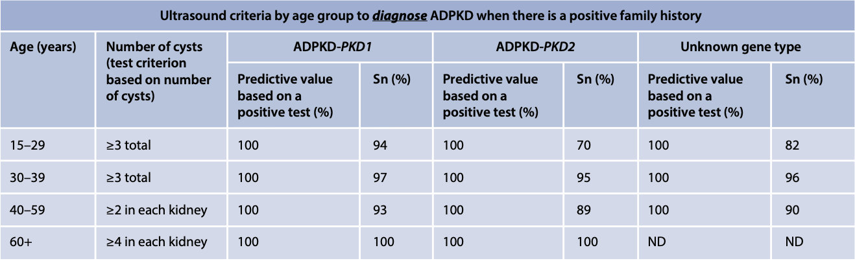
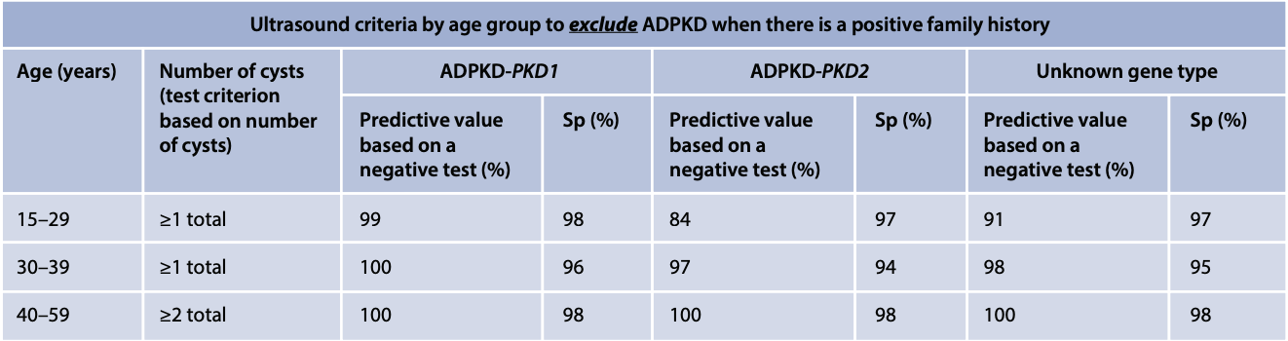
Diagnosis: US Criteria
ADPKD Guidelines. KDIGO. 2025

Slide 22
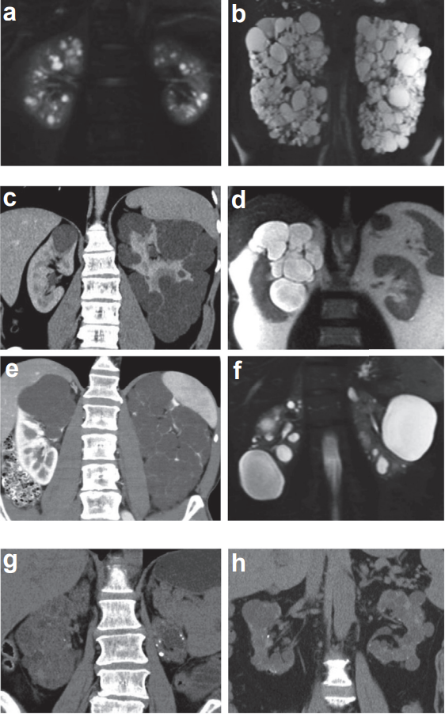
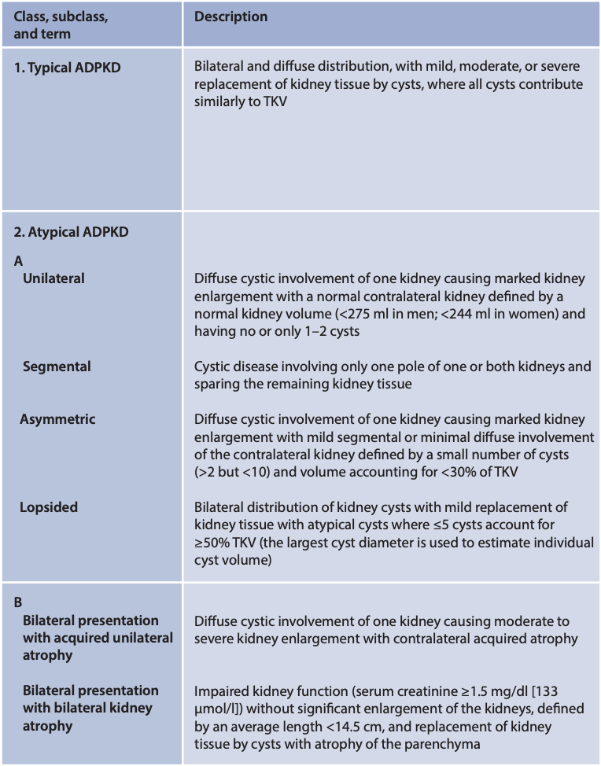
Typical vs. Atypical
ADPKD Guidelines. KDIGO. 2025
Notes:
Figure 4 | Mayo Image Classification (MIC) and prognostic of autosomal dominant polycystic kidney disease (ADPKD). TKV, total kidney volume. Top: Principles of the MIC of (left panel) ADPKD, with examples (right panel) of MIC subclass (a) 1A and (b) 1E for typical ADPKD; and (c–f) MIC subclass 2A and (g,h) MIC subclass 2B for atypical ADPKD. Only the classification of typical ADPKD (subclass 1) has prognostic value.

Slide 23
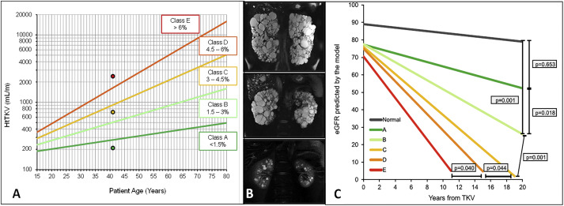
Mayo Imaging Classification (MIC)
-4.78
-3.48
-2.63
-1.33
-0.23
Irazabal ,MV, et. Al, JASN 2014
Chebib, FT., et. Al., AJKD. 2016

Slide 25
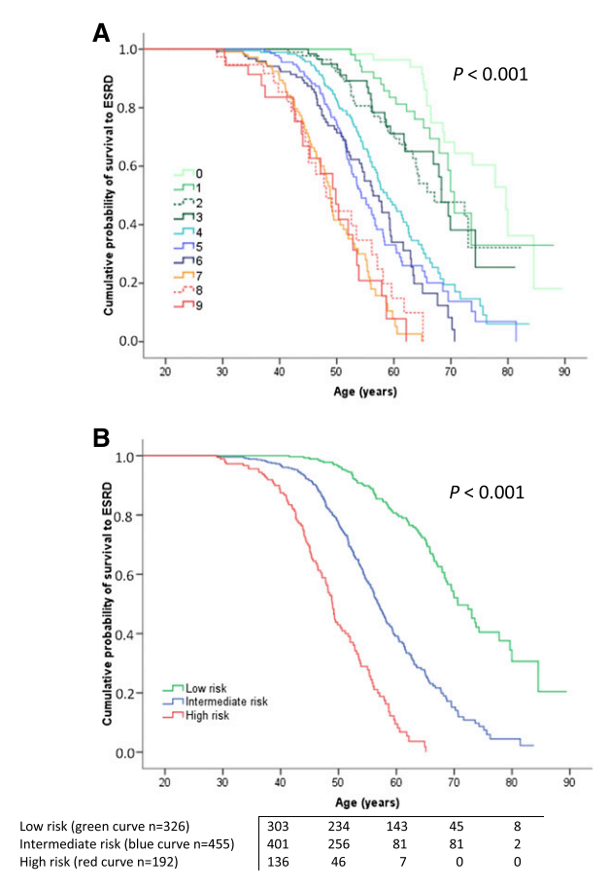
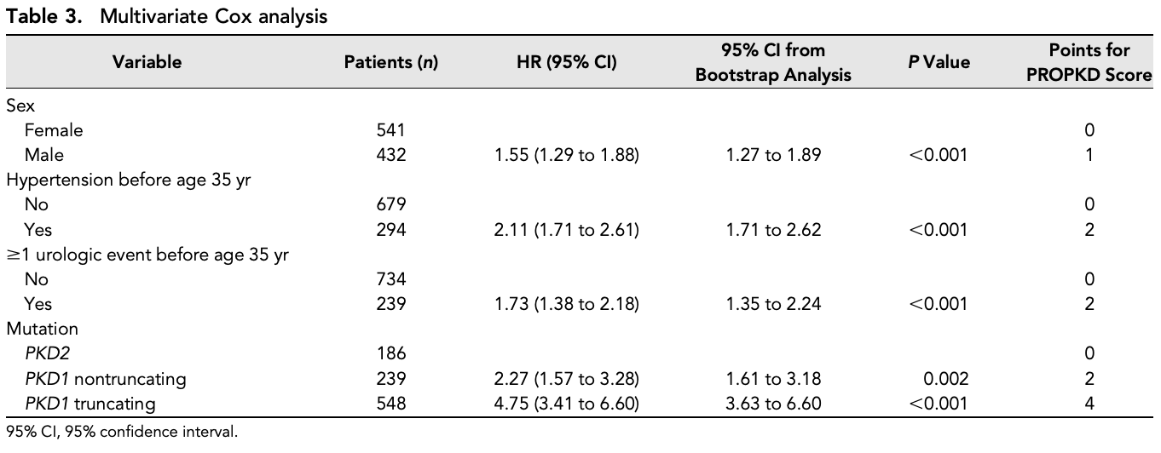
PRO-PKD Score
Cornec-Le Gall, et al. JASN. 2016
Notes:
PROPKD score (ranging from 0–9) is another validated prognostication tool for ADPKD that combines clinical parameters (sex, presence of hypertension before 35 years of age, occurrence of the first urologic event before 35 years of age) with genetic information (PKD1 versus PKD2 mutation, and truncating versus nontruncating PKD1 mutation). The PROPKD score categorizes patients into low risk (0 to 3 points), intermediate risk (4 to 6 points), and high risk (7 to 9 points) for progression to ESKD, with corresponding median ages for ESKD onset of 70.6, 56.9, and 49 years. This scoring system is limited in that individuals less than 35 years of age cannot be fully scored and genetic testing is required. It is currently unknown if the PROPKD score functions independently of HtTKV in prognostication as age of onset of complications are tightly linked to cyst burden or HtTKV.

Slide 26
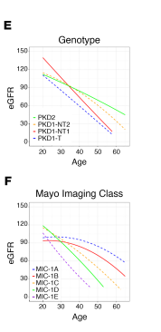
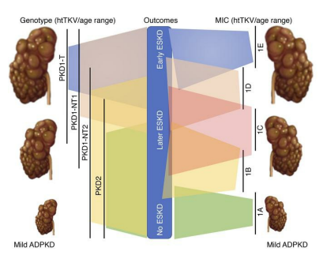
Genotyping and Imaging in ADPKD
Lavu, JCI insight, 2020

Slide 27
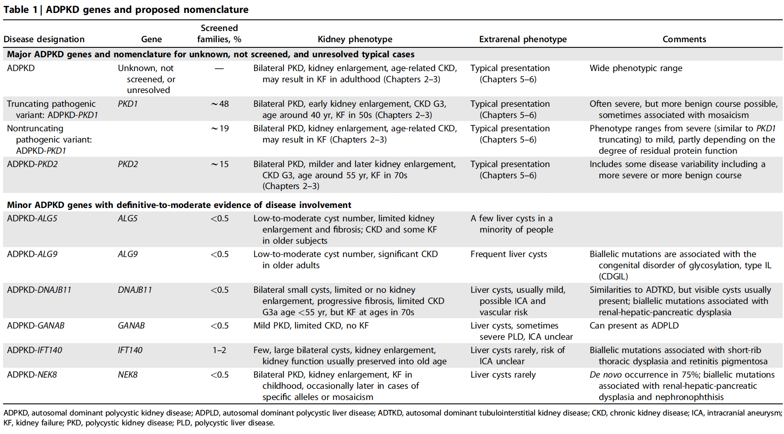
ADPKD Guidelines. KDIGO. 2025

Slide 29
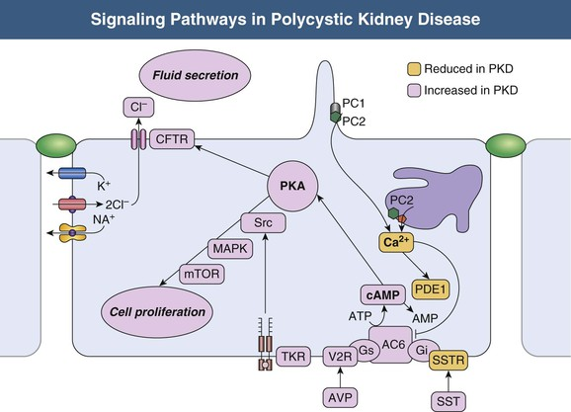
Notes:
PC1 is located in the primary cilium, focal adhesions, tight junctions, desmosomes, and adherens junctions. PC1 plays an important role in cell-cell interactions and cell-matrix interactions.
It localizes to the endoplasmic reticulum, plasma membrane, primary cilium, centrosome, and mitotic spindles in dividing cells. PC2 belongs to the family of voltage-activated calcium channels (e.g., transient receptor potential polycystin-2 [TRPP-2]) and is involved in intracellular calcium regulation through several pathways
PC1 and PC2 are co-localized in the primary cilium of renal epithelial cells, which function as a mechanosensor. Primary cilia create transmembrane calcium currents in the presence of stretch or luminal flow. PC1 and PC2 contribute to ciliary function, and the physical interaction between PC1 and PC2 is required for a membrane calcium channel to operate properly. Normal polycystin function increases intracellular calcium, which initiates a signaling cascade leading to vesicle fusion and a change in gene transcription. The magnitude of these changes contributing to the PKD epithelial phenotype has recently been challenged because the reservoir of calcium released from primary ciliary stimulation is relatively low.
Polycystins affect cell proliferation, differentiation, and fluid secretion through G-coupled protein receptors and JAK-STAT-mediated signaling pathways. The interaction of PC1 ligand on the basolateral surface with adenylate cyclase and the G protein–coupled response of adenylate cyclase to binding of vasopressin to the vasopressin V2 receptor produces similar results. Both result in increased intracellular concentrations of cyclic adenosine monophosphate (cAMP) and, ultimately, in chloride secretion across the luminal membrane. This chloride-rich fluid secretion is a critical component of cystogenesis, enabling expansion of cysts even after they detach from their parent nephron. The accumulation of cyst fluid, rich in chloride and sodium, relies on the active luminal excretion of chloride primarily through the cystic fibrosis transmembrane conductor regulator (CFTR)

Slide 30
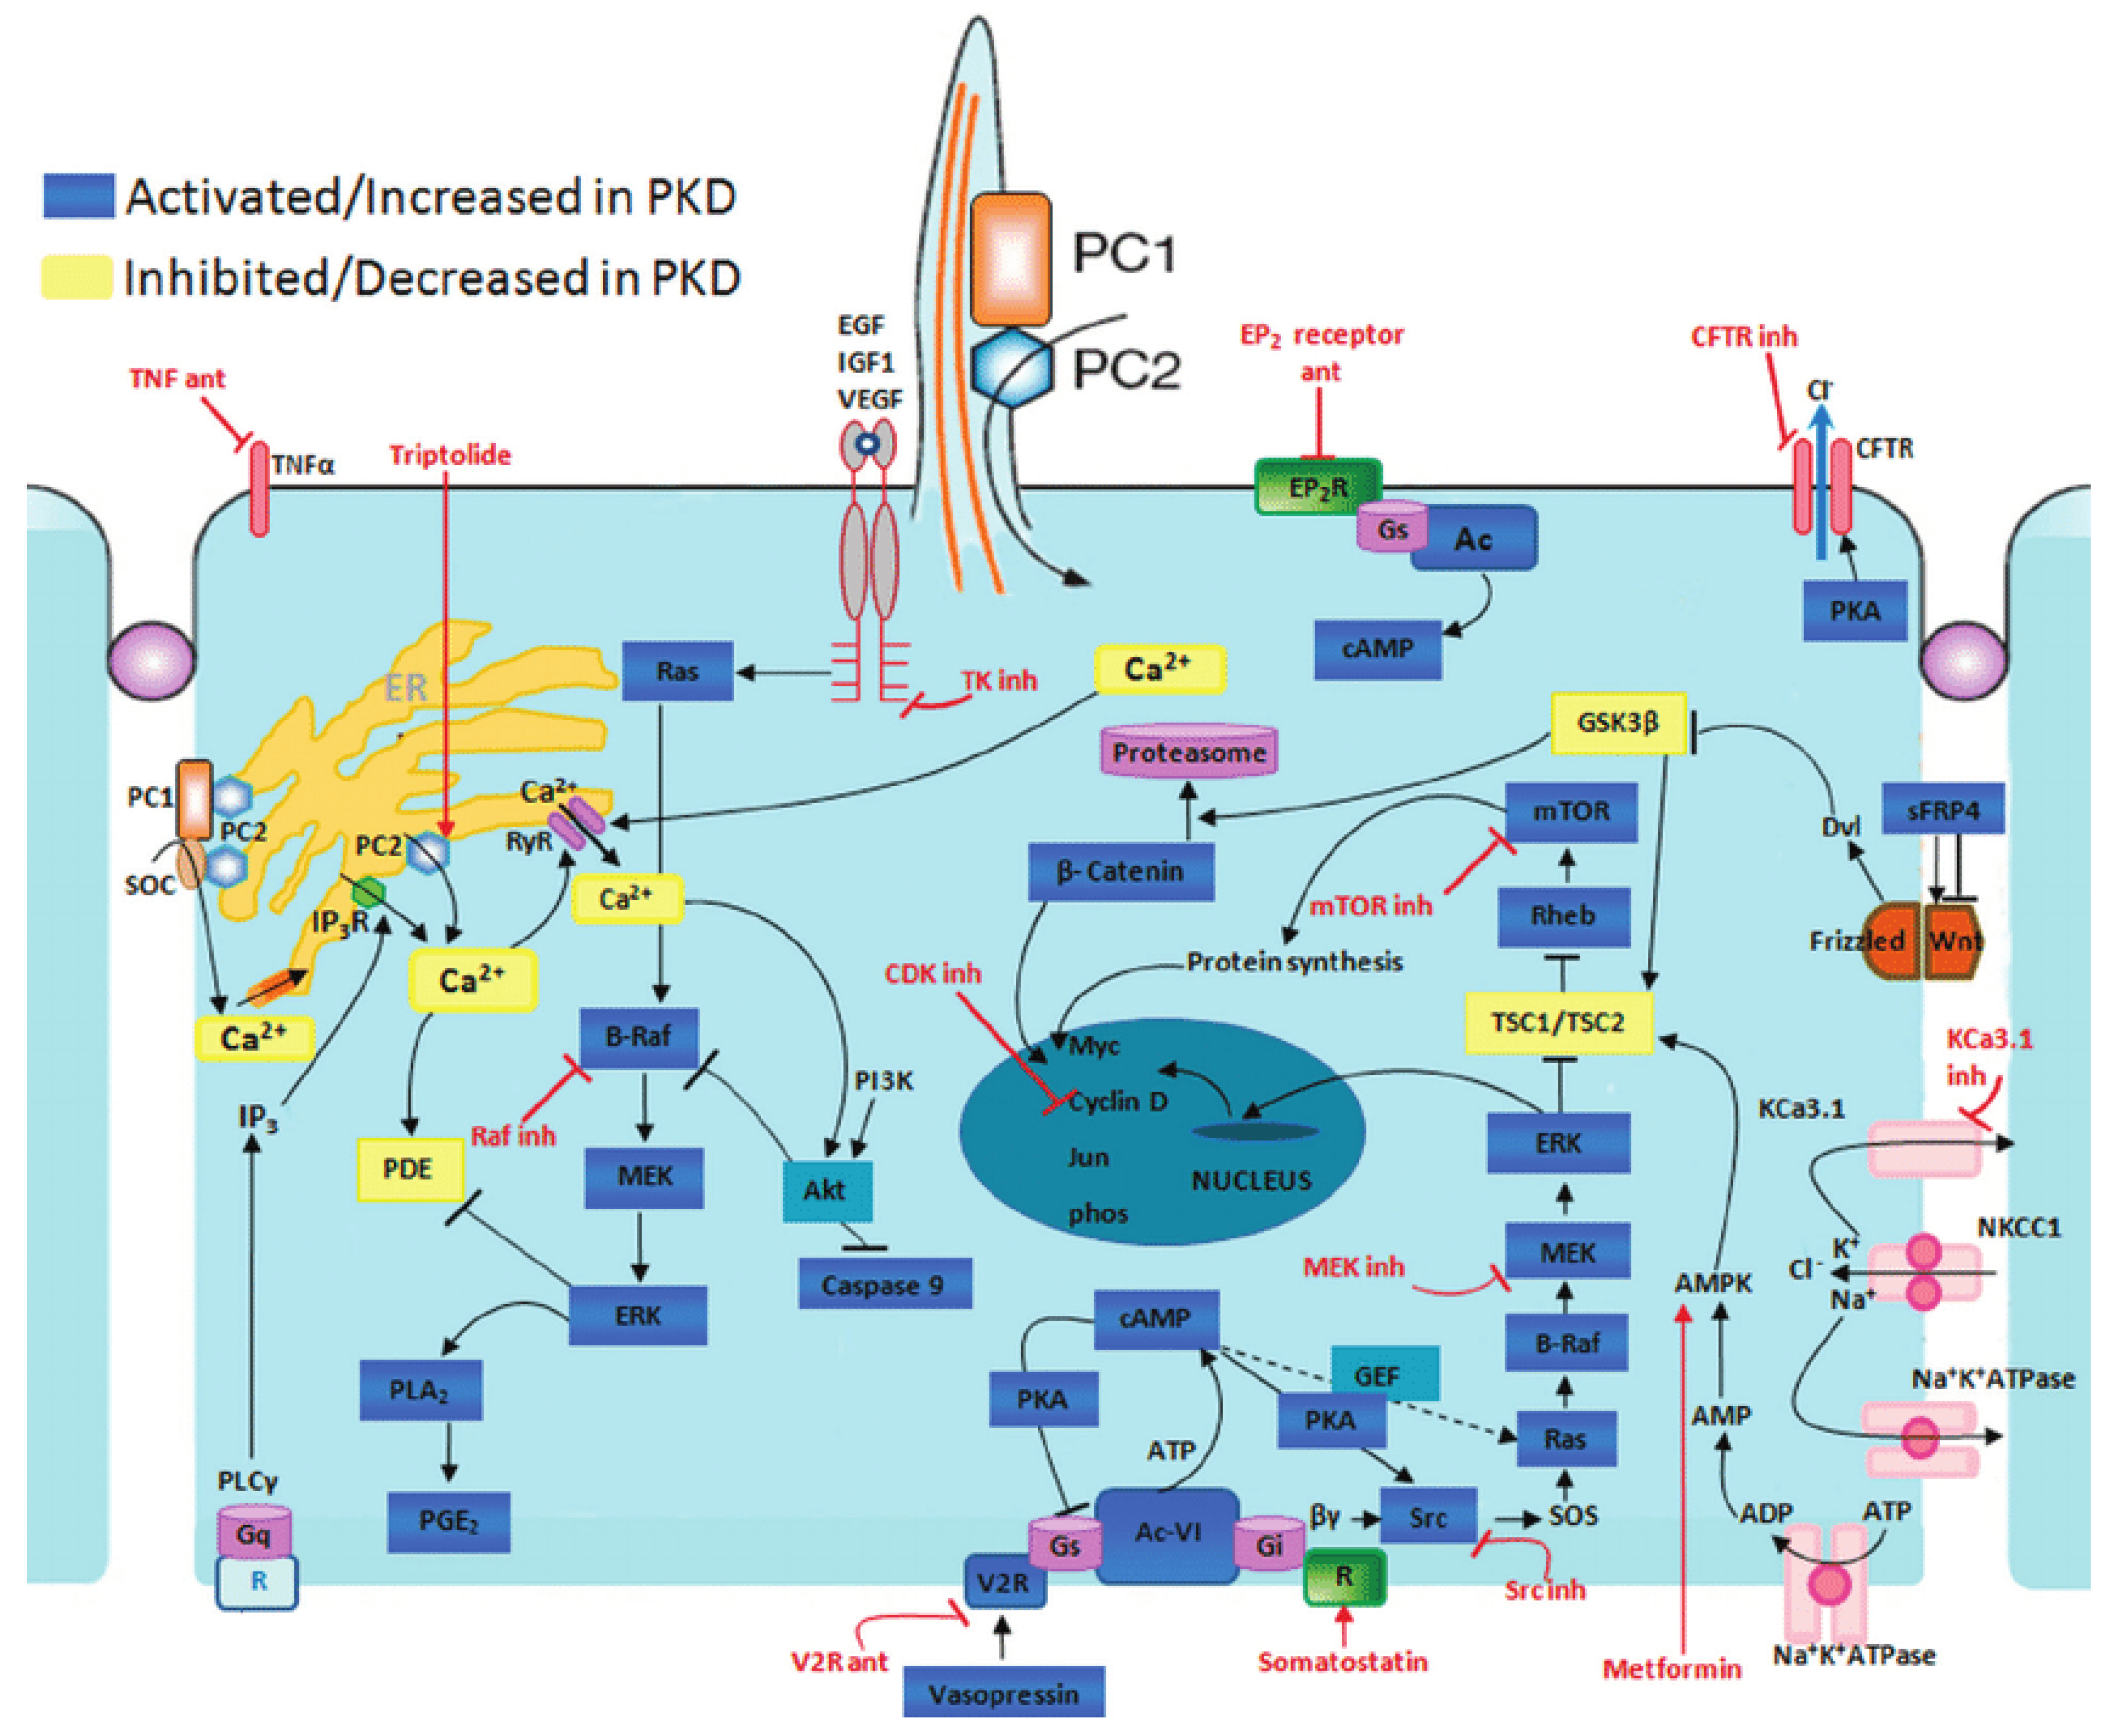
Reiterova, J. et al., IJMS 2022
Notes:
Figure 1. Disrupted pathways in polycystic kidney disease (PKD) and potential therapeutic intervention with specific agents. Agents associated with potential therapeutic interventions are represented in red; ant = antagonist; inh = inhibitor. AC-VI = adenylate cyclase 6; Akt = protein kinase B; AMPK = AMP kinase; B-Raf = v-raf murine sarcoma viral oncogene homolog B1; CDK = cyclin-de-pendent kinase; CFTR = cystic fibrosis transmembrane conductance regulator; EGF = epidermal growth factor; EP 2 R = E-prostanoid receptor 2; ERK = extracellular signal-regulated protein kinase; GSK3 = glycogen synthase kinase 3; IGF1 = insulin-like growth factor 1; IP 3 R = inositol 1,4,5-trisphosphate receptor; MAPK = mitogen-activated protein kinase; mTOR = mammalian target for rapamycin; PC1 = polycystin-1; PC2 = polycystin-2; PDE = phosphodiesterase; PGE 2 = prostaglandin E2; PI3K = phosphatidylinositol 3-kinase; PKA = protein kinase A; PLA 2 = phospholipase A2; PLCγ = phospholipase C-γ2; R = somatostatin sst2 receptor; Rheb = ras homolog enriched in brain; RyR = ryanodine receptor; sFRP4 = secreted Frizzled-related protein 4; TK = tyrosine kinase; TNF-α = tumor necro-sis factor-α; TSC = tuberous sclerosis proteins tuberin (TSC2) and hamartin (TSC1); V2R = vasopressin V2 receptor; VEGF = vascular endothelial growth factor [9].

Slide 31
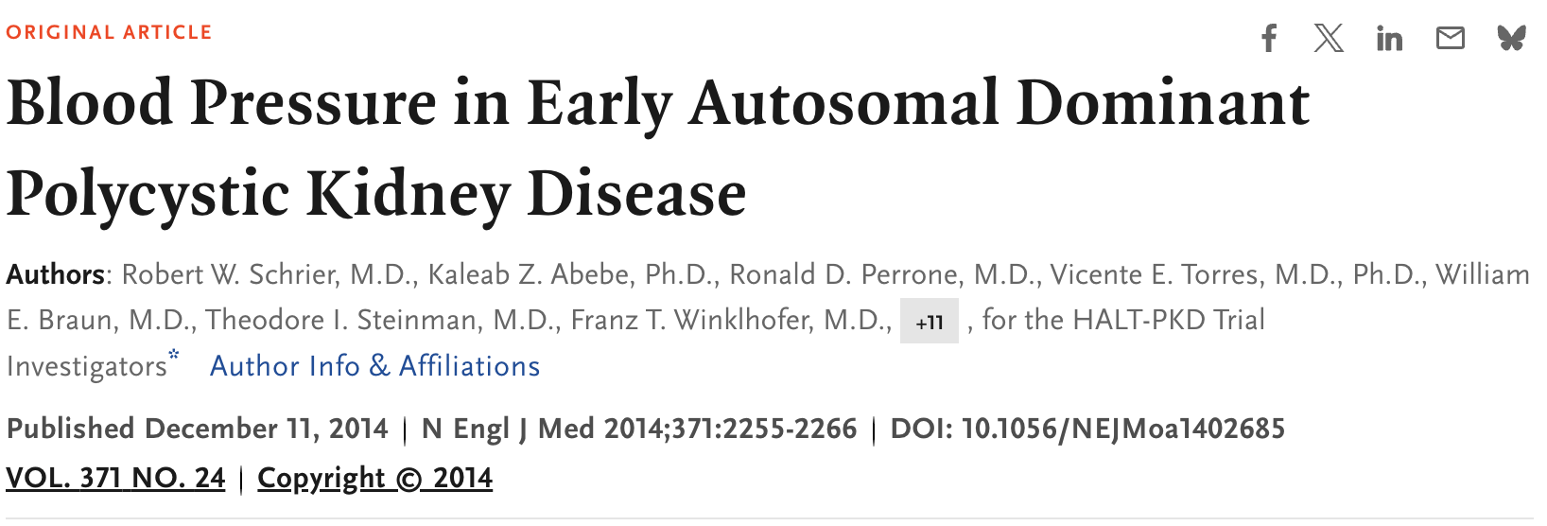
HALT-PKD A
Young patients (15 to 49 years) with preserved kidney function (eGFR >60)
BP target of standard (120-130) vs Low BP (95-110)
ACE vs ACE/ARB combo
Follow for 5 years
Notes:
HALT-PKD trial showed that in young patients (15 to 49 years) with preserved kidney function, treatment with inhibitors of the RAAS with a goal blood pressure of <110/75 mmHg resulted in a 14.2% slower increase in TKV over 5 years, reduced urinary albumin excretion, and a greater decline in left ventricular mass index. The overall rate of decline in estimated GFR (eGFR) in the strict and the standard blood pressure group was similar overall but slower in the lower blood pressure group during the chronic phase of the 5-year study.

Slide 32
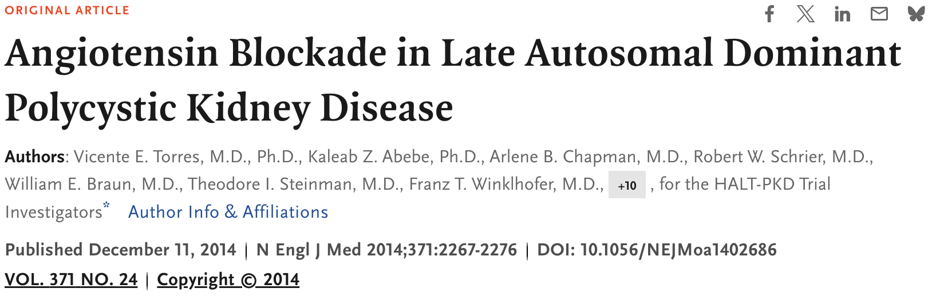
HALT-PKD B
18-64 year old
eGFR 25-60
ACE+Placebo vs ACE+ARB
BP goal 110-130mmHg systolic

Slide 33
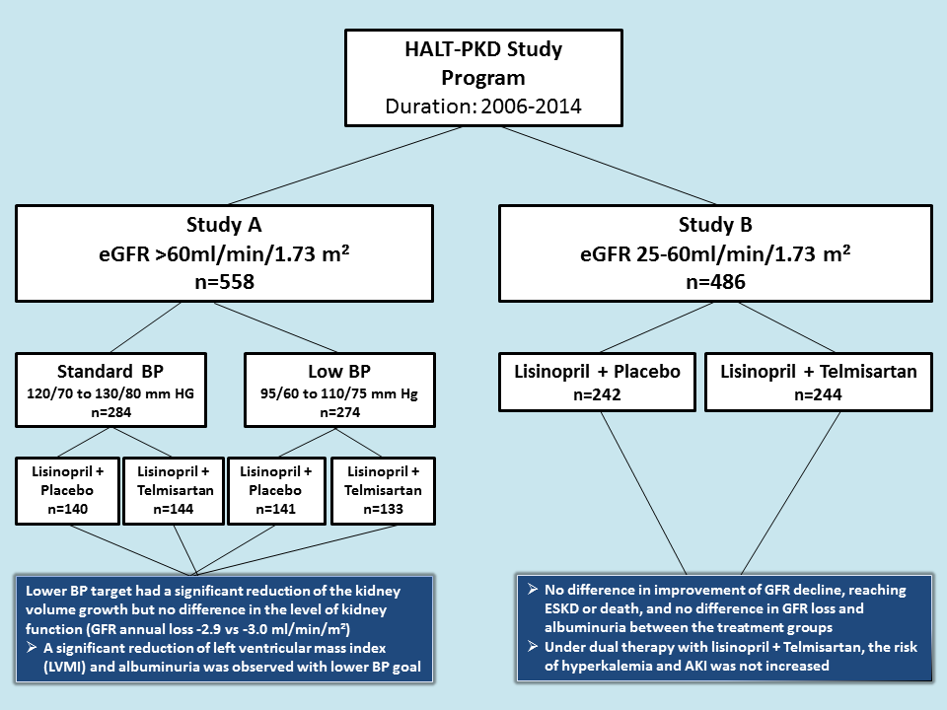
5.5% vs 6.5%
p=0.006
Scheir, RW. et al., NEJM 2014
Torres, VE. Et al., NEJM 2014

Slide 35
Reiterova, J. et al., IJMS 2022
Notes:
Figure 1. Disrupted pathways in polycystic kidney disease (PKD) and potential therapeutic intervention with specific agents. Agents associated with potential therapeutic interventions are represented in red; ant = antagonist; inh = inhibitor. AC-VI = adenylate cyclase 6; Akt = protein kinase B; AMPK = AMP kinase; B-Raf = v-raf murine sarcoma viral oncogene homolog B1; CDK = cyclin-de-pendent kinase; CFTR = cystic fibrosis transmembrane conductance regulator; EGF = epidermal growth factor; EP 2 R = E-prostanoid receptor 2; ERK = extracellular signal-regulated protein kinase; GSK3 = glycogen synthase kinase 3; IGF1 = insulin-like growth factor 1; IP 3 R = inositol 1,4,5-trisphosphate receptor; MAPK = mitogen-activated protein kinase; mTOR = mammalian target for rapamycin; PC1 = polycystin-1; PC2 = polycystin-2; PDE = phosphodiesterase; PGE 2 = prostaglandin E2; PI3K = phosphatidylinositol 3-kinase; PKA = protein kinase A; PLA 2 = phospholipase A2; PLCγ = phospholipase C-γ2; R = somatostatin sst2 receptor; Rheb = ras homolog enriched in brain; RyR = ryanodine receptor; sFRP4 = secreted Frizzled-related protein 4; TK = tyrosine kinase; TNF-α = tumor necro-sis factor-α; TSC = tuberous sclerosis proteins tuberin (TSC2) and hamartin (TSC1); V2R = vasopressin V2 receptor; VEGF = vascular endothelial growth factor [9].

Slide 36
Tolvaptan
Oral V2-receptor antagonist
Selectivity for V2 receptors about 30X that for V1a receptors
Affinity for V2 receptor about 2X that of native AVP
Metabolized by CYP3A4 (metabolism inhibited by ketoconazole)
Half-life of dose is 8.4 hours
Produces a dose-dependent aquaretic effect with no effect on BP
Most common side effects: thirst, dry mouth, LFT abnormalities
High fetal mortality and fetal malformation when given to pregnant animals

Slide 37
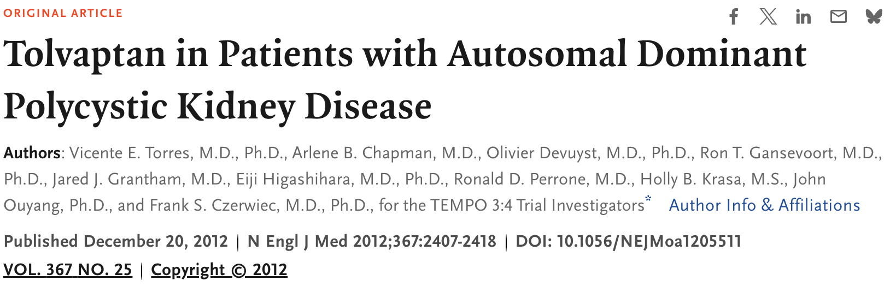
TEMPO 3:4
Phase 3, randomized, double-blind, placebo-controlled trial
1445 participants
3 year period
18-50 TKV 750ml or more
GFR >60 ml/min/m2
2:1 Tolvaptan
Notes:
Tolvaptan Efficacy and Safety Management of Autosomal Dominant Polycystic Kidney Disease and Its Outcomes (TEMPO) 3 : 4 trial is a phase 3, randomized, double-blind, placebo-controlled trial. Among 1445 participants over 3 years of follow-up, the tolvaptan-treated group had a slower rate of kidney volume growth (2.8% vs. 5.5%/year). The slope of kidney function decline, measured as the reciprocal of the serum creatinine, also favored tolvaptan therapy. Tolvaptan also showed a beneficial effect on kidney pain and frequency of urinary tract infections.

Slide 38
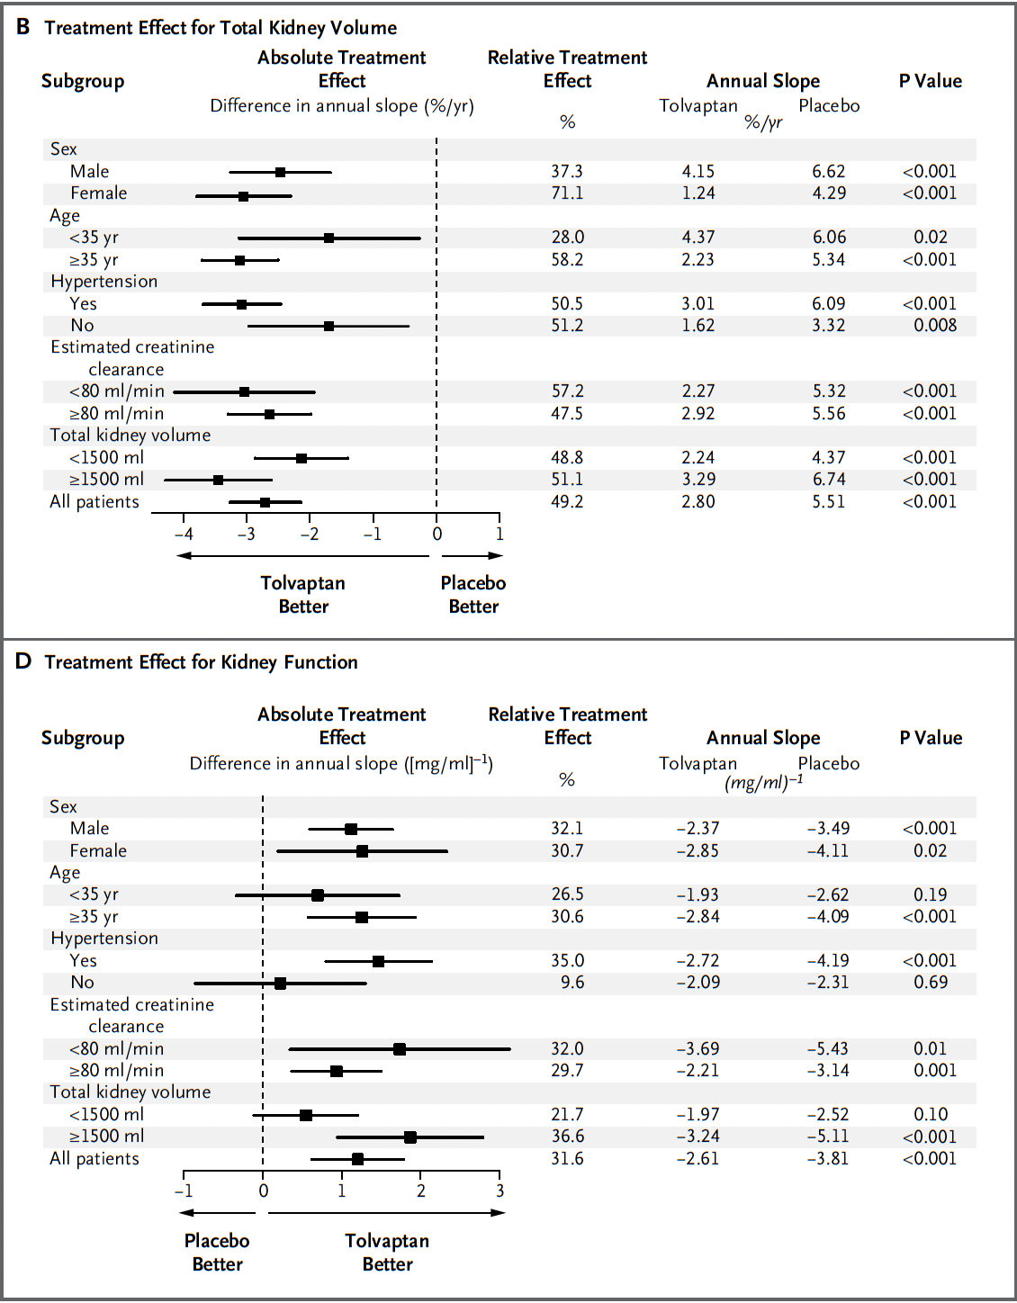
TEMPO 3:4
Scheir, RW. et al., NEJM 2014
Torres, VE. Et al., NEJM 2014
Notes:
Tolvaptan Efficacy and Safety Management of Autosomal Dominant Polycystic Kidney Disease and Its Outcomes (TEMPO) 3 : 4 trial is a phase 3, randomized, double-blind, placebo-controlled trial. Among 1445 participants over 3 years of follow-up, the tolvaptan-treated group had a slower rate of kidney volume growth (2.8% vs. 5.5%/year). The slope of kidney function decline, measured as the reciprocal of the serum creatinine, also favored tolvaptan therapy. Tolvaptan also showed a beneficial effect on kidney pain and frequency of urinary tract infections.

Slide 39
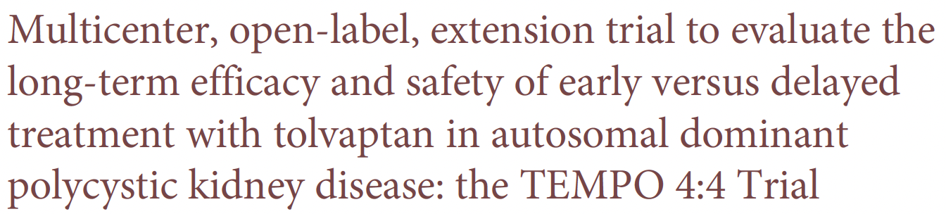
TEMPO 4:4
2 year open label extension
18-50 TKV 750ml or more
GFR >30 ml/min/m2
2:1 Tolvaptan

Slide 40
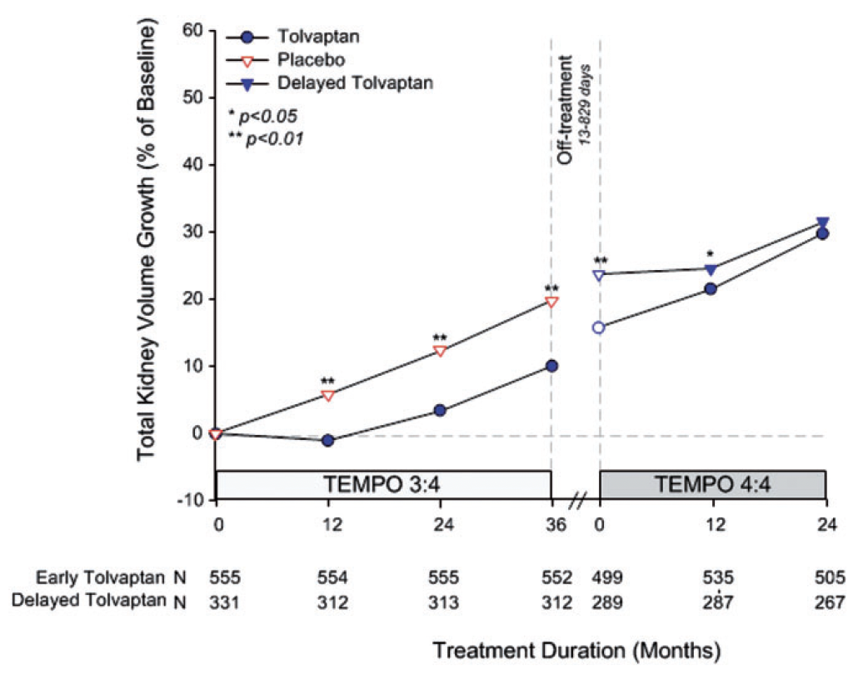
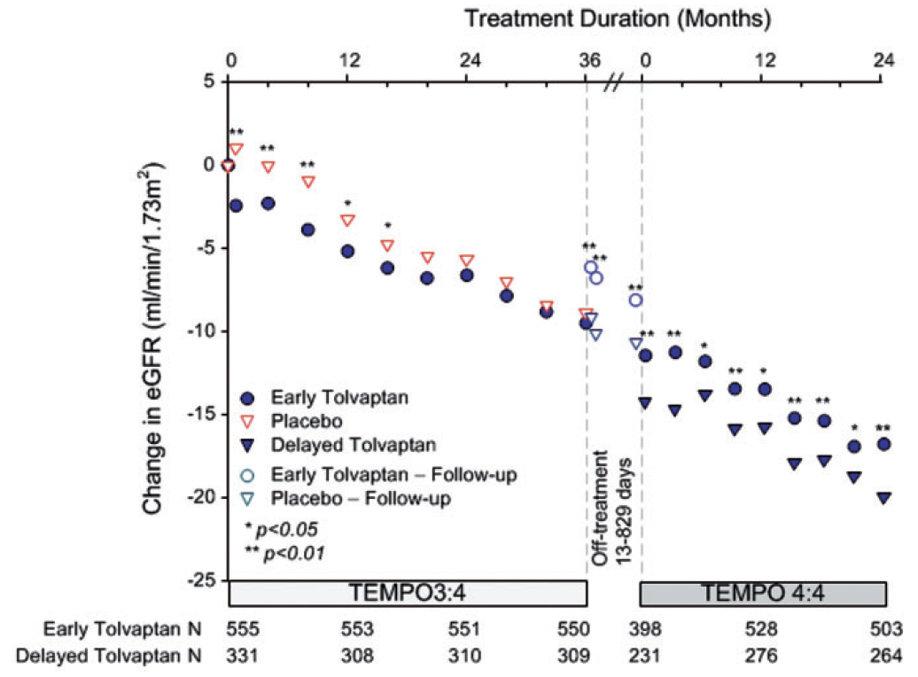
TEMPO 4:4
Torres, VE. et al., NDT 2018

Slide 41
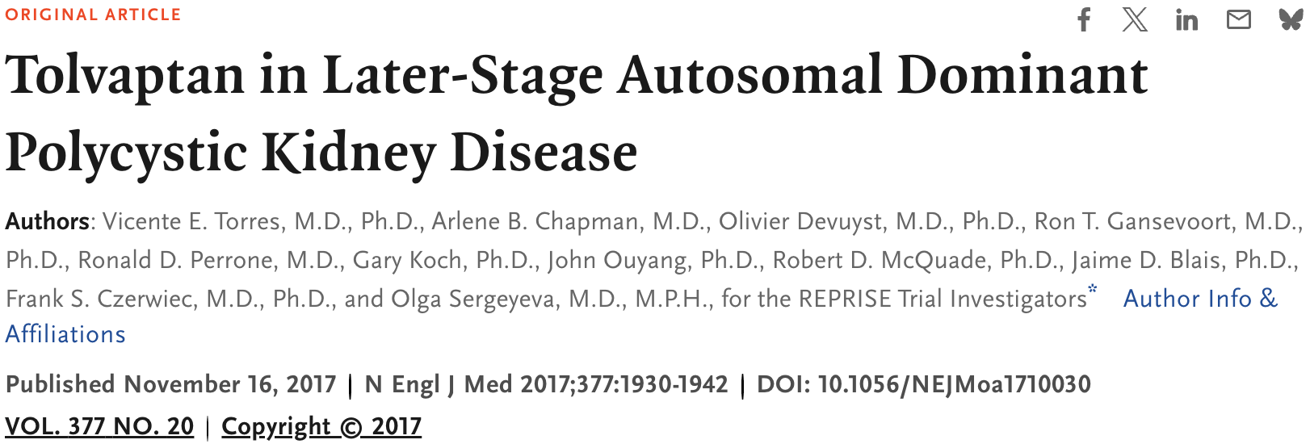
REPRISE
Replicating Evidence of Preserved Renal Function: An Investigation of Tolvaptan Safety and Efficacy in ADPKD (REPRISE trial)
1370 patients
aged 18–65
eGFRs between 25 and 65 mL/min/1.72 m2
Notes:
Replicating Evidence of Preserved Renal Function: An Investigation of Tolvaptan Safety and Efficacy in ADPKD (REPRISE trial) was subsequently conducted in 1370 patients aged 18–65 with eGFRs between 25 and 65 mL/min/1.72 m2 and showed similar protective effects; at 12 months, the change from baseline eGFR was lower among those assigned tolvaptan compared with placebo (–2.34 versus –3.61 mL/min/1.73 m2).

Slide 42
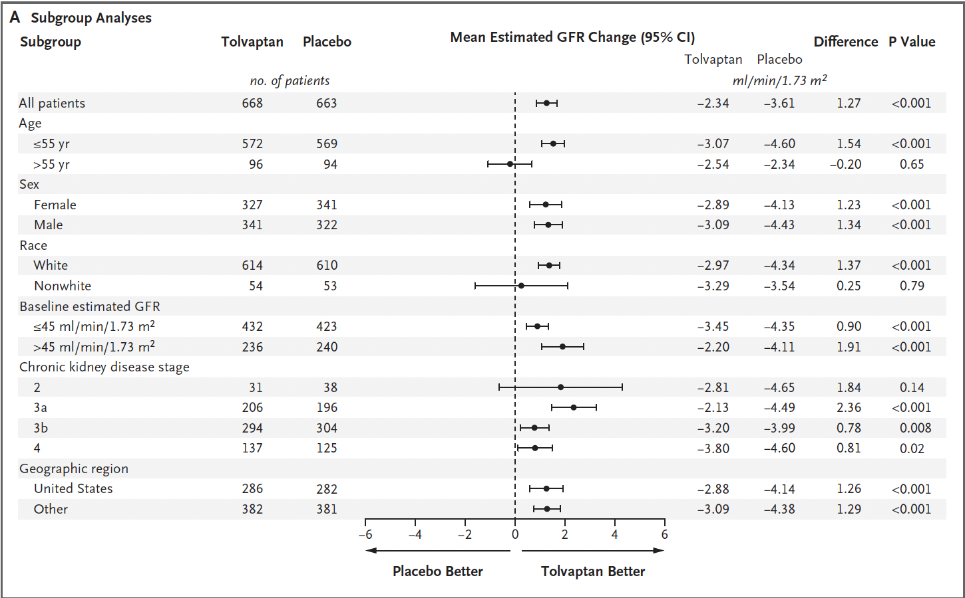
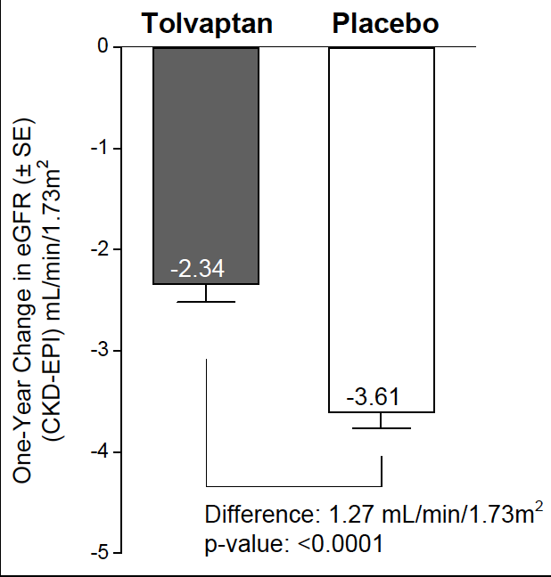
REPRISE
Torres, VE. et al., NEJM 2017
Notes:
Replicating Evidence of Preserved Renal Function: An Investigation of Tolvaptan Safety and Efficacy in ADPKD (REPRISE trial) was subsequently conducted in 1370 patients aged 18–65 with eGFRs between 25 and 65 mL/min/1.72 m2 and showed similar protective effects; at 12 months, the change from baseline eGFR was lower among those assigned tolvaptan compared with placebo (–2.34 versus –3.61 mL/min/1.73 m2).

Slide 43

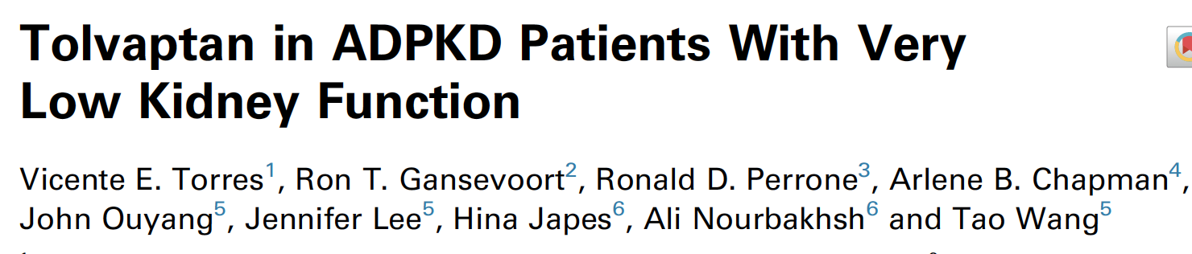
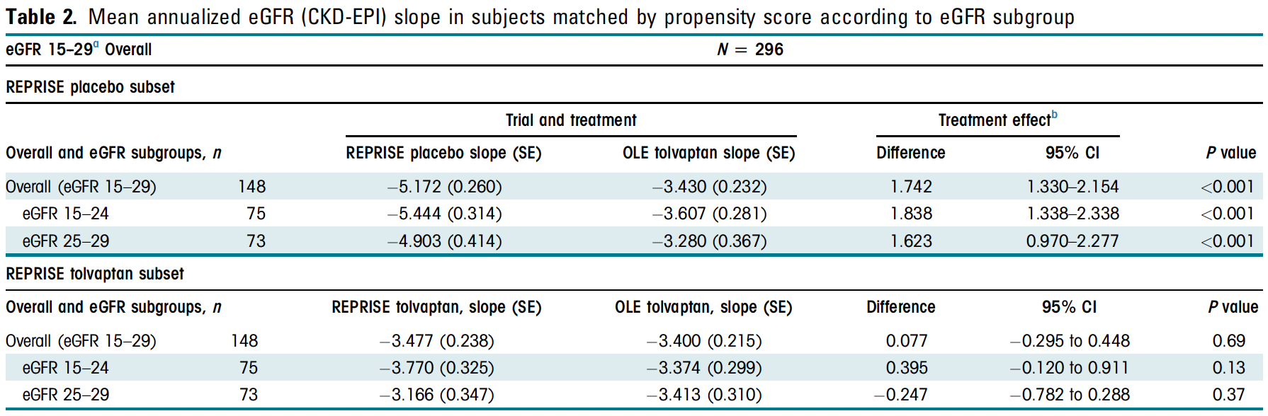

Slide 45
Reiterova, J. et al., IJMS 2022
Notes:
Figure 1. Disrupted pathways in polycystic kidney disease (PKD) and potential therapeutic intervention with specific agents. Agents associated with potential therapeutic interventions are represented in red; ant = antagonist; inh = inhibitor. AC-VI = adenylate cyclase 6; Akt = protein kinase B; AMPK = AMP kinase; B-Raf = v-raf murine sarcoma viral oncogene homolog B1; CDK = cyclin-de-pendent kinase; CFTR = cystic fibrosis transmembrane conductance regulator; EGF = epidermal growth factor; EP 2 R = E-prostanoid receptor 2; ERK = extracellular signal-regulated protein kinase; GSK3 = glycogen synthase kinase 3; IGF1 = insulin-like growth factor 1; IP 3 R = inositol 1,4,5-trisphosphate receptor; MAPK = mitogen-activated protein kinase; mTOR = mammalian target for rapamycin; PC1 = polycystin-1; PC2 = polycystin-2; PDE = phosphodiesterase; PGE 2 = prostaglandin E2; PI3K = phosphatidylinositol 3-kinase; PKA = protein kinase A; PLA 2 = phospholipase A2; PLCγ = phospholipase C-γ2; R = somatostatin sst2 receptor; Rheb = ras homolog enriched in brain; RyR = ryanodine receptor; sFRP4 = secreted Frizzled-related protein 4; TK = tyrosine kinase; TNF-α = tumor necro-sis factor-α; TSC = tuberous sclerosis proteins tuberin (TSC2) and hamartin (TSC1); V2R = vasopressin V2 receptor; VEGF = vascular endothelial growth factor [9].

Slide 46
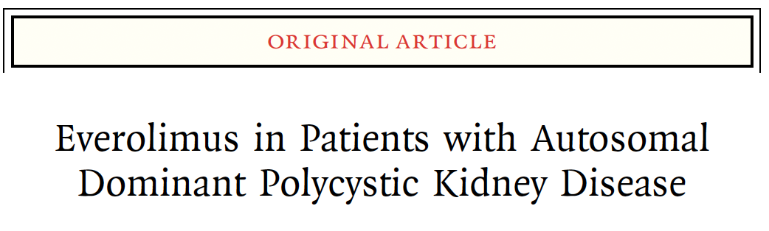
mTOR
2 years
Everolimus 2.5mg BID, goal 3-8
eGFR 30-89, or CKD Stage 1 + single kidney volume >1000mL

Slide 47
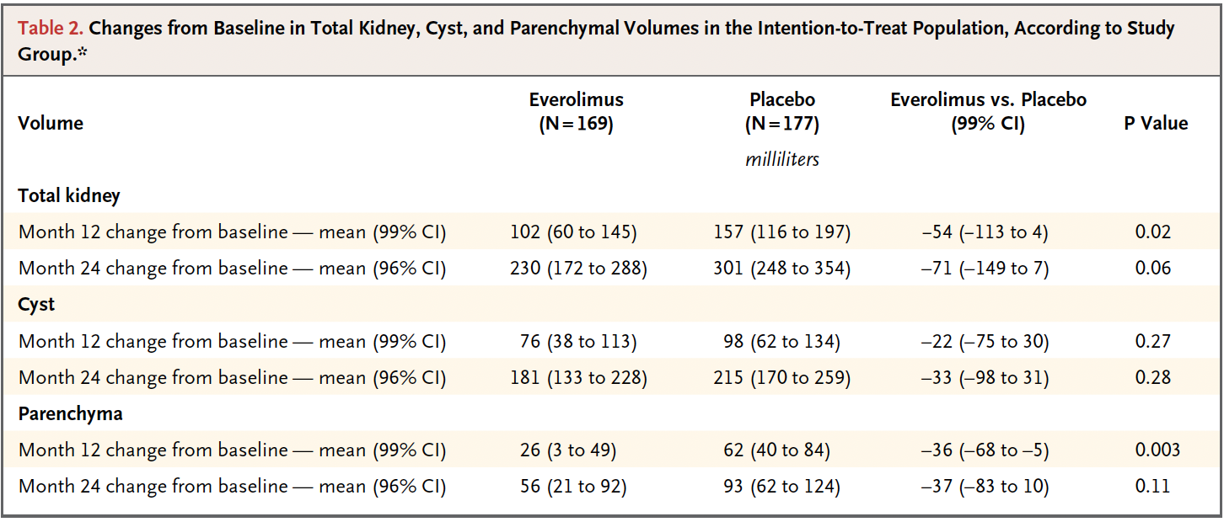
mTOR
Walz, G.. et al., NEJM 2010
Notes:
eGFR 5.4 mTOR and 3.2 placebo

Slide 48
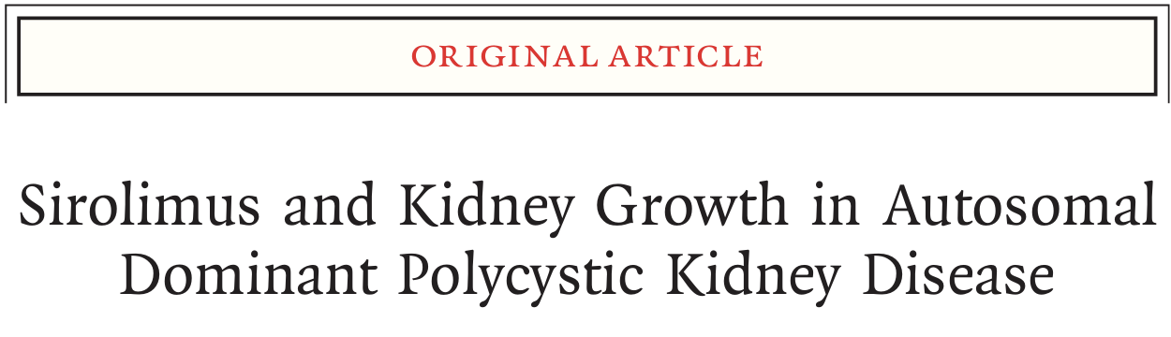
mTOR
18-40
eGFR >70
18 months
Sirolimus 2mg – titrate to target 4-10

Slide 49
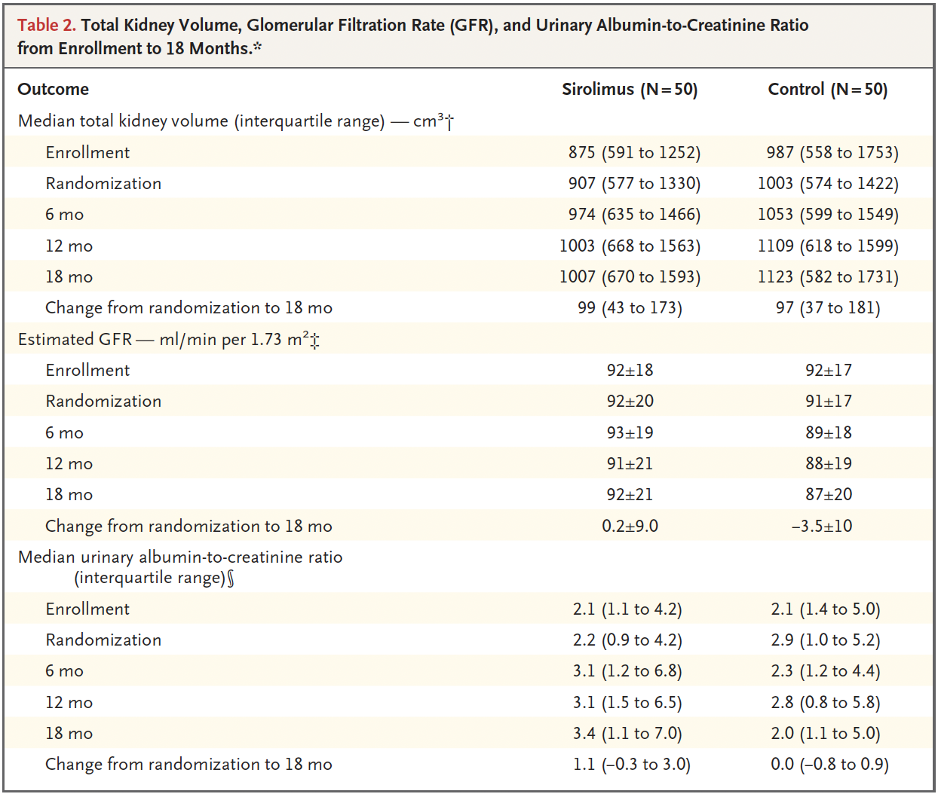
mTOR
p=0.07
Serra, AL.. et al., NEJM 2010

Slide 51
Reiterova, J. et al., IJMS 2022
Notes:
Figure 1. Disrupted pathways in polycystic kidney disease (PKD) and potential therapeutic intervention with specific agents. Agents associated with potential therapeutic interventions are represented in red; ant = antagonist; inh = inhibitor. AC-VI = adenylate cyclase 6; Akt = protein kinase B; AMPK = AMP kinase; B-Raf = v-raf murine sarcoma viral oncogene homolog B1; CDK = cyclin-de-pendent kinase; CFTR = cystic fibrosis transmembrane conductance regulator; EGF = epidermal growth factor; EP 2 R = E-prostanoid receptor 2; ERK = extracellular signal-regulated protein kinase; GSK3 = glycogen synthase kinase 3; IGF1 = insulin-like growth factor 1; IP 3 R = inositol 1,4,5-trisphosphate receptor; MAPK = mitogen-activated protein kinase; mTOR = mammalian target for rapamycin; PC1 = polycystin-1; PC2 = polycystin-2; PDE = phosphodiesterase; PGE 2 = prostaglandin E2; PI3K = phosphatidylinositol 3-kinase; PKA = protein kinase A; PLA 2 = phospholipase A2; PLCγ = phospholipase C-γ2; R = somatostatin sst2 receptor; Rheb = ras homolog enriched in brain; RyR = ryanodine receptor; sFRP4 = secreted Frizzled-related protein 4; TK = tyrosine kinase; TNF-α = tumor necro-sis factor-α; TSC = tuberous sclerosis proteins tuberin (TSC2) and hamartin (TSC1); V2R = vasopressin V2 receptor; VEGF = vascular endothelial growth factor [9].

Slide 52
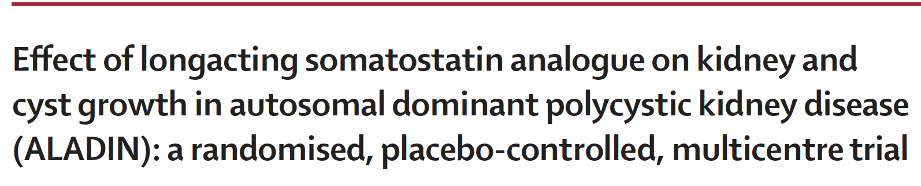
ALADIN 1
>18 years old
>40 eGFR
3 years

Slide 53
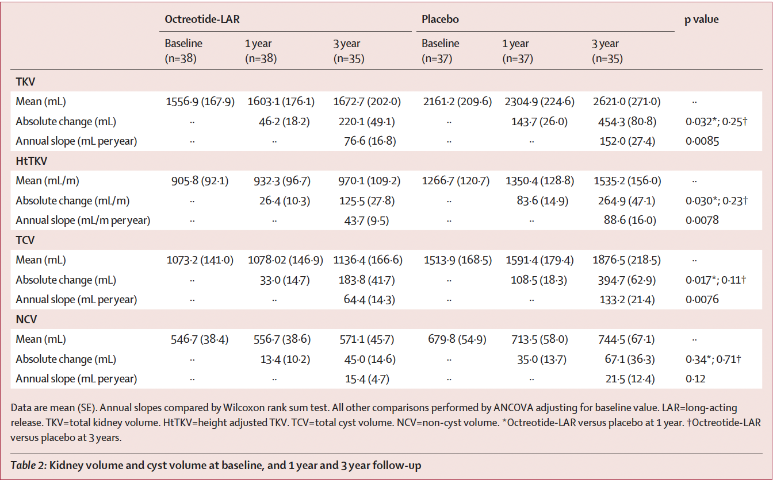
ALADIN 1
Caroli et al., Lancet 2013
Notes:
>18, GFR >40, ADPKD

Slide 54
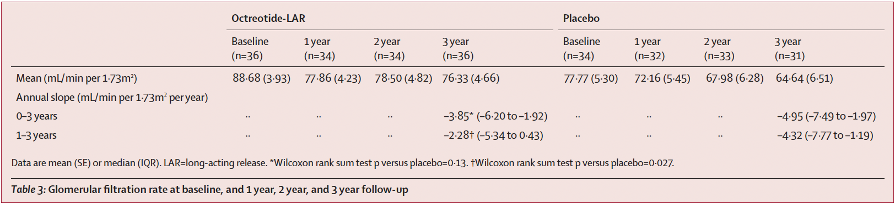
ALADIN 1
Caroli et al., Lancet 2013
Notes:
>18, GFR >40, ADPKD

Slide 55
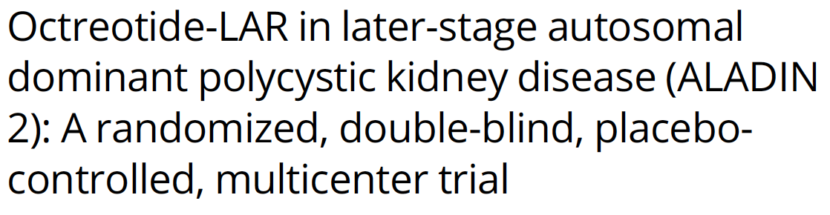
ALADIN 2
>18 years old
15 – 40 eGFR
3 years
Notes:
>18, ADPKD, 15-40

Slide 56
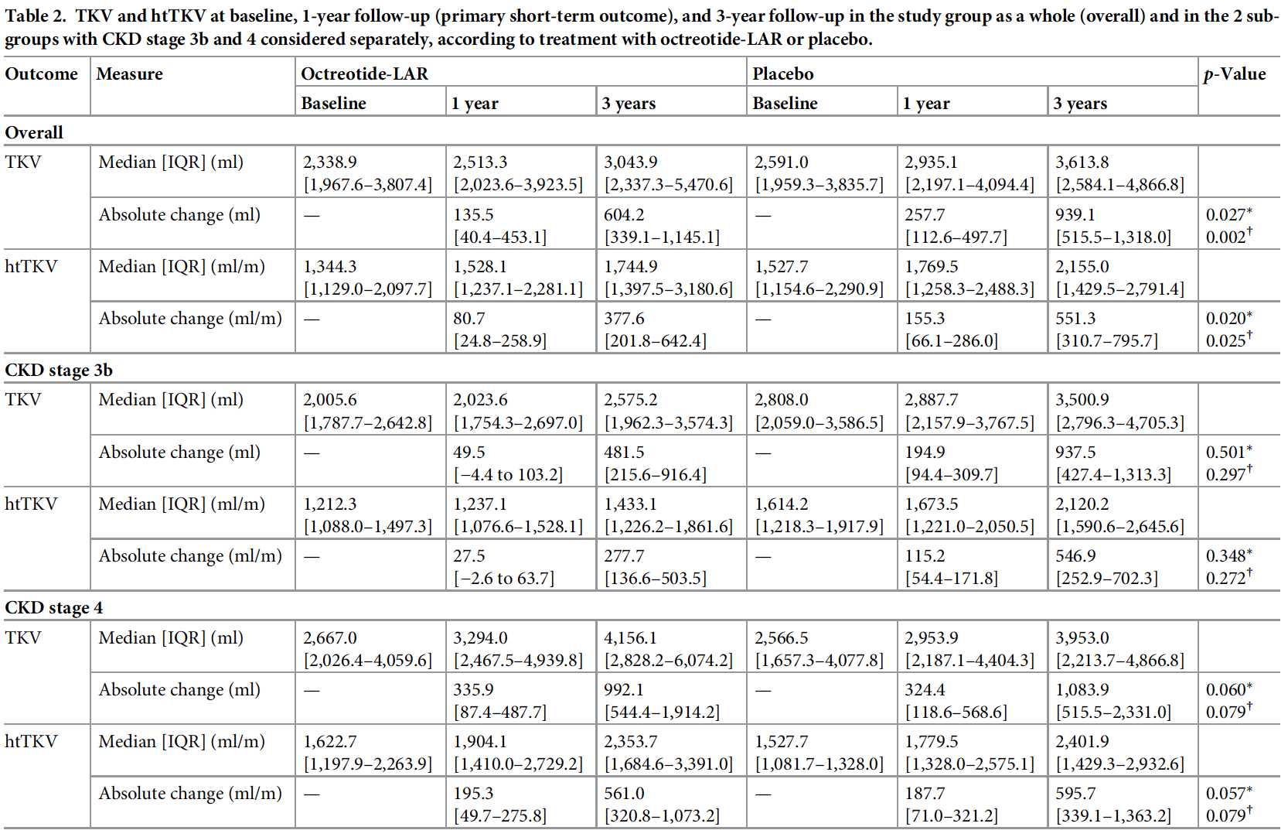
ALADIN 2
Pericos.. et al., PLOS 2018

Slide 57
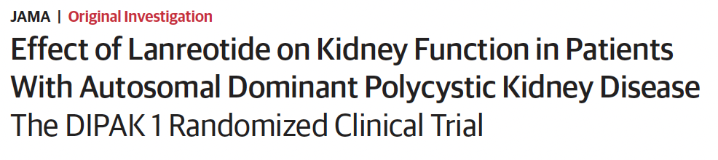
DIPAK 1
18-65 years old
30 – 60 eGFR
2.5 years
Notes:
18-60, ADPKD, 30-60

Slide 58

DIPAK 1
Meijer.. et al., JAMA 2018
Notes:
18-60, ADPKD, 30-60

Slide 59

DIPAK 1
Meijer.. et al., JAMA 2018
Notes:
18-60, ADPKD, 30-60

Slide 61
Future Direction(s)
Registries
Genetic Risks
Dietary
Metformin
SGLT-2
PCLD – Somatostatin Analogs
RGLS8429 - Farabursen

Slide 62


Notes:
Pathway schematic representation of glycosphingolipid metabolism in autosomal dominant PKD and GCS inhibitor venglustat. The de novo synthesis of sphingolipids is a multistep process that results in the production of ceramide from serine and palmitoyl-CoA. Polycystin dysfunction enhances activation of mTORC2, increasing de novo ceramide synthesis and increasing GL-1 via increases in GCS production, indirectly increasing lactosylceramide and GM3. Venglustat inhibits GCS, resulting in reductions in GL-1, lactosylceramide, and GM3. Ceramide accumulation in PKD may also be mediated by the production of ROS. The levels of ceramide and sphingosine-1-phosphatase also mediate apoptosis. Red boxes indicate molecules that are upregulated with PKD when compared to non-PKD models. Abbreviations: PKD, polycystic kidney disease; GCS, glucosylceramide synthase; GL-1, glucosylceramide; GM3, monosialodihexosylganglioside; mTORC2, mammalian target of rapamycin complex 2; ROS, reactive oxygen species

Slide 63
RGLS4326 -> RGLS8429
Farabursen
next generation oligonucleotide for the treatment of ADPKD designed to inhibit miR-17 and to preferentially target the kidney
Preferentially delivers to kidney tubules and cysts, derepresses miR-17 targets Pkd1 and Pkd2, increases PC1 and PC2, and attenuates cyst growth in multiple PKD mouse models.

Slide 64
Thank you

Slide 65


Slide 66


Slide 67
Resources
Caroli A, Perico N, Perna A, Antiga L, Brambilla P, Pisani A, Visciano B, Imbriaco M, Messa P, Cerutti R, Dugo M, Cancian L, Buongiorno E, De Pascalis A, Gaspari F, Carrara F, Rubis N, Prandini S, Remuzzi A, Remuzzi G, Ruggenenti P; ALADIN study group. Effect of longacting somatostatin analogue on kidney and cyst growth in autosomal dominant polycystic kidney disease (ALADIN): a randomised, placebo-controlled, multicentre trial. Lancet. 2013 Nov 2;382(9903):1485-95. doi: 10.1016/S0140-6736(13)61407-5. Epub 2013 Aug 21. PMID: 23972263.
Chebib FT, Torres VE. Autosomal Dominant Polycystic Kidney Disease: Core Curriculum 2016. Am J Kidney Dis. 2016 May;67(5):792-810. doi: 10.1053/j.ajkd.2015.07.037. Epub 2015 Oct 31. PMID: 26530876; PMCID: PMC4837006.
Grantham JJ, Chapman AB, Torres VE. Volume progression in autosomal dominant polycystic kidney disease: the major factor determining clinical outcomes. Clin J Am Soc Nephrol. 2006 Jan;1(1):148-57. doi: 10.2215/CJN.00330705. Epub 2005 Oct 19. PMID: 17699202.
Irazabal, María V.*; Rangel, Laureano J.†; Bergstralh, Eric J.†; Osborn, Sara L.*; Harmon, Amber J.*; Sundsbak, Jamie L.*; Bae, Kyongtae T.‡; Chapman, Arlene B.§; Grantham, Jared J.‖; Mrug, Michal¶; Hogan, Marie C.*; El-Zoghby, Ziad M.*; Harris, Peter C.*; Erickson, Bradley J.**; King, Bernard F.**; Torres, Vicente E.* the CRISP Investigators. Imaging Classification of Autosomal Dominant Polycystic Kidney Disease: A Simple Model for Selecting Patients for Clinical Trials. Journal of the American Society of Nephrology 26(1):p 160-172, January 2015. | DOI: 10.1681/ASN.2013101138
Meijer E, Visser FW, van Aerts RMM, Blijdorp CJ, Casteleijn NF, D'Agnolo HMA, Dekker SEI, Drenth JPH, de Fijter JW, van Gastel MDA, Gevers TJ, Lantinga MA, Losekoot M, Messchendorp AL, Neijenhuis MK, Pena MJ, Peters DJM, Salih M, Soonawala D, Spithoven EM, Wetzels JF, Zietse R, Gansevoort RT; DIPAK-1 Investigators. Effect of Lanreotide on Kidney Function in Patients With Autosomal Dominant Polycystic Kidney Disease: The DIPAK 1 Randomized Clinical Trial. JAMA. 2018 Nov 20;320(19):2010-2019. doi: 10.1001/jama.2018.15870. PMID: 30422235; PMCID: PMC6248170.
Perico N, Ruggenenti P, Perna A, Caroli A, Trillini M, Sironi S, Pisani A, Riccio E, Imbriaco M, Dugo M, Morana G, Granata A, Figuera M, Gaspari F, Carrara F, Rubis N, Villa A, Gamba S, Prandini S, Cortinovis M, Remuzzi A, Remuzzi G; ALADIN 2 Study Group. Octreotide-LAR in later-stage autosomal dominant polycystic kidney disease (ALADIN 2): A randomized, double-blind, placebo-controlled, multicenter trial. PLoS Med. 2019 Apr 5;16(4):e1002777. doi: 10.1371/journal.pmed.1002777. PMID: 30951521; PMCID: PMC6450618.
Reiterová J, Tesař V. Autosomal Dominant Polycystic Kidney Disease: From Pathophysiology of Cystogenesis to Advances in the Treatment. Int J Mol Sci. 2022 Mar 19;23(6):3317. doi: 10.3390/ijms23063317. PMID: 35328738; PMCID: PMC8949594.
Schrier RW, Abebe KZ, Perrone RD, Torres VE, Braun WE, Steinman TI, Winklhofer FT, Brosnahan G, Czarnecki PG, Hogan MC, Miskulin DC, Rahbari-Oskoui FF, Grantham JJ, Harris PC, Flessner MF, Bae KT, Moore CG, Chapman AB; HALT-PKD Trial Investigators. Blood pressure in early autosomal dominant polycystic kidney disease. N Engl J Med. 2014 Dec 11;371(24):2255-66. doi: 10.1056/NEJMoa1402685. Epub 2014 Nov 15. PMID: 25399733; PMCID: PMC4343258.
Serra AL, Poster D, Kistler AD, Krauer F, Raina S, Young J, Rentsch KM, Spanaus KS, Senn O, Kristanto P, Scheffel H, Weishaupt D, Wüthrich RP. Sirolimus and kidney growth in autosomal dominant polycystic kidney disease. N Engl J Med. 2010 Aug 26;363(9):820-9. doi: 10.1056/NEJMoa0907419. Epub 2010 Jun 26. PMID: 20581391.
Torres VE, Abebe KZ, Chapman AB, Schrier RW, Braun WE, Steinman TI, Winklhofer FT, Brosnahan G, Czarnecki PG, Hogan MC, Miskulin DC, Rahbari-Oskoui FF, Grantham JJ, Harris PC, Flessner MF, Moore CG, Perrone RD; HALT-PKD Trial Investigators. Angiotensin blockade in late autosomal dominant polycystic kidney disease. N Engl J Med. 2014 Dec 11;371(24):2267-76. doi: 10.1056/NEJMoa1402686. Epub 2014 Nov 15. PMID: 25399731; PMCID: PMC4284824.
Torres VE, Chapman AB, Devuyst O, Gansevoort RT, Perrone RD, Dandurand A, Ouyang J, Czerwiec FS, Blais JD; TEMPO 4:4 Trial Investigators. Multicenter, open-label, extension trial to evaluate the long-term efficacy and safety of early versus delayed treatment with tolvaptan in autosomal dominant polycystic kidney disease: the TEMPO 4:4 Trial. Nephrol Dial Transplant. 2018 Mar 1;33(3):477-489. doi: 10.1093/ndt/gfx043. PMID: 28379536; PMCID: PMC6019005.
Torres VE, Chapman AB, Devuyst O, Gansevoort RT, Perrone RD, Koch G, Ouyang J, McQuade RD, Blais JD, Czerwiec FS, Sergeyeva O; REPRISE Trial Investigators. Tolvaptan in Later-Stage Autosomal Dominant Polycystic Kidney Disease. N Engl J Med. 2017 Nov 16;377(20):1930-1942. doi: 10.1056/NEJMoa1710030. E
Walz G, Budde K, Mannaa M, Nürnberger J, Wanner C, Sommerer C, Kunzendorf U, Banas B, Hörl WH, Obermüller N, Arns W, Pavenstädt H, Gaedeke J, Büchert M, May C, Gschaidmeier H, Kramer S, Eckardt KU. Everolimus in patients with autosomal dominant polycystic kidney disease. N Engl J Med. 2010 Aug 26;363(9):830-40. doi: 10.1056/NEJMoa1003491. Epub 2010 Jun 26. Erratum in: N Engl J Med. 2010 Nov 11;363(20):1977. Erratum in: N Engl J Med. 2010 Sep 16;363(12):1190. PMID: 20581392.pub 2017 Nov 4. PMID: 29105594.

