Slide 1


Slide 2






About Me
Medical School: LMU-DCOM 17’
Residency: Norton Community 20’
  Junior Faculty/4th year chief 21’
Fellowship: University of Cincinnati 23’
Assistant Program Director of Nephrology Fellowship
Adult Nephrologist Tuberous Sclerosis Center of Excellence
Areas of Interest
  Critical Care
  Cystic and Genetic Diseases
  Tuberous Sclerosis

Slide 3
Disclosures
Medical Advisory Committee – Alexion, atypical HUS
Speakers Bureau - Natera
Medical Advisory Board for NKF Cincinnati
Rare Kidney Disease Foundation (RKDF) Clinician Council
This lecture is intended for a brief overview of high-yield points

Slide 4
Objectives
Broad work-up for Glomerular Disease
Better understanding of a glomerular disease and differentiation
Key words for diagnosis in answering questions

Slide 5
What is Normal
Color yellow
Clarity clear
Spec Grav 1.015
pH 6.5
Protein neg
Ketones neg
Bilirubin neg
Blood neg
Nitrite neg
Urobilinogen neg
WBC esterase neg
RBC < 3 cells/hpf
WBC < 3 cells/hpf
Casts*
Albumin/Cr < 30g/g
Prot/Cr <300mg

Slide 6
What is Normal
Bowmans Space
Mesangium
Mesangial Cells
Capillary Lumens
Interstitium
Proximal Tubules

Slide 7
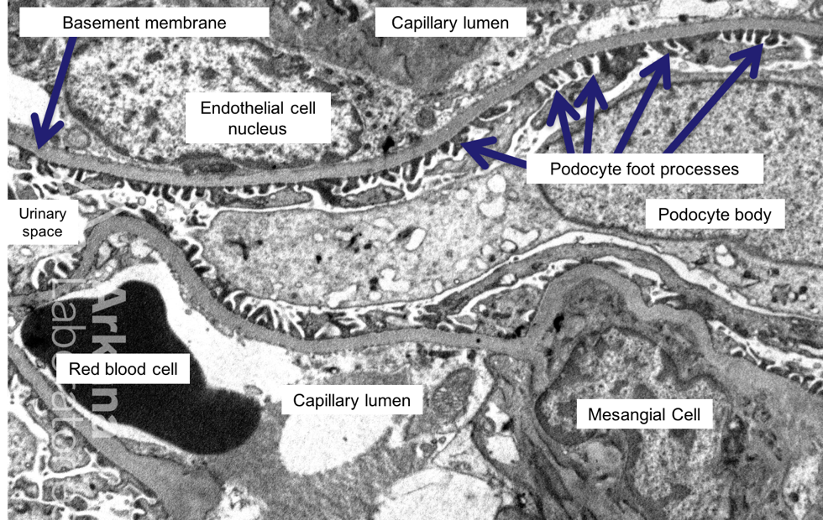
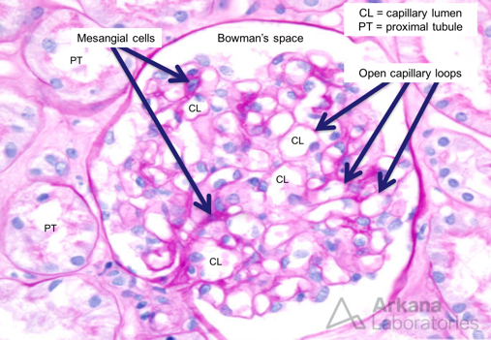
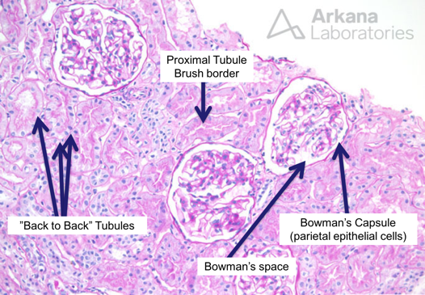

Slide 8
Proteinuria
Normal: < 300mg
Nephrotic Range: >3.5g/g on 24hr or >3g/g on ”spot” UP/Cr
Not all protein comes from Glomerulus
  Albuminuria (A1-A3 classification for CKD)
  Tubular Protein

Slide 9
Glomerular Disease
Glomerular disease are the third leading cause of end-stage kidney disease (ESKD) in the US behind Diabetes and Hypertension
Heterogeneous group of conditions that damage various glomerular structures and produce characteristic clinical physiologic, biochemical, and histologic manifestations.
Primary (idiopathic) – intrinsic process
Secondary – Systemic Process
Normal, noninflamed glomerulus forms a tight barrier, largely due to the slit diaphragms that connect podocyte (visceral epithelial cell) foot processes on the outside surface of the glomerular basement membrane. When healthy it prevents passage of blood and protein into the urinary filtrate.
Glomerular injury results in impaired filtration. Consequently, constituents of blood that are normally excluded from the urinary space (red blood cells, wbcs, proteins) pass through the damaged glomerulus and are excreted in urine.
Result of untreated leads scarring of the glomerular filters (glomerulosclerosis) with subsequent decline in renal function and elevated Creatinine

Slide 10
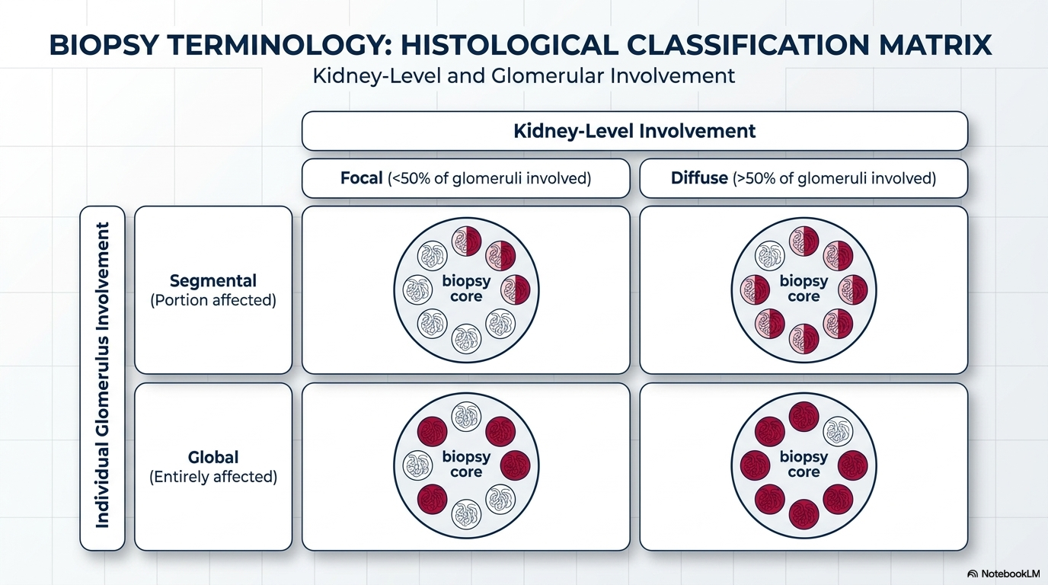

Slide 11
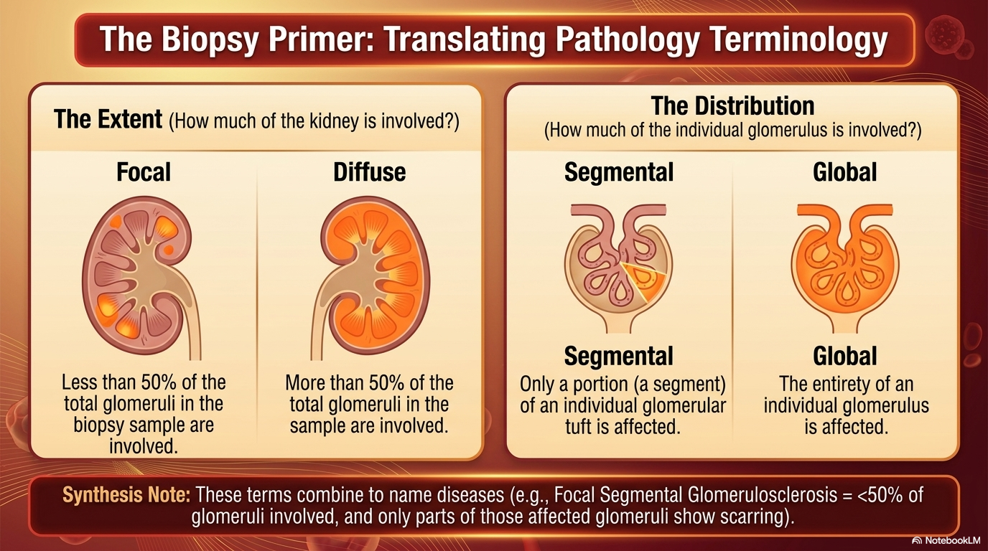

Slide 12
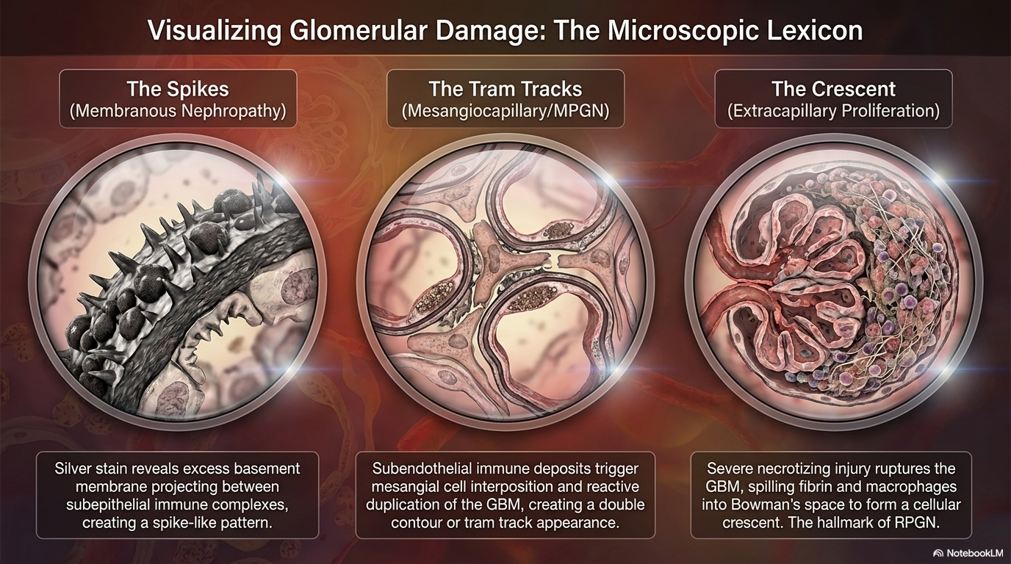

Slide 13
Common Presentation
Nephrotic
Nephritic
Peripheral Edema (anasarca)
Fatigue
Dyspnea
Foamy Urine
Hypertension
Hematuria
AKI
Pleuritic Chest Pain Peripheral Edema
Headache
Malaise
Arthralgia/Myalgia
Flu-like symptoms that can include fever

Slide 14
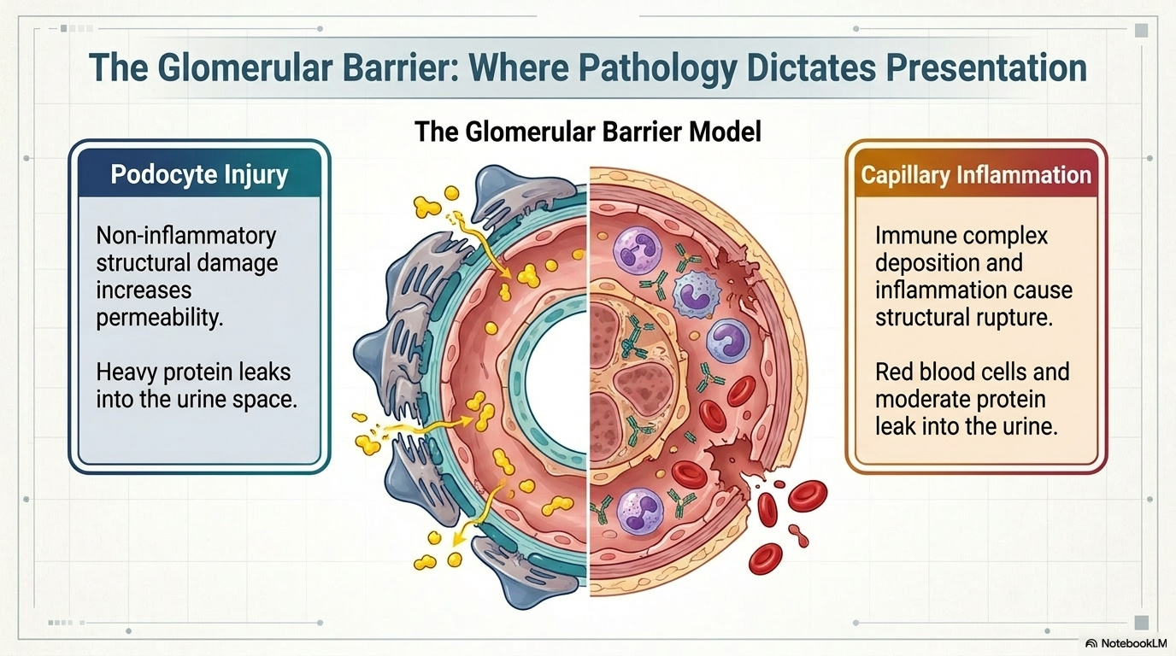

Slide 15
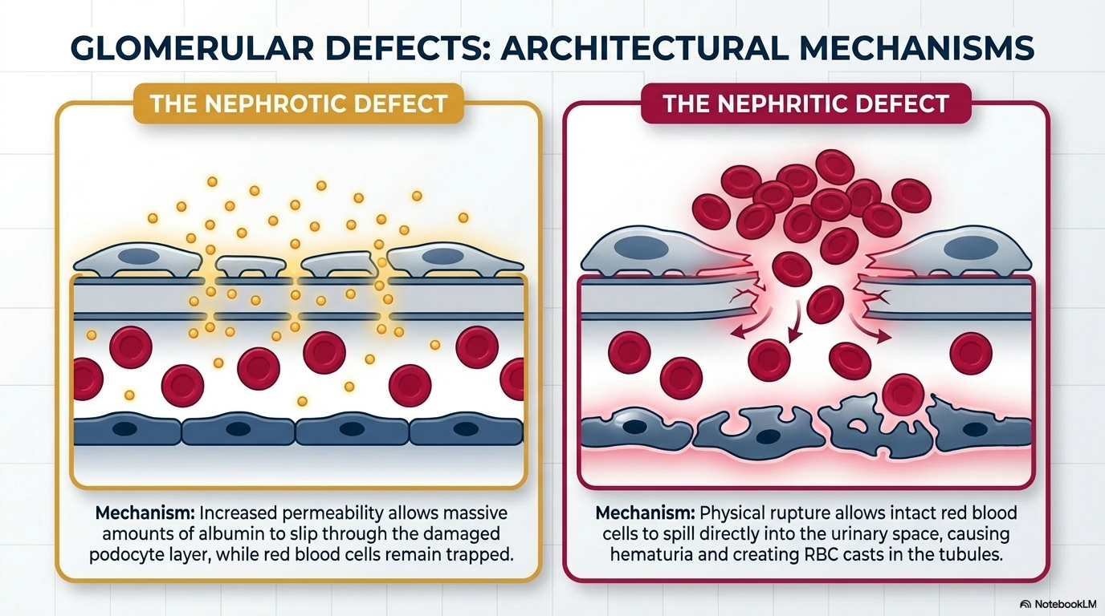

Slide 16
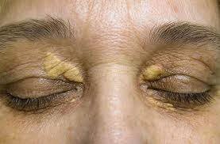
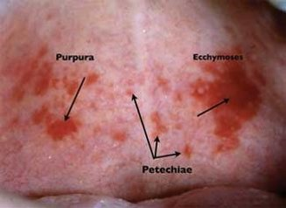
Common Physical Findings
Nephrotic
Nephritic
Hypertension
Dependent/Pitting Edema
Ascites
Pleural Effusion
Nail (Muehrcke’s lines)
Eruptive Xanthomata
Xanthelasma
Hypertension
Palpable Purpura
Edema
Pericardial Friction Rub
Hematuria

Slide 17
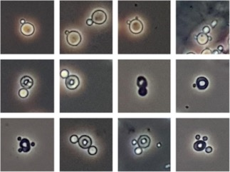
Common Lab Findings
Nephrotic
Nephritic
Proteinuria >3.5g/day
?small hematuria
Serum Albumin <2.5g/dL
Hyperlipidemia (Total >180)
Variable Cr
Dysmorphic RBCs (acanthocytes)
RBC Casts
WBC and WBC Casts
Variable Protein
Variable Cr

Slide 18
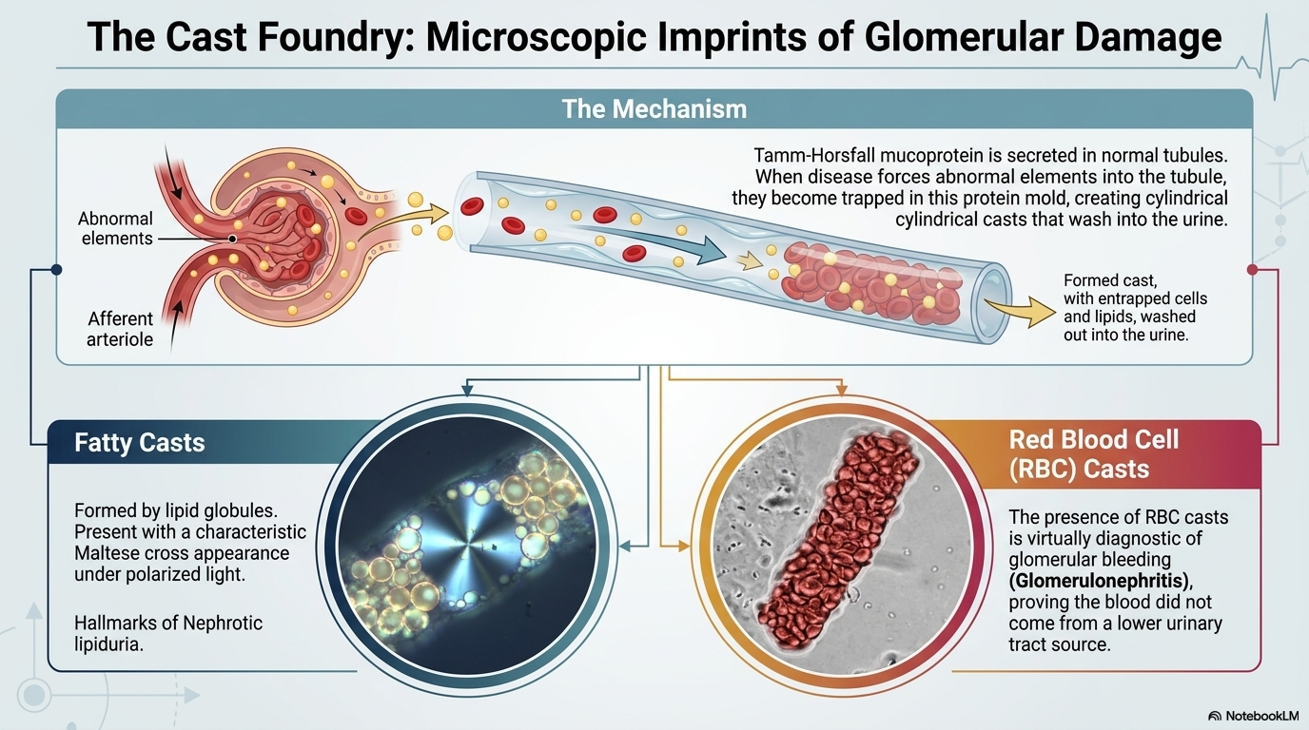

Slide 19
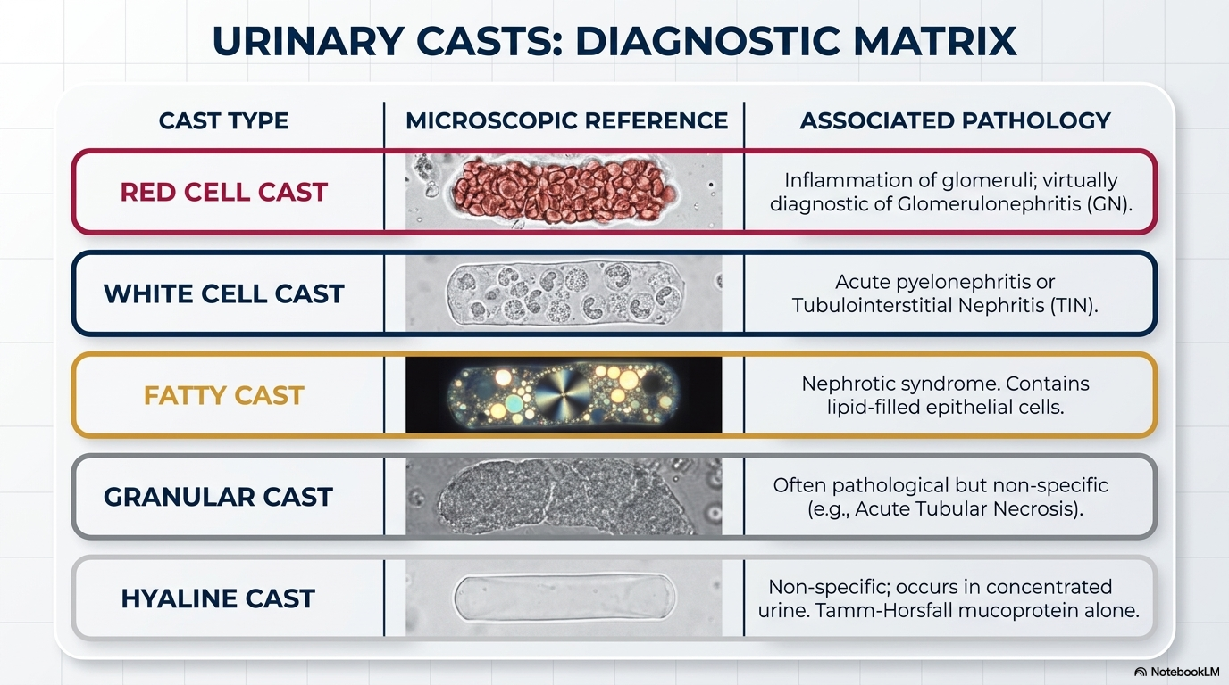

Slide 20
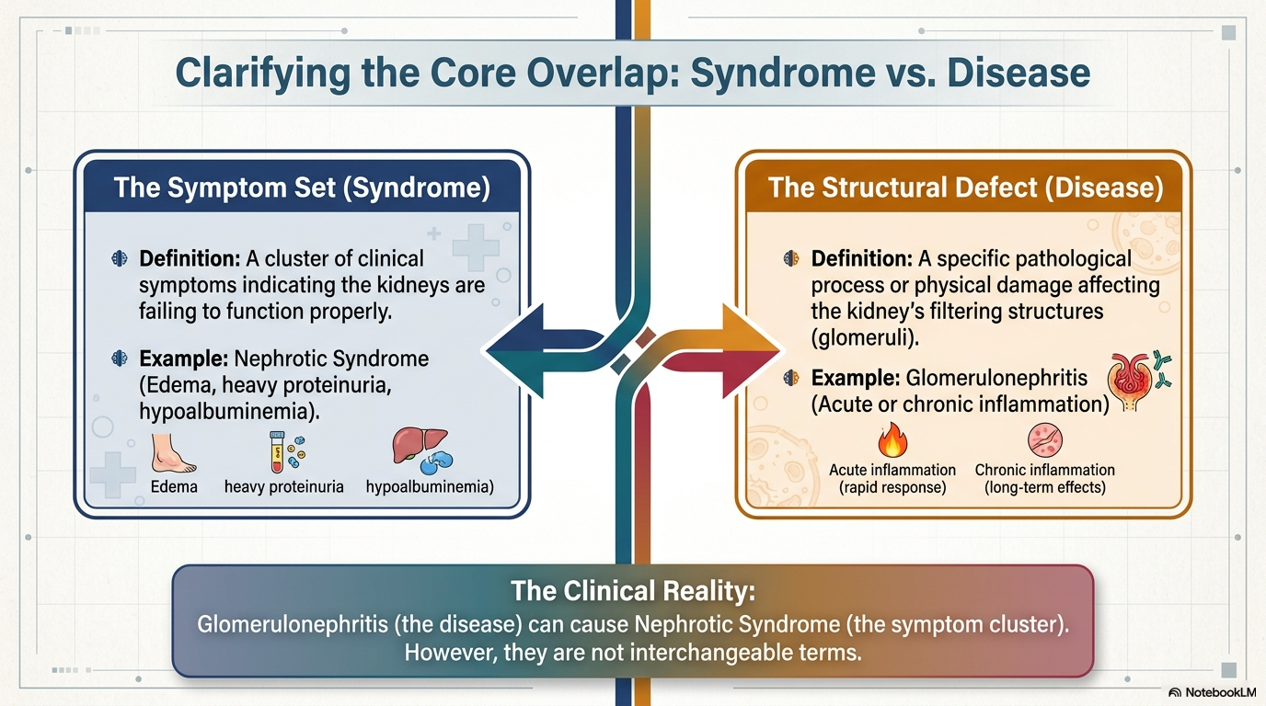

Slide 21
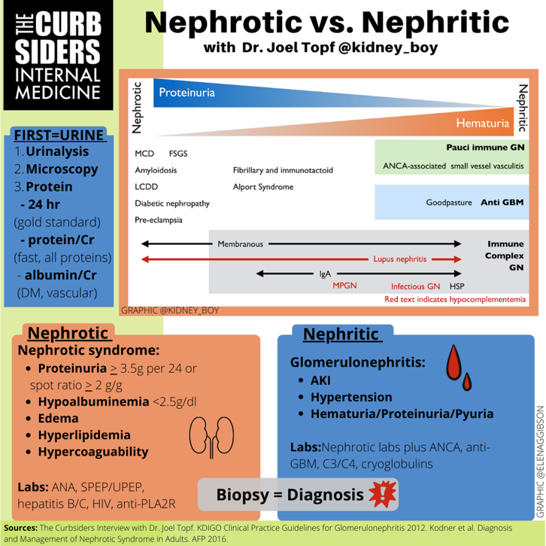

Slide 22
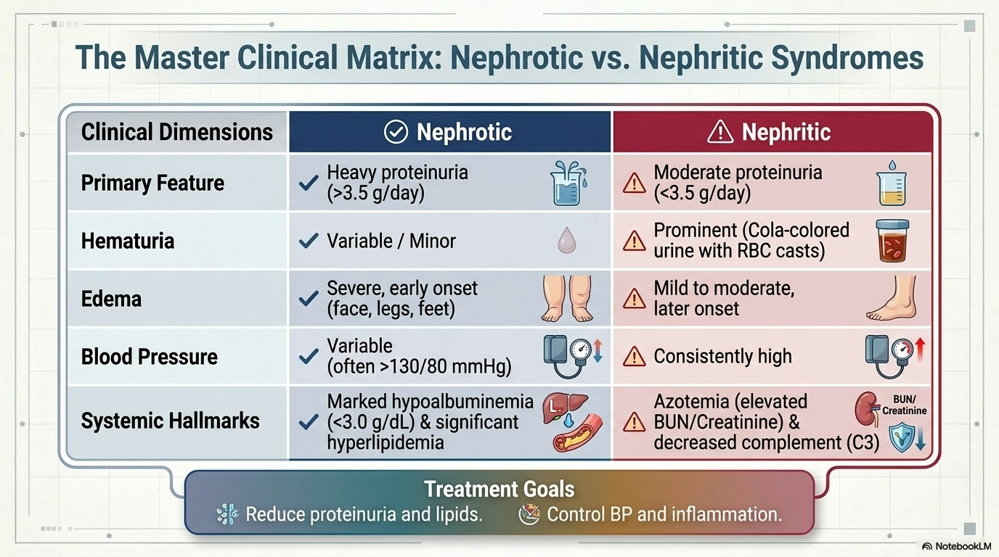

Slide 23
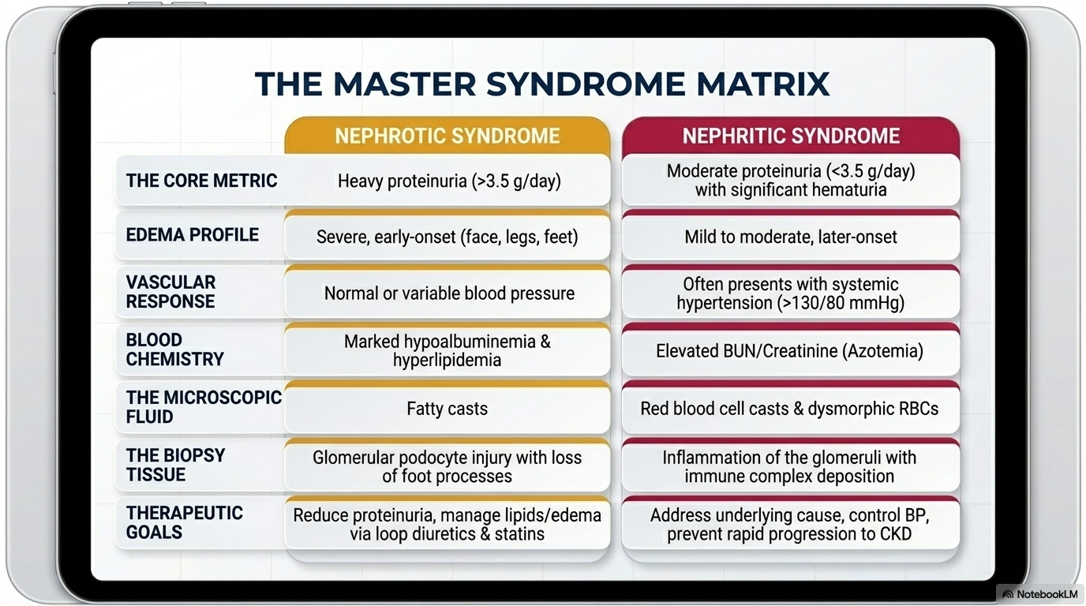

Slide 24
(2) An 81-year-old man is hospitalized for acute onset edema in his legs and his abdomen. History significant for chronic back pain, for which she takes daily ibuprofen. He has no other symptoms.
On physical examination, vital signs are normal. There is no rash. Cardiac examination is without extra sounds or murmurs, and the estimated central venous pressure is normal. The lungs are clear on examination. Ascites is noted. There is 3 mm pitting edema in the extremities to the mid thigh.
Laboratory studies:
Albumin 2.1
Creatinine 2.9
Electrolytes normal
Urinalysis no blood; 4+ protein
Urine protein-creatinine ratio 7200
24 hour urine output 1.5 L
Doppler ultrasound kidneys are unremarkable
Which of the following is the most appropriate next step in management?
A) initiate dialysis
B) schedule kidney biopsy
C) start heparin
D) start IV glucocorticoids

Slide 25
(2) An 81-year-old man is hospitalized for acute onset edema in his legs and his abdomen. History significant for chronic back pain, for which she takes daily ibuprofen. He has no other symptoms.
On physical examination, vital signs are normal. There is no rash. Cardiac examination is without extra sounds or murmurs, and the estimated central venous pressure is normal. The lungs are clear on examination. Ascites is noted. There is 3 mm pitting edema in the extremities to the mid thigh.
Laboratory studies:
Albumin 2.1
Creatinine 2.9
Electrolytes normal
Urinalysis no blood; 4+ protein
Urine protein-creatinine ratio 7200
24 hour urine output 1.5 L
Doppler ultrasound kidneys are unremarkable
Which of the following is the most appropriate next step in management?
A) initiate dialysis
B) schedule kidney biopsy
C) start heparin
D) start IV glucocorticoids

Slide 26
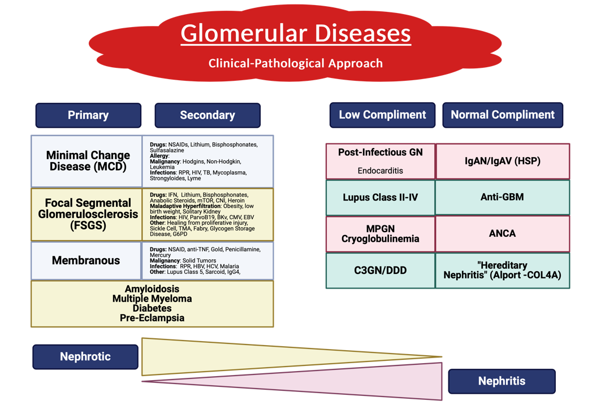

Slide 27
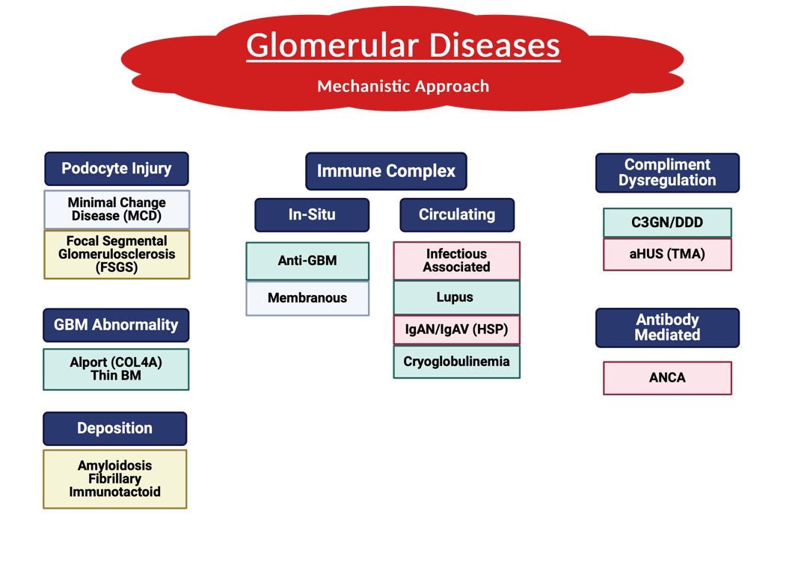

Slide 28
 |  |  |  | Glomerular Disease
 | Nephrotic Syndrome |  |  |  |  |  |  | Nephritic Syndrome
Primary |  | Secondary |  |  | ANCA |  | (+) Anti-GBM |  | Decreased Compliment |  | Other
FSGS |  | Diabetes |  |  | c-ANCA (PR3) | p-ANCA (MPO) | Goodpastures |  | Post-Infectious |  | IgA Nephropathy
Membranous |  | Pre-eclampsia |  |  | GPA (Wegners) | Microscopic Polyangiitis |  |  | Membranoproliferative |  | HSP
Minimal Change |  | Medications |  |  |  | EGPA (Churg Straus) |  |  | SLE
 |  | Infectious |  |  |  |  |  |  | Infective Endocarditis
 |  | Malignancy |  |  |  |  |  |  | Cryoglobulinemia
 |  | SLE
 |  | Amyloidosis

Slide 29
Work-up
General
Specific
Good Medical History
BMP, Hepatic Profile
CBC
Lipids
A1c
UA
Microalbumin, Spot Protein-Cr ratio
24hr protein
Infectious: HBV, HCV, HIV, RPR, ASO (other infections)
AI: C3, C4, CH50, ANA (with IFE), dsDNA, p-ANCA, c-ANCA (PR3 and MPO), Anti-GBM
SPEP / UPEP/Kapp—Lambda
Anti-PLA2R Antibody
LDH, Hapto, Peripheral Smear
More specific Autoimmune
Kidney Biopsy

Slide 30

Nephrotic Syndrome
Nephrotic syndrome occurs when there is impairment of glomerular charge and size selectivity, which are normally maintained by a combination of glomerular basement membrane, endothelial cells, and epithelial cells (podocytes). The resultant increase in permeability allows large molecules such as albumin to escape into the urine.
Underfill Hypothesis – low albumin leads to reduction in intravascular oncotic pressure and a resultant shift of plasma from capillaries to the interstitium. Further more the depletion stimulates the RAAS system leading to salt/water retention.
Overfill Hypothesis – sodium is retained in the collecting duct triggered by the abnormally filtered proteins
Thrombophilia – hypothesized to be an imbalance between prothrombotic and antithrombotic factors. This imbalance occurs as a result of loss of anticoagulant proteins in the urine, including antithrombin and proteins C and S, and increased production of procoagulant proteins such as fibrinogen. Most common sites of thrombosis are renal veins and veins of lower extremities.
Nephrotic syndrome can develop generalized infections more frequently than the normal population. Believed to be due to low serum IgG concentration and diminished T-cell function.

Slide 31
Generalized Treatment for all Nephrotic
Diuretics (loop) – sometimes necessary to a 2nd thiazide/Potassium sparing
  High doses of loop diuretics, increased delivery of salt and water to the distal portions of the nephron can lead to hypertrophy of these segments and overabsorption of sodium, undermining the effects of the loop diuretics.
Salt restriction
Anticoagulation?
RAAS blockade – HTN, proteinuria
Statin - Hyperlipidemia

Slide 32
Focal Segmental Glomerulosclerosis (FSGS)
Most common form of inherited nephrotic syndrome
APOL1
US – prevalence 20,000. Yearly incidence 5,000
Abnormality in the podocyte. Podocyte detachment and death lead to segmental sclerosis
Diagnosis: Kidney Biopsy
  Light Microscopy – Glomerulosclerosis (scarring), focal (<50%) and segmental
Tx:
  General Treatment
  Steroids (cyclophosphamide, MMF, rituximab are 2nd)

Slide 33
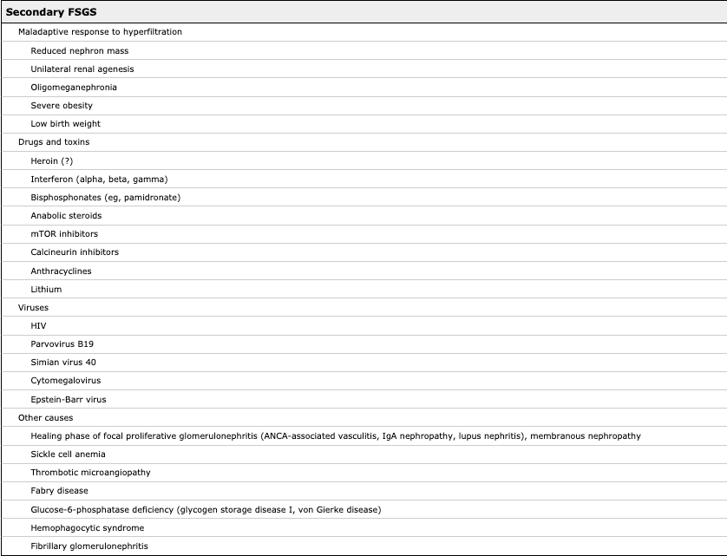

Slide 34
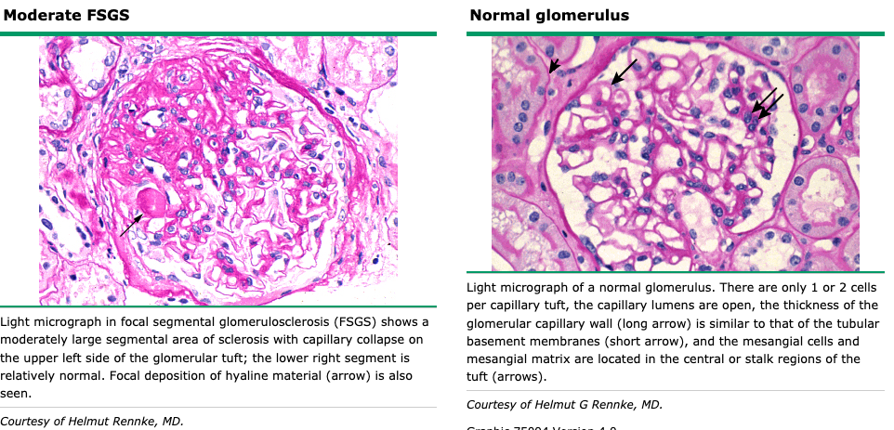

Slide 35
(15.) A 68-year-old woman is evaluated during a follow-up visit for a three-week history of nephrotic syndrome. She otherwise has been well and reports no additional symptoms. She has a 50 pack history of cigarette smoking with ongoing tobacco use.
On physical examination, vital signs are normal. Pitting edema to the ankles is present. Remainder the examination is unremarkable.
Laboratory studies:
Albumin 2.9
C3 normal
C4 normal
Creatinine normal
Rapid plasma region normal
Anti Nuclear Antibodies negative
Hepatitis-B antibodies negative
Hepatitis C antibodies negative
With 24 hour urine protein excretion 10,000 mg
A kidney ultrasound shows normal-appearing kidneys with no evidence of thrombus in the renal veins. Lower extremity Doppler ultrasound shows no evidence of deep vein thrombosis.
Kidney biopsy shows membranous glomerulonephropathy with negative staining for PhosphoLipase A2 Receptor (PLA2R) on immunofluorescence.
Which of the following is the most appropriate management?
A) age appropriate cancer screening
B) immunosuppression therapy
C) prophylactic anticoagulation
D) serologic testing for anti-PLA2R antibiotics

Slide 36
(15.) A 68-year-old woman is evaluated during a follow-up visit for a three-week history of nephrotic syndrome. She otherwise has been well and reports no additional symptoms. She has a 50 pack history of cigarette smoking with ongoing tobacco use.
On physical examination, vital signs are normal. Pitting edema to the ankles is present. Remainder the examination is unremarkable.
Laboratory studies:
Albumin 2.9
C3 normal
C4 normal
Creatinine normal
Rapid plasma region normal
Anti Nuclear Antibodies negative
Hepatitis-B antibodies negative
Hepatitis C antibodies negative
With 24 hour urine protein excretion 10,000 mg
A kidney ultrasound shows normal-appearing kidneys with no evidence of thrombus in the renal veins. Lower extremity Doppler ultrasound shows no evidence of deep vein thrombosis.
Kidney biopsy shows membranous glomerulonephropathy with negative staining for PhosphoLipase A2 Receptor (PLA2R) on immunofluorescence.
Which of the following is the most appropriate management?
A) age appropriate cancer screening
B) immunosuppression therapy
C) prophylactic anticoagulation
D) serologic testing for anti-PLA2R antibiotics

Slide 37
Membranous Glomerulopathy
Leading cause in white adults, 1 – 100,000 persons per year, Peak incidence 30-50 years old
>65 – malignancies are found in up to 25% in 1 year.
PLA2R – specific podocyte antigen (75% cases)
Circulating antibodies permeate the glomerular basement membrane and in the subepithelial space form immune complexes with epitopes on podocytes membranes
Diagnosis: Biopsy
  Subepithelial immune deposits that alter the glomerular capillary wall, classically accompanied by intervening “spikes” of glomerular basement membrane extending between the immune deposits.
  Biopsy can be stained for PLA2R antigen
Treatment
  Observe conservative 6-12 months (RAAS, Lipid, Edema) (30% remission 1-2 years).
  If nephrotic persists
    1) Glucocorticoids and alkylating agents (Cyclophosphamide) 75-80% remission. Ponticelli Regiment
    2) Calcineurin inhibitors (cyclosporine or tacrolimus) 70-75% remission (relapse rates higher).
    3) Rituximab showing non-inferiority in treatment with less relapses
  Secondary (treat underlying)
  Complete or partial remission 10%, Nephrotic protein >50%
Notes:
Prone to Thrombotic Conditions (25%)

Slide 38
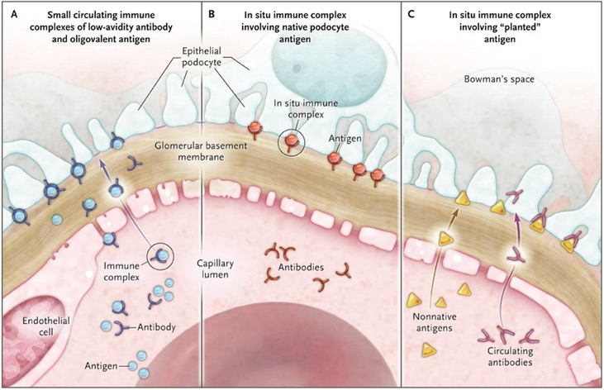
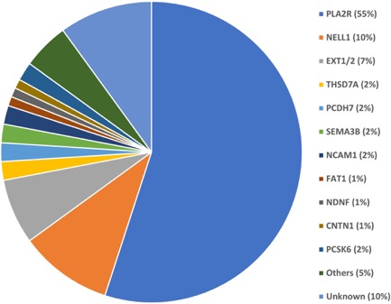
Membranous Glomerulopathy
Sethi, S. Kidney Int
Glassock, R. AJKD

Slide 39
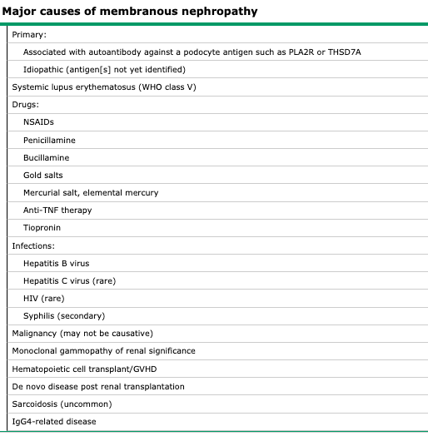

Slide 40
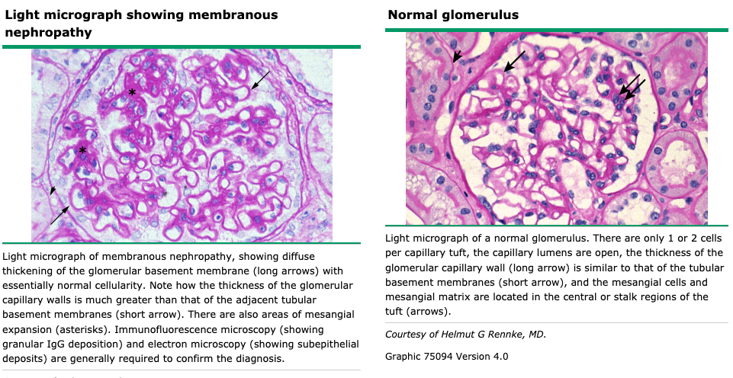

Slide 41
(4) 59-year-old woman is evaluated in the emergency department for new onset dependent edema that began 3 weeks ago. She says it is difficult to walk, and she has gained 4.5 kg (10 pounds) fluid weight. History significant for obesity and hypertension. Only medication is lisinopril.
On physical examination vital signs are normal. BMI is 32. There is no rash. There is 3 mm bilateral dependent edema stopping just below the abdomen; it is equal on both sides. The remainder the examination is unremarkable.
Laboratory studies:
Albumin 2.1
Creatinine 1.3
Urine protein-creatinine ratio 8700
Kidney biopsy findings are consistent with a diagnosis of minimal change glomerulopathy with superimposed acute tubular necrosis.
In addition to initiating diuretic therapy, which of the following is the most appropriate treatment?
A) cyclosporin
B) high-dose oral prednisone
C) rituximab
D) no additional treatment

Slide 42
(4) 59-year-old woman is evaluated in the emergency department for new onset dependent edema that began 3 weeks ago. She says it is difficult to walk, and she has gained 4.5 kg (10 pounds) fluid weight. History significant for obesity and hypertension. Only medication is lisinopril.
On physical examination vital signs are normal. BMI is 32. There is no rash. There is 3 mm bilateral dependent edema stopping just below the abdomen; it is equal on both sides. The remainder the examination is unremarkable.
Laboratory studies:
Albumin 2.1
Creatinine 1.3
Urine protein-creatinine ratio 8700
Kidney biopsy findings are consistent with a diagnosis of minimal change glomerulopathy with superimposed acute tubular necrosis.
In addition to initiating diuretic therapy, which of the following is the most appropriate treatment?
A) cyclosporin
B) high-dose oral prednisone
C) rituximab
D) no additional treatment

Slide 43
Minimal Change Disease
Most common in children (>90%), Adult (10-15% nephrotic)
Podocytopathy
Presumed model of injury is immunologic (circulating factors from B and T cell) alters podocyte function resulting in proteinuria.
Rapid response (>90% of cases) to nonspecific immunosuppression (glucocorticoids)
Diagnosis: Biopsy
  Light Microscopy and Immunofluorescence Stain: Negative
  Electron Microscopy: Podocyte Foot Effacement
Treatment:
  Glucocorticoids (90% remission)
  Steroid resistant disease (>16 weeks of therapy). Calcineurin Inhibitors, MMF, alkylating agents

Slide 44
Primary (idiopathic)
Secondary
 | Drugs
 |  | NSAIDS
 |  | Ampicillin, Rifampicin, Cephalosporin
 |  | Lithium
 |  | Penicillamine, Tiopronin
 |  | Pamidronate and other bisphosphonate
 |  | Sulfasalazine and derivative
 |  | Trimethadione
 |  | Immunizations
 |  | Gamma interferon
 | Neoplasm
 |  | Hodgkins
 |  | Non-Hodgkins
 |  | Leukemia
 | Infectious
 |  | Syphilis
 |  | TB
 |  | Mycoplasma
 |  | Ehrlichiosis
 |  | Hep C
 |  | HIV
 |  | Lyme
 | Allergy

Slide 45
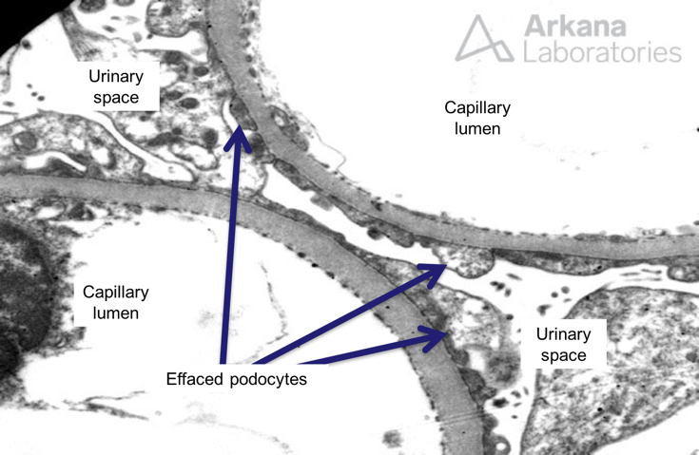


Slide 46
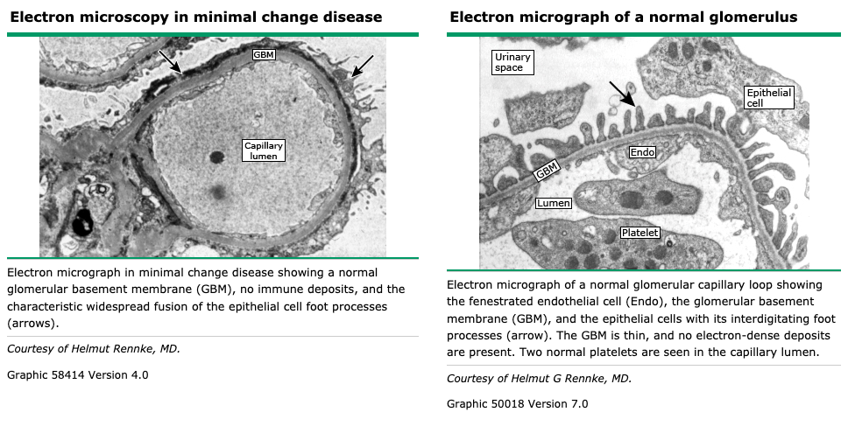

Slide 47
Diabetic Nephropathy
Leading cause of chronic kidney disease and ESRD worldwide
>50,000 new cases requiring dialysis each year
Defined: clinical evidence of kidney injury in response to chronic longstanding hyperglycemia (10-12% incidence over 25years)
Advanced glycation end products are felt to be the primary mediator activating mesangial cell synthesis of profibrogenic cytokines, including platelet derived growth factor and transforming growth factor Beta
Typically starts with microalbuminuria progressively worsening to Nephrotic syndrome
Microalbumin check (yearly type 2, after 5years type 1)
Biopsy if clinical presentation is not entirely consistent
Biopsy: nodular mesangial sclerosis (Kimmelstein-Wilson Nodules) with glomerular and tubular basement thickening, abscense of immune deposits, is the classic description of diabetic nephropathy.
Tx: Glycemic control, HTN control, RAAS blockade

Slide 48
Secondary Buzz Words
Kimmelsteil-Wilson – Diabetes
Pregnant – Pre-eclampsia
Medications– Gold or penicillamine, NSAIDS, Lithium, Captopril, and Tamoxifen
Malignancy – Lymphoma, Multiple Myeloma, Lung Cancer, Renal Cell Carcinoma (minimal and membranous)
Murmur – infective endocarditis – Bacterial (endo, syphilis), viral (HIV, hepatitis), protozoal (malaria, toxoplasmosis), and helminthic
B-symptoms in young patient – Hodgkin’s Lymphoma
Autoimmune – SLE (nephrotic and nephritic)
Congo red staining and polarized light microscopy - Amyloidosis

Slide 49
(25) A 27-year-old woman is evaluated for 6 month history of fatigue, arthralgia, myalgia. She has a history urinary tract infection. Medications are an oral contraceptive pill and as needed naproxen for pain.
On physical examination temperature is 100.8 F, blood pressure is 142/90, pulse rate is 90. Cardiac, lung, and abdominal exam are normal.
Lab studies show serum creatinine level of 1.4, urinalysis shows 2+ blood, 3+ protein, positive leukocyte esterase, no nitrites, 10-15 erythrocytes/HPF, 5-10 leukocytes/HPF, no crystals. Urine microscopy with RBC Casts
Which of the following is the most likely diagnosis?
A) bladder cancer
B) glomerulonephritis
C) tubular interstitial nephritis
D) urinary tract infection

Slide 50
(25) A 27-year-old woman is evaluated for 6 month history of fatigue, arthralgia, myalgia. She has a history urinary tract infection. Medications are an oral contraceptive pill and as needed naproxen for pain.
On physical examination temperature is 100.8 F, blood pressure is 142/90, pulse rate is 90. Cardiac, lung, and abdominal exam are normal.
Lab studies show serum creatinine level of 1.4, urinalysis shows 2+ blood, 3+ protein, positive leukocyte esterase, no nitrites, 10-15 erythrocytes/HPF, 5-10 leukocytes/HPF, no crystals. Urine microscopy with RBC Casts
Which of the following is the most likely diagnosis?
A) bladder cancer
B) glomerulonephritis
C) tubular interstitial nephritis
D) urinary tract infection

Slide 52
 |  |  |  | Glomerular Disease
 | Nephrotic Syndrome |  |  |  |  |  |  | Nephritic Syndrome
Primary |  | Secondary |  |  | ANCA |  | (+) Anti-GBM |  | Decreased Compliment |  | Other
FSGS |  | Diabetes |  |  | c-ANCA (PR3) | p-ANCA (MPO) | Goodpastures |  | Post-Infectious |  | IgA Nephropathy
Membranous |  | Pre-eclampsia |  |  | GPA (Wegners) | Microscopic Polyangiitis |  |  | Membranoproliferative |  | HSP
Minimal Change |  | Medications |  |  |  | EGPA (Churg Straus) |  |  | SLE
 |  | Infectious |  |  |  |  |  |  | Infective Endocarditis
 |  | Malignancy |  |  |  |  |  |  | Cryoglobulinemia
 |  | SLE
 |  | Amyloidosis

Slide 53
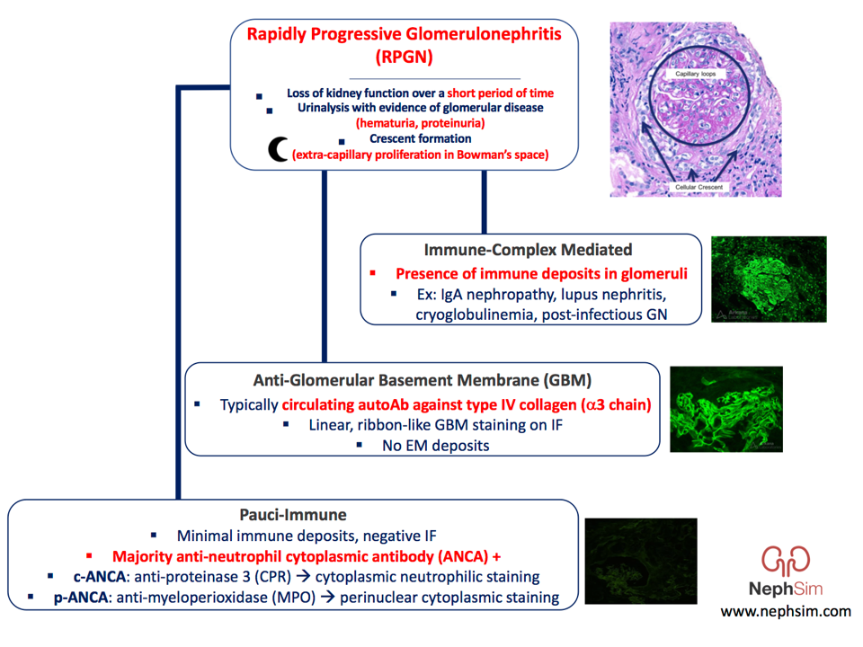

Slide 54
Rapidly Progressive Glomerulonephritis
Crescentic Glomerulonephritis
Not a specific disease, but clinical entity by multiple disease processes
1) at least 50% decline in GFR over a short period (days to weeks)
2) pathology findings of extensive glomerular crescents
  Crescents signal focal rupture of glomerular capillary walls.
  Rupture allows accumulation of fibrin and fibronectin in the urinary space, where they activate de-differentiated glomerular parietal epithelial cells to proliferate, surround, and compress the glomerular tuft
Macroscopic/microscopic hematuria, erythrocyte casts, varying ranges of proteinuria, and AKI which can rapidly lead to dialysis
Serology (ANA, ANCA, anti-GBM) or compliment (low vs. normal)
Tx: specific etiology. If untreated RPGN is expected to progress to dialysis in matter of days to weeks.

Slide 55
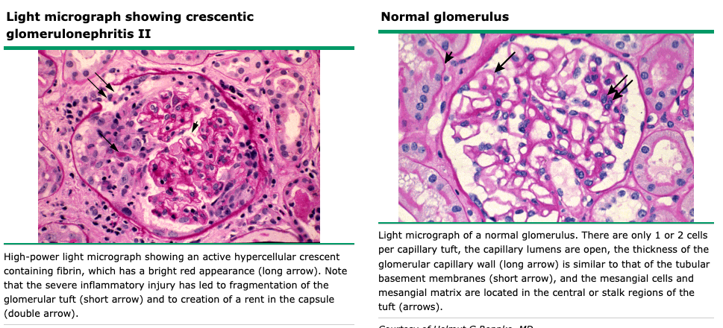

Slide 56
Anti-Glomerular Basement Membrane
Rare RPGN (<1 per million per year) accounts for 20% of RPGN in adults
Bimodal age/gender (young men 2-3rd decade and older women 6-7 decade)
½ have pulmonary hemorrhage, 1/3 purely nephritis, 1/3 has concurrent ANCA (MPO or c-ANCA)
Circulating anti-GBM antibodies target the alpha-3 chain of type IV collagen which incites intense inflammatory response.
>50% have lung involvement (Goodpasture's)
Biopsy: Crescentic Glomerulonephritis on Light Microscopy
  Light Microscopy: Crescentic Glomerulonephritis
  Linear Staining for IgG along capillaries
Serologic anti-GBM antibodies (sensitivity 60-100%) which a kidney biopsy to confirm unless contra-indicated. Antibodies should always be tested as it allows to follow efficacy of therapy
Goodpasture Syndrome – Pulmonary Hemorrhage

Slide 57
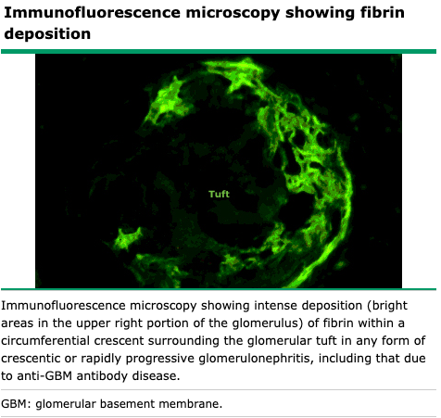
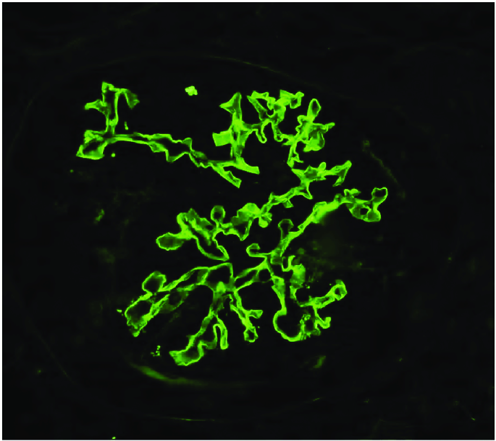

Slide 58
(21) An 83-year-old man is evaluated for 1 week history of poor appetite, myalgia, fatigue, arthralgia, and low-grade fever. He was previously healthy and active. His only medication is Tylenol as needed.
On physical examination, patient is afebrile. Blood pressure is 155/95, pulse rate of 80; there are no orthostatic changes. There is trace lower extremity edema. A faint red blue reticular rash is present over the lower extremities.
Laboratory studies:
Hemoglobin 12
Calcium 9.8
Creatinine 3.1 (baseline 0.9)
Urinalysis 3+ blood, 2+ protein, 20-30 dysmorphic erythrocytes; 5-10 leukocytes
Chest radiograph shows no acute infiltrate. Kidney ultrasound shows no masses or obstruction
Which of the following is most likely diagnosis?
A) ANCA associated glomerulonephritis
B) anti-glomerular basement membrane antibody disease
C) minimal change glomerulopathy
D) myeloma cast nephropathy
E) proliferative lupus nephritis

Slide 59
(21) An 83-year-old man is evaluated for 1 week history of poor appetite, myalgia, fatigue, arthralgia, and low-grade fever. He was previously healthy and active. His only medication is Tylenol as needed.
On physical examination, patient is afebrile. Blood pressure is 155/95, pulse rate of 80; there are no orthostatic changes. There is trace lower extremity edema. A faint red blue reticular rash is present over the lower extremities.
Laboratory studies:
Hemoglobin 12
Calcium 9.8
Creatinine 3.1 (baseline 0.9)
Urinalysis 3+ blood, 2+ protein, 20-30 dysmorphic erythrocytes; 5-10 leukocytes
Chest radiograph shows no acute infiltrate. Kidney ultrasound shows no masses or obstruction
Which of the following is most likely diagnosis?
A) ANCA associated glomerulonephritis
B) anti-glomerular basement membrane antibody disease
C) minimal change glomerulopathy
D) myeloma cast nephropathy
E) proliferative lupus nephritis

Slide 60
ANCA-Associated
ANCA associated (pauci-immune crescentic glomerulonephritis) accounts for more than half of all RPGN with higher prevalence >65yo
Bimodal distribution (teens vs >60)
Target proteins within neutrophil granules and monocyte lysosome
P-ANCA (perinuclear) = neutrophil enzyme myeloperoxidase (MPO)
C-ANCA (cytoplasmic) = neutrophil proteinase 3 (PR3)
Light Microscopy: Crescentic glomerulonephritis
Immunofluorescence: paucity or absence of immune-type deposits.
Foci of necrosis or cellular crescents are highlighted by immunofluorescence staining for fibrinogen.
Treatment
  1) Induction therapy (glucocorticoids with cyclophosphamide or Rituximab)
    Plasmapheresis preserved for patients with alveolar hemorrhage or severe kidney failure**.
  2) Maintenance therapy 12-24 months (rituximab, azathioprine, or MMF)
Notes:
Fever, malaise, FLS
C-ANCA have higher rates of relapse (particularly with lung/sinus)
ANCA associated glomerulonephritis is approximately 20% mortality rate within the 1st year of diagnosis and results in ESRD in up to 25% within first 4 years.

Slide 61
  PR3 (c-ANCA)
    Granulomatosis with Polyangiitis (Wegners)
    May not be positive ANCA in some
    Sinusitis and saddle nose deformity with hemoptysis, hematuria, AKI
    Majority have renal involvement within 2 years
  MPO (p-ANCA)
    Microscopic Polyangiitis (MPA) – absence of granulomas
    Eosinophilic Granulomatosis with Polyangiitis (EGPA or Churg-Strauss)
    Asymptomatic proteinuria to Rapidly progressive GN

Slide 63
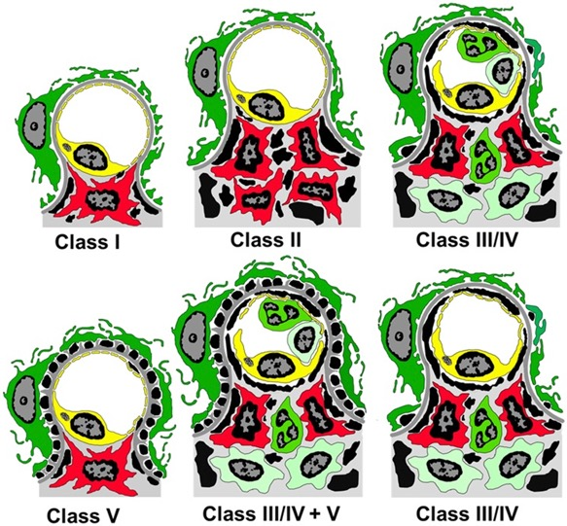
Lupus Nephritis
Can be anything

Slide 64
Infectious Related Glomerulonephritis
Results from recently resolved infection or ongoing at time of development of GN (typically 1-2 weeks)
Antibodies directed at bacterial antigens form immune complexes in the circulation that subsequently deposit in the glomerulus
Hypocomplementemia is common (decrease C3)
Biopsy is definitive
  Light microscopy – proliferative glomerulonephritis with significant presence of infiltrating neutrophils
  Electron microscopy – hump shaped subepithelial electron dense deposits
Treatment: is typically supportive and aimed at infectious etiology
Notes:
Formerly used Post infectious GN, Classic poststreptococcal GN
Diabetes is the most common comorbidity (malignancy, immunosuppression, aids, alcoholism, and IVDA)
Older age is a key risk factors (>65 account for 1/3)
Typically children in acute nephritic syndrome of hematuria, proteinuria, hypertension, edema

Slide 65
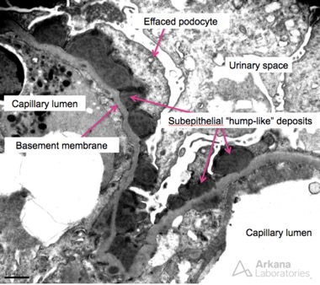
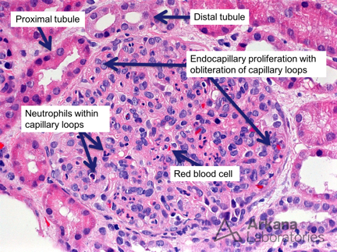
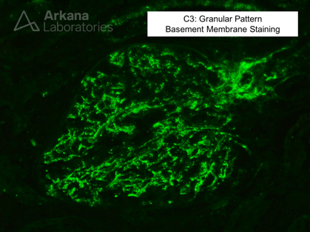
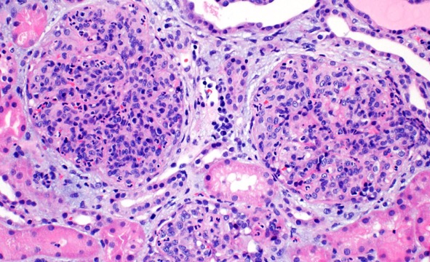
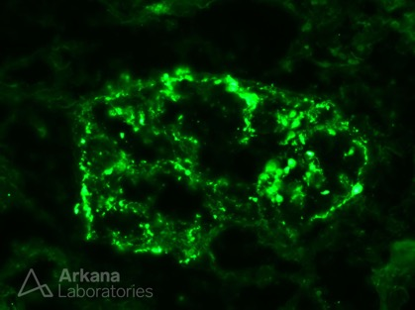

Slide 66
Next is tricky

Slide 67
(6) 31-year-old man is evaluated during follow-up visit for IgA nephropathy pound on kidney biopsy 3 months ago, at which time lisinopril was initiated. He is asymptomatic.
Physical examination vital signs are unremarkable.
Laboratory studies: (3 months prior)
Creatinine 1.1 (1.0)
Potassium 4.8 (4.4)
Urinalysis 3+ blood, 2+ protein (3+ blood, 3+ protein)
Urine protein-creatinine ratio 700 (1200)
Which of the following is the most appropriate next step in management?
A) add losartan
B) add oral glucocorticoid therapy
C) start alternating courses of IV and oral glucocorticoids therapy
D) make no changes in the current medication regimen

Slide 68
(6) 31-year-old man is evaluated during follow-up visit for IgA nephropathy pound on kidney biopsy 3 months ago, at which time lisinopril was initiated. He is asymptomatic.
Physical examination vital signs are unremarkable.
Laboratory studies: (3 months prior)
Creatinine 1.1 (1.0)
Potassium 4.8 (4.4)
Urinalysis 3+ blood, 2+ protein (3+ blood, 3+ protein)
Urine protein-creatinine ratio 700 (1200)
Which of the following is the most appropriate next step in management?
A) add losartan
B) add oral glucocorticoid therapy
C) start alternating courses of IV and oral glucocorticoids therapy
D) make no changes in the current medication regimen

Slide 69
Immune Complex Mediated Glomerulonephritis
Granular immunofluorescence microscopy staining patterns all fall under the umbrella category of immune complexes deposition in kidney in various locations
Immune complex deposition activates classic complement pathway as a co-player in glomerular inflammation, injury, and scarring.
Associated with low levels of C3 and/or C4
IgA nephropathy is the exception due to the chronic, gradual nature (normal C3 and C4) where hepatic production to replace is enough. (except rare case of RPGN with IgA)

Slide 70
IgA Nephropathy
Most common primary glomerular disease worldwide, higher prevalence in Asian ancestry
Any age with 2:1 male-to-female
Defect in IgA1-producing cells leading to hypogalaactosylation of the hinge region of IgA1. (Gd-IgA1) are elevated to form immune complexes that accumulate in the glomerular mesangium
Mesangial immune deposits of IgA with C3 and occasionally IgG or IgM
Treatment
  General Management
  Immunosuppression timing in IgAN remains controversial*
Notes:
1/3 benign long term course with microscopic hematuria
40% reach ESRD within 15 years of diagnosis
>50% tubular atrophy and interstitial fibrosis on kidney biopsy is predictor

Slide 71
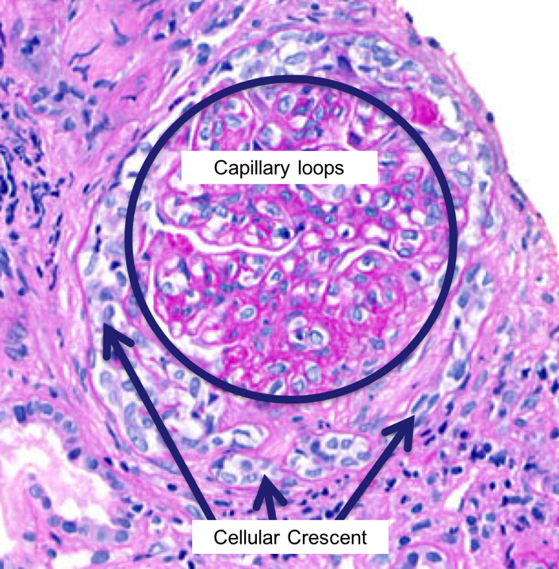
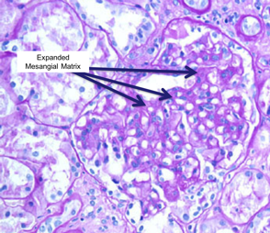
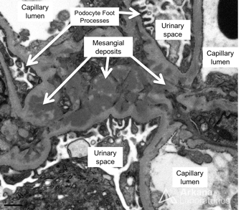
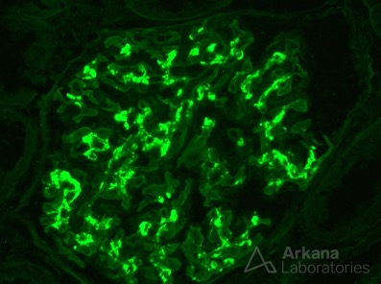

Slide 72
IgA Vasculitis
Henoch-Schonlein purpura
Tetrad: Rash, Arthralgia, Abdominal Pain, and Kidney disease
Identical to IgA nephropathy on histology
HSP has extrarenal manifestations (palpable purpura)
Often diagnosed empirically in pediatric patients, requires tissue biopsy (skin or kidney) to confirm
Treatment included glucocorticoids (and cyclophosphamide in RPGN)

Slide 73
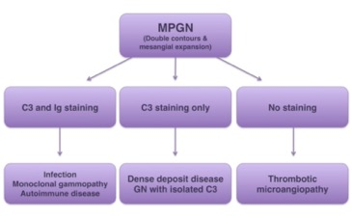
Membranoproliferative Glomerulonephritis
MPGN is rare
Primarily in young adults and children
Immune complex (antigen-antibody interaction triggering compliment classical)
Complement mediated at MPGN (termed C3, Low C3 and Normal C4)
Immune-complex MPGN with or without cryoglobulinemia – typically with Hepatitis C (alternative complement)
Idiopathic or secondary (SLE, MGUS, Hep C)
More common presentation is chronic glomerulonephritis (microscopic hematuria and subnephrotic proteinuria)
Biopsy
Immunofluorescence microscopy absence or presence of immunoglobulin staining signals an independent manner of triggering complement and hence alternative pathway hyperactivity
Electron Microscopy: Subendothelial Immune Deposits
Tx: Immunosuppression when nephrotic range or compliment targeting

Slide 75
References
Frameworks of Internal Medicine – Andre M. Mansoor
MKSAP 18 – Nephrology
Harrison's 20th
Up-to-date
Glassock, Richard J. The Pathogenesis of Idiopathic Membranous Nephropathy: A 50-Year Odyssey. American Journal of Kidney Diseases, Volume 56, Issue 1, 157 – 167
Sethi, Sanjeev et al. Mayo Clinic consensus report on membranous nephropathy: proposal for a novel classification. Kidney International, Volume 104, Issue 6, 1092 - 1102

Slide 78
1) A 45-year-old man presents with bilateral lower extremity edema, fatigue, and foamy urine for 3 weeks. Labs: serum albumin 2.1 g/dL, total cholesterol 340 mg/dL, 24-hour urine protein 5.2 g. Urinalysis shows oval fat bodies and no RBC casts. Serum creatinine is 1.0 mg/dL.
Which of the following is the most likely diagnosis?
A) Nephritic syndrome
B) Nephrotic syndrome
C) Acute tubular necrosis
D) Chronic kidney disease stage 4
E) Hepatorenal syndrome

Slide 79
B) Nephrotic syndrome
Explanation: Nephrotic syndrome is defined by proteinuria >3.5 g/day, hypoalbuminemia (3 g/dL), peripheral edema, and hyperlipidemia. Oval fat bodies ("Maltese cross" under polarized light) are characteristic of nephrotic-range proteinuria. The absence of RBC casts and active sediment distinguishes this from nephritic syndrome. Nephritic syndrome typically presents with hematuria, RBC casts, hypertension, and mild-to-moderate proteinuria. In adults, the most common primary causes of nephrotic syndrome are membranous nephropathy and focal segmental glomerulosclerosis (FSGS).

Slide 80
2) A 52-year-old woman with no significant past medical history presents with nephrotic syndrome. Kidney biopsy shows diffuse thickening of the glomerular basement membrane with subepithelial "spike and dome" deposits on silver stain. Immunofluorescence shows granular IgG and C3 along capillary walls. Serum anti-PLA2R antibodies are positive.
What is the most likely diagnosis?
A) Minimal change disease
B) Focal segmental glomerulosclerosis
C) Membranous nephropathy
D) Membranoproliferative glomerulonephritis
E) Amyloidosis

Slide 81
2) C) Membranous nephropathy
Explanation: Membranous nephropathy is the most common cause of primary nephrotic syndrome in white adults. The hallmark pathologic findings are diffuse GBM thickening with subepithelial deposits that create a "spike and dome" pattern on silver stain. Anti-PLA2R antibodies are present in 70–80% of primary membranous nephropathy cases and correlate with disease activity. Anti-THSD7A antibodies are found in 1–3% of cases. Secondary causes (SLE, hepatitis B, malignancy, NSAIDs) must be excluded.

Slide 82
3) A 28-year-old man presents with sudden-onset nephrotic syndrome. Kidney biopsy shows normal glomeruli on light microscopy. Immunofluorescence is negative. Electron microscopy reveals diffuse podocyte foot process effacement.
What is the most likely diagnosis?
A) IgA nephropathy
B) Minimal change disease
C) Focal segmental glomerulosclerosis
D) Thin basement membrane disease
E) Diabetic nephropathy

Slide 83
3) B) Minimal change disease
Explanation: Minimal change disease (MCD) is characterized by normal glomeruli on light microscopy, negative immunofluorescence, and diffuse podocyte foot process effacement on electron microscopy. MCD accounts for 10–25% of nephrotic syndrome in adults and is the most common cause in children (>70%). It is highly responsive to corticosteroids, with remission in >80% of adults. Relapses are common, occurring in approximately 50% of patients during steroid tapering.

