Slide 1

Genetics in Kidney Disease
Jacob Nysather D.O.
Assistant Professor of Medicine in Nephrology
University of Cincinnati
nysathjb@ucmail.uc.edu

Slide 2

DISCLOSURES
None

Slide 3
OBJECTIVES
1
Describe the indications for genetic testing in kidney disease patients
2
Review the genetic basis of common CKD causes and the implications
X
Become an expert in genetic testing

Slide 4





CASE
A 34 year old female was evaluated in the ED after a motor vehicle accident. CT imaging revealed a total of multiple simple cysts with a mass with some lipid content noted on each kidney (Right 7mm -7HU and Left 4mm -5HU). Her lab work was unremarkable and after observation was discharged with follow-up recommended to nephrology for incidental kidney lesions/cysts. Given her labs were at baseline she was discharged home with recommended follow-up.
Upon further questioning she has a positive family history of mother who was diagnosed with ADPKD who received a kidney transplant at age 54. She was also had part of her kidney removed in her early 40s with concern for RCC – ultimately with benign pathology.

Slide 5
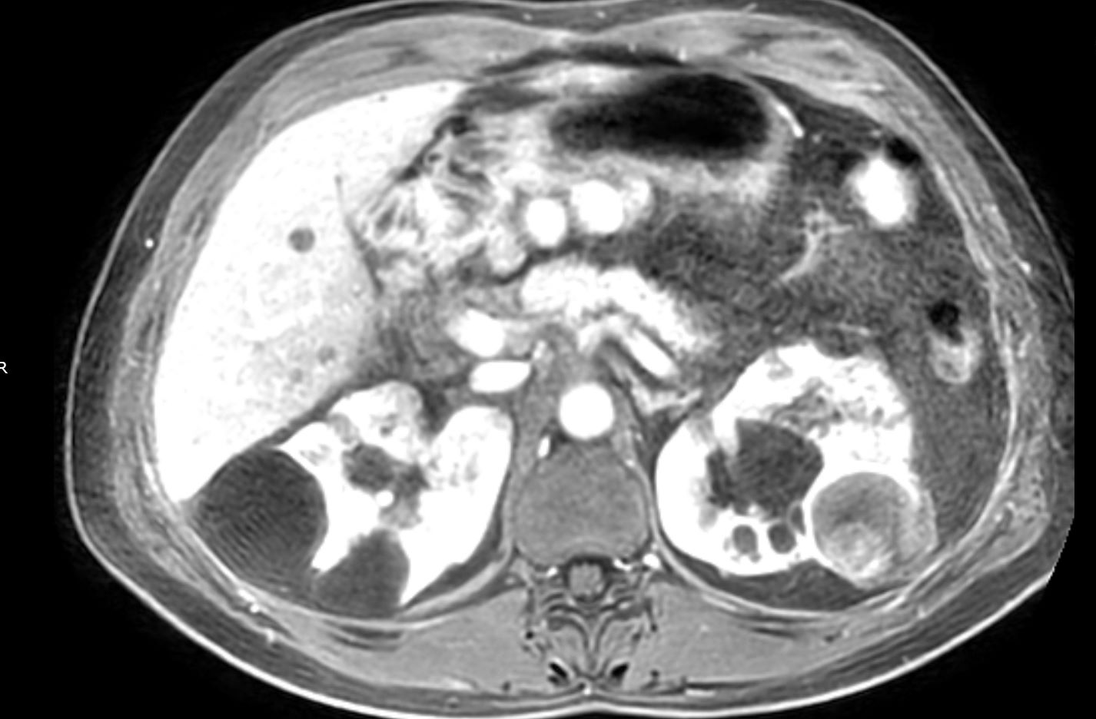
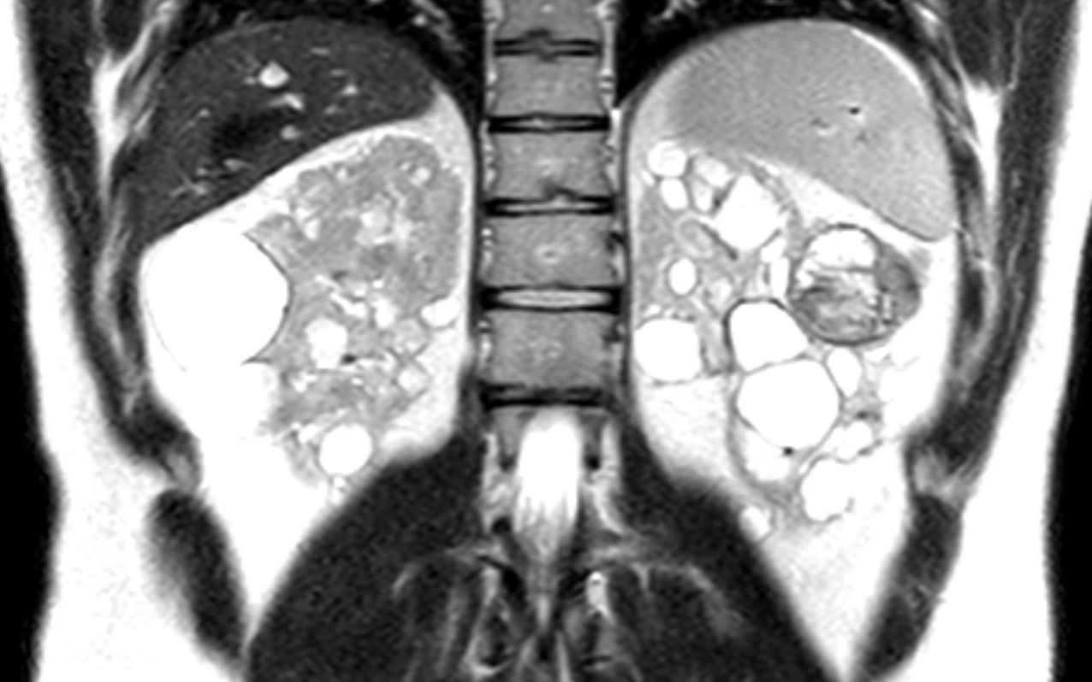
CASE
Do I have cancer?
Will I need to be on dialysis like my mom?

Slide 6
Why Genetics Matter
CKD affects more than 800 million people worldwide
20-27% of ESKD have a positive family history
Monogenetic disorders in General CKD population
  Pediatric: 30-50%
  Adults: 10-30%

Slide 7
Why Genetics Matter
Clinical Presentation
  Constellation of comorbidities
  Biomarkers
Histological
  Kidney Biopsy
Genetic*
Precision medicine in CKD is aimed at providing an accurate diagnosis, establishing a prognosis, and appropriately individualizing treatment

Slide 8
Role of Genetics in Nephrology
Classification: Clinical, Histological, and Genetic
Even if a clinical diagnosis is strongly suspected, genetic testing can be useful in confirming the diagnosis and reclassifying the disease and in prognostication
A genetic diagnosis leads to reclassification of the original clinical or histologic diagnosis in up to 50% of cases and change in management up to 90% of cases

Slide 9
Role of Genetics in Nephrology
In genetic disorders of renal structure and function, the same phenotype can result from defects in a number of distinct individual genes – thus complicating single gene based genetic testing
Genetic testing is not 100% sensitive in mutation detection, even in cases where the phenotype strongly indicates a specific clinical diagnosis

Slide 10

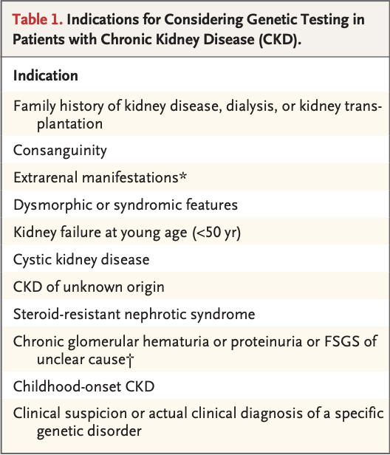
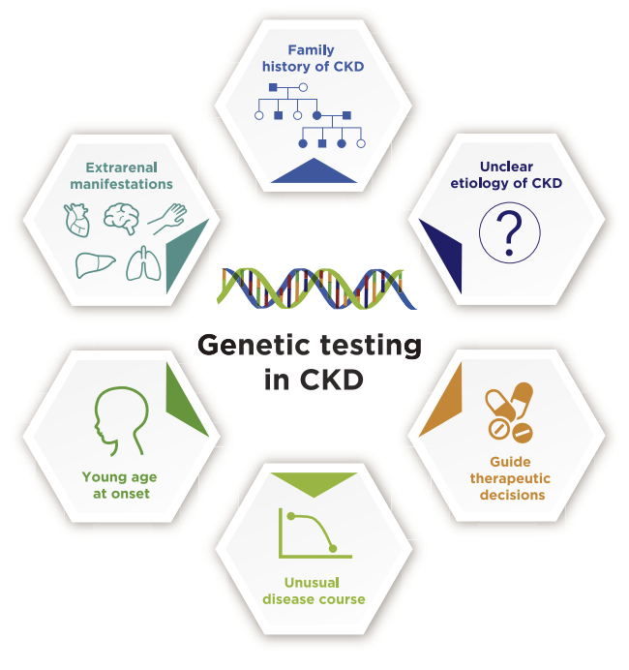
WHO SHOULD BE TESTED
Vivante, A. NEJM 2024
Devarajan, P. et al. Kidney Medicine 2022

Slide 11

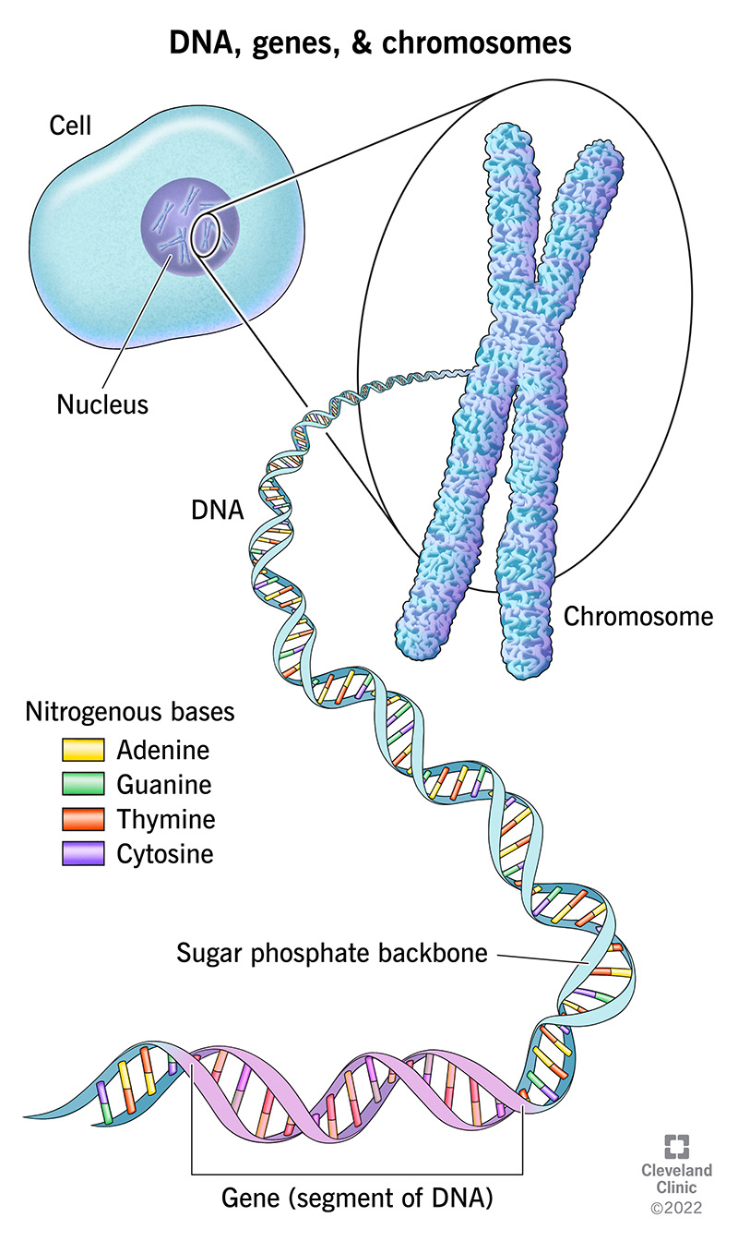



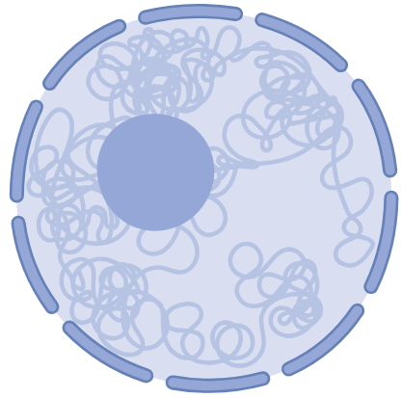


Basics of Genetics
Book
Chapter
Sentence
Genome
Chromosome
Gene
Made with Biorender

Slide 12

The cat ran down the hall
The cat ran down the Ball
The cat ran down the Tall
The cat ran down the ___
MUTATIONS

Slide 13
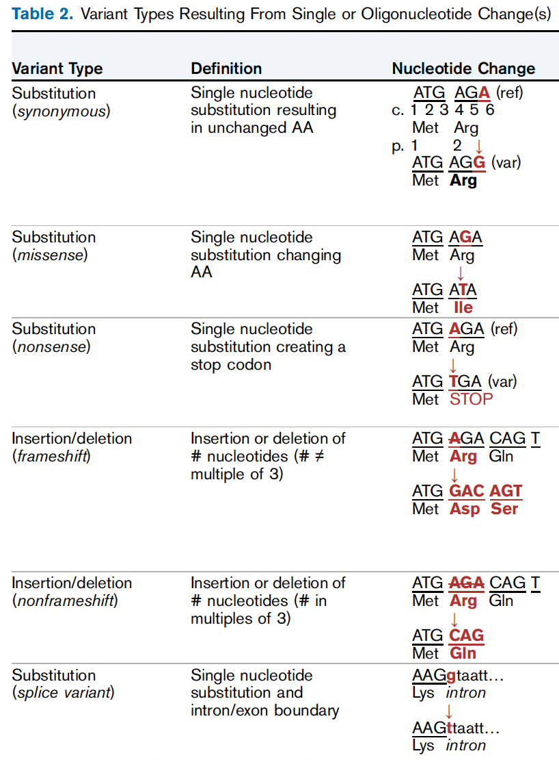
VARIANT TYPES
Aron and Dahl. AJKD. 2024

Slide 14
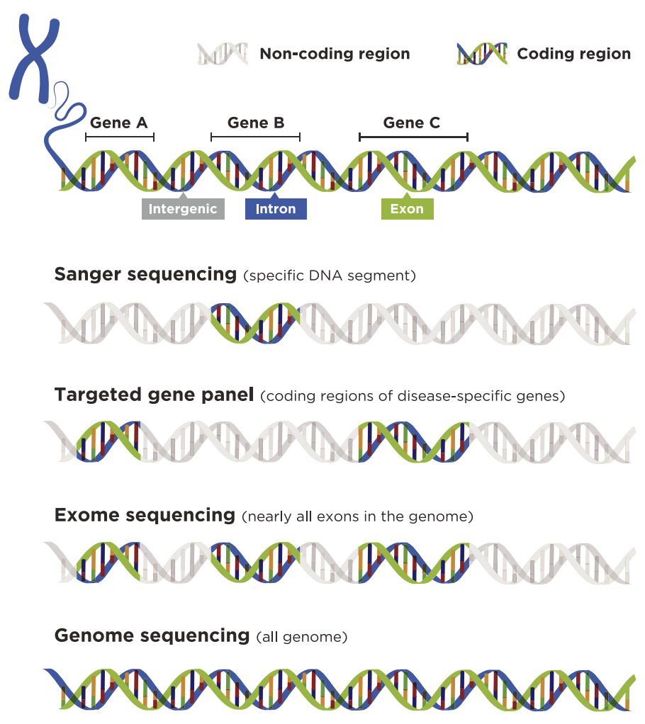
Types of
Genetic Testing
Devarajan, P. et al. Kidney Medicine 2022

Slide 15

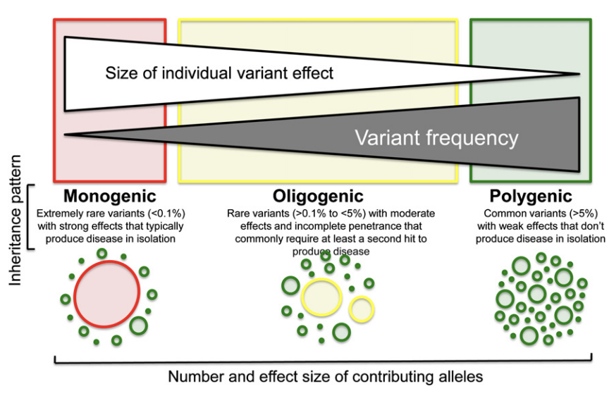
INHERITANCE
Giudicessi, JR. et al. Transl Res. 2013
Notes:
- Monogenic forms of disease are usually caused by rare or even private variants in a single gene that have a large effect
- Modifier alleles exhibit intermediate allele frequencies and more modest effect sizes
- Polygenic subtypes of kidney disease usually reflect the collective contributions of multiple common variants each of which has a small effect on disease risk, however polygenic risk scores have shown that individuals who have many common variants can have a similar disease risk to individuals with a mongenic form
- Relatively common variants have been shown to each have a large impact on disease risk (association of APOL1 risk variants with various form of non-diabetic CKD and association of risk alleles at HLA and PLA2R1 loci with idiopathic Membranous Nephropathy
In addition to being shaped by the type of genetic mutation and environmental factors these phenomena can be mediated by the actions of modifier genes. Some monogenic conditions can vary substantially depending on the genotype at other loci suggestive of oligogenic inheritance
- Novel approaches to help to address challenges posed by complexity of CKD (such as polygenic risk scores and phenotypic risk scores)
- However, many of these disorders can arise from genetic etiologies, can also occur from secondary factors (metabolic disease, immune dysfunction, infection, toxic injury)

Slide 16
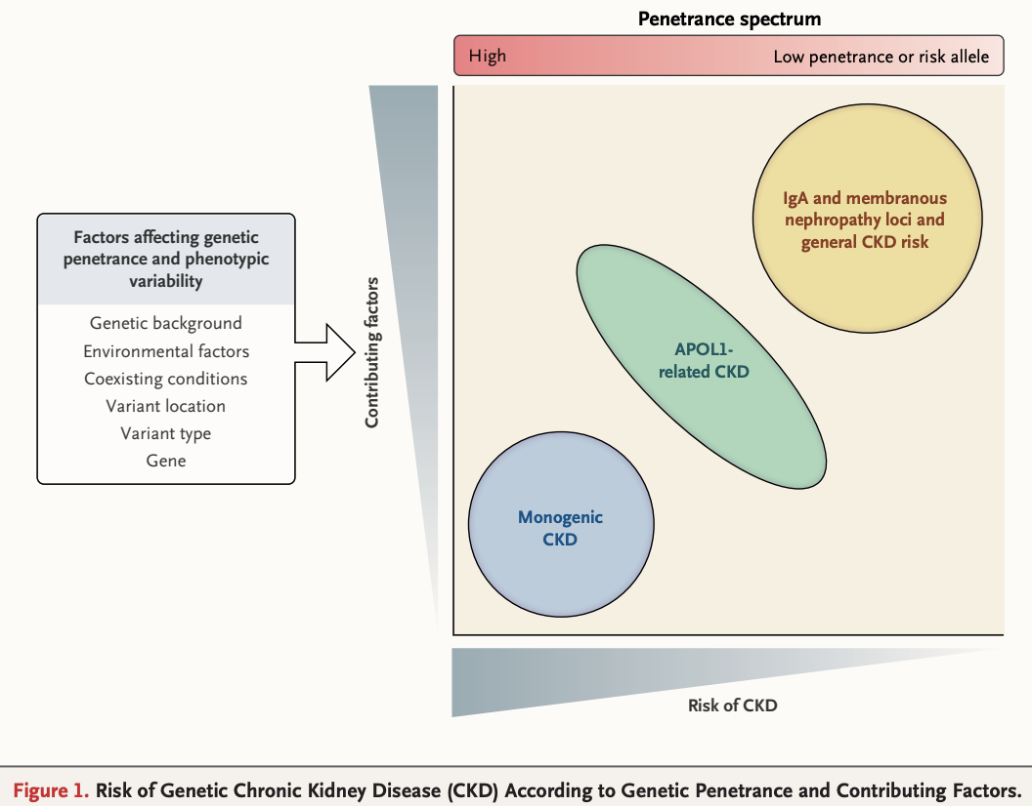
INHERITANCE IN
NEPHROLOGY
Vivante, A. NEJM 2024
Notes:
- Monogenic forms of disease are usually caused by rare or even private variants in a single gene that have a large effect
- Modifier alleles exhibit intermediate allele frequencies and more modest effect sizes
- Polygenic subtypes of kidney disease usually reflect the collective contributions of multiple common variants each of which has a small effect on disease risk, however polygenic risk scores have shown that individuals who have many common variants can have a similar disease risk to individuals with a mongenic form
- Relatively common variants have been shown to each have a large impact on disease risk (association of APOL1 risk variants with various form of non-diabetic CKD and association of risk alleles at HLA and PLA2R1 loci with idiopathic Membranous Nephropathy
In addition to being shaped by the type of genetic mutation and environmental factors these phenomena can be mediated by the actions of modifier genes. Some monogenic conditions can vary substantially depending on the genotype at other loci suggestive of oligogenic inheritance
- Novel approaches to help to address challenges posed by complexity of CKD (such as polygenic risk scores and phenotypic risk scores)
- However, many of these disorders can arise from genetic etiologies, can also occur from secondary factors (metabolic disease, immune dysfunction, infection, toxic injury)

Slide 17

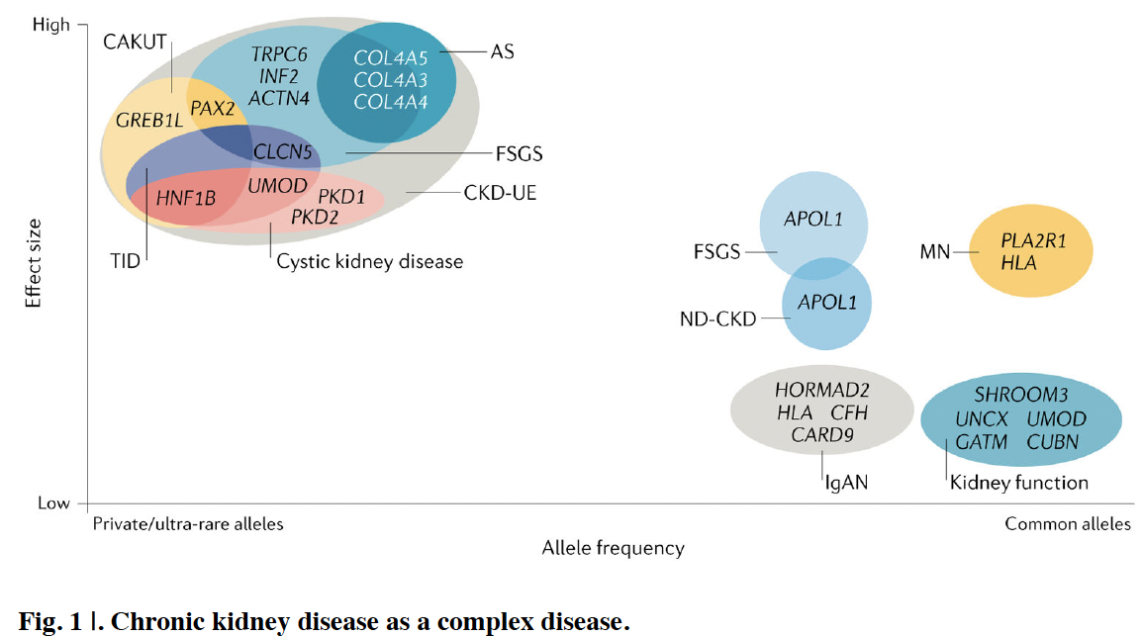



INHERITANCE IN NEPHROLOGY
Groopman, EE. et al. Nat Rev Nephrol. 2020

Slide 18
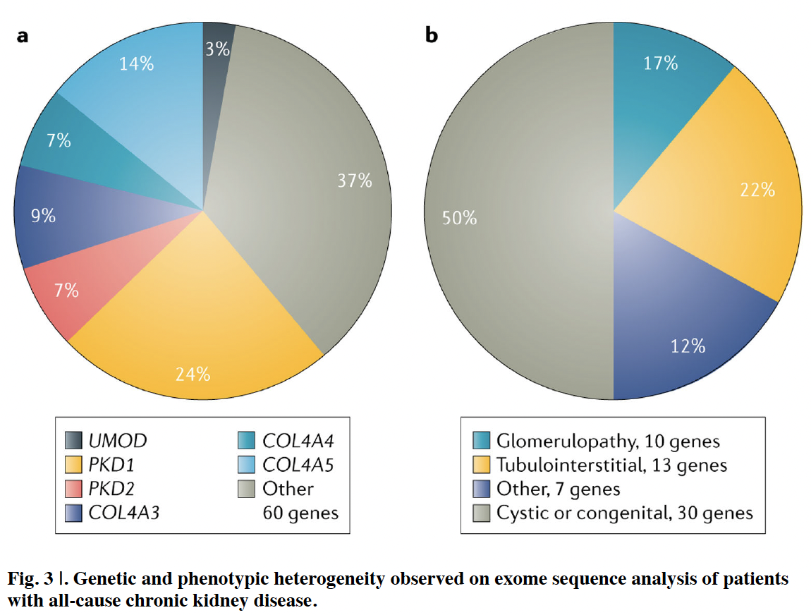
PHENOTYPIC HETEROGENEITY
Groopman, EE. et al. Nat Rev Nephrol. 2020

Slide 19



Benefits
Risks
Precise Diagnosis
1
1
Inconclusive Results
Early Detection in Affected Family Members
2
2
Effects on Family Members
Pre and Post Prognostication
3
3
Access to Genetic Experts
Genetic
Testing
Prevention of Ineffective or Harmful Treatment
4
4
Availability and Cost
Targeted Therapy
5
5
No Available Treatment
6
6
Implications for Disability and Life Insurance
Extra-Renal Manifestations

Slide 20
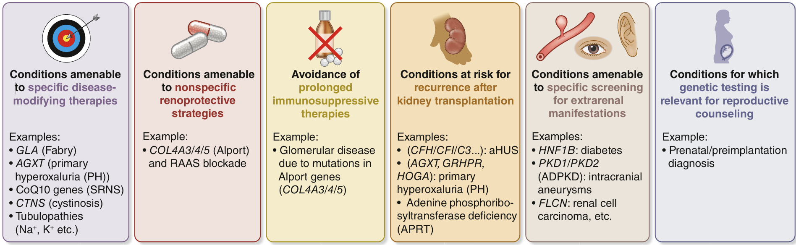
Clinical Application
Notes:
Actionability refers to the potential for genetic rest results to lead to specific clinical actions from prevention or treatment of a condition, supported by recommendations based on evidence. ADPKD, autosomal dominant polycystic kidney disease; aHUS, atypical hemolytic uremic syndrome, CKD, chronic kidney disease; RAAS, renin-angiotensin-aldosterone system, SRNS, steroid-resistant nephrotic syndrome. Reproduced from KDIGO Conference Participants. Genetics in chronic kidney disease: conclusions from a Kidney Disease: Improving Global Outcomes (KDIGO) Controversies Conference. Kidney Int. 2022;101:1126–1141.100 Copyright ª 2022, Kidney Disease: Improving Global Outcomes (KDIGO). Published by Elsevier Inc. on behalf of the International Society of Nephrology.

Slide 21
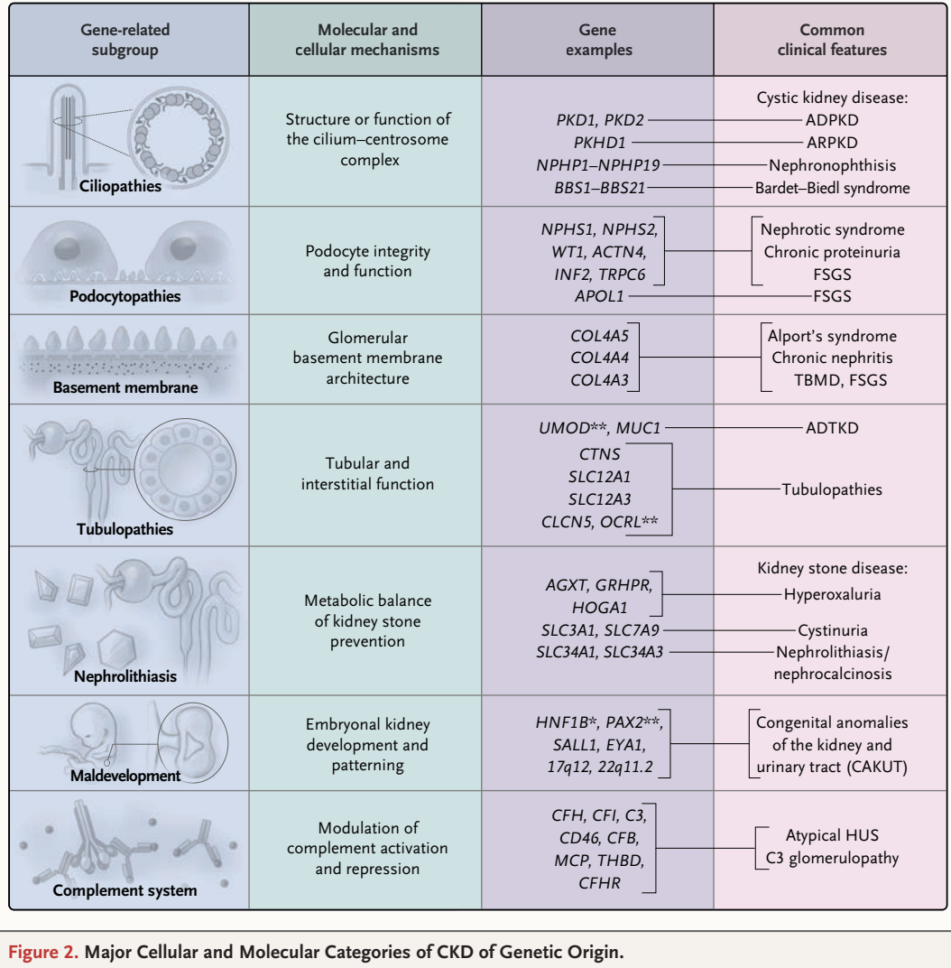
NEPHROLOGY SPECIFIC
Vivante, A. NEJM 2024

Slide 22
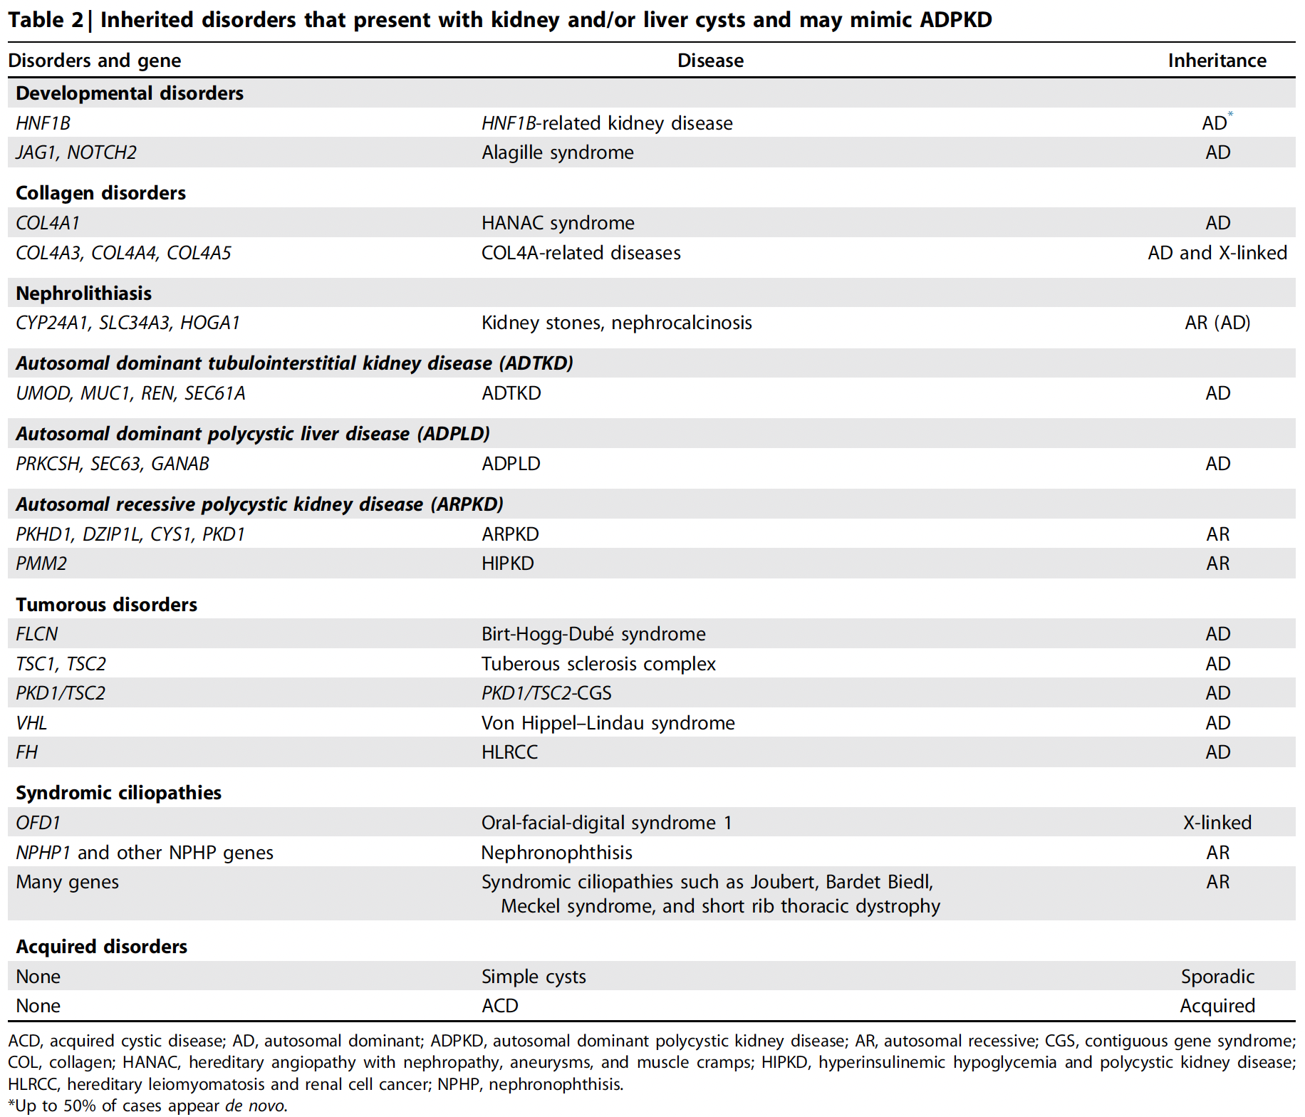
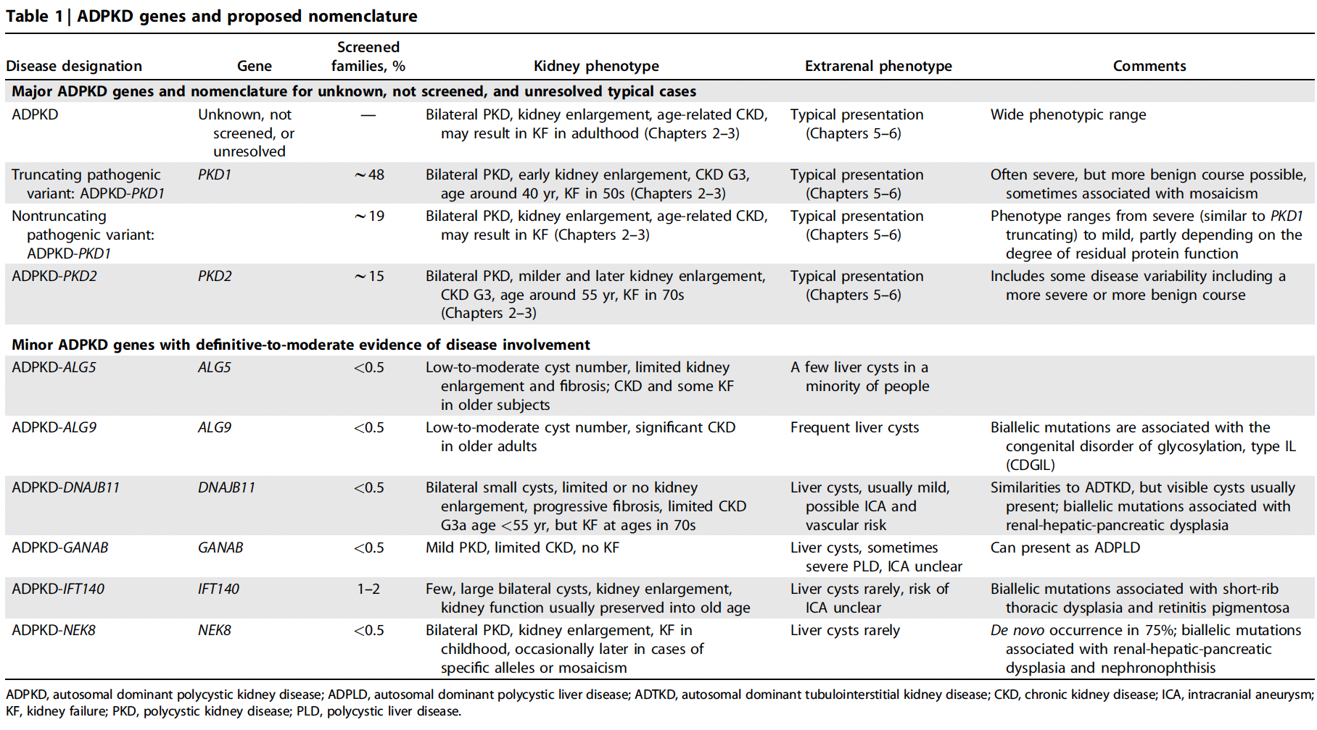
CYSTIC DISEASES
ADPKD Guidelines. KDIGO. 2025

Slide 23
CASE
Patient undergoes genetic testing and is diagnosed with TSC2 mutation
She is started on an mTOR inhibitor for treatment of her AMLs
3 years later – AMLs have decreased 50% in size

Slide 24

Thank you

Slide 25
RESOURCES
Aron AW, Dahl NK. Clinical Genetic Testing in Nephrology: Core Curriculum 2024. Am J Kidney Dis. 2024 Nov;84(5):632-645. doi: 10.1053/j.ajkd.2024.05.011. Epub 2024 Sep 26. PMID: 39340488.
Devarajan P, et al. Emerging Role of Clinical Genetics in CKD. Kidney Med. 2022 Feb 11;4(4):100435. doi: 10.1016/j.xkme.2022.100435. PMID: 35372818; PMCID: PMC8971313.
Franceschini N, et al; NKF Genetic Testing Working Group. Advancing Genetic Testing in Kidney Diseases: Report From a National Kidney Foundation Working Group. Am J Kidney Dis. 2024 Dec;84(6):751-766. doi: 10.1053/j.ajkd.2024.05.010. Epub 2024 Jul 19. PMID: 39033956; PMCID: PMC11585423.
Giudicessi JR, Ackerman MJ. Determinants of incomplete penetrance and variable expressivity in heritable cardiac arrhythmia syndromes. Transl Res. 2013 Jan;161(1):1-14. doi: 10.1016/j.trsl.2012.08.005. Epub 2012 Sep 17. PMID: 22995932; PMCID: PMC3624763.
Groopman EE, et al. Rare genetic causes of complex kidney and urological diseases. Nat Rev Nephrol. 2020 Nov;16(11):641-656. doi: 10.1038/s41581-020-0325-2. Epub 2020 Aug 17. PMID: 32807983; PMCID: PMC7772719.
Teresa Bada-Bosch, Angel M Sevillano, María Teresa Sánchez-Calvin, Carmen Palma-Milla, Ignacio Alba de Cáceres, Francisco Díaz-Crespo, Hernando Trujillo, Marina Alonso, Clara Cases-Corona, Amir Shabaka, Juan Francisco Quesada-Espinosa, José Miguel Lezana-Rosales, Eduardo Gutiérrez, Gema Fernández-Juárez, Fernando Caravaca-Fontán, Manuel Praga, Cystic phenotype and chronic kidney disease in autosomal dominant Alport syndrome, Nephrology Dialysis Transplantation, Volume 39, Issue 8, August 2024, Pages 1288–1298, https://doi.org/10.1093/ndt/gfae002
Vivante A. Genetics of Chronic Kidney Disease. N Engl J Med. 2024 Aug 15;391(7):627-639. doi: 10.1056/NEJMra2308577. PMID: 39141855.

