Slide 1

Filling the Gaps: From Osmolar Gap to Non-Anion Gap Metabolic Acidosis
Jacob Nysather D.O.

Slide 2

Disclosures
None

Slide 3
Lecture Series Overview
Renalism Approach
Lecture 1: Approach to acid-base problems and an overview of physiologic mechanisms at work. Focus on intro to acidosis. 9/3
Lecture 2: Continue the journey of mastering acidosis with a physiologic approach in dissecting and understanding acid-base problems 9/17
Lecture 3: Flip the script and become basic. Touch “base” on the less complex regulator of acid-base. (Have to give credit that it is a faster worker than the kidneys). 10/1
  If time will review other approaches

Slide 4
Objectives
Understand the importance of acid-base control in the human body
Understand the physiologic approach to diagnosing acid-base disturbances
Identify what constitutes the anion gap and it’s clinical implication in acidosis.
Recognize hyperchloremic metabolic acidosis and it’s primary clinical etiologies

Slide 5

pH Panorama

Slide 6
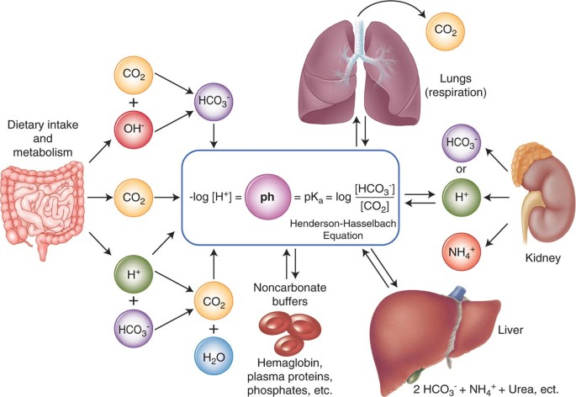
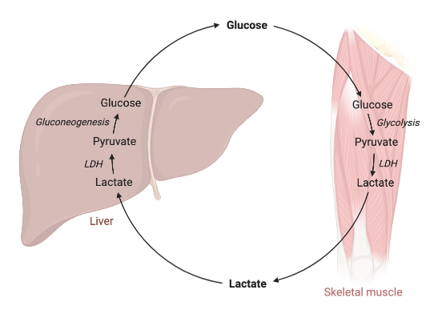
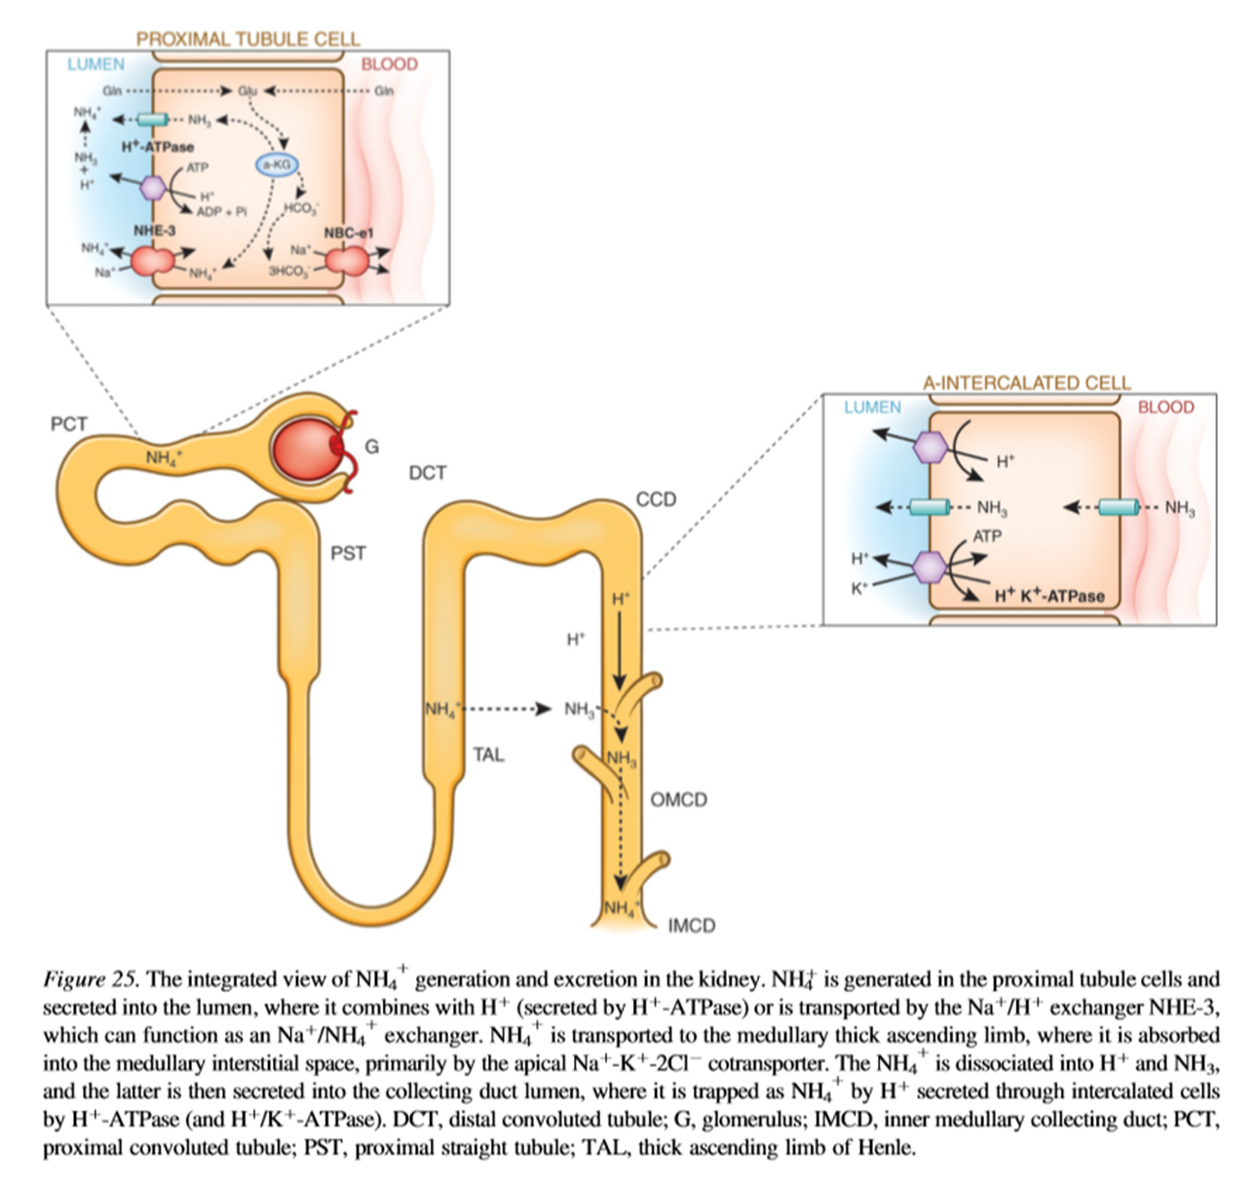
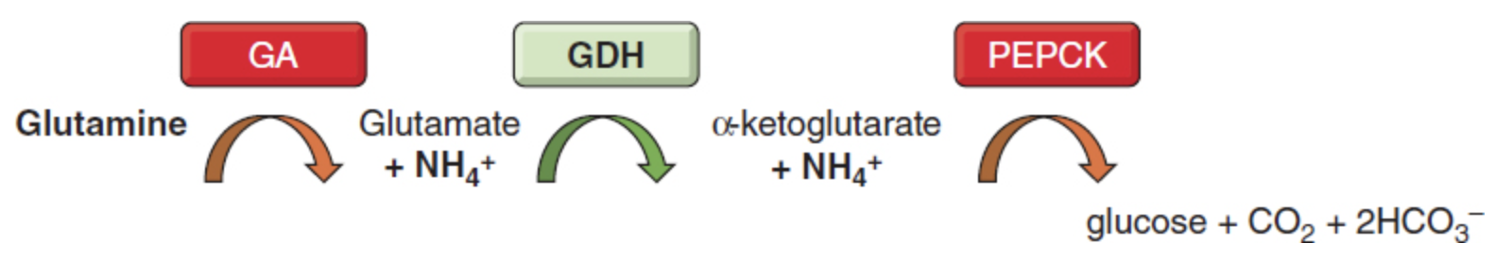
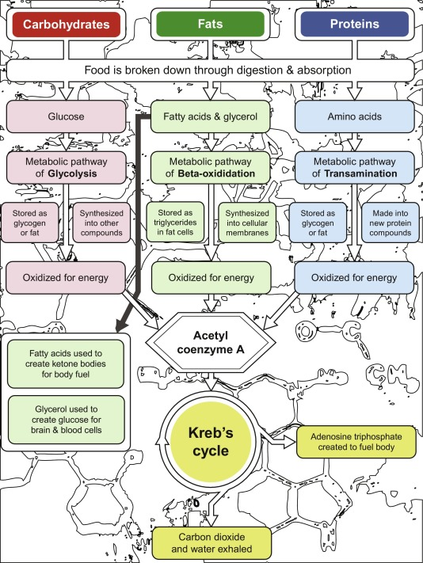
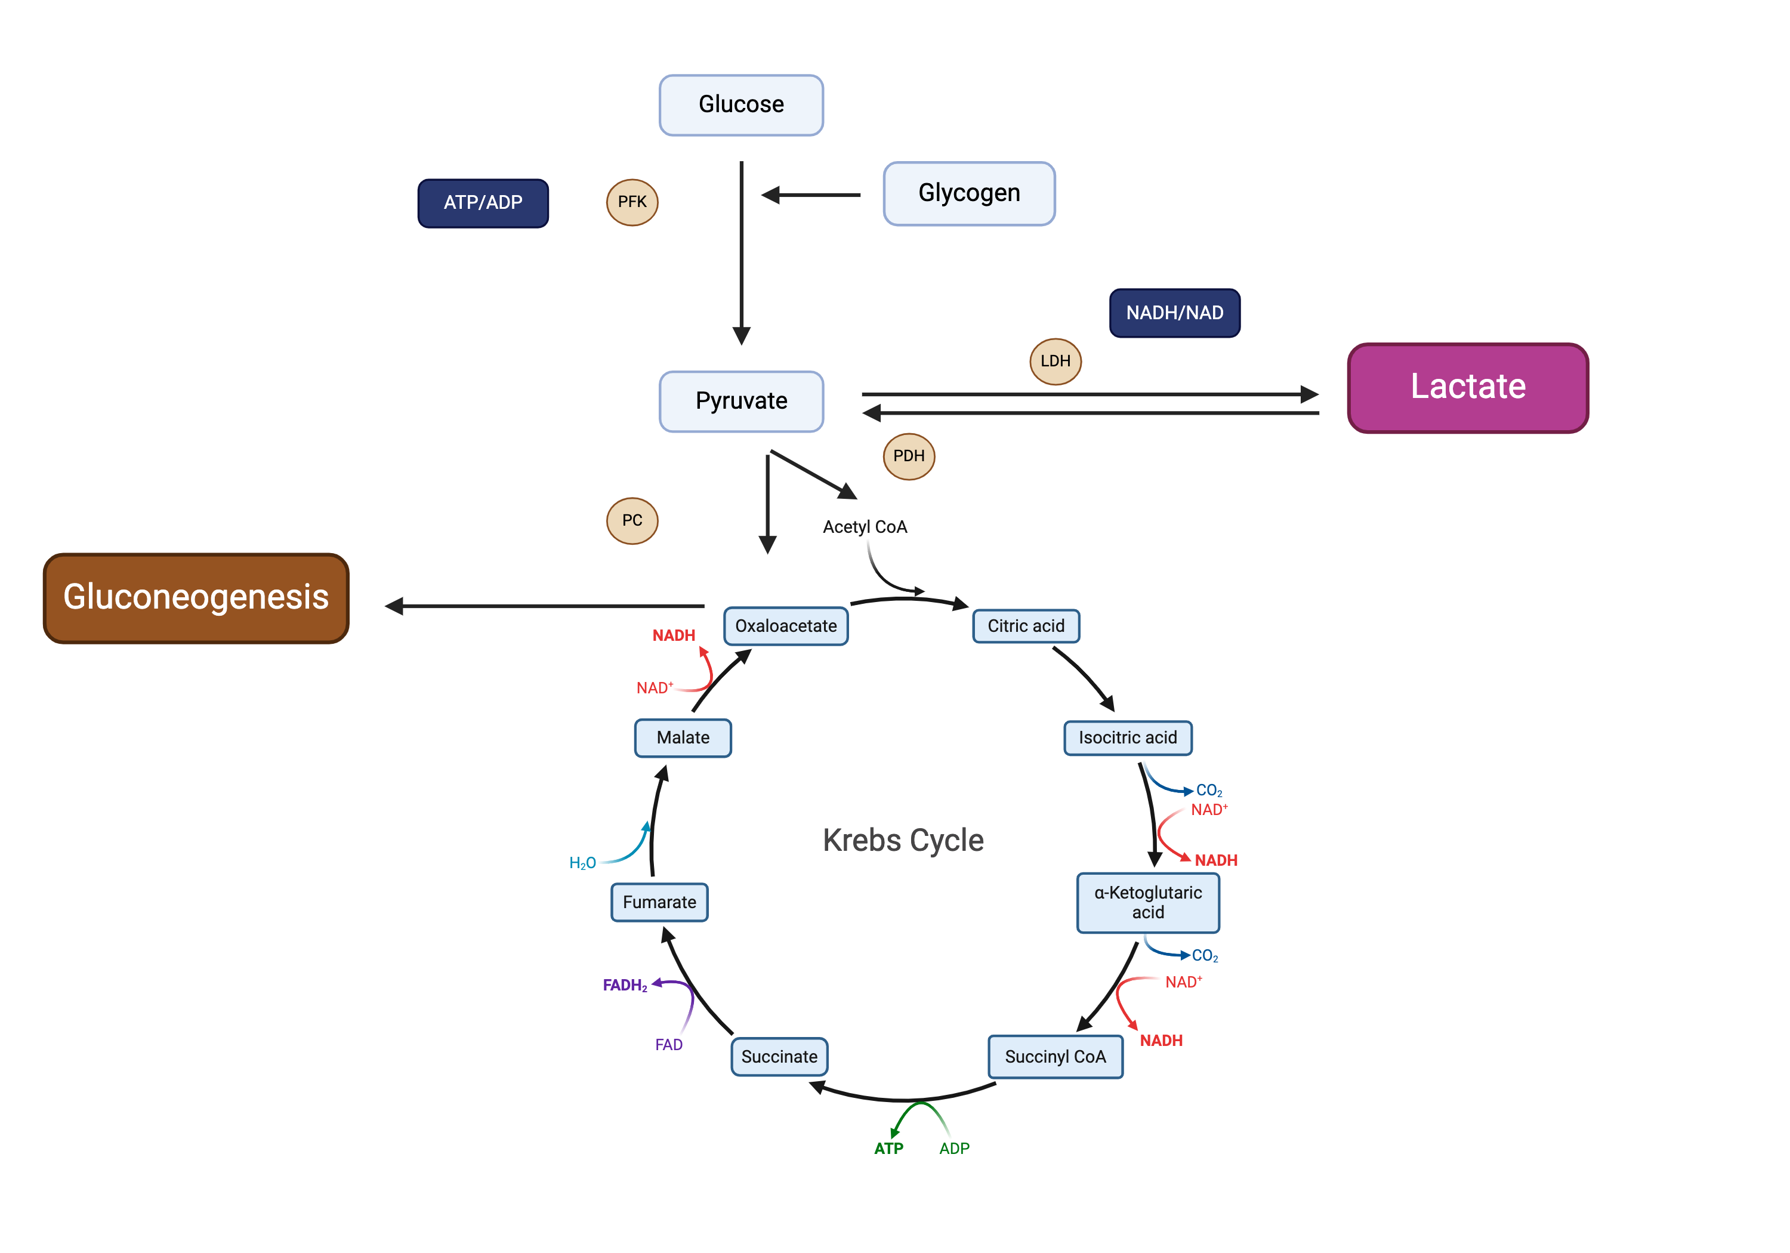
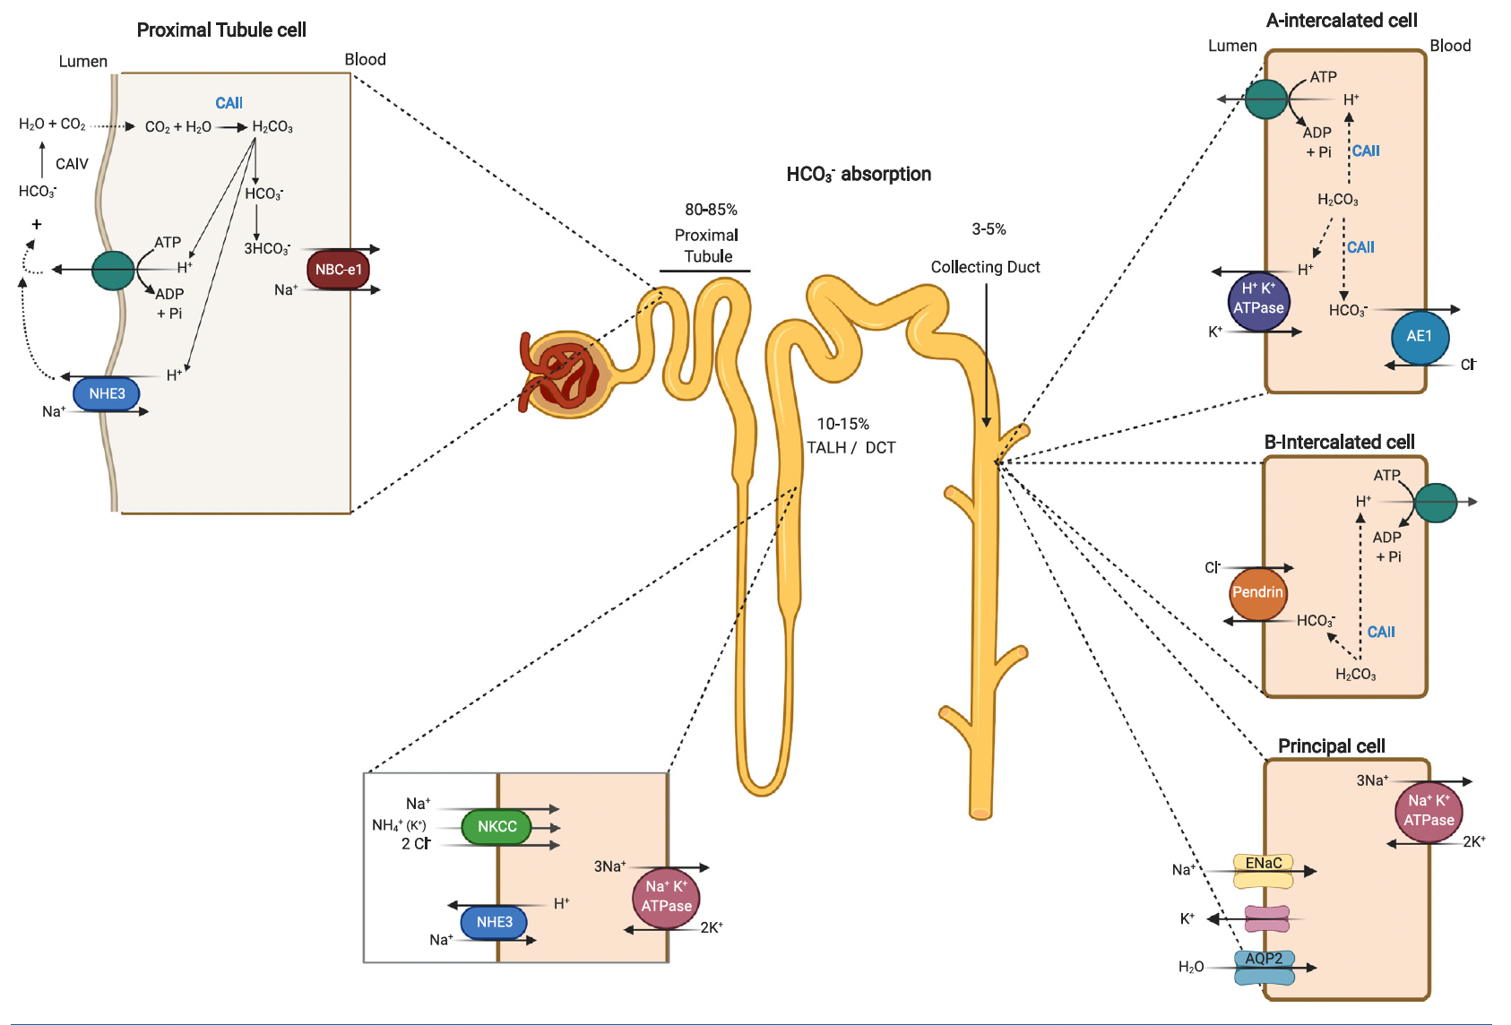
Notes:
H+ donors (acid) and H+ receivers (base)

Slide 7
Overview of Disturbances

Slide 8
Approach to Acid-Base Disorders
Establish the Primary Disturbance
Is there Appropriate Compensation?
The Gaps (Metabolic Acidosis)
Delta/Delta (HAGMA)
Don’t forget the history as it gives important clues!!

Slide 9
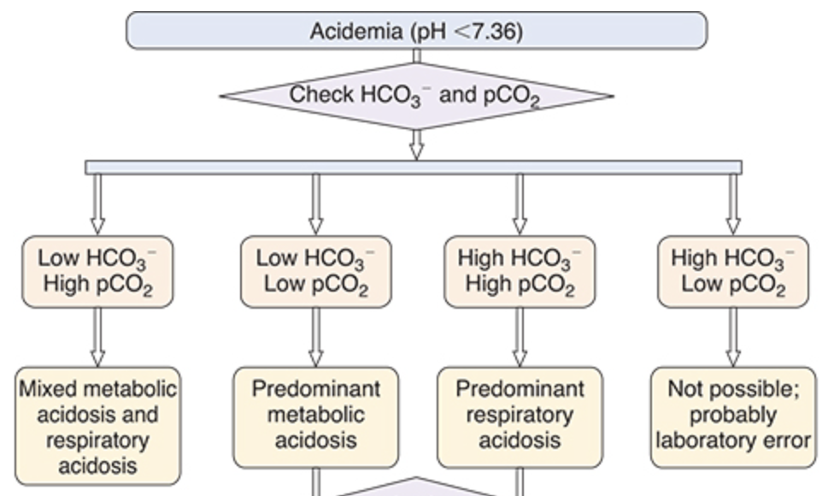
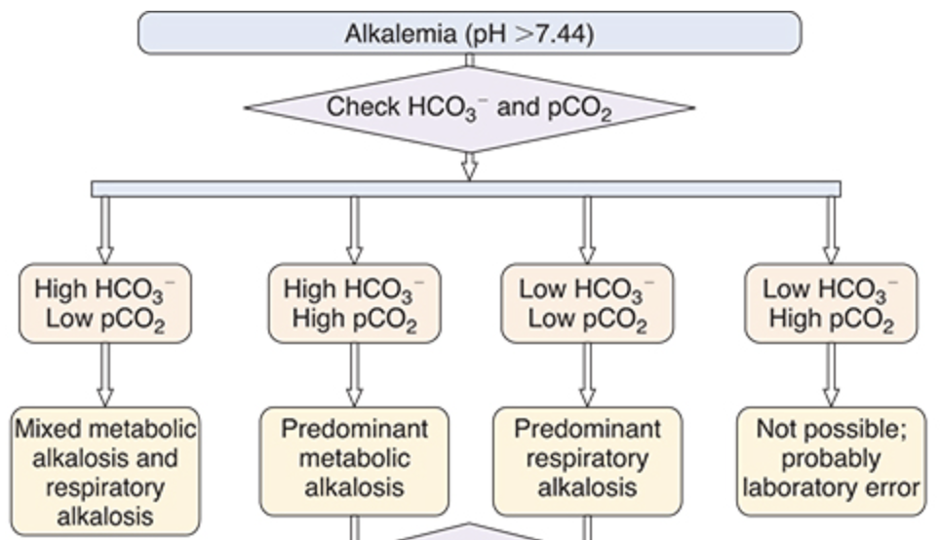
Primary Disturbances
Fig 12.5 (left) and 12.6 (right) Primer 8th ed

Slide 10
Appropriate Compensation

Slide 11
Primary Disorder | pH | Initial Chemical Change | Compensatory Response | Expected Compensation | Complete Adaptive Response
Metabolic Acidosis | Low | ↓ HCO₃- | ↓ pCO₂ | pCO₂ = (1.5 × HCO₃-) + 8 ± 2 pCO₂ = HCO₃- + 15 pCO₂ = decimal digits of pH | 12-24 hrs
Metabolic Alkalosis | High | ↑ HCO₃- | ↑ pCO₂ | pCO₂ = 40 + 0.7x([HCO_{3 measure}] – [HCO_{3 normal}]) pCO₂ = (0.9 × HCO₃-) + 9 pCO₂ = (0.7 × HCO₃-) + 20 | 24-36 hrs
Respiratory Acidosis
Acute | Low | ↑ pCO₂ | ↑ HCO₃- | HCO₃- increases 1 mEq/L for every 10 mm Hg increase in pCO₂ | 2-5 days
Chronic | Low | ↑ pCO₂ | ↑↑ HCO₃- | HCO₃- increases 3 to 4 mEq/L for every 10 mm Hg increase in pCO₂
Respiratory Alkalosis
Acute | High | ↓ pCO₂ | ↓ HCO₃- | HCO₃- decreases 2 mEq/L for every 10 mm Hg decrease in pCO₂ | 2-5 days
Chronic | High | ↓ pCO₂ | ↓ HCO₃- | HCO₃- decreases 5 mEq/L for every 10 mm Hg decrease in pCO₂
Table 12.1: Acid-Base Rules: Changes in pH, pCO₂, and [HCO₃⁻] and Expected Compensatory Responses in Simple Disturbances

Slide 12
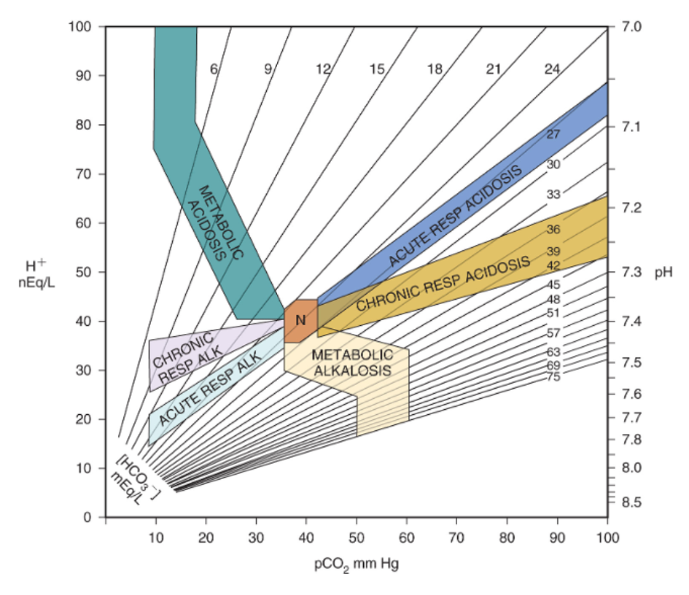
Notes:
The shaded areas represent the 95% confidence limits for zones of compensation for simple acid base disorders. If it falls outside of the shaded areas it is likely a mixed acid base disorder.

Slide 13
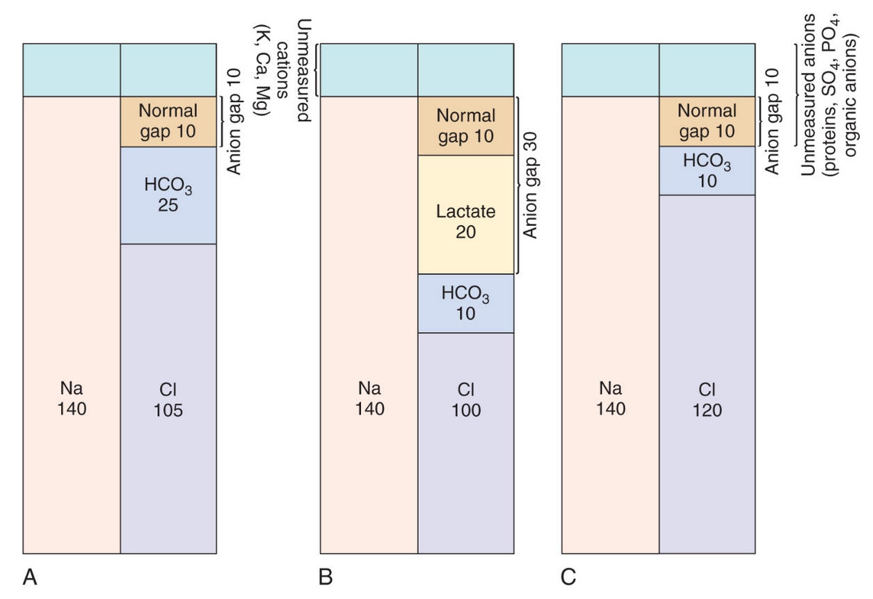
Primer 8th edition

Slide 14
Anion Gap Metabolic Acidosis
M: Methanol
U: Uremia
D: DKA
P: Phenformin, Paraldehyde
I: INH, Iron
L: Lactic Acid
E: Ethanol, Ethylene Glycol
S: Salicylates
G: Glycols
O: Oxoproline (Acetaminophen)
L: L-lactate
D: D-lactate
M: Methanol
A: Aspirin
R: Renal Failure
K: Ketoacidosis

Slide 15
High Anion Gap Pneumonics
CUTE DIMPLES
• Cyanide, Citrate (citric acid)
• Uremia
• Toluene (hippuric acid)
• Ethylene Glycol (oxalic acid)
• Diabetic Ketoacidosis
• INH, Iron
• Methanol, Metformin (lactate)
• Pyroglutamic Acid (oxoproline), Propylene Glycol (lactate), Paraldehyde, Propofol (lactate)
• Lactic Acidosis, Linezolid (lactate)
• Ethanol Ketoacidosis
• Salicylates (lactate + ketones), Starvation Ketoacidosis, Sodium Thiosulfate (?)
GOLD MARK
• Glycols – ethylene (oxalic acid), propylene (lactate)
• Oxoproline (pyroglutamic acid)
• L-lactate (lactic acid)
• D-lactate (lactic acid)
• Methanol (formic acid)
• Aspirin (lactate + ketones)
• Renal failure
• Ketoacidosis – diabetes, starvation, alcohol
MUDPILES
• Methanol (formic acid)
• Uremia (Renal failure)
• Diabetic Ketoacidosis (starvation, alcohol)
• Phenformin, Paraldehyde, Pyroglutamic acid (Oxoproline)
• Lactic Acidosis (D and L)
• Ethanol, Ethylene Glycol
• Salicylates

Slide 16
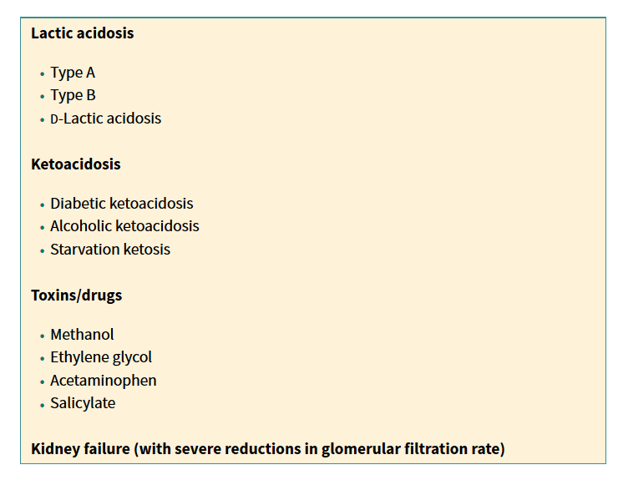
Anion Gap Metabolic Acidosis
Primer 8th edition

Slide 17
Alcoholic Ketoacidosis
Positive AGMA
Positive osmolar gap
Tx Fomepizole a competitive inhibitor for ADH
Ethylene glycol
  alcohol dehydrogenase into glycolic acid, oxalic acid and lactic acid
  renal failure and AMS
Methanol
  metabolized by alcohol dehydrogenase to formaldehyde and formic acid
  blurry vision to blindness due to optic nerve involvement and pancreatitis
Primer 8th edition
Notes:
Isopropyl alcohol does not cause an elevated anion gap acidosis, retinal toxicity (as does methanol), or renal failure (as does ethylene glycol), although it does increase the osmol gap
It does not cause an anion gap because the active metabolite, acetone, is a terminal ketone in the metabolic pathway and is an uncharged molecule, unlike the active metabolites in other toxic alcohol ingestions
2 to 3 times more potent a central nervous system (CNS) depressant than ethanol leading to prolong sedation or coma. Large ingestions may lead to respiratory arrest, hypotension due to vasodilation, and myocardial suppression

Slide 18
Causes of a normal anion gap and a high osmolar gap
Essentially, this will be any substance administered into the bloodstream which does not dissociate at physiologic pH. Question 7.3 from the first paper of 2014 presented the candidate with such a scenario. Several possible explanations can be offered:
Mannitol therapy
Glycine absorption (TURP syndrome)
Non-metabolised glycols: propylene glycol or polyethylene glycol (found in IV drug ampoules)
Maltose (IV immunoglobulin is suspended in maltose)
Ethanol
Soon (immediately) after toxic alcohol ingestion.
A normal-looking anion gap in the presence of low albumin - if the albumin is not used to calculate what the "expected normal" anion gap should be (i.e. the "real" anion gap is raised, but it appears normal because you neglected the contribution of albumin)
Up-to-date

Slide 19
Causes of high anion gap and a high osmolar gap
Question 7.2 from the first paper of 2014 asks for this specifically. And even more specifically, Question 19.2 from the first paper of 2009 aska about which toxins are responsible for this sort of picture.
Toxicological causes
  Methanol intoxication (the anion is formic acid)
  Ethylene glycol intoxication (the anions are glycolic acid and oxalic acid)
  Diethylene glycol intoxication (the anion is 2-hydroxyethoxyacetic acid, HEAA)
  Propylene glycol intoxication (the anions are pyruvate, lactate and acetate)
  Salicylate intoxication (the anions are salicylate and lactate)
  Any toxin causing massive lactic acidosis, eg. isoniazid
Up-to-date

Slide 20
Endocrine and metabolic disturbances
  Lactic acidosis
  Alcoholic or diabetic ketoacidosis
  Acute kidney injury
Up-to-date

Slide 21
Causes of high anion gap and a normal osmolar gap
Abnormally large value of albumin or other negatively charged serum protein (i.e. the "expected normal" anion gap is higher, and without correction the calculated anion gap appears raised - but there are no extra osmoles, as all the extra proteins do not contribute much to osmolality)
Unusual equations used to calculate osmolality (there are ~15)
Late stage of toxic alcohol intoxication (all the extra osmoles have been metabolised)
Up-to-date

Slide 22
The importance of timing in toxicological comedy
As Jeffrey Kraut reminds us, timing is very important in the appearance and disappearance of the raised osmolar gap, particularly where it concerns the ingestion of toxic alcohols. All of these toxic alcohols are non-polar at physiological pH, and so cannot raise the anion gap - only the osmolar gap. Ergo, early in the intoxication only the osmolar gap will be raised. Later, as the intoxicated patient staggers vomiting around the emergency department, some of the toxic alcohol will have been matabolised into organic acids, raising the anion gap (and decreasing the osmolar gap). Ultimately, as they lay in their ICU bed, the extra osmoles will have been metabolised into organic acid anions, and the bicarbonate will have decreased stoichiometrically. Thus only the anion gap will be raised in late intoxication.
Up-to-date

Slide 23
Do you use the corrected sodium, or the uncorrected sodium?
The uncorrected, of course.
The corrected sodium merely gives you the impression of what the sodium level would "naturally" be like if the extra osmoles were removed. However, the measured sodium is the actual serum sodium, and this is the concentration which is contributing to the osmolality of the solution.
Up-to-date

Slide 24
Approach to Acid-Base Disorders
Establish the Primary Disturbance
Is there Appropriate Compensation?
The Gaps (Metabolic Acidosis)
Delta/Delta (HAGMA)
Don’t forget the history as it gives important clues!!

Slide 25
Hyperdynamic Stage Sepsis
B Agonist
Pheochromocytoma
Type B
Aerobic
Isoniazid
Metformin
NRTI
Metformin
Linezolid
Propofol

Slide 26
Jumping In

Slide 27
A 59-year-old woman with history of Type 2 diabetes and epilepsy (last known seizure 2 years prior. Medical history well controlled with Metformin and levetiracetam. She was found by her spouse in the garage in ICU for management of status epilepticus. After failing treatment with propofol, the sedative regimen was changed to continuous infusion of pentobarbital.
Admission labs: (mEq/L) Na+ 142, K+ 4.3, Cl- 105, HCO3- 22, creatinine 1.4, BUN 25, glucose 100, Hematocrit 36, pH 7.35, pCO2 45, pO2 75. Serum osmolality 302mOsm/l.
After 24 hours of seizure control repeat labs show: (mEq/l) Na+ 138, K+ 4.8, Cl- 100, HCO3- 10, creatinine 1.8, BUN 28, glucose 120, Serum osmolality 330 mOsm/l
Which is the most likely cause of the electrolyte disturbances in this patient?
A) Sepsis-induced lactic acidosis
B) Propylene glycol toxicity
C) Hydroxyethyl starch toxicity
D) Normal saline induced acidosis

Slide 28
A 59-year-old woman with history of Type 2 diabetes and epilepsy (last known seizure 2 years prior. Medical history well controlled with Metformin and levetiracetam. She was found by her spouse in the garage in ICU for management of status epilepticus. After failing treatment with propofol, the sedative regimen was changed to continuous infusion of pentobarbital.
Admission labs: (mEq/L) Na+ 142, K+ 4.3, Cl- 105, HCO3- 22, creatinine 1.4, BUN 25, glucose 100, Hematocrit 36, pH 7.35, pCO2 45, pO2 75. Serum osmolality 302mOsm/l.
After 24 hours of seizure control repeat labs show: (mEq/l) Na+ 138, K+ 4.8, Cl- 100, HCO3- 10, creatinine 1.8, BUN 28, glucose 120, Serum osmolality 330 mOsm/l
Which is the most likely cause of the electrolyte disturbances in this patient?
A) Sepsis-induced lactic acidosis
B) Propylene glycol toxicity
C) Hydroxyethyl starch toxicity
D) Normal saline induced acidosis

Slide 29
Osmolar Gap
Calculated Serum Osm = 2(Na) + BUN/2.8 + Glucose/18
Osmolar Gap = Measured - Calculated
Normal < +10 (often toxic alcohols are > +20)

Slide 30
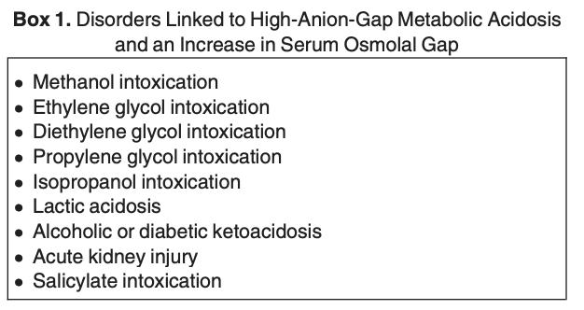
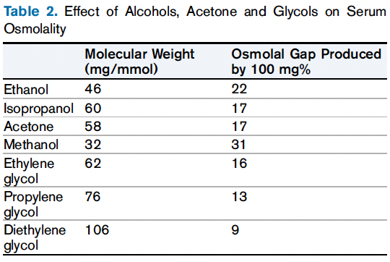
Contributory Osmols
AJKD HAGMA 2021

Slide 31
Natural (endogenous) active osmole
Sodium and its associated anions (chloride, bicarbonate)
Glucose
Urea (though urea is an ineffective osmole for tonicity, it does contribute to measured osmolality)
Potassium (minor contributor)
Endogenous organic acids
Ketone bodies in ketoacidosis
Lactic acid in severe lactic acidosis*
Unnatural (exogenous) active osmoles
Ethanol
Methanol*
Ethylene Glycol*
Isopropanol
Propylene glycol
Mannitol (used therapeutically)
Radiocontrast agents
Other small molecules from poisoning or iatrogenic source
Formaldehyde and Paraldehyde*
Notes:
lactate itself does not significantly increase the osmolar gap at clinical concentrations

Slide 32
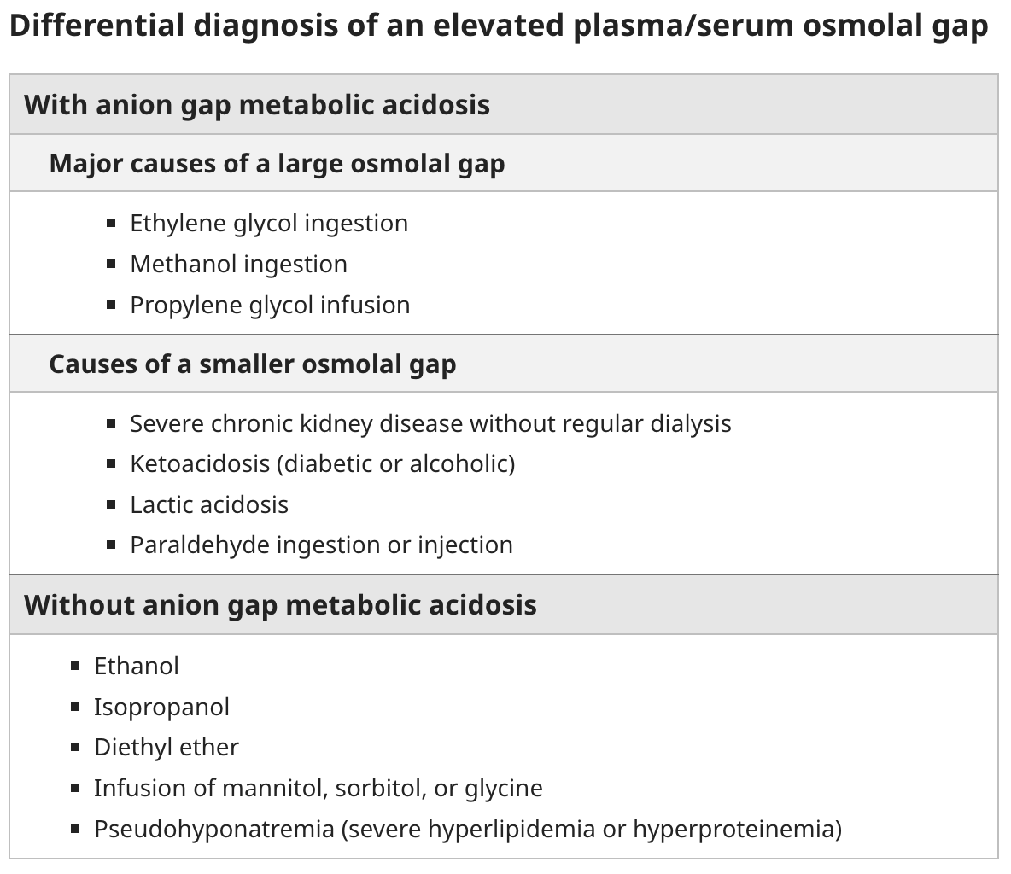
Up-to-date

Slide 33
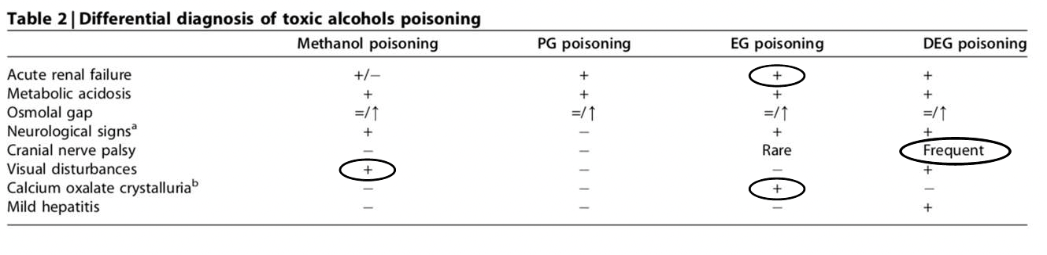
BRCU 2024

Slide 34
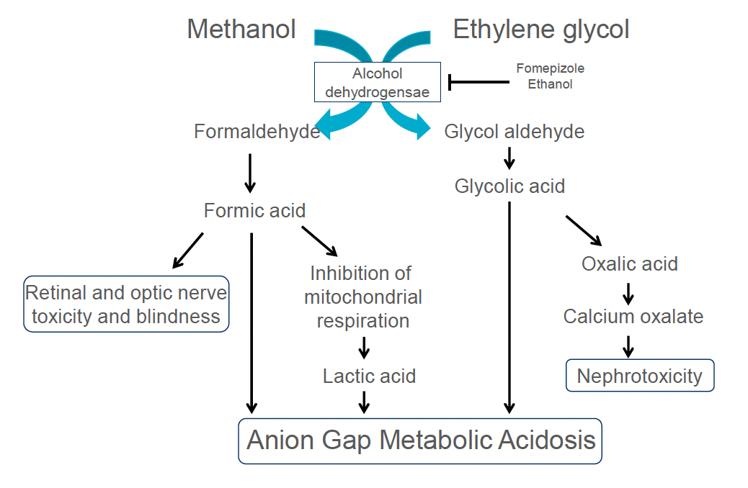
BRCU 2024

Slide 35
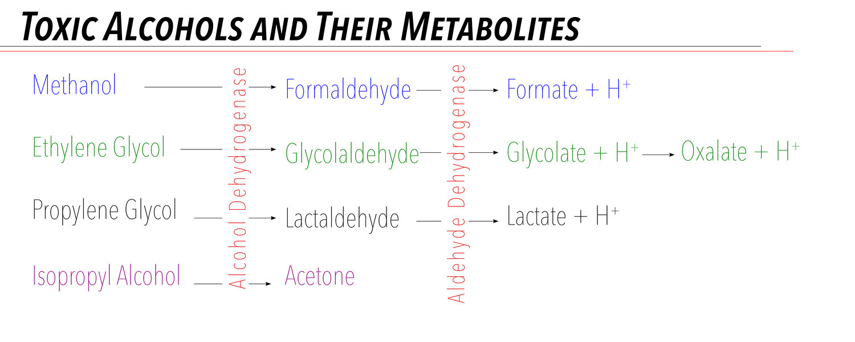
Taming the SRU

Slide 36
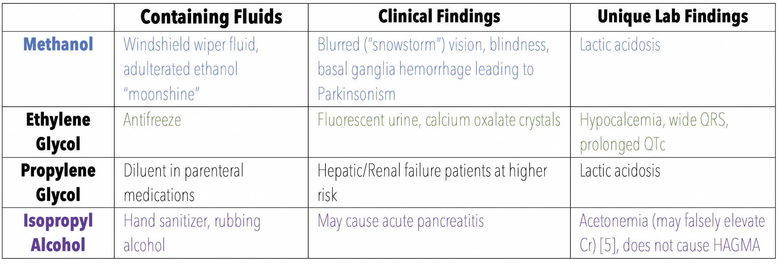
Taming the SRU

Slide 37
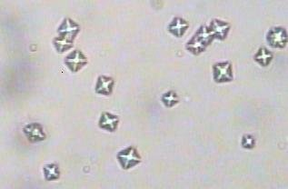

Slide 38
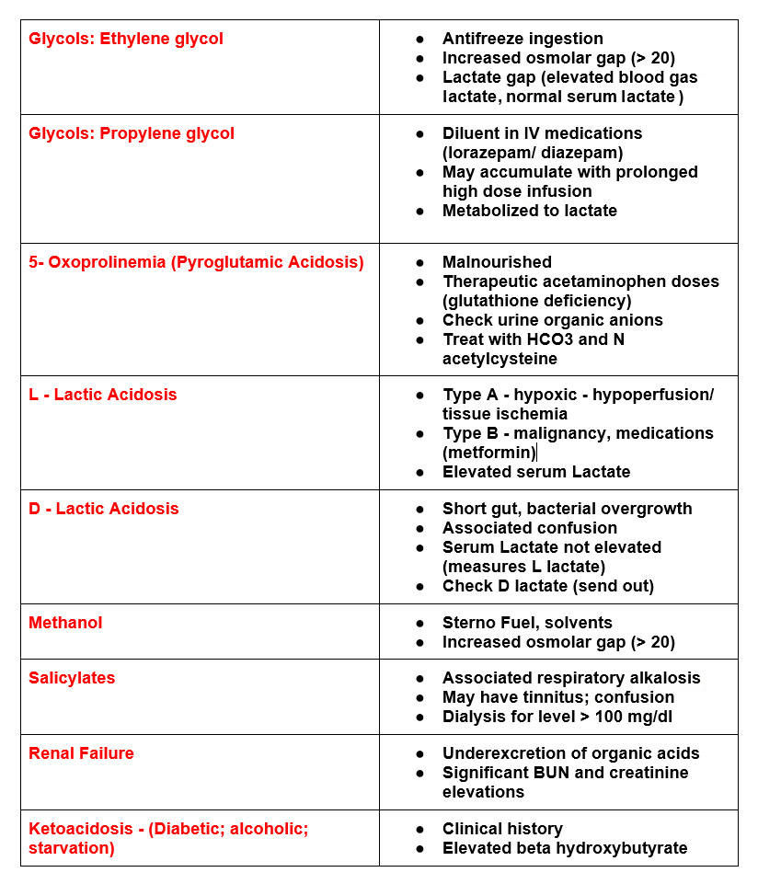

Slide 39
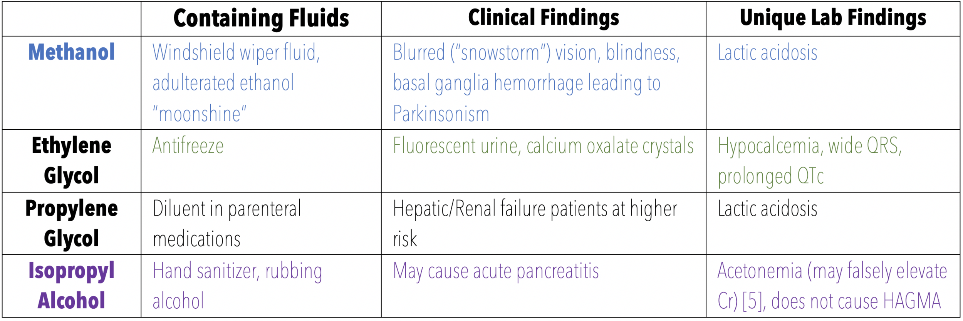

Slide 40
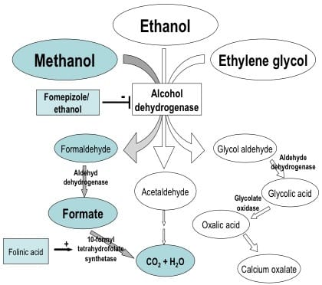

Slide 41
Situation | pH | AG | Keto | Glu | OG | (Contribution to OG)*
Ethanol only | N | N | N | N | High | [Ethanol]/3.8
Methanol (early) |  |  |  |  |  | [Methanol]/3.2
Methanol (late) | Low | High | N | N/High | N/High | [Methanol]/3.2
Isopropanol | N | N | POS | N | High | [Isopropanol]/6.0
Ethylene Glycol | Low | High | N | N | High | [Ethylene glycol]/6.2
Alcoholic Ketoacidosis | Low | High | Weak/POS | 300 | High | [Ethanol]3.8
Diabetic Ketoacidosis | Low | High | POS | 300 | N or High (<20-25) | [Acetone]/5.8
Notes:
*The contributions to osmolar gap are estimated by taking the plasma concentration and then dividing by the number indicated. For example, an ethylene glycol plasma concentration of 124 mg/dL will contribute approximately 20 (=124/6.2) to the osmolar gap. Note that the some of the substances generate metabolites that themselves may contribute to osmolar gap. For instance, heavy consumption of ethanol 24 hours prior to hospital admission can show an elevated osmolar gap mainly due to metabolites of ethanol (acetaldehyde, etc.) even when the parent drug (ethanol) is mostly gone.
**Osmolar gap may be increased in early methanol poisoning.
Non-toxic examples of an elevated osmolar gap include hyperlipidemia (less plasma water), chronic renal failure, and myeloma (increased plasma proteins).
Because ethanol ingestion is a common cause of elevated osmolar gap, ethanol can be included in calculated osmolar formulas. At the University of Iowa Hospitals and Clinics, the formula used for this is the calculated osmolality equation given above with an additional term for ethanol (EtOH):
(3) CO/EtoH = 2 x NA + 1.15 * GLU/18 + BUN/2.8 + [EtOH]/3.8: calculated osmolality including ethanol contribution
(4) "Unexplained" osmolar gap = MO - CO/EtoH: osmolar gap remaining after correction for ethanol
For the ethanol/volatile panel orderable in Epic, NA, GLU, BUN, MO, and EtOH concentrations in plasma are all determined. The osmolar gap (OSMOL GAP in Epic) uses formula (2) above. The unexplained osmolar gap (UOSMOL GAP in Epic) uses formula (4) above. High unexplained osmolar gaps indicate the possible presence of a toxic compound other than ethanol (ethylene glycol, methanol, acetone, isopropanol, or propylene glycol).

Slide 42
Which Ones do you Dialyze?

Slide 43
A 68-year-old man with a history of well-controlled hypertension and benign prostatic hypertrophy presents to the emergency department (ED) with 3 days of fever, dysuria, and weakness and 1 day of rigors. His vital signs are temperature 38.6 C; blood pressure, 90/70 mm Hg; and pulse, 110/min and regular. The physical examination is notable for dry mucous membranes and lethargy. His laboratory values are [Na+], 138 mEq/L; potassium ([K+]), 3.1 mEq/L; [Cl−], 111 mEq/L; [HCO3−], 17 mEq/L; serum urea nitrogen (SUN), 26 mg/dL; creatinine, 1.1 mg/dL; glucose, 126 mg/ 100 mL; albumin, 2.0 g/dL. His arterial blood gas (ABG) values are pH 7.30; pCO2, 32mm Hg; [HCO3−], 15 mEq/L; and pO2, 72mm Hg.
Which of the following acid-base abnormalities exist in this patient?
A) HAGMA with appropriate respiratory compensation
B) Hyperchloremic (normal AG) metabolic acidosis
C) Mixed metabolic acidosis and respiratory alkalosis
D) Metabolic alkalosis and metabolic acidosis

Slide 44
A 68-year-old man with a history of well-controlled hypertension and benign prostatic hypertrophy presents to the emergency department (ED) with 3 days of fever, dysuria, and weakness and 1 day of rigors. His vital signs are temperature 38.6 C; blood pressure, 90/70 mm Hg; and pulse, 110/min and regular. The physical examination is notable for dry mucous membranes and lethargy. His laboratory values are [Na+], 138 mEq/L; potassium ([K+]), 3.1 mEq/L; [Cl−], 111 mEq/L; [HCO3−], 17 mEq/L; serum urea nitrogen (SUN), 26 mg/dL; creatinine, 1.1 mg/dL; glucose, 126 mg/ 100 mL; albumin, 2.0 g/dL. His arterial blood gas (ABG) values are pH 7.30; pCO2, 32mm Hg; [HCO3−], 15 mEq/L; and pO2, 72mm Hg.
Which of the following acid-base abnormalities exist in this patient?
A) HAGMA with appropriate respiratory compensation
B) Hyperchloremic (normal AG) metabolic acidosis
C) Mixed metabolic acidosis and respiratory alkalosis
D) Metabolic alkalosis and metabolic acidosis

Slide 45
This patient has signs and symptoms of a urinary infection and probable sepsis. His ABG reveals acidemia (pH 7.30), a reduced [HCO3 −] of 15 mEq/L, and a reduced pCO2 of 32 mm Hg. The Winters equation predicts that his pCO2 should be about 31 mm Hg {(1.5 Å~ [HCO3−]) + 8} = 31. The patient’s laboratory results are therefore all consistent with appropriately compensated metabolic acidosis.
Is this acidosis a HAGMA, hyperchloremic, or a mixed disorder? The initial AG calculation is (138 – [111+17]) = 10 mEq/L and this suggests a normal AG (or hyperchloremic) metabolic acidosis. However, this calculation did not consider the patient’s marked hypoalbuminemia (2.0 g/100 mL). This degree of hypoalbuminemia will reduce the [AG] by 2.5 Å~ (4.5 − 2) = 6.2. Therefore, the [AG], after correction for hypoalbuminemia, is actually increased to about 16mEq/L. Subsequently the patient’s lactate level was reported to be 6 mEq/L. These results are all consistent with an HAGMA due to L-lactic acidosis. Therefore, the correct answer to question 1 is (a), HAGMA with appropriate respiratory compensation.

Slide 46
A 25-year-old man with a 10-year history of type 1 diabetes mellitus becomes anorexic after developing gastroenteritis and reducing his insulin dose. He then develops nausea, vomiting, polyuria, and dyspnea and presents to the ED. The patient also has a long history of depression and is taking fluoxetine. He has orthostatic hypotension. His breath has a fruity odor. The initial laboratory studies reveal SUN, 40 mg/dL; creatinine, 1.5 mg/dL; glucose, 800 mg/100 mL; [Na+], 120 mEq/L; [Cl−], 75 mEq/L; [HCO3−], 12mEq/L; K+, 3.0 mEq/L; ([AG], 32 mEq/L); and albumin, 4.0 g/100 mL. The measured osmolality is 330 mOsm/L; serum β-hydroxybutyrate, >8 mEq/L; and urine ketones, 3+ by dipstick. Blood ethanol level is nondetectable. ABG values are pH 7.16; PO2, 90 mm Hg; pCO2, 35 mm Hg; and [HCO3−], 12 mEq/L.
What is his acid-base disorder?
A. HAGMA due to diabetic ketoacidosis (DKA)
B. HAGMA due to DKA and metabolic alkalosis
C. HAGMA due to DKA, metabolic alkalosis, and respiratory acidosis
D. HAGMA due to DKA and hyperchloremic acidosis
AJKD HAGMA 2021

Slide 47
A 25-year-old man with a 10-year history of type 1 diabetes mellitus becomes anorexic after developing gastroenteritis and reducing his insulin dose. He then develops nausea, vomiting, polyuria, and dyspnea and presents to the ED. The patient also has a long history of depression and is taking fluoxetine. He has orthostatic hypotension. His breath has a fruity odor. The initial laboratory studies reveal SUN, 40 mg/dL; creatinine, 1.5 mg/dL; glucose, 800 mg/100 mL; [Na+], 120 mEq/L; [Cl−], 75 mEq/L; [HCO3−], 12mEq/L; K+, 3.0 mEq/L; ([AG], 32 mEq/L); and albumin, 4.0 g/100 mL. The measured osmolality is 330 mOsm/L; serum β-hydroxybutyrate, >8 mEq/L; and urine ketones, 3+ by dipstick. Blood ethanol level is nondetectable. ABG values are pH 7.16; PO2, 90 mm Hg; pCO2, 35 mm Hg; and [HCO3−], 12 mEq/L.
What is his acid-base disorder?
A. HAGMA due to diabetic ketoacidosis (DKA)
B. HAGMA due to DKA and metabolic alkalosis
C. HAGMA due to DKA, metabolic alkalosis, and respiratory acidosis
D. HAGMA due to DKA and hyperchloremic acidosis
AJKD HAGMA 2021

Slide 48
This patient’s history, examination, and initial laboratory studies were entirely consistent with DKA. This form of HAGMA is due to the ECF accumulation of the 2 “ketoacids” (β-hydroxybutyric acid and acetoacetic acid). When the concentration of these 2 acids increases, the [HCO3−] falls reciprocally, and the [AG] increases. At the time of admission, patients with DKA have an average “delta/delta” or Δ[AG]/Δ[HCO3−] ratio of about 1. However, to the extent that ketoacid anions are excreted into the urine, together with sodium and potassium ions, this will reduce the [AG] and partially convert the metabolic acidosis from a HAGMA to a hyperchloremic acidosis. This phenomenon usually develops after hospitalization, as the patient’s volume status is re-expanded with NaCl-containing intravenous fluids, and kidney function improves.
If we assume his baseline [AG] was 10 and his baseline [HCO3−] was 24; then his [AG] increased by 23, from 10 to 33 and his [HCO3 −] fell by 12, from 24 to 12 (all mEq/L). Thus, his Δ[AG], or [AG] increase, far exceeded the fall in his [HCO3−]; that is, his Δ[AG]/Δ[HCO3−] was >>1. Consequently, we must assume that either additional bicarbonate was generated during the illness or that his initial [HCO3−] was not normal, but instead was already increased to about 34 mEq/L when the DKA developed. This patient reported that he had been vomiting so gastric metabolic alkalosis was the likely etiology of a high [HCO3−]. Whenever the Δ[AG] increase markedly exceeds the Δ[HCO3−] decrease, this suggests coexisting HAGMA and metabolic alkalosis (or less commonly HAGMA and chronic respiratory acidosis, which increases the [HCO3−]due to a compensatory response).
Now consider this patient’s degree of respiratory compensation. His [HCO3−] was 12 mEq/L and the Winters equation predicts that his PaCO2 should be about 26 mm Hg. However, this patient’s PaCO2 was 35 mm Hg, which is too high. This indicates respiratory acidosis exists in addition to his HAGMA and metabolic alkalosis. Hypokalemia may have produced respiratory muscle weakness. Therefore, this patient has a triple A-B disorder (HAGMA due to DKA, metabolic alkalosis due to vomiting, and respiratory acidosis probably

Slide 49
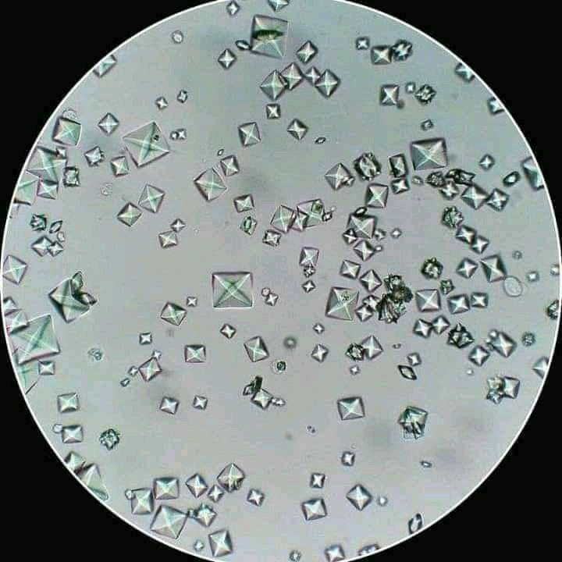

Slide 50
A 25-year-old man with a 10-year history of type 1 diabetes mellitus becomes anorexic after developing gastroenteritis and reducing his insulin dose. He then develops nausea, vomiting, polyuria, and dyspnea and presents to the ED. The patient also has a long history of depression and is taking fluoxetine. He has orthostatic hypotension. His breath has a fruity odor. The initial laboratory studies reveal SUN, 40 mg/dL; creatinine, 1.5 mg/dL; glucose, 800 mg/100 mL; [Na+], 120 mEq/L; [Cl−], 75 mEq/L; [HCO3−], 12mEq/L; K+, 3.0 mEq/L; ([AG], 32 mEq/L); and albumin, 4.0 g/100 mL. The measured osmolality is 330 mOsm/L; serum β-hydroxybutyrate, >8 mEq/L; and urine ketones, 3+ by dipstick. Blood ethanol level is nondetectable. ABG values are pH 7.16; PO2, 90 mm Hg; pCO2, 35 mm Hg; and [HCO3−], 12 mEq/L.
What is the most likely cause of this patient’s 25 mOsm/L osmolal gap?
A) Accumulated ketoacids
B) Ingestion of an alcohol or glycol (other than ethanol, which was not detectable on admission)
C) Acetone
D) The sodium reduction generated by hyperglycemia
AJKD HAGMA 2021

Slide 51
A 25-year-old man with a 10-year history of type 1 diabetes mellitus becomes anorexic after developing gastroenteritis and reducing his insulin dose. He then develops nausea, vomiting, polyuria, and dyspnea and presents to the ED. The patient also has a long history of depression and is taking fluoxetine. He has orthostatic hypotension. His breath has a fruity odor. The initial laboratory studies reveal SUN, 40 mg/dL; creatinine, 1.5 mg/dL; glucose, 800 mg/100 mL; [Na+], 120 mEq/L; [Cl−], 75 mEq/L; [HCO3−], 12mEq/L; K+, 3.0 mEq/L; ([AG], 32 mEq/L); and albumin, 4.0 g/100 mL. The measured osmolality is 330 mOsm/L; serum β-hydroxybutyrate, >8 mEq/L; and urine ketones, 3+ by dipstick. Blood ethanol level is nondetectable. ABG values are pH 7.16; PO2, 90 mm Hg; pCO2, 35 mm Hg; and [HCO3−], 12 mEq/L.
What is the most likely cause of this patient’s 25 mOsm/L osmolal gap?
A) Accumulated ketoacids
B) Ingestion of an alcohol or glycol (other than ethanol, which was not detectable on admission)
C) Acetone
D) The sodium reduction generated by hyperglycemia
AJKD HAGMA 2021

Slide 52
When a HAGMA develops, the increase in acid anions is generally matched by the reduction in [HCO3−]. Therefore, multiplying the [Na+] by 2 accounts for the chloride, bicarbonate, and any additional strong acid anions. Consequently, a HAGMA should not directly generate an osmolal gap. However, the addition to the blood of alcohols, acetone, glycerol, and so on will raise the measured osmolality and create an “osmolal gap.”
This osmolal gap disappears if the alcohol/glycol/etc. is metabolized to an acid. Patients with ketoacidosis often develop an osmolal gap because of increased levels of acetone (and to a smaller extent glycerol). This phenomenon also occurs commonly in patients with alcoholic ketoacidosis, so be cautious about diagnosing a toxic alcohol or glycol poisoning in that situation on the basis of a high osmolal gap. Also, note that acetone is not an acid and does not reduce the [HCO3 −] or raise the [AG]. Thus the correct answer to question 3 is (c), this patient’s osmolal gap is most likely due to acetone.

Slide 53
A 38-year-old woman with a history of severe restrictive lung disease had a bilateral lung transplant 4 months ago. She has had a complex posttransplant course with several episodes of successfully treated acute lung rejections. She also had 2 episodes of AKI, and now has a persistently reduced GFR. Her poor oral intake required placement of a gastric feeding tube. She is very depressed and reports persistent pain at the site of her G-tube. She has been taking acetaminophen, 650 mg 3 times a day, for the past 3 weeks. She denies use of any other medications and said she would not try to harm herself. Physical examination shows normal vital signs and malnutrition, with temporal wasting and diffuse muscle wasting. The G-tube exit site is erythematous but without drainage. Her serum chemistries are glucose, 90 mg/100 mL; SUN, 10 mg/dL; creatinine, 0.7 mg/dL; [Na+], 140mEq/L; K+, 4.2 mEq/L; [Cl−], 106 mEq/L; [HCO3−], 12 mEq/L. Her ABG values are pH 7.21; paCO2 26 mm Hg; [HCO3−], 10 mEq/L. Her albumin is 3.0 g/dL, and L-lactate is 0.8 mmol/L. Her urine is negative for ketones, and her serum β-hydroxybutyrate is normal at 0.5 mEq/L. Serum osmolality (by freezing point depression) is 290 mOsm/L. Serum salicylate is undetectable. Acetaminophen level is in the therapeutic range.
The most likely cause of the patient’s HAGMA is:
A) Ethylene glycol ingestion/instillation
B) 5-Oxoproline (pyroglutamic acid)
B) Starvation ketoacidosis
D) D-Lactic acidosis

Slide 54
A 38-year-old woman with a history of severe restrictive lung disease had a bilateral lung transplant 4 months ago. She has had a complex posttransplant course with several episodes of successfully treated acute lung rejections. She also had 2 episodes of AKI, and now has a persistently reduced GFR. Her poor oral intake required placement of a gastric feeding tube. She is very depressed and reports persistent pain at the site of her G-tube. She has been taking acetaminophen, 650 mg 3 times a day, for the past 3 weeks. She denies use of any other medications and said she would not try to harm herself. Physical examination shows normal vital signs and malnutrition, with temporal wasting and diffuse muscle wasting. The G-tube exit site is erythematous but without drainage. Her serum chemistries are glucose, 90 mg/100 mL; SUN, 10 mg/dL; creatinine, 0.7 mg/dL; [Na+], 140mEq/L; K+, 4.2 mEq/L; [Cl−], 106 mEq/L; [HCO3−], 12 mEq/L. Her ABG values are pH 7.21; paCO2 26 mm Hg; [HCO3−], 10 mEq/L. Her albumin is 3.0 g/dL, and L-lactate is 0.8 mmol/L. Her urine is negative for ketones, and her serum β-hydroxybutyrate is normal at 0.5 mEq/L. Serum osmolality (by freezing point depression) is 290 mOsm/L. Serum salicylate is undetectable. Acetaminophen level is in the therapeutic range.
The most likely cause of the patient’s HAGMA is:
A) Ethylene glycol ingestion/instillation
B) 5-Oxoproline (pyroglutamic acid)
B) Starvation ketoacidosis
D) D-Lactic acidosis

Slide 55
This patient has an anion gap metabolic acidosis, with appropriate respiratory compensation. The [AG] is 25mEq/L, which is 15 mEq/L above an assumed baseline level of 10 mEq/L. This matches the reduction in [HCO3−] from 25 to 10 mEq/L. Thus, the Δ[AG] increase = Δ[HCO3−] decrease. The pCO2 is appropriately reduced, so he does not have a respiratory acid-base disorder. The clinical presentation did not suggest sepsis, and his L-lactate level is normal. Chronic diarrhea will often produce a normal AG (hyperchloremic) metabolic acidosis. There was no history of toxic alcohol or glycol ingestion, but measurement of an osmolal gap should be strongly considered in this case because a definitive diagnosis may take several days. However, given his surgical and clinical history, the disorder of D-lactic acidosis should rise to the very top of the differential diagnosis list; thus, the correct answer to question 10 is (c).

Slide 56
Pyroglutamic Acidosis
Hereditary or acquired form of acidosis
Acquired form (deficiency in glutathione)
  Acetaminophen
  Vigabatrin
  Dietary glycine deficiency (malnutrition, pregnancy, type II diabetes, antibiotics)

Slide 57
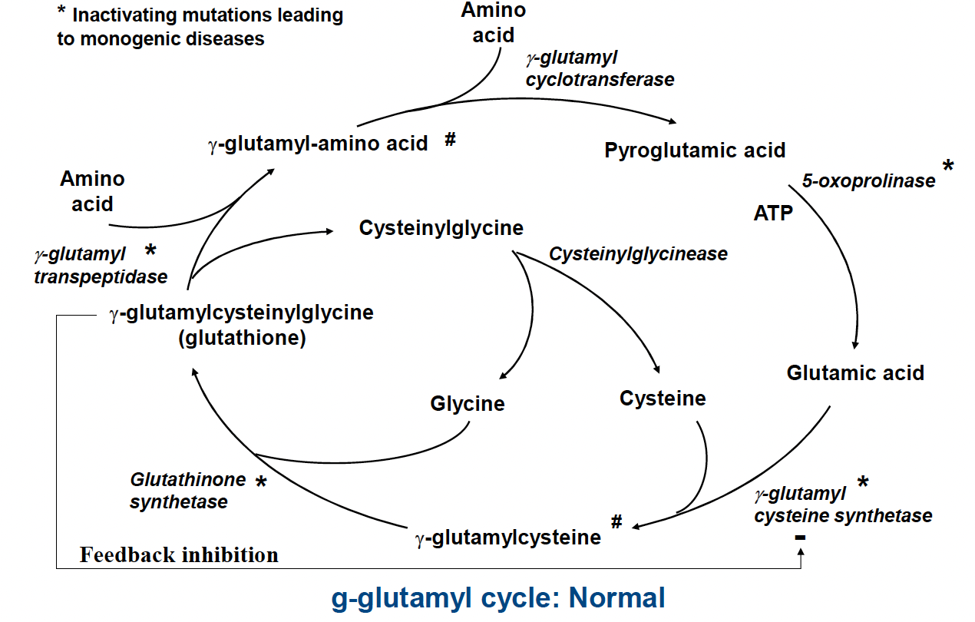
BRCU 2024

Slide 58
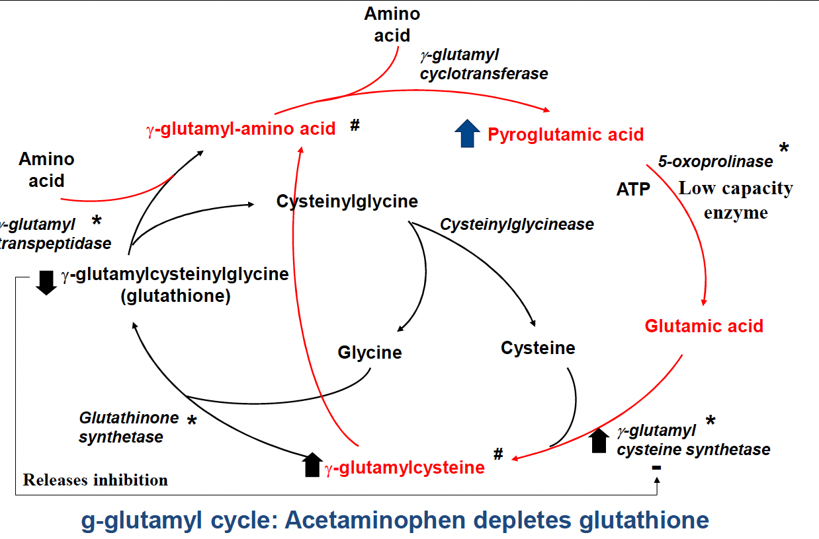
BRCU 2024

Slide 59
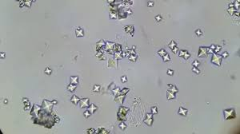
A 38-year-old woman with a history of short-bowl surgery for complication of trauma and kidney stones. She presents with slured speech, confusion, weakness, multiple loose stools, impaired motor coordination, and irritability. She likes ice cream and developed these symptoms after eating a large container of ice cream. She is not on any medications or special diet. ABG: pH 7.27, pCO2 24 mmHg, and calculated HCO3- 16. Urine ketones are negative. Serum lactate levels are 1.5 mmol/L. Serum Cr is normal. The anion gap is 20 and osmolar gap is 10. A urinalysis with microscopy as performed with crystals shown.
Which of the following is the MOST likely cause of this acid-base disturbance in this patient?
A) L-Lactic Acid
B) Pyroglutamic Acid
C) D-Lactic Acid
D) Methanol
E) Topiramate

Slide 60
A 38-year-old woman with a history of short-bowl surgery for complication of trauma and kidney stones. She presents with slured speech, confusion, weakness, multiple loose stools, impaired motor coordination, and irritability. She likes ice cream and developed these symptoms after eating a large container of ice cream. She is not on any medications or special diet. ABG: pH 7.27, pCO2 24 mmHg, and calculated HCO3- 16. Urine ketones are negative. Serum lactate levels are 1.5 mmol/L. Serum Cr is normal. The anion gap is 20 and osmolar gap is 10. A urinalysis with microscopy as performed with crystals shown.
Which of the following is the MOST likely cause of this acid-base disturbance in this patient?
A) L-Lactic Acid
B) Pyroglutamic Acid
C) D-Lactic Acid
D) Methanol
E) Topiramate

Slide 61
A 55 year old man with chronic alcoholism presents to the ED with agitation, blurred vision, and eye pain. Blood pressure and pulse rate are normal. He is afebrile. Lab findings are as follows.
Sodium 144 mmol/L
Potassium 3.1 mmol/L
Chloride 101 mmol/L
Total CO2 12 mmol/L
Blood urea nitrogen 9 mg/dL
Creatinine 1.5 mg/dL
Glucose 103 mg/100mL
Calcium 7.8 mg/dL
Magnesium 1.5 mg/dL
Phosphorus 2.1 mg/dL
Lactate 2.1 mmol/L
Osmolality 335 mOsm/L
Arterial blood gas: pH 7.10, pCO2 28 mm Hg
What enzyme does initial treat for this underlying processes competitively inhibit?
A) 5-Oxoprolinase
B) Lactate Dehydrogenase
C) Aldehyde Dehydrogenase
D) Alcohol Dehydrogenase
E) Pyruvate Dehydrogenase

Slide 62
A 55 year old man with chronic alcoholism presents to the ED with agitation, blurred vision, and eye pain. Blood pressure and pulse rate are normal. He is afebrile. Lab findings are as follows.
Sodium 144 mmol/L
Potassium 3.1 mmol/L
Chloride 101 mmol/L
Total CO2 12 mmol/L
Blood urea nitrogen 9 mg/dL
Creatinine 1.5 mg/dL
Glucose 103 mg/100mL
Calcium 7.8 mg/dL
Magnesium 1.5 mg/dL
Phosphorus 2.1 mg/dL
Lactate 2.1 mmol/L
Osmolality 335 mOsm/L
Arterial blood gas: pH 7.10, pCO2 28 mm Hg
What enzyme does initial treat for this underlying processes competitively inhibit?
A) 5-Oxoprolinase
B) Lactate Dehydrogenase
C) Aldehyde Dehydrogenase
D) Alcohol Dehydrogenase
E) Pyruvate Dehydrogenase

Slide 63
NAGMA

Slide 64
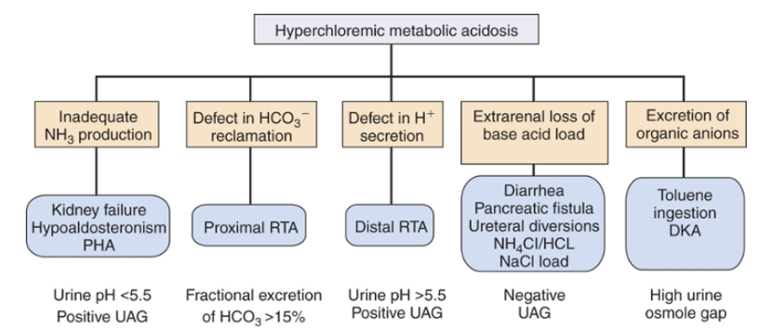
Nonanion gap Metabolic acidosis
Primer 8th edition

Slide 65
Evaluation of Urinary Acidification
The simplest test is to measure the urine pH.
Urine studies are not accurate if the urine Na is <20
UTIs and hypokalemia can lead to urinary pH elevation
Primer 8th edition
Notes:
However, the dipstick is not very accurate
A more accurate way to test urine pH would be to collected under oil and the pH measured, using a pH electrode to prevent the loss of CO₂, in fact when the urine pH is less than 6.0, the amount of dissolved CO₂ is minimal and the use of oil is unnecessary

Slide 66
Evaluation of Urinary Acidification
Renal excretion of accounts for the majority of acid excretion
An estimate of excretion, however, is easily obtained by calculating the urine anion gap (UAG) or urine osmole gap
The anion balancing the charge of the is Cl− is NH4
The UAG [(Na⁺ + K⁺) − Cl⁻] should be negative because the chloride is greater than the sum of Na⁺ and K⁺
The excretion of keto anions or hippurate can affect UAG; urine osmolar gap becomes a better option.
  A urine osmole gap of greater than 100 mmol/L signifies normal excretion.
Primer 8th edition
Notes:
UNH4 = 0.5 (urine osm – (2Na+K) + urea + glucose) = 75mEq/L or more is normal;
<25mEq/L is abnormally low

Slide 67

Urinary acidification
Biff F. Palmer CJASN doi:10.2215/CJN.08580813
©2014 by American Society of Nephrology

Slide 68
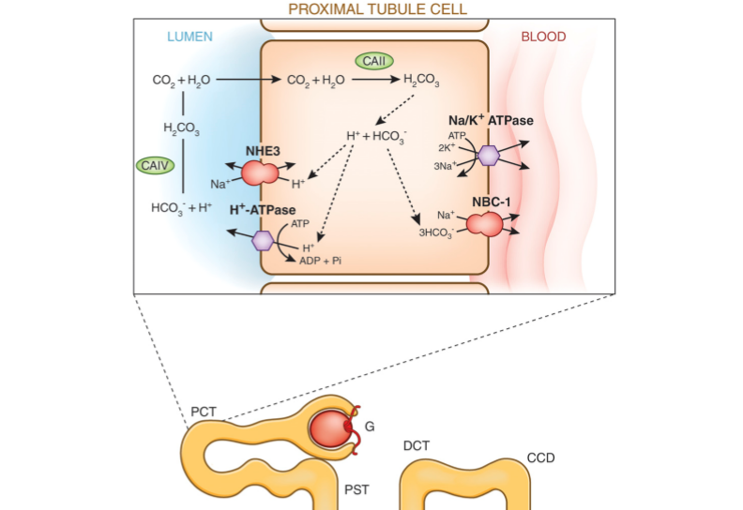
Renal excretion of acid also occurs thru ammoniagenesis in the proximal tubule
Glutamine → Glutamate → alpha ketoglutarate
acidosis and ↓K
↑K
Biff F. Palmer CJASN doi:10.2215/CJN.08580813
©2014 by American Society of Nephrology
Notes:
2 things happen in the proximal tubule
Reclaim bicarb
Ammoniagenesis
Glutamine is converted to glutamic acid by phosphate-dependent glutaminase
Glutamic acid to alpha ketoglutarate by glutamate dehydrogenase which releases HCO3 and NH4

Slide 69
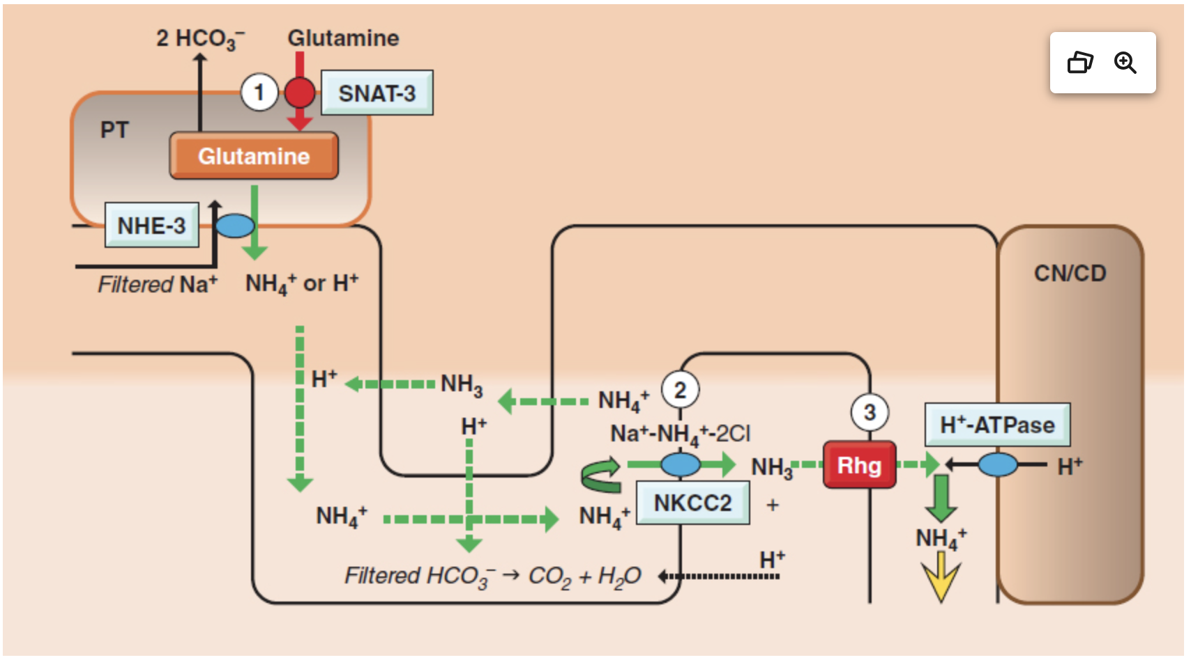
Fig 2.4: Pham, Pham
Notes:
Ammoniagenesis within the nephron. 1. NH4+ generated from glutamine in the proximal tubule is secreted into the lumen via NHE3. 2. Luminal NH4+ may be reabsorbed at the loop of Henle via NKCC2. 3. Secretion of NH3 at the connecting segments and collecting duct is facilitated by nonerythroid glycoproteins RhBg and RhCg. Abbreviations: CD, collecting duct; CN, connecting segment; NHE3, sodium hydrogen exchanger-3; NKCC2, Na+-K+-2Cl− cotransporter; PT, proximal tubule; Rhg, nonerythroid glycoproteins B and C (RhBg, RhCg); SNAT-3, sodium-dependent amino acid transporter.

Slide 70
Normal – 3% of glutamine available
Acute acidosis – 2x fold increase (skeletal muscle > liver) → increased 50% uptake of glutamine
https://dx.doi.org/10.1002%2Fcphy.c120010. PMID: 23720285
Notes:
phosphate-dependent glutaminase
Under conditions of normal acid-base balance, renal glutamine uptake is low, less than 3% of delivered glutamine. During acute metabolic acidosis there is a rapid, approximately 2×-fold increase in plasma glutamine levels, primarily from increased skeletal muscle glutamine release. There is a parallel increase in renal glutamine uptake, to approximately 20% of delivered glutamine. With chronic metabolic acidosis, renal glutamine uptake increases substantially, to as much as 50% of delivered glutamine, even though plasma glutamine levels often decrease. Increased renal glutamine utilization is balanced by increased skeletal muscle and liver glutamine release.

Slide 71
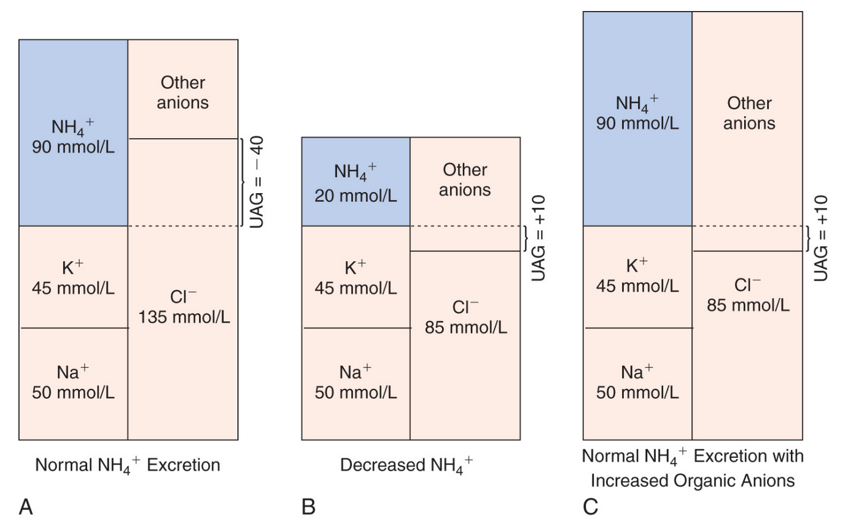
Primer 8th edition
Notes:
In the presence of acidemia NH4 excretion increases. Urine anion gap is an indirect way of measuring NH4. If the accompanied anion is Cl- which is usually is the UAG is negative.

Slide 73
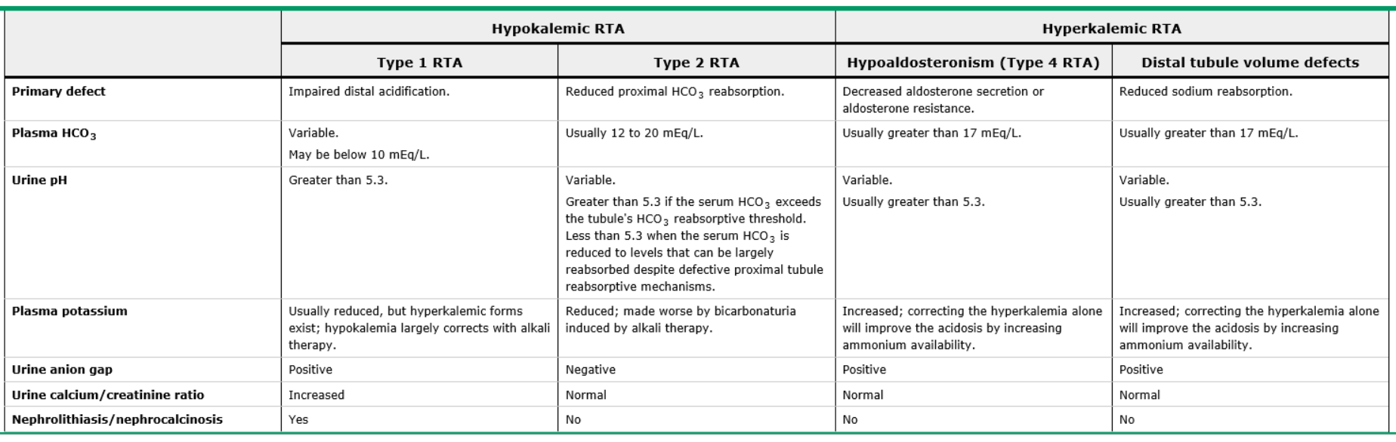
RTA
UpToDate.com

Slide 74
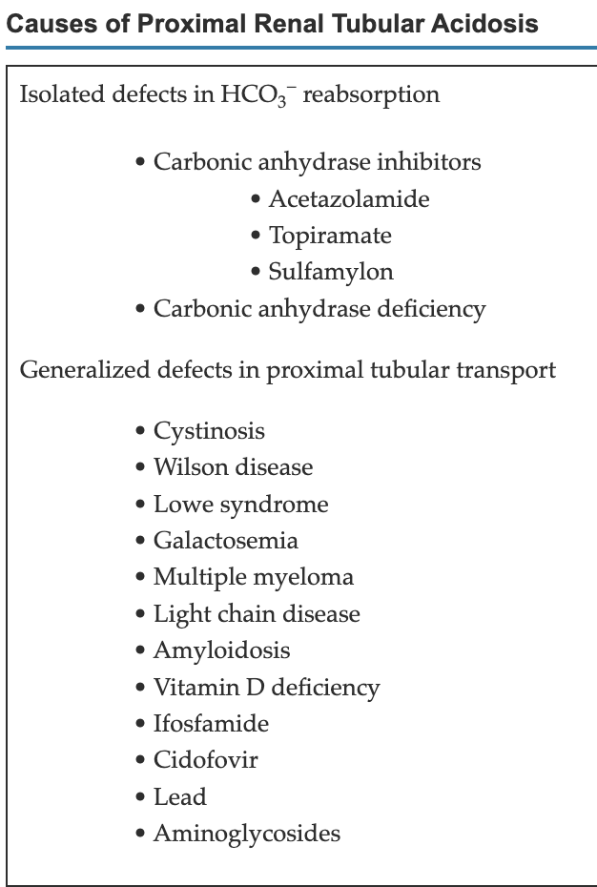
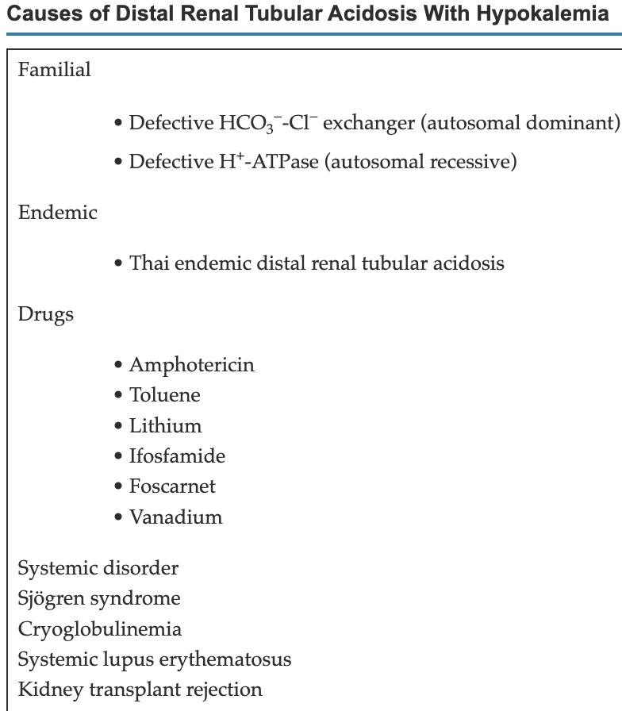
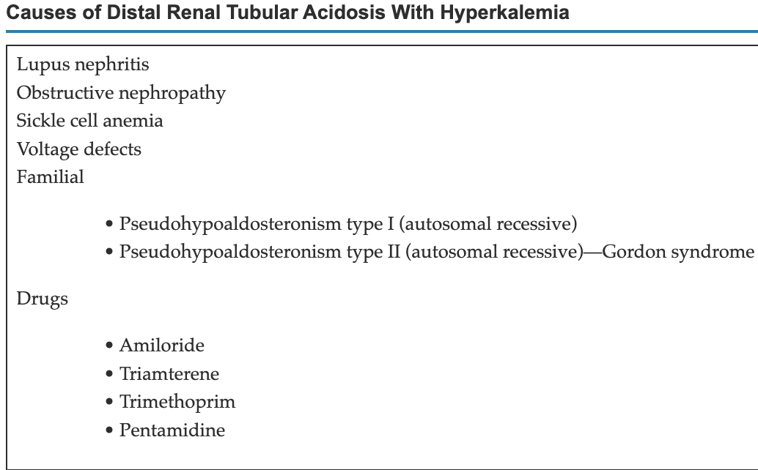

Slide 75
Hypoaldosteronism
The acidosis is primarily caused by decreased ammoniagenesis as a result of the associated hyperkalemia induced by the aldosterone deficiency.
Primer 8th edition

Slide 76
Hyperkalemia and Ammonia
In the loop, ammonium reabsorption is furosemide sensitive, suggesting a role for the apical Na/K/2Cl co-transporter
Hyperkalemia diminishes this transcellular transport, probably by direct competition between elevated luminal K and ammonium for the K binding site on the co-transporter
In the inner medulla, failure of normal, transcellular ammonium secretion into urine in setting of hyperkalemia has been linked to impaired capacity of the collecting duct’s basolateral sodium pump to carry the NH4 ion
In the collecting duct the reduced availability of ammonia in the lumen decreases urine acidification → decreased H secretion
Biff F. Palmer CJASN doi:10.2215/CJN.08580813

Slide 77
Urinary acidification
Biff F. Palmer CJASN doi:10.2215/CJN.08580813
©2014 by American Society of Nephrology

Slide 78
Pseudohypoaldosteronism
Type 1
  Renal salt wasting is accompanied by hyperkalemia and hyperchloremic metabolic acidosis
    Loss of function of ENaC (severe)
    Abnormalities in the mineralocorticoid receptor, dominant form (mild)
Type 2 (Gordon syndrome)
  Dominantly inherited hyperkalemic hypertension with an associated (usually mild) acidosis
    Removal of the distal NaCl cotransporter inhibition in the distal convoluted tubule apical surface → decreased in Na distal delivery
    Impaired insertion of ROMK into the collecting duct → inability to secrete K into lumen
    Renin-aldosterone axis fails to compensate
    Like RTA 4 w/o renal impairment
Biff F. Palmer CJASN doi:10.2215/CJN.08580813

Slide 79
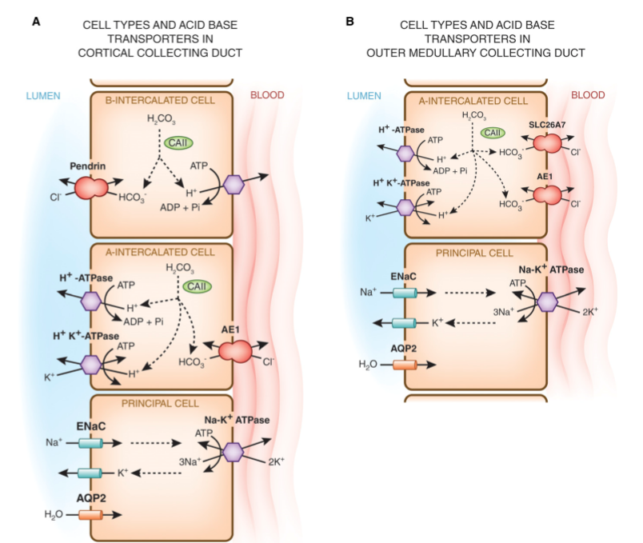
Distal RTA
Autosomal-recessive PHA type I
Biff F. Palmer CJASN doi:10.2215/CJN.08580813
©2014 by American Society of Nephrology

Slide 80
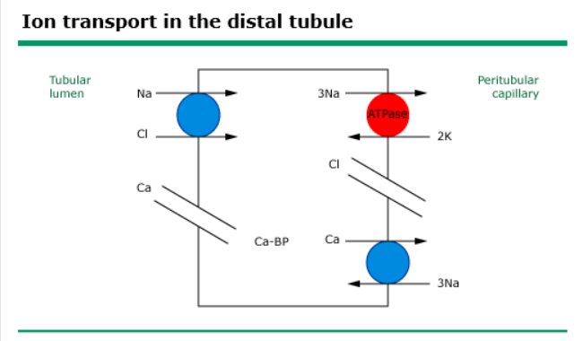
Gordon’s syndrome | Pseudohypoaldo II
Like RTA 4 w/o renal impairment
UpToDate

Slide 81
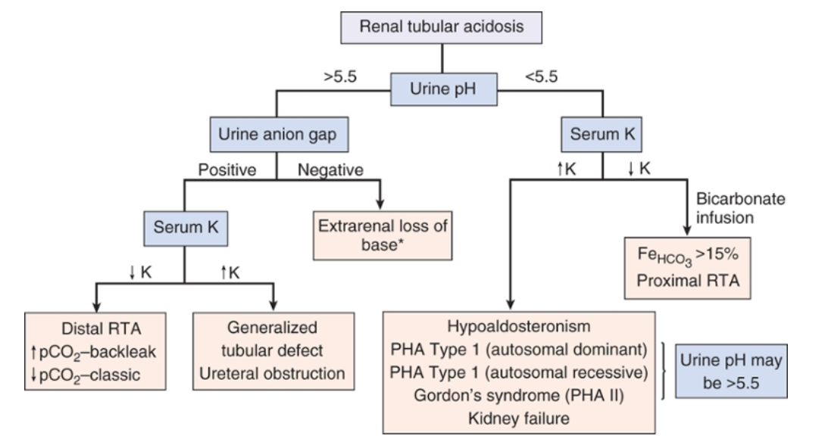
RTA
Primer 8th edition
Notes:
Hypokalemia leads to renal cysts and chronic interstitial nephritis.

Slide 82
Urinary anion gap is the difference between the excreted chloride and the excreted cations.
The formula is (Na⁺ + K⁺) - Cl⁻
If there is more chloride than cations, i.e. a "negative" urinary anion gap, it means another cation - namely ammonium - is being excreted
Increased ammonium excretion is the appropriate renal reaction to acidosis
Thus, a negative urinary anion gap demonstrates that the cause of a normal anion gap metabolic acidosis is not related to renal tubular function. In other words, its not an RTA, its diarrhoea.
BRCU 2024

Slide 83
UOG falls between 10 to 100 mosmol/kg
Calculated urine osmolality (mosmol/kg) = (2 x [Na + K]) + [Urea nitrogen in mg/dL]/2.8 + [Glucose in mg/dL]/18
The ammonium salts include ammonium chloride (NH₄Cl) as well as ammonium excreted with any "unmeasured" anions such as beta-hydroxybutyrate or hippurate.
Thus, the UOG will increase when the urinary excretion of any ammonium salt increases. In contrast to the UAG, the relationship between the UOG and urine ammonium is not disrupted by a high concentration of "unmeasured" urine anions.
BRCU 2024

Slide 84
f all of the above assumptions were correct, then the urine ammonium concentration would be approximately one-half of this value (due to accompanying anions, assuming they are univalent) and would normally be between 5 and 50 mEq/L. However, as was discussed with regard to the UAG, the UOG is a gross qualitative, rather than quantitative, measure of the urine ammonium concentration.
BRCU 2024

Slide 85
UOG of less than 150 mosmol/kg in a patient with chronic metabolic acidosis suggests that ammonium excretion is impaired
Because ammonium excretion is reduced in patients with distal renal tubular acidosis (RTA), a low UOG is consistent with (but not diagnostic of) this diagnosis. Reduced urine ammonium concentrations are also consistent with type 4 RTA
BRCU 2024

Slide 86
UOG exceeds 400 mosmol/kg, it is likely that the urine ammonium concentration is 200 mEq/L or greater
This would be expected with hyperchloremic metabolic acidosis generated by chronic diarrhea, by inhalation of toluene, and by other disorders in which the renal response to acidemia remains intact.
BRCU 2024

Slide 87
Urinary tract infections caused by bacteria that produce urease will disrupt the relationship between the UOG and renal ammonium excretion. Urease catalyzes the formation of ammonium and bicarbonate from urea and water. The UOG will increase, reflecting the high ammonium bicarbonate (NH₄HCO₃) concentration. However, this ammonium is formed outside of the kidney (in the bladder or the collection container) and therefore does not represent renal ammonium or acid excretion.
Urinary excretion of osmotically active, non-ammonium solutes that are not included in the above formulas (eg, alcohols [methanol, ethylene glycol] and mannitol) will increase the UOG even when renal ammonium excretion is not high. Although ethanol is metabolized quite rapidly, toxic alcohols are significantly excreted in the urine, especially during treatment with ethanol or fomepizole. Thus, measurement of the UOG as well as the plasma osmolal gap can be helpful in the diagnosis of toxic alcohol ingestion.
BRCU 2024

Slide 88
Thank You
BRCU 2024

Slide 89


