Slide 1

Nephronomics
Billing and Coding 101
Jacob Nysather DO
2-4-2026

Slide 2
Disclosures
I am not and expert or credentialed as a CPC, CCA, or any other certified billing/coding specialist (yet)
Document or it didn’t happen
Primary purpose is to share information learned and ways to help optimize what you may already be doing. This is to help capture the effort that is already being done.
  RPA and many coding providers take a conservative position when providing billing and coding advice

Slide 3
Lecture Series Overview
Part 1: Introduction to Healthcare and Policy
Part 2: Billing, Coding, and Documentation
Part 3: Insurers and Payers, Dialysis Specifics
Part 4: Specific Policies and Governmental Involvement
Part 5: Contracts and Incentives Benefits
*Part 6: Medical Directorship

Slide 4

Learning Objectives
This section outlines the key learning objectives for nephrology residents and fellows, focusing on essential billing and coding skills necessary for effective patient care and compliance.

Slide 5
Essential Billing and Coding Terminology
CPT CODES
ICD-10 CODES
RVU
Current Procedural Terminology (CPT) codes are maintained by the AMA and are essential for identifying billed procedures and services, ensuring accurate documentation and reimbursement for medical services.
The International Classification of Diseases, 10th Edition (ICD-10) codes are used for diagnosing conditions, crucial for effective billing, healthcare statistics, and maintaining patient records accurately.
Relative Value Units (RVUs) serve as a measure of value used in determining reimbursement rates for physician services based on the complexity and resources required for the provided care.

Slide 6
Who Sets the Rules and When
CMS GUIDELINES
AMA UPDATES
ICD-10 CHANGES
The Centers for Medicare and Medicaid Services (CMS) annually releases the Physician Fee Schedule in November, becoming effective on January 1, setting the framework for billing practices.
The American Medical Association (AMA) updates the Current Procedural Terminology (CPT) codes every October, which take effect on January 1, ensuring that coding practices reflect the latest medical standards.
The ICD-10-CM codes are revised twice yearly in April and October, with major updates implemented on October 1, keeping billing codes aligned with current diagnostic practices.

Slide 7
Essential Concepts for Nephrology Billing
  CPT: Current Procedural Terminology, AMA-maintained codes for procedures.
  ICD-10-CM: Diagnosis codes critical for patient assessment.
  HCPCS: Codes for supplies, drugs, and durable medical equipment.
  HCC: Hierarchical Condition Category, used for risk adjustment coding.
  RVU: Relative Value Unit, representing the currency of physician work.
  MDM: Medical Decision Making, primary driver for EM level since 2021.
  CMS: Centers for Medicare and Medicaid Services, key federal rule-setter.

Slide 8
Key Regulatory Agencies and Their Updates
  CMS: Physician Fee Schedule released annually in November, effective January 1.
  AMA: CPT codes released in October, effective January 1.
  ICD-10-CM: Updated twice yearly on October 1 and April 1.
  HCPCS Level II: Updated quarterly in January, April, July, and October.
  OIG Work Plan: Updated continuously throughout the year at oig.hhs.gov.
  ASN and RPA: Provide annual nephrology-specific coding guidance.
  MIPS QPP: Thresholds are updated annually in the CMS Final Rule in November.

Slide 9
The EM Code Overhaul
MAJOR CHANGES
In 2021, outpatient EM codes underwent a significant restructuring. The traditional history and physical examination are no longer the primary determinants for EM level; instead, MDM now dictates the level of service.
INPATIENT REVISIONS
The 2023 update reformulated inpatient EM codes utilizing the same MDM framework. The goal is to reduce administrative burden while ensuring alignment of payment with the complexity of patient care.

Slide 10
Medical Decision Making Overview
ELEMENTS OF MDM
Medical Decision Making (MDM) involves three critical elements: the number and complexity of problems addressed, the amount of data reviewed, and the risk of complications.
MDM LEVELS
MDM is categorized into four levels: straightforward, low, moderate, and high, with nephrology cases often qualifying for moderate to high based on complexity and risk factors.
NEPHROLOGY CONSIDERATIONS
In nephrology, conditions like CKD progression and AKI complications frequently elevate the MDM level, necessitating thorough documentation to support the complexity of care provided.

Slide 11
Outpatient EM Codes
WORK RVUS
CODE RANGES
Each code has a corresponding work RVU, which quantifies the physician's work involved. These values help determine fair compensation for the services provided in outpatient settings.
The outpatient EM codes range from 99202 to 99215, categorizing visits based on the complexity of medical decision-making and time spent during the encounter.
TIME ALLOCATIONS
DOCUMENTATION IMPORTANCE
Time allocated for each code varies, with straightforward visits requiring less time, while higher complexity cases demand longer engagement to ensure comprehensive patient care and documentation.
Accurate documentation is essential for billing compliance and reflects the complexity of patient interactions. Proper notes support the selected EM codes and protect against audits and denials.

Slide 12
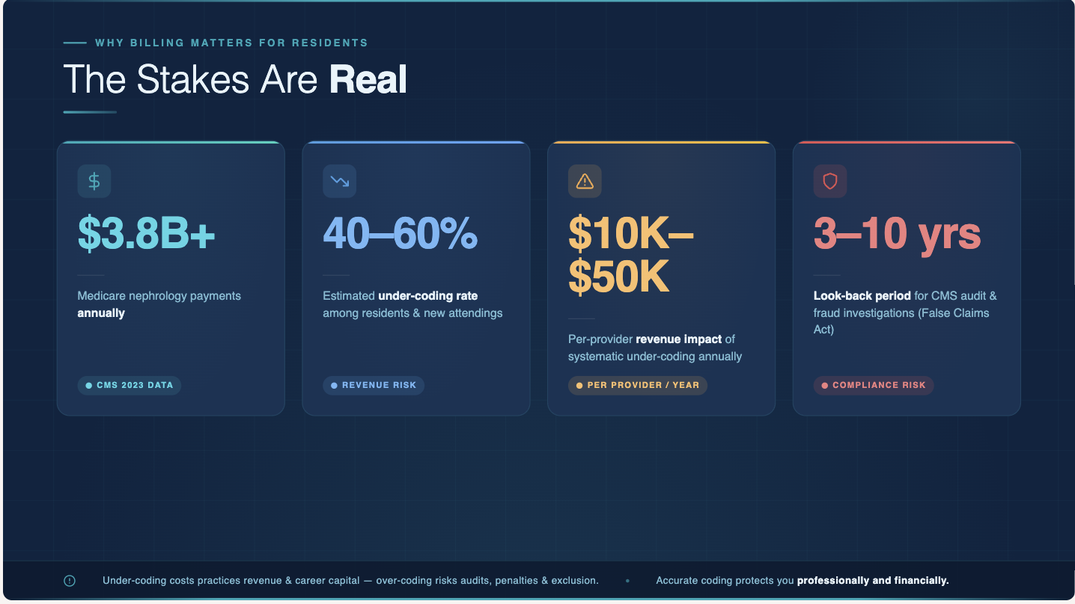

Slide 13
Objectives
Review common inpatient and outpatient MDM requirements for billing
Areas of potential optimization/under-utilization
2024 RVU

Slide 14
MDM and Descriptions

Slide 15
MDM

Slide 16
MDM: Complexity

Slide 17
Number and Complexity
Problems Addressed at the Encounter
A problem is addressed or managed when it is evaluated or treated at the encounter by the physician or other qualified health care professional reporting the service.
This includes consideration of further testing or treatment that may not be elected by virtue of risk/benefit analysis or patient/parent/guardian/surrogate choice.
Noting that another professional is managing a problem without additional assessment or care coordination documented does not qualify as being ‘addressed’ or managed by the physician reporting the service.

Slide 18
Number and Complexity
Problems Addressed at the Encounter

Slide 19
Number and Complexity
Problems Addressed at the Encounter

Slide 20
MDM: Data

Slide 21
Amount and Complexity
Data to be Reviewed and Analyzed
Category 1
Tests, documents, or independent historians (3+)
  Review of external notes
  Unique test results
  Ordering of unique tests
  Assessment requiring independent historians
Category 2
Independent interpretation of tests
  Cannot count this if the interpretation is separately billed (e.g. your office ultrasound)
  Hospital examples include review of EKG for patient with hyperkalemia, review of chest x-ray for patient with hypervolemia
Category 3
Discussion of management or test interpretation(with another qualified healthcare provider or appropriate source)
  Discussion = interactive exchange (not simply sending a note)
  May be asynchronous, e.g. within a day or two of the encounter
  This happens more frequently for inpatients than outpatients
* 1/3 for a level 4
* 2/3 for a level 5

Slide 22
Amount and Complexity
Discussion with Qualified Healthcare Professional
An individual who is qualified by education, training, licensure/regulation (when applicable) and facility privileging (when applicable) who performs a professional service within his/her scope of practice and independently reports that professional service
  NP, PA, CSW, PT, CRNA
Non-healthcare professionals that may be involved in management of care
  Lawyer, parole officer, case manager, teacher

Slide 23
MDM: Risk

Slide 24
Risk of Complications
Morbidity or Mortality of Patient Management
There is no set standard list of medications, lab monitoring requirement(s), etc. which encompass criteria. Different insurance companies may look at this differently between them.
Document continuing therapy* even if it is a refill.
It is key to document what you are monitoring and why it is high risk, intensive, or toxicity
Personal perspective: Chronic/stable medication(s) that may fall on suggested lists (without complicating factors) may not meet criteria and should be evaluated on independent basis.

Slide 25
Risk of Complications
AMA Definition of Intensive Monitoring
Drug therapy requiring intensive monitoring for toxicity: A drug that requires intensive monitoring is a therapeutic agent that has the potential to cause serious morbidity or death. The monitoring is performed for assessment of these adverse effects and not primarily for assessment of therapeutic efficacy. The monitoring should be that which is generally accepted practice for the agent, but may be patient specific in some cases.
Intensive monitoring may be long-term or short term. Long-term intensive monitoring is not less than quarterly. The monitoring may be by a lab test, a physiologic test or imaging. Monitoring by history or examination does not qualify. The monitoring affects the level of medical decision making in an encounter in which it is considered in the management of the patient.
Examples may include monitoring for a cytopenia in the use of an antineoplastic agent between dose cycles or the short-term intensive monitoring of electrolytes and renal function in a patient who is undergoing diuresis.
Examples of monitoring that does not qualify include monitoring glucose levels during insulin therapy as the primary reason is the therapeutic effect (unless severe hypoglycemia is a current, significant concern); or annual electrolytes and renal function for a patient on a diuretic as the frequency does not meet the threshold.”

Slide 26
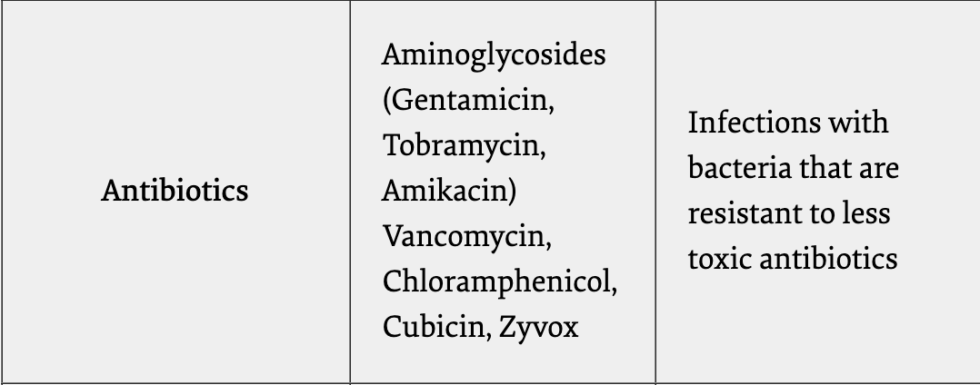

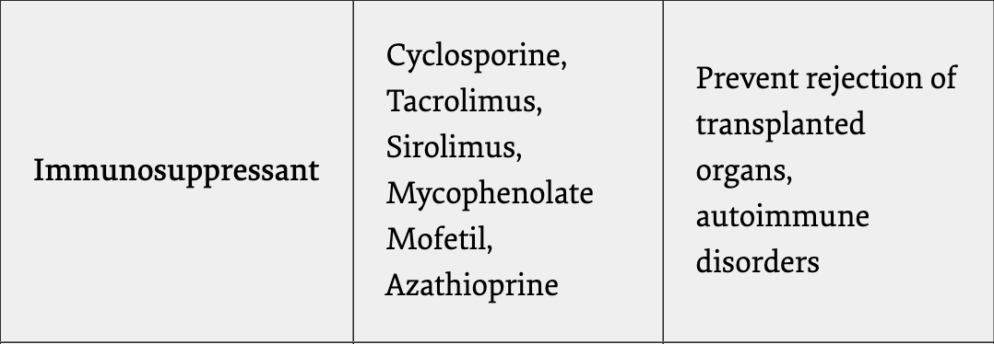

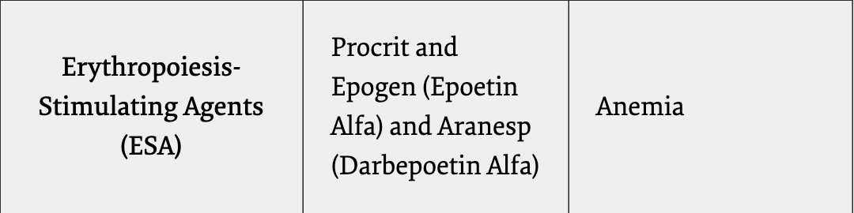
Risk of Complications
Intensive Monitoring to Palmetto GBA
For drugs with a well-defined clinical response and a high therapeutic index (i.e., low toxicity), intensive therapeutic drug monitoring is not necessary. For acute or short-term drug therapy, there is no advantage to monitoring drug levels. For treatment of chronic disorders, such as antihypertensive therapy, if the desired response can be readily assessed by a noninvasive technique, such as blood pressure monitoring, serial drug level monitoring is not medically necessary.
Administration of cytotoxic chemotherapy is always considered high risk under management options when monitoring of blood cell counts is used as a surrogate for toxicity.
Drugs that have a narrow therapeutic window and a low therapeutic index may exhibit toxicity at concentrations close to the upper limit of the therapeutic range and may require intensive clinical monitoring. The table below (primary meds included) lists examples of drugs that may need to have drug levels monitored for toxicity. This is not an all-inclusive list. On medical review, to consider therapy with one of these drugs as a high risk management option, we would expect to see documentation in the medical record of drug levels obtained at appropriate intervals.
Electrolyte abnormalities from diuretics

Slide 27
Case
Mr. Smith comes to your office for follow-up for resistant hypertension. Blood pressure in office is 200/90, relatively consistent with home readings. He is asymptomatic. You review a recent note from his primary care physician and see his blood pressure was 170/92 at that visit. Since last seeing you he had also seen orthopedic surgery for chronic hip pain. You review an A1c and renal panel done by his primary care doctor. You send in a script for nifedipine 60mg PO BID.
Your diagnosis is hypertension
As the visit was 12 minutes in length you bill a 99213.

Slide 28
Level 3 E/M MDM

Slide 29
Case
Mrs. Smith comes to your office for follow-up for CKD 3a. She overall is doing well and reports her blood glucose from her diabetes is well controlled. She recently had a renal, cbc, a1c, ua, and uacr completed prior to your visit. You note her UACr is 50 but all else is stable. No new medications prescribed at this time and request RTC in 6 months.
What E/M code would you choose for this patient?
  99212, 99213, 99214, 99215

Slide 30
Level 4 E/M MDM

Slide 31
Case
Mr. Smith comes to your office for follow-up for resistant hypertension. Blood pressure in office is 200/110, relatively consistent with home readings. He has had a headache for the last month and now notes chest pain occurring over the last 2 days and has progressively worsened. You review a recent note from his primary care physician and see his blood pressure was 170/92 at that visit. Since last seeing you he had also seen orthopedic surgery for chronic hip pain. You review an A1c and renal panel done by his primary care doctor.
Given his uncontrolled blood pressure and chest pain, you send him to the ER and call the ER and provide background to the case.
What E/M code would you choose for this patient?
  99212, 99213, 99214, 99215

Slide 32
Level 5 E/M MDM

Slide 33
Potential Areas of Optimization

Slide 34
Hospital Dialysis Codes
90935 vs 90937 (HD)
90945 vs 90947 (procedures other than hemodialysis)
  90937 and 90947 are for repeated evaluation(s) with or without substantial revision of dialysis prescription
Inpatient dialysis of an ESRD patient ONLY without acute abnormalities qualifies as a 99232 (level 2) or 90935. If billing for 99233 (level 3), MDM must justify level of service.

Slide 35
2024 RVU

Slide 36


UNDERSTANDING RVUS
Relative Value Units (RVUs)
3
wRVU (Work): Your mental/physical effort.
peRVU (Practice Expense): Staff, rent, supplies.
Components
mRVU (Malpractice): Liability risk weighting.

Slide 37
THE PAYMENT FORMULA
Medicare uses a mathematical formula to determine payment based on your coding:
GPCI = Geographic Practice Cost Index | CF = Conversion Factor (~$32.74 for 2024)

Slide 38
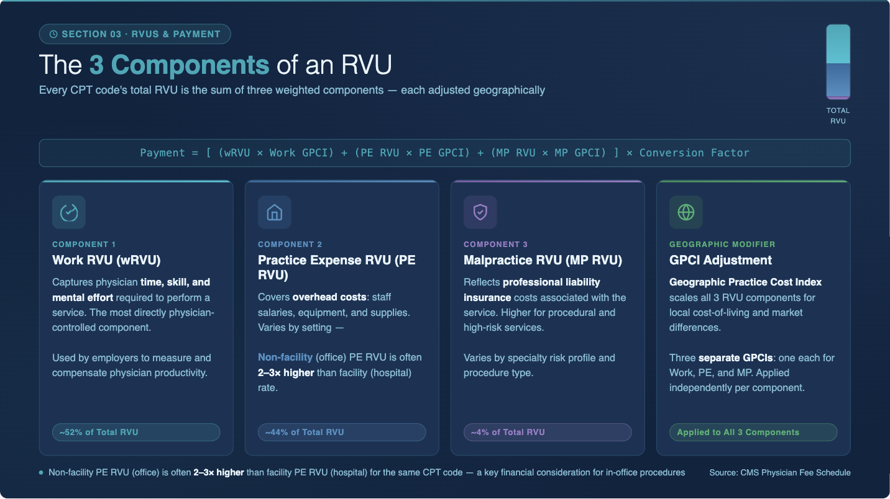

Slide 39
2024 RVU

Slide 40
NEPHROLOGY WRVU BENCHMARKS
Service Type | CPT Code | Work RVU (Approx)
Monthly Dialysis (4+ visits) | 90960 | 2.10 - 2.80
Initial Inpatient (High) | 99223 | 3.50
Subsequent Inpatient (High) | 99233 | 2.40
Acute Hemodialysis (Single) | 90935 | 1.45

Slide 41

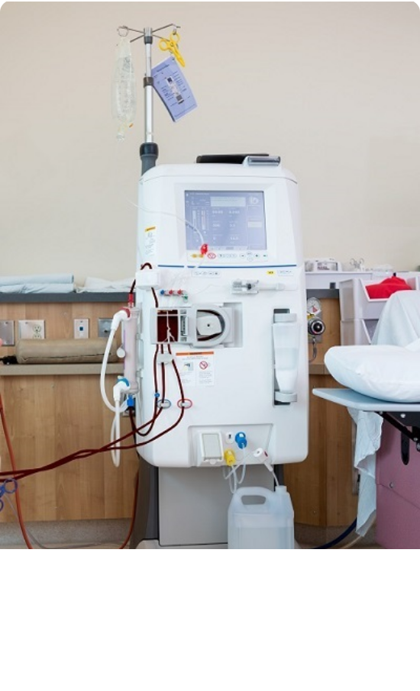
THE MCP BUNDLE (90960-90962)
End-Stage Renal Disease (ESRD) monthly management is billed as a Monthly Capitated Payment (MCP).
90960: 4+ face-to-face visits per month.
90961: 2-3 visits per month.
90962: 1 visit per month.
Required: Documentation of dialysis modality, weight/BP monitoring, and medication review.

Slide 42
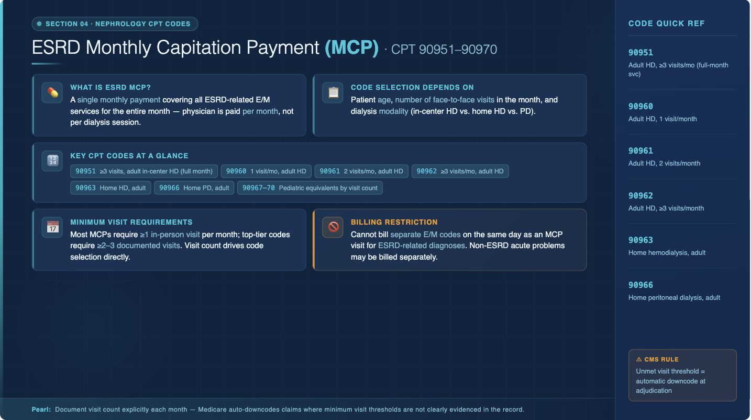

Slide 43
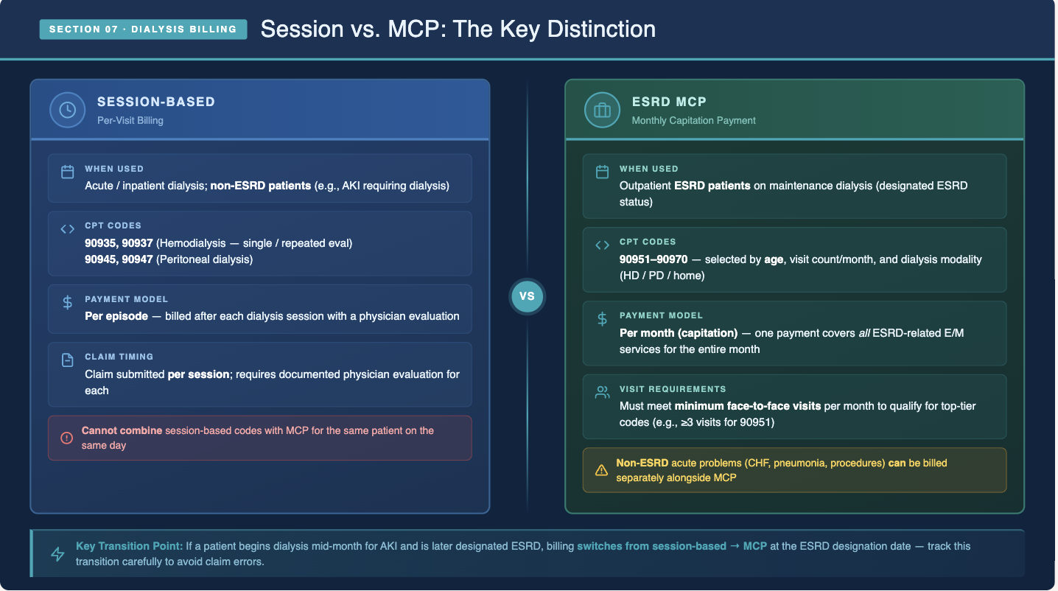

Slide 44
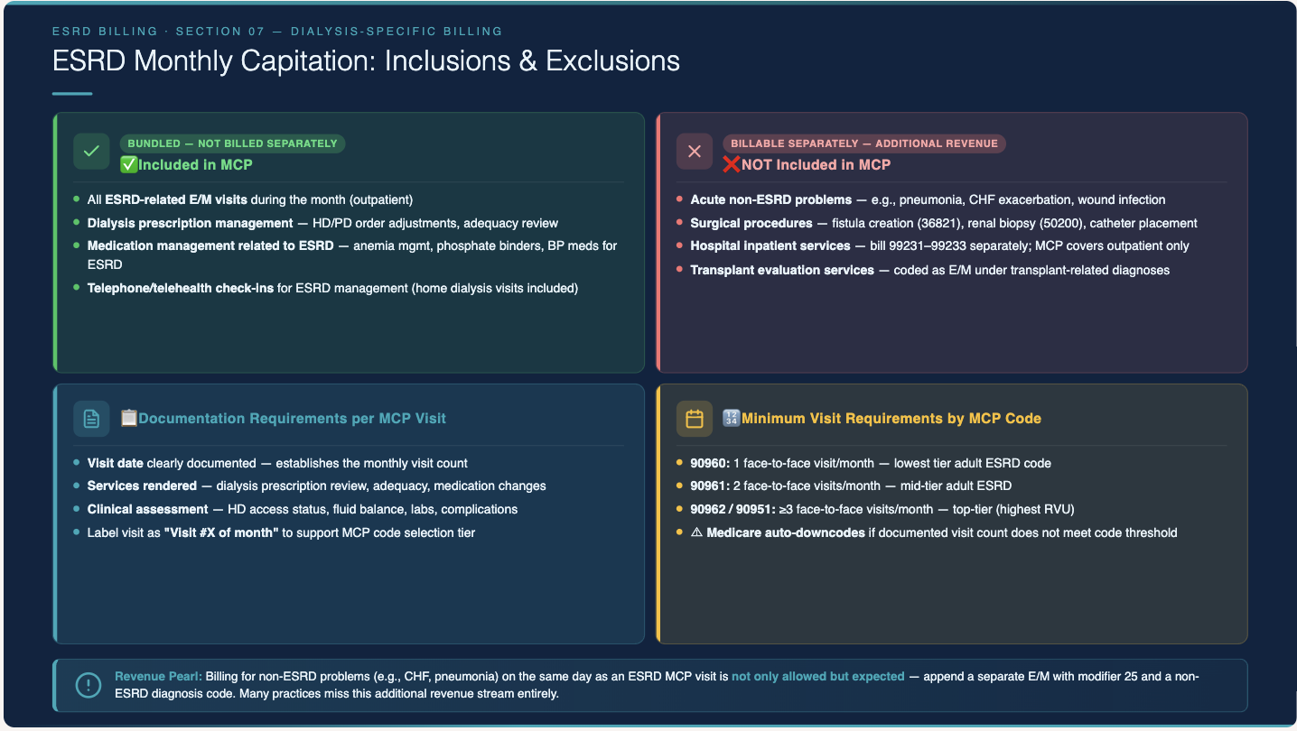

Slide 45
Common Billing Errors
UPCODING RISKS
Upcoding occurs when a higher EM level is billed than documented, leading to potential fraud allegations and increased scrutiny during audits.
DOCUMENTATION ISSUES
Inadequate documentation can result in denials and compliance risks; ensure all medical necessity and visit details are thoroughly recorded to avoid common pitfalls.

Slide 46
Best Practices in Documentation
BE SPECIFIC
Clearly state the CKD stage and underlying causes in documentation, rather than using broad terms. This enhances the clarity and accuracy of medical records and coding.
DOCUMENT ADDRESSED ISSUES
Explicitly record the problems addressed during each visit, rather than just listing them. This ensures accurate representation of care provided and supports proper billing.
LINK CODES AND NOTES
Always connect diagnosis codes to clinical documentation. This strengthens the link between the patient’s condition and the services rendered, aiding in compliance and audit readiness.

Slide 47
Key Credentialing Agencies and Resources
CMS RESOURCES
AMA GUIDANCE
ASN SUPPORT
The Centers for Medicare and Medicaid Services (CMS) offers comprehensive guidelines, coding resources, and updates on physician fee schedules, enhancing billing and coding accuracy in nephrology.
The American Medical Association (AMA) provides essential updates on CPT codes, ensuring nephrology residents and fellows stay informed about the latest coding practices and compliance standards.
The American Society of Nephrology (ASN) offers valuable resources and coding guidance tailored to nephrology, including annual updates and educational materials to support residents in their training.

Slide 48
Questions

Slide 49
Questions
Other HCPCS Level 2 Codes like G2211?
  Yes, but difficult to use on a routine basis and are typically time base and require distinctly separate documentation and do NOT overlap with other billed codes.
Attestations (GC Modifier): do they need to assign resident or fellow correctly, or does it matter?
  Short answer “yes”
  Although both are listed as “resident” according to CMS and fall under ”GME trainee”. Discrepancy can lead to denials and can open up opportunities for audits etc.
Is time-based billing more efficient/straightforward compared to medical decision making in the outpatient setting?
  Time based could be the more straight forward way of billing if appropriate time is spent and documented (in some instances may be easier to justify for billing a level 5)
  However, MDM based may be more accurate in documenting complexity of patient in all other scenerios outside of a 40-60 minute documentation of a level 5 visit.
  Example: You spend 24 minutes with an established patient and documentation/management. This would be a 99213. This same patient has CKD Stage 3a with microalbuminuria of 70 and hypertension (controlled). You reviewed their primary care’s note and order a renal panel, UA, and UACr to be completed prior to next visit. Without any ”risk” category this already qualifies for a 99214 having 2 categories at moderate for the MDM.

Slide 50
Resources
AMA
CMS
Palmetto GBA
UC Health Provider Education
RPA Billing and Coding

