Slide 1
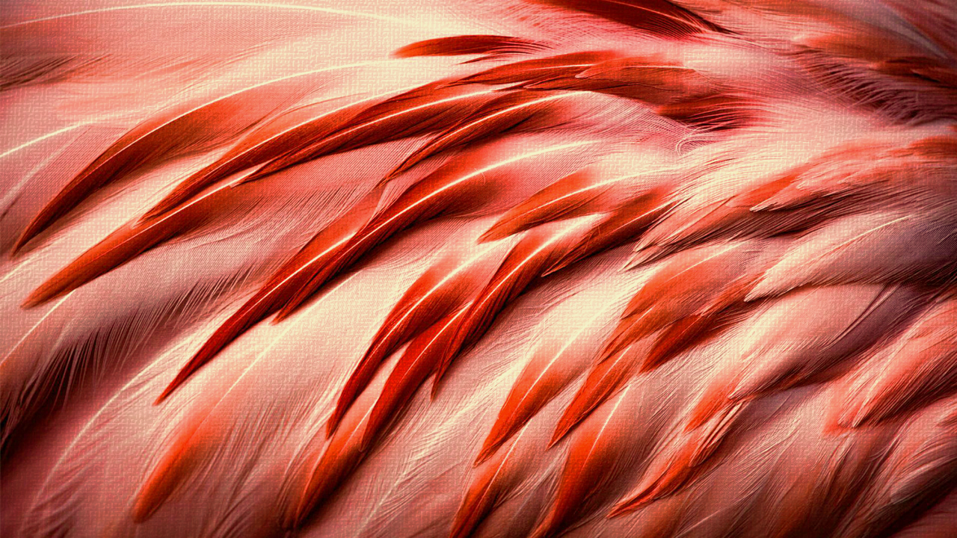
Dialysis for the internist
Jacob Nysather D.O.
September 5th 2023

Slide 2


Objectives/Outline
 | Why is this topic important
 | Progression towards end stage
 | Medications
 | Types of dialysis
 | Access

Slide 3
Disclosers
 | None

Slide 4

Why is it important
Dialysis for the Internist

Slide 5
Why is it important
According to 2018 data, ~37 million people in the US have CKD* (1 in 7 adults)
  More prevalent with advancing age: 65 years and older (>38%)
Incidence in the US : ~131,600 individuals started dialysis for ESRD
  2000-2019: 94,466 to 134,862
  2020: 130,522
Prevalence in the US in 2020: ~807,920 individuals are living with ESRD (2:1,000)
  ~70-75% dialysis dependent
  ~25-30% kidney transplant

Slide 6
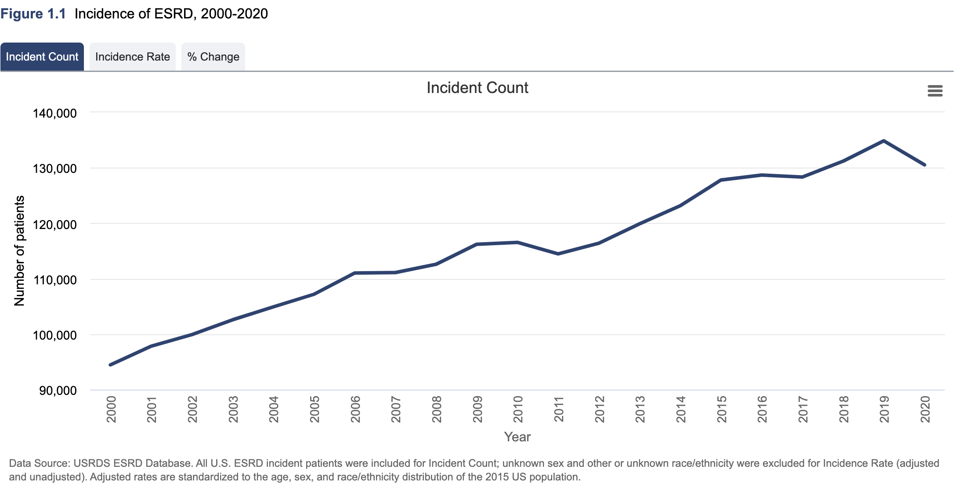
Incidence
Notes:
57% at 3 years after onset of ESKD as compared to 68% for patients receiving peritoneal dialysis (PD)
3-year survival improves to 85%

Slide 7
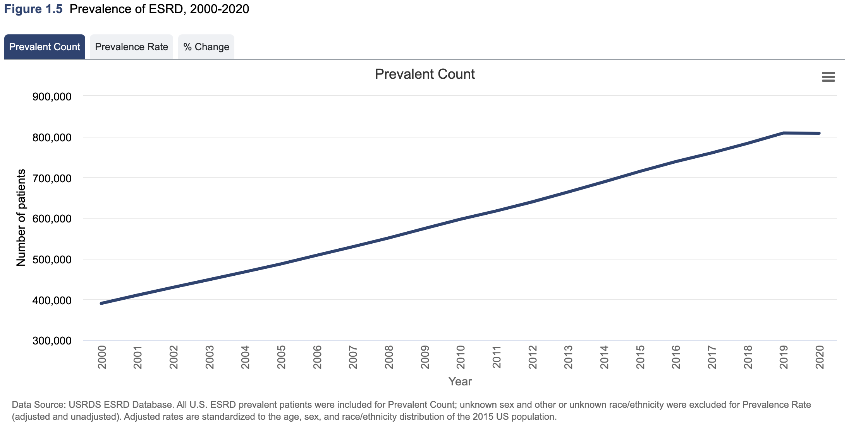
Prevalence

Slide 8
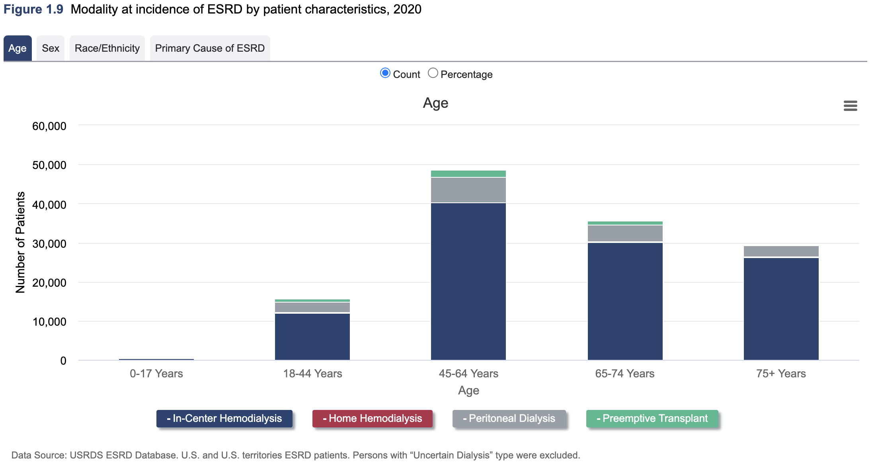
Modality

Slide 9
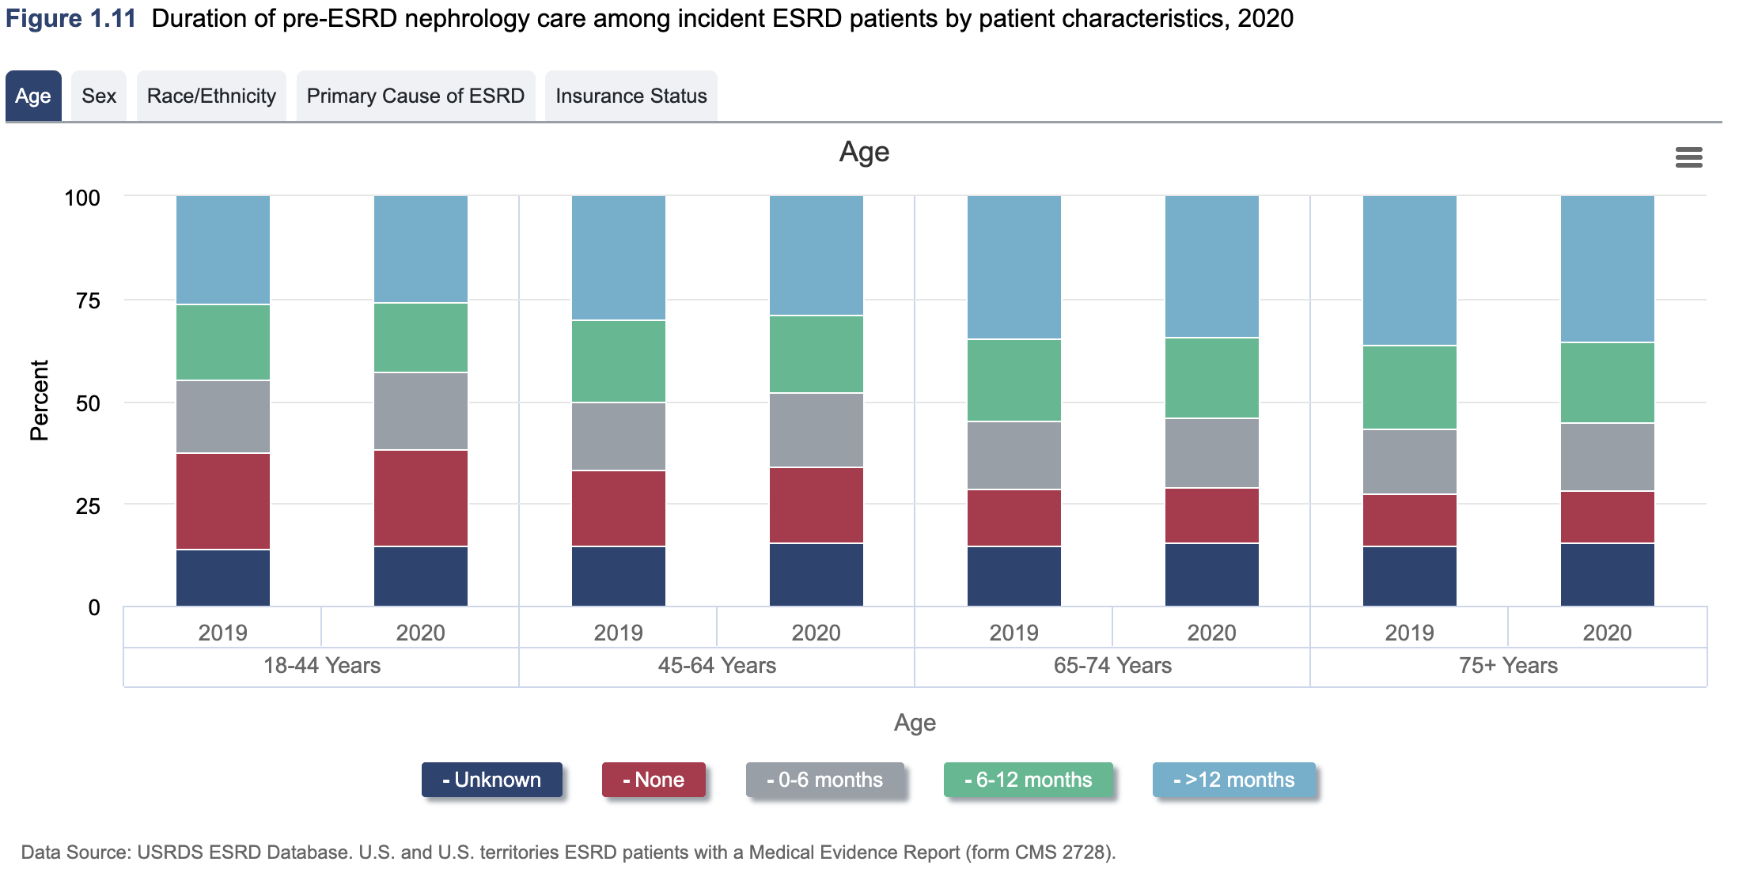
Pre-esrd education

Slide 10
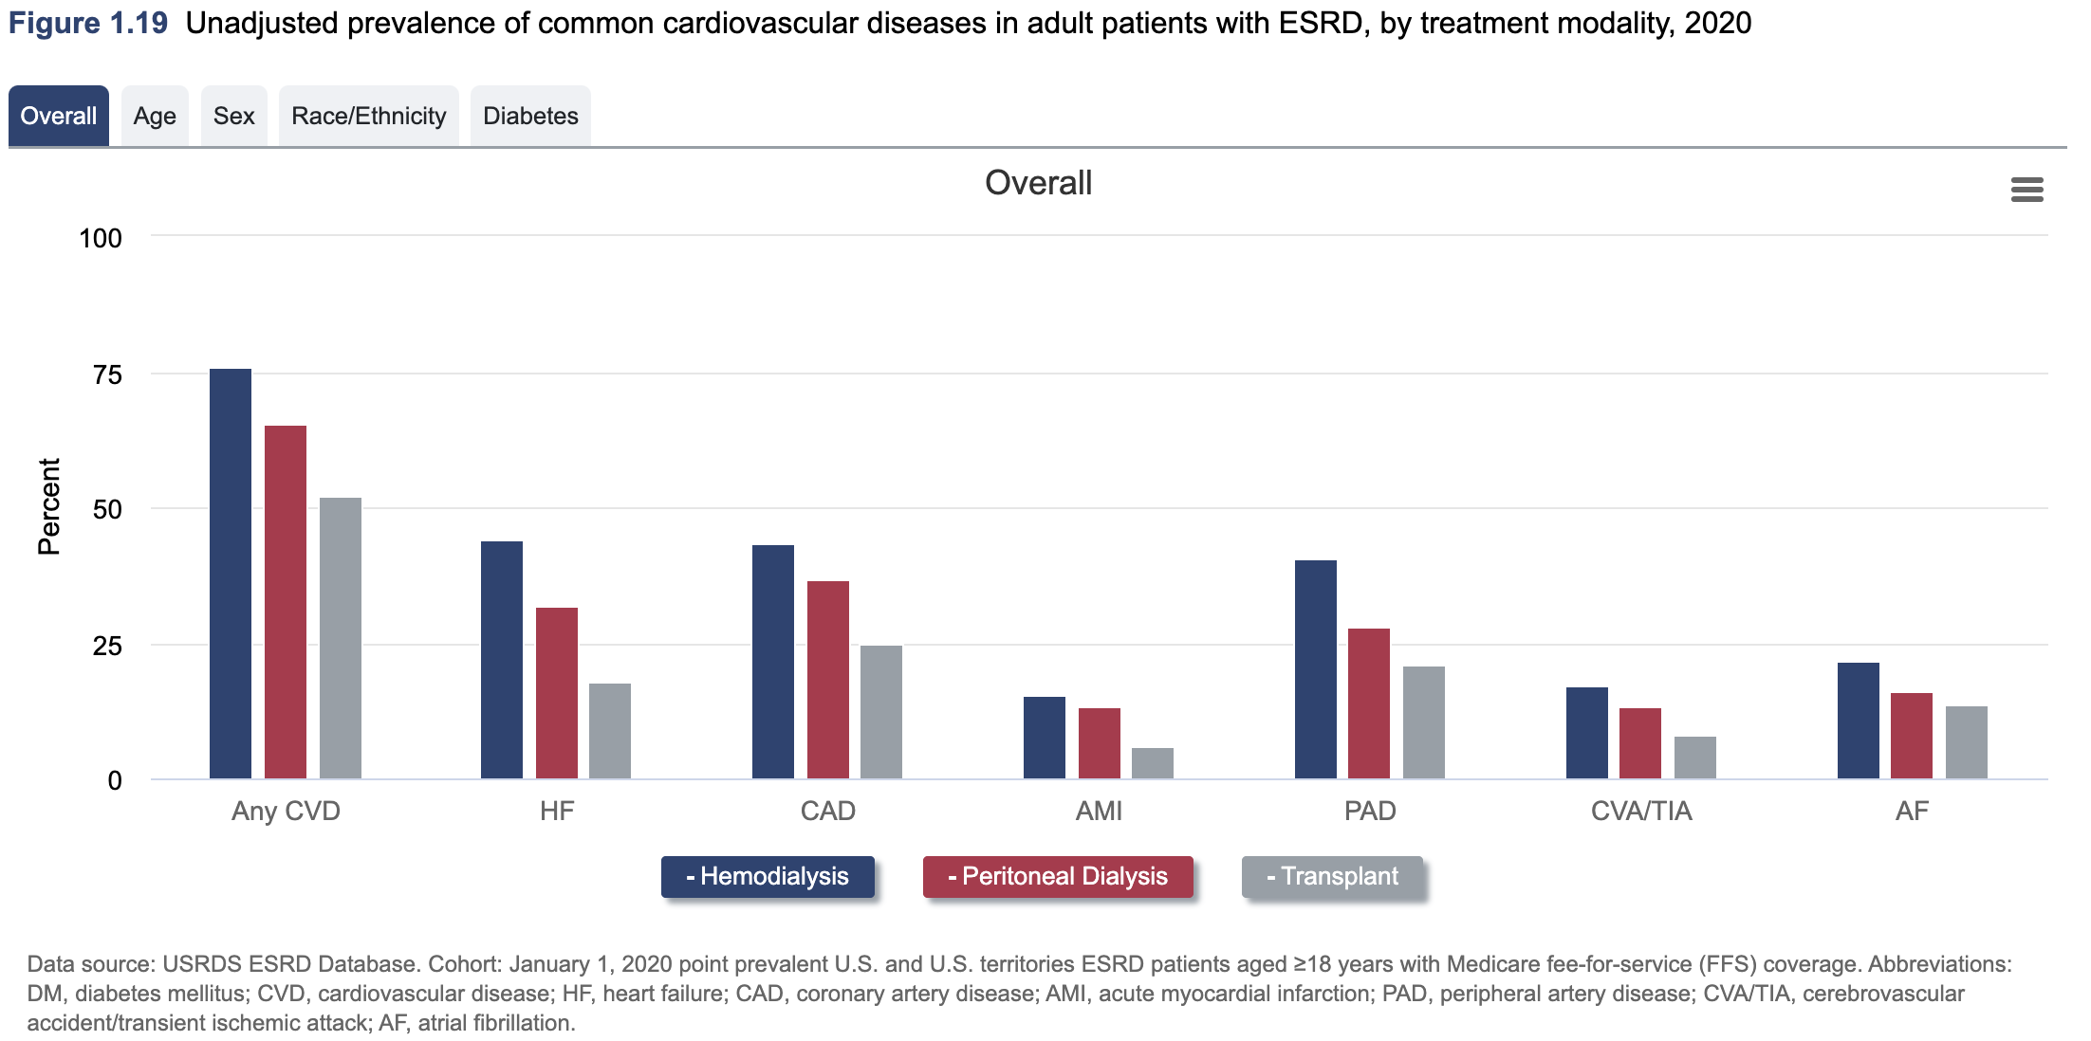
Prevalence of cardiovascular disease in ESRD

Slide 11
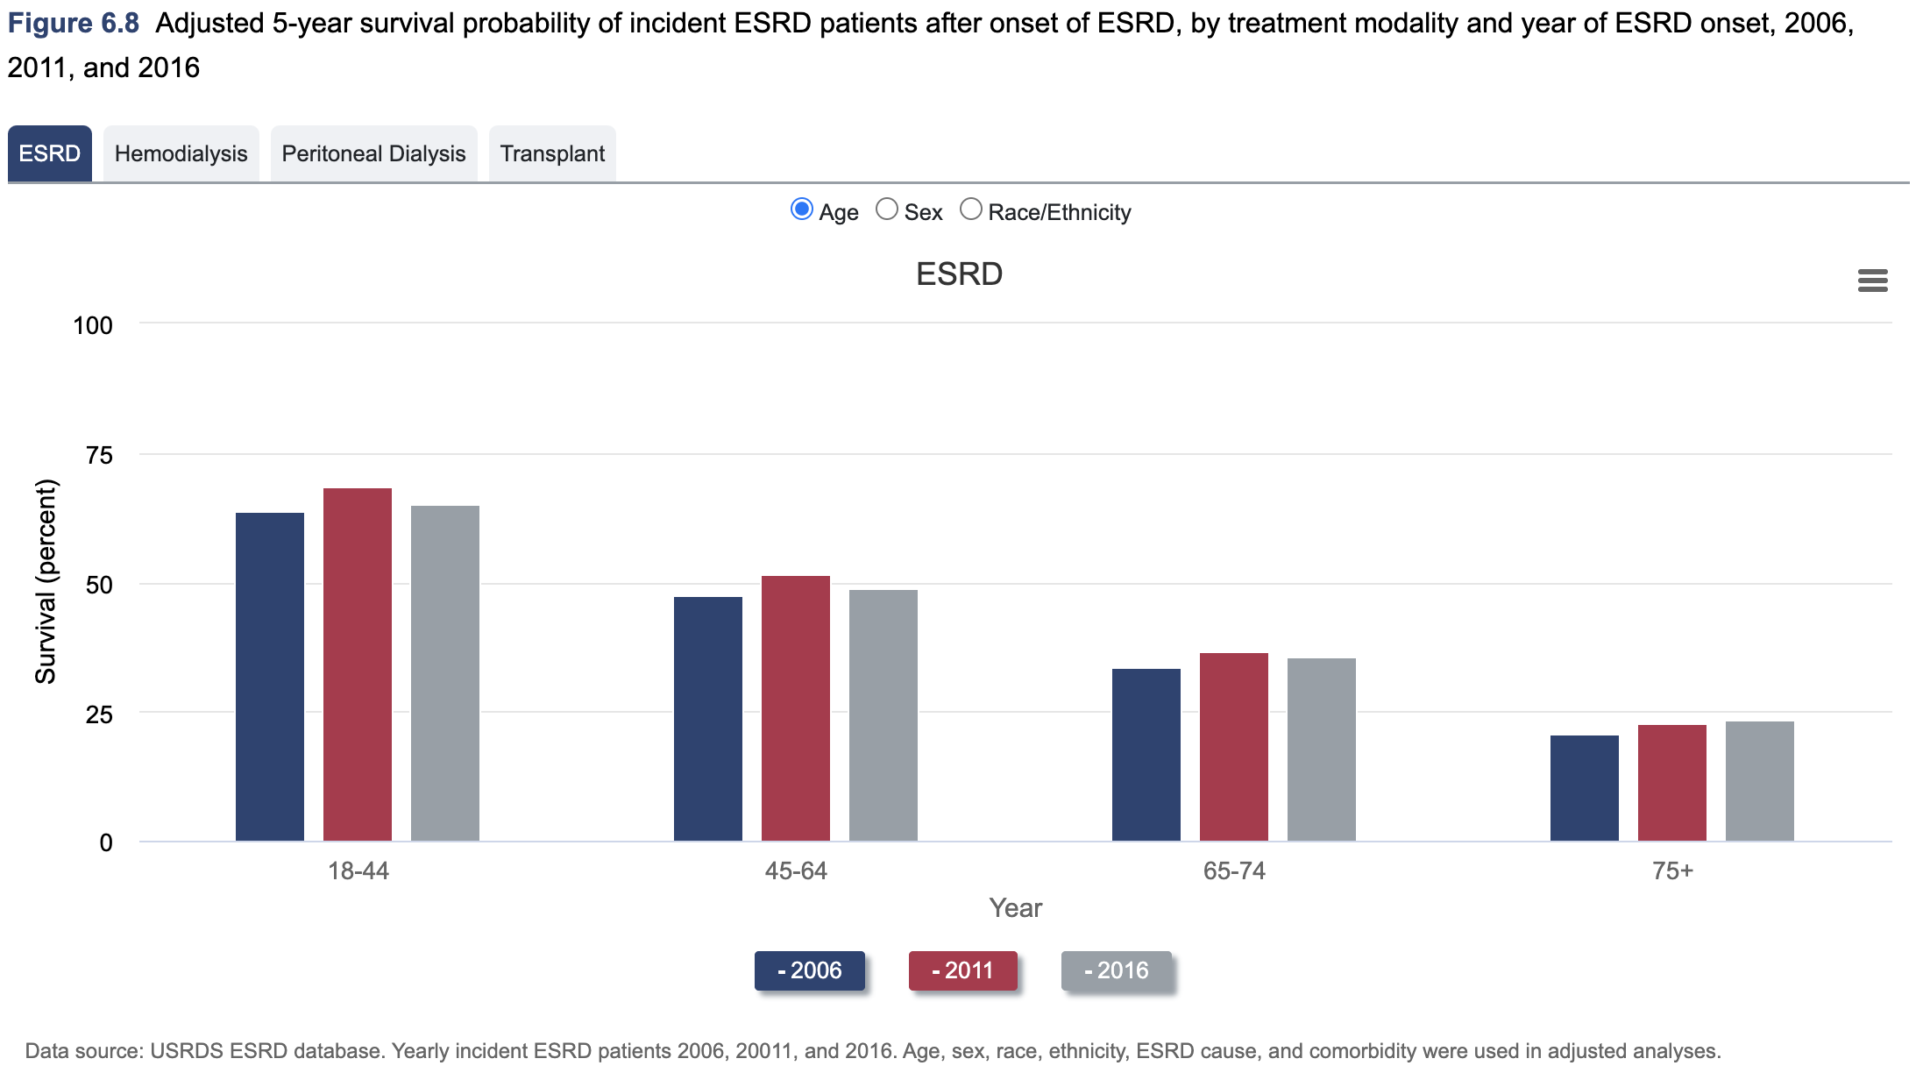
5-year survival of esrd
Notes:
57% at 3 years after onset of ESKD as compared to 68% for patients receiving peritoneal dialysis (PD) 3-year survival improves to 85%

Slide 12
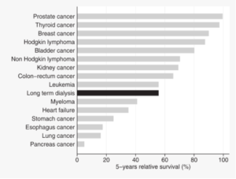
Mortality
Wachterman et al. One-Year Mortality After Dialysis Initiation Among Older Adults. JAMA Intern Med. 2019
  Health and Retirement Study Data 1998-2014 linked to Medicare claims (65.5 years and older)
  30 days: 22.5%
  6 months: 44.2%
  1 year: 54.5%
Nordio et al. Italian Dialysis and Transplant Registry. Survival rates compared to general population. AJKD 2012
  2000-2008
  Figure (right)

Slide 13
Progression towards dialysis
Dialysis for the Internist

Slide 14
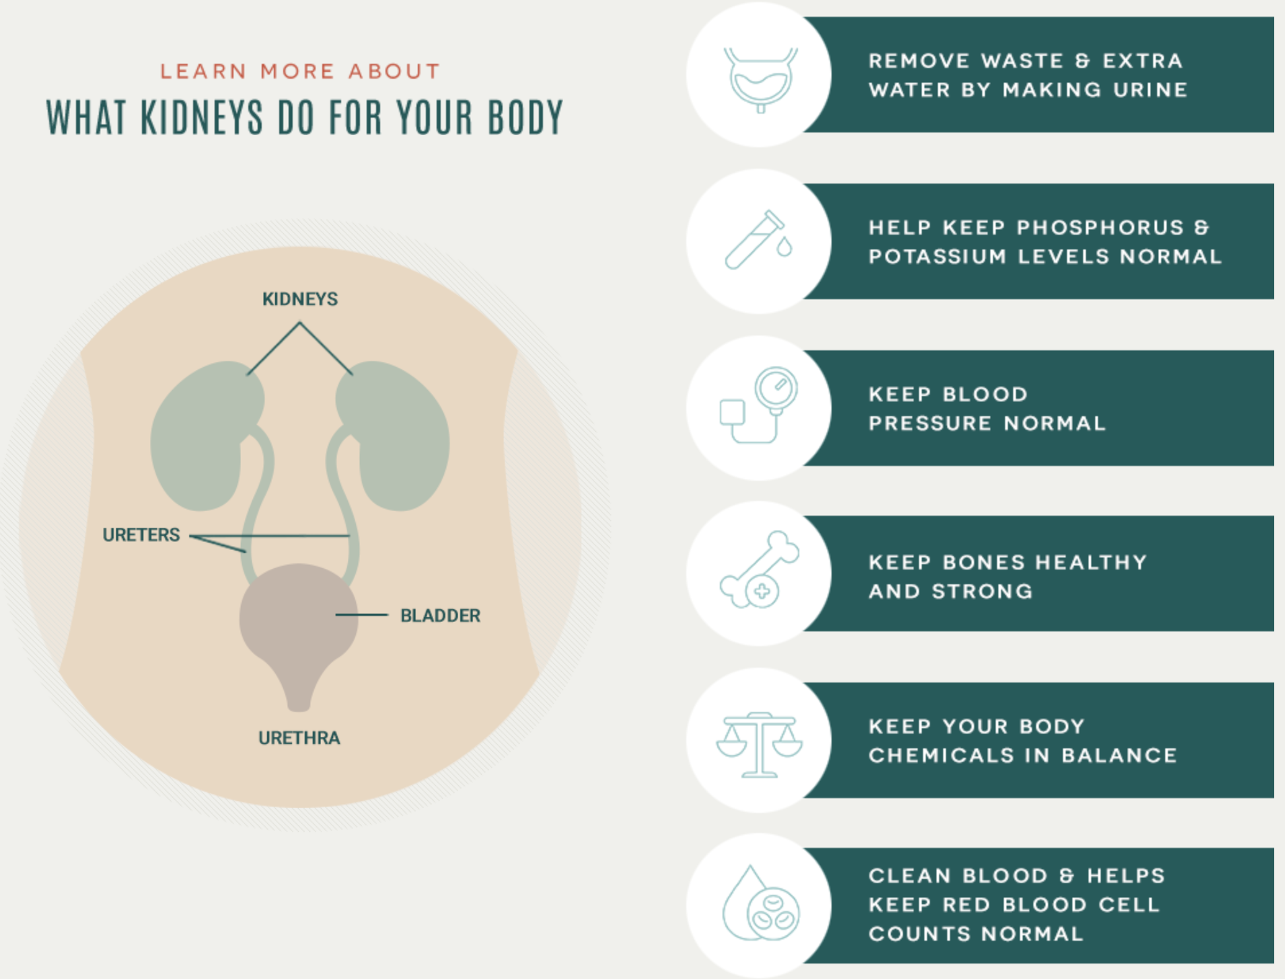
https://kidneyfailurerisk.com/
Tangri Kidney Failure Risk Calculator

Slide 15

Do you do it
72 year old male with PMH of OLT 2003 (HCV s/p treatment), CAD s/p PCI 2009, HLD, HTN. Patient comes to see you for routine care (last visit 6 weeks prior). Since the last time he has seen you he reports a metallic taste when he wakes up from sleep. Associated symptoms include fatigue. Vitals are notable for Temp 37*C, HR 67bpm, BP 134/72 mmHg, SpO2 97% on room air, Wt 89kg (prior visit 92kg, previously 102kg 6 months prior). Physical exam pertinent for chronically ill appearing male, RRR no MRG, lungs are CTAB, LUE AVF with +bruit with palpable thrill, lower extremities with 1+ pitting edema (similar to prior). Labs are noted below:
Are you worried about uremia and do you start dialysis?
6 weeks prior
Today
137
102
57
137
102
72
104
97
4.9
22
5.21
4.7
24
4.97

Slide 16
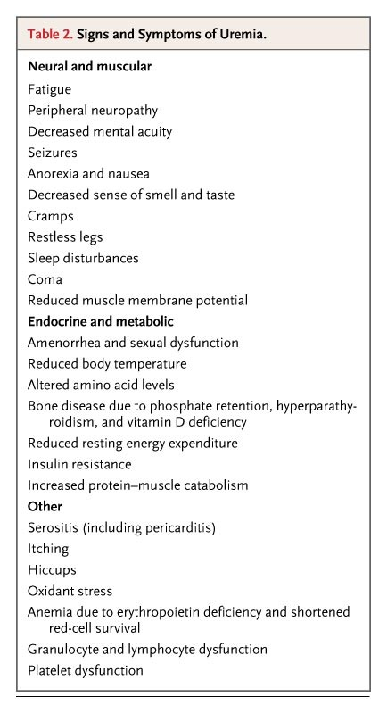
When is it time to start
When GFR reaches <15?
  IDEAL Trial: No improvement in survival when starting early (GFR 10-15) vs late/symptoms (5-7)
Acidosis, uncontrolled
Electrolytes, uncontrolled
Intoxication/Ingestion
Overload, refractory (hypertension)
Uremia
Uremia Review. Meyer and Hostetter. N Engl J Med 2007; 357:1316-1325 DOI: 10.1056/NEJMra071313

Slide 17

How can help we delay
Conservation of residual renal function
  Avoid nephrotoxins
  Intervene within areas previously mentioned
  Minimize long term complications
  Preserve access opportunities
Education and Empowerment
Early referral and Planning

Slide 18



Patient resources
Local Nephrologist
Dieticians
Dialysis Companies
  Education team
Support Groups/Experiences

Slide 19
Medications
Dialysis for the Internist

Slide 20
Common medications used
Acid-Base
  Sodium Bicarbonate (1:84mEq) vs Sodium Citrate (1:1mEq)
Electrolytes
  PO Binders: Sodium Zirconium vs Patiromer
Hypertension
  RAAS inhibition: STOP-ACE
Volume
  Loop Diuretics
BMD
  Binders (following slides)
  Calcium/Vitamin D
    Calcitriol, Doxercalciferol (Hectorol)
  Calcium Sensing Receptors
    Cinacalcet
Anemia
  Iron and other nutritional contributions
  Erythropoiesis Stimulating Agents (ESA)
    EPO/Retacrit, Darbepoetin/Aranesp, Mircera
Anticoagulation and Anti-platelets
  Apixaban

Slide 21
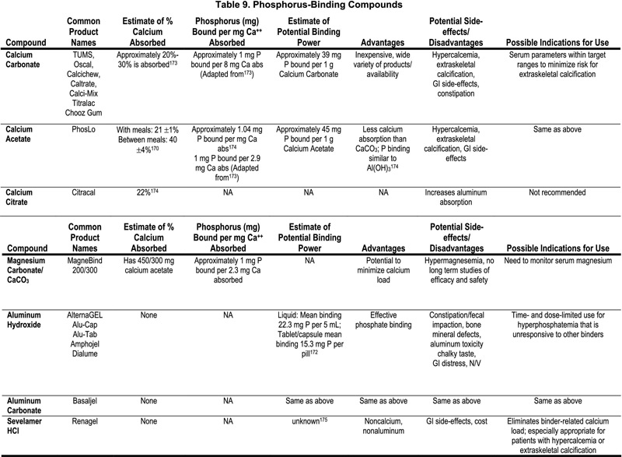
KDIGO Guidelines
Notes:
Iron based: Ferric Citrate (Auryxia), Sucroferric oxyhydroxide (Velphoro)

Slide 22
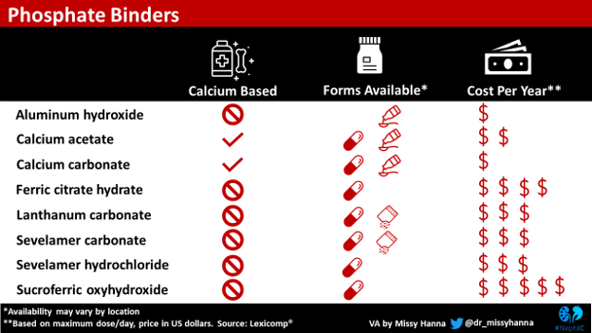

Slide 23

Do you do it
Patient is a 72 year old female with PMH of ESRD on iHD, CAD s/p PCI, HTN, T2DM, and chronic opioid use due to complicated hip replacement (arthritis c/b post-op infection). Presented to the hospital for SOB. Found to have community acquired pneumonia causing acute hypoxic respiratory failure. Hospitalization day 3 patient complains of abdominal pain and tell you “I think I’m constipated”. Further questioning reports last bowel movement 5 days ago. Patient receiving chronic hydrocodone with pain adequately controlled. Patient has been receiving home dose stool softener. Exam unremarkable other than right sided tunneled dialysis catheter. KUB consistent with moderate to severe constipation without obstruction. You prescribe a laxative during rounds. Later on in the day, the patient’s nurse calls and states no bowel movement yet. She asks if you can put in a FLEETs enema as it had good success with another patient earlier in the day.

Slide 24
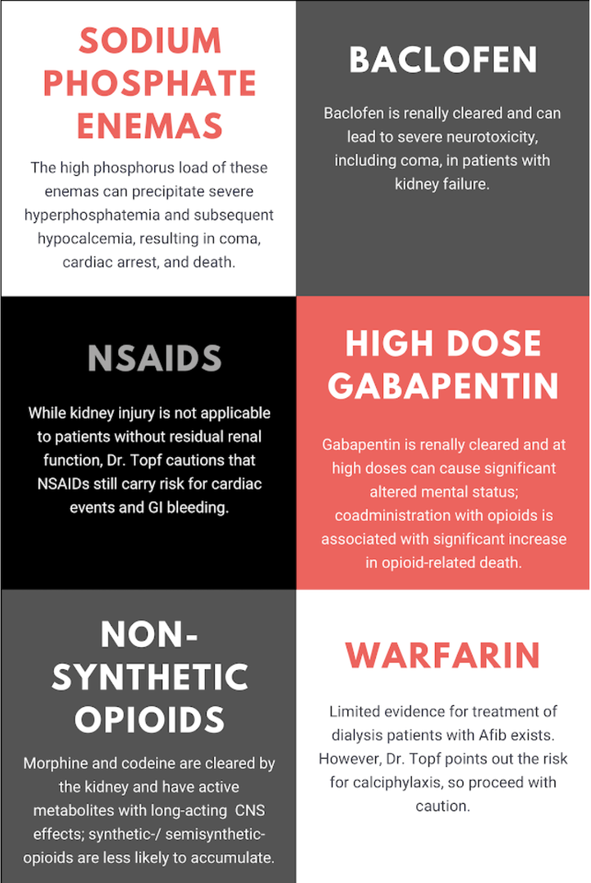

ESRD Medication Caution
Renally excreted medications
  Talk with pharmacy collogues
  Epocrates or other apps/resources
CNS acting medications
Do they bind with substances in the GI tract?
  What is absorbed?
Electrolytes!
Insulin – don’t overdo it
Fluids – PO > IV
Dr. Topf - Curbsiders Ep. #192

Slide 25
Types of dialysis
Dialysis for the Internist

Slide 26
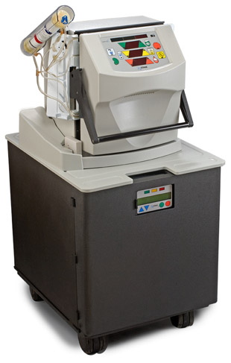
Home therapies
Home-Hemodialysis
  3 - 7 days per week (we say 5 or more*)
  Less fatigue post-dialysis
  More liberal in diet, better phosphate control
  Same types of access
  Solo or Partner

Slide 27
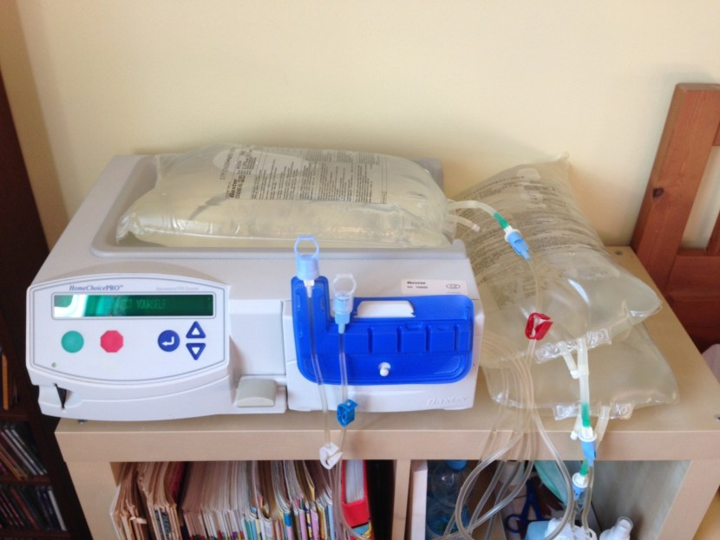
Home therapies
Peritoneal Dialysis
  7 days per week
    Nocturnal
    Intermittent fill and drains
  0K solutions
    Often require K supplementation
  Dextrose based solutions
    Higher dextrose concentration more UF
    Goal blood glucose <180
  Aggressive bowel regiments
    Constipation obstructs flow and increases risk of peritonitis
  Urine output preservation

Slide 28
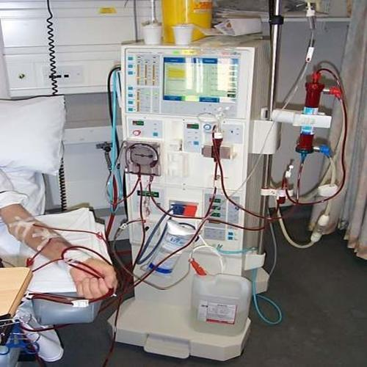
In center hemodialysis
3 days a week
  Occasionally extra sessions required
Limited time constraints
Transportation
Hypotension*
13ml/kg/hr UF

Slide 29
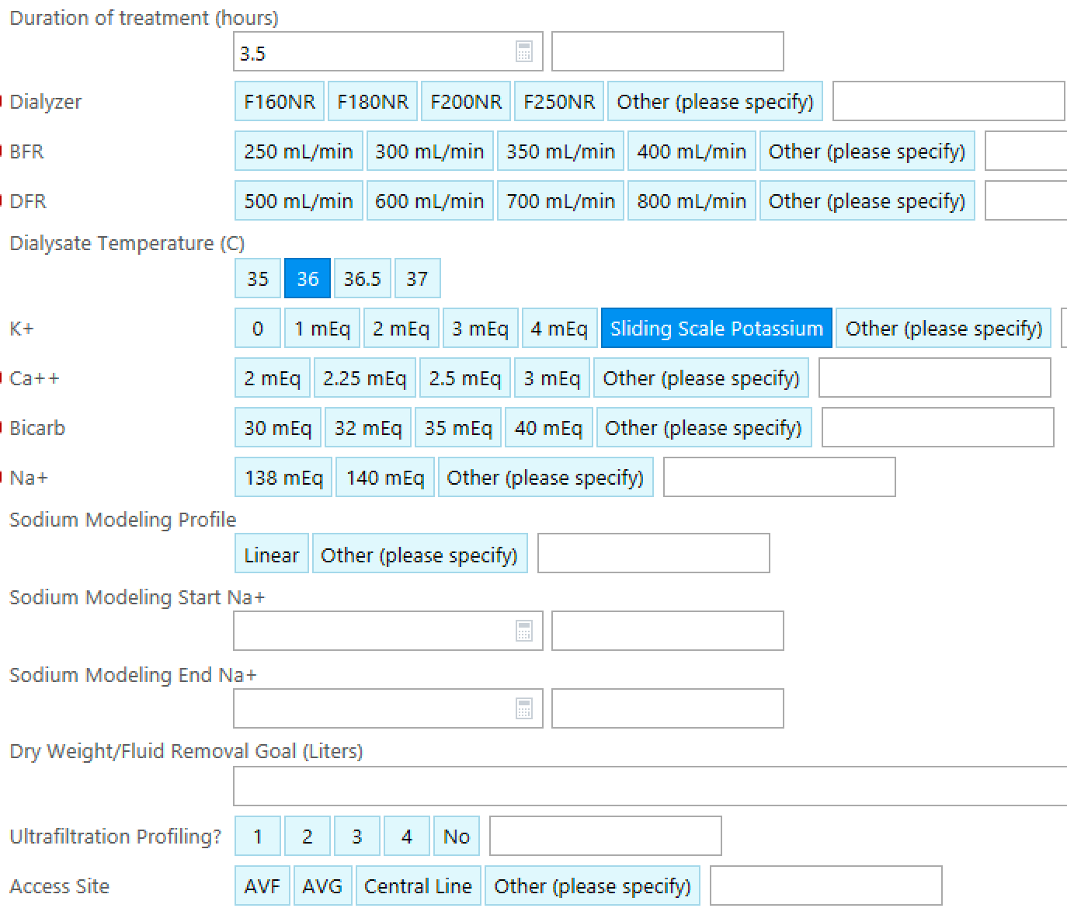

Slide 30
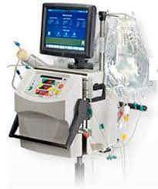
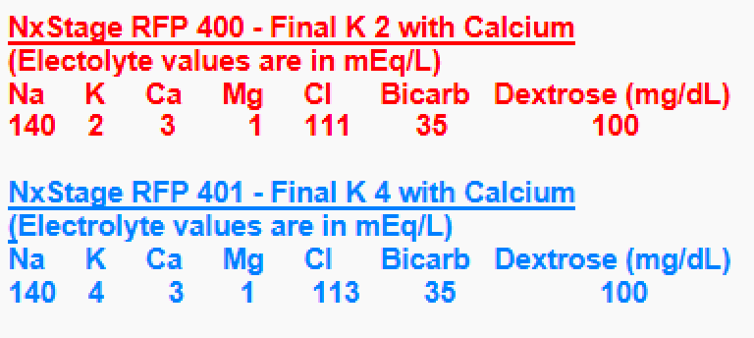
Continuous Renal Replacement Therapy
Typically 24hr therapy (expect down time)
Slower blood flows
More UF over time
Central catheter required
Anticoagulation
  Heparin and Citrate

Slide 31

Do you do it
Patient is a 67 year old female with PMH of ESRD on iHD, HTN, and T2DM. Patient presented after falling down stairs walking out to her car on her non-dialysis day. Work-up in ED is remarkable for a hip fracture. Orthopedic surgery plans to take to OR for ORIF tomorrow (her dialysis day) with time planned in the afternoon. Patient underwent routine iHD in the AM. The surgical team gives you a call while patient is receiving iHD and wants you to make sure she is medically optimized and wants to repeat a renal panel as her potassium was 5.4 this morning. Patient returns to her room post-dialysis and phlebotomy just so happens to be collecting a sample from a nearby patient.
Do you call phlebotomy for a stat renal panel prior to OR?

Slide 32
Types of access
Dialysis for the Internist

Slide 33
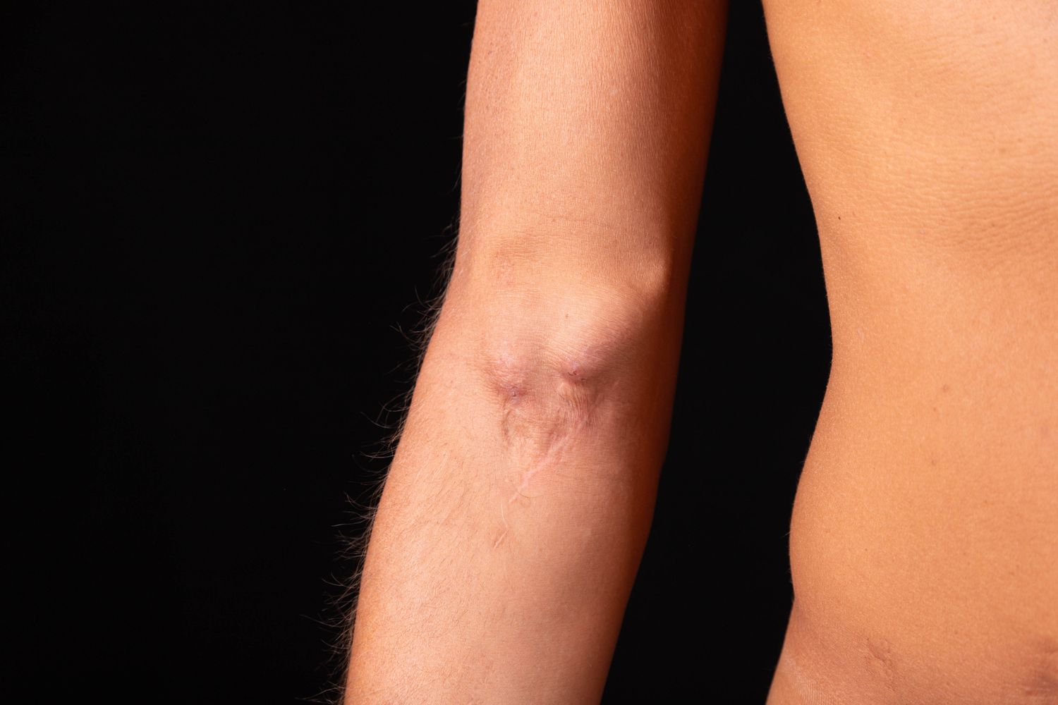
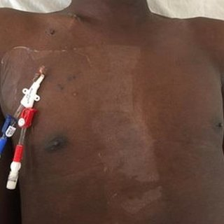
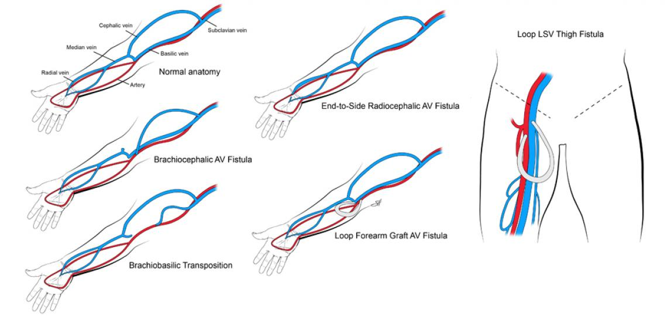
Catheters
AV Fistula and Grafts
Catheters
  Instant use
  Highest rates of infection complications
  High risk of fibrin/clots
Fistulas
  Take ~3 months to mature
  Up to 60% of surgical failure
  Lowest infection risk
Grafts
  Still needs 2-4 weeks to use
  Individual basis evaluation for removal with bacteremia
  Clot burden

Slide 34
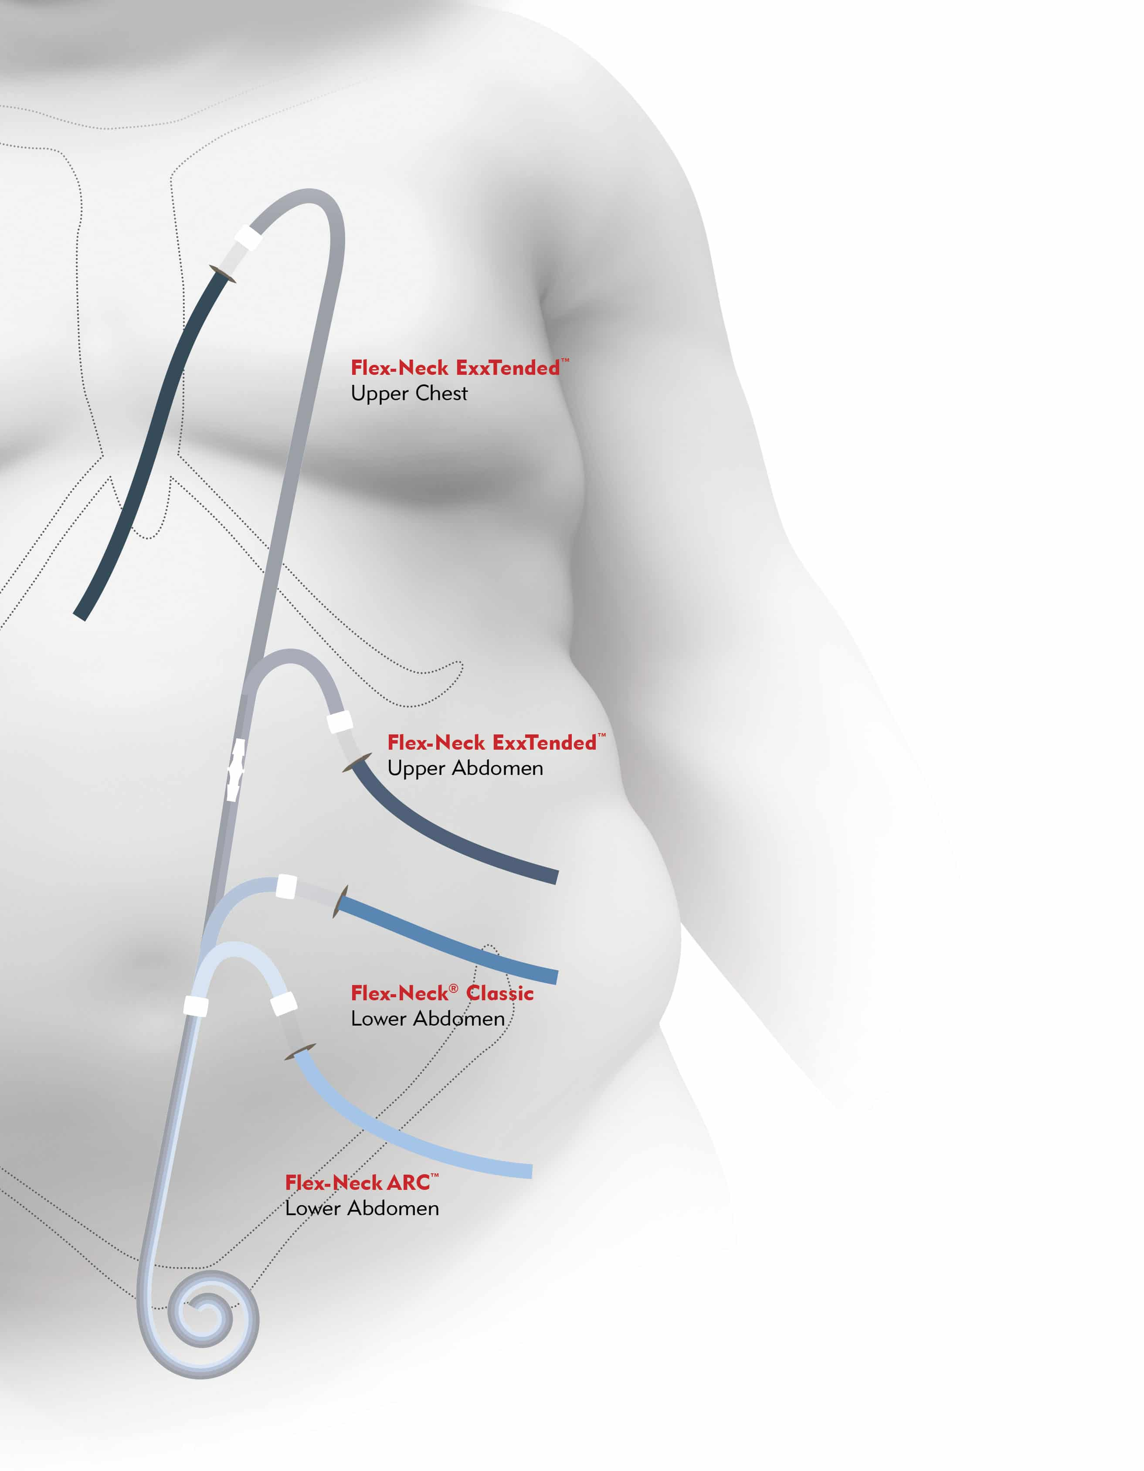
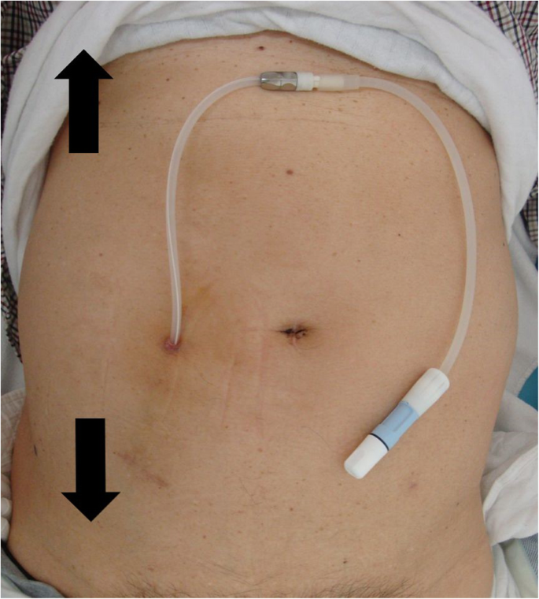
PD Catheters
2 weeks*
Patient technique is important

Slide 35

Do you do it
47 year old female with PMH of ESRD on iHD MWF vis right IJ tunneled dialysis catheter (3 years), SLE, HTN, and Depression. Hospitalization day 6 for endocarditis. Notable 4mm vegetation of the tricuspid valve. Blood cultures are now negative x2 for 96 hours. Recommended IV antibiotics daily x6 weeks per ID recommendations. You anticipate discharge over the next 24-48 hours.
Do you plan on placing a PICC for antibiotic administration?

Slide 36
How can primary care providers help
Dialysis for the Internist

Slide 37

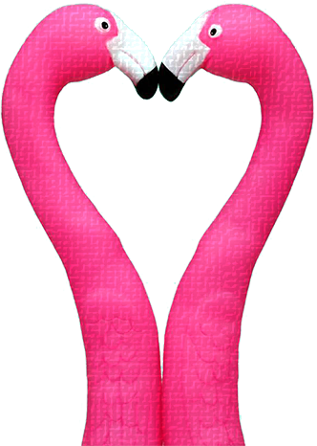
How can PCP help
Immunizations
General Health Screening
Communication on any concerns

Slide 38


SUMMARY
ESRD patients are chronically ill
Patient centered goals of care
Early referral and education
Preservation is key
Keep in mind pharmacology when prescribing
Maintain access options

Slide 39
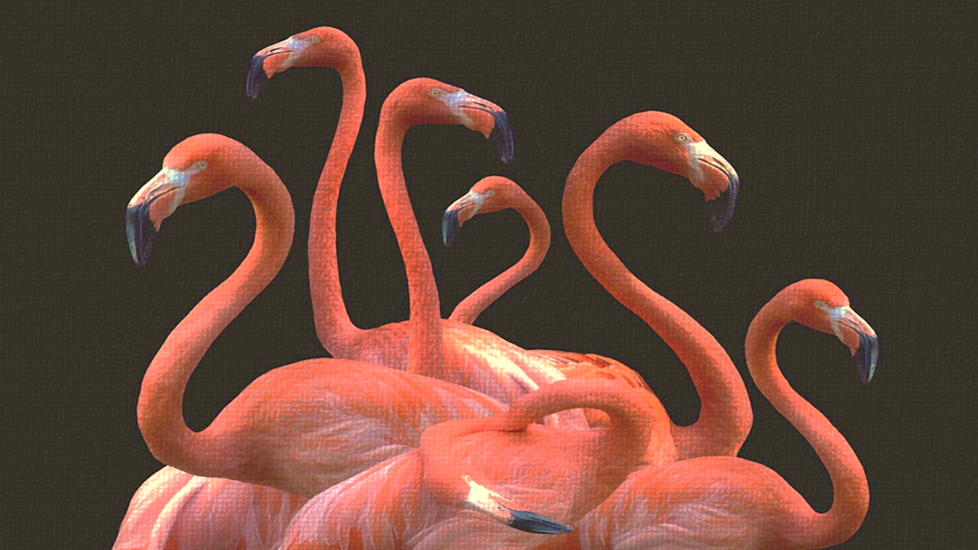
THANK
Jacob Nysather D.O.
September 5th 2023
You

