Slide 1

Cystic Kidney Diseases
Dr. Jacob Nysather

Slide 2

Disclosures
No financial disclosures

Slide 3
Objectives
Identify anatomical features in differentiating
Simple vs Complex imaging
Differentiation between ADPKD and ARPKD
Describe Potter Sequence
Identification of other inherited diseases with cystic kidney disease

Slide 4
Overview
Brief Anatomy Review
Simple vs Complex Cysts
Inherited Diseases
Questions

Slide 5

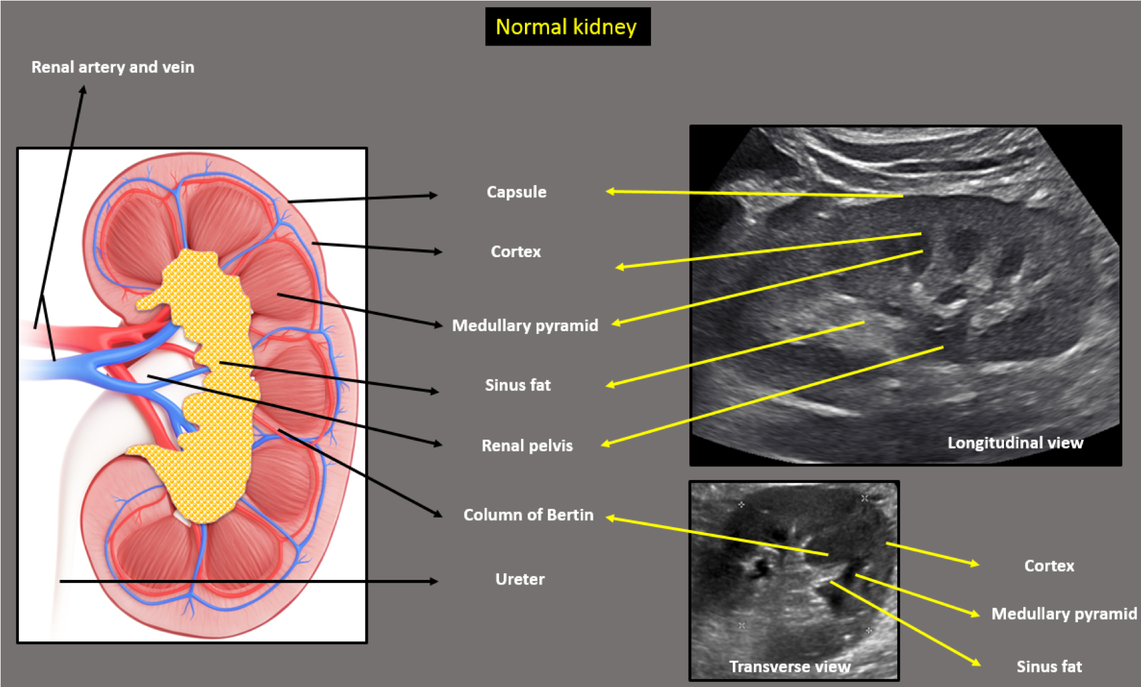
Renal Fellow Network

Slide 6
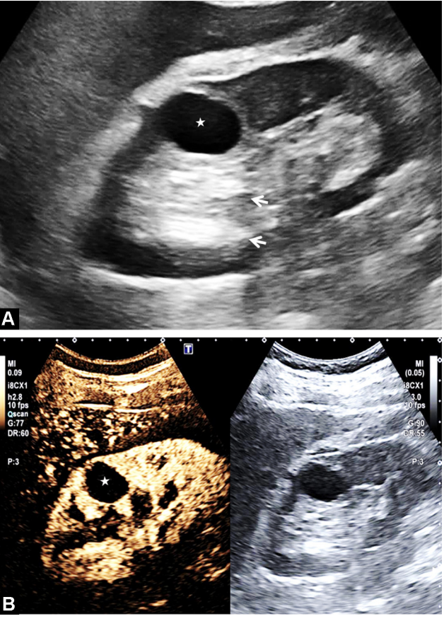
Simple Cysts
Benign Cysts
Prevalence: 1 in 10 individuals, accounts for the majority of renal lesions
Very rare in childhood (<2%)
Location: Typically Renal Cortex
Ultrasound Features:
  Well-defined, smooth, thin walls, no vascular component
  Anechoic (dark)
Asymptomatic, no treatment or follow-up is recommended. The risk of malignancy is low.
If >1 cyst is found in pediatric patients or a family history of inherited cystic disease, work-up should be completed

Slide 7
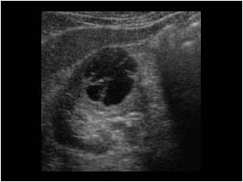
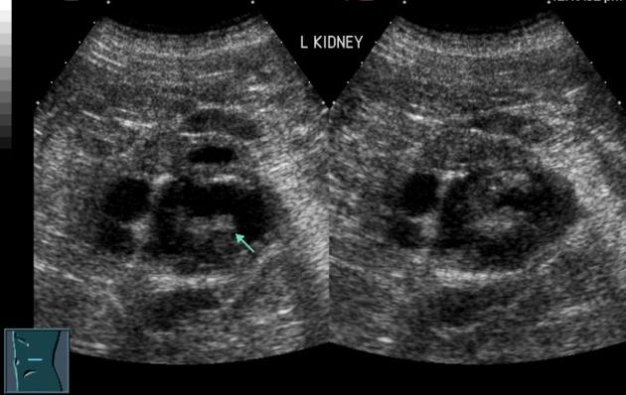
Complex Cysts
High risk of malignancy
Ultrasound Features
  Septations
  Calcifications
  Solid features
  Thickened or irregular walls
  Vascular component (contrast/doppler enhanced)
Require further imaging with CT or MRI
Radiopedia.org

Slide 8
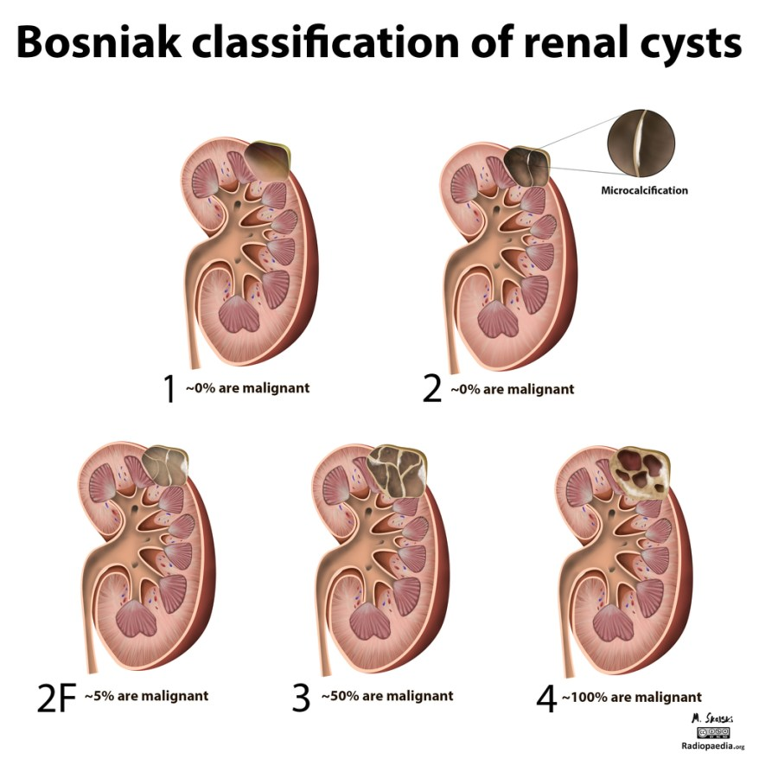
Bosniak classification illustration: Case courtesy of Dr Matt Skalski, Radiopaedia.org, rID: 20989

Slide 9
Congenital Solitary Functioning Kidney
Conditions of being born with only one functioning kidney
The majority are asymptomatic with compensatory hypertrophy of the contralateral kidney, but anomalies in the contralateral kidney are common
Often diagnosed prenatally via ultrasound

Slide 10
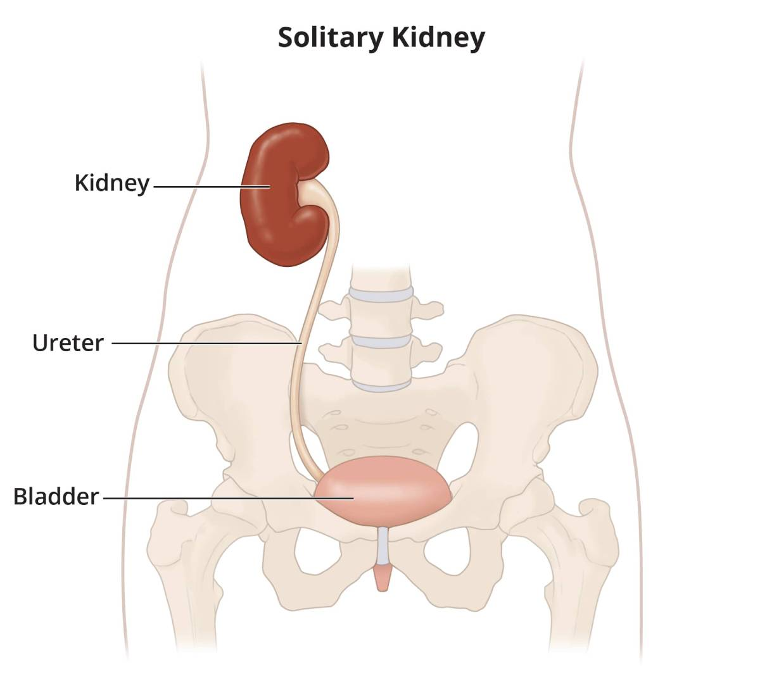
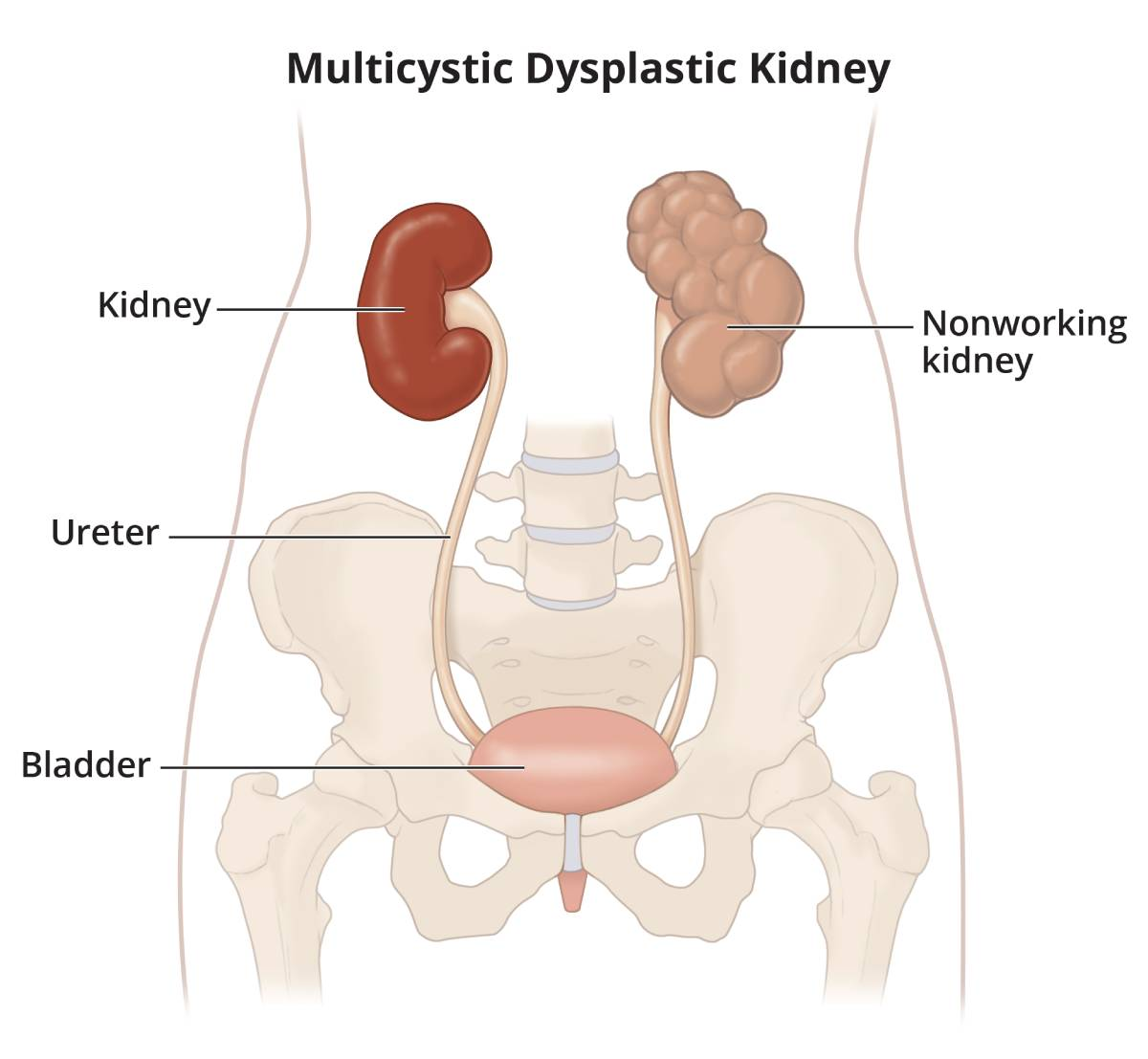
Unilateral Renal Agenesis
Multi-Cystic Dysplastic Kidney
Ureteric bud fails to develop and induce differentiation = complete absence of kidney and ureter
Ureteric bud develops but fails to induce differentiation = nonfunctioning kidney consisting of cysts and connective tissue.
Predominantly nonhereditary and usually unilateral

Slide 11
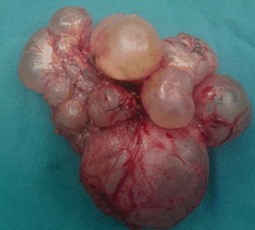
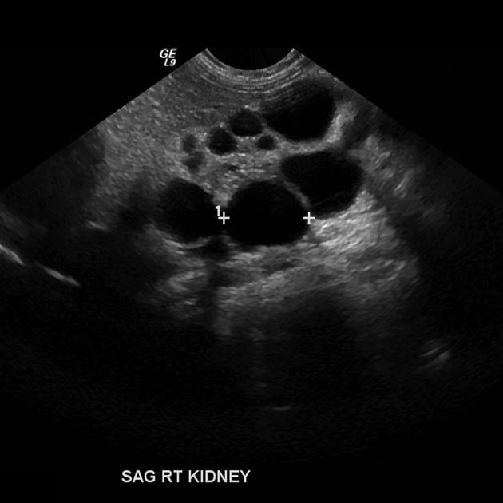
Multicystic Dysplastic Kidney
Etiology
  Non-hereditary
  Some could have genetic predisposition to CAKUT (Congenital Anomalies of the Kidney and Urinary Tract)
Epidemiology
  Only occurs in 1/3000-4000 live births
Presentation
  Most commonly identified on prenatal ultrasound
Prognosis
  Kidney general will involute (ie, shrink until it's gone!) over the first few years of life
  The contralateral kidney will develop "compensatory hypertrophy"
  Ultimately have solitary kidney physiology
Radiopedia.org

Slide 12
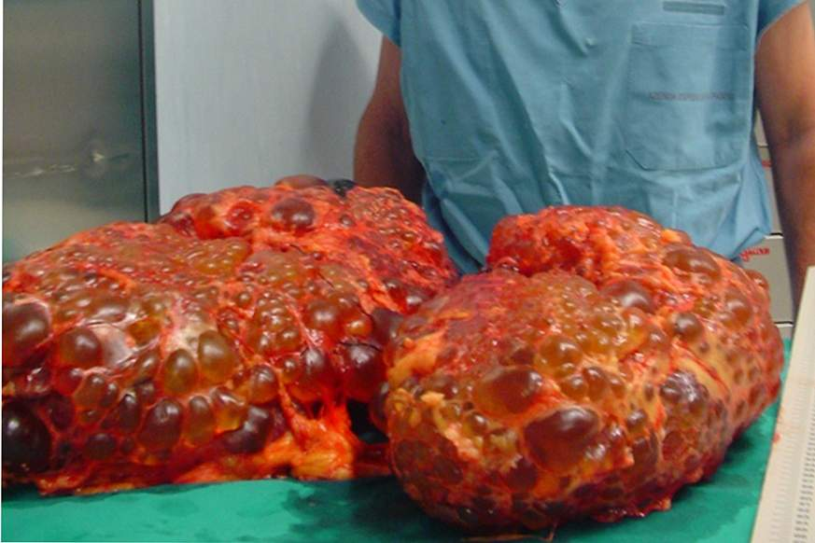
Polycystic Kidney Diseases

Slide 13
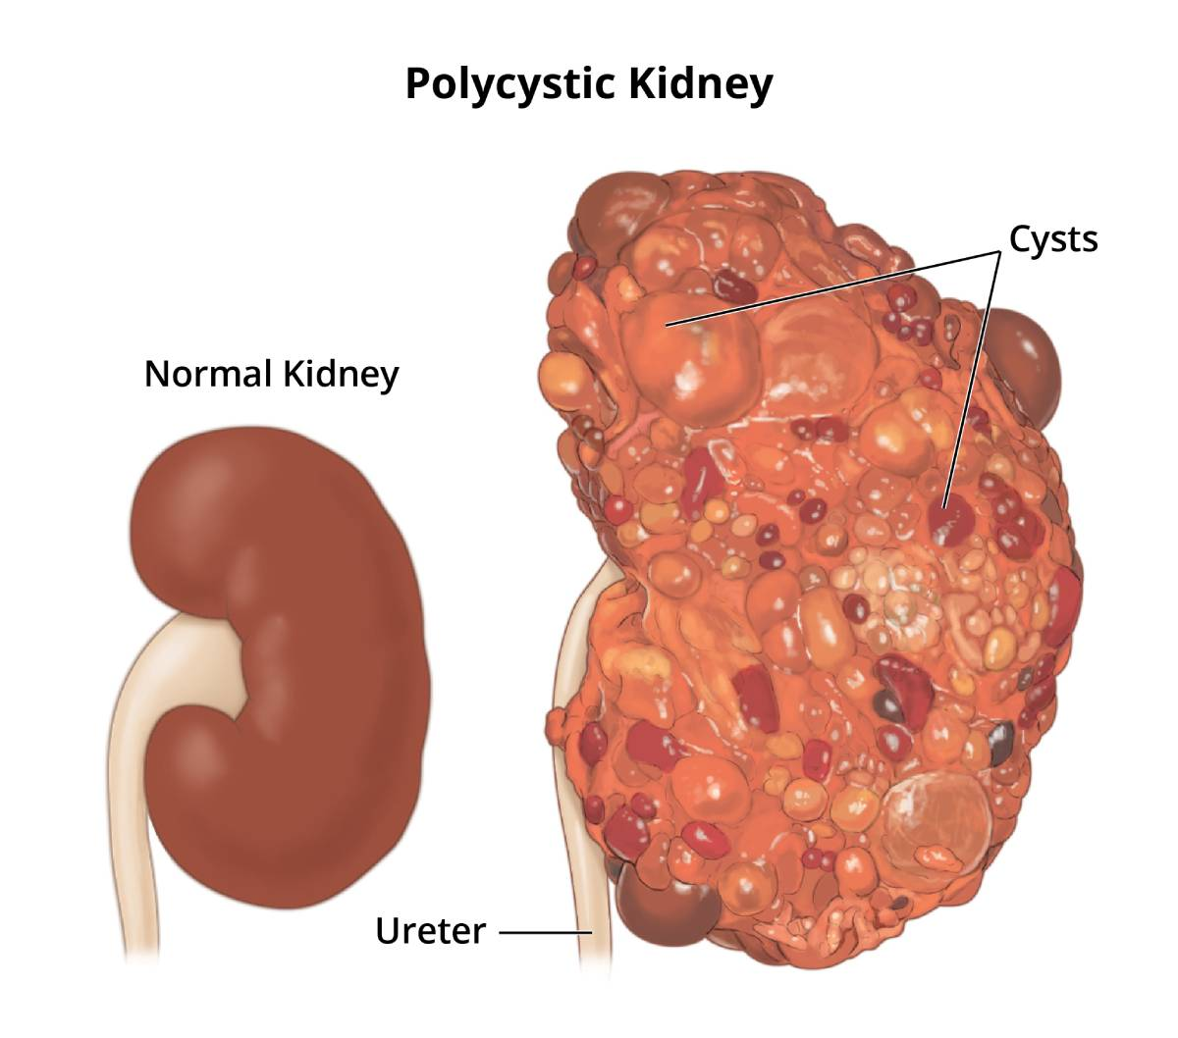
Autosomal Dominant Polycystic Kidney Disease (ADPKD)
Genetic disease where kidneys develop small cysts in the cortex and the medulla
  Compression of:
    Blood vessels
      Activate RAA system leading to fluid retention and hypertension
    Urine collecting system
      Leading to obstruction which can cause infection and kidney stones
  Risk of renal failure
Two types of PKD
  ADPKD
  ARPKD

Slide 14
ADPKD Epidemiology
Most common inherited kidney disorder
1:400-1,000 live births
Affects all ethnic groups equally
5% of ESKD population (10% in US under 60 years old)
Systemic disorder affecting almost every organ

Slide 15
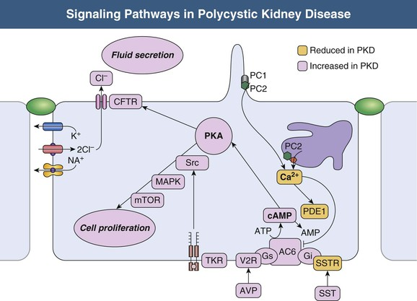
ADPKD Genetics and Pathophysiology
Genetic:
  Autosomal Dominant
  PKD1 (~80%) Chromosome 16p13.3 (Polycystin-1, primary cilia)
  PKD2 (~15%) Chromosome 4q12.2 (Polycystin-2, mitochondria and cilia)
  GANAB (1-5%)
Focal (< 5%) of all nephrons become cystic
Most cysts detach from the parent nephron when cysts size exceeds 2cm
Phenotypes typically vary, however, PKD2 tends to have a milder disease course
  Fewer cyst
  Later onset of hypertension
  Less ESKD compared to PKD1 (74 vs 54 years old)
Fig 46.2. Comprehensive Clinical Nephrology
Notes:
Two-hit hypothesis
PC1 and PC2 are co-localized in the primary cilium of renal epithelial cells, which function as a mechanosensory.
Primary cilia create transmembrane calcium currents in the presence of stretch and luminal flow.
Normal function increases intracellular calcium, which initiates a signaling cascade leading to vesicle fusion and a change in gene transcription.

Slide 16
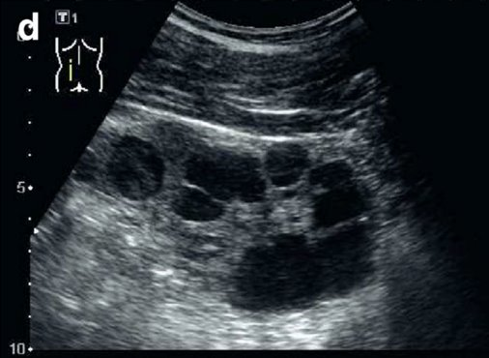
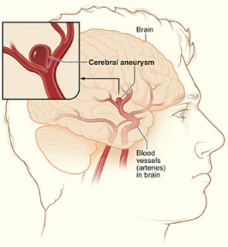
ADPKD Clinical Characteristics
Presentation:
  Often presents in adulthood during third decade
  Hypertension, hematuria, proteinuria
  Flank pain, obstructive stones, or UTI, are the most common symptoms reported by patients
  May have a palpable flank mass
Associated organ systems:
  Liver – most common, usually benign cysts
  Vasculature – aortic root dilation or intracerebral aneurysms (~10% as opposed to general population ~2%)
Diagnosis of ADPKD by ultrasound is established in at-risk individuals aged 15–39 years if three or more (unilateral or bilateral) renal cysts are detected
Renal Fellow Network

Slide 17
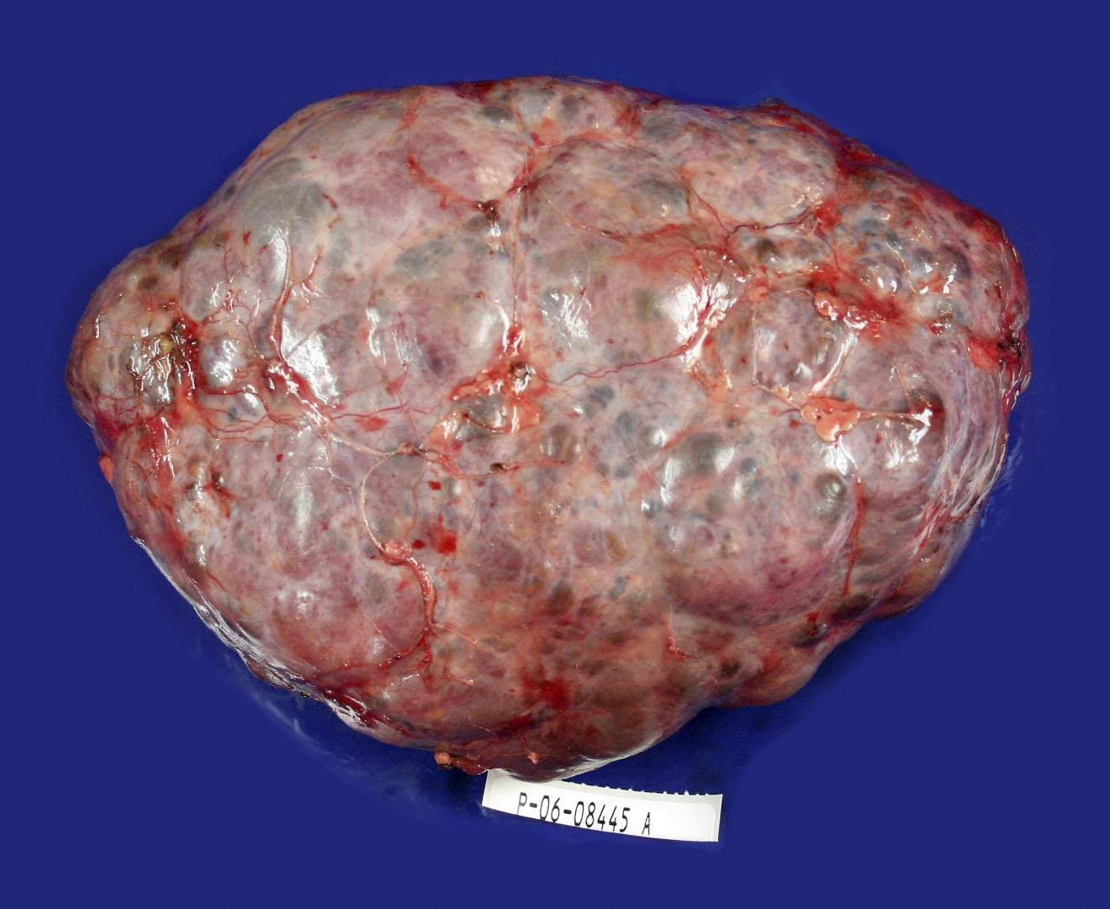
Notes:
P06-8445
1515g kidney

Slide 18
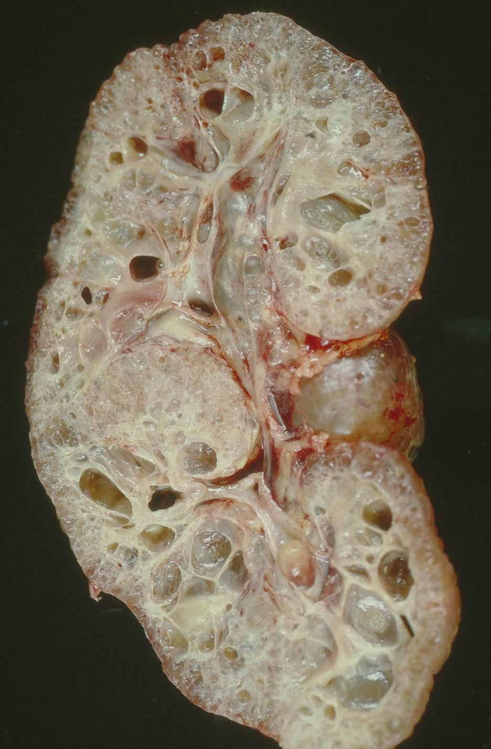
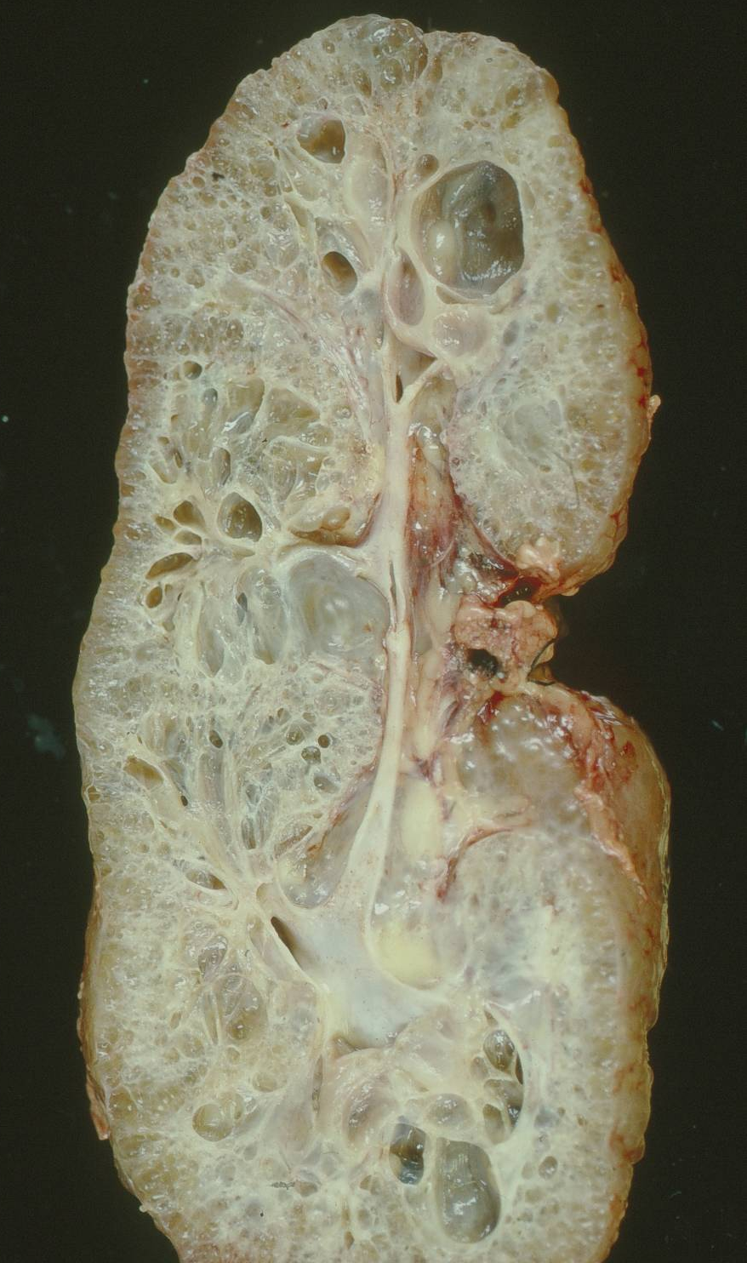
Notes:
P91-3042
14 year old male with bilateral polycystic kidneys
No known family history of polycystic kidney disease

Slide 19
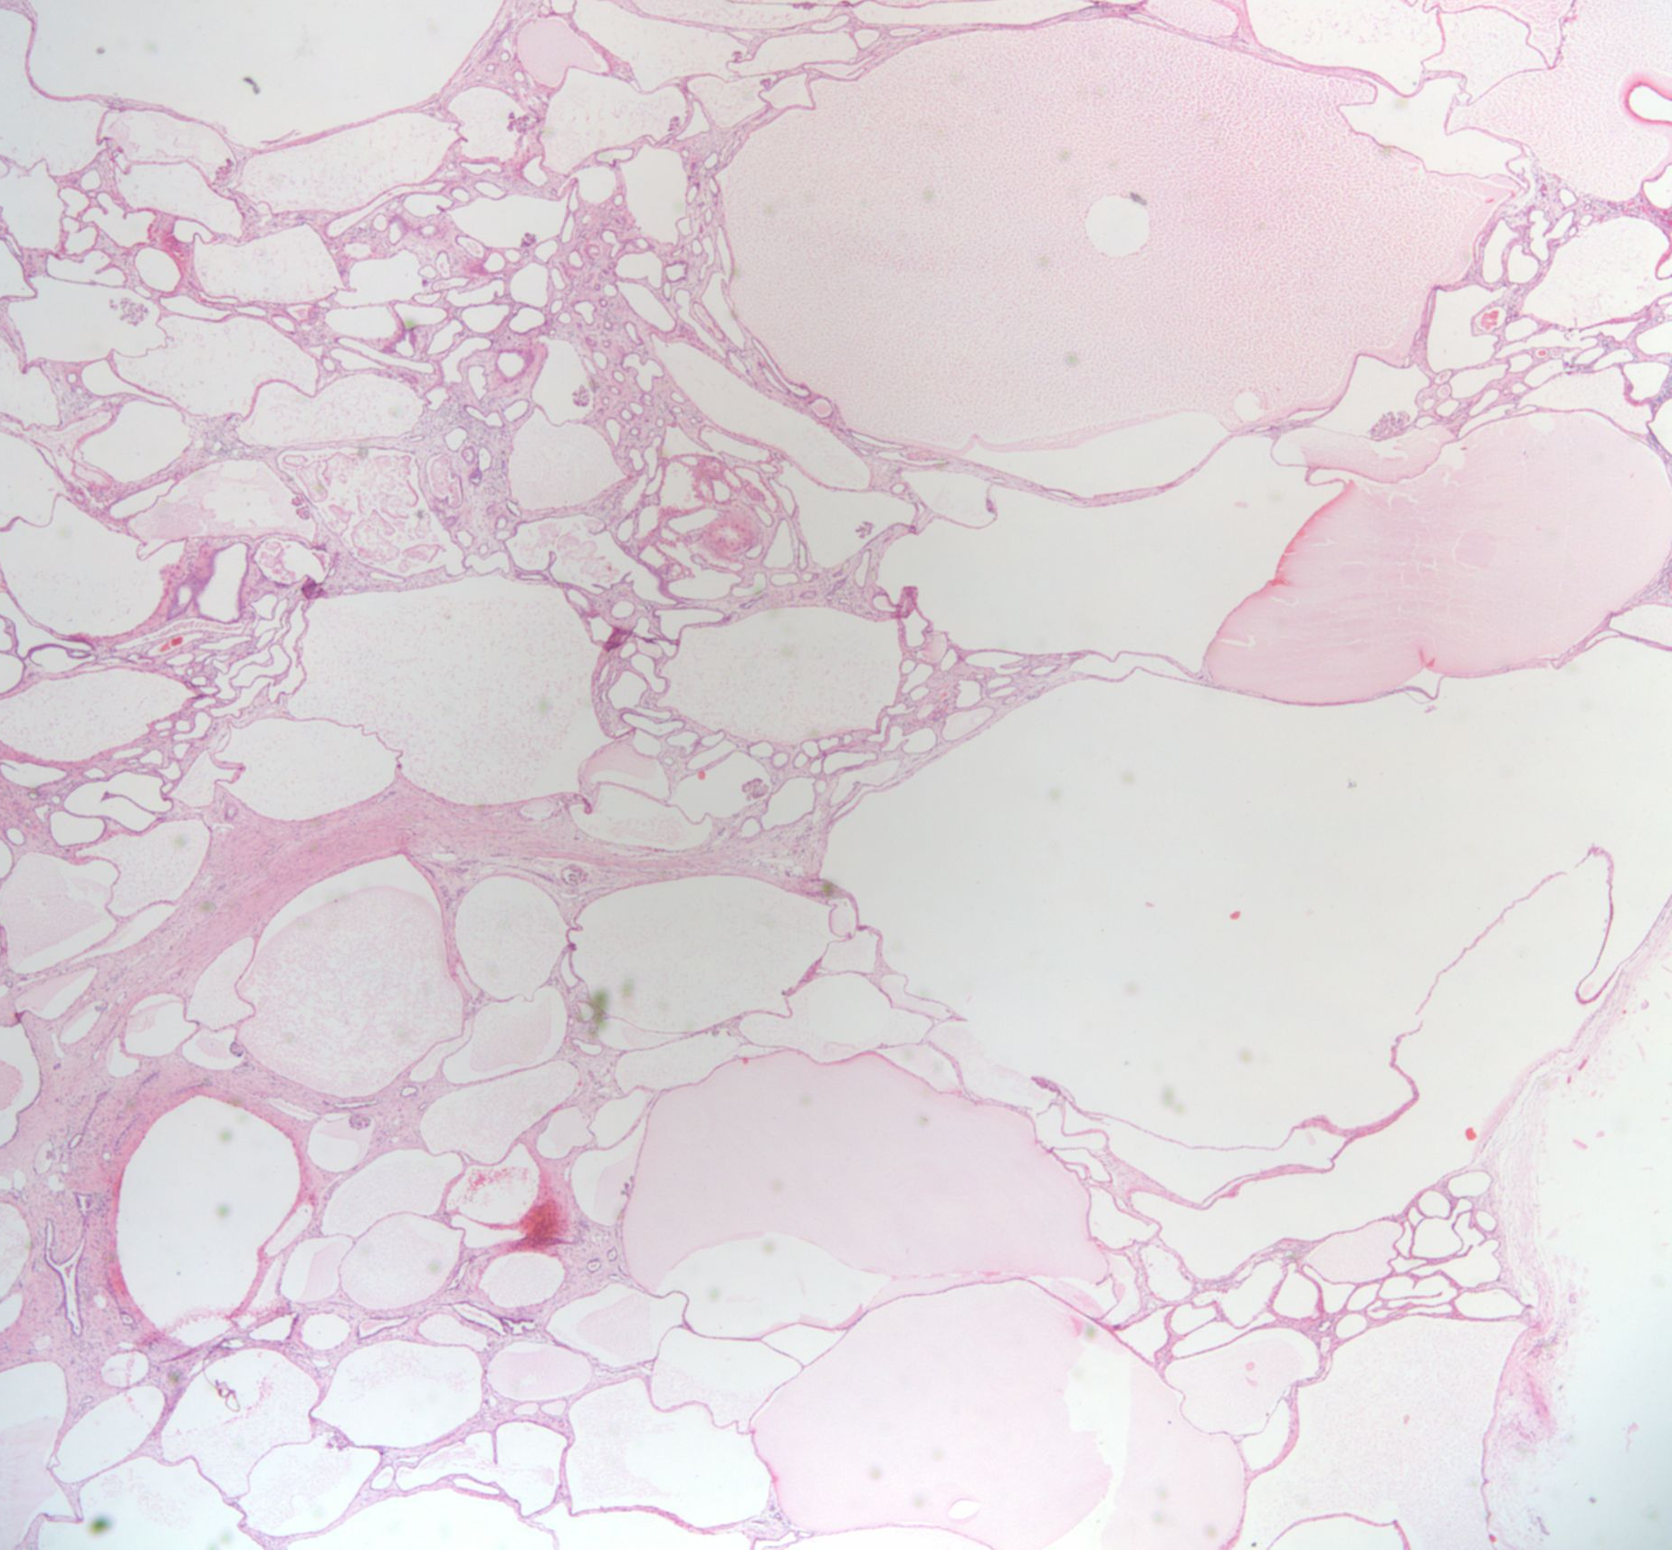
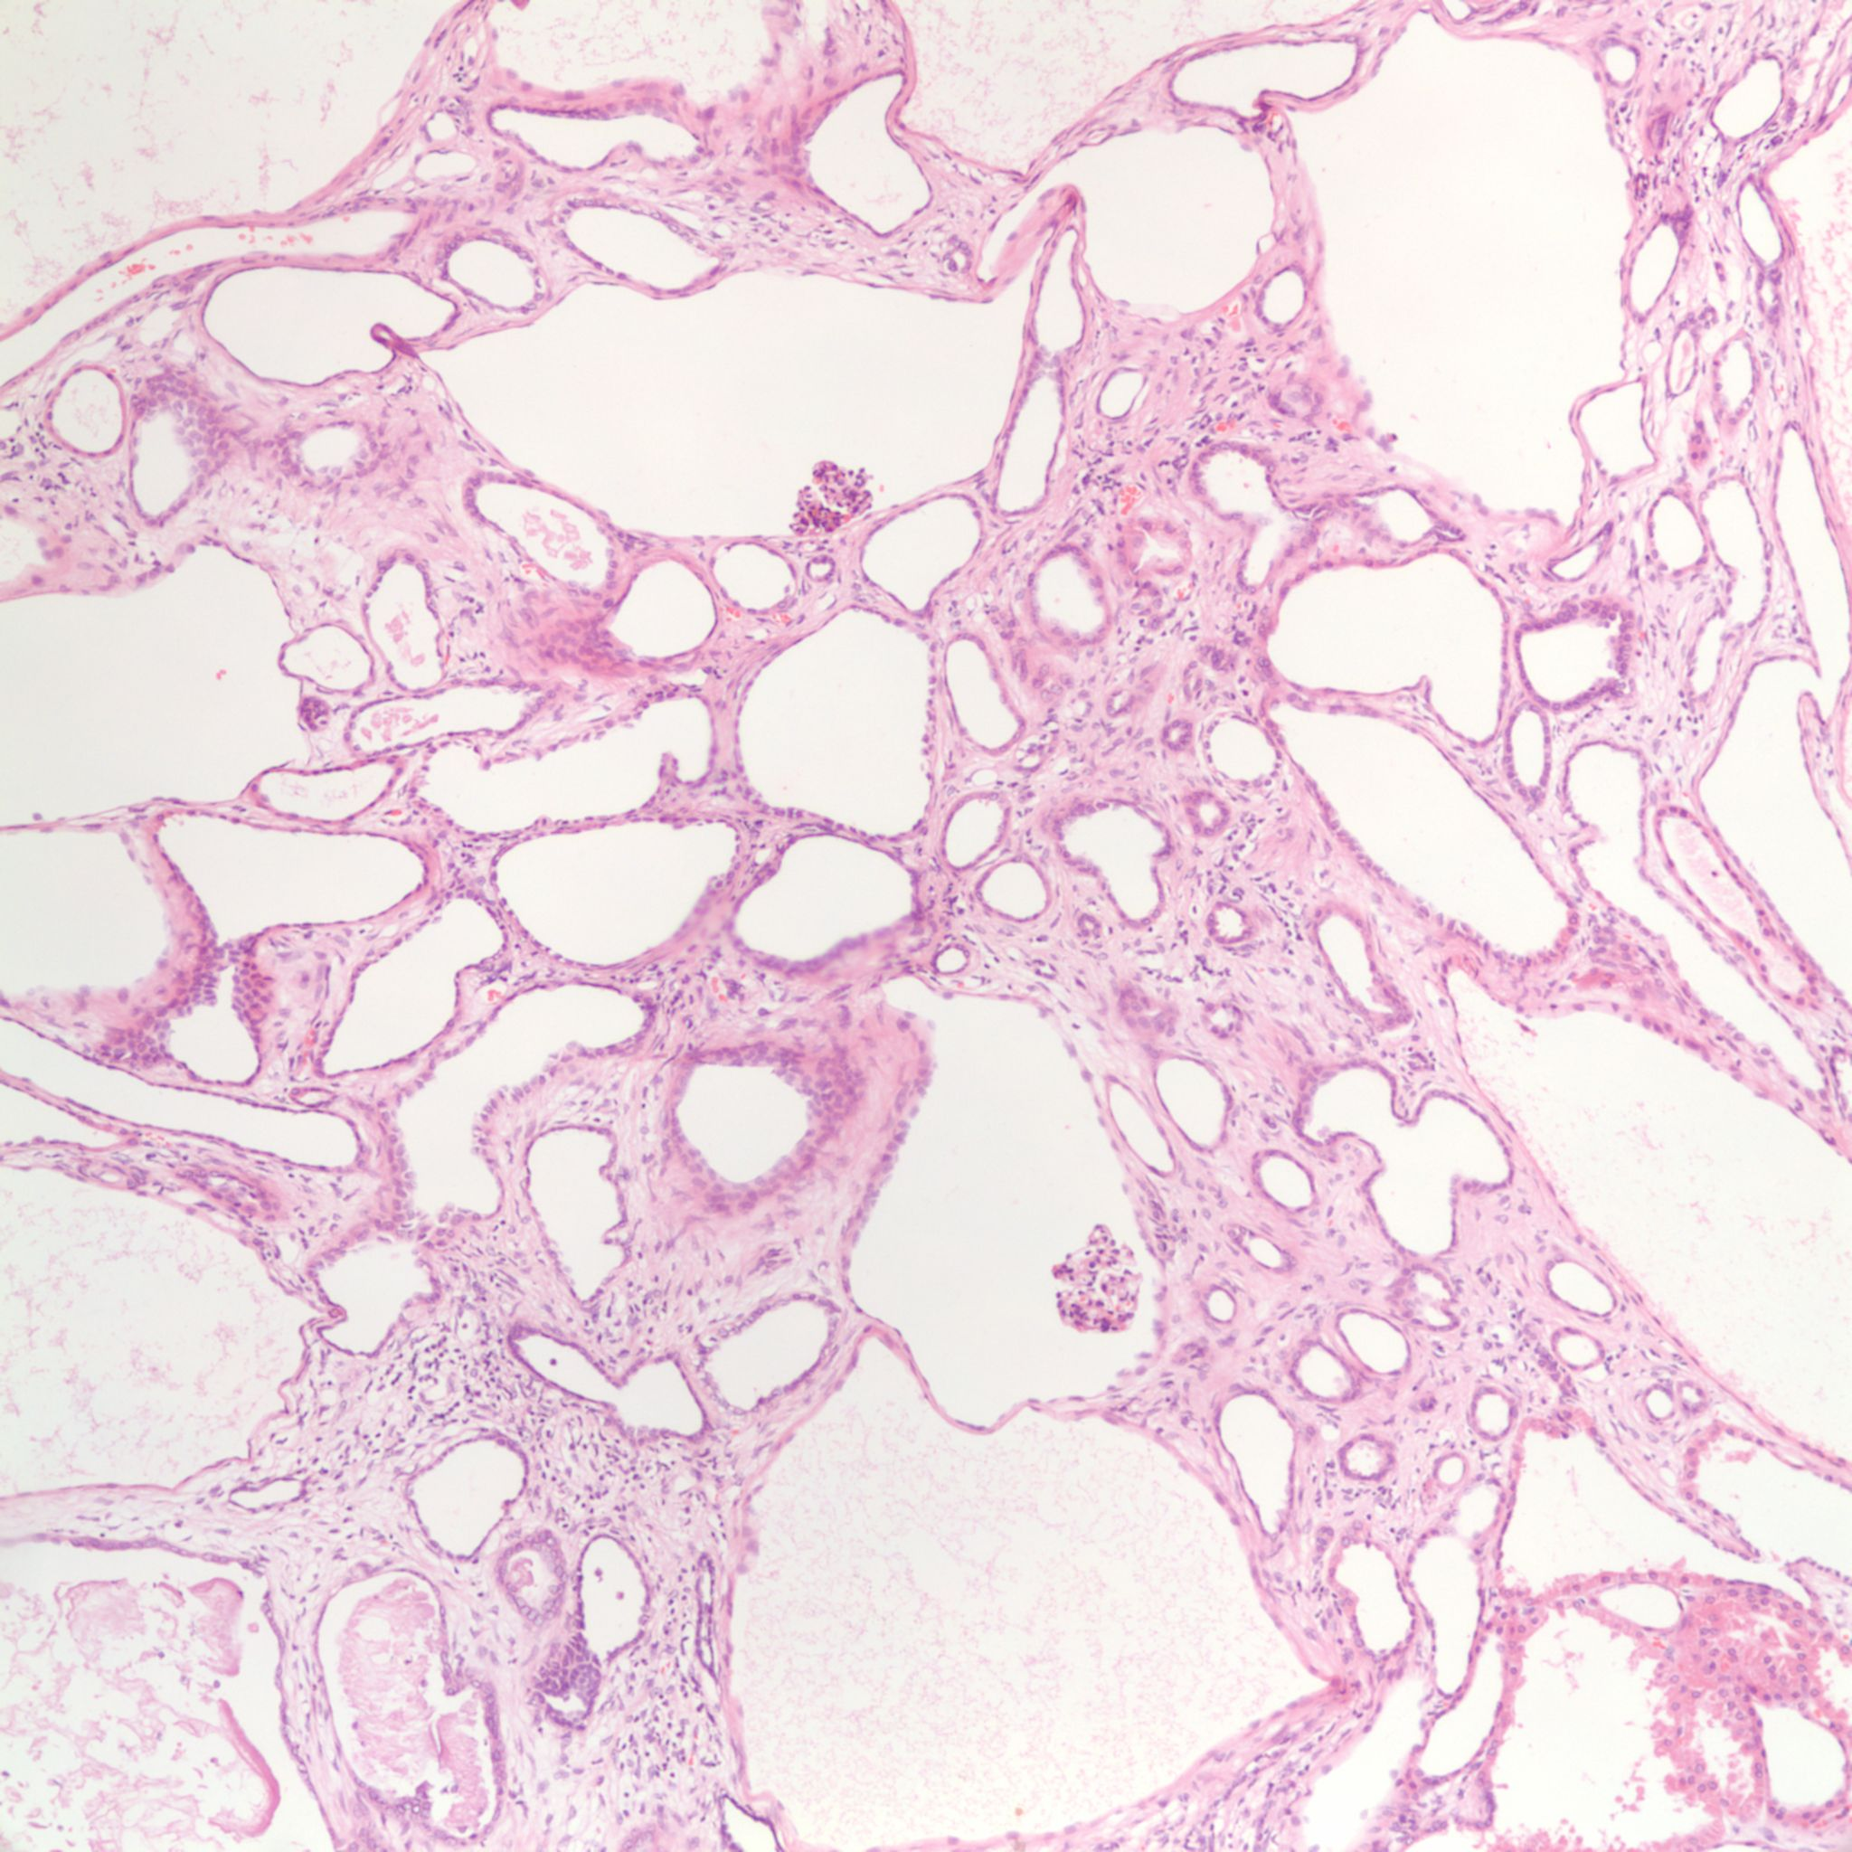
Notes:
P91-3042
Flat to cuboidal epithelium lining cysts; cysts resember collecting tubules or cortical tubules
Solid areas with atrophic tubules and hypertrophied glomeruli
Poorly formed papillary projections in the medulla
Cyst architecture suggest cyst formation from various components of the nephron (consistent with autosomal dominant (adult) polycystic kidney disease, despite absence of known family history)

Slide 20
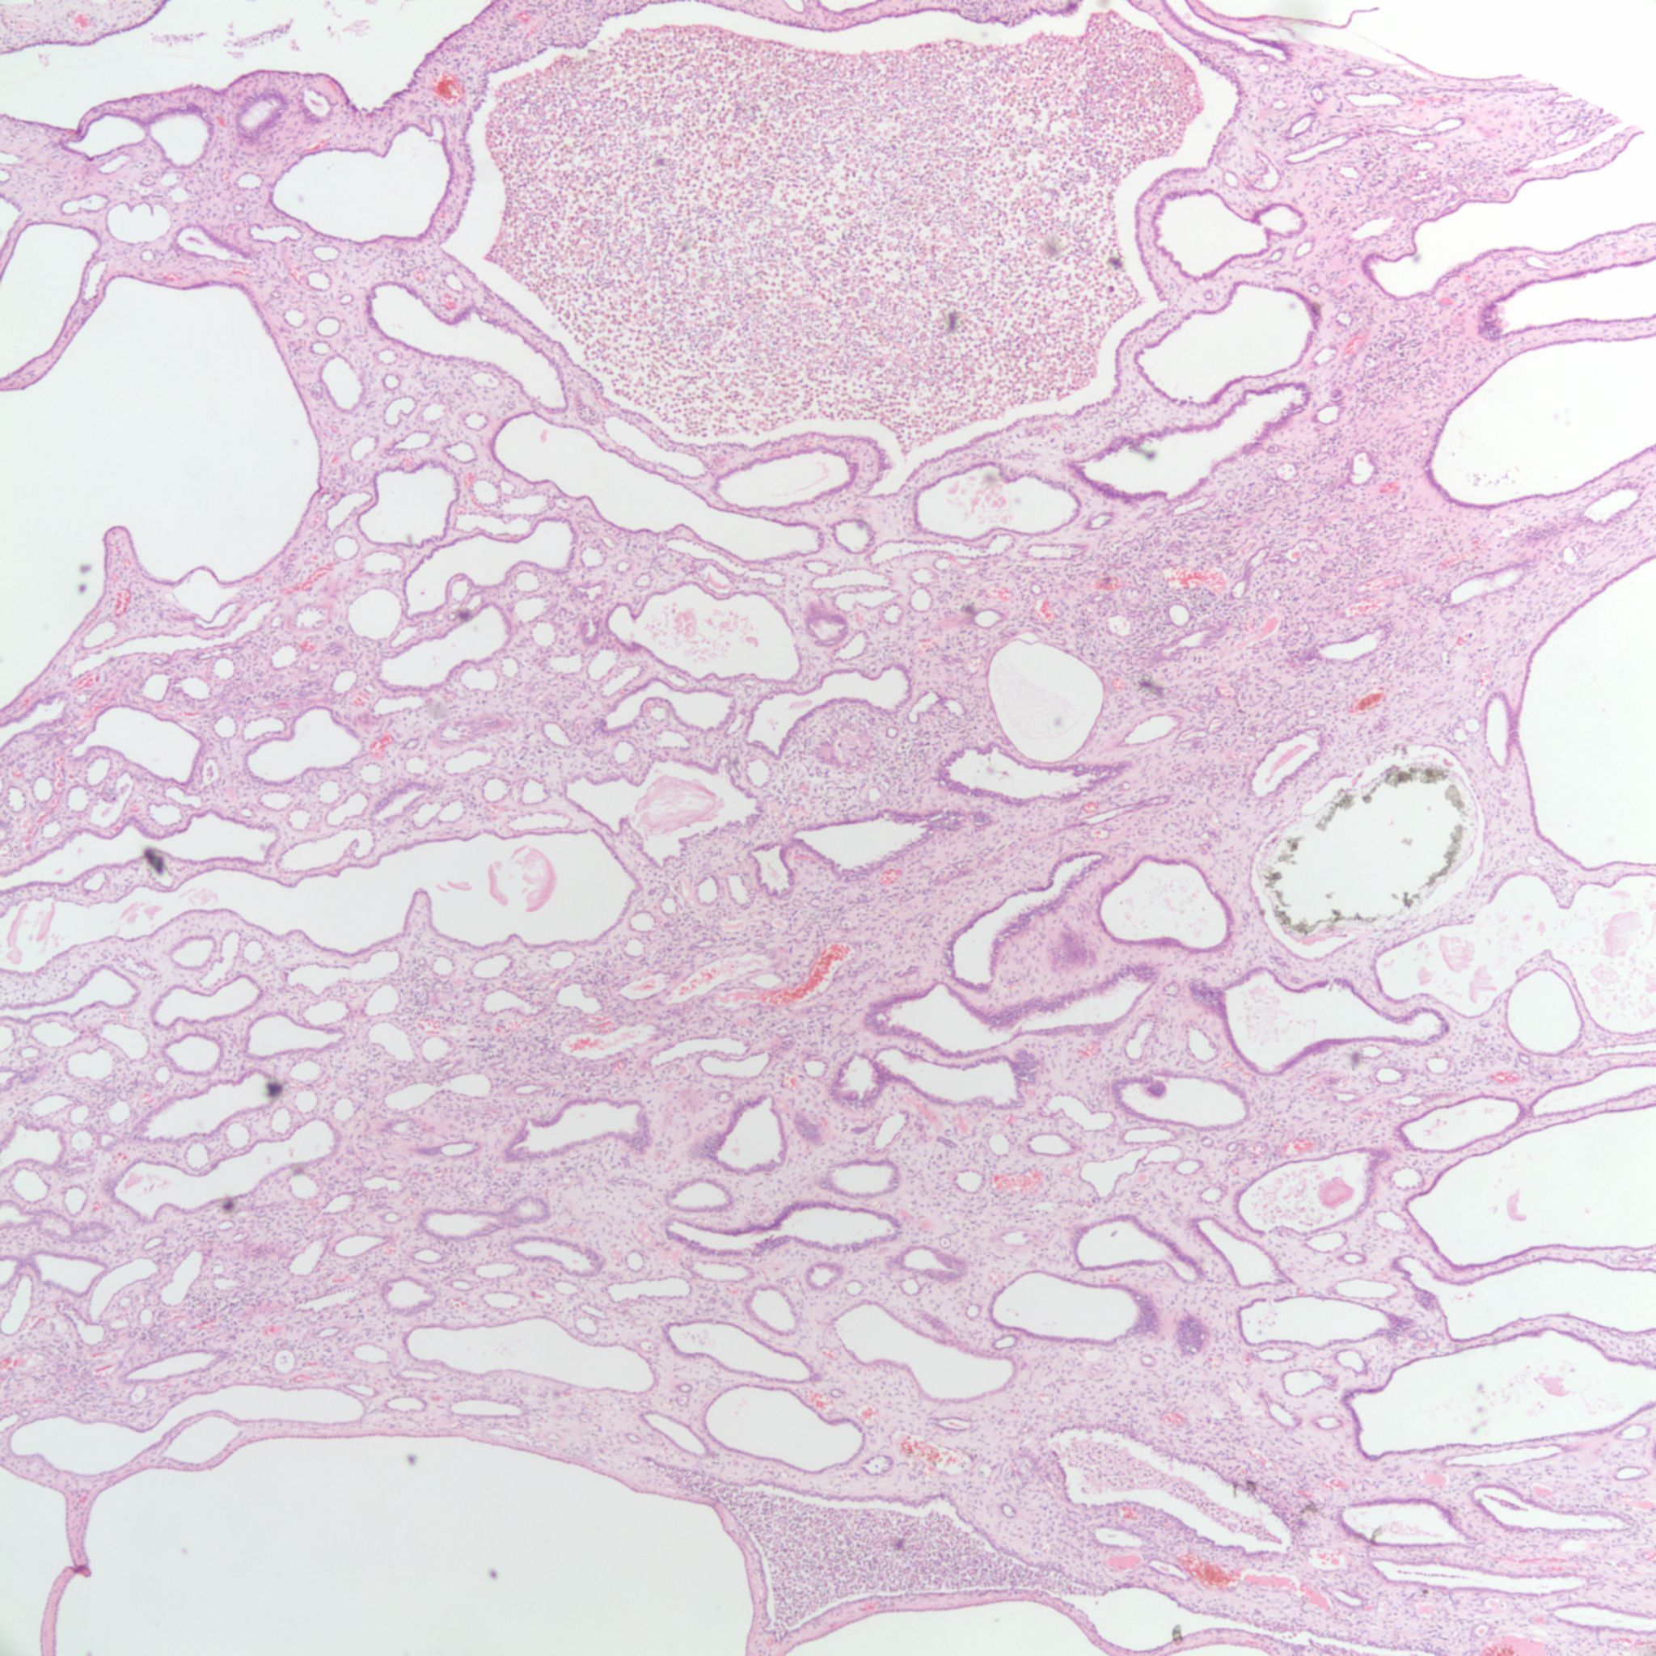
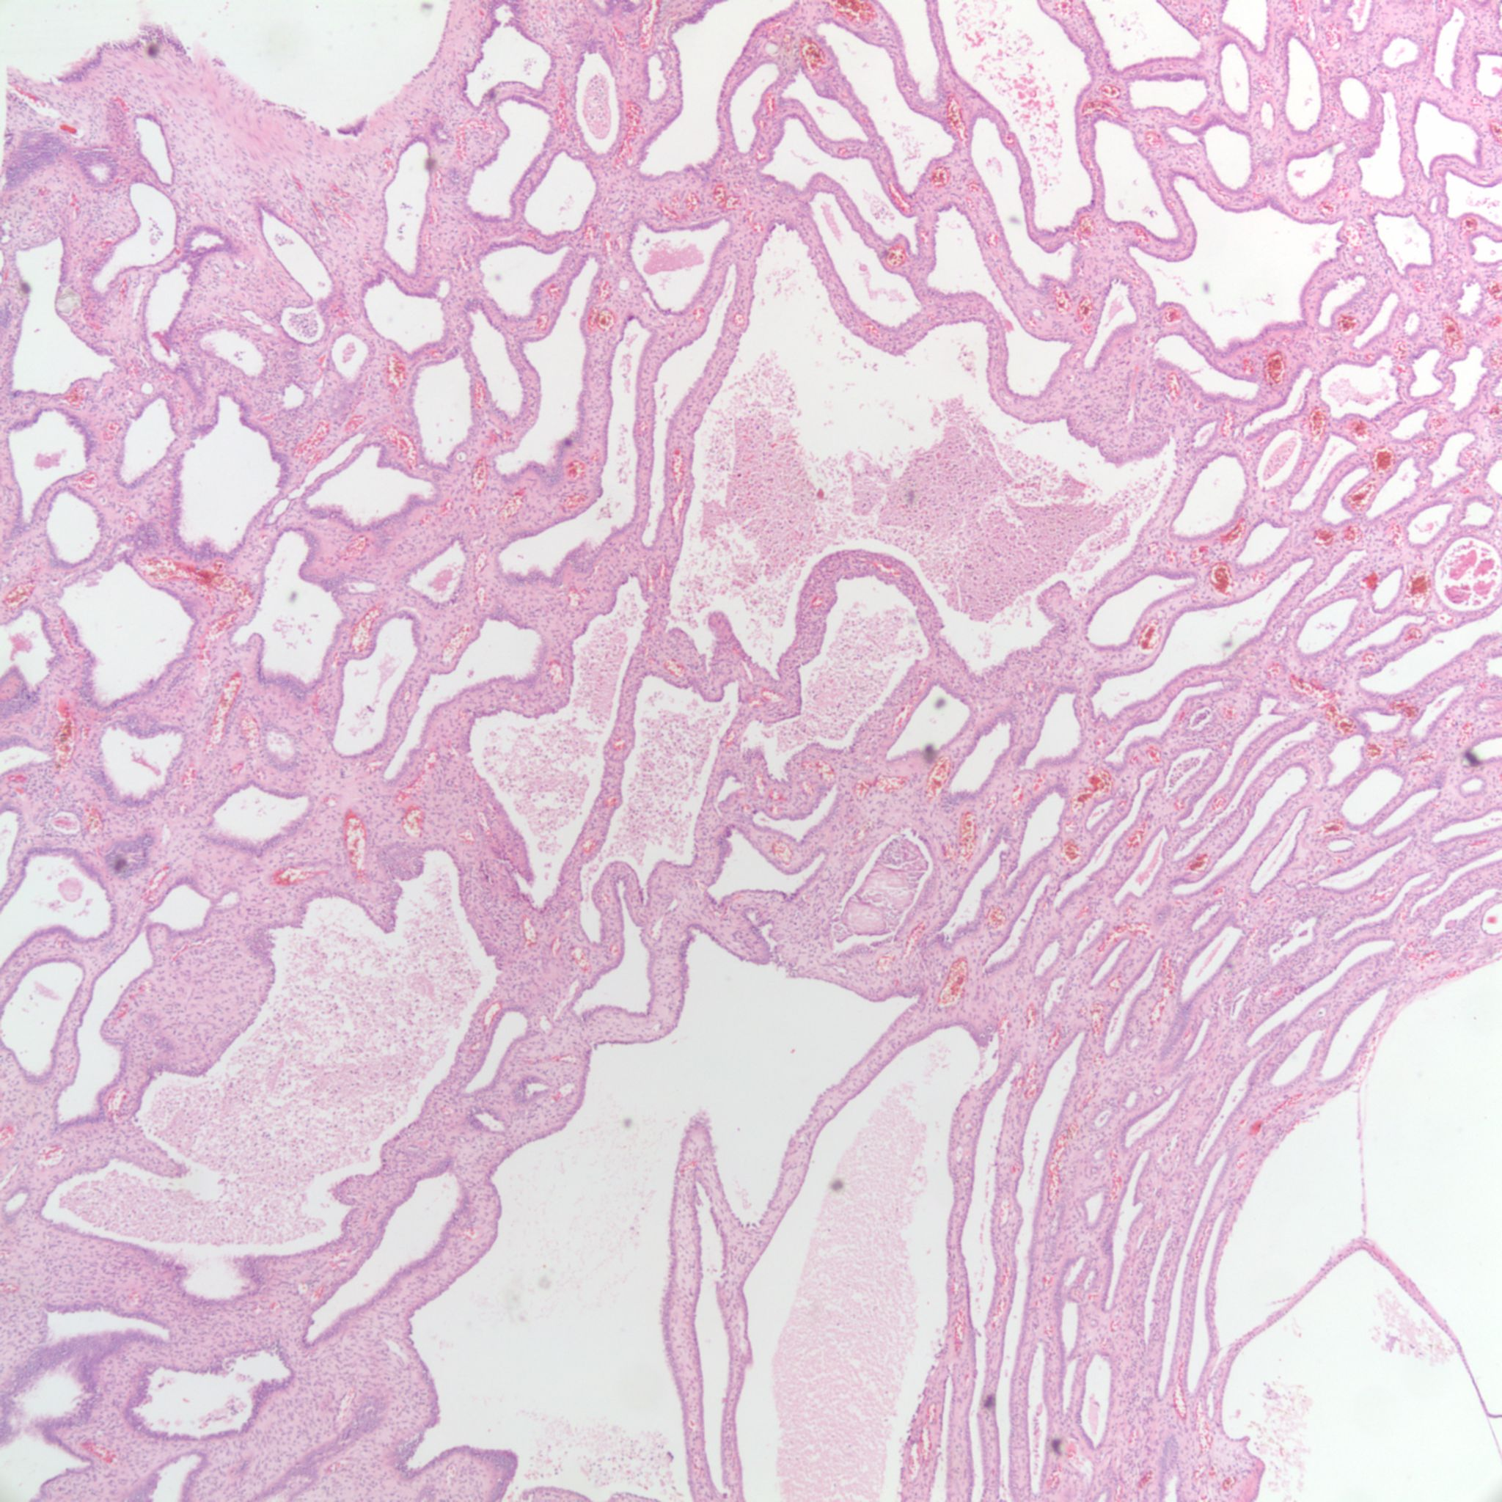
Notes:
20
P91-3042
Flat to cuboidal epithelium lining cysts; cysts resember collecting tubules or cortical tubules
Solid areas with atrophic tubules and hypertrophied glomeruli
Poorly formed papillary projections in the medulla
Cyst architecture suggest cyst formation from various components of the nephron (consistent with autosomal dominant (adult) polycystic kidney disease, despite absence of known family history)

Slide 21
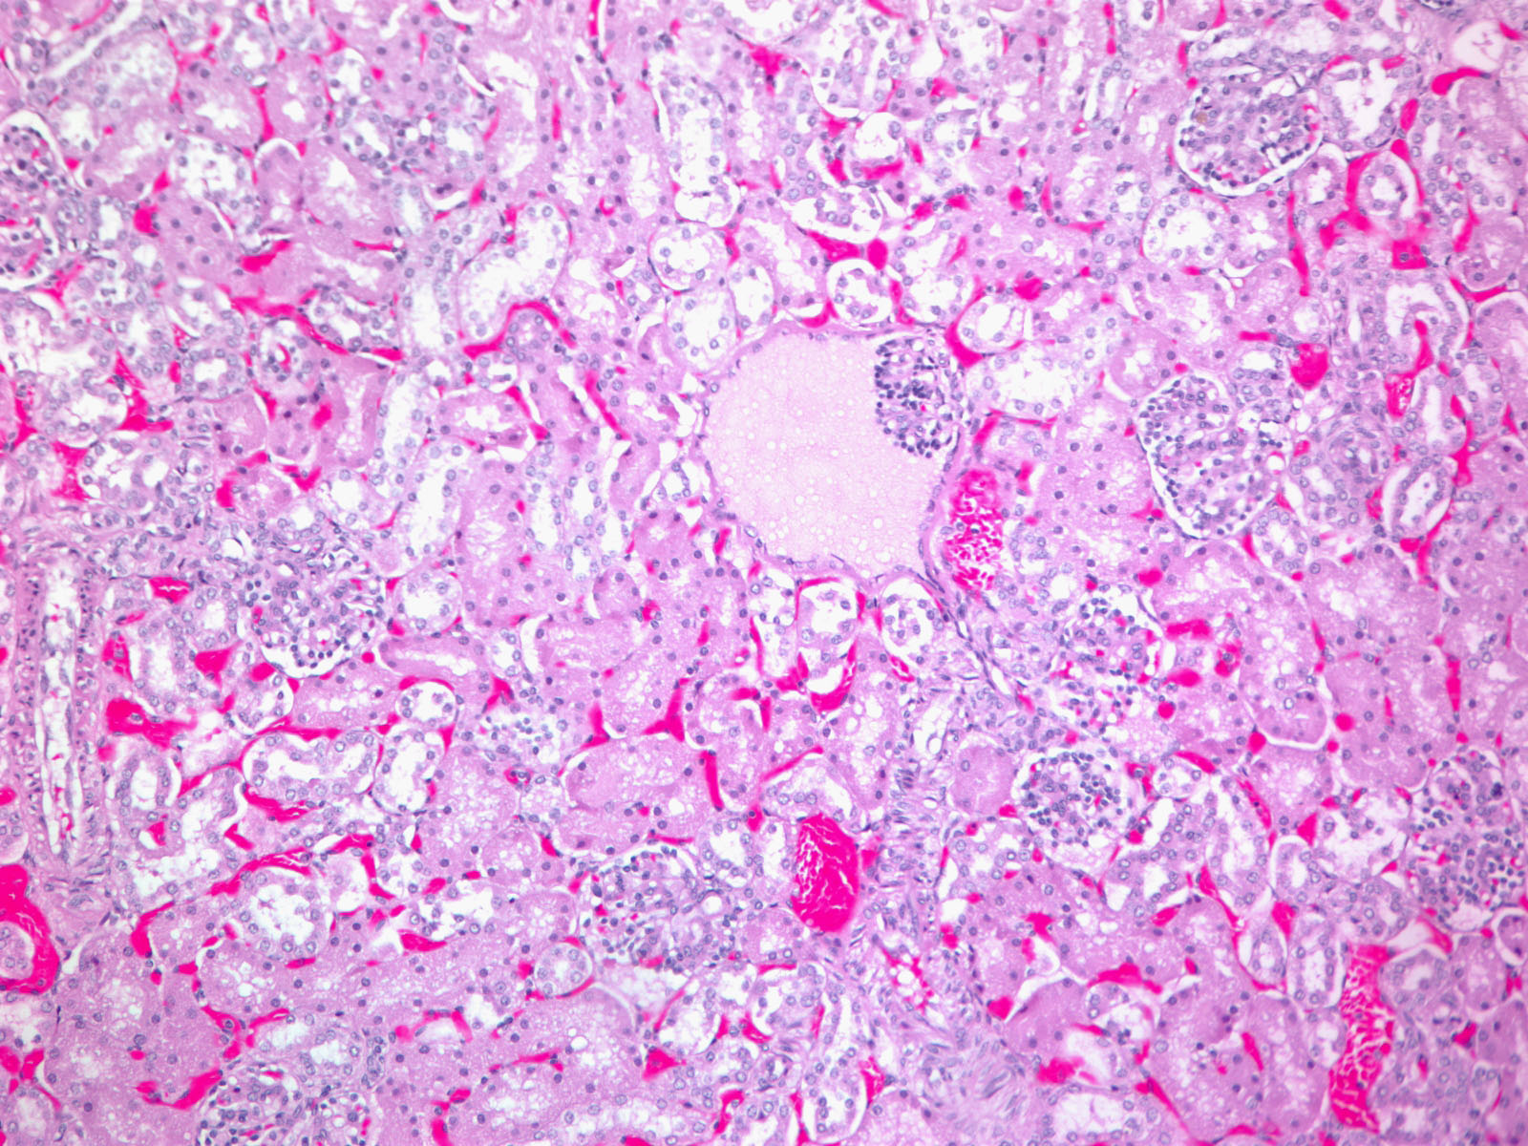
C05-31 APKD
Notes:
21

Slide 22
Autosomal Recessive Polycystic Kidney Disease (ARPKD)
Prevalence:
  1:20,000
Genetic:
  Autosomal Recessive
  PKHD1 (Ch 6p21.1) Fibrocystin
Pathogenesis:
  Kidney cystic disease is a result of fusiform dilation of renal collecting tubules
  Up to 90% of tubules are involved are diffuse and continue to retain their connection to parent nephron
Presentation:
  Intra-utero, Potter Sequence
  Most have severely enlarged kidneys perinatally with poor cortico-medullary differentiation
  Fibrocystic kidney and liver involvement
Treatment:
  Hypertension

Slide 23
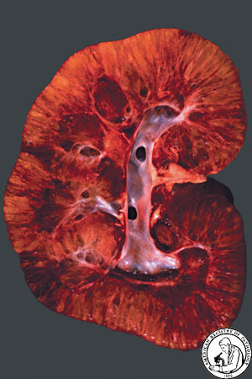
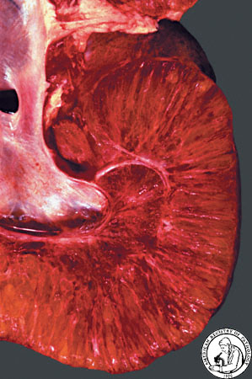

Slide 24
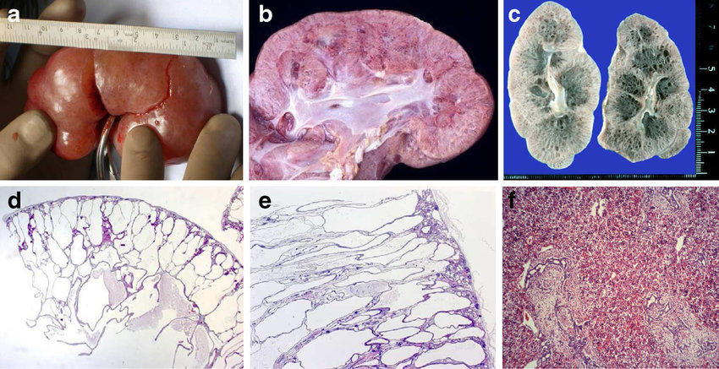
Notes:
Cut sections resemble a sponge
Radially oriented cysts replacing the cortex
Rounded cysts replacing the medulla
Cysts are dilated collecting ducts
Number of nephrons are normal, although appear decreased due to separation by dilated collecting ducts and edematous interstitium

Slide 25
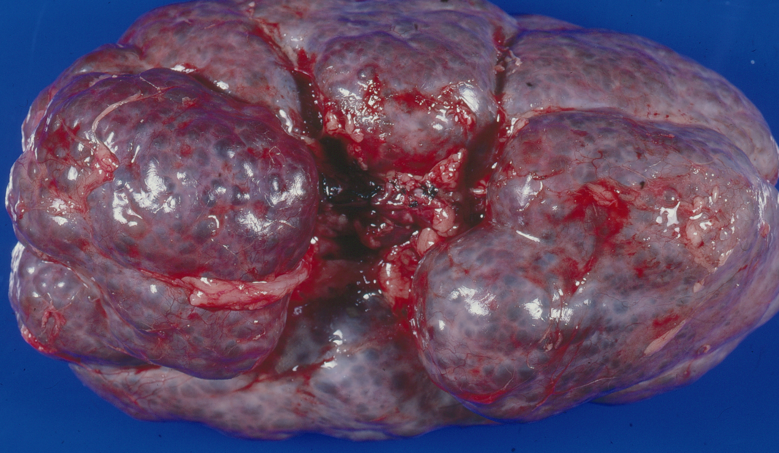
P90-3503
Notes:
P90-3503
2 year old female with history of polycystic kidneys; right kidney 505g, left kidney 440g
Sectioning of kidney revealed elongated cortical cysts radially arranged and spherical medullary cysts evenly distributed
Had a liver biopsy showing changes typical of congenital hepatic fibrosis (large number of irregular complex bile duct profiles, moderate portal expansion by fibrosis without portal-portal or central-portal bridging fibrosis, and hamartomatous bile duct proliferation)

Slide 26
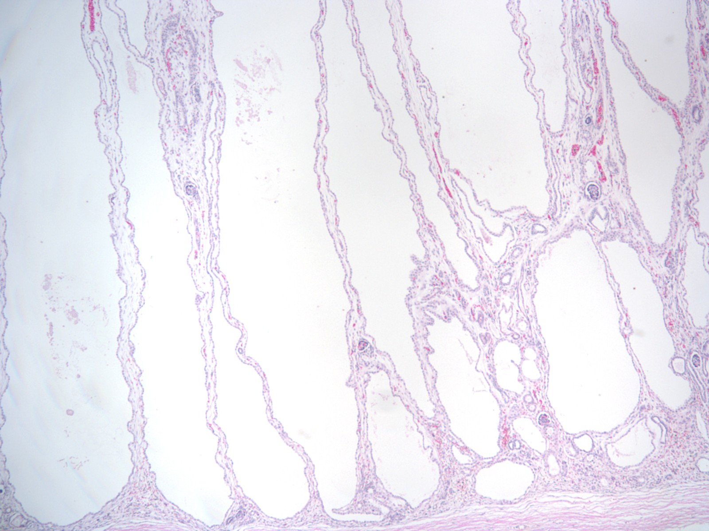

Slide 27
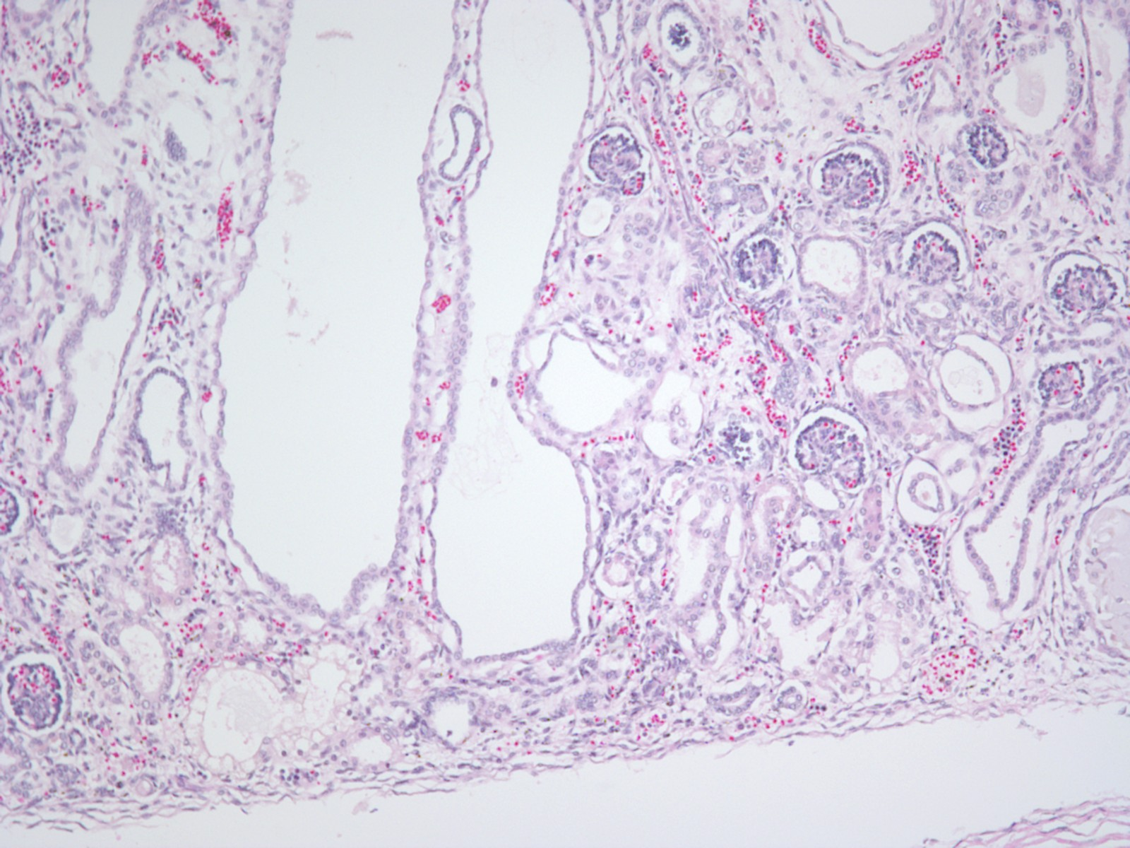

Slide 28
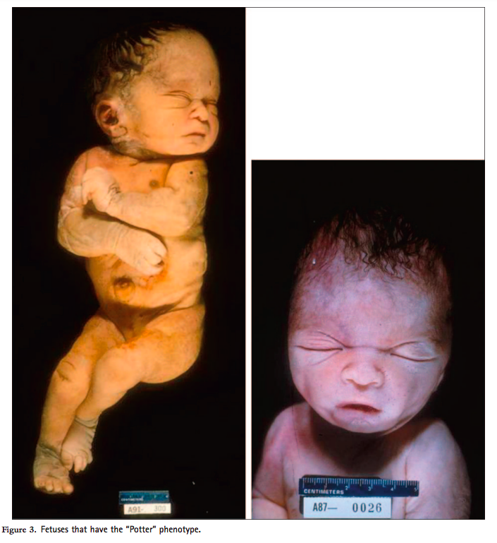
Potter Sequence
Low urine output leads to low amniotic fluid called oligohydramnios (low + fluid + amnion) leading to compression of developing fetus and limb/facial deformities, facial anomalies (eg. low-set ears and retrognathia, flattened nose). Lack of amniotic fluid aspiration into fetal lungs -> pulmonary hypoplasia (cause of death).
Pulmonary hypoplasia
Oligohydramnios (trigger)
Twisted face
Twisted skin
Extremity defects
Renal failure (in utero)
Caused by chronic placental insufficiency or reduced fetal urine output (ARPKD), obstructive uropathy (posterior urethral valves), bilateral renal agenesis

Slide 29
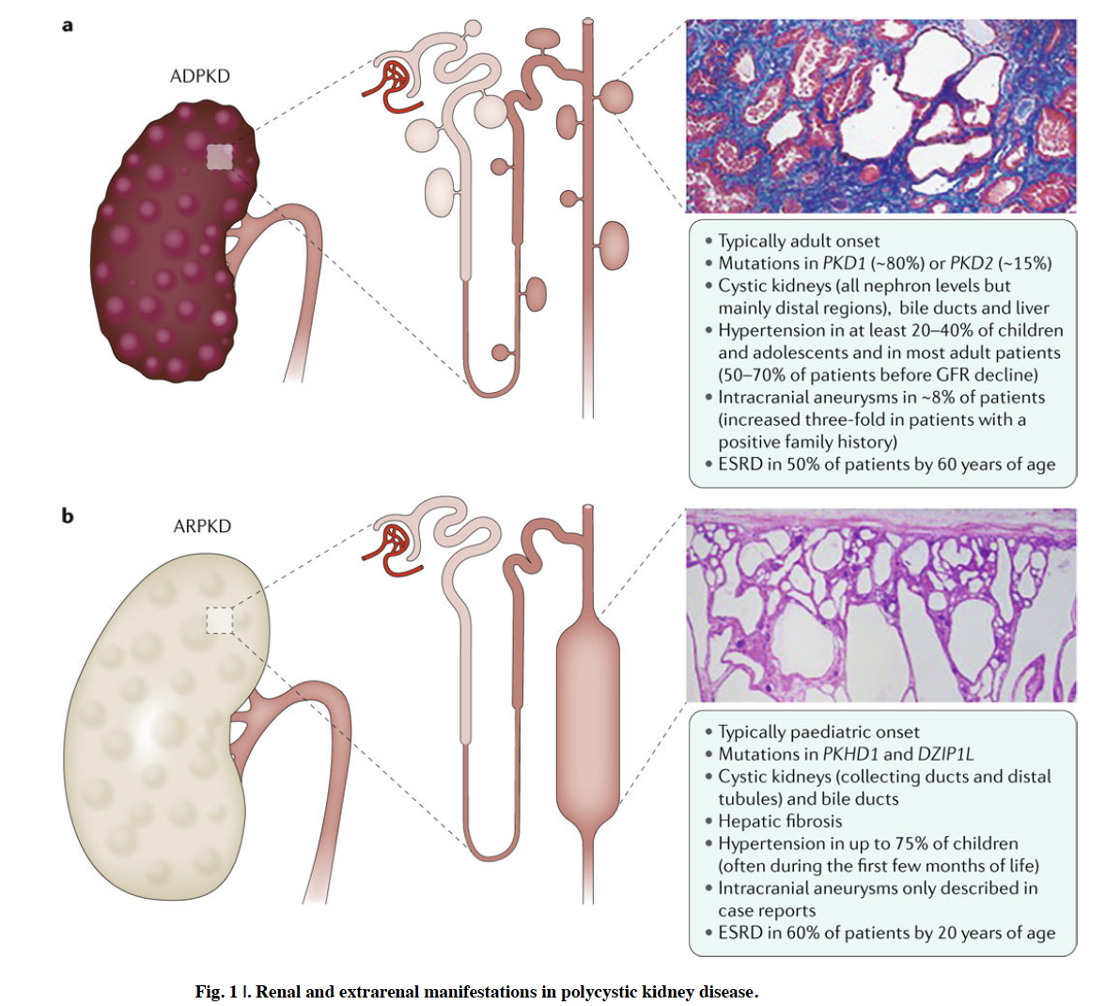
Bergmann, C.; et al.

Slide 30
Disease Characteristics | ADPKD | ARPKD
Inheritance pattern | Autosomal dominant | Autosomal recessive
Risk of sibling being affected | 50% | 25%
Associated genes | PKD1, PKD2 | PKHD1
Associated proteins | PC1, PC2 | Fibrocystin
Expected age of presentation | Adolescent or adult | Neonate or infant
Ultrasound findings | Macroscopic renal cysts, asymmetric in distribution | Enlarged echogenic kidneys, dilated tubules Often seen on prenatal US
Progression to ESKD | Lifetime risk of 50% | If survival to adulthood, lifetime risk of >60%
Renal features | Corticomedullary cysts | Dilation of the collecting ducts, oliguria
Associated organ systems | Hepatic cysts Pancreatic cysts Intracranial aneurysms | Pulmonary hypoplasia Congenital hepatic fibrosis, biliary duct dilatation, portal HTN

Slide 31
Other Cystic Diseases

Slide 32
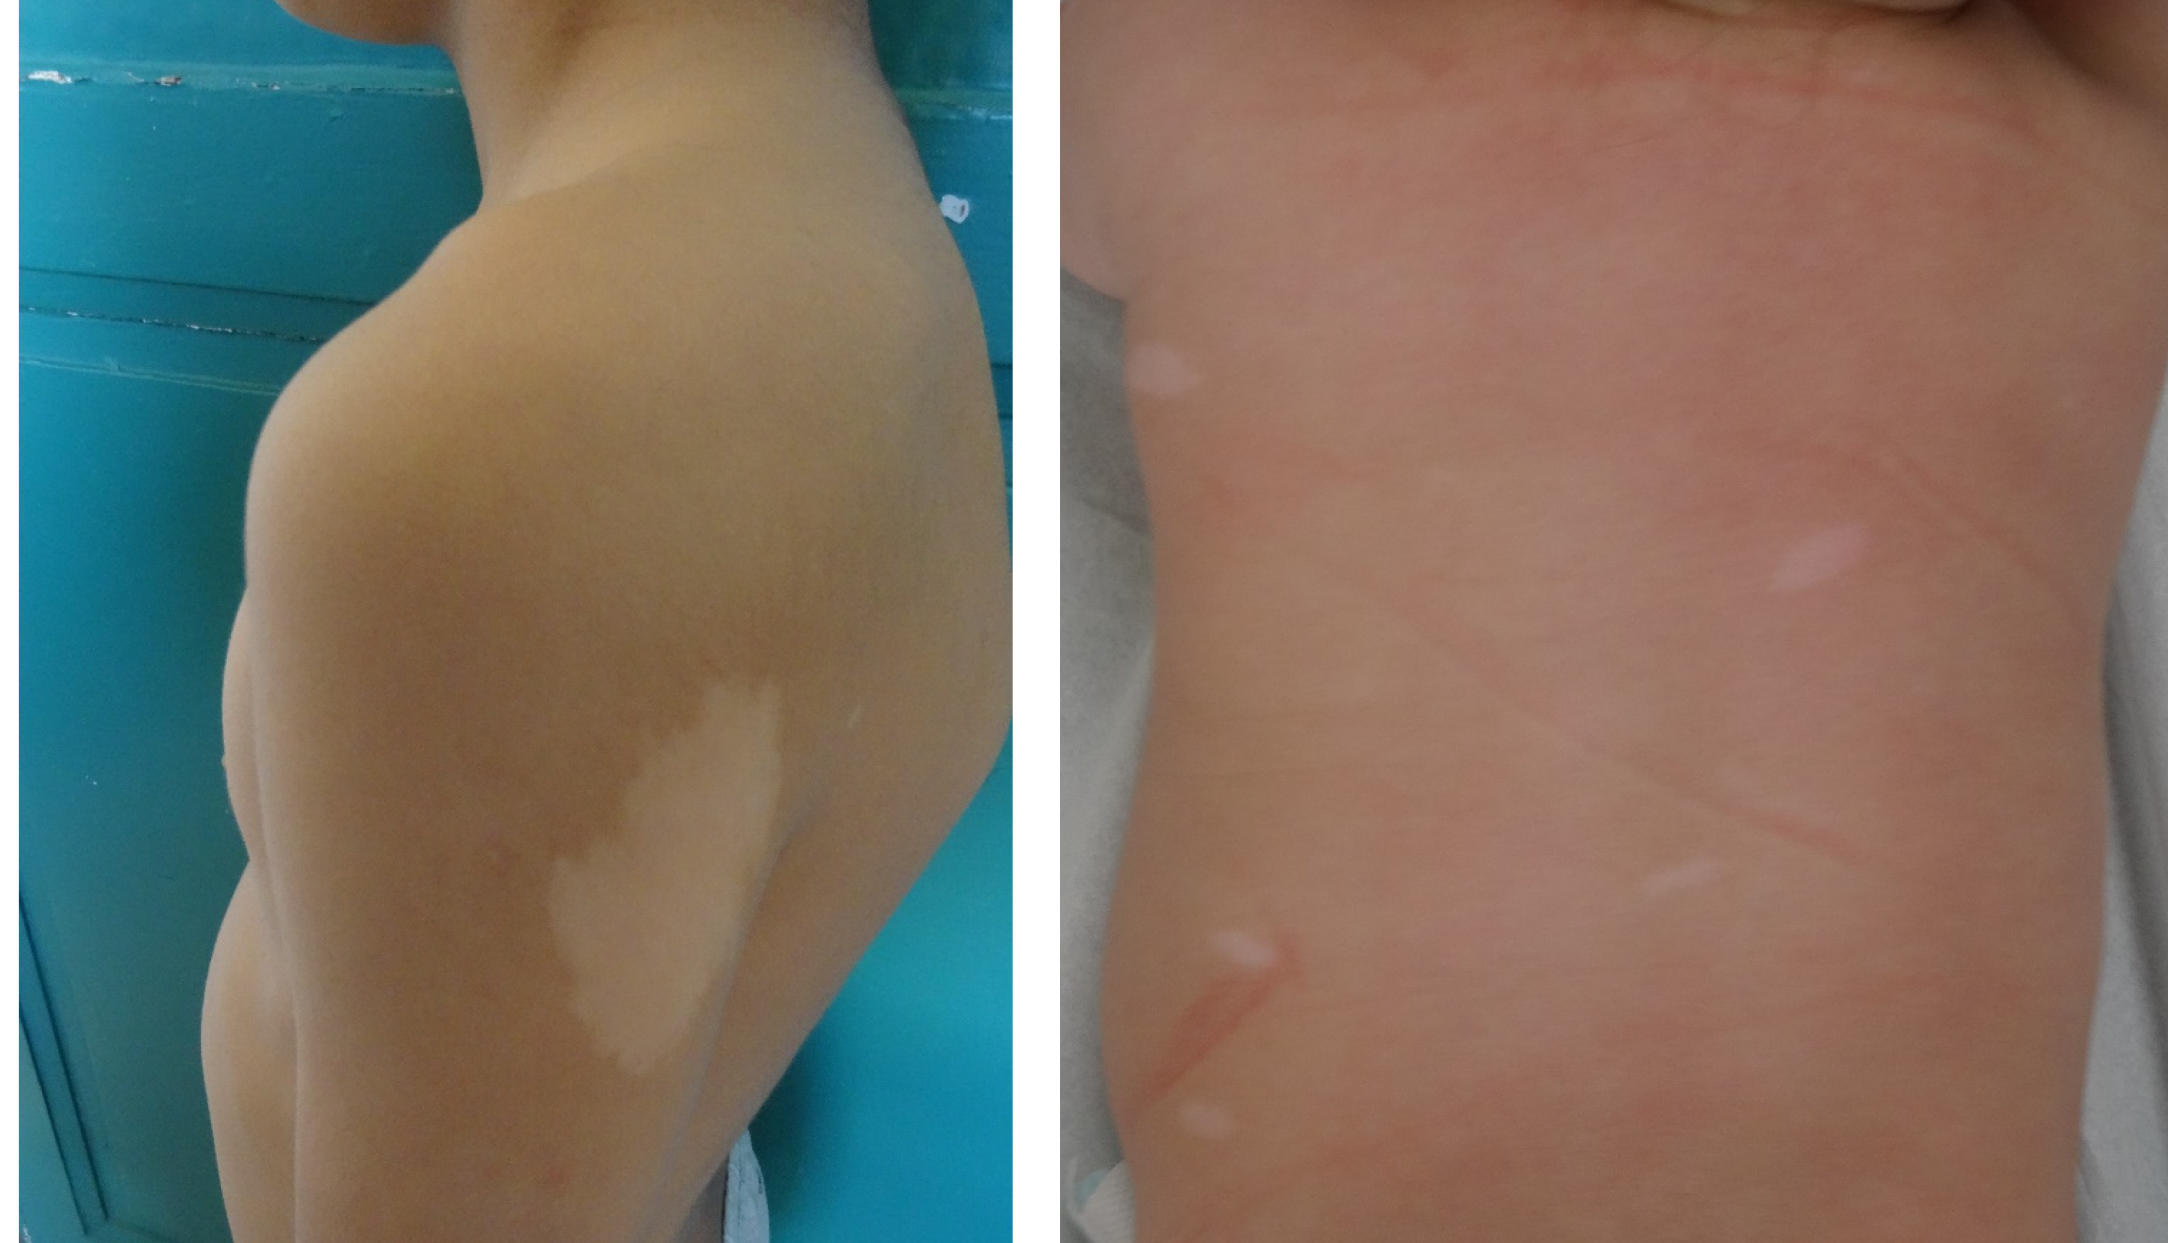
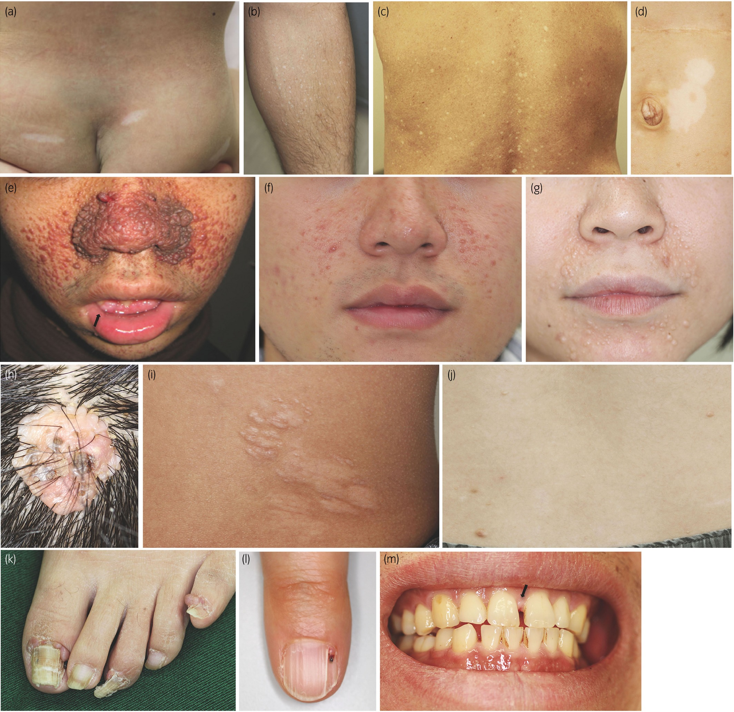
Tuberous Sclerosis Complex (TSC)
Epidemiology and Genetics
  Prevalence: 1:6,000 births
  Autosomal Dominant
  TSC 1 (Ch 9), TSC2 (Ch 16)
Renal Manifestations
  50% cysts, 80% angiomyolipomas
Extra-Renal Manifestations
  Neurologic: Seizures, behavioral
  Skin: Ash-leaf spots, angiofibromas
  Pulm: Lymphangiomyomatosis (LAM)
  Cardiac: Rhabdomyomas (infant)
  Angiomyolipomas (AMLs) can be present inmost intra-abdominal organs
Treatment
  mTOR inhibitors (Sirolimus, Everolimus)

Slide 33
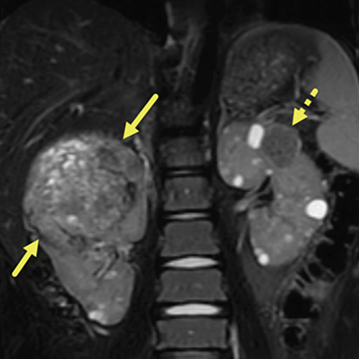
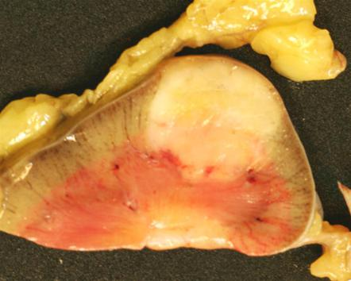
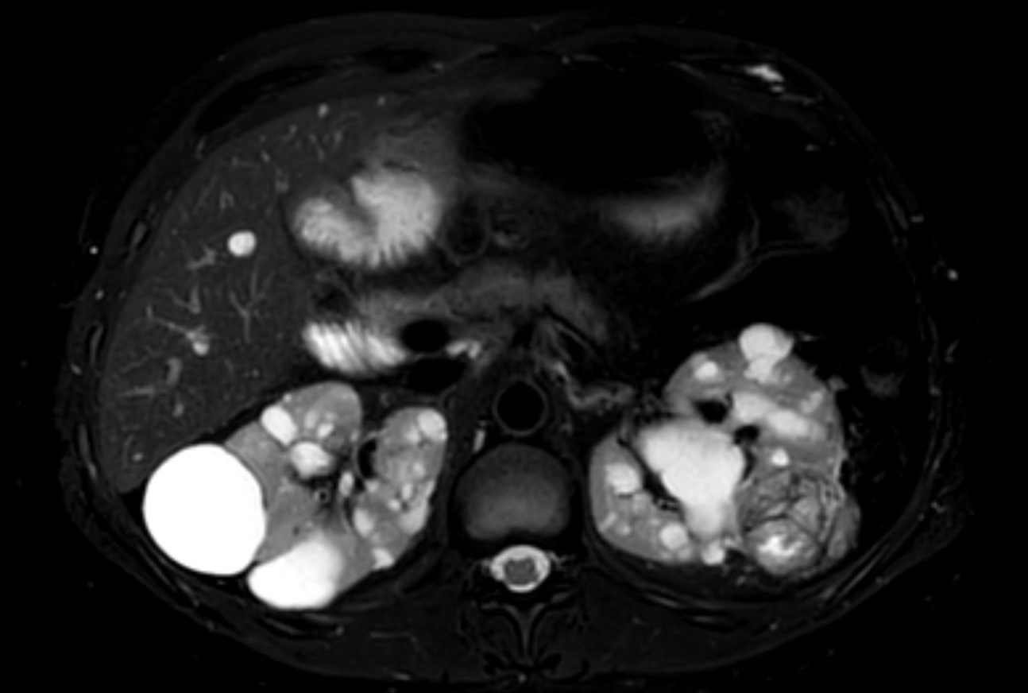
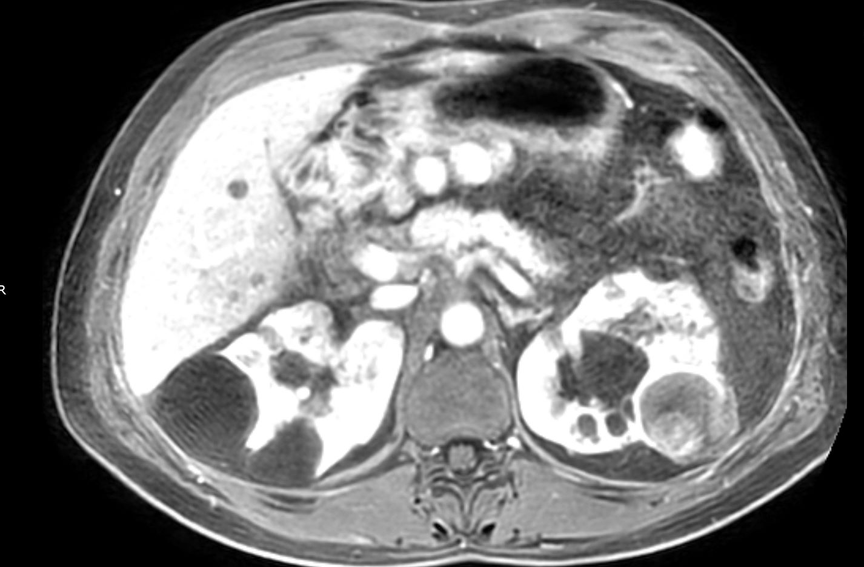
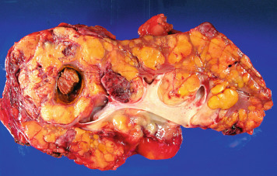
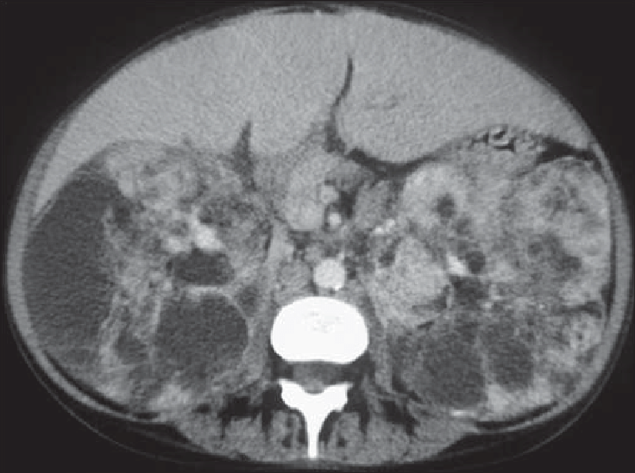
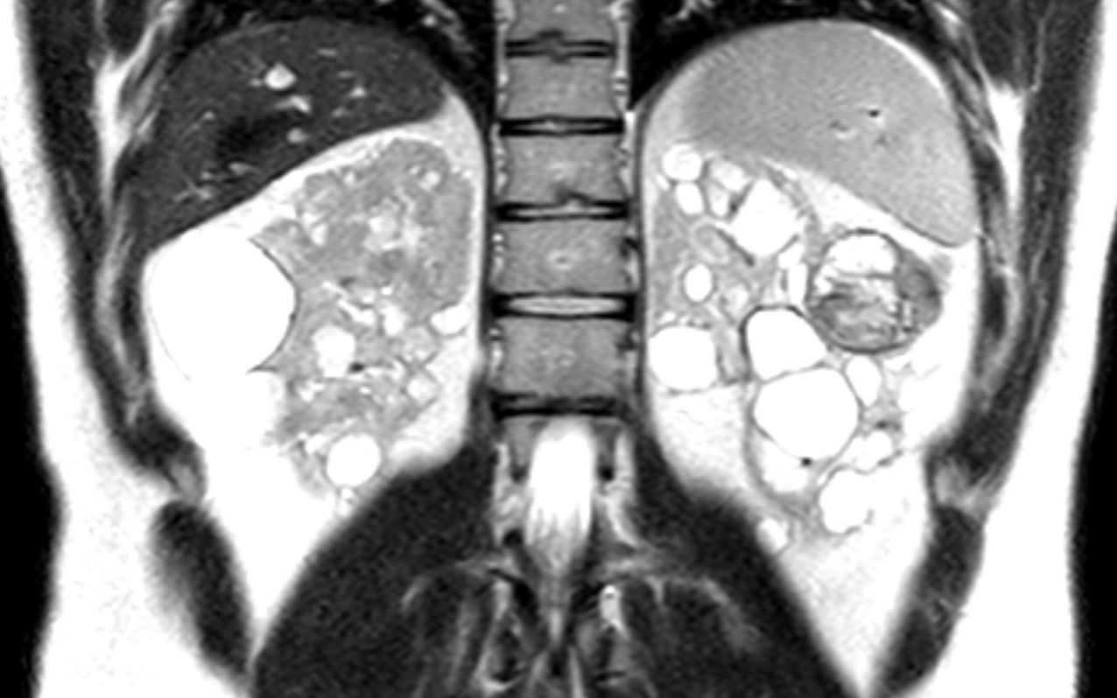

Slide 34
Von Hippel-Lindau (VHL)
Epidemiology and Genetics
  1:36,000 births
  Autosomal Dominant
  VHL Ch 3p25
  20% de novo
  Mean age of diagnosis 40 years old
Pathogenesis
  Unregulated tumor suppression (VHL)
  Benign and malignant tumors in multiple organs
Renal Manifestations
  Renal Cysts
  Renal Cell Carcinoma, high risk.
  Up to 70% are either multifocal or bilateral
Extra-renal Manifestations
  Retinal angiomas and spinal hemangioblastomas, Pheochromocytomas, pancreatic islet tumors, endolymphatic sac tumors (ELSTs), pancreatic cysts
Treatment
  Surgical removal
  Close surveillance

Slide 35
Wilms Tumor (Nephroblastoma)
Epidemiology and Genetics:
  90% of cases of Wilms tumor are sporadic and unilateral
  10% present as part of congenital syndromes or familial history
  Most often present as an abdominal mass
  Usually presents between 1 and 4 years of age, 98% occur before 10 years
  Loss of Function of WT1 (Ch11p13) or WT2 (Ch11p15). W11ms
Malignant neoplasm of embryonal nephrogenic elements composed of mixtures of blastemal, stromal, and epithelial cells

Slide 36
Wilms Tumor Syndromes
WAGR Syndrome (WT1)
  Wilms tumor, Aniridia, Genitourinary anomalies, Range of developmental delay
Denys-Drash Syndrome (WT1)
  Wilms tumor, Diffuse mesangial sclerosis (glomerular disease), Dysgenesis of gonads
Beckwith-Wiedemann Syndrome (WT2)
  Wilms tumor, overgrowth (hemihypertrophy) visceromegaly, and macroglossia

Slide 37
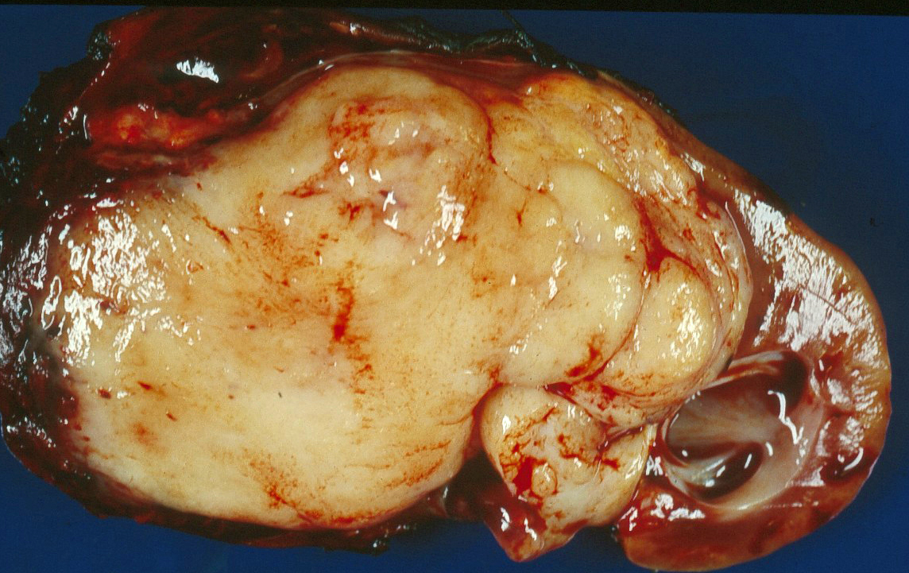
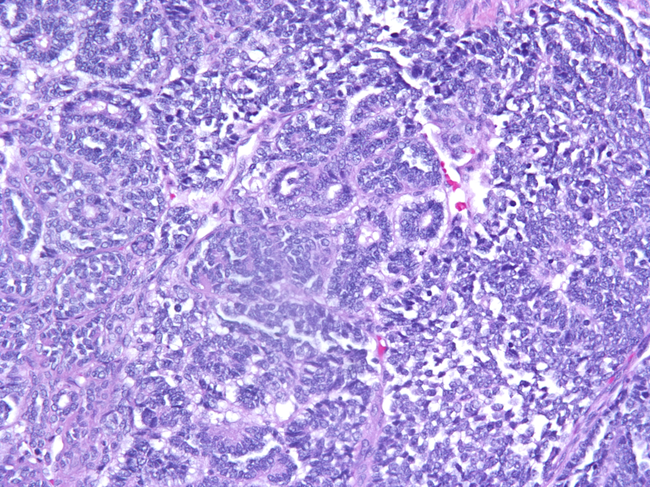

Slide 38
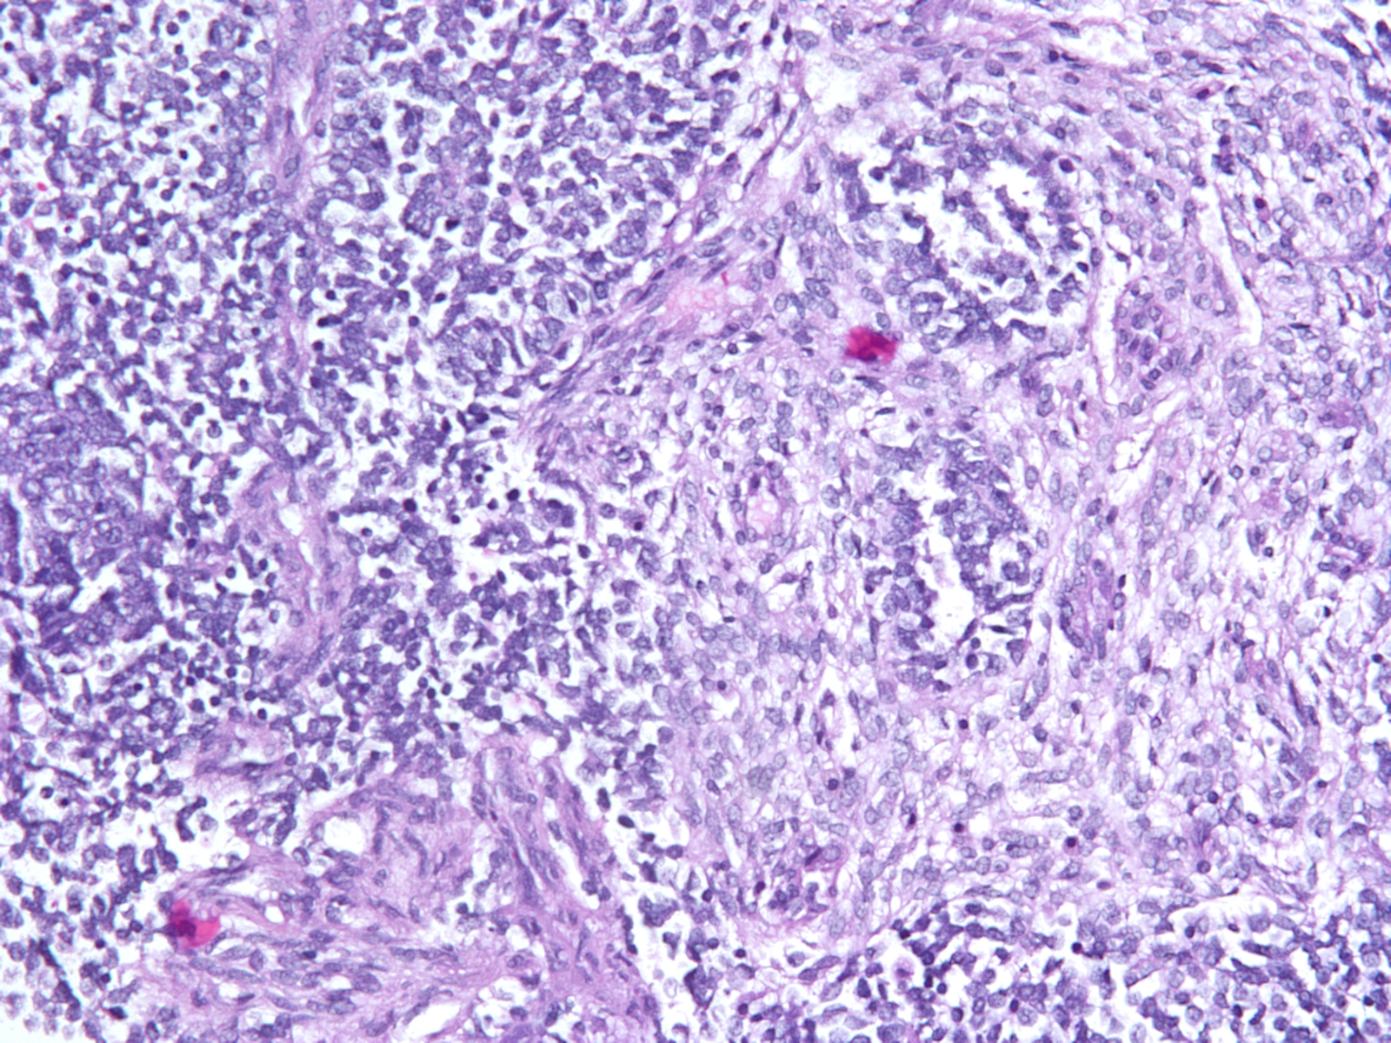
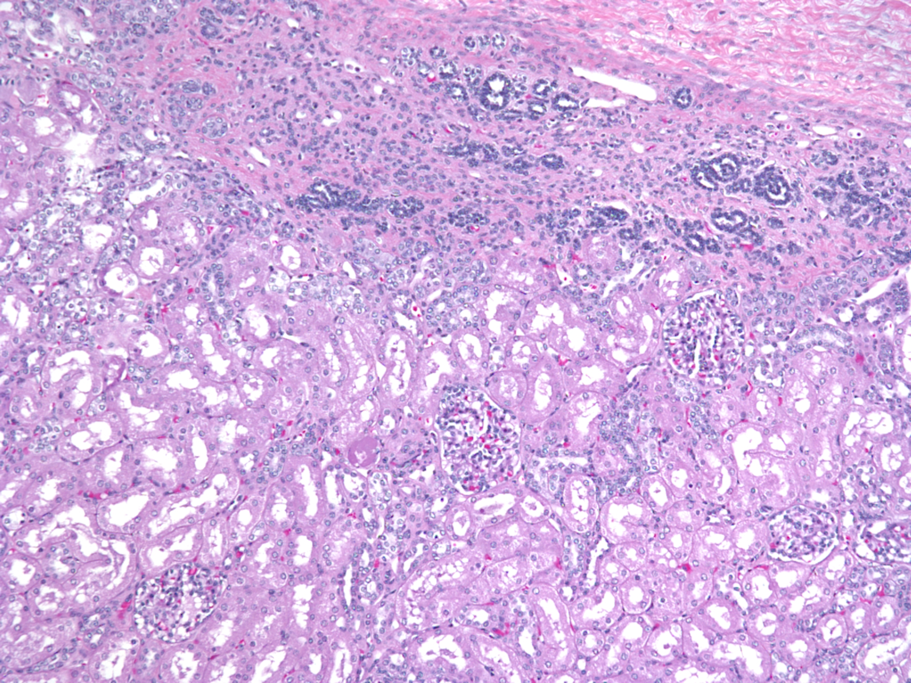

Slide 39
Tubulointerstitial Cystic Diseases
Nephronophthisis (NPHP)
Autosomal Dominant Tubulointerstitial Kidney Disease (ADTKD)
Epidemiology and Genetics
  Autosomal Recessive
  20+ genes identified
Presentations
  progress to kidney failure within first 3 decades
Renal Manifestations
  interstitial fibrosis, tubular atrophy, TBM disruption, and corticomedullary cysts
  Chronic tubular interstitial nephritis
  Urinary concentrating defect polyuria, secondary enuresis, nocturnal polydipsia
  Kidney size is normal or reduced
Extra-Renal Manifestations:
  Involvement, cysts have not been observed in other organs in contrast to ADPKD/ARPKD
Epidemiology and Genetics
  Autosomal Dominant
  MUC1 and UMOD predominant genes
  HNF1b – associated with diabetes
Previously known as Medullary Cystic Kidney Disease (MCKD)
Presentation
  4-7th decade
Renal Manifestations
  Urinary concentrating defect polyuria, secondary enuresis, nocturnal polydipsia
  Chronic tubular interstitial nephritis
  Urinary concentrating defect polyuria, secondary enuresis, nocturnal polydipsia
  Kidney size is normal or reduced
  Kidneys with medullary cysts that may not be visualized on ultrasound, kidneys may appear small on ultrasound
Extra-Renal Manifestations
  Gout

Slide 40
Acquired Cystic Kidney Disease
Sporadic, non-inherited development of cysts in CKD or ESKD
Helpful hints include the lack of family history and extrarenal manifestations
Ability to distinguish normal parenchyma between cysts with preservation of corticomedullary junction
Kidneys are usually small or normal size

Slide 41
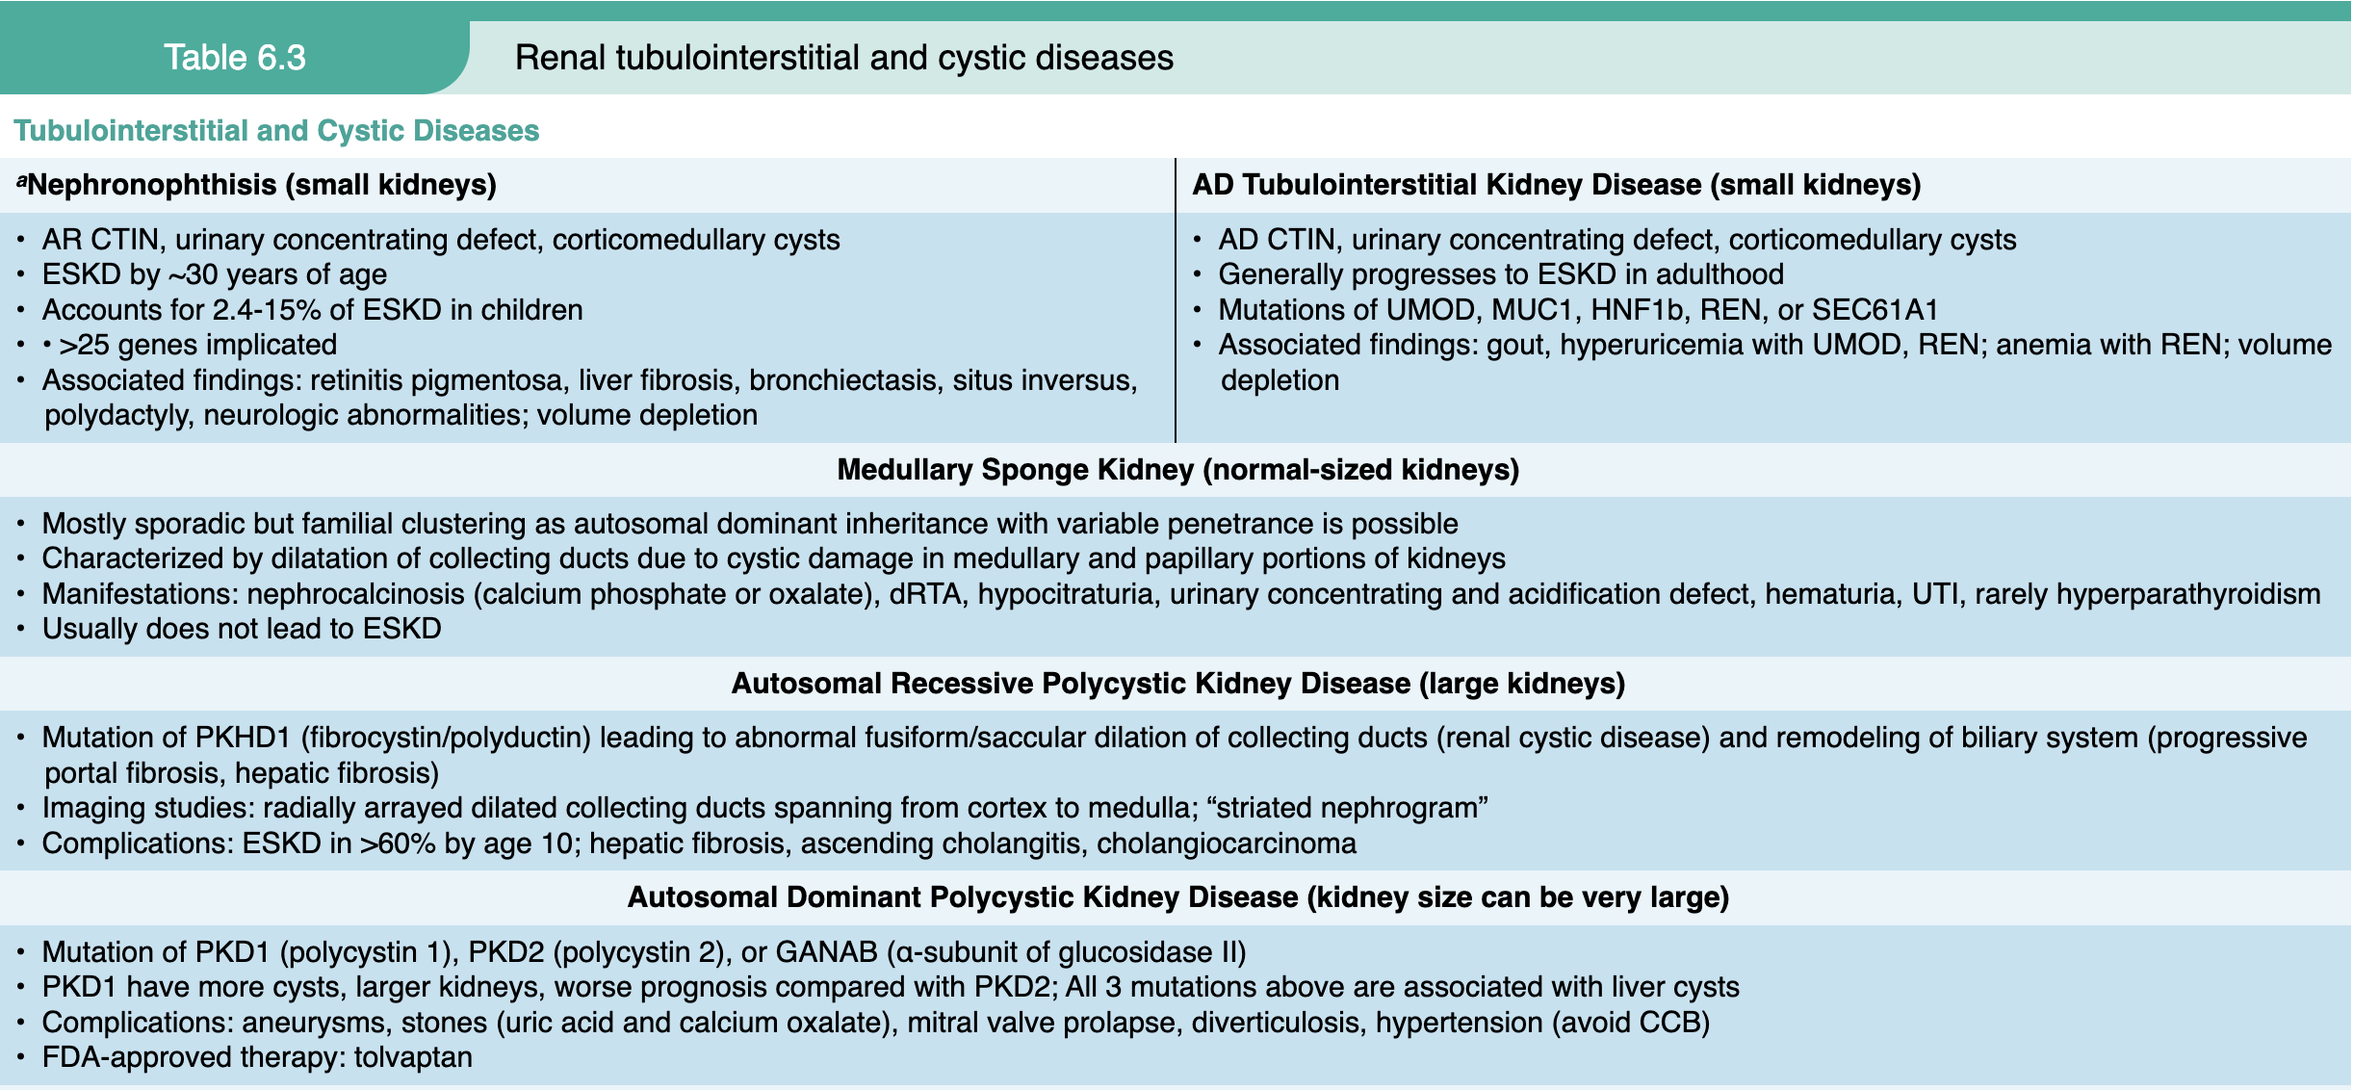
Notes:
aNephronophthisis is previously known as medullary cystic kidney disease.
bTSC/PKD1 continuous gene syndrome also belongs to syndromes with kidney tumors.
cIn BHD, pulmonary cystic disease and fibrofolliculomas may occur without the somatic mutation, but RCC requires somatic mutation of the second FLCN copy.
Abbreviations: AD, autosomal dominant; ADPKD, autosomal dominant polycystic kidney disease; AR, autosomal recessive; BHD, Birt–Hogg–Dubé; CCB, calcium channel blocker; CKD, chronic kidney disease; CNS, central nervous system; CTIN, chronic tubulointerstitial nephritis; dRTA, distal renal tubular acidosis; ESKD, end-stage kidney disease; FDA, Food and Drug Administration; FSGS, focal segmental glomerulosclerosis; G5D, CKD stage 5 on dialysis; G5T, CKD stage 5 in transplant recipients; HNF1β, gene encoding hepatic nuclear factor 1β; MUC1, gene encoding mucin 1; RCC, renal cell carcinoma; REN, gene encoding prorenin; SEC61A1, gene encoding the α1-subunit of SEC61 translocon pore; TSC, tuberous sclerosis complex; UMOD, gene encoding uromodulin; UTI, urinary tract infection; VHL, von Hippel–Lindau; VHLp, von Hippel–Lindau protein.

Slide 42
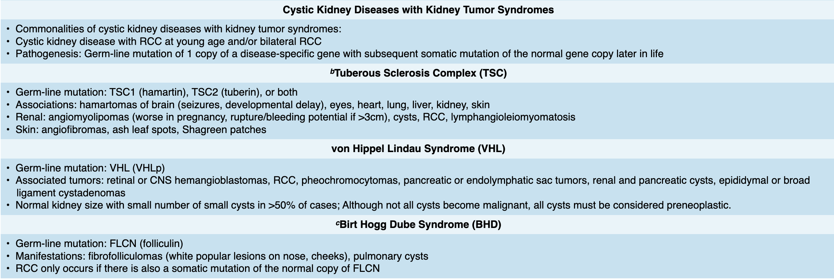
Notes:
aNephronophthisis is previously known as medullary cystic kidney disease.
bTSC/PKD1 continuous gene syndrome also belongs to syndromes with kidney tumors.
cIn BHD, pulmonary cystic disease and fibrofolliculomas may occur without the somatic mutation, but RCC requires somatic mutation of the second FLCN copy.
Abbreviations: AD, autosomal dominant; ADPKD, autosomal dominant polycystic kidney disease; AR, autosomal recessive; BHD, Birt–Hogg–Dubé; CCB, calcium channel blocker; CKD, chronic kidney disease; CNS, central nervous system; CTIN, chronic tubulointerstitial nephritis; dRTA, distal renal tubular acidosis; ESKD, end-stage kidney disease; FDA, Food and Drug Administration; FSGS, focal segmental glomerulosclerosis; G5D, CKD stage 5 on dialysis; G5T, CKD stage 5 in transplant recipients; HNF1β, gene encoding hepatic nuclear factor 1β; MUC1, gene encoding mucin 1; RCC, renal cell carcinoma; REN, gene encoding prorenin; SEC61A1, gene encoding the α1-subunit of SEC61 translocon pore; TSC, tuberous sclerosis complex; UMOD, gene encoding uromodulin; UTI, urinary tract infection; VHL, von Hippel–Lindau; VHLp, von Hippel–Lindau protein.

Slide 43
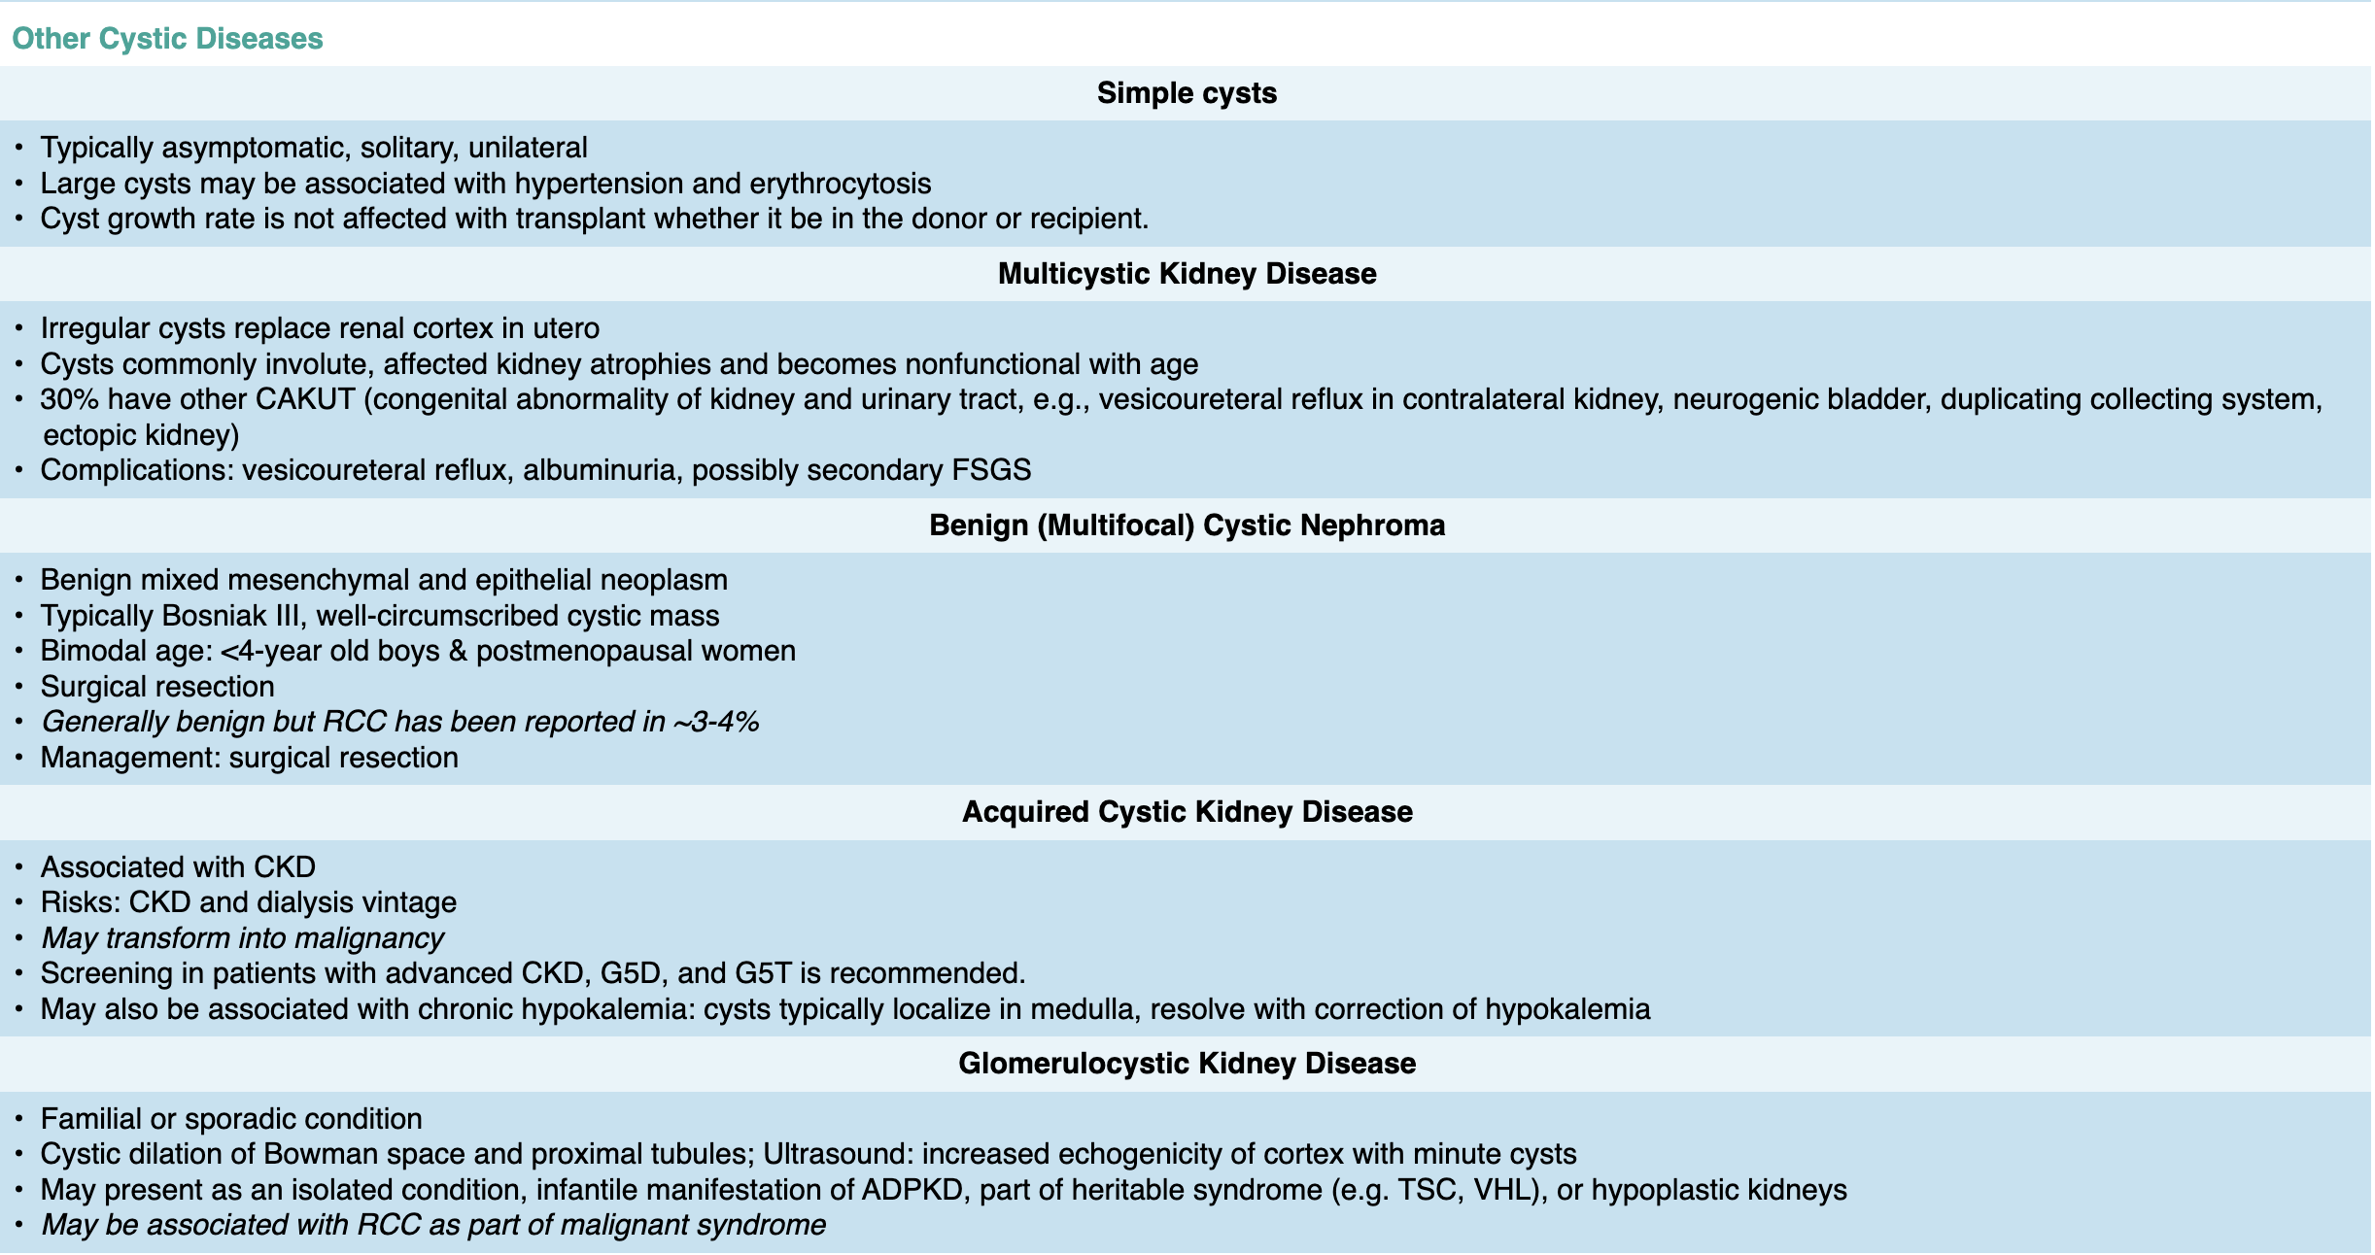
Notes:
aNephronophthisis is previously known as medullary cystic kidney disease.
bTSC/PKD1 continuous gene syndrome also belongs to syndromes with kidney tumors.
cIn BHD, pulmonary cystic disease and fibrofolliculomas may occur without the somatic mutation, but RCC requires somatic mutation of the second FLCN copy.
Abbreviations: AD, autosomal dominant; ADPKD, autosomal dominant polycystic kidney disease; AR, autosomal recessive; BHD, Birt–Hogg–Dubé; CCB, calcium channel blocker; CKD, chronic kidney disease; CNS, central nervous system; CTIN, chronic tubulointerstitial nephritis; dRTA, distal renal tubular acidosis; ESKD, end-stage kidney disease; FDA, Food and Drug Administration; FSGS, focal segmental glomerulosclerosis; G5D, CKD stage 5 on dialysis; G5T, CKD stage 5 in transplant recipients; HNF1β, gene encoding hepatic nuclear factor 1β; MUC1, gene encoding mucin 1; RCC, renal cell carcinoma; REN, gene encoding prorenin; SEC61A1, gene encoding the α1-subunit of SEC61 translocon pore; TSC, tuberous sclerosis complex; UMOD, gene encoding uromodulin; UTI, urinary tract infection; VHL, von Hippel–Lindau; VHLp, von Hippel–Lindau protein.

Slide 44
Resources
Comprehensive Clinical Nephrology, 7ed
Le, Tao. First Aid for the USMLE Step 1. 2024 ed
NKF Primer on Kidney Disease, 8ed

Slide 46
1) A 3-year-old child has become more irritable over the past two months and does not want to eat much at meals. On physical examination the pediatrician notes an enlarged abdomen and can palpate a mass on the right. An abdominal CT scan reveals a 10 cm solid mass involving the right kidney. The resected mass has a microscopic appearance with sheets of small blue cells along with primitive tubular structures. The child receives chemotherapy and radiation therapy, and there is no recurrence.
Which of the following neoplasms is this child most likely to have had?
A Angiomyolipoma
B Renal cell carcinoma
C Urothelial carcinoma
D Wilms tumor
E Medullary fibroma

Slide 47
1) A 3-year-old child has become more irritable over the past two months and does not want to eat much at meals. On physical examination the pediatrician notes an enlarged abdomen and can palpate a mass on the right. An abdominal CT scan reveals a 10 cm solid mass involving the right kidney. The resected mass has a microscopic appearance with sheets of small blue cells along with primitive tubular structures. The child receives chemotherapy and radiation therapy, and there is no recurrence.
Which of the following neoplasms is this child most likely to have had?
A Angiomyolipoma
B Renal cell carcinoma
C Urothelial carcinoma
D Wilms tumor
E Medullary fibroma

Slide 48
2) A 60-year-old woman has had increasing abdominal discomfort and flank pain for the past 5 years. Vital signs shows blood pressure 150/100 mm Hg. On physical examination there are mass-like areas in the posterior abdomen bilaterally. Laboratory studies show serum creatinine 5 mg/dL and urea nitrogen 44 mg/dL. There is a family history of similar findings.
What is most likely to be found with abdominal ultrasound examination?
A Bilateral calyceal dilation with cortical atrophy
B Bilateral renal enlargement with echogenic cysts
C Bilateral solid mass lesions of the kidneys
D Bridge of tissue connecting renal lower poles
E Markedly dilated urinary bladder

Slide 49
2) A 60-year-old woman has had increasing abdominal discomfort and flank pain for the past 5 years. Vital signs shows blood pressure 150/100 mm Hg. On physical examination there are mass-like areas in the posterior abdomen bilaterally. Laboratory studies show serum creatinine 5 mg/dL and urea nitrogen 44 mg/dL. There is a family history of similar findings.
What is most likely to be found with abdominal ultrasound examination?
A Bilateral calyceal dilation with cortical atrophy
B Bilateral renal enlargement with echogenic cysts (ADPKD)
C Bilateral solid mass lesions of the kidneys
D Bridge of tissue connecting renal lower poles
E Markedly dilated urinary bladder

Slide 50
3) 18-year-old primigravida has noted minimal fetal movement during pregnancy. She gives birth at 30 weeks gestation to a 2000 gm female infant with Apgar scores of 4 and 5 at 1 and 5 minutes respectively. The baby dies from respiratory distress within an hour of birth. At autopsy, the kidneys are markedly enlarged bilaterally. Microscopically, the renal parenchyma is replaced by numerous small radially arranged cysts.
These findings are most likely to be seen in association with which of the following pathologic conditions?
A Alobar holoprosencephaly
B Hepatic cysts and hepatic fibrosis
C Concomitant presence of an imperforate anus
D Lack of ureteral development
E Papilloma of the bladder

Slide 51
3) 18-year-old primigravida has noted minimal fetal movement during pregnancy. She gives birth at 30 weeks gestation to a 2000 gm female infant with Apgar scores of 4 and 5 at 1 and 5 minutes respectively. The baby dies from respiratory distress within an hour of birth. At autopsy, the kidneys are markedly enlarged bilaterally. Microscopically, the renal parenchyma is replaced by numerous small radially arranged cysts.
These findings are most likely to be seen in association with which of the following pathologic conditions?
A Alobar holoprosencephaly
B Hepatic cysts and hepatic fibrosis (ARPKD)
C Concomitant presence of an imperforate anus
D Lack of ureteral development
E Papilloma of the bladder

Slide 52
4) A 25-year-old G3 P2 woman has felt no fetal movement by 18 weeks gestation. Fetal ultrasound scan reveals the lack of amniotic fluid, making imaging difficult, but bilaterally asymmetrically enlarged fetal kidneys are seen. No fetal bladder can be visualized. The fetal heart appears to have four chambers, and the feet have marked varus deformities. At the time of birth at 36 weeks gestation, the neonate has severe respiratory difficulty.
Which of the following is the most likely diagnosis?
A Bilateral Wilms tumor
B Autosomal dominant polycystic kidney disease
C Urethral atresia
D Congenital cytomegalovirus infection
E Multicystic renal dysplasia

Slide 53
4) A 25-year-old G3 P2 woman has felt no fetal movement by 18 weeks gestation. Fetal ultrasound scan reveals the lack of amniotic fluid, making imaging difficult, but bilaterally asymmetrically enlarged fetal kidneys are seen. No fetal bladder can be visualized. The fetal heart appears to have four chambers, and the feet have marked varus deformities. At the time of birth at 36 weeks gestation, the neonate has severe respiratory difficulty.
Which of the following is the most likely diagnosis?
A Bilateral Wilms tumor
B Autosomal dominant polycystic kidney disease
C Urethral atresia
D Congenital cytomegalovirus infection
E Multicystic renal dysplasia (Potter Sequence)

Slide 54
5) A 38-year-old male is referred for abnormal kidney labs after obtaining blood work for establishing with a primary care provider. His serum creatinine is 1.8 mg/dL (normal <1.2 mg/dL). He does report having blood in his urine twice over the last 5 year that resolved on its own. Physical exam is positive for distended abdomen with firmness. He reports similar events with his father who passed away suddenly at the age of 47. His paternal aunt is 54 and is currently on dialysis.
What additional complication is this patient at risk for?
Clear Cell Carcinoma
Subarachnoid hemorrhage
Lymphangiomyomatosis
Pheochromocytoma

Slide 55
5) A 38-year-old male is referred for abnormal kidney labs after obtaining blood work for establishing with a primary care provider. His serum creatinine is 1.8 mg/dL (normal <1.2 mg/dL). He does report having blood in his urine twice over the last 5 year that resolved on its own. Physical exam is positive for distended abdomen with firmness. He reports similar events with his father who passed away suddenly at the age of 47. His paternal aunt is 54 and is currently on dialysis.
What additional complication is this patient at risk for?
Clear Cell Carcinoma
Subarachnoid hemorrhage (ADPKD)
Lymphangiomyomatosis
Pheochromocytoma

Slide 56
6) A 28 year old female presents for abnormal kidney imaging found during fetal imaging with her recent pregnancy. She has successfully delivered a healthy male child 1 month ago without complications. During fetal ultrasound was found to have enlarged kidneys with simple cysts bilaterally and fat-containing cysts bilaterally, largest 4.2cm. She reports a personal history of seizures at a young age that have not recurred. Physical exam is prominent for 5 1-3cm depigmented patches on her trunk and arms.
Which of the following genes is likely responsible for patient presentation?
PKD2
PKHD1
UMOD
TSC2
WT2

Slide 57
6) A 28 year old female presents for abnormal kidney imaging found during fetal imaging with her recent pregnancy. She has successfully delivered a healthy male child 1 month ago without complications. During fetal ultrasound was found to have enlarged kidneys with simple cysts bilaterally and fat-containing cysts bilaterally, largest 4.2cm. She reports a personal history of seizures at a young age that have not recurred. Physical exam is prominent for 5 1-3cm depigmented patches on her trunk and arms.
Which of the following genes is likely responsible for patient presentation?
PKD2
PKHD1
UMOD
TSC2
WT2

Slide 58
7) A 2-day-old male infant is admitted to the neonatal intensive care unit for respiratory distress. Prenatal ultrasound showed enlarged, hyperechogenic kidneys and oligohydramnios. On examination, the infant has a distended abdomen and signs of portal hypertension. Imaging confirms bilaterally enlarged kidneys with diffuse microcysts.
Which inheritance pattern is most likely for this condition?
Autosomal dominant
Autosomal recessive
X-linked recessive
Mitochondrial
Multifactorial

Slide 59
7) A 2-day-old male infant is admitted to the neonatal intensive care unit for respiratory distress. Prenatal ultrasound showed enlarged, hyperechogenic kidneys and oligohydramnios. On examination, the infant has a distended abdomen and signs of portal hypertension. Imaging confirms bilaterally enlarged kidneys with diffuse microcysts.
Which inheritance pattern is most likely for this condition?
Autosomal dominant
Autosomal recessive (ARPKD – POTTER)
X-linked recessive
Mitochondrial
Multifactorial
Notes:
The presentation is consistent with autosomal recessive polycystic kidney disease (ARPKD), which often presents in infancy with enlarged kidneys and hepatic fibrosis

Slide 60
8) A 12-year-old boy is evaluated for growth retardation and excessive thirst. He has a history of polyuria and enuresis. Family history is negative for kidney disease. Renal ultrasound shows small kidneys with corticomedullary cysts. Laboratory studies reveal mild anemia and decreased concentrating ability.
What is the most likely diagnosis?
Autosomal dominant polycystic kidney disease
Nephronophthisis
Medullary sponge kidney
Multicystic dysplastic kidney
Simple renal cysts

Slide 61
8) A 12-year-old boy is evaluated for growth retardation and excessive thirst. He has a history of polyuria and enuresis. Family history is negative for kidney disease. Renal ultrasound shows small kidneys with corticomedullary cysts. Laboratory studies reveal mild anemia and decreased concentrating ability.
What is the most likely diagnosis?
Autosomal dominant polycystic kidney disease
Nephronophthisis
Medullary sponge kidney
Multicystic dysplastic kidney
Simple renal cysts
Notes:
Nephronophthisis presents in childhood with small kidneys, corticomedullary cysts, and progressive renal failure, often without a family history

Slide 62
9) A 40-year-old man presents with hypertension and bilateral flank pain. His father had kidney failure in his 50s. Renal ultrasound shows enlarged kidneys with numerous bilateral cysts. Genetic testing reveals a truncating mutation in the PKD1 gene.
Which protein is most likely dysfunctional, and what is its primary cellular location?
Polycystin-1; primary cilium
Fibrocystin; endoplasmic reticulum
Polycystin-2; mitochondria
Nephrin; slit diaphragm
Uromodulin; thick ascending limb

Slide 63
9) A 40-year-old man presents with hypertension and bilateral flank pain. His father had kidney failure in his 50s. Renal ultrasound shows enlarged kidneys with numerous bilateral cysts. Genetic testing reveals a truncating mutation in the PKD1 gene.
Which protein is most likely dysfunctional, and what is its primary cellular location?
Polycystin-1; primary cilium
Fibrocystin; endoplasmic reticulum
Polycystin-2; mitochondria
Nephrin; slit diaphragm
Uromodulin; thick ascending limb
Notes:
ADPKD is most commonly caused by mutations in PKD1, encoding polycystin-1, which localizes to the primary cilium of renal tubular epithelial cells

Slide 64
10) A 28-year-old woman presents with seizures, facial angiofibromas, and hypopigmented macules. Renal ultrasound reveals multiple small, simple cysts and bilateral angiomyolipomas. Genetic testing is pending
Which inheritance pattern is most likely for this condition?
Autosomal dominant
Autosomal recessive
X-linked recessive
Mitochondrial
Multifactorial

Slide 65
10) A 28-year-old woman presents with seizures, facial angiofibromas, and hypopigmented macules. Renal ultrasound reveals multiple small, simple cysts and bilateral angiomyolipomas. Genetic testing is pending.
Which inheritance pattern is most likely for this condition?
Autosomal dominant
Autosomal recessive
X-linked recessive
Mitochondrial
Multifactorial

