Slide 1
Cystic Kidney Diseases
Jacob Nysather D.O.

Slide 2

Disclosures
None

Slide 3
Objectives

Slide 4
Outline
Brief Anatomy Review
Some Radiology Review***
Types of Cysts***
Inherited Cystic Kidney Diseases
Tumor Diseases***

Slide 5
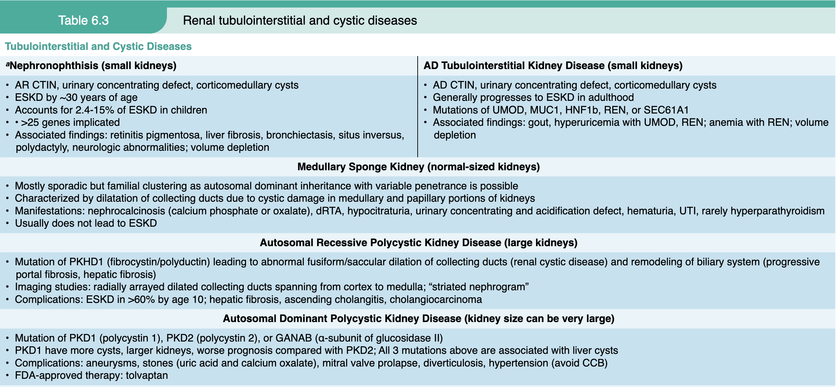
Notes:
aNephronophthisis is previously known as medullary cystic kidney disease.
bTSC/PKD1 continuous gene syndrome also belongs to syndromes with kidney tumors.
cIn BHD, pulmonary cystic disease and fibrofolliculomas may occur without the somatic mutation, but RCC requires somatic mutation of the second FLCN copy.
Abbreviations: AD, autosomal dominant; ADPKD, autosomal dominant polycystic kidney disease; AR, autosomal recessive; BHD, Birt–Hogg–Dubé; CCB, calcium channel blocker; CKD, chronic kidney disease; CNS, central nervous system; CTIN, chronic tubulointerstitial nephritis; dRTA, distal renal tubular acidosis; ESKD, end-stage kidney disease; FDA, Food and Drug Administration; FSGS, focal segmental glomerulosclerosis; G5D, CKD stage 5 on dialysis; G5T, CKD stage 5 in transplant recipients; HNF1β, gene encoding hepatic nuclear factor 1β; MUC1, gene encoding mucin 1; RCC, renal cell carcinoma; REN, gene encoding prorenin; SEC61A1, gene encoding the α1-subunit of SEC61 translocon pore; TSC, tuberous sclerosis complex; UMOD, gene encoding uromodulin; UTI, urinary tract infection; VHL, von Hippel–Lindau; VHLp, von Hippel–Lindau protein.

Slide 6
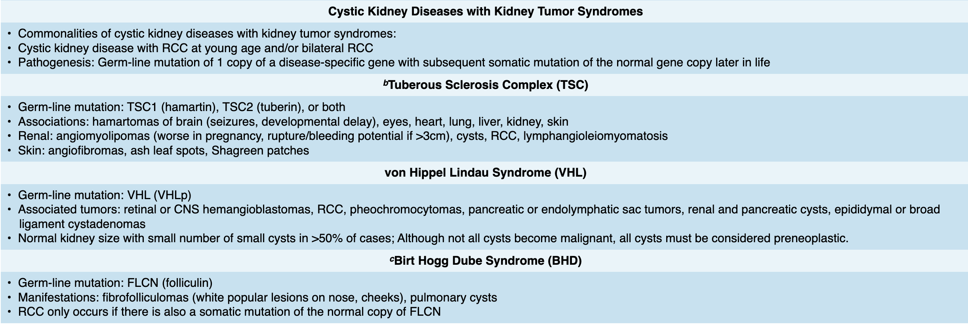
Notes:
aNephronophthisis is previously known as medullary cystic kidney disease.
bTSC/PKD1 continuous gene syndrome also belongs to syndromes with kidney tumors.
cIn BHD, pulmonary cystic disease and fibrofolliculomas may occur without the somatic mutation, but RCC requires somatic mutation of the second FLCN copy.
Abbreviations: AD, autosomal dominant; ADPKD, autosomal dominant polycystic kidney disease; AR, autosomal recessive; BHD, Birt–Hogg–Dubé; CCB, calcium channel blocker; CKD, chronic kidney disease; CNS, central nervous system; CTIN, chronic tubulointerstitial nephritis; dRTA, distal renal tubular acidosis; ESKD, end-stage kidney disease; FDA, Food and Drug Administration; FSGS, focal segmental glomerulosclerosis; G5D, CKD stage 5 on dialysis; G5T, CKD stage 5 in transplant recipients; HNF1β, gene encoding hepatic nuclear factor 1β; MUC1, gene encoding mucin 1; RCC, renal cell carcinoma; REN, gene encoding prorenin; SEC61A1, gene encoding the α1-subunit of SEC61 translocon pore; TSC, tuberous sclerosis complex; UMOD, gene encoding uromodulin; UTI, urinary tract infection; VHL, von Hippel–Lindau; VHLp, von Hippel–Lindau protein.

Slide 7
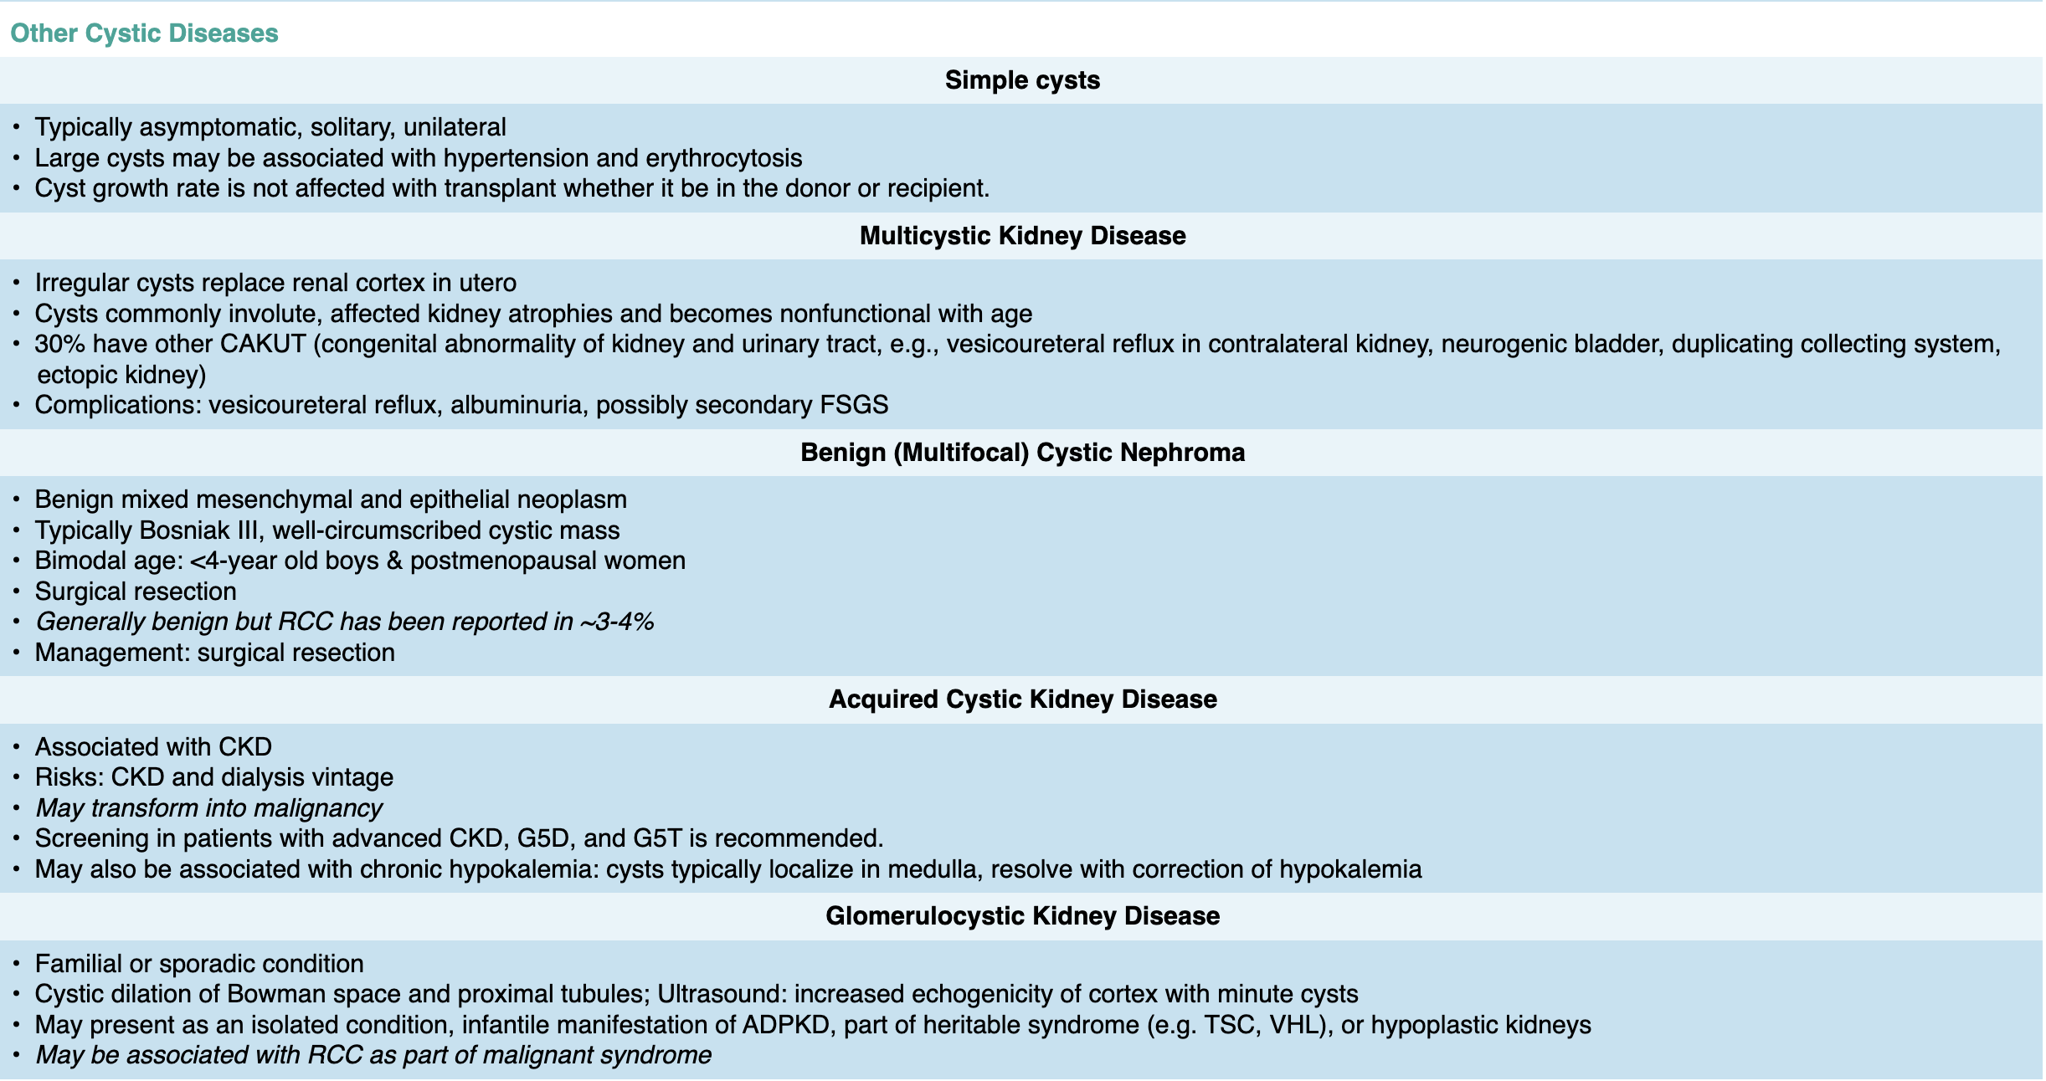
Notes:
aNephronophthisis is previously known as medullary cystic kidney disease.
bTSC/PKD1 continuous gene syndrome also belongs to syndromes with kidney tumors.
cIn BHD, pulmonary cystic disease and fibrofolliculomas may occur without the somatic mutation, but RCC requires somatic mutation of the second FLCN copy.
Abbreviations: AD, autosomal dominant; ADPKD, autosomal dominant polycystic kidney disease; AR, autosomal recessive; BHD, Birt–Hogg–Dubé; CCB, calcium channel blocker; CKD, chronic kidney disease; CNS, central nervous system; CTIN, chronic tubulointerstitial nephritis; dRTA, distal renal tubular acidosis; ESKD, end-stage kidney disease; FDA, Food and Drug Administration; FSGS, focal segmental glomerulosclerosis; G5D, CKD stage 5 on dialysis; G5T, CKD stage 5 in transplant recipients; HNF1β, gene encoding hepatic nuclear factor 1β; MUC1, gene encoding mucin 1; RCC, renal cell carcinoma; REN, gene encoding prorenin; SEC61A1, gene encoding the α1-subunit of SEC61 translocon pore; TSC, tuberous sclerosis complex; UMOD, gene encoding uromodulin; UTI, urinary tract infection; VHL, von Hippel–Lindau; VHLp, von Hippel–Lindau protein.

Slide 8

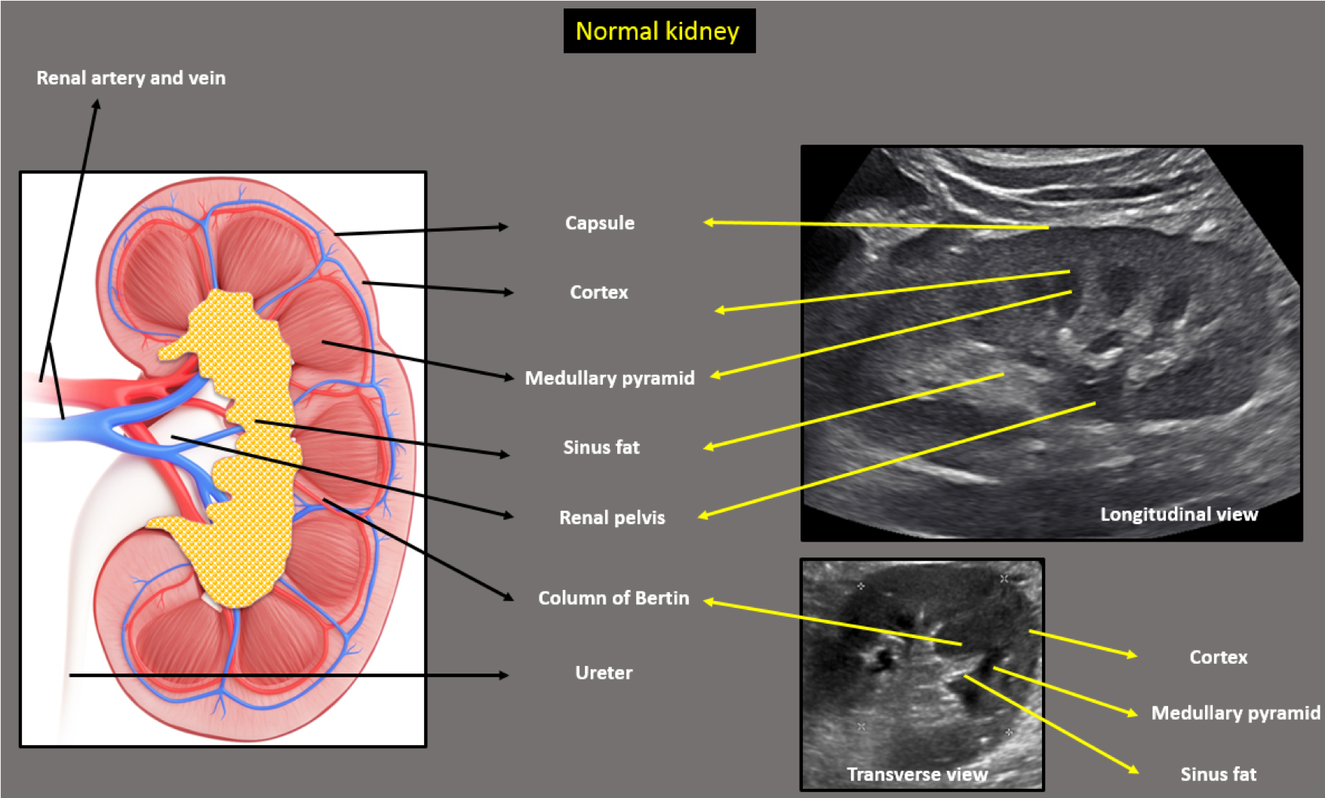
Renal Fellow Network

Slide 9
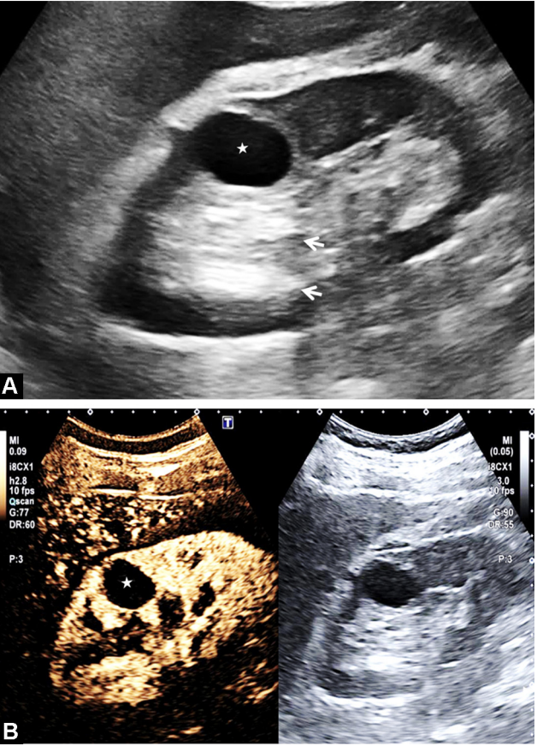
Simple Cysts
Benign Cysts
Prevalence: 1 in 10 individuals, accounts for the majority of renal lesions
Very rare in childhood (<2%)
Location: Typically Renal Cortex
Ultrasound Features:
  Well-defined, smooth, thin walls, no vascular component
  Anechoic (dark)
Asymptomatic, no treatment or follow-up is recommended. The risk of malignancy is low.
If >1 cyst is found in pediatric patients or a family history of inherited cystic disease, work-up should be completed

Slide 10
Simple Cysts
Most commonly acquired cystic lesion with a 2:1 male:female predominance
Prevalence increases with age
  30 to 49yo: 1.7%
  50 to 70yo: 11%
  >70yo: 22-30%
Suspected to originate from the distal convoluted tubule or collecting ducts and may arise from kidney tubular diverticula, but the pathogenic mechanisms are unknown.
Simple cysts are usually unilateral and may be either solitary or multiple.
They occur rarely in children but become increasingly common with age.

Slide 11
Simple Cysts: Pathogenesis and Risk
Focal tubular obstruction and/or kidney parenchymal ischemia that lead to aberrant hypertrophic response causing cystic growth
Associated risks factors: increasing age, male gender, HTN, reduced renal mass, increased BMI, reduced kidney function/GFR, and possibly smoking.
Simple cysts are typically asymptomatic solitary and unilateral cysts located in the renal cortex.

Slide 12
Simple Cysts: Clinical Manifestations
Typically asymptomatic
Patients can also present with hematuria, flank pain, evidence of infection, or obstruction of the collecting system
  Clinical symptoms are more common with neoplasms than simple cysts and should therefore prompt evaluation for cyst-associated malignancy
Increasing evidence supports a relationship between simple kidney cysts and hypertension

Slide 13
Simple Cysts: Imaging Features
Whether unilateral or bilateral, simple cysts are usually spherical and unilocular. They may be solitary or multiple. On average, simple cysts measure 0.5 to 1.0 cm in diameter, but 3 to 4 cm cysts are not uncommon.
Simple cysts can occur in the cortex, where they can protrude from the cortical surface (exophytic cysts), the corticomedullary junction, or in the medulla.
By definition, they do not communicate with the kidney pelvis. The cyst walls are typically thin and transparent, lined with a single layer of flattened epithelium.
Cyst fluid is essentially an ultrafiltrate of plasma. In the wake of infection, cyst walls can become thickened, fibrotic, and even calcified.

Slide 14
Simple Cysts: Imaging Features
The ultrasound features of simple cysts include smooth walls, lack of septae, and no intracystic debris.
If the ultrasound pattern is indeterminate, CT/MRI should be performed.
Benign cysts have homogeneous attenuation, no contrast enhancement, thin and smooth cyst walls, lack septae, no intracystic debris, and no associated calcifications, unless prior infection has occurred.
CT: Sharp margin where they meet the normal renal parenchyma. They have density measurements (Hounsfield numbers) of water density (−10 to +20).
US: simple cysts are echo-free (anechoic) masses with strong through transmission of the ultrasound signal; they have sharp borders where they meet the renal parenchyma and round or oval shapes. Thickening of the wall or dense internal echoes raise suspicion for a malignant lesion
A classification system for kidney cysts based on their appearance and enhancement on CT, described by Israel and Bosniak, is widely used and informs management

Slide 15
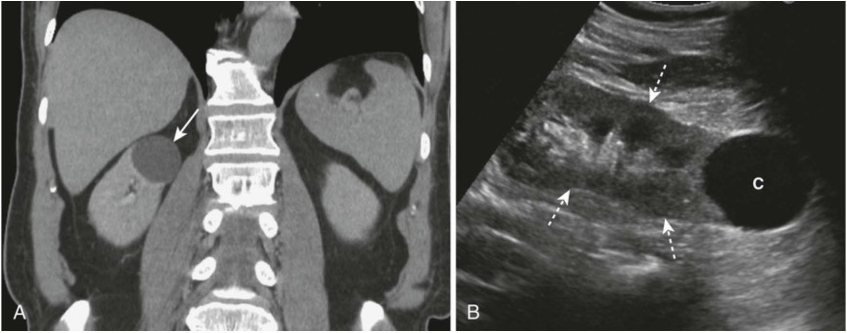
Notes:
FIGURE 20-37 Renal cysts, computed tomography (CT) urogram, and ultrasonography. A, This is an image from a CT urogram, which demonstrates a low-attenuation mass (white arrow) in the upper pole of the right kidney, which is homogeneous in density and sharply marginated. These findings are characteristic of a simple cyst. B, A sagittal ultrasound of the kidney (dotted white arrows) in another patient demonstrates an anechoic mass (C) with features consistent with a simple cyst of the lower pole.

Slide 16
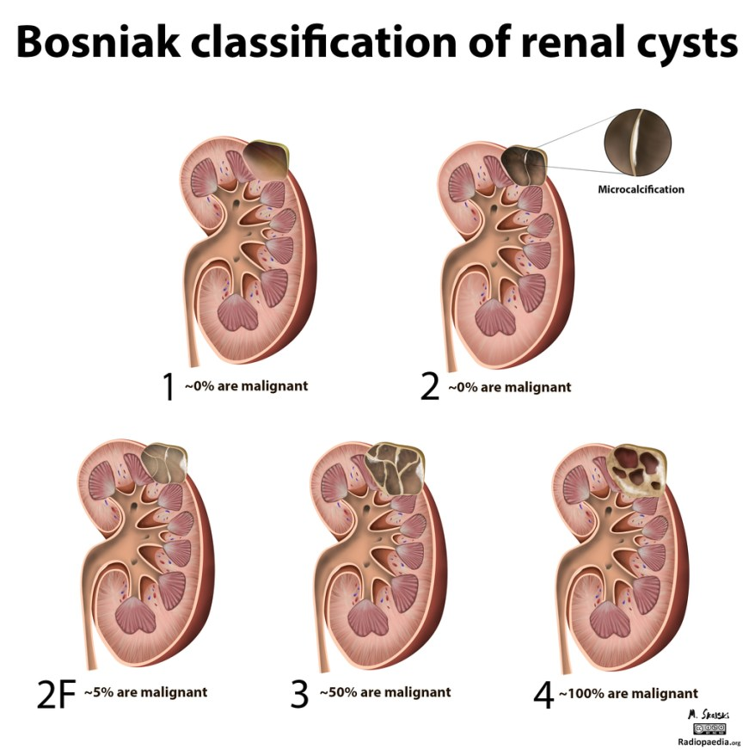
Bosniak I: benign simple cyst
hairline-thin wall of ≤2 mm
water density, no septa, calcifications, or solid components, no enhancement
Bosniak II: benign cyst - "minimally complex”
few hairlines thin <1 mm septa or thin calcifications (thickness not measurable), perceived but no measurable enhancement,
non-enhancing high-attenuation (due to proteinaceous or hemorrhagic contents) renal lesions <3 cm, generally well marginated
Bosniak IIF: minimally complex
multiple hairline thin septa or minimally smooth thickened walls or septa, perceived but no measurable enhancement of wall or septa,
calcification can be present and may be thick and nodular, generally well marginated, high-attenuation lesion >3 cm diameter, totally intrarenal (<25% of wall visible); no enhancement
Bosniak III: indeterminate cystic mass
Thickened irregular or smooth walls or septa with measurable enhancement
Bosniak IV: clearly malignant cystic mass,
Bosniak III criteria + enhancing soft tissue components adjacent to but independent of wall or septum

Slide 17
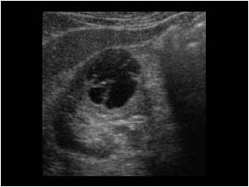
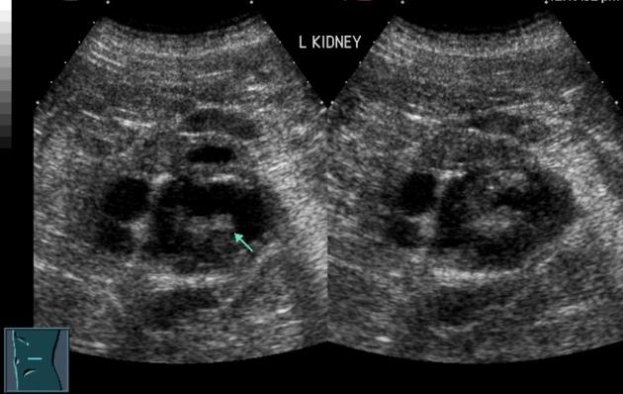
Complex Cysts
High risk of malignancy
Ultrasound Features
  Septations
  Calcifications
  Solid features
  Thickened or irregular walls
  Vascular component (contrast/doppler enhanced)
Require further imaging with CT or MRI
Radiopedia.org

Slide 18
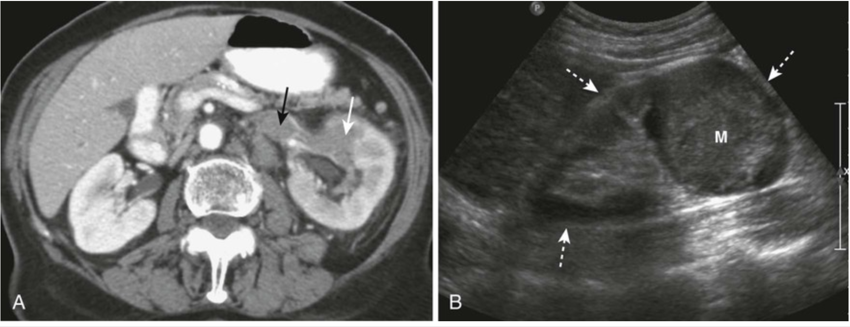
Notes:
FIGURE 20-38 Renal cell carcinomas, computed tomography and ultrasonography. A, There is a low-density mass involving the anterior portion of the left kidney (white arrow). The tumor is seen to extend directly into the left renal vein (black arrow), a feature of renal cell carcinomas. B, Sagittal ultrasound on another patient with renal cell carcinoma shows an echogenic mass (M) occupying the midportion of the kidney (dotted white arrows).

Slide 19
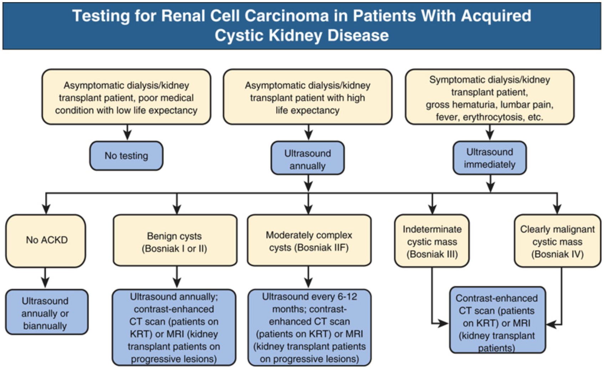
Notes:
FIG. 92.4 Proposed Approach to Testing for Renal Cell Carcinoma in Patients with Acquired Cystic Kidney Disease (ACKD). CT, Computed tomography; MRI, magnetic resonance imaging; KRT, kidney replacement therapy. Modified from Truong LD, Krishnan B, Cao JT, et al. Renal neoplasm in acquired cystic kidney disease. Am J Kidney Dis. 1995;26:1–12; Sarasin FP, Wong JB, Levey AS, Meyer KB. Screening for acquired cystic kidney disease: a decision analytic perspective. Kidney Int. 1995;48:207–219; and Schwarz A, Vatandaslar S, Merkel S, Haller H. Renal cell carcinoma in transplant recipients with acquired cystic kidney disease. Clin J Am Soc Nephrol. 2007;2:750–756.

Slide 20
Hypokalemic Cystic Disease
Kidney cysts are often seen in association with chronic hypokalemia secondary to primary hyperaldosteronism or other kidney potassium-wasting disorders.
Medullary cysts
Radiologic findings of medullary sponge kidney

Slide 21
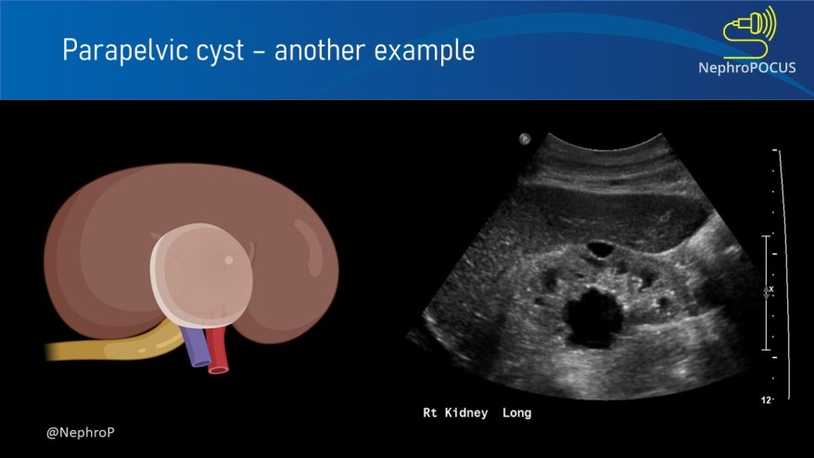
Hilar Cysts
Hilar cysts are spherical accumulations of clear, fat droplet-containing fluid within the kidney sinus. These cystic structures are not lined by epithelia. They are most commonly seen in debilitated patients and may represent atrophy of the kidney sinus fat.

Slide 22
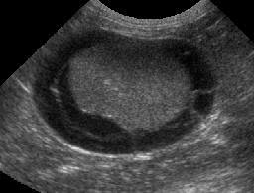
Perinephric Pseudocysts
Typically occur under the kidney capsule or in the perirenal fascia as a result of urine extravasation from traumatic or spontaneous rupture of a kidney cyst or as the posterior extension of a pancreatic pseudocyst. Surgical intervention is indicated for associated urinary tract obstruction. Otherwise, treatment is directed to the underlying cause.

Slide 24
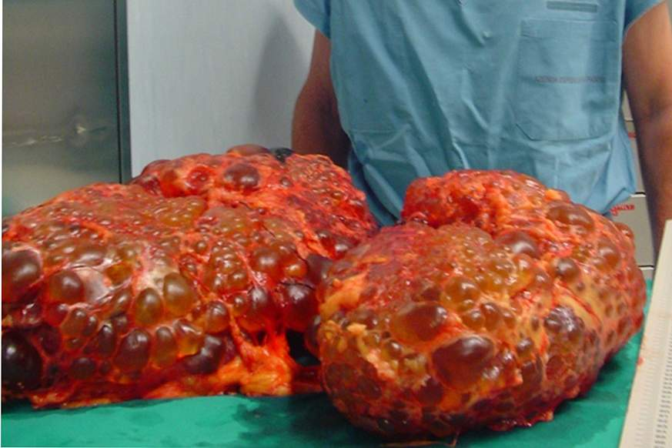
Polycystic Kidney Diseases

Slide 25
Autosomal Dominant Polycystic Kidney Disease (ADPKD)
Most common inherited kidney disorder
  1:400 to 1000 live births
  Affects all ethnic groups equally and reported worldwide.
Approximately 5% of ESKD population in the United States
  10% <60 years of age
ADPKD is a systemic disorder

Slide 26
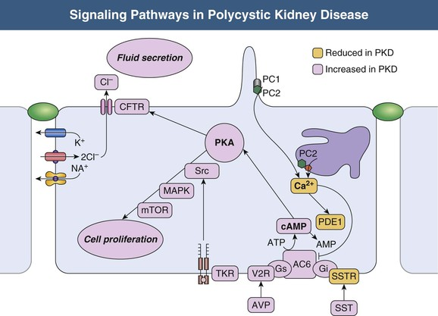
ADPKD Genetics and Pathophysiology
Genetic:
  Autosomal Dominant
  PKD1 (~80%) Chromosome 16p13.3 (Polycystin-1)
  PKD2 (~15%) Chromosome 4q12.2 (Polycystin-2)
  GANAB (1-5%)
Focal (< 5%) of all nephrons become cystic
Most cysts detach from the parent nephron when cysts size exceeds 2cm
Phenotypes typically vary, however, PKD2 tends to have a milder disease course
  Fewer cyst
  Later onset of hypertension
  Less ESKD compared to PKD1 (74 vs 54 years old)
Fig 46.2. Comprehensive Clinical Nephrology
Notes:
Two-hit hypothesis
PC1 and PC2 are co-localized in the primary cilium of renal epithelial cells, which function as a mechanosensory.
Primary cilia create transmembrane calcium currents in the presence of stretch and luminal flow.
Normal function increases intracellular calcium, which initiates a signaling cascade leading to vesicle fusion and a change in gene transcription.
PC1 is located in the primary cilium, focal adhesions, tight junctions, desmosomes, and adherens junctions. PC1 plays an important role in cell-cell interactions and cell-matrix interactions.
It localizes to the endoplasmic reticulum, plasma membrane, primary cilium, centrosome, and mitotic spindles in dividing cells. PC2 belongs to the family of voltage-activated calcium channels (e.g., transient receptor potential polycystin-2 [TRPP-2]) and is involved in intracellular calcium regulation through several pathways
PC1 and PC2 are co-localized in the primary cilium of renal epithelial cells, which function as a mechanosensor. Primary cilia create transmembrane calcium currents in the presence of stretch or luminal flow. PC1 and PC2 contribute to ciliary function, and the physical interaction between PC1 and PC2 is required for a membrane calcium channel to operate properly. Normal polycystin function increases intracellular calcium, which initiates a signaling cascade leading to vesicle fusion and a change in gene transcription. The magnitude of these changes contributing to the PKD epithelial phenotype has recently been challenged because the reservoir of calcium released from primary ciliary stimulation is relatively low.
Polycystins affect cell proliferation, differentiation, and fluid secretion through G-coupled protein receptors and JAK-STAT-mediated signaling pathways. The interaction of PC1 ligand on the basolateral surface with adenylate cyclase and the G protein–coupled response of adenylate cyclase to binding of vasopressin to the vasopressin V2 receptor produces similar results. Both result in increased intracellular concentrations of cyclic adenosine monophosphate (cAMP) and, ultimately, in chloride secretion across the luminal membrane. This chloride-rich fluid secretion is a critical component of cystogenesis, enabling expansion of cysts even after they detach from their parent nephron. The accumulation of cyst fluid, rich in chloride and sodium, relies on the active luminal excretion of chloride primarily through the cystic fibrosis transmembrane conductor regulator (CFTR)

Slide 27
Notes:
PC1 is located in the primary cilium, focal adhesions, tight junctions, desmosomes, and adherens junctions. PC1 plays an important role in cell-cell interactions and cell-matrix interactions.
It localizes to the endoplasmic reticulum, plasma membrane, primary cilium, centrosome, and mitotic spindles in dividing cells. PC2 belongs to the family of voltage-activated calcium channels (e.g., transient receptor potential polycystin-2 [TRPP-2]) and is involved in intracellular calcium regulation through several pathways
PC1 and PC2 are co-localized in the primary cilium of renal epithelial cells, which function as a mechanosensor. Primary cilia create transmembrane calcium currents in the presence of stretch or luminal flow. PC1 and PC2 contribute to ciliary function, and the physical interaction between PC1 and PC2 is required for a membrane calcium channel to operate properly. Normal polycystin function increases intracellular calcium, which initiates a signaling cascade leading to vesicle fusion and a change in gene transcription. The magnitude of these changes contributing to the PKD epithelial phenotype has recently been challenged because the reservoir of calcium released from primary ciliary stimulation is relatively low.
Polycystins affect cell proliferation, differentiation, and fluid secretion through G-coupled protein receptors and JAK-STAT-mediated signaling pathways. The interaction of PC1 ligand on the basolateral surface with adenylate cyclase and the G protein–coupled response of adenylate cyclase to binding of vasopressin to the vasopressin V2 receptor produces similar results. Both result in increased intracellular concentrations of cyclic adenosine monophosphate (cAMP) and, ultimately, in chloride secretion across the luminal membrane. This chloride-rich fluid secretion is a critical component of cystogenesis, enabling expansion of cysts even after they detach from their parent nephron. The accumulation of cyst fluid, rich in chloride and sodium, relies on the active luminal excretion of chloride primarily through the cystic fibrosis transmembrane conductor regulator (CFTR)

Slide 28
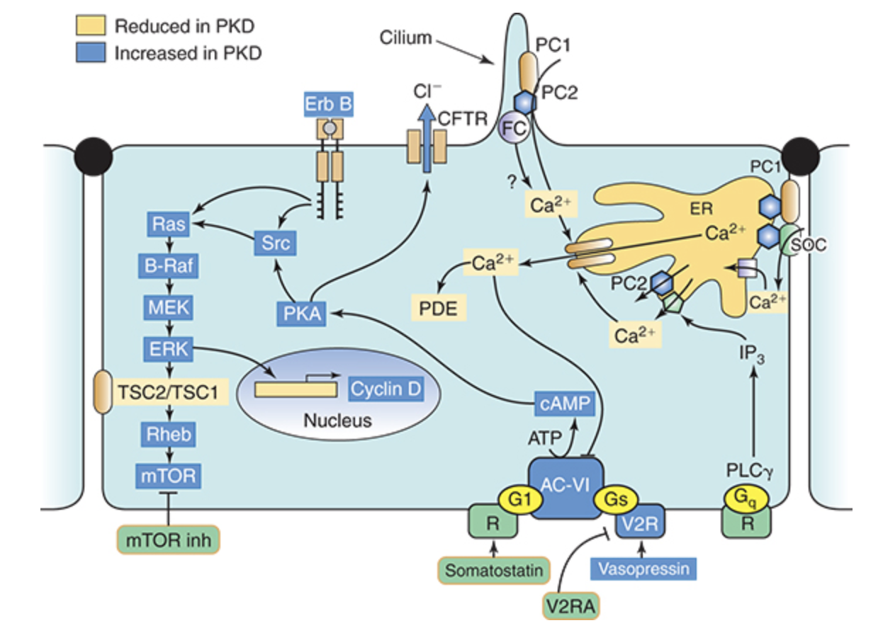
Notes:
PC1 is located in the primary cilium, focal adhesions, tight junctions, desmosomes, and adherens junctions. PC1 plays an important role in cell-cell interactions and cell-matrix interactions.
It localizes to the endoplasmic reticulum, plasma membrane, primary cilium, centrosome, and mitotic spindles in dividing cells. PC2 belongs to the family of voltage-activated calcium channels (e.g., transient receptor potential polycystin-2 [TRPP-2]) and is involved in intracellular calcium regulation through several pathways
PC1 and PC2 are co-localized in the primary cilium of renal epithelial cells, which function as a mechanosensor. Primary cilia create transmembrane calcium currents in the presence of stretch or luminal flow. PC1 and PC2 contribute to ciliary function, and the physical interaction between PC1 and PC2 is required for a membrane calcium channel to operate properly. Normal polycystin function increases intracellular calcium, which initiates a signaling cascade leading to vesicle fusion and a change in gene transcription. The magnitude of these changes contributing to the PKD epithelial phenotype has recently been challenged because the reservoir of calcium released from primary ciliary stimulation is relatively low.
Polycystins affect cell proliferation, differentiation, and fluid secretion through G-coupled protein receptors and JAK-STAT-mediated signaling pathways. The interaction of PC1 ligand on the basolateral surface with adenylate cyclase and the G protein–coupled response of adenylate cyclase to binding of vasopressin to the vasopressin V2 receptor produces similar results. Both result in increased intracellular concentrations of cyclic adenosine monophosphate (cAMP) and, ultimately, in chloride secretion across the luminal membrane. This chloride-rich fluid secretion is a critical component of cystogenesis, enabling expansion of cysts even after they detach from their parent nephron. The accumulation of cyst fluid, rich in chloride and sodium, relies on the active luminal excretion of chloride primarily through the cystic fibrosis transmembrane conductor regulator (CFTR)

Slide 29
Mechanisms of Cyst Formation
The polycystins are involved in the detection of extracellular cues at primary cilia, cell-cell contacts, and cell-matrix contacts and are essential to maintain the differentiated phenotype of the tubular epithelium.
Reduction in one of the polycystins to below a critical threshold results in inability to maintain planar polarity, increased rates of proliferation, expression of a secretory phenotype, and remodeling of the extracellular matrix. 2
PC1 and PC2 in the primary cilium may be required for the increase in cytosolic calcium that occurs in response to ciliary bending. 11 PC2 is a TRP channel (TRPP2) and functions as a calcium release channel in the ER. 12
PC1 interacts with and modulates the maturation and function of PC2, and vice versa. 13
PC1 and PC2 also interact with additional calcium channel proteins. Precisely how intracellular calcium homeostasis is altered in ADPKD remains uncertain, but many studies show reduced resting intracellular calcium, ER calcium stores, and store-operated calcium entry in primary cell cultures or microdissected samples from human and rodent polycystic tissues 2 (Fig. 46.2).

Slide 30
A common finding in animal models of PKD is increased levels of cyclic adenosine monophosphate (cAMP), not only in the kidney but also in the liver and vascular smooth muscle. 14
Tissue levels of cAMP are determined by the activities of membrane-bound and soluble adenylyl cyclases and cAMP phosphodiesterases (PDEs), themselves subject to complex regulatory mechanisms.
Reduced intracellular calcium in PKD may activate calcium inhibitable AC6 or AC5, directly inhibit calcium/calmodulin-dependent PDE1, and indirectly inhibit cGMP inhibitable PDE3, thereby accounting for the accumulation of cAMP and activation of protein kinase A (PKA), which, in turn, contributes to the development and progression of PKD by stimulating cystic fibrosis transmembrane conductance regulator (CFTR)-driven chloride and fluid secretion and cell proliferation (see Fig. 46.2).

Slide 31
Chloride enters across basolateral Na+-K+-2Cl − cotransporters, driven by the sodium gradient generated by basolateral Na+,K+-ATPase, and exits across apical PKA-stimulated CFTR. Basolateral recycling of potassium occurs through the KCa3.1 channel.
cAMP exerts opposite effects on cell proliferation in different cell types. cAMP and PKA signaling enhance several proproliferative pathways (extracellular signal–regulated kinase [ERK]) in cells derived from polycystic kidneys and inhibit proliferation in cells derived from normal human kidney cortex. 15 , 16 Treatment of normal human kidney or murine collecting duct cells with calcium channel blockers replicates the proliferative response of the ADPKD cells to cAMP, thus linking this response to the reduction in intracellular calcium that results from disrupting the polycystin pathway. 17 Conversely, treatment of ADPKD cyst–derived cells with calcium channel activators or calcium ionophores restores the normal antimitogenic response to cAMP (see Fig. 46.2).

Slide 32
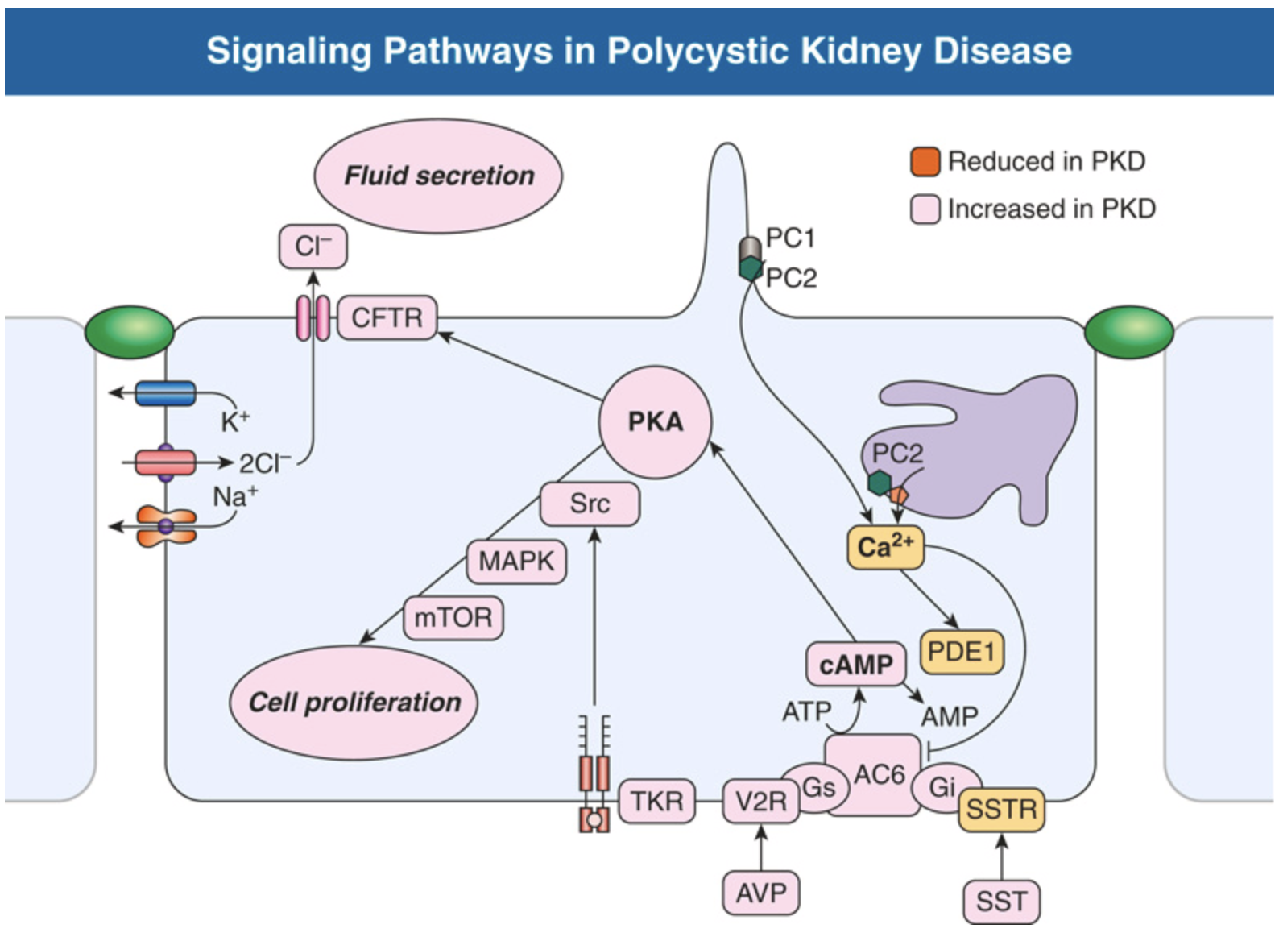
Notes:
FIG. 46.2 Signaling Pathways in Polycystic Kidney Disease (PKD).Pathways that are upregulated or downregulated in PKD and the rationale for potential therapies. Dysregulation of intracellular calcium homeostasis leads to intracellular accumulation of cyclic adenosine monophosphate (cAMP), activation of protein kinase A (PKA), cystic fibrosis transmembrane conductance regulator (CFTR) phosphorylation, and stimulation of chloride-driven fluid secretion. In the setting of reduced intracellular calcium, PKA activates Src, mitogen-activated protein kinase (MAPK)/extracellular signal–regulated kinase (ERK), and mammalian target of rapamycin (mTOR) signaling. Activation of tyrosine kinase receptors (TKR) for several growth factors contributes to the activation of Src and downstream proproliferative pathways. Therapies currently under clinical investigation target G protein–coupled receptors (modulating activity of adenylyl cyclase 6 [AC6] and generation of cAMP), Src, mTOR, and TKRs. AVP, Arginine vasopressin; PDE1, phosphodiesterase-1; SST, somatostatin; SSTR, somatostatin receptor.

Slide 33
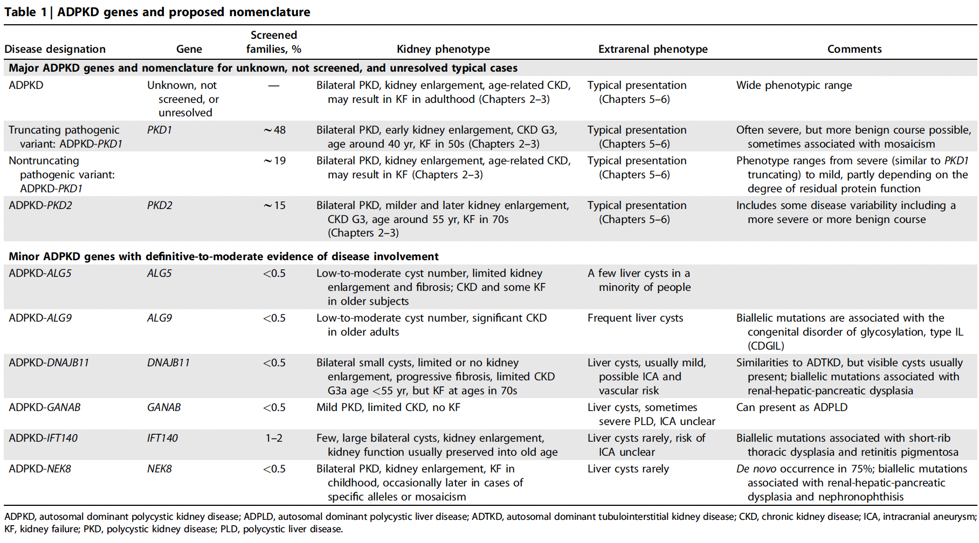
ADPKD Guidelines. KDIGO. 2025

Slide 34
Diagnosis
Kidney imaging by ultrasound remains the primary method for diagnosing ADPKD.
  Enlarged kidneys and the presence of multiple cysts throughout the kidney parenchyma
  Family history is important!
When disease status must be determined with certainty, CT or MRI should be pursued if ultrasound imaging is negative.
Genetic testing should also be considered in individuals under the age of 40 if imaging is negative, given that PKD2 disease appears later than PKD1 disease. If the mutation in the family is known and is a PKD1 mutation, then negative screening over the age of 30 is sufficient.

Slide 35
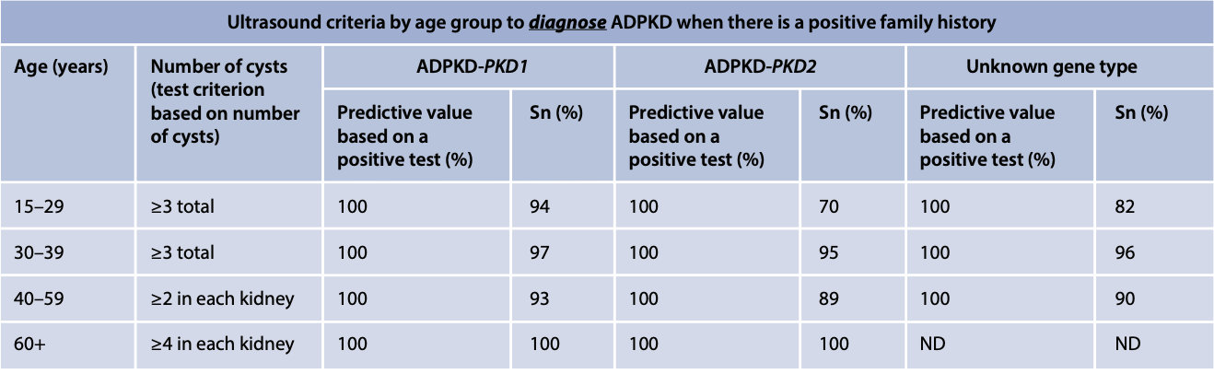
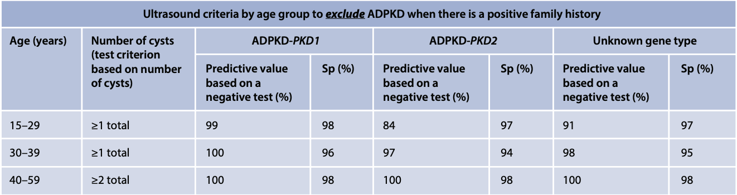
Diagnosis: US Criteria
ADPKD Guidelines. KDIGO. 2025

Slide 36
Diagnosis: Imaging in negative family history?
No stringent criteria
10 cysts (5 bilaterally)

Slide 37
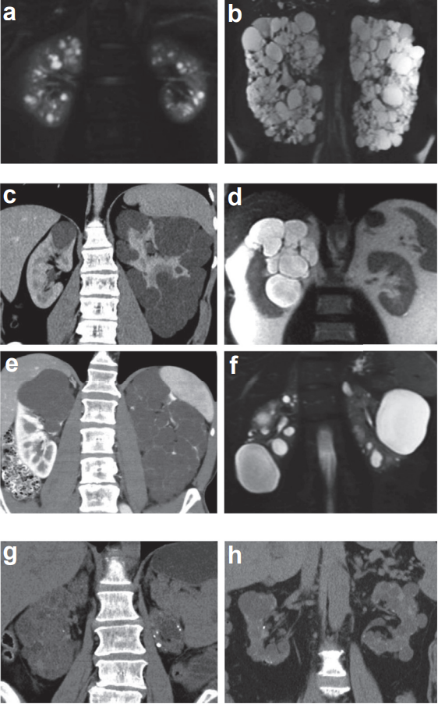
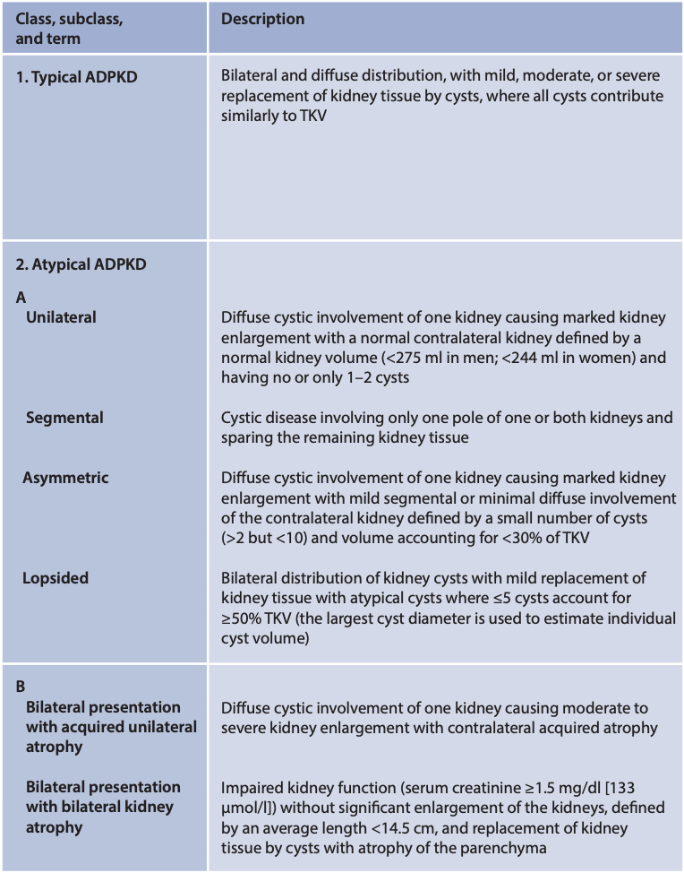
Typical vs. Atypical
Notes:
Figure 4 | Mayo Image Classification (MIC) and prognostic of autosomal dominant polycystic kidney disease (ADPKD). TKV, total kidney volume. Top: Principles of the MIC of (left panel) ADPKD, with examples (right panel) of MIC subclass (a) 1A and (b) 1E for typical ADPKD; and (c–f) MIC subclass 2A and (g,h) MIC subclass 2B for atypical ADPKD. Only the classification of typical ADPKD (subclass 1) has prognostic value.

Slide 38
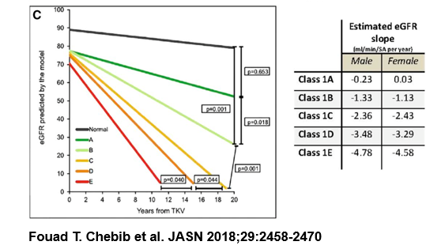
Mayo Imaging Classification (MIC)

Slide 39
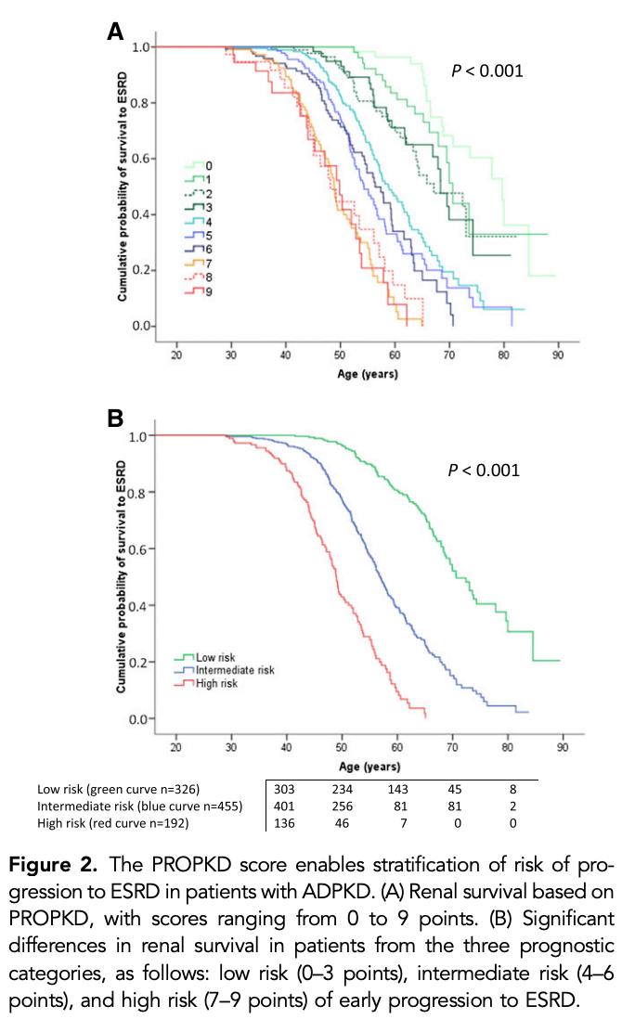
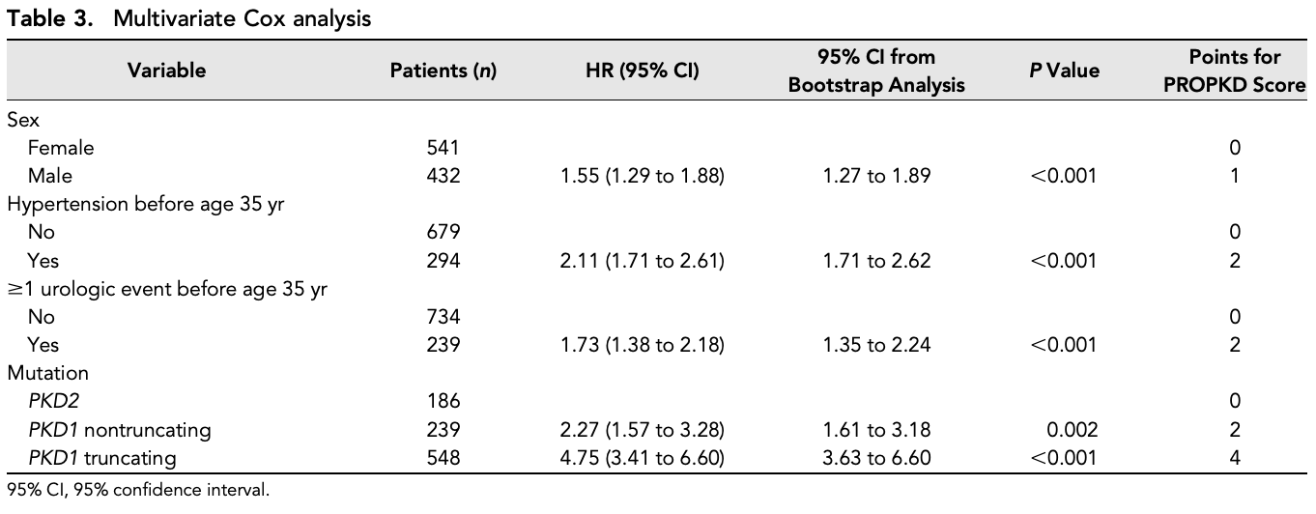
PRO-PKD Score
Cornec-Le Gall, et al. JASN. 2016
Notes:
PROPKD score (ranging from 0–9) is another validated prognostication tool for ADPKD that combines clinical parameters (sex, presence of hypertension before 35 years of age, occurrence of the first urologic event before 35 years of age) with genetic information (PKD1 versus PKD2 mutation, and truncating versus nontruncating PKD1 mutation). The PROPKD score categorizes patients into low risk (0 to 3 points), intermediate risk (4 to 6 points), and high risk (7 to 9 points) for progression to ESKD, with corresponding median ages for ESKD onset of 70.6, 56.9, and 49 years. This scoring system is limited in that individuals less than 35 years of age cannot be fully scored and genetic testing is required. It is currently unknown if the PROPKD score functions independently of HtTKV in prognostication as age of onset of complications are tightly linked to cyst burden or HtTKV.

Slide 40
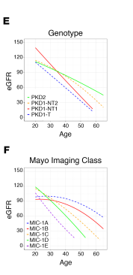
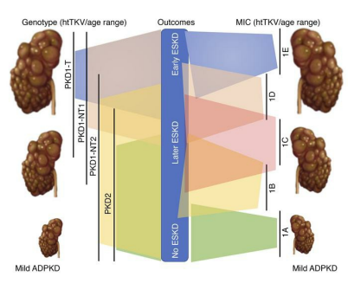
Genotyping and Imaging in ADPKD
Lavu, JCI insight, 2020

Slide 41
Clinical Manifestations
Kidney
Cardiovascular
Liver

Slide 42
Clinical Manifestations: Kidney
Hematuria
  Gross or microscopic, occurs in about 35% to 50% of patients and often precedes loss of kidney function. It is associated with increased TKV and with worse kidney outcomes. Hematuria can be precipitated by an acute event such as trauma, heavy exertion, cyst rupture, lower urinary tract infection, pyelonephritis, cyst infection, or nephrolithiasis.
  Dx on imaging
  Management: supportive
Urinary Tract Infection
  Pyelonephritis and kidney cyst infections can occur and may be challenging to differentiate. Patients with cyst infection commonly present with fever, abdominal pain, and, often, elevated C-reactive protein. Typically, blood cultures identify the offending pathogen more frequently than urine cultures.
  Treatment of cyst infections requires a prolonged, 4-week course of antibiotics that adequately penetrate into the cyst, such as quinolones, vancomycin, chloramphenicol, or trimethoprim-sulfamethoxazole.
  Recent reports have suggested that positron emission tomography with fluorodeoxyglucose (FDG-PET) may be a promising diagnostic tool for detecting infected cysts in challenging cases.
Nephrolithiasis
  5-10x higher for ADPKD patients, 25%
  Increased urinary stasis and metabolic disturbances, including hypocitraturia, low urinary pH, and abnormal renal transport of ammonium
  Most common stone: Uric Acid (50%) and calcium oxalate

Slide 43
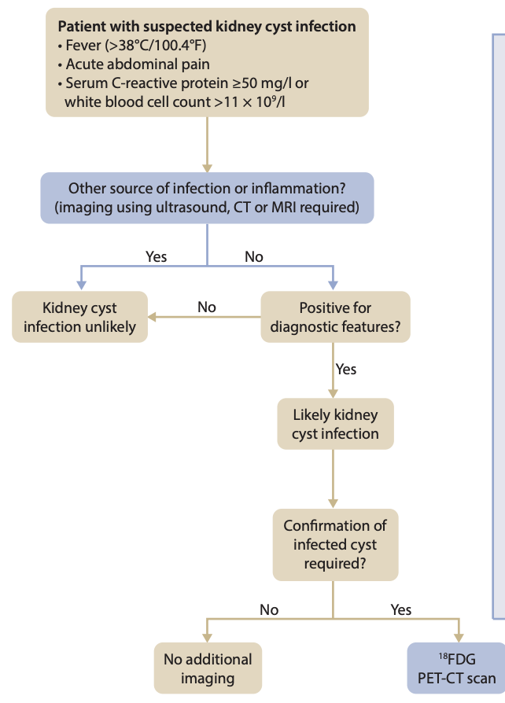
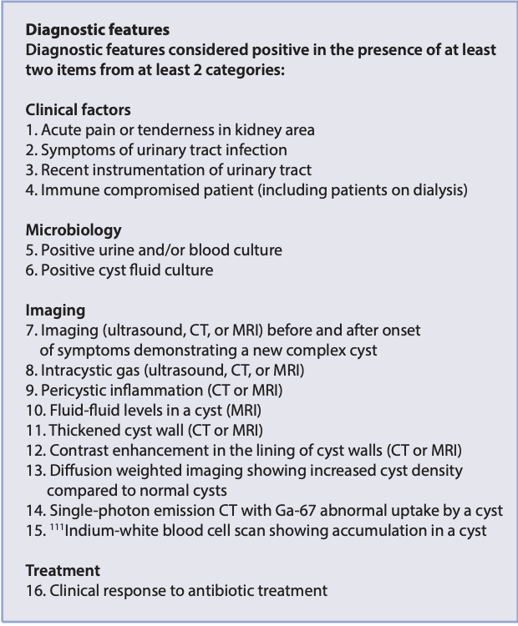
Infected Cyst?
ADPKD Guidelines. KDIGO. 2025
Notes:
Figure 5 | Diagnostic algorithm for an infected kidney cyst in autosomal dominant polycystic kidney disease. CT, computed tomography; 18FDG PET-CT, positron emission tomography with 18F-fluorodeoxyglucose integrated with computed tomography; Ga-67, Gallium-67; MRI, magnetic resonance imaging. Adapted from Lantinga et al. 15

Slide 44
Clinical Manifestations: Kidney
Increased thirst, polyuria, nocturia, and urinary frequency. A decrease in urinary concentrating ability is one of the earliest manifestations of ADPKD
  Approximately 60% of affected children demonstrated a decreased response to desmopressin, possibly because of disruption of tubular architecture and alterations in principal cell function.
Proteinuria
  Typically mild, <300mg
  Although the level of proteinuria is low-grade in ADPKD, the presence of proteinuria and albuminuria is associated with increased TKV and more rapid decline in kidney function.

Slide 45
Clinical Manifestations: Cardiovascular
Hypertension
  Precedes diagnosis of ADPKD in ~30% of cases (onset ~29 years old)
  Associated with greater rate of TKV enlargement
  Intrarenal arteriolar tapering causing reduction in renal blood flow leading to ischemia and RAAS activation
Cerebral Aneurysms
Other: Coronary aneurysms, valvular heart disease including mitral valve prolapse and mitral regurgitation (26% of ADPKD individuals, compared with 3% of the general population), and aortic insufficiency (11%)

Slide 46
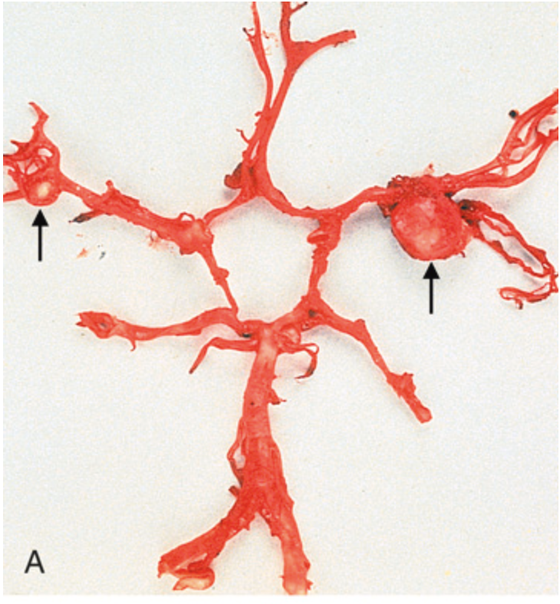
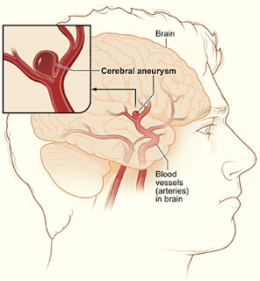
Clinical Manifestations: Cerebral Aneurysms
High risk
  General Population: 3%
  ADPKD: 10-12%
  Family History: 18-22%
Screening
  Family history of aneurysm, CVA/TIA, hemorrhage
  Neurologic symptoms
  High risk occupation (i.e. pilots)
  Surgery (i.e. transplant)
  *anyone who wants one
Follow-up*:
  < 7mm – assess for stability (recommended 6-12 months and progress out). Further follow-up not specified
  Negative Screen with Positive History – repeat every 5-10 years
  Onset of symptoms
Intervention:
  < 5mm – if no significant growth, risk of rupture relatively small
  5-10mm, asymptomatic – discussion with neuro-interventionalist
  > 10mm – intervention
Risk factors for aneurysmal growth including smoking and HTN

Slide 47
Clinical Manifestations: GI
Symptoms often due to compression
  Nausea, vomiting, constipation
Polycystic Liver Disease
  Liver cysts are the most common extrarenal manifestation in ADPKD. Liver cysts occur in more than 80% of patients by the age of 30
  Previous estrogen or progesterone exposure, through birth control pills, hormone replacement therapy, or pregnancy, is associated with significant polycystic liver disease.
  Liver function is preserved even in the presence of massive liver cystic disease, and standard biochemical tests are normal except for mild elevation in the serum concentration of alkaline phosphatase.
Pancreatic Cysts

Slide 48
Liver Cyst Development
Liver cysts arise by excessive proliferation and dilation of biliary ductules and peribiliary glands. Estrogen receptors, insulin-like growth factor 1 (IGF-1), IGF-1 receptors, and growth hormone receptors are expressed in the epithelium lining the hepatic cysts, and estrogens and IGF-1 stimulate hepatic cyst–derived cell proliferation. Cyst growth is also promoted by growth factors and cytokines secreted into the cyst fluid.

Slide 49
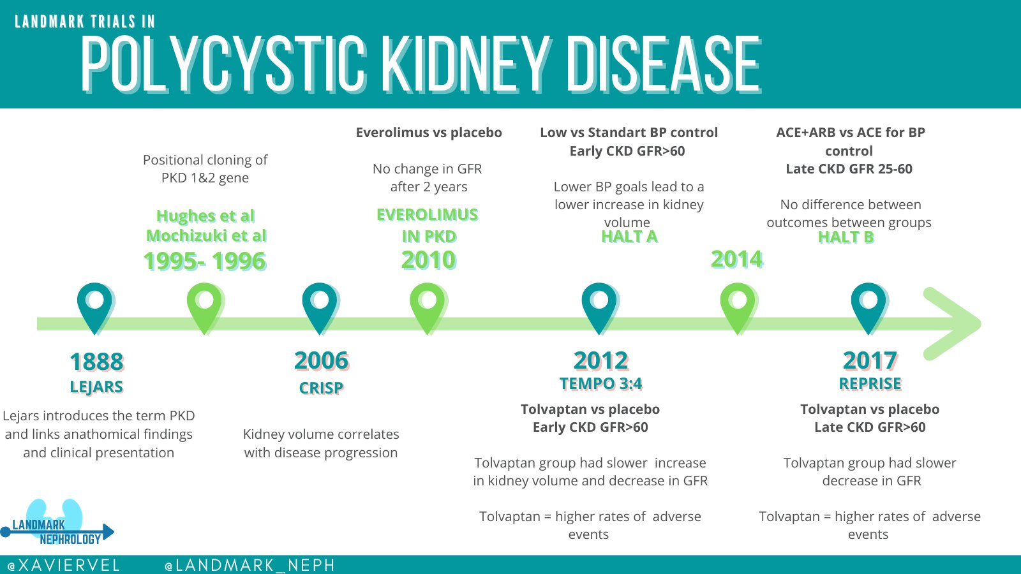
Trials

Slide 50
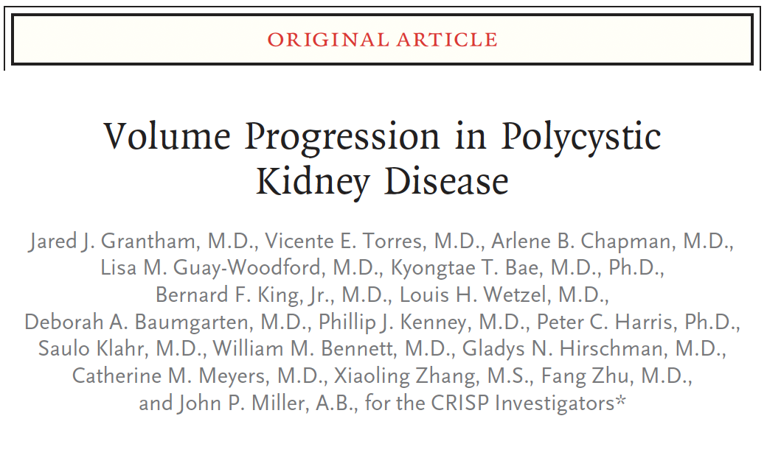
CRISP
Kidney Volumes correlate with disease progression
In the Consortium for Radiologic Imaging in the Study of Polycystic Kidney Disease (CRISP), a large multicenter study of 241 ADPKD patients with intact kidney function, patients were followed prospectively with serial MRIs and demonstrated a 5.2%/year increase in TKV.
More recently, data from the CRISP study showed that height-adjusted total kidney volume (HtTKV) of greater than 600 mL/m accurately predicts progression to CKD stage 3 within 8 years. For each 100 mL/m change in HtTKV, there was a 48% relative risk of reaching CKD stage 3. Therefore, TKV is a good predictive biomarker for the development of future GFR loss, with potential application for risk stratification in clinical practice.
Notes:
Total kidney volume (TKV) incorporates all of the aforementioned clinical and genetic risk factors and is the strongest predictor of future GFR loss.
In the Consortium for Radiologic Imaging in the Study of Polycystic Kidney Disease (CRISP), a large multicenter study of 241 ADPKD patients with intact kidney function, patients were followed prospectively with serial MRIs and demonstrated a 5.2%/year increase in TKV.
More recently, data from the CRISP study showed that height-adjusted total kidney volume (HtTKV) of greater than 600 mL/m accurately predicts progression to CKD stage 3 within 8 years. For each 100 mL/m change in HtTKV, there was a 48% relative risk of reaching CKD stage 3. Therefore, TKV is a good predictive biomarker for the development of future GFR loss, with potential application for risk stratification in clinical practice.

Slide 51
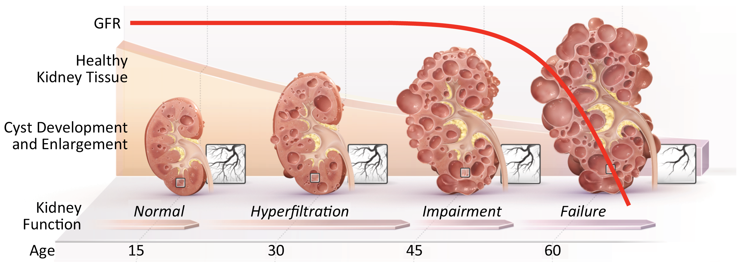
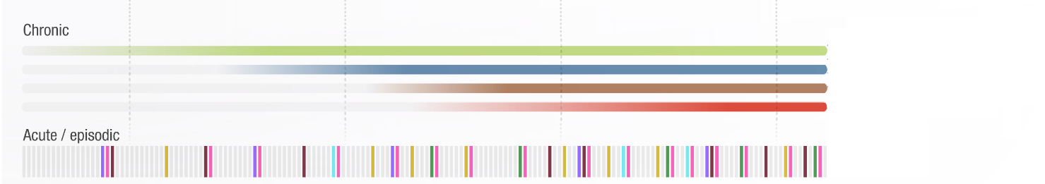
CRISP
Concentrating Defects
Hypertension
Dull Pain & Discomfort
Proteinuria
Adapted from Grantham JJ, et al. N Eng J Med 2006; 354(20):2122-30.

Slide 52
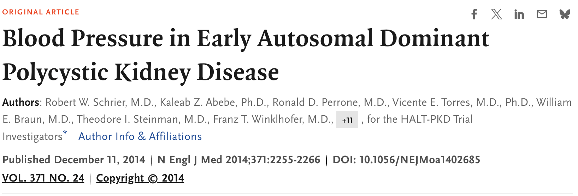
HALT-PKD A
HALT-PKD trial showed that in young patients (15 to 49 years) with preserved kidney function, treatment with inhibitors of the RAAS with a goal blood pressure of <110/75 mmHg resulted in a 14.2% slower increase in TKV over 5 years, reduced urinary albumin excretion, and a greater decline in left ventricular mass index. The overall rate of decline in estimated GFR (eGFR) in the strict and the standard blood pressure group was similar overall but slower in the lower blood pressure group during the chronic phase of the 5-year study.
Notes:
HALT-PKD trial showed that in young patients (15 to 49 years) with preserved kidney function, treatment with inhibitors of the RAAS with a goal blood pressure of <110/75 mmHg resulted in a 14.2% slower increase in TKV over 5 years, reduced urinary albumin excretion, and a greater decline in left ventricular mass index. The overall rate of decline in estimated GFR (eGFR) in the strict and the standard blood pressure group was similar overall but slower in the lower blood pressure group during the chronic phase of the 5-year study.

Slide 53
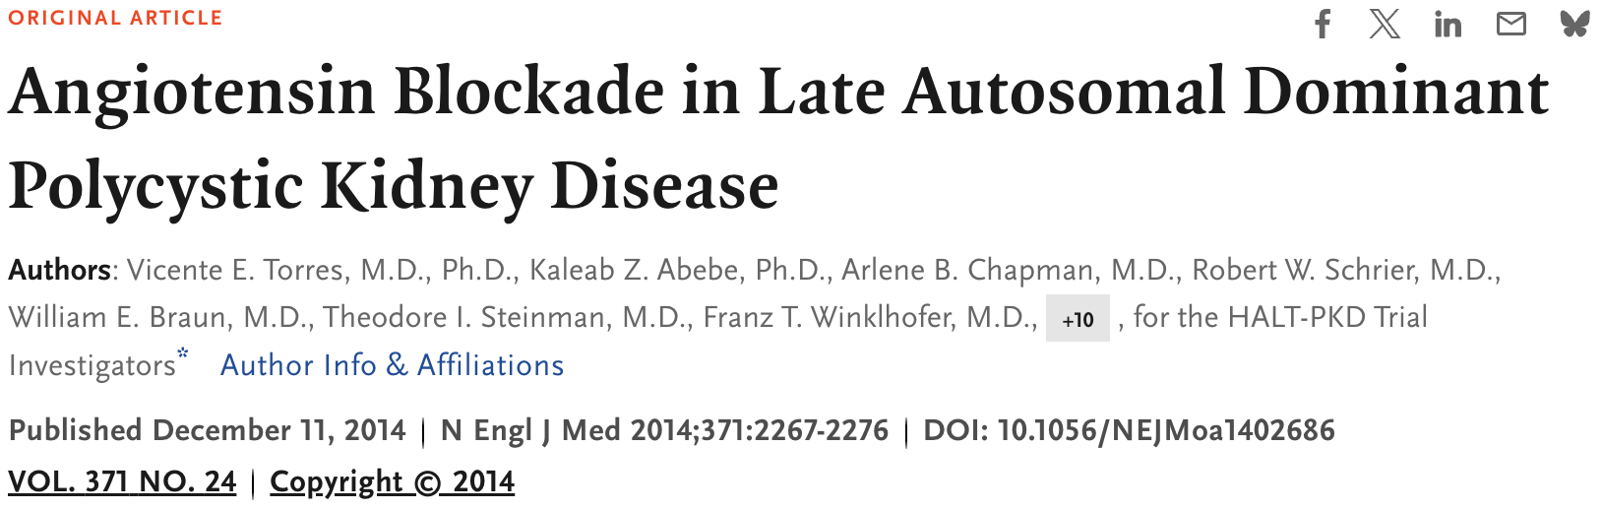
HALT-PKD B
Double-blind, placebo-controlled trial, we randomly assigned 486 patients, 18 to 64 years of age, with ADPKD (estimated glomerular filtration rate [GFR], 25 to 60 ml per minute per 1.73 m2 of body-surface area) to receive an ACE inhibitor (lisinopril) and placebo or lisinopril and an ARB (telmisartan), with the doses adjusted to achieve a blood pressure of 110/70 to 130/80 mm Hg. The composite primary outcome was the time to death, end-stage renal disease, or a 50% reduction from the baseline estimated GFR. Secondary outcomes included the rates of change in urinary aldosterone and albumin excretion, frequency of hospitalizations for any cause and for cardiovascular causes, incidence of pain, frequency of ADPKD-related symptoms, quality of life, and adverse study-medication effects. Patients were followed for 5 to 8 years.
Monotherapy with an ACE inhibitor was associated with blood-pressure control in most patients with ADPKD and stage 3 chronic kidney disease. The addition of an ARB did not alter the decline in the estimated GFR.

Slide 54
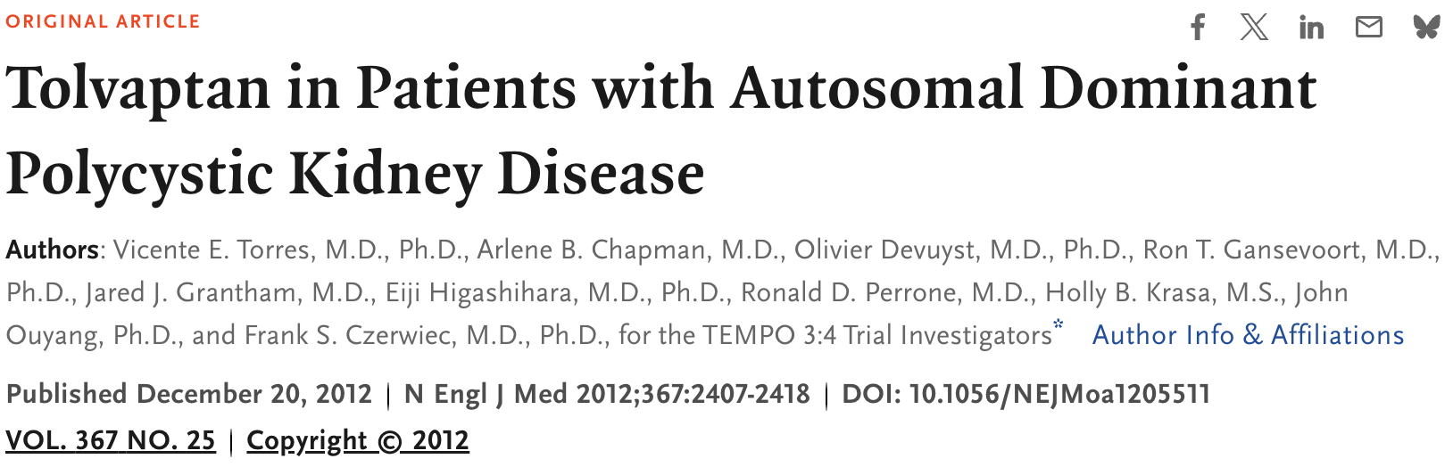
TEMPO 3:4
Tolvaptan Efficacy and Safety Management of Autosomal Dominant Polycystic Kidney Disease and Its Outcomes (TEMPO) 3 : 4 trial is a phase 3, randomized, double-blind, placebo-controlled trial. Among 1445 participants over 3 years of follow-up, the tolvaptan-treated group had a slower rate of kidney volume growth (2.8% vs. 5.5%/year). The slope of kidney function decline, measured as the reciprocal of the serum creatinine, also favored tolvaptan therapy. Tolvaptan also showed a beneficial effect on kidney pain and frequency of urinary tract infections.
Notes:
Tolvaptan Efficacy and Safety Management of Autosomal Dominant Polycystic Kidney Disease and Its Outcomes (TEMPO) 3 : 4 trial is a phase 3, randomized, double-blind, placebo-controlled trial. Among 1445 participants over 3 years of follow-up, the tolvaptan-treated group had a slower rate of kidney volume growth (2.8% vs. 5.5%/year). The slope of kidney function decline, measured as the reciprocal of the serum creatinine, also favored tolvaptan therapy. Tolvaptan also showed a beneficial effect on kidney pain and frequency of urinary tract infections.

Slide 55
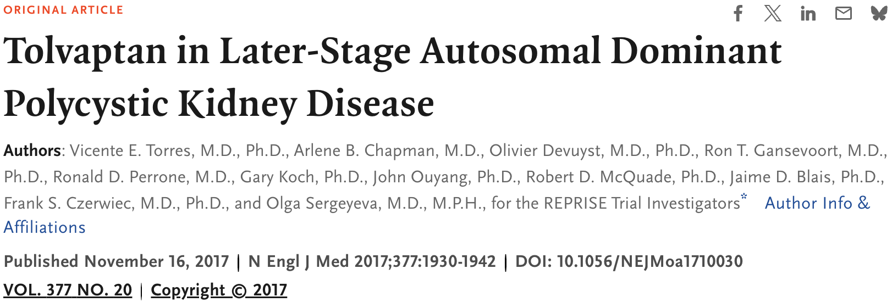
REPRISE
Replicating Evidence of Preserved Renal Function: An Investigation of Tolvaptan Safety and Efficacy in ADPKD (REPRISE trial) was subsequently conducted in 1370 patients aged 18–65 with eGFRs between 25 and 65 mL/min/1.72 m2 and showed similar protective effects; at 12 months, the change from baseline eGFR was lower among those assigned tolvaptan compared with placebo (–2.34 versus –3.61 mL/min/1.73 m2).
Notes:
Replicating Evidence of Preserved Renal Function: An Investigation of Tolvaptan Safety and Efficacy in ADPKD (REPRISE trial) was subsequently conducted in 1370 patients aged 18–65 with eGFRs between 25 and 65 mL/min/1.72 m2 and showed similar protective effects; at 12 months, the change from baseline eGFR was lower among those assigned tolvaptan compared with placebo (–2.34 versus –3.61 mL/min/1.73 m2).

Slide 56
Indications for Tolvaptan
Mayo classes 1C, 1D, or 1E
Age ≤ 55 years and an eGFR <65 mL/min/1.73 m2
Kidney length (by ultrasound, MRI, or CT) >16.5 cm in a patient aged <50 years
PROPKD score >6
A documented annual decline rate of greater than 2.5 mL/min/ 1.73 m2/year over a 6-month period without any other causes for kidney injury.

Slide 57
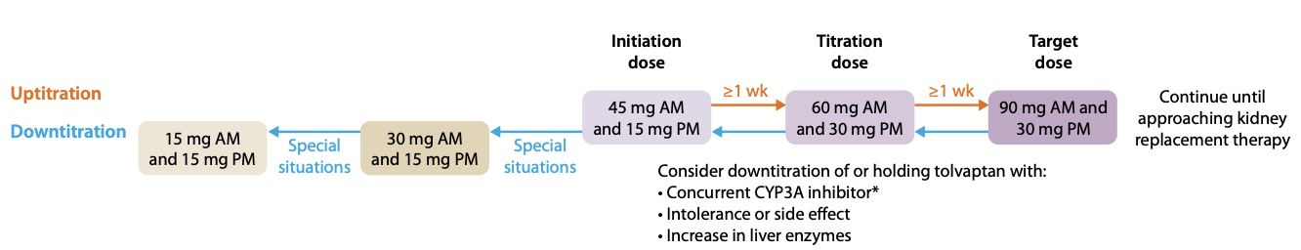
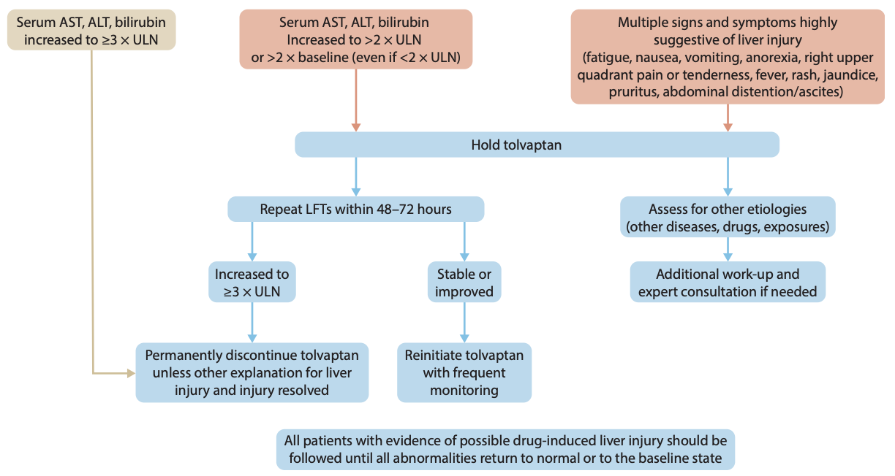
Recommendation 4.1.1.1: We recommend initiating tolvaptan treatment in adults with ADPKD with an estimated glomerular filtration rate (eGFR) ‡25 ml/min per 1.73 m2 who are at risk for rapidly progressive disease (Figure 25) (1B).
ADPKD Guidelines. KDIGO. 2025
Notes:
Figure 6 | Commencement of and titration approach to tolvaptan use in autosomal dominant polycystic kidney disease. * Examples of strong cytochrome P450, family 3, subfamily A (CYP3A) inhibitors (reduce clearance by >80%) are as follows: antifungals (itraconazole, ketoconazole); antibiotics (clarithromycin); and protease inhibitors (saquinavir, atazanavir, darunavir, indinavir, lopinavir, nelfinavir, ritonavir, tipranavir). Examples of moderate CYP3A inhibitors (reduce clearance by 50%–80%) are as follows: antiarrhythmics (amiodarone); antifungals (fluconazole); antibiotics (erythromycin); calcium-channel blockers (diltiazem, verapamil); protease inhibitors (amprenavir, fosamprenavir); and complementary and/or dietary agents, such as grapefruit juice (240 ml coadministration).
Figure 7 | Algorithm summarizing recommendations for evaluation and management of potential tolvaptan-induced liver injury. ALT, alanine transaminase; AST, aspartate aminotransferase; LFT, liver function test; ULN, upper limit of normal. Reproduced from Chebib et al.21

Slide 59
Autosomal Recessive Polycystic Kidney Disease (ARPKD)
Prevalence:
  1:20,000
Genetic:
  Autosomal Recessive
  PKHD1 (Ch 6p21.1) Fibrocystin
Pathogenesis:
  Kidney cystic disease is a result of fusiform dilation of renal collecting tubules
  Up to 90% of tubules are involved are diffuse and continue to retain their connection to parent nephron
Presentation:
  Intra-utero, Potter Sequence
  Most have severely enlarged kidneys perinatally with poor cortico-medullary differentiation
  Fibrocystic kidney and liver involvement
Treatment:
  Hypertension

Slide 60
Pathophysiology ARPKD
Gene encodes for a protein product called fibrocystin (also known as polyductin). Itis expressed primarily in the renal collecting ducts and ascending loop of Henle as well as biliary epithelial and pancreatic epithelial cells
Function of fibrocystin remains to be fully elucidated but, similar to other proteins involved in kidney cystic diseases, it has been localized to the basal body and primary cilia.
Notes:
Homozygous mutations that predict immediate stop codons or truncated proteins lead to the most severe phenotype and are associated with increased perinatal mortality. Most patients are compound heterozygotes having two missense mutations. Mutations tend to be unique to each pedigree. Importantly, there is significant variability in the severity of kidney disease among patients carrying the same PKHD1 mutation within the same family, suggesting that modifier genes and environmental factors may play contributory roles. The use of PKHD1 sequencing data for clinical decision making or prenatal counseling is currently limited.
ARPKD typically begins in utero, and the kidney cystic lesion appears to be superimposed on a normal developmental sequence. The tubular abnormality involves nonobstructive, fusiform, and/or saccular dilation of the kidney collecting ducts. In the liver, defective remodeling of the ductal plate in utero results in persistence of primitive bile duct configurations and the evolution of progressive portal tract fibrosis. 5 The remainder of the liver parenchyma develops normally. The defect in ductal plate remodeling is accompanied by abnormalities in the branching of the portal vein. The resulting histopathologic pattern is referred to as congenital hepatic fibrosis.
ARPKD is one of several kidney cystic diseases that are associated with congenital hepatic fibrosis, prompting these disorders to be described as hepatorenal fibrocystic diseases. 6 The primary cilium appears to play a central role in the pathogenesis of ARPKD and other hepatorenal fibrocystic diseases, so the broader term “ciliopathies” is used for these disorders, in which dysfunction of the cilia-centrosome complex appears to underpin the development of a wide array of phenotypes, including kidney cystic disease.

Slide 61
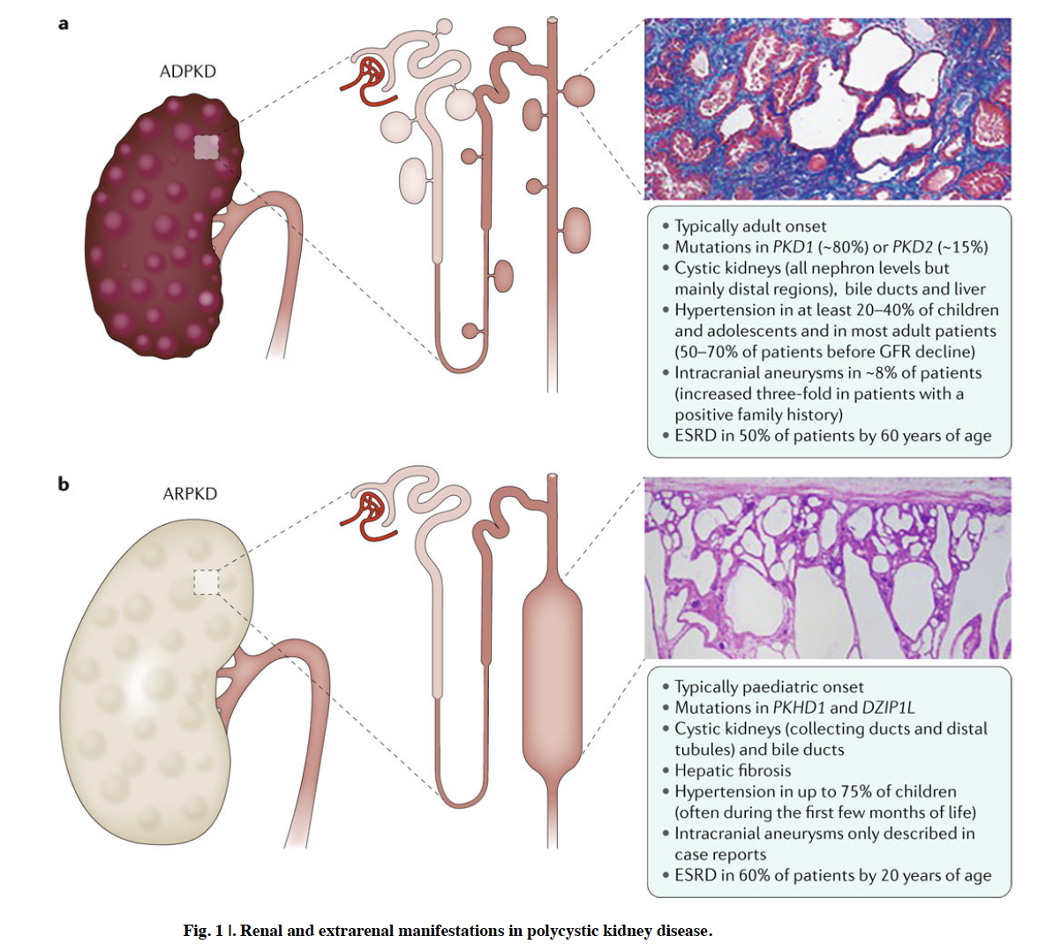
Bergmann, C.; et al.
Notes:
kidney cystic disease is a result of fusiform dilatation of renal collecting tubules. Up to 90% of collecting tubules are involved and, unlike ADPKD cysts, are diffuse, and continue to retain their connection to the parent nephron.

Slide 62
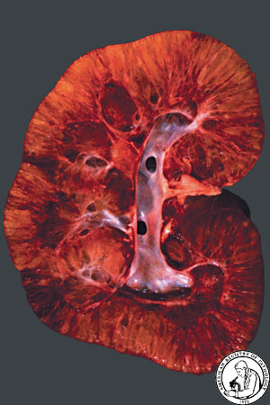
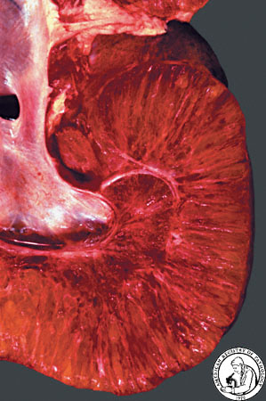

Slide 63
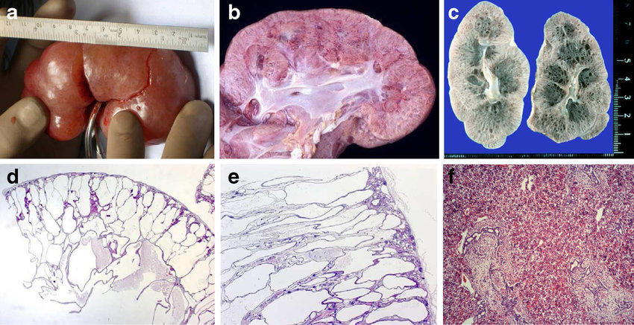
Notes:
Cut sections resemble a sponge
Radially oriented cysts replacing the cortex
Rounded cysts replacing the medulla
Cysts are dilated collecting ducts
Number of nephrons are normal, although appear decreased due to separation by dilated collecting ducts and edematous interstitium

Slide 64
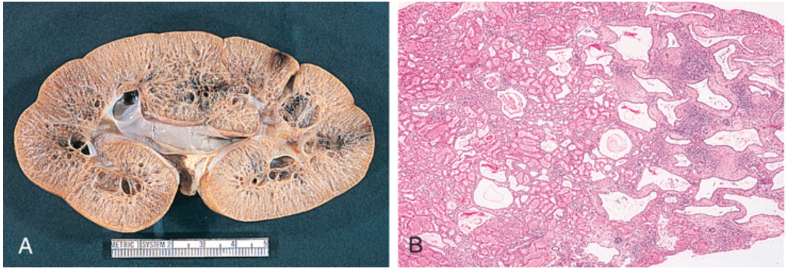
Notes:
FIG. 47.2 Pathologic Features of Autosomal Recessive Polycystic Kidney Disease.(A) Cut section of autosomal recessive polycystic kidney disease (ARPKD) kidney from a 1-year-old child shows discrete medullary cysts and dilated collecting ducts. (B) Light microscopy shows later-onset ARPKD kidney with prominent medullary ductal ectasia (H&E stain; magnification ×10). (C) Light microscopy of congenital hepatic fibrosis shows extensive fibrosis of the portal area with ectatic, tortuous bile ducts and hypoplasia of the portal vein (H&E stain; ×40).

Slide 65
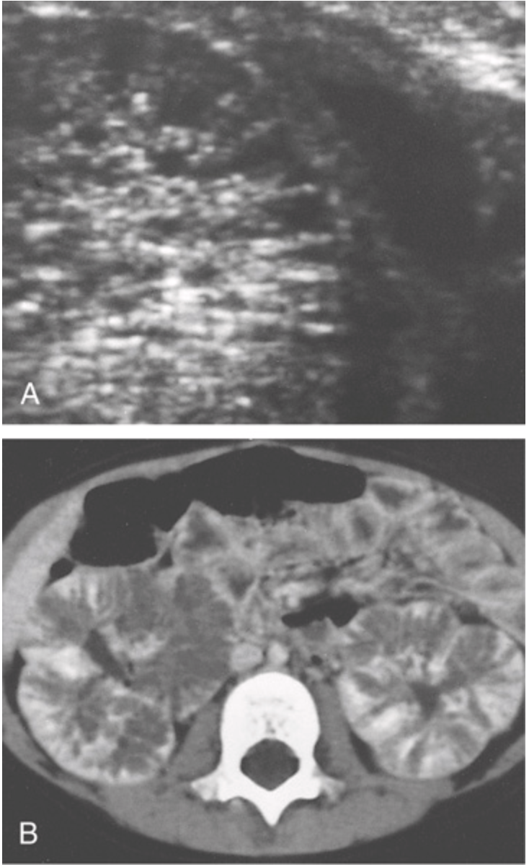
Notes:
FIG. 47.3 Radiologic Findings Associated With Autosomal Recessive Polycystic Kidney Disease.(A) Autosomal recessive polycystic kidney disease (ARPKD) in a neonate. High-resolution ultrasound reveals radially arrayed dilated collecting ducts. (B) ARPKD in a symptomatic 4-year-old girl. Contrast-enhanced computed tomography shows striated nephrogram and prolonged corticomedullary differentiation.

Slide 66
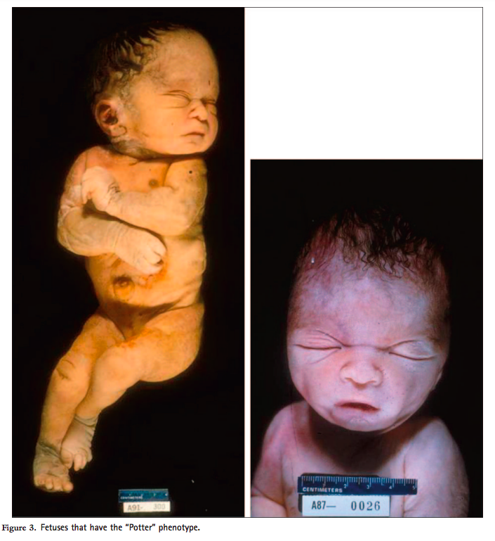
Potter Sequence
Low urine output leads to low amniotic fluid called oligohydramnios (low + fluid + amnion) leading to compression of developing fetus and limb/facial deformities, facial anomalies (eg. low-set ears and retrognathia, flattened nose). Lack of amniotic fluid aspiration into fetal lungs -> pulmonary hypoplasia (cause of death).
Pulmonary hypoplasia
Oligohydramnios (trigger)
Twisted face
Twisted skin
Extremity defects
Renal failure (in utero)
Caused by chronic placental insufficiency or reduced fetal urine output (ARPKD), obstructive uropathy (posterior urethral valves), bilateral renal agenesis

Slide 67
Disease Characteristics | ADPKD | ARPKD
Inheritance pattern | Autosomal dominant | Autosomal recessive
Risk of sibling being affected | 50% | 25%
Associated genes | PKD1, PKD2 | PKHD1
Associated proteins | PC1, PC2 | Fibrocystin
Expected age of presentation | Adolescent or adult | Neonate or infant
Ultrasound findings | Macroscopic renal cysts, asymmetric in distribution | Enlarged echogenic kidneys, dilated tubules Often seen on prenatal US
Progression to ESKD | Lifetime risk of 50% | If survival to adulthood, lifetime risk of >60%
Renal features | Corticomedullary cysts | Dilation of the collecting ducts, oliguria
Associated organ systems | Hepatic cysts Pancreatic cysts Intracranial aneurysms | Pulmonary hypoplasia Congenital hepatic fibrosis, biliary duct dilatation, portal HTN

Slide 68
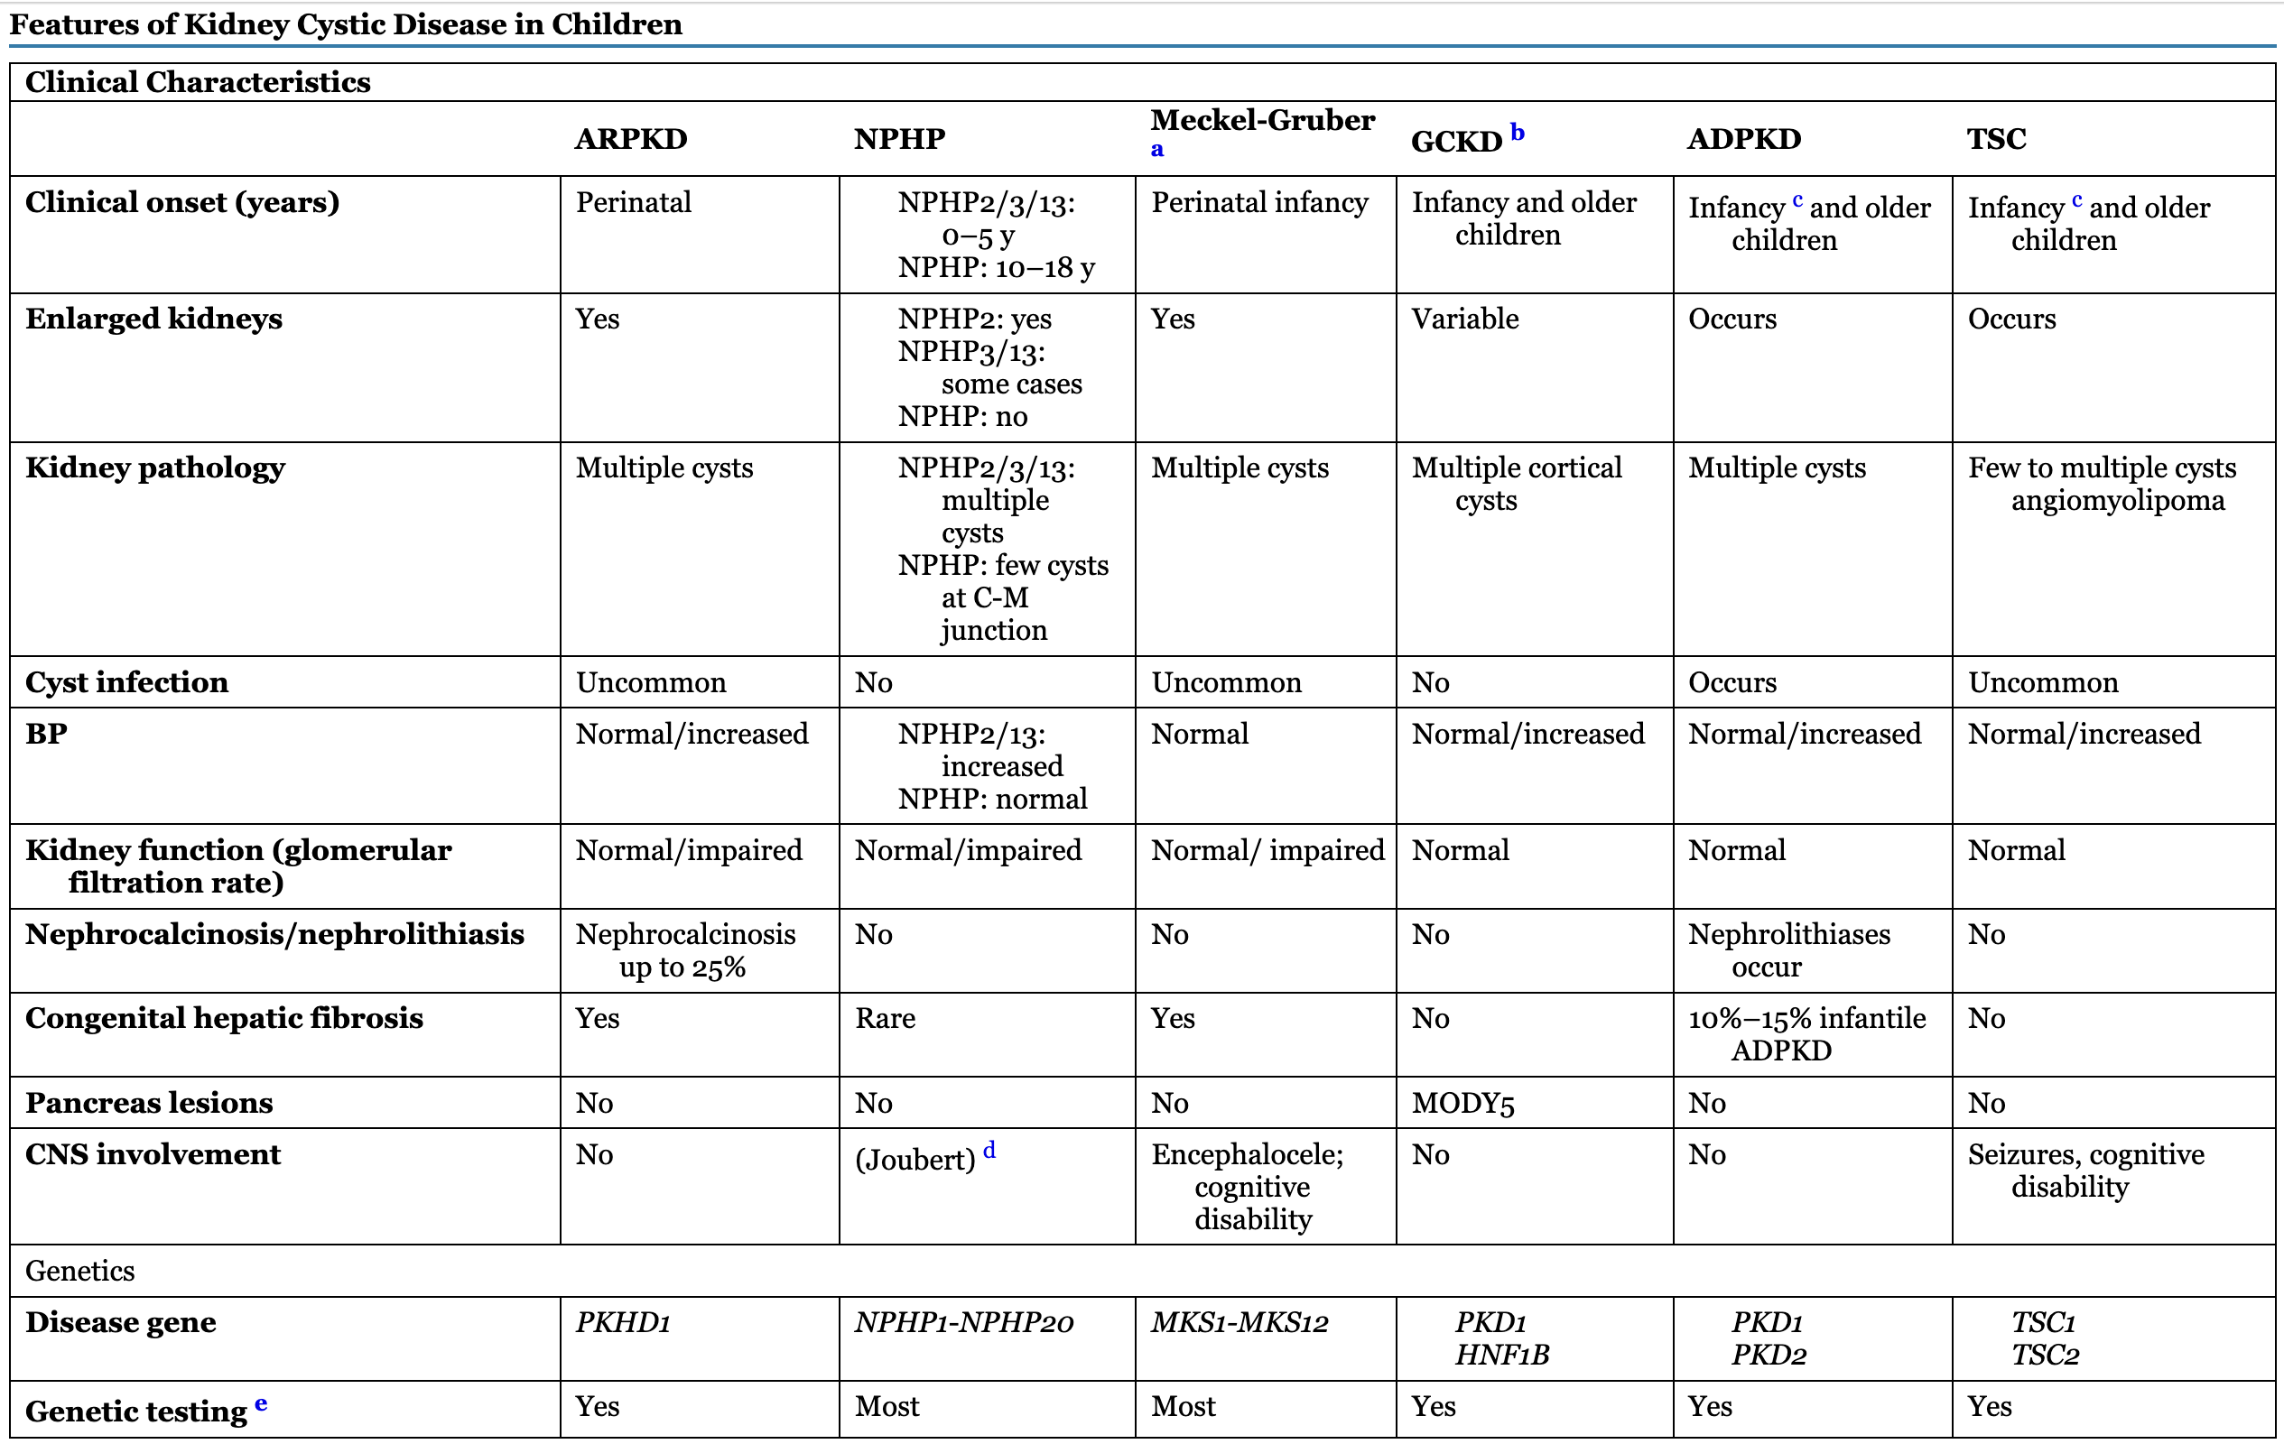
Notes:
ADPKD, Autosomal dominant polycystic kidney disease; BP, blood pressure; C-M, corticomedullary; CNS, central nervous system; GCKD, glomerulocystic kidney disease; MODY5, maturity-onset diabetes of the young, type 5; NIH, National Institutes of Health; NPHP, nephronophthisis; PKDTS, polycystic kidney disease with tuberous sclerosis; TSC, tuberous sclerosis complex.
a Meckel-Gruber syndrome is a severe, often lethal, autosomal recessive disorder characterized by bilateral kidney cystic dysplasia, biliary ductal dysgenesis, bilateral postaxial polydactyly, and variable CNS malformations. The triad of kidney cystic disease, occipital encephalocele, and polydactyly is most common. Genes disrupted in Meckel-Gruber syndrome have also been identified in NPHP and Joubert patients, suggesting a phenotypic spectrum.
b GCKD can occur as the infantile manifestation of ADPKD. Familial hypoplastic GCKD, because of mutations in HNF1B, the gene encoding hepatocyte nuclear factor (HNF1β), can be associated with MODY5.
c A contiguous germline deletion of both the PKD1 and TSC2 genes (the PKDTS contiguous gene syndrome) occurs in a small group of patients with features of TSC, as well as massive kidney cystic disease reminiscent of ADPKD, severe hypertension, and a progressive decline in kidney function with the onset of ESKD in the second or third decade of life.
d Joubert syndrome is a genetically heterogeneous, autosomal recessive disorder characterized by developmental defects in the cerebellum (cerebellar vermis aplasia) and the eye (coloboma), as well as retinitis pigmentosa, congenital hypotonia, and either ocular motor apraxia or irregularities in breathing patterns during the neonatal period. The disease can be associated with NPHP, and mutations in several NPHP genes have been described in Joubert patients.
e Genetic testing listed on the NIH Genetic Testing Registry (http://www.ncbi.nlm.nih.gov/gtr).

Slide 69
Other Cystic Diseases

Slide 70
Common pathogenesis of TSC, VHL, and BHD involves the inheritance of one copy of the mutated autosomal dominant gene (i.e., germline mutation) followed by somatic mutation of the normal gene copy later in life.
Germline mutation associated with hereditary tumor syndromes:
TSC: TSC1 or TSC2 (or both) encoding hamartin and tuberin, respectively
VHL: VHL, encoding VHL protein
BHD: FLCN, encoding folliculin
Somatic mutation of the normal gene copy that occurs later in life gives rise to the full phenotypic presentation associated with the inherited germline mutation.

Slide 71
TSC

Slide 72
What is Tuberous Sclerosis Complex
Monogenic multisystem disorder characterized by benign tumor formation in multiple organ systems (brain, skin, lungs, heart, and kidney).
  Despite a common genetic etiology, composition and timing of lesion formation varies widely across affected tissues
Inheritance Pattern:
  Autosomal dominant disorder (1/3)
    50/50 chance of passing along to child if 1 parent is affected.
  Sporadic (2/3)
Incidence: 1:6,000-10,000 births
Prevalence: >1 million worldwide
Across all racial and ethnic groups

Slide 73
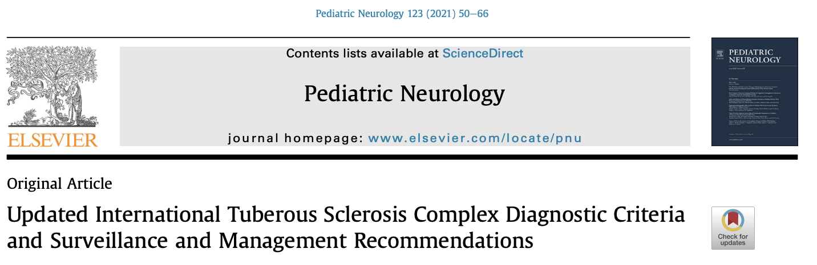




TSC Alliance
for Healthcare
Professionals
Images used from google search

Slide 74
Notes:
PC1 is located in the primary cilium, focal adhesions, tight junctions, desmosomes, and adherens junctions. PC1 plays an important role in cell-cell interactions and cell-matrix interactions.
It localizes to the endoplasmic reticulum, plasma membrane, primary cilium, centrosome, and mitotic spindles in dividing cells. PC2 belongs to the family of voltage-activated calcium channels (e.g., transient receptor potential polycystin-2 [TRPP-2]) and is involved in intracellular calcium regulation through several pathways
PC1 and PC2 are co-localized in the primary cilium of renal epithelial cells, which function as a mechanosensor. Primary cilia create transmembrane calcium currents in the presence of stretch or luminal flow. PC1 and PC2 contribute to ciliary function, and the physical interaction between PC1 and PC2 is required for a membrane calcium channel to operate properly. Normal polycystin function increases intracellular calcium, which initiates a signaling cascade leading to vesicle fusion and a change in gene transcription. The magnitude of these changes contributing to the PKD epithelial phenotype has recently been challenged because the reservoir of calcium released from primary ciliary stimulation is relatively low.
Polycystins affect cell proliferation, differentiation, and fluid secretion through G-coupled protein receptors and JAK-STAT-mediated signaling pathways. The interaction of PC1 ligand on the basolateral surface with adenylate cyclase and the G protein–coupled response of adenylate cyclase to binding of vasopressin to the vasopressin V2 receptor produces similar results. Both result in increased intracellular concentrations of cyclic adenosine monophosphate (cAMP) and, ultimately, in chloride secretion across the luminal membrane. This chloride-rich fluid secretion is a critical component of cystogenesis, enabling expansion of cysts even after they detach from their parent nephron. The accumulation of cyst fluid, rich in chloride and sodium, relies on the active luminal excretion of chloride primarily through the cystic fibrosis transmembrane conductor regulator (CFTR)

Slide 75

Second Hit Hypothesis
While initial germline inactivation of single TSC1 or TSC2 alleles may be sufficient to cause some syndrome features, tumor growth requires additional somatic mutation of the remaining normal allele (second hit). The loss of this heterozygosity via gene conversion or acquisition of compound heterozygous gene mutations has been identified in a wide variety of TSC associated tumors – Kidney lesions
Pietrobon A et al, TSC Kidney Lesion Pathogenesis, JASN 2023

Slide 76

Pietrobon A et al, TSC Kidney Lesion Pathogenesis, JASN 2023

Slide 77
Kidney Manifestations
Kidney contributes to one of the leading causes of mortality
Renal manifestations more prominent in TSC2

Slide 78

Kidney Manifestations
Kidney contributes to one of the leading causes of mortality
Renal manifestations more prominent in TSC2
Types
  Angiomyolipoma
Pietrobon A et al, TSC Kidney Lesion Pathogenesis, JASN 2023

Slide 79

Angiomyolipoma (AML)
Prevalence is > 10 million people world-wide
  Approximately 1/10th are associated with TSC or Lymphangioleiomyomatosis (LAM)
  Affects up to 80% in TSC and 60% of Sporadic LAM
  Genetic associations: Multiple, bilateral, younger age of onset (~10 years old), size
    Not usually detectable prior to school age. Rapid growth during pre-adolescence and adolescence
    Increasing incidence with age
    Female favored, estrogen sensitive*
Kingswood JC et al, Renal Manifestations TSC TOSCA, Front Neuro 2020

Slide 80
Angiomyolipoma (AML)
Perivascular Epithelioid Cell tumor (PEComas) family that exhibit both smooth muscle and melanocytic differentiation
  Imaging: Solid masses
  Histologically contain abnormal blood vessel wall architecture surrounded by smooth muscle-like perivascular cells and adipocyte-like cells
Classic, Typical, or “Triphasic” Variant
  Contain all 3 components are various degrees. Such lesions typically do not behave as a malignant lesion
  Predominant type
  Skew toward 1-2/3 lineage
Atypical, Fat-poor/invisible, or Epithelioid
  Exhibit significant mitotic activity with few or no abnormal vessels or fat cells.
  Potential to show aggressive behavior, lesion recurrence after resection.
  Sometimes may be difficult to differentiate from RCC

Slide 81








Slide 82

Angiomyolipoma (AML)
Complications
  Increased risk of bleeding:
    Hypervascular types
    >4cm lesions
    aneurysms >5mm
  Invading adjacent renal parenchyma
Kingswood JC et al, Renal Manifestations TSC TOSCA, Front Neuro 2020

Slide 83



Vascular Abnormalities with TSC
Chronic mTOR hyperactivity in smooth muscle cells can lead to the development of aneurysms by typical TSC pathologic features such as aortic wall thickening, SMC proliferation, and loss of elastin fibers.¹
  Specific deletion of TSC1 in mice¹
  Individual reports in patients²
Vascular phenotype that could be rescued by treating the mice with rapamycin
Similar mechanisms thought to contribute to microaneurysms of AMLs with response to mTOR
1
¹Li G., et al, Chronic mTOR Activation in SMC phenotype, JCI 2020
²Hedin U., et al, Resolving Biologic Paradox, JVS Vasc Sci 2021
Yamakado K., et al, Renal AML: Relationships, Radiology 2002

Slide 84
Kidney Manifestations
Kidney contributes to one of the leading causes of mortality
Renal manifestations more prominent in TSC2
Types
  Angiomyolipoma
  Cystic Diseases
Pietrobon A et al, TSC Kidney Lesion Pathogenesis, JASN 2023

Slide 85

Renal Cysts
Prevalence up to 50% of patients
Predominant kidney finding in early pediatric population
More prominent in TSC2 mutations
Contiguous Gene Syndrome
  Deletions encompassing portions of adjacent TSC2 and PKD1 (2-3% of patients)
  Severe, progressive cystic disease with ADPKD in addition to TSC
Longa L, et al, A Large TSC2 and PKD1 Gene Deletion, Nephrology Dialysis Transplantation 1997

Slide 86


Gallo-Bernal S et al, Cystic kidney disease in TSC, Ped Nephrology 2023

Slide 87
Kidney Manifestations
Kidney contributes to one of the leading causes of mortality
Renal manifestations more prominent in TSC2
Types
  Angiomyolipoma
  Cystic Diseases
  Renal Cell Carcinoma
Pietrobon A et al, TSC Kidney Lesion Pathogenesis, JASN 2023

Slide 88
Renal Cell Carcinoma
Prevalence 2-4%, similar to that of the general population
Median age of onset: 37.5 years old vs 66 years old
  As young as 7 years old
TSC1 mutations are over-represented in this population
Careful evaluation in radiologic features should be taken
  Atypical (fat poor-invisible) AMLs can often be mistaken as RCC
  Rate of growth <5mm/year for AMLs
  May require tissue sample to help differentiate prior to aggressive interventions (nephrectomy). Using a HMB-45 stain to help distinguish (fat-poor AML)

Slide 89
Renal Cell Carcinoma
TSC Associated Papillary RCC, Renal Angiomyo-adenomatous Tumor (RAT), or RCC with smooth muscle stroma (30-50%)
Hybrid Oncocytic Chromophobe Tumor (HOCT) (30-50%)
Unclassified, Granular Eosinophil Macrocystic (10-15%)
  Contain both solid and cystic foci
These tumors are HMB-45-negative (rule-out AMLs)
TSC1 and TSC2 mutations occur in sporadic RCC in general population
  clear cell RCC (2-5%)
  Chromophobe RCC (4-10%)
Henske EP, et al, RCC in TSC, Genes 2021

Slide 90

Biological pathways and the resulting therapeutic targets in RCC
Up-To-Date: Reproduced from: Rini BI, Campbell SC, Escudier B. Renal cell carcinoma. Lancet 2009

Slide 91
Kidney Manifestations
Kidney contributes to one of the leading causes of mortality
Renal manifestations more prominent in TSC2
Types
  Angiomyolipoma
  Cystic Diseases
  Renal Cell Carcinoma
  Chronic Kidney Disease
Pietrobon A et al, TSC Kidney Lesion Pathogenesis, JASN 2023

Slide 92
Chronic Kidney Disease
Approximately 40% will have premature loss of kidney function with a eGFR <60 ml/min by the 5th decade
Functional decline is likely multifactorial due to mass effects by tissue-distorting lesions, consequences of hemorrhage, potential nephron loss from interventions, and hypertension
Reported percentage of those requiring kidney replacement therapy (1-3%) is relatively low, there are multiple factors

Slide 93
Kidney Manifestations
Kidney contributes to one of the leading causes of mortality
Renal manifestations more prominent in TSC2
Types
  Angiomyolipoma (80%)
  Cystic Diseases (50%)
  Renal Cell Carcinoma (2-4%)
  Chronic Kidney Disease (>40%)
Can be a combination
Pietrobon A et al, TSC Kidney Lesion Pathogenesis, JASN 2023

Slide 94
Treatment Options
Goal of Treatment:
  Preserve normal renal architecture
  Decrease risk of spontaneous hemorrhage
AMLs
  mTOR inhibitors

Slide 95

24 month, nonrandomized, open-label trial, Phase 1-2
Sirolimus reduction of AML volume in TSC and Sporadic LAM
Sirolimus for 1 year then discontinuation follow-up
  Dose adjustment for 10% reduction by targeting troughs 1-5, 5-10, 10-15
  Nearly 50% reduction
AML regressed during therapy, but increase in volume after therapy was stopped

Slide 96

Double-blind, placebo-controlled, phase 3 trial
>18 years old, at least 1 AML >3cm and definite diagnosis of TSC or LAM
2:1 randomization (118 patients)
Everolimus 10mg per day
Primary Efficacy Endpoint: at least 50% reduction in total volume of target AML relative to baseline
  Response Rate: 42% vs 0% (median time 2.9months)
  24 weeks: 55% reach primary endpoint
  At least 30% reduction seen in 80% of Treatment arm vs 3% in placebo
Secondary Endpoint: Progression free rate 98% vs 83% (6 months) and 92% and 25% (at 12 months)
  >25% increase, new AML of at least 1cm, increase in 20% of kidney volume, AML related bleeding

Slide 97
mTOR inhibitors
First line therapy in asymptomatic patients
  Significant reduction in risk of renal hemorrhage
  Tissue/Renal function sparing compared to other therapies
  Decreased renal adverse events compared to use within transplant (mild proteinuria)
Trough goals (3-15) vs daily dosing
  Slow progression with increasing dose based upon response
ADE: Stomatitis, nasopharyngitis, acne-like skin lesions, hyperlipidemia, proteinuria

Slide 98
Treatment Options
Goal of Treatment:
  Preserve normal renal architecture
  Decrease risk of spontaneous hemorrhage
AMLs
  mTOR inhibitors
  Embolization
  Nephrectomy

Slide 99
Embolization and Nephrectomy
One lesion at a time
Not all lesions are amendable to intravascular intervention (location, vascularity)
Post-Embolization Syndrome
  Significantly reduced with steroids¹
Collateral damage to surrounding normal renal parenchyma
Best size reduction of up to 50%²
First line – Acute/active hemorrhage³
¹Bissler JJJ et al, Reduction of PES, AJKD 2002
²Williams JM et al, Embolization of renal AML in TSC, AJKD 2006
³Northrup H et al, Updated International TSC Guidelines, Ped Neurology 2021

Slide 100
Treatment Options
Goal of Treatment:
  Preserve normal renal architecture
  Decrease risk of spontaneous hemorrhage
AMLs
  mTOR inhibitors
    1st line treatment in asymptomatic patients
    Well tolerated
  Embolization
  Nephrectomy
    Emergent/Acute bleed.
    2nd line for non-responsive or progressive lesions at risk of hemorrhage
Renal Cysts

Slide 101
Treatment of Cysts
No FDA approved treatments for TSC-related cystic disease
Risk factor optimization/consequences of cystic disease
  Blood pressure control
    RAAS blockade (HALT-PKD)
  CKD targeted therapies
mTOR?
  Multiple preclinical studies demonstrated effect on cystic disease
  Clinical trials for ADPKD failed to demonstrate benefit^{1,2}
  Size of cysts/timing of initiation/detachment
¹Serra AL et al, Sirolimus in ADPKD, NEJM 2010
²Walz G et al, Everolimus in ADPKD, NEJM 2010

Slide 102
Treatment Options
Goal of Treatment:
  Preserve normal renal architecture
  Decrease risk of spontaneous hemorrhage
AMLs
  mTOR inhibitors
    1st line treatment in asymptomatic patients
    Well tolerated
  Embolization
  Nephrectomy
    Emergent/Acute bleed.
    2nd line for non-responsive or progressive lesions at risk of hemorrhage
Renal Cysts
  Risk factor optimization, management of consequences of disease (RAASi, HTN)

Slide 104
Von Hippel-Lindau (VHL)
Epidemiology and Genetics
  1:36,000 births
  Autosomal Dominant
  VHL Ch 3p25
  20% de novo
  Mean age of diagnosis 40 years old
Pathogenesis
  Unregulated tumor suppression (VHL)
  Benign and malignant tumors in multiple organs
Renal Manifestations
  Renal Cysts
  Renal Cell Carcinoma, high risk.
  Up to 70% are either multifocal or bilateral
Extra-renal Manifestations
  Retinal angiomas and spinal hemangioblastomas, Pheochromocytomas, pancreatic islet tumors, endolymphatic sac tumors (ELSTs), pancreatic cysts
Treatment
  Surgical removal
  Close surveillance
Notes:
Autosomal dominant mutation of VHL gene encoding the VHL protein. VHL protein is part of the ubiquitin-ligase complex involved in ubiquitination and subsequent degradation of the α-subunit of the hypoxia-inducible factors HIF-1 and HIF-2. Accumulated HIF-α binds to HIF-β, translocate to nucleus, bind to the hypoxia response element to induce transcriptions of vascular endothelial growth factor (VEGF), erythropoietin, tumor growth factor-β1, and platelet-derived growth factor, among others (see Fig. 4.1).

Slide 105
VHL disease is a tumor suppressor disorder, with disease resulting from a germ-line mutation and a subsequent somatic mutation in the VHL gene. In approximately 80% of patients, VHL is familial, whereas disease in about 20% of cases results from de novo mutations. Moreover, VHL mutations have been identified in sporadic RCC, implying that VHL plays an important role in the pathogenesis of RCC.
The VHL protein (pVHL) is a central driver in a finely tuned rheostat system that regulates the response to low oxygen levels. In the normal physiologic state, pVHL functions as part of a multiprotein E3 ubiquitin ligase complex that directs a number of proteins, most notably the alpha subunits of the transcription factor, hypoxia-inducible factor (HIF-α), for destruction via the ubiquination pathway. In cells that lack pVHL, HIF-α subunits are stabilized and bind to HIF-β. The heterodimer then translocates to the nucleus, leading to overexpression of HIF-target genes, which encode proteins that regulate glucose uptake, metabolism, extracellular pH, erythropoiesis, angiogenesis (vascular endothelial growth factor [VEGF] and platelet-derived growth factor B [PDGFB]), and mitogenesis (transforming growth factor β [TGF-β]). This transcriptional dysregulation promotes the pathologic growth and survival of endothelial cells, pericytes and stromal cells and, ultimately, their malignant transformation.

Slide 106
Nephron-sparing surgery continues to be the mainstay of treatment for localized RCC in patients with VHL disease. 56 Repeated surgical intervention may be required as tumors continue to develop. Percutaneous and laparoscopic radiofrequency ablation therapy is effective in treating smaller tumors (<3 cm) with low complication rates, but frequent posttreatment monitoring is required. 56 The role of adjuvant therapy with drugs that inhibit the pVHL-HIF-VEGF pathway, such as the multiple tyrosine kinase inhibitors (TKI; e.g., sunitinib, sorafenib, and pazopanib) and monoclonal antibody VEGF inhibitor (e.g., bevacizumab), remains controversial.
Bilateral nephrectomy and kidney transplantation may be an acceptable alternative to repeated nephron-sparing surgery in patients with VHL disease–associated RCC. It remains to be determined whether posttransplant immunosuppression enhances the growth of the retinal and CNS hemangioblastomas and other lesions found in patients with VHL disease.
For RCCs that have locally advanced or metastasized, systemic approaches with immunotherapy (checkpoint inhibitors) and molecularly targeted agents (VEGF receptor TKIs, monoclonal antibody VEGF inhibitors, and mTOR inhibitors), as well as radiation therapy, all may have a role depending on the extent of disease, sites of involvement, and patient-specific factors.

Slide 107
Management
Annual BP measurements, urine studies for pheochromocytomas, MRI or CT of kidneys and CNS.
Renal-sparing surgery is appropriate for RCC < 3 cm in size due to multifocal nature of RCC. Radioablative therapy is an option for multicentric lesions.
Medical therapies with promising results include tyrosine kinase inhibitors (e.g., sunitinib, pazopanib), anti-VEGF antibody (e.g., bevacizumab), mTOR inhibitor (e.g., everolimus), and checkpoint inhibitors (e.g., anti-programmed cell death PD-1 [nivolumab], inhibitor of CTLA-4 [ipilimumab]).

Slide 108

Notes:
ADPKD, Autosomal dominant polycystic kidney disease; AML, angiomyolipoma; BP, blood pressure; CNS, central nervous system; ESKD, end-stage kidney disease; GFR, glomerular filtration rate; MSK, medullary sponge kidney; RCC, kidney cell carcinoma; TSC, tuberous sclerosis complex; VHL, von Hippel–Lindau disease.
a Genetic testing is listed at the NIH Genetic Testing Registry (http://www.ncbi.nlm.nih.gov/gtr).

Slide 109

Notes:
FIG. 47.10 Radiologic Findings Associated With von Hippel–Lindau Syndrome.(A) Noncontrast computed tomography shows massive cystic involvement of the pancreas (arrowheads) and bilateral kidney cysts (arrows). (B) Contrast-enhanced magnetic resonance imaging shows a right cerebellar hemangioblastoma with a small enhancing mass (arrow).

Slide 111
Birt–Hogg–Dubé Syndrome
Autosomal dominant mutation of the tumor suppression folliculin (FLCN) gene. Folliculin is involved in cell–cell adhesion, cell polarity, mTOR signaling pathways, and ciliogenesis. Loss of folliculin function can lead to dysregulated cell growth and tumor formation.
Heterozygous inheritance of the mutated FLCN gene is enough to cause fibrofolliculomas and pulmonary cysts, but not enough to cause RCC. Random mutation of the normal FLCN copy later in life is required for dysregulated cell growth in the kidneys and RCC transformation.
Clinical manifestations: RCC (30%), fibrofolliculomas (white papular lesions on nose and cheeks), cystic lung disease, recurrent spontaneous pneumothorax
Diagnosis may be made by genetic testing.

Slide 113
A 22 year old male presents with his mother for evaluation of abnormal creatinine of 1.3mg/dL and a strong family history of kidney disease. His great uncle had ESKD at age 39 requiring transplantation
Further evaluation shows no other serologic abnormalities other than hyperuricemia of 11.2mg/dL. Analysis of his urine is “bland” and without significant proteinuria. MRI imaging is show.

Slide 114


Slide 115
Hereditary Tubulointerstitial Disease

Slide 116
Hereditary Tubulointerstitial Disease
Inheritance may be autosomal dominant or recessive.
Autosomal dominant form is referred to as autosomal dominant tubulointerstitial kidney disease (ADTKD), formally medullary cystic kidney disease (MCKD).
Autosomal recessive tubulointerstitial disease is known as nephronophthisis (NPHP).
Common histologic features of inherited tubulointerstitial disease: TBM irregularities, tubular atrophy with cystic formation, interstitial cell infiltration with fibrosis

Slide 117
Autosomal Dominant Tubulointerstitial Kidney Disease (ADTKD)
ADTKD is a rare kidney disease characterized by tubular damage and interstitial fibrosis with normal glomeruli that progress to ESKD in adulthood. Subclassification of ADTKD is based on the underlying gene mutation, involving UMOD, MUC1, REN, HNF1β, or SEC61A1. ADTKD is previously known as medullary cystic kidney disease.
Epidemiology
  Not accurately determined, given rarity and under-recognition of disease
  Prevalence estimated to be 0.3% to 1% of patients with CKD stages 3 to 5, and 2% of patients with ESKD have ADTKD-UMOD.

Slide 118
Pathogenesis of ADTKD
ADTKD-UMOD
  Mutation of UMOD, encoding uromodulin = previously known as Tamm–Horsfall glycoproteins.
  Mutated uromodulin proteins are trapped in tubular epithelial cells, which lead to tubular cell apoptosis, reactive interstitial fibrosis, and cyst formation.
  Defective function of thick ascending limb of Henle loop, salt-wasting, volume depletion, hyperuricemia, gout, and ESKD early in the third decade of life.
ADTKD-MUC1
  Mutation of MUC1, encoding Mucin-1, which normally functions to protect epithelial mucus barrier and maintain immunomodulatory properties and signal transduction
  ADTKD-MUC1 may present with ESKD by the sixth decade of life.
  Not detected by current NGS Genetic Tests
ADTKD-HNF1β
  Mutation of HNF1β, encoding the hepatocyte nuclear factor-1β, a transcription factor involved in the early development of neural tube, lung, kidney, and GI and genital tracts
  ADTKD-HNF1β is associated with maturity-onset diabetes mellitus of the young type 5, renal cyst, hypomagnesemia, and diabetes syndrome.

Slide 119
Pathogenesis of ADTKD
ADTKD-REN
  Mutation of REN, encoding preprorenin. Mutated preprorenin results in defective translocation to endoplasmic reticulum (ER) and lysozymes for processing into renin. Cytoplasmic accumulation of preprorenin in renin-producing cells leads to tubular dilation and fibrosis.
  ADTKD-REN is associated with anemia, hyporenin, hypovolemia, early-onset hyperuricemia, gout.
ADTKD-SEC61A1 (most rare of all ADTKD)
  Mutation of SEC61A1, encoding the α1-subunit of SEC61 translocon pore—The translocon complex mediates transport of signal peptide–containing precursor polypeptides across the ER.
  ADTKD-SEC61A1 is associated with small, dysplastic kidneys and/or simple cysts, congenital anemia, intrauterine or postnatal growth retardation, neutropenia with recurrent cutaneous abscesses.

Slide 120

Pathogenesis of ADTKD
Devuyst, O., et al., ADTKD, Nature Primer 2019
Notes:
Table 1
Consensus classification endorsed by Kidney Disease Improving Global Outcomes1 . ADTKD, autosomal dominant tubulointerstitial kidney disease; DCT, distal convoluted tubule; ER, endoplasmic reticulum; OMIM, Online Mendelian Inheritance in Man; TAL, thick ascending limb (of the loop of Henle). a The term ADTKD-NOS (not otherwise specified) refers to all ADTKD cases not tested or for which genetic testing did not provide conclusive results. This category also includes additional ADTKD subtypes for which the causal mutated gene is yet to be identified. For example, mutations in DNAJB11 have been associated with some features of ADTKD, such as non-enlarged cystic kidneys and progressive interstitial fibrosis, suggesting that they could underlie a new ADTKD subtype13.

Slide 121

Pathogenesis of ADTKD
Devuyst, O., et al., ADTKD, Nature Primer 2019

Slide 122
Clinical Manifestations of ADTKD
Small kidneys with or without corticomedullary cysts
Renal insufficiency, bland urine
ESKD by the third decade of life with UMOD and sixth decade of life with MUC1 mutations
Hyperuricemia and gout may be seen, particularly in ADTKD-UMOD and ADTKD-REN.
HTN is uncommon prior to ESKD. Because this is a chronic tubulointerstitial disease with concentrating defects, these patients tend to have volume depletion.
Genetic testing is indicated for living-related kidney donors.

Slide 123
Autosomal Recessive Tubulointerstitial Disease (NPHP – Nephronophthisis)
Autosomal Recessive
NPHP is an autosomal recessive tubulointerstitial disease characterized by urinary concentrating defect, CTIN, cyst formation
Progression to ESKD, typically by the age of 30.
Epidemiology
  One of the most common genetic disorders leading to ESKD in children
  Accounts for up to 2.4% to 15% of ESKD in this age group
Pathogenesis
Mutations of more than 25 different genes have been implicated in the pathogenesis of NPHP. Responsible genes are those encoding the nephrocystin protein involved in the function of primary cilium, basal body, and centrosome in tubular epithelial cells. Causal gene is not known in two-thirds of NPHP cases.

Slide 124
Pathogenesis of NPHP
Mutations of more than 25 different genes have been implicated in the pathogenesis of NPHP.
Responsible genes are those encoding the nephrocystin protein involved in the function of primary cilium, basal body, and centrosome in tubular epithelial cells. Causal gene is not known in two-thirds of NPHP cases.

Slide 125

NPHP Types
Sayers, J. et al., Many Genes – one disease NPHP, Pediatric Frontiers 2018

Slide 126
Clinical Manifestations of NPHP
Polyuria, polydipsia requiring fluid intake at night, secondary enuresis, anemia, growth retardation
Extrarenal manifestations reflecting a ciliopathy syndrome occur in 10% to 20% of cases and include retinal defects (retinitis pigmentosa, ocular apraxia, nystagmus, coloboma), liver fibrosis, cardiac malformation, situs inversus, bronchiectasis, ulcerative colitis, skeletal abnormalities (polydactyly), and neurologic abnormalities (encephalocele, vermis aplasia, hypopituitarism).
ESKD by the third decade of life, but may range from the first few years to the fifth decade of life depending on the affected gene.
Ultrasound findings are similar to those seen in ADTKD: Kidneys are small to normal size with increased echogenicity and loss of corticomedullary differentiation. Corticomedullary or medullary cysts may be present. Thin-section CT may identify corticomedullary junction cysts.
Histolopathology: tubular atrophy, interstitial fibrosis, and corticomedullary microcystic dilation of renal tubules

Slide 127
Management of ADTKD and NPHP
No specific treatment
  Follow guidelines established for the management of CKD.
Consider losartan and/or xanthine oxidase inhibitors in patients with gout.
Use diuretics with caution, given potential for volume depletion and hyperuricemia.
Low-salt diet is not recommended, given concerns for potential volume depletion.
Anemia and hypotension/hyperkalemia may be treated with erythropoiesis-stimulating agents and fludrocortisone, respectively.

Slide 128
Tubulointerstitial Cystic Diseases
Nephronophthisis (NPHP)
Autosomal Dominant Tubulointerstitial Kidney Disease (ADTKD)
Epidemiology and Genetics
  Autosomal Recessive
  20+ genes identified
Presentations
  progress to kidney failure within first 3 decades
Renal Manifestations
  interstitial fibrosis, tubular atrophy, TBM disruption, and corticomedullary cysts
  Chronic tubular interstitial nephritis
  Urinary concentrating defect polyuria, secondary enuresis, nocturnal polydipsia
  Kidney size is normal or reduced
Extra-Renal Manifestations:
  Involvement, cysts have not been observed in other organs in contrast to ADPKD/ARPKD
Epidemiology and Genetics
  Autosomal Dominant
  MUC1 and UMOD predominant genes
  HNF1b – associated with diabetes
Previously known as Medullary Cystic Kidney Disease (MCKD)
Presentation
  4-7th decade
Renal Manifestations
  Urinary concentrating defect polyuria, secondary enuresis, nocturnal polydipsia
  Chronic tubular interstitial nephritis
  Urinary concentrating defect polyuria, secondary enuresis, nocturnal polydipsia
  Kidney size is normal or reduced
  Kidneys with medullary cysts that may not be visualized on ultrasound, kidneys may appear small on ultrasound
Extra-Renal Manifestations
  Gout

Slide 130


Unilateral Renal Agenesis
Multi-Cystic Dysplastic Kidney
Ureteric bud fails to develop and induce differentiation = complete absence of kidney and ureter
Ureteric bud develops but fails to induce differentiation = nonfunctioning kidney consisting of cysts and connective tissue.
Predominantly nonhereditary and usually unilateral

Slide 131
Multicystic Dysplastic Kidney Disease (MCDK)
Multicystic dysplastic kidney disease (MCDK) is a congenital abnormality of the kidney and urinary tract (CAKUT) where irregular cysts of various sizes replace the normal renal cortex, leading to a nonfunctional kidney.
0.1%; male-to-female ratio: 1.3 to 1.9:1
Pathogenesis
  Known mutations account for <20% of cases and predominantly include genes involved in glomerular development, ureteric branching, and metanephric mesenchyme.
  May be seen with fetal alcohol syndrome
Clinical manifestations of MCDK
  Age of onset: in utero, may present with oligohydramnios
MCDK is a unilateral disease.
  30% of patients have other CAKUT: vesicoureteral reflux in contralateral kidney, neurogenic bladder, duplicating collecting systems, ectopic kidney
Ultrasound: Typically, only involves one kidney that may be seen as an enlarged kidney in utero due to multiple cysts without normal renal parenchyma. Spontaneous involution with cystic collapse may occur in utero. Higher rate of involution by 10 years is seen with kidney size <5 cm and more commonly for right than left kidney. Adults may present with an atrophic kidney and a single functioning kidney, which may be confirmed with a renal nuclear scan study.
MCDK is not associated with HTN or malignancy.
Long-term follow-up for vesicoureteral reflux, albuminuria, and kidney injury is recommended.

Slide 133
Notes:
aNephronophthisis is previously known as medullary cystic kidney disease.
bTSC/PKD1 continuous gene syndrome also belongs to syndromes with kidney tumors.
cIn BHD, pulmonary cystic disease and fibrofolliculomas may occur without the somatic mutation, but RCC requires somatic mutation of the second FLCN copy.
Abbreviations: AD, autosomal dominant; ADPKD, autosomal dominant polycystic kidney disease; AR, autosomal recessive; BHD, Birt–Hogg–Dubé; CCB, calcium channel blocker; CKD, chronic kidney disease; CNS, central nervous system; CTIN, chronic tubulointerstitial nephritis; dRTA, distal renal tubular acidosis; ESKD, end-stage kidney disease; FDA, Food and Drug Administration; FSGS, focal segmental glomerulosclerosis; G5D, CKD stage 5 on dialysis; G5T, CKD stage 5 in transplant recipients; HNF1β, gene encoding hepatic nuclear factor 1β; MUC1, gene encoding mucin 1; RCC, renal cell carcinoma; REN, gene encoding prorenin; SEC61A1, gene encoding the α1-subunit of SEC61 translocon pore; TSC, tuberous sclerosis complex; UMOD, gene encoding uromodulin; UTI, urinary tract infection; VHL, von Hippel–Lindau; VHLp, von Hippel–Lindau protein.

Slide 134
Notes:
aNephronophthisis is previously known as medullary cystic kidney disease.
bTSC/PKD1 continuous gene syndrome also belongs to syndromes with kidney tumors.
cIn BHD, pulmonary cystic disease and fibrofolliculomas may occur without the somatic mutation, but RCC requires somatic mutation of the second FLCN copy.
Abbreviations: AD, autosomal dominant; ADPKD, autosomal dominant polycystic kidney disease; AR, autosomal recessive; BHD, Birt–Hogg–Dubé; CCB, calcium channel blocker; CKD, chronic kidney disease; CNS, central nervous system; CTIN, chronic tubulointerstitial nephritis; dRTA, distal renal tubular acidosis; ESKD, end-stage kidney disease; FDA, Food and Drug Administration; FSGS, focal segmental glomerulosclerosis; G5D, CKD stage 5 on dialysis; G5T, CKD stage 5 in transplant recipients; HNF1β, gene encoding hepatic nuclear factor 1β; MUC1, gene encoding mucin 1; RCC, renal cell carcinoma; REN, gene encoding prorenin; SEC61A1, gene encoding the α1-subunit of SEC61 translocon pore; TSC, tuberous sclerosis complex; UMOD, gene encoding uromodulin; UTI, urinary tract infection; VHL, von Hippel–Lindau; VHLp, von Hippel–Lindau protein.

Slide 135
Notes:
aNephronophthisis is previously known as medullary cystic kidney disease.
bTSC/PKD1 continuous gene syndrome also belongs to syndromes with kidney tumors.
cIn BHD, pulmonary cystic disease and fibrofolliculomas may occur without the somatic mutation, but RCC requires somatic mutation of the second FLCN copy.
Abbreviations: AD, autosomal dominant; ADPKD, autosomal dominant polycystic kidney disease; AR, autosomal recessive; BHD, Birt–Hogg–Dubé; CCB, calcium channel blocker; CKD, chronic kidney disease; CNS, central nervous system; CTIN, chronic tubulointerstitial nephritis; dRTA, distal renal tubular acidosis; ESKD, end-stage kidney disease; FDA, Food and Drug Administration; FSGS, focal segmental glomerulosclerosis; G5D, CKD stage 5 on dialysis; G5T, CKD stage 5 in transplant recipients; HNF1β, gene encoding hepatic nuclear factor 1β; MUC1, gene encoding mucin 1; RCC, renal cell carcinoma; REN, gene encoding prorenin; SEC61A1, gene encoding the α1-subunit of SEC61 translocon pore; TSC, tuberous sclerosis complex; UMOD, gene encoding uromodulin; UTI, urinary tract infection; VHL, von Hippel–Lindau; VHLp, von Hippel–Lindau protein.

Slide 137
1) Age of ESKD onset in the patient with ADPKD depends on:
A. mutated gene (PKD1 vs. PKD2).
B. type of mutation.
C. modifier genes.
D. environmental factors.
E. all of the above.
Notes:
CCN, Ch 46

Slide 138
1) E. All of the above
All options all been shown to contribute to the rate of progression of the kidney cystic disease in ADPKD.
Notes:
CCN, Ch 46

Slide 139
2) Which one of the following statements about ADPKD and intracranial aneurysm is true?
A. All ADPKD patients should be evaluated for intracranial aneurysms.
B. Most intracranial aneurysms rupture.
C. The risk for rupture of an intracranial aneurysm depends on its size and location.
D. Magnetic resonance angiography to screen for intracranial aneurysms is contraindicated in advanced CKD because it requires the administration of gadolinium.
E. None of the above.
Notes:
CCN, Ch 46

Slide 140
2) C. The risk for rupture of an intracranial aneurysm depends on its size and location.
C. Aneurysms in the posterior circulation of the circle of Willis have an increased risk for rupture compared with those in the anterior circulation. Although some authors argue that all patients with ADPKD should undergo presymptomatic screening for intracranial aneurysms, there is no evidence to support the efficacy or cost-effectiveness of this strategy. Most intracranial aneurysms do not rupture. Screening for intracranial aneurysms by magnetic resonance angiography does not require administration gadolinium.
Notes:
CCN, Ch 46

Slide 141
3. Which one of the following is the most common risk factor for nephrolithiasis in ADPKD?
A. Low urine citrate
B. Hypercalciuria
C. Hyperuricosuria
D. Hyperoxaluria
E. Renal tubular acidosis
Notes:
CCN, Ch 46

Slide 142
3) A. Low urine citrate
A. Hypocitraturia is a common metabolic abnormality in patients with ADPKD even before there is a decline in kidney function. Hypercalciuria, hyperuricosuria, and hyperoxaluria do not occur more frequently in these patients. Renal tubular acidosis is rarely associated to ADPKD.
Notes:
CCN, Ch 46

Slide 143
4) Which of the following statements about ADPKD and hypertension is true?
A. ACE inhibitors have been shown to be superior to β-blockers to treat hypertension and protect kidney function in patients with ADPKD.
B. Rigorous BP control has been shown to be superior to standard BP control in prospective studies to protect kidney function in patients with ADPKD and CKD stage 3.
C. Both A and B are true.
D. Both A and B are false.
Notes:
CCN, Ch 46

Slide 144
4) D. Both A and B are false.
D. The HALT PKD study showed that ACE inhibitor monotherapy is very effective in controlling BP in the majority of patients with ADPKD; however, superiority to β-blockers has not been proven in head-to-head studies. Rigorous BP control was found to be superior to standard control in young patients with ADPKD with a GFR >60 mL/min/1.73 m2 in the HALT PKD Study A clinical trial, but rigorous BP control was not used in Study B with more advanced ADPKD.
Notes:
CCN, Ch 46

Slide 145
Chapter 46
1. E. All options all been shown to contribute to the rate of progression of the kidney cystic disease in ADPKD.
2. C. Aneurysms in the posterior circulation of the circle of Willis have an increased risk for rupture compared with those in the anterior circulation. Although some authors argue that all patients with ADPKD should undergo presymptomatic screening for intracranial aneurysms, there is no evidence to support the efficacy or cost-effectiveness of this strategy. Most intracranial aneurysms do not rupture. Screening for intracranial aneurysms by magnetic resonance angiography does not require administration gadolinium.
3. A. Hypocitraturia is a common metabolic abnormality in patients with ADPKD even before there is a decline in kidney function. Hypercalciuria, hyperuricosuria, and hyperoxaluria do not occur more frequently in these patients. Renal tubular acidosis is rarely associated to ADPKD.
4. D. The HALT PKD study showed that ACE inhibitor monotherapy is very effective in controlling BP in the majority of patients with ADPKD; however, superiority to β-blockers has not been proven in head-to-head studies. Rigorous BP control was found to be superior to standard control in young patients with ADPKD with a GFR >60 mL/min/1.73 m2 in the HALT PKD Study A clinical trial, but rigorous BP control was not used in Study B with more advanced ADPKD.

Slide 146
5) Extrarenal complications of ARPKD can include which of the following?
A Congenital hepatic fibrosis
B. Caroli syndrome
C. Growth retardation
D. Intracranial aneurysms
E. All of the above
Notes:
CCN Ch 47

Slide 147
5) E. All of the above
E. ARPKD has a diverse set of extrarenal complications that primarily involve the liver, less commonly impact growth, and very rarely involve intracranial aneurysms.
Notes:
CCN Ch 47

Slide 148
6) Which kidney cystic disease is distinguished by small, contracted kidneys?
A. ARPKD
B. NPHP
C. MSK
D. von Hippel–Lindau disease
E. None of the above
Notes:
CCN Ch 47

Slide 149
6) B. NPHP
B. The term nephronophthisis derives from the Greek, meaning “progressive loss of nephrons”; nephron loss combined with fibrosis (another hallmark of NPHP) leads to small kidneys.
Notes:
CCN Ch 47

Slide 150
7) Which phenotypic feature most accurately distinguishes tuberous sclerosis complex from von Hippel–Lindau disease?
A. Systemic hypertension
B. Kidney cysts
C. Kidney angiomyolipomas
D. Kidney cell carcinoma
E. Liver cysts
Notes:
CCN Ch 47

Slide 151
7) C. Kidney angiomyolipomas
C. Angiomyolipomas are a major clinical feature of TSC and the most common kidney lesion in TSC patients.

Slide 152
8) Gene-based testing is a clinically informative tool for which of the following disorders?
A. ARPKD
B. NPHP
C. MSK
D. von Hippel–Lindau disease
E. All of the above
Notes:
CCN Ch 47

Slide 153
8) D. VHL
D. VHL-associated disease clusters into two complexes based on the nature of the germ-line mutation.
Dr. Nysather – would make an argument for all the above, however the reason D is more pertinent is due to the complications associated with
Notes:
CCN Ch 47

Slide 154
9) A 52-year-old White man comes to your clinic with new-onset hematuria. He is receiving chronic hemodialysis (HD) treatment for ESKD because of diabetic nephropathy. Ultrasound of his kidneys reveals four cysts on the left side and five cysts on the right. On the right side, two of the cysts are not echo free and have a thickened wall with multiple calcifications. Which of the following statements is correct?
A. His previous diagnosis of diabetic nephropathy causing ESKD is false. Kidney ultrasound clearly depicts the typical picture of autosomal dominant polycystic kidney disease.
B. ACKD is a common finding in patients on maintenance HD treatment and is a possible cause of hematuria.
C. This patient needs to be carefully evaluated for the presence of RCC because kidney cysts in patients on RRT almost always undergo malignant transformation.
D. Most patients with ACKD have cystic disease outside of the kidneys (liver, pancreas) and need to be screened for cerebral aneurysms.
E. ACKD is associated with exposure to toxic compounds such as benzidine and 2-naphthylamine.
Notes:
CCN Ch 92

Slide 155
9) ACKD is a common finding in patients on maintenance HD treatment and is a possible cause of hematuria.
B. ACKD is a common finding in patients on maintenance HD treatment and is a possible cause of hematuria.
Notes:
CCN Ch 92

Slide 156
10) A 45-year-old Black woman on maintenance HD for lupus nephritis is asking for your advice. She has heard about an increased risk for malignant tumors in HD patients. Which of the following statements is false?
A. The increase in risk for tumor development in patients on RRT is, in part, related to the underlying kidney disease or to the immunosuppression that may have been administered to patients with immune-mediated kidney disease.
B. Most of the increased risk is because of cancers of the kidney, bladder, and endocrine organs.
C. Cyclophosphamide therapy may predispose to cancer of the bladder.
D. Patients with analgesic nephropathy or Chinese herbs/aristolochic acid nephropathy are at increased risk for development of transitional cell carcinoma (TCC) of the upper urinary tract.
E. Data from large registries reveal a nearly 10-fold increase in the risk for colorectal cancer in patients on HD treatment.
Notes:
CCN Ch 92

Slide 157
10) E. Data from large registries reveal a nearly 10-fold increase in the risk for colorectal cancer in patients on HD treatment.
E. Data from large registries reveals a nearly 10-fold increase in the risk for colorectal cancer in patients on HD treatment.
Notes:
CCN Ch 92

Slide 158
11) A kidney transplant recipient with ESKD secondary to focal segmental glomerulosclerosis presents for a regular checkup. He reports that his primary care physician had ordered an abdominal ultrasound because of recurrent right upper quadrant pain. As an incidental finding, multiple cysts in his native kidneys were noted. Which of the following statements about his condition is false?
A. ACKD is a common finding in patients with ESKD.
B. Up to 25% of kidneys with ACKD harbor tumors, about one-third of which are carcinomas.
C. ACKD is mostly asymptomatic; however, clinical manifestations include cyst hemorrhage, cyst infection, and malignant transformation.
D. Bilateral nephrectomy is the treatment of choice for asymptomatic ACKD in kidney transplant recipients because malignant transformation occurs in almost 90% of cases.
E. Contrast-enhanced computed tomography (CT) and magnetic resonance imaging (MRI) are the methods of choice to detect small malignant lesions in patients on RRT.
Notes:
CCN Ch 92

Slide 159
11) D. Bilateral nephrectomy is the treatment of choice for asymptomatic ACKD in kidney transplant recipients because malignant transformation occurs in almost 90% of cases.
D. Bilateral nephrectomy is the treatment of choice for asymptomatic A CKD in kidney transplant recipients because malignant transformation occurs in almost 90% of cases.
Notes:
CCN Ch 92

Slide 161
12) You are asked to evaluate a 35-year-old woman as a potential kidney donor for her brother who has end-stage kidney disease from autosomal dominant kidney disease. She has no known medical history and is not taking any medications.
Her chemistry panel is within normal limit with an estimated glomerular filtration rate of 107 mL/min/1.73 m2. A kidney ultrasound reveals one cyst on the left kidney and two cysts on the right kidney. Urinalysis reveals no proteinuria, 1 to 3 red blood cells per high-power field, no white blood cells, or casts.
Which one of the following is the best statement regarding this potential kidney donor?
A. She can safely donate the right kidney to her brother since she does not have ADPKD.
B. She has ADPKD and should not donate.
C. A magnetic resonance imaging study is needed to further evaluate.
D. She can donate the left kidney to her brother.
Notes:
Pham and Pham

Slide 162
12) B. She has ADPKD and should not donate.
Based on the revised unified renal ultrasound diagnostic criteria for ADPKD for at-risk individuals, the diagnosis of ADPKD can be made if ≥ three cysts unilateral or bilateral are present in individuals between the ages of 15 to 39 years. This patient meets diagnostic criteria for ADPKD and should not donate.
Notes:
Pham and Pham

Slide 163
13) Which one of the following therapies for autosomal dominant polycystic kidney disease (ADPKD) is most evidence based?
A. Fluid intake to assure urine osmolality goal < 250 to 270 mOsm/kg with care to not cause hyponatremia
B. Competitive vasopressin receptor 2 antagonism
C. Inhibition of the mammalian target of rapamycin
D. Sodium intake less than 100 mmol/d (2.3 g of elemental sodium)
Notes:
Pham and Pham

Slide 164
13) B. Competitive vasopressin receptor 2 antagonism
Vasopressin (ADH) plays a key mediator in cystic growth. Inhibition of the vasopressin receptor 2 (tolvaptan) has been shown to reduce cystic growth and decline in glomerular filtration rate (GFR).
Tolvaptan Efficacy and Safety in Management of ADPKD and its Outcomes 3:4 Trial (TEMPO 3:4 trial): Tolvaptan reduced kidney growth by 45% and eGFR decline by 26% in early ADPKD over 3 years. “Early ADPKD” was defined as having creatinine clearance > 60 mL/min.
Replicating Evidence of Preserved Renal Function: An Investigation of Tolvaptan Safety and Efficacy in ADPKD (REPRISE) trial: eGFR decline reduced by 35% in advanced ADPKD over 1 year. “Advanced ADPKD” was defined as having eGFR 25 to 65 mL/min/1.73 m2.
Data for all other options in humans are lacking and/or not robust.
Notes:
Pham and Pham

Slide 165
14) Tolvaptan is thought to be most effective for which one of the following patient-population?
A. A 47-year-old man with ADPKD, bilateral cystic disease, height-adjusted total kidney volume of 550 mL/m, 1.5%/year cystic growth, estimated glomerular filtration (eGFR) 40 mL/min/1.73 m2
B. A 62-year-old woman with ADPKD, bilateral cystic disease, height-adjusted total kidney volume of 1,750 mL/m, 4.5%/year cystic growth, eGFR 20 mL/min/1.73 m2
C. A 52-year-old man with ADPKD, bilateral cystic disease, height-adjusted total kidney volume of 1,550 mL/m, 4.0%/year cystic growth, eGFR 35 mL/min/1.73 m2
D. A 27-year-old woman with ADPKD, unilateral cystic disease, height-adjusted total kidney volume of 750 mL/m, 1.5%/year cystic growth, eGFR 90 mL/min/1.73 m2

Slide 166
14) C. A 52-year-old man with ADPKD, bilateral cystic disease, height-adjusted total kidney volume of 1,550 mL/m, 4.0%/year cystic growth, eGFR 35 mL/min/1.73 m2
Patients who most likely benefit from tolvaptan treatment may be identified as having all of the following: ADPKD Mayo Class 1C, 1D, or 1E (which generally correspond to having height-adjusted total kidney volume > 800 to 1,000 mL/m and >3%/year cystic growth for individuals below the age of 55), eGFR ≥ 25 mL/min/1.73 m2, and age 18 to 55 years old. Current tolvaptan treatment recommendation does not include patients with atypical presentation of ADPKD (i.e., unilateral/focal disease or bilateral disease with parenchymal atrophy).

Slide 167
15) Which one of the following is not a potential complication from tolvaptan therapy for patients with autosomal dominant polycystic kidney disease?
A. Uric acid elevations
B. Hepatocellular toxicity
C. Drug interaction (CYP3A inhibitors)
D. Uric acid kidney stone

Slide 168
15) D. Uric acid kidney stone
Tolvaptan induces aquaresis, which can lead to complications associated with volume depletion including thirst and elevated uric acid but may confer lower incidence of kidney stones and urinary tract infections. Rare cases of gout have been reported with tolvaptan. Drug interactions must be considered with the use of tolvaptan. In particular, concomitant use of strong CYP3A inhibitors (e.g., ketoconazole, itraconazole, clarithromycin, lopinavir, ritonavir, and indinavir) is contraindicated. Moderate CYP3A inhibitors (e.g., amiodarone, erythromycin, fluconazole, diltiazem, verapamil, grapefruit, imatinib, and fosamprenavir) can increase tolvaptan exposure, which may necessitate lowering tolvaptan dosing. Transaminitis with potential for severe hepatocellular toxicity is a major concern with the use of tolvaptan. Tolvaptan is thought to be beneficial against stone formation (presumably via increased urine output).

Slide 169
16) Which one of the following is not an established complication observed with autosomal dominant polycystic kidney disease (ADPKD)?
A. Diverticulosis
B. Mitral valve prolapse
C. Calcium oxalate stone
D. Renal cell carcinoma (RCC)

Slide 170
16) D. Renal cell carcinoma (RCC)
Data regarding an increased risk in RCC among patients with ADPKD are conflicting. All other complications have been well described. In terms of kidney stones, both uric acid and calcium oxalate stones may occur.

Slide 171
17) A 21-year-old man from a small town in Mexico presents with a history of retinitis pigmentosa and polyuria. His family history is notable for kidney failure in his uncle at the age of 15. His parents have no known kidney disease. He does not know his grandparents’ medical history. There is no history of sensorineural deafness in patient or his family.
Laboratory findings:
Which one of the following is the most likely diagnosis?
A. Autosomal recessive nephronophthisis
B. Thin basement membrane disease
C. Mesoamerican nephropathy
D. Medullary sponge kidney
Serum chemistry:
Sodium 129 mmol/L
Potassium 4.9 mmol/L
Chloride 93 mmol/L
Total CO2 17 mmol/L
Blood urea nitrogen 67 mg/dL
Creatinine 4.9 mg/dL
Glucose 78 mg/dL
Albumin 3.1 g/dL
Uric acid 10.1 mg/dL
Urinalysis: specific gravity 1.009, pH 5.5, protein 100 mg/dL, no cells or casts
Kidney ultrasound reveals bilateral small echogenic kidneys without hydronephrosis or stones.

Slide 172
17) A. Autosomal recessive nephronophthisis
The inheritance pattern for this case may be consistent with autosomal recessive disease. Thin basement membrane disease may present with an autosomal dominant or recessive pattern but does not commonly lead to kidney failure, particularly at a young age. Mesoamerican nephropathy is originally described in sugarcane workers in Central America who presents with severe kidney failure due to chronic tubulointerstitial nephritis and global glomerulosclerosis in association with hyperuricemia but interestingly with hypokalemia, not hyperkalemia. Medullary sponge kidney is typically sporadic but may manifest with familial clustering involving an autosomal dominant inheritance pattern and associated with nephrocalcinosis but usually does not progress to end-stage kidney disease. Current patient has a family history of kidney disease with end-stage kidney disease at a young age. His clinical presentation is consistent with a chronic tubulointerstitial disease, given bilateral small kidneys and relatively benign urinalysis. Autosomal recessive tubulointerstitial disease, also known as nephronophthisis, is the most likely diagnosis. Patients with this condition present with end-stage kidney disease in infancy/young children age, and typically by the third decade of life. Retinitis pigmentosa may be an associated clinical manifestation. Kidney ultrasound typically reveals small kidneys with or without corticomedullary cysts.

Slide 173
18) A 32-year-old woman is referred to your clinic for an estimated glomerular filtration rate of 65 mL/min/1.73 m2. Her current medical history includes mild hypertension being controlled by healthy lifestyle modifications only. She denies any history of tobacco smoking, alcohol, or recreational drug use. On review on systems, she endorses a history of intermittent headaches and palpitations. She is not taking any medications. Physical examination including skin is unremarkable.
Kidney ultrasound reveals three simple cysts on the right and six on the left kidney ranging from 1 to 2 cm. There is a 2 cm × 3.2 cm complex cyst, Bosniak III equivalent, in the upper pole of the right kidney, and a 1.2 cm × 2.7 cm complex cyst, Bosniak IIf equivalent, in the upper pole of the left kidney.
Both complex cysts enhanced with intravenous contrast computed tomography.
Which one of the following may be the most likely diagnosis?
A. Tuberous sclerosis (TSC)
B. Birt–Hogg–Dubé (BHD) syndrome
C. Von Hippel–Lindau (vHL) syndrome
D. Acquired cystic kidney disease (ACKD)
Complete blood cell count:
White blood cells 7 × 103 cells/μL
Hemoglobin 17.8 g/L
Platelets 215 × 103/μL
Serum chemistry:
Sodium 135 mmol/L
Potassium 4.3 mmol/L
Chloride 103 mmol/L
Total CO2 22 mmol/L
Blood urea nitrogen 11 mg/dL
Creatinine 1.6 mg/dL
Glucose 78 mg/dL
Albumin 3.8 g/dL
Uric acid 6.1 mg/dL
Chest radiograph reveals no acute cardiopulmonary process.
Urinalysis: specific gravity 1.009, pH 5.5, protein 100 mg/dL, 0 to 5 red blood cells per high-power field, no white blood cells, no casts

Slide 174
18) C. Von Hippel–Lindau (vHL) syndrome
Choice A: TSC is associated with mutation of either hamartin or tuberin. Under normal condition, hamartin and tuberin form a hamartin–tuberin complex, which exerts an inhibitory effect on mammalian target of rapamycin (mTOR) and effectively serves as a regulator of cell growth. Loss of function of the hamartin–tuberin complex results in dysregulated cell growth and formation of hamartomas, cystic disease, and renal cell carcinoma (RCC). Clinical criteria for the “definite diagnosis” require at least two major features or one major and at least two minor features. Major features: hypomelanotic macules, angiofibromas, ungual fibromas, Shagreen patch, multiple retinal hamartomas, cerebral cortical dysplasias, subependymal nodules, subependymal giant cell astrocytoma, cardiac rhabdomyoma, lymphangioleiomyomatosis, and angiomyolipomas; minor features: “confetti” skin lesions, dental enamel pits, intraoral fibromas, retinal achromic patch, multiple renal cysts, and nonrenal hamartomas. This patient does not meet diagnostic criteria for TSC.
Choice B: BHD syndrome involves an autosomal dominant mutation of the tumor suppression folliculin gene FLCN. Loss of folliculin function can lead to dysregulated cell growth and tumor formation. Classical manifestation of BHD involves RCC (30%), fibrofolliculomas (white papular lesions on nose and cheeks), cystic lung disease, and recurrent spontaneous pneumothorax. This patient has no lung or skin lesions.
Choice C: vHL involves an autosomal dominant or sporadic mutation of VHL gene encoding the vHL protein. vHL protein is part of the ubiquitin–ligase complex involved in ubiquitination and subsequent degradation of the α -subunit of the hypoxia-inducible factor HIF-1 and HIF-2. Accumulated HIF-α binds to HIF-β, translocates to nucleus, and binds to the hypoxia response element to induce transcriptions of vascular endothelial growth factor, erythropoietin, tumor growth factor-β1, and platelet-derived growth factor, among others. Dysregulated cell growth and tumor formation commonly include retinal or hemangioblastomas in the central nervous system, clear cell RCC, pheochromocytomas, pancreatic islet tumors, endolymphatic sac tumors, renal and pancreatic cysts, and epididymal or broad ligament cystadenomas. This patient has a history of palpitations, hypertension, and headaches, which may be associated with pheochromocytoma, and erythrocytosis, which may be associated with cerebellar hemangioblastoma. vHL is the most likely diagnosis for this patient.
Choice D: ACKD is typically seen in patients with advanced kidney disease, particularly among patients who have received dialysis for many years. This patient’s CKD is still in its early stage.

Slide 175
19) A 78-year-old man with a history of gout, hypertension, end-stage kidney disease, dialysis-dependent for 6 years is brought in by her family for failure to thrive. Full evaluation is notable for multiple cysts in bilateral kidneys, ranging from too small to characterize up to 3 cm. Right kidney measures approximately 9 cm and left kidney measures 10 cm. Renal cortices are noted to be significantly thinned. All other intra-abdominal organs are relatively within normal limits.
Which one of the following statements is the most likely diagnosis for his renal cysts?
A. Acquired cystic kidney disease (ACKD)
B. Autosomal dominant polycystic kidney disease (ADPKD)
C. Autosomal recessive polycystic kidney disease (ARPKD)
D. Medullary cystic kidney disease (nephronophthisis)

Slide 176
19) A. Acquired cystic kidney disease (ACKD)
Choice A: This is consistent with ACKD. The diagnosis of ACKD may be made in a patient with chronic kidney disease, particularly in association with greater dialysis vintage. The cysts are typically < 0.5 cm but may be up to 2 to 3 cm and generally asymptomatic. ACKD need to be monitored due to increased risk for transformation into adenomas or renal cell carcinomas. Choice B: ADPKD leading to end-stage kidney disease should present as very enlarged kidneys unless patient has been on renal replacement for years. Choice C: ARPKD typically presents in younger age group and is associated with hepatobiliary complications. Choice D: Medullary cystic kidney disease is an old term for autosomal recessive tubulointerstitial kidney disease or nephronophthisis. Patients with these conditions typically present with very small kidneys. End-stage kidney disease occurs by the third decade of life. Cysts tend to be corticomedullary in location.

Slide 177

20) Which one of the following conditions may present with the kidney biopsy shown?
A. Medullary sponge kidney
B. Hyperuricemia
C. Hypokalemia
D. Hypervitaminosis D

Slide 178
20) C. Hypokalemia
The figure shows tubular epithelial cells containing large irregular cytoplasmic vacuoles and acute injury with focal loss of brush border staining and cytoplasmic volume (hematoxylin and eosin stain × 60). This finding is consistent with chronic hypokalemia-induced tubular injury.

Slide 179
21) Which one of the following is the best diagnostic tool for acute tubulointerstitial nephritis?
A. Urine albumin-to-creatinine ratio (ACR) over urine protein-to-creatinine ratio (PCR) (ACR/PCR) < 25%
B. Urine eosinophils
C. Kidney biopsy
D. Gallium scan

Slide 180
21) C. Kidney biopsy
Kidney biopsy is the gold standard. However, in routine clinical practice, a kidney biopsy is not always obtained, and the diagnosis may be best based on the clinical history and urinary findings of low-level tubular proteinuria and relatively bland urine with or without white and red blood cells, and negative structural abnormality by kidney ultrasound. A urine ACR/PCR < 25% in association with low degree of proteinuria (e.g., urine PCR < 1g/g) generally suggests tubulointerstitial disease, which could be seen with acute tubular necrosis or interstitial nephritis and is, therefore, nonspecific for the diagnosis of AIN. Urine eosinophils and gallium scan are not sensitive or specific and are not recommended as diagnostic tools in the evaluation of acute interstitial nephritis.

Slide 181
22) A 60-year-old woman has had increasing abdominal discomfort and flank pain for the past 5 years. Vital signs shows blood pressure 150/100 mm Hg. On physical examination there are mass-like areas in the posterior abdomen bilaterally. Laboratory studies show serum creatinine 5 mg/dL and urea nitrogen 44 mg/dL. There is a family history of similar findings.
What is most likely to be found with abdominal ultrasound examination?
A Bilateral calyceal dilation with cortical atrophy
B Bilateral renal enlargement with echogenic cysts
C Bilateral solid mass lesions of the kidneys
D Bridge of tissue connecting renal lower poles
E Markedly dilated urinary bladder

Slide 182
22) A 60-year-old woman has had increasing abdominal discomfort and flank pain for the past 5 years. Vital signs shows blood pressure 150/100 mm Hg. On physical examination there are mass-like areas in the posterior abdomen bilaterally. Laboratory studies show serum creatinine 5 mg/dL and urea nitrogen 44 mg/dL. There is a family history of similar findings.
What is most likely to be found with abdominal ultrasound examination?
A Bilateral calyceal dilation with cortical atrophy
B Bilateral renal enlargement with echogenic cysts (ADPKD)
C Bilateral solid mass lesions of the kidneys
D Bridge of tissue connecting renal lower poles
E Markedly dilated urinary bladder

Slide 183
23) 18-year-old primigravida has noted minimal fetal movement during pregnancy. She gives birth at 30 weeks gestation to a 2000 gm female infant with Apgar scores of 4 and 5 at 1 and 5 minutes respectively. The baby dies from respiratory distress within an hour of birth. At autopsy, the kidneys are markedly enlarged bilaterally. Microscopically, the renal parenchyma is replaced by numerous small radially arranged cysts.
These findings are most likely to be seen in association with which of the following pathologic conditions?
A Alobar holoprosencephaly
B Hepatic cysts and hepatic fibrosis
C Concomitant presence of an imperforate anus
D Lack of ureteral development
E Papilloma of the bladder

Slide 184
23) 18-year-old primigravida has noted minimal fetal movement during pregnancy. She gives birth at 30 weeks gestation to a 2000 gm female infant with Apgar scores of 4 and 5 at 1 and 5 minutes respectively. The baby dies from respiratory distress within an hour of birth. At autopsy, the kidneys are markedly enlarged bilaterally. Microscopically, the renal parenchyma is replaced by numerous small radially arranged cysts.
These findings are most likely to be seen in association with which of the following pathologic conditions?
A Alobar holoprosencephaly
B Hepatic cysts and hepatic fibrosis (ARPKD)
C Concomitant presence of an imperforate anus
D Lack of ureteral development
E Papilloma of the bladder

Slide 185
24) A 25-year-old G3 P2 woman has felt no fetal movement by 18 weeks gestation. Fetal ultrasound scan reveals the lack of amniotic fluid, making imaging difficult, but bilaterally asymmetrically enlarged fetal kidneys are seen. No fetal bladder can be visualized. The fetal heart appears to have four chambers, and the feet have marked varus deformities. At the time of birth at 36 weeks gestation, the neonate has severe respiratory difficulty.
Which of the following is the most likely diagnosis?
A Bilateral Wilms tumor
B Autosomal dominant polycystic kidney disease
C Urethral atresia
D Congenital cytomegalovirus infection
E Multicystic renal dysplasia

Slide 186
24) A 25-year-old G3 P2 woman has felt no fetal movement by 18 weeks gestation. Fetal ultrasound scan reveals the lack of amniotic fluid, making imaging difficult, but bilaterally asymmetrically enlarged fetal kidneys are seen. No fetal bladder can be visualized. The fetal heart appears to have four chambers, and the feet have marked varus deformities. At the time of birth at 36 weeks gestation, the neonate has severe respiratory difficulty.
Which of the following is the most likely diagnosis?
A Bilateral Wilms tumor
B Autosomal dominant polycystic kidney disease
C Urethral atresia
D Congenital cytomegalovirus infection
E Multicystic renal dysplasia (Potter Sequence)

Slide 187
25) A 38-year-old male is referred for abnormal kidney labs after obtaining blood work for establishing with a primary care provider. His serum creatinine is 1.8 mg/dL (normal <1.2 mg/dL). He does report having blood in his urine twice over the last 5 year that resolved on its own. Physical exam is positive for distended abdomen with firmness. He reports similar events with his father who passed away suddenly at the age of 47. His paternal aunt is 54 and is currently on dialysis.
What additional complication is this patient at risk for?
Clear Cell Carcinoma
Subarachnoid hemorrhage
Lymphangiomyomatosis
Pheochromocytoma

Slide 188
25) A 38-year-old male is referred for abnormal kidney labs after obtaining blood work for establishing with a primary care provider. His serum creatinine is 1.8 mg/dL (normal <1.2 mg/dL). He does report having blood in his urine twice over the last 5 year that resolved on its own. Physical exam is positive for distended abdomen with firmness. He reports similar events with his father who passed away suddenly at the age of 47. His paternal aunt is 54 and is currently on dialysis.
What additional complication is this patient at risk for?
Clear Cell Carcinoma
Subarachnoid hemorrhage (ADPKD)
Lymphangiomyomatosis
Pheochromocytoma

Slide 189
26) A 28 year old female presents for abnormal kidney imaging found during fetal imaging with her recent pregnancy. She has successfully delivered a healthy male child 1 month ago without complications. During fetal ultrasound was found to have enlarged kidneys with simple cysts bilaterally and fat-containing cysts bilaterally, largest 4.2cm. She reports a personal history of seizures at a young age that have not recurred. Physical exam is prominent for 5 1-3cm depigmented patches on her trunk and arms.
Which of the following genes is likely responsible for patient presentation?
PKD2
PKHD1
UMOD
TSC2
WT2

Slide 190
26) A 28 year old female presents for abnormal kidney imaging found during fetal imaging with her recent pregnancy. She has successfully delivered a healthy male child 1 month ago without complications. During fetal ultrasound was found to have enlarged kidneys with simple cysts bilaterally and fat-containing cysts bilaterally, largest 4.2cm. She reports a personal history of seizures at a young age that have not recurred. Physical exam is prominent for 5 1-3cm depigmented patches on her trunk and arms.
Which of the following genes is likely responsible for patient presentation?
PKD2
PKHD1
UMOD
TSC2
WT2

