Slide 1
Clinical Case
02-01-2022
Jacob Nysather DO PGY-4

Slide 2
Disclosures
None

Slide 3
HPI
63 year old male with PMH of severe COPD and GERD. Presented with abdominal pain worsening for the last week. Associated symptoms include dyspnea, swelling, decreased oral intake, and intermittent confusion. Remote history of alcohol use >10 years ago. Treated for Hepatitis C in 14 years prior. No known underlying liver or cardiac disease. No other associated symptoms, contact, or social history identified. Patient noted to have AKI with Cr of 3 with baseline ~1. Underwent Paracentesis of ~4L since admission for tense abdomen. Current reports abdominal pain improved after paracentesis. No issues urinating, drinking plenty of water. Reports pain medication twice daily for 6 months (OTC) unsure if it is Tylenol of NSAID. Due to concern for cirrhosis of unclear etiology, patient was initially started on midodrine, octreotide, Albumin, Rocephin. Consulted for AKI

Slide 4
Review of systems
GEN: Denies recent fever, chills, night sweats, or recent weight change (weight loss ?intentional 230-240lbs down to 180s in 1.5 years)
HEENT: Denies changes in vision, sore throat, or rhinorrhea
CV: Denies chest pain, palpitations, orthopnea, syncope/pre-syncope, pedal edema
Pulmonary: +Dyspnea on exertion Denies purulent sputum or hemoptysis
GI: +Abdominal pain and fullness Denies nausea, vomiting, diarrhea, constipation or
GU: Denies bowel or bladder incontinence, dysuria, hematuria, urinary hesitancy, or urgency
MSK: +Generalized (more proximal) muscle weakness (>6 months), chronic joint pain
Neuro: +Right foot occasional numbness (>6 months). Denies headaches, weakness, sensory changes, or tremors
Skin: Denies rashes, wounds or itching
Psych: Denies depression/anxiety symptoms

Slide 5
Past Medical History
Past Surgical History
COPD
GERD
HCV s/p Treatment (interferon 14 years prior)
Lung volume resection
Appendectomy
Knee surgery unspecified
Bone graft from hip to leg
LHC/RHC (2020) for pre-transplant work-up (<30% disease)
Liver biopsy 2017: F1 fibrosis

Slide 6
Medications
Allergies
LAMA/LABA
Albuterol prn
Omeprazole
Gabapentin
Amitriptyline

Slide 7
Family History
Social History
No reported family history from patient. Denies any renal disease
Former alcohol use, quit >8 years ago
Denies tobacco or illicit drug use
Independent at home

Slide 8
VS: Temp 97.9F, HR 95, BP 110/58, RR 16, SpO2 97% RA
Physical:
General: Caucasian male, no acute distress
HEENT: NCAT, moist membranes.
Neck: Supple, no masses palpated. No bruits. No JVD
Pulm: CTAB on room air
CV: RRRR no MRG
ABD: (+)BS, soft, non-tender, non-distended
Ext: No edema
Neuro: AOx3, moving all extremities freely, ambulates without difficulty
Skin: No rashes, wounds, or lesions noted

Slide 9
Renal | 1.5 years ago | Presentation
Glucose | 97 | 89
Sodium | 141 | 142
Potassium | 4.3 | 3.8
Chloride | 108 | 105
Bicarb | 28 | 26
Calcium | 9.2 | 9.0
BUN | 22 | 48
Cr | 1.12 | 3.11
GFR | >60 | 20
CBC | 1.5 years ago | Presentation
WBC | 5.1 | 3.1
Hgb | 14.1 | 12.4
HCT | 41.3 | 36.9
PLT | 190 | 133
MCV | 100.6 | 111.1
ANC | 3,100 | 1,700
Target cells and Howel-Jolly bodies noted
UA: 300 protein, SpGrav 1.008, 1+ blood but no RBCs, otherwise bland
Una 45, Ucr 23 (FeNa 4.1%)
INR 1.5
Initial T. Prot/Alb 7/2.5 (repeat 5.9/1.9)
ALK Phos 580, AST 201, ALT 64
SAAG >1.1, Protein <2.0
Notes:
consistent with cirrhosis

Slide 10
Imaging
CT ABD: Moderate ascites. Some biliary sludge noted. No liver or kidney abnormalities reported
US Kidney 12.5R and 11.0L with a simple cyst. No hydronephrosis
MRCP: Mild nodular contour with hypertrophy. Advanced in cirrhotic morphology (since 2018) with stigmata of portal hypertension. 1.1cm pancreatic cyst favoring IPMN (intraductal papillary mucinous neoplasm).

Slide 11
UPCr: 239/17 (14.1)
24hr Urine Protein 5.4G
Notes:
Nephrotic syndrome (Membranous, FSGS, MCD, Amyloidosis

Slide 12
Infectious:
  HBV negative
  HCV not detected
  HIV negative
Serologic:
  C3 191, C4 50
  ANA 1:160 (rods and rings)
  ANCA and Anti-GBM panel negative
  Anti-Midocondrial: <1:20
  Anti-SM: <1:20
  Anti-CCP: WNL
SPEP:
  Decreased albumin, no monoclonal
UPEP:
  8G on 24hr.
  No monoclonal proteins. IFE positive for free kappa light chains
Free Light Chains:
  Kappa 334, Lambda 40.11 (8.35)
PLA2R <1:10, IgG WNL, IgG 4 30 (normal)

Slide 13
Light Microscopy
Two glomeruli available. None are globally sclerosed
Glomeruli contain pale amorphous material in mesangium and focally in capillary walls. Endocapillary hypercellularity and crescents are not identified. IFTA 10% with scant predominantly mononuclear inflammatory infiltrate. Few tubules are dilated with flattening of epithelial cells and loss of brush border and contain proteinaceous casts with no inflammatory reaction. The arterioles exhibit mild wall thickening and contain pale amorphous material. Interlobular arteries exhibit mild intima and media fibrous thickening and contain pale amorphous material

Slide 14
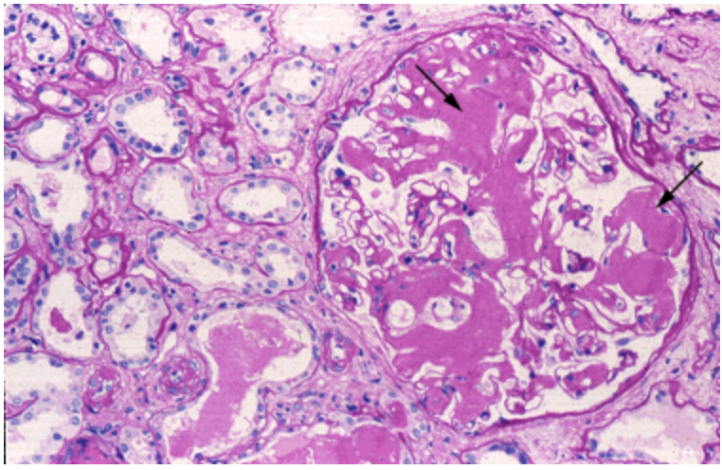
Amyloid Related Kidney Disease - JASN

Slide 15
Immunofluorescence
5 glomeruli, 2 are globally sclerosed
2+ focal, segmental, smudgy stain in mesangium and arterioles at the vascular pole and occasional interstitial is seen with Kappa light chains only. Few casts are highlighted by IgA and both light chains (2+). IgG, IgA, IgM, C1q, C3, lambda light chain, and fibrinogen are negative in the glomeruli

Slide 16
Electron Microscopy
3 glomeruli with pale material in the mesangium
Glomerular basement membranes appear segmentally wrinkled but are of normal thickness and texture without subepithelial nor subendothelial deposits.
Epithelial cells show cytoplasmic vacuoles and there is marked foot process effacement involving extensively the capillary loop circumference.
The mesangial areas are expanded and contain fibrillary material composed of straight, non-branching randomly oriented fibrils. Fibrils are also seen focally within the glomerular basement membrane. Fibrillary material seen in the interstitium and surrounding peritubular capillaries

Slide 17
Congo Red positive material is frequently identified in arterioles, glomeruli, and focally in the interstitium

Slide 18
Amyloid deposition involving glomeruli, interstitium, and arteries
FSGS 20%
Mild IFA IFTA (10%)
Mild arterio and ateriolosclerosis
Findings consistent with glomerular, interstitial, and vascular involvement by amyloidosis. There is staining only for Kappa light chain which favors AL-type amyloidosis. No evidence of cast nephropathy or light chain deposition disease.

Slide 19
Diagnosis
AL Amyloidosis

Slide 21
Epidemiology
Incidence: 9 to 14 cases per million person-years (~4,000cases/yr)
  AL Amyloidosis is a disease of older adults (as with other plasma cell dyscrasias).
  Incidence rates increase each decade of life after 40 years.
  Median: 64 years (<5% are <40)
Male predominance (65-70%)
> 23 different types of amyloid

Slide 22
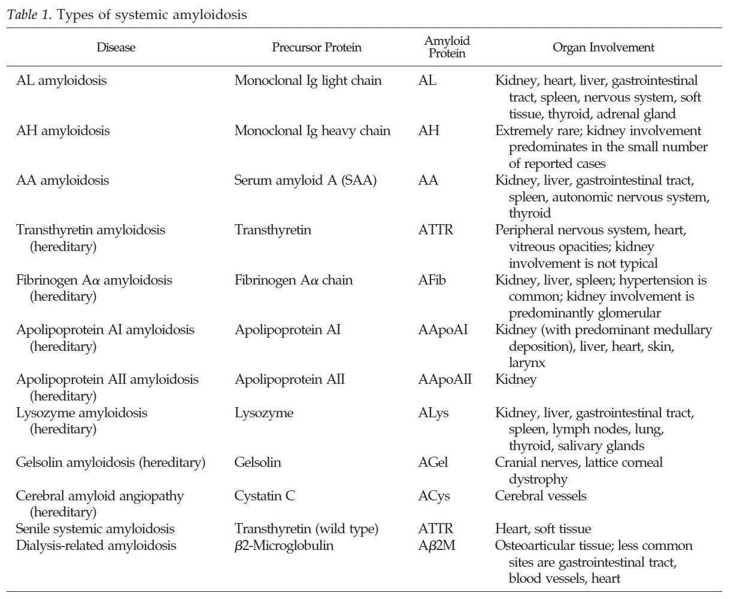
Amyloid Related Kidney Disease - JASN

Slide 23
Nephrotic Syndrome (renal involvement 65-70%), Restrictive Cardiomyopathy (cardiac involvement 70%), Peripheral Neuropathy, Hepatomegaly with elevated liver enzymes, Macroglossia, Purpura and other skin manifestations, Bleeding diathesis
Multisystem nature of systemic amyloidosis can contribute to the difficulty of managing fluid retention, particularly in AL amyloidosis, since cardiac and autonomic nervous system involvement can cause hemodynamic fragility that limits the effectiveness or tolerability of diuretics

Slide 24
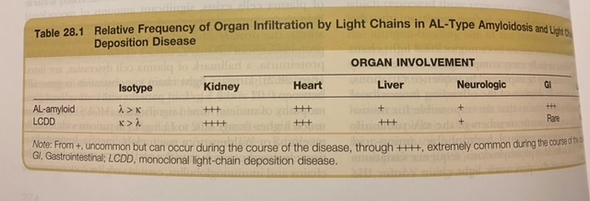
NKF Primer

Slide 25
Kidney Manifestations
Sub-nephrotic to Nephrotic range proteinuria (up to 30 g/day)
Nephrogenic Diabetes Insipidus (peri-collecting duct tissue)
Fanconi Syndrome (proximal tubular damage)
Amyloid deposition on biopsy does not correlate with severity of clinical manifestations
Urinary protein excretion or rate of GFR decline cannot be predicted on the basis of biopsy findings
Urine sediment is typically benign (reflecting the lack of inflammation)
Serum Creatinine may be normal or only moderately elevated.
  ESRD develops in approximately 20% of those with the nephrotic syndrome and is associated with poor patient survival overall

Slide 26
Biopsy and Congo Red Staining
The sensitivity of abdominal fat biopsy
  80-90% in AL Amyloid
  65-75% in AA Amyloid
  Substantially lower in many of the familial amyloidosis
Absence of Congo red positivity of abdominal fat does not eliminate the diagnosis.
  Consider End-Organ biopsy if suspicion is high
Irrespective of location of deposition, Congo red staining produces the disease-defining birefringence under polarized light
Notes:
substantially lower in many of the familial amyloidosis

Slide 27
Glomerular Findings
Amyloid appears as amorphous material in the mesangium and capillary loops. Substantial mesangial deposition can produce nodules that resemble diabetic nephropathy or LCDD.
  Differentiation is PAS weak staining (amyloid deposit rather than extracellular matrix)
  In LCDD, the deposition of light chains stimulates production of collagen and other extracellular matrix components. PAS staining is much more intense than in amyloidosis
Poor correlation between the extent of glomerular amyloid deposits and the degree of proteinuria
Although rare, crescentic glomerulonephritis can occur in patients with renal amyloidosis. Almost all reported patients have had AA amyloidosis or its variants (due to systemic disease, i.e. rheumatoid arthritis).
Notes:
A possible mechanism is amyloid fibril-induced ruptures in the capillary loops, leading to fibrin entry into Bowman's space

Slide 28
Vascular and Tubulointerstitium
Tubulointerstitium produces tubular
  IFTA
  Small amount of patients can have deposits confined to TI or Vasculature
When amyloid is confined to the tubulointerstitium or vasculature, proteinuria is minimal and reduced GFR is the principal clinical manifestation

Slide 29
Immunofluorescence
AL Amyloid
  Negative for compliment, immunoglobulin, and fibrin
  Typically stains for light chains (L > K)
  Multiple Myeloma (K or L)
AA Amyloid
  Negative for compliment, immunoglobulin, and fibrin
  Typically negative light chains
  Available antibodies against AA protein
False negatives with immunofluorescence can occur in 25-35%

Slide 30
Electron Microscopy
Nonbranching fibrils with diameter of 8-12 nm
Randomly arrayed in mesangium, basement membranes, interstitium, and vessels

Slide 31
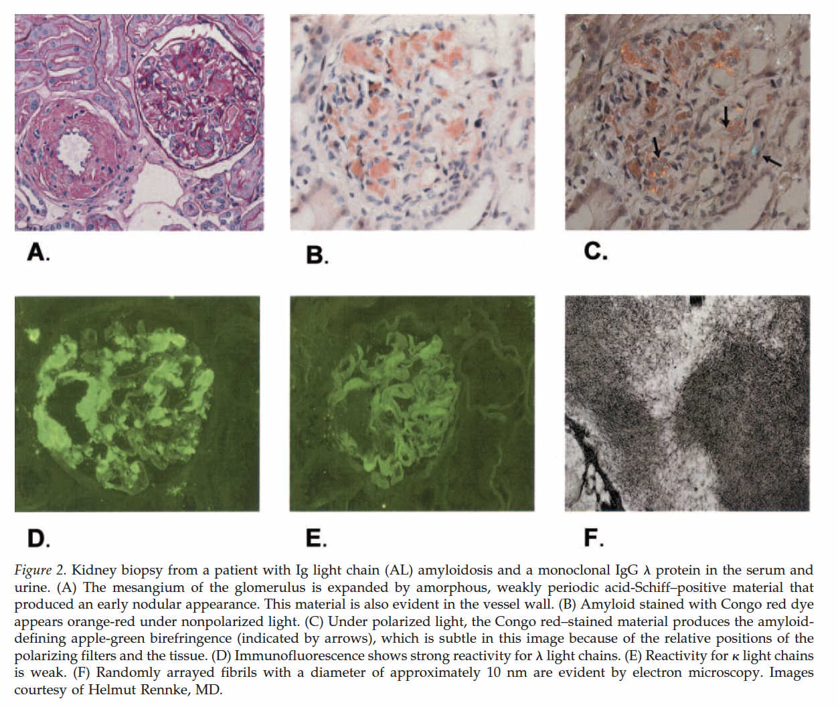
Amyloid Related Kidney Disease - JASN

Slide 32
Treatment
AL Amyloidosis
Goal of current treatment approaches for AL amyloidosis is to eradicate the clonal plasma cells that produce the amyloidogenic light chain
Standard treatment:
  Melphalan and autologous HCT
Investigation:
  Subcutaneous daratumumab plus cyclophosphamide, bortezomib, and dexamethasone
  Lenalidomide and thalidomide are generally avoided as these drugs are typically less well-tolerated
AA Amyloidosis
current treatment approach for AA amyloidosis is to treat the underlying inflammatory disease and thereby reduce production of SAA

Slide 33
Thank you

Slide 34
Amyloidosis Related Kidney Disease. Dember, Laura. JASN
Primer. NKF
Up-to-date

