Slide 1
Clinical Case
Jacob Nysather D.O.
02-07-2023

Slide 2
Case: 72 year old Caucasian male
PMH:
  Hypertension (age 45)
  CAD s/p PCI
  HLD
  PTSD
  Agent Orange Exposure
PSH:
  bilateral inguinal hernia repair
FH:
  Mother: ?Bladder cancer
  Father: unknown medical
Allergies:
  None
Medications:
  Metoprolol 100mg BID
  HCTZ/Lisinopril 25mg/40mg
  Hydralazine 50mg BID
  Clonidine PO 0.2mg BID
  Amlodipine 10mg

Slide 3
Prior Hypertension Work-up:
CTA with focal stenosis of left renal artery
Renal artery Dopplers were normal
24hr urine tests negative for pheochromocytoma
Renin 3, Aldo 8.8
Cortisol and TSH WNL

Slide 4
Labs 2019
Labs 2022
137
107
22
140
107
51
111
101
4
22
0.98
4.2
25
2.08
15.3
12.5
9.0
223
45.1
9.7
240
37.4
UA: No protein. Bland
UA: 200 protein, 3+ blood,
16-20 WBC, TNTC RBC
UPCr: 6/41
UPCr: 215/44

Slide 5
What would you do?
Repeat labs consistent
US Renal : Kidney sizes ~10cm bilateral, increased echogenicity, no hydronephrosis, normal post-void
Infectious:
  Hep B, Hep C, HIV, RPR negative
Autoimmune:
  C3/C4 WNL, ANA 1:40 homogenous, p-ANCA 1:320, MPO >800, PR3 negative, anti-GBM negative
SPEP: Negative*

Slide 6
What would you do next?

Slide 7
Kidney Biopsy
No glomeruli on LM
No glomeruli for IF
No glomeruli on EM

Slide 8
Anything else?
Father history of TB
  Treated as a child
CT with RUL nodule concerning for malignancy
  Poorly differentiated squamous cell carcinoma

Slide 10
ANCA Associated Vasculitis
Annual Incidence: 10-20/million
  GPA: ~13/million (US)
  EULAR: GPA (2.1-14.4), MPA (2.4-10.1), and EGPA (0.5-3.7) per million in Europe
Ancestry
  European twice as high vs non-European
  GPA and PR3-ANCA are more prevalent in Northern Europe
  MPA more prevalent in Southern Europe and Asia
  More common in Caucasian individuals. Black patient more likely to have MPO-ANCA and younger
  No difference in treatment in development of ESKD, Renal Relapse, and death between black and white
5-year survival rates (EULAR)
  GPA (74–91%)
  MPA (45-76%)
  EGPA (60-97%)
Factors that have been implicated in pathogenesis of MPO-ANCA
  Environmental (i.e. Silica)
  Drug Exposure: Levamisole-adulterated cocaine, hydralazine, PTU. Potential with minocycline, allopurinol, methimazole, penicillamine, and sulfasalazine
  Infections

Slide 11
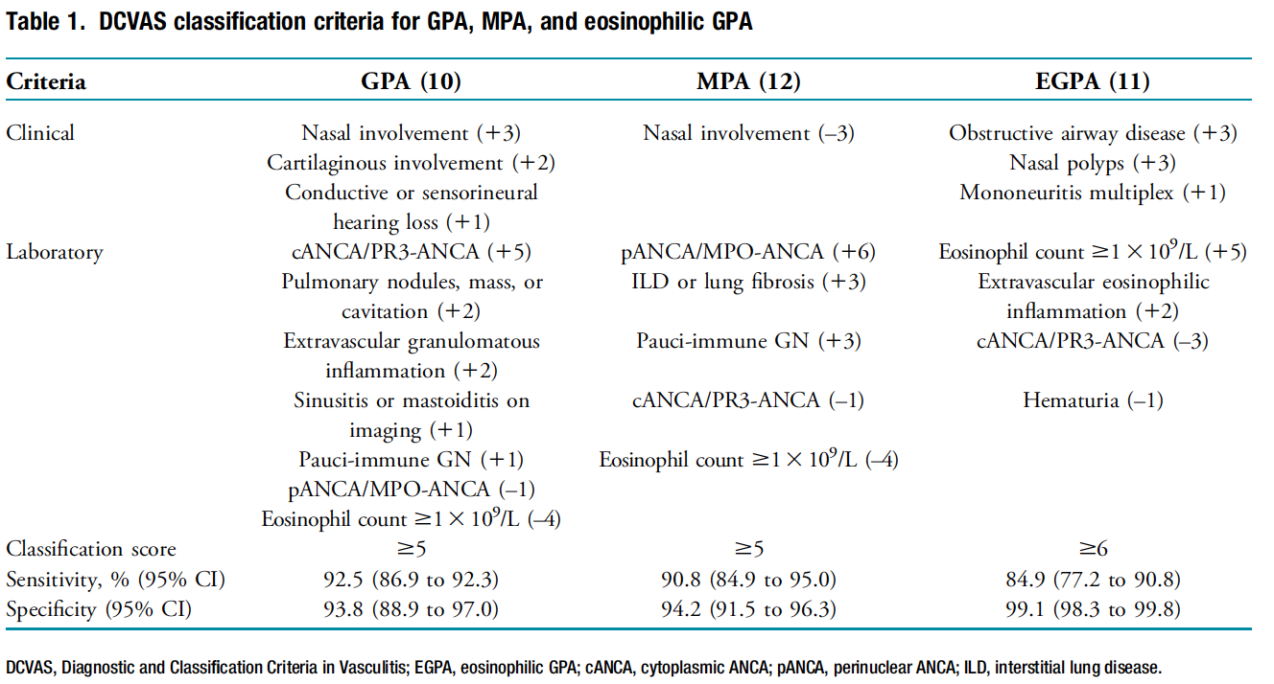
Diagnostic and Classification Criteria for Vasculitis (CVAS)

Slide 12
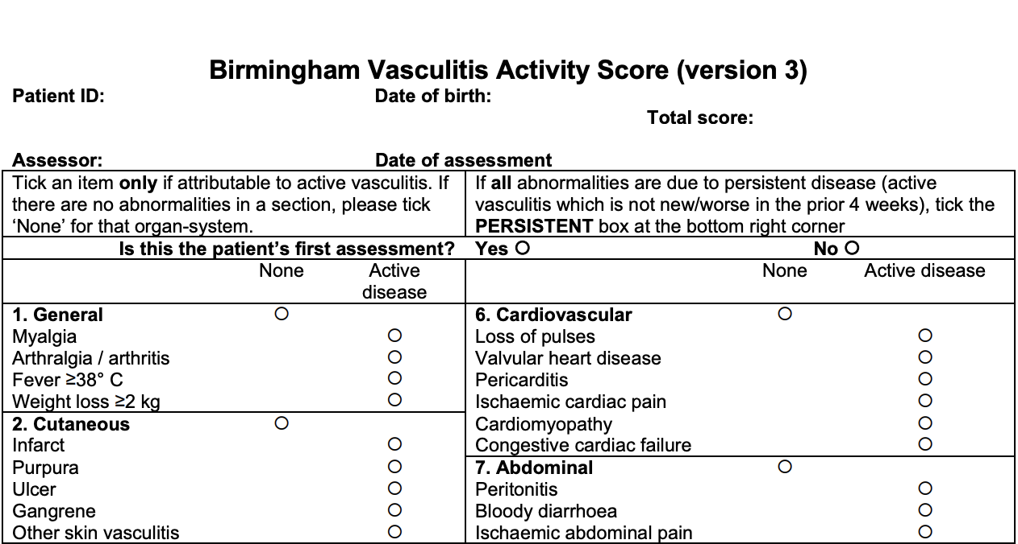
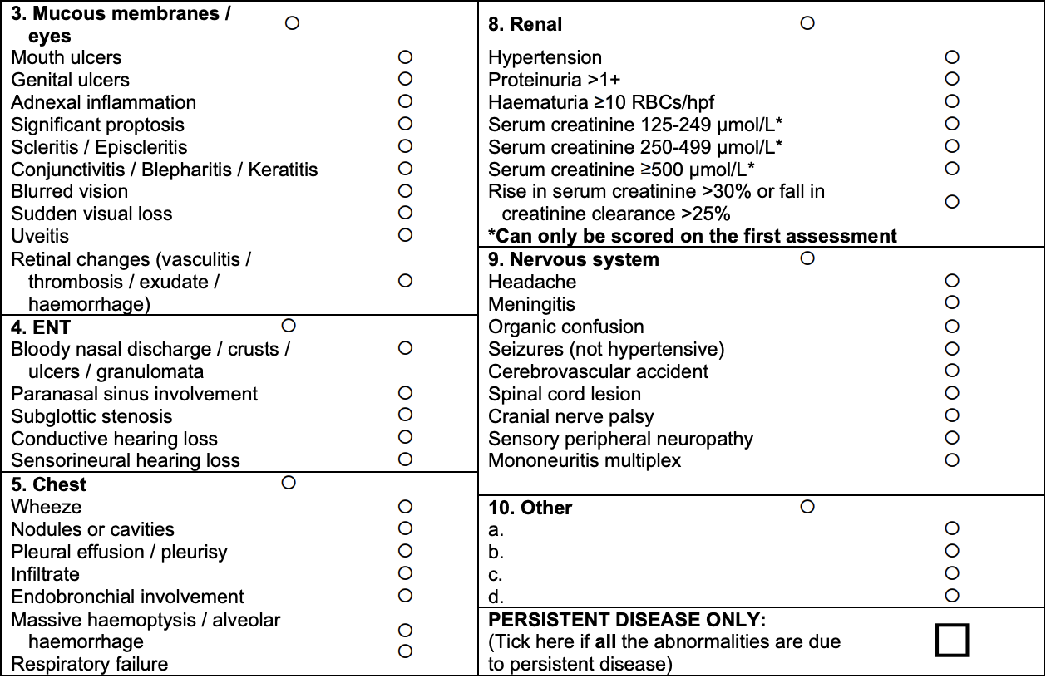

Slide 13
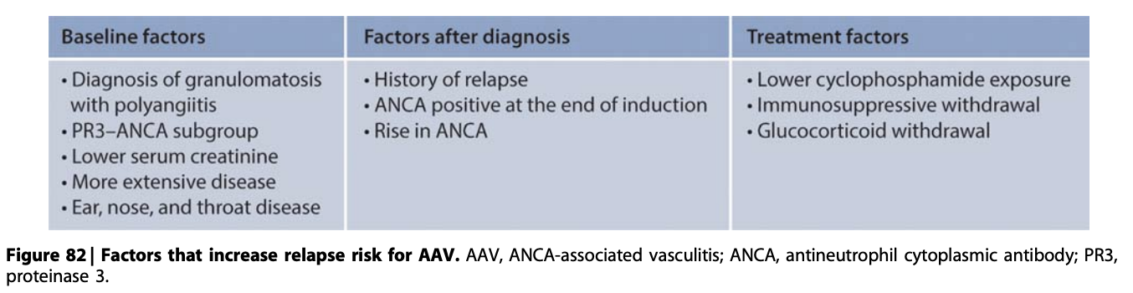
Increased Risk of Relapse

Slide 14
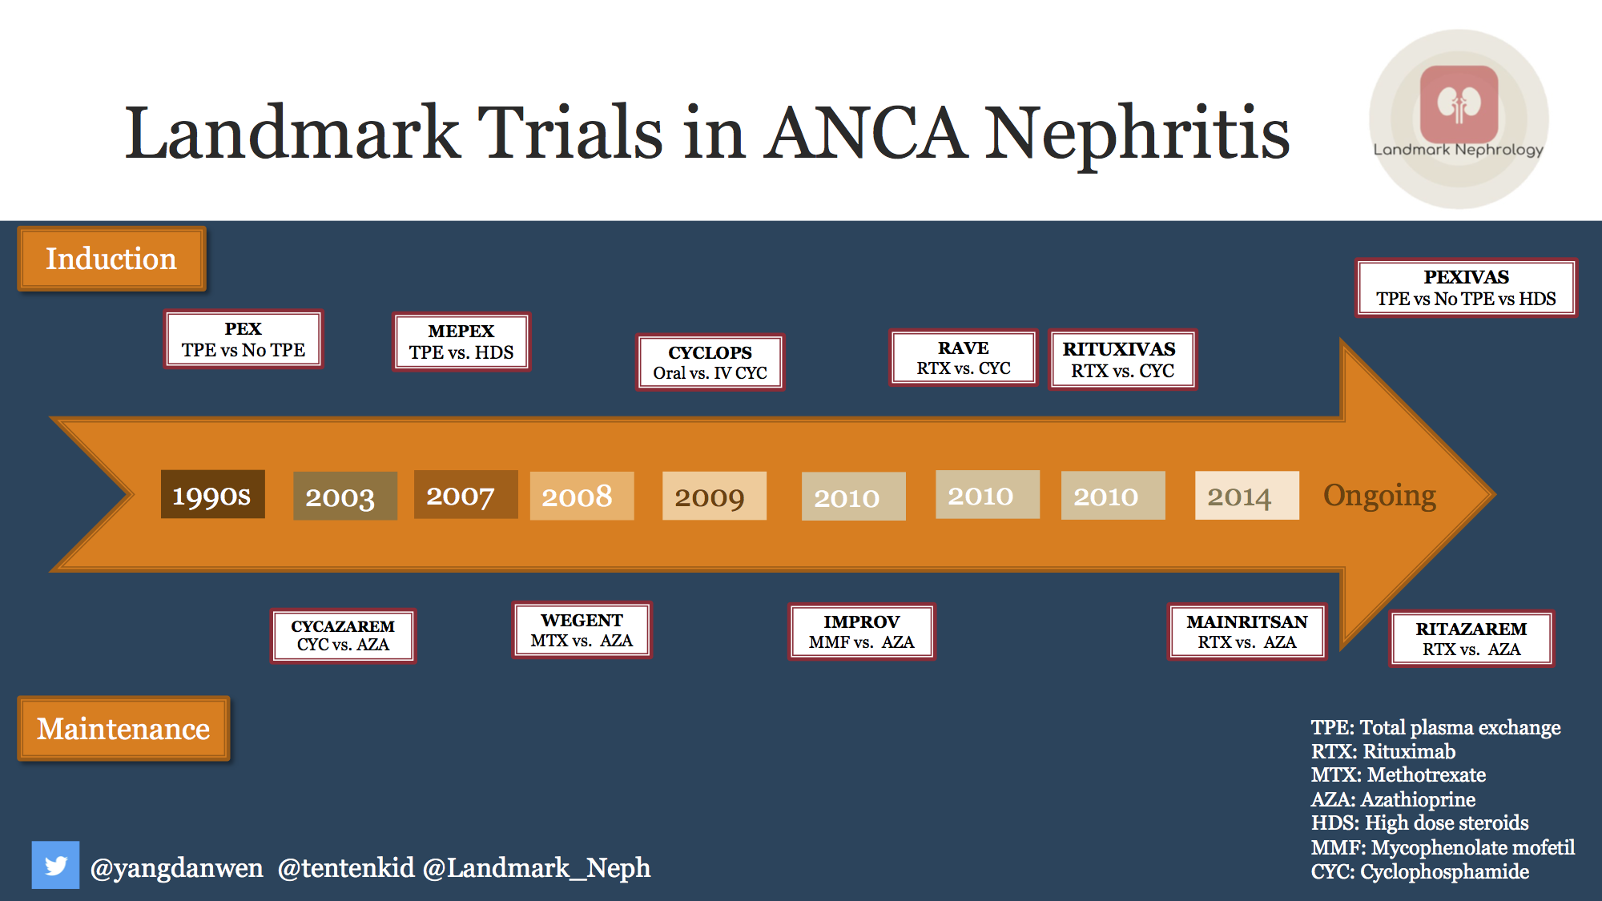

Slide 15
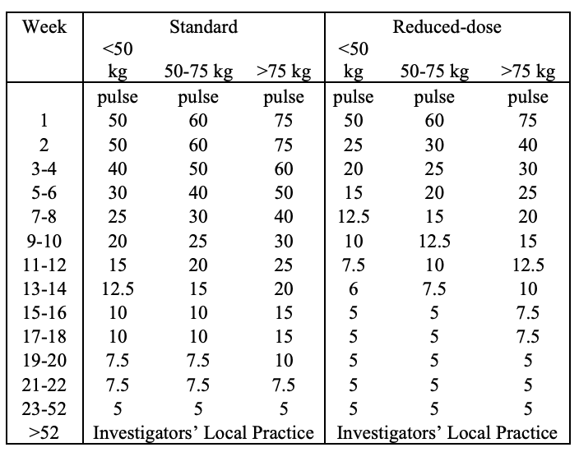
Steroids
Traditionally Induction
  1-3G IV followed by 1mg/kg per day oral
  IV methylprednisolone had higher incidence of diabetes and infection
RAVE
  RTX vs CYC
  Successful tapered prednisone by 5 months
PEXIVAS
  TPE
  Standard Steroid vs. Reduced (non-inferior)
Ongoing Trial:
  RTX
  High Dose (1mg/kg/day) vs Low Dose (0.5mg/kg/day)
*PEXIVAS Regiment

Slide 16
Steroid Sparing
ADVOCATE
  Avacopan vs Steroids (RTX or CYC)
  C5a receptor antagonist
  Similar remission at 26 weeks
  Avacopan superior at 52 weeks in sustaining remission

Slide 17
Cyclophosphamide
Alkylating agent that inhibits nuclear DNA replication potently affecting rapidly dividing cells
CYCLOPS
  IV vs Oral (Cumulative Doses: 8.2G vs 15.9G)
  No difference in time to remission
  Pulse with lower cumulative dose and lower rate of leukopenia
  Long term follow-up high risk of relapse with pulse dose but no difference in survival and renal function
  Both maintenance treatment with AZA

Slide 18
Rituximab
Anti-CD20 chimeric mAb
RAVE
  RTX was non-inferior to oral CYC for remission induction
  RTX was more efficacious in relapsing disease
  Post-analysis higher complete remission rates in PR3-ANCA
  Cr >4 excluded
RITUXVAS
  RTX with 2 doses of IV CYC vs IV CYC for 3-6 months followed by AZA
  Did include severe renal disease
  Similar high rates of remission indication at 12 months and SAE
  Similar at 2 year follow-up

Slide 19
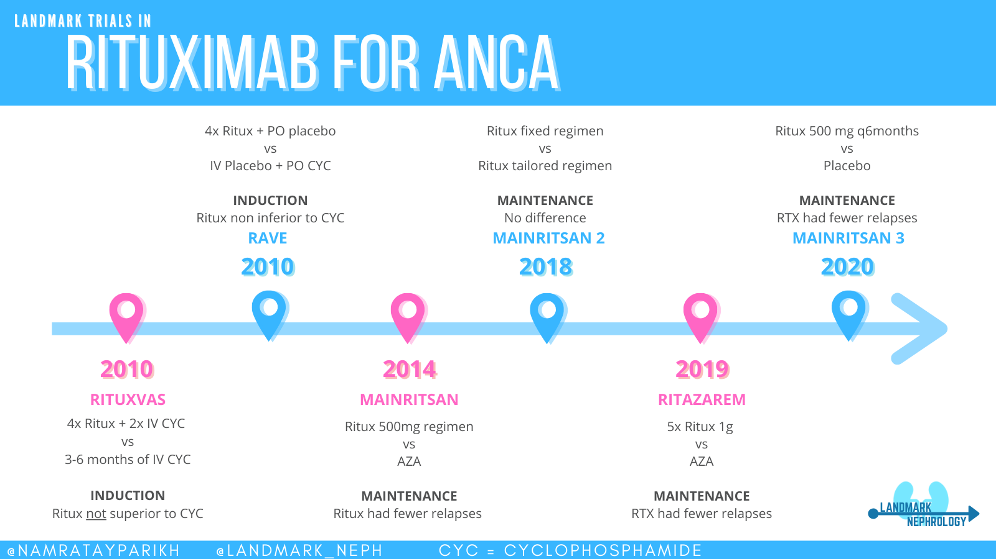

Slide 20
Therapeutic Plasma Exchange
MEPEX
  Biopsy proven with serum Cr >5.8mg/dl
  Both groups received oral steroids and oral CYC
  One group IV Steroids and the other PLEX
  No difference in ADE or survival at 1 year
  PLEX was associated with lower progression to ESKD over 12 months
  Long-term follow-up showed no difference in all-cause mortality and risk of progression was not statistically significant but trend towards benefit
PEXIVAS
  Did not reduce composite end point of all cause mortality and ESKD in severe vasculitis (GFR <50ml/min or pulmonary hemorrhage)
  Without kidney biopsy to assess IFTA
  Pulmonary hemorrhage analysis (subgroup) showed trend for benefiting the primary composite outcome although not statistically significant

Slide 21
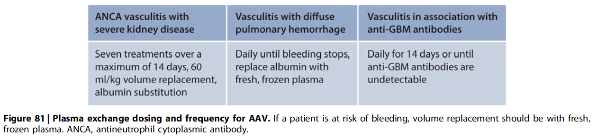
TPE Guideline Recommendations
EULAR (2016):
  Consider with RPGN (Cr >5.6mg/dL) (1B)
  Consider with Diffuse Alveolar Hemorrhage (3C)
ACR (2021):
  Conditionally against routine for induction with active GN (low-high)
  Conditionally against in Severe GPA/MPA with alveolar hemorrhage (low-high)
KDIGO (2021):

Slide 22
Mycophenolate
Small RCTs
  Against CYC
  Some with non-inferiority in induction but more relapses seen
  Some with fewer patients attaining remission

Slide 23
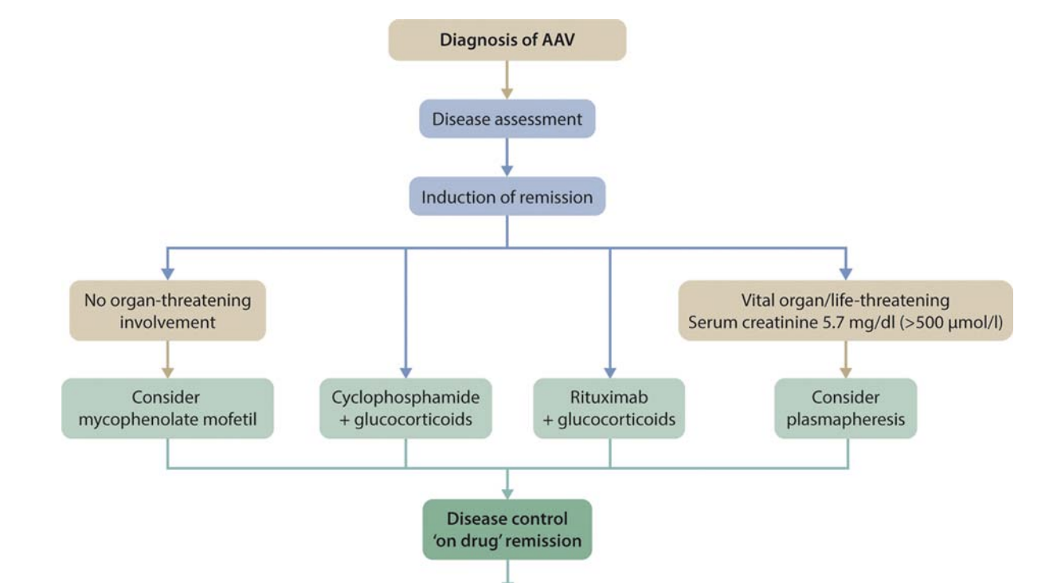
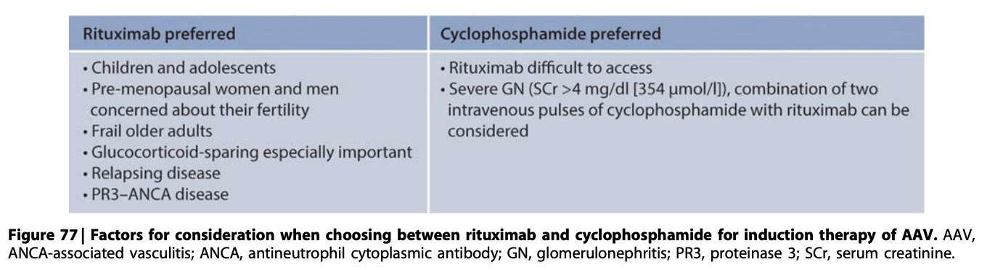
KDIGO Guidelines for Induction (2021)

Slide 24
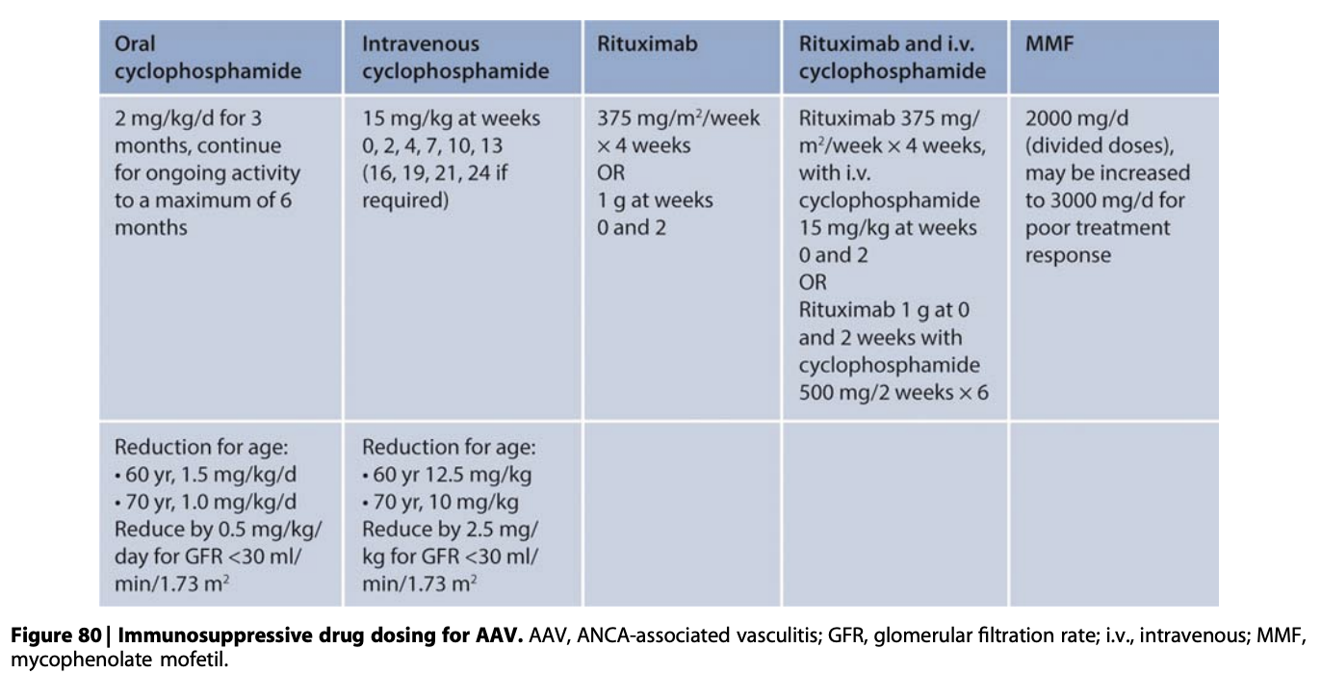
KDIGO Guidelines for Induction (2021)

Slide 25
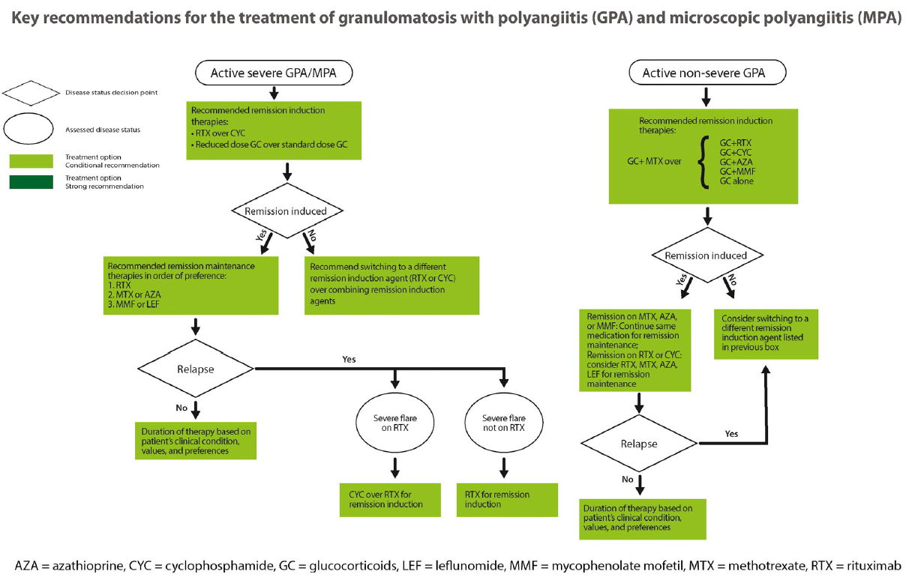
ACR Guidelines (2021)

Slide 26
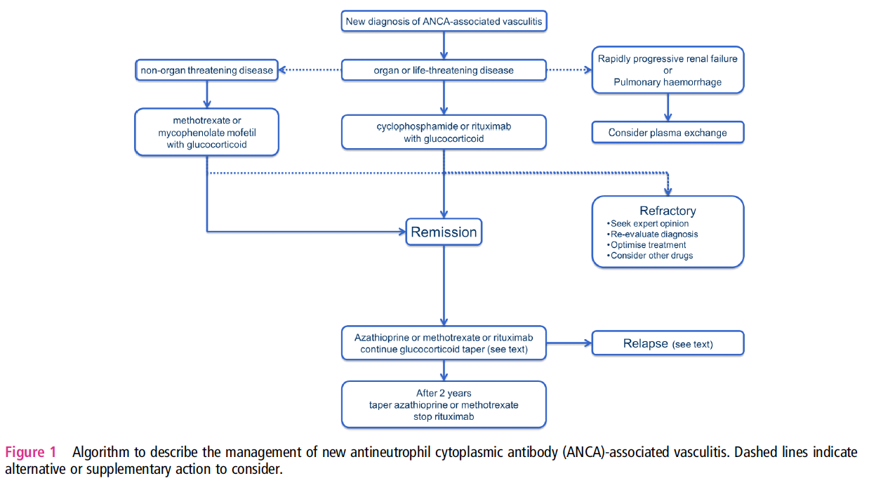
EULAR Guidelines (2016)

Slide 28
Maintenance Trials:
CYCAZAREM
  CYC or AZA
  AZA could replace for maintenance without increasing relapse
IMPROVE
  MMF with AZA for maintaining remission after CYC induction
  Both similar ADE but MMF with higher relapse rates
WEGENT
  AZA with MTX
  No difference in safety or relapse between the groups

Slide 29
Maintenance Trials:
MAINRITSAN:
  Low dose RTX: 500mg with Day 0 and 14, Months 6, 12, 18
  AZA until 22 months (after CYC)
  RTX was superior
RITAZAREM
  Achieved remission with RTX after experiencing a relapse
  1G q4months for 5 doses or 2mg/kg of AZA for 24months.
  Lower relapse in RTX

Slide 30
Maintenance Trials:
MAINRITSAN2
  Dosing of RTX
  Fixed q6months vs redosing on basis of CD19+ B-lympohocytes or ANCA titer
  Relapses were similar but fewer infusions (~3 vs 5)
MAINRITSAN3
  Extended maintenance evaluating relapses and death
  MAINRITSAN2 patients in remission at month 28 for biannual RTX for an additional 18 months
  96% vs 74% RTX vs placebo relapse free with number of SAE similar between the 2 groups

Slide 31
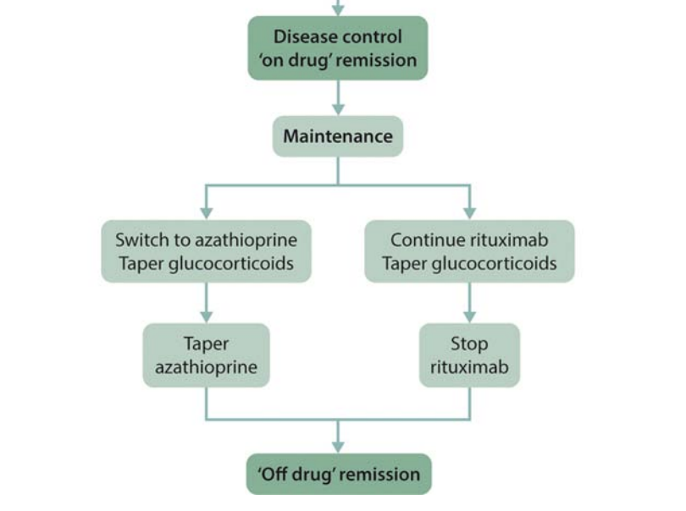
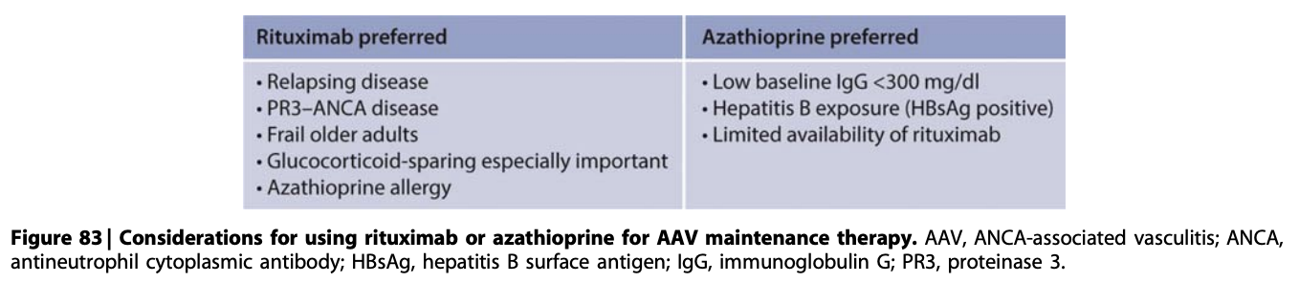
KDIGO Guidelines for Maintenance (2021)

Slide 32
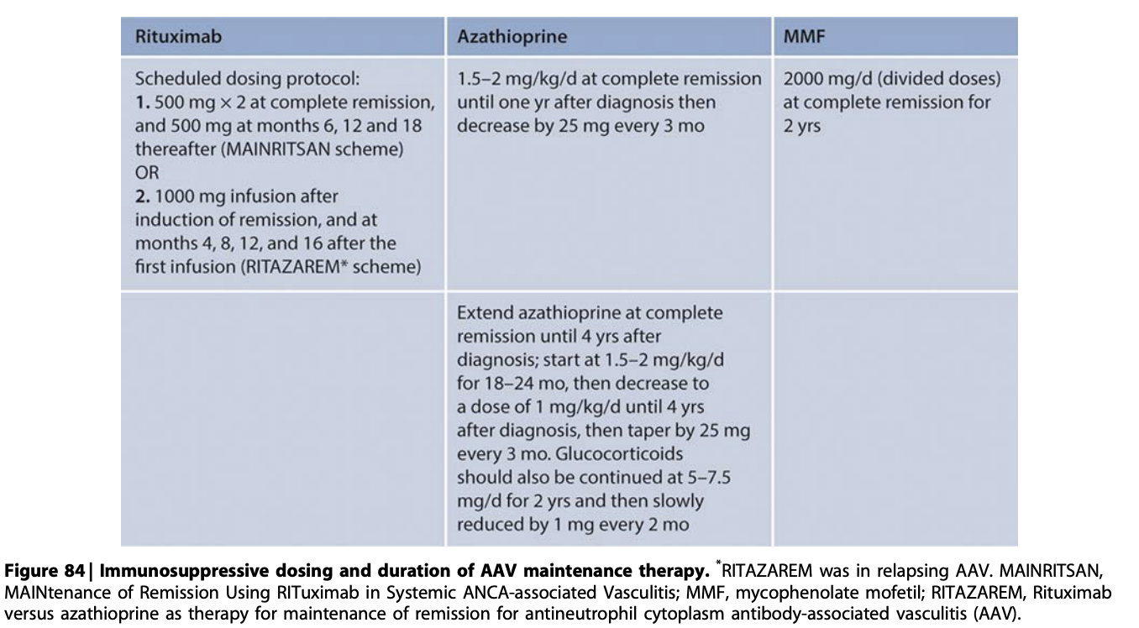
KDIGO Guidelines for Maintenance (2021)

Slide 33
Paraneoplastic Syndrome?
Vasculitis and cancer. Clin Dermatol 1993; Kurzrock et al.
  200 patients with vasculitis cancer association, 155 (77.5%) had a haematological malignancy, 34 (17%) a solid tumor, and 11 (5.5%) an unspecified malignancy
Systemic vasculitis and epithelioma. A report or three cases with a literature review. Rev Rhum Engl Ed 1997; Hayem et al.
  79 patients with vasculitis associated to solid tumors; these vasculitides were as follows, in decreasing order of frequency: leukocytoclastic vasculitis (33%), polyarteritis nodosa (16.5%), Henoch–Scho¨nlein purpura (11.5%), microvasculitis/microscopic polyarteritis nodosa (10%), giant cell arteritis (9%), necrotizingvasculitis (4%), lymphocytic vasculitis (2.5%), polymyalgia rheumatica (1%), Churg–Strauss syndrome (1%), Wegener’s granulomatosis (1%) and unclassifiable vasculitis (10%).
  Solid tumors found in this review were: lung cancer (23%), digestive system cancers (17.5%, including colon cancer in 5%), renal cancer (14%), cancer of the urinary bladder (5.3%), prostate cancer (5.3%), breast cancer (5.3%) and endometrial cancer (3.5%).
Postgrad Medical Journal 1994 Navarro et al:
  ANCA vasculitis preceding undifferentiated adenocarcinoma in anterior mediastinum
Lupus 2005 Diez-Porres et al:
  pANCA preceding Adenocarcinoma of Colon
Rheumatoid International 2011 Haruo Abe et al
  MPA simultaneously Adenoma carcinoma of stomach/duodenum improved after cancer resection
Case Reports Oncology 2018 Kancharla et al
  NSCLC Adenocarcinoma developed Seronegative Pauci-Immune RPGN

Slide 34
Resources
ACR/Vasculitis Foundation 2021: Guideline for AAV
EULAR 2016: Recommendations for Treatment AAV
KDIGO 2021: Glomerular Disease Guidelines
Kidney360 Review 2021: Treatment of AAV
NEPHSAP 12/2022: AAV, Anti-GBM, Lupus Nephritis

Slide 35
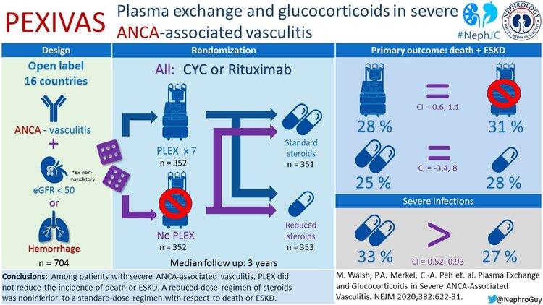

Slide 36
