Slide 1
Clinical Case Conference
If You Incyst
Jacob Nysather D.O.
08/02/2022

Slide 2
Disclosures
none

Slide 3
Outline
3 small cases intermixed throughout
Epidemiology
Pathogenesis
Clinical Manifestations
Management

Slide 4
Case 1
18 year old female with past medical history of ADHD (on lisdexamfetamine). Patient underwent RUQ pain work-up with mild elevation in LFTs improved with removing gluten from diet (celiac panel negative). Upon work-up was noted to have renal cysts on RUQ US. Designated Renal US noted with cluster of cysts on right upper pole.
R 11.4cm, L 11.6cm. Normal position and echogenicity. No scarring.
Cluster of cysts in upper pole of the right kidney. Cysts appear anechoic and at least 4 present. 2.8cmx3.6cm with largest cyst 2.3x1.5.1.9cm. This larger cyst may contain a septation or possibly 2 smaller cysts combined

Slide 5
Differential?

Slide 6
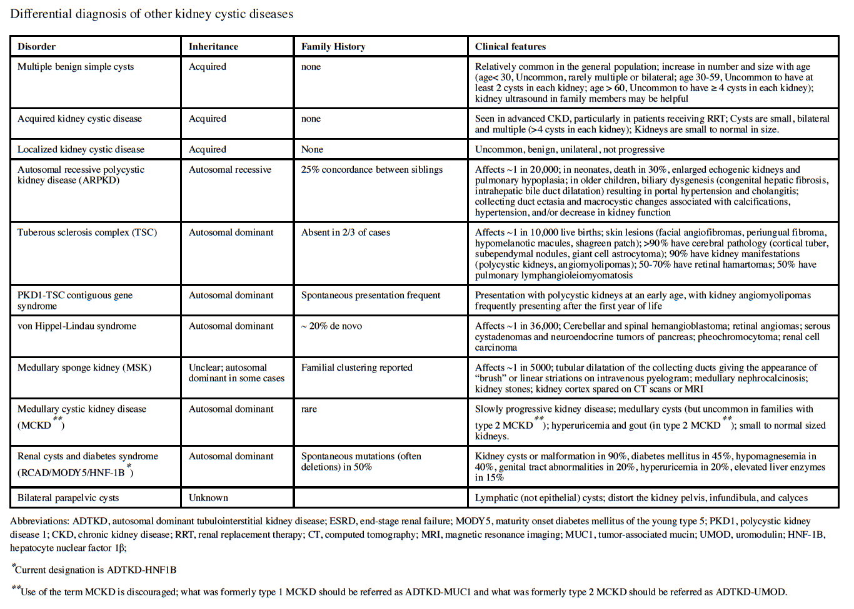
Chebib, FT.; et al.

Slide 7
CT findings
In the upper lateral right kidney there is a lobulated predominantly cystic mass measuring 3.6 x 2.3 x 3.8 cm this has several thin septations, some of which have some linear calcification. Bosniak 2F

Slide 8
Autosomal Dominant Polycystic Kidney Disease

Slide 9
Epidemiology
ADPKD is the most common inherited kidney disorder occurring in 1:400-1000 live births
5-15% spontaneous mutation
All ethnic groups equally
Approximately 5% of ESRD population in US with ADPKD (10 of <60)
ADPKD is a systemic disorder

Slide 10
Pathogenesis/Genetics
3 genes:
  PKD1 (~85%) Chromosome 16p13.3 (polycystin-1 – integral membrane protein)
  PKD2 (~15%) Chromosome 4q12.2 (polycystin-2)
  GANAB (~1%)
Although phenotypes vary between genes, PKD2 typically have a milder disease course with fewer cysts, later onset of hypertension, and less ESRD compared to PKD1 (74 vs 54)
GANAB relatively rare with milder phenotype than PKD1 with hepatic cystic disease predominating
Second hit hypothesis as cystic disease is focal with 1-5% of nephrons becoming cystic (thought each cyst is derived from a single clonal hyperproliferative epithelial cell that has genetically transformed)
Most cysts detach from the parent nephron when cysts size exceeds 2cm and continue to secrete fluid autonomously resulting in cyst and kidney enlargement and progressive loss of kidney function

Slide 11
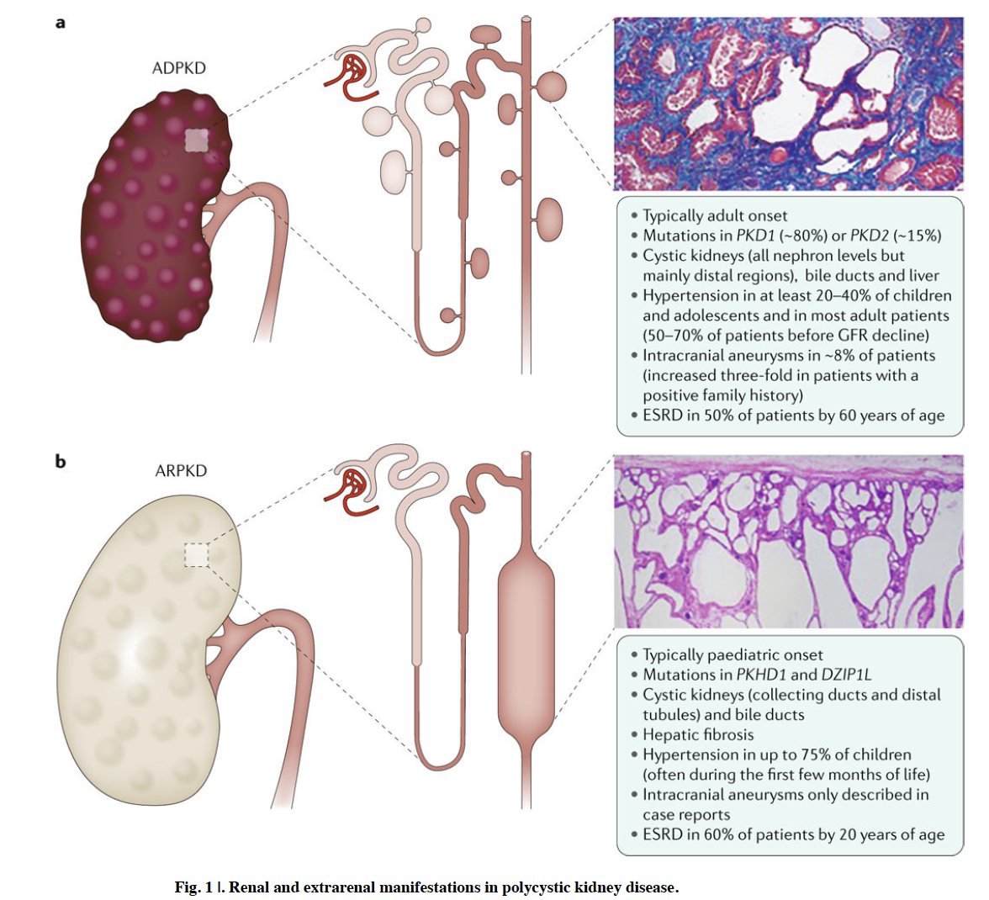
Bergmann, C.; et al.

Slide 12
PC1 and PC2 work in the primary cilium of renal epithelial cells, functioning as a mechanosensor. Primarily, they create transmembrane calcium current (presence of stretch or luminal flows). This interaction between PC1 and PC2 is required for membrane calcium channel to operate properly.
Increase in intracellular calcium initiates signaling cascades leading to vesicle fusion and change in gene transcription.
Other mechanisms involved with increase in intracellular calcium include inhibiting Adenylate Cyclase (inhibits cAMP formation) as well as increases Phosphodiesterase activity (increased activity hydrolyzes cAMP).
Decrease in intracellular calcium leads to a constant tonic effect of Vasopressin at the Vasopressin V2 receptor relatively unregulated at action site
Increase in RAS and activity of CFTR (chloride secretion and cyst formation). Tubulogenesis, cell proliferation, increased fluid secretion, and interstitial inflammation

Slide 13
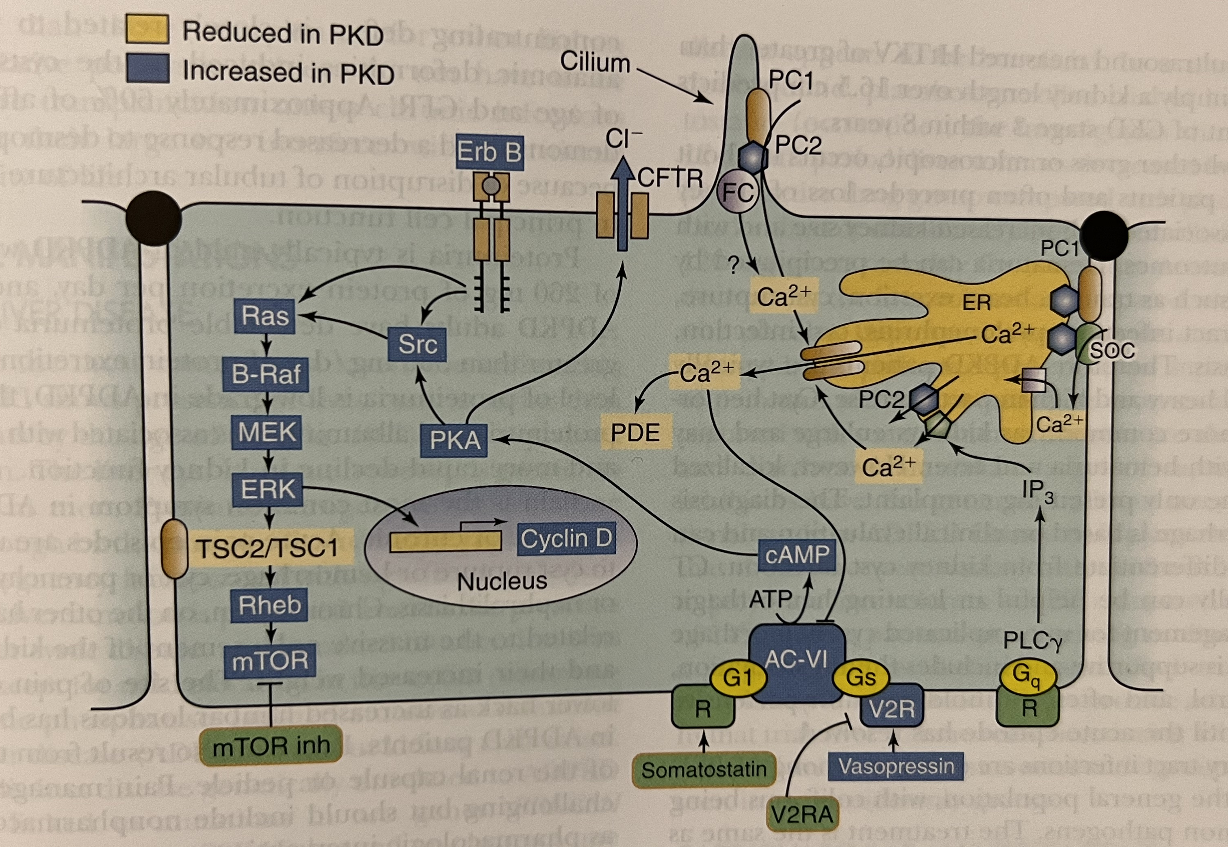
Figure 40.1 NKF Primer

Slide 14
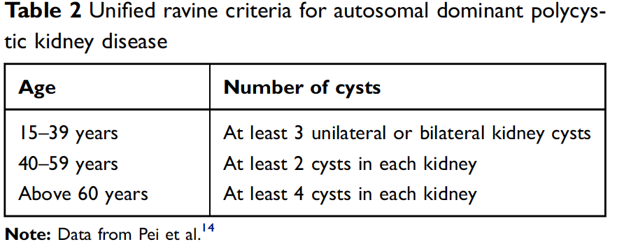
Diagnosis
Ultrasound remains primary method in diagnosing ADPKD (10mm)
If uncertainty remains MRI/CT can assist (3mm)
Unified diagnostic US criteria for at risk individuals independent of genotype were developed by Pei and colleagues in 2009
  Genetic testing should be considered in young individuals under age 40 if imaging is negative
No family history, at least 5 cysts bilaterally by age 30/40 and a phenotype consistent with ADPKD
Rastogi, A. et al.

Slide 15
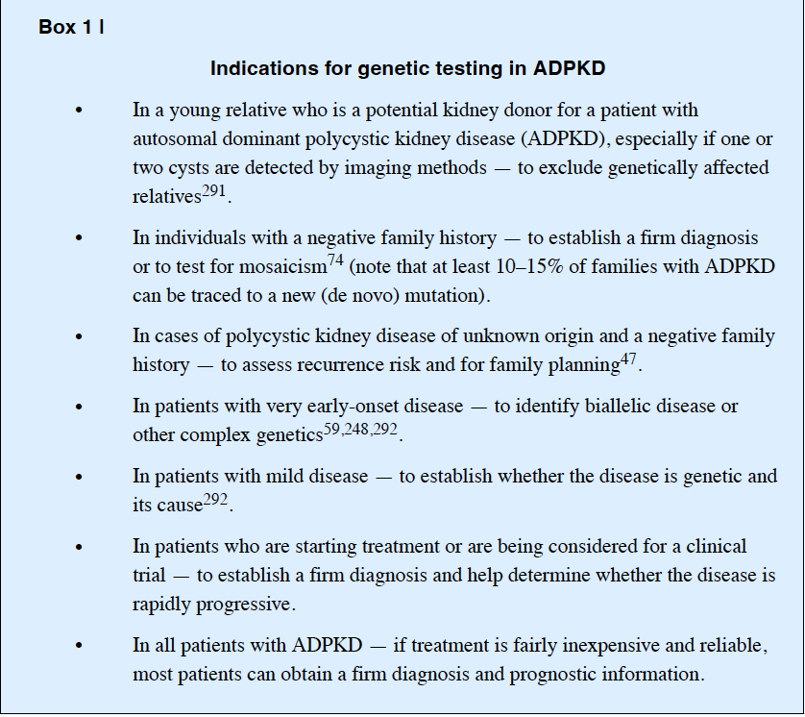
Bergmann, C.; et al.

Slide 16
Case 2
33 year old female with PMH of hypertension, hyperthyroidism, ADPKD. Presents 3 months post partum. Term delivery complicated by peripartum hysterectomy due to hemorrhage. Reported family history of mother with ADPKD on HD passed in 50s with seizure activity. Currently systolic BP 120s at home on Nifedpine 60mg BID. Trial of ACE with symptomatic hypotension.
Serum Cr ~1
UA Bland
UPCr <200mg on 24 hour collection (during pregnancy, UPCr consistent)

Slide 17
CT ABD ~1 year ago: R 14cm, L 14.7cm. TKV 1.4L. Few scattered lesions favoring hemorrhagic cysts
MRA Brain ~6 years ago: No intracranial lesions

Slide 18
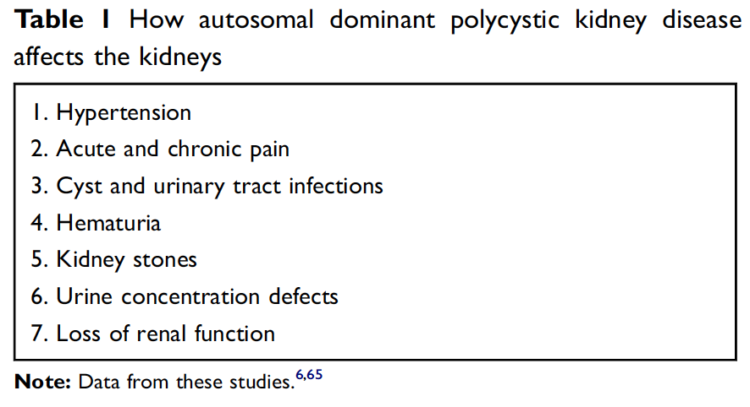
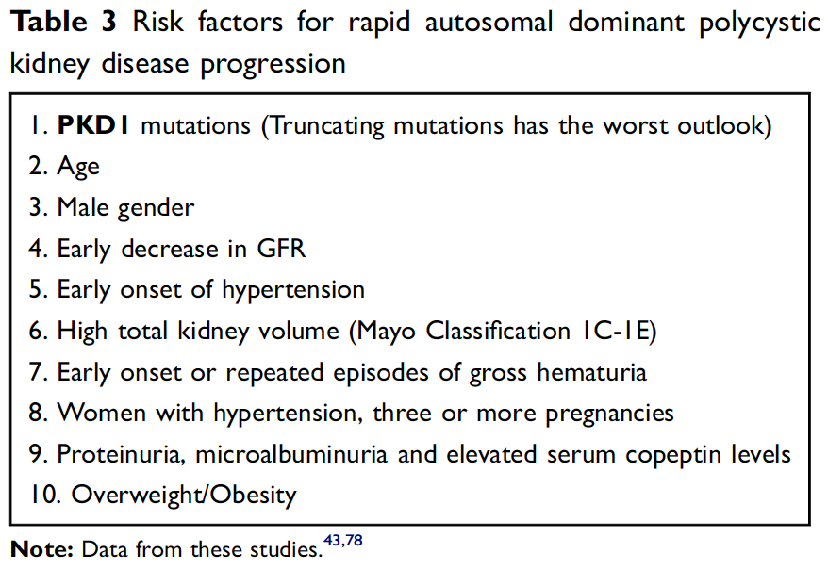
Kidney Manifestations
Early signs of progressive disease prior to GFR loss: increasing total kidney volume (TKV), hypertension, hematuria (macro or micro)
After kidney function becomes impaired, progression is typically universal and rapid with average decline in GFR 4-5 ml/min/year
Rastogi, A. et al.
Notes:
kidney enlargement precedes loss of kidney function by decades in ADPKD

Slide 19
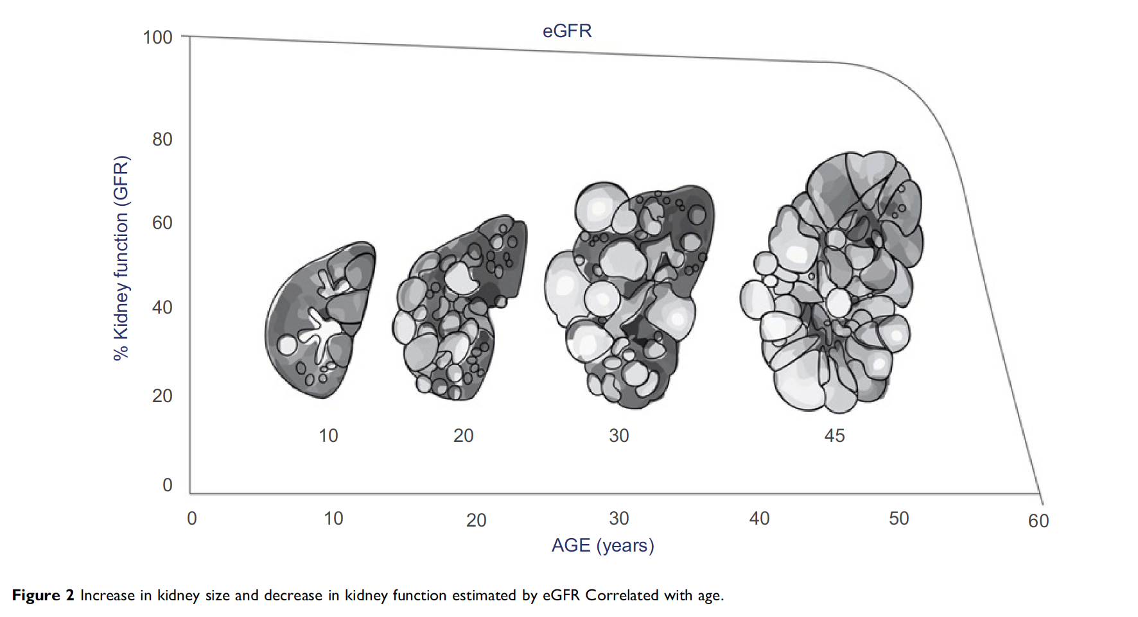
Rastogi, A. et al.

Slide 20
Total Kidney Volume
Mayo Clinic Imaging Class (MCIC) (http://www.mayo.edu/research/documents/pkd-center-adpkd-classification/doc-20094754)
  Class 1A < 1.5%
  Class 1B 1.5–3.0%
  Class 1C 3.0–4.5%
  Class 1 D 4.5–6.0%
  Class 1 E > 6.0% per year
  Class 2: Asymmetric cyst distribution, substantial fibrosis, or solitary kidneys (pattern of decline is generally slower compared to class 1)
HtTKV >600ml/m accurately predicted progression to CKD stage 3 within 8 years.
Every 100 ml/m change in HtTKV there is a 48% relative risk of reaching CKD stage 3
MRI modality of choice
*US overestimates TKV by ~11%
Combined kidney volumes exceeding 1500 ml are frequently associated with a decreased GFR
*Yearly MRI for trending change

Slide 21
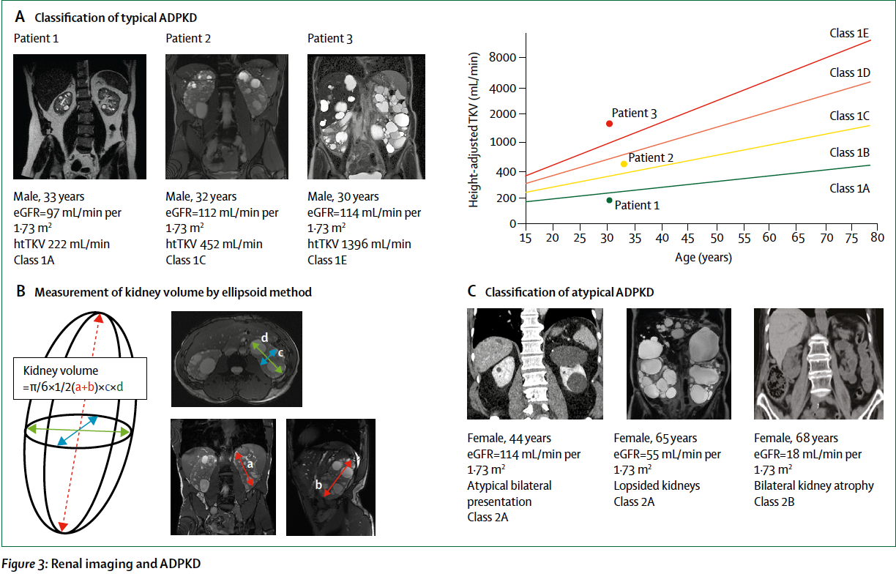
Cornec-Le Gall, E.; et al.

Slide 22
Other Kidney Manifestations and Complications
Hematuria (Gross or Microscopic)
  35-50% and often precedes loss of kidney function
  Precipitated by trauma, heavy exertion, cyst rupture, infections, stones
Cyst Hemorrhage
  Increased risk with increasing size
  Management of uncomplicated cyst hemorrhage and hematuria is supportive
Nephrolithiasis
  5-10 higher risk
  Urinary stasis, metabolic disturbances (hypocitraturia, low urinary pH, and abnormal of ammonium)
  Most common stone uric acid (50%) followed by calcium oxalate

Slide 23
Hypertension
Increase in RAAS activation due to increased cAMP signaling (decreased intracellular calcium)
Kidneys have an attenuated vasculature with angiographic evidence of intrarenal arteriolar tapering on MRI resulting in reduction of renal blood flow (inversely correlates with TKV). This suggests renal ischemia induced by cyst expansion.
Average age of onset ~29 (favors rapid progression)

Slide 24
Case 3
47 year old male LDKT ~4 years ago (pre-emptive for PKD) s/p bilateral nephrectomies, 1mm saccular aneurysm at right M1 and bifurcation of right MCA (prior to transplant), HTN. Transplant course complicated by pyelocaliectasis with chronic mild hydronephrosis in transplanted kidney, mild level DSA resolved. Patient diagnosed with Metastatic Seminoma Stage 2B s/p orchiectomy 3 years ago and Chemo (Cisplatin, Etoposide - last cycle 2.5 years ago). Comes to establish care. BP this visit 112/68 no antihypertensive agents
Cr at baseline since transplant of ~2-2.2
UPCr <500mg (~250mg)

Slide 25
Extrarenal Manifestations
Liver:
  Hepatic cysts (80% ADPKD by age 30)
  20% are symptomatic (compression of surrounding structures)
Cardiovascular:
  *Intracranial Aneurysms
  LVH, Coronary Aneurysms, Valvular heart disease (MVP and MR 26% compared to 3% of population), Aortic Insufficiency (11%)

Slide 26
Intracranial Aneurysms
Prevalence of ICA in ADPKD is 9-12% compared to 2-3% in general population
  22-27% with family history of ICA or Hemorrhagic Stroke
Most often in anterior cerebral circulation and multiple ICAs are common
Average age of ICA rupture with ADPKD is ~40 years (mortality or permanent morbidity after is >50%)
Ruptured aneurysm contribute to 4-7% of deaths in ADPKD

Slide 27
Intracranial Aneurysms Continued
Screening:
  All asymptomatic patient with: family history of ICA, hemorrhage, high risk occupations, prior to major elective surgery (transplant), long term anticoagulation*
  Symptomatic patients
  Those who do not meet these criteria and are without additional concern, screening is typically provider dependent
Follow-up*:
  < 7mm – assess for stability (recommended 6-12 months and progress out). Further follow-up not specified
  Negative Screen with Positive History – repeat every 5-10 years
  Onset of symptoms
Intervention:
  < 5mm – if no significant growth, risk of rupture relatively small
  5-10mm, asymptomatic – discussion with neuro-interventionalist
  > 10mm – intervention
Risk factors for aneurysmal growth including smoking and HTN

Slide 28
Fertility and Pregnancy
Fertility rates in ADPKD not yet on dialysis are similar to those in general population
Higher incidence of ectopic pregnancies, congenital absence of their seminiferous tubules, seminal vesical cysts, and immotile spermatozoa
Affected women with normal GFR and normal blood pressure experience pregnancy outcomes similar to those of the general population
Pregnancy induced hypertension, worsening hypertension, and preeclampsia occur with increased frequency in women with ADPKD and higher rates of premature delivery
Patients with decreased GFR before pregnancy are high risk for midgestational fetal loss and progressive loss of kidney function
*Estrogen role in progression

Slide 29
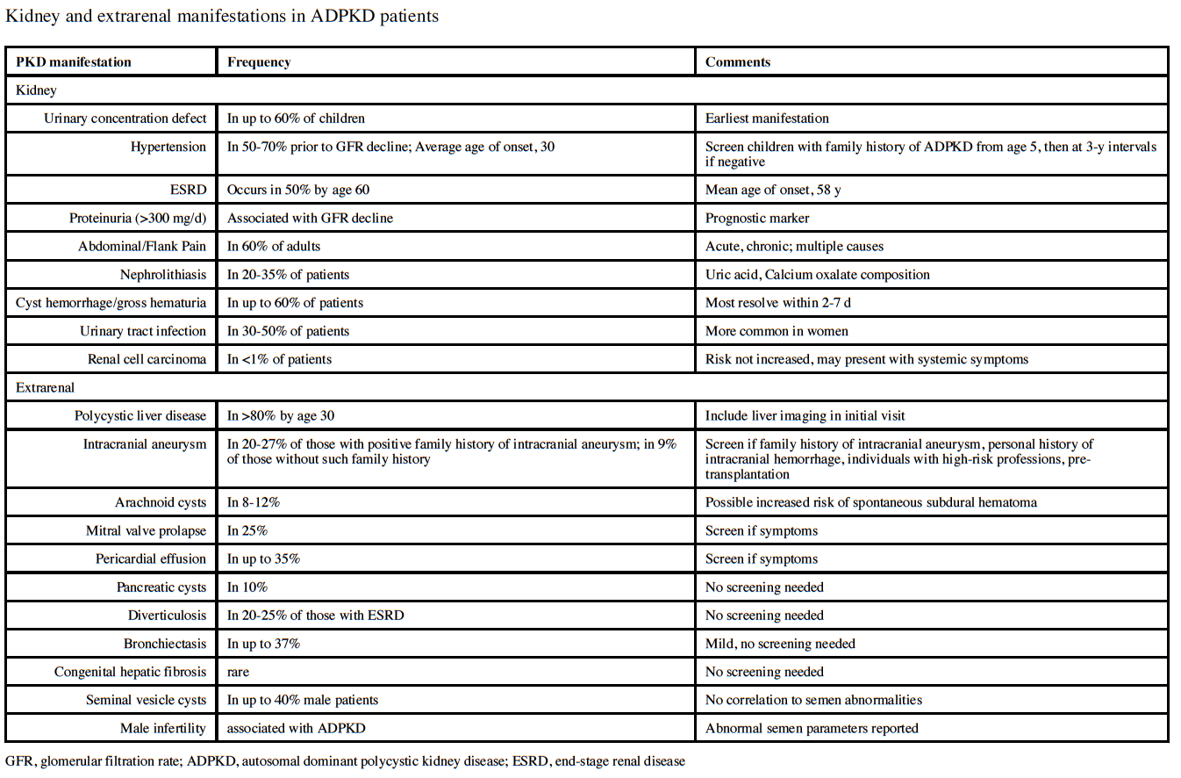
Chebib, FT.; et al.

Slide 30
Treatment: Lifestyle Modifications
Dietary salt <2g/day and calorie/protein restriction
  Positive correlation between 24hr urine sodium excretion and rate of TKV increase
Limit caffeine intake
  cAMP production
Optimize weight, cardiovascular exercise (non-rigorous), avoid smoking, limit NSAIDs
  Overweight and Obesity associated with decline in eGFR and increase in TKV in early ADPKD
High water intake (>3L/day)
  *if normal renal function
  Suppresses vasopressin secretion
  Prevention of kidney stones

Slide 31
Treatment: Hypertension
Rigorous BP control
  110/75 in young patients with preserved kidney function (HALT PKD trial)
Agents
  ACE/ARB are 1st line therapy
    Slower increase in TKV, reduced albumin extraction, greater reduction in LV mass index
  CCB and Diuretics can be used cautiously (may worsen progression)
HALT PKD
  Population: 15-49 years old (1A and 1B excluded)
  Strict BP control associated with a 1% slower increase in total kidney volume
  RAAS inhibition with strict BP control 14.2% slower increase in TKV over 5 years
  No definitive benefit on progression in eGFR (although slower in strict control over 5 years)

Slide 32
Treatment: Vasopressin V2R Antagonist
Tolvaptans
  Studies: TEMPO 3:4, TEMPO 4:4, REPRISE
  TEMPO 3:4 – RCT of 1445 patients (18-50 with GFR >45, TKV >750cc). 3 year follow-up with tolvaptan treated group with slower rate of kidney volume growth (2.8% vs 5.5% per year) and GFR decline (3.70 to 2.72). Greatest effect within 1st year. Significant proportion of treated patients with hepatocellular injury (LFT elevation, reversed with drug discontinuation)
    No difference in decline for low risk of progression
  REPRISE – FDA request for data in advanced disease. Reduction in decline of eGFR in those treated with tolvaptan over 1-year; although this effect was not seen in the subgroup of patients aged at least 55 years.

Slide 33
Tolvaptan Use
18–55 years
CKD Stage 1-4
High risk (MCIC >1C or PROPKD score >6)
Rapid GFR decline: >5ml/min in 1 year or >2.5ml/min per year over 5 years

Slide 34
Treatment: Other
Statins:
  Small RCT 110 children (4-21 years) showed pravastatin slowed growth of htTKV over 3 years
  Post-hoc analysis of other studies (HALT-PKD) does not confer
mTOR Inhibitors:
  Preclinical in murine models were encourage however everolimus and rapamycin did not slow decline in eGFR or the increase in TKV
  Transplant patients: observed decrease in polycystic liver volumes by 12% (compared to >8% growth)
Somatostatin analogs:
  Initial improvement at year 1 but results not sustained
  More promising data for polycystic liver disease
Deroofing (surgical) for hepatic cysts with severe compression symptoms
Percutaneous Drainage of large (>5cm) cysts refractory to antibiotic therapy

Slide 35
Treatment: Transplant
Primary treatment option in advanced CKD/ESRD population
Native nephrectomy prior to transplantation is indicated only in patients with symptomatic recurrent bleeding, infection, stones, severe pain, massive kidney size preventing allograft placement.
  Interference with nutrition/quality of life
ADPKD patients with liver involvement require pretransplant imaging using CT or MRI and measurement of baseline serum CA19- 9 levels
Pre-transplant MRI screening of intracranial aneurysms
Still require ICA follow-up

Slide 36
Transplant
Native nephrectomy prior to transplantation is indicated only in patients with symptomatic recurrent bleeding, infection, stones, severe pain, or massive kidney size preventing allograft placement.
ADPKD patients with liver involvement require pretransplant imaging using CT or MRI and measurement of baseline serum CA19- 9 levels
Pre-transplant MRI screening of intracranial aneurysms in patients with ADPKD should follow general recommendations to identify high risk patients, and control of hypertension and hyperlipidaemia is strongly recommended

Slide 37
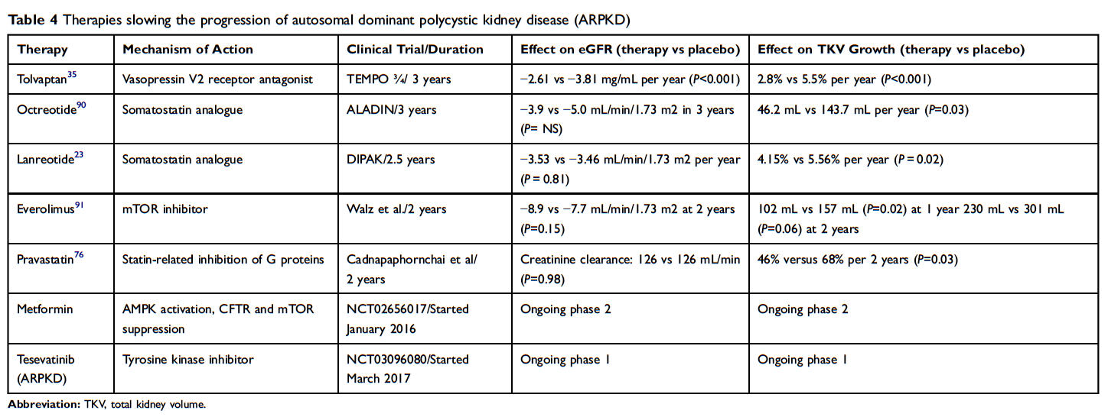
Rastogi, A. et al.

Slide 38
Thank you

Slide 39
References
Bergmann, C.; et al. Polycystic Kidney Disease. Nature Review
Chebib, FT.; et al. ADPKD: Core Curriculum. AJKD
Cornec-Le Gall, E.; et al. ADPKD. Lancet
Gaur, P.; et al. ADPKD: What Radiologist Should Know. BR J Radiology
Gordon, GE.; et al. Assessing Risk of Progression in ADPKD. CJASN
Grantham, JJ.; ADPKD. NEJM
KDIGO: ADPKD Executive summary 2015
NKF Primer on Kidney Disease, 7ed.
Rastogi, A.; et al. ADPKD: Updated perspectives. Therapetuics and Clinical Risk Management

