Slide 1

Chronic Kidney Disease
Jacob Nysather D.O.

Slide 2

Outline
Definition
Staging
Pathophysiology
Causes
Risk Assessments
Management

Slide 3
Role of Kidneys
Excretory, endocrine, metabolic regulation, volume and blood pressure regulation, erythropoietin production, electrolyte regulation, acid-base, mineral balance
Homeostasis

Slide 4
Global Burden of Chronic Kidney Disease
2017: Systemic analysis estimated 697.5 million or 9.1% (8.5-9.8%), 1.2 million deaths from CKD (most burden was concentrated in the 3 lowest quintiles of sociodemographic index)
2021: Estimated 850 million (double diabetes, 20x more than prevalence cancer or AIDS/HIV world wide)

Slide 5
Definition and Staging

Slide 6
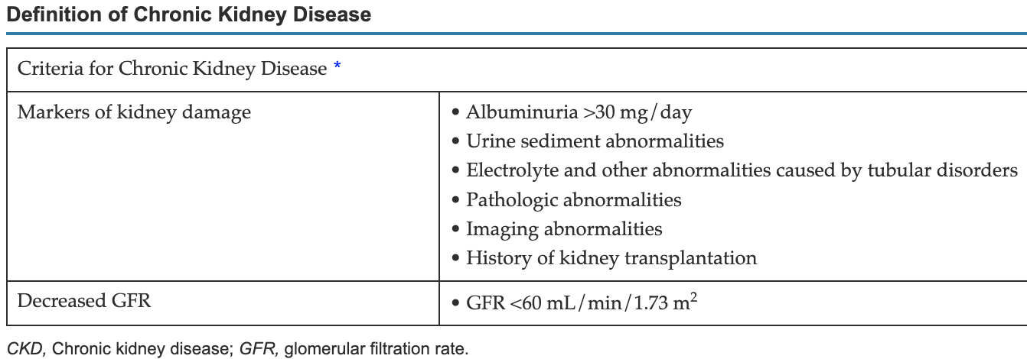
What is Chronic Kidney Disease?
Definition: Abnormalities of kidney structure or function, present for a minimum of 3 months with implications for health
  Definition includes many different markers, but the classification is 2 dimensional
Classification: Causes, GFR category (G1-G5), Albuminuria (A1-A3) abbreviated as C-G-A
Why is it critical to assess for severity and risk?

Slide 7
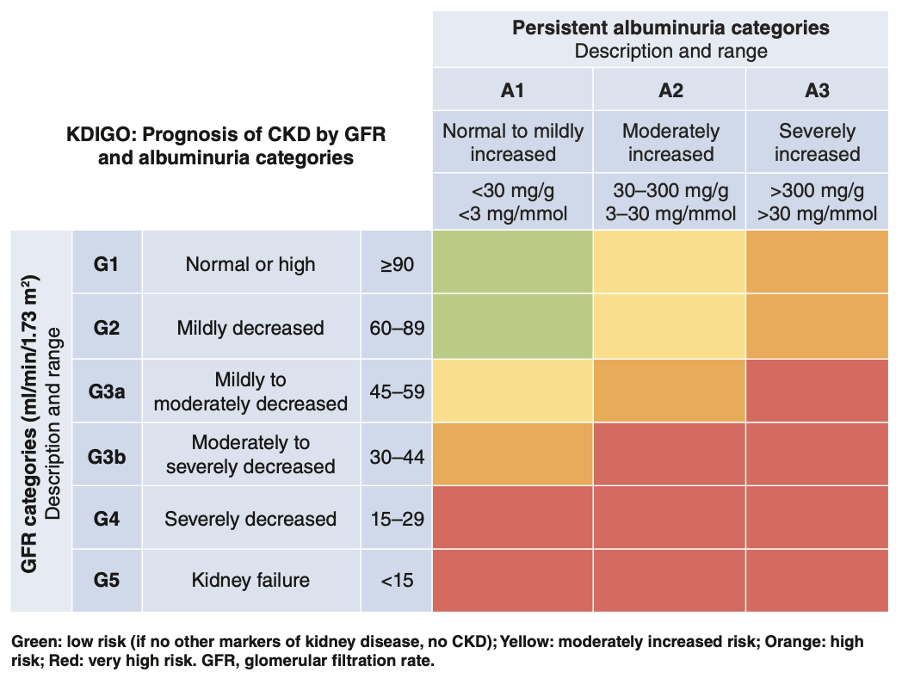
KDIGO Staging and Prognosis

Slide 8
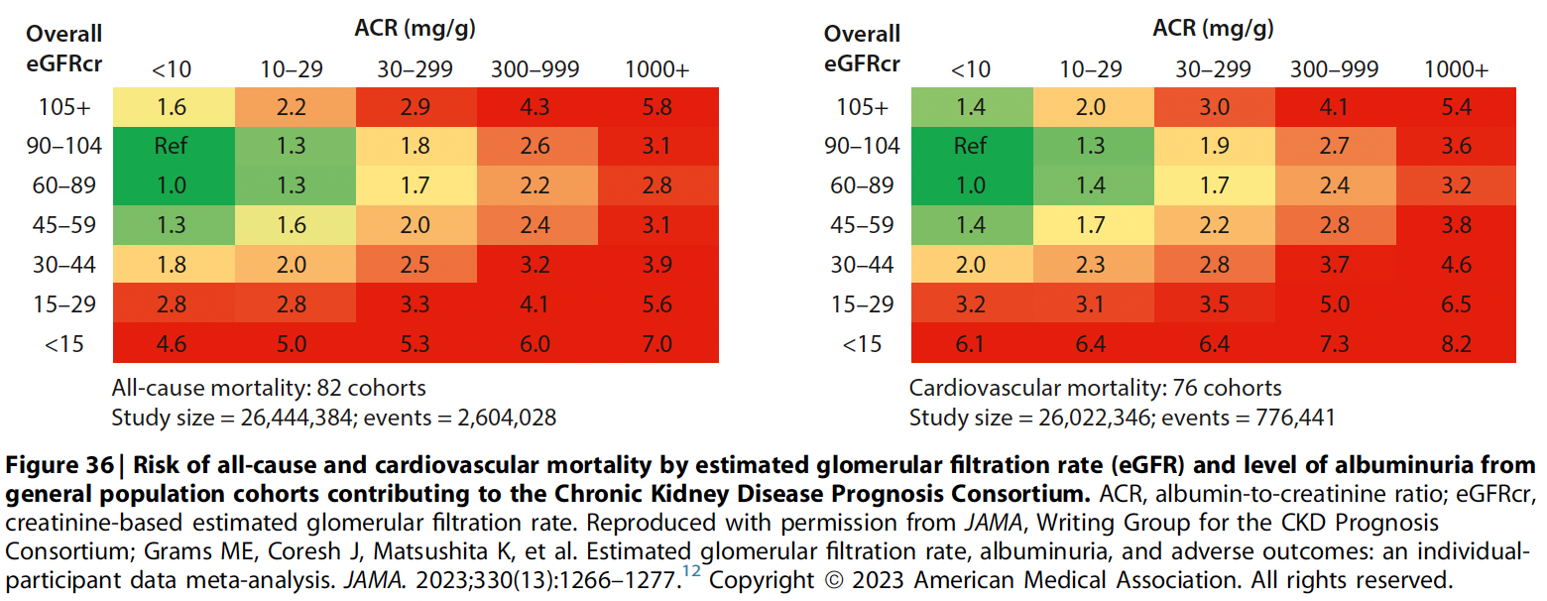
KDIGO Staging and Prognosis

Slide 9
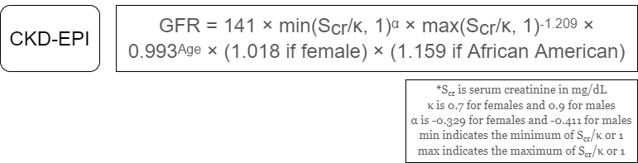
What comprises eGFR?

Slide 10
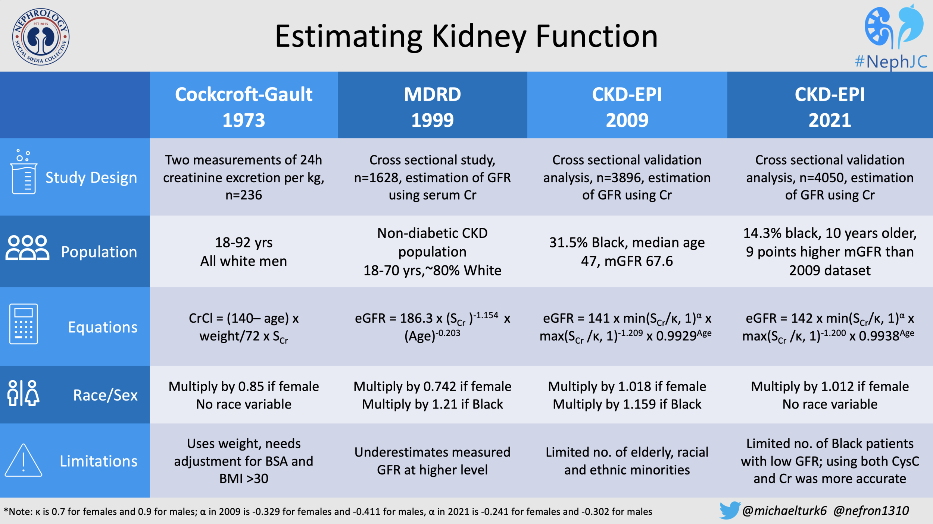

Slide 11
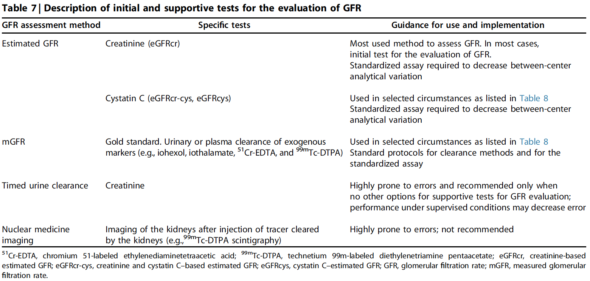

Slide 12
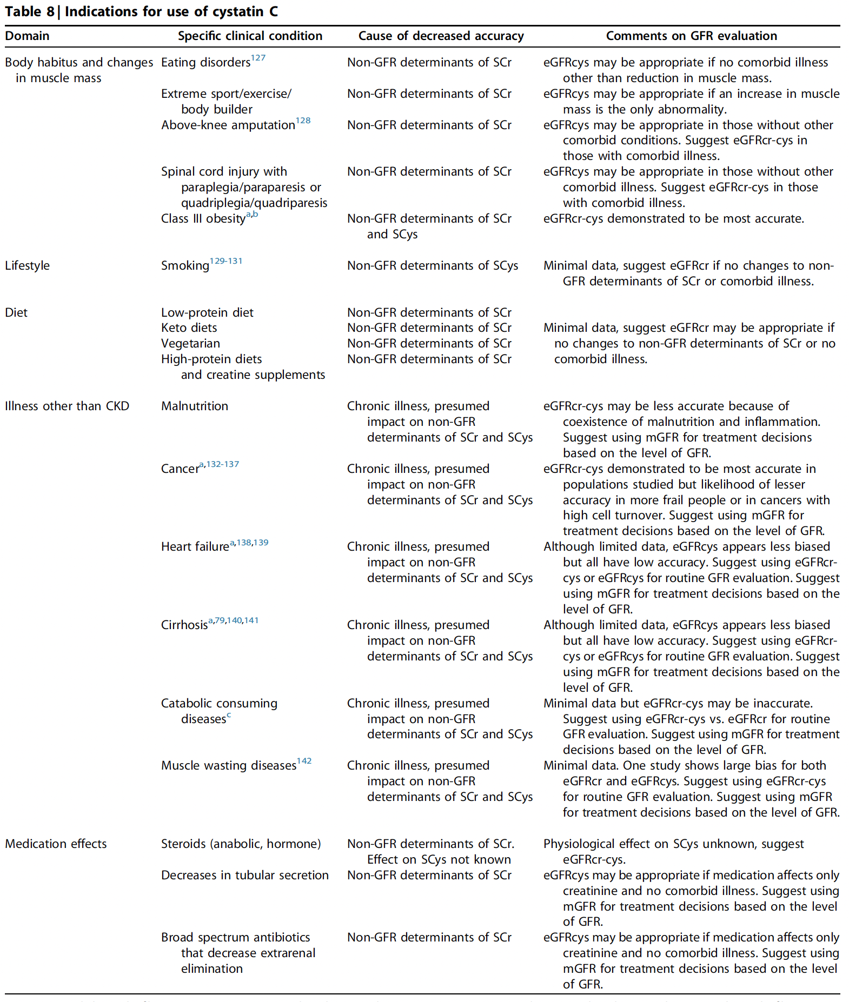
Cystatin C
All nucleated cells
↑ cell turn-over = ↑ Cystatin C
Cancer, Inflammation, Adiposity, Thyroid, Steroid use

Slide 13
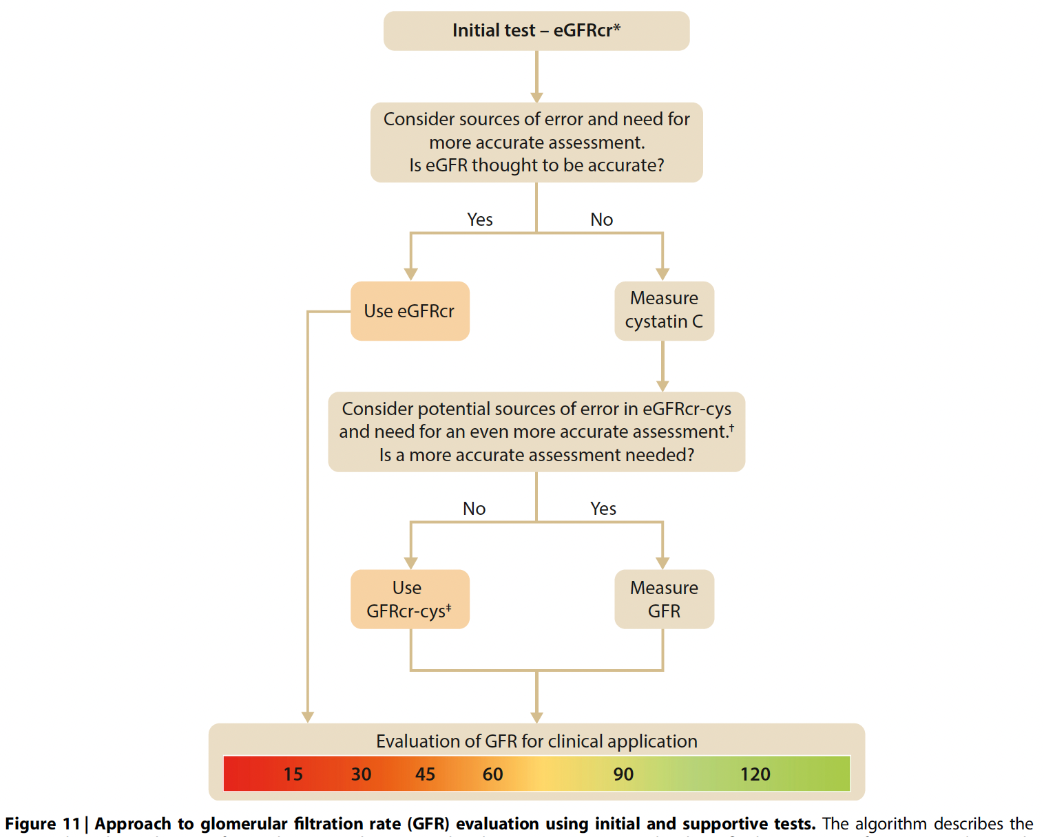

Slide 14
Pathophysiology

Slide 15
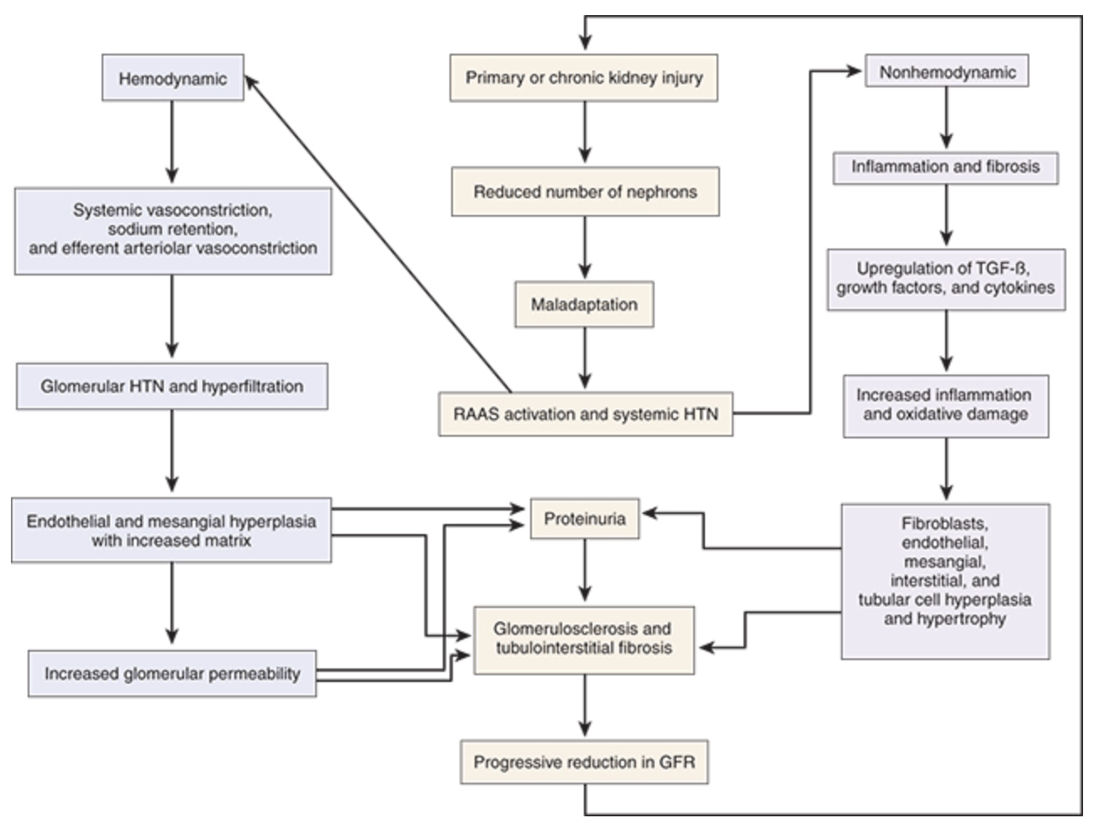
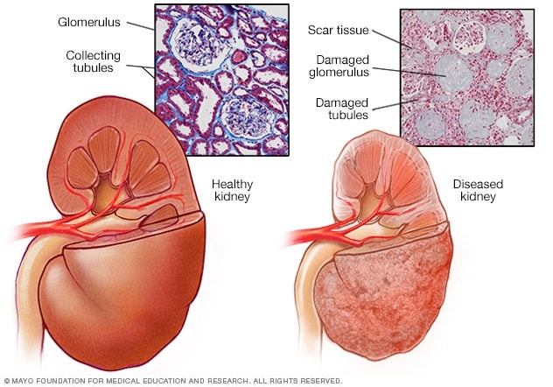
Pathophysiology of Chronic Kidney

Slide 16
Determining the Cause

Slide 17
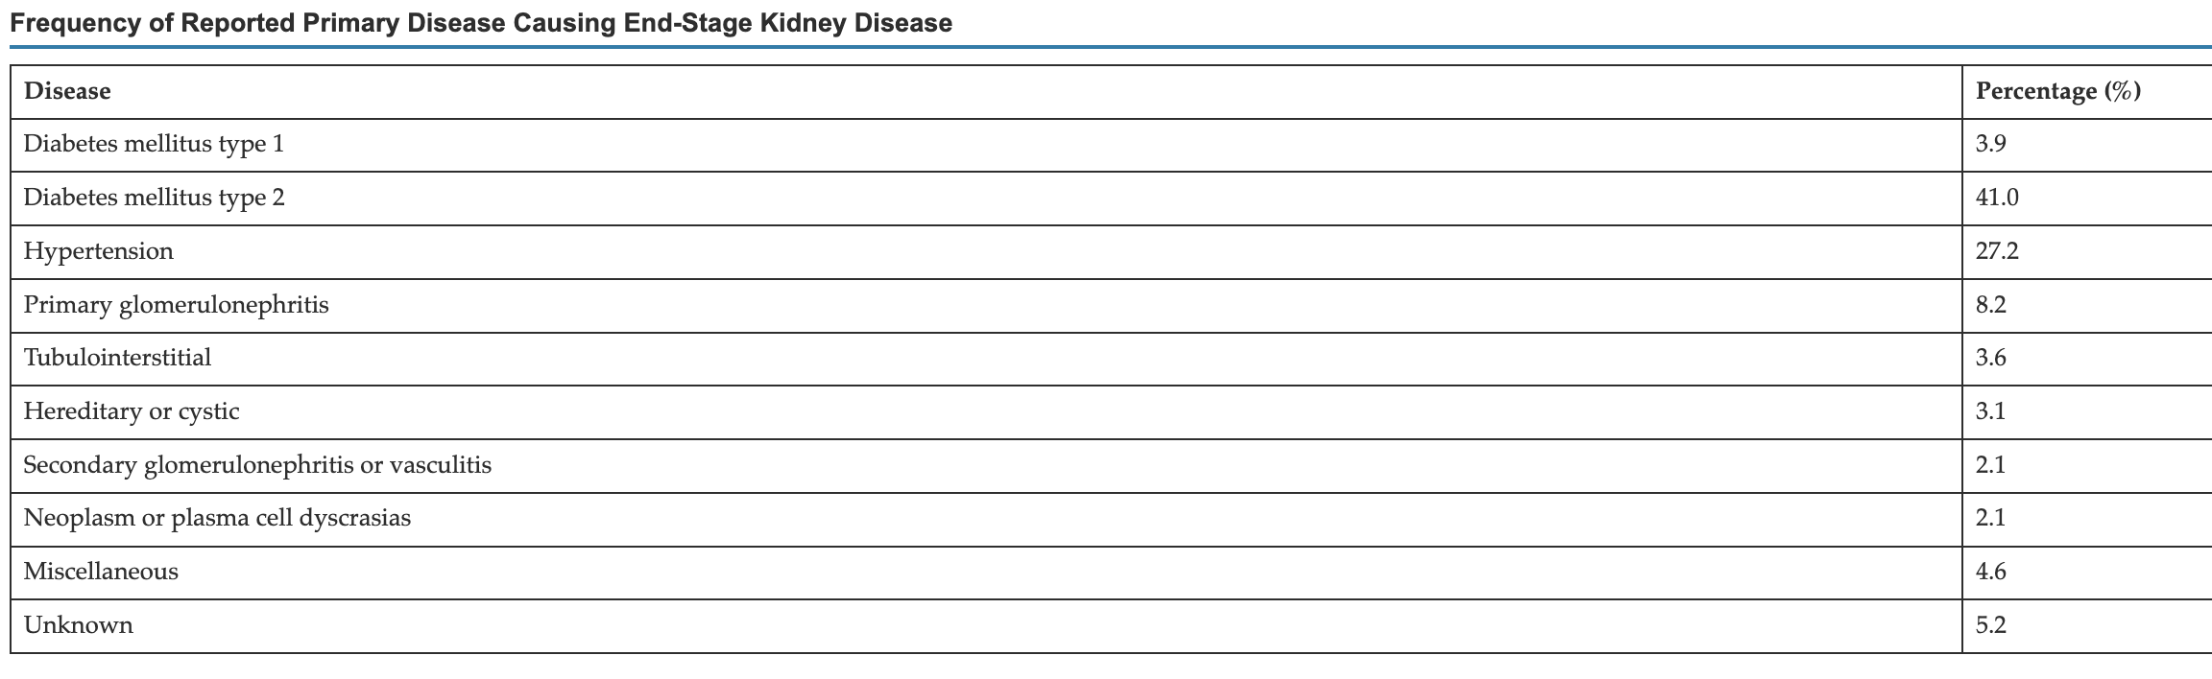
Determining the Cause

Slide 18
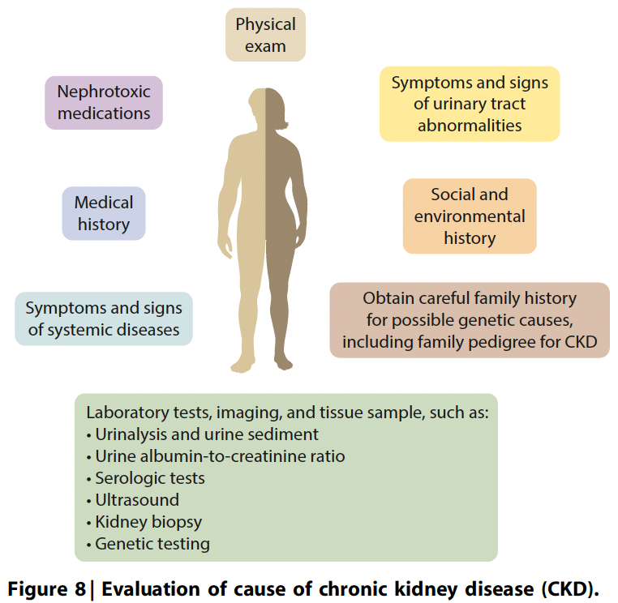
Determining the Cause
Classification of CKD
Presence of Systemic Disease | Primary Kidney Disease
Glomerular Disease
Tubulointerstitial Disease
Vascular Disease
Cystic and Congenital/Genetic Disease

Slide 19
Risk Assessments

Slide 20
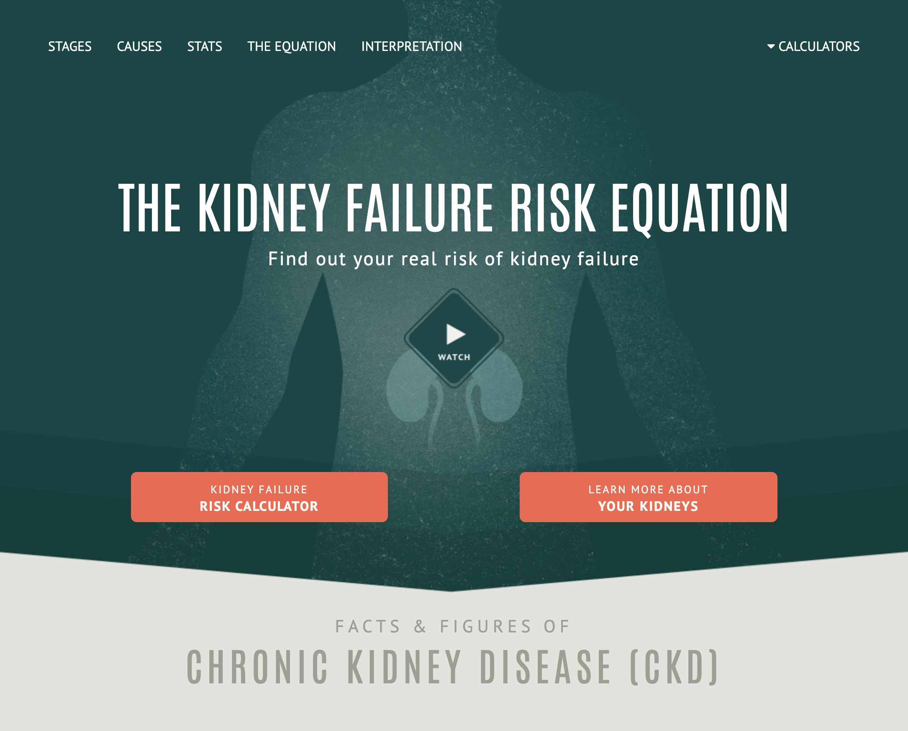
Risk Assessment Tools
Renal Progression
  The Kidney Failure Risk Equation (KFRE)
  Z6 Score*
  https://www.ckdpc.org/risk-models.html
Cardiovascular
  QRisk3
  ASCVD
  PREVENT
Contrast
  Mehran Score
  Thakar Score

Slide 21
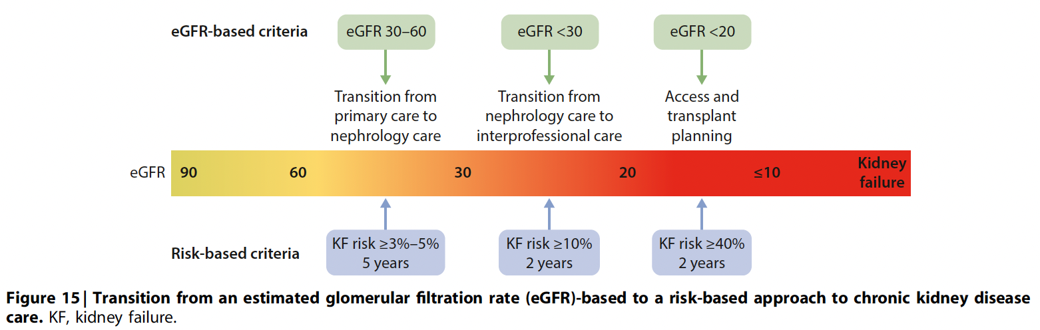

Slide 22
Managing Kidney Disease

Slide 23
Managing Chronic Kidney Disease
Complications of CKD
Slowing Progression
Hypertension
  Goal < 120mmHg*
Cardiovascular Risk
  Statin, Weight Loss
Acidosis
  Sodium Bicarb/Citrate
Hyperkalemia/Electrolyte
  Diet, Binders, Diuretics
Edema/Volume
  Sodium Diet (<2G), Diuretics
Bone-Mineral Disease
  Binders, Vitamin D
Anemia
  Iron/ESA
RAAS Inhibition
  Efferent vasodilation causing decrease intraglomerular pressure
  Albuminuria
SGLT-2 Inhibitors
  Reduced hyperfiltration through Tubulo-Glomerular Feedback
  Diabetics, CVD, Albuminuria, ?CKD
Mineralocorticoid Receptor Antagonist
  ns-MRA: Finerenone
    Fidelio and Figaro
  Steroidal-MRA: Spironolactone, Eplerenone
  Reduces aldosterone mediated fibrosis
Other
  Underlying disease process
  Hypertension and Diabetes management
  Weight Loss (GLP1-RA, FLOW)
  Diet (sodium, protein?)

Slide 24
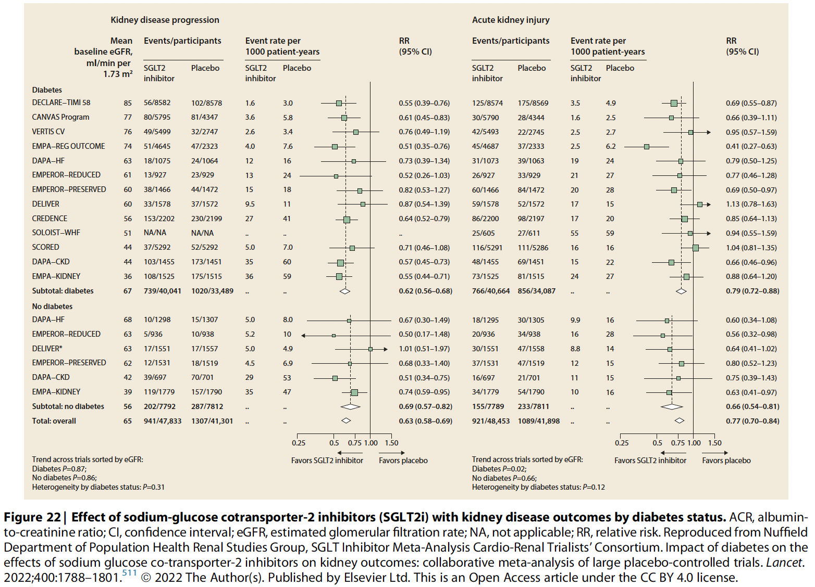

Slide 25
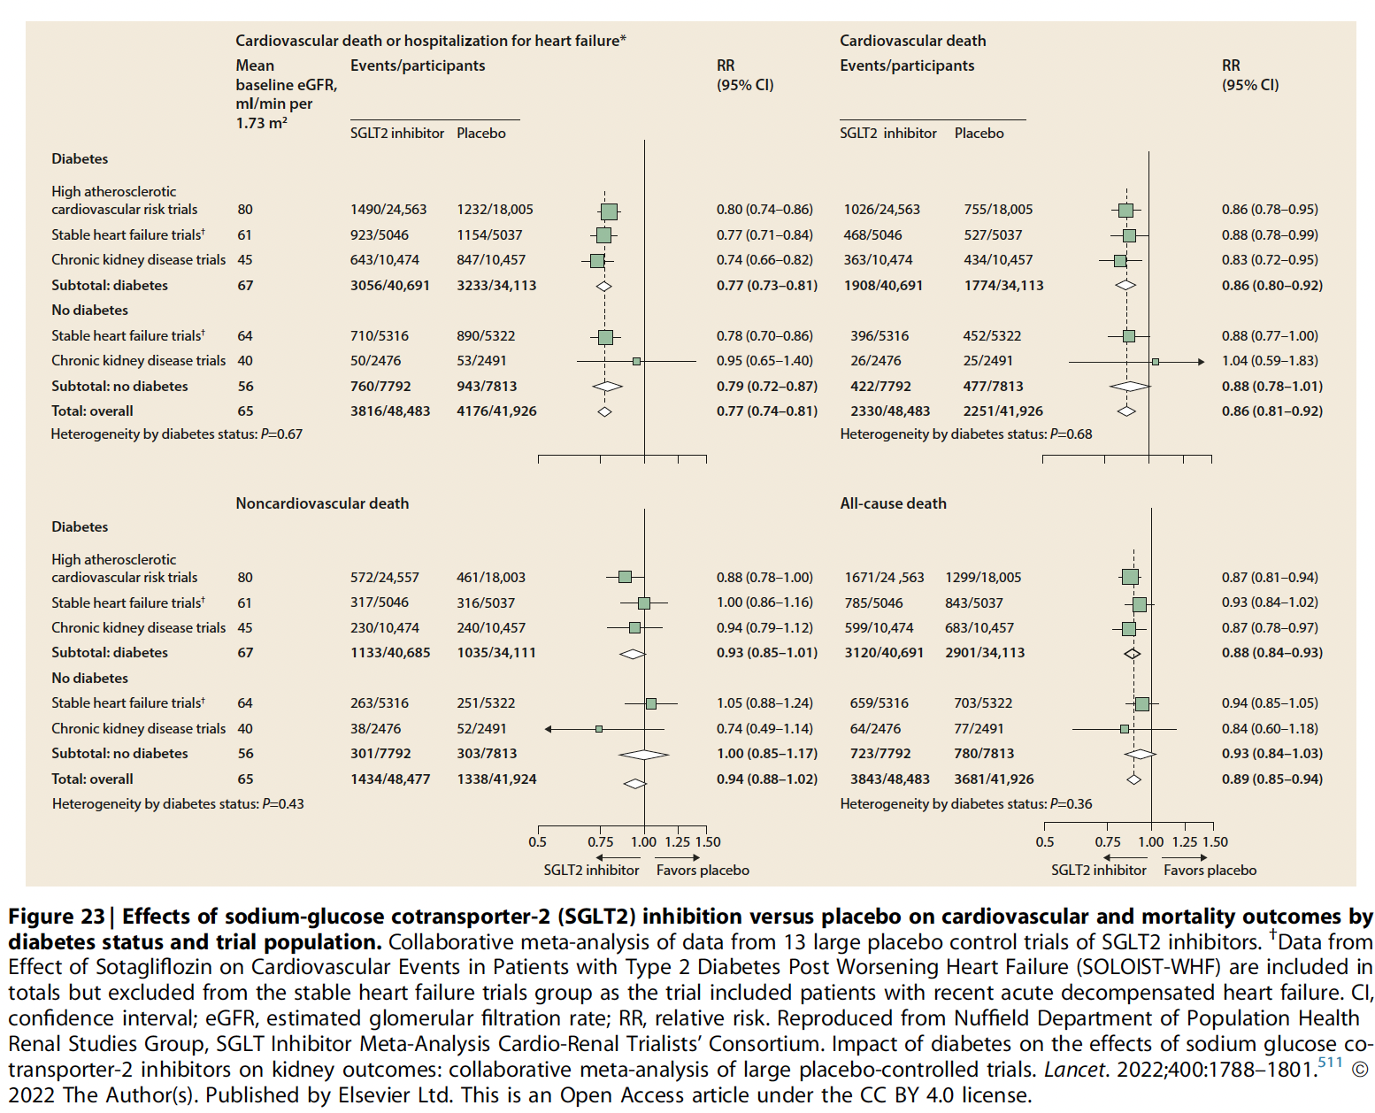

Slide 26
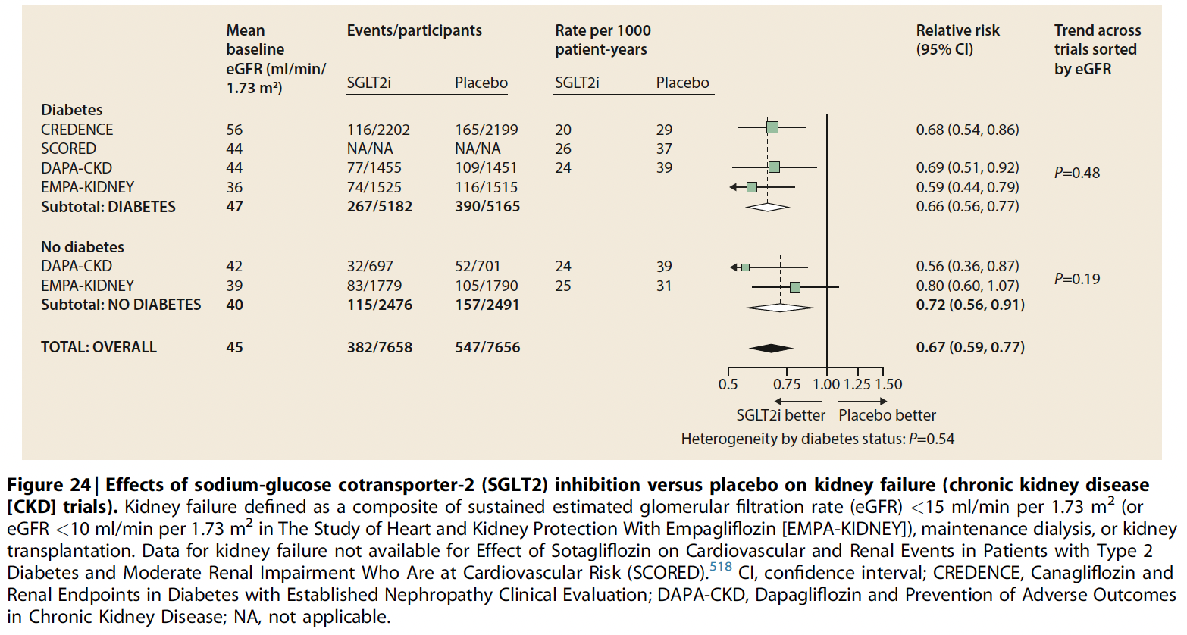

Slide 27
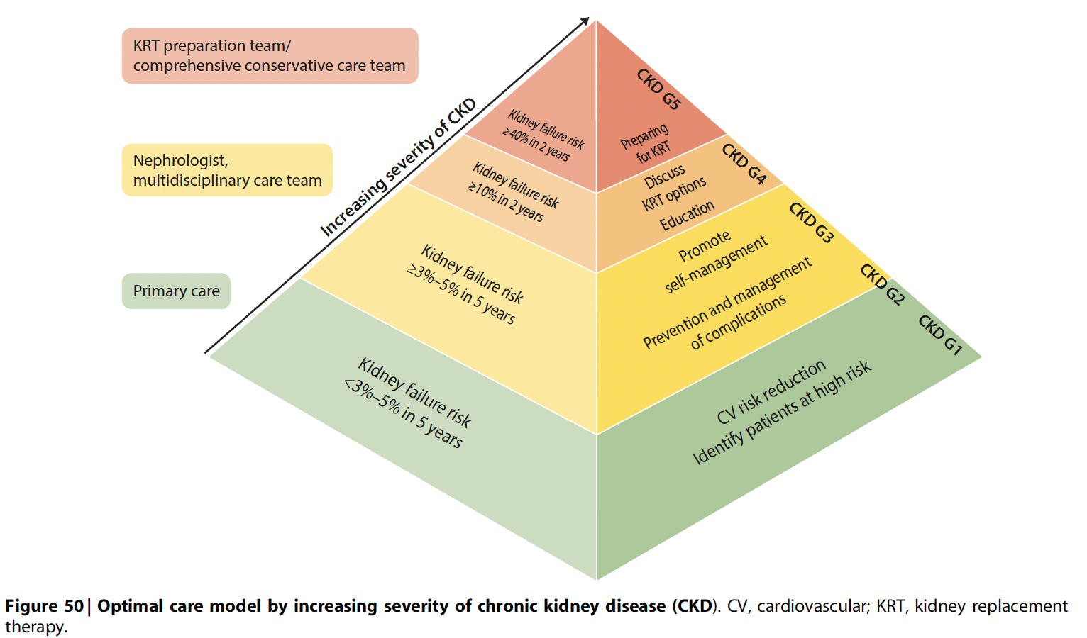

Slide 28
Questions

Slide 29
Resources
KDIGO 2024 CKD Guidelines
NKF Primer, 8th ed.

