Slide 1
Pump Pump Pump It Up
Jacob Nysather D.O. PGY-4

Slide 2
Disclosures
None

Slide 3
Outline
Case (brief)
HF and LVAD Indications
Types
Parameters
AKI
Other Complications

Slide 4
Case
55 year old male with PMH of Nonischemic HFrEF (20-25%) and grade III diastolic dysfunction, hx of dual chamber AICD (2018), CKD III (baseline Cr ~1.5), DMII, HTN, HLD, OSA (on CPAP), Gout, obesity. Patient initially presented to OSH for worsening dyspnea on exertion associated with orthopnea and PND.
PMH: NICM HFrEF (20-25%) with grade 3 diastolic, AICD, CKD 3, DM2, OSA on CPAP, Gout, HTN, HLD
PSH: Right shoulder unspecified. RHC x3, LHC, AICD
Meds: ASA, Atorvastatin, Allopurinol, Dapagliflozin, glipizide, Levemir, Coreg, Entresto, Aldactone, Torsemide Metolazone, iron
NKDA
SH: former smoker, quite 25 years prior (~30 years old)
FH: Noncontributory

Slide 5
ECHO: LVEF 15% diffuse hypokinesis, consistent with restrictive physiology, moderate MVR
LHC and RHC: Elevated PCWP with hypervolemia. Severely reduced CO/CI with elevated PA pressures. Mild luminal irregularities
Was transferred to our facility for Cardiogenic Shock on Milrinone

Slide 6
Cr 2.5 (base ~1.5)
Una 68, Ucr 65, UPCr 0.06
Infectious: HBV, HCV, HIV, RPR negative
SPEP/UPEP Negative. K/L 1.75
ANA 1:80 speckled and homogenous
Otherwise ANA and ANCA panel negative
C3 180, C4 43
US: R 9.6cm, L 9.7cm. No hydro. Sub-optimal visualization

Slide 7
Cr and volume status improved with Milrinone and diuresis. Nephrology signed off
Was reconsulted after LVAD Placement for hypervolemia with persistent shock
Course complicated by ?MRSE bacteremia (prior to LVAD), Driverline infection (exit site), recurrent respiratory failure requiring trach, a-flutter s/p cardioversion
AKI requiring extended course of CRRT and SLED, complicated by pressure management
Ultimately recovered within 3 months of CRRT initiation with now baseline ~2

Slide 9
Heart Failure and LVAD
5.5 - 7 million American suffer from congestive heart failure (CHF)
Incidence of 21 per 1,000 in population above the age of 65 years
Advanced heart failure with or without CKD have a 1 year survival of 25%
In patients with advanced CHF refractory to medical therapy, implantable left ventricular assist devices (LVADs) improve quality of life and survival (52% vs 25% at 1 year for 1st generation ineligible for heart transplant)
Since 2006, over 25,000 adults have received LVADs

Slide 10
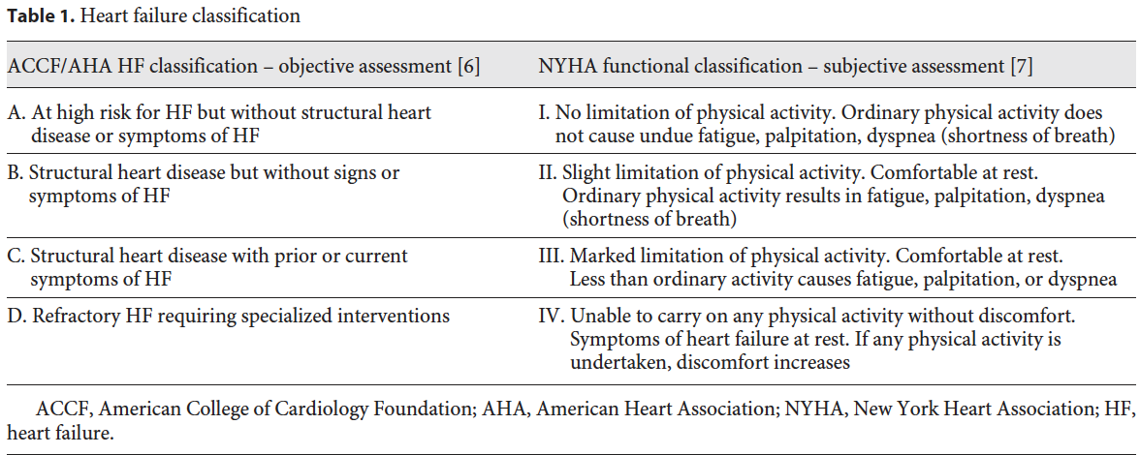

Slide 11
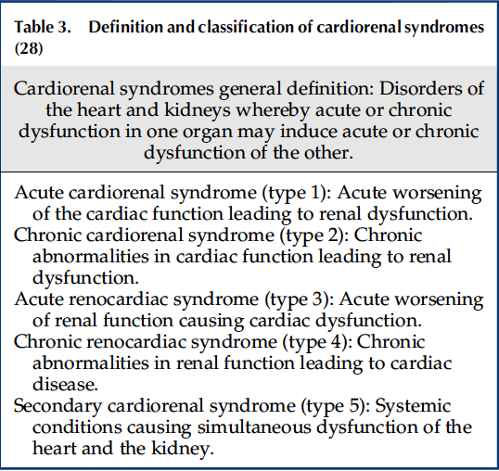
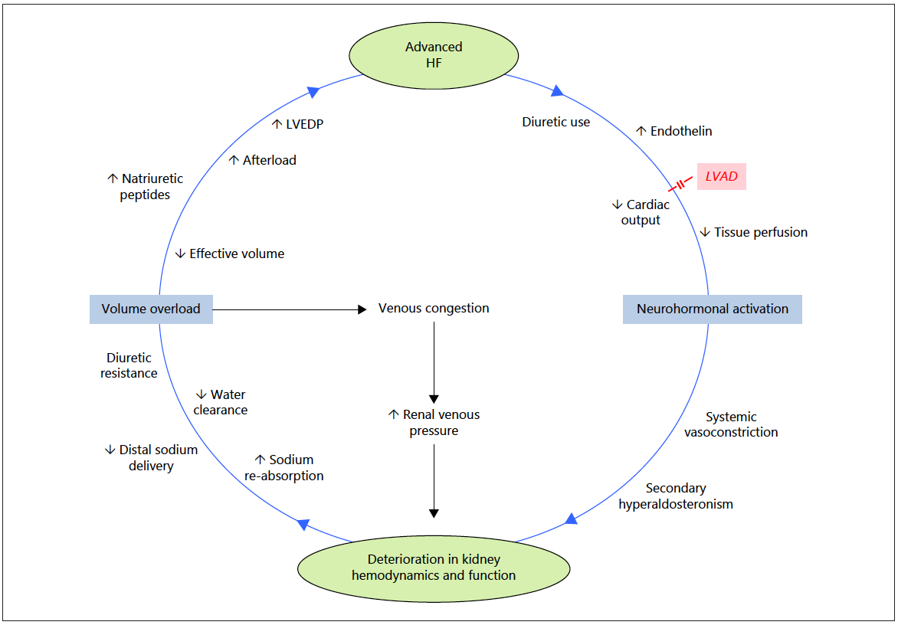
Ross DW, et al. Clin J Am Soc Nephrol. 2018.
Kamboj M. Blood Purif. 2019
Notes:
CRS 1: decreased kidney perfusion from reduced cardiac output and/or high backward pressure and renal venous congestion
CRS 2: Chronic HF leads to increased neurohormonal activation, increased renal venous congestion and RASS activation resulting in progressive decline
Fig. 2. Proposed pathophysiologic pathways underlying HF and kidney dysfunction. Advanced HF can lead to deterioration in kidney function via exacerbated neurohormonal activity (i.e., low forward
flow) or through fluid overload and renal venous congestion (i.e., high backward pressure). Image adapted with publisher’s permission from [12]. LVAD could potentially break this vicious cycle via correction of low cardiac output. LVAD, left ventricular assist device, LVEDP, left ventricular end-diastolic pressure; HF, heart failure.

Slide 12
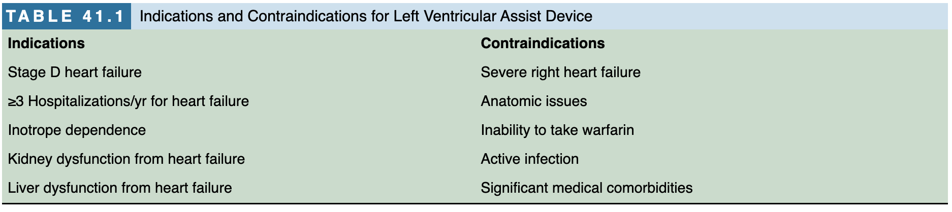
LVADs may be a bridge to transplant (BTT) to support while awaiting heart transplant or a permanent destination therapy (DT) if not a candidate
International Society for Heart and Lung Transplantation guidelines for mechanical circulatory support have thus recommended that the requirement for permanent KRT is a contraindication for LVAD implantation as a destination therapy but is not a contraindication in those receiving LVAD as a bridge to HT
  Median survival of just 16 days as compared with 2125 days for patients without ESRD or a need for dialysis
Handbook of Critical Care Nephrology

Slide 13
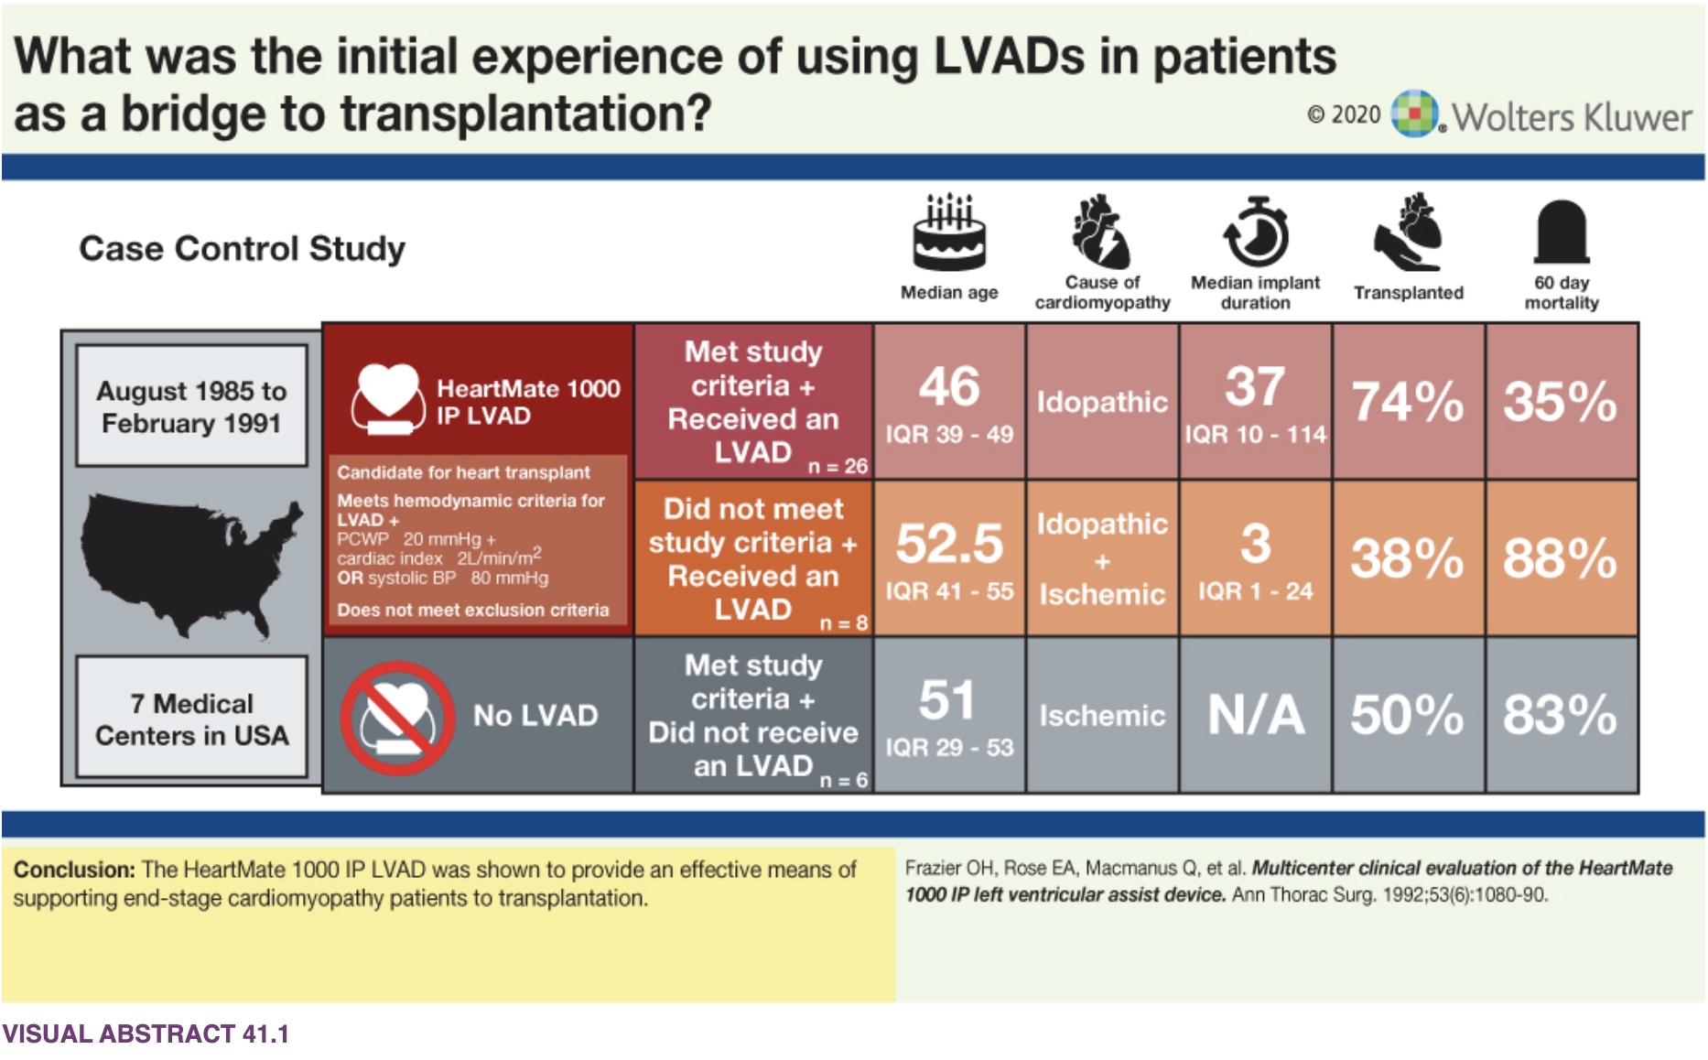
Handbook of Critical Care Nephrology

Slide 14
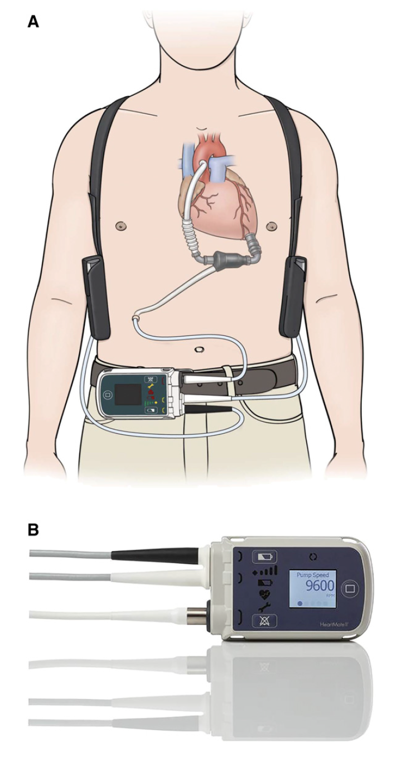
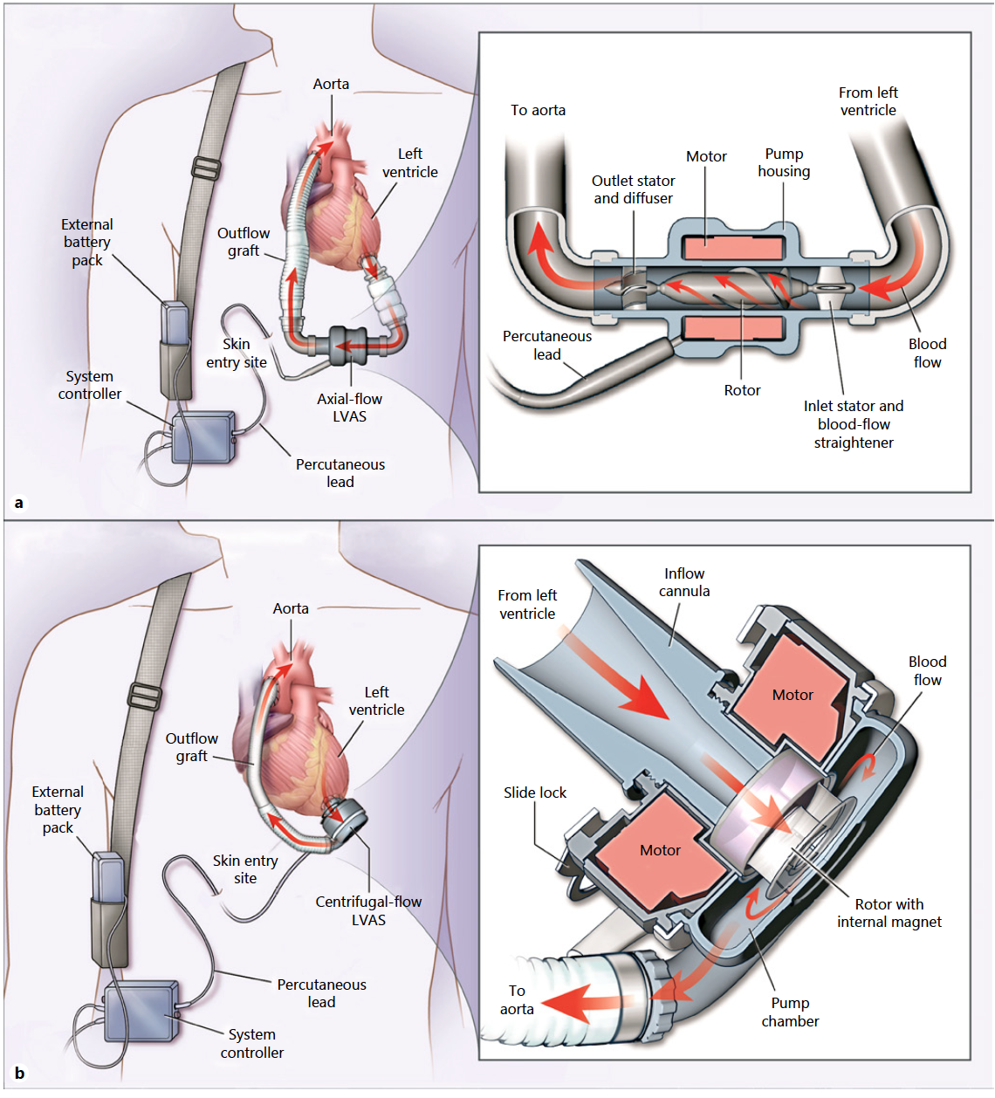
Ross DW, et al. Clin J Am Soc Nephrol. 2018.
Kamboj M. Blood Purif. 2019
Notes:
Figure 1. A: HeartMate II LVAD. our components: implantable pump, driveline, external power source (e.g., batteries), and a system controller. Blood travels from the apex of the left ventricle through the inflow cannula, into the pump, and out via a graft that is attached to the ascending aorta and to the systemic circulation effectively bypassing the aortic valve. B: A closeup of the HeartMate II system controller with parameters (speed, flow, power, and pulsatility index
continuous low-level hemolysis
Fig. 2. A: 2nd generation LVAD with axial flow (along axis of rotor). B: 3rd generation fully magnetic centrifugal-flow
Newer models are lowering device thrombus but not mortality
Mechanical pump that is surgically attached to LV apex via an inflow cannula and to their aorta via an outflow cannula, moving blood from heart to rest of body as a means of augmenting cardiac output.

Slide 15
General Mechanics
Continuous flow (2nd-3rd gen) rather than pulsatile (1st gen)
Preload dependent and afterload sensitive
  Caution with antihypertensive therapy, negative inotropes (beta-blockers) and non-dihydropyridine (decrease preload)
  ACE/ARB preferred (decrease afterload)
  Increased afterload can reduce pump output and/or cause retrograde flow through the LVAD due to the absence of valves in the device
Program speed. Calculate pump flow and pulsatility index

Slide 16
Pump Speed (rpm)
Increased Speed
  Decrease pre-load ultimately causing LV and LA collapse causing instability
  Aortic Insufficiency
Decrease speed
  Placement in descending aorta: proximal thrombus or coronary occlusion
  Intravascular hemolysis
  Platelet activation
  Interventricular septal shift with decreased right ventricular function

Slide 17
Pump Flow
Derived from set pump speed and measured power usage (NOT a direct measurement)
↑speed = ↑flow; ↓speed = ↓flow
Inversely related to the pressure differential across the pump
Dependent on both preload and afterload

Slide 18
Pulsatility Index
Calculated value from LVAD pump over an interval of 15 seconds
  [(flow maximum – flow minimum)/flow average] x 10
Can reflect preload (low = inadequate preload; I.e. excessive UF, negative inotropes (RV function), venodilators, sepsis)

Slide 19
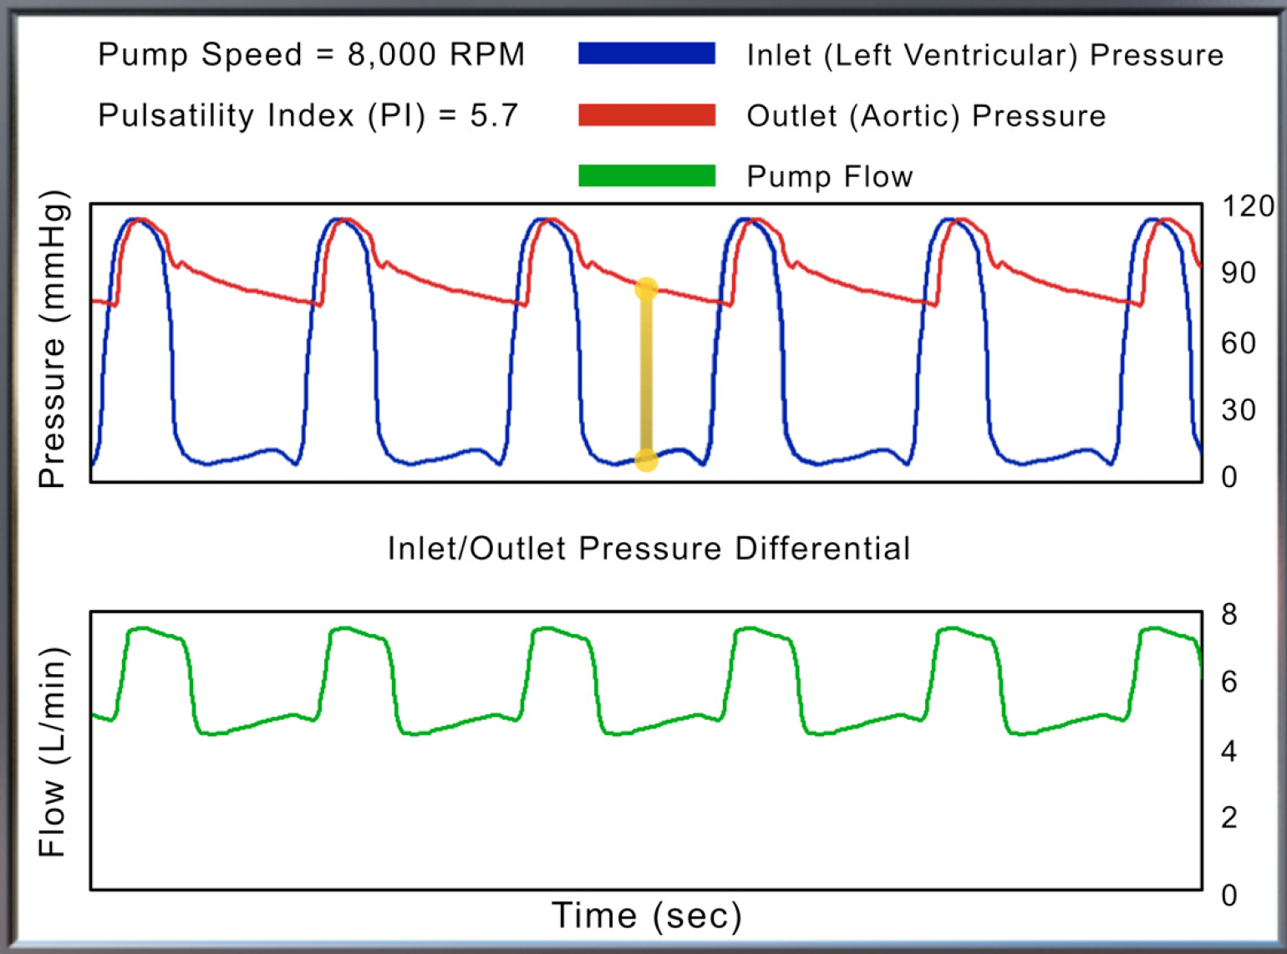
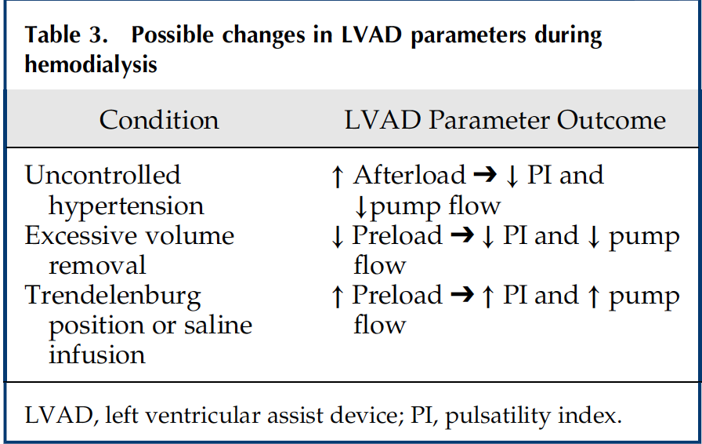
Jawaid O, et al. Adv Chronic Kidney Dis. 2021
Notes:
Figure 2. | Relationship between LVAD flow and pressure. The pump flow is inversely related to the pressure differential across the pump,
which is the difference between the pressure measured at the outflow cannula (i.e., aortic pressure, as shown by the red line) and that at the
inflow cannula (i.e., left ventricular pressure, as shown by the blue line). As the pressure difference between these two locations decreases
(during systole), the pump flow (green line) is increased. As the pressure differential increases (during diastole), the pump flow (green line) is
decreased because the pump must overcome this increased pressure difference (yellow line) in order to propel blood forward. Reprinted from
reference 79, with permission.

Slide 20
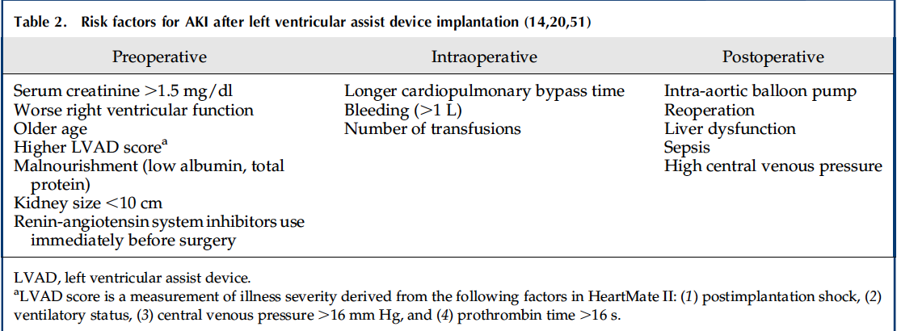
AKI and Patient Outcomes
Incidence of early AKI ranges from 10% to 45%
Need for RRT ranges from 6-32%
  Mortality is high among patients who develop AKI reaching up to 75% in those requiring dialysis
  Unclear is kidney failure itself causes increased mortality or if kidney failure is a marker of multi-organ failure
Ross DW, et al. Clin J Am Soc Nephrol. 2018.
Notes:
*most improved after (opposite of table)
56.1% diagnosed with AKI (defined by top 15 discharge codes) (49.6% without dialysis and 6.5% with dialysis)
In hospital mortality 14.5% with noted decline of 36.7% down to 10.2%
AKI-D 40% higher absolute mortality risk than without (AKI without dialysis present from >20% down to <10%)

Slide 21
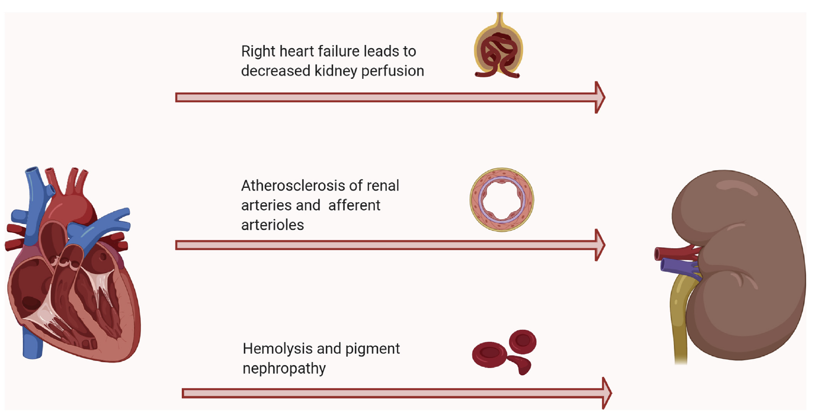
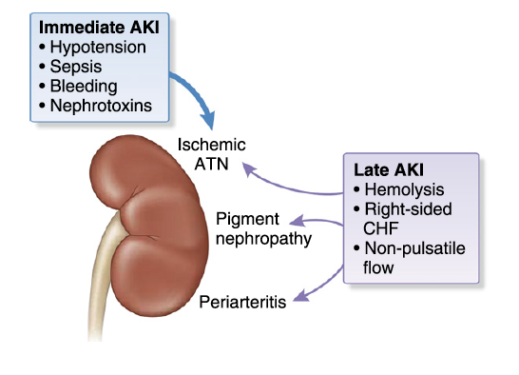
Jawaid O, et al. Adv Chronic Kidney Dis. 2021
Ross DW, et al. Clin J Am Soc Nephrol. 2018.
Notes:
Figure 1. Mechanisms of late kidney dysfunction after LVAD implant. Abbreviation: LVAD, left ventricular assist device.
Figure 2. | Many factors contribute to early and late AKI after LVAD. Postulated mechanisms of immediate AKI and late stage AKI. ATN, acute tubular necrosis; CHF, congestive heart failure.
Late
(1) chronic hemolysis, ( iron/hemosiderin deposition in tubular cells )
(2) diminished pulsatility resulting from continuous flow
(3) progressive right ventricular failure

Slide 22
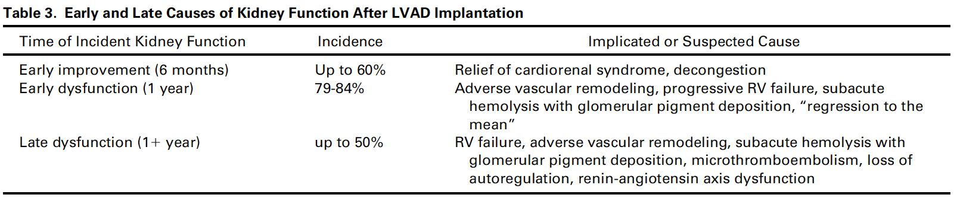
Jawaid O, et al. Adv Chronic Kidney Dis. 2021

Slide 23
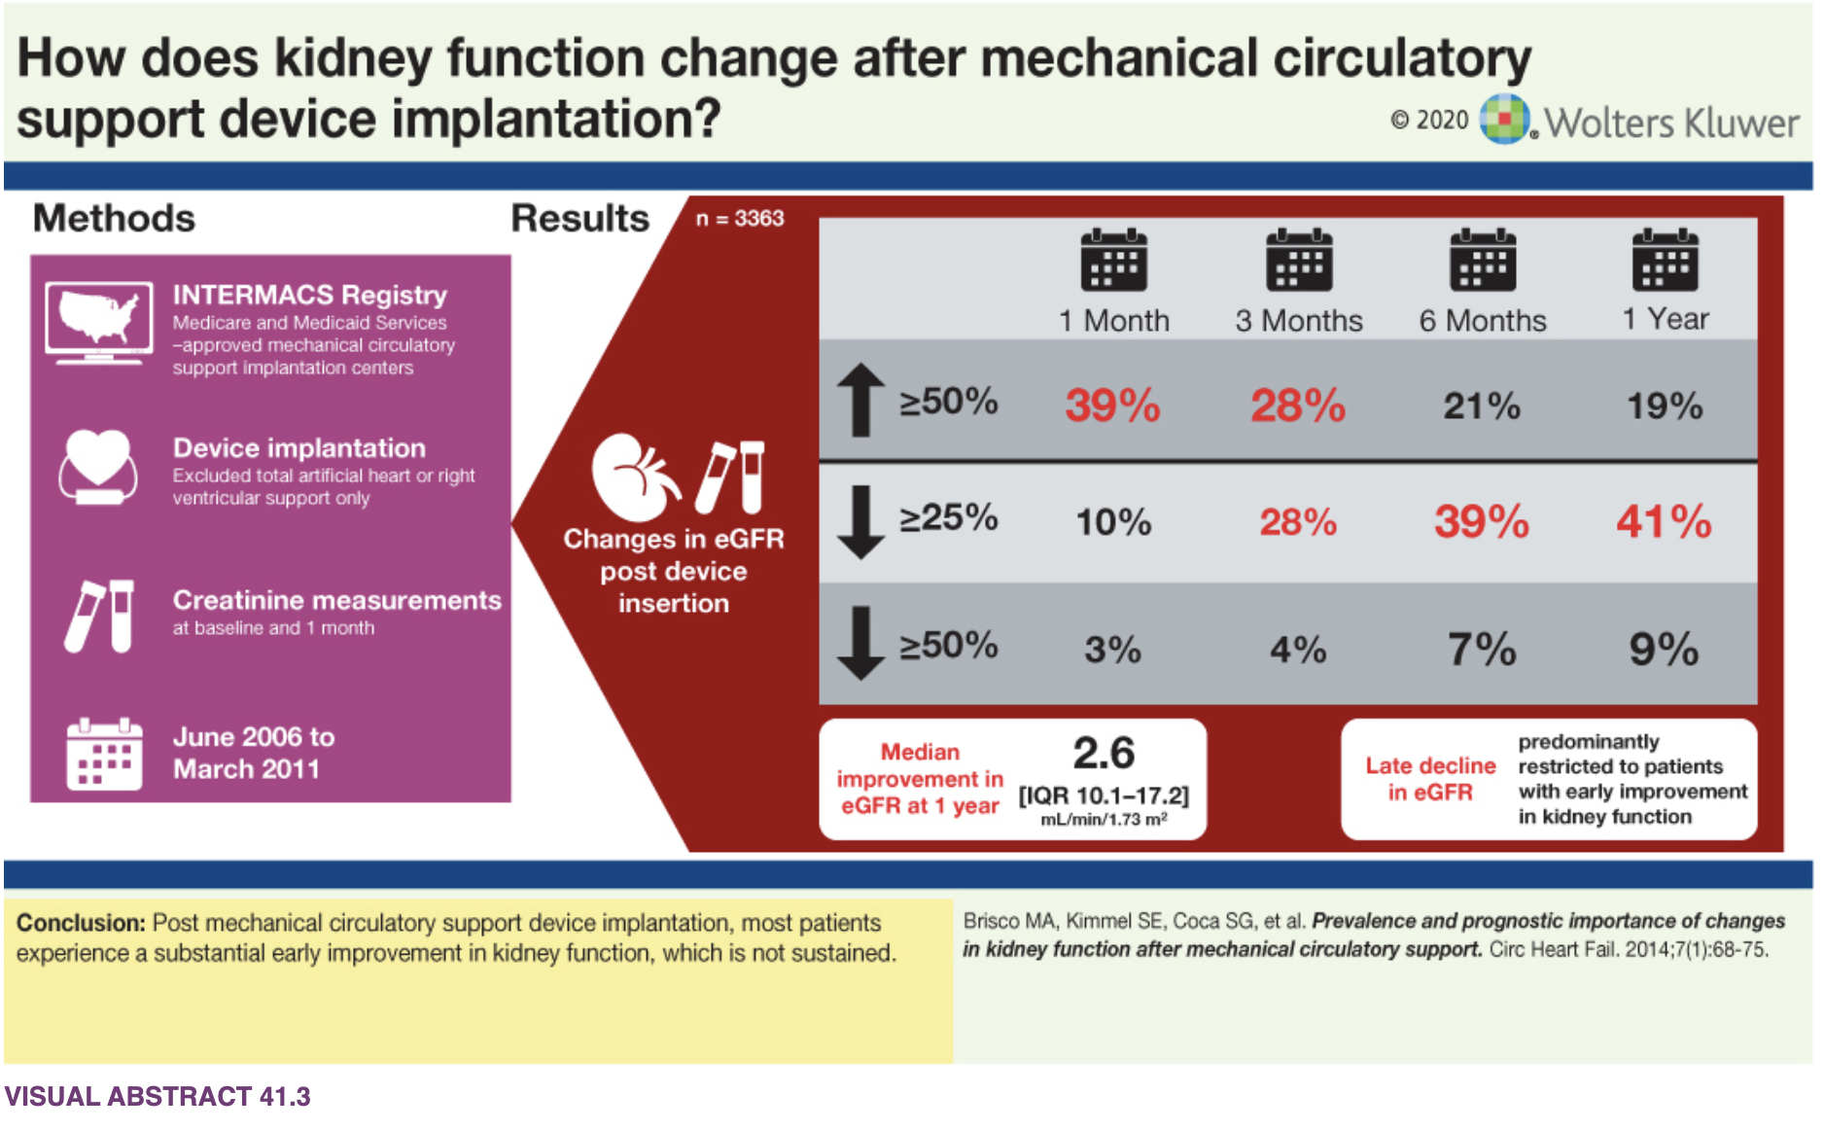
Handbook of Critical Care Nephrology
Notes:
However, the currently available data show an intriguing pattern of post-LVAD kidney function. In a study by Brisco et al. [27], nearly half of the patients (i.e., 48.9%) initially experienced improvement in GFR after LVAD implantation. But this improvement was only short lived for majority of the patients; after 1 month, a decline in GFR was noted such that GFR was only 2.6 mL/min/1.73 m2 above the pre-LVAD level at 1 year.

Slide 24
Dialysis with LVADs
Hemodialysis is currently favored modality
Blood Pressure Measurement
  Art line or doppler manual pressure (gold standard)
  Radial pulse palpable -> Doppler = systolic
  NOT palpable -> Doppler = MAP
  MAP goal 70-80mmHg ideal (range listed depending on article 60-90mmHg)
Blood Pressure issues
  Hypotension = lack of perfusion. May require vasopressors or inotropes
  Hypertension = high afterload = decreased LVAD flow = increased risk of stroke, thromboembolic events, and aortic insufficiency
Hypotension, vasopressors and inotropes may be used in consultation with heart failure cardiologist

Slide 25
Maintenance Dialysis
iHD is most frequently used maintenance modality but
  PD and home-hemo are options (latter may be preferable given lower ultrafiltration rates with resultant lower cardiac demand particularly for those with right ventricular failure)
Catheters are most frequently used for HD access
  Acute nature of HD needs
  Higher risk of infection
  Vasculature may not be favorable (implanted devices or PICCs)
If adequate vessels, an AV fistula or graft should be considered
  Several reports describe successful AV fistula creation in LVAD patients even without pulsatile flow
Dry weights?
Use Pulsitility Index to aid in volume assessment
ESAs
  Reported to avoid (occasional case reports with increased risk with elevated GFR and risk of device thrombus)
  Use with caution but reasonable with advanced CKD (avoid high dosing)
Notes:
Although concerns are natural regarding the use of continuous vs intermittent kidney replacement therapy in post- LVAD patients, intermittent HD seems to be well tolerated.
Quader et al. (37) reviewed ten patients that required hemodialysis (HD) on LVAD support. A total of 281 HD sessions were administered for 1025 hours. Only 5.3% of sessions were interrupted, and only two of these were for low flow LVAD alarms. No serious adverse events were noted in these patients

Slide 26
Common LVAD Alarms
Low-flow alarms typically = low circulating volume or obstruction
Suction event alarms occur when the inflow cannula pulls against the intraventricular septum (LV preload is insufficient to meet demands)
  Both of these events are initially treated with volume infusion (suction events may respond to decreasing the pump speed, not us)
High power if obstruction in pump (thrombosis) where power increases to maintain speed

Slide 27
Ischemic Events
Increase risk of VTE (ischemic strokes and pump thrombosis)
  Pump Thrombosis = increased power and hemolysis
  Suffering a stroke increases risk of 30-day mortality up to 25% higher. 12-21% will suffer stroke
Lower MAP with medical management = lower ischemic risk
Antithrombotic and antiplatelet agents
  ASA 81 and Warfarin (INR typically 2-3)*
  DOACs have not been formally studied
Notes:
HeartMate 3 is favored over older due to lower risk of pump thrombosis (<2% compared to 14% of axial flow)

Slide 28
Hemorrhagic Events
GI Bleed
  Acquired von Willebrand syndrome - increased clearance/breakdown
  Arteriovenous (AV) malformations
  Angiodysplasia – vascular remodeling with loss of vascular integrity
Hemorrhagic Stroke
  1month survival of 45% and 1 year of 30%

Slide 29
Right Sided Heart Failure
RV failure usually occurs in the first few weeks following LVAD implantation though late failure can occur
  LVAD offloads LV, Interventricular septum shifts to the left, changing the shape of the RV and reducing its contractility
  Cardiac output from the LV improves with LVAD, RV must be able to match cardiac output - may be difficult because many have RV dysfunction and also because of long standing LV failure can lead to pHTN with increased afterload on an already compromised RV

Slide 30
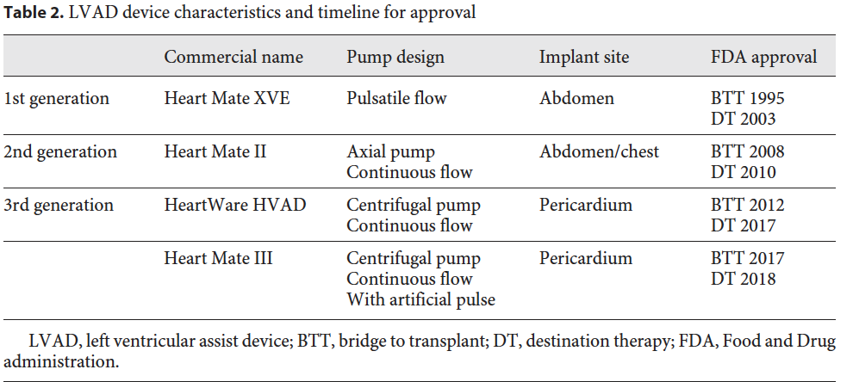
Device Infections
Most common complications after implantation period
  Driveline is most common source (breaks skin barrier)
  Often seeding from elsewhere (skin, >50% staph)
  lifelong suppressive therapy
PD catheters?
  Newer models often do not break peritoneal space
  Surgeon specific
Kamboj M. Blood Purif. 2019
Notes:
impaired renal function before LVAD implantation is inversely related to post-implant survival.
PD catheter placement in the proximity of the LVAD driveline may theoretically increase the risk of a driveline infection.
Only a few case reports describe successful PD in LVAD patients.
PD was previously contraindicated in patients with LVADs due to location of the driveline in the peritoneum and risk for infection. However, drivelines in newer smaller devices are outside the peritoneum.

Slide 31
Concerns from outpatient centers
Feasibility of hemodynamic monitoring in patients without a pulse
Risk of drive line infection through dialysis catheters
Poor AV fistula maturation due to lack of vascular reactivity
Anticoagulation management and risk of bleeding,

Slide 32
Resources
Ajuria M, et al. Peritoneal Dialysis Following Left Ventricular Assist Device Placement and Kidney Recovery: A Case Report. Kidney Med. 2021;3(3):438-441. Published 2021 Feb 17. doi:10.1016/j.xkme.2020.12.009
Bansal N, et al. Outcomes Associated With Left Ventricular Assist Devices Among Recipients With and Without End-stage Renal Disease. JAMA Intern Med. 2018;178(2):204-209. doi:10.1001/jamainternmed.2017.4831
CardioNerds podcast: LVAD 101
Handbook of Critical Care Nephrology
Jawaid O, et al. Ventricular Assist Devices and Chronic Kidney Replacement Therapy: Technology and Outcomes. Adv Chronic Kidney Dis. 2021;28(1):37-46. doi:10.1053/j.ackd.2021.01.002
Kamboj M, Kazory A. Left Ventricular Assist Device and the Kidney: Getting to the Heart of the Matter. Blood Purif. 2019;48(4):289-298. doi:10.1159/000502080
Koppel CJ, et al. Peritoneal dialysis improves quality-of-life in a left ventricular assist device destination therapy patient-a case report. Eur Heart J Case Rep. 2021;5(10):ytab307. Published 2021 Jul 29. doi:10.1093/ehjcr/ytab307
Patel AM, et al. Renal failure in patients with left ventricular assist devices. Clin J Am Soc Nephrol. 2013;8(3):484-496. doi:10.2215/CJN.06210612
Ross DW, et al. Left Ventricular Assist Devices and the Kidney. Clin J Am Soc Nephrol. 2018 Feb 7;13(2):348-355. PMID: 29070522
Walther CP, et al. Acute Kidney Injury With Ventricular Assist Device Placement: National Estimates of Trends and Outcomes. Am J Kidney Dis. 2019;74(5):650-658. doi:10.1053/j.ajkd.2019.03.423

