Slide 1
AKI and a Rash
Jacob Nysather D.O. PGY-4

Slide 2
Outline

Slide 3
Clinical Case
Topic Review
Discussion

Slide 4
73 year old white male with PMH CKD 3a (BCr ~1.3), T2DM, HTN, CAD s/p CABGx4v 2019, A-fib, PVD s/p R BKA. Originally hospitalized 7/23 with concerns of Osteomyelitis Left Heel and subsequent Debridement. Cultures at the time showing bacillus and Coag-negative Staph. PICC line was placed and discharged with course of IV Vancomycin and Cefepime.
Patient followed up with ID 8/25 with symptoms of general malaise and weakness, questionable weight loss. Was noted to have AKI with Cr 2.86 and Vanc Trough of 26.4. At this time patient was hospitalized at OSH. Patient’s antibiotics were discontinued and he was switched to Daptomycin. Due to symptoms underlying malignancy was of concern and underwent a “pan-scan” which showed bilateral perinephric stranding. He continued to deteriorate was was transferred to our facility 8/31.

Slide 5
CKD 3a, CAD, A-fib, PVD, HF (baseline 1.3) CAD s/p CABG-quadruple bypass 2019, PVD s/p R BKA, HFpEF, T2DM, HTN, HLD, PTSD, CVA 2016, multinodular goiter
Ezetimibe 10mg
Apixaban 2.5mg BID
Metoprolol Succinate 150mg
Amitriptyline 10mg
Metformin 1G BID
Iron every day
Nifedipine 60mg qday
Tamsulosin 0.4mg
Omeprazole 20mg
CABG x4, appendectomy, cholecystectomy, Rt inguinal hernia repair, L orchiectomy hydrocele, right bka, l heal debridement , L 4th and 5th toe amputation
No pertinent social or family history
Allergy: Lisinopril

Slide 6
Lab | 7/23 | 8/19 | 8/25 | 8/30
Sodium | 142 | 142 | 144 | 141
Cl | 112 | 113 | 116 | 112
K | 4.1 | 4.8 | 4.4 | 4.3
CO2 | 22 | 21 | 14 | 17
Glucose | 93 | 129 | 145 | 170
BUN | 29 | 34 | 43 | 60
Cr | 1.27 | 1.31 | 2.86 | 4.48
ALT |  | 11
AST |  | 14
ALP |  | 83
T. Prot |  | 6.4
Alb |  | 3.o
Lab | 7/27 | 8/19 | 8/25 | 8/30
WBC | 9.6 | 10.6 | 9.5
Hgb/HCT | 10.1/29.9% | 11.7/38.2 | 11.6/38%
PLT | 178 | 235 | 170
Neutrophils k/cmm | 5.85 (61.2*) | 6.02 (56.6%) | 6.18 (65%)
Lymphocytes | 2.2 (22.7%) | 2.4 (22%)
Eos | 0.6 (5.9%) | 1.2 (11.2% | 1.0 (10.6%) | 1.5
Mono | 0.1 (0.8%) | 0.8 (7.6%) | 1.1 (11.9%)
8/26: FeNa 2.6% UNa 80, UK 29, Uurea 284, Ucr 58
UA 8/26: SpG 1.013, 2+Prot, pH 5.0, LE 3+11-20 RBC, >50WBC, Abundant WBC Clumps, Rare Mucus/Squam
US 8/26: R 12.4cm, L 12.5 cm. 4mm non-obstructing stone L inferior pole. No hydronephrosis, normal echogenicity

Slide 7
Upon transfer to our facility there were no changes within initial labs. Vitals were pertinent for a low grade temp of 100.7F and tachycardia.
Physical exam pertinent for Chronically ill appearing male. IRR no MRG. Right BKA, left foot debridement with 4th and 5th digit amputation, wrapped in gauze and serous strikethrough. Diffuse maculopapular rash.
ID was consulted and 6 week antibiotic course was completed with Daptomycin 9/3.
Patient continued to deteriorate with Kidney biopsy performed 9/1 and ultimately a TDC and started on dialysis 9/4. Indications: azotemia, oliguria, hyperkalemia
With concern for AIN, steroids were started after biopsy was obtained. Was initially started on 1G methyprednisilone (received 2 doses). This ultimately sent the patient into DKA and transferred to ICU for insulin gtt. Steroids were titrated to 100mg Prednisone.
With addition of large dose of IV steroids, patient’s diffuse maculopapular rash become puritic.

Slide 8
UPCr 97/22 (~4g)
Infectious: negative HBV, HCV, HIV, RPR
C3 87 and C4 30
ANA <1:40
ANCA: Pending
Notes:
Peak Cr 6.2
Follow-up Eos

Slide 9
Kidney Biopsy
Diffuse diabetic Glomerulosclerosis
Acute tubular damage and Mixed Interstitial Inflammatory Infiiltrates
Secondary FSGS
Moderate IFTA (50%)
Moderate Arterio- and arteriolosclerosis
- Consistent with ATN, AIN (drug hypersensitivity reachtion), DN, and HTN
No immune Complexes

Slide 10
Punch Biopsy
DRESS syndrome

Slide 11
Steroids continued to taper to 60mg with prolonged taper course set 8-12 weeks
Non-oliguric with current AKI-D
Rash began to significantly improve
Discharged to SNF

Slide 13
Drug Induced – Acute Interstitial Nephritis (AIN)
Acute interstitial nephritis (AIN) is characterized by the presence of inflammatory infiltrates and edema within the interstitium, usually associated with an acute deterioration in renal function.
AIN represented 1–3% of all renal biopsies in some studies
When limited to acute kidney failure, AIN represented in15–27%.
Notes:
True incidence is underestimated
No biopsy confirmed and empirical treatment

Slide 14
Pathogenesis
Immunologic reaction against endogenous nephritogenic antigens or exogenous antigens processed by tubular cells, with cell-mediated immunity having a major pathogenic role.
  Uromodulin or Megalin (Proximal Tubule)
  Antibodies against the Tubulointerstitial Membrane (TBM)
  Interstitial deposition (planted antigens).
Interstitial infiltrates are mostly composed of T lymphocytes, macrophages, eosinophils, and plasma cells.
Experience a rapid transformation into areas of interstitial fibrosis
Notes:
- Immunization of rabbits or rats with Tamm–Horsfall protein or megalin (a protein localized in the brush border of proximal tubular cells) induced an AIN,8 thus suggesting a possible pathogenic role of these proteins as endogenous antigens in the development of some human AIN.
Glycoprotein important for TBM integrity and whose molecular composition has been cloned and sequenced idiopathic AIN that are caused by this pathogenic mechanism, remain unknown
Tubular cells have the capacity to hydrolyze and process exogenous proteins. In this regard, medications can bind to a normal component of TBM, behaving as a hapten, or can mimic an antigen normally present within the TBM, inducing an immune response directed against this antigen

Slide 15
Pathogenesis
Interstitial infiltrates are mostly composed of T lymphocytes, macrophages, eosinophils, neutrophils and plasma cells
  Cytokines = increase production of extracellular matrix and interstitial fibroblasts
  Induce an amplification process that recruits more inflammatory cells and eosinophils into the interstitium
  Transforming growth factor-b, platelet-derived growth factor-BB, endothelin-1, epidermal growth factor, and fibroblast growth factor-2
  Important stimulus for local epithelial-to-mesenchymal transition that affects tubular epithelium after injury
Ultimately leading to a rapid transformation of areas with interstitial fibrosis
  Loss of renal tubules
  Accumulation of fibroblasts and extracellular matrix proteins (collagens, fibronectin, laminin)
Notes:
Fibrotic changes can already be seen within 7–10 days

Slide 16
Histologic Findings – Light Microscopy
Interstitial edema consisting primarily of T lymphocytes and monocytes
  Eosinophils, plasma cells, and neutrophils also may be found.
  Diffuse or Patchy
  Classic lesion of "tubulitis" is found when inflammatory cells invade the tubular basement membrane (TBM)
Granuloma formation
  Medication induced
  Sarcoidosis
  Infectious: Mycobacterium, fungi (histoplasmosis, coccidioidomycosis), bacteria (Brucella, Chlamydia, Francisella), spirochetes (Treponema), and parasites (Leishmania, Toxoplasma)
Glomeruli and vessels are distinctly normal (unless autoimmune thought to be involved – Lupus)
Notes:
- medication-induced interstitial nephritis was the leading cause of granulomatous interstitial nephritis, equaling or exceeding sarcoidosis in all
- granuloma formation also suggests a greater likelihood of infection-induced AIN compared with AIN without granulomas

Slide 17
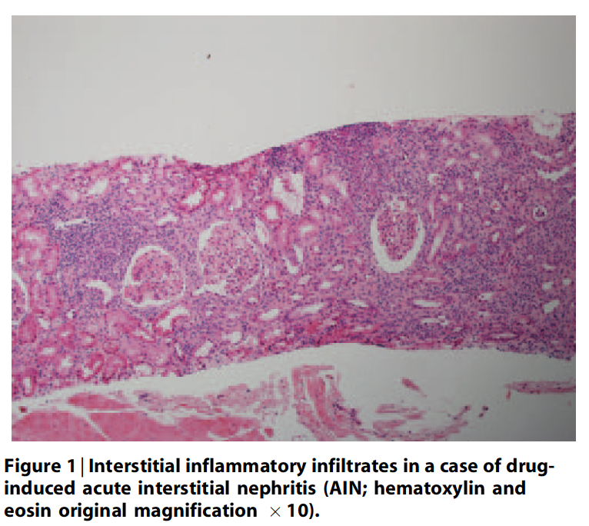
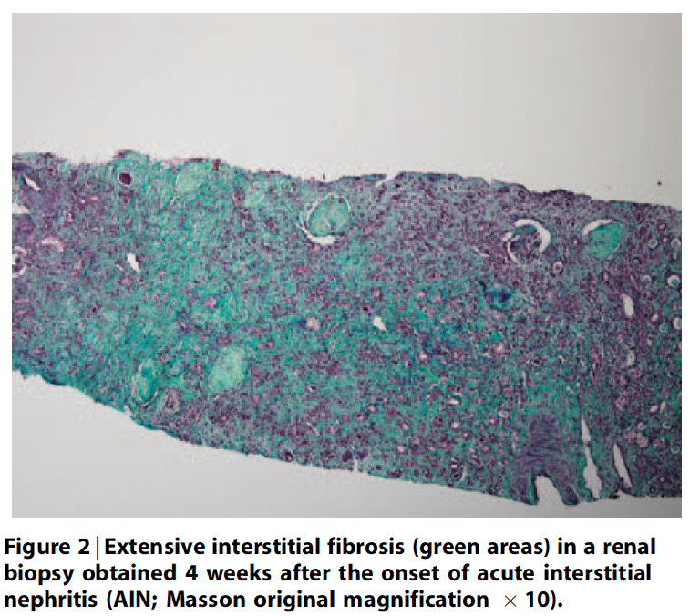
Praga, et al
Notes:
inflammatory cell infiltrates of AIN (Figure 1) can be diffuse or patchy.
Fibrotic changes can already be seen within 7–10 days of initiation of the inflammatory process and they progress to advanced interstitial fibrosis accompanied by tubular atrophy (Figure 2)

Slide 18
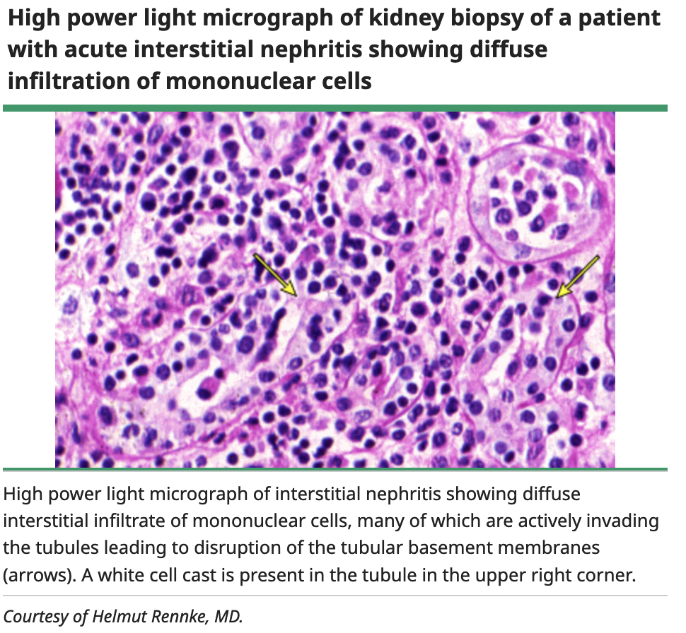
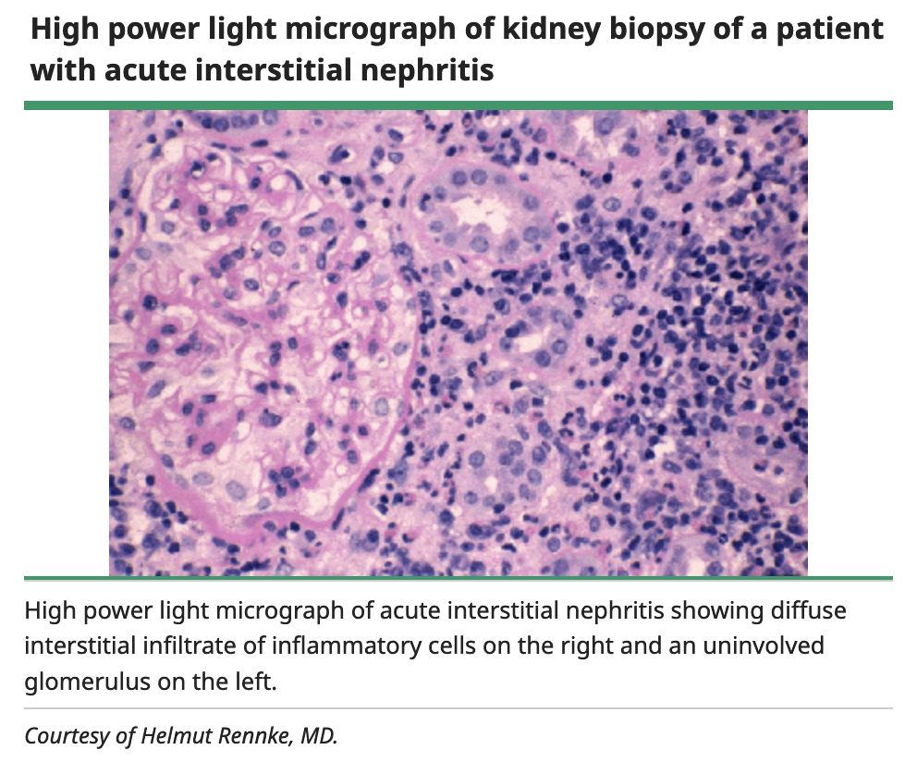
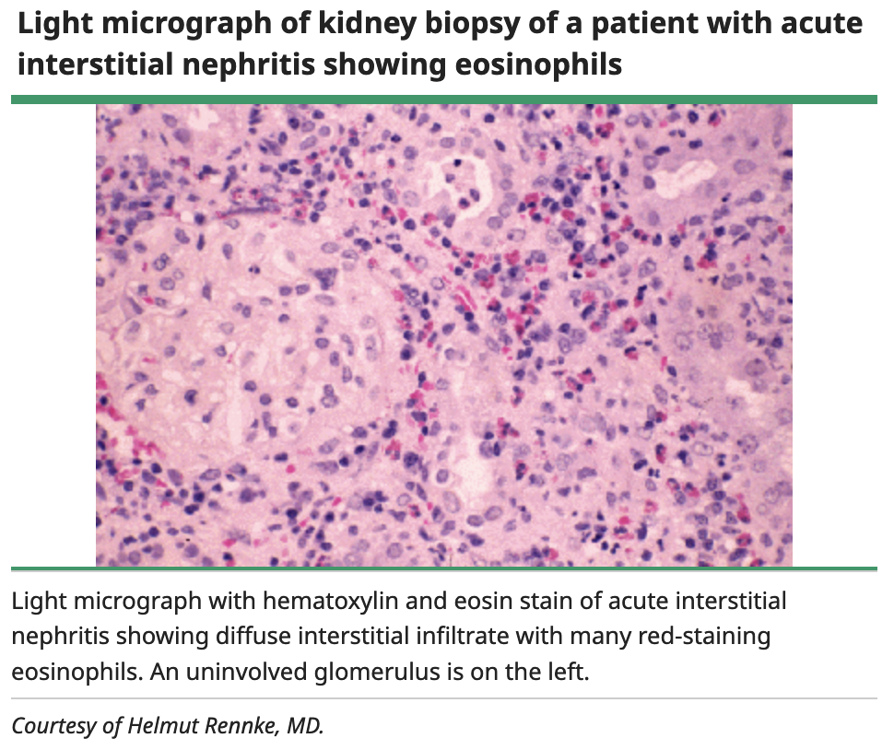
High-power Light Microscopy
Up-to-Date

Slide 19
Histologic Findings
Immunofluorescence
  Generally negative, indicating the absence of antibody-mediated immunity.
  IgG4 related disease includes presence of TBM immune complex deposits and an increase in IgG4-positive plasma cells in the interstitium
Electron Microscopy
  Generally nonspecific lesions
  NSAID-induced can have diffuse podocyte foot effacement
Notes:
NSAIDs – Nephrotic syndrome. Can resemble Membranous and Minimal Change

Slide 20
Clinical Presentation
Often present with non-specific symptoms with an acute to sub-acute nature with nausea, vomiting, malaise. However, many are asymptomatic
Oliguric vs non-oliguric
Triad of Rash, Fever, eosinophilia (10-35%, typically related to Methicillin)
Typical onset of 3-7 days, however can be as short as 1 day (rifampin) long as 18 months with certain medications (NSAIDS)
Notes:
A definitive diagnosis of AIN is made by kidney biopsy.

Slide 21
Clinical Pres
Eosinophilia
  Absolute blood eosinophil count of ≥500 eosinophils/mcL
  Only found in 25 – 35% of AIN
  Significantly less common with NSAID-induced
Eosinophiluria
  Eosinophils that account for more than 1% of urinary white cells by Hansel stain
  Among 179 patients who had a positive test for urinary eosinophils (defined as ≥1 percent of urinary white cells), only 28 had AIN on biopsy
  >1% Cutoff: 30.8 Sensitivity and 68.2% Specificity*
  >5% Cutoff: 19.8 Sensitivity and 91.2% Specificity*
*NKF Primer

Slide 22
Urine Sediment: white cells, red cells, and white cell casts
Typically do not have significant Proteinuria (<1% with Nephrotic range proteinuria) – Exception with NSAID induced membranous or MCD
FENa may be >1% indicative of tubular damage
No radiographic findings that are diagnostic for AIN
Notes:
relatively normal urinalysis should not exclude the diagnosis

Slide 23
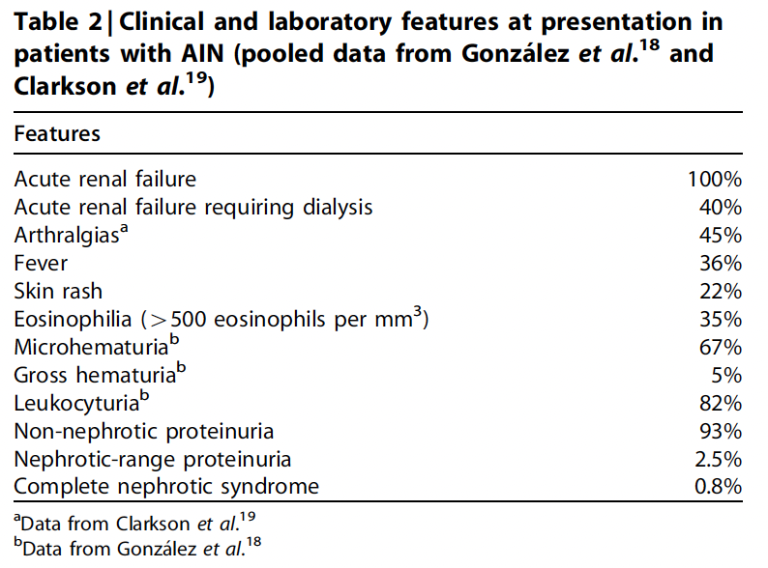
Praga, et al

Slide 24
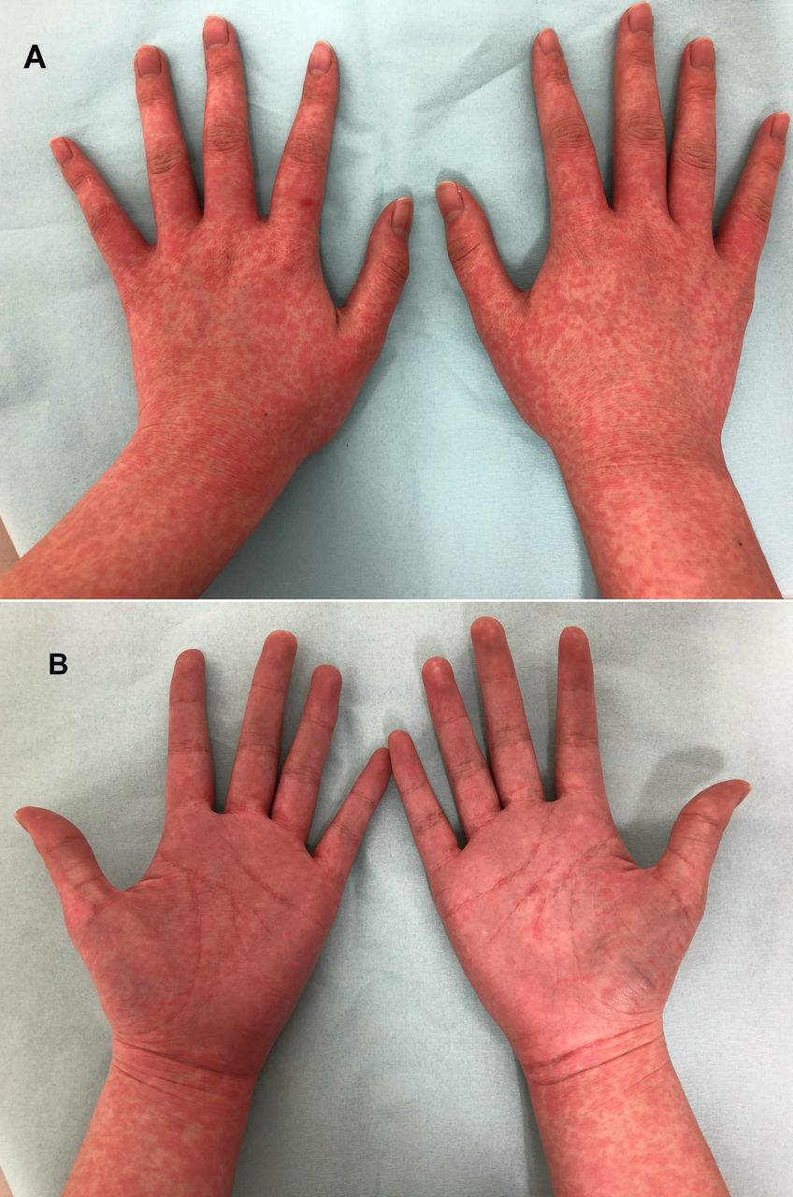
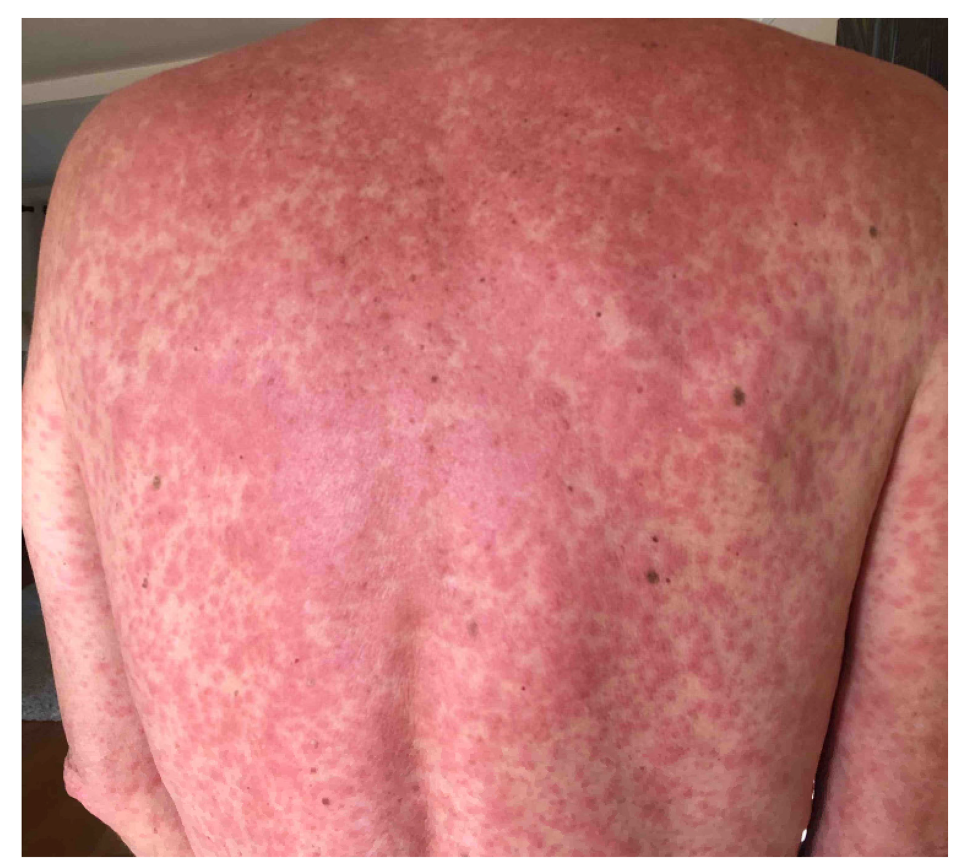
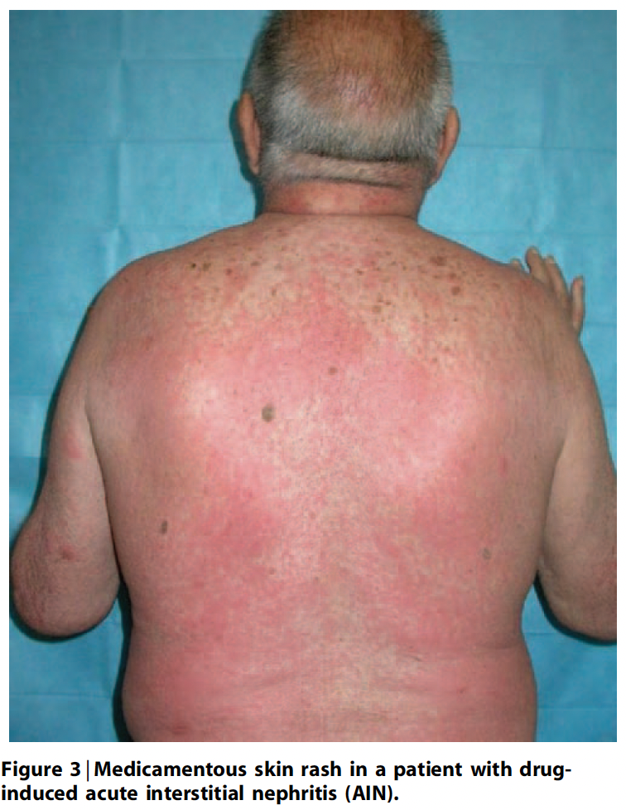
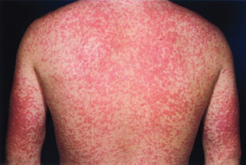
Praga, et al
Visual Dx
Notes:
Maculopapular or morbilliform

Slide 25
AIN should be suspected in a patient who presents with an elevated serum creatinine and a urinalysis that shows white cells, white cell casts, and, in some cases, eosinophiluria

Slide 26
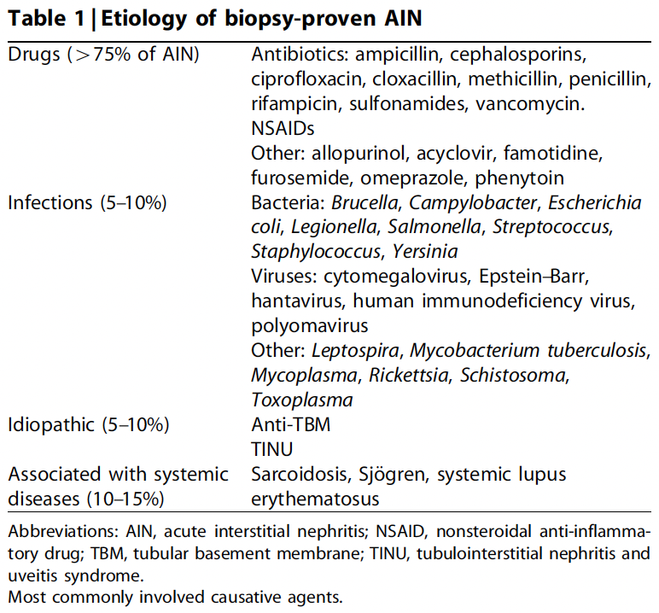
Praga, et al

Slide 27
Diagnosis
Clinical Suspicion
Definitive Diagnosis by Kidney Biopsy

Slide 28
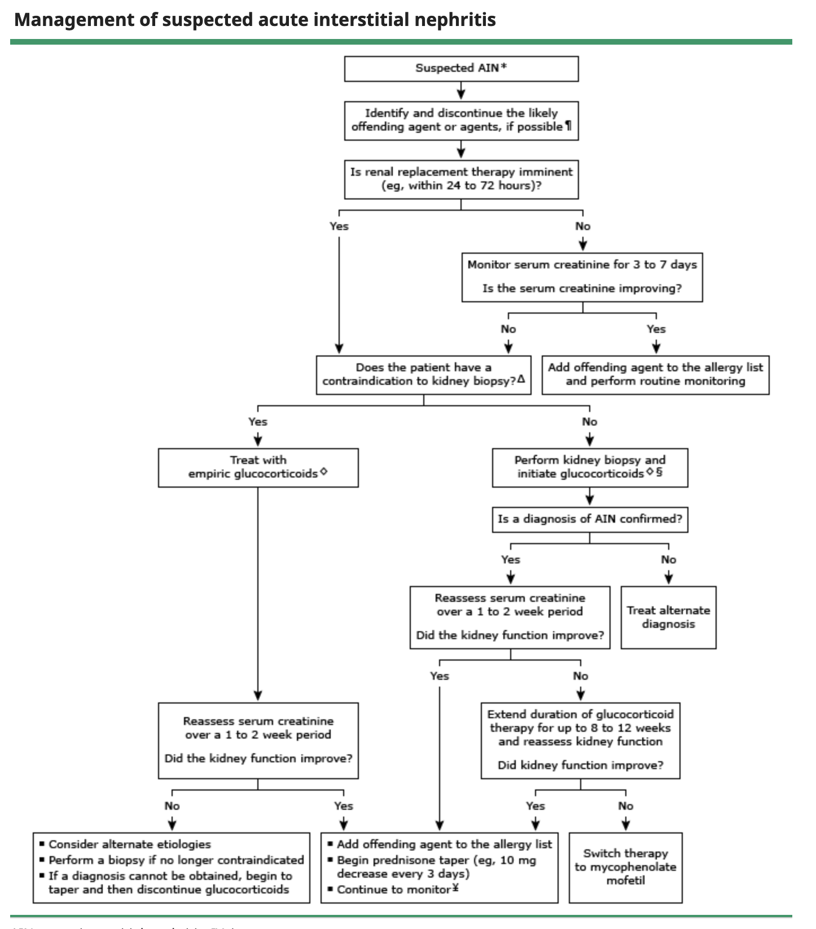
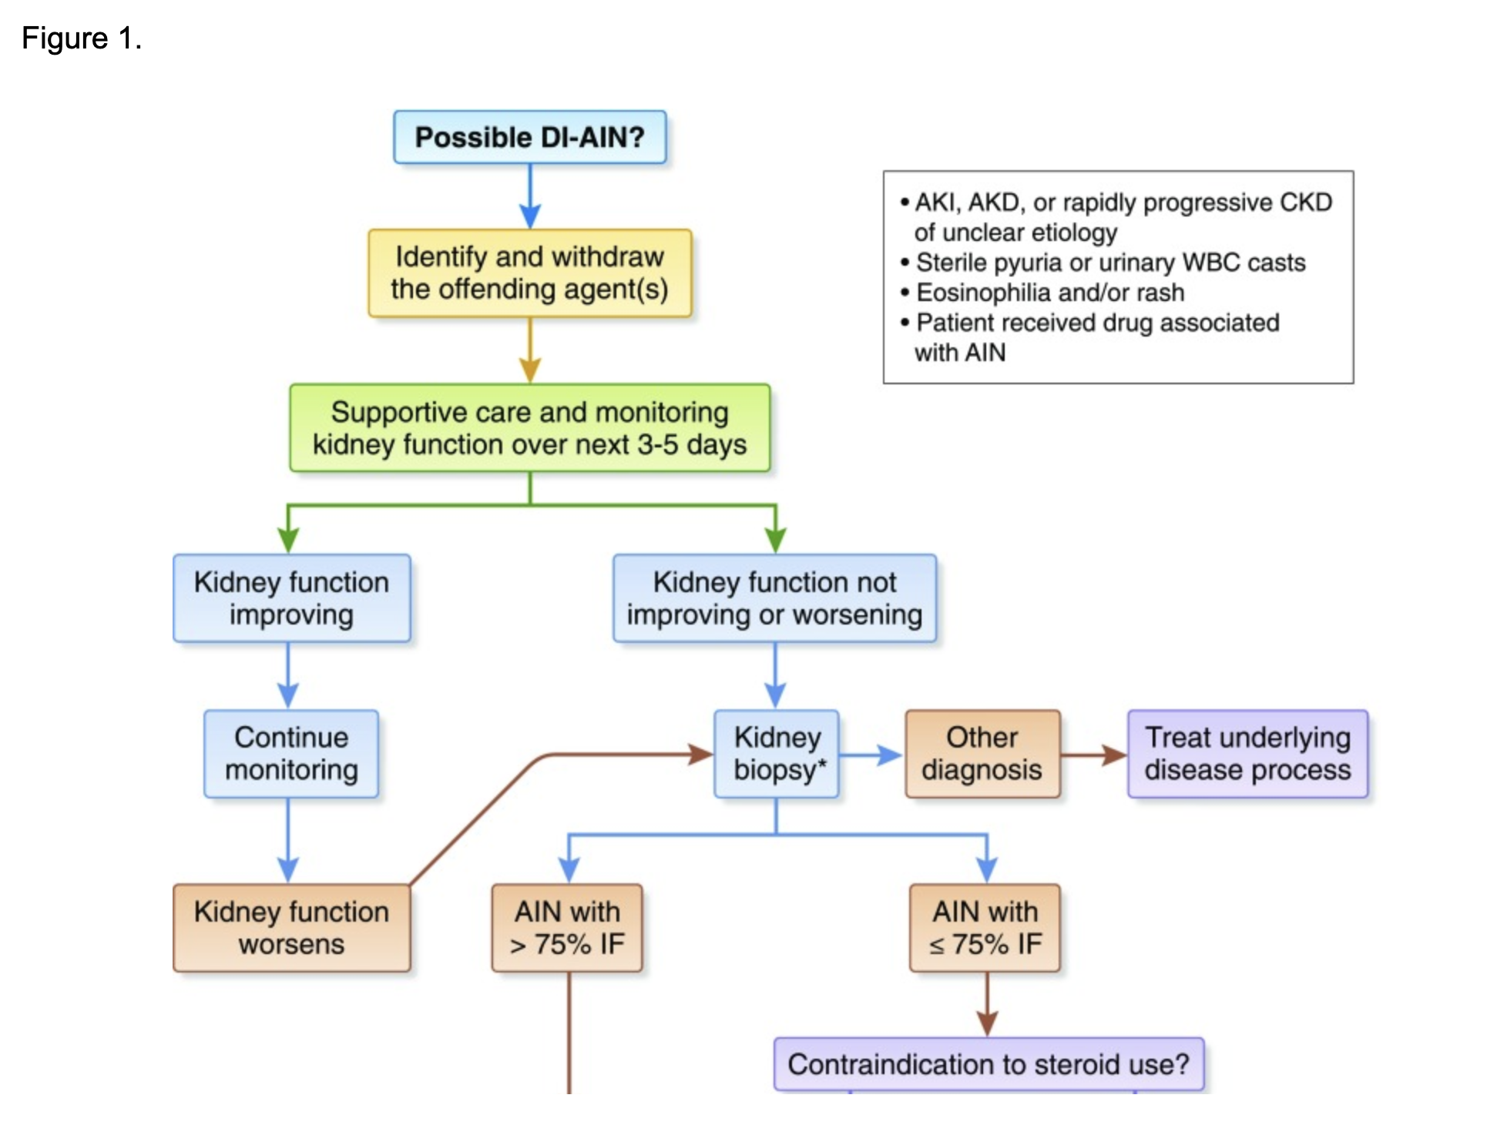
Moledina, D.G., et al
Up-to-Date
Notes:
characteristic urinalysis for AIN but are not being treated with a drug known to cause AIN
Patients who are being treated with a drug known to cause AIN but do not have a characteristic urinalysis
being considered for treatment with glucocorticoids for AIN (usually drug induced). Among selected patients (such as those at high risk of complications of a biopsy or who do not wish to undergo a biopsy), glucocorticoids may be initiated without first obtaining a kidney biopsy. However, among patients who do not improve after the first five to seven days of empiric glucocorticoid therapy, those without contraindications should have a biopsy
present with advanced kidney failure, providing the onset of kidney failure is known to be relatively recent
any features (such as high-grade proteinuria) that cause the diagnosis of AIN to be uncertain

Slide 29
Imminent need for dialysis
Severe enough to warrant dialysis within 24 to 72 hours of the initial evaluation should have a kidney biopsy and initiate glucocorticoid therapy without delay (unless contraindicated)
Initial Steroid Therapy – Methylprednisolone vs Prednisone

Slide 30
Without an imminent need for dialysis
May be observed for 3-7 days after discontinuation of the potential offending agent.
If the kidney function has not stabilized, then a kidney biopsy should be performed and glucocorticoids initiated.

Slide 31
Treatment - Drugs
Stop offending agent
If there are multiple potentially offending drugs,
  Generally discontinue them sequentially if the acute kidney injury (AKI) is mild
  Discontinue them simultaneously if the AKI is severe.
Do not discontinue the potentially offending drug if the drug is a crucial treatment for a severe disease process and there are no reasonable alternatives or if the diagnosis is uncertain.
Remember – It is NOT dose dependent. Can have a rapid recurrence with re-exposure.
If drug is identified it should be listed as an allergy.

Slide 32
Treatment - Steroids
Role of steroids in the treatment of drug-induced AIN remains controversial
(NSAID)-induced AIN does not generally respond to glucocorticoid therapy
There are no randomized, controlled trials or large observational studies that inform the treatment of AIN
  Prednisolone Treatment in Acute Interstitial Nephritis (PRAISE) - BMC Nephrology, Protocol Published May 2021 ClinicalTrials.gov identifier NCT04376216
Several studies reported a significantly better outcome in patients who were treated with steroids. However, the number of patients included in such positive studies was short and other studies failed to found a beneficial influence of steroids in comparison with conservative measures.
Notes:
- Clarkson performed a retrospective study in a relatively large series of 60 patients with biopsy-proven AIN to define the influence of steroids on this disease. AIN was drug related in 92% of cases and NSAIDs were the most common offending drug, accounting for 44% of cases.
Follow-up data were available in 42 patients. Of them, 25 patients (60%) received steroid treatment, whereas the remaining 17 (40%) received only supportive care. No difference in serum creatinine levels was observed between the two groups after 1, 6, and 12 months following AIN
- An important aspect of Clarkson’s study that should be kept in mind when interpreting its results is the considerable delay between the onset of AIN symptoms and the performance of renal biopsy (median time 3 weeks); steroids were always started after renal biopsy

Slide 33
Treatment - Steroids
Physio-pathological rationale for early steroid treatment in DI-AIN
  Rapid transformation of interstitial cellular infiltrates (responsive to high-dose steroids) into areas of irreversible interstitial fibrosis, a process that starts after only 7 days of interstitial inflammation
  Early steroid administration would likely reduce the number and extent of inflammatory infiltrates, thus decreasing the risk of subsequent fibrosis

Slide 34
Treatment - Steroids
High-dose IV (250mg – 1G) Methylprednisolone (x3 days)
Oral Prednisone (0.5-1mg/kg/day)
  Reported max 40-60mg per day
  Duration ranging 4-12 weeks
    Rapid taper off if biopsy not consistent with AIN

Slide 35
Treatment - Other
In patients with idiopathic AIN resistant to steroids, anecdotal reports suggest benefit from cyclophosphamide and cyclosporine
Plasmapheresis and cytotoxics have been used in anti-TBM disease
Steroid-dependent, recurrent AIN documented an interesting beneficial effect of mycophenolate mofetil (1-2G and wean off steroids).
Notes:
limited experience with treating AIN with alternative immunosuppressive drugs. There are case reports and small series using MMF and cyclosporine [21,22] and anecdotal experience with use of cyclophosphamide.
MMF was used for 13 to 34 months in eight patients with biopsy-proven AIN who had responded to but who could not tolerate withdrawal of glucocorticoids after six months
After addition of MMF, all patients were able to discontinue glucocorticoids, and only two patients failed to show improvement in serum creatinine (one with a positive antineutrophil cytoplasmic antibody [ANCA] and another with AIN of unknown etiology).

Slide 36
Prognosis
Generally, if the offending agent is discontinued and glucocorticoids are initiated within seven days of appropriate interventions, then many, but not all, patients will begin to recover kidney function over the subsequent one to two weeks.
  30-70% do not recover to prior baseline
  ~10% remain dialysis dependent
If confirmed by biopsy, clinical indicators of a decreased likelihood of renal recovery:
  >50-75% of fibrosis may reflect substantial chronic kidney damage rather than acute inflammation
  Prolonged kidney failure (>weeks)
  Associated with NSAIDs
  Histologic findings (including interstitial granulomas, interstitial fibrosis, and tubular atrophy) on kidney biopsy

Slide 38
Resources
Arkana Lab – Pathology Review
Dr. Saha’s AIN lecture
Fogo, A.B., et al. AJKD Atlas of Renal Pathology: Acute Interstitial Nephritis. AJKD 2016
Harrison’s Principles of Internal Medicine – 20th ed.
Moledina, D.G., et al. Drug-Induced Acute Interstitial Nephritis. CJASN 2017
NKF Primer on Kidney Disease – 7th Ch 33
Praga, M., Gonzalez, E. Acute Interstitial Nephritis. Kidney International. 2010
Up-to-Date

Slide 39
Prednisolone Treatment in Acute Interstitial Nephritis (PRAISE) - BMC Nephrology, Protocol Published May 2021 ClinicalTrials.gov identifier NCT04376216

Slide 40
