Slide 1
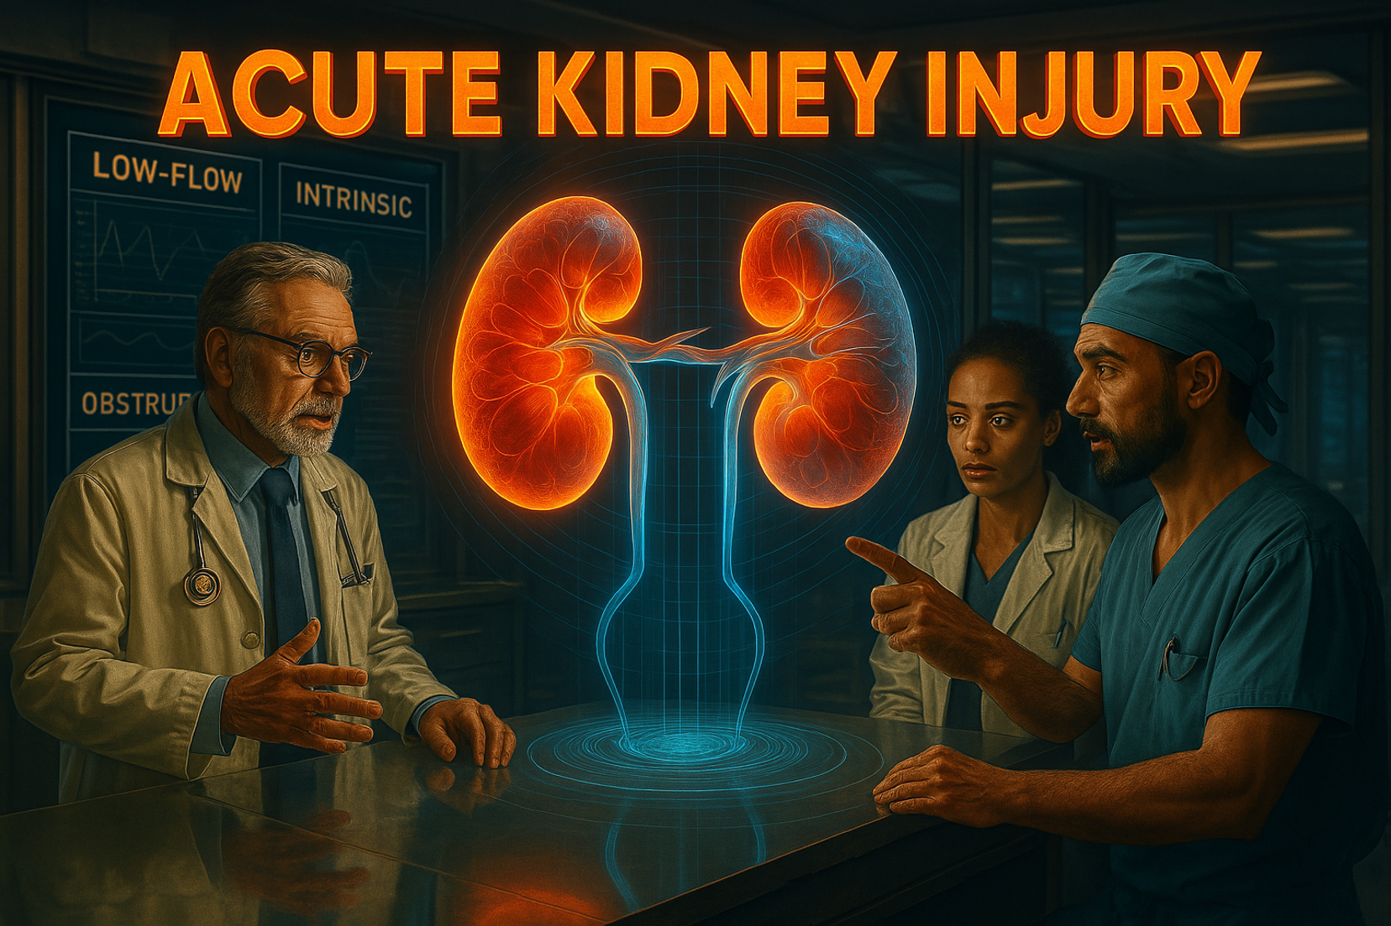
Jacob Nysather D.O.
4-15-26

Slide 2

Disclosures
Medical Advisory Committee – Alexion, atypical HUS
Speakers Bureau - Natera

Slide 3
Objectives
Define and apply criteria for Acute Kidney Injury
Review diagnostic evaluation tool and provide a structured framework for Acute Kidney Injury
Review high yield AKI syndromes

Slide 4

Case
54 year old male with PMH of Cirrhosis due to Hepatitis C (post-treatment) complicated by esophageal varices, hepatic encephalopathy, and ascites requiring paracentesis. Other PMH includes: diabetes type 2, alcohol dependence, tobacco use. He presents to the ED for worsening abdominal pain for the last 3 days.
NKDA
Meds: Propranolol 10mg BID, furosemide 40mg, spironolactone 100mg, lactulose, metformin 500mg BID
RAAS Inhibitors

Slide 5
Case
Vitals:
  HR 92, BP 92/54, RR 20, SpO2 96% on RA
Physical:
  Chronically ill
  Jaundice
  Pulm/CV: WNL
  Abd: Distended with +fluid wave, mild tenderness
  Ext: 1-2+ BLE edema

Slide 6
Case
CMP: Na 129, K 3.6, Cl 94, CO2 20, Cr 1
LFT: T. Bili 10, ALT 10, AST 12, Alb 2.7, T.Prot 5.6
CBC: WBC 12, Hgb 11.2, PLT 112
INR 1.6
UA: 2+ urobilogen
Urine Studies: Una <10, Ucr 60

Slide 7
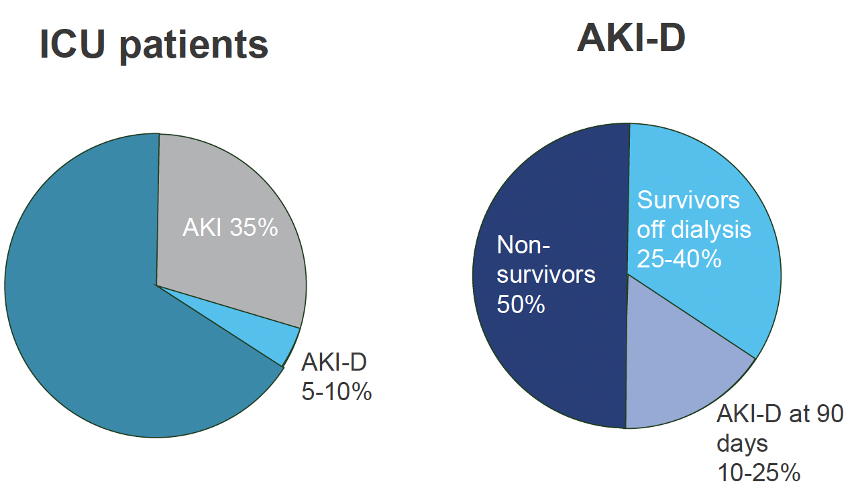

Slide 8
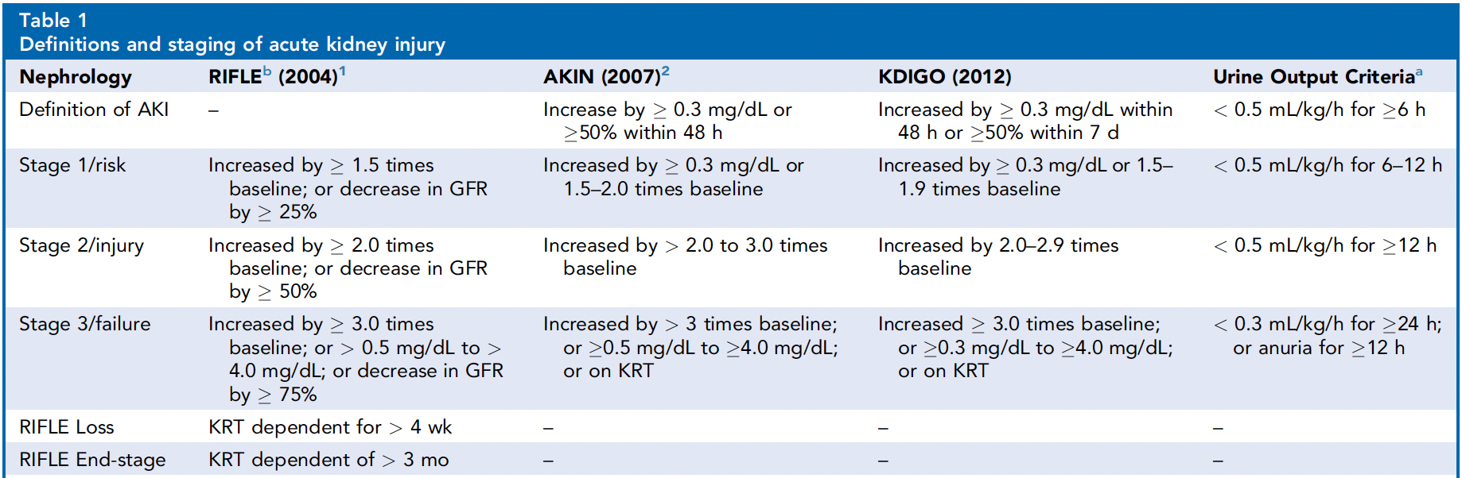
Definition of AKI
Intervent Card Clin. 2023

Slide 9
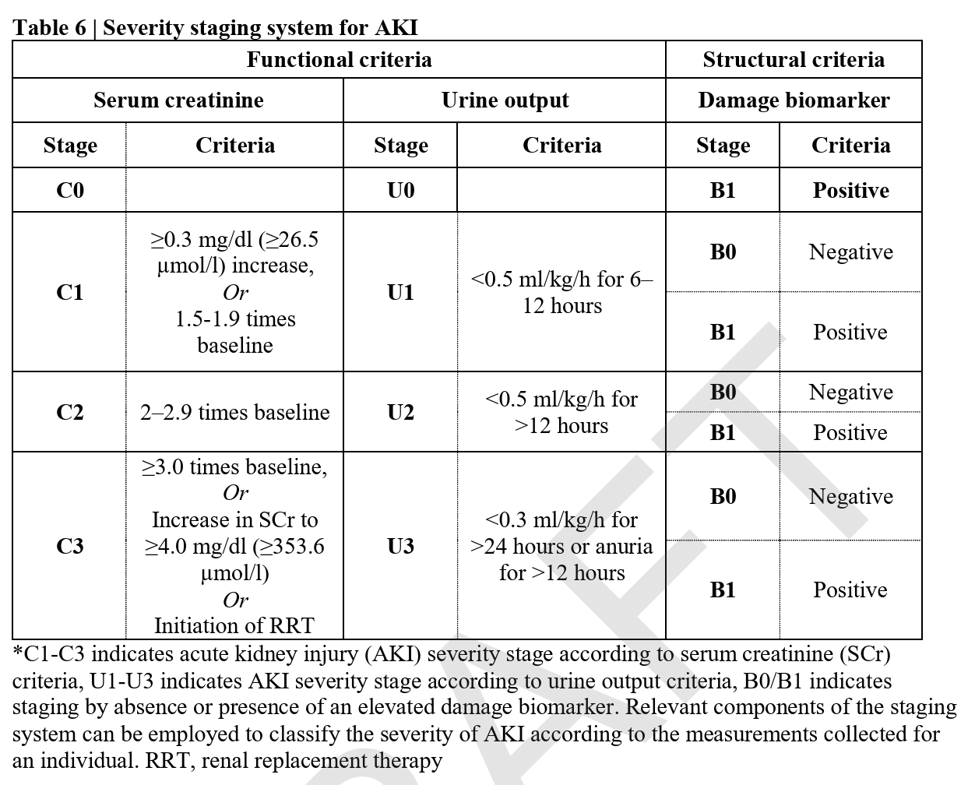

Slide 10
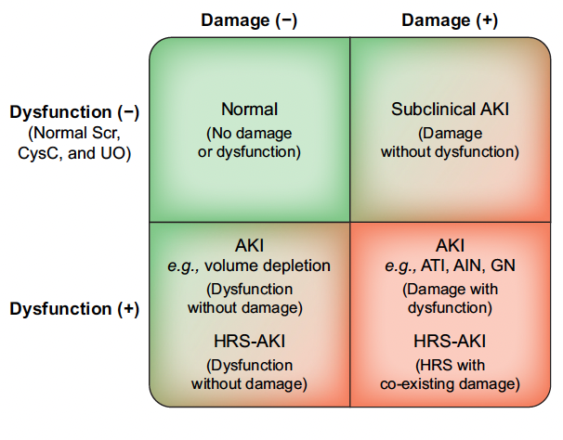
Nadim, MK. et al. J Hepatol. 2024

Slide 11
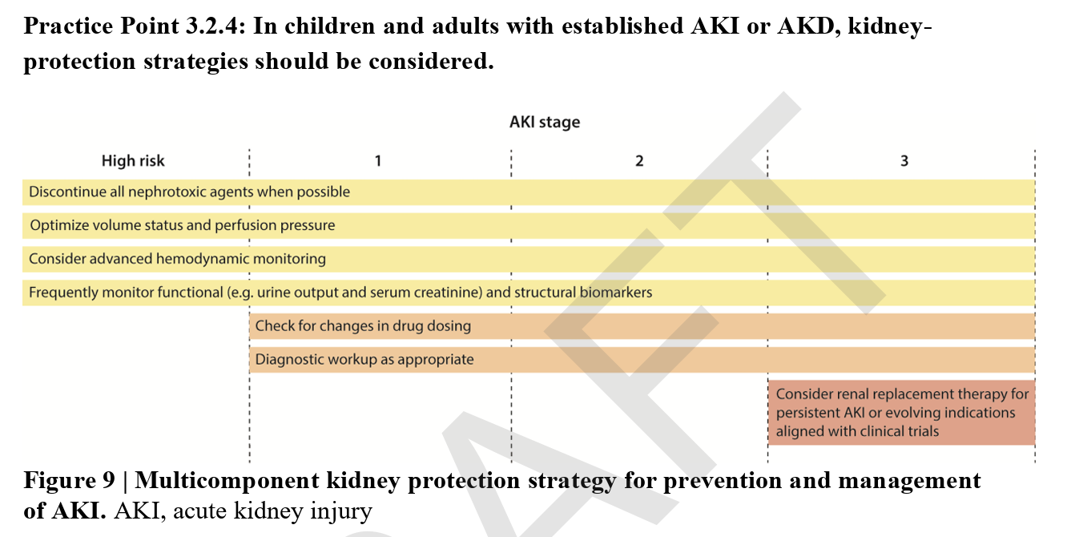

Slide 12
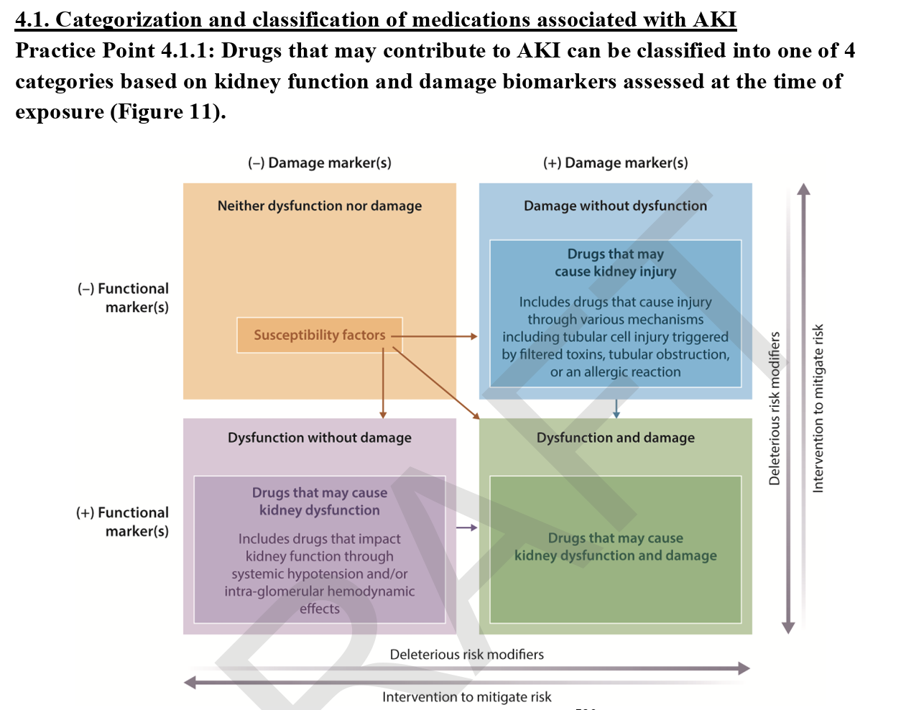

Slide 13
Definition
Sudden loss of renal function over hours to days
Commonly reflected by rise of creatinine and/or decrease in urine output

Slide 14
Case
54 year old male with PMH of Cirrhosis due to Hepatitis C (post-treatment) complicated by esophageal varices, hepatic encephalopathy, and ascites requiring paracentesis. Other PMH includes: diabetes type 2, alcohol dependence, tobacco use. He presents to the ED for worsening abdominal pain for the last 3 days.
NKDA
Meds: Propranolol 10mg BID, furosemide 40mg, spironolactone 100mg, lactulose, metformin 500mg BID
RAAS Inhibitors

Slide 15
Case
Vitals:
  HR 92, BP 92/54, RR 20, SpO2 96% on RA
Physical:
  Chronically ill
  Jaundice
  Pulm/CV: WNL
  Abd: Distended with +fluid wave, mild tenderness
  Ext: 1-2+ BLE edema

Slide 16
Case
CMP: Na 129, K 3.6, Cl 94, CO2 20, Cr 1
LFT: T. Bili 10, ALT 10, AST 12, Alb 2.7, T.Prot 5.6
CBC: WBC 12, Hgb 11.2, PLT 112
INR 1.6
UA: 2+ urobilogen
Urine Studies: Una <10, Ucr 60

Slide 17
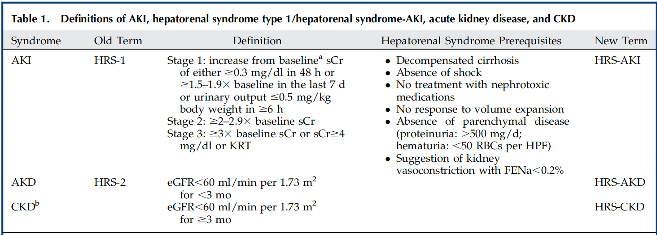
Hepato-Renal Syndrome
Cullaro, G. et al. CJASN 2022

Slide 18
How did you get through your process

Slide 19
Acute Kidney Injury
Pre-Renal
(low flow)
Intrinsic
Post-Renal
(obstructive)

Slide 20
Acute Kidney Injury
Pre-Renal
(low flow) 30%
Intrinsic
Post-Renal
(obstructive) 10%
Glomerular
Tubular (ATN) 50%
Interstitium (AIN)
Vascular

Slide 21
Diagnostic Work-up
What are you doing with your work-up?
Help rule-in or rule-out causes
To differentiate through your differential

Slide 22
What are some things we ant to look at?

Slide 23
Baseline levels – is it an AKI?
History
  Recent Events
  Medications (changes)
  Family History
Vital Signs
Exam

Slide 24
Metabolic Panel
Urinalysis with microscopy
Urine Electrolytes (Na, Urea)
Urine Protein/Creatinine (albumin)
Any other specifics based on history
Imaging
  Bladder Scan
  Abdominal/Retroperitoneal Ultrasound
  CT Scan
Intravascular Volume Status

Slide 25
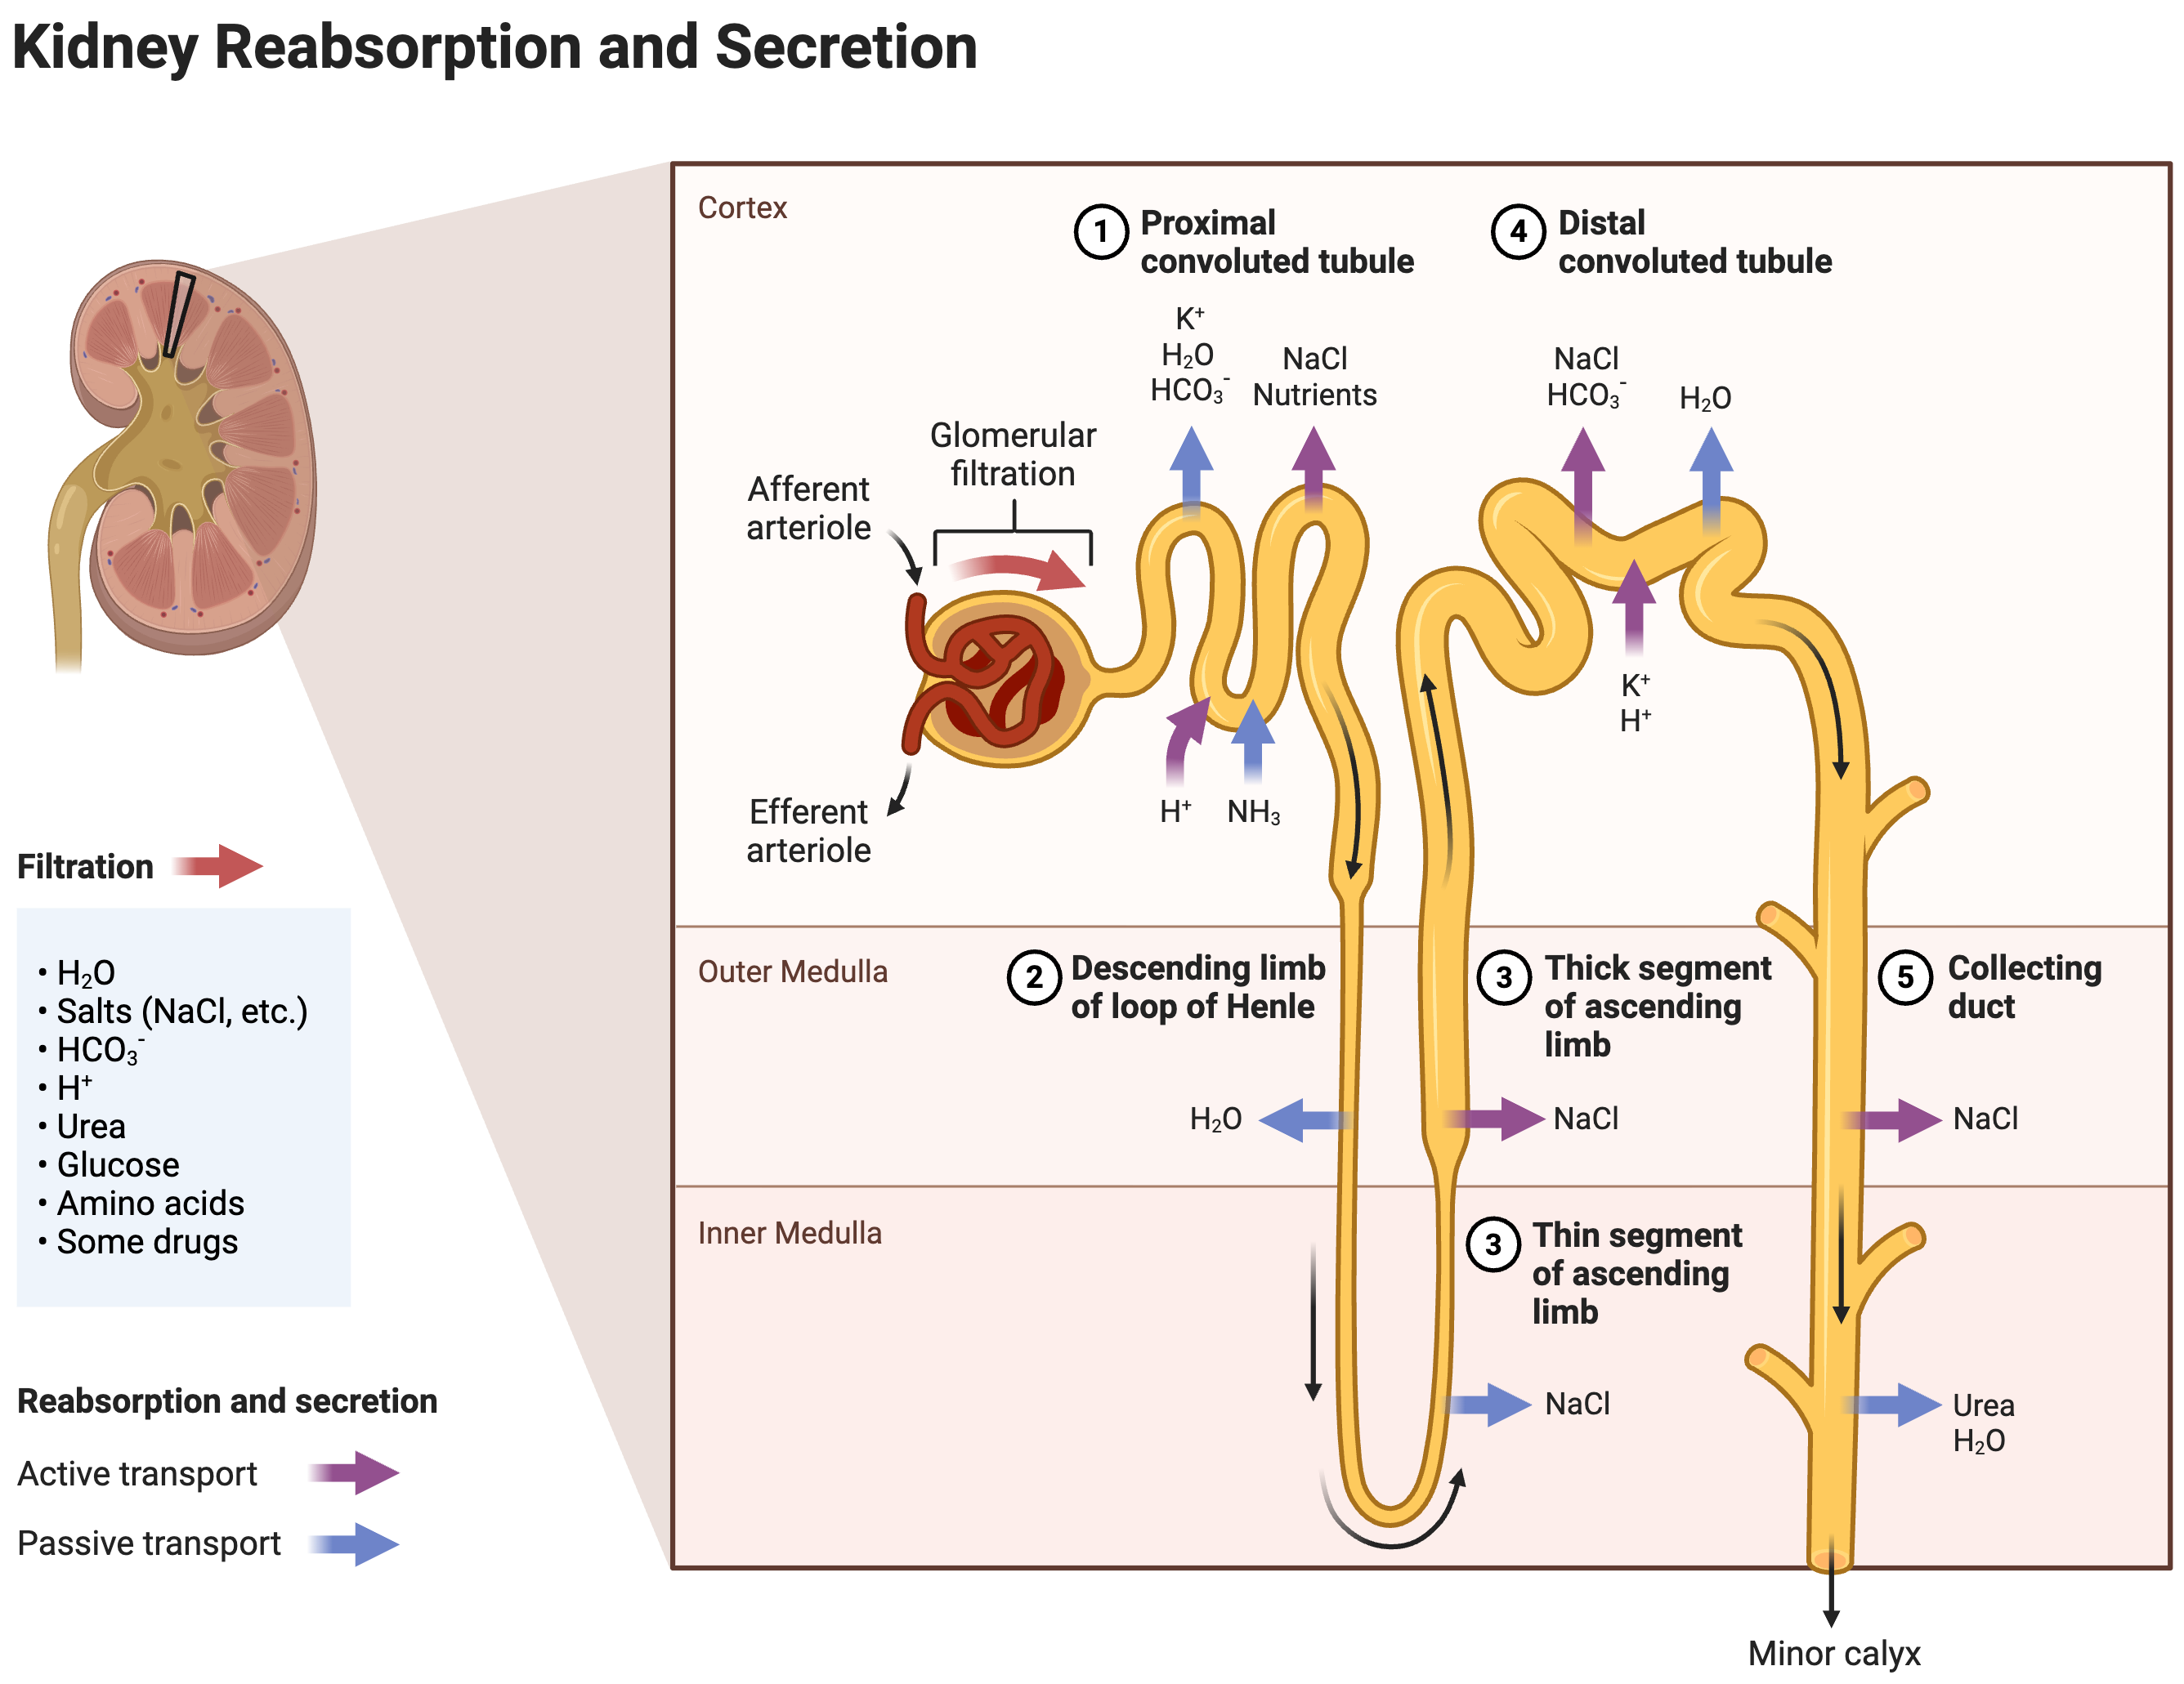

Slide 26
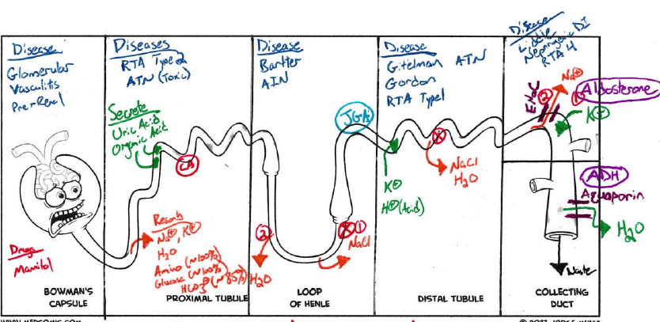
Filter/Secrete = Green Resorb = Orange Disease = Blue
Drugs = Red Hormone= Purple Channels = Maroon

Slide 27
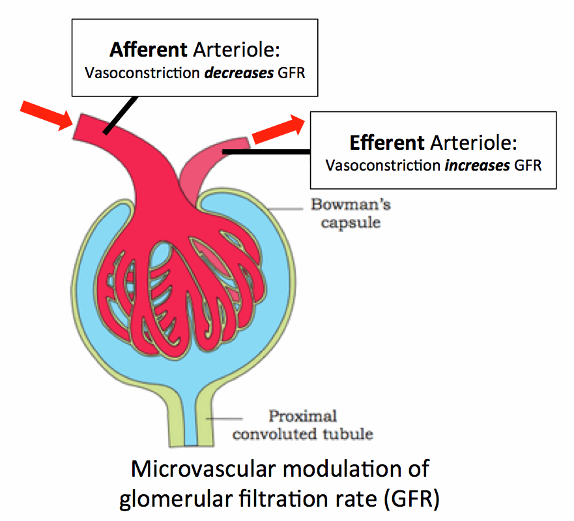

Slide 28
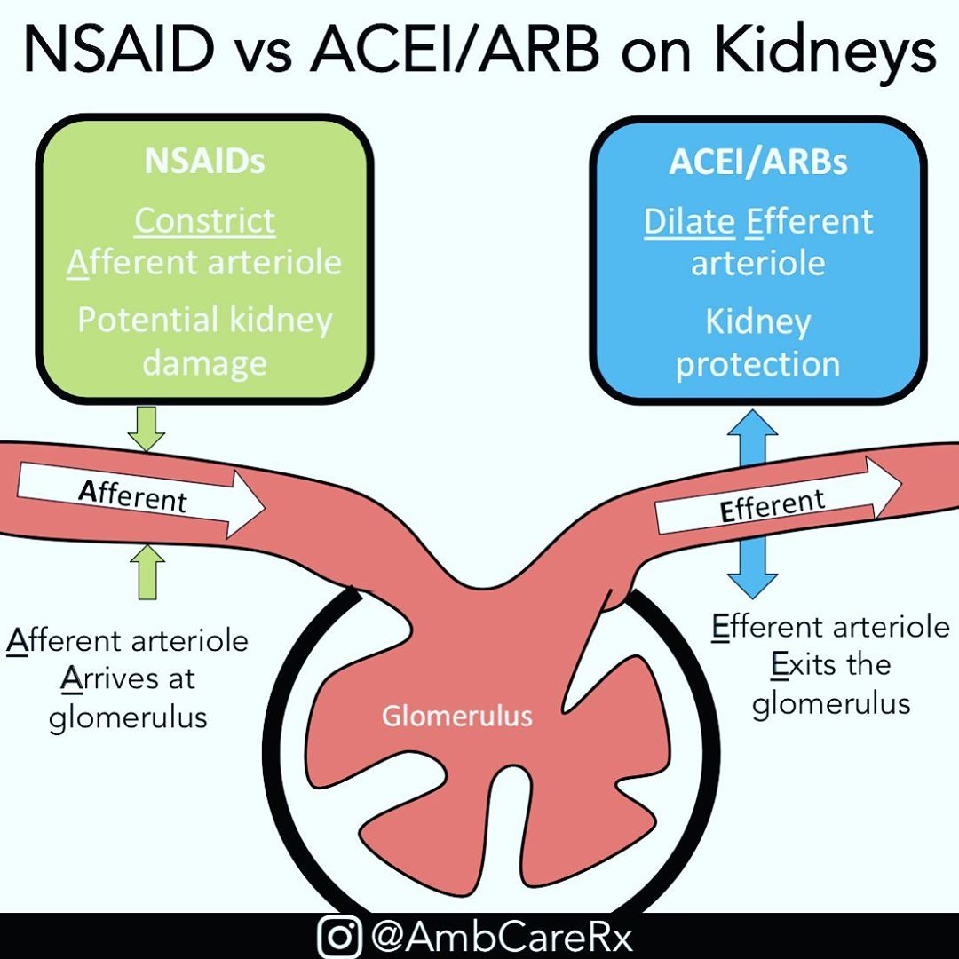

Slide 29
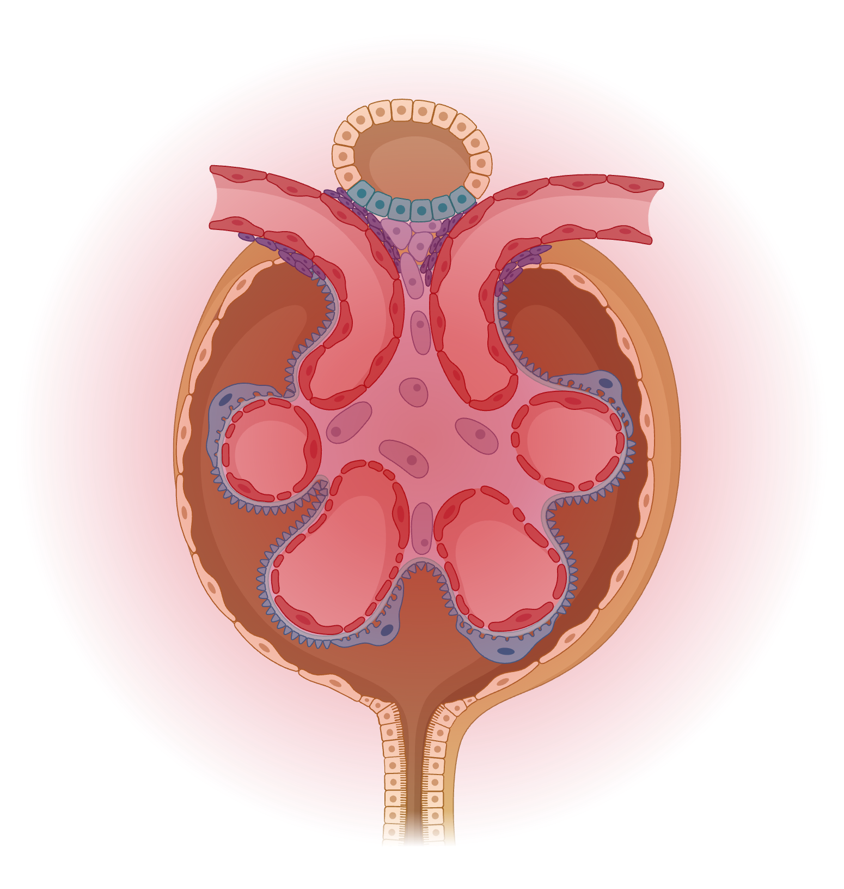
Afferent
Efferent
Na Reabsorption
Urea Reabsorption

Slide 30
Afferent
Efferent
Na Reabsorption
Urea Reabsorption

Slide 31
GFR
Efferent
Afferent
Efferent Dilation
- Angiotensin
RAAS Inhibitors
Na Reabsorption
Urea Reabsorption

Slide 32
Afferent
Efferent
Afferent Constriction
- Prostaglandins
NSAIDs
Calcineurin Inhibitors
- Tacrolimus
- Cyclosporin
High Calcium
Low volume states
Na Reabsorption
Urea Reabsorption

Slide 33
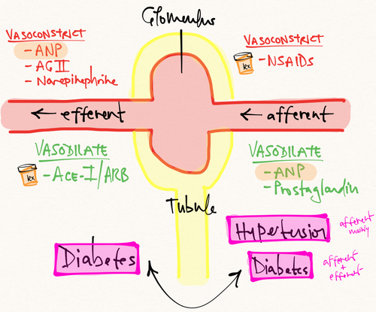
Afferent and Efferent Arterioles

Slide 34
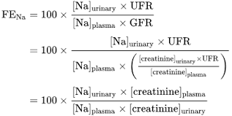
Fractional Excretion of ________
How well does your tubules function (concentration, dilution)
<1% = Kidney is reabsorbing Sodium
>2% = Not doing a good job

Slide 35
Sympathetic Hormones
RAAS System
ADH

Slide 37
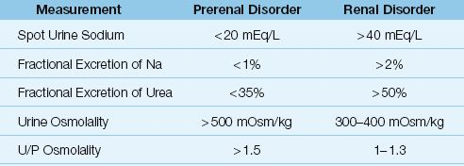

Slide 38
26 year old man presented to primary care physician with nausea and vomiting and found to have a creatinine of 6.1mg/dL.
Four days prior he had developed calf pain during a hike. Took ibuprofen 200mg during the hike and 400mg that evening. Urine turned dark after pain onset
Na 135, K 4.2, Cl 100, 24, 56/7.7.
Ca 7.7, PO4 8.5
CPK 28,946
What is the most likely cause of his AKI
A hemolysis
B Rhabdomyolysis
C Acute Intermittent Porphyria
D Paroxysmal nocturnal hemoglobinuria

Slide 39
B Rhabdomyolysis
Urine supernatant CLEAR in hematuria, but remains RED in rhbdomyolysis and hemoglobinuria. Plasma supernantant may remain RED in hemoglobinuria due to Hgb large size compared to myoglobin (which is filtered and cleared
Red urine does not spin out = heme pigment
Plasma with supernantant will remain red in hemoglobinuria

Slide 40
10) A 32 year old woman is brought to the ED by her boyfriend after she was found unresponsive and lying on the ground. She was last seen more than 24 hours ago. History is significant. For substance use disorder. She has no other medical history or prescription drugs.
On physical the patient is intubated and on mechanical ventilation. She is minimally responsive. Blood pressure is 120/75 mmHg and pulse rate is 110/min. The remainder of the vital signs and the cardiac, pulmonary, and abdominal exam are unremarkable. The neurologic examination is nonfocal. Urine output has been <20 ml/hr for the past 2 hours.
Labs: Calcium of 6.9mg/dL, CK 40,000 U/L, Creatinine 2.8mg/dL, Sodium 150, potassium 5.5mEq/L, Chloride 110 mEq/L, Bicarb 16mEq/L, Phosphate 5.9 mg/dL, FeNA <1%,
Urine: reddish brown urine. pH 5.2. 4+ blood, 2+ protein, granular casts.
Toxicology positive for cocaine and opiates
What is the most likely cause of AKI?

Slide 41
10) A 32 year old woman is brought to the ED by her boyfriend after she was found unresponsive and lying on the ground. She was last seen more than 24 hours ago. History is significant. For substance use disorder. She has no other medical history or prescription drugs.
On physical the patient is intubated and on mechanical ventilation. She is minimally responsive. Blood pressure is 120/75 mmHg and pulse rate is 110/min. The remainder of the vital signs and the cardiac, pulmonary, and abdominal exam are unremarkable. The neurologic examination is nonfocal. Urine output has been <20 ml/hr for the past 2 hours.
Labs: Calcium of 6.9mg/dL, CK 40,000 U/L, Creatinine 2.8mg/dL, Sodium 150, potassium 5.5mEq/L, Chloride 110 mEq/L, Bicarb 16mEq/L, Phosphate 5.9 mg/dL, FeNA <1%,
Urine: reddish brown urine. pH 5.2. 4+ blood, 2+ protein, granular casts.
Toxicology positive for cocaine and opiates
What is the most the most appropriate treatment?
Hemodialysis
IV 0.9% saline
IV 5% dextrose
IV calcium gluconate infusion
IV isotonic sodium bicarbonate in 5%

Slide 42
10) A 32 year old woman is brought to the ED by her boyfriend after she was found unresponsive and lying on the ground. She was last seen more than 24 hours ago. History is significant. For substance use disorder. She has no other medical history or prescription drugs.
On physical the patient is intubated and on mechanical ventilation. She is minimally responsive. Blood pressure is 120/75 mmHg and pulse rate is 110/min. The remainder of the vital signs and the cardiac, pulmonary, and abdominal exam are unremarkable. The neurologic examination is nonfocal. Urine output has been <20 ml/hr for the past 2 hours.
Labs: Calcium of 6.9mg/dL, CK 40,000 U/L, Creatinine 2.8mg/dL, Sodium 150, potassium 5.5mEq/L, Chloride 110 mEq/L, Bicarb 16mEq/L, Phosphate 5.9 mg/dL, FeNA <1%,
Urine: reddish brown urine. pH 5.2. 4+ blood, 2+ protein, granular casts.
Toxicology positive for cocaine and opiates
What is the most the most appropriate treatment?
Hemodialysis
IV 0.9% saline
IV 5% dextrose
IV calcium gluconate infusion
IV isotonic sodium bicarbonate in 5%

Slide 43
23) An 18 year old man is evaluated in the ICU for oliguric AKI. 18 hours ago he underwent a hepatectomy for a giant fibrolamellar hepatic carcinoma. During the procedure he developed coagulopathy and hepatic bleeding and required resuscitation with 8 units of pRBC, multiple units of FFP and several liters of crystalloid fluids. He is receiving cefepime, gentamicin, and propofol, and fentanyl. Urine output has decreased to 10ml/hr since ICU admission 14 hours ago.
On physical, the patient is mechanically ventilated. Blood pressure is 120/70, pulse of 115/min, and respiration rate is 12/min. Breath sounds are decreased bilaterally. The Abdomen is distended and tense with intact midline incision and weall edema. The remainder of the exam is noncontributory.
Labs: Hgb 10g/dL, CK 1250 U/L, Cr 1.7mg/dL on (baseline 0.9mg/dL), Potassium 5.2, Urine sodium <20 mEq/L,
UA: SpG 1.030, pH 5.5, 4+ blood, trace protein, TNC RBCs, few hyaline casts.
Ultrasound revails normal sized kidneys and no hydronephrosis: a large volume of ascites is noted.
Which of the following is the most appropriate diagnostic test to perform next?
Fractional excretion of sodium
Intra-abdominal pressure measurements
Urine myoglobin level
Urine stain for eosinophils

Slide 44
23) An 18 year old man is evaluated in the ICU for oliguric AKI. 18 hours ago he underwent a hepatectomy for a giant fibrolamellar hepatic carcinoma. During the procedure he developed coagulopathy and hepatic bleeding and required resuscitation with 8 units of pRBC, multiple units of FFP and several liters of crystalloid fluids. He is receiving cefepime, gentamicin, and propofol, and fentanyl. Urine output has decreased to 10ml/hr since ICU admission 14 hours ago.
On physical, the patient is mechanically ventilated. Blood pressure is 120/70, pulse of 115/min, and respiration rate is 12/min. Breath sounds are decreased bilaterally. The Abdomen is distended and tense with intact midline incision and weall edema. The remainder of the exam is noncontributory.
Labs: Hgb 10g/dL, CK 1250 U/L, Cr 1.7mg/dL on (baseline 0.9mg/dL), Potassium 5.2, Urine sodium <20 mEq/L,
UA: SpG 1.030, pH 5.5, 4+ blood, trace protein, TNC RBCs, few hyaline casts.
Ultrasound revails normal sized kidneys and no hydronephrosis: a large volume of ascites is noted.
Which of the following is the most appropriate diagnostic test to perform next?
Fractional excretion of sodium
Intra-abdominal pressure measurements
Urine myoglobin level
Urine stain for eosinophils

Slide 45
26) A 61 year old woman is evaluated in the ICU for AKI. She was discharged from the hospital 10 days ago following elective cholecystectomy. Seven days ago she was readmitted with sepsis. A CT scan of the abdomen with IV contrast did not show any abdominal pathology but confirmed pneumonia. She was treated with IV fluids, lnorepinephrine infusion, vancomycin, and cefepime. The norepinephrine was stopped yesterday. History of hypertension, CKD 3a. Baseline Cr is 1.4mg/dL. On admission the serum Cr was 1.9 and returned to baseline by hospital day 2. It is 3.1mg/dL today. Outpatient medicaitons are lisinopril and chlorthalidone.
On physical temp of 99.7F, BP of 140/82, HR 103/min, RR of 0/min. Examination of the lungs reveals bilateral crackles. 1+ pedal edema of the extremities. The remained of the physical exam is noncontributory.
Labs: Cr 3.1, Vanc trough 25mg/L, FeNA 2.5%
UA: SpG 1.012, pH 5.5, no blood, 1+ protein, trace LE, no nitrites, no glucose, 2-4 WBC, 5-10 rental tubular epithelial cells, 5-10 coarse granular casts.
Ultrasound: normal sized kidneys and no hydronephrosis.
Which of the following is the most likely cause of this patient’s AKI?
Cefepime
Intravenous contrast
Omeprazole
Vancomycin

Slide 46
26) A 61 year old woman is evaluated in the ICU for AKI. She was discharged from the hospital 10 days ago following elective cholecystectomy. Seven days ago she was readmitted with sepsis. A CT scan of the abdomen with IV contrast did not show any abdominal pathology but confirmed pneumonia. She was treated with IV fluids, lnorepinephrine infusion, vancomycin, and cefepime. The norepinephrine was stopped yesterday. History of hypertension, CKD 3a. Baseline Cr is 1.4mg/dL. On admission the serum Cr was 1.9 and returned to baseline by hospital day 2. It is 3.1mg/dL today. Outpatient medicaitons are lisinopril and chlorthalidone.
On physical temp of 99.7F, BP of 140/82, HR 103/min, RR of 0/min. Examination of the lungs reveals bilateral crackles. 1+ pedal edema of the extremities. The remained of the physical exam is noncontributory.
Labs: Cr 3.1, Vanc trough 25mg/L, FeNA 2.5%
UA: SpG 1.012, pH 5.5, no blood, 1+ protein, trace LE, no nitrites, no glucose, 2-4 WBC, 5-10 rental tubular epithelial cells, 5-10 coarse granular casts.
Ultrasound: normal sized kidneys and no hydronephrosis.
Which of the following is the most likely cause of this patient’s AKI?
Cefepime
Intravenous contrast
Omeprazole
Vancomycin

Slide 47
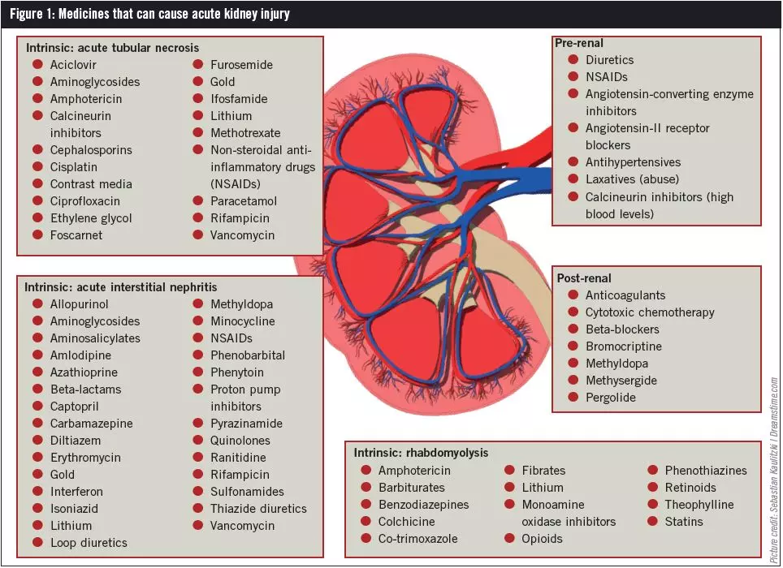

Slide 48
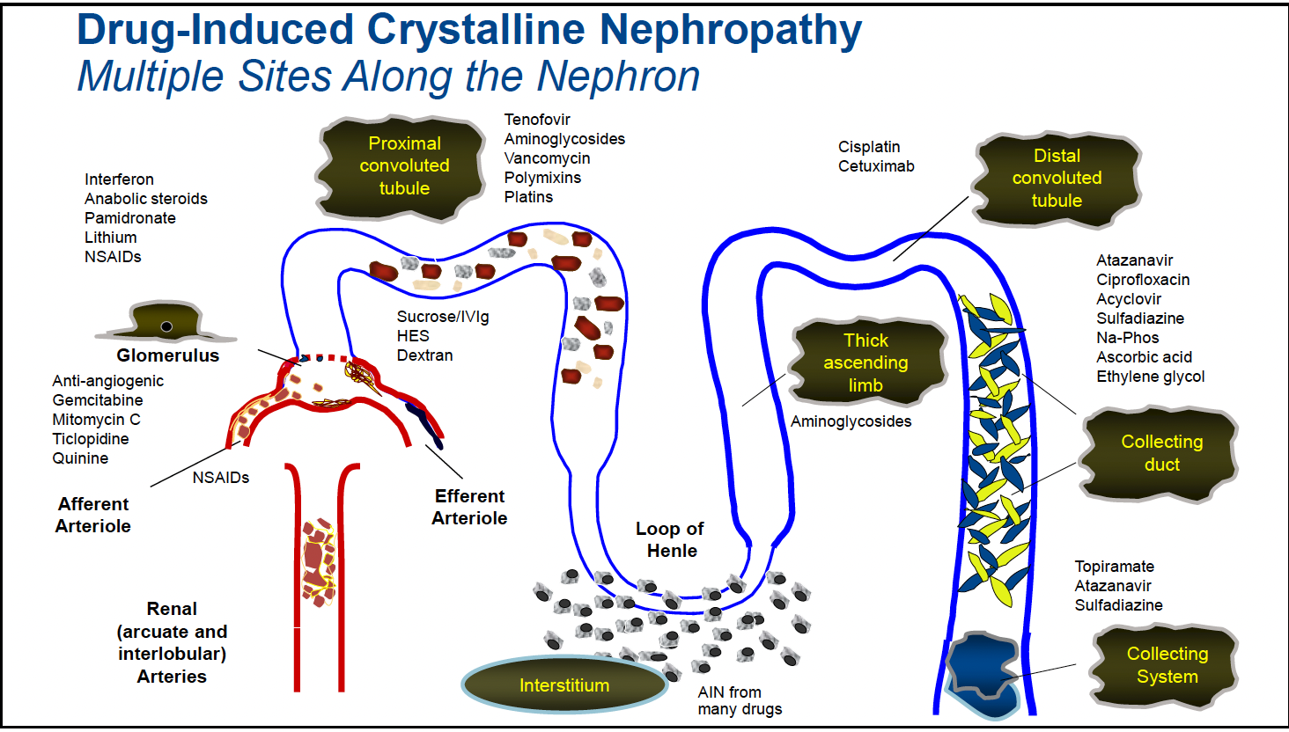

Slide 49
51) A 72 year old man is hospitalized for a 1 week history of worsening shortness of breath. He also has worsening lower extremity edema despite an increase in his furosemide dose 2 days ago. History is significant for hypertension, CKD 3a, and HFpEF. Outpatient medications are amlodipine, lisinopril, furosemide, and low dose aspirin.
On physical exam, BP 112/60, HR 97, BMI 28. Cardiac exam reveals an elevated jugular venous pressure and an S4. Breath sounds are diminished at the lung bases. There is 2+ pitting edema in the lower legs.
Labs: BUN 64mg/dL, Cr 2.3 mg/dL, Sodium 130mEq/L
Labs 2 weeks prior: BUN 40, Cr 1.9mg/dL, Sodium 133
UA: SpG 1.009, 1+ protein, few hyaline casts
Chest radiograph shows bibasilar effusions and vascular congestion
Which of the following is the most appropriate treatment?
Start Ultrafiltration
Add dobutamine infusion
Increase furosemide
Stop all medications and follow
IV fluids

Slide 50
51) A 72 year old man is hospitalized for a 1 week history of worsening shortness of breath. He also has worsening lower extremity edema despite an increase in his furosemide dose 2 days ago. History is significant for hypertension, CKD 3a, and HFpEF. Outpatient medications are amlodipine, lisinopril, furosemide, and low dose aspirin.
On physical exam, BP 112/60, HR 97, BMI 28. Cardiac exam reveals an elevated jugular venous pressure and an S4. Breath sounds are diminished at the lung bases. There is 2+ pitting edema in the lower legs.
Labs: BUN 64mg/dL, Cr 2.3 mg/dL, Sodium 130mEq/L
Labs 2 weeks prior: BUN 40, Cr 1.9mg/dL, Sodium 133
UA: SpG 1.009, 1+ protein, few hyaline casts
Chest radiograph shows bibasilar effusions and vascular congestion
Which of the following is the most appropriate treatment?
Start Ultrafiltration
Add dobutamine infusion
Increase furosemide
Stop all medications and follow
IV fluids

Slide 51
Thank you

Slide 52
MKSAP18
10, 12, 23, 26, 34*, 35, 43, 51, 56, 59, 65, 71, 73, 84, 96
A
A
a

