Slide 1
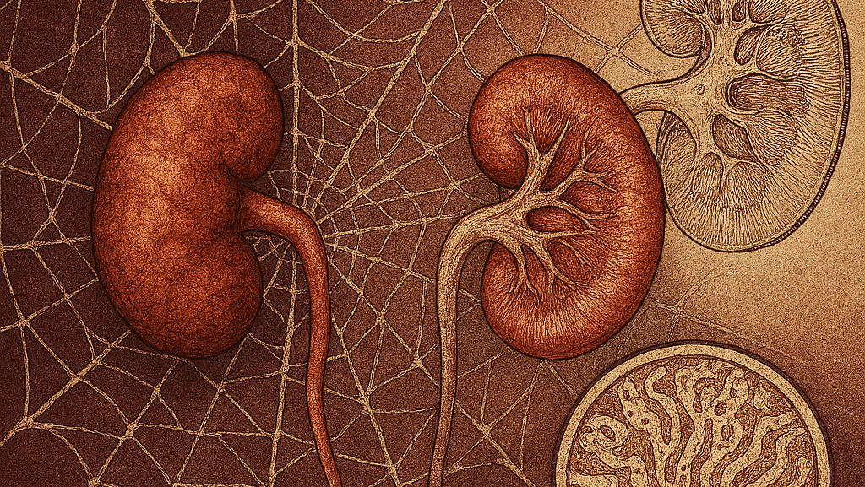
Woven Webs of Silent Fibrosis, Historical and Mechanistic Insights into ADTKD
Jacob Nysather D.O.
Kidney Care Grand Rounds
September 4th 2025

Slide 2
Disclosures
None

Slide 3
Objectives
Review historical progression of ADTKD
Review current understanding of pathophysiology and the impact of genetic mutation variations
Analyze current evidence in therapeutic options and their impact on disease progression

Slide 4


Slide 5
A 32 year old female presents as a consult with concern for CKD. After her pregnancy at age 27 was told the pre-eclampsia she experienced could be due to underlying kidney issues. She was encouraged by family to see a nephrologist given her family history of her father developed ESRD in his mid 40s (1960s, scarlet fever after untreated strep throat in his 20s) received the first father-son living donor transplant in the US. Other reported history is grandfather passed away in his 40s thought to be kidney related (1920s). Labs reveals a stable creatinine of 0.9 (eGFR >60), UA negative for protein or blood, ultrasound negative.

Slide 6
Fast forward an unremarkable 7 years, at age 39, having declining kidney function as was told she had CKD Stage 3. Stated it was likely the result of pre-eclampsia with her pregnancy. Was re-assured that although she had CKD the decline was slow.
Over the next 6 years her renal function continued to decline with a negative autoimmune work-up. But after another 2 years was diagnosed with Sarcoidosis and treated with steroids.

Slide 7
At the time her kidney function qualified her for a transplant evaluation, her brother (not the one who donated) was dealing with CKD as well in his upper 40s thought to be environmental exposures from being a mechanic.

Slide 8
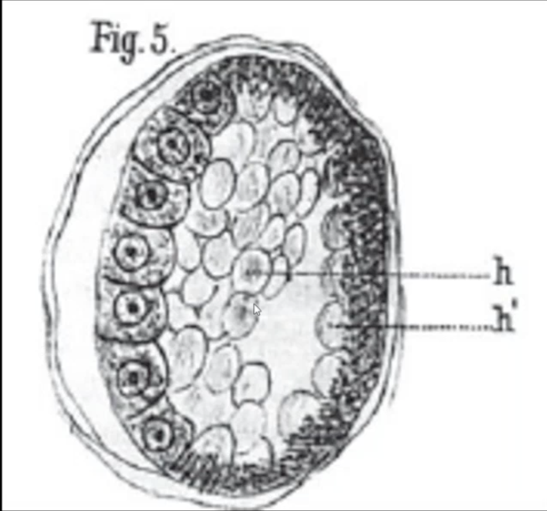
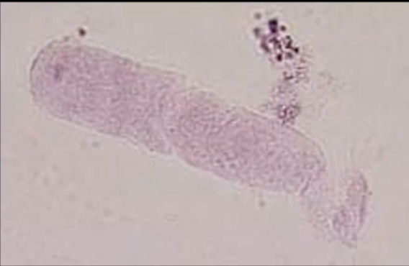
Carlo R. Rovida (Univ. Turin) first described a wax-like substance, cilindrina, produced by kidney tubular cells and forming hyaline

Slide 9
Thorn and Kopf
Young Man
Salt wasting and CKD
Duncan and Dixon
Gout and Kidney Disease
FJHN
Goldman and Gardner
5 generation kidney disease
Fanconi describes AR
Kidney disease
in childhood
Straus 18 cases of cystic
Disease in medulla
2 inherited
Dahan proposes FJHN
and MCKD2 are the same
1944
1951
1960
1962
1966
1999
2001
2009
2013
2015
2018
2024
UMOD
HNF1-Beta
REN
MUC1
DNAJB11
APOA4
KDIGO
Notes:
More than half a century has elapsed since Thorn, Keorf and Clinton in 1944 presented a case of salt losing nephritis¹ and Smith and Graham first described medullary cystic disease (MCD) in 1945². In 1951 Fanconi et al published their experience with familial juvenile nephronophthisis³ and Murphy et al reported a case of salt losing nephritis in 1952 that at autopsy showed bilateral small medullary and corticomedullary renal cysts⁴. The first report on the clinical aspects of MCD was from Strauss et al, who studied 18 young adults (mean age of 27 years) with renal failure and salt wasting⁵. Heredity was not evident except in two of their cases. Goldman et al reported the first large family with MCD showing that the disease was inherited with a dominant trait, either autosomal or X-linked⁶. Mongeau et al published their own experience, proposing that MCD and familial juvenile nephronophthisis (NPH) were subcategories of the same disease entity, representing probably a toxic nephropathy that was transmitted as an inherited metabolic error. They also mentioned that macroscopic renal cysts were not essential for the diagnosis. This latter statement is still true today⁷.

Slide 10

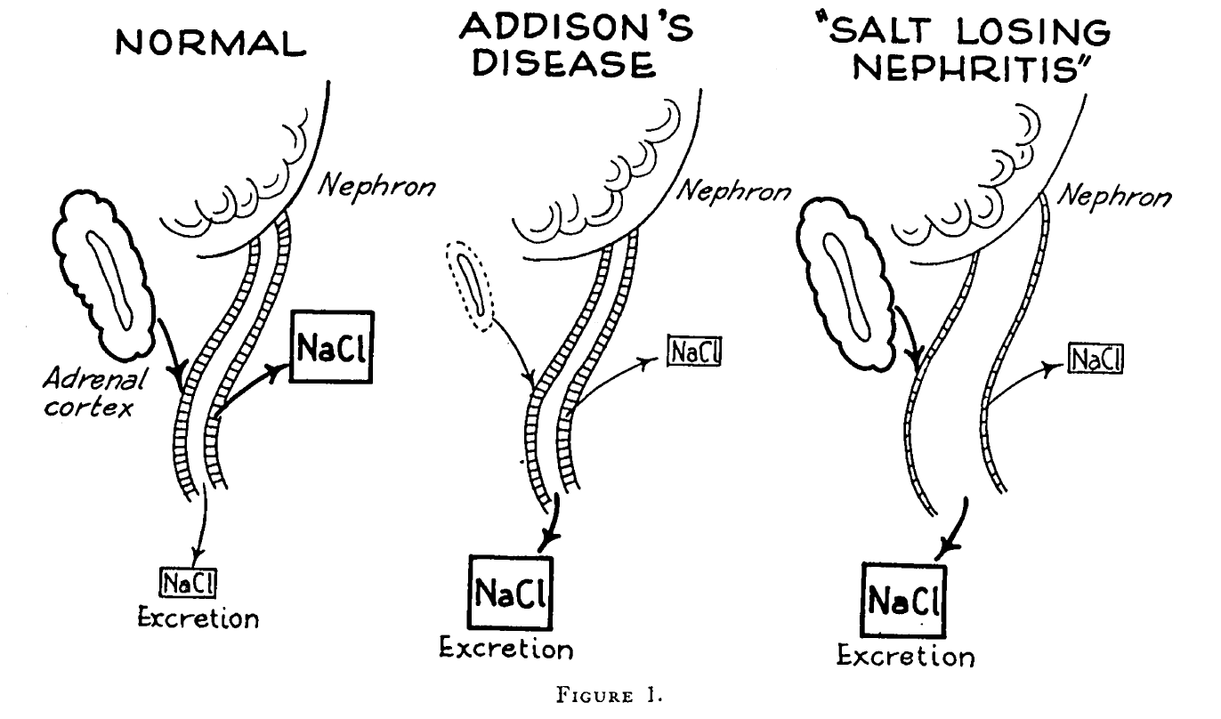
1944 first described 2 cases of cases that are like Addison’s disease, but of renal origin.
“Presenting signs and symptoms indistinguishable from those of acute adrenal insufficiency occurring in patients with chronic nephritis and normal adrenal glands has not been reported. The present study is concerned with a report of two patients who, on admission to the hospital, were considered to be suffering from acute adrenal insufficiency. Subsequent studies over a period of two to four years, including post-mortem examinations, proved that the metabolic changes in the body followed renal rather than adrenal disease”

Slide 11
Thorn and Kopf
Young Man
Salt wasting and CKD
Duncan and Dixon
Gout and Kidney Disease
FJHN
Goldman and Gardner
5 generation kidney disease
Fanconi describes AR
Kidney disease
in childhood
Straus 18 cases of cystic
Disease in medulla
2 inherited
Dahan proposes FJHN
and MCKD2 are the same
1944
1951
1960
1962
1966
1999
2001
2009
2013
2015
2018
2024
UMOD
HNF1-Beta
REN
MUC1
DNAJB11
APOA4
KDIGO
Notes:
More than half a century has elapsed since Thorn, Keorf and Clinton in 1944 presented a case of salt losing nephritis¹ and Smith and Graham first described medullary cystic disease (MCD) in 1945². In 1951 Fanconi et al published their experience with familial juvenile nephronophthisis³ and Murphy et al reported a case of salt losing nephritis in 1952 that at autopsy showed bilateral small medullary and corticomedullary renal cysts⁴. The first report on the clinical aspects of MCD was from Strauss et al, who studied 18 young adults (mean age of 27 years) with renal failure and salt wasting⁵. Heredity was not evident except in two of their cases. Goldman et al reported the first large family with MCD showing that the disease was inherited with a dominant trait, either autosomal or X-linked⁶. Mongeau et al published their own experience, proposing that MCD and familial juvenile nephronophthisis (NPH) were subcategories of the same disease entity, representing probably a toxic nephropathy that was transmitted as an inherited metabolic error. They also mentioned that macroscopic renal cysts were not essential for the diagnosis. This latter statement is still true today⁷.

Slide 12
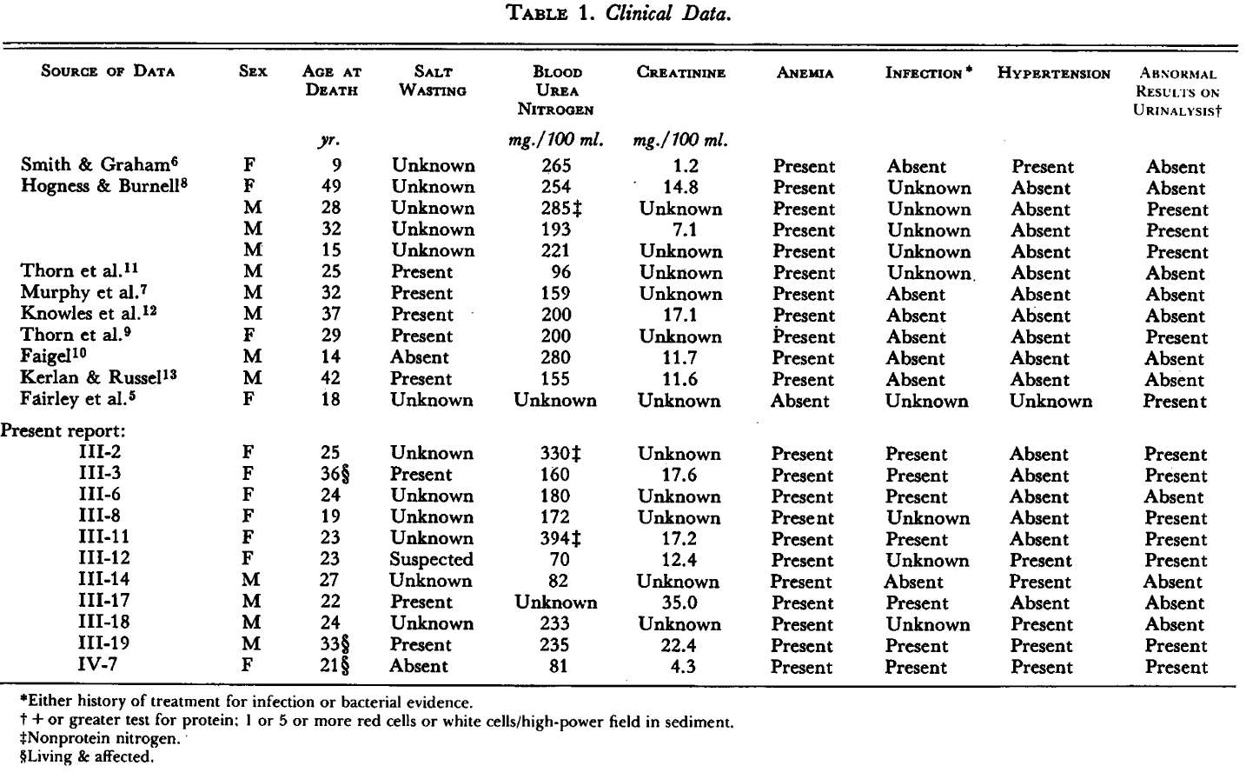

Slide 13
Thorn and Kopf
Young Man
Salt wasting and CKD
Duncan and Dixon
Gout and Kidney Disease
FJHN
Goldman and Gardner
5 generation kidney disease
Fanconi describes AR
Kidney disease
in childhood
Straus 18 cases of cystic
Disease in medulla
2 inherited
Dahan proposes FJHN
and MCKD2 are the same
1944
1951
1960
1962
1966
1999
2001
2009
2013
2015
2018
2024
UMOD
HNF1-Beta
REN
MUC1
DNAJB11
APOA4
KDIGO
Notes:
More than half a century has elapsed since Thorn, Keorf and Clinton in 1944 presented a case of salt losing nephritis¹ and Smith and Graham first described medullary cystic disease (MCD) in 1945². In 1951 Fanconi et al published their experience with familial juvenile nephronophthisis³ and Murphy et al reported a case of salt losing nephritis in 1952 that at autopsy showed bilateral small medullary and corticomedullary renal cysts⁴. The first report on the clinical aspects of MCD was from Strauss et al, who studied 18 young adults (mean age of 27 years) with renal failure and salt wasting⁵. Heredity was not evident except in two of their cases. Goldman et al reported the first large family with MCD showing that the disease was inherited with a dominant trait, either autosomal or X-linked⁶. Mongeau et al published their own experience, proposing that MCD and familial juvenile nephronophthisis (NPH) were subcategories of the same disease entity, representing probably a toxic nephropathy that was transmitted as an inherited metabolic error. They also mentioned that macroscopic renal cysts were not essential for the diagnosis. This latter statement is still true today⁷.

Slide 14
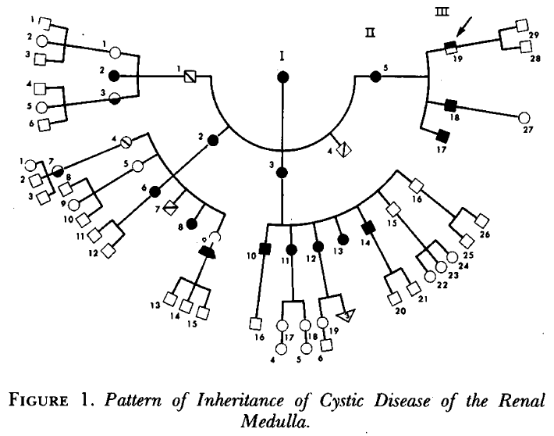
1964 a 33 year old man admitted with ESRD with a strong family history of illnesses causing death by uremia. Post-mordem microscopical sections of their kidneys showed cystic diseases of the medulla.

Slide 15
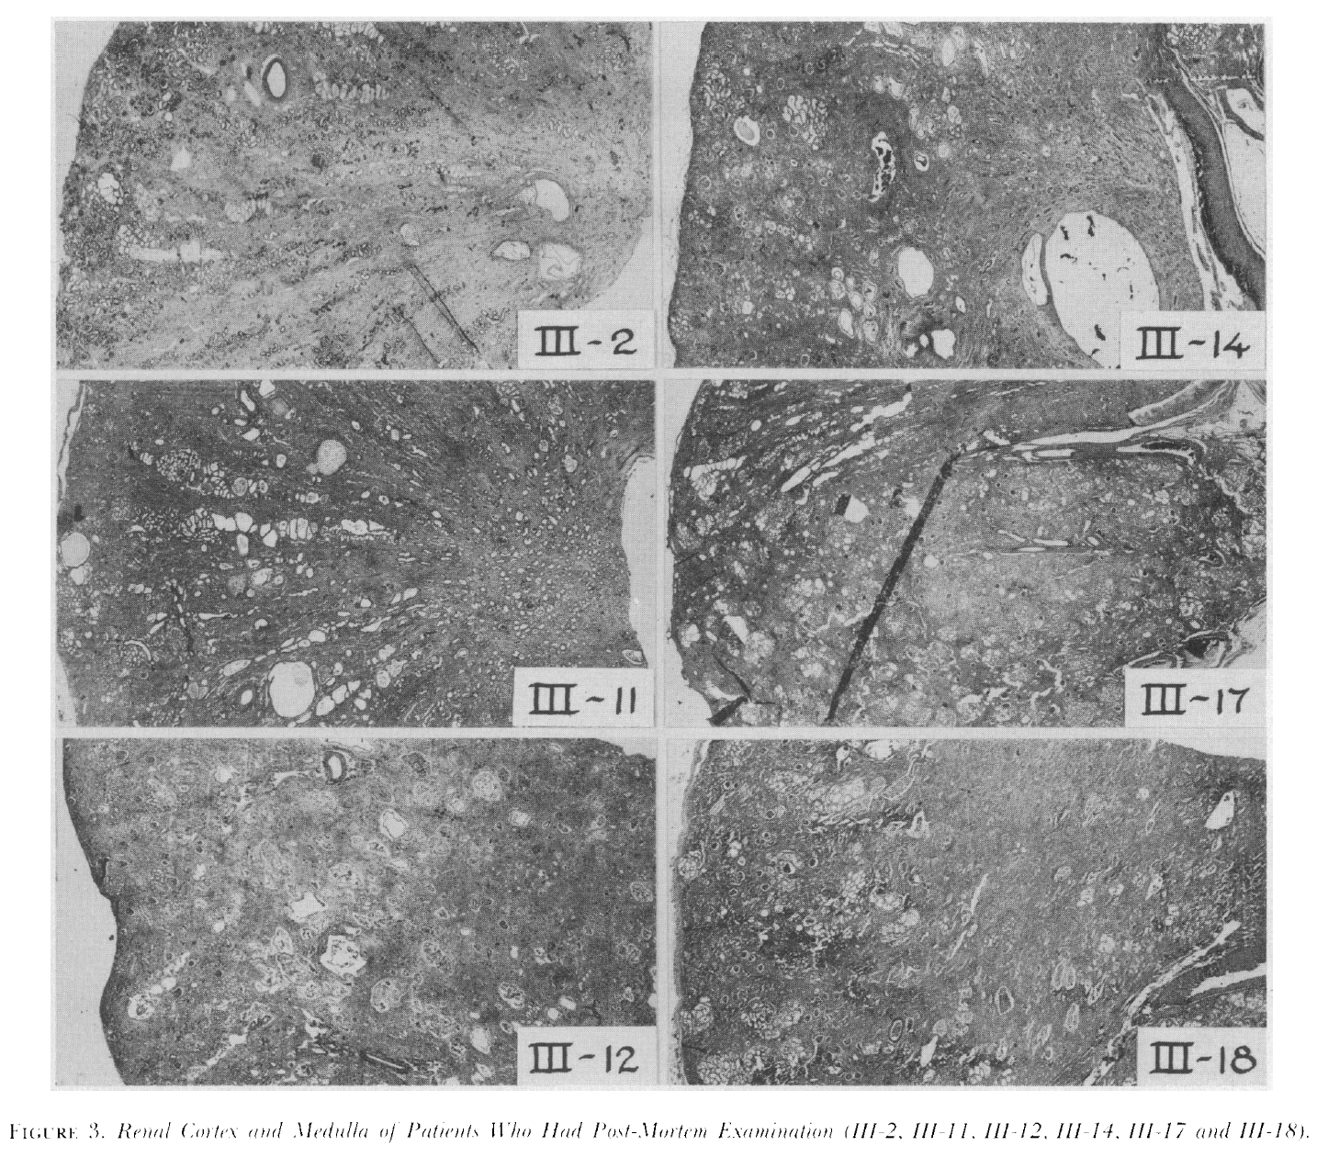
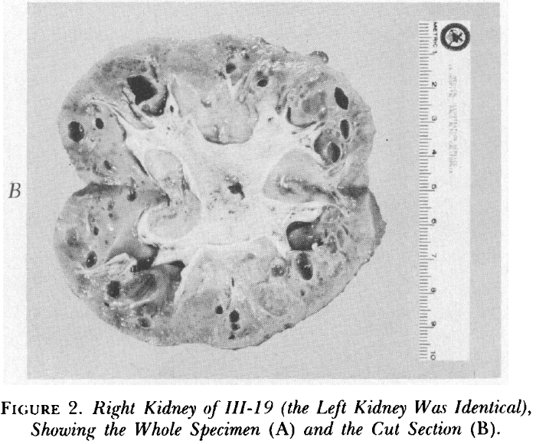

Slide 16
Thorn and Kopf
Young Man
Salt wasting and CKD
Duncan and Dixon
Gout and Kidney Disease
FJHN
Goldman and Gardner
5 generation kidney disease
Fanconi describes AR
Kidney disease
in childhood
Straus 18 cases of cystic
Disease in medulla
2 inherited
Dahan proposes FJHN
and MCKD2 are the same
1944
1951
1960
1962
1966
1999
2001
2009
2013
2015
2018
2024
UMOD
HNF1-Beta
REN
MUC1
DNAJB11
APOA4
KDIGO
Notes:
More than half a century has elapsed since Thorn, Keorf and Clinton in 1944 presented a case of salt losing nephritis¹ and Smith and Graham first described medullary cystic disease (MCD) in 1945². In 1951 Fanconi et al published their experience with familial juvenile nephronophthisis³ and Murphy et al reported a case of salt losing nephritis in 1952 that at autopsy showed bilateral small medullary and corticomedullary renal cysts⁴. The first report on the clinical aspects of MCD was from Strauss et al, who studied 18 young adults (mean age of 27 years) with renal failure and salt wasting⁵. Heredity was not evident except in two of their cases. Goldman et al reported the first large family with MCD showing that the disease was inherited with a dominant trait, either autosomal or X-linked⁶. Mongeau et al published their own experience, proposing that MCD and familial juvenile nephronophthisis (NPH) were subcategories of the same disease entity, representing probably a toxic nephropathy that was transmitted as an inherited metabolic error. They also mentioned that macroscopic renal cysts were not essential for the diagnosis. This latter statement is still true today⁷.

Slide 17


Slide 18
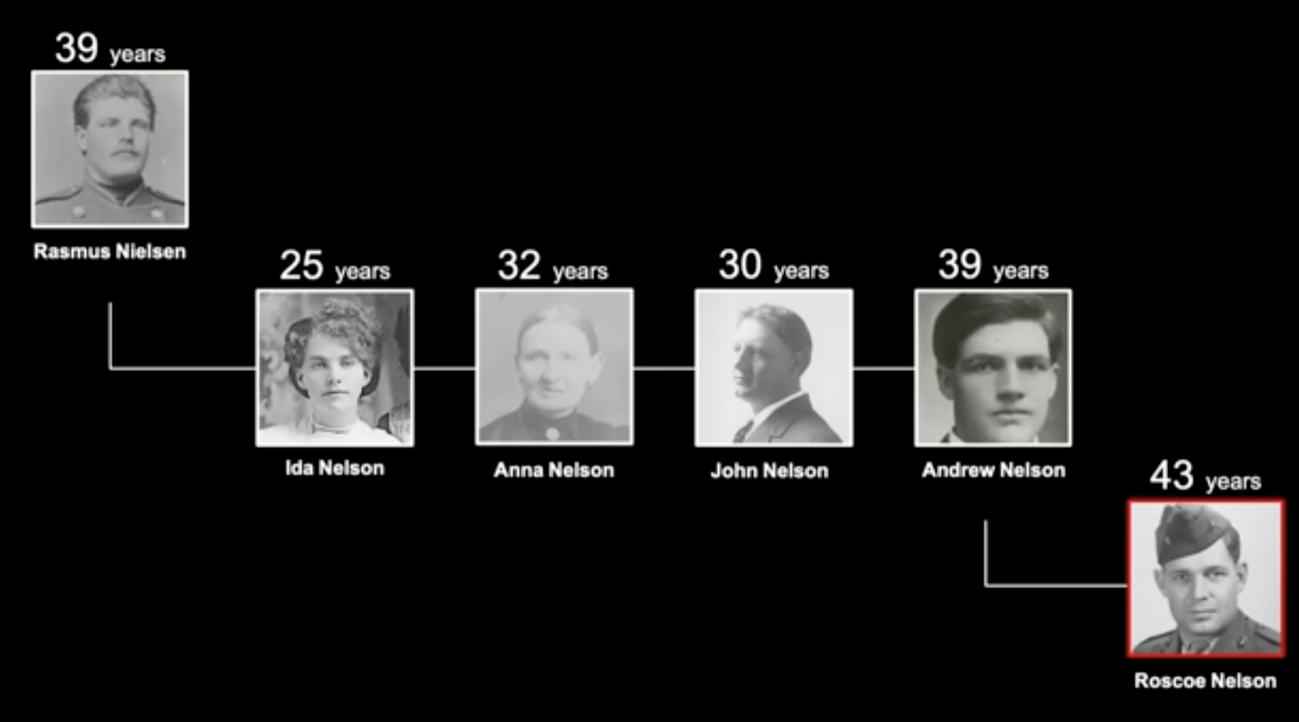

Slide 19
medullary cystic kidney disease (MCKD)
familial juvenile hyperuricaemic nephropathy (FJHN)
hereditary interstitial kidney diseases tubulointerstitial nephritis

Slide 20
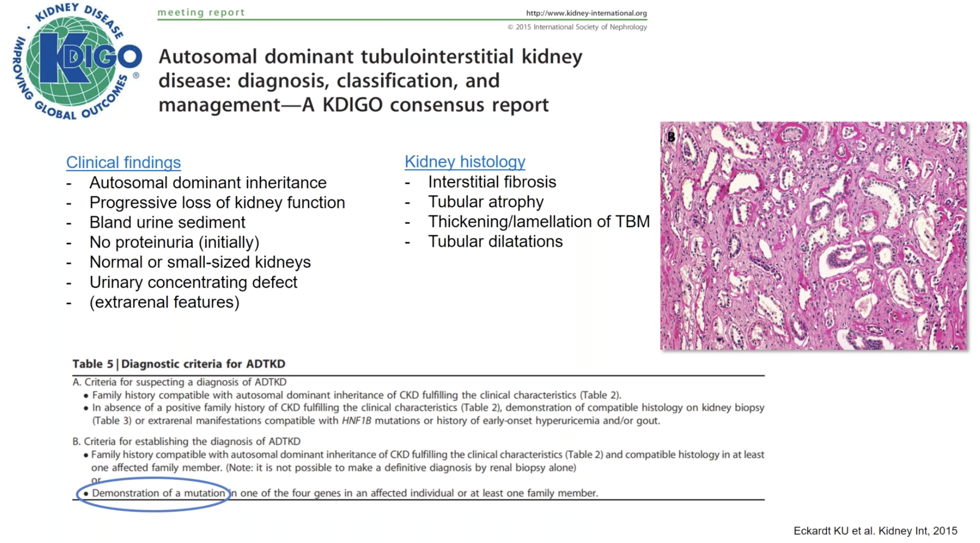

Slide 21
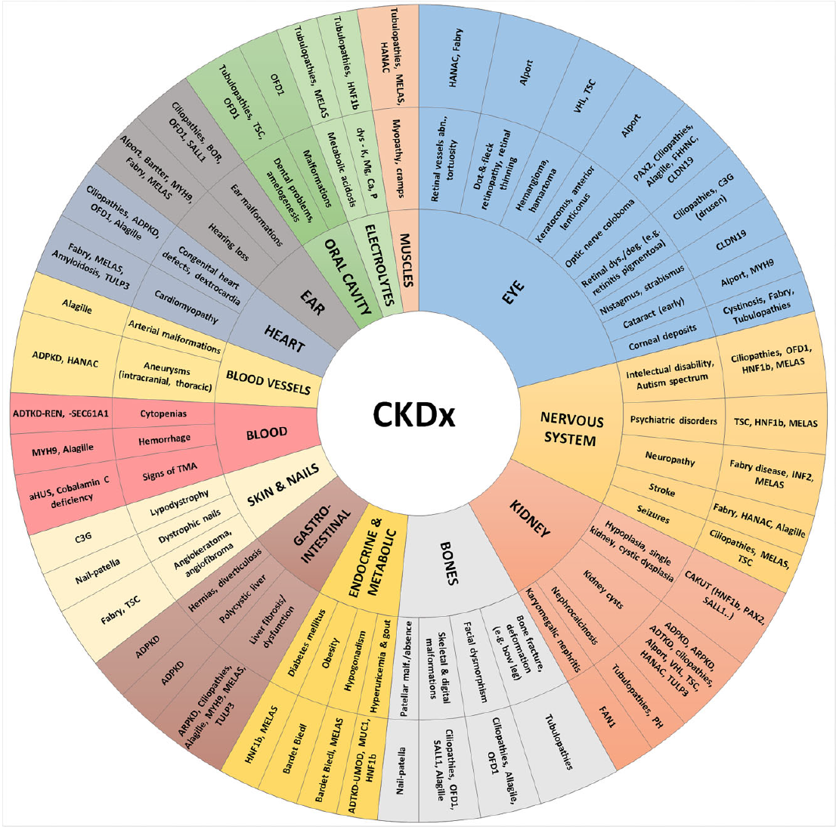
Genetics
Figure 2. Halbritter J, et al., Nephrol Dial Transplant. 2025
Notes:
Figure 2: Sunburst-like plot showing possible extrarenal and renal features associated with genetic kidney conditions. (Of note: pie-size does not reflect real frequency; not all possible extrarenal features are listed here nor all genetic kidney diseases are covered.) Abbreviations: ADPKD, autosomal dominant polycystic kidney disease; ARPKD, autosomal recessive polycystic kidney disease; ADTKD, autosomal dominant tubulointerstitial kidney disease; BOR, branchio-oto-renal; CAKUT, congenital anomalies of the kidneys and urinary tract; C3G, C3 glomerulopathy; HANAC, hereditary angiopathy with nephropathy, aneurysms and cramps ( COL4A1 gene); HNF1b , gene coding for hepatic nuclear factor 1-beta; FAN1 , FANCD2/FANCI-associated nuclease 1; MELAS, mitochondrial encephalopathy, lactic acidosis, stroke-like episodes; MUC1 , gene coding for mucin 1; MYH9 , gene coding for myosin heavy chain 9; OFD1, orofaciodigital syndrome 1; PH, primary hyperoxaluria; REN , gene coding for renin; SALL1 , gene coding for spalt-like transcription factor 1 (Townes-Brockes syndrome); SEC61A1 , gene coding for Sec61 subunit alpha isoform 1; TMA, thrombotic microangiopathy; TSC, tuberous sclerosis complex; TULP3 , gene coding for TUB like protein 3 (hepatorenocardiac syndrome), UMOD —gene coding for uromodulin; VHL , von Hippel Lindau disease, WT1 , Wilms’ tumour suppressor gene. Explanations: 1. The term ‘ciliopathies’ refers to broad spectrum of multisystemic disorders originating from primary cilia disorder with kidney, nervous system, skeleton, eye and other organs affection. (e.g. nephronophtysis, Senior-Loken syndrome, Joubert syndrome, Alström syndrome, Bardet-Biedl, etc.). Ciliopathies may include disorders like ADPKD, ARPKD and OFD1-related disease, although in this figure they are shown separately. 2. The term ‘tubulopathies’ refers to broad spectrum of diseases caused by renal tubular disfunction resulting in electrolyte (K, P, Ca, Mg, Na, Cl) and/or renal acid-base disorders with common systemic implications (e.g. Gitelman syndrome, Bartter syndrome, renal hypophosphatemia, familial hypomagnesaemia with hypercalciuria and nephrocalcinosis, etc.).

Slide 22
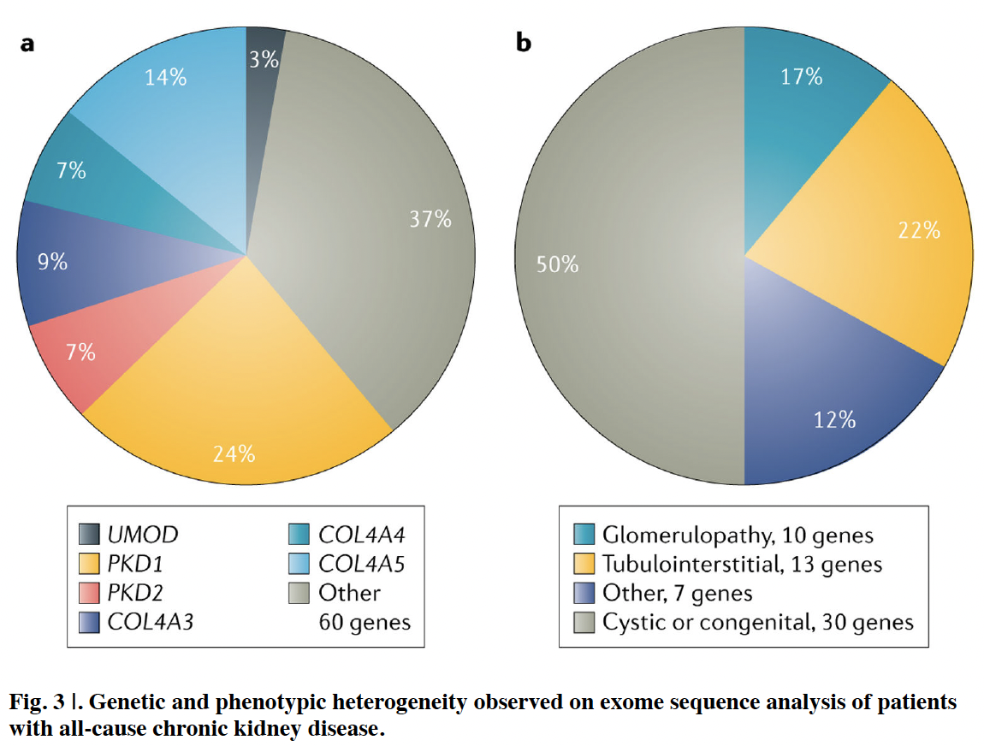
Phenotypic Heterogeneity
Groopman, EE. et al. Nat Rev Nephrol. 2020

Slide 23
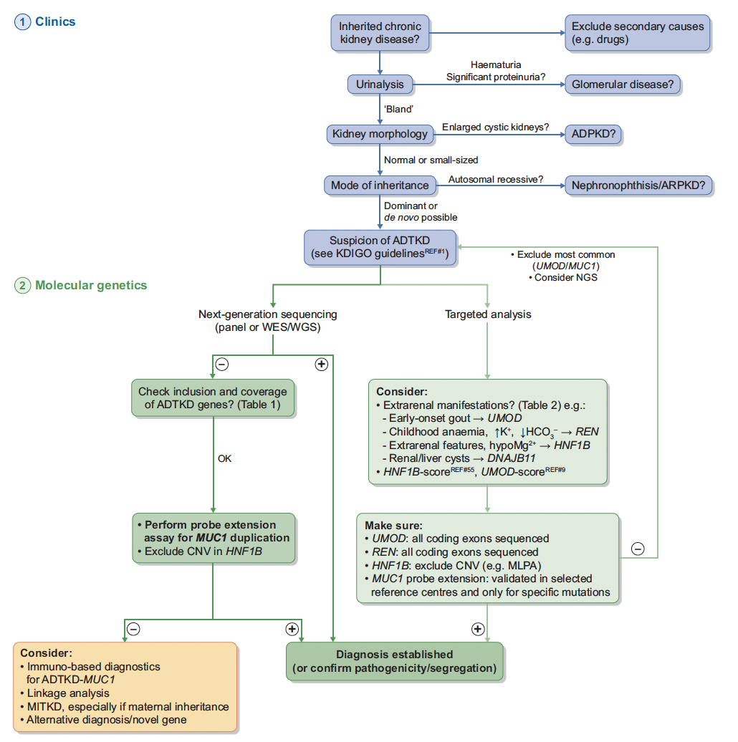
Figure 2. Mabillard H, et al.. Nephrol Dial Transplant. 2023
Notes:
FIGURE 2: Diagnostic algorithm in ADTKD. ADTKD should be suspected based on a series of clinical findings (or the absence thereof) and
typically a positive family history (in blue) [1]. A firm diagnosis in suspected cases can only be established by molecular genetics (in green).
Diagnostic approaches are likely to change with evolving molecular methodologies. Targeted analysis should take into consideration typical
extrarenal features where present and may also take into account clinical scores developed for the rational prioritization of genetic tests. NGSbased
approaches will likely become the preferred technology for detecting ADTKD with the limitations that variants in MUC1 VNTR are not
detectable by NGS and require tailored approaches.ﬂ, positive result; –, negative result; ARPKD, autosomal recessive polycystic kidney disease;
CNV, copy number variation; MLPA, multiplex ligation-dependent probe amplification.;Adapted from Devuyst O, Olinger E, Weber S et al.
Autosomal dominant tubulointerstitial kidney disease. Nat Rev Dis Primer 2019; 5: 60.

Slide 24
Prevalence
3rd leading genetic cause of kidney disease responsible for 5% of monogenic kidney disease
Minimum prevalence 2.6/million
  North Carolina 12/million
  Other estimates 3-16/million
Comparisons – Goodpasture 1/million and cystinosis 1.6/million

Slide 25
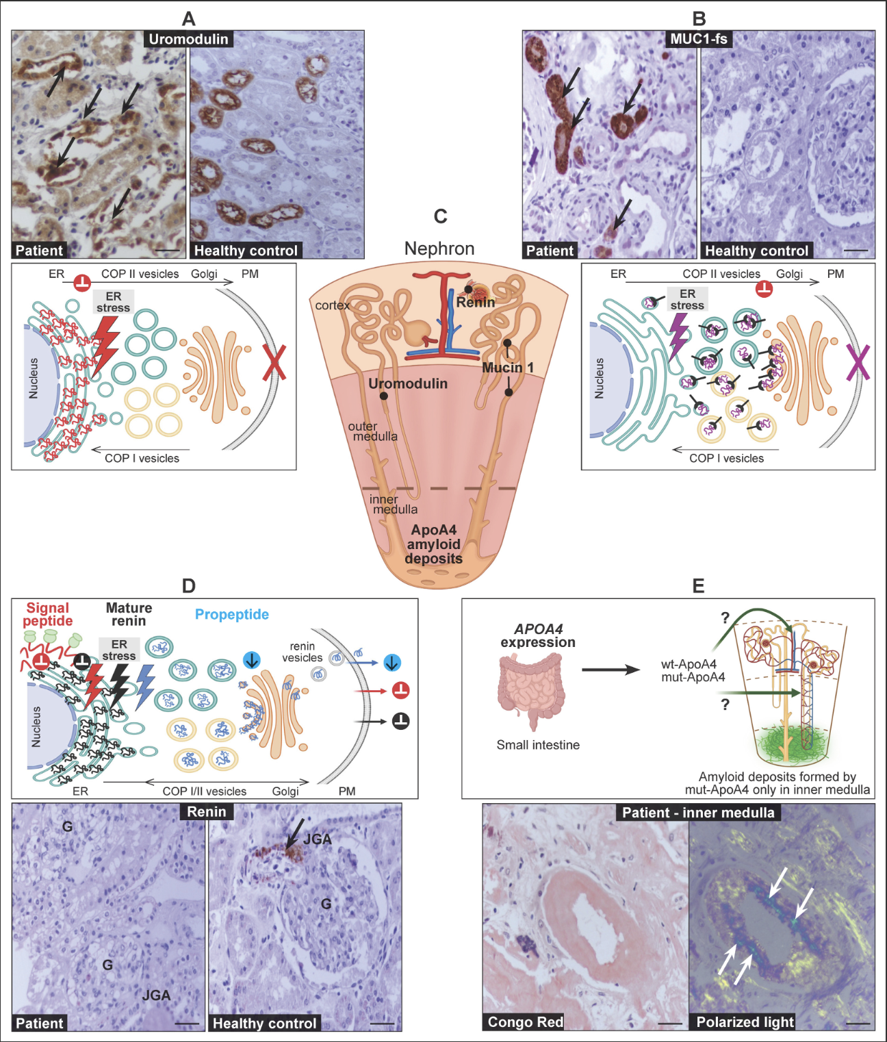

Slide 26
ADTKD-UMOD

Slide 27
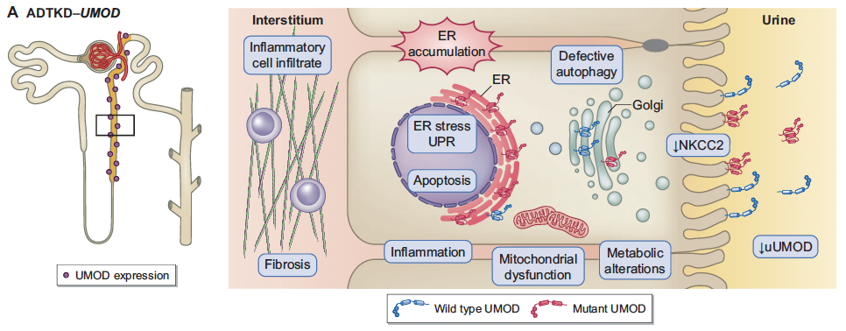
ADTKD-UMOD
Figure 1. Mabillard H, et al.. Nephrol Dial Transplant. 2023
Notes:
FIGURE 1: Pathophysiology of ADTKD-UMOD and ADTKD-MUC1. (A) Left panel: UMOD expression is restricted to the thick ascending
limb and the early DCT. Right panel: Cellular pathways activated by the expression of mutant UMOD (in cellular and murine studies as well
as patient biopsies) and its toxic accumulation in the ER. (B) Left panel: Mucin 1 expression along the entire distal tubule. Right panel: Cellular
pathways activated by the expression of mutant mucin 1 (in cellular and murine studies as well as patient biopsies) and its toxic accumulation
in the ERGIC.

Slide 28
ADTKD-UMOD
Uromodulin (Tamm-Horsfall glycoprotein)
Membrane-anchored glycoprotein expressed exclusively in the thick ascending limb of Henle and early distal convoluted tubule
Uromodulin has 48 conserved cysteine residues that form 24 disulfide bonds critical to the tertiary structure of the protein

Slide 29
ADTKD-UMOD
severity of clinical disease in ADTKD-UMOD correlates with the degree of retention of the mutant uromodulin for the various pathogenic UMOD variants.
Experimental studies suggest that abnormal protein folding leads to a toxic gain of function with inability of the mutant uromodulin to exit the endoplasmic reticulum (ER), leading to a cascade of ER stress, accelerated apoptosis, tubular cell death, nephron dropout, and CKD.
Immunostaining for uromodulin reveals irregular clumping of uromodulin instead of the diffuse staining found in unaffected individual

Slide 30
ADTKD-UMOD
Uromodulin facilitates transport of the sodium-sensitive NKCC2 transporter to the surface of the thick ascending limb of Henle. Decreased uromodulin production in ADTKD-UMOD results in decreased apical transport of the NKCC2 transporter, less sodium reabsorption and a mild natriuresis.
The mild natriuresis is compensated for by increased proximal tubular reabsorption of sodium, which is associated with increased proximal uric acid uptake, leading to hyperuricemia and a decreased fractional excretion of uric acid.

Slide 31
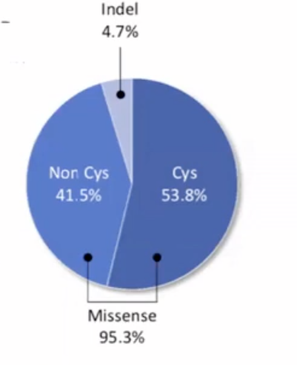
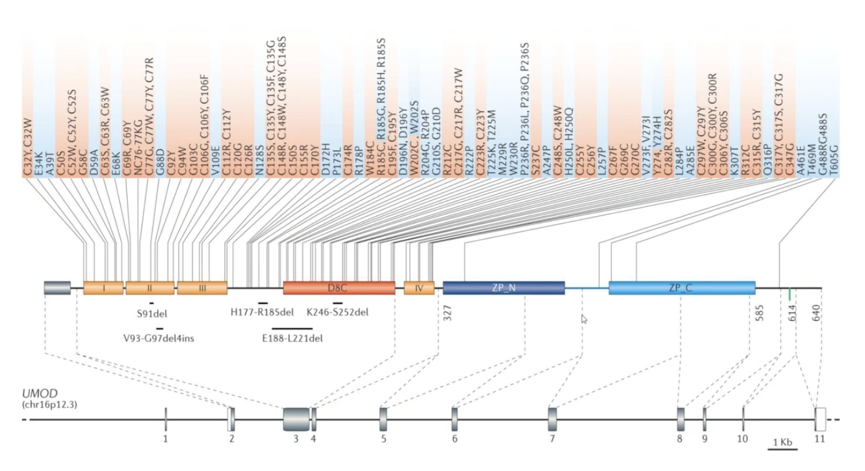
UMOD- Genetic
Devuyst O, et al., Nat Rev Disease 2017
Mabillard et al, DNT 2021
Notes:
Devuyst O et al Nat Rev Neph 2017
125 mutations
95% cluster 3 and 4
121/125 missense

Slide 32
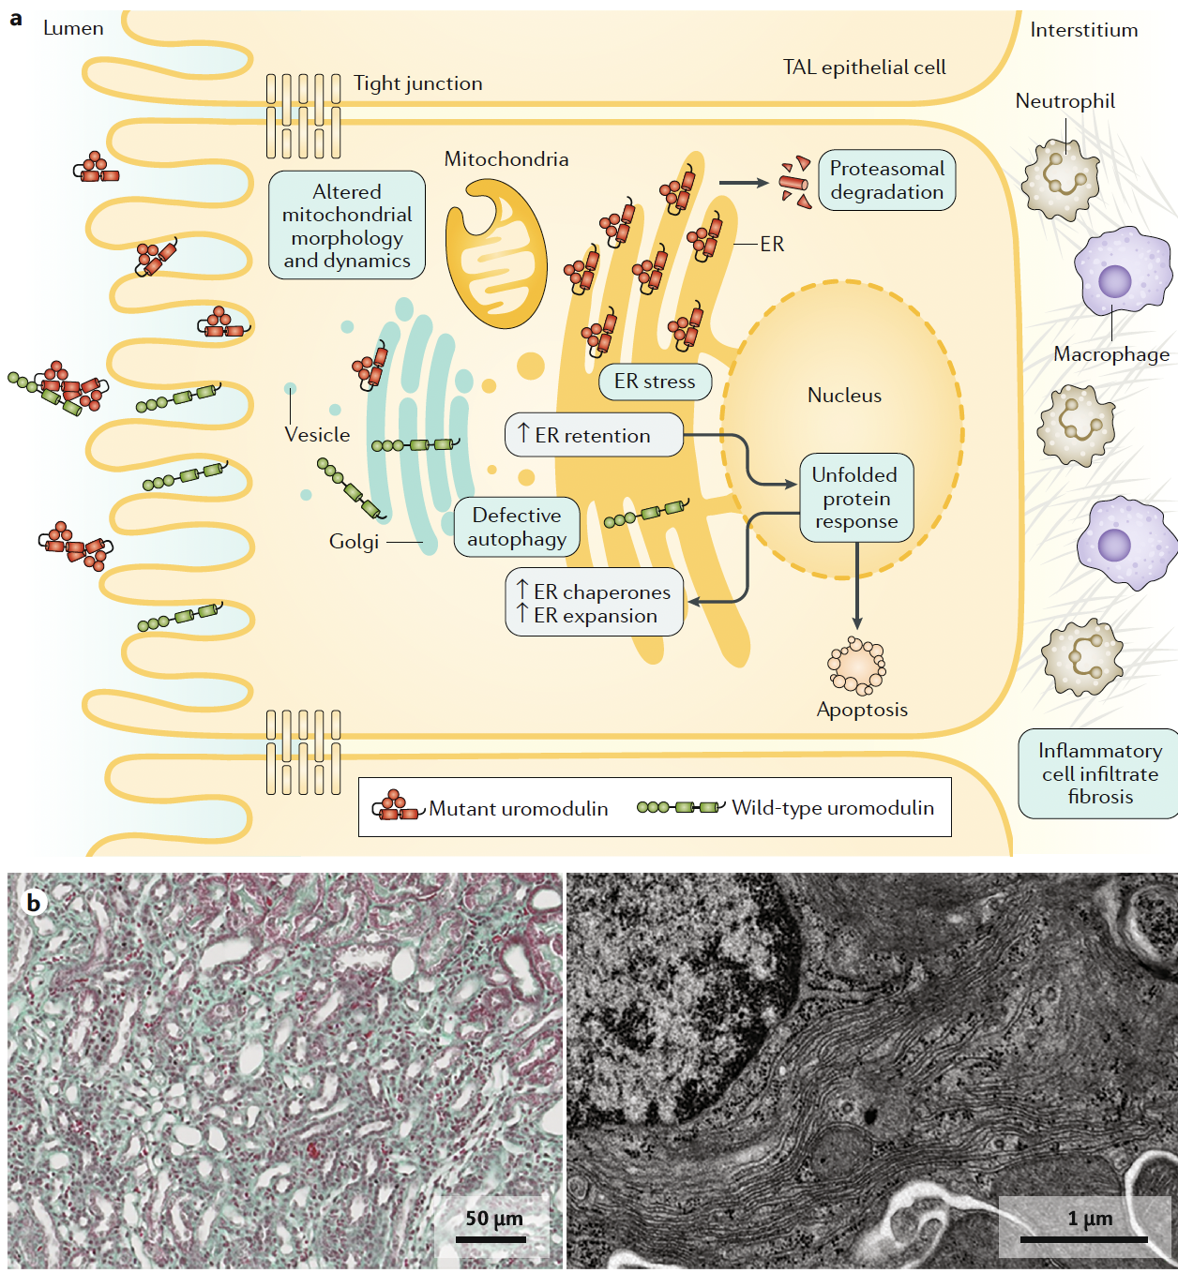
Figure 2 Devuyst O, et al., Nat Rev Dis Primers. 2019
Notes:
Fig. 2 | Mechanisms of ADTKD- UMOD. a | Cellular pathways activated by expression of mutant uromodulin (encoded by
UMOD) in autosomal dominant tubulointerstitial kidney disease (ADTKD). Endoplasmic reticulum (ER) accumulation of
misfolded mutant uromodulin triggers ER stress and the unfolded protein response. It also leads to defective autophagy
and protein homeostasis, and to altered mitochondria morphology and dynamics. Mutant uromodulin escaping ER quality
control or proteasomal degradation can reach the cell plasma membrane, where it interferes with the polymerization of
wild- type protein. Chronic induction of the unfolded protein response eventually leads to activation of proinflammatory
signals and cell death. b | Humanized knock- in mouse models (Umod+/Mut) recapitulate the main disease features of
ADTKD- UMOD. The mutant uromodulin accumulates in aggregates within the ER, eventually leading to ER expansion,
interstitial fibrosis and kidney damage. The left panel shows a light microscopy, trichrome blue staining image of a kidney
section from a mutant Umod+/Mut mouse showing increased interstitial fibrosis (green/blue). The right panel shows a
transmission electron micrograph of a thick ascending limb (TAL) cell from a mutant Umod+/Mut mouse kidney showing
expansion and hyperplasia of ER stacks.

Slide 33
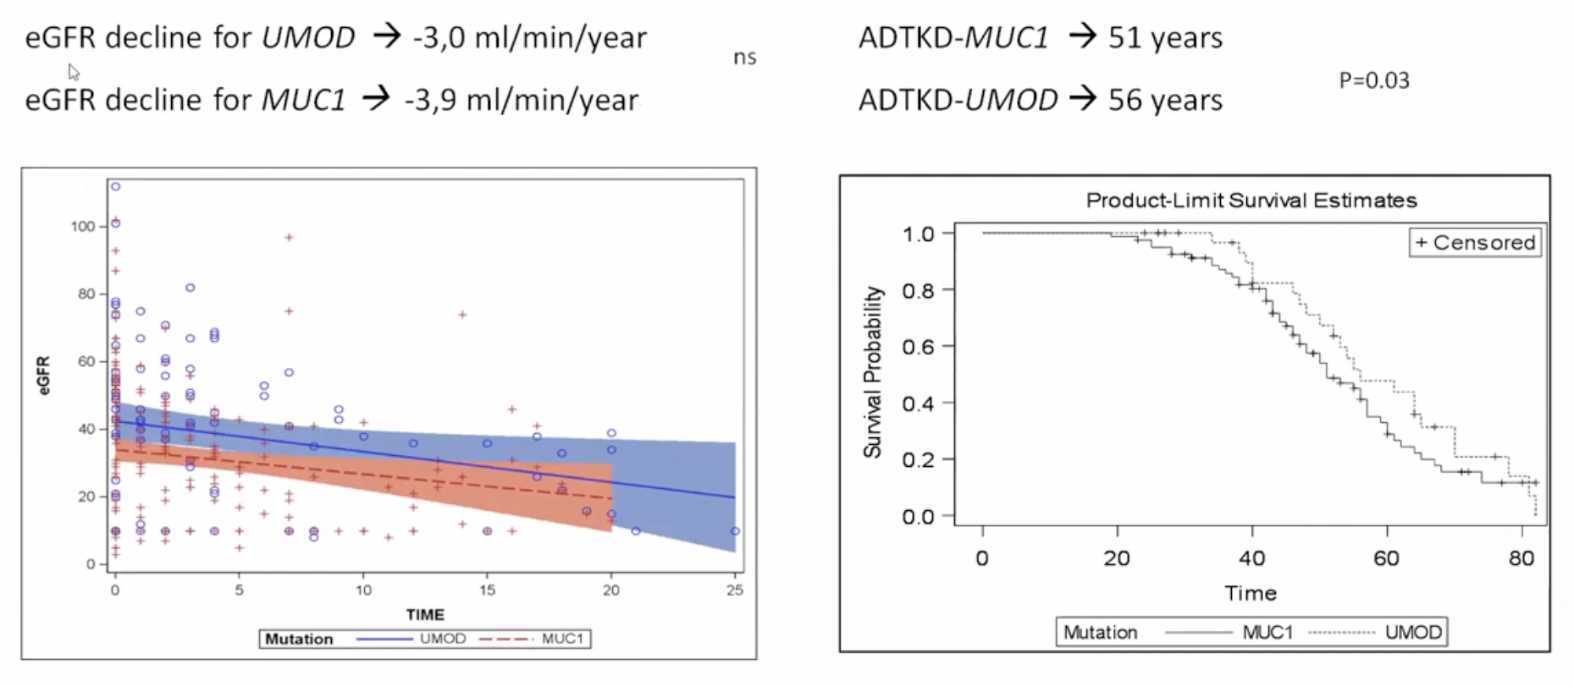

Slide 34
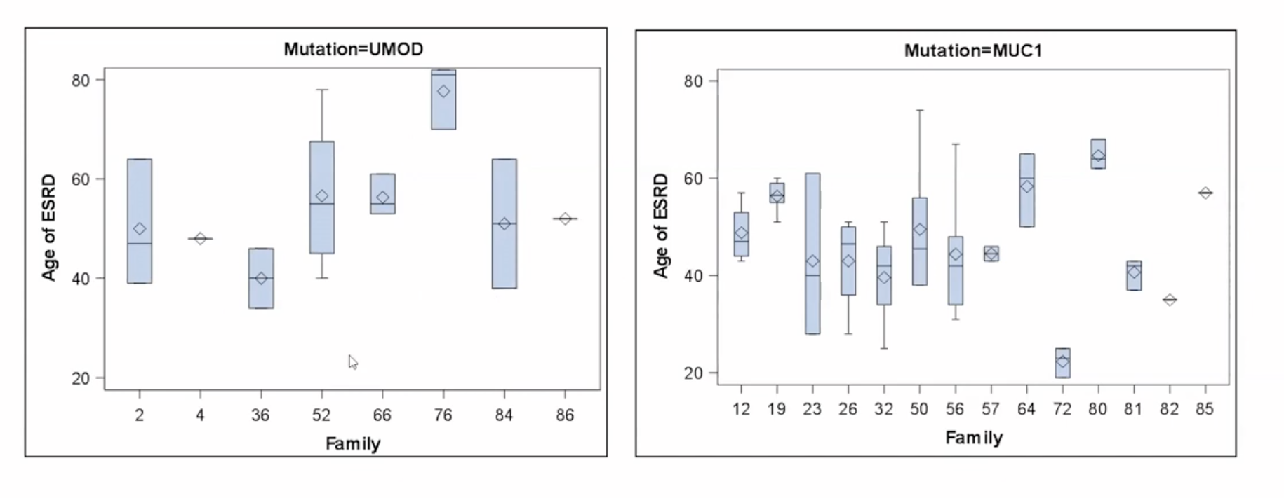

Slide 35
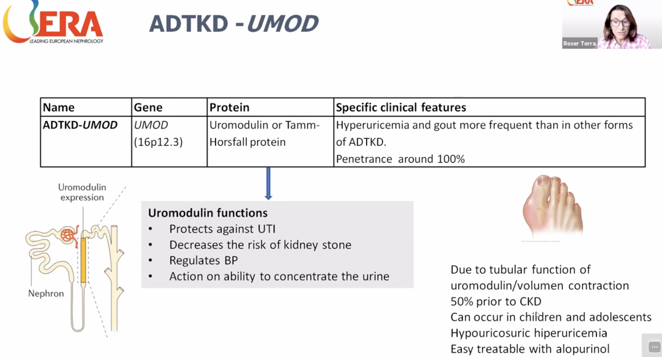

Slide 36
UMOD
Characteristic findings in patients with ADTKD-UMOD include gout in many affected individuals, autosomal dominant inheritance, and CKD
In a cohort of 447 patients with ADTKD-UMOD
55% developed gout, with a median age of onset of 28 years, and 25% developed gout before age 20 years

Slide 37
UMOD
The average rate of loss of eGFR is about 3ml/min/year with an average age of kidney failure of approximately 45 years, though there is significant inter- and intrafamilial variation.
Men progress somewhat more rapidly than women. Within families, the age of kidney failure may vary from 20 to greater than 70.
The reason for this variation is unknown
Some families have more severe disease, with affected family members developing progressive CKD in their teenage years leading to kidney failure as early as age 20.

Slide 38
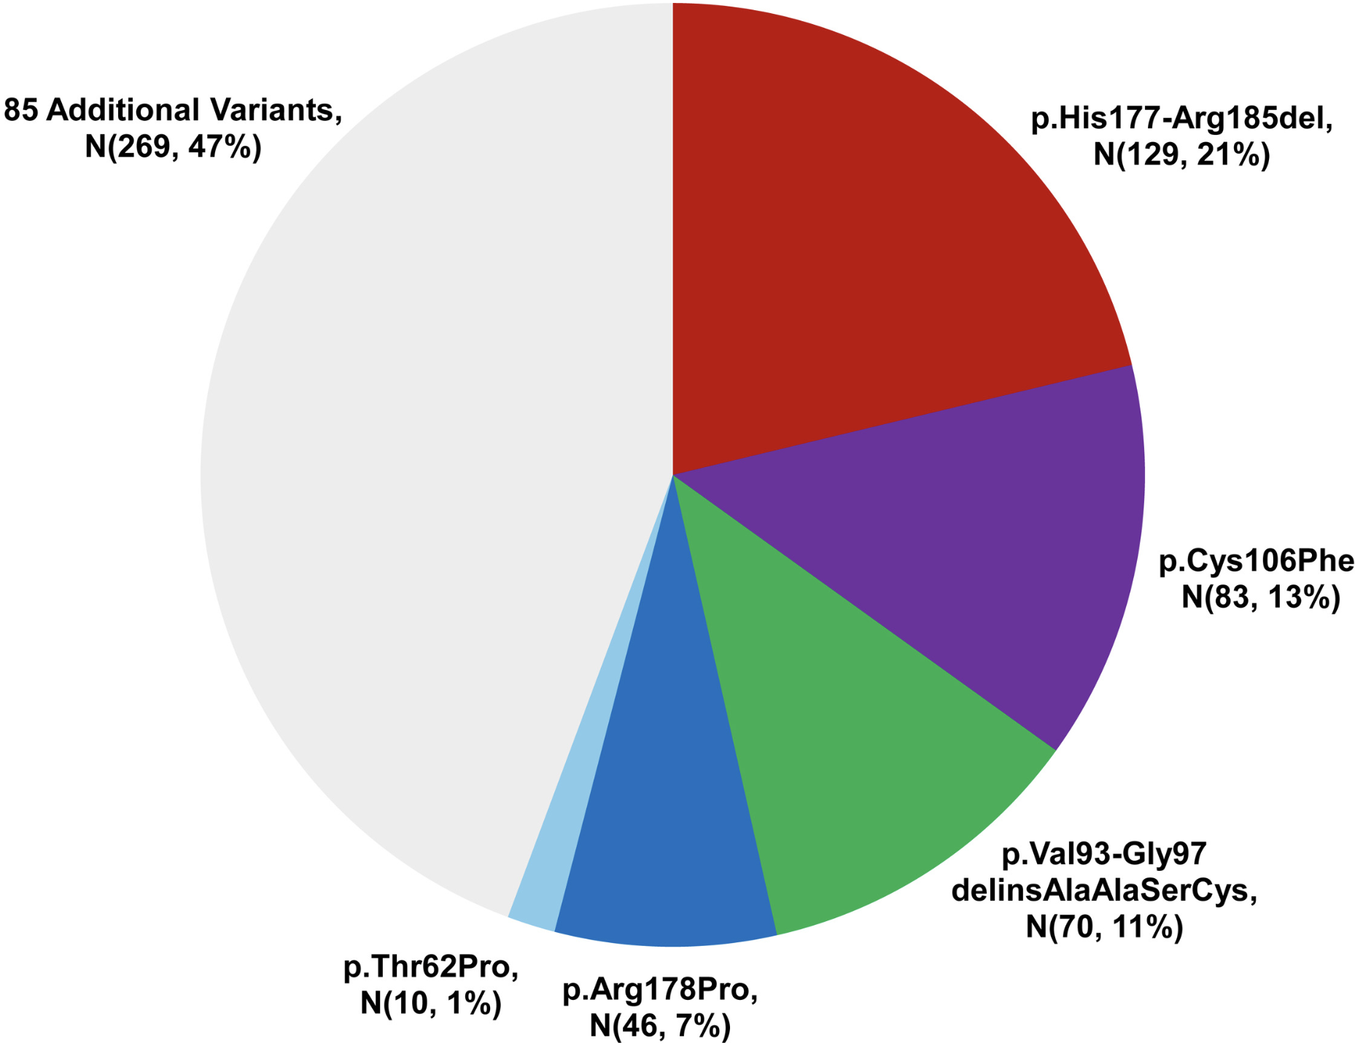
Notes:
Knowing the mean familial age of kidney failure can be helpful in the management of patients and can be found in Table 1 and Table S1. Further updates will be available at the UMOD Mutation Registry website.²⁷ There are four pathogenic variants from large ancestral families that constitute 52% of US patients in the Wake Forest ADTKD registry (see Figure 3 and Table 1). Families with these variants have an older mean age of kidney failure. The remaining 48% of patients in the registry have 86 different pathogenic variants.

Slide 39
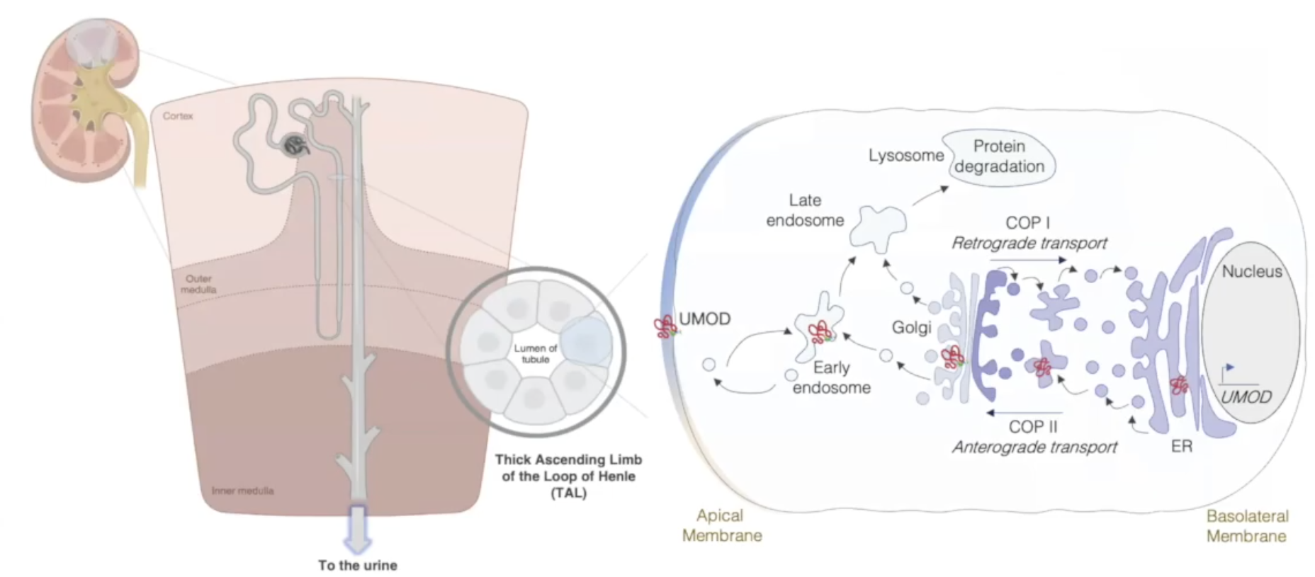
The Molecular Culprit

Slide 40
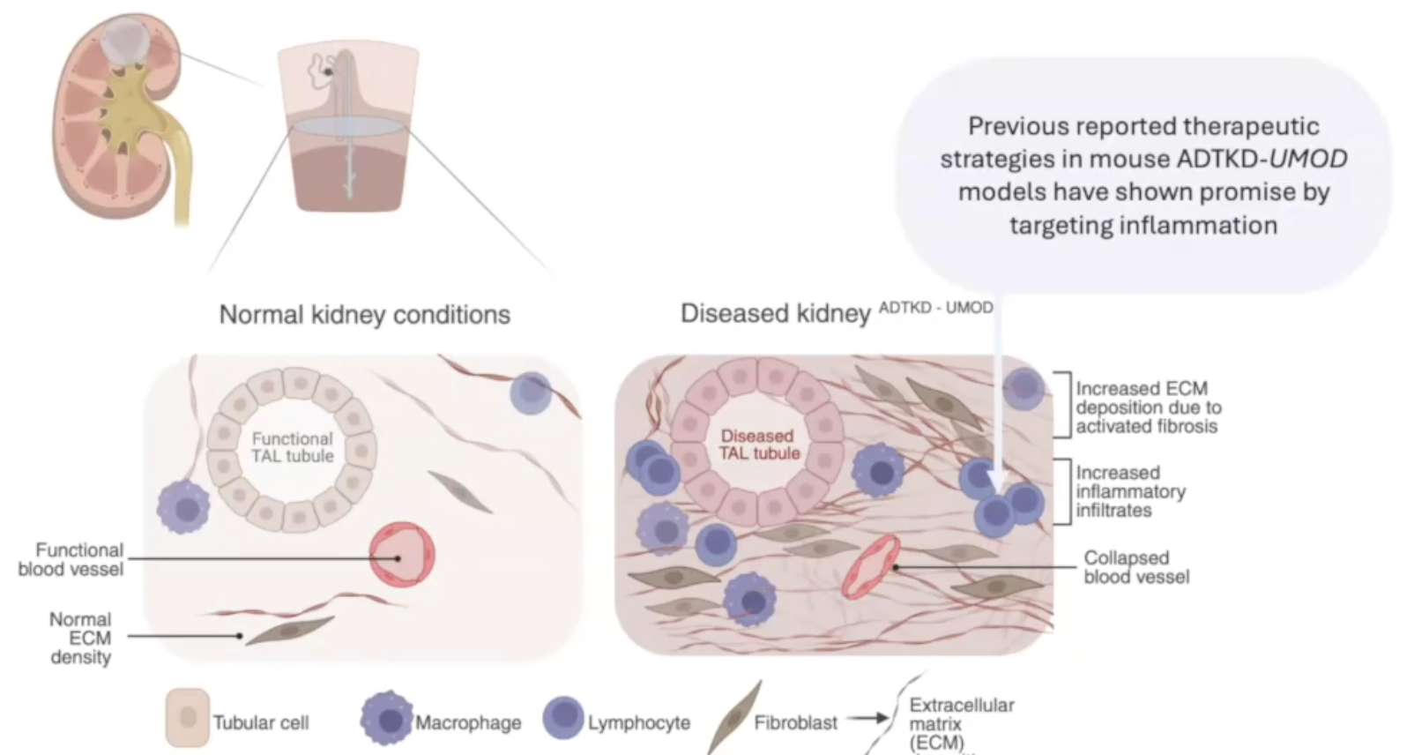
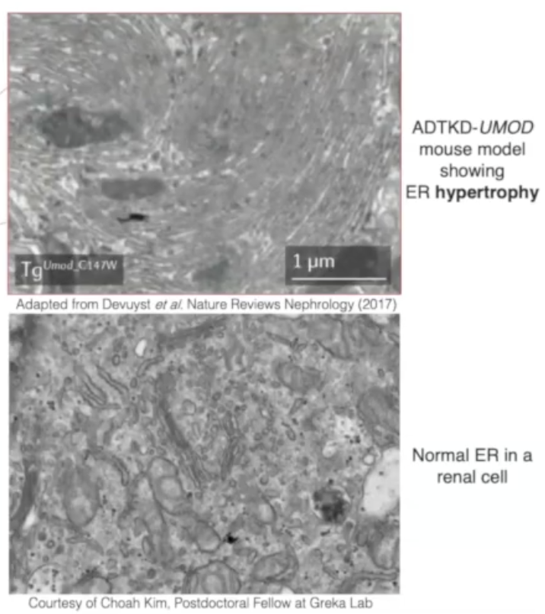
Pathologic Cascade from ER Stress to Fibrosis

Slide 42
ADTKD-MUC1

Slide 43
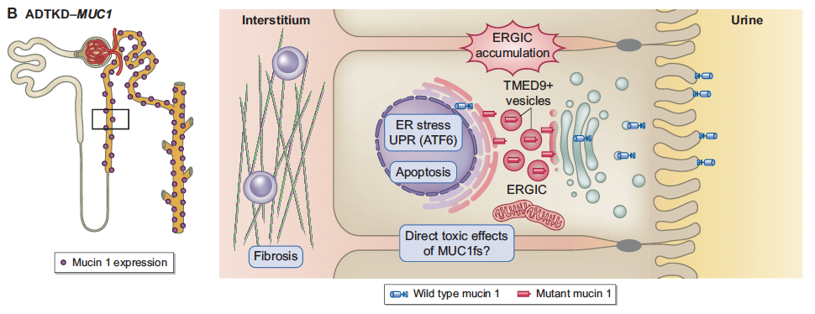
ADTKD-MUC1
Figure 1. Mabillard H, et al.. Nephrol Dial Transplant. 2023
Notes:
FIGURE 1: Pathophysiology of ADTKD-UMOD and ADTKD-MUC1. (A) Left panel: UMOD expression is restricted to the thick ascending
limb and the early DCT. Right panel: Cellular pathways activated by the expression of mutant UMOD (in cellular and murine studies as well
as patient biopsies) and its toxic accumulation in the ER. (B) Left panel: Mucin 1 expression along the entire distal tubule. Right panel: Cellular
pathways activated by the expression of mutant mucin 1 (in cellular and murine studies as well as patient biopsies) and its toxic accumulation
in the ERGIC.

Slide 44
ADTKD-MUC1
Mucin-1 is a membrane-anchored protein that is expressed on the epithelial surface of many tissues in conjunction with other mucins
In the kidney, mucin-1 is expressed specifically in the thick ascending limb and early distal convoluted tubule.
Mucin-1 plays a role in signal transduction and protects and lubricates epithelial surfaces.

Slide 45
ADTKD-MUC1
The mucin-1 protein contains a region of a variable number (20-125) of tandem repeats (VNTR) that is a repetitive sequence of 20 amino acids to which sugar residues are added to produce the mucinous qualities of mucin-1
In ADTKD-MUC1, the most common pathogenic variant is the insertion of an extra cytosine residue in a string of seven cytosine residues in one of the VNTR repeats resulting in a frameshift in translation that leads to the biosynthesis of neo-VNTRs with 20 different amino acids.

Slide 46
ADTKD-MUC1
The mutated MUC1 frameshift protein (MUC1fs) has an atypical sequence foreign to the body’s normal protein metabolic pathways. The neopeptide deposits in the ER Golgi intermediate compartment (ERGIC) in vesicles that normally shuttle newly synthesized proteins between the ER and Golgi apparatus. This abnormal deposition leads to intracellular stress, apoptosis, cell death, and nephron dropout.
Immnohistochemical studies of human kidney tissue reveal intracellular deposition of the MUC1fs protein in thick ascending limb and early distal convoluted tubule

Slide 47
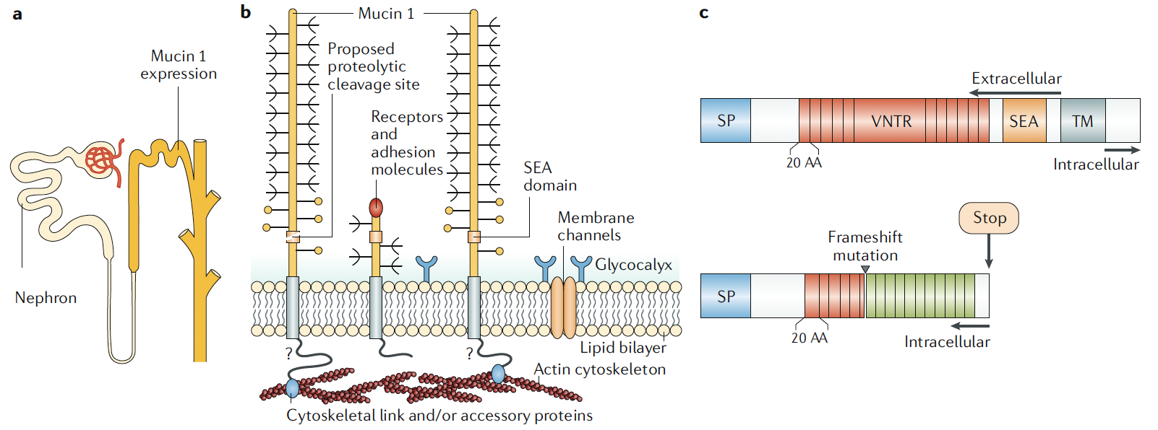
Figure 3 Devuyst O, et al., Nat Rev Dis Primers. 2019
Notes:
Fig. 3 | Pathobiology of ADTKD- MUC1. a | Localization of mucin 1 in the distal nephron segments including the
thick ascending limb, distal convoluted tubule and collecting ducts. b | Mucin 1 is a heterodimeric membrane- based
protein lining the apical surface of epithelial cells in multiple organs. The protein is composed of an N- terminal
extracellular α subunit containing a variable number of tandem repeat (VNTR) regions that encode 20 amino acids (AA),
which is important for extensive O- glycosylation, and C- terminal cytoplasmic β subunits that anchor mucin 1 to the
cytoskeleton (this hypothetical interaction with the cytoskeleton is indicated with a question mark). The extracellular
domain is involved in the lubrication and protection of luminal epithelial surfaces and the intracellular domain is
involved in signalling through phosphorylation and protein–protein interactions73. c | The predicted structure of wildtype
mucin 1 (top) contains the signal peptide (SP) that drives co- translational translocation in the endoplasmic reticulum,
the VNTR region, a sperm protein, enterokinase and agrin (SEA) domain within which an auto- proteolytic cleavage
into the N- terminal extracellular α subunit and C- terminal cytoplasmic β subunit forms a heterodimeric mucin 1
complex, and a hydrophobic transmembrane (TM) domain that embeds mucin 1 into the plasma membrane of epithelial
cells. The mutated protein, MUC1fs (bottom), contains the SP, part of the wild- type VNTR and a new VNTR segment
(green boxes) after the frameshift mutation (triangle). MUC1fs lacks all C- terminal information needed for posttranslational
processing, cellular signalling, membrane targeting and recycling of mucin 1. Part b adapted with
permission from ref.13,

Slide 50
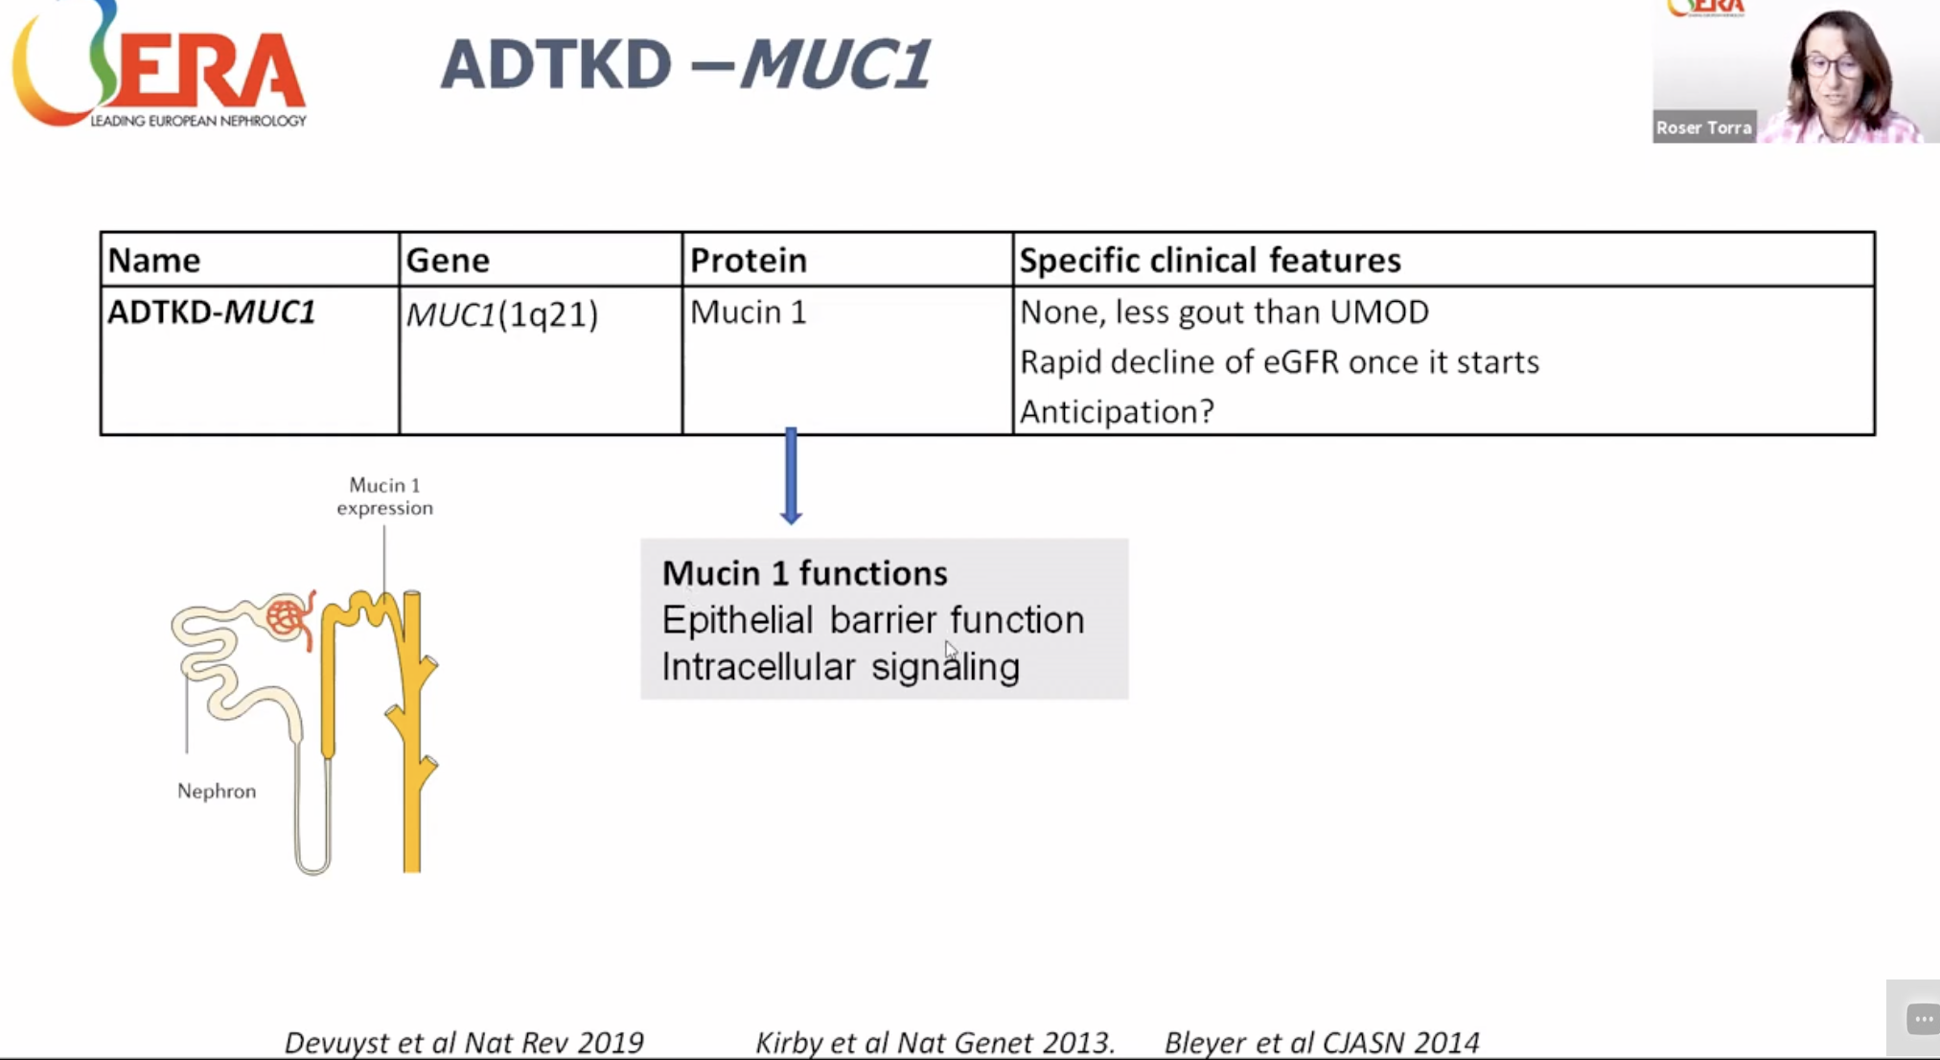

Slide 52
ADTKD-REN

Slide 53
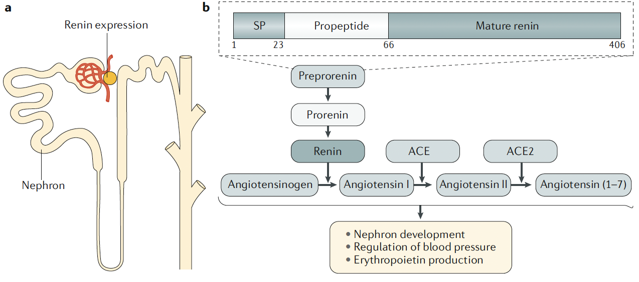
ADTKD-REN
Figure 5 Devuyst O, et al., Nat Rev Dis Primers. 2019
Notes:
Fig. 5 | Pathobiology of ADTKD- REN. a | Renin is expressed in the juxtaglomerular cells of the nephron. b | The predicted
structure of preprorenin contains a signal peptide (SP) that drives co- translational translocation, a propeptide that
regulates renin activity and the mature renin that is formed upon proteolytic cleavage of prorenin. Preprorenin is
specifically expressed in juxtaglomerular cells of the kidney. The REN subtype of autosomal dominant tubulointerstitial
kidney disease (ADTKD- REN) is caused by dominant mutations in the SP sequence of preprorenin affecting synthesis,
glycosylation and secretion of prorenin and mature renin. In the short term, the mutations lead to hyporeninaemic
hypoaldosteronism and anaemia. In the long term, the expression of the mutated protein is thought to cause endoplasmic
reticulum stress, which affects the viability of juxtaglomerular cells and causes a slowly progressive tubular atrophy,
glomerular scarring and interstitial fibrosis. ACE, angiotensin converting enzyme.

Slide 54
ADTKD-REN
Early on-set (<10 years old)
Delayed growth, acidosis, anemia or CKD.⁵²
Partial renin deficiency
  acidemia, hyperkalemia, mild hypotension, CKD, and anemia
  often develop gout in their teenage years.⁵²

Slide 55
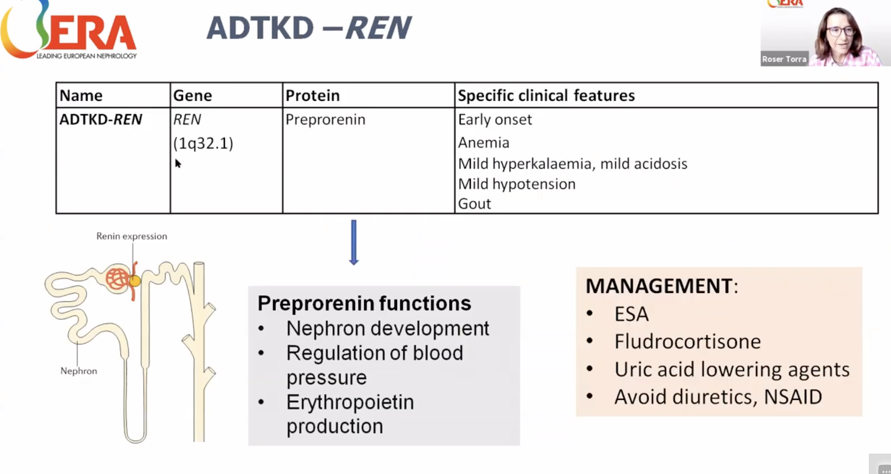

Slide 57
ADTKD – APOA4

Slide 58
APOA4
APOA4 encodes for apolipoprotein-IV (ApoA4), an apolipoprotein synthesized by the small intestine in response to fat intake
ApoA4 transports lipids and then is filtered and reabsorbed by the kidney. Pathogenic variants in APOA4 result in changes in protein structure and lead to deposition of mutated ApoA4 as amyloid in the medulla of the kidney leading to slowly progressive CKDAs with other forms of ADTKD, some patients are more affected than others.
The mean age of kidney failure 58 years

Slide 59
APOA4 Clinical
All patients diagnosed with this condition have presented with ADTKD.
Patients develop slowly progressive CKD without other symptoms. The patient’s lipid profile is normal and there is no increased incidence of atherosclerosis.
While cardiac involvement has been seen in sporadic forms of apoA4 amyloidosis there was no clinical evidence of cardiac involvement in individuals with ADTKD-APOA4.
Urinalysis is bland without blood or protein.
Notes:
Genetic testing for ADTKD-APOA4 is definitive. This condition has only recently been described and may or may not be part of multi-gene panels but is available at the Resources for ADTKD website.²⁸ Kidney biopsies may reveal medullary amyloid, and staining can be carried out for ApoA4 (see Figure 1D).⁵⁸ However, most percutaneous kidney biopsies contain only renal cortex, and therefore medullary amyloid is often not identified on biopsy in patients with ADTKD-APOA4.⁵⁸
Some may prefer the term autosomal dominant medullary amyloidosis due to APOA4 pathogenic variants. We prefer the clinical term ADTKD-APOA4 as medullary amyloidosis will not be identified in the vast majority of patients, and the term amyloidosis is confusing to patients and may lead to anxiety when patients search “amyloidosis” on the Internet. As with other genetic conditions, it is critically important that affected individuals learn the name of the affected gene, as disease nomenclature can change over time.

Slide 61
ADTKD-Other

Slide 62
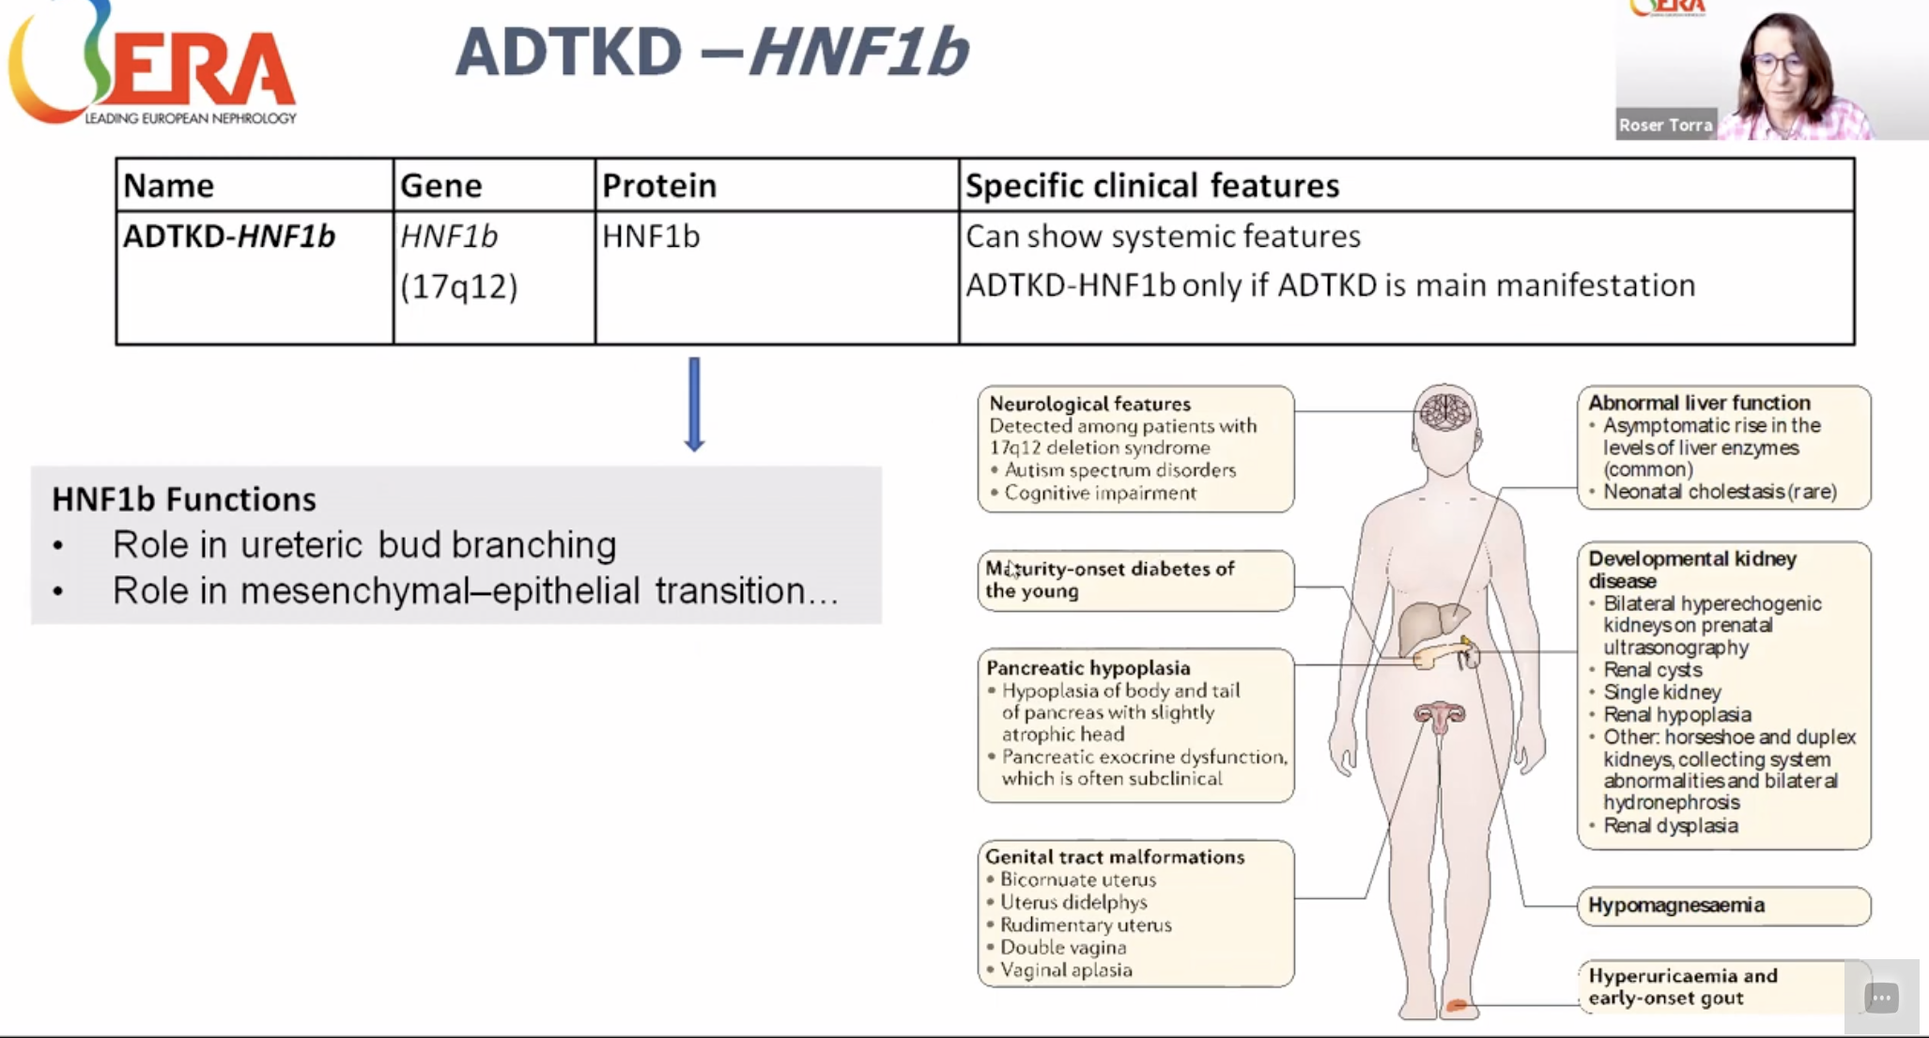
ADTKD-HNF1b

Slide 63
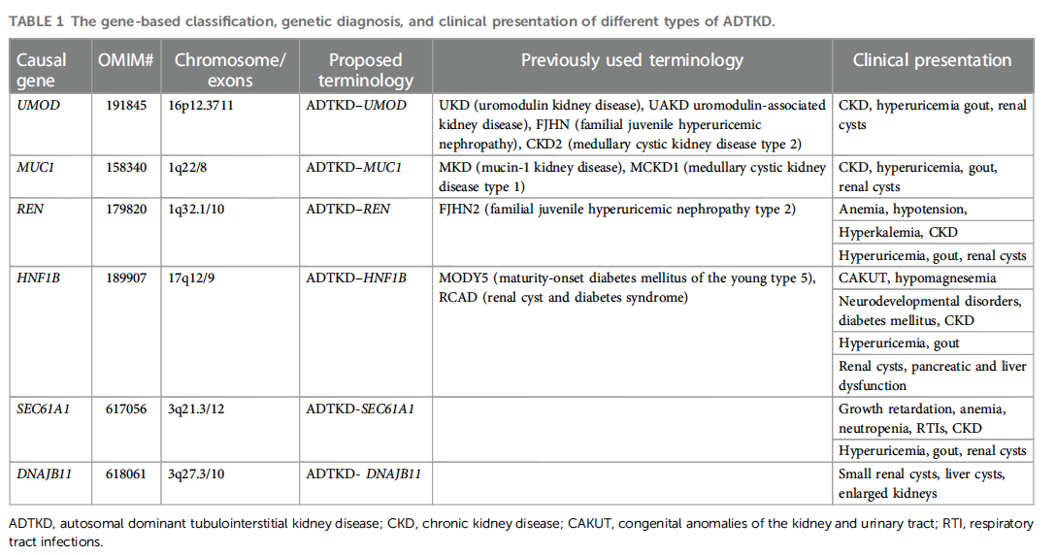

Slide 64
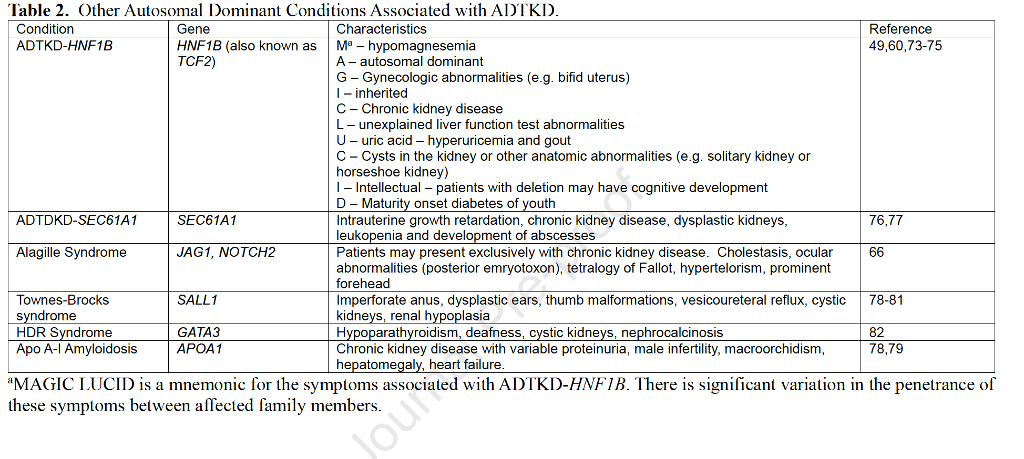

Slide 65
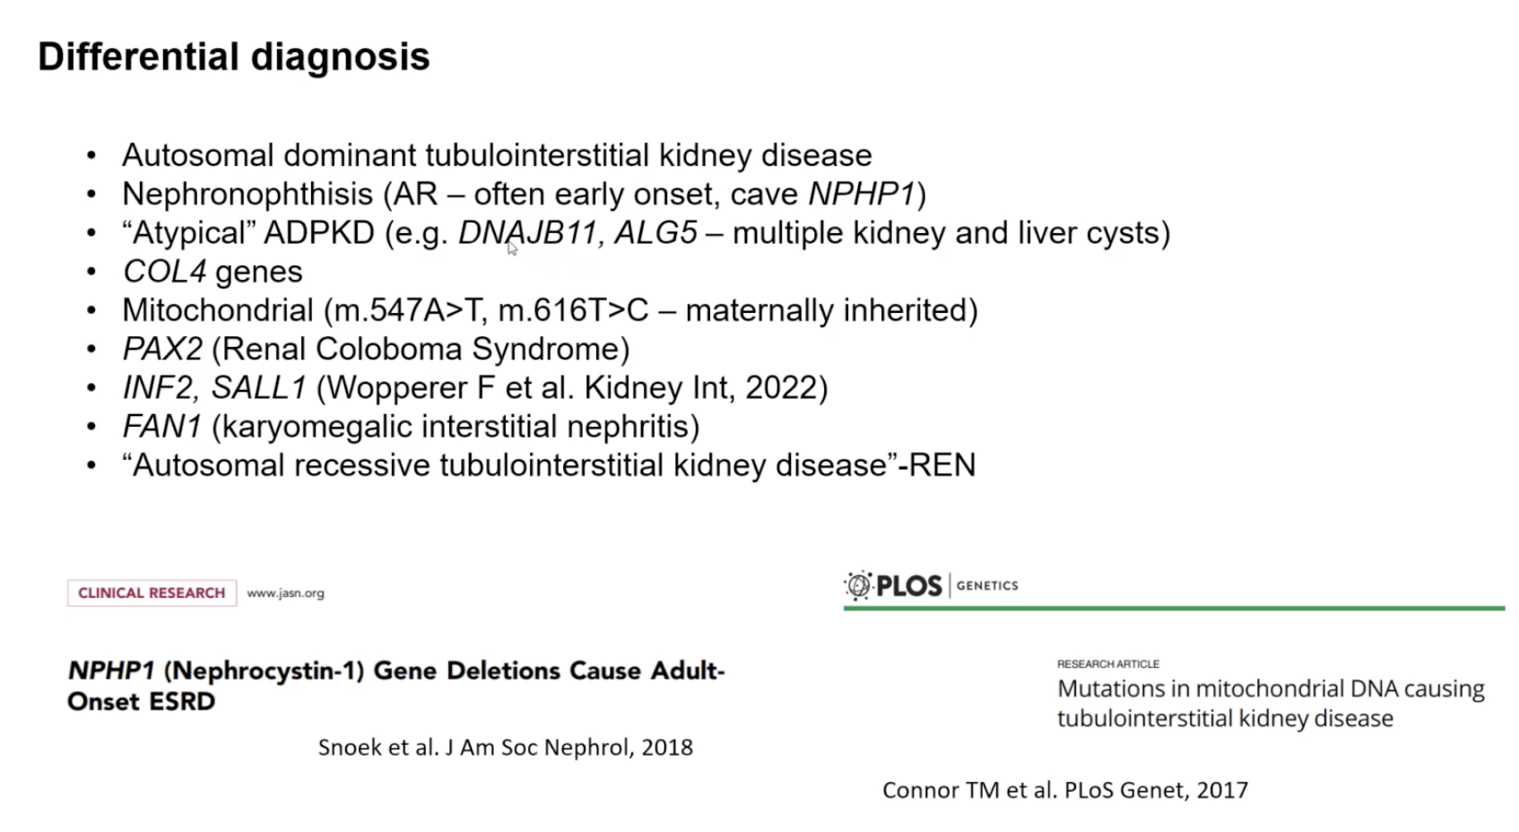

Slide 66
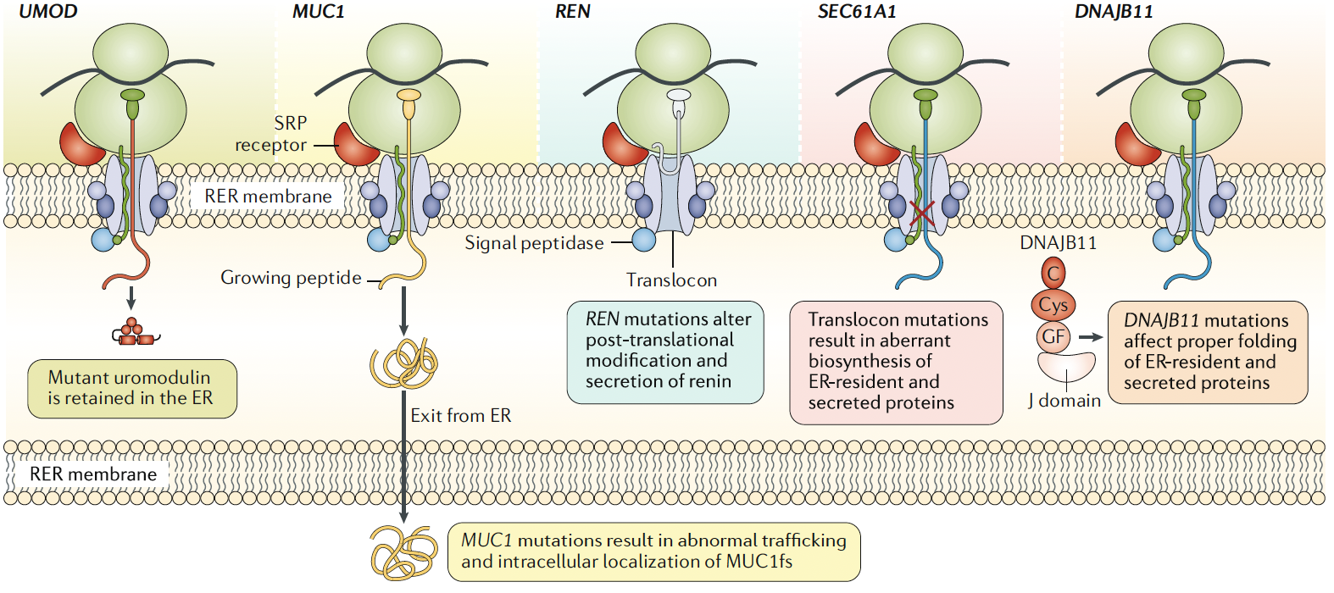
Figure 7 Devuyst O, et al., Nat Rev Dis Primers. 2019
Notes:
Fig. 7 | ER stress and unfolded protein response in ADTKD. During biosynthesis, uromodulin, mucin 1 and renin,
which are glycosylated secretory proteins expressed in the kidney, need to be co- translationally translocated into the
endoplasmic reticulum (ER). This process is initiated in the cytoplasm by interaction of the signal sequence of the nascent
protein with the signal recognition particle (SRP) and proceeds further via interaction of the protein translating complex
with SRP receptor and SEC61 complex, which is a membrane channel through which the protein is transferred into the
ER lumen. In the ER, the nascent protein undergoes a series of modifications including removal of the signal peptide by
signal peptidase, N- glycosylation, disulfide bond formation, and oxidoreductase- mediated and chaperone- mediated
folding. Properly modified and folded proteins then exit the ER and enter the Golgi and secretory pathway. Abnormalities
in this process induce ER stress and the unfolded protein response. For example, in the UMOD subtype of autosomal
dominant tubulointerstitial kidney disease (ADTKD- UMOD), mutations affect uromodulin folding and mutant protein
accumulates in the ER lumen. In ADTKD- MUC1, the frameshift mutations lead to production of an abnormal MUC1fs
protein in the ER and to its retention along the secretory pathway. In ADTKD- REN, mutations in the signal peptide impair
ER translocation and processing of preprorenin and result in deficient prorenin and renin secretion. In ADTKD- SEC61A1,
mutations affect the integrity of the plug domain or the constriction ring to disrupt translocon pore function, leading
to aggregation of mutated SEC61α in the ER and partial mislocalization of mutant SEC61α to the Golgi and ER–Golgi
intermediate compartment. This abnormal translocon function affects production of many proteins, potentially including
uromodulin, mucin 1 and renin. The potential link between ER stress and ADTKD is supported by the recent identification
of heterozygous mutations in DNAJB11 (ref.13), a key chaperone of the ER quality control mechanism. RER, rough
endoplasmic reticulum.

Slide 68
Treatment

Slide 69
Therapeutic Options for ADTKD
﻿﻿Follow established CKD guidelines
﻿﻿No data in ADTKD patients concerning possible benefits of ACEls and ARBs on CKD progression
﻿﻿Hyperuricemia: losartan - lowers serum urate levels (increased FEurate)
﻿﻿Patients with ADTKD-UMOD and gout: Allopurinol
﻿﻿Diuretics should be used with caution: aggravate hyperuricemia and volume depletion
﻿﻿Low-salt diet is NOT recommended for ADTKD-UMOD and ADTKD-REN patients (it may aggravate hyperuricemia & volume depletion)
﻿﻿Liberal water intake to compensate for possible urinary concentration

Slide 70
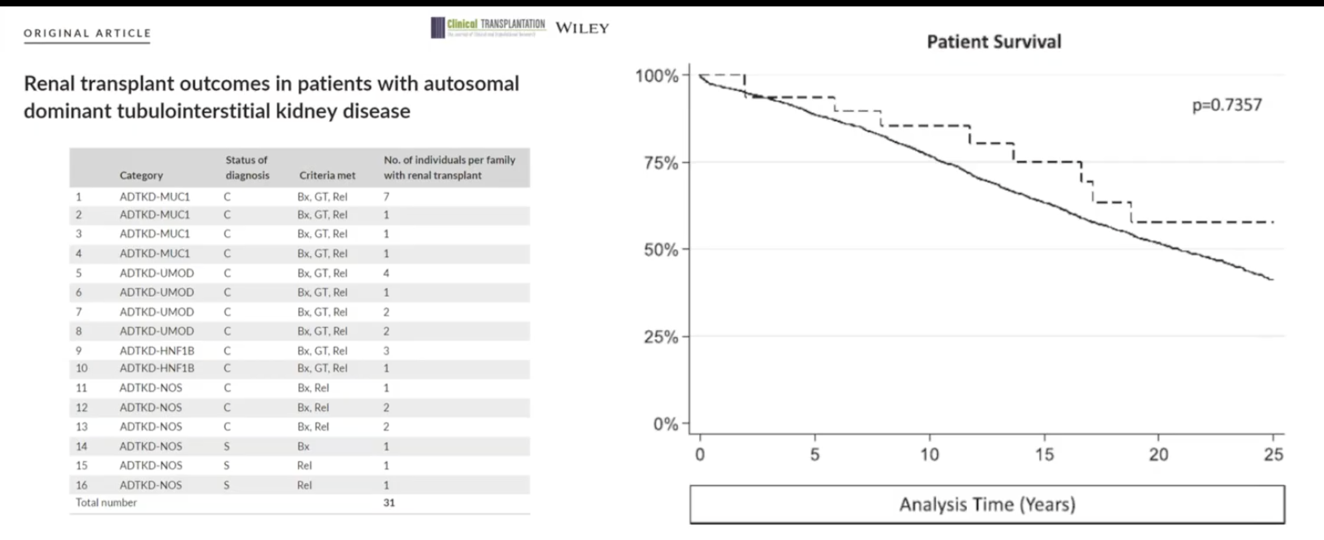
Transplant

Slide 71
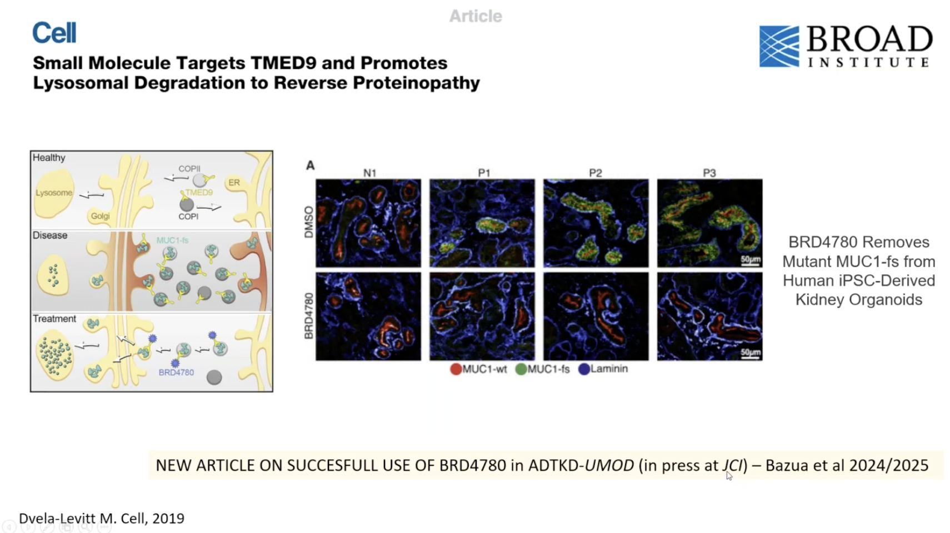

Slide 72
Take Home
﻿﻿A specific presentation of ADTKD -> probably underdiagnosed | genetic testing required
﻿﻿Mutations in UMOD are the most common form of ADTKD
﻿﻿A positive family history and early gout are associated with ADTKD-UMOD
﻿﻿Variability in disease progression: gender, mutation score + genetic modifiers ?
﻿﻿Clinical features & urine uromodulin levels can help to discriminate between ADTKD-UMOD, ADTKD-MUC1 or other diagnoses (non-ADTKD)
﻿﻿No specific therapy available to date - Gain of toxic function

Slide 73
Thank You

Slide 74
Resources
Bleyer AJ, Kmoch S. Autosomal dominant tubulointerstitial kidney disease: of names and genes. Kidney Int. 2014 Sep;86(3):459-61. doi: 10.1038/ki.2014.125. PMID: 25168494.
Devuyst O, Olinger E, Weber S, Eckardt KU, Kmoch S, Rampoldi L, Bleyer AJ. Autosomal dominant tubulointerstitial kidney disease. Nat Rev Dis Primers. 2019 Sep 5;5(1):60. doi: 10.1038/s41572-019-0109-9. PMID: 31488840.
Eckardt KU, Alper SL, Antignac C, Bleyer AJ, Chauveau D, Dahan K, Deltas C, Hosking A, Kmoch S, Rampoldi L, Wiesener M, Wolf MT, Devuyst O; Kidney Disease: Improving Global Outcomes. Autosomal dominant tubulointerstitial kidney disease: diagnosis, classification, and management--A KDIGO consensus report. Kidney Int. 2015 Oct;88(4):676-83. doi: 10.1038/ki.2015.28. Epub 2015 Mar 4. PMID: 25738250.
Econimo L, Schaeffer C, Zeni L, Cortinovis R, Alberici F, Rampoldi L, Scolari F, Izzi C. Autosomal Dominant Tubulointerstitial Kidney Disease: An Emerging Cause of Genetic CKD. Kidney Int Rep. 2022 Aug 29;7(11):2332-2344. doi: 10.1016/j.ekir.2022.08.012. PMID: 36531871; PMCID: PMC9751576.
Goldman, SH., et al. Hereditary Occurrence of Cystic Disease of the Renal Medulla. NEJM 1966;274:984-992. vol 274. no. 18. DOI: 10.1056/NEJM196605052741802
Groopman EE, et al. Rare genetic causes of complex kidney and urological diseases. Nat Rev Nephrol. 2020 Nov;16(11):641-656. doi: 10.1038/s41581-020-0325-2. Epub 2020 Aug 17. PMID: 32807983; PMCID: PMC7772719.
Halbritter J, Figueres L, Van Eerde AM, Capasso G, Hoorn EJ, Nijenhuis T, Perez-Gomez MV, Sayer JA, Simons M, Walsh S, Zagorec N, Müller RU, Cornec-Le Gall E. Chronic Kidney Disease of unexplained cause (CKDx): a consensus statement by the Genes & Kidney Working Group of the ERA. Nephrol Dial Transplant. 2025 Jun 3:gfaf092. doi: 10.1093/ndt/gfaf092. Epub ahead of print. PMID: 40459916.
Hildebrandt F, Otto E. Cilia and centrosomes: a unifying pathogenic concept for cystic kidney disease? Nat Rev Genet. 2005 Dec;6(12):928-40. doi: 10.1038/nrg1727. PMID: 16341073.
Mabillard H, Sayer JA, Olinger E. Clinical and genetic spectra of autosomal dominant tubulointerstitial kidney disease. Nephrol Dial Transplant. 2023 Feb 13;38(2):271-282. doi: 10.1093/ndt/gfab268. PMID: 34519781; PMCID: PMC9923703.
Thorn, GW., et al. Renal Failure Simulating Adrenocortical Insufficiency. NEJM 1944;231:76-85. vol 231. no. 3. DOI: 10.1056/NEJM194407202310302
Vivante A. Genetics of Chronic Kidney Disease. N Engl J Med. 2024 Aug 15;391(7):627-639. doi: 10.1056/NEJMra2308577. PMID: 39141855.

Slide 76

Tubulointerstitial Cystic Diseases
Nephronophthisis (NPHP)
Autosomal Dominant Tubulointerstitial Kidney Disease (ADTKD)
Epidemiology and Genetics
  Autosomal Recessive
  20+ genes identified
Presentations
  progress to kidney failure within first 3 decades
Renal Manifestations
  interstitial fibrosis, tubular atrophy, TBM disruption, and corticomedullary cysts
  Chronic tubular interstitial nephritis
  Urinary concentrating defect polyuria, secondary enuresis, nocturnal polydipsia
  Kidney size is normal or reduced
Extra-Renal Manifestations:
  Involvement, cysts have not been observed in other organs in contrast to ADPKD/ARPKD
Epidemiology and Genetics
  Autosomal Dominant
  MUC1 and UMOD predominant genes
  HNF1b – associated with diabetes
Previously known as Medullary Cystic Kidney Disease (MCKD)
Presentation
  4-7th decade
Renal Manifestations
  Urinary concentrating defect polyuria, secondary enuresis, nocturnal polydipsia
  Chronic tubular interstitial nephritis
  Urinary concentrating defect polyuria, secondary enuresis, nocturnal polydipsia
  Kidney size is normal or reduced
  Kidneys with medullary cysts that may not be visualized on ultrasound, kidneys may appear small on ultrasound
Extra-Renal Manifestations
  Gout

Slide 78
Hereditary Tubulointerstitial Disease

Slide 79
Hereditary Tubulointerstitial Disease

Slide 80

Hereditary Tubulointerstitial Disease
Inheritance may be autosomal dominant or recessive.
Autosomal dominant form is referred to as autosomal dominant tubulointerstitial kidney disease (ADTKD), formally medullary cystic kidney disease (MCKD).
Autosomal recessive tubulointerstitial disease is known as nephronophthisis (NPHP).
Common histologic features of inherited tubulointerstitial disease: TBM irregularities, tubular atrophy with cystic formation, interstitial cell infiltration with fibrosis

Slide 81
Autosomal Dominant Tubulointerstitial Kidney Disease (ADTKD)
ADTKD is a rare kidney disease characterized by tubular damage and interstitial fibrosis with normal glomeruli that progress to ESKD in adulthood. Subclassification of ADTKD is based on the underlying gene mutation, involving UMOD, MUC1, REN, HNF1β, or SEC61A1. ADTKD is previously known as medullary cystic kidney disease.
Epidemiology
  Not accurately determined, given rarity and under-recognition of disease
  Prevalence estimated to be 0.3% to 1% of patients with CKD stages 3 to 5, and 2% of patients with ESKD have ADTKD-UMOD.

Slide 82
Pathogenesis of ADTKD
ADTKD-UMOD
  Mutation of UMOD, encoding uromodulin = previously known as Tamm–Horsfall glycoproteins.
  Mutated uromodulin proteins are trapped in tubular epithelial cells, which lead to tubular cell apoptosis, reactive interstitial fibrosis, and cyst formation.
  Defective function of thick ascending limb of Henle loop, salt-wasting, volume depletion, hyperuricemia, gout, and ESKD early in the third decade of life.
ADTKD-MUC1
  Mutation of MUC1, encoding Mucin-1, which normally functions to protect epithelial mucus barrier and maintain immunomodulatory properties and signal transduction
  ADTKD-MUC1 may present with ESKD by the sixth decade of life.
  Not detected by current NGS Genetic Tests
ADTKD-HNF1β
  Mutation of HNF1β, encoding the hepatocyte nuclear factor-1β, a transcription factor involved in the early development of neural tube, lung, kidney, and GI and genital tracts
  ADTKD-HNF1β is associated with maturity-onset diabetes mellitus of the young type 5, renal cyst, hypomagnesemia, and diabetes syndrome.

Slide 83
Pathogenesis of ADTKD
ADTKD-REN
  Mutation of REN, encoding preprorenin. Mutated preprorenin results in defective translocation to endoplasmic reticulum (ER) and lysozymes for processing into renin. Cytoplasmic accumulation of preprorenin in renin-producing cells leads to tubular dilation and fibrosis.
  ADTKD-REN is associated with anemia, hyporenin, hypovolemia, early-onset hyperuricemia, gout.
ADTKD-SEC61A1 (most rare of all ADTKD)
  Mutation of SEC61A1, encoding the α1-subunit of SEC61 translocon pore—The translocon complex mediates transport of signal peptide–containing precursor polypeptides across the ER.
  ADTKD-SEC61A1 is associated with small, dysplastic kidneys and/or simple cysts, congenital anemia, intrauterine or postnatal growth retardation, neutropenia with recurrent cutaneous abscesses.

Slide 84
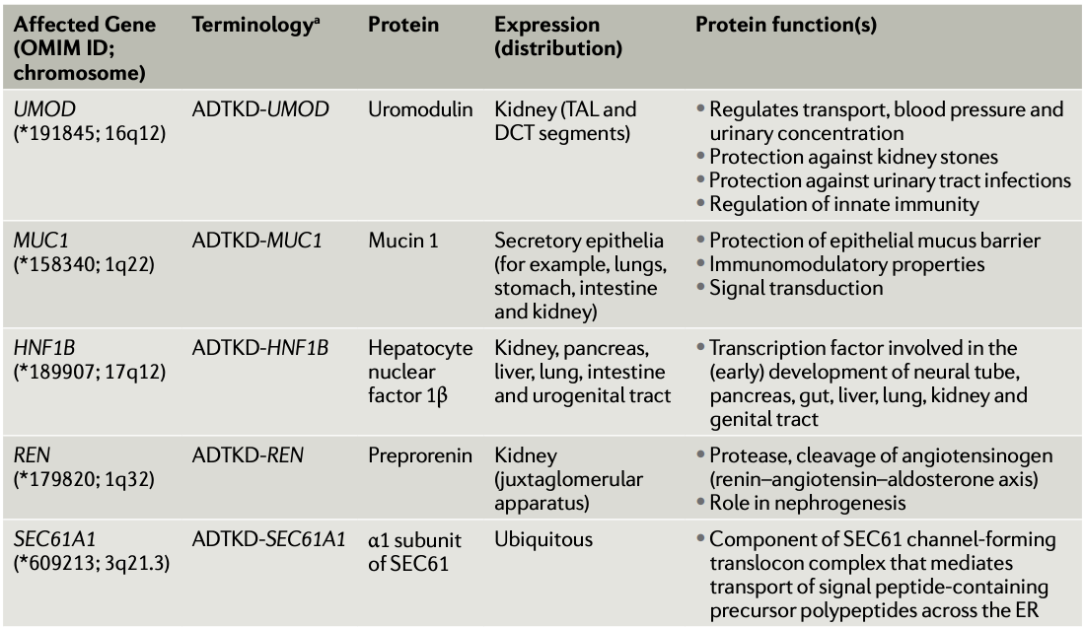
Pathogenesis of ADTKD
Devuyst, O., et al., ADTKD, Nature Primer 2019
Notes:
Table 1
Consensus classification endorsed by Kidney Disease Improving Global Outcomes1 . ADTKD, autosomal dominant tubulointerstitial kidney disease; DCT, distal convoluted tubule; ER, endoplasmic reticulum; OMIM, Online Mendelian Inheritance in Man; TAL, thick ascending limb (of the loop of Henle). a The term ADTKD-NOS (not otherwise specified) refers to all ADTKD cases not tested or for which genetic testing did not provide conclusive results. This category also includes additional ADTKD subtypes for which the causal mutated gene is yet to be identified. For example, mutations in DNAJB11 have been associated with some features of ADTKD, such as non-enlarged cystic kidneys and progressive interstitial fibrosis, suggesting that they could underlie a new ADTKD subtype13.

Slide 85
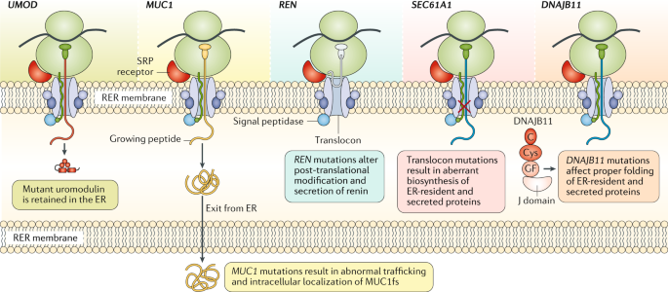
Pathogenesis of ADTKD
Devuyst, O., et al., ADTKD, Nature Primer 2019

Slide 86
Clinical Manifestations of ADTKD
Small kidneys with or without corticomedullary cysts
Renal insufficiency, bland urine
ESKD by the third decade of life with UMOD and sixth decade of life with MUC1 mutations
Hyperuricemia and gout may be seen, particularly in ADTKD-UMOD and ADTKD-REN.
HTN is uncommon prior to ESKD. Because this is a chronic tubulointerstitial disease with concentrating defects, these patients tend to have volume depletion.
Genetic testing is indicated for living-related kidney donors.

Slide 87
Autosomal Recessive Tubulointerstitial Disease (NPHP – Nephronophthisis)
Autosomal Recessive
NPHP is an autosomal recessive tubulointerstitial disease characterized by urinary concentrating defect, CTIN, cyst formation
Progression to ESKD, typically by the age of 30.
Epidemiology
  One of the most common genetic disorders leading to ESKD in children
  Accounts for up to 2.4% to 15% of ESKD in this age group
Pathogenesis
Mutations of more than 25 different genes have been implicated in the pathogenesis of NPHP. Responsible genes are those encoding the nephrocystin protein involved in the function of primary cilium, basal body, and centrosome in tubular epithelial cells. Causal gene is not known in two-thirds of NPHP cases.

Slide 88
Pathogenesis of NPHP
Mutations of more than 25 different genes have been implicated in the pathogenesis of NPHP.
Responsible genes are those encoding the nephrocystin protein involved in the function of primary cilium, basal body, and centrosome in tubular epithelial cells. Causal gene is not known in two-thirds of NPHP cases.

Slide 89
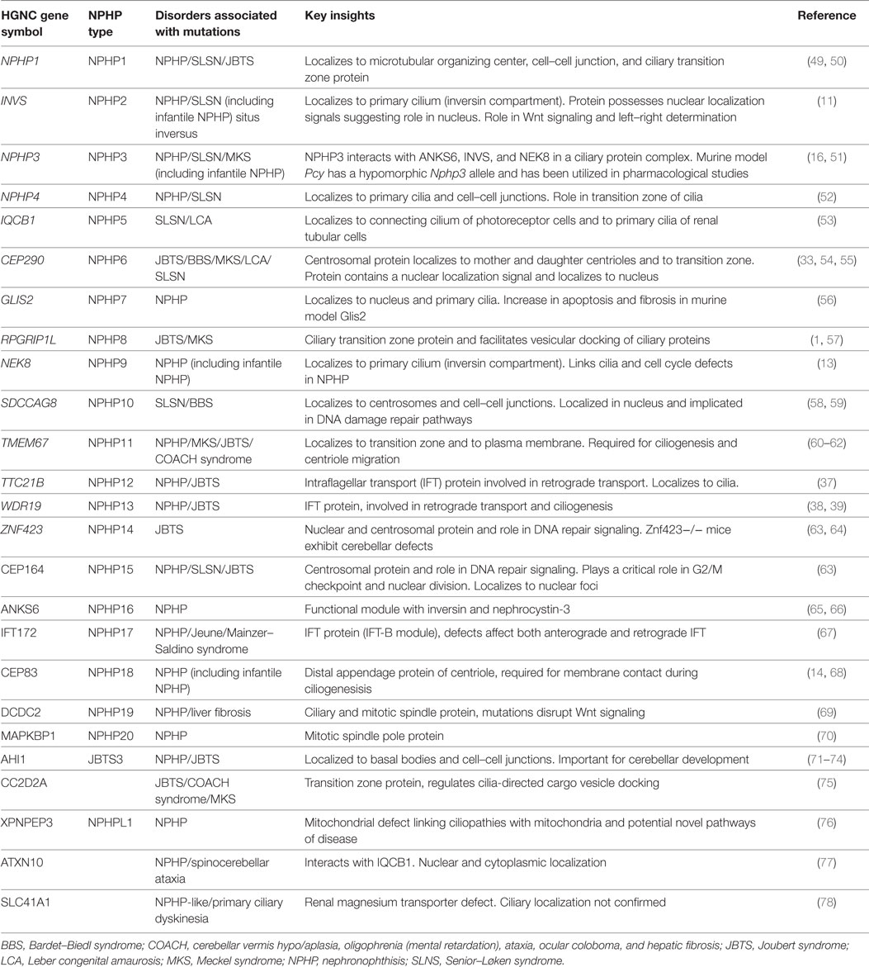
NPHP Types
Sayers, J. et al., Many Genes – one disease NPHP, Pediatric Frontiers 2018

Slide 90
Clinical Manifestations of NPHP
Polyuria, polydipsia requiring fluid intake at night, secondary enuresis, anemia, growth retardation
Extrarenal manifestations reflecting a ciliopathy syndrome occur in 10% to 20% of cases and include retinal defects (retinitis pigmentosa, ocular apraxia, nystagmus, coloboma), liver fibrosis, cardiac malformation, situs inversus, bronchiectasis, ulcerative colitis, skeletal abnormalities (polydactyly), and neurologic abnormalities (encephalocele, vermis aplasia, hypopituitarism).
ESKD by the third decade of life, but may range from the first few years to the fifth decade of life depending on the affected gene.
Ultrasound findings are similar to those seen in ADTKD: Kidneys are small to normal size with increased echogenicity and loss of corticomedullary differentiation. Corticomedullary or medullary cysts may be present. Thin-section CT may identify corticomedullary junction cysts.
Histolopathology: tubular atrophy, interstitial fibrosis, and corticomedullary microcystic dilation of renal tubules

Slide 91
Management of ADTKD and NPHP
No specific treatment
  Follow guidelines established for the management of CKD.
Consider losartan and/or xanthine oxidase inhibitors in patients with gout.
Use diuretics with caution, given potential for volume depletion and hyperuricemia.
Low-salt diet is not recommended, given concerns for potential volume depletion.
Anemia and hypotension/hyperkalemia may be treated with erythropoiesis-stimulating agents and fludrocortisone, respectively.

Slide 92
Tubulointerstitial Cystic Diseases
Nephronophthisis (NPHP)
Autosomal Dominant Tubulointerstitial Kidney Disease (ADTKD)
Epidemiology and Genetics
  Autosomal Recessive
  20+ genes identified
Presentations
  progress to kidney failure within first 3 decades
Renal Manifestations
  interstitial fibrosis, tubular atrophy, TBM disruption, and corticomedullary cysts
  Chronic tubular interstitial nephritis
  Urinary concentrating defect polyuria, secondary enuresis, nocturnal polydipsia
  Kidney size is normal or reduced
Extra-Renal Manifestations:
  Involvement, cysts have not been observed in other organs in contrast to ADPKD/ARPKD
Epidemiology and Genetics
  Autosomal Dominant
  MUC1 and UMOD predominant genes
  HNF1b – associated with diabetes
Previously known as Medullary Cystic Kidney Disease (MCKD)
Presentation
  4-7th decade
Renal Manifestations
  Urinary concentrating defect polyuria, secondary enuresis, nocturnal polydipsia
  Chronic tubular interstitial nephritis
  Urinary concentrating defect polyuria, secondary enuresis, nocturnal polydipsia
  Kidney size is normal or reduced
  Kidneys with medullary cysts that may not be visualized on ultrasound, kidneys may appear small on ultrasound
Extra-Renal Manifestations
  Gout

Slide 94
Take Home
﻿﻿A specific presentation of ADTKD -> probably underdiagnosed | genetic testing required
﻿﻿Mutations in UMOD are the most common form of ADTKD
﻿﻿A positive family history and early gout are associated with ADTKD-UMOD
﻿﻿Variability in disease progression: gender, mutation score + genetic modifiers ?
﻿﻿Clinical features & urine uromodulin levels can help to discriminate between ADTKD-UMOD, ADTKD-MUC1 or other diagnoses (non-ADTKD)
﻿﻿No specific therapy available to date - Gain of toxic function

Slide 95
Thank You

Slide 96
Resources
Bleyer AJ, Kmoch S. Autosomal dominant tubulointerstitial kidney disease: of names and genes. Kidney Int. 2014 Sep;86(3):459-61. doi: 10.1038/ki.2014.125. PMID: 25168494.
Devuyst O, Olinger E, Weber S, Eckardt KU, Kmoch S, Rampoldi L, Bleyer AJ. Autosomal dominant tubulointerstitial kidney disease. Nat Rev Dis Primers. 2019 Sep 5;5(1):60. doi: 10.1038/s41572-019-0109-9. PMID: 31488840.
Eckardt KU, Alper SL, Antignac C, Bleyer AJ, Chauveau D, Dahan K, Deltas C, Hosking A, Kmoch S, Rampoldi L, Wiesener M, Wolf MT, Devuyst O; Kidney Disease: Improving Global Outcomes. Autosomal dominant tubulointerstitial kidney disease: diagnosis, classification, and management--A KDIGO consensus report. Kidney Int. 2015 Oct;88(4):676-83. doi: 10.1038/ki.2015.28. Epub 2015 Mar 4. PMID: 25738250.
Econimo L, Schaeffer C, Zeni L, Cortinovis R, Alberici F, Rampoldi L, Scolari F, Izzi C. Autosomal Dominant Tubulointerstitial Kidney Disease: An Emerging Cause of Genetic CKD. Kidney Int Rep. 2022 Aug 29;7(11):2332-2344. doi: 10.1016/j.ekir.2022.08.012. PMID: 36531871; PMCID: PMC9751576.
Goldman, SH., et al. Hereditary Occurrence of Cystic Disease of the Renal Medulla. NEJM 1966;274:984-992. vol 274. no. 18. DOI: 10.1056/NEJM196605052741802
Groopman EE, et al. Rare genetic causes of complex kidney and urological diseases. Nat Rev Nephrol. 2020 Nov;16(11):641-656. doi: 10.1038/s41581-020-0325-2. Epub 2020 Aug 17. PMID: 32807983; PMCID: PMC7772719.
Halbritter J, Figueres L, Van Eerde AM, Capasso G, Hoorn EJ, Nijenhuis T, Perez-Gomez MV, Sayer JA, Simons M, Walsh S, Zagorec N, Müller RU, Cornec-Le Gall E. Chronic Kidney Disease of unexplained cause (CKDx): a consensus statement by the Genes & Kidney Working Group of the ERA. Nephrol Dial Transplant. 2025 Jun 3:gfaf092. doi: 10.1093/ndt/gfaf092. Epub ahead of print. PMID: 40459916.
Hildebrandt F, Otto E. Cilia and centrosomes: a unifying pathogenic concept for cystic kidney disease? Nat Rev Genet. 2005 Dec;6(12):928-40. doi: 10.1038/nrg1727. PMID: 16341073.
Mabillard H, Sayer JA, Olinger E. Clinical and genetic spectra of autosomal dominant tubulointerstitial kidney disease. Nephrol Dial Transplant. 2023 Feb 13;38(2):271-282. doi: 10.1093/ndt/gfab268. PMID: 34519781; PMCID: PMC9923703.
Thorn, GW., et al. Renal Failure Simulating Adrenocortical Insufficiency. NEJM 1944;231:76-85. vol 231. no. 3. DOI: 10.1056/NEJM194407202310302
Vivante A. Genetics of Chronic Kidney Disease. N Engl J Med. 2024 Aug 15;391(7):627-639. doi: 10.1056/NEJMra2308577. PMID: 39141855.

Slide 97
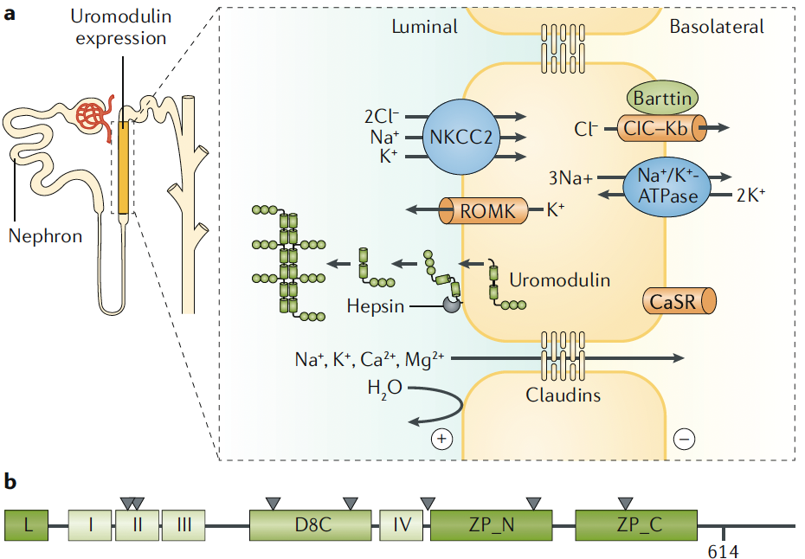
Figure 1 Devuyst O, et al., Nat Rev Dis Primers. 2019
Notes:
Fig. 1 | Function of uromodulin. a | Uromodulin is produced in the thick ascending
limb (TAL) of the loop of Henle, a tubular segment involved in the reabsorption of sodium
chloride (NaCl) and divalent cations but impermeable to water. The salt reabsorption is
mediated by the apical co- transporter solute carrier family 12 member 1 (commonly
known as NKCC2), the basolateral sodium pump (Na+/K+-ATPase) and the complex
formed of chloride channel ClC–Kb and the accessory protein Barttin. The apical
recycling of potassium (K+) ions via the channel ATP- sensitive inward rectifier potassium
channel 1 (commonly known as ROMK) generates a lumen- positive transepithelial
voltage (positive (+) charge), which drives the paracellular reabsorption of monovalent
and divalent cations (including calcium (Ca2+) and magnesium (Mg2+)) to the basolateral
space (negative (–) charge). The urinary secretion of uromodulin depends on physiological
cleavage by the serine protease hepsin154, and is modulated by the activity of the calciumsensing
receptor (CaSR) operating at the basolateral side of TAL cells155. Immunogold
labelling studies have shown that uromodulin is present in vesicles close to the basement
membrane of TAL cells37. However, the mechanism by which a small fraction of the
produced uromodulin is targeted to the basolateral membrane and then to the blood
remains unknown. Proteolytic cleavage is required for monomeric uromodulin to
assemble into high molecular weight polymeric filaments forming a dense matrix in
the urine. Such a matrix is probably required for the protective function of uromodulin
against urinary tract pathogens and renal stone formation. b | The predicted structure
of uromodulin contains a leader peptide (L), four epidermal growth factor (EGF)-like
domains (I–IV; whereby EGF- II and EGF- III are predicted to be Ca2+ binding), a cysteinerich
domain (D8C) and a bipartite C- terminal Zona Pellucida domain (ZP_N and ZP_C).
The position of glycosylphosphatidylinositol anchoring (predicted at position 614)
and the seven N- glycosylation sites (triangles) are indicated34. Part a adapted with
permission from ref.156,

