Slide 1
Long-Term Management of Patients on Dialysis
Management of Traditional Cardiovascular Risk Factors in Patients on Hemodialysis
Dialysis Core Curriculum 2021
Peter N. Van Buren, MD, MS
University of Texas Southwestern Medical Center

Slide 2
Peter Noel Van Buren
Disclosures
Employer: University of Texas Southwestern, Veterans Affairs North Texas Health Care System
Research Funding: NIH Patient Oriented Career Development Award; VA Merit 1 (pending); University of Texas Southwestern Medical Center (Dedman Family Scholar in Clinical Care)
Other Interests/Relationships: Salary support from an institutional award at UT Southwestern - Dedman Family Scholar in Clinical Care
Dialysis Core Curriculum 2021

Slide 3
Learning Objectives
Identify the impact of extracellular volume overload on hypertension in hemodialysis patients
Discuss the associated harm of intradialytic hypotension and excessive ultrafiltration rates
Describe ongoing uncertainty for specific antihypertensive therapy in dialysis patients
Analyze differences in observational study and clinical trial data on the effects of statin use in patients on dialysis
State observational studies regarding glycemic control in dialysis patients
Dialysis Core Curriculum 2021

Slide 4
Case Presentation
You recently accepted a patient as a transfer to your outpatient hemodialysis (HD) unit for continuation of maintenance HD after he moved from another state. He is 65 years old and has been on HD for about 1 year. He makes very little urine, and he typically gains about 2 kg between treatments. He has no acute complaints, but he does get dyspnea on exertion, especially over the weekend.
Past Medical History:
Diabetes Mellitus type 2 - diagnosed at age 45
Hypertension - diagnosed at age 45
Coronary Artery Disease - s/p stenting 1 year ago
ESRD - on HD for 1 year following progressive course of CKD thought to be secondary to diabetic nephropathy
Dialysis Core Curriculum 2021

Slide 5
Case Presentation (cont.)
His family history includes relatives with diabetes and high BP. His mother was on HD prior to her death.
Physical Examination: His dry weight is 90 kg. His average pre-HD BP is 162/90 mmHg. His average post-HD BP is 141/80 mmHg. His BP nadir is never less than 100/70 mmHg. He reports that his systolic BP is typically in the 140s-150s (mmHg) at home. He has distended neck veins. His lungs are clear. He has an S4, but no S3 or rub. He has a tunneled dialysis catheter in his right internal jugular vein (LUE AVG clotted 6 months ago and is in workup for new access). He has 1+ bilateral lower extremity edema.
He dialyzes for 4 hours. His medications which have been stable since before starting dialysis are ASA 81 mg daily, Losartan 50 mg every night, Carvedilol 25 mg twice daily, Simvastatin 20 mg every night, Glargine Insulin 40 units each day and regular insulin before meals.
His serum Na is 137 mmol/L, K is 4.9 mmol/L, bicarbonate 29 mmol/L, Calcium 8.8 mg/dL. Total cholesterol is 185 mg/dL, LDL cholesterol is 105 mg/dL. His Hemoglobin A1c is 6.6%. His home readings range from 60-200 mg/dL, and he often develops symptomatic hypoglycemia.
Important questions to consider:
  What steps should be taken to address his hypertension that might improve cardiovascular outcomes?
  How should other traditional cardiovascular disease risk factors (hyperlipidemia, diabetes) be managed?
Dialysis Core Curriculum 2021

Slide 6
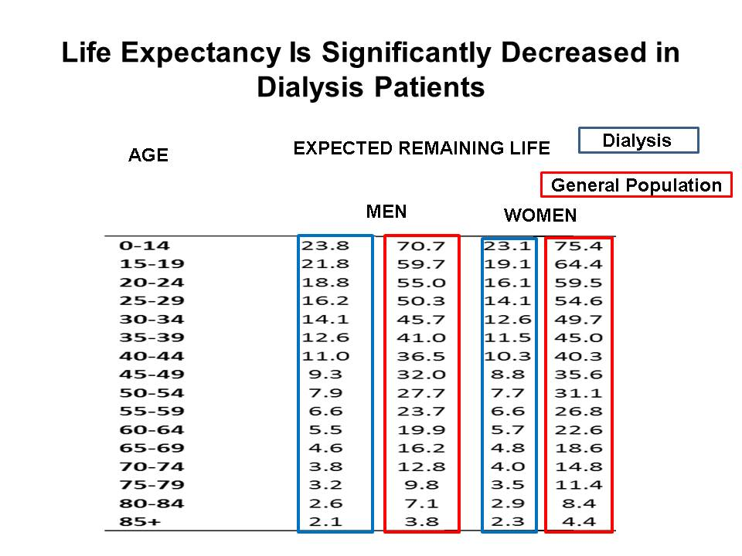
Life Expectancy of Dialysis Patients Is Significantly Shorter Than Age-Matched Individual from General Population
Adapted from data obtained from
United States Renal Data System, 2017
Dialysis Core Curriculum 2021

Slide 7
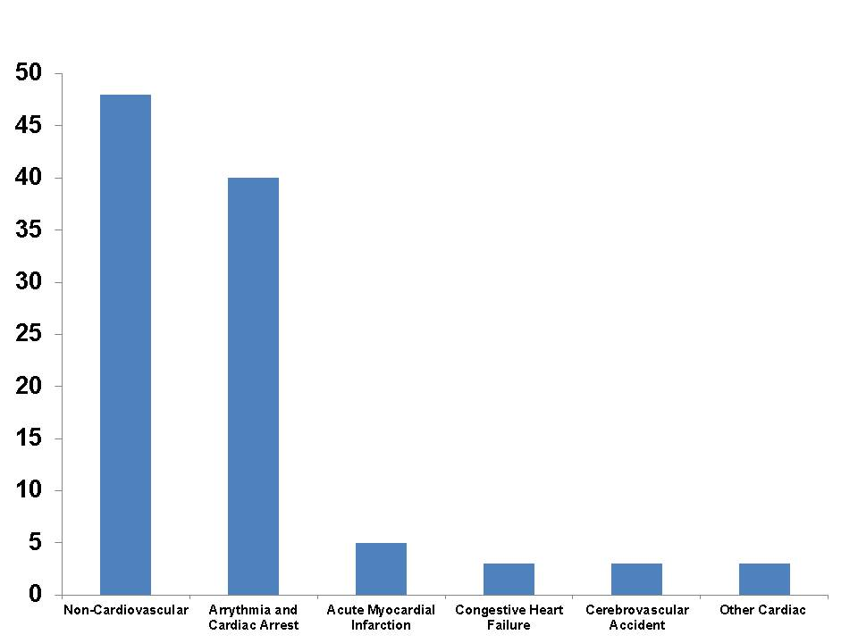
While CVD Is Leading Cause of Death in Dialysis Patients, Arrhythmias and Cardiac Arrest Are More Common than Other Causes of Cardiac Death
Cardiovascular Deaths
Percentage of Deaths
Adapted from data obtained from
United States Renal Data System, 2018
Causes of Death
Dialysis Core Curriculum 2021

Slide 8
Despite Frequency of Cardiac Death, Optimal Management of “Traditional” CV Risk Factors in HD Patients Differs Compared to Patients With Normal Renal Function with Regards to:
Hypertension
Dyslipidemia
Diabetes Mellitus
Dialysis Core Curriculum 2021

Slide 9
Hypertension and Extracellular Volume (ECV) Management in HD Patients
Dialysis Core Curriculum 2021

Slide 10
Most Recent Published Guidelines for BP Management Are from 2005
KDOQI Guidelines
  Predialysis and post-dialysis BP goals should be <140/90 and <130/80 mmHg, respectively. (C)
  Management of BP by adjustment of dry weight:
    Management of hypertension in dialysis patients requires attention to both management of fluid status and adjustment of antihypertensive medications. (B)
    Excessive fluid accumulation should be managed with:
      Education and regular counseling by dieticians
      Low sodium intake (2-3 g/day) and drugs that reduce salt appetite
      Increase ultrafiltration
      Longer dialysis / more than three treatments per week
Am J Kidney Dis 45(4 Suppl 3):S1-153, 2005
Dialysis Core Curriculum 2021

Slide 11
Most Recent Published Guidelines for BP Management Are from 2005 (cont.)
  Management of hypertension with drugs in dialysis patients:
    Drugs that inhibit the renin-angiotensin system, such as ACE inhibitors or angiotensin II-receptor blockers, should be preferred because they cause greater regression of LVH, reduce sympathetic nerve activity, reduce pulse wave velocity, may improve endothelial function, and may reduce oxidative stress. (C)
    Antihypertensive drugs should be given preferentially at night, because it may reduce the nocturnal surge of BP and minimize intradialytic hypotension, which may occur when drugs are taken the morning before a dialysis session. (C)
    In patients with difficult-to-control hypertension, the dialyzability of antihypertensive medications should be considered.
Am J Kidney Dis 45(4 Suppl 3):S1-153, 2005
Dialysis Core Curriculum 2021

Slide 12
Learning Objectives:
Hypertension and ECV Overload
Identify the epidemiologic associations between BP measured at different points in the dialysis cycle and cardiovascular morbidity and mortality in HD patients
Describe the impact of ECV overload on hypertension in HD patients
Indicate the associated harm of intradialytic hypotension and excessive ultrafiltration rates
Identify ongoing uncertainty for specific antihypertensive therapy in HD patients
Dialysis Core Curriculum 2021

Slide 13
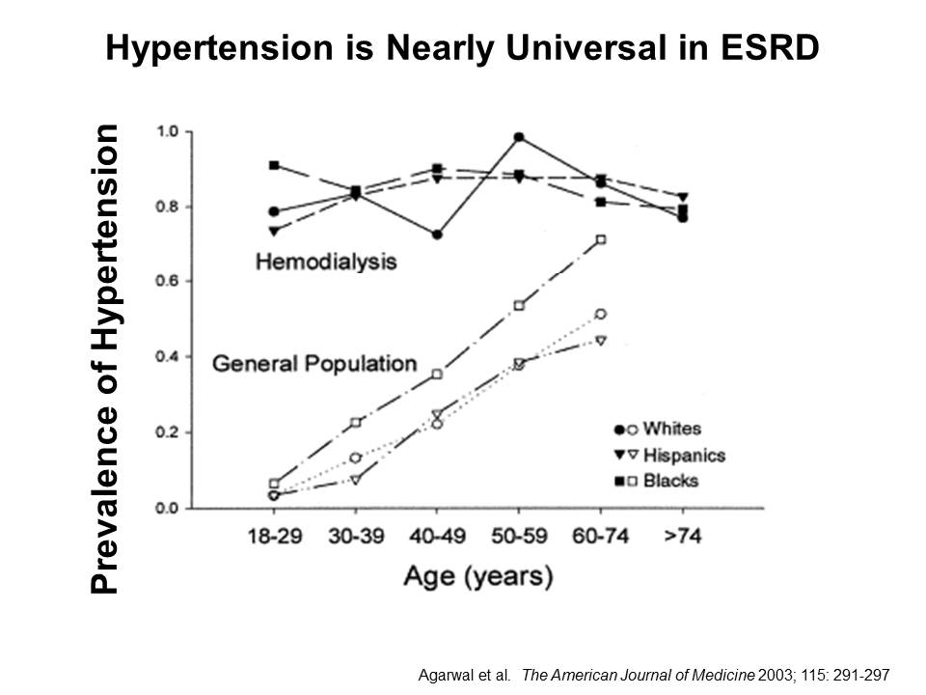
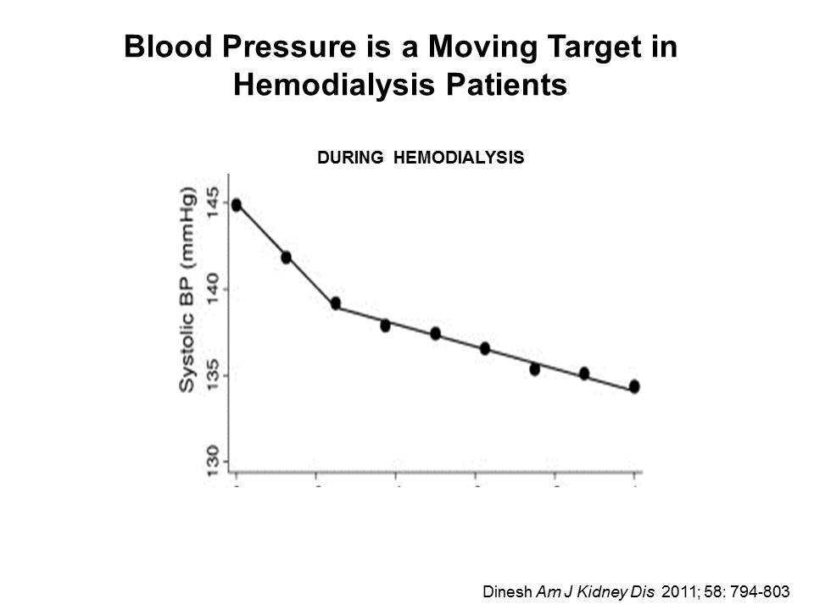
Hypertension Is Nearly Universal in HD Patients
hypertension
BP and the prevalence of hypertension increase with age in the general population, but hypertension is present in more than 80% of HD patients regardless of age.
BP constantly changes both during and between dialysis treatments due to changes in intravascular and extracellular volume, changes in osmolality, and changes in the balance of circulating vasoconstrictors and vasodilators during these intervals.
Time During Dialysis (Hours)
Modified from Am J Med 115(4):291-297, 2003
Modified from Am J Kidney Dis 58(5):794-803, 2011
Dialysis Core Curriculum 2021

Slide 14
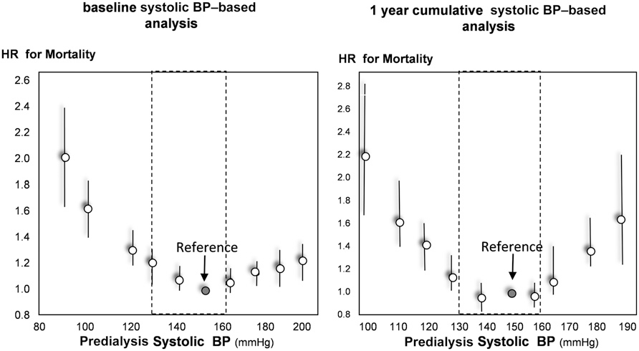
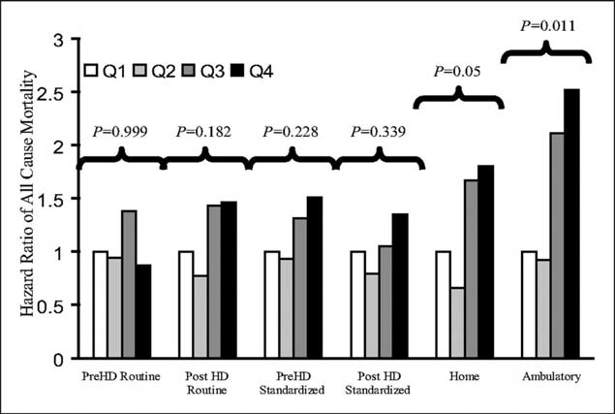
Interdialytic BP Measurements Are Superior to Intradialytic and Peridialytic Measurements at Predicting Adverse Outcomes
Fig 1
KDOQI guidelines recommend targeting a pre-HD systolic BP <140 mmHg or post-HD systolic BP <130 mmHg based on the relationship between BP and non-fatal cardiovascular outcomes in observational studies.
Many epidemiologic studies show that a U-shaped curve defines the relationship between pre-HD or post-HD systolic BP and mortality. (Figure 1)
However, there is evidence that elevated home or ambulatory BP measurements are more predictive of increased risk of end-organ damage or mortality than peridialytic measurements. (Figure 2)
There is currently no clinical trial data to support a specific BP target in HD patients.
Modified from J Am Soc Nephrol 28(8):2491-2497, 2017
Fig 2
Modified from Clin J Am Soc Nephrol 2(6):1228-1234, 2007
Dialysis Core Curriculum 2021

Slide 15
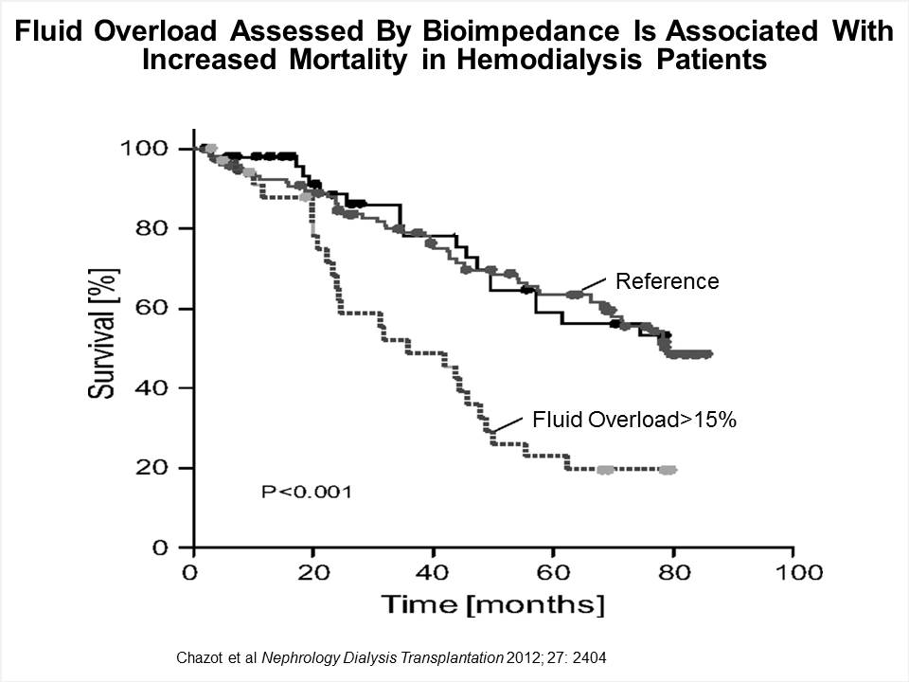
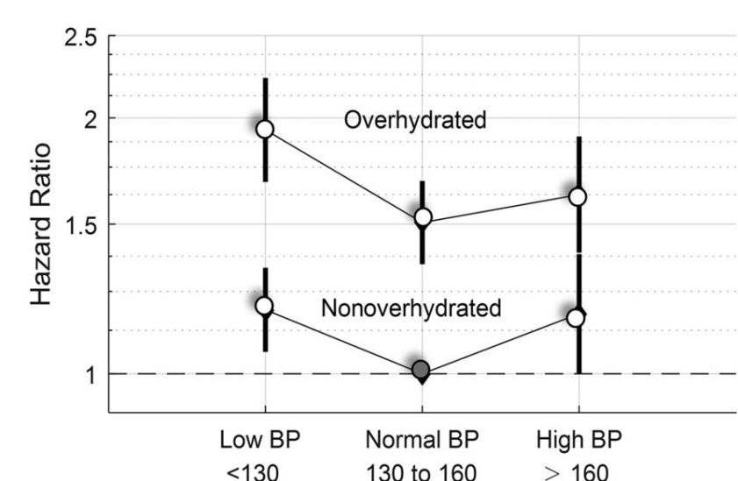
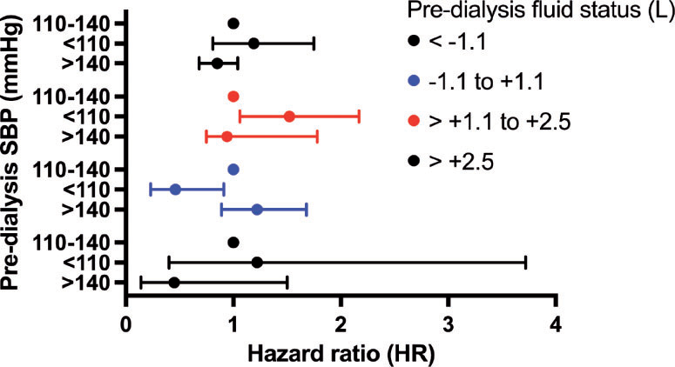
ECV Overload Is an Independent Predictor of Mortality and Modifies the Association Between Peridialytic BP and Mortality
Extracellular volume (ecv) overload
Objective assessments of ECV using bioimpedance spectroscopy show that ECV overload is associated with increased mortality risk. (Figure 1)
At any given BP, increased ECV further increases mortality risk. (Figure 2)
There is not an increased mortality risk from low/normal pre-HD BP in euvolemic patients. (Figure 3)
Fig 1
Fig 2
Fig 3
Modified from Nephrol Dial Transplant
27(6):2404-2410, 2012
Modified from J Am Soc Nephrol 28(8):2491-2497, 2017
Modified from Nephrol Dial Transplant
33(11):2027-2034, 2018
Dialysis Core Curriculum 2021

Slide 16
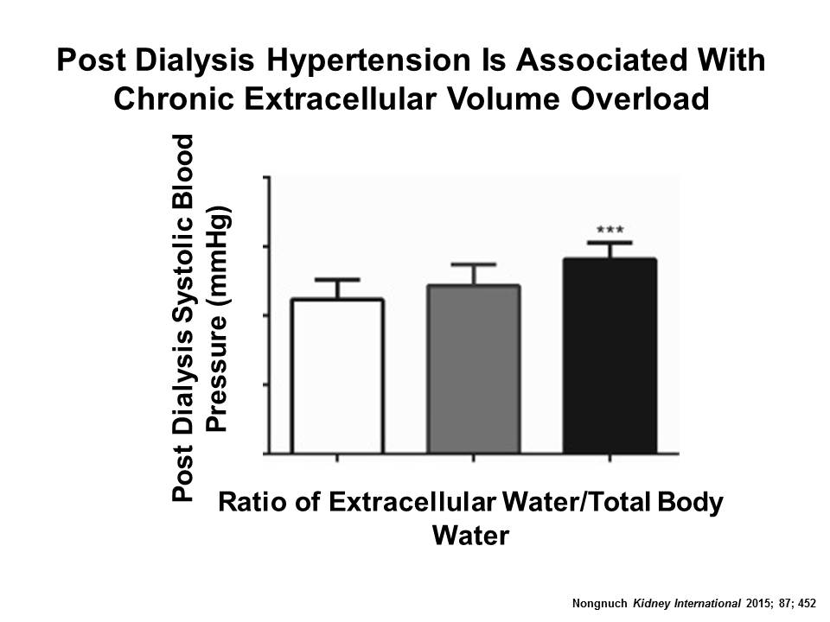
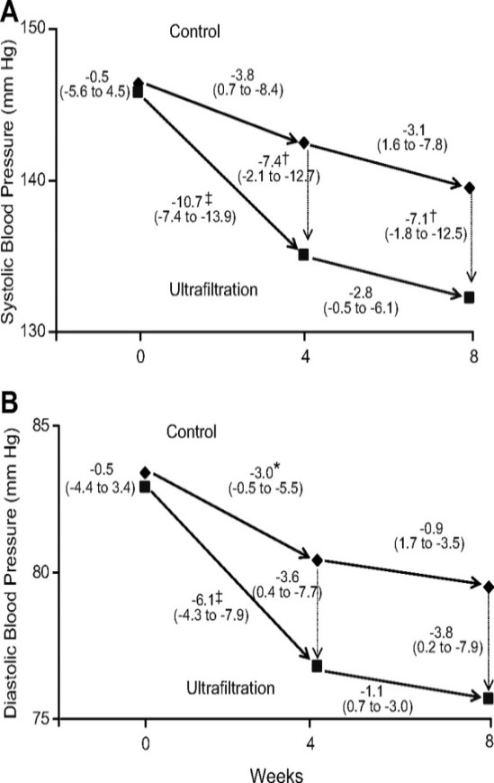
ECV Overload Contributes to Hypertension in HD Patients and Should Be Addressed as a Primary Therapy for BP Control
There is an association between ratio of extracellular water/total body water measured with bioimpedance spectroscopy and post-dialysis BP.
There is clinical trial evidence that intentional dry weight reduction over the course of several weeks results in significant reduction in ambulatory BP.
Weeks
Modified from Kidney Int 87: 452-457, 2015
Modified from Hypertension 53:500-507, 2009
Dialysis Core Curriculum 2021

Slide 17
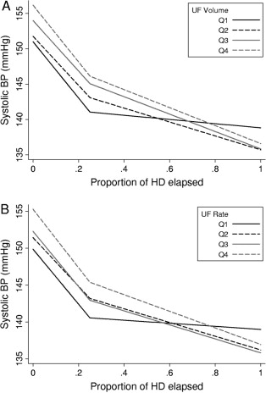
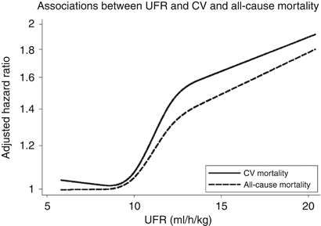
Intradialytic Hypotension and Excessive Ultrafiltration Are Mortality Risk Factors that Should Be Avoided in Process of Controlling Hypertension and ECV Overload
BP decreases during dialysis occur in most HD patients, but the causes, severity, and associated symptoms can vary. However, there is evidence that the faster ultrafiltration takes place, the steeper the decline in BP. (Figure 1)
There is evidence that recurrent decreases in systolic BP to a nadir <90 mmHg (<100 mmHg if pre-HD systolic BP is >160 mmHg) is associated with increased mortality. This threshold is a stronger predictor than any specific change in BP during dialysis.
There is additional evidence that excessively rapid ultrafiltration rates more than 13 mL/kg/hr are associated with increased mortality. (Figure 2)
Fig 1
Fig 2
Modified from Am J Kidney Dis 58(5):794-803, 2011
Modified from Kidney Int 79(2): 250-257, 2011
Dialysis Core Curriculum 2021

Slide 18
Pharmacologic Management of Hypertension
Two separate meta-analyses have identified that pharmacologic treatment of hypertension is associated with decreased cardiovascular events and mortality in HD patients.
Author | Studies | Outcomes
Heerspink | 8 trials 1679 patients | CV events: RR 0.71, CI 0.55-0.92 All Cause Mortality: RR 0.80, CI 0.66-0.96 CV Mortality: RR 0.71, CI 0.5-0.99
Agarwal | 5 studies 1202 patients | CV events: HR: 0.69, CI 0.56-0.84 All cause mortality: RR 0.79, CI 0.65-0.96
Data compiled from Lancet 373: 1009-1015, 2009 and Hypertension 53(5):860-866, 2009
Dialysis Core Curriculum 2021

Slide 19
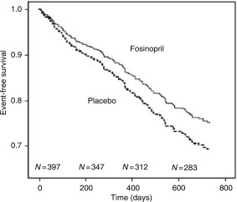
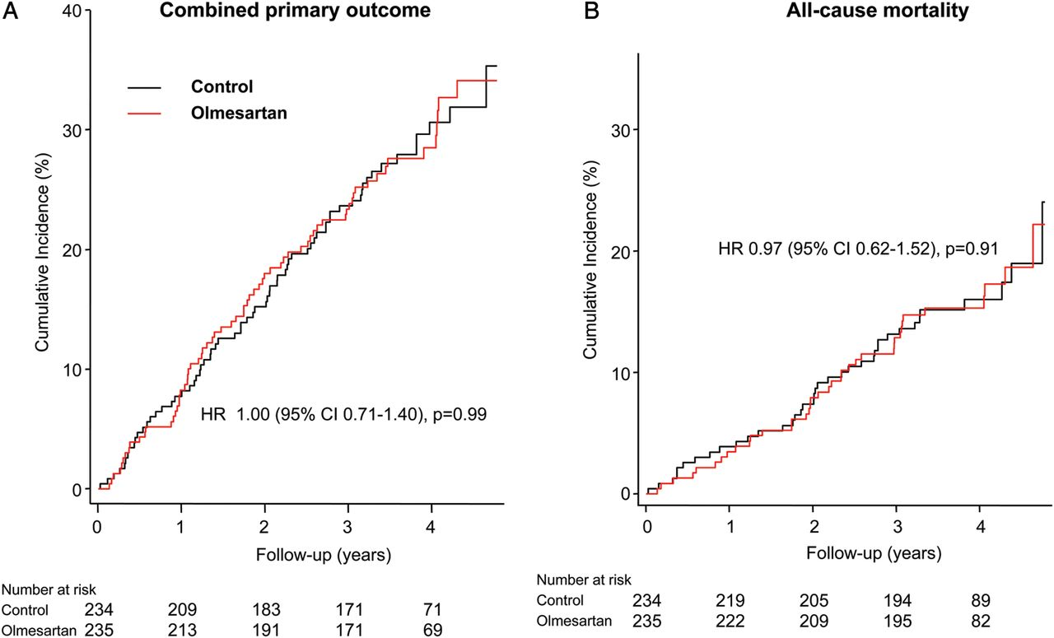
Conflicting Evidence Regarding Benefits of Specific Antihypertensive Drugs
There was no mortality benefit in randomized trial comparing fosinopril to placebo. (Figure 1)
One small randomized trial demonstrated a mortality benefit using candesartan (ARB) vs. control.
Large ARB trials have not established a mortality benefit. (Figure 2)
Meta analysis has shown benefit regarding reduction in left ventricular hypertrophy.
Fig 2
N=235
N=234
N=196
RR = 0.79
p = 0.1
N=210
Modified from Kidney Int 70(7):1318-1324, 2006
Modified from Nephrol Dial Transplant 28(6):1579-1589, 2013
Dialysis Core Curriculum 2021

Slide 20
Hypertension and ECV Overload Summary
Hypertension is associated with increased risk of cardiovascular disease.
  Recommend to target pre-HD systolic BP <140/90 mmHg or post-HD systolic BP <130/80, although the evidence of a mortality benefit from a randomized trial is lacking.
  Home and ambulatory BP measurements better predict mortality than HD-unit measurements and may be more appropriate to make decisions regarding changes in management.
ECV overload is associated with hypertension and mortality, and ECV reduction lowers ambulatory BP.
Aggressive fluid removal as indicated by excessive ultrafiltration rates or intradialytic hypotension are associated with mortality and should be avoided.
  To help avoid these, considerations should be made to:
    Limit interdialytic intake of sodium and fluid.
    Extend dialysis treatments or offer additional ultrafiltration treatments to minimize the ultrafiltration rate.
Pharmacologic antihypertensive treatment is appropriate, but the ideal drug/drug class are uncertain at this time with regards to mortality benefit.
Dialysis Core Curriculum 2021

Slide 21
Dyslipidemia Management in HD Patients
Dialysis Core Curriculum 2021

Slide 22
Current KDIGO Recommendations
Recommend evaluation with a lipid profile (total cholesterol, LDL cholesterol, HDL cholesterol, triglycerides). (1C)
Follow-up measurements of lipid levels are not required for the majority of patients (not graded).
Suggest that statins or statin/ezetimibe combination not be initiated. (2A)
In patients already receiving statins or statin/ezetimibe combination at the time of dialysis initiation, suggest that these agents be continued. (2C)
Kidney Int Suppl 3(3):287-296, 2013
Dialysis Core Curriculum 2021

Slide 23
Learning Objectives:
Dyslipidemia Management
Illustrate clinical trial data showing benefit from statin initiation in patients with advanced CKD
Examine clinical trial data showing absence of benefit from statin initiation in patients on dialysis
Interpret updated observational data showing a potential benefit of statin continuation in patients transitioning to ESRD
Dialysis Core Curriculum 2021

Slide 24
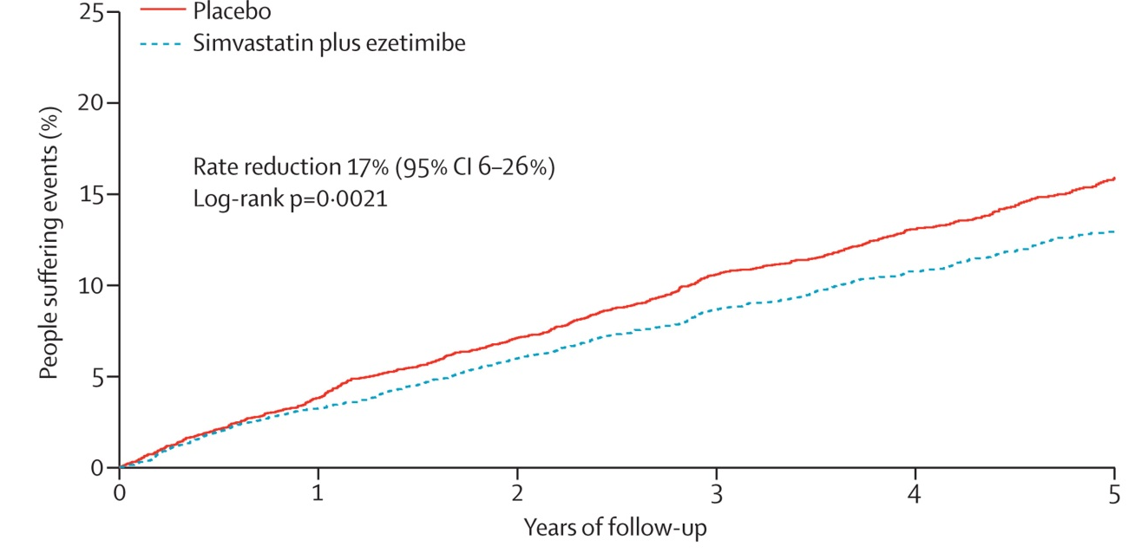
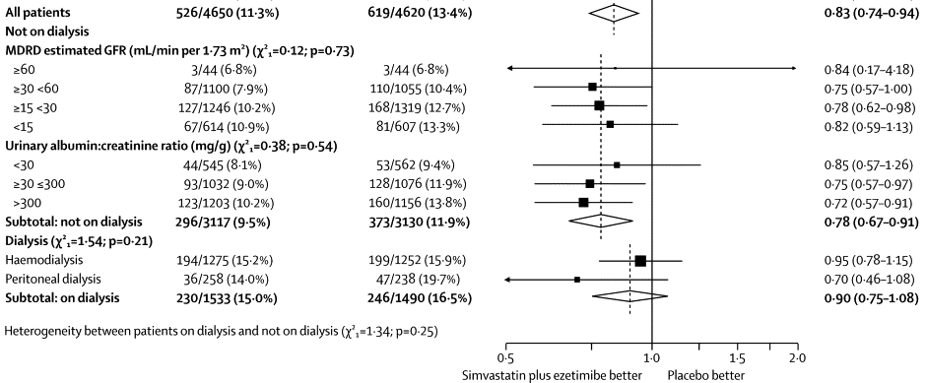
Benefit of Lipid-Lowering Therapy from Statins Achieved in Patients Without Kidney Disease and With Pre-Dialysis CKD Are Less Certain in Dialysis Patients
SHARP Trial: Patients with serum creatinine greater than 1.5-1.7 mg/dL were randomized to either simvastatin 20 mg + ezetimibe 10 mg daily or placebo.
  There was a significant 17% relative risk reduction in the endpoint of major atherosclerotic events in the statin group. (Figure 1)
  There was no significant between-group difference in the patients that were on dialysis. (Figure 2)
Figures Modified from Lancet 377: 2181-2192, 2011
Dialysis Core Curriculum 2021

Slide 25
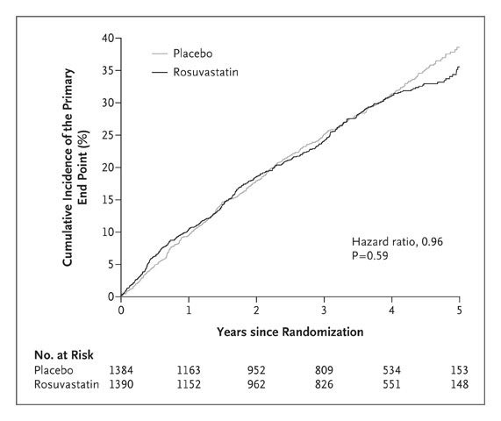
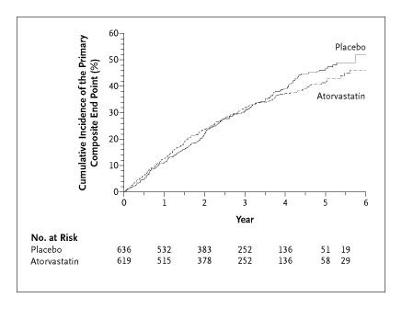
Trials Specifically in Dialysis Patients Have Shown No Benefit of Initiation of Statins
The 4D trial
ESRD patients with type 2 diabetes were randomized to daily atorvastatin or placebo.
Despite significant reduction in LDL cholesterol in the statin group, there was no between-group difference in the primary outcome of CV death, fatal stroke, non-fatal myocardial infarction, or non-fatal stroke.
There were some secondary endpoints more common in the statin group (stroke death) and placebo group (composite of all CV events).
The AURORA Trial
  HD patients were randomized to rosuvastatin or placebo.
  Despite a significant reduction of LDL cholesterol in the statin group, there was no significant difference in the primary endpoint of major cardiovascular events.
Modified from N Engl J Med 353(3):238-248, 2005
Modified from N Engl J Med 360(14):1395-1407, 2009
Dialysis Core Curriculum 2021

Slide 26
Updated Observational Study Shows Association Between Improved Survival With Continuation of Statins at the Time of Dialysis Initiation
Statin therapy use in one year prior progression to dialysis is associated with decreased mortality during the first year on dialysis.
 | Rate per 100 person years | p-value and confidence interval (adjusted analysis)
All cause mortality |  | <0.0001 0.79 (0.76-0.82) use vs. non-use
Total | 35.3
No statin use | 37.9
Statin use | 33.1
CV Mortality |  | <0.0001 0.83 (0.78-0.88) use vs. non-use
Total | 12.3
No statin use | 12.4
Statin use | 12.2
Modified from J Am Heart Assoc 8(6):e011869, 2019
Dialysis Core Curriculum 2021

Slide 27
Dyslipidemia Summary
The initiation of the combination of statin/ezetimibe decreases the risk of atherosclerotic events in patients with advanced CKD.
The benefit of statin initiation has not been clearly demonstrated in dialysis patients, but the evidence referenced and observational evidence that statin continuation may be beneficial at the time of progression to ESRD make it appropriate to continue statin treatment in ESRD patients that are already receiving these prior to dialysis initiation.
Dialysis Core Curriculum 2021

Slide 28
Diabetes Management in HD Patients
Dialysis Core Curriculum 2021

Slide 29
KDIGO Recommendations for CKD
Recommend a target HgbA1c of 7.0% to prevent or delay progression of microvascular complications of diabetes. (1A)
Recommend not treating to a HgbA1c of <7.0% in patients at risk of hypoglycemia. (1B)
Suggest that target HgbA1c be extended above 7.0% in individuals with co-morbidities or limited life expectance and risk of hypoglycemia. (2C)
Kidney Int Suppl 3(1): 73-90, 2013
Dialysis Core Curriculum 2021

Slide 30
Learning Objectives:
Diabetes Management
Indicate additional complications with glycemic management (assessment of glycemic control, risk for hypoglycemia, pharmacologic limitations) that exist in dialysis patients
Identify observational studies regarding glycemic control in dialysis patients
Dialysis Core Curriculum 2021

Slide 31
Diabetes Is Prevalent in Dialysis Patients, But There Are Unique Aspects of Balancing Glycemic Control
Diabetes was the reported cause of ESRD in approximately 46% of incident patients.
In advanced CKD, balancing glycemic control is difficult due to:
  Risk for hypoglycemia from:
    Decreased insulin clearance
    Decreased renal gluconeogenesis
    Malnutrition
    Poor clearance of hypoglycemic drugs
  Increased insulin resistance from uremia
  Unreliability of HgbA1c as a reflection of glycemic control in the context of anemia and erythropoietin stimulating agents
USRDS: 2018 Annual data report: Epidemiology of kidney disease in the United States.
Am J Kidney Dis 63(Suppl 2): S22-S38, 2014
Dialysis Core Curriculum 2021

Slide 32
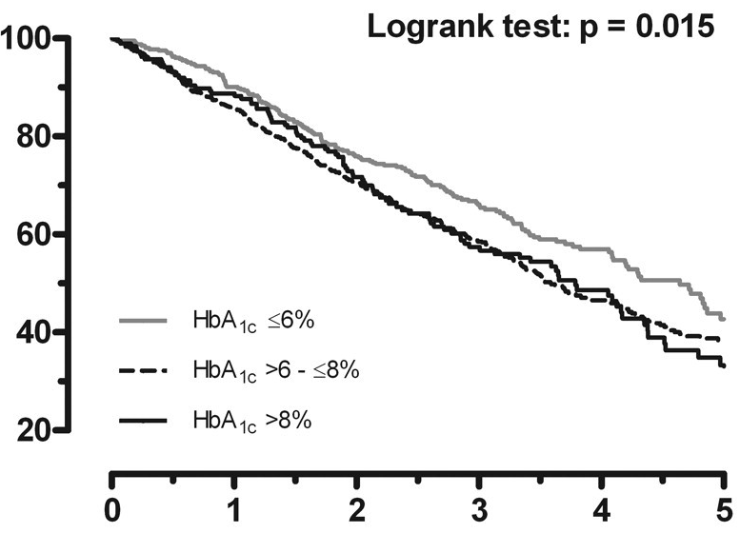
Observational Studies Identify Risk from Poor Glycemic Control in Dialysis Patients
Observational data from a randomized trial investigating statins in diabetic ESRD patients (4D) supported that higher HgbA1c is associated with worse outcomes.
  Among 1255 HD patients with DM2 in the 4D trial, there was a significant increase in mortality for HgbA1c >8% compared to <6%.
  The mortality risk was primarily influenced by increased risk of sudden death.
    Each 1% increase in HgbA1c was associated with 18% increase in sudden death.
There is no randomized clinical trial to guide targets or specific therapy for diabetes in ESRD patients.
Mortality
p=0.015
Percent Survival
Time (years)
Adapted from Circulation 120(24):2421-2428, 2009
Dialysis Core Curriculum 2021

Slide 33
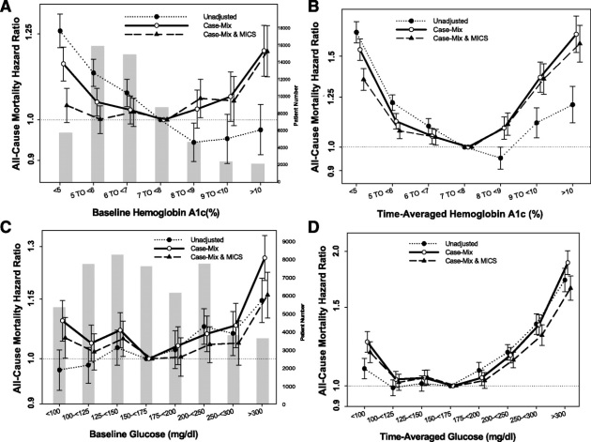
Updated Study Shows Possible Risk of Low HgbA1c
More recent epidemiologic data demonstrates a U-shaped curve defining the relationship between HgbA1c and cardiovascular mortality in HD patients.
  55,000 maintenance diabetic HD patients using time averaged DaVita dialysis data.
  Malnutrition and inflammation were felt to be contributing significantly to association with low HgbA1c.
There is no randomized clinical trial to guide targets or specific therapy for diabetes in ESRD patients.
All-Cause Mortality
HgbA1c (time averaged %)
Adapted from Diabetes 61(3):708-715, 2012
Dialysis Core Curriculum 2021

Slide 34
Other than Insulin, Many Frequently-Used Diabetes Medications Not Appropriate for Use in Dialysis Patients
Insulin is likely preferable agent for HD patients.
  50% of dose for patients with normal renal function should be considered, at least for starting dose.
  Patients likely will require both long-acting basal and short-acting prandial insulin, but individualized dosing should be determined on clinical context.
Semin Dial 27(2):135-145, 2014
Am J Kidney Dis 63(Suppl 2): S22-S38, 2014
Dialysis Core Curriculum 2021

Slide 35
Other than Insulin, Many Frequently-Used Diabetes Medications Not Appropriate for Use in Dialysis Patients (cont.)
Non-insulin compounds
  Sulfonylurea: Can cause hypoglycemia; avoid use except for glipizide due to shorter half life and metabolism in the liver
  Biguanides (Metformin): Should not be used in ESRD
  Thiazolidinediones: Carry theoretic risk of edema and heart failure which may not be relevant in anuric patients; observational studies have had mixed results regarding mortality
  Dipeptidyl-peptidase 4 inhibitor: Reduced dose sitagliptin and linagliptin are acceptable to use in ESRD, but there is no clinical trial data demonstrating superiority over any other agent
  GLP-1 receptor agonists: Exenatide not approved for eGFR<30 mL/min; generally, these drugs associated with significant side effects including nausea and vomiting in CKD patients
  Meglitinides: Repaglinide has not been studied in dialysis patients but has lower risk of hypoglycemia than other agents due to liver metabolism
  Other agents (SGLT-2 Inhibitors, alpha glucosidase inhibitors, amylin analogues) are not recommended due to limited studies in ESRD patients
Semin Dial 27(2):135-145, 2014
Am J Kidney Dis 63(Suppl 2): S22-S38, 2014
Dialysis Core Curriculum 2021

Slide 36
Diabetes Management Summary
Dialysis patients are at increased risk for hypoglycemia compared to patients with preserved renal function and diabetes for a variety of reasons.
There is a U-shaped curve that defines the relationship between glycemic control (HgbA1c or glucose) and mortality in dialysis patients in epidemiologic studies.
There are no randomized trials to guide recommendations for target HgbA1c in dialysis patients, but many recommend targets >7% among patients at risk for hypoglycemia.
Insulin is an acceptable therapy at lower doses, but many non-insulin therapies should be avoided in patients on dialysis.
Dialysis Core Curriculum 2021

Slide 37
references
United States Renal Data System: 2017 USRDS annual data report: Epidemiology of kidney disease in the United States. National Institutes of Health, National Institute of Diabetes and Digestive and Kidney Diseases, Bethesda, MD, 2017.
United States Renal Data System: 2018 USRDS annual data report: Epidemiology of kidney disease in the United States. National Institutes of Health, National Institute of Diabetes and Digestive and Kidney Diseases, Bethesda, MD, 2018.
K/DOQI Workgroup: K/DOQI clinical practice guidelines for cardiovascular disease in dialysis patients. Am J Kidney Dis 45(4 Suppl 3):S1-153, 2005
Agarwal R, Nissenson AR, Batlle D, Coyne DW, Trout JR, Warnock DG: Prevalence, treatment, and control of hypertension in chronic hemodialysis patients in the United States. Am J Med 115(4):291-297, 2003
Dinesh K, Kunaparaju S, Cape K, Flythe JE, Feldman HI, Brunelli SM: A model of systolic blood pressure during the course of dialysis and clinical factors associated with various blood pressure behaviors. Am J Kidney Dis 58(5):794-803, 2011
Zoccali C, Moissl U, Chazot C, Mallamaci F, Tripepi G, Arkossy O, Wabel P, Stuard S: Chronic Fluid Overload and Mortality in ESRD. J Am Soc Nephrol 28(8):2491-2497, 2017
Alborzi P, Patel N, Agarwal R: Home blood pressures are of greater prognostic value than hemodialysis unit recordings. Clin J Am Soc Nephrol 2(6):1228-1234, 2007
Chazot C, Wabel P, Chamney P, Moissl U, Wieskotten S, Wizemann V: Importance of normohydration for the long-term survival of haemodialysis patients. Nephrol Dial Transplant 27(6):2404-2410, 2012
Dekker M, Konings C, Canaud B, Carioni P, Guinsburg A, Madero M, et al: Pre-dialysis fluid status, pre-dialysis systolic blood pressure and outcome in prevalent haemodialysis patients: results of an international cohort study on behalf of the MONDO initiative. Nephrol Dial Transplant 33(11):2027-2034, 2018
Nongnuch A, Campbell N, Stern E, El-Kateb S, Fuentes L, Davenport A: Increased postdialysis systolic blood pressure is associated with extracellular overhydration in hemodialysis outpatients. Kidney Int 87: 452-457, 2015
Dialysis Core Curriculum 2021

Slide 38
references
Agarwal R, Alborzi P, Satyan S, Light RP: Dry-weight reduction in hypertensive hemodialysis patients (DRIP): a randomized, controlled trial. Hypertension 53:500-507, 2009
Dinesh K, Kunaparaju S, Cape K, Flythe JE, Feldman HI, Brunelli SM: A model of systolic blood pressure during the course of dialysis and clinical factors associated with various blood pressure behaviors. Am J Kidney Dis 58(5):794-803, 2011
Flythe JE, Kimmel SE, Brunelli SM: Rapid fluid removal during dialysis is associated with cardiovascular morbidity and mortality. Kidney Int 79(2): 250-257, 2011
Heerspink HJ, Ninomiya T, Zoungas S, de Zeeuw D, Grobbee DE, Jardine MJ, et al: Effect of lowering blood pressure on cardiovascular events and mortality in patients on dialysis: a systematic review and meta-analysis of randomised controlled trials. Lancet 373: 1009-1015, 2009
Agarwal R, Sinha AD: Cardiovascular protection with antihypertensive drugs in dialysis patients: systematic review and meta-analysis. Hypertension 53(5):860-866, 2009
Zannad F, Kessler M, Lehert P, Grünfeld JP, Thuilliez C, Leizorovicz A, Lechat P: Prevention of cardiovascular events in end-stage renal disease: results of a randomized trial of fosinopril and implications for future studies. Kidney Int 70(7):1318-1324, 2006
Iseki K, Arima H, Kohagura K, Komiya I, Ueda S, Tokuyama K, Shiohira Y, Uehara H, Toma S; Olmesartan Clinical Trial in Okinawan Patients Under OKIDS (OCTOPUS) Group: Effects of angiotensin receptor blockade (ARB) on mortality and cardiovascular outcomes in patients with long-term haemodialysis: a randomized controlled trial. Nephrol Dial Transplant 28(6):1579-1589, 2013
Methods for guideline development. Kidney Int Suppl 3(3): 287-296, 2013
Dialysis Core Curriculum 2021

Slide 39
references
Baigent C, Landray MJ, Reith C, Emberson J, Wheeler DC, Tomson C, et al; SHARP Investigators: The effects of lowering LDL cholesterol with simvastatin plus ezetimibe in patients with chronic kidney disease (Study of Heart and Renal Protection): a randomised placebo-controlled trial. Lancet 377: 2181-2192, 2011
Wanner C, Krane V, März W, Olschewski M, Mann JF, Ruf G, Ritz E; German Diabetes and Dialysis Study Investigators: Atorvastatin in patients with type 2 diabetes mellitus undergoing hemodialysis. N Engl J Med 353(3):238-248, 2005
Fellström BC, Jardine AG, Schmieder RE, Holdaas H, Bannister K, Beutler J, et al; AURORA Study Group: Rosuvastatin and cardiovascular events in patients undergoing hemodialysis. N Engl J Med 360(14):1395-1407, 2009
Soohoo M, Moradi H, Obi Y, Rhee CM, Gosmanova EO, Molnar MZ et al: Statin Therapy Before Transition to End-Stage Renal Disease With Posttransition Outcomes. J Am Heart Assoc 8(6):e011869, 2019
KDIGO 2012 Clinical Practice Guideline for the Evaluation and Management of Chronic Kidney Disease. Kidney Int Suppl 3(1): 136-150, 2013 https://www.sciencedirect.com/journal/kidney-international-supplements/vol/3/issue/1
Williams ME, Garg R: Glycemic management in ESRD and earlier stages of CKD. Am J Kidney Dis 63(2 Suppl 2): S22-S38, 2014
Drechsler C, Krane V, Ritz E, März W, Wanner C: Glycemic control and cardiovascular events in diabetic hemodialysis patients. Circulation 120(24):2421-2428, 2009
Ricks J, Molnar MZ, Kovesdy CP, Shah A, Nissenson AR, Williams M, Kalantar-Zadeh K: Glycemic control and cardiovascular mortality in hemodialysis patients with diabetes: a 6-year cohort study. Diabetes 61(3):708-715, 2012
Rhee CM, Leung AM, Kovesdy CP, Lynch KE, Brent GA, Kalantar-Zadeh K: Updates on the management of diabetes in dialysis patients. Semin Dial 27(2):135-145, 2014
Chapter 3: Management of Progression and Complications of CKD. Kidney Int Suppl 3(1): 73-90, 2013
Dialysis Core Curriculum 2021

