Slide 1
Patient-Centered Care in Dialysis Symptom Management
Dialysis Core Curriculum 2021
Holly M. Koncicki, MD
Icahn School of Medicine at Mount Sinai

Slide 2
Holly M. Koncicki
Disclosures
Employer: Mount Sinai Hospital
Honoraria: Royalties for authorship in UpToDate
Dialysis Core Curriculum 2021

Slide 3
Learning Objectives
Identify the most commonly experienced symptoms of dialysis patients including pain, pruritus, restless legs syndrome (RLS), and fatigue/poor sleep
Describe potential treatment options while limitations in evidence
Explain how different symptoms may overlap, and how this interplay can affect a patient’s quality of life
Dialysis Core Curriculum 2021

Slide 4
Case Presentation 1
Symptom: Pain
Maggie is a 73-year-old female with ESRD who you are seeing in the outpatient hemodialysis (HD) unit.
She has been cutting her treatments short once per week due to knee and back pain. She has had multiple admissions over the last 3 months for fluid overload in the setting of not meeting her estimated dry weight.
The pain has been present for years but worsened over the last 3 months. She is also having numbness and tingling in her feet bilaterally. The pain is worsened with sitting, and she currently rates it 10/10 in intensity.
Previously she received knee injections and attended physical therapy (PT), which helped, but due to declining health she was not able to continue. She had used ibuprofen in the past but was told to stop when her kidney function began to decline.
Maggie asks you what she can do for the pain and if you think that she can start taking ibuprofen again now that she is on dialysis.
Dialysis Core Curriculum 2021

Slide 5
Patient History
Symptom: Pain
Past Medical History: Diabetes, Hypertension, Osteoarthritis of right knee, Severe Degenerative Joint Disease L3-L4 and L4-L5, Secondary Hyperparathyroidism
Family History: No family history of renal disease, substance abuse, or psychiatric disorders
Psychosocial: Started using a wheelchair in 2019 due to pain in lower back and knees, lives alone with son nearby
Review of Systems: 10-point ROS negative except for feeling sad over her change in functional status and her inability to carry out some daily activities and to work
Dialysis Core Curriculum 2021

Slide 6
Symptom Burden
Symptoms
HD patients with high comorbidity scores (Charlson score >8) have a large symptom burden.¹
Average of 10.5 symptoms
Only 40% of which were noted by nephrologists
Similar to the symptom burden of inpatient (11.1) and outpatient (9.8) oncology patients
Most common symptoms experienced by HD patients using the Dialysis Symptoms Index²
Most Common Symptoms²
>50% of patients reported: | Tired or lack of energy
 | Bone or joint pain
 | Dry skin or itching
>40% of patients reported: | Trouble falling or staying asleep
Dialysis Core Curriculum 2021

Slide 7
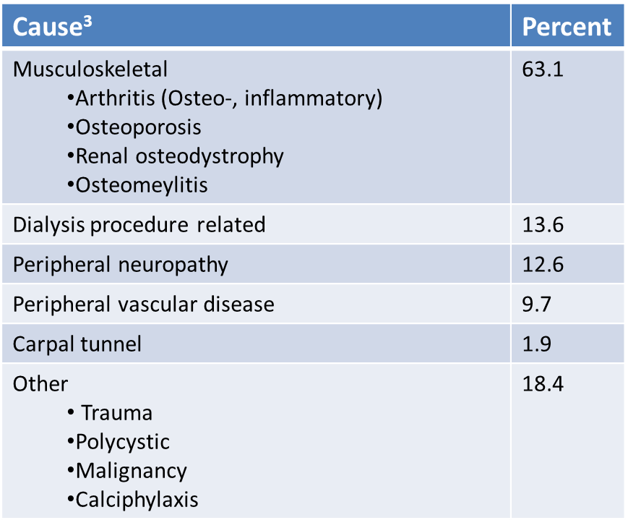
Chronic Pain
SYMPTOM: PAIN
Chronic pain (>3 months) is more prevalent in patients who have kidney disease³
20% have multiple causes
Correlated with dialysis vintage
Similar rates in HD, PD and conservative management
~83% of patients with kidney disease rate pain as moderate to severe in intensity
Prevalence of Chronic Pain
General population | CKD patients | ESRD patients
45% | > 60% | >50%
Modified from Am J Kidney Dis 42: 1239-1247, 2003
Dialysis Core Curriculum 2021

Slide 8
Outcomes of Untreated Pain
Symptom: Pain
Negative impact on quality of life
High rates of: depression, insomnia, increased perception of burden of disease, decreased perception of social support
Increased frequency of: ⁴
Number of shortened (16%) or missed dialysis treatments
Hospitalizations (22%) and emergency room visits (58%)
Rates of withdrawal from dialysis
Dialysis Core Curriculum 2021

Slide 9
General Approach to Pain
Symptom: Pain
1. Pain assessment
2. Set expectations of treatment
3. World Health Organization Analgesic Ladder
4. Follow up, dose adjust
5. Monitor for side effects
Dialysis Core Curriculum 2021

Slide 10
Symptom: Pain
General Approach to Pain Management
1. Pain Assessment | Take pain history Pain intensity: Select one and use it for initial evaluation and when assessing response Numerical rating scale (From 1 to 10…) Visual analog scale Multidimensional: McGill Pain Questionnaire or Brief Pain Inventory
2. Set expectations | Pain relief Will not be “pain free” Determine acceptable level of pain Define Goals: Ex: To be able to participate in normal activities Improve quality of life Set duration of therapy Will re-evaluate in a certain amount of time
Dialysis Core Curriculum 2021

Slide 11
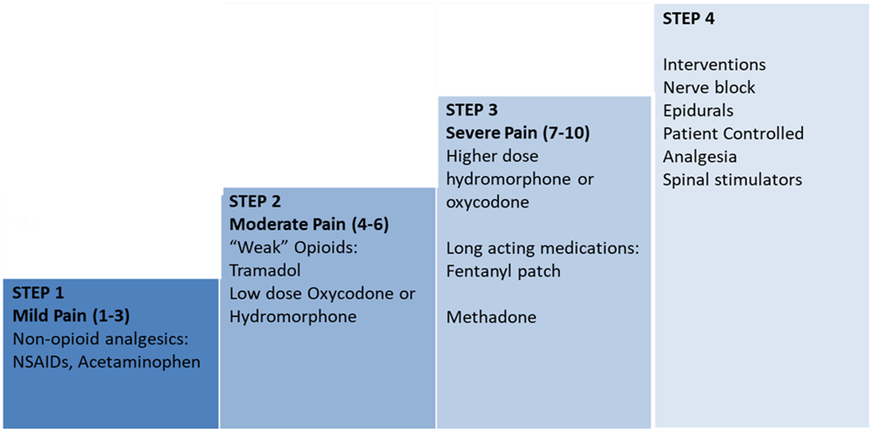
World Health Organization Analgesic Ladder
Symptom: Pain
Efficacy validated in HD patients⁵
Start with “step 1” agents and can up titrate, or add a “step 2” medication if pain is still severe
Long-acting medications (transdermal fentanyl) are for patients on a stable dose and not for acute titration
Step 4 should be used earlier
Encourage concurrent use of adjuvant therapy, topical therapy, physical therapy, or complementary/ alternative medicine
Dialysis Core Curriculum 2021

Slide 12
Step 1: Acetaminophen
Symptom: Pain Non-Opioid Analgesics
Non-opioid drug of choice
Maximum is 4 grams per day
Dosing for normal kidney function:
650 mg every 4-6 hours as needed
Dosing for ESRD
650 mg every 6-8 hours PRN
Dialysis Core Curriculum 2021

Slide 13
Step 1: Non-Steroidal Anti-Inflammatory Drugs (NSAIDS)
Symptom: Pain Non-Opioid Analgesics
Often discouraged in renal disease due to concerns of effects on blood pressure, renal decline, fluid retention
Limited evidence regarding clinical significance of these effects exist
Increase in blood pressure⁷
Observational study (few patients with CKD)
~2mmHG increase in systolic BP (range 3-5mmHg)
Ibuprofen had greatest effect on BP compared to other NSAIDs
Evidence in ESRD is limited⁸
One study showed a 31% increased risk of stroke related to NSAID use during the 30 days prior to stroke
Increased risk for nonselective NSAIDs
Dialysis Core Curriculum 2021

Slide 14
Step 1: Non-Opioid Analgesics
Symptom: Pain
Acetaminophen is non-opioid, non-NSAID analgesic of choice
NSAIDs
In ESRD, reasonable for short-term use with monitoring of BP and volume status
Dialysis Core Curriculum 2021

Slide 15
Case Presentation (cont.)
Symptom: Pain
You advise Maggie to take ibuprofen 400 mg three times daily as needed for pain and to take one of those doses 30 minutes prior to dialysis.
She is also referred to physical medicine and rehabilitation (PM&R) for evaluation of PT and any potential interventions (e.g., injections).
Agree to evaluate progress after 2 weeks.
2 weeks later, she is continuing to cut treatments short despite increasing the dose of ibuprofen at your discretion, as well as adding a lidocaine patch. She has appointment with PM&R in 2 weeks.
She asks if there is anything else that she can try.
Dialysis Core Curriculum 2021

Slide 16
Steps 2 and 3: Opioid Analgesics
Symptom: Pain
Limited data for use in kidney impairment
Dosing guidelines
Based upon pharmacokinetic data, metabolism pathways, and ability of medication to be dialyzed
No dedicated studies on dosing recommendations
Cautious dosing is recommended
Start at lowest possible dose and slow titration with close monitoring for side effects
Dialysis Core Curriculum 2021

Slide 17
Opioid Medications To Avoid⁹
Symptom: Pain
Morphine
Active metabolite, morphine-6-glucuronide (M6G) accumulates in impaired kidney function.
CSF concentration of M6G in dialysis patients is 15 times that of patients with normal kidney function.
Case reports of CNS depression, myoclonus, and death.
Codeine
Reduced clearance and prolonged half life in impaired kidney function.
Case reports of CNS depression, hypotension, respiratory arrest.
Hydrocodone
Same metabolic pathway as codeine.
Tapentadol
Meperidine
Extended-Release Tramadol
Dialysis Core Curriculum 2021

Slide 18
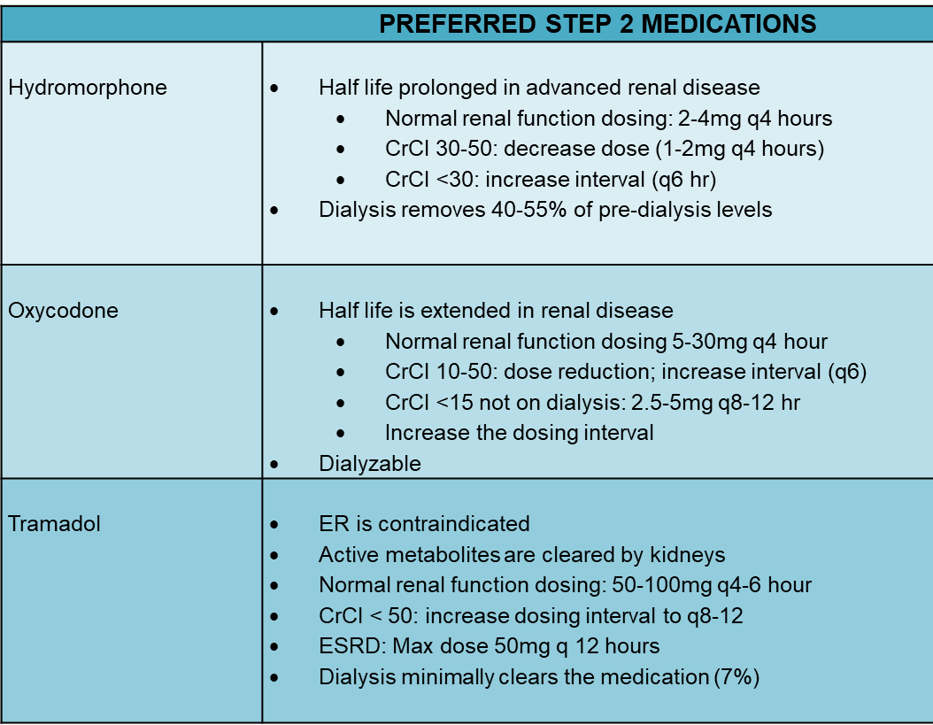
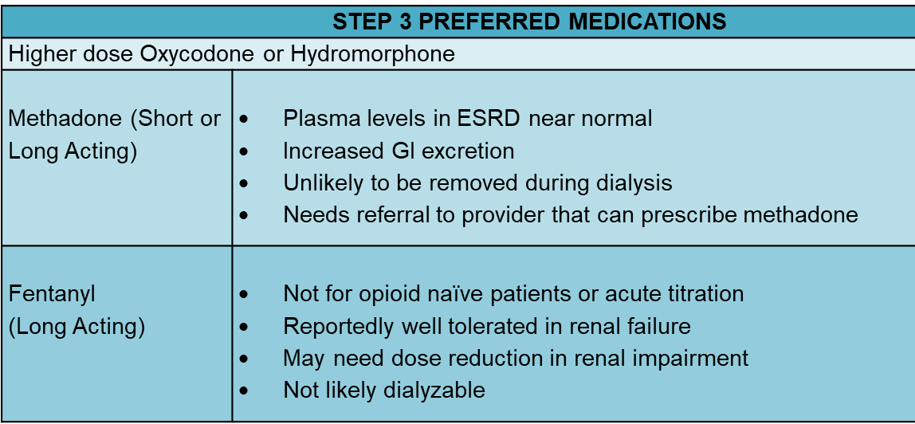
Opioid Medications: Preferred⁹
Symptom: Pain
Modified from Am J Kidney Dis 69: 451-460, 2017
Dialysis Core Curriculum 2021

Slide 19
Opioids: Adverse Effects
Symptom: Pain
Drowsiness
Usually improves with duration of use
Constipation
In addition to lifestyle changes, may require medications
e.g., senna and docusate, or polyethylene glycol (osmotic laxative)
Pruritus
If persistent, may need to rotate to a different opioid agent
Dialysis Core Curriculum 2021

Slide 20
Case Presentation (cont.)
Symptom: Pain
You prescribe oxycodone 5 mg to take every 8 hours as needed and advise use of the ibuprofen for less severe pain.
You review a pain contract agreement and advise her that she cannot receive opioids from any other provider and is not to adjust the dose or frequency of the medication without speaking to you first. She agrees.
After 1 week she notes that she is able to use the ibuprofen during the day and oxycodone only prior to dialysis and has been completing her treatment. After receiving injections by PM&R she has not required use of opioids in several weeks.
Unfortunately, the numbness and tingling in her feet and legs have become increasingly bothersome and keeping her awake at night. She asks if there is anything to help with this different type of pain.
Dialysis Core Curriculum 2021

Slide 21
Neuropathic Pain
Symptom: Neuropathic Pain
Described as: burning, shooting, numbness
Etiology¹⁰:
Systemic processes: diabetes, amyloid, uremia, chemotherapy induced, viral syndromes (post-herpetic neuralgia)
Anatomic: carpal tunnel syndrome, ulnar neuropathy
Common in HD patients due to alterations in venous congestion and increased pressure in the access arm during.
Carpal tunnel - 28.5% of HD patients
Ulnar neuropathy - 40-60% of HD patients
Dialysis Core Curriculum 2021

Slide 22
Gabapentin and Pregabalin
Symptom: Neuropathic Pain - Treatment
Pregabalin is FDA approved for diabetic neuropathic pain and post herpetic neuralgia
Gabapentin is not FDA approved for neuropathic pain so when used, it is off label
Excreted through the kidneys
Potential for medications to accumulate
Monitor for toxicity:
Lethargy
Dizziness
Myoclonus
Dialysis Core Curriculum 2021

Slide 23
Dosing Recommendations
Symptom: Neuropathic Pain - treatment
Second Line agents
Limited studies in renal impairment
No studies evaluating safe or effective dose
Guidelines will vary based upon provider experience and comfort and “expert opinion”
Start at lowest dose and titrate up slowly
For CKD 5 and ESRD on dialysis, would consider starting with every other day dosing
Consider dosing at night, as may be sedating
Dialysis Dosing⁹
Gabapentin | Start: 100mg post HD Max: 300mg daily
Pregabalin | Start: 25mg post HD Max: 75mg daily
Second Line Agents
Desipramine and Nortriptyline | Superior to serotonin norepinephrine reuptake inhibitors (SNRI) Use limited by anti-cholinergic side effects No clear dosing recommendations
Modified from Am J Kidney Dis 69: 451-460, 2017
Dialysis Core Curriculum 2021

Slide 24
Safety
Symptom: Neuropathic Pain - Treatment
Recent retrospective study of ~140,000 HD patients evaluated the risk of altered mental status, fall and fracture and use of different doses of gabapentin and pregabalin.¹¹
Gabapentin was associated with higher risk of altered mental status (50%), fall (55%), and fracture (38%) in highest dose category (>300mg/day).
At lower doses also increased risk of altered mental status and falls
Pregabalin was also associated with increased risk of altered mental status and falls.
Limitations: observational study, confounding variables may have existed, and this study shows association not causation
Supports cautious prescribing of medications with using the lowest effective dose
Dialysis Core Curriculum 2021

Slide 25
Case Presentation (cont.)
Symptom: Neuropathic Pain
You prescribe Maggie gabapentin 100 mg at night, three times per week on her dialysis days.
After 2 weeks, she has not noticed any improvement in symptoms and denies feeling more sedated from the medication. You increase the dose to 100 mg every night.
After 1 week, she notes improvement in her pain. Though it is still present, it is not severe enough to keep her awake at night or limit her ability to carry out daily activities.
Dialysis Core Curriculum 2021

Slide 26
Case Presentation 2
Symptom: Pruritus
Helen is a 59-year-old female with ESRD on HD who you are seeing in the outpatient unit. She has frequent hospitalizations related to dialysis non-compliance, volume overload, and hyperkalemia.
During rounds, she complains of pruritus all over her body. The itch keeps her awake at night, and sometimes she is so tired she is unable to come to dialysis the following morning.
She has terminated treatments early due to the itching and has even sought ER evaluation. Despite using diphenhydramine and hydroxyzine (antihistamine agents), the itch persists.
She asks if there is anything that can be done to help decrease the itch?
Dialysis Core Curriculum 2021

Slide 27
Patient History
Symptom: Pruritus
Past Medical History: Diabetes, Hypertension, Chronic Pancreatitis, Secondary Hyperparathyroidism
Family History: No family history of renal disease
Psychosocial: Lives alone, not currently working, non-smoker
Review of Systems: 10-point ROS negative except for pruritus and some bleeding over dry areas of skin which she has scratched
Pertinent Labs: iPTH 330 pg/mL, Calcium 9.0 mg/dL, Phosphorus 6.8 mg/dL, Ferritin >1000 ng/mL, Kt/V 1.9
Dialysis Core Curriculum 2021

Slide 28
Pruritus: Presentation and Evaluation¹²
Symptom: Pruritus
Reported in over 40% of dialysis patients
Presentation is usually non dermatomal, bilateral, and symmetrical
Presence and severity is associated with:
Decreased health related quality of life
Low mood, poor sleep
Increased number of missed treatments (2.6-2.8 sessions/year)
Increased infection rate (50%) ad antibiotic use
Mortality
Dialysis Core Curriculum 2021

Slide 29
Pruritus: Mechanism
Symptom: pruritus
Decreased hydration of the stratum corneum causing Xerosis
Opioid theory:
Stimulation of mu receptors increase itch, stimulation of kappa decrease itch.
In uremia, increased ratio of beta-endorphine (mu receptor agonist) to dynorphine A (kappa receptor agonist)
Inflammatory theory:
In uremic pruritus, higher levels of CRP, IL6, IL2 and inflammatory markers (increased ferritin, lower albumin.)
Not histamine mediated¹²
Antihistamines (e.g., diphenhydramine, hydroxyzine, loratadine) are the most common medication prescribed by nephrologists for itch.
Functional MRI studies of itch found that uremic pruritus is mediated through non-histamine-mediated neural pathways.
Given risk of adverse effects (confusion, dizziness, drowsiness) and that mechanism of uremic pruritus is NOT histamine mediated, these medications should be avoided.
Dialysis Core Curriculum 2021

Slide 30
Symptom: pruritus
Pruritus: Approach to Management
1. Evaluate for primary dermatologic condition | Is there presence of bullous lesions, ulcerations, or rash? If present, referred to dermatology. Check for signs/symptoms of other systemic diseases.
2. General skin care | Use of emollients 2-4x/day. Avoid fragrant soap or lotions.
3. Optimization of dialysis parameters | Outdated studies suggesting benefit of improvement in Kt/V was shown with lower Kt/V targets (improvement from Kt/V of 1.05 to 1.2) and prior to standard use of high flux dilayzers. Recent DOPPS data shows no association with Kt/V and pruritus.
4. Optimization of mineral bone disease | Ranked #1 intervention by nephrologists. Inconsistent data exist regarding association with calcium, phosphorus, or PTH. No published studies showing lowering of serum phosphorus with improvement in pruritus.
Dialysis Core Curriculum 2021

Slide 31
Symptom: pruritus
Pruritus: Approach to Management
5. Systemic Therapies
Gabapentin or Pregabalin | Preferred, though not FDA approved for pruritus. A systemic review found nine studies evaluating use of these medications for pruritus.¹⁴ When either was compared to placebo, there was a benefit seen. Limitations include heterogeneity of studies and lack of long-term follow up.
Nalfurafine¹⁵ | Selective kappa opioid receptor agonist; not FDA approved. Meta-analysis of 144 HD patients who received 5 μ g IV 3x/week showed benefit. Study of 337 HD patients treated with 2.5 or 5 μ g oral daily had improvement after 7 days compared to placebo.
Difelikefalin²⁴ | Peripherally restrictive, kappa opioid receptor agonist. Phase 3, double-blind, placebo control trial of 378 HD patients with moderate to severe itch were randomized to receive Difelikefalin 0.5mg/kg 3x/week × 12 weeks vs. placebo. Treatment group with significant reduction in itch intensity and itch related quality-of-life scores.
Dialysis Core Curriculum 2021

Slide 32
Complementary and Alternative Therapies
Symptom: Pruritus - Approach
UV phototherapy¹⁴
UVB light treatment has been associated with clinical improvement in pruritus.
Heterogeneity exists as studies vary in type of UV light (A or B) and narrow vs. broadband.
Broadband UV-B therapy showed some benefit, with side effects of sunburn and tanning noted.
Long-term effects of this therapy are unknown.
Acupuncture
Small studies suggest benefit.^{13,14}
40 patients with refractory uremic pruritus randomized to acupuncture or sham procedure 3x/week for 1 month.¹³
Significant improvement in acupuncture group (1) compared to sham group (2).
Symptoms remained improved at 3 months.
Dialysis Core Curriculum 2021

Slide 33
Case Presentation (cont.)
Symptom: Pruritus
You check Helen’s skin and do not see any lesions or rashes suggestive of a primary dermatologic condition.
You review her labs and note that her phosphorus is high. You encourage compliance with her phosphate binder and encourage her to use an emollient twice a day.
Due to lack of improvement, you discuss with her using gabapentin and advise her that it is not FDA approved for this symptom. After discussing the risks and benefits, she agrees to try it. You prescribe gabapentin 100 mg three times a week at night after dialysis and up titrate to nightly after 2 weeks.
At that time, she notes near resolution of her pruritus and has not terminated any treatments early.
Dialysis Core Curriculum 2021

Slide 34
Case Presentation 3
Symptom: Restless Legs Syndrome
James is a 72-year-old male with hypertension, diabetes mellitus, obesity, and asthma who was admitted to the hospital with hypertensive urgency and progression of his CKD stage 5 to ESRD. You are seeing him in the inpatient dialysis unit during his hospitalization.
While he has been tolerating dialysis well, he notes that his sleep has been poor. You review his sleep habits, and he notes that when he is falling asleep, he has the urge to move his legs, and this will not remit unless he actually moves his legs. He finds that this disrupts his ability to sleep and relax.
He asks you if there is anything that can be done to help this bothersome symptom and his sleep.
Dialysis Core Curriculum 2021

Slide 35
Patient History
Symptom: Restless Legs Syndrome
Past Medical History: Hypertension, Diabetes, Iron-deficiency anemia
Family History: No family history of renal disease or neurologic disease
Psychosocial: Widow, lives alone
Review of Systems: ROS is otherwise negative
Pertinent Labs: Hemoglobin 8.3 g/dL, Iron sat 8%, Ferritin 100 ng/mL
Dialysis Core Curriculum 2021

Slide 36
Restless Legs Syndrome (RLS)
Symptom: Restless Legs Syndrome
Urge to move legs during periods of inactivity; relieved by movement
Prevalence¹⁸
General population: 5-15%
Dialysis patients: 20-73%
Transplant patients: 5%
Associated with:
Reduced CNS iron stores
ESRD: low hemoglobin, iron, and diabetes
Medications: selective serotonin reuptake inhibitors, tricyclic antidepressants, dopamine antagonists
Peripheral neuropathy
Dialysis Core Curriculum 2021

Slide 37
Restless Legs Syndrome (RLS)
Symptom: Restless Legs Syndrome
Clinical outcomes:
Poor sleep
Impaired health-related quality of life
Depression
Increased mortality
Increased risk of suicide or self harm
Dialysis Core Curriculum 2021

Slide 38
RLS: Treatment¹²
Symptom: Restless Legs Syndrome
Modified Dialysis:
Short daily HD reduced prevalence and severity of symptoms
No change in number of patients needing additional pharmacologic therapy of symptoms
Renal Transplantation
Improvement in days to weeks
Iron Supplementation: transient benefit
Exercise
Intradialytic exercise shows improvement in small case series.
Meta-analysis of exercise training showed benefit on RLS, depression, and fatigue.
Dialysis Core Curriculum 2021

Slide 39
RLS: Pharmacologic Treatment
Symptom: Restless Legs Syndrome
Dopamine Agonists
Pramipexole and Ropinirole
Onset of action is 90-120 minutes after ingestion
Study of 10 HD patients with RLS causing early termination of treatment
Given Pramipexole starting at 0.125 mg and increasing to maximum daily dose of 0.75 mg.¹⁹
Results:
9/10 patients showed response during first week of treatment – mean dose of 0.25mg
Well tolerated.
Improvement in RLS scores, but no change in sleep time, awakenings, or sleep efficiency.
Dialysis Core Curriculum 2021

Slide 40
RLS: Pharmacologic Treatment
Symptom: Restless Legs Syndrome
Severe impulse control disorders have been reported in association with dopamine receptor agonists.²⁰
Strongest association with Ropinirole and Pramipexole.
Dopamine against were being used for restless leg syndrome in ~24% of cases.
Risks of these medications should be discussed with patients when being prescribed.
Dialysis Core Curriculum 2021

Slide 41
RLS: Pharmacologic Treatment
Symptom: Restless Legs Syndrome
Alternative: Gabapentin and Pregabalin
Not FDA approved for use in RLS
16 patients with RLS randomized to either Gabapentin or placebo²¹
6 weeks of treatment
1 week washout period
Switched x 6 weeks
11/16 patients responded to Gabapentin but not to placebo
Dialysis Core Curriculum 2021

Slide 42
Case Presentation (cont.)
Symptom: Restless Legs Syndrome
You note that James is iron deficient and start him on IV iron with dialysis. Though there is some improvement in his restless leg symptoms, it is still bothersome enough to keep him awake at night.
You discuss the potential risks of dopamine agonists including impulsive behavior, and he is agreeable to taking the medication. You prescribe pramipexole 0.125 mg daily 90 minutes before bed, which you increase to 0.25 mg daily over 1 week.
He notes improvement in his symptoms but still poor sleep quality and fatigue.
Dialysis Core Curriculum 2021

Slide 43
Fatigue²² Poor Sleep²²
Symptom: Poor Sleep AND Fatigue
Fatigue experienced by 60-97% of HD patients
Associated with :
Increased mortality
Depression
Lower quality of life
Contributing factors:
Comorbid conditions
Medication side effects
Dialysis factors
Nutritional factors
Metabolic factors
Inflammation
Sleep disturbance in 40-85% of HD patients
In a study of 1600 patients:
50% had trouble falling asleep
50% had night awakenings
49% had early morning awakening
Associated with:
Increased mortality
Lower mental and physical component summary scores
Higher prescriptions of antihistamines, antidepressants, anti-inflammatories, narcotics, GI medications, hypnotics
Dialysis Core Curriculum 2021

Slide 44
Poor Sleep: Approach¹²
Evaluate and treat non-dialysis related factors
Presence of comorbid conditions (e.g., orthopnea, sleep apnea)
Review medications that may disrupt sleep (e.g., stimulants, diuretics)
Consider changing administration time
Review lifestyle and sleep hygiene
Caffeine, eating, or alcohol late in the day, inconsistent sleep schedule (daytime naps, variable wake times), stimulating activities at night (phone usage)
Consider cognitive behavioral therapy
Evaluate dialysis-related factors
Presence of contributing symptoms (e.g., RLS, pain, pruritus)
HD patients have loss of nocturnal melatonin surge, less REM sleep, higher brief arousal index, longer sleep onset latency, and increased wake time after sleep onset – all of which leads to less sleep time and worse sleep efficiency.
Dialysis Core Curriculum 2021

Slide 45
Symptom: Poor Sleep & Fatigue
Poor Sleep: Dialysis Related Factors and Modification ¹²
Nocturnal Dialysis | Daytime HD increases daytime sleep leading to decrease sleep onset and nighttime sleep. Nocturnal HD shown to have variable effects. Decrease in sleep apnea and daytime sleepiness. Improvement in sleep latency. Partial recovery in melatonin effects.
Lower Dialysate Temperature | Dialysis causes changes in core body temperature. Cytokine release due to interaction of cells with dialyzer and heat load of the dialysis bath. This leads to cooling mechanisms in the body that enhance daytime sleepiness. Using temperature of 35º C vs. 37º C was associated with longer total sleep and shorter sleep latency.
Transplant | Reduction in nighttime awake minutes 3 months after transplant. Subjective improvement in sleep quality, quality of life, and daytime sleepiness scores.
Dialysis Core Curriculum 2021

Slide 46
Poor Sleep: Pharmacologic Management
Symptom: Poor Sleep and Fatigue
Melatonin
Double-blind study of 67 HD patients with sleep problem randomize to receive either melatonin 3 mg/day or placebo over a 23-month period.²⁴
Results:
62% of patients completed study
3 months: improvement in sleep efficiency and sleep time with melatonin
12 months: no significant difference between melatonin and placebo
Conclusion: Short-term benefit of melatonin, long-term results may have been confounded by higher-than-expected drop-out rate (reasons included death, transplantation, change of dialysis modality, or study withdrawal for not specified reasons).
Dialysis Core Curriculum 2021

Slide 47
Poor Sleep: Pharmacologic Management¹²
Symptom: Poor Sleep AND Fatigue
Benzodiazepine-receptor agonists
e.g., lorazepam, temezapam
Non-benzodiazepine agonists of benzodiazepine receptors
e.g., eszopiclone, zolpidem, zaleplon
Lack of strong evidence regarding dosing recommendations of these medications in renal impairment.
Start at lowest dose with slow titrating with monitoring of side effects.
Discontinue use if not needed. Chronic use is discouraged.
Monitor for use of other medications that can potentially cause alteration in mental status or sedation.
Dialysis Core Curriculum 2021

Slide 48
Poor Sleep: Pharmacologic Management
Symptom: Poor Sleep AND Fatigue
Dialysis Morbidity and Mortality Wave 2 Study²³
3690 incident dialysis patients
14% used a benzodiazepine or non-benzodiazepine (such as zolpidem)
Compared to non-users:
Use of these medications was associated with a 15% higher mortality rate
3x increase risk of fracture
Cautious use in patients on dialysis
Dialysis Core Curriculum 2021

Slide 49
Poor Sleep: Pharmacologic Management
Symptom: Poor Sleep AND Fatigue
Other potential classes of medication exist.
All of the following lack evidence regarding dosing in renal impairment.¹²
Antidepressants
Trazadone
Mirtazipine
Doxepin
Orexin antagonist
Suvorexant
Melatonin agonist
Ramelteon
Dialysis Core Curriculum 2021

Slide 50
Case Presentation (cont.)
Symptom: Poor Sleep and Fatigue
You review non-dialysis related factors with James and identify some areas to improve on sleep-related hygiene, including not having an evening glass of wine, eating earlier in the day, and not using his smartphone in bed.
You also cool his dialysate and encourage him not take naps during the day.
After 2 weeks, he notes some improvement in his sleep and is satisfied with his sleep quality.
You decide that should the aforementioned mechanisms fail to work in the future, you will give a trial of melatonin.
Dialysis Core Curriculum 2021

Slide 51
Conclusions
Patients on dialysis have a large symptom burden, comparable to that of patients with other serious diseases.
Limited evidence and lack of clear guidelines for symptom assessment and management exist.
Clinicians should discuss with the patient what symptoms they are experiencing, how it is affecting their quality of life, and risks and benefits of treatment.
Setting expectations that goal of treatment is that symptoms can be tolerated so that they will not negative affect the patient’s quality of life.
Utilization of non-pharmacologic approaches should be attempted prior to addition of medications.
Referral to palliative care or pain management can be considered for difficult to treat symptoms.
Dialysis Core Curriculum 2021

Slide 52
references
Weisbord SD, Carmody SS, Bruns FJ, et al: Symptom burden, quality of life, advance care planning and the potential value of palliative care in severely ill haemodialysis patients. Nephrol Dial Transplant 18: 1345-1352, 2003
Weisbord SD, Fried FF, Arnold RM, et al: Prevalence, severity, and importance of physical and emotional symptoms in chronic hemodialysis patients. J Am Soc Nephrol 16: 2487-2494, 2005
Davison SN: Pain in hemodialysis patients: prevalence, cause, severity and management. Am J Kidney Dis 42: 1239-1247, 2003
Weisbord SD, Mor MK, Sevic MA, et al: Association of depressive symptoms and pain with dialysis adherence, health resource utilization, and mortality in patients receiving cronic hemodialysis. Clin J Am Soc Nephrol 9: 1594-1602, 2014
Barakzoy AS, Moss AH: Efficacy of the world health organization analgesic ladder to treat pain in end-stage renal disease. J Am Soc Nephrol 17: 3198-3203, 2006
Moller B, Pruijm M, Adler S, et al: Chronic NSAID use and long-term decline of renal function in a prospective rheumatoid arthritis cohort study. Ann Rheum Dis 74: 718-723, 2015
Aljadhey H, Tu W, Hansen RA, et al: Comparative effects of non-steroidal anti-inflammatory drugs (NSAIDs) on blood pressure in patients with hypertension. BMC Cardiovasc Disord 12: 93, 2012
Hsu CC, Chang YK, Hsu YH, et al: Association of nonsteroidal anti-inflammatory drug use with stroke among dialysis patients. Kidney Int Rep 2: 400-409, 2017
Koncicki HM, Unruh M, Schell JO: Pain management in CKD: a guide for nephrology providers. Am J Kidney Dis 69: 451-460, 2017
Koncicki HM, Brennan F, Vinen, K, Davison SN: An approach to pain management in end stage renal disease: considerations for general management and intradialytic symptoms. Sem Dial 28: 384-391, 2015
Dialysis Core Curriculum 2021

Slide 53
references
Ishida JH, McCulloch CE, Steinman MA, Grimes BA, Johansen KL: Gabapentin and pregabalin use and association with adverse outcomes among hemodialysis patients. J Am Soc Nephrol 29:1970-1978, 2018
Scherer JS, Combs SA, Brennan F: Sleep disorders, restless legs syndrome, and uremic pruritus: diagnosis and treatment of common symptoms in dialysis patients. Am J Kidney Dis 69:117-128, 2017
Che-yi C, Wen CY, Min-Ysung K, Chiu-Ching H: Acupuncture in haemodialysis patietns at the Quchi (LI11) acupoint for refractory uraemic pruritus. Nephrol Dial Transplant 20: 1912-1915, 2005
Simonsen E, Komenda P, Lerner B, et al: Treatment of uremic pruritus: a systematic review. Am J Kidney Dis 70:638-655, 2017
Mettang T, Kremer AE. Uremic pruritus. Kidney Int 87: 685-691, 2015
Cukor D, Ver Halen N, Asher DR, et al: Psychosocial intervention improves depression, quality of life, and fluid adherence in hemodialysis. J Am Soc Nephrol 25: 196-206, 2014
Nagler EV, Webster AC, Vanholder R, Zoccali C: Antidepressants for depression in stage 3-5 chronic kidney disease: a systematic review of pharmacokinetics, efficacy and safety with recommendations by the European Renal Best Practice (ERBP). Nephrol Dial Transplant 27: 3736-3745, 2012
Novack M, Winkelman JW, Unruh M: Restless legs syndrome in patients with chornic kidney disease. Semin Nephrol 35:347-358, 2015
Miranda M, Kagi M, Fabres L, et al: Pramipexole for the treatment of uremic restless legs in patients undergoing hemodialysis. Neurology 62: 831-832, 2004
Moore TJ, Glenmullen J, Mattison DR: Reports of pathologic gambling, hypersexuality, and compulsive shopping associated with dopamine receptor agonist drugs. JAMA Intern Med 174:1930-1933, 2014
Dialysis Core Curriculum 2021

Slide 54
references
Thorp ML, Morris CD, Bagby SP: A crossover study of gabapentin in treatment of restless legs syndrome among hemodialysis patients. Am J Kidney Dis 38: 104-108, 2001
Flythe JE, Hilliard T, Lumby E, et al: Fostering innovation in symptom management among hemodialysis patients: paths forward for insomnia, muscle cramps, and fatigue. Clin J Am Soc Nephrol 14: 150-160, 2019
Winkelmayer WC, Mehta J, Wang PS: Benzodiazepine use and mortality of incident dialysis patients in the United States. Kindey Int 72:1388-1393, 2007
Russcher M, Koch BC, Nagtegaal JE, et al: Long-term effects of melatonin on quality of life and sleep in haemodialysis patients (Melody Study): a randomized controlled trial. Br J Clin Pharmacol 76: 668-679, 2013
Fishbane S, Jamal A, Munera C, Menzaghi F: A phase 3 trial of Difelikefalin in hemodialysis patients with pruritus. N Engl J Med 382;222-232, 2020
Dialysis Core Curriculum 2021

