Slide 1
Long-Term Management of Patients on Dialysis Sudden Cardiac Death in Patients on Hemodialysis
Dialysis Core Curriculum 2021
Patrick H. Pun, MD, MHS, FASN
Duke University School of Medicine

Slide 2
Patrick H. Pun
Disclosures
Employer: Duke University/Duke Clinical Research Institute
Research Funding: Hope Pharmaceuticals
Honoraria: Relypsa
Dialysis Core Curriculum 2021

Slide 3
Learning Objectives
Describe the current epidemiology of sudden cardiac death (SCD) in hemodialysis patients
Discuss evidence of the link between the “unphysiology” of hemodialysis and specific relationships between modifiable aspects of the hemodialysis prescription and risk of sudden death
Describe general measures to manage SCD risk, with focus on dialysis clinic-specific strategies
Dialysis Core Curriculum 2021

Slide 4
Case Presentation
A 69-year-old woman with ESKD 2/2 SLE, on 3x/wk hemodialysis. After finishing HD, she complained of cramps and tingling in her legs and collapsed after a few seconds. Her husband called EMS, and she was brought to local hospital. In ED, she was found to be in VT. She was treated with 300 mg of amiodarone and corrected to normal sinus rhythm. While in the ED, she became unconscious again, and had another episode of VT. She received lidocaine 100 mg IV, magnesium IV, and was admitted to the ICU.
She has a known history of QT prolongation, attributed to hydroxychloroquine and fluoxetine.
Dialysis Core Curriculum 2021

Slide 5
Laboratory Values
Sodium 137 mEq/l, Chloride 104 mEq/l, Potassium 2.5 mEq/l,
Bicarbonate 29 mEq/l, BUN 6mEq/l, Creatinine 1.6 mEq/l,
Glucose 104 mg/dl, Calcium 8.3 mg/dl, Phosphorus 4.1 mg/dl,
Magnesium 1.5 mg/dl, Albumin 2.0 g/dl, Hemoglobin 10.6 g/dL,
WBC 8,600/mm³, Platelet 32,000/µL
Dialysis Core Curriculum 2021

Slide 6
Laboratory values
Recent history of her dialysate and serum K values are shown below.
Could anything have been done to prevent sudden cardiac arrest in this patient?
Month | Serum K | Dialysate K
1 | 4.2 | 2
2 | 4.5 | 2
3 | 5.8 | 1
4 (earlier this week) | 4.6 | 1
Dialysis Core Curriculum 2021

Slide 7
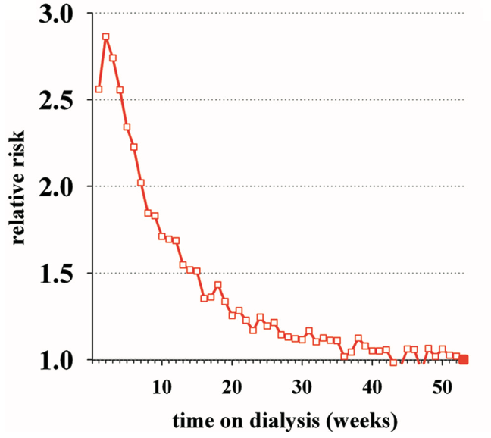
Impact of Sudden Cardiac Death: ESRD vs. Other Populations
Epidemiology of scd in hd patients
Annual Rates of Sudden Cardiac Death
ESRD
Heart Failure
Pre-Dialysis CKD
General Population
Prevalent 5%
Incident (first year) 7%
4%
Clin J Am Soc Nephrol 6 (11) 2642-2649, 2011
Approx 1%
<0.1%
Modified from Kidney Int 76(6):652-658, 2009
Modified from N Engl J Med 345: 1473-1482, 2001
Dialysis Core Curriculum 2021

Slide 8
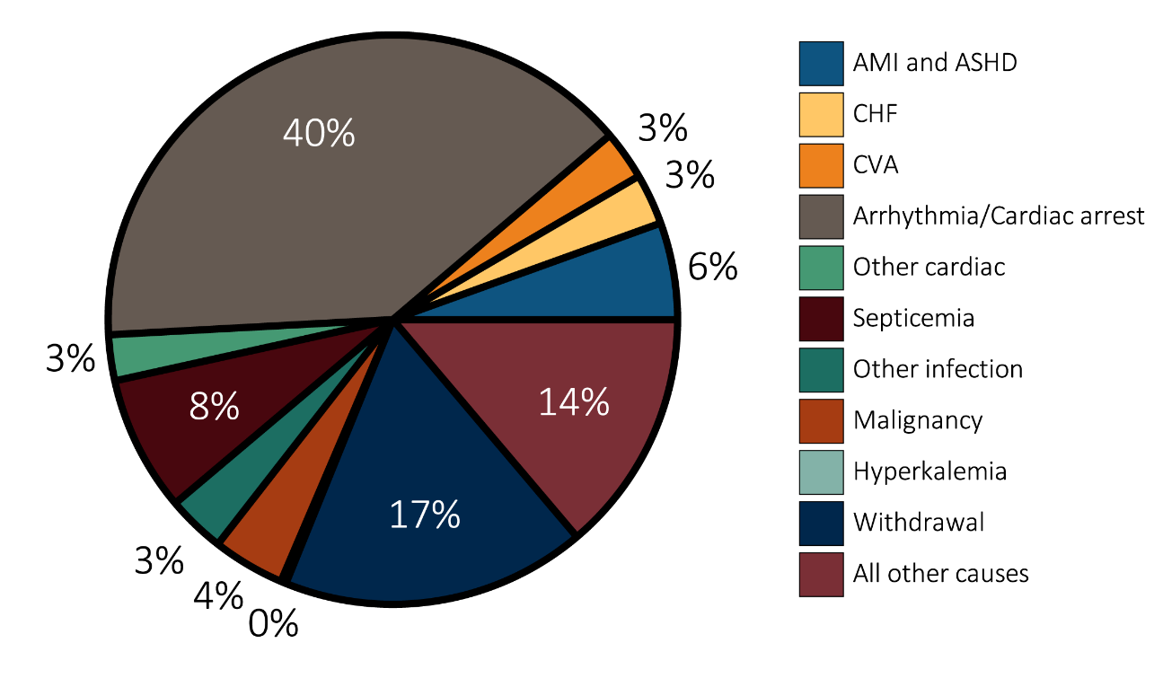
Sudden Death Is the Leading Cause of Death in Dialysis Patients
Epidemiology of scd in hd patients
Arrhythmia/Cardiac Arrest
Arrhythmia/Cardiac Arrest
1 of every 4 dialysis patients will die of sudden death
USRDS 2017: Vol 2 ESRD, Chapt 5 Mortality, Figure 5.4a, pg 345
Dialysis Core Curriculum 2021

Slide 9
Proportion of SCD: US vs. Worldwide
Modified from Clin J Am Soc Nephrol 7(5):765-774, 2012
Dialysis Core Curriculum 2021

Slide 10
Are Outcomes Improving over Time?
One Year Cardiovascular & Sudden Cardiac Mortality Rates in Prevalent Dialysis Patients.
14
12
10
Deaths per 100 pt-yrs
8
CV mortality
6
SCD mortality
96
97
98
99
00
01
02
03
04
05
06
07
08
09
10
11
12
13
14
Adapted from Am J Kidney Dis 71(1):123-132, 2018
Dialysis Core Curriculum 2021

Slide 11
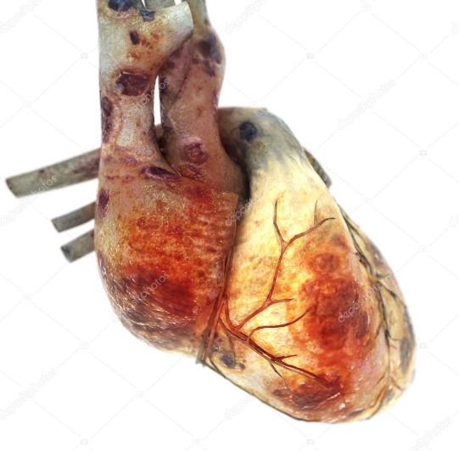
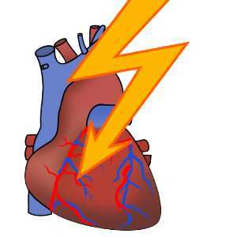
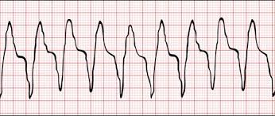
Abbreviations:
HFrEF= Heart failure with reduced ejection fraction
HFpEF= Heart failure with preserved ejection fraction
VT= Ventricular Tachycardia
CHD= Coronary Heart Disease
LVH= Left Ventricular Hypertrophy
Pathophysiology of SCD
Cardiomyopathy
Arrhythmic Trigger
Malignant Arrhythmias
+
=
SCD
General Population
HFrEF
Acute Coronary Syndrome
VT
Conventional CHD-related Risk Factors
Electrolyte disturbances
Dialysis-induced ischemia
Asystole
Bradyarrhythmia
VT
LVH
HFpEF
Nonconventional Risk Factors
Advanced CKD Population
Dialysis Core Curriculum 2021

Slide 12
Cardiovascular Risk Is Tied to Dialysis Schedule
Mortality and CV Events on Days of the Dialysis Week
32,000 US HD patients
32,000 US HD patients
Rate per 100 pt years
Adapted from N Engl J Med 365(12):1099-107, 2011
Dialysis Core Curriculum 2021

Slide 13
High Risks During Intradialytic and Pre-Dialytic Period
Sat→ Tues Fri→Mon
High risk within 12 hours of dialysis start
High risk in 12 hours preceding HD over dialysis-free weekend
Ratio observed: expected deaths
Hours from start of dialysis
Adapted from Kidney Int 69(12):2268-2273, 2006
Dialysis Core Curriculum 2021

Slide 14
The “Unphysiology” of Hemodialysis
A population of patients afflicted with
Coronary artery disease
Cardiomyopathy
Left ventricular hypertrophy
is subjected to
Excess
CV events
Long interdialytic periods characterized by gradual accumulation of uremic cardiotoxins
and is then subjected to
Hemodialysis treatments characterized by rapid correction of uremic toxins
Adapted from Kidney Int Suppl (2):30-34, 1975
Dialysis Core Curriculum 2021

Slide 15
Fluid management and scd risk
Cardiac Risks Associated with Dialytic Fluid Management
Inadequate volume removal → hypervolemia → HTN → LVH → heart failure
Rapid/Excessive Ultrafiltration → Intradialytic hypotension → myocardial injury
Cardiomyopathy
Arrhythmic Trigger
SCD
Dialysis Core Curriculum 2021

Slide 16
Rate of Fluid Removal During Dialysis Is Associated with Cardiovascular Mortality
2
Post hoc analysis of the HEMO study
1.8
CV mortality
UFR >13 ml/kg/hr
59% increase in overall mortality
71% increase in CV mortality
1.6
All-cause mortality
Adjusted Hazard Ratio
1.4
1.2
1
5
10
15
20
UFR (ml/h/kg)
Adapted from Kidney Int 79: 250-257, 2011
Dialysis Core Curriculum 2021

Slide 17
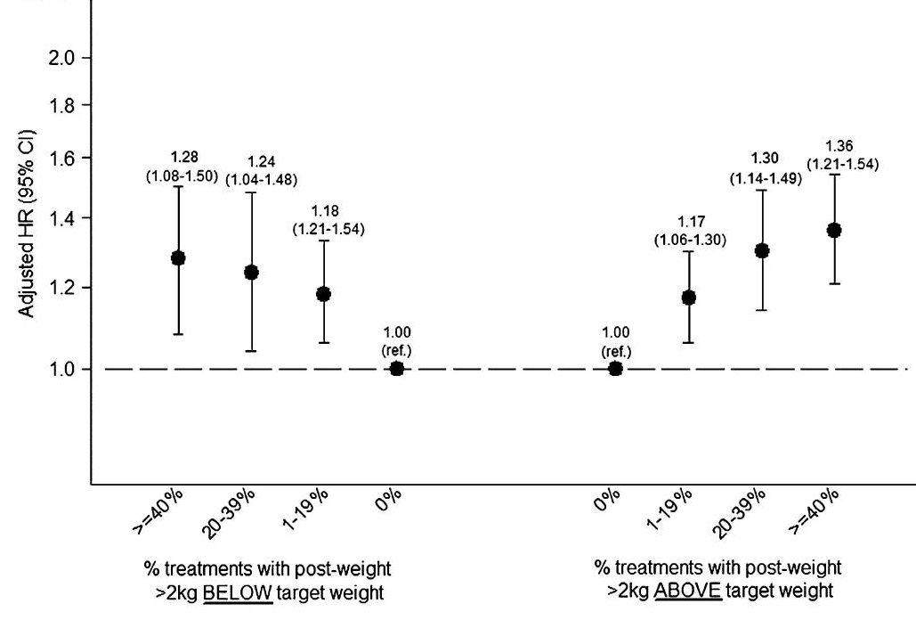
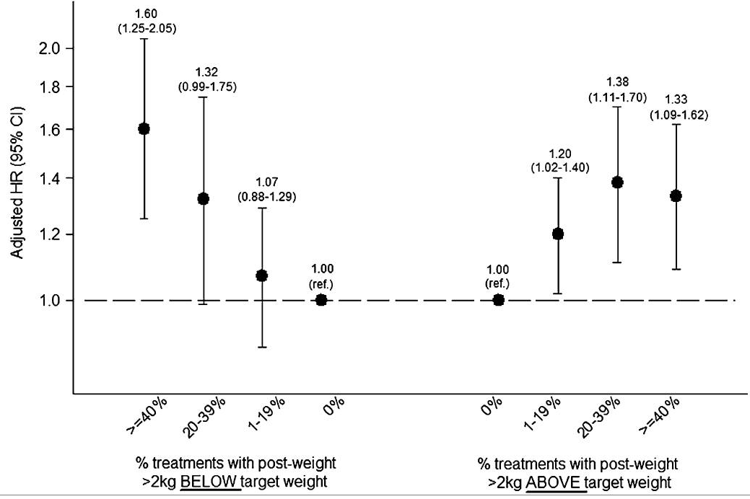
Association Between Failure to Achieve Target Weight and Mortality
30-day all-cause mortality
30-day CV mortality
N = 10,785 prevalent HD patients, 2005-2008
Examined % treatments in 30-day exposure period leaving 2 kg above target weight
Clin J Am Soc Nephrol 10(5):808-816, 2015
Dialysis Core Curriculum 2021

Slide 18
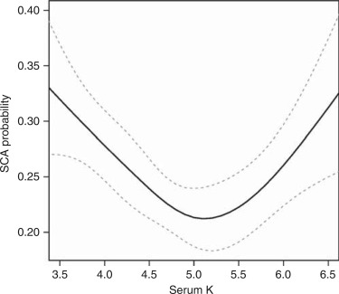
Serum Potassium Levels Are Strongly Linked to Risk of SCA in HD Patients
Pre-Dialysis Serum Potassium and SCA Risk
Risk linked to extremes of serum potassium (K⁺)
Lowest risk at K⁺ ~ 5.1
Probability of SCA
Modified from Kidney Int 79(2):218-227, 2011
Last measured serum K⁺
Dialysis Core Curriculum 2021

Slide 19
Larger Serum-Dialysate Gradients Result in Wider Serum K⁺ Swings During HD
Pre HD K⁺ 6.8, Dk 1.0
7
6
5
Serum Potassium (mEq/L)
4
Pre HD K⁺ 5.7, Dk 1.0
3
0
1
2
3
4
1
2
3
4
5
6
44
Hours from start of dialysis
Hours from end of dialysis
Modified from Nephrol Dial Transplant 12(8):1629-1634, 1997
Dialysis Core Curriculum 2021

Slide 20
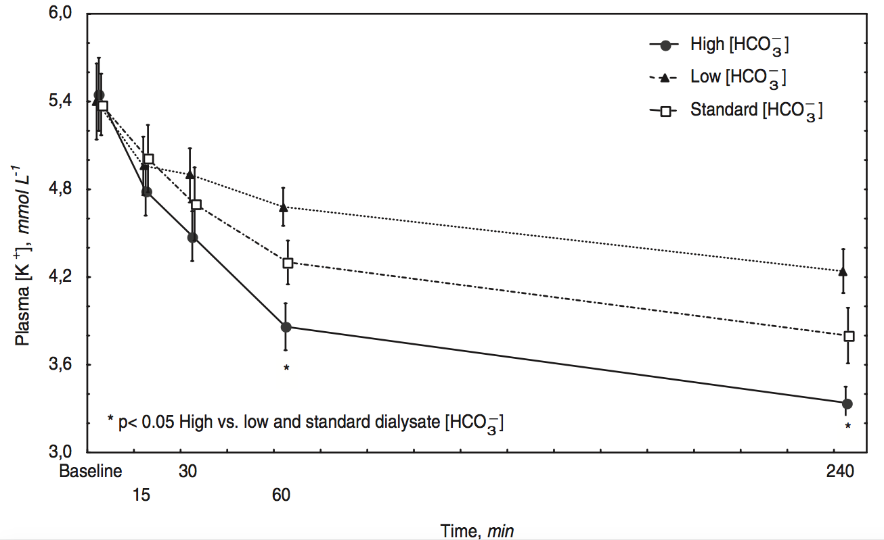
Higher Dialysate Bicarbonate Levels Are Associated with Greater Falls in Serum K⁺ Levels During HD
27 mEq/L
35 mEq/L
39 mEq/L
Modified from Nephrol Dial Transplant 20(3):591-597, 2005
Dialysis Core Curriculum 2021

Slide 21
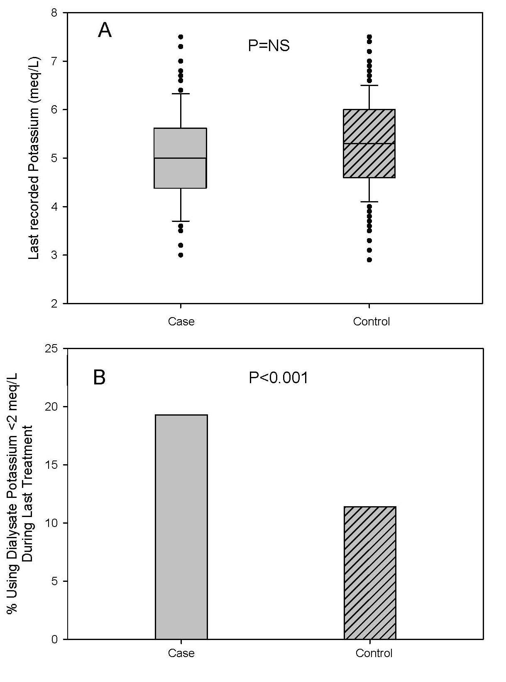
Low Dialysate Potassium and Peridialytic SCD
P=NS
20% of SCA pts on very low K dialysate at time of event (mostly 1K⁺)
Mean Predialysis plasma K⁺ was in the normal range (4.9 mEq/L)
SCA
Control
P<0.0001
SCA
Control
Modified from Kidney Int 79(2):218-227, 2011
Dialysis Core Curriculum 2021

Slide 22
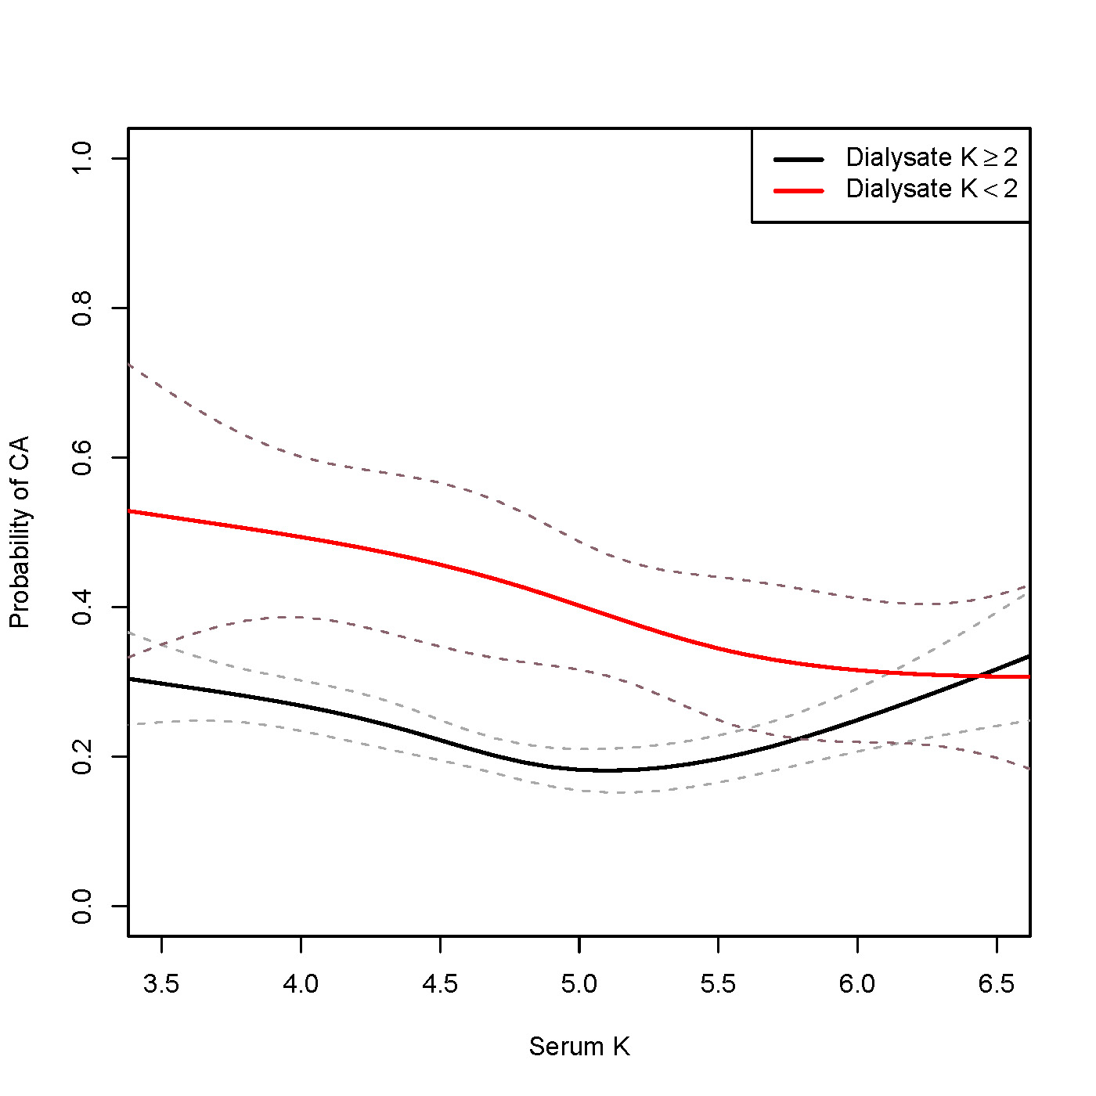
Is Low K⁺ Bath for Hyperkalemic Patients Harmful or Helpful?
Difference in risk between low and high K dialysate decreases as plasma K increases.
No indication of benefit for low K dialysate at any level of plasma K.
SCA probability
Last recorded serum potassium (mEq/L)
Modified from Kidney Int 79(2):218-227, 2011
Dialysis Core Curriculum 2021

Slide 23
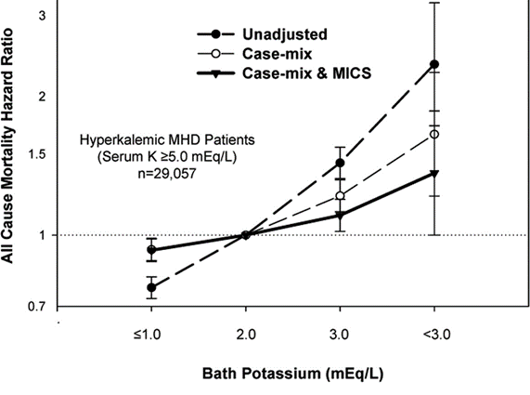
What About High Potassium Bath? Increased Mortality Risk of Dk>3 Among Hyperkalemic Patients
Plasma K⁺ ≥5.0 mEq/L
N=81,013
aHR=1.36 (1.02-1.86)
>3.0
Modified from Clin J Am Soc Nephrol 2(5):999-1007, 2007
Dialysis Core Curriculum 2021
Notes:
On the other hand, there is also some evidence that using HIGH dialysate potassium in hyperkalemic patients could also be detrimental. On contrast to the previous studies, this study by Kovesdy and colleagues of 80,000 Davita patients examined ALL CAUSE MORTALITY in relationship to plasma K and dialysate K assignment. Among patients who were hyperkalemic, patients treated with high K baths of 3 or greater had Increased mortality compared to 2 K after adjusting for nutritional factors and other covariates.

Slide 24
What About 2K⁺ vs. 3K⁺ bath? DOPPS N=55,183
2K⁺ vs. 3K⁺
All Cause Mortality: Adjusted OR 0.96 (0.91-1.01)
Arrhythmia composite outcome: OR 0.98 (0.88-1.08)
No interaction effect with predialysis serum potassium=
No evidence of significant difference in outcomes between 2K and 3K bath
Am J Kidney Dis 69(2)266, 2017
Dialysis Core Curriculum 2021

Slide 25
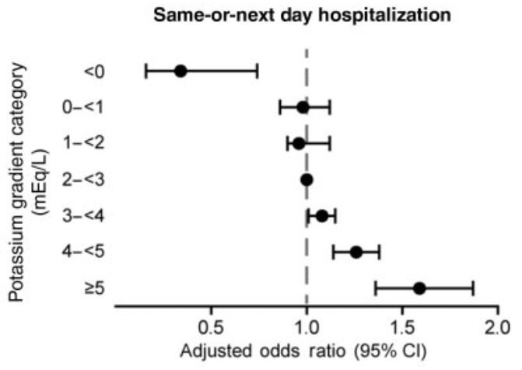
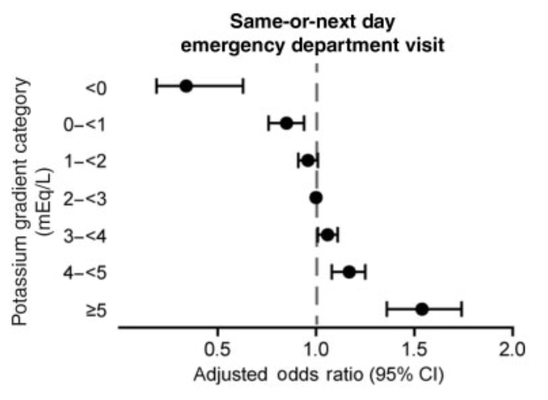
High Serum-Dialysate Potassium Gradient and Outcomes
62,388 HD patients 2010-2011
Serum-Dialysate gradient vs. Risk of Same-day/Next day hospitalization.
No 0 K⁺ dialysate
Dose response relationships between gradient and outcomes
No association with mortality
Adapted from Nephrol Dial Transplant 33(7): 1207-1214,2018
Dialysis Core Curriculum 2021

Slide 26
Summary: Serum and Dialysate K⁺
Mild predialysis hyperkalemia is not associated with worse outcomes.
No randomized controlled studies to guide therapy, only observational data which could be confounded.
Observational studies consistently identify harm with Dk<2 with normal or low predialysis potassium.
Observational studies consistently identify harm with Dk>3 with normal or high predialysis potassium.
No convincing evidence that Dk 2 is better than 3.
No convincing evidence that Dk<2 is necessarily harmful or beneficial for patients with hyperkalemia; however, concern for larger serum-dialysate potassium gradient.
Dialysis Core Curriculum 2021

Slide 27
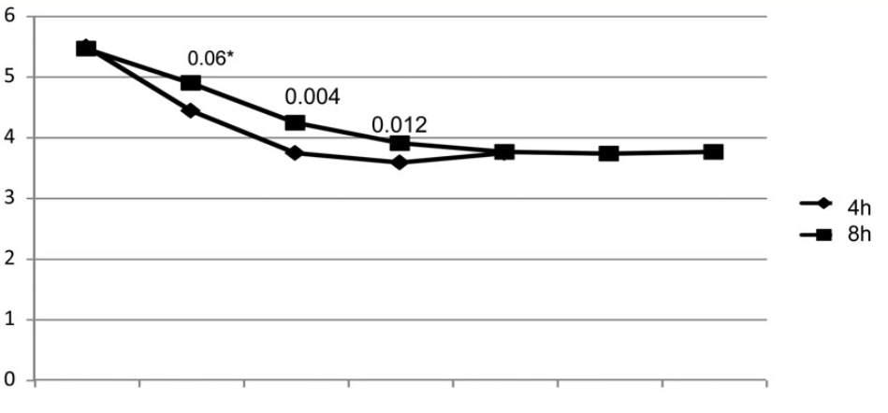
Dialytic Approaches to Reduce Intradialytic Potassium Swings and Hyperkalemia: Extended/Frequent Dialysis
Cross-over study
4 hr vs. 8 hr
Pair matched for total UF, dialysate K and dialysate volume
Slower rate of potassium fall
15% overall increase in total potassium removal
Identical end-of treatment serum K
Serum Potassium (mEq/L)
1
2
3
4
5
6
7
Time (hours)
Adapted from Nephrol Dial Transplant 30(3):505-513, 2015
Dialysis Core Curriculum 2021

Slide 28
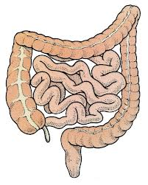
Non-Dialytic Approaches: Modulating Colonic Secretion
RAAS inhibitors may have effects on [K⁺] in anuric patients via colonic AT1 receptors
Fludrocortisone not effective in decreasing [K⁺] in a RCT.
Polystyrene-based potassium binding resins reduce K⁺ in HD patients but utility limited by poor long-term adherence and tolerability
Treatment with daily bisacodyl is associated with significant reduction in K⁺ (5.9 to 5.5 mEq/L)
Novel Potassium Binding agents: No large-scale studies in HD patients, but data from CKD trials and small HD studies promising.
Am J Med 112(2):110-114, 2002
Am J Kidney Dis 47(5):809-814, 2006
Ren Fail 35(2):185-188, 2013
Nephrol Dial Transplant 18(2):341-347, 2003
JAMA 314(2):151-161, 2015
N Engl J Med 372(3):222-231, 2015
Dialysis Core Curriculum 2021
Notes:
We have another organ which can secrete potassium and that is the colon, and secretory activity is actually enhanced in ESRD. Another way to optimize potassium homeostasis is to use the increase colonic secretion potassium. There are numerous ways that colonic secretion could be modulated in dialysis patients. Patiromer/sodium zirconium cryosilicate are two novel potassium binding agents which have been tested in large scale studies in CKD patients, but none so far in HD patients but early small HD studies appear to be promising.

Slide 29
Dialysate Adjustment Protocol Approach to Avoid Dialysate Mismatch
Risks associated with hyperkalemia management
Hyperkalemia: Bad (greatest risk K>5.5)
Low K Bath/High Serum-Dialysate gradient: Probably Bad
Mismatched Serum/Dialysate Assignment: Worst!
Dialysis Core Curriculum 2021

Slide 30
Protocol Approach to Avoid Dialysate Mismatch
Involve renal dieticians in reviewing serum/dialysate potassium levels for potential mismatches.
Establish an adjustment protocol based on serum K⁺ values.
Distinguish typical vs. atypical changes in potassium–one–off change in bath treatment vs. permanent change.
After initial adjustments in first 3 months, new steady state was reached and only 4% of patients required bath adjustment.
Hemodial Int 20(4):573-579, 2016
Dialysis Core Curriculum 2021

Slide 31
Proposed Dialysate Adjustment Algorithms
 | Pre-Dialysis Potassium Level (mEq/L)
 | <4 | 4.1-5.5 | 5.6-6.4 | >6.5 | Comments
"Rule of 7" | 4 mEq/L | 3 or 2 mEq/L | 1 mEq/L | 1 or 0 mEq/L | Potential for large serum-dialysate gradients; Potential for large mismatches without frequent follow-up of serum potassium values.
Lee and Mendelsohn Hemodialysis Int 2015 | Increase dialysate by 1 to max of 4 | Increase dialysate by 1 to max of 3 | 2 mEq/L | 2 mEq/L; Consider longer dialysis treatment time or frequent HD | Targets avoidance of low K dialysate; found to result in only 4% of patients requiring dialysate potassium changes after using algorithm for 5 months.
Abuelo Semin Dial 2015 | Increase dialysate by 1 to max of 4 | Maintain current dialysate potassium level | Lower dialysate K by 1 mEq to minimum of 0 K ; consider other potassium lowering medications. |  | Targets avoidance of hyperkalemia.
Pun and Middleton JASN 2017 | 3 mEq/L Increase to 4 if persistent Sk<3.5. Adjust dialysate Mg and HCO3 | 2 mEq/L | 2 mEq/L Add potassium binder Dietary Counseling Lengthen Treatment Last Resort: Use 1 mEq/L |  | Increase potassium monitoring to q week when utilizing Dk >3 and <2, and when Sk <3.5 and >6.5.
Hemodial Int 20(4):573-579, 2016
Semin Dial 28(3):266-275, 2015
J Am Soc Nephrol 28(12):3441-3451, 2017
Dialysis Core Curriculum 2021

Slide 32
Dialysate Calcium and SCD risk
QTc Interval Prolongation with Changes in Calcium During Dialysis
100
R = 0.62
P< 0.001
80
60
40
QTc msec delta
20
0
-20
-40
-60
-0.2
0
0.2
0.4
0.6
Ca ²⁺ mmol/L delta
Modified from Europace 10(6):771-777, 2008
Dialysis Core Curriculum 2021

Slide 33
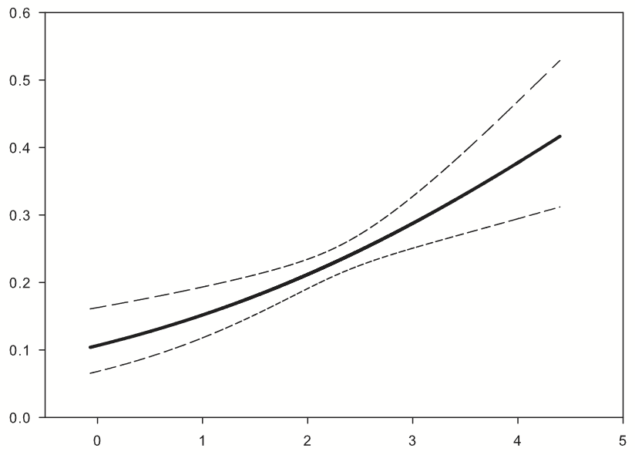
Low Calcium Dialysate Associates with Increased Risk of SCD
Matched Case Control Study of 2100 patients
50% Increase in SCA risk with dialysate calcium <2.5 mEq/L
Risk rises incrementally with increasing serum: dialysate gradient
aOR=1.83 (1.4-2.5) per 1 mmol/L increase in gradient
Probability of Sudden Death
Clin J Am Soc Nephrol 8(5):797-803, 2013
Ca ²⁺ mmol/L gradient
Dialysis Core Curriculum 2021

Slide 34
General Management of SCD
Other strategies to reduce SCD risk
Prevent sudden cardiac arrest
Medical therapies to treat underlying cardiac disease
Reduce exposure to triggers (attention to dialysis-specific factors)
Improve survival following SCA
Defibrillation
CPR
Dialysis Core Curriculum 2021

Slide 35
Medical Therapies for SCD Prevention: Beta Blockers
MEDICATION MANAGEMENT AND SCD RISK
Beta blockers shown to be helpful for prevention in patients with minimal or no CKD.
Poor Implementation: Only 24% of dialysis patients with CAD or prior MI are on beta blockers.
Only one randomized trial of beta-blockers in ESRD.
114 patients with DCM randomized to Carvedilol or placebo
Significant survival advantage: non-significant reduction (24%) in SCD
J Am Coll Cardiol 41:1438-1444, 2003
Dialysis Core Curriculum 2021

Slide 36
QT Prolongation and Medications
QT prolonging Medications and SCD risk
QT prolongation is also a dangerous toxicity of some medications and can lead to SCD.
QT prolongation is one of the most common reasons cited by the Food and Drug Administration (FDA) for medication restriction or market withdrawal, impacting >9 medications since 1990.
Common medications implicated include macrolides, quinolones, and SSRIs and other antidepressants.
Dialysis Core Curriculum 2021

Slide 37
Prescription of SSRI with Higher QT Prolonging Potential Associated with Increased SCD Risk
65,654 HD patients treated with (selective serotonin reuptake inhibitors) SSRIs.
SSRI users treated with citalopram/escitalopram had 18% increased risk of SCD compared to patients treated with lower QT prolonging SSRis.
Warrants attention to prescription of QT prolonging medications, especially among those with other risk factors for SCD.
J Am Soc Nephrol 30:611-623, 2019
Dialysis Core Curriculum 2021

Slide 38
No Evidence to Support Primary Prevention ICD in Dialysis Patients with EF>35
Defibrillators and SCD in HD patients
Prophylactic ICDs are guideline recommended for patients with EF≤35.
ICD2 trial (2019) enrolled 188 prevalent HD+PD patients with EF>35% to receive ICD or usual care.
No difference in SCD or survival after 6.8 years median follow-up.
Circulation 139(23):2628-2638, 2019
Dialysis Core Curriculum 2021

Slide 39
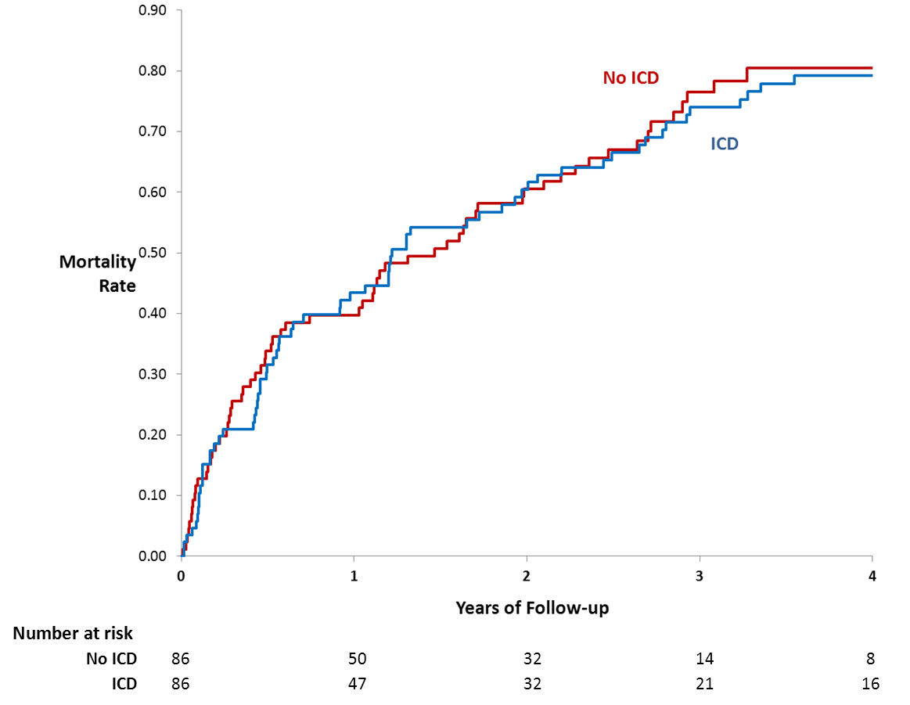
No Evidence to Support Primary Prevention ICD in Dialysis Patients with EF≤35
No trial data to inform
Retrospective Matched cohort study
Dialysis patients in ICD registry vs. EF and propensity-matched patients in GWTG-HF registry
HR=0.94 (95% CI 0.67-1.31)
Log-rank P=0.71
1-yr mortality 40%
3-yr mortality 75%
Modified from Nephrol Dial Transplant 30(5):829-835, 2015
Dialysis Core Curriculum 2021

Slide 40





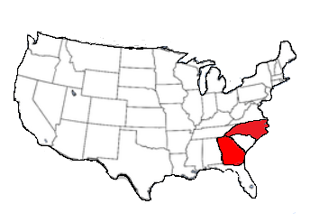


When Staff Provide Immediate CPR After Cardiac Arrest in Dialysis Clinics, Outcomes Are Improved
CPR in dialysis clinics and outcomes
METHODS
OUTCOMES
CPR Initiated by
Adjusted Odds Ratio
(95% CI)
CARES Outpatient Cardiac Arrest Registry 2010 - 2016
81%
Survival to hospital discharge
2.89
(1.18-6.97)
HD Staff
vs
N = 398
Cardiac Arrests in HD clinic
19%
3.15
(1.11-8.92)
Southeastern US
158 HD clinics
911 Responder
Favorable Neurologic Status
CONCLUSION
Dialysis staff-initiated CPR was associated with a large increase in survival but was only performed in 81% of cardiac arrest events.
J Am Soc Nephrol 30: 461–470, 2019
Dialysis Core Curriculum 2021

Slide 41
Summary: Management of SCD Risk in HD
Cardiomyopathy
Arrhythmic Trigger)
Malignant Arrhythmias
+
=
SCA
Electrolyte Disturbances
Dialysis-induced Ischemia
LVH
HFpEF
Asystole
Bradyarrhythmia
VT
Nonconventional Risk Factors
Advanced CKD Population
Minimize IDWG
Individualized Na
Prolonged/Frequent Treatment
Cool dialysate
Beta blockers?
Avoid low K dialysate/Tailor dialysate K
Minimize UFR
Prolonged/Frequent Treatment
Avoid higher QT prolonging medications when possible
Review capabilities, training and protocols for dialysis clinic resuscitation
Dialysis Core Curriculum 2021

Slide 42
references
Chan KE, Maddux FW, Tolkoff-Rubin N, Karumanchi SA, Thadhani R, Hakim RM: Early outcomes among those initiating chronic dialysis in the United States. Clin J Am Soc Nephrol 6 (11) 2642-2649, 2011
Pun PH, Smarz TR, Honeycutt EF, Shaw LK, Al-Khatib SM, Middleton JP: Chronic kidney disease is associated with increased risk of sudden cardiac death among patients with coronary artery disease. Kidney Int 76(6):652-658, 2009
Huikuri HV, Castellanos, Myerburg RJ: Sudden Death Due to Cardiac Arrhythmias. N Engl J Med 345: 1473-1482, 2001
USRDS Annual Data Report 2017: Volume 2 End Stage Renal Disease, Chapter 5 Mortality Report. Figure 5.4a, pg 345
Jadoul M, Thumma J, Fuller DS, Tentori F, Li Y, Morgenstern H, et al: Modifiable practices associated with sudden death among hemodialysis patients in the Dialysis Outcomes and Practice Patterns Study. Clin J Am Soc Nephrol 7(5):765-774, 2012
Wetmore JB, Li S, Molony JT, Guo H, Herzog CA, Gilbertson DT, Peng Y, Collins AJ: Insights From the 2016 Peer Kidney Care Initiative Report: Still a Ways to Go to Improve Care for Dialysis Patients. Am J Kidney Dis 71(1):123-132, 2018
Foley RN, Gilbertson DT, Murray T, Collins AJ: Long interdialytic interval and mortality among patients receiving hemodialysis. N Engl J Med 365(12):1099-107, 2011
Bleyer AJ, Hartman J, Brannon PC, Reeves-Daniel A, Satko SG, Russell G: Characteristics of sudden death in hemodialysis patients. Kidney Int 69(12):2268-2273, 2006
Kjellstrand CM, Evans RL, Petersen RJ, Shideman JR, von Hartitzsch B, Buselmeier TJ: The "Unphysiology" of Dialysis: A Major Cause of Dialysis Side Effects? Kidney Int Suppl (2):30-34, 1975
Flythe JE, Kimmel SE, Brunelli SM: Rapid fluid removal during dialysis is associated with cardiovascular morbidity and mortality. Kidney Int 79(2):250-257, 2011
Flythe JE, Kshirsagar AV, Falk RJ, Brunelli SM: Associations of Posthemodialysis Weights above and below Target Weight with All-Cause and Cardiovascular Mortality. Clin J Am Soc Nephrol 10(5):808-816, 2015
Pun PH, Lehrich RW, Honeycutt EF, Herzog CA, Middleton JP: Modifiable risk factors associated with sudden cardiac arrest within hemodialysis clinics. Kidney Int 79(2):218-227, 2011
.
Dialysis Core Curriculum 2021

Slide 43
references
Heguilén RM, Sciurano C, Bellusci AD, Fried P, Mittelman G, Rosa Diez G, Bernasconi AR: The faster potassium-lowering effect of high dialysate bicarbonate concentrations in chronic haemodialysis patients. Nephrol Dial Transplant 20(3):591-597, 2005
Kovesdy CP, Regidor DL, Mehrotra R, Jing J, McAllister CJ, Greenland S, Kopple JD, Kalantar-Zadeh K: Serum and dialysate potassium concentrations and survival in hemodialysis patients. Clin J Am Soc Nephrol 2(5):999-1007, 2007
Karaboyas A, Zee J, Brunelli SM, Usvyat LA, Weiner DE, Maddux FW, et al: Dialysate Potassium, Serum Potassium, Mortality, and Arrhythmia Events in Hemodialysis: Results From the Dialysis Outcomes and Practice Patterns Study (DOPPS). Am J Kidney Dis 69(2)266, 2017
Brunelli SM, Spiegel DM, Du Mond C, Oestreicher N, Winkelmayer WC, Kovesdy CP: Serum-to-dialysate potassium gradient and its association with short-term outcomes in hemodialysis patients. Nephrol Dial Transplant 33(7): 1207-1214,2018
Basile C, Libutti P, Lisi P, Teutonico A, Vernaglione L, Casucci F, Lomonte C: Ranking of factors determining potassium mass balance in bicarbonate haemodialysis. Nephrol Dial Transplant 30(3):505-513, 2015
Knoll GA, Sahgal A, Nair RC, Graham J, van Walraven C, Burns KD: Renin-angiotensin system blockade and the risk of hyperkalemia in chronic hemodialysis patients. Am J Med 112(2):110-114, 2002
Kaisar MO, Wiggins KJ, Sturtevant JM, Hawley CM, Campbell SB, Isbel NM, et al: A randomized controlled trial of fludrocortisone for the treatment of hyperkalemia in hemodialysis patients. Am J Kidney Dis 47(5):809-814, 2006
Chaaban A, Abouchacra S, Gebran N, Abayechi F, Hussain Q, Al Nuaimi N, Hassan ME: Potassium Binders in Hemodialysis Patients: A Friend or Foe? Ren Fail 35(2): 185-188, 2013
Mathialahan T, Sandle GI: Dietary potassium and laxatives as regulators of colonic potassium secretion in end-stage renal disease. Nephrol Dial Transplant 18(2):341-347, 2003
Bakris GL, Pitt B, Weir MR, Freeman MW, Mayo MR, Garza D, Stasiv Y, Zawadzki R, Berman L, Bushinsky DA; AMETHYST-DN Investigators: Effect of Patiromer on Serum Potassium Level in Patients With Hyperkalemia and Diabetic Kidney Disease: The AMETHYST-DN Randomized Clinical Trial. JAMA 314(2):151-161, 2015
.
Dialysis Core Curriculum 2021

Slide 44
references
Packham DK, Rasmussen HS, Lavin PT, El-Shahawy MA, Roger SD, Block G, Qunibi W, Pergola P, Singh B: Sodium zirconium cyclosilicate in hyperkalemia. N Engl J Med 372(3):222-231, 2015
Lee J, Mendelssohn DC: Optimizing dialysate potassium. Hemodial Int 20(4):573-579, 2016
Abuelo JG: Low dialysate potassium concentration: an overrated risk factor for cardiac arrhythmia? Semin Dial 28(3):266-275, 2015
Pun PH, Middleton JP: Dialysate Potassium, Dialysate Magnesium, and Hemodialysis Risk. J Am Soc Nephrol 28(12):3441-3451, 2017
Genovesi S, Dossi C, Viganò MR, Galbiati E, Prolo F, Stella A, Stramba-Badiale M: Electrolyte concentration during haemodialysis and QT interval prolongation in uraemic patients. Europace 10(6):771-777, 2008
Pun PH, Horton JR, Middleton JP: Dialysate calcium concentration and the risk of sudden cardiac arrest in hemodialysis patients. Clin J Am Soc Nephrol 8(5):797-803, 2013
Cice G, Ferrara L, D'Andrea A, D'Isa S, Di Benedetto A, Cittadini A, et al: Carvedilol increases two-year survivalin dialysis patients with dilated cardiomyopathy: a prospective, placebo-controlled trial. J Am Coll Cardiol 41:1438-1444, 2003
Assimon MM, Brookhart MA, Flythe JE: Comparative Cardiac Safety of Selective Serotonin Reuptake Inhibitors among Individuals Receiving Maintenance Hemodialysis. J Am Soc Nephrol 30:611-623, 2019
Jukema JW, Timal RJ, Rotmans JI, Hensen LCR, Buiten MS, de Bie MK, ICD2 Trial Investigators, et al: Prophylactic Use of Implantable Cardioverter-Defibrillators in the Prevention of Sudden Cardiac Death in Dialysis Patients. Circulation 139(23):2628-2638, 2019
Pun PH, Hellkamp AS, Sanders GD², Middleton JP, Hammill SC, Al-Khalidi HR, et al: Primary prevention implantable cardioverter defibrillators in end-stage kidney disease patients on dialysis: a matched cohort study. Nephrol Dial Transplant 30(5):829-835, 2015
Pun PH, Dupre ME, Starks MA, Tyson C, Vellano K, Svetkey LP, et al, CARES Surveillance Group: Outcomes for Hemodialysis Patients Given Cardiopulmonary Resuscitation for Cardiac Arrest at Outpatient Dialysis Clinics. J Am Soc Nephrol 30:461–470, 2019
.
Dialysis Core Curriculum 2021

