Slide 1
Basic Principles of Uremic Toxicity and Uremic Toxin Removal: Small Water Soluble Compounds
Dialysis Core Curriculum 2021
Raymond C. Vanholder, MD, PhD
University Hospital Ghent Belgium

Slide 2
Raymond C. Vanholder
Disclosures
Consultancy: Nextkidney Project; Kibow; Jafron; BBraun; Baxter Healthcare; Fresenius Medical Care
Scientific Advisor/Membership: European Kidney Health Alliance; International Scientific Advisory Board Dutch Kidney Foundation; J Am Soc Nephrol; Nephrol Dial Transplant; NRN Reviews Nephrol
Dialysis Core Curriculum 2021

Slide 3
Learning Objectives
State a number of small water soluble compounds
Describe their pathophysiologic effects
Describe their kinetic behavior
Discuss the validity (or not) of Kt/V urea
Explain how removal of small water soluble compounds other than urea can be influenced
Dialysis Core Curriculum 2021

Slide 4
Small Water Soluble Compounds
Guanidino compounds
Asymmetric Dimethylamine
Symmetric dimethylamine
Creatinine
Guanidines
Phenylacetylglutamate
Oxalate
Myoinositol
Spermine
Spermidine
Trimethylamine-N-oxide
Urea
Uric acid
Xanthine
Hypoxanthine
Dialysis Core Curriculum 2021
Notes:
These are a few examples of small water soluble compounds. The list is not exhaustive. For a more complete list the reader is referred to Toxins, 10, 33, 2018.

Slide 5
Urea
Urea is a classical marker of uremic toxicity and removal by dialysis, but also because some exciting new data on this solute have been generated.
Dialysis Core Curriculum 2021

Slide 6
Effect of Increasing Dialysate Urea
Urea generally was considered as a relatively inert molecule on the biological level. In a classical >40-year-old study from the Mayo Clinic, the authors added urea to the dialysate at a level exceeding the maxima reached pre-dialysis by a factor of 2, and dialyzed in this way a group of patients for 3 consecutive months. One can see the urea concentrations, that went up after the first dialysis sessions and then stabilized at a high level, until after three months dialysis was again performed without urea. Creatinine in contrast did not change. The authors meticulously followed during these three months of high urea dialysis uremic symptoms and scored them in function of their intensity as 0, 1, 2, or 3. It is clear that there is no relation between uremic symptoms and urea concentration, suggesting no marked clinical activity of this molecule.
Mayo Clin Proc, 47, Johnson et al., Effects of urea loading in patients with far-advanced renal failure, 21-29.
Dialysis Core Curriculum 2021

Slide 7
Urea Disrupts Intestinal Wall Protective Barrier
However, some recent data seem to suggest that urea, at concentrations as occurring in uremia, nevertheless exerts biological activity. In a study from Vaziri et al, urea was added to intestinal cell monolayers and the transepithelial electrical resistance was assessed as a proxy of the efficacy of the intestinal wall barrier. A decrease of resistance corresponds to a loss of barrier function, and the latter in its turn corresponds to an increase in permeability for intestinal lumen contaminants like lipopolysaccharide (endotoxin). This in vitro study shows a dose responsive loss of barrier function in the presence of urea. As this mechanism could be at the origin of more transfer of lipopolysaccharide into the body, this is a potentially pro-inflammatory component.
Vaziri et al, Am J Nephrol, 37: 1-6; 2013
Dialysis Core Curriculum 2021

Slide 8
Urea Induces Insulin Resistance
In a study from D’Apolito et al, urea was added to adipocytes to study the response to insulin (glucose transport). If insulin is added in absence of urea, glucose transport is standardized at 100%. If next to insulin also urea is added, however, the response is severely blunted and almost identical to experiments in absence of insulin. When next to insulin mannitol is added in stead of urea to obtain the same molar concentration as with urea, response to insulin is normal (100%). The data point to insulin resistance in the presence of urea. Insulin resistance in its turn has been linked to cardio-vascular morbidity and mortality.
Urea causes decreased insulin sensitivity in differentiated 3T3L1 adipocytes.
D’Apolito et al, J Clin Invest, 120: 203-213; 2010

Slide 9
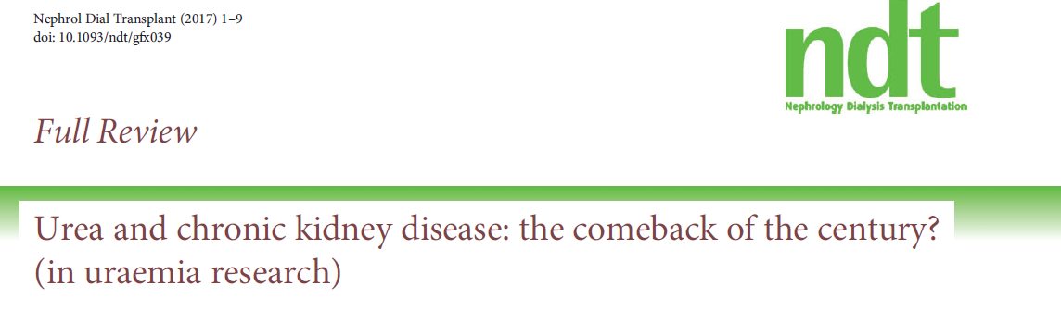
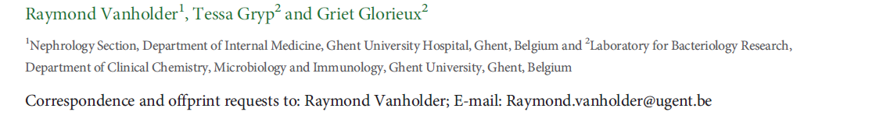
Apart from the two examples shown in the slides before, several other experimental studies showed toxicity of urea at concentrations identical to those observed in uremia, as summarized in this review.
Vanholder et al, NDT, 33, 4-12, 2018
Dialysis Core Curriculum 2021

Slide 10
Toxic Effects of Urea
Vanholder et al in Nephrology Dialysis Transplantation summarizes all available studies in which urea exerts toxic biologic effects, either in vitro or in vivo, in animal studies. Also the affected biological/biochemical systems are summarized. Many of these effects relate to inflammation and cardio-vascular morbidity and moretality. However, none of these data has up until today been corroborated by controlled clinical data.
Vanholder et al, NDT, 33, 4-12, 2018
Dialysis Core Curriculum 2021

Slide 11
Urea Exerts Toxic Effects at Uremic Concentrations
Apart from the direct toxic effects of urea, there are also indirect effects. Vandholder et al in Nephrology Dialysis Transplantation illustrates the various pathways, through which urea could be toxic. The direct pathway has also been summarized in the previous slide. Next to this, there are also two indirect pathways. One pathway goes via cyanate (for which there are also other sources than urea, like smoking) and carbamylation. The toxicity of carbamylation products is discussed more in depth in part 4 of this series, on middle molecules. The second axis goes via intestinal ammonia production which affects the intestinal protective barrier. All pathways lead to cardiovascular damage and progression of CKD. Again, however, there ar no controlled clinical data corroborating the several elements of this flowchart.
Vanholder et al, NDT, 33, 4-12, 2018
Dialysis Core Curriculum 2021

Slide 12
Transport of Urea and Analogues via Erythrocye Cell Wall
Even if urea would, in contrast to what was accepted before, exert toxic effects, then still its removal (which is frequently used to define dialysis adequacy via the determination of Kt/Vurea) remains a not really appropriate marker of the removal of other uremic solutes for the reason as illustrated on this slide: whereas cell wall permeability is high for urea (corresponding to almost no resistance), meaning that the removal of urea from the intracellular compartment is almost as quick as that from the plasma, most other molecules are subject to substantially less permeability and more resistance, even if they are, just like urea, small and water soluble. Guanidine, the molecule entirely at the bottom of the list of solutes in this slide, is a solute with similar molecular weight and origin as urea, but transcellular resistance is markedly higher and cell permeability virtually nil resulting in multicompartmental behavior and hence more difficult removal by dialysis as compared to urea (the toxicity and kinetics of guanidino compounds will be illustrated a bit further in this presentation).
Zhao et al., Biochim Biophys Acta, 1768
Dialysis Core Curriculum 2021

Slide 13
Solute Concentration Correlates with Renal Function and Protein Intake (Not Kt/V)
Solute | Covariates / R² full model
Urea | nPCR / 0.850
Crea | nPCR / 0.150
Uric acid | nPCR/ 0.195
beta-2-microglobulin | nPCR/ 0.172
Hippuric acid | nPCR/ 0.187 | nPCR / 0.220
Indoxyl sulfate | nPCR / 0.059
p-cresylsulfate | nPCR/ 0.268
p-cresylglucuronide | RRF/ 0.134 | nPCR / 0.151
Free hippuric acid | RRF / 0.206
Free indoxyl sulfate | RRF / 0.144
Free indole acetic acid | RRF / 0.166
Free p-cresylsulfate | nPCR/ 0.189 | RRF / 0.257
Free p-cresylglucuronide | RRF/ 0.135 | nPCR / 0.150
Model: age, gender, nPCR, Kt/V, RRF, diabetes, body weight, vintage
Eloot et al, Plos One,8,
e76838, 2013
Dialysis Core Curriculum 2021
Notes:
In this study, various factors with potential impact on uremic solute concentration [age, gender, protein intake (nPCR), residual renal function (RRF), diabetes, body weight, and dialysis vintage] were correlated to the pre-dialysis concentration of a large number of retention solutes, but significant correlations were found only for protein intake and residual renal function, not for Kt/Vurea, the traditional marker of dialysis adequacy, based on intra-dialytic urea removal. These data suggest that rather than dialysis adequacy as assessed by Kt/Vurea, other factors weigh at least as much on uremic solute concentration.

Slide 14
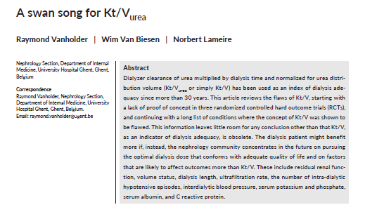
Is Kt/Vurea a Valid Marker of Dialysis Adequacy?
Thus the question arises whether Kt/Vurea is a valid marker of dialysis adequacy. This review article contains lists of examples where Kt/V as a dialysis marker appeared to be inadequate. As the abstract states: “This article … (contains) a long list of conditions where the concept of Kt/V was shown to be flawed” and that “The nephrology community (would better concentrate) … (on other parameters) that conform(s) with adequate quality of life and on factors that are (more) likely to affect outcomes than Kt/V”. These might include: residual kidney function, volume status, dialysis length, ultrafiltration rate, the number of intra-dialystic hypotensive episodes, interdialytic blood pressure, serum potassium and phosphate, serum albumin, and C reactive protein.
Vanholder et al, Semin Dial, 32, 424-437, 2019
Dialysis Core Curriculum 2021

Slide 15
Is Kt/Vurea a Valid Marker of Dialysis Adequacy?
In Seminars in Dialysis, Vanholder et al’s table contains all studies in which Kt/Vurea did not fit with concentration or removal of other uremic toxins. This list contains as well small water soluble compounds as protein bound compounds and middle molecules.
Likewise, a second table shows all the studies in which Kt/Vurea did not correlate with (mostly hard) outcomes.
Vanholder et al, Semin Dial, 32, 424-437, 2019
Dialysis Core Curriculum 2021

Slide 16
ADMA + SDMA Guanidino Compounds
Asymmetric dimethyl arginine (ADMA) and symmetric dimethyl arginine (SDMA) are also small water soluble compounds. They belong to the larger group of guanidino compounds, of which also several other compounds such as creatinine, creatine and several guanidine congugates are part.
Dialysis Core Curriculum 2021

Slide 17
ADMA Concentration Is Linked to Mortality
ADMA has repeatedly been associated with negative cardio-vascular outcomes. In a study by Zoccali et al, each rise in ADMA concentration is associated with higher mortality.
Zoccali et al. Lancet 358: 2113-2115, 2001
Dialysis Core Curriculum 2021

Slide 18
ADMA Has a Marked Hemodynmic Effect in Healthy Volunteers
This is very likely related to the cardio-vascular impact of ADMA. ADMA is an inhibitor of Nitric Oxide (NO) synthase, which as such is a protector of the endothelium and its function. Inhibition of NO-synthase is damaging the endothelium. The hemodynamic impact of ADMA is clearly demonstrated in a Kielstein et al study on healthy volunteers, in which ADMA was infused intravenously to obtain plasma concentrations comparable with those observed in uremia. During infusion of ADMA, Cardiac Output decreased and Systemic Vascular Resistance (SVR) increased. This effect was maintained for more than 2 hours after ADMA infusion had been stopped.
Kielstein et al. Circulation 109: 172-177, 2004
Dialysis Core Curriculum 2021

Slide 19
SDMA Induces In Vitro Cytokine Generation
Although both ADMA and SDMA are structurally comparable with only minimal steric differences, SDMA, in contrast to ADMA, was for a long time considered as biologically inert (non-toxic). However, the in vitro impact of SDMA at concentrations like observed in uremia induces intracellular monocyte cytokine generation, which was observed for both TNFα and Il-6, confirming with a pro-inflammatory impact.
Schepers et al, CJASN, 6, 2374-2383, 2011
Dialysis Core Curriculum 2021

Slide 20
SDMA Is More Strongly Correlated with Cytokine Concentration than ADMA
In a Schepers et al clinical study, this in vitro suggestion of a pro-inflammatory potential for SDMA is corroborated by showing a strong correlation of SDMA concentration with both plasma TNF-α and IL-6. Of note, the correlation for ADMA was substantially weaker.
Schepers et al, CJASN, 6, 2374-2383, 2011
Dialysis Core Curriculum 2021

Slide 21
Most Guanidines Are Distributed over a Larger Compartment than Urea
Thus the question arises, in how far urea, which like the guanidines is a small water soluble compound with the same metabolic origin, has the same compartmental distribution and kinetics. To check this question, in an analysis by Eloot et al, kinetics of guanidino compounds were compared to those of urea, based on data collected in patients during hemodialysis. It appeared that the guanidino compounds showed a kinetic behavior that was entirely different from that of urea. Distribution volume (V) is up to 3 times higher for guanidino compounds than for urea, resulting in a decrease of effective removal (Eff Rem) by up to 45% (guanidino acetic acid). These kinetically calculated findings were subsequently confirmed by an in vivo study (Eloot et al, 50, 279-288, 2007 - data not shown).
Eloot et al. KI 67: 1566-1575, 2005
Dialysis Core Curriculum 2021

Slide 22
A Solution to This Problem Is Modifying the Timeframe of Dialysis
How could removal of these guanidines during dialysis be improved? In a study by Eloot et al, several mathematical simulations were made, assessing which modifications in dialysis timing might increase removal, compared to a reference 4 hour dialysis three times weekly at a blood flow (QB) of 300 ml/min. Reported values are weekly time averaged toxin concentrations. For the compounds with a large distribution volume, extending dialysis time (3 times 8 hours at 200 ml/min) seems more beneficial, whereas for the solutes with small distribution volume, increasing frequency (6 times 2 hours at 300 ml/min) seems more advantageous. Overall, more frequent and longer dialysis simultaneously is the most profitable solution (6 times 8 hours at 200 ml/min). These data support the importance to optimize removal by allowing a flexible dialysis time regimes, as can be obtained in home hemodialysis programs.
Eloot S et al. NDT 24: 2225-2232, 2009
Dialysis Core Curriculum 2021

Slide 23
Trimethylamine-N-Oxide (TMAO)
Dialysis Core Curriculum 2021

Slide 24
TMAO Enhances Atherogenesis
In a comprehensive study based on metabolomic research, Wang et al searched for a molecule with strong links to cardiovascular disease in the general population and detected that TMAO was such molecule. Subsequent experimental studies pointed to a strong atherogenic capacity, like in the graph above where atherogenic mice fed TMAO itself and its precursors choline and betaine had stronger atherogenic markers (the macrofage scavenger receptor molecule CD36, implicated in atherogenesis) than the control group. This study contained also an observational analysis showing a relationship between TMAO plasma concentration and cardiovascular events which was confirmed in several subsequent independent analyses. Only later studies disclosed also TMAO retention in kidney failure.
It then appeared that TMAO was generated in the intestine, after metabolism of its precursors like choline by the gut microbiota which produces trimethlamine (TMA) that subsequently is oxidized in the liver to TMAO.
Wang et al, Nature, 472: 57-63; 2011
Dialysis Core Curriculum 2021

Slide 25
Inhibition of Intestinal TMAO Generation by DMB Blocks Atherogenic Mechanisms
Simultaneous administration of DMB, which inhibits intestinal TMAO generation, together with TMAO precursor choline diminished the atherogenic effect (foam cell generation) of choline alone.
Wang et al, Cell, 17, 163, 1585–1595, 2015
Dialysis Core Curriculum 2021

Slide 26
Conclusions
Urea, our current marker of dialysis adequacy, has long been considered to be inert, but recent data may suggest a biological (toxic) effect.
ADMA and SDMA are guanidines with proven toxic effects.
TMAO was detected only recently as a uremic retention solute with atherogenic potential.
Kinetics of urea are not representative for that of other water soluble compounds, like the guanidines.
Dialysis Core Curriculum 2021

