Slide 1
Long-Term Management of Patients on Dialysis
Nutrition, Metabolism, and
Trace Elements in Patients on Dialysis
Dialysis Core Curriculum 2021
T. Alp Ikizler, MD, FASN
Vanderbilt University Medical Center

Slide 2
T. Alp Ikizler, MD FASN
Disclosures
Employer: Vanderbilt University Medical Center (VUMC)
Consultancy: Fresenius- Kabi, Corvidia, Nestle, ISN
Honoraria: Fresenius- Kabi, ISN
Patents/Inventions: VUMC
Scientific Advisor/Member: Fresenius- Kabi, Associate Editor – Kidney International
Dialysis Core Curriculum 2021

Slide 3
Learning Objectives
  Describe the prevalence of Protein Energy Wasting (PEW) in CKD patients and explain the consequences of PEW in a clinical setting
  Discuss the mechanisms resulting in lower protein synthesis and higher catabolism in advanced kidney disease
  Explain how to use the results of nutrition screening and assessment to make nutritional recommendations and improve outcomes in CKD patients
  Describe informed decisions regarding nutrition management for PEW prevention
Dialysis Core Curriculum 2021

Slide 4
Case Presentation 1
74-year-old female
PMH: T2 DM; CAD; on maintenance HD for five months
She presents to the HD unit with low grade fever and chills. She cannot tolerate meals well (usually less than half consumed), and she has a very poor appetite.
She specifically feels sick towards the end of her HD treatments, usually after the third hour, and often signed off early due to cramps.
HD Rx: 4 hrs high-flux membrane, 350 mL/min blood flow, 800 mL/min dialysate flow. Most recent spKt/V of 1.6. She is dialyzed with ultrapure dialysate and 2 mEq/L potassium and 2.5 mg/dL calcium dialysate concentrations.
She has been dialyzing through a dialysis perm-catheter that was placed prior to initiation of HD. An upper left arm arterio-venous fistula (AVF) was created 3 months prior but was not being used. Her urine output has dropped to less than 200 mL/d.
Weight 59 kg, BMI 24.6 kg/m², BP 110/60 mmHg, and heart rate 105 beats/min.
Blood cultures were obtained and returned positive for gram positive cocci in clusters.
Dialysis Core Curriculum 2021

Slide 5
Selected Laboratory Values for Different Encounters with the Patient
 | 12 Months Prior | Current
tCO2 (mEq/L) | 24 | 24
BUN (mg/dL) | 36 | 24
Creatinine (mg/dL) | 2.5 | 4.5
Glucose (mg/dL) | 145 | 165
Albumin (g/dL) | 3.4 | 2.9
Calcium (mg/dL) | 8.2 | 9.3
Phosphorus (mg/dL) | 4.0 | 5.3
HbA1c | 9.2 | N/D
Hb (g/dL) | 11.2 | 9.4
eGFR (mL/min) | 19 | N/D
hsCRP (mg/dl) | 0.4 | 9.8
tCO2 - total serum bicarbonate; Hb - hemoglobin; eGFR - estimated glomerular filtration rate; hsCRP: high sensitivity C-reactive protein; N/D - not done.
Dialysis Core Curriculum 2021

Slide 6
Case presentation: nutrition history
Information was collected from the patient and her son during the first day of hospitalization.
Since the initiation of HD, the patient has had a gradual weight loss from premorbid 68 kg to the current 59 kg. The nurses have been trying to “adjust” her estimated dry weight.
For the last three months, the patient has had problems with eating. She states that she does not tolerate meals well (usually less than half consumed), and she has a very poor appetite.
She especially feels weak the afternoons after dialysis and has had no energy to cook a full meal on those days; she has been compensating with snacks. Her dialysis time is at 11 a.m., which interferes with her lunch. Her attempts to bring food to the dialysis unit are discouraged by the nurses due to administrative (prohibited) and medical issues (frequent intradialytic hypotension).
The dialysis unit dietitian has been very concerned about her high phosphorus levels and has discussed compliance with taking phosphate binders at multiple times throughout the day. She was offered nutritional supplements, which she has tried to drink once in the morning and once at supper. She has had trouble tolerating supplements due to fullness and some bloating. While she has had history of diabetes, she has not required any treatment since initiation of HD.
How should this patient’s nutrition be managed?
Dialysis Core Curriculum 2021

Slide 7
Considerations for Nutritional Requirements in CKD
introduction
CKD - CVD
Na/K/PO4 (HTN; Hyperkalemia; Bone Mineral Disorders)
Protein intake (Progression)
Calorie intake (Obesity; Insulin Resistance)
Metabolic Disorders (Inflammation; Oxidative Stress)
ESRD - PEW
Protein/Calorie (Wasting-Obesity Paradox)
Na/K/PO4 (HTN/CHF; Hyperkalemia; Bone Mineral Disorders)
Metabolic Disorders (Inflammation; Oxidative Stress)
Dialysis Core Curriculum 2021

Slide 8
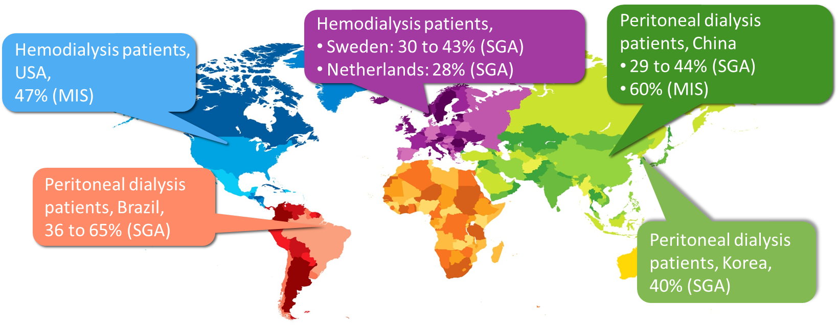
PEW Is Present in 30 to 65% or More of Dialysis Patients Around the World
Epidemiology of PEW in esrd
J Ren Nutr 28(6):380-392, 2018
Dialysis Core Curriculum 2021

Slide 9
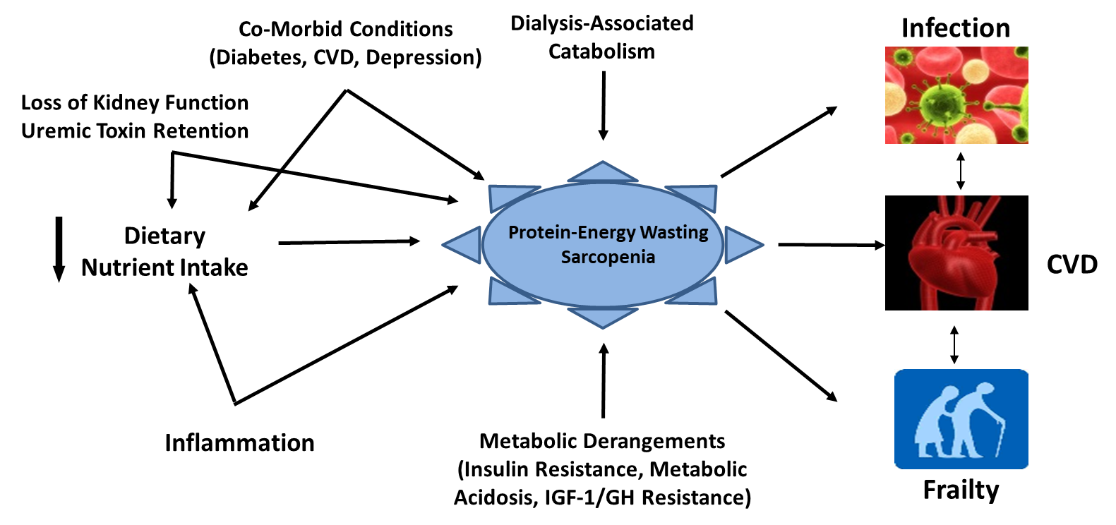
Etiology and Consequences of PEW
J Ren Nutr 23: 77-90, 2013
Dialysis Core Curriculum 2021

Slide 10
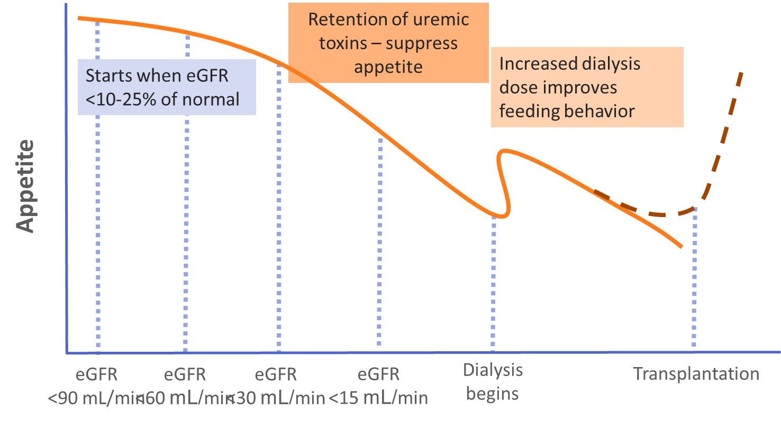
Etiology and Consequences of PEW
eGFR eGFR eGFR eGFR Dialysis Transplantation
<90 mL/min <60 mL/min <30 mL/min <15 mL/min Begins
J Ren Nutr 23: 77-90, 2013
Dialysis Core Curriculum 2021

Slide 11
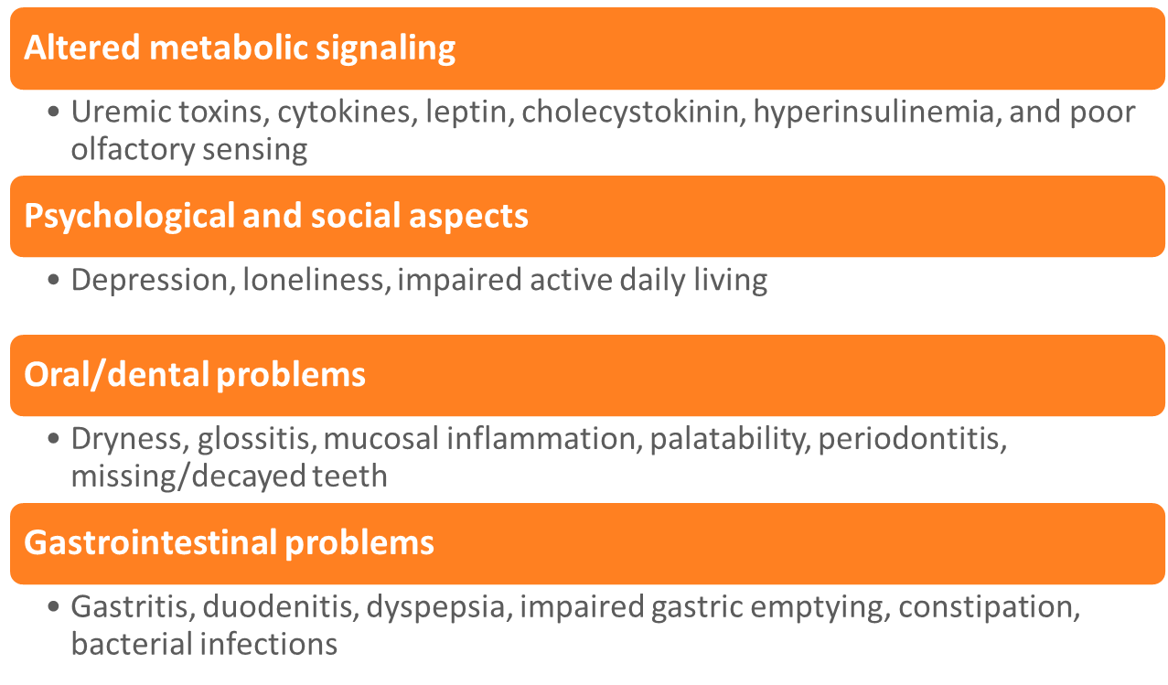
Etiology of Appetite Loss is Multi-Factorial
Etiology and Consequences of PEW
J Ren Nutr 23: 77-90, 2013
Dialysis Core Curriculum 2021

Slide 12
Dialysis Procedure Is Protein and Energy Catabolic
Etiology and Consequences of PEW
Significant loss of amino acids
  6-8 grams per session in HD
  3-4 grams per day in PD
Significant increase in energy expenditure
  appr. 10% increase in Basal Metabolic Rate
Activation of inflammatory cascade
Activation of complement system
Limited food intake (country dependent)
Dialysis Core Curriculum 2021

Slide 13
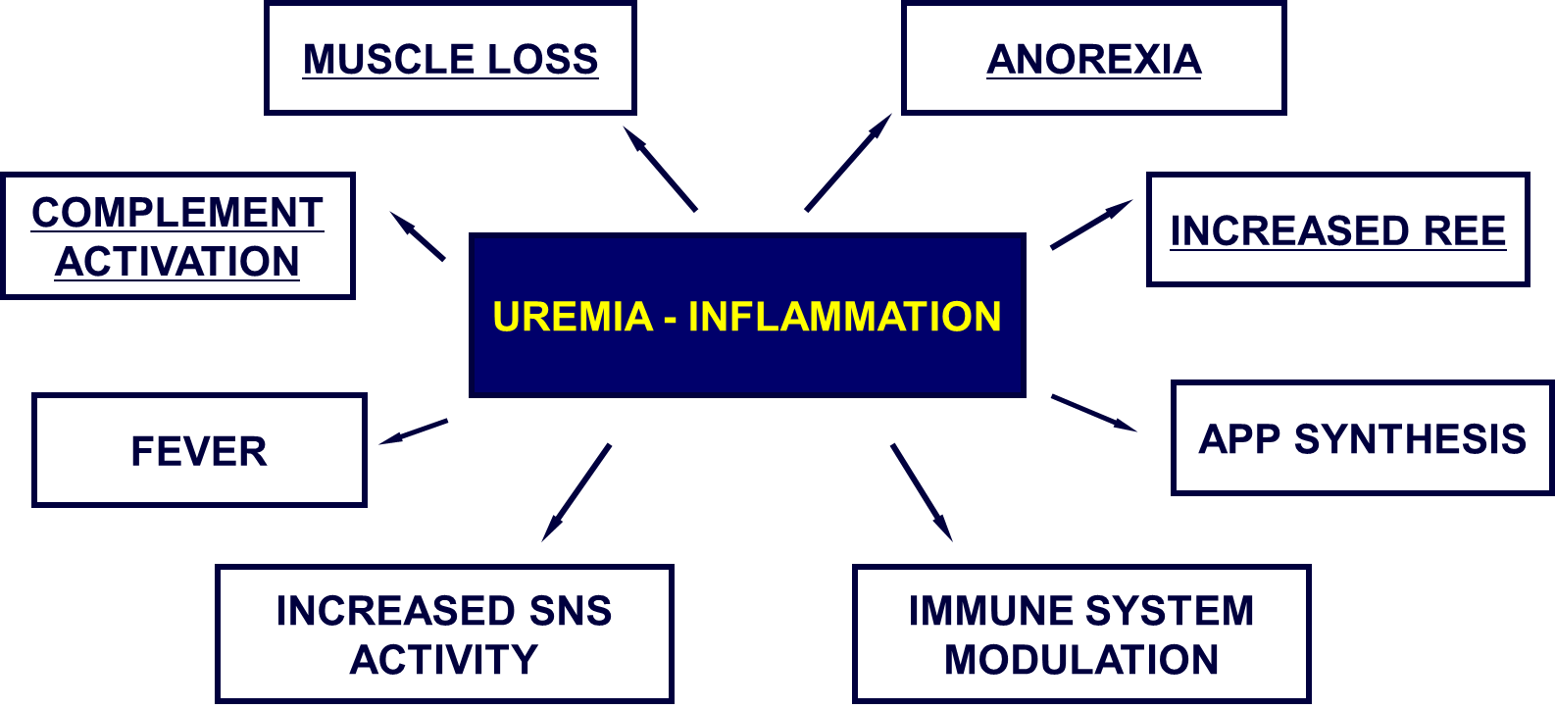
Metabolic Effects of Inflammation Are Commonly Observed in ESRD Patients
Etiology and Consequences of PEW
Dialysis Core Curriculum 2021

Slide 14
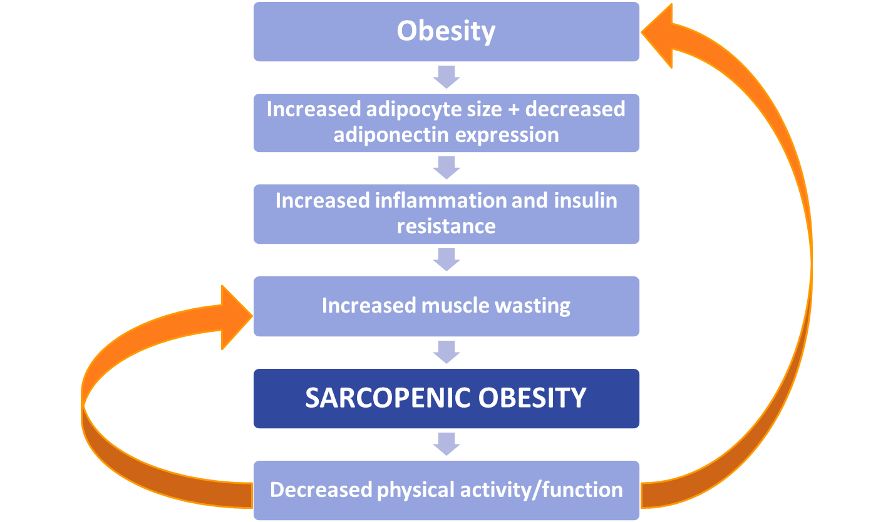
Obesity May Lead to Sarcopenia (Muscle Wasting) in CKD and ESRD
Etiology and Consequences of PEW
Dialysis Core Curriculum 2021

Slide 15
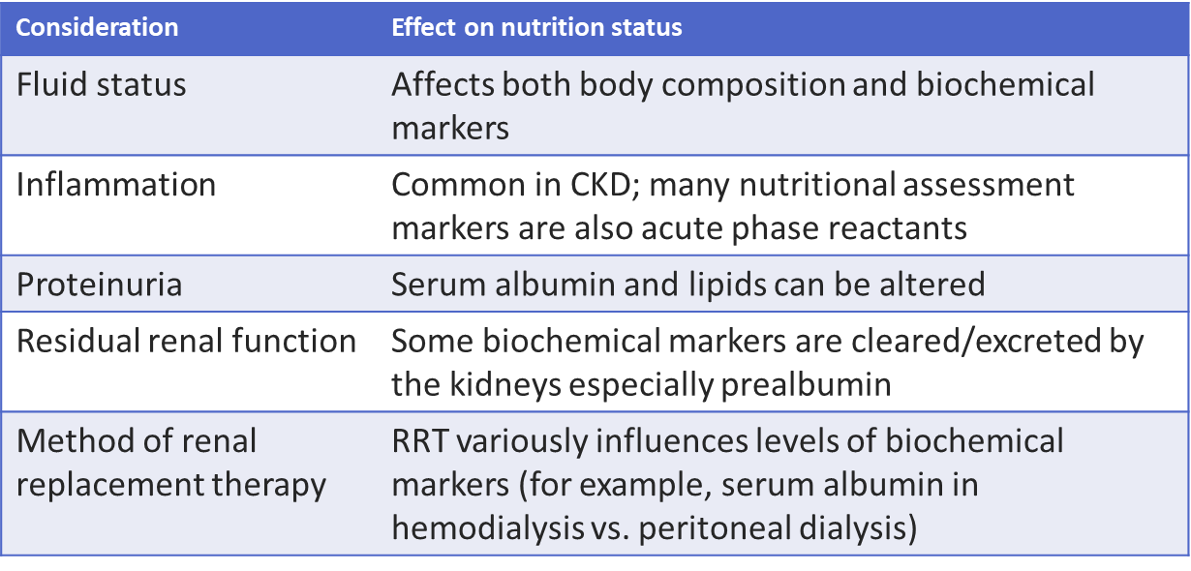
Nutrition Screening and Assessment Must Take into Account the Unique Influences of CKD
Screening and assessment
Dialysis Core Curriculum 2021

Slide 16
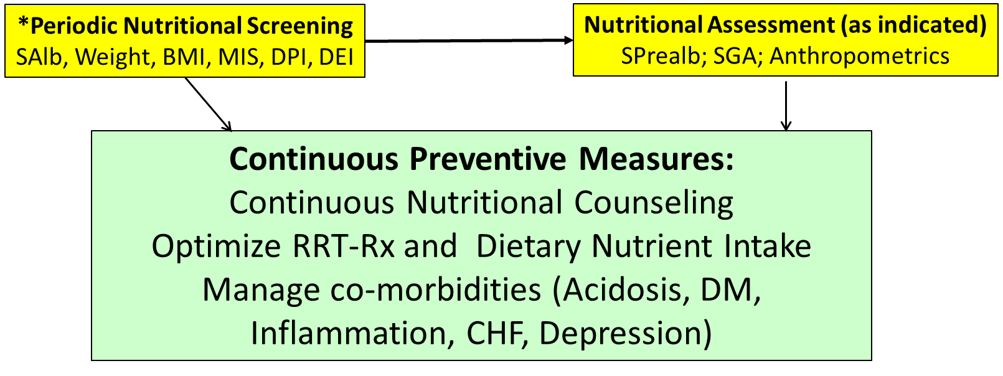
Screening and assessment
MIS: Malnutrition Inflammation Score, DPI: Dietary Protein Intake, DEI: Dietary Energy Intake, SGA: Subjective Global Assessment
Modified from Kidney Int 84: 1096-1107, 2013
Dialysis Core Curriculum 2021

Slide 17
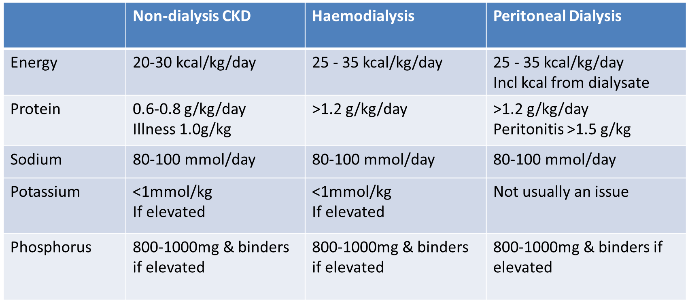
Specific Nutrient Requirements in CKD
Treatment
Modified from Kidney Int 84: 1096-1107, 2013
Dialysis Core Curriculum 2021

Slide 18
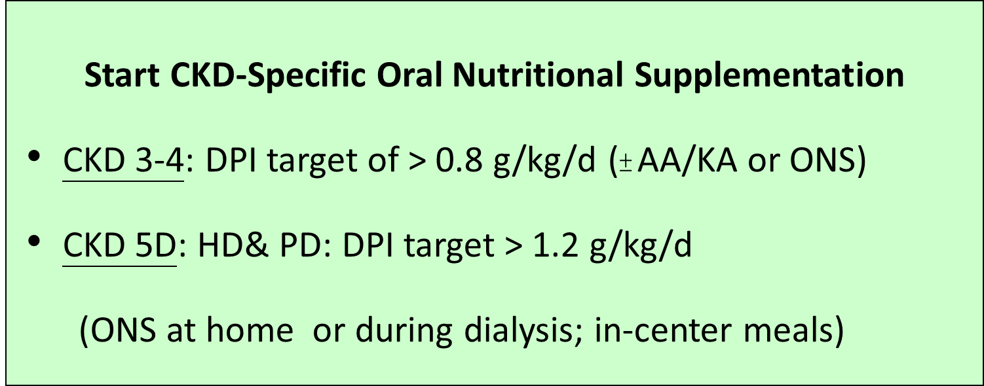
Use of Nutritional Supplements in CKD/ESRD
treatment
DPI: dietary protein intake
Modified from Kidney Int 84: 1096-1107, 2013
Dialysis Core Curriculum 2021

Slide 19
Implications of Randomized Clinical Trials Using Oral or Parenteral Supplementation in Dialysis Patients
Intradialytic Nutrition supplementation
The nutritional response to therapy is directly correlated with severity of Protein Energy Wasting at baseline and amount of nutrients delivered.
Underlying systemic inflammatory response does NOT hinder the beneficial effects of nutritional supplementation.
The route of administration of nutritional supplementation (i.e., oral or parenteral) does NOT have any significant difference in the response to therapy as long as equal and adequate amounts of protein and calories are provided.
Diabetic patients differ in their response to nutritional therapy and may require individualized prescription.
Adv Chronic Kidney Dis 20: 181-189, 2013
Dialysis Core Curriculum 2021

Slide 20
Special Considerations for Fat Intake in CKD
Treatment
CKD patients are recommended to follow general advice for heart health, including:
  Saturated fat <7% of total calories
  Unsaturated fat to substitute saturated fat
Omega 3 fatty acids demonstrate promising benefits in ESRD:
  Triglyceride levels, dialysis access patency, and cardiovascular risk factors
Dialysis Core Curriculum 2021

Slide 21
Special Considerations for Vitamins and Trace Elements
Treatment
Water-soluble vitamins (especially B6, C, and folate)
  Losses: Dialysis removal > normal urinary losses
  Excess intake should be avoided
Fat-soluble vitamins
  Usually only Vit D supplemented
  Vit A & E (risk of toxicity), intake should meet RDI
Trace elements
  Zinc, selenium, copper, aluminum, magnesium: No obvious deficiency
Iron: IV (preferred) or oral supplements
Dialysis Core Curriculum 2021

Slide 22
Case Follow-Up
During hospitalization, the patient was treated with appropriate antibiotics, and her permanent HD catheter was replaced once her blood cultures were negative.
After discharge, the family elected to place the patient in a nursing home. She began receiving renal specific oral nutritional supplement, two cans a day taken between main meals. She also received one of the supplements during dialysis.
The renal dietitian performed biweekly food recalls and instructed the patient and nursing home staff on increased dietary protein and calorie intake.
The patient also began to take an antidepressant. She subsequently resumed more of her social activities. A procedure was performed to ligate accessory veins at the site of the AVF, with improved fistula blood flow within a few weeks and removal of the tunneled HD catheter.
The patient’s weight stabilized, and her serum albumin increased to 3.7 g/dl over the subsequent 3 months.
Dialysis Core Curriculum 2021

Slide 23
Summary
Protein Energy Wasting is common in moderate to advanced kidney disease.
Uremia, dialysis procedure, and co-morbid conditions contribute to Protein Energy Wasting in CKD.
Negative nutrient balance and activation of inflammatory cascade are the primary etiologies of dialysis-induced catabolism.
Patients with CKD have special dietary macronutrient and micronutrient needs. A personalized approach that takes into account stage of kidney disease and patient characteristics is key to appropriate nutritional management in CKD.
Dialysis Core Curriculum 2021

Slide 24
References
Carrero JJ, Thomas F, Nagy K, Arogundade F, Avesani CM, Chan M, et al: Global Prevalence of Protein-Energy Wasting in Kidney Disease: A Meta-analysis of Contemporary Observational Studies From the International Society of Renal Nutrition and Metabolism. J Ren Nutr 28(6):380-392, 2018
Carrero JJ, Stenvinkel P, Cuppari L, Ikizler TA, Kalantar-Zadeh K, Kaysen G, et al: Etiology of the protein-energy wasting syndrome in chronic kidney disease: a consensus statement from the International Society of Renal Nutrition and Metabolism (ISRNM). J Ren Nutr 23(2):77-90, 2013
Ikizler TA, Cano NJ, Franch H, Fouque D, Himmelfarb J, Kalantar-Zadeh K, et al: Prevention and treatment of protein energy wasting in chronic kidney disease patients: a consensus statement by the International Society of Renal Nutrition and Metabolism. Kidney Int 84(6):1096-1107, 2013
Ikizler TA: Optimal nutrition in hemodialysis patients. Adv Chronic Kidney Dis 20: 181-189, 2013
Dialysis Core Curriculum 2021

