Slide 1
Complications of Peritoneal Dialysis
Noninfectious Complications of Peritoneal Dialysis
Dialysis Core Curriculum 2021
Joanne M. Bargman, MD
University Health Network
Professor of Medicine, University of Toronto

Slide 2
Disclosures
Disclosures
Joanne M. Bargman
Employer: University Health Network
Honoraria: Baxter Healthcare Canada, DaVita Healthcare Partners, Amgen
Scientific Advisor/Membership: Editorial Boards: JASN, Peritoneal Dialysis International, CJASN
Speakers Bureau: DaVita Healthcare Partners, Baxter Canada, Baxter Global
Dialysis Core Curriculum 2021

Slide 3
Learning Objectives
Discuss the diagnosis and management of complications related to increased intra-abdominal pressure in peritoneal dialysis
Describe the etiology and treatment of bloody peritoneal dialysis effluent
Identify the risk factors, diagnosis, and treatment of encapsulating peritoneal sclerosis
Dialysis Core Curriculum 2021

Slide 4
Case #1
36-year-old man, IgA nephropathy
Deceased donor transplant × 10 years, chronic allograft nephropathy
Returns to PD
Catheter inserted laparoscopically
Patient trained on APD
Dialysis Core Curriculum 2021

Slide 5
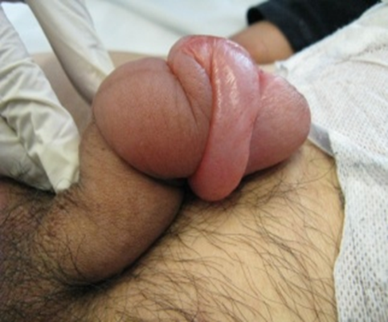
Case #1 (cont.)
Discharged on night IPD, day dry
1 month later, started on day dwell
Comes to unit 1 week after start of day dwell complaining of an edematous penis
Dialysis Core Curriculum 2021

Slide 6
Case #1: What Should We Do?
Prescribe high-dose loop diuretics.
Ask for a urology opinion.
Get a CT scan with IP radiocontrast.
Get a serologic test for syphilis.
Dialysis Core Curriculum 2021

Slide 7
Case #1: What Should We Do?
Prescribe high-dose loop diuretics.
Ask for a urology opinion.
Get a CT scan with IP radiocontrast.
Get a serologic test for syphilis.
Dialysis Core Curriculum 2021

Slide 8
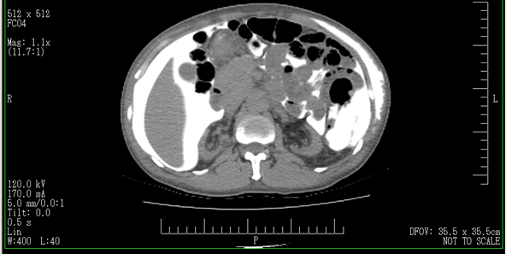
CT Scan with IP Radiocontrast
Leak of dialysis fluid
through a still-patent
laparoscopic port hole
Dialysis Core Curriculum 2021

Slide 9
Case #1
The leak didn’t become apparent until he was put on a day dwell.
The day dwell is subject to higher intra-abdominal pressure.
Dialysate leaked through the port hole into the tissues of the torso and also onto the penis.
Dialysis Core Curriculum 2021

Slide 10
Case #1: Problem Solved
Patient placed back on night cycler PD, day dry for a few months
Day dwell gradually reintroduced
No recurrence of leak
Dialysis Core Curriculum 2021

Slide 11
PD and Increased Intra-Abdominal Pressure (IAP)
Instillation of dialysate into the peritoneal cavity leads to increased abdominal pressure.
The magnitude of the increase depends on:
volume of dialysate instilled
position of the patient (sitting > standing > supine)
age, body mass index
Other intermittent activities, such as exercise, can transiently increase the IAP.
Dialysis Core Curriculum 2021

Slide 12
Relationship Among Intra-Abdominal Pressure (IAP), Position, and Dialysate Volume
IAP
(mmHg)
sitting
standing
supine
after
Twardowski
Perit Dial Bull 1980
0
1
2
3
VOLUME OF DIALYSATE (L)
Dialysis Core Curriculum 2021

Slide 13
Relationship Among Intra-Abdominal Pressure (IAP), Position, and Dialysate Volume
IAP
(mmHg)
sitting
standing
supine
Lowest IAP for a given
volume is in the supine position
after
Twardowski
Perit Dial Bull 1980
0
1
2
3
VOLUME OF DIALYSATE (L)
Dialysis Core Curriculum 2021

Slide 14
Abdominal Wall and Genital Edema
Presentation:
Abdominal swelling or bogginess, scrotal, or labial edema
Diminished effluent return
Pericatheter leak: wetness or swelling at exit site
Dialysis Core Curriculum 2021

Slide 15
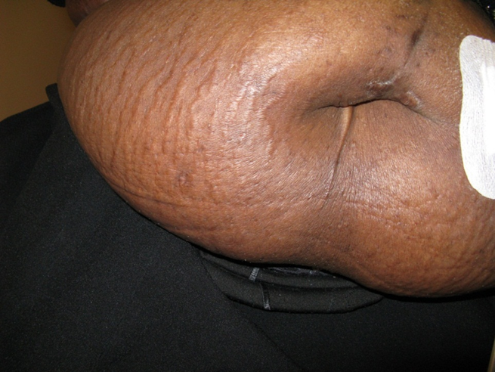
Abdominal Wall and Genital Edema
Diagnosis:
Physical exam (have patient stand in front of you)
Unchanged PET results
CT scan very helpful
Dialysis Core Curriculum 2021

Slide 16
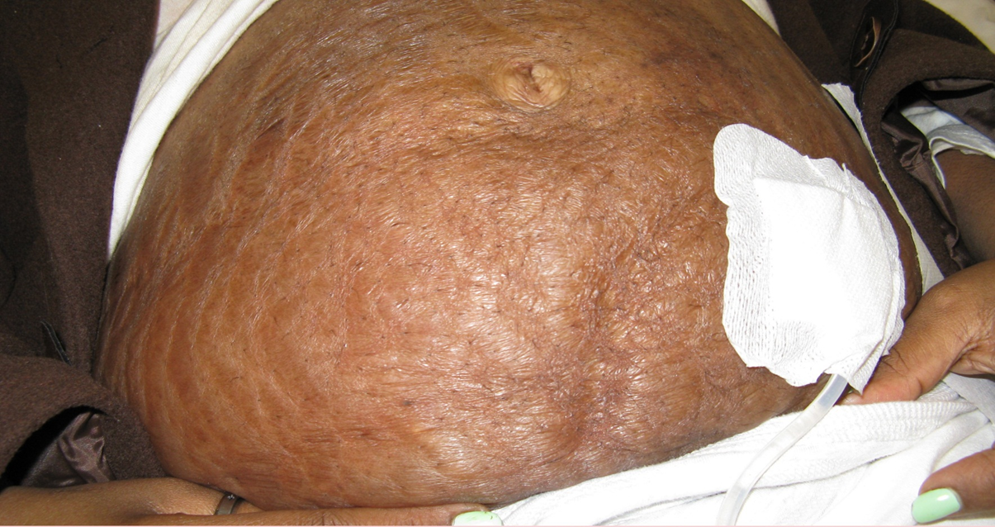
Abdominal Wall Leak and Edema:“Peau d’Orange”
Dialysis Core Curriculum 2021

Slide 17
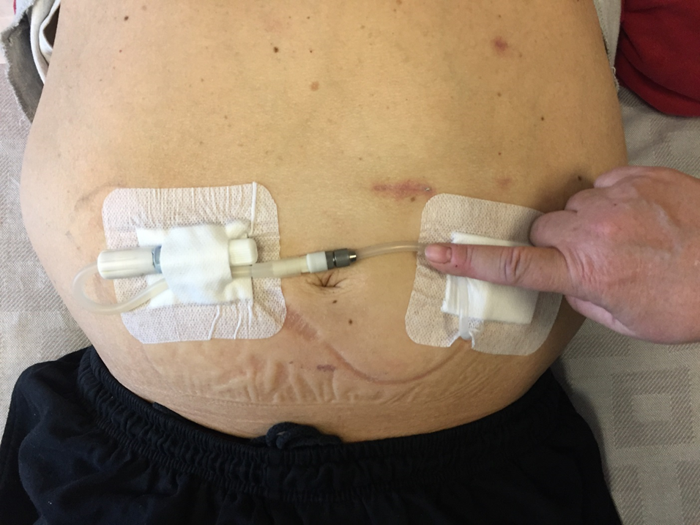
Patient with Large Polycystic Kidneys and Leak of Dialysis Fluid into the Abdominal Wall
Dialysis Core Curriculum 2021

Slide 18
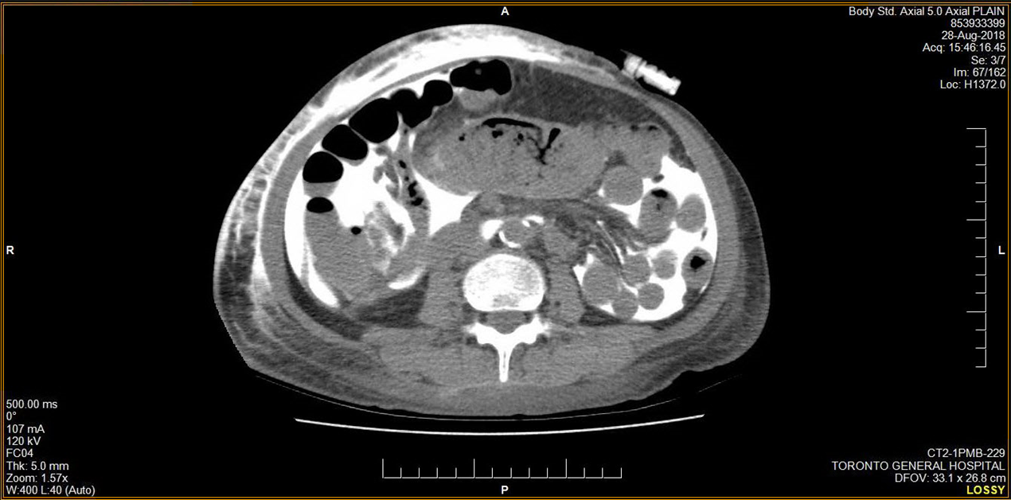
CT Scan with PD Fluid and Contrast Dye Showing Leak into the Subcutaneous Tissues
Dialysis Core Curriculum 2021

Slide 19
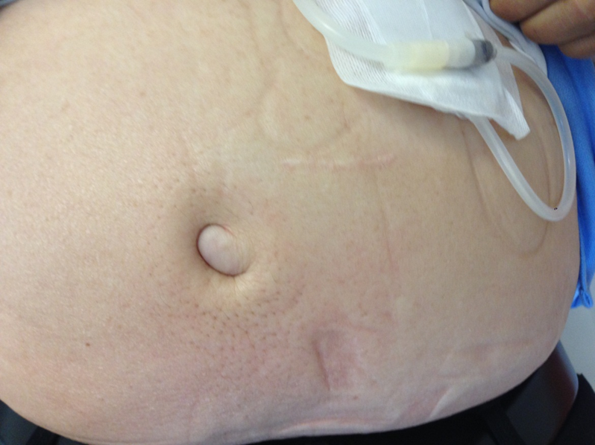
Abdominal Wall Leak Through Umbilical Hernia
Dialysis Core Curriculum 2021

Slide 20
CT Scanning for Abdominal Wall and Genital Edema
Add 100-150 ml Omnipaque to dialysis bag
Infuse dialysate into patient
Have patient ambulatory for 30-60 minutes to increase intra-abdominal pressure
Send for CT scan - discuss with the radiologist
Dialysis Core Curriculum 2021

Slide 21
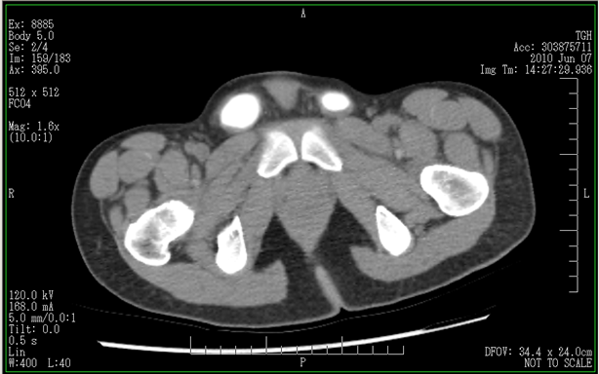
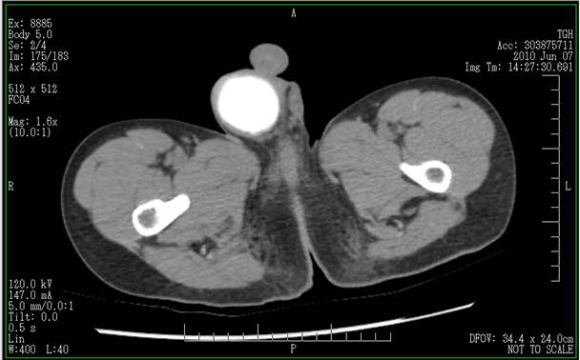
CT Scan in a Young Man with Scrotal Edema
Dialysis Core Curriculum 2021

Slide 22
Abdominal Wall and Genital Edema
Management
Reintroduce low pressure PD (e.g., APD with low volumes), or
Temporary HD to allow healing if not a hernia
Abdominal wall: CT scan for occult hernia
Genital: CT scan for patent processus vaginalis, which is easily repaired
Dialysis Core Curriculum 2021

Slide 23
So What Happened to the Man with the Swollen Penis?
Patient reverted to NIPD (day dry) × 1 month
Low-volume day dwells gradually re-introduced
No recurrence of leak
Did great on PD, then received a second renal transplant
Dialysis Core Curriculum 2021

Slide 24
Case #2
42-year-old woman with progressive GN decides on home PD.
She is discharged on APD, 2L × 3 exchanges over 8 h, 1.5L last fill.
3 days later: She calls the unit, complaining of progressive shortness of breath.
Mild cough, but no fever or sputum
Weight is increased 1 kg, but no edema nor change in BP.
Dialysis Core Curriculum 2021

Slide 25
Case #2: What to Do?
Advise the patient to use all 4.25% dialysate solutions.
Advise the patient to take furosemide 40 mg bid.
Get a chest X-ray.
Advise the patient to use icodextrin exchanges every 4 hours.
Dialysis Core Curriculum 2021

Slide 26
Case #2: What to Do?
Advise the patient to use all 4.25% dialysate solutions.
Advise the patient to take furosemide 40 mg bid.
Get a chest X-ray.
Advise the patient to use icodextrin exchanges every 4 hours.
Dialysis Core Curriculum 2021

Slide 27
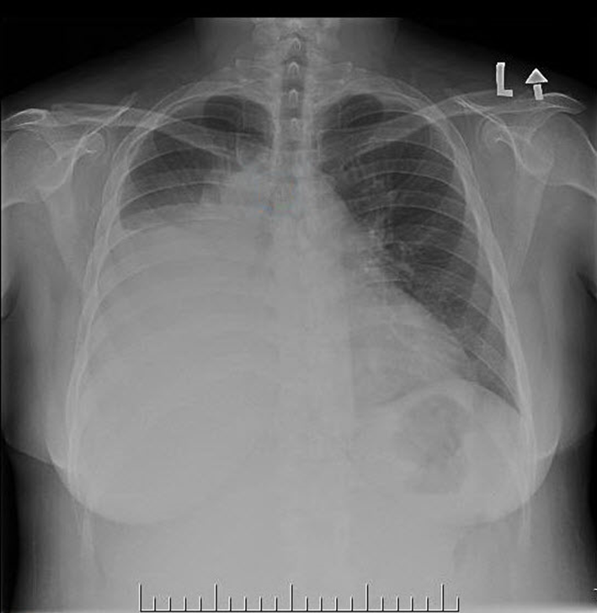
Case #2: The Chest X-Ray
Dialysis Core Curriculum 2021

Slide 28
Case #2: What to Do Now?
Start IV antibiotics to cover community-acquired pneumonia.
Order pulmonary angiography to rule out pulmonary embolus.
Start anti-tuberculous therapy as soon as possible.
Stop peritoneal dialysis.
Dialysis Core Curriculum 2021

Slide 29
Case #2: What to Do Now?
Start IV antibiotics to cover community-acquired pneumonia.
Order pulmonary angiography to rule out pulmonary embolus.
Start anti-tuberculous therapy as soon as possible.
Stop peritoneal dialysis.
Dialysis Core Curriculum 2021

Slide 30
PD Hydrothorax
Definition: The presence of peritoneal dialysis fluid in the pleural cavity
Incidence: Probably <5%
Pathogenesis: Movement of dialysate, under increased intra-abdominal pressure, from peritoneal to pleural cavity through congenital or acquired defects in the diaphragm
Dialysis Core Curriculum 2021

Slide 31
Hydrothorax: Diagnosis
Thoracentesis for relief of symptoms and/or diagnosis
Pleural fluid analysis:
transudate
high glucose concentration (but not always)
Don’t use intraperitoneal methylene blue (irritating to the peritoneum; significant false negative rate)
Dialysis Core Curriculum 2021

Slide 32
If the Pleural Fluid Is Dialysis Fluid,
Why Isn’t the Glucose Concentration High?
With a long dwell, glucose can diffuse out of the pleural cavity just like it does out of the peritoneal cavity, or
The patient may be using a non-glucose dialysis fluid (icodextrin)
Dialysis Core Curriculum 2021

Slide 33
Hydrothorax: Treatment
Thoracentesis may be helpful, if short of breath
Stop PD
Temporary hemodialysis, if dialysis necessary
Dialysis Core Curriculum 2021

Slide 34
Discuss Next Steps with the Patient
If the patient transitions off PD to hemodialysis, the pleural leak doesn’t have to be fixed.
If the patient wants to persevere with PD, the peritoneal-pleural communication will have to be closed.
These communications may be microscopic or larger.
Dialysis Core Curriculum 2021

Slide 35
Hydrothorax: Treatment
Pleurodesis (talc, tetracycline, bleomycin, autologous blood)
Operative or pleuroscopic repair (diaphragmatic defects identified and patched or oversewn)
Can re-start PD in 4-6 weeks
Dialysis Core Curriculum 2021

Slide 36
Case #3: Complications of Fixing a Sink
48-year-old man with PKD is trained on cycler dialysis. Current prescription is 2.0L × 4 exchanges over 8 hours at night, with 1.8L day dwell.
One year later, he is doing well.
Residual renal GFR is 8 ml/min.
His wife is almost finished being worked up as a kidney donor and is likely to be accepted.
Dialysis Core Curriculum 2021

Slide 37
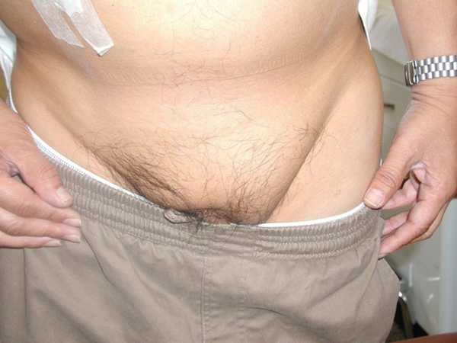
Case #3
At clinic, he reports a new “lump” in his left groin.
He had been bent overlooking under a sink and felt a “pop” and some tenderness in the groin.
On physical exam, there is a left inguinal hernia.
Dialysis Core Curriculum 2021

Slide 38
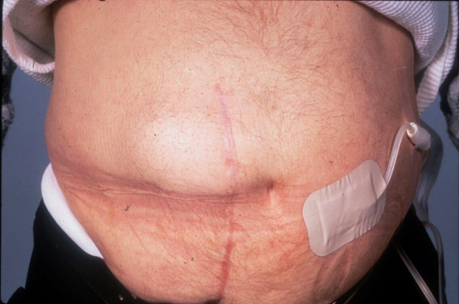
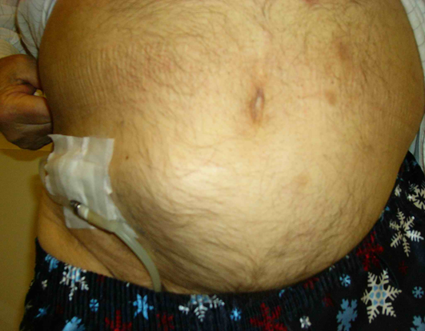
Other Types of Hernias: Ventral Hernia
Dialysis Core Curriculum 2021

Slide 39
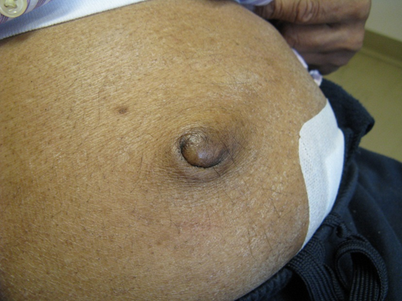
Umbilical Hernias:
Highest Risk for Bowel Incarceration
Dialysis Core Curriculum 2021

Slide 40
Hernias: Treatment
Warn patient about signs of incarceration
Surgical repair of hernias:
Dialysis around repair depends on renal function and condition of the patient.
You don’t usually have to put them on HD unless there is bowel compromise.
Reintroduce PD with low volumes, supine posture, increase volume over 2 weeks.
Dialysis Core Curriculum 2021

Slide 41
Case #3: What Happened to the Sink Fixer?
Continued night cycler dialysis, volume decreased
Dry during day (enough residual GFR 8 ml/min)
Elective hernia repair
No PD for 2 days
Back to night cycler 1.5L volume × 4 weeks, then 2L volume
Left day dry
Dialysis Core Curriculum 2021

Slide 42
Case #4: Recurrent Bowel Obstruction
Vasculitis (GPA) at age 10
ESRD, on CAPD × 7 years (refused TP)
Now anuric
Severe S. aureus peritonitis – catheter removal and interim HD
Re-insertion of PD catheter – severe intra-abdominal adhesions
Dialysis Core Curriculum 2021

Slide 43
Case #4: Recurrent Bowel Obstruction
Transferred to adult hospital age 18 on chronic hemodialysis
1 year later: Recurrent bowel obstruction, weight loss, malnutrition
Dialysis Core Curriculum 2021

Slide 44
Case #4: What to Do?
Colonoscopy with prophylactic antibiotics
Colonoscopy without prophylactic antibiotics
Oncology consult
CT scan of the abdomen
Dialysis Core Curriculum 2021

Slide 45
Best Answer: CT Scan of the Abdomen
Given her long time on PD, she is at risk for encapsulating peritoneal sclerosis.
This complication can occur even after modality transfer (to HD or to transplant).
CT scan can delineate peritoneal membrane thickening, calcification, and encapsulation of the bowel.
Dialysis Core Curriculum 2021

Slide 46
Encapsulating Peritoneal Sclerosis
Typically diagnosed in the later stages
Long-term (>60 months) PD patient with:
  recurrent bowel obstruction
  anorexia, weight loss, malnutrition
Dialysis Core Curriculum 2021

Slide 47
The Inflammatory Prodrome of EPS
There is an inflammatory phase that often precedes the fibrosing phase.
This inflammation can be missed or misdiagnosed.
Symptoms can be non-specific.
Dialysis Core Curriculum 2021

Slide 48
Symptoms and Signs in the Inflammatory Phase
Anorexia, nausea, vomiting
Fever
Weight loss, malnutrition
Hemoperitoneum
Increased serum CRP
Rapid increase in transport status
Late-onset inflow or outflow pain
Hypoalbuminemia
Anemia and resistance to ESA
Dialysis Core Curriculum 2021

Slide 49
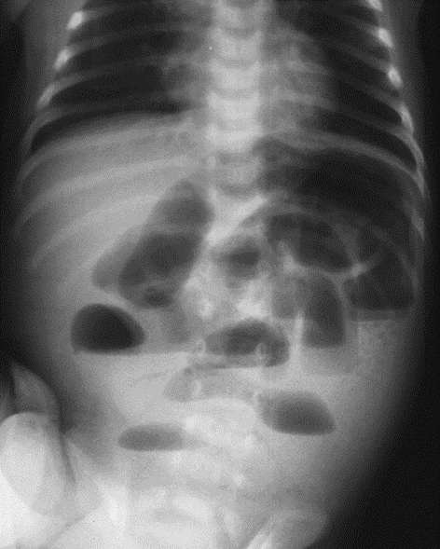
The Fibrosing/Sclerosing Phase
Recurrent bowel obstruction
Progressive malnutrition
Dialysis Core Curriculum 2021

Slide 50
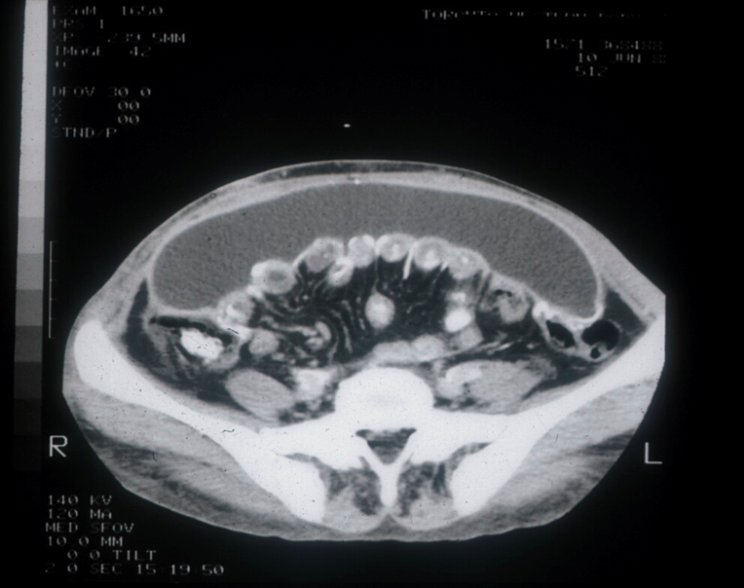
Cocoon in a Former Long-Term PD Patient
Dialysis Core Curriculum 2021

Slide 51
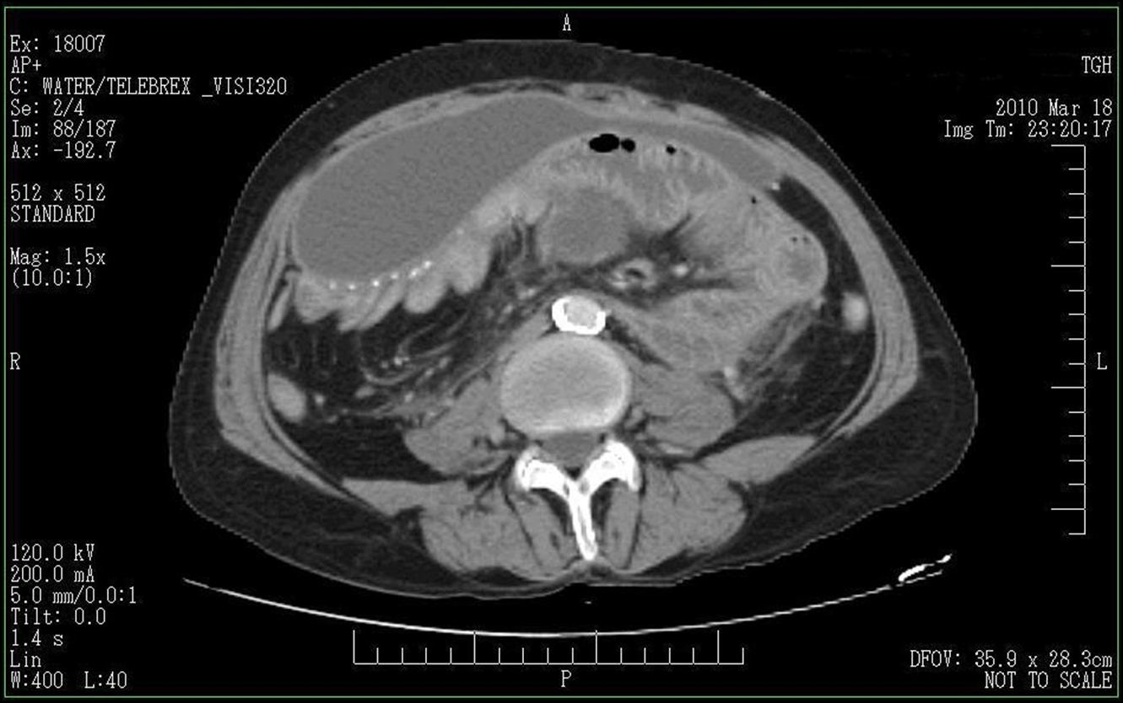
EPS: A “Milder” Example
Dialysis Core Curriculum 2021

Slide 52
Peritoneal Thickening Does Not Equal EPS
There is gradual thickening and “leathering” of the peritoneal membrane over time on PD.
This thickening can be visualized on CT scan.
The radiologist may incorrectly call this thickening EPS.
EPS is a clinical syndrome, and “it is as it does.”
Dialysis Core Curriculum 2021

Slide 53
EPS: Epidemiology and Risk Factors
Incidence 0.5-2.8%
Mortality 38-63%
Both incidence and mortality increase with increased time on PD therapy.
Frequent peritonitis is NOT a risk factor for EPS.
Dialysis Core Curriculum 2021

Slide 54
EPS: Epidemiology and Risk Factors
At-risk patients include:
Long-term patients
Rapid transporters, especially those who evolve into rapid transport status
Unresolving peritonitis, with removal of the PD catheter
Cessation of PD, even without peritonitis
Autoimmune disease as underlying cause of renal failure (my observation)
Dialysis Core Curriculum 2021

Slide 55
EPS: The Two-Hit Hypothesis
The “First Hit”
Ongoing compromise of the peritoneal membrane by exposure to PD fluid and/or PD catheter?
  Hyperosmotic
  High glucose and derivatives (GDPs, AGEs)
  Acidic
Mesothelial cell damage and peritoneal sclerosis
Dialysis Core Curriculum 2021

Slide 56
EPS: The Two-Hit Hypothesis
The “Second Hit”
Bacterial peritonitis
Discontinuation of PD
Abdominal surgery
Calcineurin inhibitors?
Dialysis Core Curriculum 2021

Slide 57
EPS: Treatment
In the inflammatory phase, corticosteroids may be helpful
Dose is unknown – we usually use the equivalent of 15-20 mg/day of prednisone, with a gradual taper
Some reports of tamoxifen or MMF for their anti-fibrotic properties
  risk of thrombosis with tamoxifen therapy
Careful attention to nutrition, including TPN if indicated
Dialysis Core Curriculum 2021

Slide 58
EPS: Surgical Treatment
Surgical lysis of intestinal adhesions and stripping of fibrous cocoon
Indications for surgery:
  Persistent or recurrent bowel obstruction
  Failing nutritional status
  Failure to respond to medical therapy
  Recurrent peritonitis from bowel compromise
This demands a surgeon knowledgeable about this syndrome
Dialysis Core Curriculum 2021

Slide 59
Case #5: A Bag of Blood!
28-year-old woman with ESKD from IgA nephropathy
Amenorrheic for 6 months (pregnancy tests negative)
Starts on peritoneal dialysis
Resumption of the menses within 2 months
Presents with bloody PD effluent at the time of her menses
Dialysis Core Curriculum 2021

Slide 60
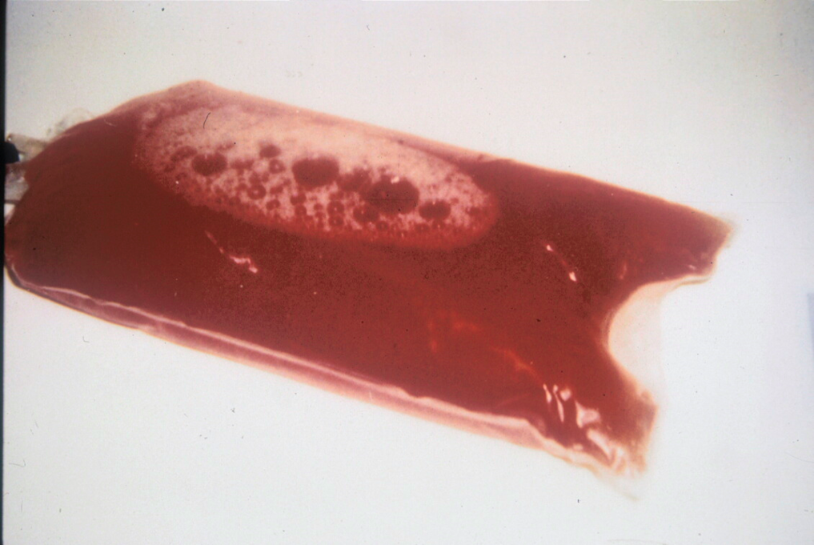
Case #5: The Bloody Effluent
Dialysis Core Curriculum 2021

Slide 61
Case #5: What to Do?
Admit to hospital, cross and type for 4U PRBC, call surgery.
Add heparin to the dialysis fluid.
Order CT scan of the abdomen.
Start intra-peritoneal antibiotics.
Dialysis Core Curriculum 2019

Slide 62
Case #5: What to Do?
Admit to hospital, cross and type for 4U PRBC, call surgery.
Add heparin to the dialysis fluid.
Order CT scan of the abdomen.
Start intra-peritoneal antibiotics.
Dialysis Core Curriculum 2021

Slide 63
Hemoperitoneum
Definition
Bloody peritoneal effluent
Presentation
Scary! (not as bad as it looks)
Must consider “benign” and “serious” causes
Dialysis Core Curriculum 2021

Slide 64
Hemoperitoneum: Benign Causes
Menstruation
Ovulation
Ruptured renal or ovarian cysts
Trauma
Coagulopathy
Dialysis Core Curriculum 2021

Slide 65
How Does the Menses Lead to Bloody Effluent?
Retrograde uterine bleeding
Endometriosis of peritoneal cavity
Dialysis Core Curriculum 2021

Slide 66
Hemoperitoneum Secondary to the Menses
Commonest cause of hemoperitoneum in PD patients
No investigations are necessary
Dialysis Core Curriculum 2021

Slide 67
Hemoperitoneum: More Worrisome Causes
Ischemic bowel
Hepatic or colon cancer
Pancreatitis
Encapsulating peritoneal sclerosis
Kidney cancer
Dialysis Core Curriculum 2021

Slide 68
Why Add Heparin to Bloody Dialysate?
Same idea as adding heparin when there is a lot of fibrin
It is to prevent coagulation and blockage of the intra-peritoneal segment of the peritoneal dialysis catheter
Probably not advisable in the rare case of active bleeding, such as from trauma
  In that case, frequent flushing of the peritoneal cavity (e.g., 2L in and 2L out) may be a good idea
Dialysis Core Curriculum 2021

Slide 69
Summary 1
Hernias and leak of dialysis fluid are common complications of PD
Consider PD under lower intra-abdominal pressure (supine position, smaller volume) in vulnerable patients
  Obese patients
  Polycystic kidney disease
  Malnutrition with poor tissue quality
  Previous hernias
Dialysis Core Curriculum 2021

Slide 70
Summary 2
Hernias can often be repaired without changing the patient to HD.
  Exceptions: compromised bowel, anuric patients prone to hyperkalemia
CT with intra-abdominal contrast mixed with a full volume of PD fluid is helpful to image hernias and the source of dialysis leaks.
Very often these leaks can be repaired.
A right-sided pleural effusion in a PD patient should suggest the possibility of hydrothorax from leak of dialysis fluid.
Dialysis Core Curriculum 2021

Slide 71
Summary 3
The commonest cause of hemoperitoneum is the menstrual period and needs no particular investigation in that setting.
  Other presentations of hemoperitoneum should be investigated.
Encapsulating peritoneal sclerosis is a rare but serious complication of PD, and the principal risk factor is time on therapy.
Dialysis Core Curriculum 2021

Slide 72
REFERENCES
Ratajczak A Lange-Ratajczak M, Bobkiewicz A, et al: Surgical Management of Complications with Peritoneal Dialysis. Semin Dial 30(1): 63-68, 2017
Balda S, Gupta V, Gupta N, et al: Impact of Hernias in Peritoneal Dialysis Technique Survival and Residual Renal Function. Perit Dial Int 33(6): 629-34, 2013
Shah H, Chu M, Bargman JM: Perioperative Management of Peritoneal Dialysis Patients Undergoing Hrenia Surgery Without the Use of Interim Hemodialysis. Perit Dial Int 26(6): 684-7, 2006
Lambie M, Teece L, Johnson DW, et al: Estimating Risk of Encapsulating Peritoneal Sclerosis Accounting for the Competing Risk of Death. Nephrol Dial Transplant 34(9): 1585 – 1591, 2019
McCormick B, Bargman JM: Noninfectious Complications of Peritoneal Dialysis: Implications for Patient and Technique Survival. J Am Soc Nephrol 18(12): 3023-35, 2007
Dialysis Core Curriculum 2021

