Slide 1
Home Hemodialysis
Longitudinal Management of Patients on Home HD
Dialysis Core Curriculum 2021
Brent W. Miller, MD
Indiana University School of Medicine

Slide 2
Brent W. Miller
Disclosures
Employer: Indiana University
Consultancy Agreements: Fresenius Kidney Care
Honoraria: UpToDate, Davita, Home Dialysis University, Fresenius Renal Therapies Group, Advanced Renal Education Program, University of Southern California
Scientific Advisor or Membership: NxStage Medical Scientific Advisory Board
Other Interests: Author, UpToDate in Medicine
Dialysis Core Curriculum 2021

Slide 3
Learning Objectives
Describe efficient management of the post-training follow up of home hemodialysis patients
Discuss avoidance, recognition, and management of common complications in home hemodialysis
Dialysis Core Curriculum 2021

Slide 4
Outline
Immediate post-training issues and common problems
Efficient outpatient management strategies
Vascular access in home hemodialysis
Other problems in home hemodialysis
Special issues related to extended (nocturnal) hemodialysis treatments
Dialysis Core Curriculum 2021

Slide 5
IMMEDIATE POST-TRAINING ISSUES
Home Hemodialysis
Dialysis Core Curriculum 2021

Slide 6
Target Weight and BP Medications
Immediate Post-Training Issues
Most HD patients and PD patients are “volume-overloaded.”¹
More frequent HD usually shows an improvement in BP control.^{2,3}
Adjustment of both target weight and BP medications during the initial phase of HHD is critical.
Dialysis Core Curriculum 2021

Slide 7
Ultrafiltration Rate
Immediate Post-Training Issues
Numerous studies have demonstrated deleterious effects of high ultrafiltration rates during HD.
Higher ultrafiltration rates also increase the likelihood of a symptomatic low BP during HD treatment. This is problematic in the home setting.
Limiting the patient’s ultrafiltration rate (simplified to liters per hour) is a key component of the prescription. Less than 10 ml/min/kg is a reasonable estimate for a maximum HHD ultrafiltration rate.
If the patient has a higher interdialytic weight gain, then the dialysis time will need to be increased to compensate for the fluid removal rate.
Dialysis Core Curriculum 2021

Slide 8
Ultrafiltration Rate and Mortality in HD⁴
Immediate Post-Training Issues
118,394 HD patients between 2008-2012 retrospectively reviewed
All-Cause Mortality Hazard Ratio
UFR (mL/hour/kg)
Adapted from Table 3, Assimon MM et al. Am J Kidney Dis 68:911-922, 2016
Dialysis Core Curriculum 2021

Slide 9
Anemia Management^{5,6}
Immediate Post-Training Issues
Erythropoiesis-Stimulating Agents
  Most data shows no difference in ESA dosing or hemoglobin for HHD patients.
  Some observational and anecdotal reports show:
    Patients on nocturnal HD with minimal or no ESA.
    Patients requiring more ESA and iron during the first several months at home presumably from blood loss (access and extracorporeal circuit).
  Administration should be simplified from in-center HD.
    Once weekly by patient
    Once or twice monthly in clinic by staff
Iron
  Parenteral administration by patient similar to in-center HD
  Parenteral administration monthly by clinic staff
  Oral iron daily
Dialysis Core Curriculum 2021

Slide 10
Technique Failure
Immediate Post-Training Issues
Current practice of HHD in the U.S. results in a loss of >4% of patients per month with more than half of those patients returning to in-center HD.
Experienced centers have reported markedly less technique failure in HHD of 10% annually or less.⁷
The cause of technique failure is markedly different than PD.
  In PD, peritonitis and access problems are the most common reasons.
  In HHD, caregiver and/or patient burden are the most common reasons.
The highest risk of technique failure is in the first 6 months.⁸
Dialysis Core Curriculum 2021

Slide 11
Strategies to Avoid Early Technique Failure
Immediate post-training Issues
Address expectations and experience of HHD prior to training.
Consider having separate caregiver and patient meetings.
Encourage patient to perform as much of self care as possible.
Frequent home visits by nursing staff.
Liberal use of respite care.
Consider prescription adjustments to benefit lifestyle.
Dialysis Core Curriculum 2021

Slide 12
Efficient Outpatient MANAGEMENT
Home Hemodialysis
Dialysis Core Curriculum 2021

Slide 13
Characteristics of Successful HHD Programs
EFFICIENT OUTPATIENT MANAGEMENT
Pre-HHD training expectation management
Staff attitude and temperament
Utilization of patient care technicians and medical assistants for non-nursing tasks
Training flexibility and adaptability
Access to respite care and back-up care
Social worker involvement
Visibility within the home (e.g., home visits)
Efficient monthly clinics
Dialysis Core Curriculum 2021

Slide 14
Outpatient Clinic Visits
EFFICIENT OUTPATIENT MANAGEMENT
As of January 1, 2019, HHD patients may have 2 of every 3 clinic visits performed via telehealth after the first 3 months of training.
Patients often choose HHD to minimize time in the dialysis clinic, so visits should reflect that efficiency. A large database of physician visits in the U.S. showed a median wait time of approximately 4 minutes and approximately 20% longer than 20 minutes and 10% longer than 30 minutes.⁸
A multidisciplinary approach with team communication during the clinic experience is optimal.
Dialysis Core Curriculum 2021

Slide 15
Routine Laboratory Testing
EFFICIENT OUTPATIENT MANAGEMENT
Testing frequency and specific tests are the same as center-based HD except hepatitis B surface antigen and water testing (see below).
  Some dialysis centers will require a hepatitis B surface antigen within 30 days for a back-up HD treatment, so consider routine measurement versus on-demand measurement.
Patients draw blood at home (need pre- and post-BUN measurement for kinetics calculation).
  Provide small blood vials and small centrifuge to patient.
  Can bring to clinic for processing.
  Can ship samples directly to laboratory from patient’s home.
Urea Kinetics (discussed at length in separate presentation)
  Utilization of a standardized Kt/V_{urea} (recommended target >2.0) to compare differing dialysis schedules.
  Residual renal function can be included in the kinetic calculation similar to PD, with equal frequency of measuring residual renal function (every 2-3 months).
Water and dialysate testing for HHD
  Chlorine/Chloramine testing every treatment
  Product water and dialysate testing quarterly for bacteriological standards
  Tap water AAMI water analysis prior to installation
Dialysis Core Curriculum 2021

Slide 16
Vascular Access
Home Hemodialysis
Dialysis Core Curriculum 2021

Slide 17
Ergonomics of Self-Cannulation for HHD
Vascular Access
Patients must be able to see and comfortably insert needles.
  Most patients choose to place both needles antegrade.
  Because needles are both antegrade, insertion sites should be at least 3 inches apart.
  Cannulation sites should be chosen by a collaboration of training nurse and patient.
All supplies for cannulation should be within reach before beginning.
All supplies for hemostasis, including the discarded needle container should be placed within reach before starting needle removal.
Dialysis Core Curriculum 2021

Slide 18
Choice of AVF Cannulation for HHD¹⁰
Vascular Access in HHD
 | Potential Pros | Potential Cons
Rotating-Site | Lower risk of infection Can move site easily with difficult cannulation Less training time | Infiltration Must have several sites to rotate along segment Aneurysm development
Constant-Site | Less aneurysm formation Some patients find less pain Some patients find less difficulty Patient acceptance | Higher risk of infection Damage to track with mis-cannulation Longer training time Must also learn rotating site technique for back-up
Adapted from multiple reports and personal experience including Muir CA et al. Clin J Am Soc Nephrol 9:110-114, 2014;
Moist LM and Nesrallah GE Clin J Am Soc Nephrol 9:3-5, 2014:and Mokrzycki MH. ASN Kidney News July 2020 14-15.
Dialysis Core Curriculum 2021

Slide 19
Risk of Infection with Constant Site Cannulation¹¹
Vascular Access in HHD
Review of 90 HHD patients
p=0.03
p=0.04
Additionally, patients with foreign material (joint replacement, artificial valve)
or immunosuppression should avoid constant site cannulation.
Adapted from Muir CA et al. Clin J Am Soc Nephrol 9:110-114, 2014
Dialysis Core Curriculum 2021

Slide 20
Key Points for HHD Vascular Access
Vascular Access
Aseptic technique
Ergonomics of access
  Cannulation
  Hemostasis
Anchoring of needles and dialysis lines
  Taping should be done to minimize risk of needle infiltration or dislodgement
  No anchoring to stationary objects
Constant site (“buttonhole”) or rotating-site (“rope-ladder”) technique?
Clinical monitoring of vascular access
Dialysis Core Curriculum 2021

Slide 21
Aseptic Technique Agents
Vascular Access
Povidone-Iodine
  Allow to dry—approximately 3-5 minutes
Chlorhexidine Gluconate 2% and Isopropyl Alcohol 70%
  Allow to dry—approximately 3 minutes
Chlorhexidine Gluconate 0.5% and Isopropyl Alcohol 70%
  Allow to dry—approximately 3 minutes
Sodium Hypochlorite 0.114%
  Approximately 2 minutes
Alcohol
  60 seconds, access prior to completely drying
Dialysis Core Curriculum 2021

Slide 22
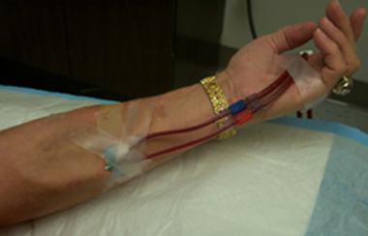
Anchoring of Dialysis Needles and Lines
Vascular Access in HHD
Line secured at hand to prevent tension on needle
Key Point: Assume patient movement at home that could place tension on dialysis line
Needle secured with “chevron” dressing. Other types of dressing, such as the “H method”, also work and may be easier to remove.
Note that this is a single-needle set-up.
Picture courtesy of Dr. Brent Miller
Dialysis Core Curriculum 2021

Slide 23
Monthly Evaluation of Vascular Access in HHD
Vascular Access
Discuss any changes or difficulty with cannulation.
Note any changes in the appearance of the access.
If access is a fistula, assess arterial augmentation of the fistula.
If access is a fistula, assess appearance of fistula changes in position and gravity.
Assess the thrill of the fistula and any changes from prior month.
Review and emphasize aseptic technique.
Assess and discuss appropriate choice of cannulation sites with the patient and the dialysis nurse together.
Dialysis Core Curriculum 2021

Slide 24
Clinical Monitoring of Vascular Access
Vascular Access
Unexplained decrease in urea clearance or solute removal (e.g., hyperkalemia)
Unexplained uremic symptoms
New difficulty in cannulation
Bleeding around needles during therapy
Reports of increased bleeding after removal of needles
Increase in venous pressures during therapy
  At beginning of therapy with blood flow rate of 200 ml/min, venous pressures should not exceed approximately 100 mm.
  During final blood flow rate, venous pressures should not consistently exceed approximately 250 mm or approximately ½ the blood flow rate.
Dialysis Core Curriculum 2021

Slide 25
Incidence of Cannulation Problems should be < 2% or about 1 in Every 50 Treatments
Key Point: When higher, consider investigation and retraining.
Vascular Access
Chart adapted from data in Parisotto MT et al J Vasc Access 18: 114-119, 2017
Dialysis Core Curriculum 2021

Slide 26
Other Problems
Home Hemodialysis
Dialysis Core Curriculum 2021

Slide 27
Air Embolism
Other Problems
Air embolism occurs during manipulation of the vascular access at the beginning or end of dialysis therapy.
Particular careful attention should be paid to ending treatment with a central venous catheter after a nocturnal HD treatment.
Dialysis Core Curriculum 2021

Slide 28
Cartridge and Dialyzer Leaks
Other Problems
Rare occurrences and usually more damaging to environment than patient
Collection trays and moisture alarms prevent significant damage
Dialysis Core Curriculum 2021

Slide 29
Parenteral Antibiotic Dosing
Other Problems
Antibiotic dosing for patients on more frequent dialysis or lower volume dialysate have not been extensively studied. Comparison to dosing with continuous veno-venous hemodialysis may be most appropriate.
Location of administration of antibiotics is not simple.
  Transfer to incenter HD during antibiotic dosing
  Antibiotic dosing given in home training center
  Patient-administered antibiotic dosing in the home
  Home health administered antibiotic dosing in the home
Dialysis Core Curriculum 2021

Slide 30
Nocturnal Hemodialysis
Home Hemodialysis
Dialysis Core Curriculum 2021

Slide 31
Special Considerations for Nocturnal HD
Nocturnal Hemodialysis
Lower blood flows (200-300 ml/min) and dialysate flows (100 ml/min) are generally used to prevent alarms.
Precautions against venous needle disconnect are necessary (taping technique and moisture detectors).
Profound removal or infusion of solute can occur (potassium, calcium, phosphorus, and base), so careful attention to the dialysate bath must be done.
Dialysis Core Curriculum 2021

Slide 32
Case Presentation
Mrs. Smith is a 48-year-old woman with IgA Nephropathy. She works full-time as a teacher and is married with a 13-year-old daughter. Her husband works full-time as a building supervisor for a large apartment building.
She has a failed transplant and has been on peritoneal dialysis for the last 2 years. She has become anuric, and although her urea kinetics are considered “adequate” at 1.9, she has lost residual renal function and struggles with ultrafiltration (<1L per day) and volume control. She remains hypertensive with clinical manifestations of excess extracellular volume. After multiple marginally successful lifestyle modifications, BP medication adjustments and prescription changes, she decides to transition to home hemodialysis.
Dialysis Core Curriculum 2021

Slide 33
Question 1
Case Presentation
The patient has a mature upper arm arteriovenous fistula (AVF) in her right (dominant) arm, and she plans to self-cannulate. The AVF has a blood flow of 800 ml/min and a cannulation length of 13 cm. Based on the best available evidence, which type of cannulation would you recommend to her?
Constant site cannulation with a blunt needle for ease of cannulation because she is using her non-dominant hand
Rotating site cannulation with a sharp needle because of the lowest risk of infection
Area cannulation with a sharp needle in the middle of AVF for decreased incidence of miscannulation
Constant site cannulation with a blunt needle to reduce discomfort with cannulation
Dialysis Core Curriculum 2021

Slide 34
Question 1: Answer
Case Presentation
B. Rotating site cannulation with a sharp needle because of the lowest risk of infection
However, the definitive study on HHD cannulation by self-cannulators has yet to be done. Constant site cannulation (”buttonhole”) cannulation has been shown to have an increased risk of infection in numerous observational trials and reports^{10,11}. The potential benefit often seen in constant site cannulation is the decline in mechanical complications such as aneurysm, hematoma, and infiltration. In this patient with a well-developed fistula with a long cannulation segment that potential benefit would not be compelling and was not a choice in this question. Options A and D are incorrect because ease and discomfort with cannulation has not been consistently demonstrated. Option D is incorrect as although area cannulation is often easier, it predisposes an AVF to aneurysm formation and should not be utilized.
Dialysis Core Curriculum 2021

Slide 35
Question 2
Case Presentation
The patient calls experiencing mild fatigue and occasional light-headedness when bending over at work. She did not have this during training, and it seems to not be as noticeable on her 2 off days each week. Her most recent treatment flowsheets are attached.
HD Time | HD Liters | Pre-HD Weight | Post-HD Weight | Pre-HD BP | Post-HD BP
2:47 | 25 | 83.1 | 82 | 122/68 | 116/70
2:51 | 25 | 84 | 82 | 128/76 | 112/72
2:48 | 25 | 83.2 | 82 | 118/66 | 114/70
2:49 | 25 | 83.4 | 82 | 120/64 | 118/68
Figure courtesy of Dr. Brent Miller
Dialysis Core Curriculum 2021

Slide 36
Question 2 (cont.)
Case Presentation
Which is the best option now?
Increase target weight by 1 kg
Increase dialysis time by 30 minutes
Have patient increase dietary sodium intake
Discontinue amlodipine
Dialysis Core Curriculum 2021

Slide 37
Question 2: Answer
Case Presentation
D. Discontinue amlodipine
A large percentage of patients experience a reduction in BP medications after starting more frequent HD². Since this patient was struggling with volume overload on PD, better control of BP would be a likely outcome. Discontinuing BP medications and adjusting her target weight are best done aggressively during the training period, but sometimes continue after training. The other answers would not address the primary cause of the problem.
Dialysis Core Curriculum 2021

Slide 38
Question 3
Case Presentation
6 months after training, the patient reports difficulty with cannulation at the arterial needle site and has experienced 2 infiltrations this month. The fistula is mildly enlarged throughout. Venous pressure at Q_{b} 200 ml/min is 80 mm Hg. Venous pressure at Q_{b} 500 ml/min is 180 mm Hg. Hemostasis is 6 minutes. Thrill and bruit are unchanged. The AVF collapses during arm elevation.
Which step would you order next?
Fistulogram of AVF by interventional nephrologist
Ultrasound of AVF by interventional nephrologist
Treatment observed by nurse at home training area to examine technique
Change from 1.5-inch fistula needle to 1-inch needle
Dialysis Core Curriculum 2021

Slide 39
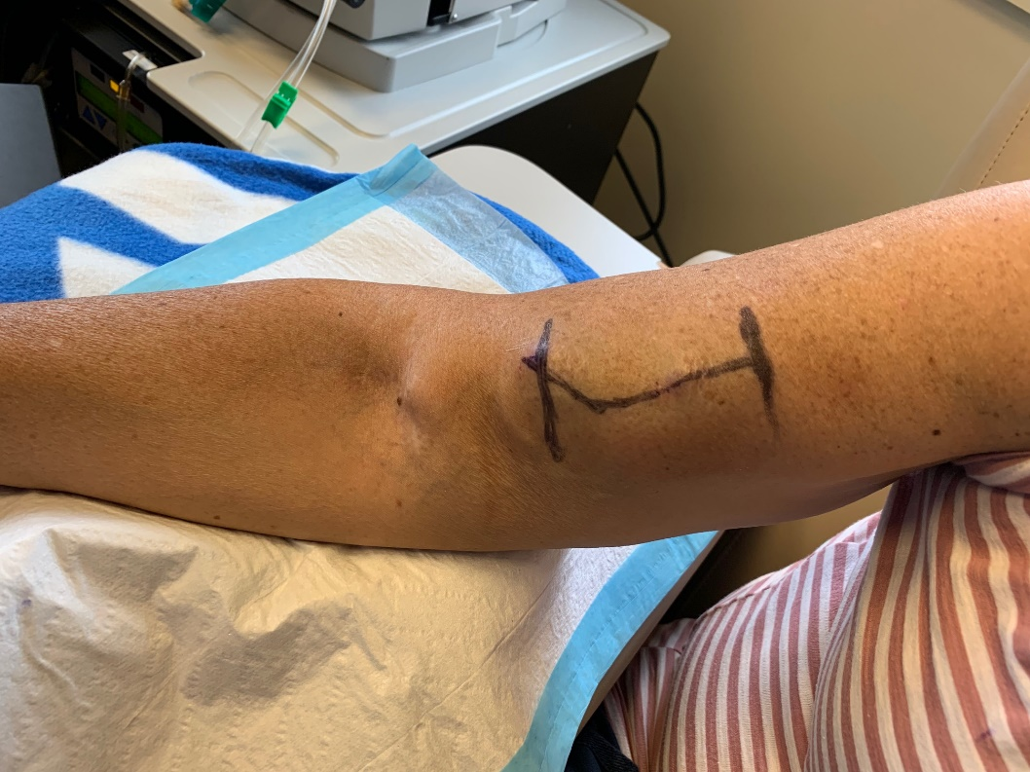
Question 3: Answer
Case Presentation
C. Treatment observed by nurse at home training area to examine technique
In this case, the patient’s fistula had increased in size with use, and since the arterial end is fixed, the arterial segment of the fistula developed a curve. The nurse noted the insertion of the arterial needle was no longer parallel to the fistula. This was subsequently confirmed in the home training area by point-of-care ultrasound. Once this was demonstrated to the patient, she had no further cannulation issues. The exam findings and venous pressures do not suggest an intraluminal problem with the AVF, so the patient’s technique should be reviewed first before a procedure is ordered. Thus, A and B are incorrect as they could not have identified the technique error. D is incorrect as needle direction was the problem, not needle depth.
Image courtesy of Dr. Brent Miller
Dialysis Core Curriculum 2021

Slide 40
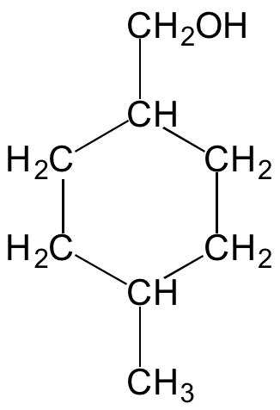
Question 4
Case Presentation
8 months after training, the patient calls to tell you that her neighborhood has been told to consume only bottled water because of an industrial contamination of 4-methyl-cyclohexane methanol (below) in the municipal water supply source. She utilizes a batched dialysate preparation system that produces ultrapure water from tap water including carbon purification and deionization.
What would be your recommendation for her dialysis treatment?
Transfer to center-based dialysis until the water problem is corrected
Continue current treatment since organic compounds are removed by carbon filter
Test dialysate for contamination
Switch to bagged, pre-mixed dialysate from the vendor
Dialysis Core Curriculum 2021

Slide 41
Question 4: Answer
Case Presentation
D. Switching to bagged, premixed dialysate from the vendor is the single bet answer as it allow the patient to continue her current treatment without risk.
This is the only option that ensures immediate HD at home without a problem. Option A is less desirable as changing to center-based dialysis would be more disruptive to the patient and may cause childcare or employment issues. Option B is incorrect because although carbon filters do indeed remove organic compounds, the amount of the spill and concentration in her tap water is not immediately known and without testing available, there is no guarantee of safety. Similarly, Option C is wrong; the dialysate could be tested, but this specific test will take days to weeks to receive results, and she needs dialysis treatment in the interim.
Dialysis Core Curriculum 2021

Slide 42
Question 5
Case Presentation
10 months after training, the patient calls to say her husband’s work schedule has been changed, and she would like to start dialysis approximately 2 hours before he gets home in the evening. She has had no safety issues and has been doing well. She performs all of her dialysis procedures herself and has done well with ongoing clinic educational and retraining events.
What is the best option?
Allow patient to do HHD alone after re-training with staff
Train 13-year-old daughter to be her care partner
Instruct patient to wait until husband arrives home to undergo dialysis
Offer patient center-based dialysis at the time she wants to perform dialysis
Dialysis Core Curriculum 2021

Slide 43
Question 5: Answer
Case Presentation
A. The Food and Drug Administration approved HHD without a partner in 2017 with the stipulation that risks are discussed with the patient, ancillary safety devices are utilized and patient training occurs.¹⁴
Options C and D would require significant changes to the patient’s lifestyle that may impair adherence to the dialysis regimen or create personal problems. Option B would place significant responsibility with a minor child.
Dialysis Core Curriculum 2021

Slide 44
Question 6
Case Presentation
12 months after HHD training, the patient wishes to change to nocturnal HD, 5 nights weekly for 7 hours each night. Which change will need to be made to her hemodialysis prescription?
Change her dialysate potassium bath to 2 meq/L from 1 meq/L
Change her heparin dose from one 3000 unit bolus at the start to a second 3000 unit bolus at hour 3 of dialysis
Increase dialysate volume from 25 L per treatment to 50 L per treatment
Add sodium phosphate to the dialysate bath for a concentration of 1 mg/dl
Dialysis Core Curriculum 2021

Slide 45
Question 6: Answer
Case Presentation
A. Change potassium bath from 1 meq/L to 2 meq/L
The marked increase in HD time, even if the dialysate volume is maintained constant, will markedly increase the amount of potassium removed during the treatment.¹⁵ Patients on nocturnal HD often need more heparin than a shorter GD treatment, but this is usually given in a continuous infusion rather than having the patient wake up to administer. The dialysis volume could be increased, but this is not necessary. Some patients on frequent nocturnal HD do occasionally need phosphate added to the dialysate, but this is the exception, particularly when dialysate volumes of <30L are utilized.
Dialysis Core Curriculum 2021

Slide 46
References
Plum et al NDT 16:2378, 2001
Kraus M et al. Hemodialysis Int 11:468-477, 2007
FHN Trial Group N Engl J Med 2287-2300, 2010
Assimon MM et al. Am J Kidney Dis 68:911-922, 2016
Culleton BF et al. JAMA 298:1291-1299, 2007
Chan et al. Clin J Am Soc Nephrol 20:665-671, 2009
Pauly RP et al. Am J Kidney Dis 73:230-239, 2019
Perl J, Na Y, Tennankore KK, Chan CT. Clin J Am Soc Nephrol 12: 1248-1258, 2017
Oostrom T, Einav L, Finkelstein A. Health Aff (Millwood) 36:826-832, 2017
Moist LM and Nesrallah GE. Clin J Am Soc Nephrol 9:3-5, 2014
Muir CA et al. Clin J Am Soc Nephrol 9:110-114, 2014
Parisotto MT et al. J Vasc Access 18:114-119, 2017
McRae JM et al. Clin J Am Soc Nephrol 7:1632-1638, 2012
https://www.accessdata.fda.gov/cdrh_docs/pdf17/k171331.pdf. Accessed October 21, 2020
Rocco MV et al. Kidney Int 80:1080-1091, 2011
Dialysis Core Curriculum 2021

