Slide 1
Complications of Peritoneal Dialysis
Prevention and Management of Infectious Complications of PD
Dialysis Core Curriculum 2021
Jeffrey Perl, MD
St. Michael’s Hospital, Unity Health Toronto
University of Toronto

Slide 2
Jeffrey Perl
Disclosures
Employer: St Michael’s Hospital
Consultancy Agreements: Baxter Health Care Canada; Fresenius Medical Care, Davita Healthcare Partners, LiberDi
Honoraria: AstraZeneca, Baxter Healthcare, DaVita Healthcare Partners, Fresenius Medical Care, US Renal care, Dialysis Clinics Incorporated, Satellite Healthcare
Speakers Bureau: Baxter Healthcare; Fresenius Medical Care
Scientific Advisor/Membership: Baxter Healthcare, DaVita Healthcare Partners, Fresenius Medical Care, Ostsuka, and LiberDi
Other Interests/Relationships: Salary Support: Arbor Research Collaborative For Health
Dialysis Core Curriculum 2021

Slide 3
Learning Objectives
State what are infectious complications in PD, their importance, and clinical consequences
Describe evidence-based prevention strategies for the prevention of PD peritonitis, exit site, and tunnel infections
Identify the approach to the diagnosis of exit site, tunnel infections, and PD-associated peritonitis
Discuss evidence-based treatment strategies for exit site, tunnel infections, and PD-associated peritonitis
Dialysis Core Curriculum 2021

Slide 4
Case: Part I
36-year-old male
ESKD due to IGA nephropathy
Seen for renal replacement therapies education and chooses PD while sister in workup for possible living kidney donation
PD catheter inserted
Begins PD training and sent home on APD 2L × 4 cycles 85% tidal over 9 hours day dry
Dialysis Core Curriculum 2021

Slide 5
Question 1
All are prophylactic antimicrobial strategies to reduce his risk of developing PD peritonitis except:
Antibiotics at the time of PD catheter insertion
Antibiotics at the time of a wet PD catheter contamination
Antibiotics at the time of lower GI endoscopy
Antifungals for prolonged courses of antibiotic therapy
Antibiotics at the time of a dry PD catheter contamination
Dialysis Core Curriculum 2021
Notes:
Wet contamination, not dry contamination, requires prophylactic antibiotics.

Slide 6
Case: Part II
Develops cloudy fluid 3 months after initiating PD
Cell count consistent with peritonitis
  Cell count 46000 E6/L, 80% neutrophils
Admits to not washing hands prior to connecting to the cycler
Starts empiric peritonitis treatment with:
  Vancomycin 1.5 g intraperitoneal
  Ceftazidime 1.5 g intraperitoneal
  Both in one daily 6-hour exchange per day
Dialysis Core Curriculum 2021

Slide 7
Question 2
All be indications for PD catheter removal during the course of his peritonitis treatment except:
Culture of the PD fluid grows Candida parapsilosis and cell count is improved following IP fluconazole
Culture of the PD fluid grows gentamicin-sensitive Pseudomonas aureginosa and the patient and cell count are improving on IP gentamicin and oral ciprofloxacin
Culture of the PD fluid and PD catheter exit site grows gentamicin-sensitive Pseudomonas aureginosa and the patient and cell count are improving on IP gentamicin and oral ciprofloxacin
The PD fluid cell count of a methicillin-sensitive Staphylococcus aureus peritonitis being treated with IP ancef is 895 cells/ uL on day 10 with 75 percent neutrophils
B and C
Dialysis Core Curriculum 2021

Slide 8
What Are the Infectious Complications of PD?
PD INFECTIONS AND THEIR IMPORTANCE
Peritonitis
Tunnel Infection
Exit Site Infection
Dialysis Core Curriculum 2021

Slide 9
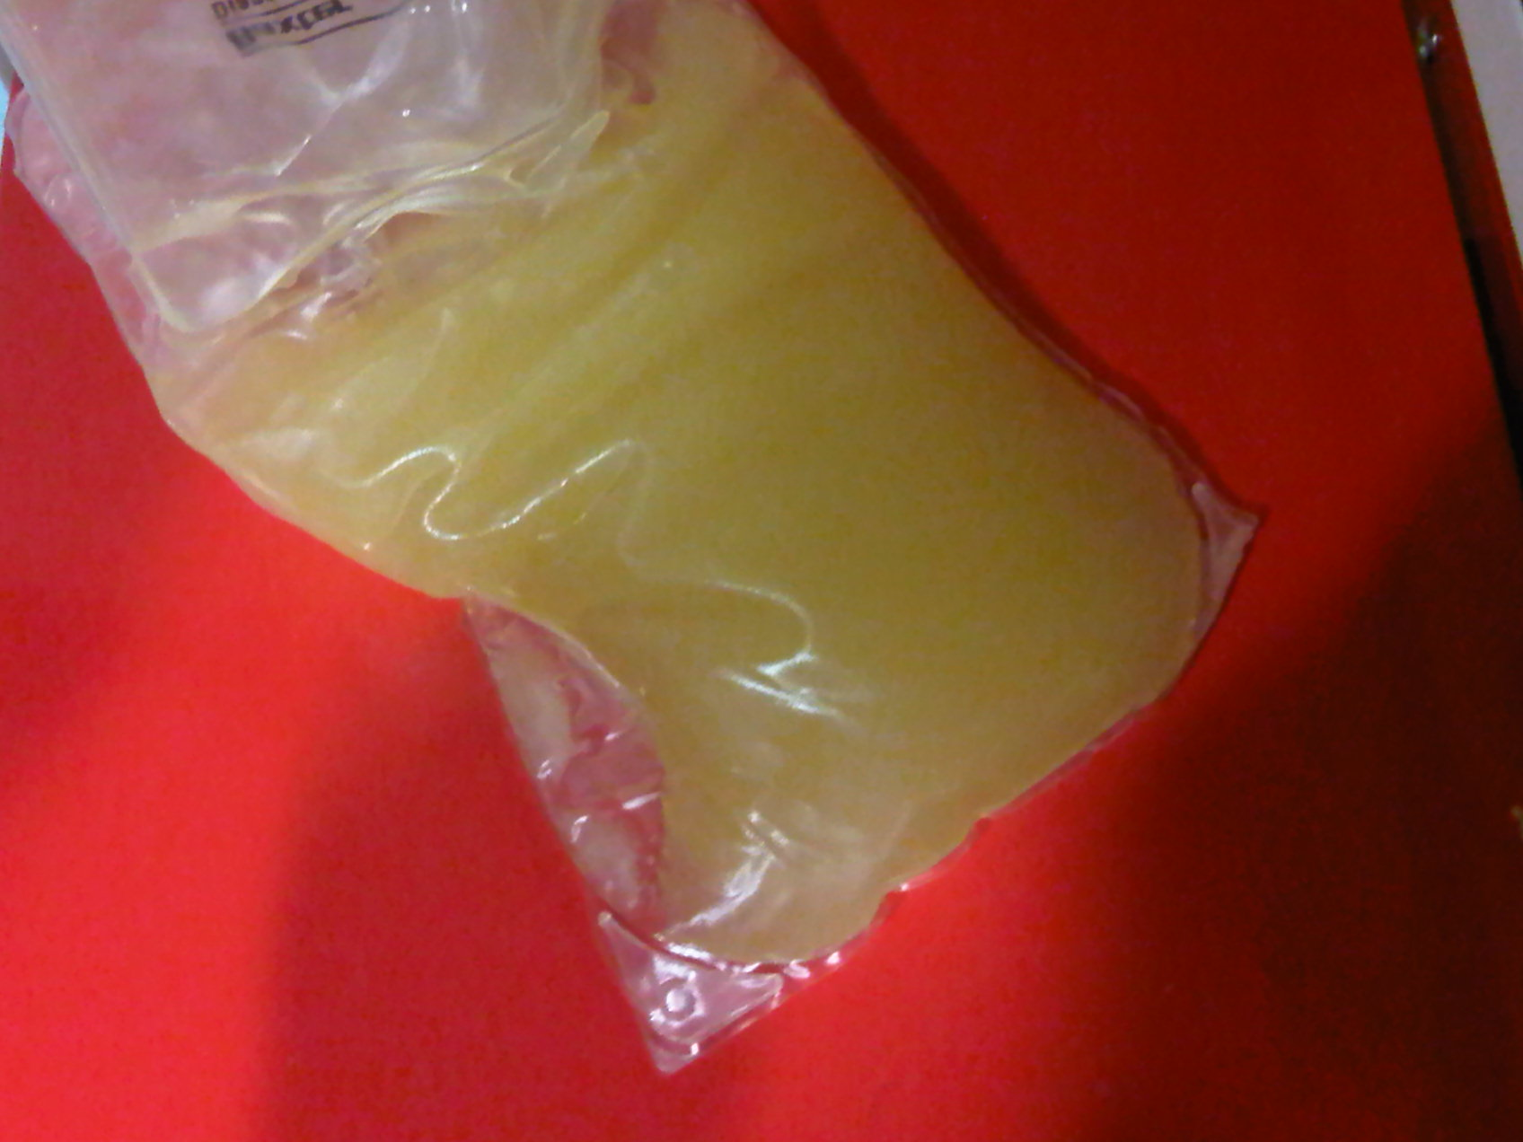
PD INFECTIONS AND THEIR IMPORTANCE
Clinical Consequences of Peritonitis
Mortality
Transfer to Hemodialysis
Pain and Discomfort
Alterations To The Peritoneal Membrane
Hospitalization / Added Treatment Costs
Dialysis Core Curriculum 2021

Slide 10
Infection Is the Leading Cause of Transfer to HD in the PDOPPS
PD INFECTIONS AND THEIR IMPORTANCE
Perl et al Unpublished
Dialysis Core Curriculum 2021

Slide 11
Flush Before Fill Principle
PREVENTION OF PERITONITIS
3. New fluid is instilled after flush
1. Spent dialysate
fluid drained
2. Portion of new PD Fluid flushes line but not instilled into patient
Dialysis Core Curriculum 2021

Slide 12
Antibiotics at the Time of PD Catheter Insertion
PREVENTION OF PERITONITIS
Randomized controlled trial among 221 patients:
  Group I: A single intravenous (IV) dose of vancomycin, 1,000 mg, 12 hours before insertion (86 procedures)
  Group II: A single IV dose of cefazolin, 1,000 mg, 3 hours before the procedure (85 procedures)
  Group III: No pre-operative antibiotic prophylaxis recommended (83 procedures)
Odds ratio of developing peritonitis:
  11.6 without antibiotic vs vancomycin
  6.45 cefazolin vs vancomycin
Choice of vancomycin vs cefazolin should be dictated by local resistance patterns
Gadallah et al Am J Kidney Dis. 2000 Nov;36(5):1014-9
Dialysis Core Curriculum 2021

Slide 13

Medical Directors Surveyed Who Reported that Their Program Routinely Administers Antibiotics at the Time of PD Catheter Insertion
PREVENTION OF PERITONITIS
% of medical directors indicating “Yes”
18
20
28
22
65
N facilities:
17
ANZ: Australia, New Zealand; UK: United Kingdom; US: United States
Boudville et al Nephrol Dial Transplant. 2018 Jul 23
Dialysis Core Curriculum 2021

Slide 14
Use of Antibiotics Peri-Colonoscopy
PREVENTION OF PERITONITIS
Colonic biopsy or polypectomy did not appear to increase the risk of peritonitis
 | Peritonitis | No Peritonitis | p value
Patients (n) | 5 | 92
Age (years) | 60 +/-13.9 | 64.7 +/-12.1 | 0.5
Sex (M:F) | 0:5 | 44:48 | 0.06
Duration of Dialysis (months) | 37.5 +/- 30.3 | 44.6 +/- 39.3 | 0.6
Diabetes Mellitus | 2 | 34 | 1
Scope passed up to ascending colon | 3 | 44 | 0.7
Received antibiotics before colonoscopy | 0 | 18 | 0.6
Make Sure Patient Is Dry For Procedure!!!
Yip et al Peritoneal Dialysis International, vol. 27, 5: pp. 560-564
Dialysis Core Curriculum 2021

Slide 15
Wet Contamination: Possible Scenarios
PREVENTION OF PERITONITIS
Hole tear in bag
Transfer set
Catheter
Exit site
Titanium connector
Open twist clamp
Dialysis Core Curriculum 2021

Slide 16
PREVENTION OF PERITONITIS
Management of Wet Contamination
Have patient come into emergency or home dialysis unit
Check where it occurred
Inspect PD catheter and transfer set to be changed
Prophylactic antibiotics options:
  cefazolin x 1 (IP)
  vancomycin x 1 (IP)
  oral cephalexin 2-day course
Review of technique if needed
Repair of catheter if needed
Li et al Peritoneal Dialysis International, 2016 Vol. 36, pp. 481–50
Dialysis Core Curriculum 2021

Slide 17
Prophylactic Antifungals During Antibiotic Therapy
PREVENTION OF PERITONITIS
May reduce the risk of antibiotic associated fungal peritonitis
Particularly if being treated with broad spectrum antibiotics
Nystatin 500 000 U pod qid (swallow no swish!!) is one option
Not just for peritonitis-related antibiotics
Continue for one week after antibiotics done
Use for all antibiotic courses in patients on PD (not just during peritonitis)
Reference* | Prophylaxis | Rate of peritonitis (without vs with)
Zaruba K, et al. Am J Kid Dis. 1991;17:43-46 | Nystatin S & S tid | 0.29 vs 0.02
Robitaille P. Perit Dial Int. 1995;15:77-79 | Nystatin or ketoconazole | 0.17 vs 0
Wadhwa N, et al. Adv Perit Dial. 1996;12:189-191 | Fluconazole qd | 0.08 vs 0.01
Lo WK, et al. Am J Kid Dis. 1996;28:549-552 | Nystatin qid | 0.02 vs 0.01
Thodis E, et al. Perit Dial Int. 1998;18:583-589 | Nystatin qid | 0.02 vs 0.02
Williams P, et al. Perit Dial Int. 2000;20:352-353 | Nystatin qid | 0.01 vs 0.01
Dialysis Core Curriculum 2021

Slide 18
Gentamicin v.s. Mupirocin at the Exit Site Results of a Randomized Controlled Trial
PREVENTION OF PERITONITIS
Mupirocin (intranasal and at the exit site) shown to reduce the risk of S. aureus peritonitis and exit site infections in a meta-analysis
133 patients were randomized, 67 to gentamicin, and 66 to mupirocin cream
Significantly lower rate of Gm + and Gm - exit-site infection (ESI) with Gentamicin (0.23 vs 0.54 per patient-year)
Same rate of S. aureus ESI between groups
No Pseudomonas aeruginosa ESI in the gentamicin group
Lower rate of peritonitis with Gentamicin: 0.34/yr vs 0.52/yr (p=0.03)
  R/t reduced Gm neg peritonitis (1 vs 8)
  No P. aeruginosa peritonitis (0 vs 2)
Tacconelli E, Clin Infect Dis 37:1629-1638, 2003
Bernardini et al J Am Soc Nephrol 16: 539-545, 2005
Dialysis Core Curriculum 2021

Slide 19
What Exit Site Strategy Is Used in Programs?
PREVENTION OF PERITONITIS
ANZ: Australia, New Zealand; UK: United Kingdom; US: United States
Boudville et al Nephrol Dial Transplant. 2018 Jul 23
Dialysis Core Curriculum 2021

Slide 20
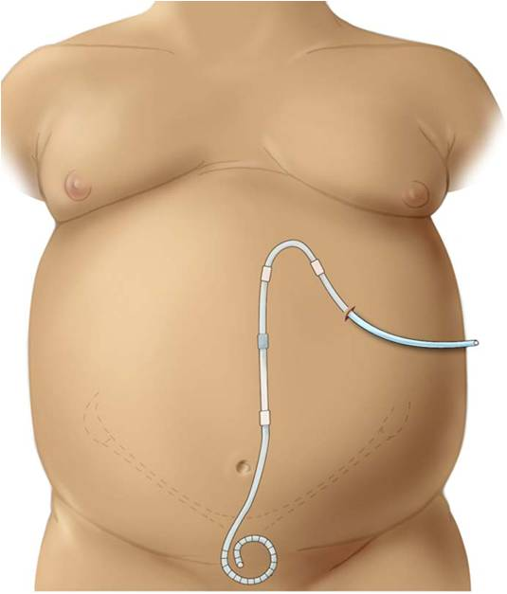
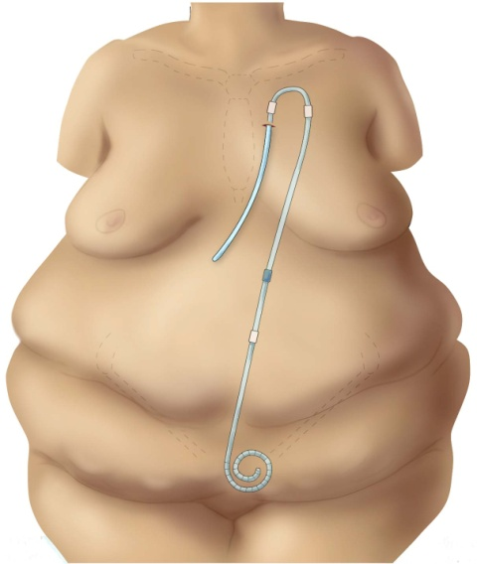
Extended Two-Piece Catheters
PREVENTION OF PERITONITIS
Upper Abdominal
Presternal
Illustrations courtesy of Dr. John Crabtree
Crabtree et al OPTIMAL PD ACCESS: 2019 GUIDELINES PDI 2019
Dialysis Core Curriculum 2021

Slide 21
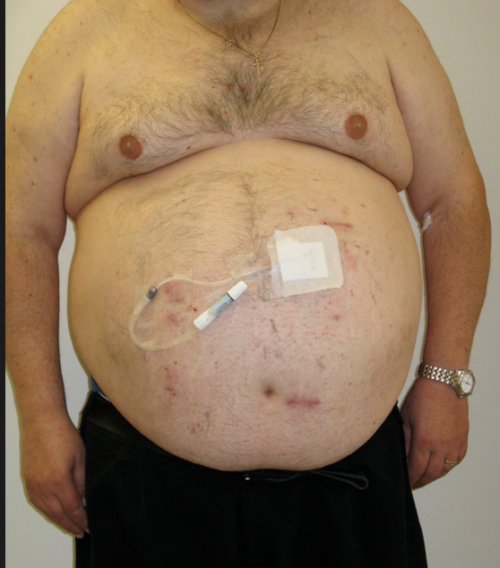
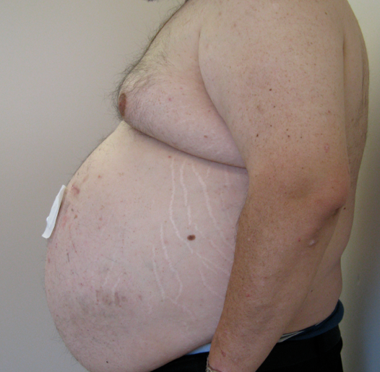
Extended Two-Piece Catheters Such as Upper Abdominal Catheter Allow Optimal Placement of Exit Site in Obese Individuals
PREVENTION OF PERITONITIS
Pictures: Dr. Jeffrey Perl
Dialysis Core Curriculum 2021

Slide 22
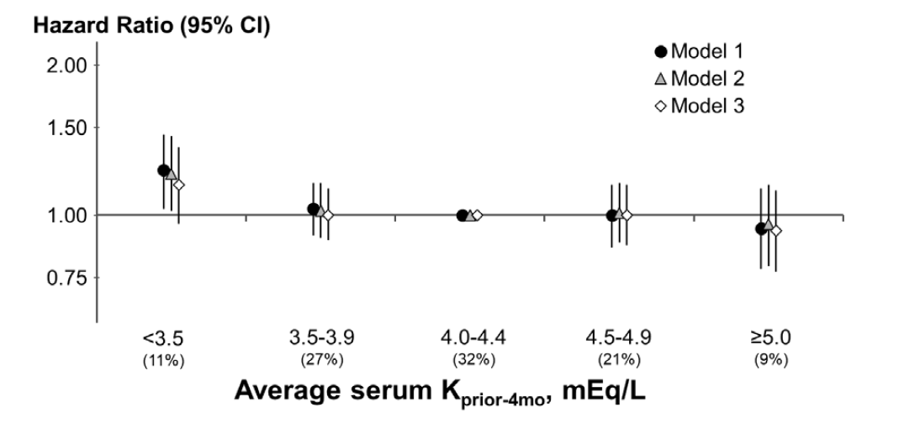
PREVENTION OF PERITONITIS
Hypokalemia and Risk of All Cause Peritonitis Risk in
the PDOPPS
All Cause peritonitis n=7157, 1680 events
Davies et al. KI Reports (in press)
Dialysis Core Curriculum 2021

Slide 23
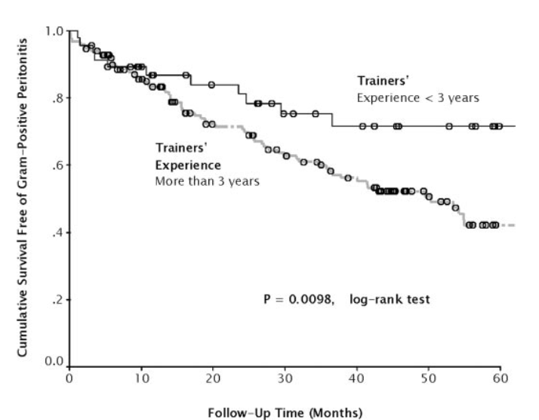
Trainer’s Experience and the Risk of Peritonitis
PREVENTION OF PERITONITIS
Patients trained by nurses >3 years of experience had a more than two-fold increased likelihood of subsequent gram-positive peritonitis.
Maintaining competency among nurse trainers is critical.
Chow et al Clin J Am Soc Nephrol 2: 647-652, 2007
Dialysis Core Curriculum 2021

Slide 24
ESI AND TUNNEL INFECTION DIAGNOSIS
Exit Site and Tunnel Infections
Concerning because may lead to peritonitis
  especially for S. Aureus and Pseudomonas species
Exit site infection
  erythema
  +/- seropurulent drainage
  culture pus not swab skin
  may need to milk hard
Diagnosis of tunnel infection
  edema and tenderness along catheter tunnel
  +/- ultrasound if unsure
Dialysis Core Curriculum 2021

Slide 25
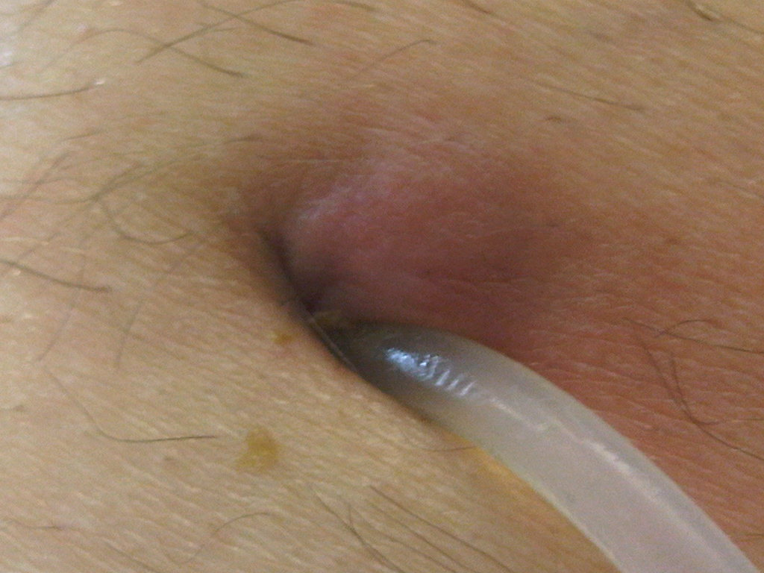
EXIT SITE INFECTION DIAGNOSIS
Exit Site Infection
Normal
Exit Site Infection
Pictures: Dr. Jeffrey Perl
Dialysis Core Curriculum 2021

Slide 26
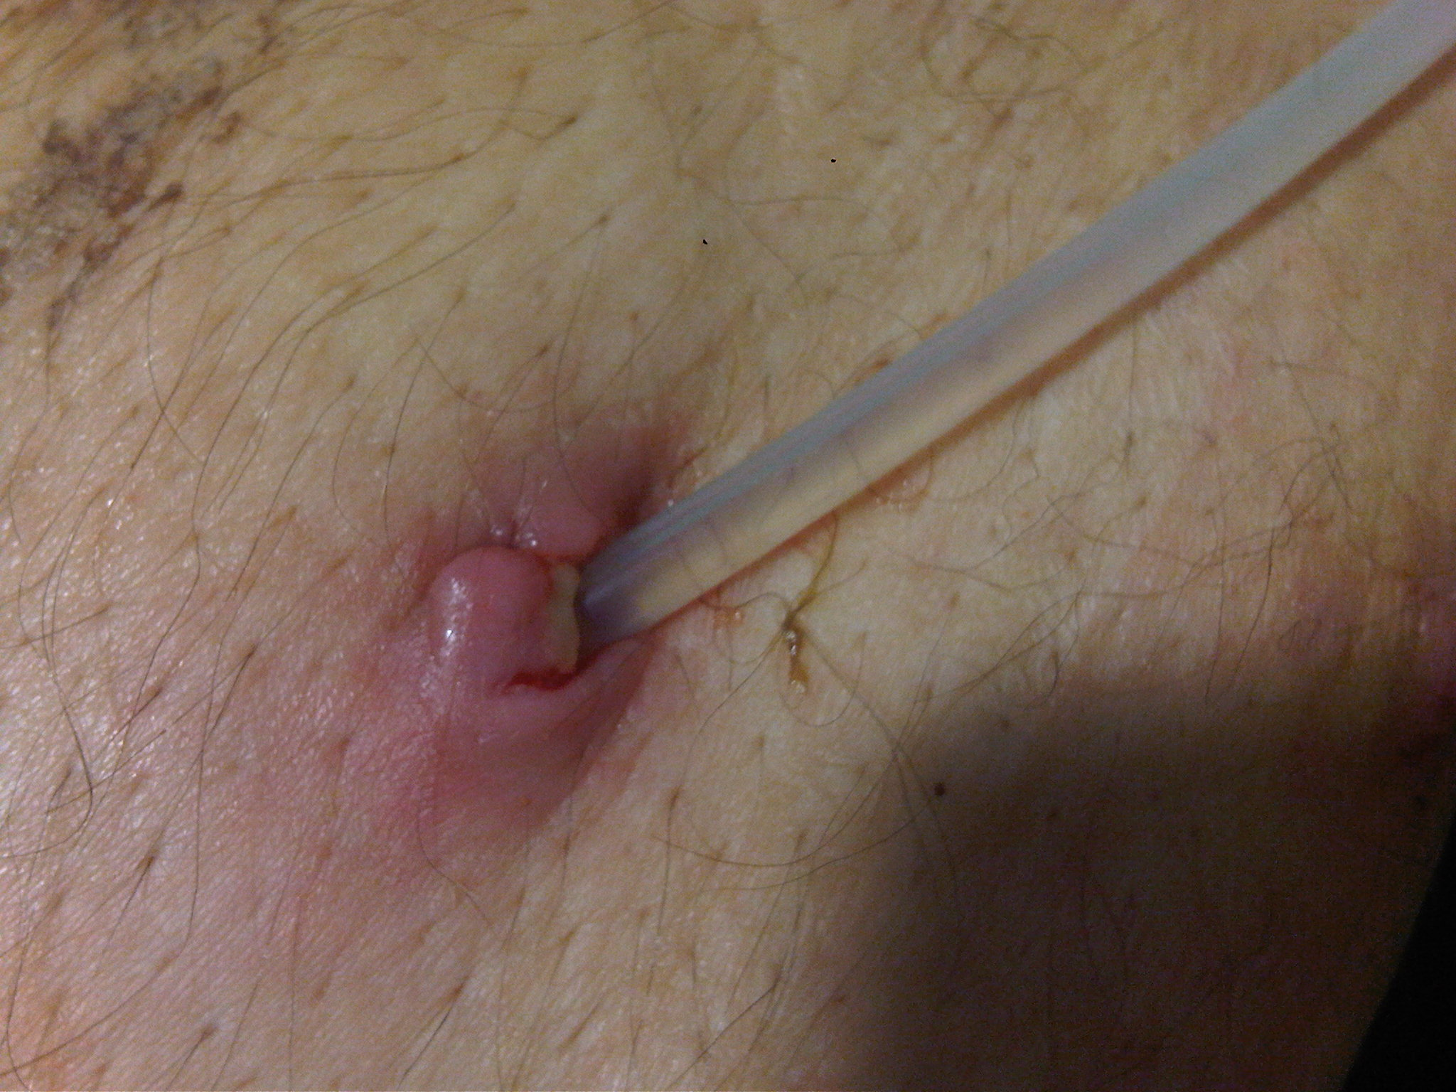
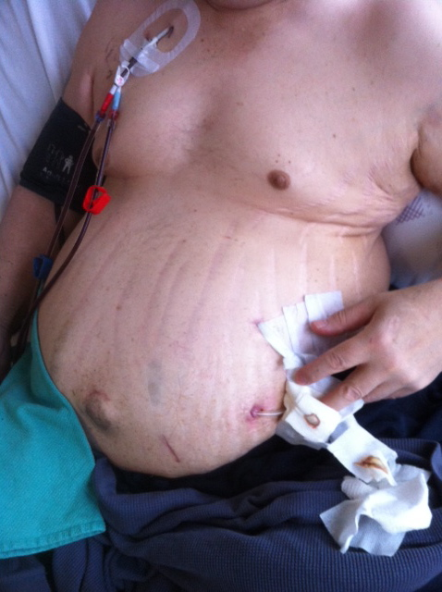
Prevention of Exit Site Infection
ESI AND TUNNEL INFECTION PREVENTION
Avoid anchoring suture at exit site
Avoid exit site placement at beltline
Pictures: Dr. Jeffrey Perl
Dialysis Core Curriculum 2021

Slide 27
Prevention of Exit Site Infections: Summary
ESI AND TUNNEL INFECTION PREVENTION
Appropriate catheter type and location:
  may need a two-piece extended PD catheter
Exit site care (antiseptic solution vs antibacterial soap and water)
Exit site ointment or cream (mupirocin or gentamicin)
Dialysis Core Curriculum 2021

Slide 28
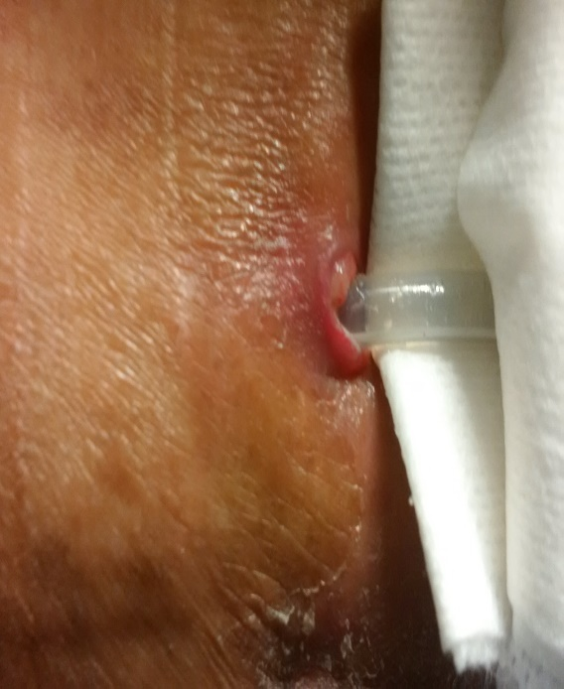
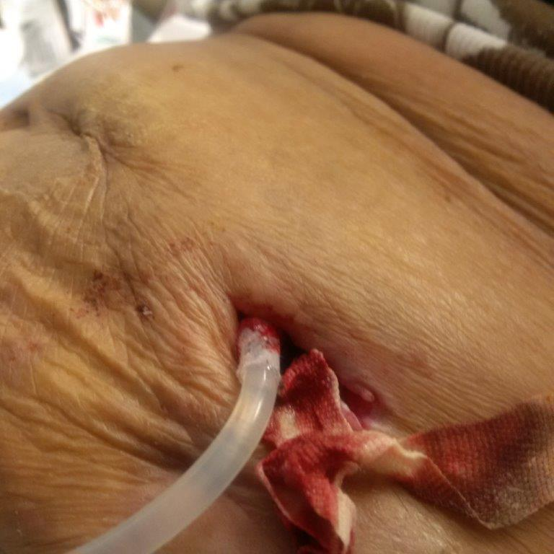
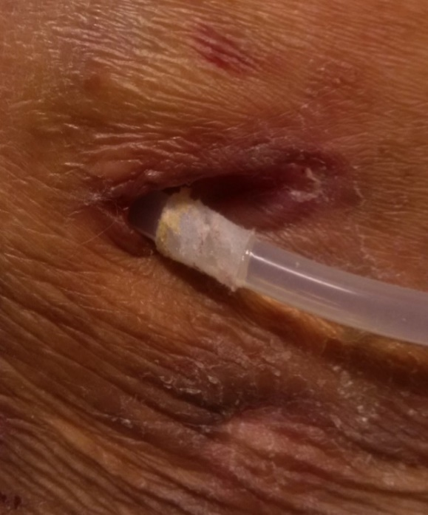
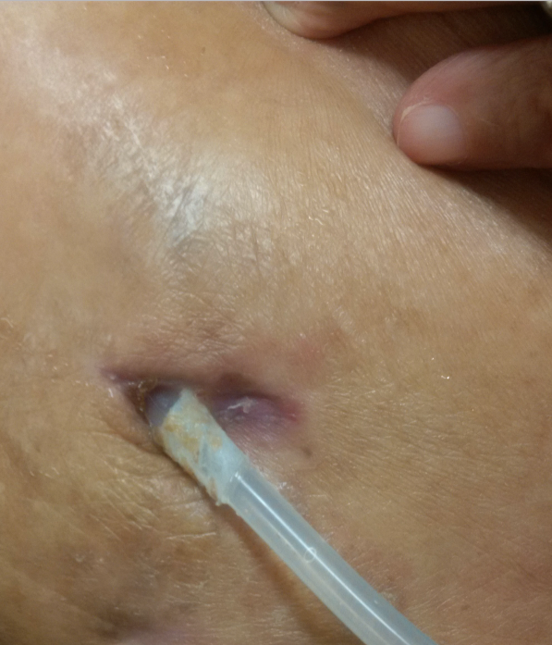
TREATMENT OF ESI AND TUNNEL INFECTIONS
Tunnel Deroofing and Cuff Shaving for Tunnel Infection Refractory to Antibiotic Therapy to Salvage PD Catheter
Tunnel opened and Superficial PD catheter cuff is shaved and converts two cuff catheter to one cuff catheter and new placement of exit site
Pre-deroofing
After
deroofing
One week
Post-deroofing
Two weeks
Post-deroofing
Picture: Dr. Jeffrey Perl
Dialysis Core Curriculum 2021

Slide 29
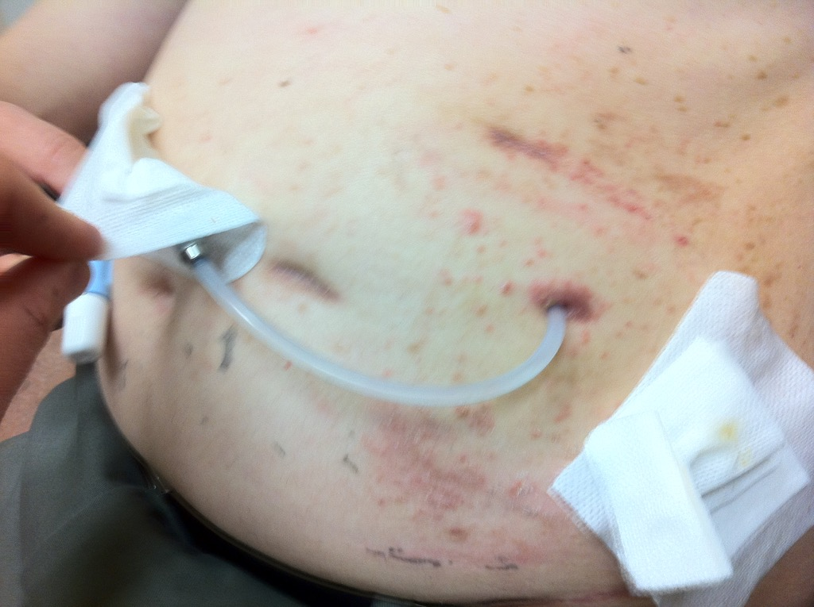
TREATMENT OF ESI AND TUNNEL INFECTIONS
Yeast Infection with Satellite Lesions
Picture: Dr. Jeffrey Perl
Dialysis Core Curriculum 2021

Slide 30
TREATMENT OF ESI AND TUNNEL INFECTIONS
Management of Exit-Site Infection
Culture/Gram stain purulent drainage from exit site
Oral and/or IP antibiotics
Adjust antibiotics to culture and sensitivity
Adjust antibiotics to culture and sensitivity
Re-evaluate
Infection resolving: continue treatment for at least two weeks, re-evaluate
Infection unresolved
(3-4 weeks): consider catheter revision, removal, or reinsertion at another site (may consider removal and reinsertion under same procedure)
Adapted from Li P, et al. Perit Dial Int 2010;30:393–423
Dialysis Core Curriculum 2021

Slide 31
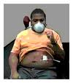

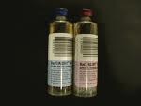

Peritonitis: Routes of Entry of Organisms
PERITONITIS: MICROBIOLOGY AND OUTCOMES
frequency
Skin, PD Catheter
Across Bowel Wall
Hematogenous
Transvaginal
Determine the Root Cause: History and Physical
Dialysis Core Curriculum 2021

Slide 32
PERITONITIS: MICROBIOLOGY AND OUTCOMES
Peritonitis: Organisms
Gram-Positive
  Coagulase-negative Staph
  Staph aureus
  Alpha-hemolytic Strep
  Enterococcus
  Diphtheroid (don’t let the lab tell you it’s a contaminant)
Gram-Negative
  Enterobacteria
  Pseudomonas
  Acinetobacter
Anaerobes
  Clostridium
  Bacteroides
Mycobacterium
  M. tuberculosis
Fungi/Yeasts
  Candida species
  Aspergillus
Dialysis Core Curriculum 2021

Slide 33
Peritonitis Organism-Specific Rate, by Country
PERITONITIS: MICROBIOLOGY AND OUTCOMES
ANZ: Australia, New Zealand; UK: United Kingdom; US: United States
Perl et al AJKD 2020
Dialysis Core Curriculum 2021

Slide 34
Peritonitis Rarely Leads to Bacteremia but Bacteremia May Lead to Peritonitis
PERITONITIS: MICROBIOLOGY AND OUTCOMES
Look for other source if PD fluid is growing the same organism as blood (i.e., endocarditis)
If an enteric organism, consider CT imaging to look for secondary cause (i.e. cholangitis)
Bacteremia
Peritonitis

Slide 35
The Risk of Catheter Loss Varies, By Organism
PERITONITIS: MICROBIOLOGY AND OUTCOMES
Mujais et al KI 2006
Dialysis Core Curriculum 2021

Slide 36
Peritonitis: Diagnosis
PERITONITIS DIAGNOSIS
2 of:
  PD Fluid Cell count
    >100/mm3
    at least 50% polymorphonuclear cells
    Dwell time (2-4 hours)
  Abdominal Pain
  Positive PD Effluent Culture (not known at time of presentation)
Li et al Peritoneal Dialysis International, 36:481–508 2016
Dialysis Core Curriculum 2021

Slide 37
A Word About the Cell Count
PERITONITIS DIAGNOSIS
Cell count is dwell time dependent.
Long dwells, dry abdomen – monocyte predominant cell count
Short dwells: less time to mount a cell count (i.e., APD presenting at night)
  Differential will be very helpful here.
An appropriate dwell time is usually 2 hours.
A cell count of 600 with 95% monocytes is less concerning for peritonitis than a cell count of 89 with 90% neutrophils.
Dialysis Core Curriculum 2021

Slide 38
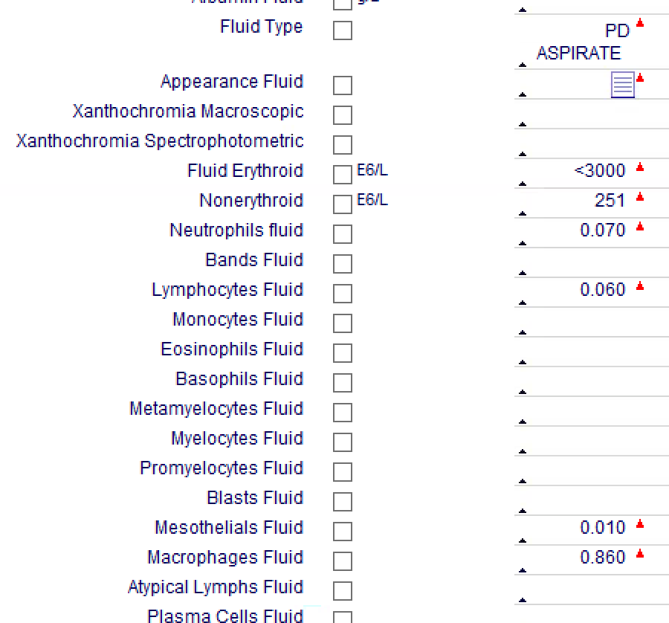
A Word About the Cell Count
PERITONITIS DIAGNOSIS
Not Peritonitis
Dialysis Core Curriculum 2021

Slide 39
PERITONITIS DIAGNOSIS
The Drive-By PD Fluid Culture
If there are no symptoms, a positive culture in the absence of a positive cell count may not be peritonitis and may not warrant treatment.
Dialysis Core Curriculum 2021

Slide 40
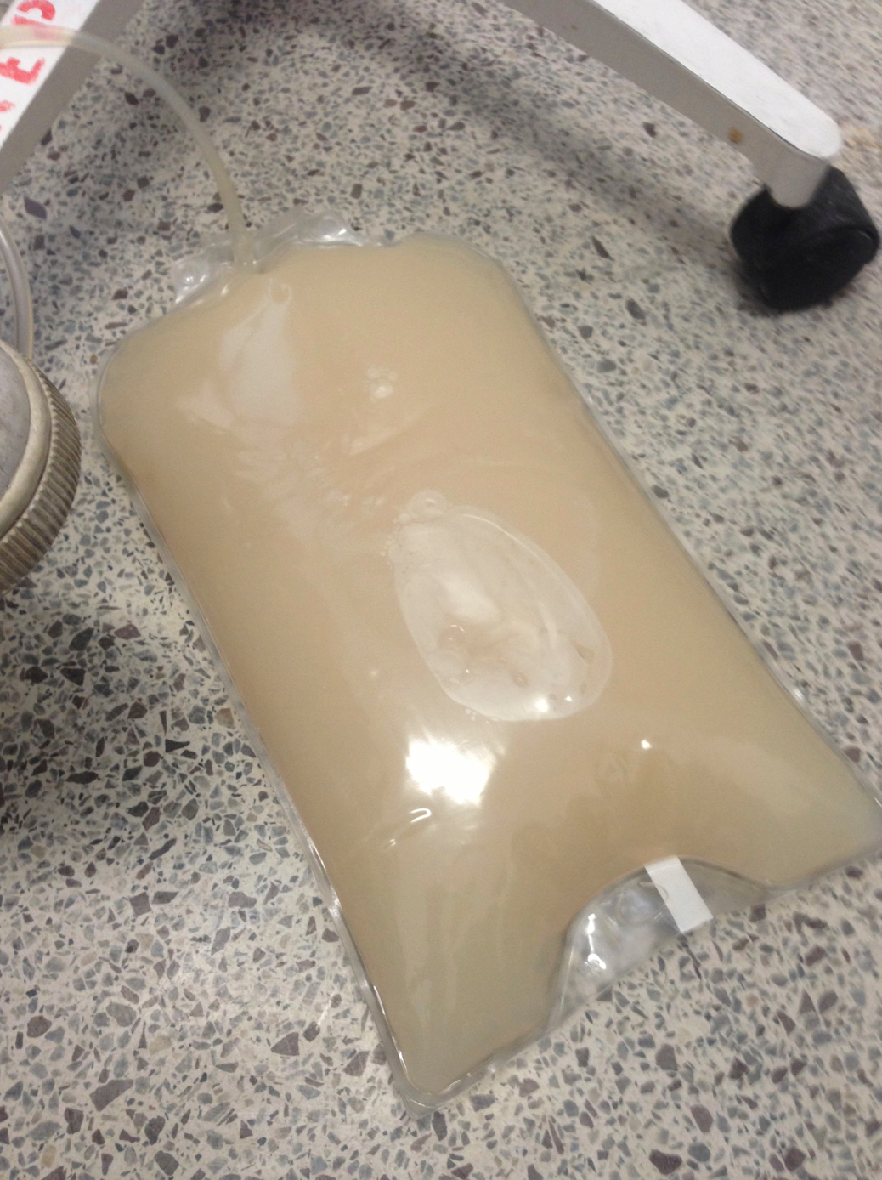
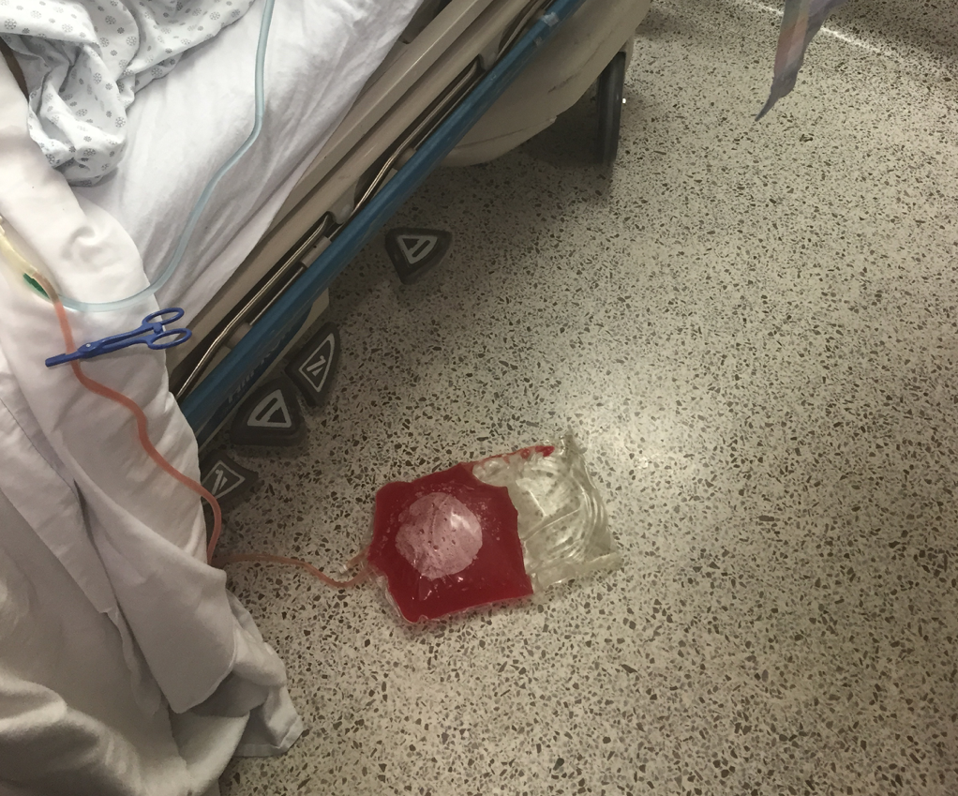
Not All that Is Cloudy Is Peritonitis
PERITONITIS DIAGNOSIS
Clostridium Difficile infection
Encapsulating Peritoneal Sclerosis
Chyloperitoneum (rare)
Hemoperitoneum
Sample from dry abdomen
Eosinophilic peritonitis
Chemical Peritonitis
Malignancy
Chyloperitonuem
Hemoperitoneum
Pictures: Dr. Jeffrey Perl
Dialysis Core Curriculum 2021

Slide 41
Peritonitis: Differential Diagnosis
PERITONITIS DIAGNOSIS
Eosinophilic peritonitis
Ischemic colitis
Pancreatitis
Pyelonephritis
Ruptured cyst (ovary, PCKD)
Transplant kidney rejection
Clostridium difficile infection
Constipation
Strangulated/incarcerated hernia
Dialysis Core Curriculum 2021

Slide 42
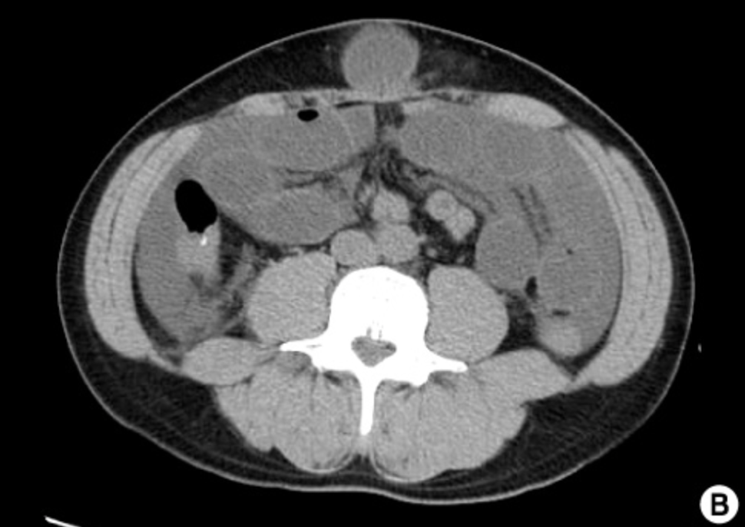
Peritonitis Secondary to Strangulated Umbilical Hernia
PERITONITIS: MICROBIOLOGY AND OUTCOMES
Think about particularly if peritonitis presents with localized pain
Dialysis Core Curriculum 2021

Slide 43
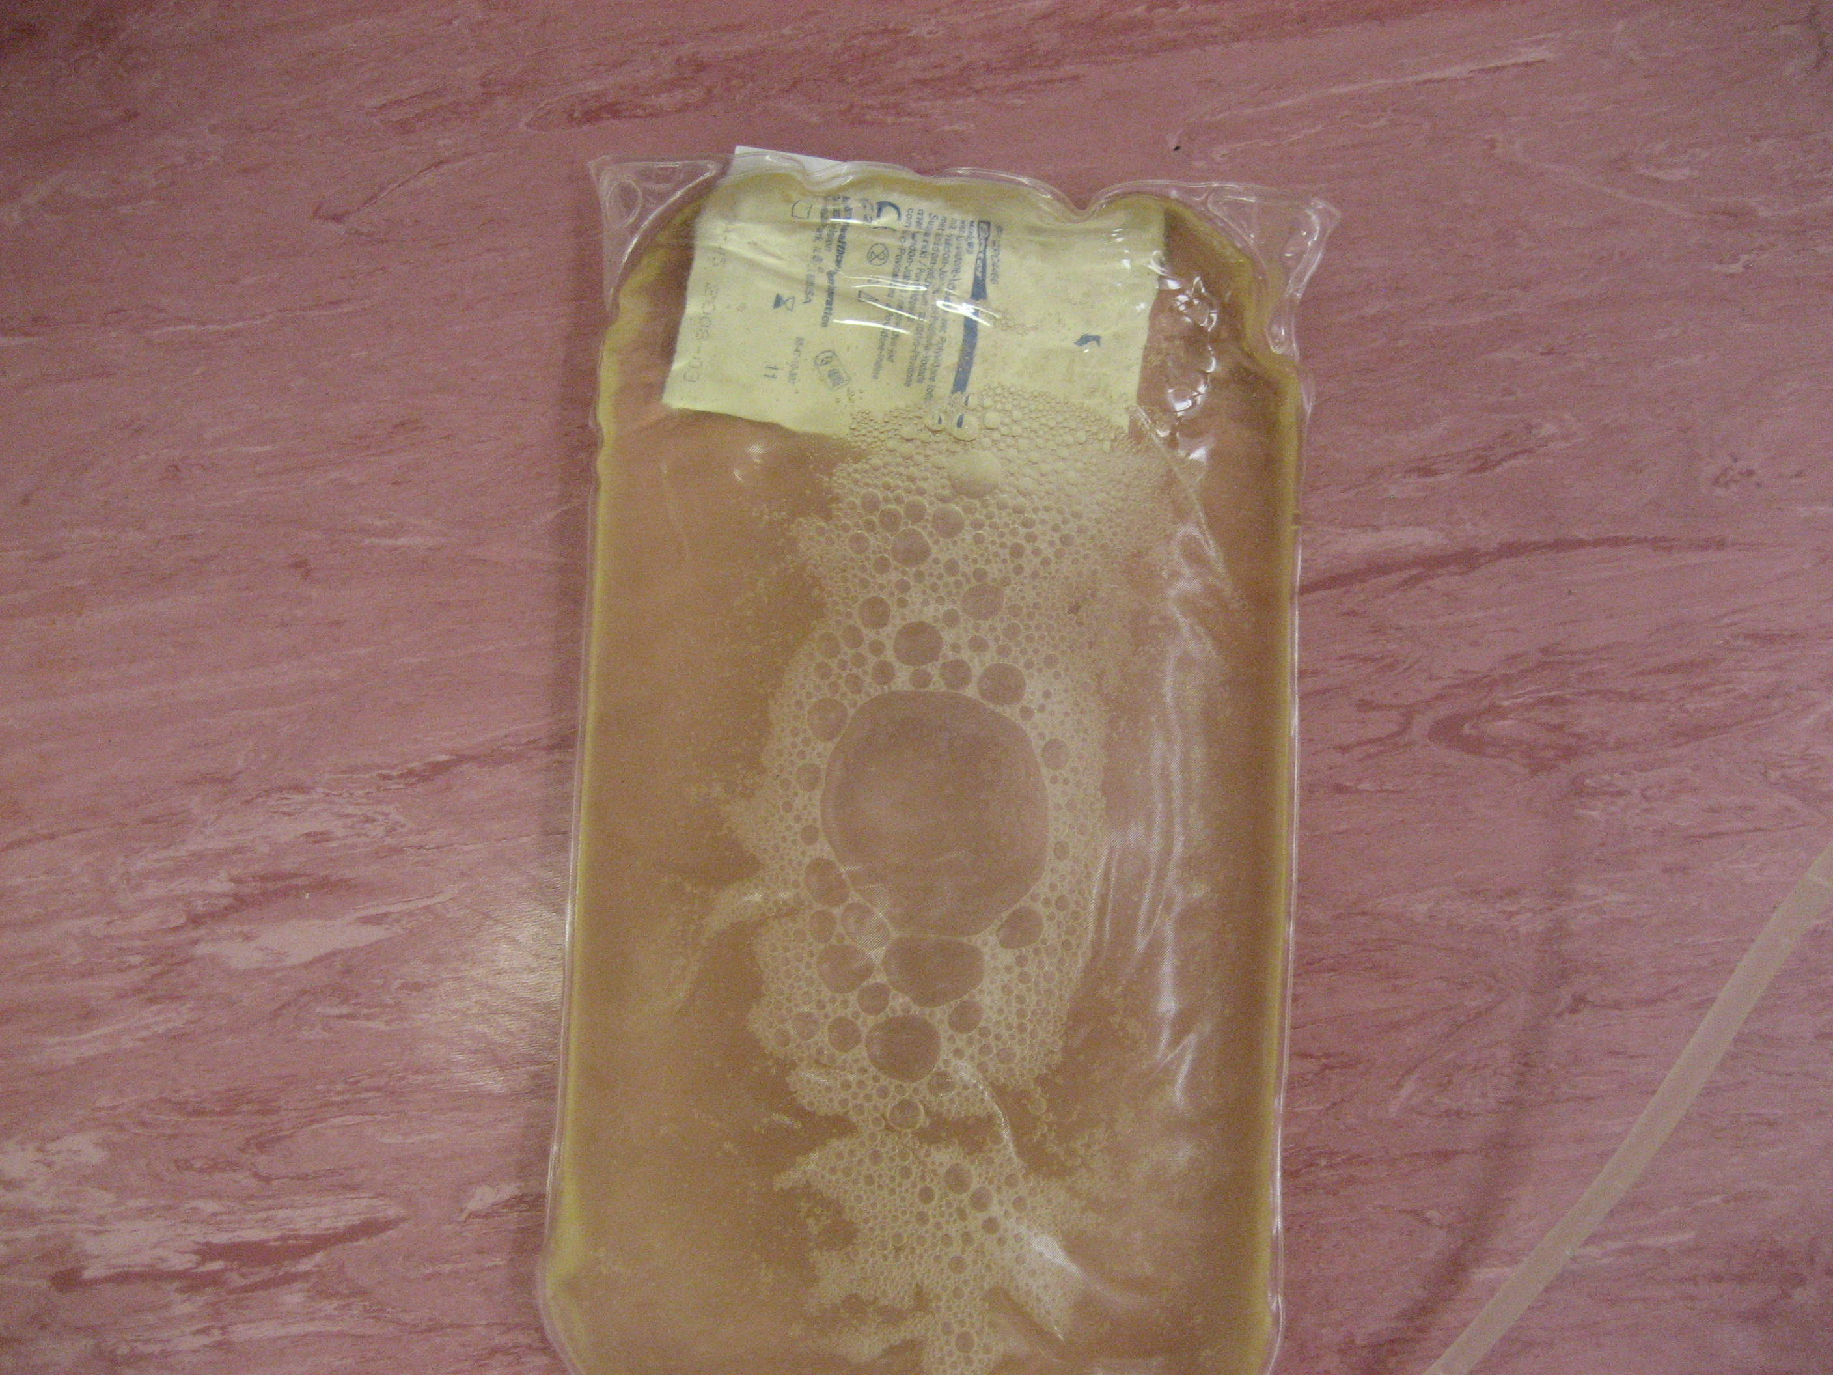
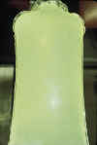
PERITONITIS DIAGNOSIS
Cloudy Fluid: The Read Test
Can read through bag: not cloudy
Cannot read through bag: cloudy
Pictures: Dr. Jeffrey Perl
Dialysis Core Curriculum 2021

Slide 44
PERITONITIS DIAGNOSIS
Peritonitis Classification: The Four ‘’R’’s
Relapsing – within 4 weeks same organism
Repeat – after 4 weeks same organism
Recurrent – within 4 weeks different organism
Refractory – failure of effluent count to normalize or organism persists to grow after 5 days of appropriate therapy
Li et al Peritoneal Dialysis International, 36: 481–508 2016
Dialysis Core Curriculum 2021

Slide 45
Microbiology of Repeat Peritonitis
Peritonitis diagnosis
Baxter POET Database: 1996-2005 over 4000 peritonitis
episodes captured
Microbial Profile in Patients Experiencing at Least Two Infections with the Same Organism
Variable | Value
Total episodes (n) | 181
Organisms involved (%)
Coagulase-negative Staphylococcus (CNS) | 65.7
Staphylococcus aureus | 12.2
Streptococcus viridans | 12.2
Escherichia coli | 6.0
Others | 3.9
1-year risk of repeat CNS:
  OR 2.1 (95% CI: 1.5 to 2.8)
  48% within 6 months
Nessim et al PDI 2012
Dialysis Core Curriculum 2021

Slide 46
What Is a Biofilm?
Peritonitis diagnosis
Defence for bacteria to thrive
Aggregated communities enmeshed in an extracellular matrix of microbial and host-derived components; demonstrated by microscopy and culture
DNA fragments demonstrated in “sterile’’ dialysis fluid
Repeat peritonitis may relate to development of biofilm on the surface of PD catheters that may not be treated with antibiotics alone
May require PD catheter removal if same organism grows with consecutive peritonitis episodes as antibiotics may not eradicate organisms on the biofilm
Szeto et al Clin J Am Soc Nephrol 2013; 8:1935–41
Sampaio et al PLOS One 2016; 11(6):e0157870
Camargo et al CJASN June 2014, 9 (6) 1074-1081
Dialysis Core Curriculum 2021

Slide 47
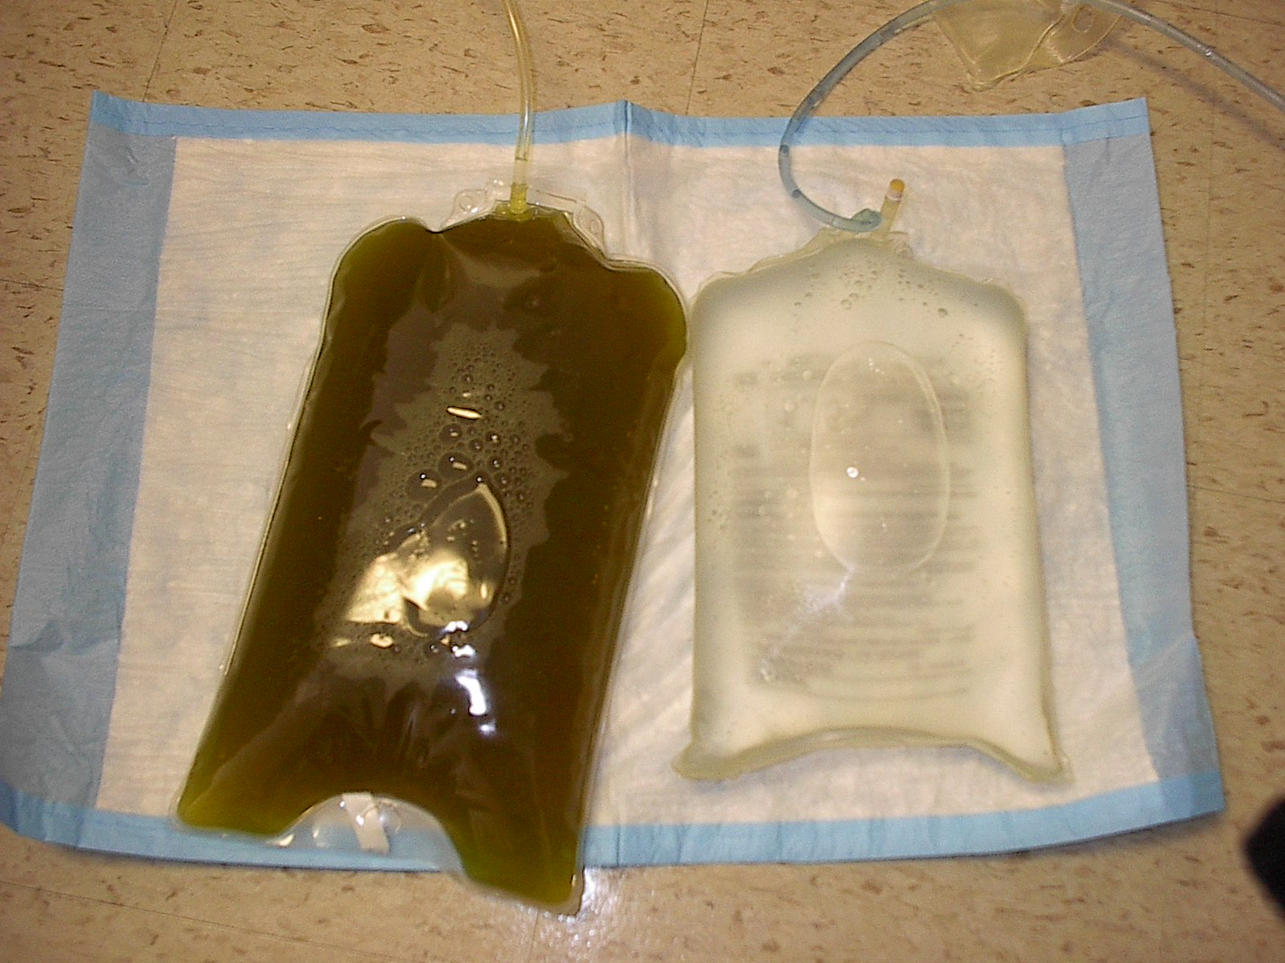
PERITONITIS DIAGNOSIS
Peritonitis: Secondary
Appendicitis
Perforated Viscus
Diverticulitis
Strangulated Hernia
Clues
  Polymicrobial enteric organisms
  Systemically unwell (hypotensive, fever)
  Non-resolving enteric organism peritonitis
Dialysis Core Curriculum 2021

Slide 48
Antibiotics Administered: Advantage of IP
PERITONITIS TREATMENT
IP therapy results in very high antibiotic concentrations at the site of infection
Precludes need for venous access
  Poor IV access
  Home therapy in remote locations
Can be given irrespective of GI symptoms (e.g., nausea/vomiting)
Not just for peritonitis; consider in prolonged outpatient antibiotic course
IP: intraperitoneal; IV: intravenous; GI: gastrointestinal
Manley HJ, Bailie GR. Semin Dial 2004;15:418–421
Dialysis Core Curriculum 2021

Slide 49
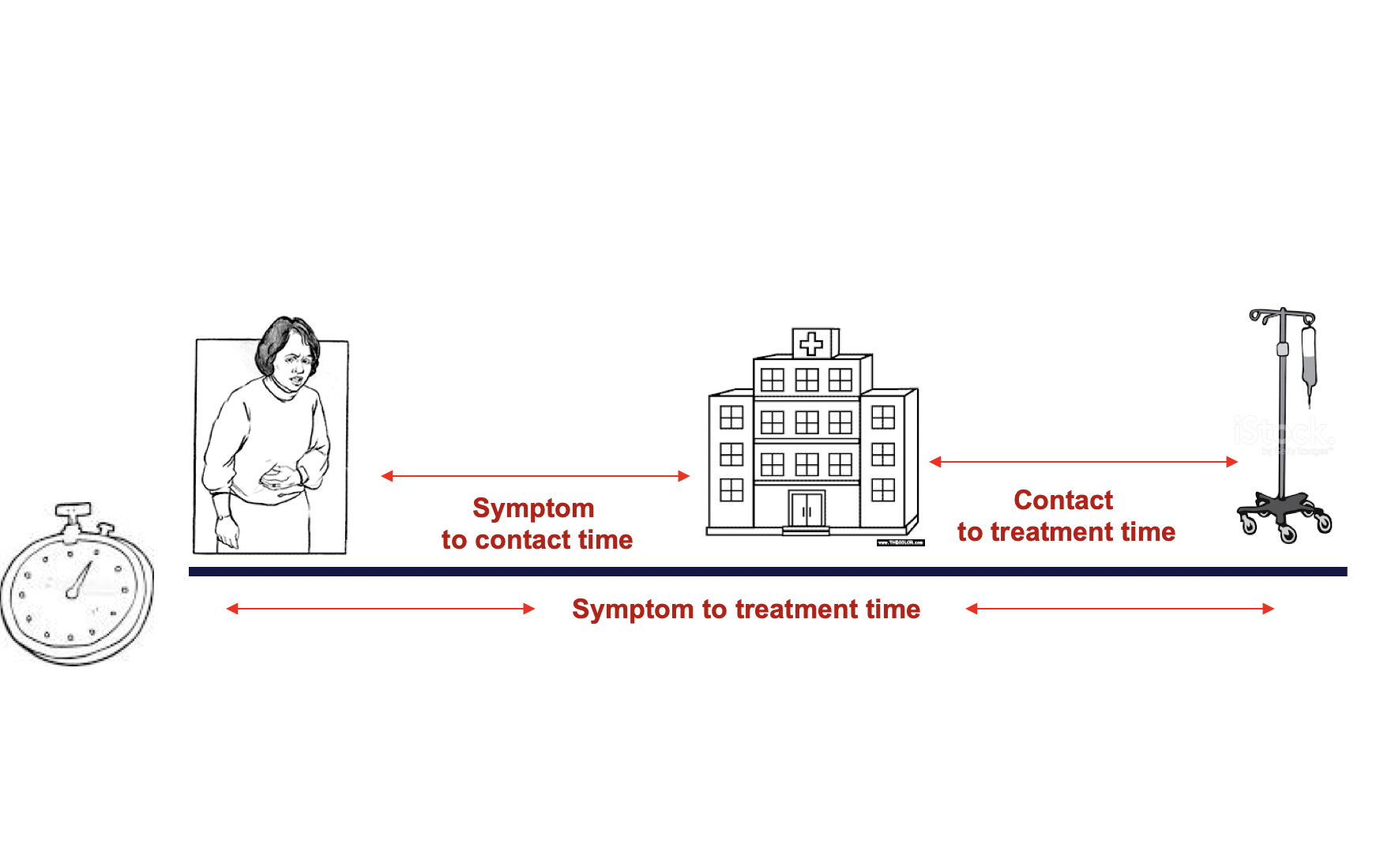
Don’t Delay Antibiotic Administration: PROMPT STUDY
PERITONITIS TREATMENT
159 episodes of PD peritonitis
116 patients in Western Australia
Measured and looked at outcomes for
  symptom to contact time
  contact to treatment time
  symptom to treatment time
38 PD ’’failures’’
  28 catheter removals
  10 deaths
  Contact to treatment time and female sex were associated with failure.
  The risk of PD failure increased by 5.5% for each hour of delay of administration of antibiotics.
Muthucumarana et al, Kidney Intl (2016) 1, 65-72
Slide courtesy Joanne Bargman
Dialysis Core Curriculum 2021

Slide 50
Principles of Management: Antibiotics
PERITONITIS TREATMENT
Broad spectrum antibiotic coverage with IP antibiotics
  Gram +ve-
    1st generation cephalosporin or vancomycin
  Gram –ve (includes anti-pseudomonal)
    3rd generation cephalosporin or aminoglycoside
Your local resistance patterns (i.e., MR- methicillin resistance)
  MRSA / MR-CNST should dictate vanco vs first generation cephalosporin
Dialysis Core Curriculum 2021

Slide 51
Principles of Management: Antibiotics
PERITONITIS TREATMENT
Presence of residual kidney function
  Avoid aminoglycoside and consider 3rd generation cephalosporin and increase dose of antibiotics
Presence of drug allergy (i.e., penicillin)
  May need to avoid cephalosporins
Cover for organism if recent peritonitis (within 4 weeks) (my advice)
Intermittent intraperitoneal antibiotics (one daytime exchange) must dwell for at least 6 hours but longer is OK!!!
Can use antibiotic in every PD exchange
  Superiority over once daily intermittent antibiotics unknown
Li et al Peritoneal Dialysis International, 36:481–508, 2016
Dialysis Core Curriculum 2021

Slide 52
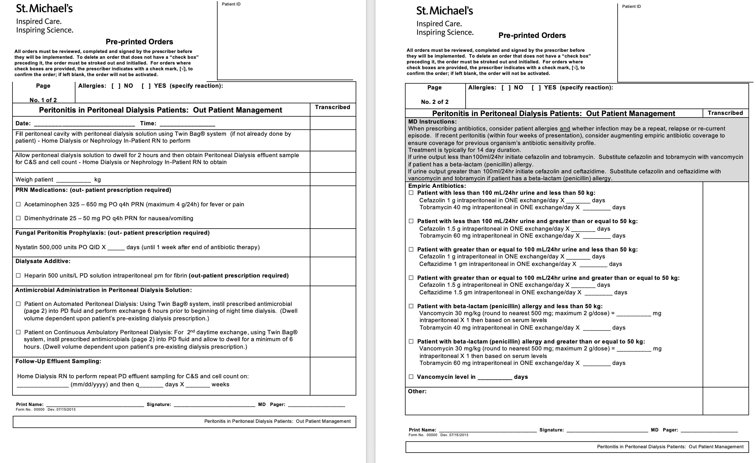
PERITONITIS TREATMENT
Example of a Peritonitis Treatment Protocol

Slide 53
PERITONITIS TREATMENT
Is Vancomycin or Cefazolin the Empiric Antibiotic of Choice for Gram-Positive Coverage?
Meta analysis
  Glycopeptide (vanco or tecoplainin) achieved a higher cure rate compared compared to cefazolin
  1.66 [1.01, 2.72] 3 trials 28/189 vs 37/181¹
Driven by one study in which cefazolin was dosed lower than ISPD guideline recommendations² (50 vs 125 mg/mL)
Both for HD (Catheter related bacteremia) and PD guidelines, empiric choice should be dictated by a “threshold level’’ of methicillin resistance and it is unclear what that is ^{3,4}
In HD, continuing empiric vancomycin in the context of methicillin sensitivity has a higher risk of treatment failure compared to switching to cefazolin.⁵
Ballinger AE et al. Cochrane Database Syst Rev 2014; 2. Flanigan MJ, et al. Perit Dial Int 1991; 11:31–7;
3. Allon et al. Am J Kidney Dis. 2009 Jul; 54(1): 13–17; 4. Li et al. PDI 2016 - VOL. 36, NO. 5; 5. Stryjewski et al. CID 2007
Dialysis Core Curriculum 2021

Slide 54
PERITONITIS TREATMENT
Continuous (every exchange) vs. Intermittent (one daily exchange) Antibiotics
CAPD
  Intermittent vancomycin and gent is equally effective, can follow levels
  Intermittent gent to reduce toxicity
APD
  Intermittent vs continuous dosing is controversial each exchange as pharmacokinetic data largely studied among CAPD patients
  Data insufficient to recommend switching to CAPD
  Impact may be antibiotic and dose dependent
  Most programs administer antibiotics in a single daily exchange out of convenience (exception: vancomycin can be administered every 2-4 days)
Dialysis Core Curriculum 2021

Slide 55
Dose of antibiotic may need to be increased in the setting of significant residual kidney function
PERITONITIS TREATMENT
Dialysis Core Curriculum 2021

Slide 56
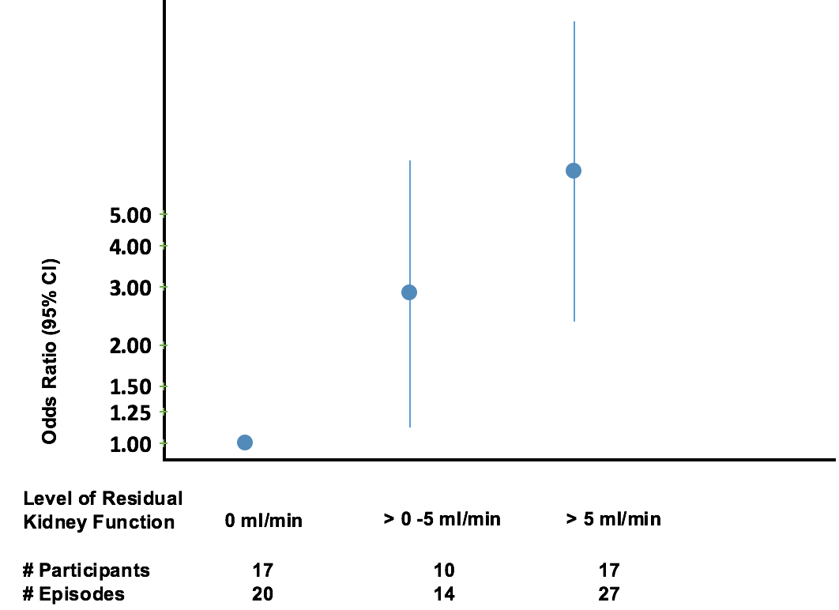
PERITONITIS TREATMENT
Risk of Peritonitis Treatment Failure for Gram-Positive and Culture-Negative Peritonitis by Level of Residual Kidney Function
Adjusted Odds of Treatment Failure
Models adjusted for age, duration of
PD, actual body weight, diabetes status, and PD modality (continuous ambulatory peritoneal dialysis [CAPD]
vs continuous cyclic PD)
Whitty et al CJASN 2017
Dialysis Core Curriculum 2021

Slide 57
Monitoring and Maintaining Higher Trough Vancomycin Levels May Reduce Relapse Risk
PERITONITIS TREATMENT
 | No Relapse (%) | Relapse (%) | p value
Patients (n) 26 | 9
Diabetes | 7(27) | 5(56) | 0.22
Embedded PD access | 20 (77) | 7(78) | 1.0
CCPD vs CAPD | 18(69) | 5(56) | 0.68
Use of Vancomycin | 15(58) | 5(56) | 1.0
Mean Vanco level (mg/L) | 18.2 +/-4.6 | 13.3 +/-2.2 | 0.04
Mean Vanco doses (n) | 3.6 +/- 0.72 | 3.8 +/- 0.44 | 0.7
Mean antibiotic duration (days) | 14.4 +/- 2.1 | 15.0 +/- 2.3 | 0.46
Mean GFR (mL/min) | 2.6 +/- 3.1 | 3.8 +/- 4.8 | 0.41
Dahlan et al PDI 2007
Dialysis Core Curriculum 2021

Slide 58
PERITONITIS TREATMENT
Principles of Management
Assess response to therapy
  Daily PD effluent cell count
  Daily PD effluent culture
  Status of abdominal pain
Narrow antibiotics to culture results
  NOT based on gram stain
  Yeast is the only exception
  Wait for sensitivities before changing empiric therapy
Root cause analysis
Consider alternate diagnosis resistant organism if not responding to empiric therapy
Li et al Peritoneal Dialysis International, 36: 481–508 2016
Dialysis Core Curriculum 2021

Slide 59
Indications for Catheter Removal During Peritonitis
PERITONITIS TREATMENT
Urgent
  Secondary peritonitis – i.e., bowel perforation
  Fungal peritonitis
  Refractory peritonitis (failure of effluent cell count to normalize after 5 days of appropriate therapy or persistent growth of the organism)
Semi-Elective
  Relapsing / Repeating peritonitis
  (if responding to IP antibiotics)
  Concomitant exit-site and tunnel infection
Li et al Peritoneal Dialysis International, 36:481–508 2016
Dialysis Core Curriculum 2021

Slide 60
Simultaneous PD Catheter Removal and Replacement (in one procedure)
Peritonitis treatment
Minimizes the need for temporary HD
For relapse/repeat peritonitis
  If the PD fluid has sterilized and continue antibiotic coverage for the procedure
For refractory exit site and tunnel infections (with no peritonitis)
Successful reports in United States and France
Viron et al PDI 2019
Crabtree et al PDI 2016
Dialysis Core Curriculum 2021

Slide 61
Principles of Management:
When to Admit to Hospital
PERITONITIS TREATMENT
Usually managed as an outpatient
Unrelenting pain
Frail patient
Ongoing nausea vomiting
Hemodynamic instability
Suspect secondary peritonitis or something unusual in presentation
Challenge in prompt and accurate delivery of IP antibiotics
Wong et al Perit Dial Int. 2007 27: 531-536
Dialysis Core Curriculum 2021

Slide 62
Principles of Management
PERITONITIS TREATMENT
IP Heparin – 1000 u/L (peritonitis generates fibrin)
Conversion to CAPD
  Facilitate continuous (in every exchange) IP antibiotics
  i.e., may be relevant for ampicillin-sensitive Enterococcus, as ampicillin can only be given continuously, not intermittently
+/- Bowel rest (hold PD with enteric peritonitis)
+/- Peritoneal lavage
Patient retraining and home visit
Root cause analysis
Abrahams et al Perit Dial Int. May-June 2017 37:298-306
Dialysis Core Curriculum 2021

Slide 63
PERITONITIS TREATMENT
Treatment Duration and Organism Specific Considerations
Organism | Treatment Duration | Comments
CNST | 2 weeks | Switch to vancomycin if methicillin resistant, use cephalosporin if not
Staph. Aureus | 3 weeks | Consider adjuvant rifampin
Streptococci | 2 weeks | Check oral flora, ensure no bacteremia
 | 3 weeks | Consider CAPD for ampicillin q exchange Vanco +/- oral amoxicillin
Non-pseudomonal Gram-negative | 3 weeks | SPICE/ESBL consider longer treatment time, two antibiotics to reduce relapse risk
Corynebacterium Diphtheroid | 3 weeks | Labs may not report sensitivities as they may treat as contaminant Switch to vancomycin
Pseudomonas Stenotrophonmas | 3 weeks | Consider Double Coverage Close examination of Exit site and Tunnel Use trimethoprim/sulfamethoxazole if sensitive in Stenotrophonomas
Li et al Peritoneal Dialysis International, 36:481–508 2016
Dialysis Core Curriculum 2021

Slide 64
PERITONITIS TREATMENT
Multiple Gram-Negative
Organisms +/- Anaerobes
Continue empiric treatment and add metronidazole 500 mg q8h po or IV
Consider surgical cause or ongoing bowel compromise - i.e., ischemia
  CT Abdo
Bowel rest
  Some data that may improve treatment success rate of enteric peritonitis
Low threshold for PD catheter removal
Dialysis Core Curriculum 2021

Slide 65
PERITONITIS TREATMENT
Fungal Peritonitis
Stop antibiotics
Fluconazole 200 mg po IP q 48h or PO OD (although other antifungals increasingly used due to azole-resistance
Catheter removal - IMMEDIATE
Continue antifungal Rx for 7-14 days after catheter removal
Dialysis Core Curriculum 2021

Slide 66
Peritonitis treatment
Reasons for Culture Negative Peritonitis
Inoculation of organisms not large enough to illicit positive culture results
Suboptimal/poor PD effluent culture techniques
Unusual, difficult to culture organism or requiring special culturing techniques (i.e., mycobacterial species)
Antecedent antibiotic exposure prior to culture being taken
If high rates at a center should prompt evaluation of culture techniques
  Talk to your microbiology lab!!!
Li et al Peritoneal Dialysis International, Vol. 36, pp. 481–508 2016
Dialysis Core Curriculum 2021

Slide 67
Peritonitis treatment
Culture Negative Peritonitis
If patient is improving on empiric treatment:
  Usually CNS or Corynebacterium diphtheroid
  Continue gram-positive coverage
  Stop gram-negative coverage (questionable)
    Especially if antibiotics were given prior to the first sample, I would continue both gram-positive and gram-negative coverage
  Treat for 14 days
If patient is not improving:
  Re-culture and talk to the lab
  Consider unusual peritonitis (e.g., typical and atypical Tb)
  Consider other diagnoses (e.g., Chyloperitoneum, EPS, malignancy)
Dialysis Core Curriculum 2021

Slide 68
PERITONITIS TREATMENT
Spice Organisms
Denotes a family of several unique gram-negative bacteria with inducible chromosomally mediated beta-lactamases
  Serratia
  Pseudomonas/Providencia
  Indole-positive Proteus/Acinetobacter/Morganella
  Citrobacter
  Enterobacter or Hafnia
  Others emerging
Usually treated with carbapenem
Some reports of response with oral fluoroquinolone and aminoglycoside
Dialysis Core Curriculum 2021

Slide 69
PD Infections: Key Summary Points
Conclusion
Prevention is key
Prompt treatment
Be responsive to culture results and cater therapy appropriately
Root cause analysis will help prevent the next episode!!!
Keep an open mind of other causes of abdominal pain in a PD patient
“Patient, please don’t die”
  Save the patient, not the catheter
  Recognize surgical peritonitis
Dialysis Core Curriculum 2021

Slide 70
Case: Part I
36-year-old male
ESKD due to IgA nephropathy
Seen for renal replacement therapies education and chooses PD while sister in workup for possible living kidney donation
PD catheter inserted begins PD training and sent home on APD 2L x 4 cycles over 9 hours day dry
Dialysis Core Curriculum 2021

Slide 71
Question 1
MCQ
All are prophylactic antimicrobial strategies to reduce his risk of developing PD peritonitis except:
Antibiotics at the time of PD catheter insertion
Antibiotics at the time of a wet PD catheter contamination
Antibiotics at the time of lower GI endoscopy
Antifungals for prolonged courses of antibiotic therapy
Antibiotics at the time of a dry PD catheter contamination
Dialysis Core Curriculum 2021
Notes:
Rationale for answer
A. RCT evidence
B. ISPD guidelines suggest to use cephalexin
C. Some reports of reduction in peritonitis risk with use of antibiotic prophylaxis
D. Yes, data that antifungal use reduced antibiotic associated peritonitis
E. No, evidence only for wet contamination

Slide 72
Case: Part II
Develops cloudy fluid 3 months after training
Cell count consistent with peritonitis
  Cell count 46000 E6/L, 80% neutrophils
Admits to not washing hands prior to connecting on the cycler
Starts treatment with vancomycin 1.5 g intraperitoneal and ceftazdime 1.5 g intraperitoneal in one daily 6-hour exchange per day
Dialysis Core Curriculum 2021

Slide 73
Question 2
MCQ
All would be indications for PD catheter removal during the course of his peritonitis treatment except:
Culture of the PD fluid grows Candida parapsilosis and cell count is improved following IP fluconazole
Culture of the PD fluid grows Pseudomonas aureginosa and the patient and cell count are improving on IP gentamicin and oral ciprofloxacin
Culture of the PD fluid and PD catheter exit site grow Pseudomonas aureginosa and the patient and cell count are improving on IP gentamicin and oral ciprofloxacin
The PD fluid cell count of a methicillin-sensitive Staph aureus peritonitis is 895 cells/ uL on day 10 with 75 percent neutrophils
B and C
Dialysis Core Curriculum 2021
Notes:
Indications for PD catheter removal
Urgent
Secondary peritonitis – i.e., bowel perforation
Fungal peritonitis
Refractory peritonitis
Semi-Elective
Relapsing / Repeating peritonitis
(if responding to IP antibiotics)
Concomitant exit-site and tunnel infection
May entertain catheter removal and reinsertion in one procedures
Under antibiotic coverage, organism dependent (if cell count and culture have become negative)

Slide 74
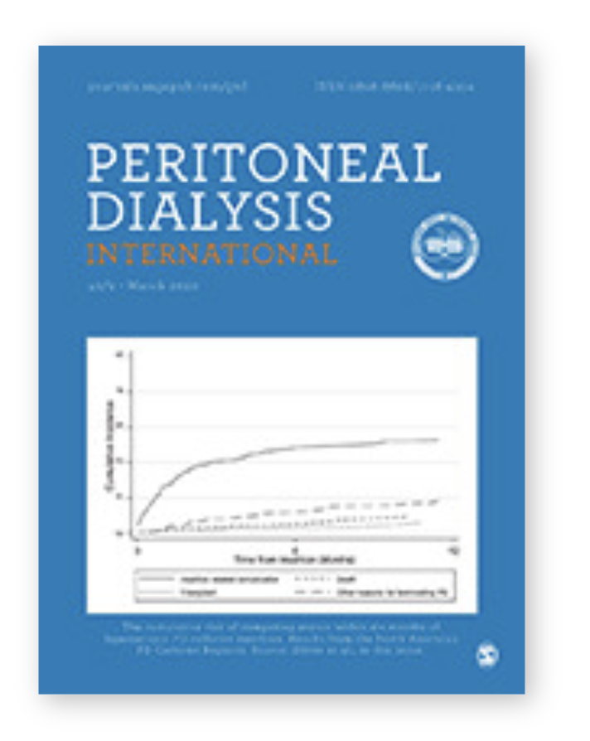

Important Resource: International Society for Peritoneal Dialysis Clinical Practice Guidelines https://ispd.org/ispd-guidelines/
conclusion
Dialysis Core Curriculum 2021

Slide 75
REFERENCES
Gadallah MF, Ramdeen G, Mignone J, et al: Role of preoperative antibiotic prophylaxis in preventing postoperative peritonitis in newly placed peritoneal dialysis catheters. Am J Kidney Dis 36(5):1014-1019, 2000
Boudville N, Johnson DW, Zhao J, et al: Regional variation in the treatment and prevention of peritoneal dialysis-related infections in the Peritoneal Dialysis Outcomes and Practice Patterns Study. Nephrol Dial Transplant 34(12):2118-2126, 2019
Yip T, Tse KC, Lam MF, et al: Risks and outcomes of peritonitis after flexible colonoscopy in CAPD patients. Perit Dial Int. 27(5):560-564, 2007
Li PK, Szeto CC, Piraino B, et al: ISPD Peritonitis Recommendations: 2016 Update on Prevention and Treatment. Perit Dial Int. 36(5):481-508, 2016
Al Sahlawi M, Bargman JM, Perl J: Peritoneal Dialysis-Associated Peritonitis: Suggestions for Management and Mistakes to Avoid. Kidney Med 2(4):467-475, 2020
Tacconelli E, Carmeli Y, Aizer A, et al: Mupirocin prophylaxis to prevent Staphylococcus aureus infection in patients undergoing dialysis: a meta-analysis. Clin Infect Dis 37(12):1629-1638, 2003
Bernardini J, Piraino B, Holley J, et al: A randomized trial of Staphylococcus aureus prophylaxis in peritoneal dialysis patients: mupirocin calcium ointment 2% applied to the exit site versus cyclic oral rifampin. Am J Kidney Dis 27(5):695-700, 1996
Crabtree JH, Shrestha BM, Chow KM, et al: Creating and Maintaining Optimal Peritoneal Dialysis Access in the Adult Patient: 2019 Update. Perit Dial Int 39(5):414-436, 2019
Chow KM, Szeto CC, Law MC, et al: Influence of peritoneal dialysis training nurses' experience on peritonitis rates. Clin J Am Soc Nephrol 2(4):647-652, 2007
Dialysis Core Curriculum 2021

Slide 76
REFERENCES
Lloyd A, Tangri N, Shafer LA, et al: The risk of peritonitis after an exit site infection: a time-matched, case-control study. Nephrol Dial Transplant 28(7):1915-1921, 2013
Viron C, Lobbedez T, Lanot A, et al: Simultaneous Removal And Reinsertion of the PD Catheter in Relapsing Peritonitis. Perit Dial Int 39(3):282-288, 2019
Crabtree JH, Siddiqi RA. Simultaneous Catheter Replacement for Infectious and Mechanical Complications Without Interruption of Peritoneal Dialysis. Perit Dial Int 36(2):182-187, 2016
Perl J, Fuller DS, Bieber BA, et al: Peritoneal Dialysis-Related Infection Rates and Outcomes: Results From the Peritoneal Dialysis Outcomes and Practice Patterns Study (PDOPPS). Am J Kidney Dis 76(1):42-53, 2020
Mujais S: Microbiology and outcomes of peritonitis in North America. Kidney Int Suppl (103):S55-62, 2006
Nessim SJ, Nisenbaum R, Bargman JM, et al: Microbiology of peritonitis in peritoneal dialysis patients with multiple episodes. Perit Dial Int 32(3):316-321, 2012
Sampaio J, Machado D, Gomes AM, et al: Deciphering the Contribution of Biofilm to the Pathogenesis of Peritoneal Dialysis Infections: Characterization and Microbial Behaviour on Dialysis Fluids. PLoS One 11(6):e0157870, 2016
Camargo CH, Cunha Mde L, Caramori JC, et al: Peritoneal dialysis-related peritonitis due to coagulase-negative Staphylococcus: a review of 115 cases in a Brazilian center. Clin J Am Soc Nephrol 9(6):1074-1081, 2014
Muthucumarana K, Howson P, Crawford D, et al: The Relationship Between Presentation and the Time of Initial Administration of Antibiotics With Outcomes of Peritonitis in Peritoneal Dialysis Patients: The PROMPT Study. Kidney Int Rep 1(2):65-72, 2016
Ballinger AE, Palmer SC, Wiggins KJ, et al: Treatment for peritoneal dialysis-associated peritonitis. Cochrane Database Syst Rev 4:CD005284, 2014
Dialysis Core Curriculum 2021

Slide 77
REFERENCES
Allon M: Treatment guidelines for dialysis catheter-related bacteremia: an update. Am J Kidney Dis 54(1):13-17, 2009
Whitty R, Bargman JM, Kiss A, et al: Residual Kidney Function and Peritoneal Dialysis-Associated Peritonitis Treatment Outcomes. Clin J Am Soc Nephrol 12(12):2016-2022, 2017
Dahlan R, Lavoie S, Biyani M, et al: A high serum vancomycin level is associated with lower relapse rates in coagulase-negative staphylococcal peritonitis. Perit Dial Int 34(2):232-235, 2014
Abrahams AC, Ruger W, Ter Wee PM, et al: Improved Outcome of Enteric Peritonitis in Peritoneal Dialysis Patients Aged 50 Years and Older with Temporary Discontinuation of Peritoneal Dialysis and Intravenous Meropenem. Perit Dial Int 37(3):298-306, 2017
Yip T, Tse KC, Lam MF, et al. Risk factors and outcomes of extended-spectrum beta-lactamase-producing E. coli peritonitis in CAPD patients. Perit Dial Int 26(2):191-197, 2006
Jarvis EM, Hawley CM, McDonald SP, et al: Predictors, treatment, and outcomes of non-Pseudomonas Gram-negative peritonitis. Kidney Int 78(4):408-414, 2010
Dialysis Core Curriculum 2021

