Slide 1
Home Hemodialysis Home HD: Outcomes and Patient Selection
Dialysis Core Curriculum 2021
Sophia L. Ambruso, DO
University of Colorado
Christopher T. Chan, MD
Toronto General Hospital

Slide 2
Sophia L. Ambruso
Disclosures
Employers: University of Colorado School of Medicine, Rocky Mountain Regional VA Medical Center
Christopher T. Chan
Employer: Toronto General Hospital
Consultancy Agreements: Baxter Global, Medtronic, and NxStage
Dialysis Core Curriculum 2021

Slide 3
Learning Objectives
Describe the benefits and risks of home frequent/intensive hemodialysis
Discuss patient suitability for home dialysis
Dialysis Core Curriculum 2021

Slide 4
Acronyms and Definitions
CHD: conventional hemodialysis
3x weekly hemodialysis
PD: peritoneal dialysis
Types of intensive or frequent hemodialysis (FHD)
HHD: home hemodialysis
NHD: nocturnal hemodialysis
SDHD: short daily hemodialysis
Dialysis Core Curriculum 2021

Slide 5
Case Presentation
Clinical outcomes
A 55-year-old gentleman with past medical history of hypertension and CKD 4 (eGFR 25ml/min/1.73m²) presents for follow up with recent decline in kidney function. This has prompted discussions regarding renal replacement therapy options. He is subsequently provided educational materials and attends dialysis education classes with his wife.
He and his wife live on a farm and he continues to maintain an active lifestyle.
He is leaning towards choosing home hemodialysis. Prior to proceeding, he asks how home hemodialysis outcomes compare to in-center and peritoneal dialysis.
How do you counsel him?
Dialysis Core Curriculum 2021

Slide 6
Selected Clinical Outcomes
Better Clinical Outcomes?
A. Survival
B. Hospitalization
C. Home HD (HHD) vs. PD
D. Cardiovascular outcomes
E. Solute(s) Removal
F. Quality of life
G. Pregnancy
H: Vascular Access and Safety
Dialysis Core Curriculum 2021

Slide 7
Selected Survival Studies: Frequent HD vs. Conventional HD
Survival outcomes
Study | Countries, Follow-up duration, design | Intensive HD | In-Center HD | Relative mortality in HHD population | Inherent bias
Johansen (2009) | USA, 3 years | 101, nocturnal HD (5.7 days per week) | 1010 matched from USRDS | HR = 0.34 (0.21-0.58) | -Low power -younger, healthier population
Johansen (2009) | USA, 3 years | 44, daily hemodialysis (5.4 days per week) | 440 matched patients from USRDS | HR = 0.61 (0.3-1.24) | -Low power -younger, healthier population
Lockridge (2011) | USA, 287 patient years | 87, nocturnal HD (40 hours per week) | 87121 incident patients from USRDS | SMR = 0.53 (0.34-0.79) | -younger, healthier population -technique failure rate
Marshall (2011) | Australia, New Zealand, 72052 patient years | 865, extended home HD | 21184 from ANZDATA | HR = 0.53 (0.41-0.70) | -younger, healthier population -higher socioeconomic status -better social support
Weinhandl (2012) | USA, 1.8 years | 1873, daily NxStage HD | 9365 from USRDS | ITT HR = 0.87 (0.78-097) As treated: 0.82 (0.72-0.94) | -1 in 4 patients switched to In-center HD -younger, healthier population
Study
1. Johansen KL, Zhang R, Huang Y, et al.: Kidney Int 76:984-990, 2009, 2., Lockridge R, Ting G, Kjellstrand CM:. Hemodial Int 16:351-362, 2011,
3. Marshall MR, Hawley CM, Kerr PG, et al.: Am J Kidney Dis 58:782-793, 2011, 4. Weinhandl ED, Liu J, Gilbertson DT, et al.: J Am Soc Nephrol 23:895-904, 2012
Dialysis Core Curriculum 2021

Slide 8
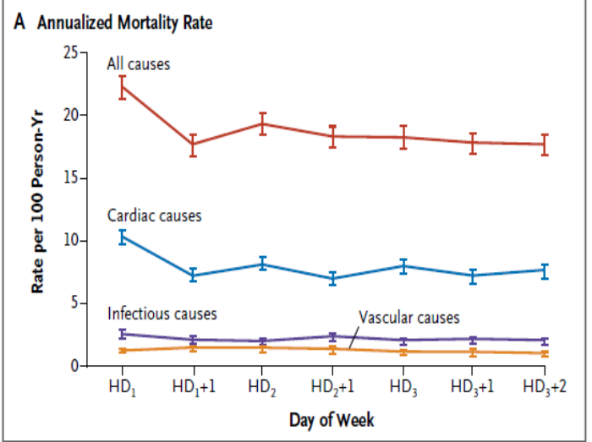
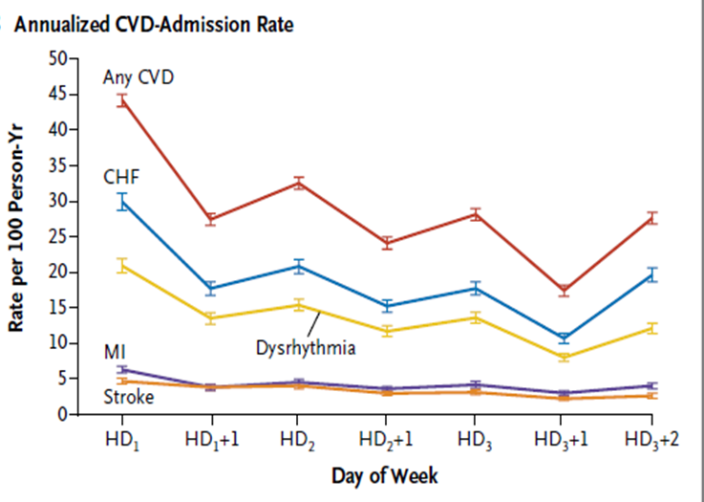
Morbidity and Mortality of Intermittent HD
Survival outcomes
Association between long interdialytic intervals and mortality/cardiovascular admission rates in conventional,
in-center, 3x weekly hemodialysis patients. Mortality rates and cardiovascular admission rates are higher following periods off dialysis. Specifically, rates are highest on HD₁, which follows the two-day period off dialysis.
Modified Foley et al – NEJM 2011
Dialysis Core Curriculum 2021

Slide 9
Summary
Survival outcomes
Survival data suggests that home hemodialysis is better than in-center HD.
Increased intradialytic time may contribute to survival differences between in-center and home hemodialysis.
Selection bias (younger, healthier and high socioeconomic status patients) and technique failure account for the majority of inherent bias.
Dialysis Core Curriculum 2021

Slide 10
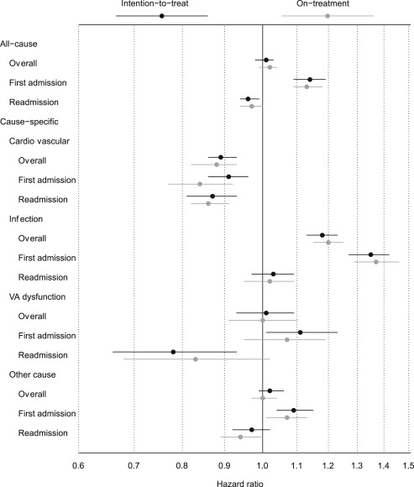
Hospitalization Outcomes
All-cause hospitalization risks were similar between HHD and 3x weekly HD.
CVD-related admissions were lower in HHD.
First admission risk was higher in HHD, however this was accounted for by the infection-related risk of first admission in HHD (likely due self-cannulation technique of new HHD patients).
Figure 1. Pooled relative hazards of all-cause and cause-specific admission for daily home hemodialysis (referent: matched thrice-weekly in-center hemodialysis patients). Abbreviation: VA, vascular access.
Modified Weinhandl et al. AJKD 2015

Slide 11
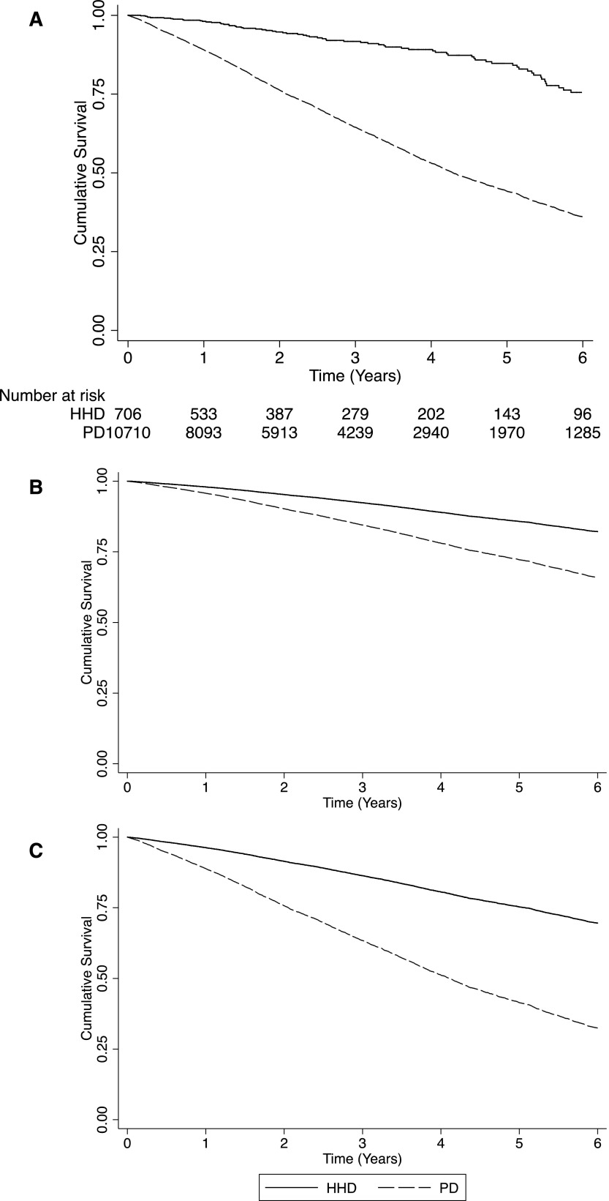
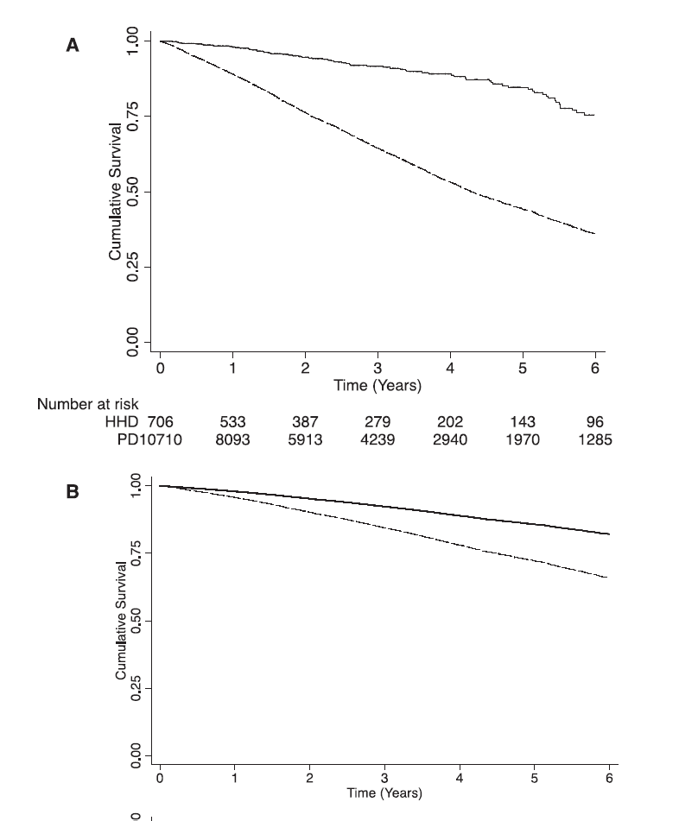
survival outcomes hhd vs. PD
Unadjusted survival
Adjusted for DM, CAD, PVD, late referral
Nadeau-Fredette et al. Clin J Am Soc Nephrol 2015

Slide 12
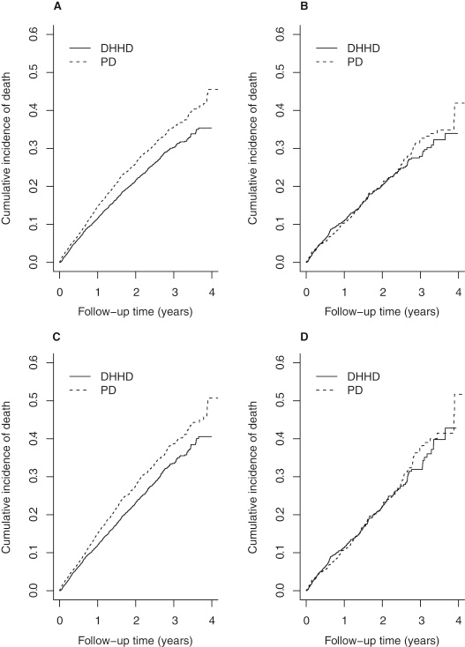
HHD vs PD: Mortality and Hospitalizations
Hospitalization outcomes hHD vs. pd
Cumulative incidence estimates of death
Intention to treat
HHD patients demonstrated lower rates of mortality and hospitalization than PD patients (A,C).
When corrected for ESRD duration of <6 months, survival/hospitalization benefit of HHD goes away (B,D).
On-treatment
Modified from Weinhandl et al. AJKD 2016

Slide 13
Peritoneal vs. Home Hemodialysis Comparisons
There are geographical variations in home dialysis outcomes.
There are also significant dialysis practice pattern differences in hemodialysis platforms. (US: low dialysate flow platform vs. outside of US single pass, conventional hemodialysis platform)
The differences in clinical outcomes between HHD and PD require further research.
Dialysis Core Curriculum 2021

Slide 14
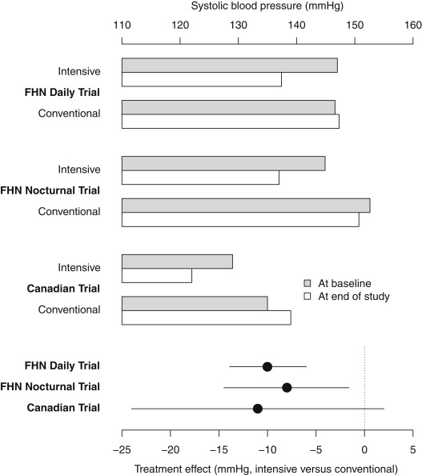
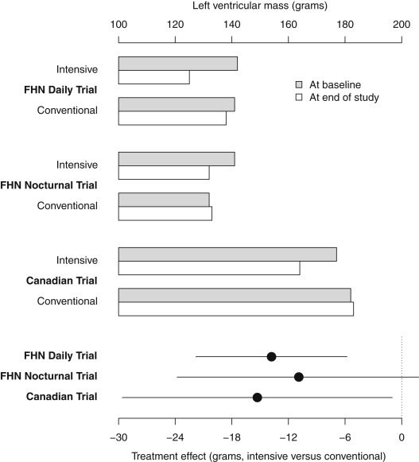
Improved BP Control and Left Ventricular Hypertrophy Regression With Frequent HD
Cardiovascular outcomes
Improved BP control and regression of left ventricular hypertrophy were observed in those undergoing frequent HD. This was observed in the FHN Daily, FHN Nocturnal and Canadian Trials.
Modified from Bakris et al AJKD 2016
Modified from McCullough et al AJKD 2017
Dialysis Core Curriculum 2021

Slide 15
Cardiovascular Summary
Cardiovascular outcomes
Frequent HD
Better BP control
LV mass decreases
Remaining questions
Does LVM change lead to improvement in survival?
Implications for mechanistic pathways?
Dialysis Core Curriculum 2021

Slide 16
Dialysis Adequacy Based on Dialysis Frequency / Modality
Solute Removal
CAPD = Continuous ambulatory PD
NHD = Nocturnal HD SDHD = Short daily HD
N days/wk
6
CONTINUOUS
7
CLEARANCE
NHD
Weekly standard KtV (stdKt/V) and corresponding equilibrated Kt/V (eKt/V) values for CAPD, NHD and SDHD.
5
6
4
CAPD
5
Weekly stdKt/V
SDHD
4
3
3
2
-------------------------------------------------------------
2
1
0
0.2
0.7
1.2
1.7
eKt/V each dialysis
Modified from Gotch FA 1998
Dialysis Core Curriculum 2021

Slide 17
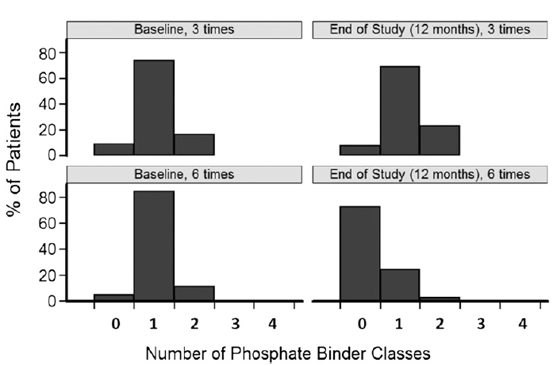
Hemodialysis 3x/week
Hemodialysis 6x/week
Daugirdas et al. J Am Soc Nephrol 2012
Dialysis Core Curriculum 2021

Slide 18
Solute Removal and Outcomes
Solute removal
Frequent HD will enhance removal of uremic toxins.
Extent of removal dependent on molecule
Frequency and duration are important
Surrogate marker vs. outcomes
Dialysis Core Curriculum 2021

Slide 19
Psychosocial Benefits of Frequent HD
Quality of life
More control
Less disruption of day
Less travel to clinic
Better sleep
More time with family or friends; less time with sick or dying people
Better sexual functioning
Twardowski et al. Nephrol Dial Transplant 2001
Dialysis Core Curriculum 2021

Slide 20
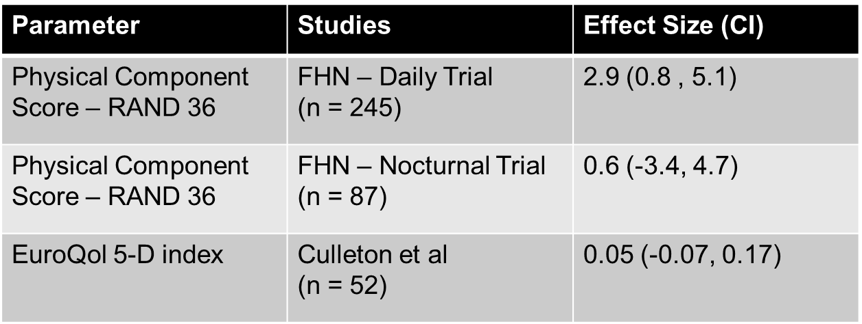
Quality of Life
Hall et al – Clin J Am Soc Nephrol 7: 782 – 794, 2012
Culleton et al – JAMA 298: 1201-9, 2007
Dialysis Core Curriculum 2021
Notes:
FHN Daily Trial: (N=245)
Retrospective
Physical component score – RAND 36
Patients on SDHD experienced significant improvement in self-reported physical health relative to those on CHD
There was also a large change in self-reported physical functioning that did not reach statistical significance in the SDHD patients relative to patients on CHD
2.9 (CI 0.8-5.1)
FHN Nocturnal Trial: (N=87)
Retrospective
Physical component score – RAND 36
There were no significant changes in self-reported physical health and functioning in subjects randomized to frequent NHD relative to patients on CHD.
0.6 (CI -3.4-4.7)
Culleton et al.
RCT
EuroQol 5-D
Frequent NHD did not significantly improve quality of life relative to CHD.
0.5 (CI 0.07-0.17)
Kidney related quality of life outcomes; effects of kidney disease and burden of kidney disease were significantly improved in NHD cohort (p=0.01, p=0.02 respectively).

Slide 21
Quality of Life: Frequent HHD Compared to CHD – A Second look
Quality of life
All patients were on standard CHD prior to randomization.
Both SDHD and NHD recovered approximately 1 hour faster than conventional HD.
FHN Daily Trial: SDHD
245 patients randomized to 3x/wk HD or 6x/wk SDHD
SDHD demonstrated higher feeling thermometer scale and better general health compared to 3x/wk HD.
FHN Nocturnal Trial: NHD
87 patients randomized to 3x/wk HD or 6x/wk NHD
No statistical difference in feeling thermometer scale and general health compared to conventional HD
Garg et al. Kidney Int 2016
Dialysis Core Curriculum 2021

Slide 22
Extended Hours Dialysis: ACTIVE Trial
Quality of life
Outcomes in extended weekly hemodialysis (>24 hours) and standard weekly hemodialysis (>12 hours)
Included both in-center and HHD patients.
There was no difference between quality of life (QOL) scores (EuroQol-5D).
Extended hours was associated with lower phosphorus and potassium levels and higher hemoglobin levels.
Extended hours was associated with fewer BP agents and phosphorus binders.
No difference between BP or dose of epoeitin agents between the groups.
In a subgroup analysis, there was no difference between left ventricular mass index between the groups.
Jardine et al. J Am Soc Nephrol 2017
Dialysis Core Curriculum 2021

Slide 23
Quality of Life Summary
Quality of Life
Heterogeneous results from observational studies and RCTs.
Overall, there seems to be an improvement of perceived physical health but not necessarily overall quality of life.
Other studies have indicated an improvement in kidney-disease related quality of life.
e.g., recovery time from dialysis
Dialysis Core Curriculum 2021

Slide 24
Pregnancy Outcomes
22 pregnancies in the Toronto pregnancy and kidney disease clinic registry (2000-2013)
Compared with 70 pregnancies from the American Registry from Pregnancy in Dialysis Patients (1990-2011)
Primary outcome = Live birth rate
Intensive HD = 86.4%
Comparator = 61%
P = 0.03
Hladunewich et al. J Am Soc Nephrol 2014
Dialysis Core Curriculum 2021

Slide 25
Pregnancy Outcomes
Secondary outcomes
Duration of pregnancy
36 weeks – intensive HD
27 weeks – comparator
P = 0.002
Pregnancy complications were few and manageable.
Pregnancy may be safe and feasible in women with ESRD receiving intensive HD.
Hladunewich et al. J Am Soc Nephrol 2014
Dialysis Core Curriculum 2021

Slide 26
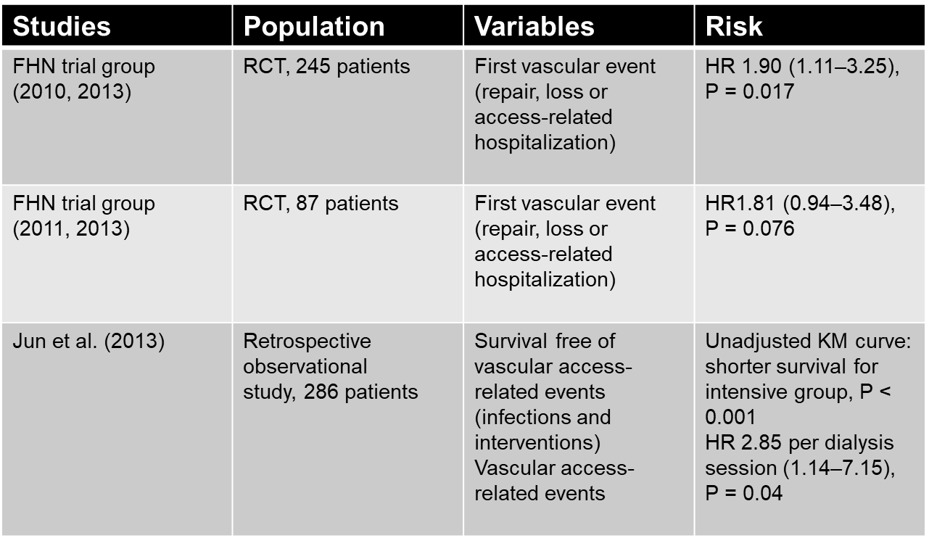
Adverse Events: Vascular Access
Adverse events
SDHD
NHD
Intensive HD
Modified from Tennankore et al NDT 29: 1342 – 1349, 2014
Dialysis Core Curriculum 2021
Notes:
• FHN trial group (2010, 2013) Patients receiving (in-center) SDHD had a significantly shorter time to first vascular event compared with the conventional HD group.
• FHN trial group (2011, 2013) A similar trend was observed in the NHD cohort, although the time to first access-related event did not reach statistical significance.
• An association between dialysis frequency and vascular access-related events was reported in an observational Australian study by Jun et al. Those with >3.5 sessions per week of HD had a lower cumulative vascular access survival compared with patients with fewer sessions. In this study, most events were infections (60%).

Slide 27
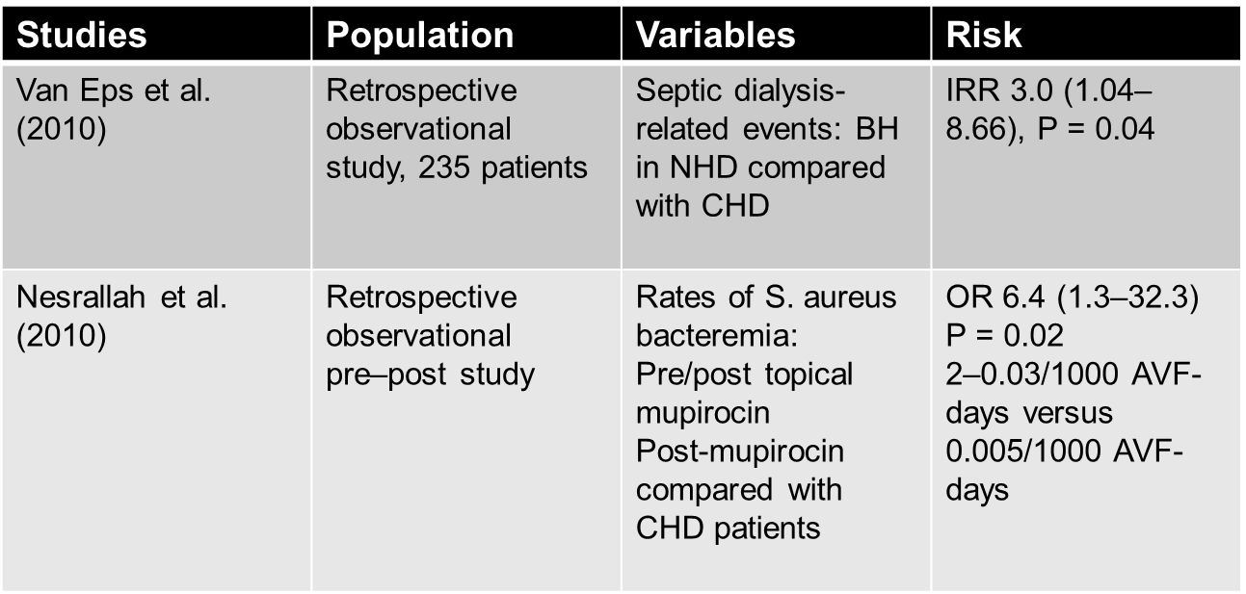
Adverse Events: Buttonhole Cannulation Technique
Adverse events
Modified from Tennankore et al NDT 29: 1342 – 1349, 2014
Dialysis Core Curriculum 2021
Notes:
• In a retrospective observational Australian cohort study (Van Eps et al.) of NHD and CHD patients, buttonhole cannulation was used in 94% of NHD patients and 10% of CHD patients. Those using buttonhole technique with NHD had an increased risk of septic dialysis-related events compared with the CHD.
• In a retrospective Canadian study (Nesrallah et al.) of NHD patients using the buttonhole technique, rates of S. aureus bacteremia was followed before and after the use of prophylactic topical mupirocin. The infection rate decreased from 0.23 to 0.03 with the topical antibiotic. Despite this significant reduction in the infection rate with topical mupirocin, it still remained higher compared with CHD.

Slide 28
Other Considerations
FHN nocturnal trial suggests that residual kidney function (urine output) may be negatively impacted by frequent hemodialysis.
Dialysis Core Curriculum 2021

Slide 29
Summary
Data suggests that augmented hemodialysis has improved:
Survival
Cardiovascular endpoints
Solute removal
Pregnancy outcomes
Adverse effects:
Dialysis access
Vascular access infections
Residual renal function
Dialysis Core Curriculum 2021

Slide 30
Case Presentation (cont.)
Recruitment and patient selection
The patient decides that he would like to pursue home hemodialysis.
What factors are considered during your evaluation for HHD candidacy?
What are true vs. perceived barriers to HHD and possible solutions?
Dialysis Core Curriculum 2021

Slide 31
Trends in Home Dialysis
Recruitment and patient selection
USRDS 2014 ADR
Dialysis Core Curriculum 2021

Slide 32
Why Do So Many Patients Dialyze In-Center When FHD May Provide…..?
Recruitment and patient selection
Better small solute clearance
Improved nutritional status
Better BP and volume control
Better anemia management
Better mineral bone disease management
Decreased pill burden
Improved QoL
Fewer hospitalizations
Possibly better survival
Lindsay R, et al. London, Ontario Daily/Nocturnal Dialysis Study. Semin Dial. 17(2):85-91, 2004.
Ting et al. Long-term study of high-comorbidity ESRD patients converted from conventional
to short daily hemodialysis. Am J Kidney Dis. 42(5):1020-1035, 2003.
Dialysis Core Curriculum 2021

Slide 33
Understanding Barriers to Home-Based and Self-Care In-Center HD
Recruitment and patient selection
What are the top nephrologist perceptions guiding patient hesitancy?
Process is intimidating and scary (75%)
Seems like too much work (55%)
They have physical limitations (46%)
They are worried about safety (44%)
Machines are too complicated (36%)
Would not want to cannulate themselves (34%)
Takes too long to learn (10%)
Yau et al. Hemodial Int. 2016
Dialysis Core Curriculum 2021

Slide 34
Understanding Barriers to Home-Based and Self-Care In-Center HD
Recruitment and patient selection
What are the top patient reasons for NOT pursuing home dialysis?
No space at home for equipment, supplies (46%)
Need a partner to help, don’t have one (46%)
Fearful of putting needles into arm (45%)
Take too long to learn it (40%)
Never offered as an option (39%)
Prefer to not bring medical treatment into the home (30%)
Yau et al. Hemodial Int. 2016
Dialysis Core Curriculum 2021

Slide 35
Understanding Barriers to Home-Based and Self-Care In-Center HD
Recruitment and patient selection
What are the most appealing features of self-care dialysis?
Treatment scheduling flexibility (62%)
I feel in control of my own care (60%)
Health benefits: less depression, infections, hospital visits (55%)
I can immediately take care of my own problems (52%)
No more waiting for dialysis to begin (50%)
Don’t have to wait for techs to take me off (20%)
Yau et al. Hemodial Int. 2016
Dialysis Core Curriculum 2021

Slide 36
Why Home HD?
Recruitment and patient selection
Improved QoL / lifestyle
Cardiovascular risk reduction
Optimal BP / ECF volume control
Optimal bone and mineral metabolism
Improved sleep apnea
Liberalized diet
Pregnancy
Survival advantage?
Dialysis Core Curriculum 2021

Slide 37
What Does It Take to Initiate a Patient on Home HD?
Recruitment and patient selection
Patients
Providers
Machines, Water Treatment, & Infrastructure in the Home
Patient Selection & Training
Prescription of Home Dialysis
Psychosocial Issues & Support
Access
Clinical Governance Structure / Localities & Infrastructure
Ensuring Patient Safety
Funding & Planning
Patient Referrals, Recruitment, & Networking
Workforce Development & Models of Care
Home
Program
ISHD : The Global Forum for Home Hemodialysis –
HDI 2015: 19 supplement 1 - 127
Dialysis Core Curriculum 2021

Slide 38
Pre-Dialysis Education
Recruitment and patient selection
A home dialysis program will not thrive without a proactive pre-dialysis interdisciplinary team.
Including physicians, nurses, social worker, and caregiver
The medical director should be a champion of home dialysis.
Patients are not likely to follow mixed messages from a divided professional front.
Dialysis Core Curriculum 2021

Slide 39
Why Do Patients Choose Self-Care Dialysis?
Recruitment and patient selection
Freedom and lifestyle were associated with increased odds of selecting self-care dialysis.
Not surprisingly, perceiving no advantage to self-care dialysis was associated with reduced odds of selecting self-care dialysis.
McLaughlin et al. Oxford Academic 2008
Dialysis Core Curriculum 2021

Slide 40
Factors Contributing to Home HD Patient Selection
Recruitment and patient selection
Medical (indications / contraindications)
Social networks
Home environment
Skill barriers
dexterity
visual acuity
Attitude barriers
willingness to learn
non-adherence
Dialysis Core Curriculum 2021

Slide 41
Key Clinical Messages to Patients
Recruitment and patient selection
Home Dialysis (especially frequent / intensive HD):
Better outcomes
Less travel / less of a “time thief”
Flexible scheduling / prescription
More privacy
More liberal diet
Dialysis Core Curriculum 2021

Slide 42
Home HD Barriers and Potential Solutions
Barriers | Potential solutions
Lack of exposure, visibility & education of HHD | Units adopt formal predialysis education with nonbias towards all treatment options
Preconception that HHD is “too difficult and complex” | Training for all clinical staff to increase HHD confidence Utilization & further development of simpler HHD training machines
Lack of patient confidence | Peer support from established HHD patients
Fears of vulnerability and isolation from medical support | Strong clinical recommendations for HHD
Unexpected problems at early stage of HHD | Increased support when patient transitioning home
Fear of self-cannulation | Technological support for patient at home Community house models of care
Caregiver burden | Encouraging HHD independence with enhanced support Paid models of family/support staff Inclusion of family members in education and training
Increased cost of HHD to patient | Transparent information regarding expected costs Reimburse for out-of-pocket costs Community houses
Increased travel expenses | Units provide flexible and individualized training programs
Extended training duration | Exploration of return and training work policy
House problems (storage and water quality) | Developments in technology and HHD machines
Socioeconomic disadvantage | Reimbursement for out-of-pocket costs, transport and set-up costs. Independent community houses Increased support and peer education for minority and indigenous groups Government policy and incentive programs
Modified from Walker et al. ClinicoEconomics and Outcomes Res 2016
Dialysis Core Curriculum 2021

Slide 43
Summary
Data suggest that augmented HD modifies:
Survival
CVS outcomes
Solutes removal
Pregnancy outcomes
Growth + Quality
Momentum to enhance HHD
Re-address education and awareness of:
Patients
Medical and allied health providers
Need to implement interventions
Education
Strategy and mentorship bundles
Dialysis Core Curriculum 2021

Slide 44
references
Bakris GL, Burkart JM, Weinhandl ED, et al: Intensive Hemodialysis, Blood Pressure, and Antihypertensive Medication Use. Am J Kidney Dis 68, S15-S23, 2016
Culleton BF, Walsh M, Klarenbach SW, et al: Effect of frequent nocturnal hemodialysis vs conventional hemodialysis on left ventricular mass and quality of life: a randomized controlled trial. JAMA 298, 1291-1299, 2007
Daugirdas JT, et al: Effects of frequent hemodialysis on measures of CKD mineral and bone disorder. J Am Soc Nephrol 23, 727-738, 2012
Foley RN, Gilbertson DT, Murray T, et al: Long interdialytic interval and mortality among patients receiving hemodialysis. N Engl J Med 365, 1099-1107, 2011
Garg AX, Suri RS, Eggers P, et al: Patients receiving frequent hemodialysis have better health-related quality of life compared to patients receiving conventional hemodialysis. Kidney Int 91, 746-754, 2017
Hall YN, Larine B, Painter P, et al. Effects of six versus three times per week hemodialysis on physical performance, health, and functioning: Frequent Hemodialysis Network (FHN) randomized trials. Clin J Am Soc Nephrol 7, 782-794, 2012
Hladunewich MA, Hou S, Odutayo A: et al. Intensive hemodialysis associates with improved pregnancy outcomes: a Canadian and United States cohort comparison. J Am Soc Nephrol 25, 1103-1109, 2014
Jardine MJ, Zuo L, Gray NA, et al. A Trial of Extending Hemodialysis Hours and Quality of Life. J Am Soc Nephrol 28, 1898-1911, 2017
Johansen KL, Zhang R, Huang Y, et al. Survival and hospitalization among patients using nocturnal and short daily compared to conventional hemodialysis: a USRDS study. Kidney Int 76, 984-990, 2009
Lindsay RM: Daily/Nocturnal Dialysis: Study, G. The London, Ontario, Daily/Nocturnal Hemodialysis Study. Semin Dial 17, 85-91, 2004
Lockridge R, Ting G, Kjellstrand CM: Superior patient and technique survival with very high standard Kt/V in quotidian home hemodialysis. Hemodial Int 16, 351-362, 2012
Dialysis Core Curriculum 2021

Slide 45
references
Marshall MR, Chan CT, Global Forum for Home: The Global Forum for Home Hemodialysis: a new open-source practical manual. Hemodial Int 19 Suppl 1, S1-3, 2015
Marshall MR, Hawley CM, Kerr PG, et al: Home hemodialysis and mortality risk in Australian and New Zealand populations. Am J Kidney Dis 58, 782-793, 2011
McCullough PA, Chan CT, Weinhandl ED, et al: Intensive Hemodialysis, Left Ventricular Hypertrophy, and Cardiovascular Disease. Am J Kidney Dis 68, S5-S14, 2016
McLaughlin K, Jones H, VanderStraeten C, et al: Why do patients choose self-care dialysis? Nephrol Dial Transplant 23, 3972-3976, 2008
Nadeau-Fredette AC, Hawley CM et al: An Incident Cohort Study Comparing Survival on Home Hemodialysis and Peritoneal Dialysis (Australia and New Zealand Dialysis and Transplantation Registry). Clin J Am Soc Nephrol 10, 1397-1407, 2015
Tennankore K, Nadeau-Fredette AC, Chan CT: Intensified home hemodialysis: clinical benefits, risks and target populations. Nephrol Dial Transplant 29, 1342-1349, 2014
Ting GO, Kjellstrand C, Freitas T, et al: Long-term study of high-comorbidity ESRD patients converted from conventional to short daily hemodialysis. Am J Kidney Dis 42, 1020-1035, 2003
Twardowski ZJ: Daily dialysis: is this a reasonable option for the new millennium? Nephrol Dial Transplant 16, 1321-1324 (2001).
Walker RC, Howard K, Morton RL: Home hemodialysis: a comprehensive review of patient-centered and economic considerations. Clinicoecon Outcomes Res 9, 149-161, 2017
Weinhandl ED, Gilbertson DT, Collins AJ, et al: Hospitalization, and Technique Failure in Daily Home Hemodialysis and Matched Peritoneal Dialysis Patients: A Matched Cohort Study. Am J Kidney Dis 67, 98-110, 2016
Weinhandl ED, Liu J, Gilbertson DT, et al: Survival in daily home hemodialysis and matched thrice-weekly in-center hemodialysis patients. J Am Soc Nephrol 23, 895-904, 2012
Yau M, Carver M, Alvarez L, Block GA, et al: Understanding barriers to home-based and self-care in-center hemodialysis. Hemodial Int 20, 235-241, 2016
Dialysis Core Curriculum 2021

