Slide 1
Basic Principles of Dialysis Hemodialyzers: Structure, Classification, and Properties
Dialysis Core Curriculum 2021
William R. Clark, MD
Purdue University
Claudio Ronco, MD
University of Padova, International Renal Research Institute of Vicenza (IRRIV), San Bortolo Hospital

Slide 2
Disclosures
William R. Clark
Employer: Purdue University
Consultancy Agreements: Fresenius Medical Care-Asia Pacific, Medtronic, Nikkiso, Astute Medical
Ownership Interest: Baxter
Honoraria: Fresenius Medical Care, Medtronic, Nikkiso, Astute Medical
Claudio Ronco
Employer: University of Padova
Consultancy Agreements: Asahi, Jafron, Toray, Astute, GE, Baxter, Medtronic, Cytosorbents, OCD, Biomerieux
Research Funding: Baxter, Toray, Jafron
Honoraria: Baxter, Fresenius, Astute, GE, Toray, ESTOR, Medtronic, Jafron, B.Braun
Scientific Advisor or Membership: Editor-in-Chief of Blood Purification; Contributions to Nephrology and Cardiorenal Medicine; Associate Editor of Nephrology Dialysis and Transplantation
Speaker: Fresenius, ESTOR, Cytosorbents, B.Braun, GE
Dialysis Core Curriculum 2021

Slide 3
Learning Objectives
Describe the structure of hollow fiber membranes and the basic principles governing blood flow in hemodialysis (HD)
Discuss the major factors influencing dialyzer flux and performance
Describe the membrane-related factors influencing ultrafiltration
Describe the two major modes of solute transport in HD and the factors influencing them
Identify the specific considerations related to the dialytic removal of larger molecular weight uremic toxins
Dialysis Core Curriculum 2021

Slide 4
Case Presentation
35-year-old white male with ESRD secondary to PKD is scheduled to begin RRT. The patient recently moved to Germany from Poland. His body weight is 95 kg and has an estimated residual renal clearance of 3 mL/min.
Although a prime candidate, he is precluded from transplantation due to a high PRA titer.
The patient is initiated on HD with a standard polysulfone high-flux dialyzer. While treatment tolerance is acceptable and clinically, he is doing well, his pre-dialysis serum β2-microglobulin remains persistently elevated (above 70 mg/L).
Dialysis Core Curriculum 2021

Slide 5
Case Presentation (cont.)
With no transplantation option and an anticipated survival of many years on dialysis, the patient’s nephrologist decides the elevated serum β2-microglobulin concentration needs to be addressed due to the risk of dialysis-related amyloidosis.
The patient is transferred to online hemodiafiltration (OLHDF) with the same dialyzer used for his HD treatment and a convective dose of 25 L.
The patient’s pre-dialysis serum β2-microglobulin gradually falls over several months; a year after the transition to OLHDF, the pre-dialysis serum β2-microglobulin is 30 mg/L.
Dialysis Core Curriculum 2021

Slide 6
Case Presentation (cont.)
The patient subsequently returns to Poland for family reasons. His new dialysis unit does not offer OLHDF, so he is returned to HD with a conventional high-flux dialyzer.
The pre-dialysis serum β2-microglobulin gradually increases, rising to 55 mg/L six months after the resumption of high-flux HD. In addition, the patient complains of some nausea and fatigue, and note is made of a 5 kg weight loss over this period.
The patient’s nephrologist concludes that augmented middle/large molecule removal is indicated.
Dialysis Core Curriculum 2021

Slide 7
Case Presentation (cont.)
After transitioning to a 2.0 m² MCO filter used in the HD mode, the patient’s pre-dialysis serum β2-microglobulin again decreases over time, reaching a value of 35 mg/L after one year.
The patient also reports improvements in his appetite and energy level. His serum albumin concentration remains stable in the 4.0-4.2 mg/dL range.
Dialysis Core Curriculum 2021

Slide 8
Membrane Structure and Function
Dialysis Core Curriculum 2021

Slide 9
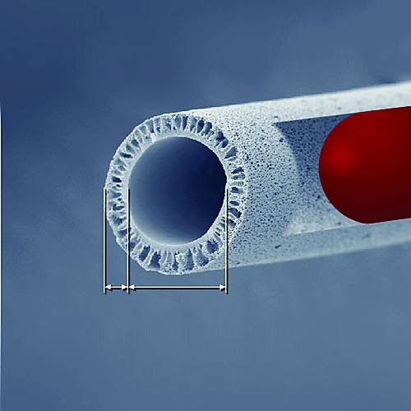
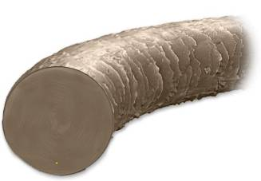
Principle of the Hollow Fiber Membrane
A human hair has a
thickness of about
0.09 mm = 90µm
35µm
190µm
Slide provided by Dr. Markus Storr (Baxter)
Dialysis Core Curriculum 2021
Notes:
In a dialyzer, the porous membranes separate the bloodstream from the dialysate stream, which is the core element of the dialyzer. Uremic toxins are removed from the blood while essential blood proteins and formed blood components are retained due to size exclusion of the membrane. A dialyzer is composed of a bundle of hollow fibers, which provide a large exchange surface area (up to 2.5m²) in a compact and housing.
A hollow fiber is about 3 times as thick as a human hair.

Slide 10
Membrane Structures
Ronco and Clark, Nature Revs Nephrol 2018
Notes:
The vast majority of hollow fiber membranes used clinically now are synthetic and most have an asymmetric wall structure. For such a structure, the inner portion (“skin”) of the membrane (in contact with blood) is very thin (~1 µm) with the rest of the wall assuming a sponge-like or finger-like appearance.

Slide 11
Characteristics of an Asymmetric Polysulfone Membrane
Ronco et al. Kidney Int 2002
Dialysis Core Curriculum 2021
Notes:
This magnification demonstrates the characteristics of a sponge-like asymmetric polysulfone membrane. The inner skin dictates the depuration properties of the membrane, while the remainder of the wall provides mechanical support and surface area for adsorption of larger molecular weight substances.

Slide 12
Blood Flow Through a Hollow Fiber Membrane: Hagen-Poiseuille Law
Dialysis Core Curriculum 2021
Notes:
In this slide, Q_{B} is blood flow rate, ΔP is axial (end-to-end) pressure drop, µ is blood viscosity (determined largely by hematocrit and protein concentration), π is a mathematical constant, and r is effective radius. The denominator in the first equation represents resistance (R). The second equation indicates resistance (and therefore pressure drop) are directly related to hollow fiber inner radius (r) at a constant blood flow rate. While a decrease in radius is favorable with respect to diffusion (shorter distance for a molecule to travel in the blood compartment) and “shear rate” (see subsequently), pressure drop is a limiting factor here.

Slide 13
Blood Flow Through a Hollow Fiber Membrane
Ronco and Clark,
Nature Revs Nephrol 2018
Notes:
This figure is a depiction of the laminar (streamlined; non-turbulent) flow that blood generally displays under typical HD conditions. After blood enters the hollow fiber, the velocity (V) profile quickly assumes the shape of a parabola having a maximum value in the midline of the hollow fiber and a minimum value (0) at the wall of the hollow fiber. For small solutes, high blood flow rate and the associated high velocity gradient (dV/dr) at the blood–membrane interface (wall shear rate (Sh_{w})) promote a high rate of diffusive mass transfer. Shear rates influence not only the diffusive boundary layer (which can be conceptualized to comprise the resistance to mass transfer – see subsequent slide) but also the plasma protein layer (secondary membrane) adsorbed to the surface (see later slide). In this figure, Q represents blood flow rate, r is hollow fiber radius, and η is blood viscosity.

Slide 14
Idealized Membrane
2 nm
5 nm
Adapted from Takeyama and Sakai,
Contrib Nephrol 1998
1 µm (skin layer)
Notes:
As explained in more detail in the next slide, dialysis membranes used in the “real world” actually have pore characteristics that depart significantly from this idealized view – this is a function of the manufacturing process used in their production. Nevertheless, it is instructive from an educational perspective to begin with a “perfect” membrane having the following pore characteristics:
Uniform spacing (i.e., one pore is equidistant from its neighbor)
No variation in radius and perfectly cylindrical
Strictly linear structure that is perpendicular to blood flow (i.e., no tortuosity) such that the travel of molecules in the pores is a straight line
No interaction between the solutes being removed and the interior pore structure
Based on these assumptions, the figure depicts an idealized membrane (skin thickness: 1 µm) having a pore diameter of 5 nm (consistent with a typical high-flux membrane.) A uremic solute with an “effective” diameter of 2 nm (akin to peptidic middle molecule) is also shown. (Even though no solute is perfectly spherical, this assumption can be made for explanatory purposes.) In this idealized scenario, the theoretical 2 nm molecule should be able to gain access to all pores in the membrane and thus be removed by both diffusion and convection without significance “hindrance” by the pores. As such, for molecules whose effective diameter is in this range, diffusive removal in this scenario is dictated exclusively by solute diffusivity (which is inversely proportional to molecular size) while convective removal is dictated exclusively by ultrafiltration rate. (These topics will be discussed later in the presentation.)
The assumption that all pores are the same size implies a precise demarcation (“cut-off”) exists with respect to the molecular weight of solutes that can permeate the membrane structure. However, as will be discussed, the characteristics of “real” dialysis membranes are actually quite different.

Slide 15
Membrane Pore Characteristics
Ronco and Clark,
Nature Revs Nephrol 2018
Dialysis Core Curriculum 2021
Notes:
For the process used in the manufacturing of hollow fiber membranes for HD, it is impossible to achieve the type of membrane described in the previous slide – a distribution of pore sizes is always produced. One of the major goals of the manufacturing process is to produce a membrane with a relatively narrow distribution of pore sizes around a desired average pore diameter, that in turn determines the overall solute and water permeability properties. In general, a tight pore size distribution corresponds to a relatively sharp molecular weight cut-off for solute depuration. While a detailed discussion is beyond the scope of this presentation, another membrane characteristic that influences both water and solute flux is pore density.

Slide 16
Membrane Materials
*
Ronco and Clark,
Nature Revs Nephrol 2018
* asymmetric CTA membrane recently reported (Kim et al, Artif Organs 2018)
Dialysis Core Curriculum 2021
*: asymmetric CTA membrane recently reported (Kim et al, Artif Organs 2018)
Notes:
The use of cellulosic membranes for HD has decreased dramatically over the past 10-15 years for many reasons, with the remaining usage being confined to modified cellulosic membranes. While unmodified cellulosic membranes were exclusively used in the early days of chronic HD, questions were raised about their relative bio-incompatibility. While the biocompatibility profile of modified cellulosic membranes is improved (relative to the unmodified type), contemporary prescription of HD is dominated by synthetic membranes.

Slide 17
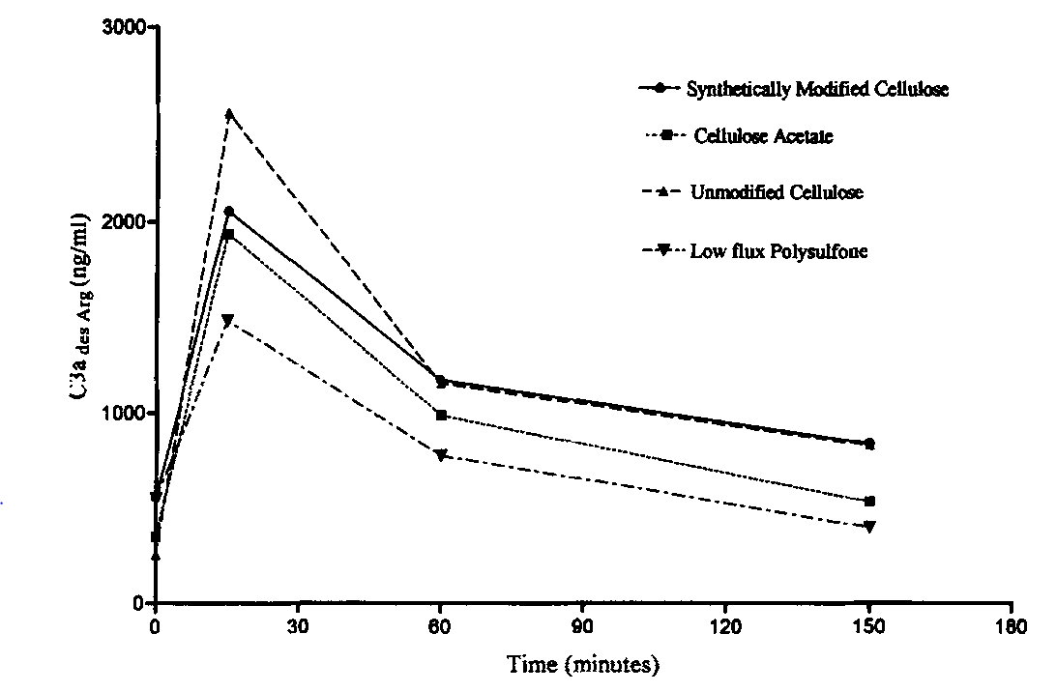
Complement Activation for Different Membranes
Hoenich et al,
Biomaterials 1997
Notes:
This is a representative study showing the hierarchy of HD membranes with respect to complement activation, the benchmark traditionally used to quantify bio-incompatibility. Unmodified cellulose membranes result in the greatest degree and synthetic membranes the lowest degree of complement activation while modified cellulosic membranes are intermediate. Complement activation by cellulosic membranes is felt to be generated by the presence of hydroxyl groups residing in the constituent cellulose polymeric chains. As the slide shows, the phenomenon is very transient, having a peak effect typically 15 minutes after HD initiation.
As synthetic membranes have assumed increasingly greater importance in HD, this type of comparison has become less relevant. In addition, other parameters have been proposed as surrogates for biocompatibility although their clinical relevance has not been established firmly.

Slide 18
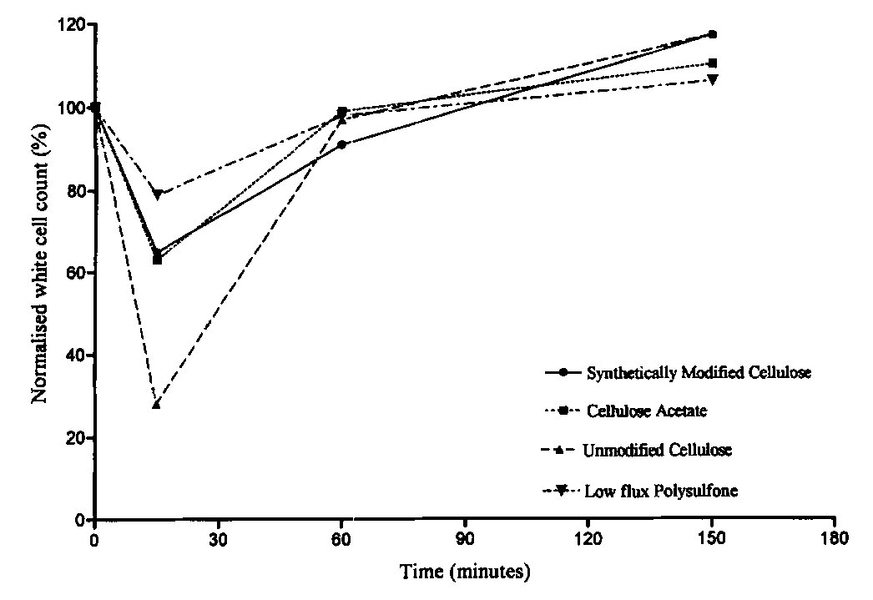
Leukopenia for Different Membranes
Hoenich et al,
Biomaterials 1997
Notes:
This figure is essentially the mirror image of the prior slide, reflecting the inverse relationship between complement activation and neutropenia. Leukopenia in HD has been felt to be a downstream effect of complement activation in which activated white blood cells are sequestered in vascular beds in the body for a transient period.

Slide 19
Dialyzer Characteristics
Dialysis Core Curriculum 2021

Slide 20
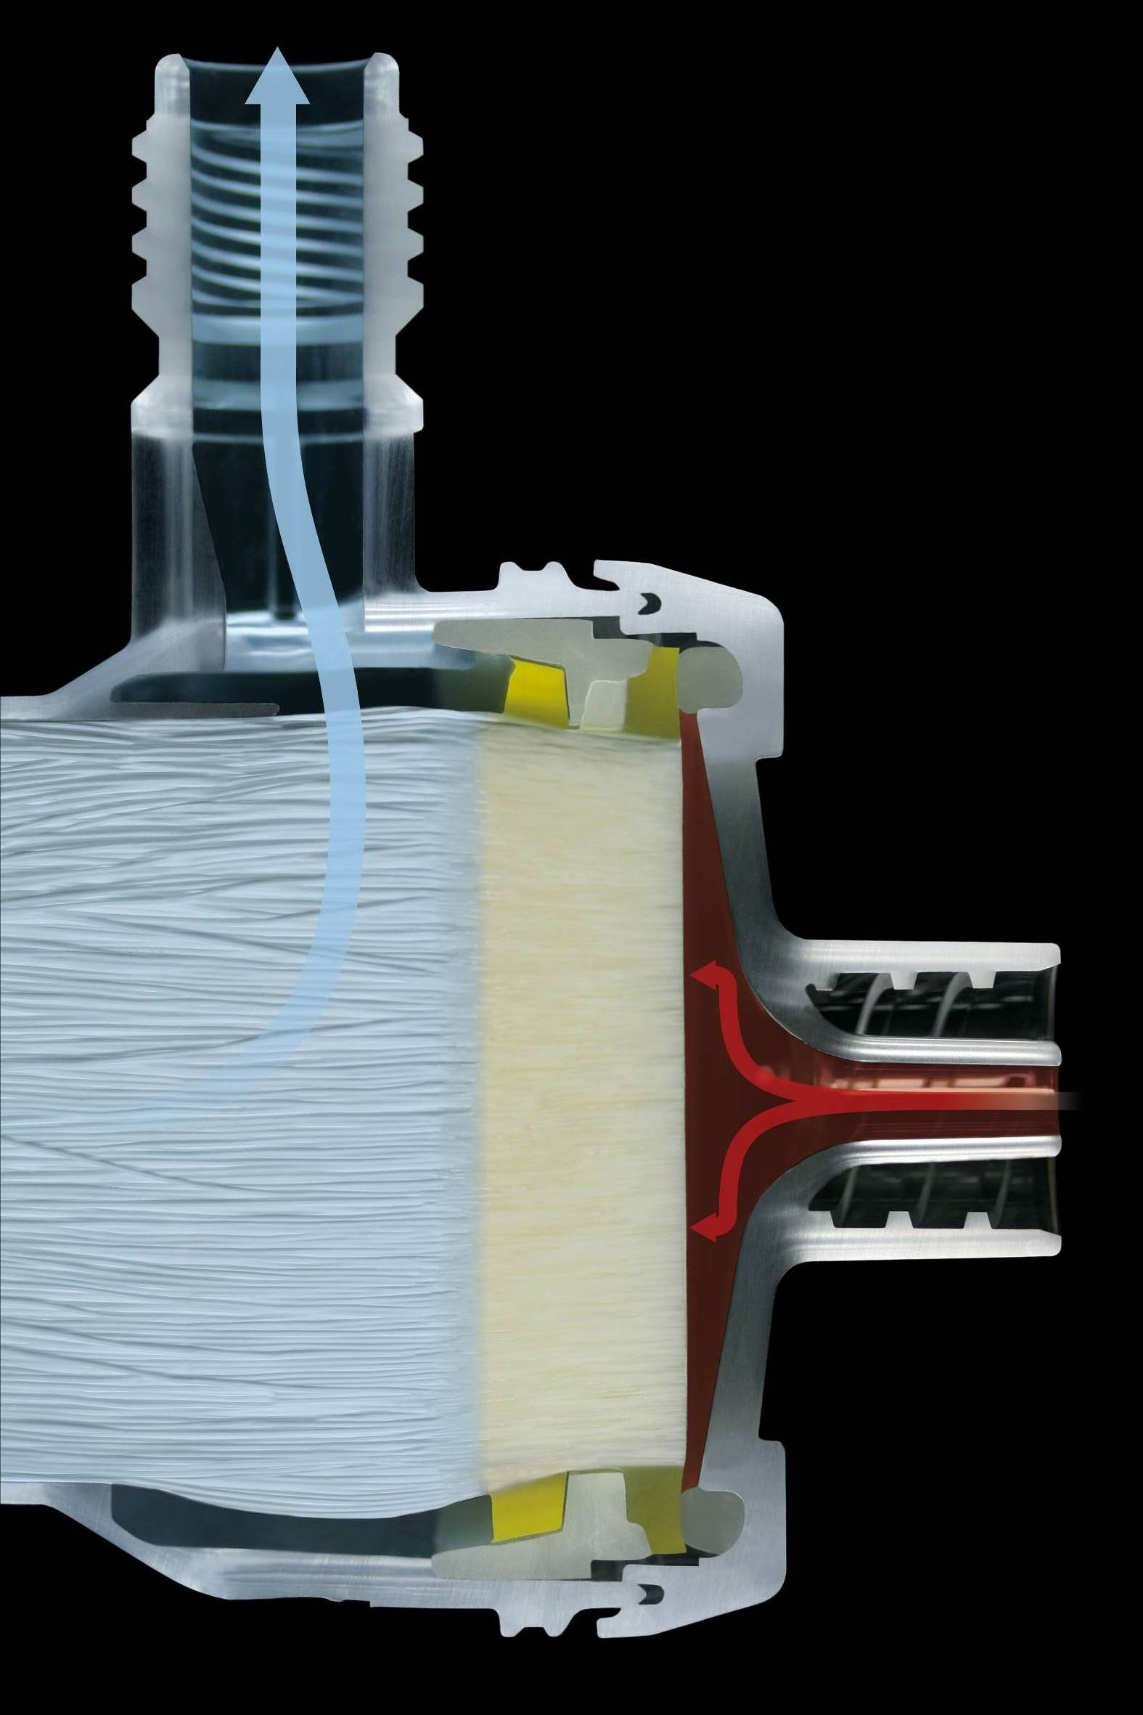
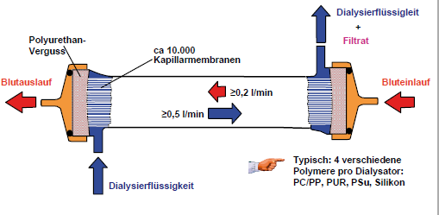
Hollow Fiber Dialyzer
Hollow fiber rmembrane
dialysis fluid
+ filtrate
Polyurethane potting
~ 10,000 capillary membranes
blood out
blood in
300 ml/min
500 ml/min
dialysis fluid
Slide provided by Dr. Markus Storr (Baxter)
Dialysis Core Curriculum 2021
Notes:
In preparation for construction of a dialyzer, several thousand (~10,000–17,000) individual hollow fibers are assembled and wound together to form a “bundle” that has defined characteristics, including a specific fiber spatial arrangement and packing density. These parameters influence the dialysate flow distribution between fibers, which is an important determinant of dialysate-side mass transfer. After this fiber bundle is inserted in the plastic housing of the dialyzer, the fibers are sealed in a two-step process. The first step involves application of a polyurethane (“potting”) compound at either end of the bundle to encapsulate the fibers. The goals of this step are to avoid fiber lumen obstruction and minimize the fiber length that is exposed to the potting compound as the corresponding membrane area does not contribute to mass exchange. After the polyurethane undergoes curing, the bundle is cut with a specialized blade at a defined temperature to control surface roughness, which influences protein deposition and coagulation. This phase is also of great importance for blood flow distribution within the bundle. Finally, the finished product is sterilized by different methods, including steam, γ-irradiation, electron beam irradiation and ethylene oxide sterilization, although the latter is used rarely owing to its allergenic potential.

Slide 21
Fiber Bundle Configuration
Ronco et al, Kidney Int 2002
Dialysis Core Curriculum 2021
Notes:
Magnification of the fiber bundle within the dialyzer plastic housing. Note the fiber undulation (“waviness”), which is designed to promote uniform dialysate distribution and minimize dialysate flow channeling. In addition, this feature may enhance diffusive mass transfer by attenuating dialysate-side boundary layer effects.

Slide 22
Blood Flow Distributor (“Header”)
Ronco et al, Kidney Int 2002
Dialysis Core Curriculum 2021
Notes:
An important component of the blood pathway in the dialyzer is the header, whose purpose is to distribute blood flow evenly throughout the fiber bundle. Headers can have a conical, spiral, or tangential configuration.

Slide 23
Dialysate Flow Distribution
Ronco et al, Kidney Int 2002
Dialysis Core Curriculum 2021
Notes:
A similar consideration is the promotion of homogenous flow distribution in the dialysate compartment. Dialysate flow velocities tend to be higher in the peripheral fibers than in the inner fibers. A fiber packing density, which is defined as the ratio of the cross-sectional area that comprises fibers to the total cross-sectional area of the dialyzer casing, close to 60% seems to be adequate to avoid channeling of the dialysate flow.

Slide 24
Hemodialyzer Specifications
Ronco et al, Kidney Int 2002
Dialysis Core Curriculum 2021
Notes:
These are typical manufacturer data available to help guide clinicians in HD prescription. In a given dialyzer series, as membrane surface area, extracorporeal volume and ultrafiltration coefficient also increase. Maximum blood flow rate is largely dictated by axial (end-to-end) pressure drop limitations – at a given blood flow rate, a larger number of fibers lowers resistance, resulting in lower pressure drop.

Slide 25
Determinants of Fluid and Solute Transport
Dialysis Core Curriculum 2021

Slide 26
Membrane Transport Mechanisms
Hemodialysis
Fluid Transport
Ultrafiltration
Diffusion
Convection
Adsorption
}
Solute Transport
Dialysis Core Curriculum 2021

Slide 27
Modes of Renal Replacement Therapy
Pre-Dilution Substitution
Pre-Dilution Substitution
Blood
Filtrate
Dialysate + Filtrate
Dialysate
Dialysate
Post-Dilution Substitution
Post-Dilution Substitution
Hemofiltration
Hemodiafiltration
Hemodialysis
Dialysis Core Curriculum 2021
Notes:
The solute and water transport mechanisms are applied in different ways to deliver not only HD but also hemodiafiltration (HDF). While hemofiltration was a precursor to HDF, its use is essentially non-existent now.

Slide 28
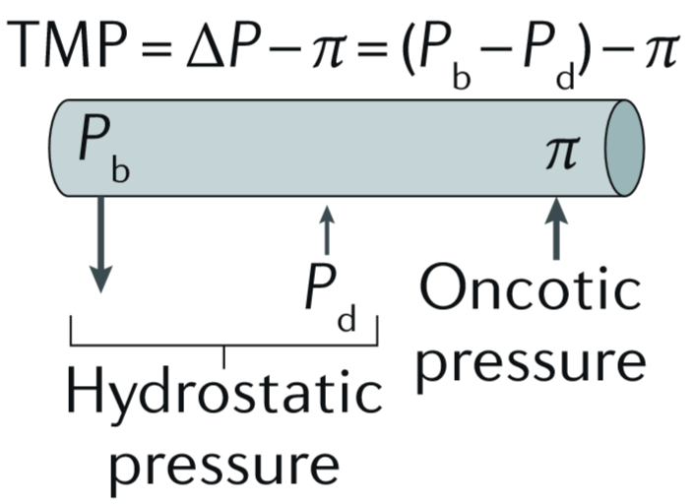
Determinants of Transmembrane Pressure (TMP)
Ronco and Clark, Nature Revs Nephrol 2018
Dialysis Core Curriculum 2021
Notes:
Hydraulic permeability is clinically defined by the ultrafiltration coefficient (Kuf), which is the slope of the linear portion of a plot between ultrafiltration rate (Qf) and transmembrane pressure (TMP). TMP is dominated by hydrostatic pressure differences between the blood (Pb) and dialysate (Pd) compartments, with a small contribution from plasma oncotic pressure (π).

Slide 29
Clinical Definitions of Dialyzer Flux
FDA definition based on water permeability
low permeability dialyzer: K_{UF} < 12 mL/hr/mm Hg
high permeability dialyzer: K_{UF} ≥ 12 mL/hr/mmHg
HEMO Study
low-flux dialyzer: first-use B₂M clearance < 10 mL/min
high-flux dialyzer: first-use B₂M clearance > 20 mL/min; K_{UF} > 14 mL/hr/mm Hg
EUDIAL
high-flux filter: ultrafiltration coefficient greater than 20 mL/hr/mm Hg/m² and a β₂-microglobulin sieving coefficient greater than 0.6
Dialysis Core Curriculum 2021
Notes:
Hydraulic flux (water permeability) is the most common criterion traditionally used to classify dialysis membranes. The clinical parameter used to quantify water permeability is ultrafiltration coefficient (Kuf), which is derived from the relationship between ultrafiltration rate (Qf) and TMP over a clinically relevant range of TMP. However, this parameter does not really provide specific information about solute permeability. As such, more recent classification systems (HEMO and EUDIAL) have combined ultrafiltration coefficient and a β2-microglobulin-related depuration parameter. (See subsequent slide for more detailed discussion of sieving coefficients.)

Slide 30
Membrane/Filter: Ultrafiltration
Ronco and Clark, Nature Revs Nephrol 2018
Notes:
This figure depicts the fundamental relationship between ultrafiltration rate and TMP. Although the ultrafiltration coefficient (Kuf) of a dialyzer (ml/h/mmHg/m2) is a specific property that characterizes a ‘clean’ (that is, unfouled) membrane, its effective value is influenced by protein–membrane interactions (“secondary membrane” formation), as will be discussed subsequently. While the slope of the linear portion of each curve represents dialyzer Kuf, the curve plateaus at a certain TMP, at which point further increases in TMP do not increase ultrafiltration rate. At this point, fouling (“gelling”) of the membrane has occurred, an irreversible phenomenon caused by a highly consolidated and organized secondary membrane.

Slide 31
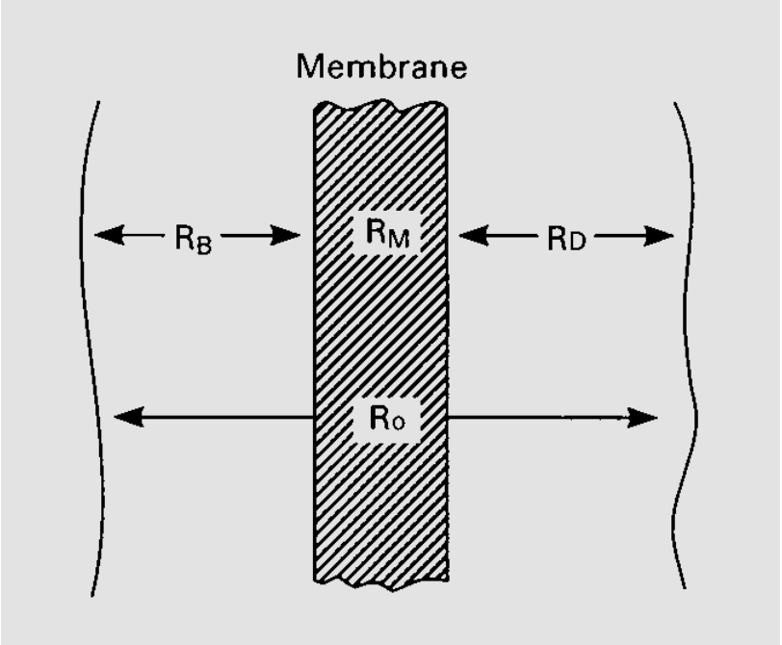
Diffusion: Mass Transfer Resistances
C_{B}
C_{D}
Clark and Shinaberger,
Blood Purif 2000
Dialysis Core Curriculum 2021
Notes:
Although the characteristics of the membrane have an important influence on diffusive solute removal by a dialyzer, the blood and dialysate compartments also play a substantial part. From an engineering perspective, diffusive mass transfer in a dialyzer is typically expressed in terms of the overall resistance to mass transfer (Ro) and the overall mass transfer coefficient (Ko), which are inversely related to one another. Overall resistance to mass transfer (Ro) takes into account the three major components of the dialyzer, where Rb, Rm and Rd are resistances contributed by the blood compartment, the membrane, and the dialysate compartment, respectively. As these three parameters can be viewed as resistances in series, the overall resistance to mass transfer for a solute has a “controlling” component, which is the dialyzer aspect that contributes most to the overall resistance.

Slide 32
Diffusive Mass Transfer in Hemodialysis
Ronco and Clark,
Nature Revs Nephrol 2018
Dialysis Core Curriculum 2021
Notes:
Whereas blood compartment resistance is typically the controlling parameter for small solutes (irrespective of dialyzer type), membrane resistance becomes most important at a specific molecular weight, with the transition occurring at a lower molecular weight for low-flux dialyzers owing to relatively small mean pore sizes. However, although the membranes of high-flux dialyzers have a more open pore structure, the membrane itself rapidly becomes the controlling resistance in this case also as solute molecular weight increases. In general, this is the case for solutes that have a molecular weight of >500 Da.

Slide 33
Instantaneous Dialyzer Clearance
Q_{Do} = Q_{Di} + Q_{F}
Q_{Di}
↑
↓
Q_{Bi}
Dialyzer
Q_{Bo}
Mass removal rate
Clearance =
Blood Concentration
Dialysis Core Curriculum 2021
Notes:
Clearance is defined as the ratio of mass removal rate to blood concentration and is the standard parameter used to quantify dialyzer efficiency. This parameter assesses dialyzer performance at a given point in time and can be used to compare different dialyzers.

Slide 34
Effect of Membrane Surface Area on Clearance
1.9 m²
1.3 m²
Adapted from Ronco et al,
Nephrol Dial Transplant 1998
Dialysis Core Curriculum 2021
Ronco et al, Nephrol Dial Tranplant 1998
Notes:
The relationship between clearance and blood flow rate typically demonstrates a linear portion at relatively low blood flow rates and a quasi-plateau region at higher blood flow rates. Increasing surface area increases both the slope of the linear portion of the curve and the eventual plateau value. In the plateau region, membrane surface area utilization is approaching maximal and further increases in blood flow rate do not result in higher clearance.

Slide 35
Clearance vs. Blood Flow Rate in HD
Ronco et al, Nephrol Dial Transplant 1998
Dialysis Core Curriculum 2021
Notes:
These curves represent the theoretical relationship between clearance and blood flow rate for molecules of varying molecular weight (MW) in HD. Each of the curves again has a linear region at relatively low blood rates and a quasi-plateau region at higher. Since solute diffusivity (both in solution and within a dialysis membrane) is inversely proportional to solute MW, small molecules are transported more quickly in diffusion-based HD. The slope of the urea (MW 60 Da) curve is greater and its plateau value higher than the other solutes. The limitations of removing a large molecule like inulin (MW, 5200) with a diffusion-based therapy like HD is evident. While small solute clearance is sensitive to blood flow rate (the most important determinant of diffusive solute removal in the blood compartment) over a wide blood flow rate range, the inulin curve plateaus at a low absolute value and at a relatively blood flow rate. This demonstrates the insensitivity of large molecules to diffusive solute removal in HD.

Slide 36
Relationship Between Dialyzer Clearance and KoA
Michaels, Trans ASAIO 1966
Dialysis Core Curriculum 2021
Notes:
The KoA (permeability-area product) parameter is a function of blood flow rate, dialysate flow rate, and dialyzer clearance, and is measured under conditions of zero net ultrafiltration. KoA can be conceptualized as the maximum clearance obtained for a dialyzer of specific membrane surface area under the theoretical conditions of infinite blood and dialysate flow rates. The condition of zero net ultrafiltration implies that KoA is a purely diffusive parameter, an assumption that is valid for all solute–membrane combinations with low-flux dialyzers. However, a zero net ultrafiltration condition is not equivalent to no fluid fluxes across a high-flux dialyzer membrane, and a condition of “pure diffusion” is not readily attainable with this type of device. The KoA values for small solutes are minimally influenced in the condition of zero net ultrafiltration and remain valid for solute removal parameters for high-flux dialyzers when measured in this context. However, diffusive KoA values for larger solutes (for example, β2-microglobulin (β2m)) cannot be reliably estimated under these conditions, as the convective clearance associated with fluid fluxes (‘internal filtration’) contributes substantially to total clearance. The concepts underlying KoA and Kuf are examined further later.

Slide 37
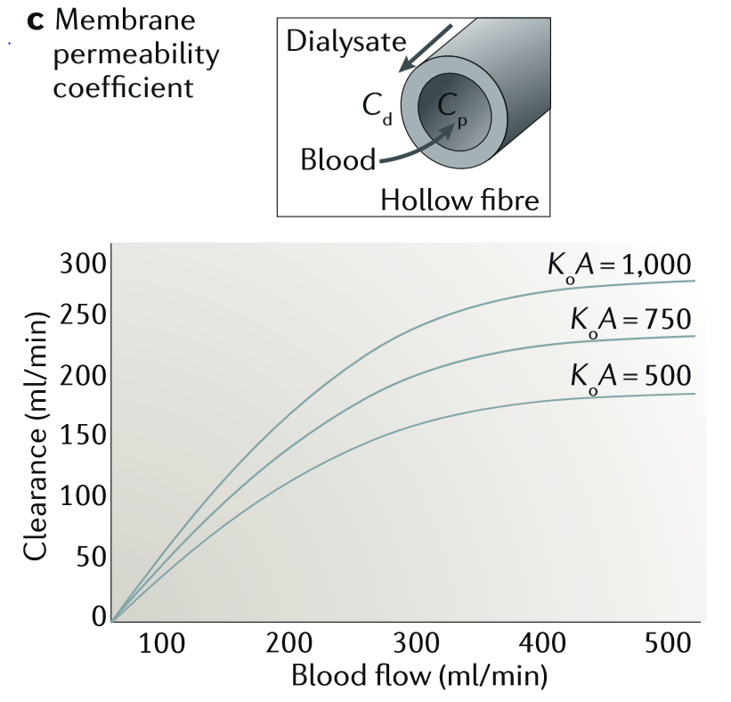
Relationship Between Clearance, Blood Flow Rate, and KoA
Ronco and Clark,
Nature Revs Nephrol 2018
Notes:
These curves are a graphical representation of the dialyzer KoA dependence on blood flow rate at a constant dialysate flow rate (shown on the previous slide) for a specific solute. These curves also characteristically show a linear portion at relatively low blood flow rates and a plateau region at higher blood flow rates. In the linear region, at a given specific blood/dialysate flow rate combination, dialyzer solute clearance is directly proportional to KoA. It should be noted that even for a dialyzer with a (urea) KoA of 1000 mL/min, blood flow rates beyond 400 mL/min generally do not have an appreciable impact on clearance. A significant effect on clearance at blood flow rates in this range can only be achieved with a dialyzer having a higher urea KoA value.

Slide 38
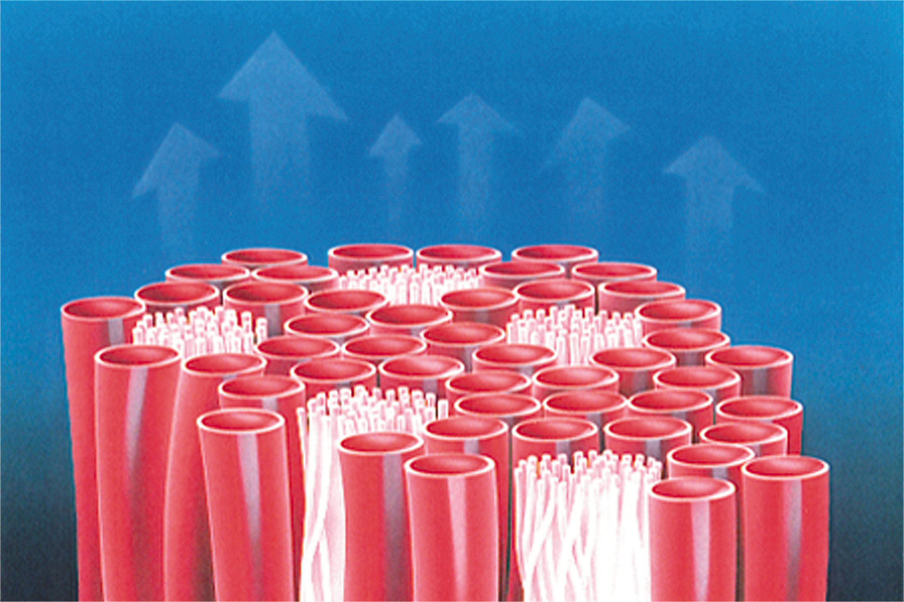
Spacer Yarn Technology
Slide provided by
Dr. Oliver Schuster
(Membrana/3M)
Dialysis Core Curriculum 2021
Notes:
While the discussion so far has focused on blood compartment and membrane transport, dialysate-side transport is also important. In addition to fiber undulation (mentioned previously), the incorporation of spacer yarns is very common now in modern dialyzers. This technology promotes uniform dialysate flow distribution by optimizing spacing between the hollow fibers.

Slide 39
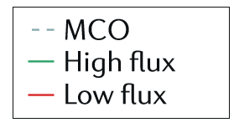
Convection: Membrane Sieving Characteristics
Notes:
Diffusive transport becomes increasingly limited as effective solute molecular weight increases. This limitation can be overcome to some extent by the introduction of convective transport, which relies on the mechanism of solvent drag. The sieving coefficient is classically used to define the convective transport properties of a membrane for a specific solute. The sieving coefficient (SC) is the ratio between the solute concentration in the filtrate (Cf) and the solute concentration in the plasma water (Cp) in the absence of a diffusion gradient across the membrane.
The observed (measured) SC values are influenced by interactions between the membrane and blood elements during dialysis. The secondary membrane reduces effective membrane permeability immediately upon exposure to blood in a process known as fouling. In the convective removal of specific solutes, the influence of secondary membrane formation is directly proportional to solute molecular weight. The proteins found in the highest concentrations in the plasma, such as albumin, fibrinogen and immunoglobulins, are the predominant components of the secondary membrane.
The medium cut-off (MCO) class of filters is a relatively recent entrant to the HD market. As this slide and the next demonstrate, the class targets a permeation profile that more closely approximates that of the glomerulus itself (relative to standard high-flux filters).

Slide 40
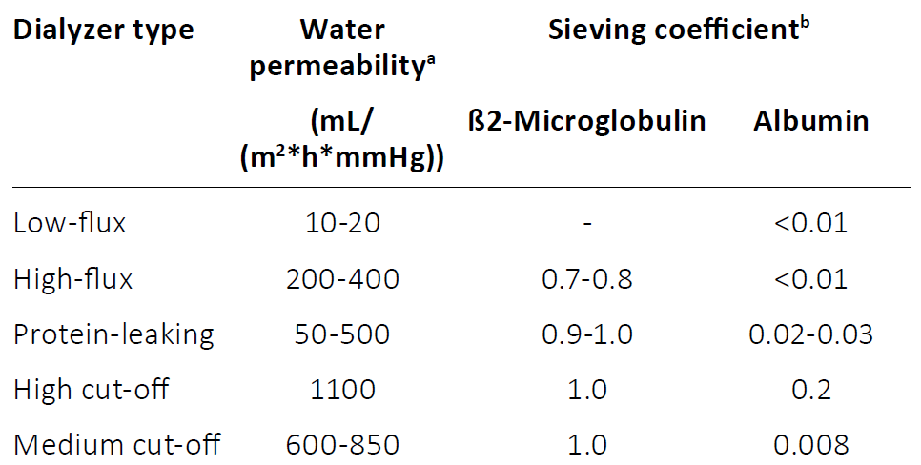
Dialyzer Classification Based on Flux and SC
Zweigart,
Int J Artif Organs 2017
Dialysis Core Curriculum 2021
Notes:
As mentioned before, contemporary dialyzer classification systems incorporate both water and solute permeability parameters. This scheme combines water permeability with sieving coefficient values for both β2-microglobulin and albumin. It should be noted that these values reflect the “virgin” state of a dialyzer (i.e., before the membrane has been exposed to blood). As discussed previously and subsequently, the adsorption of plasma proteins to the membrane surface substantially decreases both the water and solute permeability of a dialyzer.
The protein-leaking, high cut-off (HCO), and MCO classes are all relatively new adaptations of high permeability filters having various combinations of water and solute permeability. The first two classes are generally associated with albumin losses that exceed acceptable clinical limits for chronic HD and will not be discussed further.
Please see slide #48 for further context.

Slide 41
Secondary Membrane: Effect on Membrane Permeability
Fibrinogen:
MW: 340 kDa
Length: 45 nm
Conc: 3 g/L
Pore size: ~5 nm
Adapted from Takeyama and Sakai,
Contrib Nephrol 1998
Notes:
Secondary membrane formation is an important consideration in the evaluation of higher permeability dialyzers. This slide shows the relative dimensions and blood concentrations of two representative proteins: the 20 nm peptidic middle molecule mentioned on slide 14 (represented by the spherical molecules) and fibrinogen (the rod-like dark structures residing on the membrane surface). While fibrinogen is far too large to enter the pore structure of a high permeability membrane, it is a prominent component of the layer of proteins adsorbed to the membrane surface after contact with blood. While the mechanism by which fibrinogen and other large plasma proteins comprising the secondary membrane alter native membrane permeability, decreased pore access for molecules like the peptidic middle molecule due to pore “blockade” probably plays an important role.

Slide 42
Plasma Proteins: Molecular Weights/Concentrations
Ward et al.
Nephrol Dial Transplant 2019
Notes:
As suggested on the previous slide, proteins found at highest concentration in the blood (albumin, immunoglobulins, and fibrinogen) are the primary components of the secondary membrane.

Slide 43
Effect of Plasma Protein Adsorption (“Secondary Membrane”) on Solute Rejection
Plasma
% Rejection
Saline
2000
3000
5000
10000
Log [Molecular Weight]
Adapted from Feldhoff et al. Artif Organs 8:166-192, 1984
Notes:
This in vitro study using dextrans over a molecular weight range of ~2.5 kDa to 20 kDa demonstrates the impact of secondary membrane formation on the sieving properties of a high-flux synthetic membrane. In this study, the solute permeability of filters that had either been pre-exposed to saline (no secondary membrane) or plasma were evaluated. (The dependent variable, % rejection, is essentially the inverse of sieving coefficient). For example, a 5 kDa dextran has a 0 % rejection value (i.e., sieving coefficient = 1.0) for the filter pre-exposed to saline while the corresponding value for the filter pre-exposed to plasma is approximately 70% (sieving coefficient of 0.3).

Slide 44
Effect of Blood Flow Rate on Sieving Coefficient
Ronco and Clark, Nature Revs Nephrol 2018
Dialysis Core Curriculum 2021
Notes:
In convective modalities, high shear rates attenuate the effects of the secondary membrane with the sieving coefficient (SC) approximating the ideal value of the reciprocal of the rejection coefficient of the membrane (R).

Slide 45
Dialytic Removal of Large Solutes
Dialysis Core Curriculum 2021

Slide 46
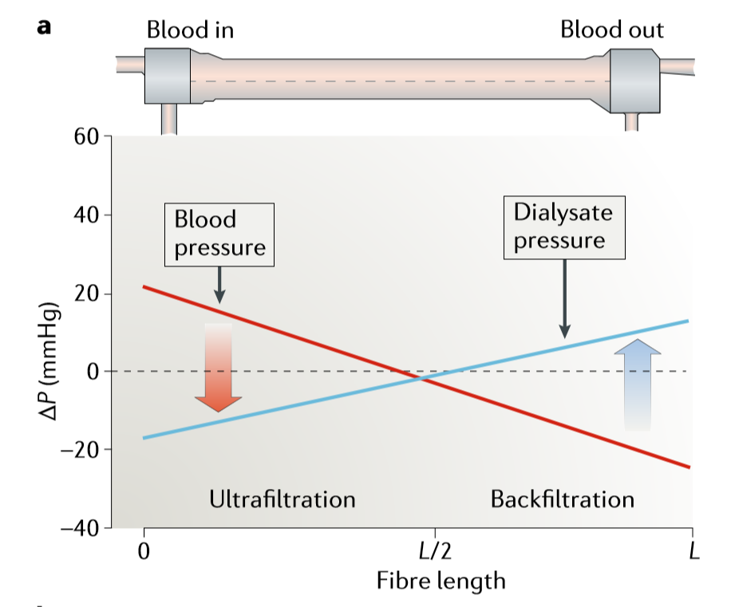
Internal Filtration in High-Flux Hemodialysis
Ronco and Clark,
Nature Revs Nephrol 2018
Notes:
In typical hemodialysis operating conditions, the water permeability characteristics for a standard high-flux dialyzer result in a fairly large drop in the blood compartment axial pressure during treatment. The pressure drop is sufficiently large that, at some point along the length of the dialyzer, the blood compartment pressure is less than the dialysate compartment pressure in normal operating conditions. Thus, especially considering the oncotic effects of plasma proteins in the blood compartment, there is a point at which the ultrafiltrate begins to be driven from the dialysate to the blood, as opposed to the “standard” (blood–dialysate) direction in the more proximal part of the dialyzer. In fact, this combination of filtration and “backfiltration” is considered to be the predominant mechanism by which larger compounds are removed during standard high-flux hemodialysis, as explained further below.
The concentration of a molecule that is removed from the blood by convection in the proximal part of a high-flux dialyzer is substantially reduced once it crosses the membrane owing to the combination of sieving and the diluting effect of dialysate flow. When a portion of the dialysate is reinfused back into the blood as backfiltrate in the distal segment of the dialyzer, the amount of solute re-infused by solvent drag is negligible compared with that removed in the proximal part of the dialyzer owing to the blood–dialysate concentration difference, even if the filtration and backfiltration rates are similar. In fact, the reinfused fluid can be considered an “internal” substitution fluid because the concentration of the solute of interest is essentially zero. As such, this mechanism has been termed “internal hemodiafiltration” or, more commonly, internal filtration.

Slide 47
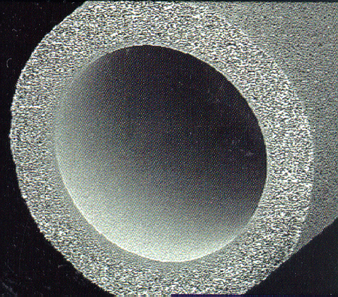
Effect of Fiber Geometry
A decrease in internal diameter significantly increases wall shear rates and internal filtration
40 μm
200 μm
185 μm
35 μm
F
Fx
Ronco et al,
Kidney Int 2000
Dialysis Core Curriculum 2021
Notes:
As indicated previously, a decrease in inner fiber diameter enhances internal filtration by increasing axial pressure drop. Maximizing the extent of internal filtration during high-flux hemodialysis through a combination of increased membrane permeability (increased pore size) and higher axial blood compartment resistance (decreased hollow-fiber inner diameter) can provide clinically meaningful increases in large-solute clearance. Internal filtration rates are estimated to be as high as 60 ml/min (~3.5 l/h), and new membrane designs may be able to extend this range.

Slide 48
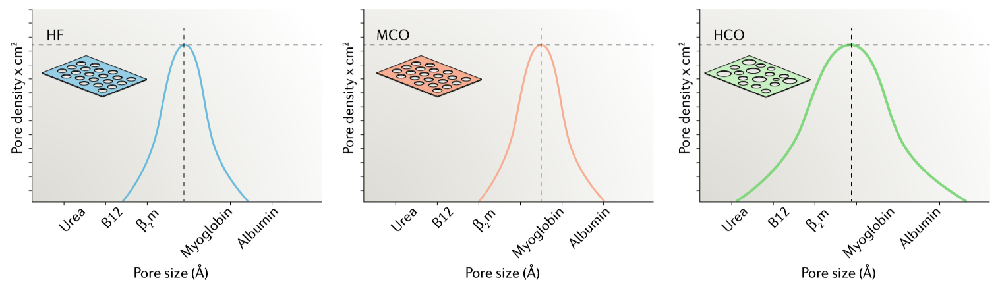
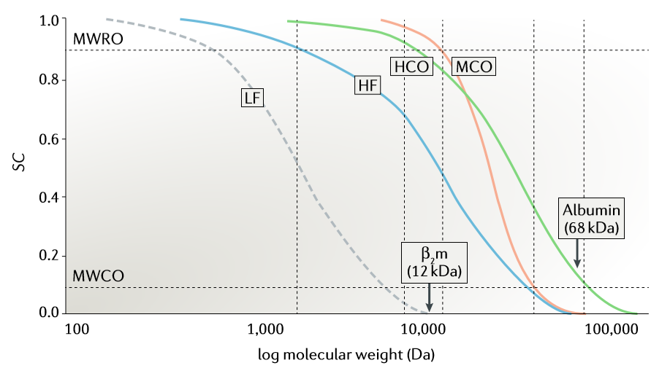
Membrane Classification: Beyond Standard High-Flux
Ronco and Clark,
Nature Revs Nephrol 2018
Notes:
A new parameter, the “molecular weight retention onset” (MWRO) index, is generated from a standard solute sieving coefficient versus molecular weight profile, as with the classic molecular weight cutoff (MWCO). The MWRO is defined as the molecular weight at which the SC value first reaches 0.9 (whereas the MWCO corresponds to a SC of 0.1). The MWRO index, which provides insights about pore size distribution, supplements information provided by the MWCO, which is primarily correlated with mean pore size. The steepness of the sieving coefficient versus molecular weight profile is determined mostly by the proximity of the values of these two parameters. A classification scheme has been proposed in which the MWCO and the MWRO are utilized in combination to define different dialyzer classes.
In this figure, pore size distribution curves are schematically depicted for three classes of membranes, high flux (HF), medium cut-off (MCO) and high cut-off (HCO), as well as their sieving coefficient (SC) profiles (part d). As the interval between molecular weight retention onset (MWRO) and molecular weight cut-off (MWCO) decreases, the profile of the curve becomes steeper, increasing the removal of large uremic toxins (such as β2-microglobulin (β2m)) while decreasing the loss of albumin. A low-flux (LF) membrane is shown for comparison. Although standard high-flux membranes made the development of convective therapies possible, MCO membranes represent the basis for a new diffusion-based therapy called “expanded hemodialysis”. (B12, vitamin B12)

Slide 49
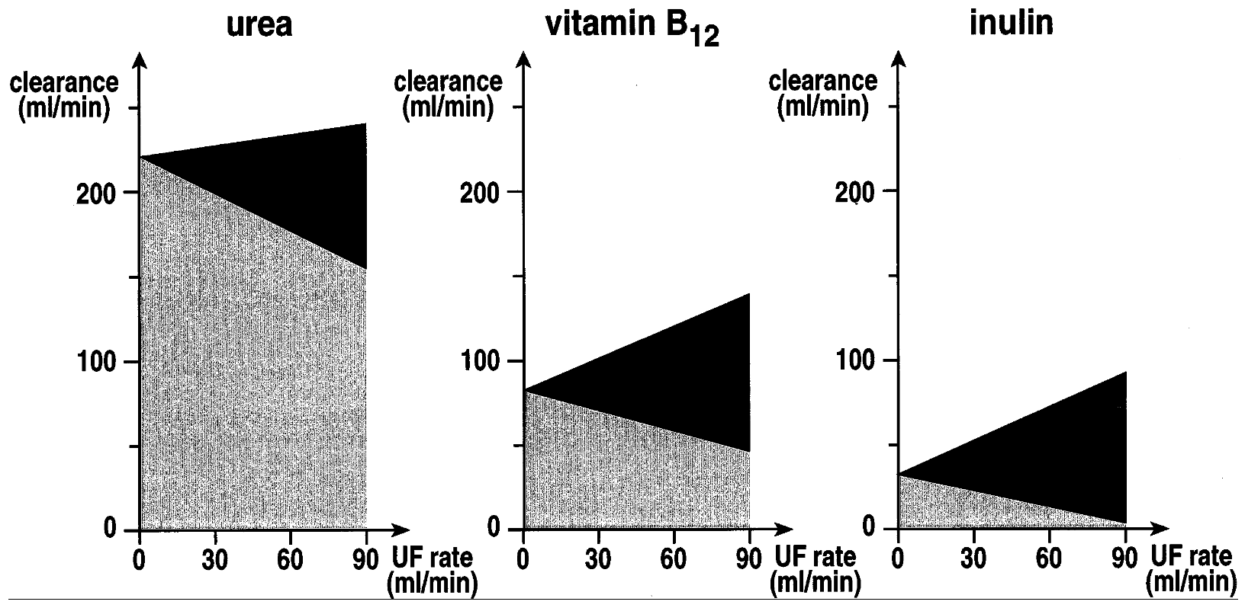
Impact of Ultrafiltration Rate in Hemodiafiltration (HDF)
Diffusive Component
Convective Component
Ledebo,
Artif Organs 1998
Dialysis Core Curriculum 2021
Notes:
For dialyzers used in the hemodialysis mode, adaptations in membrane permeability and inner diameter can achieve a significant increase in the clearance of middle and large molecular weight uremic solutes through modulation of internal filtration rates. A second, more established approach to achieve the same goal is online hemodiafiltration (OLHDF), for which the growth rate in incident patients exceeds that of HD. This slide demonstrates a foundational principle of HDF. The general idea of HDF is to apply an ultrafiltration rate far in excess of a patient’s net fluid removal requirements, with the goal of significantly enhancing convective solute clearance. (As discussed subsequently, the two most important determinants of convective clearance for a given solute are sieving coefficient and ultrafiltration rate). Of course, to prevent volume depletion, most of the ultrafiltrate losses have to be “replaced” with replacement (“substitution”) fluid – as discussed, this intravenous-quality fluid is generated by the dialysis machine “online” through a series of membrane filtration steps.
Small solutes are already efficiently removed by diffusion-based HD and, as the slide indicates, the net effect of incorporating a substantial convective component is very modest. For each solute in the figure, the gray and black areas correspond to the diffusive and convective components of clearance, respectively. Even with an ultrafiltration rate of 90 mL/min (~6 L/hr), a net increase of only ~10% in urea clearance is observed. This can be explained by two phenomena. One is that the additional contribution to clearance that convection provides reduces the blood urea concentration within the hollow fiber – this reduces the transmembrane urea concentration gradient, thus actually decreasing diffusive clearance. The other phenomenon is related to the post-dilution mode that is typically used for substitution fluid administration in OLHDF. In this mode, blood hematocrit and viscosity substantially increase along the length of the hollow fiber due to ultrafiltration of blood, resulting in an increase in diffusive mass transfer resistance in the blood compartment.
The above two phenomena are also relevant for larger molecules (MW of vitamin B12 and inulin is 1350 and 5200 Da, respectively). However, diffusive clearance is modest at baseline and the additional convective clearance achieved with high ultrafiltration rates results in a greater impact on clearance for these solutes on a relative basis. Specifically, net vitamin B12 and inulin clearance values increase from the baseline diffusive mode by ~50% and 100%, respectively.

Slide 50
Fluid Purification System for “Online” HDF
Cappelli et al, Contrib Nephrol 2007
Dialysis Core Curriculum 2021
Notes:
As mentioned, the large volume of substitution fluid for an OLHDF treatment is generated by sequential filtration of dialysate to produce ultrapure dialysate initially and then intravenous-quality infusate for substitution.

Slide 51
Dialyzer Changes During Course of OLHDF Treatment
Ronco,
Blood Purif 2015
Dialysis Core Curriculum 2021
Notes:
The predominant mode for OLHDF is post-dilution because this is the most efficient way to obtain desired solute clearances. (In this case, efficiency is measured by the volume of substitution fluid required to produce a target clearance.) As the slide indicates, convective clearance is largely a function of ultrafiltration rate and sieving coefficient. However, OLHDF modes that involve some degree of pre-dilution (either pure or mixed) result necessarily in decreased solute concentrations in the blood entering the filter (in comparison to the patient’s blood concentration of a particular solute). The lowered blood solute concentrations in the hollow fiber lumens resulting from dilution inherently reduces the treatment efficiency. To compensate for this inefficiency effect, higher ultrafiltration rates (and, therefore, substitution fluid rates) are required in pre-dilution and mixed-dilution HDF to achieve similar solute clearances as those produced in post-dilution HDF.
While the post-dilution mode is most efficient from a solute clearance/fluid requirement perspective, a number of factors can cause degradation of filter performance over time, as shown in this slide. Filtration fraction is a measure of the extent to which the blood compartment is being hemoconcentrated. Hemoconcentration promotes not only filter clotting (due to a higher concentration of RBCs) but also membrane fouling (essentially accelerated secondary membrane formation due to a high concentration of plasma proteins at the membrane surface). In turn, clotting of a certain percentage of the hollow fibers results in reduced cross-sectional fiber bundle area and increased resistance to blood flow from end-to-end (“E-E”). Likewise, membrane fouling can result in increased TMP.
Modern HD machines used for OLHDF have relatively sophisticated feedback algorithms that measure several parameters with the goal of attenuating these phenomena.

Slide 52
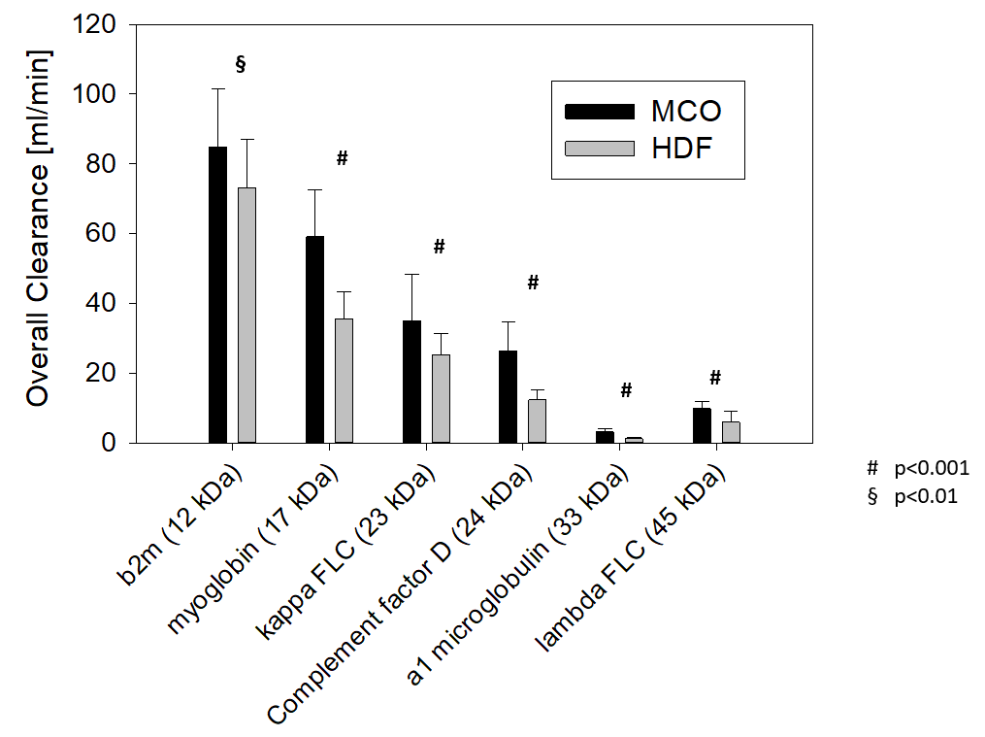
Comparison of OLHDF and HD with MCO Filter
Kirsch et al, Nephrol Dial Transplant 2017
Notes:
In this crossover study, 39 ESRD patients were treated with either online HDF (average convective dose, 24 L; 2.0 m² polysulfone high-flux filter; ) or HD with a 1.7 m² PAES/PVP MCO filter. The blood flow rate in both arms was 400 mL/min and treatment duration was 4.3-4.4 hrs on average. Overall clearance, defined as mass removal for an entire treatment divided by area under the curve for the concentration vs time profile, was estimated for a series of middle/large molecular uremic toxins ranging in molecular weight from 12 kDa to 45 kDa. For all molecules, clearance was significantly higher in the MCO arm, with the percent differences between the two arms generally larger as solute molecular weight increased.

Slide 53
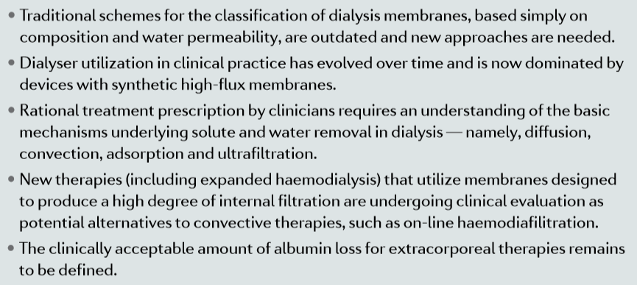
Summary
Dialysis Core Curriculum 2021

Slide 54
REFERENCES
Ronco C, Clark WR: Haemodialysis membranes. Nature Rev Nephrol 2018;14:394-410
Ronco C, Bowry SK, Brendolan A, et al: Hemodialyzer: from macro-design to membrane nanostructure; the case of the FX-class of hemodialyzers. Kidney Int Suppl 2002;80:126-42
Takeyama T, Sakai Y: Polymethylmethacrylate: One Biomaterial for a Series of Membrane. Contrib Nephrol. 1999;125:9-24
Hoenich NA, Woffindin C, Stamp S, Roberts SJ, Turnbull J: Synthetically modified cellulose: an alternative to synthetic membranes for use in haemodialysis? Biomaterials 1997;18:1299-303
Clark WR, Shinaberger JH: Effect of dialysate-side mass transfer resistance on small solute removal in hemodialysis. Blood Purif 2000;18:260-263
Ronco C, Ghezzi PM, Brendolan A, Crepaldi C, La Greca C: The haemodialysis system: basic mechanisms of water and solute transport in extracorporeal renal replacement therapies. Nephrol Dial Transplant 1998;13 Suppl 6:3-9
Michaels AS: Operating parameters and performance criteria for hemodialyzers and other membrane-separation devices. Trans Am Soc Artif Intern Organs 1966;12:387-92
Zweigart C, Boschetti-de-Fierro A, Hulko M, et al: Medium cut-off membranes - closer to the natural kidney removal function. Int J Artif Organs 2017;40:328-334
Dialysis Core Curriculum 2021

Slide 55
REFERENCES
Feldhoff P, Turnham T, Klein E: Effect of plasma proteins on the sieving spectra of hemofilters. Artif Organs 1984;8:186-92
Ronco C, Brendolan A, Lupi A, Metry G, Levin NW: Effects of a reduced inner diameter of hollow fibers in hemodialyzers. Kidney Int 2000;58:809-17
Ledebo I: Principles and practice of hemofiltration and hemodiafiltration. Artif Organs 1998;22:20-5
Cappelli G, Ricardi M, Bonucchi M, Amicis S: Quality of water, dialysate and infusate. Contrib Nephrol. 2007;158:80-86
Ronco C: Hemodiafiltration: Technical and Clinical Issues. Blood Purif 2015; 40 Suppl 1:2-11
Kirsch AH, Lyko R, Nilsson LG, et al: Performance of hemodialysis with novel medium cut-off dialyzers. Nephrol Dial Transplant 2017;32:165-172
Dialysis Core Curriculum 2021

