Slide 1
Basic Principles of Dialysis Hemodialysis Circuit Review
Dialysis Core Curriculum 2021
Bessie A. Young, MD, MPH, FASN
University of Washington
Suhail Ahmad, MD
University of Washington
Scott D. Bieber, DO
Kootenai Clinic

Slide 2
Disclosures
Bessie A. Young
Employer: VA Puget Sound Healthcare System; University of Washington
Research Funding: NIH, VA
Scientific Advisor/Membership: ASN, CJASN, Diabetes Reviews
Suhail Ahmad
Employer: University of Washington
Ownership, Patents and Inventions, Scientific Advisor or Membership: Advanced Renal Technologies
Scott D. Bieber
Employer: University of Washington, Northwest Kidney Centers
Other Interests and Relationships: Medical Director for Northwest Kidney Centers
Dialysis Core Curriculum 2021

Slide 3
Learning Objectives
Describe components of hemodialysis machine circuit
Discuss how to troubleshoot dialysis circuitry alarms
Explain potential dialysis emergencies associated with the dialysis circuit components
Dialysis Core Curriculum 2021

Slide 4
Case Presentation 1
Clinical case presentation
65-year-old male with history ESKD secondary to Diabetes Mellitus type 2 with a history of coronary artery disease and peripheral vascular disease. He has been on dialysis for the past 2 years.
The patient has been on dialysis for 3.5 hours of a 4-hour session without any issue. Suddenly, the dialysis machine conductivity alarm triggers and the conductivity decreased from 13 to 8 mS/cm.
The dialysis machine stops dialysis and puts the dialysate into bypass mode.
What is the issue and how do you trouble shoot it?
Dialysis Core Curriculum 2021

Slide 5
Case Presentation 1
Clinical Case Presentation
Given this scenario, what is the most likely cause of the low conductivity alarm?
A. Lack of solution in the acid or base concentrate
B. Use of the wrong potassium prescription for the patient
C. Blood crossing the dialysis filter
D. High dialysate pressure reading
Dialysis Core Curriculum 2021

Slide 6
Case Presentation 1
Clinical Case Presentation
The most likely reason for low conductivity is low concentration of acid or base solution. Conductivity measures the total electrolyte concentration in dialysate. Conductivity is a measure of how much electricity the fluid will conduct, measured by placing electrodes in the dialysate, and is a proxy measure for electrolyte concentration in the dialysate. Low dialysate concentration is one cause of a low conductivity level. Other potential causes are poor water flow to the proportioning system, untreated incoming water, and use of the wrong dialysate concentration.
A. Lack of solution in the acid or base concentrate
B. Use of the wrong potassium prescription for the patient
C. Blood crossing the dialysis filter
D. High dialysate pressure reading
Dialysis Core Curriculum 2021
Notes:
Use of the wrong potassium prescription for the dialysate should not cause a conductivity alarm unless the potassium concentration drastically changes the conductivity. It would have alarmed at the beginning of the session. Blood crossing the dialysis filter would set off the blood leak detector alarm. High dialysate pressure readings might trigger a dialysate pressure monitor or flow rate alarm. Dialysis flow rate alarms may be triggered by low water pressure, dialysate pump failure, a blockage in the dialysate flow path, or a power failure.

Slide 7
Dialysis Circuit Outline
Hemodialysis Machine circuit
Describe the main components of the dialysate circuit, including:
Deaeration
Dialysate proportioning and conductivity
Dialysate formulation
Monitors, alarms, and conductivity
Ultrafiltration: Volumetric and flow-sensor control
Dialysate disinfection and rinsing
Emergencies
Dialysis Core Curriculum 2021

Slide 8
Introduction to Dialysis Machine Circuit
Hemodialysis Machine circuit
Hemodialysis is the process of pumping the patients’ blood against dialysate, which can be generated either by the dialysis machine or at a central location within a dialysis unit.
Hemodialysis delivery systems are comprised of two components: the blood circuit and the internal dialysis circuit. This delivery system consists of pumps, monitors, tubing, and alarms that allow for patient’s blood to be exposed to dialysate. The system allows for the safe development and proportioning of dialysate.
It is important that nephrologists become familiar with the components of a dialysis machine circuit and be able to troubleshoot dialysis issues or emergencies for better patient safety.
Dialysis Core Curriculum 2021
Notes:
Hemodialysis delivery systems include the extracorporeal blood circuit and the internal dialysis circuit. This presentation focuses on the internal dialysis circuit. Dialysate is formed from treated water, which is another topic that is not covered in this presentation.

Slide 9
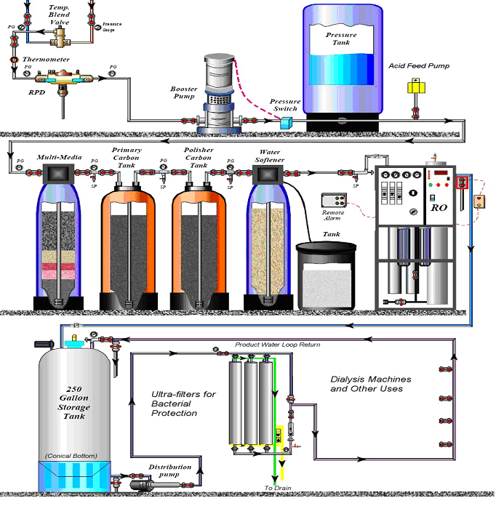
Complete Direct Feed Water Treatment Circuit
Dialysis product water is the corner-stone of dialysis and is necessary in order to perform safe dialysis.
Water treatment is based on the use of multi-depth filters, water softeners (when needed), carbon tanks to remove chlorine and chloramines (primary and polisher), and reverse osmosis to purify water for dialysis.
Water feed can be direct or indirect.
Brine
Monitoring your Dialysis Water Treatment System, ESRD Alliance Network 16, 2005, 2018
Dialysis Core Curriculum 2021

Slide 10

Backflow
Preventor
2
Purification
Unit –
RO / DI
Filter
Muti-
media
Softener
1 2
Carbon Columns
1
Pre-Treatment
To Protect
Main Treatment
Device
3
Distribution Loop
Direct Feed System
Image by Ahmad
Dialysis Core Curriculum 2021

Slide 11
City
Water
Particulate
Fines
RO
5 um
1.0
.45
0.22
Drain
Softener
0.1 F
Carbon
Water Tank
UV
0.1 F
UV
Indirect Feed
Image by Ahmad
Dialysis Core Curriculum 2021

Slide 12
Dialysis Machine Circuitry
Dialysate circuit
Once dialysis product water has been generated, bicarbonate and acid solutions are mixed with water to form the dialysate solution.
Mixing or proportioning may be done by the individual machine or centrally in a dialysis unit.
Several components of proportioning ensure safe dialysate that is checked by a series of alarms, pumps, and monitors.
Fluid ultrafiltration occurs by volumetric or flow sensor controllers.
Water is “clean,” but not sterile.
Disinfection of the machine every 24 hours is essential and prevents bacterial overgrowth in the dialysis machine.
Dialysis Core Curriculum 2021
Notes:
Dialysate flows from the treated water into the dialysis machine. Dialysate is not sterile but is “clean” and has direct contact with patient's blood. Dialysis machines build the solution “onsite,” allowing for dynamic changes of electrolytes if needed. Dialysis safety is essential and is provided by the series of checks and balances in the dialysis machine. The system is designed to shut itself off if there is evidence of an abnormality. Disinfection every 24 hrs is essential for safe patient care.

Slide 13
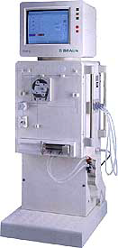
Dialysis Circuit Key Components
Dialysate circuit
The key components of the dialysate circuit include:
Heating
Deaeration
Proportioning
Monitoring
Ultrafiltration
Disinfection
Dialysis Core Curriculum 2021
Notes:
There are many components of the dialysis circuit, but we will stick to the key components that are similar no matter what the brand of dialysis machine.

Slide 14
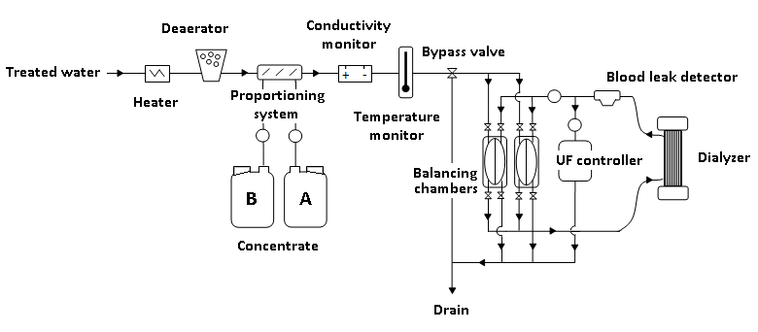
The Dialysis Circuit
Dialysate circuit
Image used with permission, ©Scott Bieber
Dialysis Core Curriculum 2021
Notes:
This schematic of the dialysis circuit shows how water is mixed with base and acid concentrate to form dialysate. There are filters, probes, and monitors that maintain safety of the dialysate before it gets to the dialyzer. The Blood Leak Detector detects breach of the dialyzer from the blood side. Negative pressure across the dialyzer maintains safety regarding exposure to non-sterile water in the dialysis machine.

Slide 15
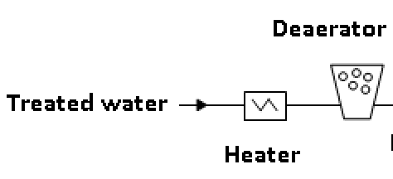
Degassing Dialysis Water
Dialysate circuit
Degassing
Treated water inflows into the dialysis machine and passes through a heat exchanger prior to entering the heater.
Water heated to body temperature (33°C–39°C ) is subjected to negative pressure in the dialysis machine to remove any air.
Air in the dialysate water can interfere with dialysate flow and cause “air trapping.”
Negative pressure is maintained by a closed loop composed of a pump, constricting valve, air trap, and vent.
Alternative methods for degassing include heating treated water to 85°C followed by cooling prior to proportioning.
Image used with permission, ©Scott Bieber
Dialysis Core Curriculum 2021
Notes:
If water was not degassed, air would be able to enter the dialysate and cause problems in the circuit.

Slide 16
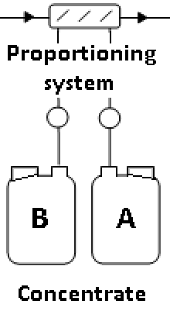
Dialysate Proportioning
Dialysate circuit: Proportioning
Proportioning assures proper mixing of heated and treated water to produce the appropriate dialysate solution.
Proportioning pumps mix premade fresh dialysate acid (A) and bicarbonate (B) solutions together to make dialysate.
Acid solutions contain acid/chloride salts, including sodium, potassium, calcium, magnesium, and acetate.
Bicarbonate solutions are made fresh, since pre-prepared bicarbonate can precipitate with calcium and release CO₂ and encourage bacterial growth.
Image used with permission, ©Scott Bieber
Dialysis Core Curriculum 2021
Notes:
Concentrated acid and base solutions are mixed together in the dialysis machine by dialysate proportioning. Solutions are kept separate to prevent calcium bicarbonate precipitation. Potential issues associated with dialysate proportioning include wrong concentration, poor mixing, clogged filters, precipitation, and human error in disarming alarms.

Slide 17
Dialysate Proportioning and Formulation
Dialysate circuit: Proportioning
proportioning
Dialysate solutions are passed through a small filter prior to and after formation
Potential problems include:
Incorrect bicarbonate or acid concentrate
Inadequate dialysate mixing
Clogged filters
Device alarms disarmed by the operator
Precipitation of calcium or bicarbonate salts
Electrolyte | Standard Concentrations
Sodium | 135-145 mEq/L
Potassium | 2-4 mEq/L
Calcium | 2.5-3.5 mEq/L (2.5 mEq/L std.)
Magnesium | 0.5-1.5 mEq/L
Chloride | 100-124 mEq/L
Bicarbonate | 32-40 mEq/L
Glucose | 100-250 mg/dL
Citrate/acetate | Cit.: 2.4 mEq/L; Acetate: 0.3 mEq/L
Acetate | Naturalyte®4.0 mEq/L Granuflo® 8 mEq/L
Dialysis Core Curriculum 2021
Notes:
The proportion of the dialysate fluid is set by the physician as part of the dialysis orders. Solutions that can be changed include sodium, potassium, and bicarbonate. Conductivity changes monitor the electrolytes in the dialysate.

Slide 18
Dialysate Modeling: Sodium
Dialysate circuit: Electrolyte
Sodium modeling was used in the past to maintain hemodynamic stability during ultrafiltration; however, it led to increased thirst, which led to more intradialytic weight gain and fluid retention.
Evidence indicates lower dialysate sodium is associated with lower intradialytic weight gain, lower BP and decreased thirst, but data are lacking for guidelines and prescriptions should be individualized.
Song et al. JASN, 2005
de Paula et al. Kidney International, 2004
Santos et al. Seminars in Dialysis, 2010
Flythe et al. Seminars in Dialysis, 2017
Dialysis Core Curriculum 2021

Slide 19
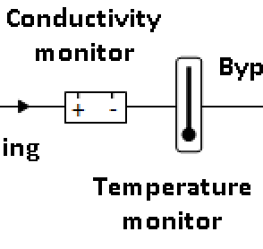
Dialysate Monitoring: pH and Temperature3
Dialysate circuit: Dialysate monitoring
Dialysis monitoring
pH: pH is measured as the ratio of HCO₃⁻ to H₂C0₃.The recommended pH range is 6.8–7.6. Not all machines have a monitor, but dialysate pH should be monitored each session.
Temperature: A heat sensor monitors dialysate temperature near the dialyzer and provides a short feedback loop for changes. Temperature should be between 35°– 42°C.
Low temperatures can cause shivering (<35°C).
High temperatures can cause protein denaturing or hemolysis (>41°C).
Lower temperatures (35°C) are used to help modulate BP and stabilize hemodynamics during runs.
Image used with permission, ©Scott Bieber
Dialysis Core Curriculum 2021

Slide 20
Conductivity
Dialysate circuit: Conductivity
:conductivity
Conductivity is the amount of electrical current conducted through the dialysate and reflects the electrolyte concentration of the dialysate.
A constant voltage is applied across two electrodes 1 cm apart in the dialysate; if the concentration of electrolytes changes, the voltage will change and change the conductivity.
Conductivity should be between 12–16 mS/cm (milliSiemens per centimeter). The greater the number of ions, the greater the conductivity.
Temperature or acid/base concentration can affect conductivity. Alarms will stop dialysate flow and place machine into bypass.
Conductivity Alarms can occur in the following scenarios:
Empty acid/base concentrate jugs
Change in electrolyte concentration of the dialysate
Abnormal water inlet pressure
Water leaks or puddles beneath the mixing chamber
Concentration line connector unplugged
Dialysis Core Curriculum 2021

Slide 21





Dialysate circuit: Conductivity
Meter with
Alarm Settings
Current Source
-
+
Thermistor
Dialysate In
Conductivity Cell
Dialysate Out
Conductivity settings should never be adjusted while the patient is on the dialysis machine! Alarms require finding the source!
Dialysis Core Curriculum 2021

Slide 22
Alarms: Temperature
Alarms: Temperature and pressure
Temperature Monitor is an internal dialysis machine monitor that measures dialysate temperature. Dialysis machines are internally calibrated to not go above or below set limits.
A malfunctioning heating element can cause abnormal dialysate temperatures. Cool temperatures (<35°C) will result in shivering. Most patients will alert you to cold or hot temperatures.
Hypothermia can occur if the patient is unconscious or not able to respond (altered mental status, intubated or paralyzed).
Warm temperature (>42°C) can cause protein denaturing or hemolysis (>45°C), which can lead to hyperkalemia and fatal arrhythmias.
Image used with permission, ©Scott Bieber
Dialysis Core Curriculum 2021
Notes:
Dialysate temperature should not be turned up above 42°C or below 35°C.

Slide 23
Alarms: Pressure Monitor
Alarms: Temperature and pressure
Dialysate pressure monitoring is an important aspect of UF in dialysis. Negative pressure in the dialysis component allows for UF and is monitored by TMP.
The pressure range is from -400 to +350mmHg, with an accuracy of ±10%.
Pressure in the dialysate compartment should not exceed that in the blood compartment, or there will be an increased risk of blood contamination by unsterile dialysate secondary to dialyzer membrane rupture and back filtration.
Ultrafiltration (UF) is controlled by transmembrane pressure (TMP) and membrane ultrafiltration coefficient (Kuf).
TMP = Pressure at blood outlet(P_{BO}) – Pressure at dialysate outlet (P_{DO}).
TMP is adjusted to achieve the desired UF rate, as low as 50 ml/hr.
Dialysis Core Curriculum 2021
Notes:
The dialysate pressure alarm limits are set at ±10% of the pressure setting. TMP used to be calculated and set manually in the older dialysis machines but is now calculated by the machine. TMP = Pressure at blood outlet(P_{BO}) – Pressure at dialysate outlet (P_{DO}) and determines how much fluid is ultrafiltered; that is, how much fluid is forced from the blood across the dialysis membrane. With today’s volumetric machines, all that is needed is to set the desired amount of fluid removal and the machine will calculate TMP and determine UF rate. UF rate should not be more that 13ml/kg/hr. (Flythe JE, et. al. Kidney International (2011) 79, 250–257)

Slide 24
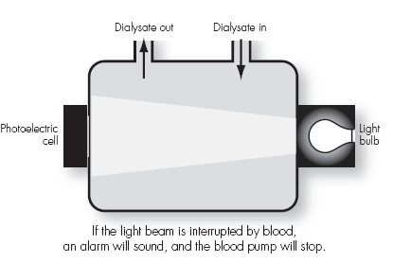
Blood Leak Detector
Dialysis Circuit: blood leak detector
Blood should not cross the blood/dialysate membrane .
Leakage of blood into the dialysate circuit is detected by the blood leak monitor, which is usually located downstream from dialyzer.
Infrared or photoelectric cells detect decreases in light from source.
Red blood cells scatter light and trigger alarm, which deactivates the blood pump.
A blood leak will cause the machine to go into bypass mode, which shunts dialysate into the drain, reducing negative pressure in the dialyzer to decrease blood loss.
Image used with permission. Core Curriculum for the Dialysis Technician.
6th Edition, ©Medical Education Institute, 2018. https//mei.org/cc6
Dialysis Core Curriculum 2021
Notes:
The dialyzer membrane is fragile and can easily tear, allowing blood to cross the dialyzer membrane. The blood leak detector monitors the dialysate for blood. If blood is found it will alarm. If it alarms, the dialyzer may need to be changed for patient safety.

Slide 25
Volumetric-Based Ultrafiltration
Dialysate circuit: volumetric UF
Ultrafiltration is the process of removing fluid from the patient in a controlled fashion, during which volume is accurately measured.
Most dialysis machines use volumetric-based control, which uses a balancing chamber(s) composed of 2 compartments separated by a flexible membrane.
One side of the membrane allows fresh dialysate in, while the other allows “spent” or used dialysate out.
Dialysis Core Curriculum 2021
Notes:
Volumetric-based ultrafiltration allows for accurate removal of fluid based on volumetric measurements. An exact amount of spent dialysate is measured with fresh dialysate to measure the exact amount of UF. The UF pump can pump additional fluid out as prescribed by the physician.

Slide 26
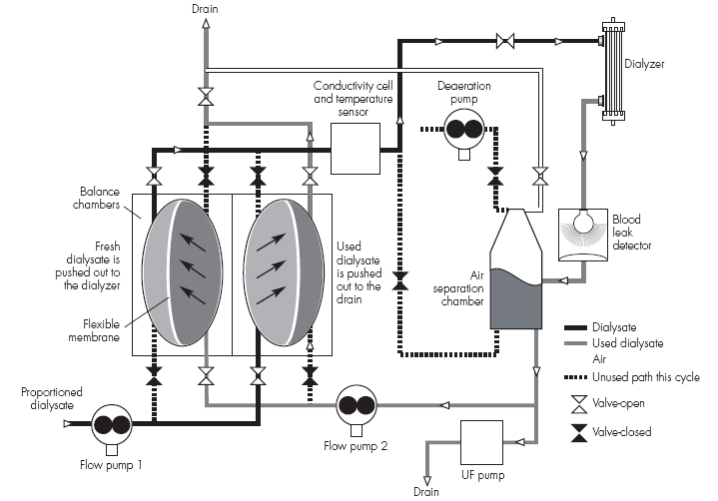
Volumetric-Based Ultrafiltration
Dialysate circuit: volumetric uf
Valves are connected on the inlet and outlet and allows fluid to enter one side of the chamber, which pushes an equal amount of fluid out of the other side of the chamber.
One chamber fills with used dialysate and pushes fresh dialysate to the dialyzer, while the other chamber fills with fresh dialysate and pushes used dialysate to the drain.
One pump moves proportioned dialysis to the balance chambers; a second pump pulls dialysate from the dialyzer and pushes it to the balance chambers.
Image used with permission. Core Curriculum for the Dialysis Technician.
6th Edition, ©Medical Education Institute, 2018. https//mei.org/cc6
Dialysis Core Curriculum 2021

Slide 27
Ultrafiltration Pump
Dialysate circuit: UF Pump
:
The UF pump or the fluid removal pump removes fluid from the closed dialysate loop, which results in fluid removal from the dialyzer membrane.
Most UF pumps are piston type and placed in the used dialysate flow path and remove about 1ml of fluid per stroke, creating a negative pressure in the dialysate loop.
Removal of fluid from the used dialysate loop creates a negative pressure in the dialysate compartment compared to the blood compartment, allowing flow of UF down a pressure gradient from blood to dialysate compartment.
When the UF pump is off, there is no pressure gradient between the blood and dialysate and no fluid is removed from the patient.
Dialysis Core Curriculum 2021
Notes:
The UF pump allows for ultrafiltration of fluid from the the patient. It applies negative pressure to the dialysate compartment and ultrafilters fluid down a pressure gradient from the blood to the dialysate compartment. When UF is off, there is no ultrafiltration of fluid from the patient.

Slide 28
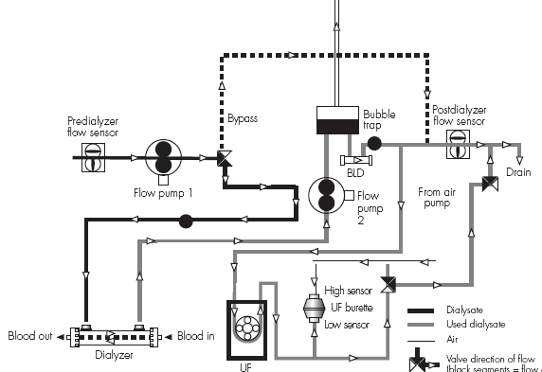
Ultrafiltration: Flow Control
Flow-control Uf
Flow-control UF has flow sensors on the inlet and outlet side of the dialyzer that allow control of dialysate flow.
A post-dialyzer UF pump removes fluid at an UF rate calculated by the dialysis machine.
UF volume is removed prior to the UF flow sensor, ensuring that volume removed by both the inlet and outlet UF flow are equal.
HD Profiling is available on some machines and can be used to remove UF early during the treatment.
Image used with permission. Core Curriculum for the Dialysis Technician.
6th Edition, ©Medical Education Institute, 2018. https//mei.org/cc6
Dialysis Core Curriculum 2021
Notes:
This is the main type of flow control used by dialysis machines. Flow sensors are on both sides of the dialyzer (inflow and outflow) and accurately measures dialysate flow into and out of the dialyzer, which should be equal. A flow pump on the dialysate outflow side can remove additional fluid as the UF rate (UFR). The machine calculates the speed of fluid removal, which is equal to the UFR. This system does not measure the volume of fluid removal, it measures the rate of fluid removal (volume/time). Your dialysis technician will know which type of UF control system your particular dialysis machine has.

Slide 29
Dialysate Disinfection and Rinsing
disinfection
Dialysate is not sterile! Dialysis machines should be disinfected according to the manufacturer’s recommendations; usually daily.
The dialysate circuit should be completely exposed to disinfectant every 24 hours before use.
Reused bicarbonate/acid containers should be disinfected between use.
Machines should be rinsed between chemicals and ALWAYS before dialysis.
Disinfectants and rinse solutions include:
Formaldehyde,
Hypochlorite (bleach)
Peracetic acid
Dead space is needed between dialysis effluent line and drain.
Some machines incorporate a filter between the water input and the dialysate circuit and can make “ultrapure” dialysate.
Always run detection tests for chemicals prior to starting dialysis.
Dialysis Core Curriculum 2021
Notes:
Dialysis disinfection and rinsing is extremely important aspect of the dialysis treatment and helps to prevent inadvertent exposure of patients to harmful chemicals. Possible sources of contamination of dialysate include: contaminated water, back siphon from the drain, dead space in the water system that contaminates loop water, inadequate disinfection of dialysis machines, bicarbonate concentrate, or contaminated bicarbonate containers.

Slide 30


Special Precautions with COVID-19
Disinfection: Covid-19
The CDC has specific recommendations for dialysis staff and treatment of patients during the COVID pandemic.
Current standards are appropriate for cleaning and disinfecting for COVID.
Any machine or equipment located within 6 feet of a symptomatic patient should be appropriately cleaned.
https://www.cdc.gov/coronavirus/2019-ncov/hcp/dialysis/dialysis-in-acute-care.html
Dialysis Core Curriculum 2021

Slide 31
Emergencies
Dialysis machine proportioning problems can result in severe serum electrolyte abnormalities. Some of these emergencies include:
High or low serum sodium, potassium, calcium or magnesium
High or low plasma osmolarity due to hyper- or hypo-osmolar dialysate
These abnormalities can result in cardiac arrhythmias, hemolysis, or hypotension.
Dialysis Core Curriculum 2021
Notes:
Dialysis circuit emergencies can occur at any time. Most dialysis machines are extremely safe, but errors occur if alarms are turned off and not addressed or the machine runs out of dialysis concentrate or there are water issues.

Slide 32
Emergencies
Clinical emergencies can occur if significant levels of contaminants are in the dialysate.
Copper or cupraphane may be released from heating element or dialyzer and can cause severe hemolysis.
Chloramines and nitrates can cause severe hemolysis as well, leading to fatal arrhythmias.
Fluoride can cause severe pruritus, nausea, and ventricular tachycardia or fatal ventricular fibrillation.
Aluminum can cause bone disease, anemia, and fatal progressive neurologic deterioration commonly known as dialysis encephalopathy syndrome.
Lead, copper, zinc, and aluminum can leach from metal pipes and cause anemia.
Dialysis Core Curriculum 2021
Notes:
Copper is not used as much on newer dialysis machines and has been replaced by stainless steel. Cupraphane dialyzers are not in use as much any more as well. Evidence of hemolysis requires searching for a cause, which can usually be traced to the blood circuit, but can sometimes occur in the dialysate circuit.

Slide 33

Emergencies: Power Failure
Emergencies: Power failure
In the event of power failure, the system is no longer safe for dialysis patients.
All systems and monitors are NOT WORKING!
Blood should not be pumped into the machine.
Blood should be returned manually to the patient.
Patients should be taken manually taken off the dialysis machine if power is not restored in 15-20 minutes.
Dialysis Core Curriculum 2021
Notes:
If there is a prolonged power failure, the patient’s blood should be returned and no new blood should go into the dialysis machine. If power is not restored immediately, the patient should be taken off. Most dialysis units have back-up generators for power failures.

Slide 34
Dialysis Blood Circuit Emergencies
Emergencies
Although not part of the dialysate circuit, blood circuit emergencies can be associated with fatalities. The two most common are air embolism and dialysis filter reactions.
Air embolism can occur if air enters the dialysis blood circuit from a line or catheter. Patients may experience loss of consciousness, convulsions, death.
Treatment: lay patient left side down; place on 100% O₂
Dialysis Core Curriculum 2021

Slide 35
Dialyzer Reaction
emergencies
Type A: Anaphylactic reaction
Clinically patients present with dyspnea, impending doom, itching, urticaria, GI cramping, diarrhea; may progress to cardiac arrest or death.
Causes: ethylene oxide, AN69 dialyzer reactions with ACE-Inhibitors, heparin contaminated dialysis solution, reuse
Treatment: stop dialysis, cardiac support, antihistamines, steroids
Type B: Non-specific
Clinically patients may present with chest pain or back pain, but less severe than Type A reactions.
Causes: unknown, but possibly due to complement activation. Other causes of chest or back pain need to be evaluated.
Treatment: continue dialysis if hemodynamically stable, O₂ as needed
Saha M and Allon M. Diagnosis, treatment, and prevention of hemodialysis emergencies. Clin J Am Soc Nephrol 12: 357–369, 2017
Dialysis Core Curriculum 2021

Slide 36
Alarms: Summary of Dialysis alarms
Alarm | Cause | Alarm
Conductivity | Checks the electrolyte concentration and appropriate mixing in dialysate and will alarm if there is a change in concentration of electrolytes in dialysate | High: Poor water flow into the system; untreated incoming water; wrong acid/base concentrates Low: Acid or bicarb jug empty or central solution is low
Temperature | Temperature can be set as part of the machine. Abnormal temperatures can represent a faculty heat exchanger or heater | High: Can cause hemolysis; protein denaturing if temperature >47° C, hyperthermia Low: Causes patient to feel cold, but slight decrease in temperature (0.5° C) can stabilize intradialytic hypotension
Flow Rate | Blockage in the dialysate flow path; incorrect flow rate | Low water pressure; dialysate pump failure
Blood Leak Detector | Detects blood crossing into the dialysate in the dialyzer or dialyzer membrane failure | Machine will go into bypass mode and divert dialysate. DO NOT RETURN THE PATIENT’S BLOOD!
pH (7.34-7.45) | Some machines have integrated pH monitor; otherwise will need to be checked manually | pH should be tested at the start of each treatment to be sure dialysate is within a safe range (6.9-7.6)
Pressure monitors | High or low arterial pressures may be due to kinks in the blood tubing, clotting or needle against a vessel wall | Pre-pump pressures are negative (-100 mmHg), while post pump pressures are positive (200 mmHg)
TMP | TMP is venous pressure minus dialysate pressure; TMP = (UF rate)/(KUF) | High TMP may indicate leak in dialysate system; fluctuating TMP may mean malfunction in the balancing system
Dialysis Core Curriculum 2021

Slide 37
Conclusions
Dialysis circuitry requires monitoring to assure patient safety.
Knowledge of dialysate circuitry is important for all nephrologists caring for dialysis patients.
Every nephrologist should “know their machine” in order to safely troubleshoot problems.
Dialysis Core Curriculum 2021

Slide 38
Acknowledgements
Dr. Scott Bieber for allowing use of his images of dialysis circuitry
Jim Curtis, CHT for allowing use of his images of dialysis circuitry
Dialysis Core Curriculum 2021

Slide 39
REFERENCES
Manual of Clinical Dialysis, 2nd Edition, S Ahmad, Springer, 2000
Monitoring your Dialysis Water Treatment System, ESRD Alliance Network 16, 2005, 2018
Misra M. The basics of hemodialysis equipment. Hemodialysis International: 9:30-36, 2005
Curtis J, Delaney K, O’Kane P, Roshio B, Sweeney J. Module 4: Hemodialysis Devices page 90-118, in National Association of Dialysis Technicians/Technologists (NANT). Dialysis Technology, a Manual for Dialysis Technicians. Third Edition, 2003. J. Curtis & P. Varughese Editors
Ahmad S, Misra M, Hoenick N, Daugirdas J. Hemodialysis Apparatus. In Daugirdas J, Black P, Ing T eds. In Handbook of Dialysis, 5th Edition, Wolters Kluwer: 66-88, 2015
Association for the Advancement of Medical Instrumentation. Dialysate for hemodialysis (ANSI/AAMI RD52:2004). Arlington (VA). American National Standard. 2004
Flythe JE, Kimmel S, Brunelli S. Kidney International: 79, 250–257, 2011
Core Curriculum for the Dialysis Technician. 6th Edition, ©Medical Education Institute, 2018 https//mei.org/cc6
Scott Bieber, MD, and Jim Curtis, CHT, for images of dialysis circuity
Dialysis Core Curriculum 2021

