Slide 1
Financial Considerations for Dialysis Physicians and Providers
Dialysis Core Curriculum 2021
John M. Burkart, MD
Wake Forest University Medical Center

Slide 2
John M. Burkart
Disclosures
  Employer: Wake Forest University Medical Center; Health Systems Management
Scientific Advisor/Membership: NxStage, Author/Section Editor, UpToDate
Dialysis Core Curriculum 2021

Slide 3
Learning Objectives
Describe the baseline financial differences/incentives for in-center vs. home dialysis therapies
  For Payers such as: CMMS, Managed Care, and Private Pay
  For Providers and for Physicians
Identify CMMS payment modifiers based on quality
State potential changes in reimbursement based on Advancing American Kidney Health (AAKH) Executive Order
Dialysis Core Curriculum 2021

Slide 4
Why More Home Dialysis? It’s the Right Thing to Do.
More patients should be on home dialysis because:
Medical evidence suggests that in general survival on home dialysis (peritoneal dialysis - PD and home hemodialysis - HHD) is similar and may even be better than for center hemodialysis (CHD).
Patient choice is important: Given that most patients do not have an absolute contraindication to PD, we should honestly explain all modality options to our patients and give them a choice.
Financial considerations:
  Overall cost to society for typical patient on PD is less than for CHD.
  Overall cost for dialysis provider tends to be the least for PD, and generally cost for HHD is <CHD.
  In a bundled environment, weekly reimbursement for the dialysis provider is same for PD and CHD. HHD is per/Rx.
  Today, physician monthly payment for a home patient is <maximal payment for CHD. The maximal CHD payment requires more visits (n=4).
  In newer or future payment models, provider/physician may be able to share in the overall cost savings or be incentivized to use more home dialysis.
Dialysis Core Curriculum 2021

Slide 5
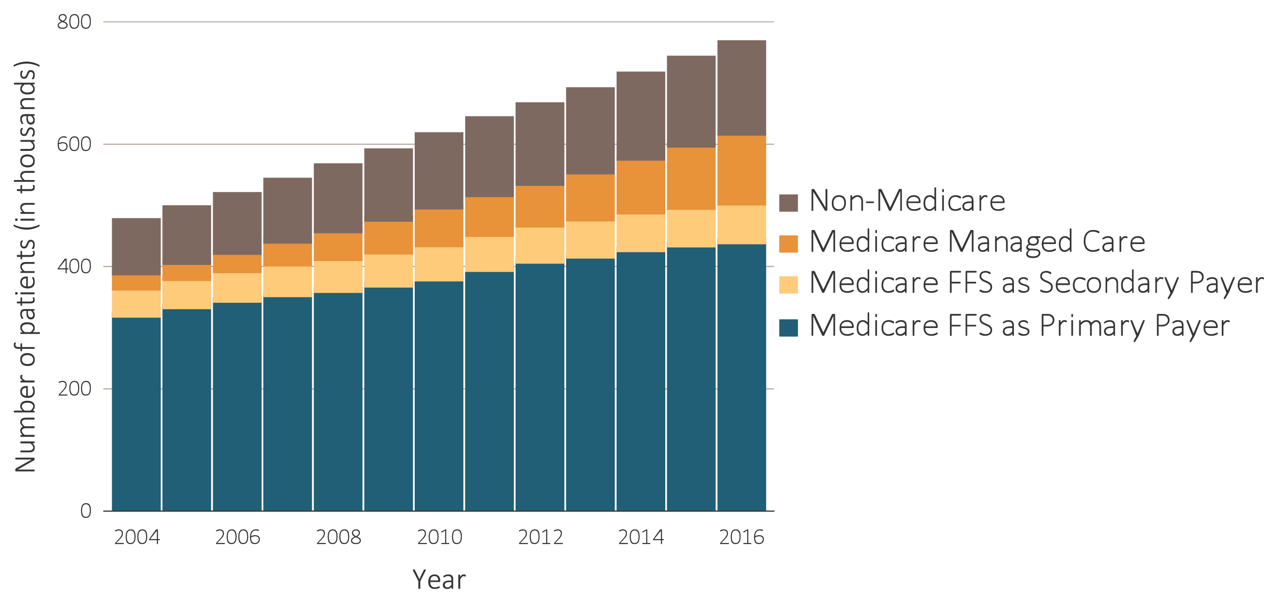
Trends in Numbers of Point Prevalent ESRD Patients, 2004-2016: By Insurance Coverage
Data Source: USRDS ESRD Database. December 31 point prevalent ESRD patients. Abbreviations: ESRD, end-stage renal disease; FFS, fee-for-service.
2018 USRDS Annual Data Report: Vol 2 ESRD, Chapter 9, Figure 9.3
Dialysis Core Curriculum 2021

Slide 6
Case Presentation
Case presentation
A 55-year-old, previously self-employed male has new onset ESRD from Diabetes. He has good vision and dexterity and has no other medical co-morbidities. He lives in an apartment with his wife. He has a semi-urgent need to start dialysis (has uremic symptoms but potassium and volume status are OK). He is now in your office after being lost to follow-up over the last 2 years. Once his business failed, he was no longer able to make health insurance payments so currently has no insurance and as a result did not go for follow up until now. Patient is undecided as to what type of dialysis to do. He is somewhat interested in doing home dialysis (PD). When first referred to access surgeon team they are hesitant to place access now because he has “no insurance.”
Assuming all modalities are equally effective and safe for this patient, are there financial implications for provider/physician based on modality choice?
Dialysis Core Curriculum 2021

Slide 7
General Types of Reimbursement for Dialysis
reimbursement
Physician is paid: Fee for service, Monthly Capitation Payment (MCP) and if an equity partner and participating in a managed care or ESRD Seamless Care Organization (ESCO) environment, possibly sharing in the overall savings or losses.
Hospital is paid: Diagnostic Related Group (DRG) with adjusters and possibly sharing in savings or losses if an equity partner in a managed care organization or an ESCO.
Dialysis unit: Bundled rate with modifiers on a per treatment basis from Centers for Medicare Services (CMS), Contractual per treatment payments from private payers and possibly sharing in savings or losses if an equity partner in a managed care organization or an ESCO.
Dialysis Core Curriculum 2021

Slide 8
Historical Review, or the Days Pre-“BUNDLE”
From the Perspectives of CMMS and Dialysis Providers
In the past (prior to 2011), providers were able to bill:
A Composite Rate for each dialysis treatment
Separately bill for:
  Dialysis specific meds:
    ESA usage
    Vit D usage
    Iron usage
  Other Injectables
  Labs
  Durable Medical Equipment
  Other Supplies
  Part D oral meds with IV equivalent
Since 2011, providers were paid a “bundled payment” per treatment based on a 3/week HD schedule.
Dialysis Core Curriculum 2021

Slide 9
Monthly Capitation Fee (MCP) for Physicians
Historically, physicians were paid one monthly rate for care of patients. No documentation of # of visits was needed.
CMS changed that approach, and physicians are now paid an MCP, which varies based on:
  Center HD patient or home patient.
    Payment varies based on # of visits for center HD (1, 2 or 3, 4, or more).
    Payment is a fixed per month amount for home dialysis (same for home HD and for PD).
      Historically, this fixed per month payment was less than the 4 visits per month payment for center HD.
    Starting in 2020, in the proposed AAKH executive order, the MCP payment can be adjusted based on outcomes such as use of home dialysis and transplant.
  Caveats:
    There must be an equivalent of a “comprehensive visit” done by one person.
      This can be done during multiple visits over the month and includes review of access and labs.
    Other providers in the practice could do visits 2, 3, and 4, where less documentation is needed.
Dialysis Core Curriculum 2021

Slide 10
Basis MCP Reimbursement Rates
Trend Toward Decreasing over Time
CPT CODE | Dialysis Location | # of Visits/month | 2010 | 2015 | 2017 | 2020
90960 | ESRD Center HD | 4/month | $294.96 | $286.40 | $287.11 | $291.24
90961 | ESRD Center HD | 2 or 3/month | $237.07 | $240.99 | $241.17 | $241.17
90962 | ESRD Center HD | 1/month | $170.70 | $185.57 | 185.90 | 185.90
90966 | ESRD Home Dialysis | 1/month | $235.96 | $239.91 | $240.45 | $244.33
CMS.gov/physician fee schedule search (Search by year and CPT code)
Dialysis Core Curriculum 2021

Slide 11
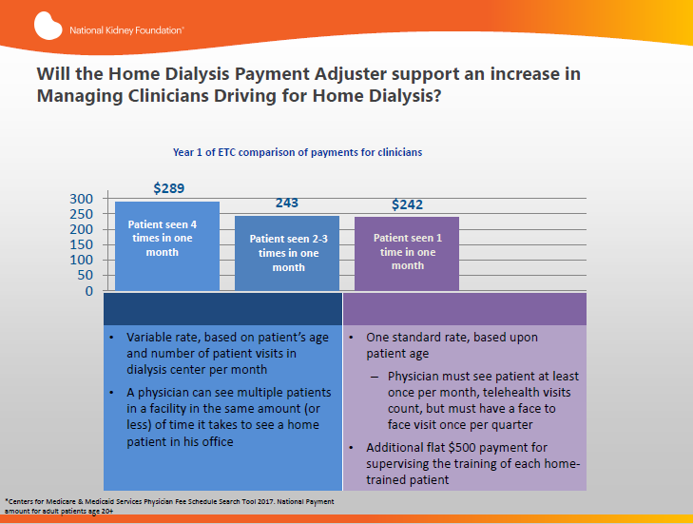
CHD
HOME
From: NKF Summary of
AAKH initiative 7/18/2019 –
Modified from CMS Physician fee schedule Search Tool 2017
Dialysis Core Curriculum 2021

Slide 12
MCP and a Quality Modifier
The Affordable Care Act (ACA) states that payments should be adjusted for quality of overall care.
  Will this component of ACA be retained under the new legislation?
At some point, the MCP will likely have a Quality Incentive Program (QIP) payment adjuster tied to it.
  What will the metrics be?
  See later in slide – modifiers in the AAKH executive order.
Note: Large Dialysis Organizations (LDOs) have lobbied in the past to have the MCP payed directly to them to better “influence/manage physician quality.”
Dialysis Core Curriculum 2021

Slide 13
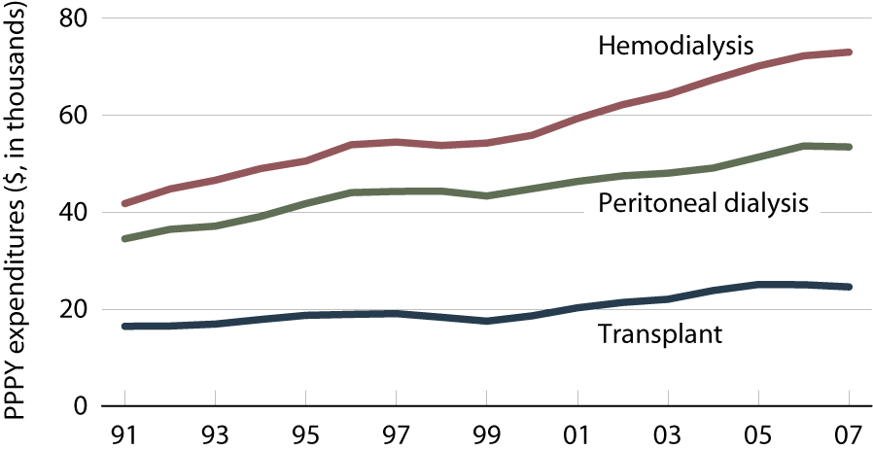
Historical Total Medicare ESRD Expenditures:
Per Person Per Year (PPPY), by Modality
CHD vs PD
Difference
Almost 19K
Period prevalent ESRD patients. Modalities determined using Model 1 methodology; patients with Medicare as secondary payor excluded.
USRDS 2009, Volume 2, Chapter 11, Figure 11.7
Dialysis Core Curriculum 2021

Slide 14
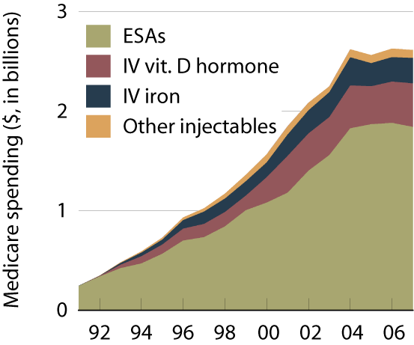
Historical Total Medicare Spending on Separately Billable Medications (Injectables – add on to composite in final bundle)
Period prevalent dialysis patients
ESAs = erythropoiesis stimulating agents
USRDS 2009, Volume 2, Chapter 11, Figure 11.13
Dialysis Core Curriculum 2021

Slide 15
CMS Stated Rationale for ESRD Prospective Payment System (PPS) or “Bundled Payment”
Eliminate incentive to overuse profitable separately billable meds (SBM). (p 49924)
Attempt to target greater payments to facilities with more costly patients to allow equitable access to services. (p 49924)
Promote operational efficiency. (p 49924)
Enhance quality of care. (p 49924)
Remove incentive to use separately billable meds as revenue (SBM) source which has potentially impeded greater use of PD. (p 49931)
We want to encourage use of home dialysis…PD is prevailing mode…proposing a PPS that does not relay on separately billables medications for modality. (p 49967)
An attempt
to encourage
home
From: Federal Register: Vol. 74; # 187; Sept 29, 2009. Proposed Rules pages noted above
Dialysis Core Curriculum 2021

Slide 16
Determination of Initial “Bundled Payment”
Bundled payment / Rx = Total amount paid / year for all services (dialysis, meds, labs, etc.) divided by total number of treatments given in that year.
  (Included PD and HD)
  Assumed 1 week of PD = 3 HD treatments
Bottom line: Since about 93% of patients were on CHD and 7% on PD − The average reimbursement for CHD went down and for PD it went up.
Dialysis Core Curriculum 2021

Slide 17
Components for Estimate of Original per Treatment Cost Used to Determine Bundled Payment – Unadjusted
COMPONENTS OF FINAL CMS BUNDLE | DOLLAR AMOUNT/Rx
Composite Rate (average CHD and PD from cost reports) | 156.20
ESA | 55.16
Vit D | 11.02
Iron | 6.48
Part D oral meds with IV equivalent | 12.48
Other Injectables | 1.20
Labs | 8.71
Durable Medical Equipment | 0.52
Other Supplies | 1.22
Total | $252.99 per treatment
= Separately Billable Meds
Modified from: Fed Reg. vol74, #187, Sept. 29, 2009 p49957
Dialysis Core Curriculum 2021

Slide 18
Average Medicare Allowable Charges: HD and PD – Basis for Proposed Ruling Using FY 2004-2006
 | CHD | PD
Average / Rx Composite Rate – Not from cost reports | $135.00 | $135.00
Average / Rx cost – Separately Billable Meds (SBM) | $87.20 | $35.15
Average total Medicare allowable cost/Rx (Composite Rate + SBM) | $222.20 | $170.15
Data source – Medicare claims for 11 most commonly used separately billable drugs
And average Medicare allowable composite rate
Federal Register: Vol. 74; # 187; Sept 29, 2009. Proposed Rules p49967
Dialysis Core Curriculum 2021

Slide 19
Example of Effect Initial Bundle Had on Reimbursement for Providers (2011)
HD vs. PD – based on FY 2004-2006; for 100 patients, assumes 93% on HD 7% on PD
 | HD | Total Monthly Payment (PD + HD) assumes 100 Pts | PD
Average total / HD Equivalent Rx cost (Composite + SBM) | $222.20 |  | $170.15
Average total monthly reimbursement | $2888.60 |  | $2211.95
Total monthly Medicare allowable for all Pts (n=93 HD and 7 PD) | $268,639.80 |  | $15,483.65
Total amount paid by Medicare / Month for PD and HD (assumes 100 pts – 93% HD and 7% PD) |  | $284,123.45
New Monthly payment / patient in Bundle (now same for CHD and PD) | $2841.23 |  | $2841.23
Net loss () or increase / month by modality | ($47.37) |  | $629.28
Example using extrapolated from: Federal Register: Vol. 74; # 187; Sept 29, 2009. Proposed Rules
Dialysis Core Curriculum 2021

Slide 20
The Times They Are A-Changing:
Examples of Bundled Payment Amounts over Time
Payment Year | Base Payment/Rx
2011 | $229.63
2012 | $234.81
2013 | $240.36
2014 | $239.02
2015 | $239.43
2016 | $230.39
Sources: Yearly report from cms.gov/newsroom/fact-sheets-updates-policies-and-payment-rates-ESRD-facilities-cy-(add specific year)
Dialysis Core Curriculum 2021

Slide 21
Likely Bottom Line from Initial Bundled Payment (PPS)
Based on 2006 data:
  For each HD patient - total monthly reimbursement will likely be about $47.37 less
  For each PD patient - total monthly reimbursement will likely be about $629.28 more (HHD may be more if >3/week payment)
For every 100 patients:
  If you have 93 on CHD and 7 on PD, total reimbursement for provider should basically be the same but less will be from CHD and more from PD.
  If % on PD <7% total pay to provider will likely be less.
  If % on PD >7% total pay to provider will likely be more.
Dialysis Core Curriculum 2021

Slide 22
Onset of Dialysis Multiplier
There now is an “Onset of Dialysis” multiplier (add on to bundled payment).
  Applies for first 120 days (4 months) of dialysis for a new patient.
  Can be paid during first 120 days for any Medicare participant.
  Onset multiplier is about + 51% = so about an additional $117.11/Rx in original bundle.
  Note: If uninsured but Medicare eligible, the dialysis unit can collect payments from day 1 if on home dialysis but must wait 90 days if on center HD to begin billing.
Dialysis Core Curriculum 2021

Slide 23
Onset of Dialysis and Use of Home Dialysis in Medicare Eligible Patients Who Are NOT a Participant at time of Start of Dialysis
KEY POINT: If a patient is Medicare eligible but not a current participant and with no other insurance:
  If you do home dialysis, payment starts day 1 but if on CHD they start after 90 days
  So during first 4 months (about 120 days) of RRT in these patients:
    Physician gets paid 4 MCPs and a $500 supervision of training fee if on home dialysis but potentially only 1 MCP if on CHD. (difference of about $1150)
    Dialysis providers:
      Get paid for equivalent of 6 months if on home dialysis.
      Get paid for only 1.5 months if on CHD. (difference about $13,000!)
Assumes onset add on about 50%
Dialysis Core Curriculum 2021

Slide 24
Additional Financial Reasons to Do Home Dialysis
Dialysis Providers:
Training fee $33.44/day
    Up to 15 for PD
    Up to 25 for HHD
Physicians:
$500.00 MD supervision of training fee
Dialysis Core Curriculum 2021

Slide 25
Bundled Payment Is then Adjusted Based on Modifiers and “Performance” or “Quality”
Examples of Quality Metrics from Performance Year 2014 /payment year 2016
Measure | Achievement Threshold (15th percentile) | Performance Standard (50th Percentile) | Benchmark (90th percentile)
Anemia Management | 1.2% | 0% | 0%
KT/V Dialysis Adequacy
Adult Hemodialysis | 86% | 93.4% | 97.4%
Adult Peritoneal | 67.8% | 85.7% | 94.8%
Pediatric Hemodialysis | 83% | 93% | 97.1%
Vascular Access Type
AVF | 49.9% | 62.3% | 77.0%
Catheter | 19.9% | 10.6% | 2.8%
National Healthcare Safety Network (NHSN) Bloodstream Infections
Hypercalcemia | 5.4% | 1.7% | 0%
From: cms.gov/Medicare/Quality-Initiatives-Patient-Assessment-Instruments/ESRDQIP/Downloads/QIP-Details-PY16.pdf
Dialysis Core Curriculum 2021

Slide 26
Accountable Care Organizations (ACOs), ESCO, Managed Care, and Home Dialysis
In a typical Accountable Care Organization (ACO), ESCO and Managed Care everyone gets paid as they are currently in fee for service mode.
BUT in addition, risk takers can share in any overall cost savings.
Remember: Overall cost/patient for home dialysis (especially PD) is usually less than CHD.
Dialysis Core Curriculum 2021

Slide 27
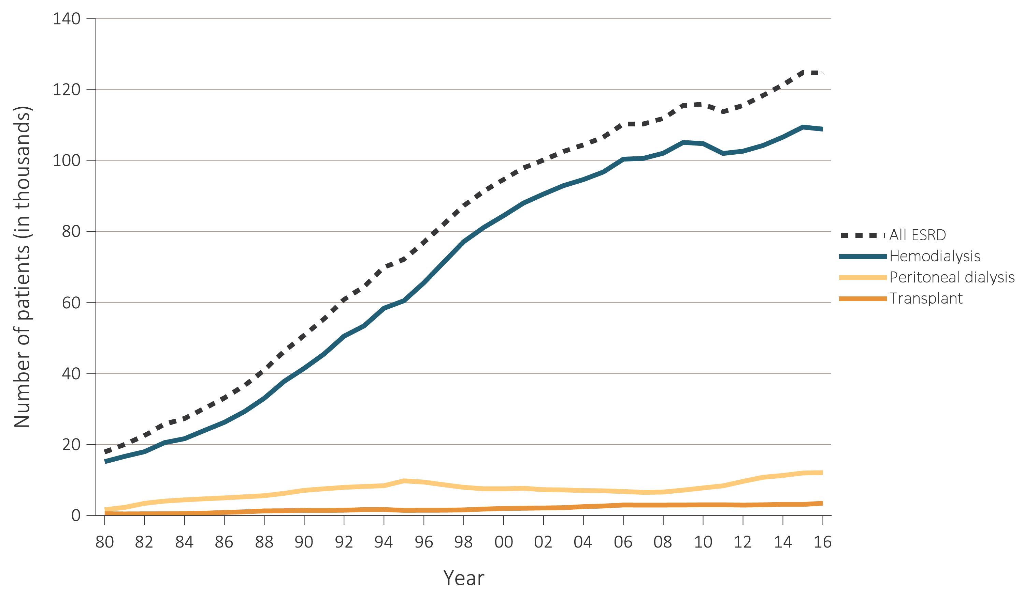
Trends in Use of Home Dialysis Post Bundle:
Incident Cases, by Modality, in U.S. Population, 1980-2016
Start of PPS (Bundled Payment)
2018 Annual Data Report Volume 2 ESRD, Chapter 1, Fig 1.2
Dialysis Core Curriculum 2021

Slide 28
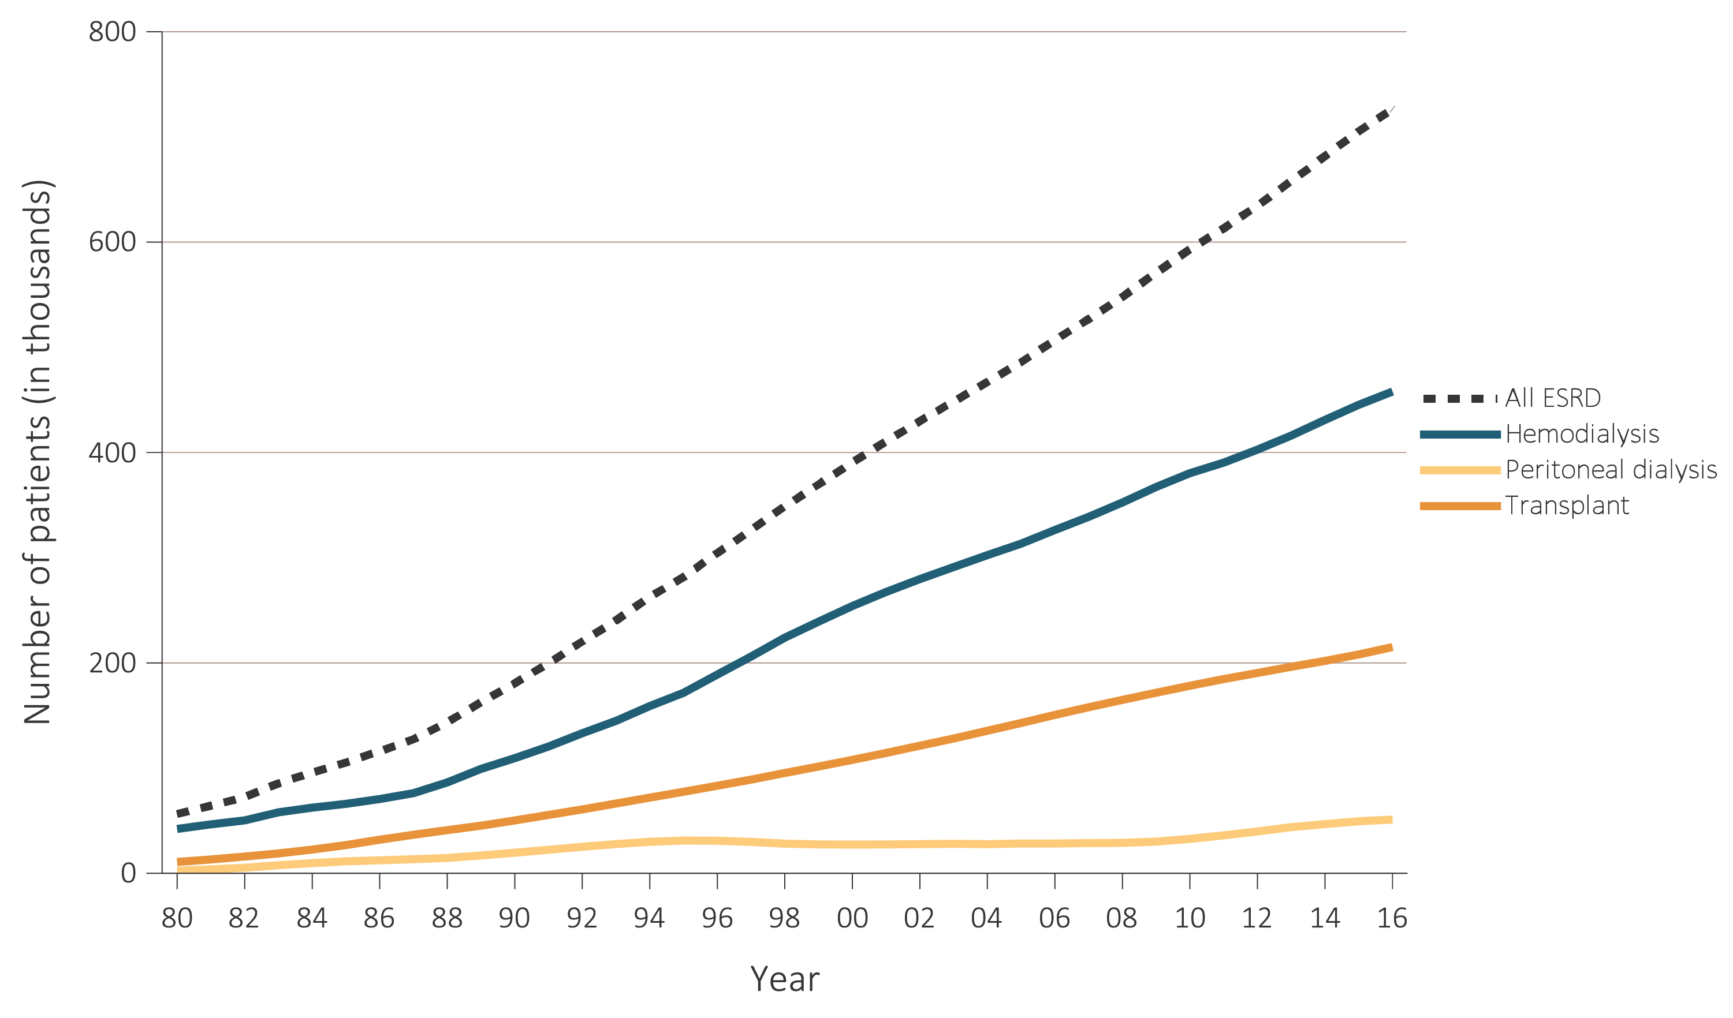
Trends in Use of Home Dialysis Post Bundle: Prevalent Cases, by Modality, in the U.S. Population, 1980-2016
Start of PPS (Bundled Payment)
2018 Annual Data Report Volume 2 ESRD, Chapter 1, Fig 1.9
Dialysis Core Curriculum 2021

Slide 29
Initial Trends in Use of Home Dialysis Post Bundle:
Incident Cases by Modality
Start of PPS (Bundled Payment)
Trends in the number of incident ESRD cases (in thousands)
using home dialysis, by type of therapy, in the U.S. population, 1996-2016
2018 USRDS Annual Data Report Volume 2 ESRD, Chapter 1, Fig 1.14
Dialysis Core Curriculum 2021

Slide 30
Initial Trends in Use of Home Dialysis Post Bundle: Prevalent Cases by Modality
Start of PPS (Bundled Payment)
Trends in number of prevalent ESRD cases (in thousands)
using home dialysis, by type of therapy, in the U.S. population, 1996-2016
2018 USRDS Annual Data Report Volume 2 ESRD, Chapter 1, Fig 1.16
Dialysis Core Curriculum 2021

Slide 31
Initial Observations Post Bundle
Growth in home therapies (especially in PD).
  Increase in incident and prevalent patients on home.
  More units that provided home therapy.
Cost of CHD supplies/meds were reduced.
  Manufacturers changed from single use to multi use vials.
  Some newer medications developed that were either longer acting (less administrative costs) or were less expensive (such as ESAs).
  Drive to use meds to “improve a number” rather than alleviate or improve symptoms was lessened.
Weekly reimbursement for modalities (CHD, PD) was the same.
Total cost difference between PD and CHD lessened.
Dialysis Core Curriculum 2021

Slide 32
Case Presentation: Follow Up
55-year-old, previously self-employed male has new onset ESRD from diabetes. He has good vision and dexterity and has no other medical co-morbidities. He lives in an apartment with his wife. Had no insurance at presentation but had previously worked >40 quarters with Medicare payments.
Was interested in home dialysis. Started on PD. Now 6 months into therapy doing well and transition from CKD to treated stage 5 CKD was uneventful.
He was happy with fact that Medicare paid for his hospital costs, PD catheter placement, his physician fees, and his cost of dialysis. Starting the first day of the month he began doing dialysis.
He is now listed for a kidney transplant.
Physician, provider, surgeon, and hospital were paid for services delivered.
Dialysis Core Curriculum 2021

Slide 33
Payments post-2020
The bundle worked, but more reforms are needed. How can CMS better correlate improved clinical outcomes with lower cost?
Dialysis Core Curriculum 2021

Slide 34
ESRD Prospective Payment System:
Baseline for 2020
Provider:
Per treatment prospective payment to provider – now $240.27
AKI is $240.27/treatment
Plus add-on/modifiers
Physician:
MCP is still adjusted based on if the patient is on home dialysis vs. in-center dialysis, and if in-center the payment is modified by number of visits/month
Dialysis Core Curriculum 2021

Slide 35
Probable CMS Perspective on ESRD Program:
In 2020 More Payment Reform Needed
WHY?
Large overall cost to CMS for ESRD care, for a relatively small number of participants.
Bundle worked to slow rise in overall costs, but overall costs are still increasing.
Most patients are on in-center HD, although as suspected the bundle did drive a small increase in home dialysis, mainly PD.
Clinical data continues to show potential clinical advantages to use of home dialysis and renal transplantation.
Preliminary evaluation of payment models such as the recent ESRD Seamless Care Organization (ESCO) have demonstrated overall cost savings while maintaining quality.
Dialysis Core Curriculum 2021

Slide 36
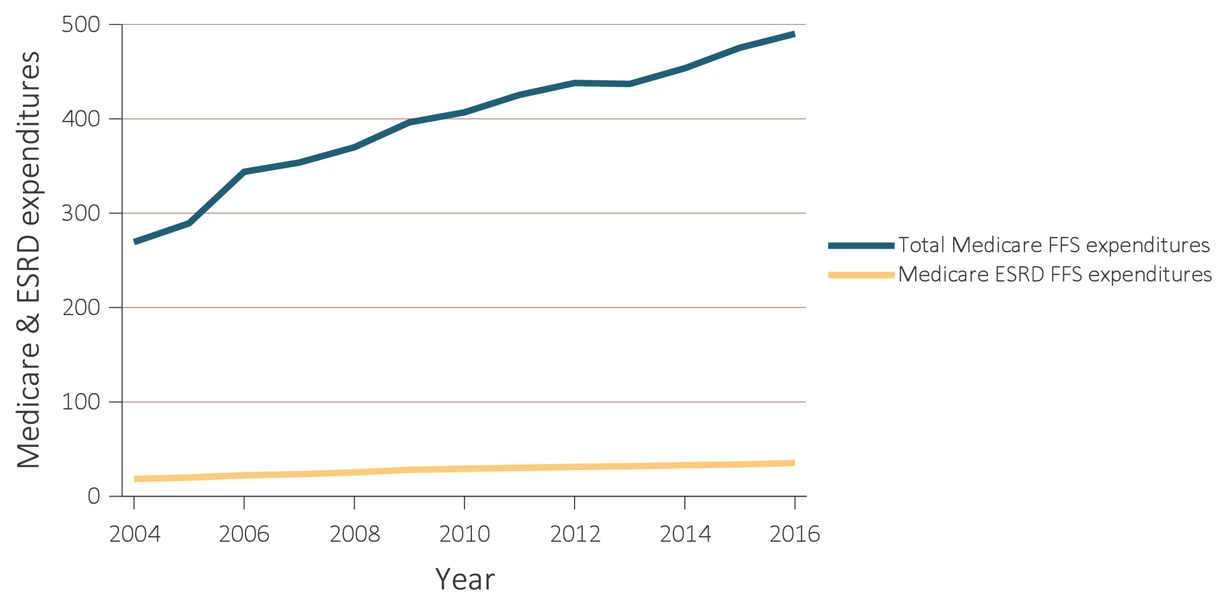
Trends in Total Medicare and ESRD Fee-for-Service Spending ($, in billions)
Note:
The cost of ESRD care is not increasing as fast as overall Medicare costs are.
ESRD related cost increases slowed after 2010 but are still increasing.
2018 USRDS Annual Data Report Vol 2, Chapter 1, Fig 9.2A
Dialysis Core Curriculum 2021

Slide 37
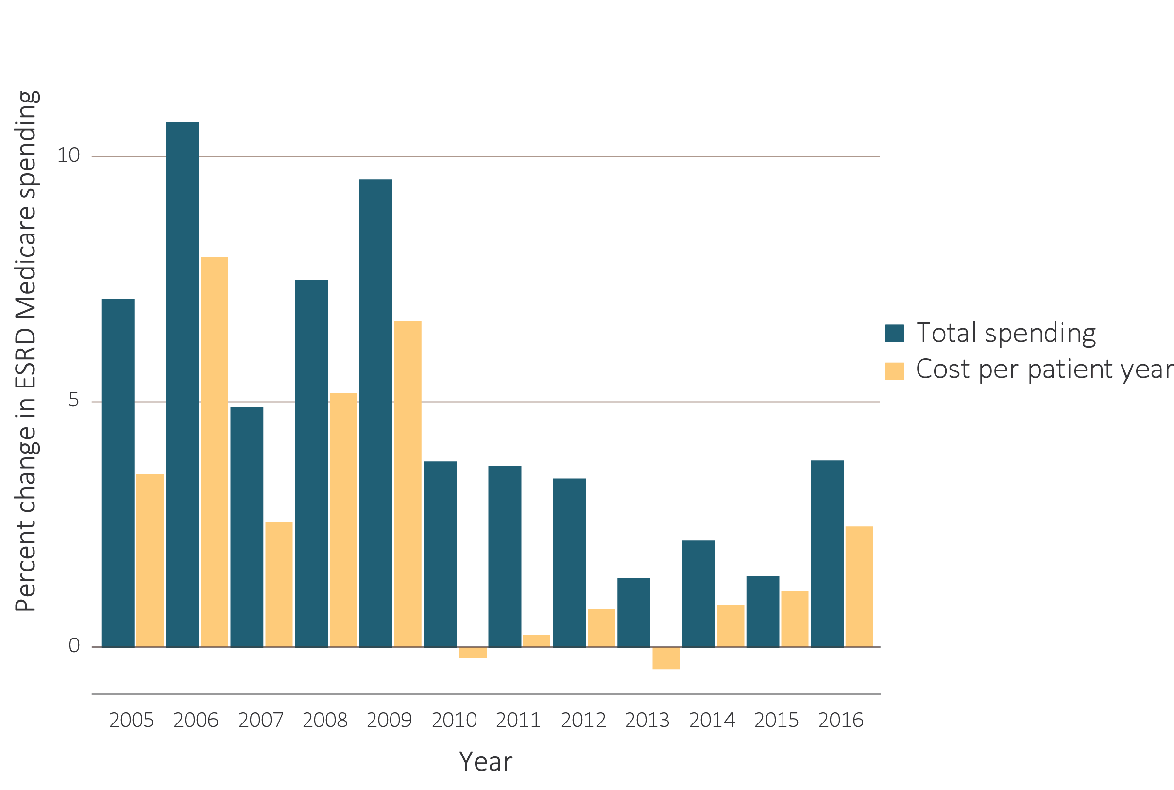
Annual Percent Change in Medicare ESRD Spending, 2004-2016
Implementation of “PPS or Bundled payment”
2018 USRDS Annual Data Report Vol 2, Chapter 1, Fig 9.4
Dialysis Core Curriculum 2021

Slide 38
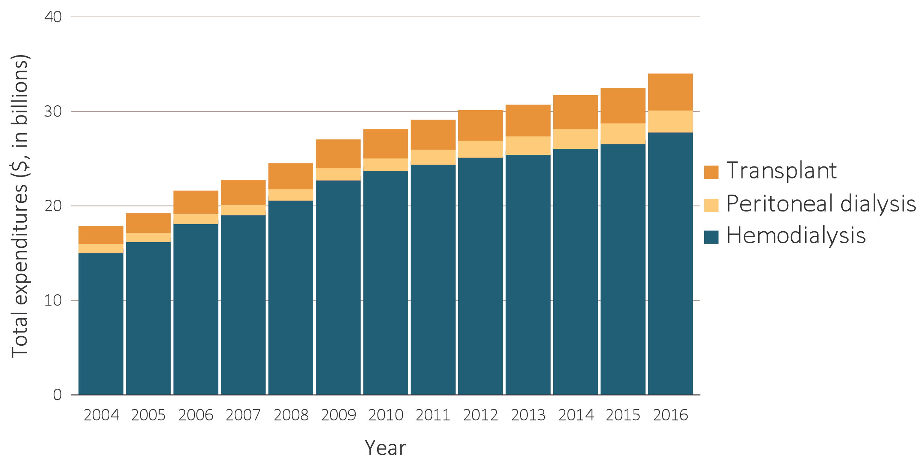
Total Medicare ESRD Expenditures, by Modality, 2004-2016
In 2016, the increase was 2.5%.
It was mostly due to a higher PPPY cost not an increase in covered lives.
2018 USRDS Annual Data Report Vol 2, Chapter 1, Fig 9.7
Dialysis Core Curriculum 2021

Slide 39
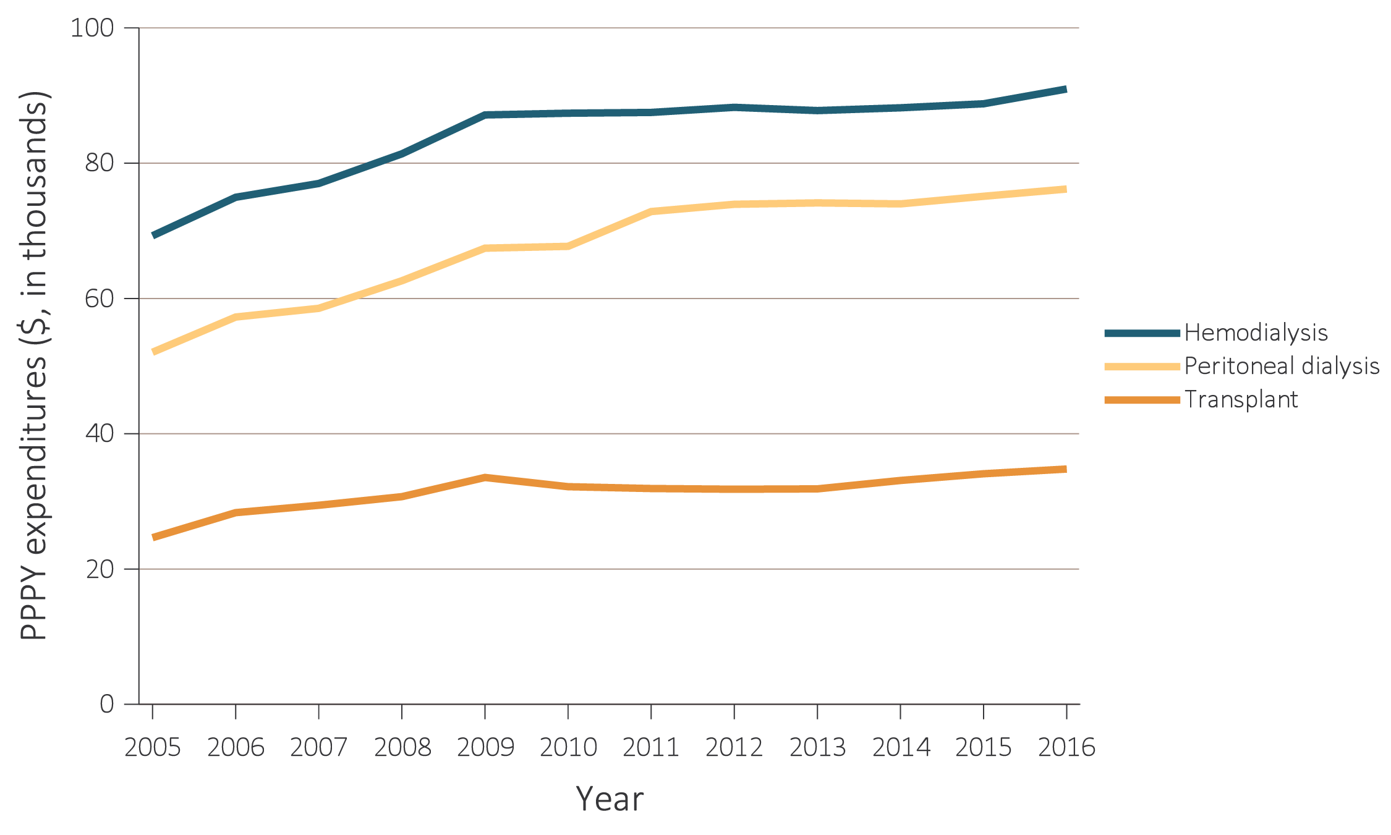
Total Medicare ESRD Expenditures, by Modality, 2004-2016
Pre and Post Bundle: Per Patient Per Year (PPPY)
Increase between 2010 and 2011
Mainly due to PPS related adjustment
in /Rx cost for PD
2018 USRDS Annual Data Report
Vol 2, Chapter 1, Fig 9.8
Pre Bundle
Post Bundle
Dialysis Core Curriculum 2021

Slide 40
Total Medicare ESRD Expenditures, by Modality, 2004-2016
In 2016, the PPPY expenditure
for PD ($76,177) was less than that for CHD ($90,971).
While PPPY cost for transplant was $34,780.
Delta PD vs CHD now less
$90,971
$76,177
$34,780
2018 USRDS Annual Data Report Vol 2, Chapter 1, Fig 9.8
Dialysis Core Curriculum 2021

Slide 41
Trends in the Annual Number of ESRD Incident Cases, by Modality, in U.S. Population, 1980-2016
2018 Annual Data Report
Volume 2 ESRD,
Chapter 1, Fig 1.2
Data Source: Reference Table D.1 and special analyses, USRDS ESRD Database.
Persons with “Uncertain Dialysis” were included in the “All ESRD” total but are not represented separately.
Dialysis Core Curriculum 2021

Slide 42
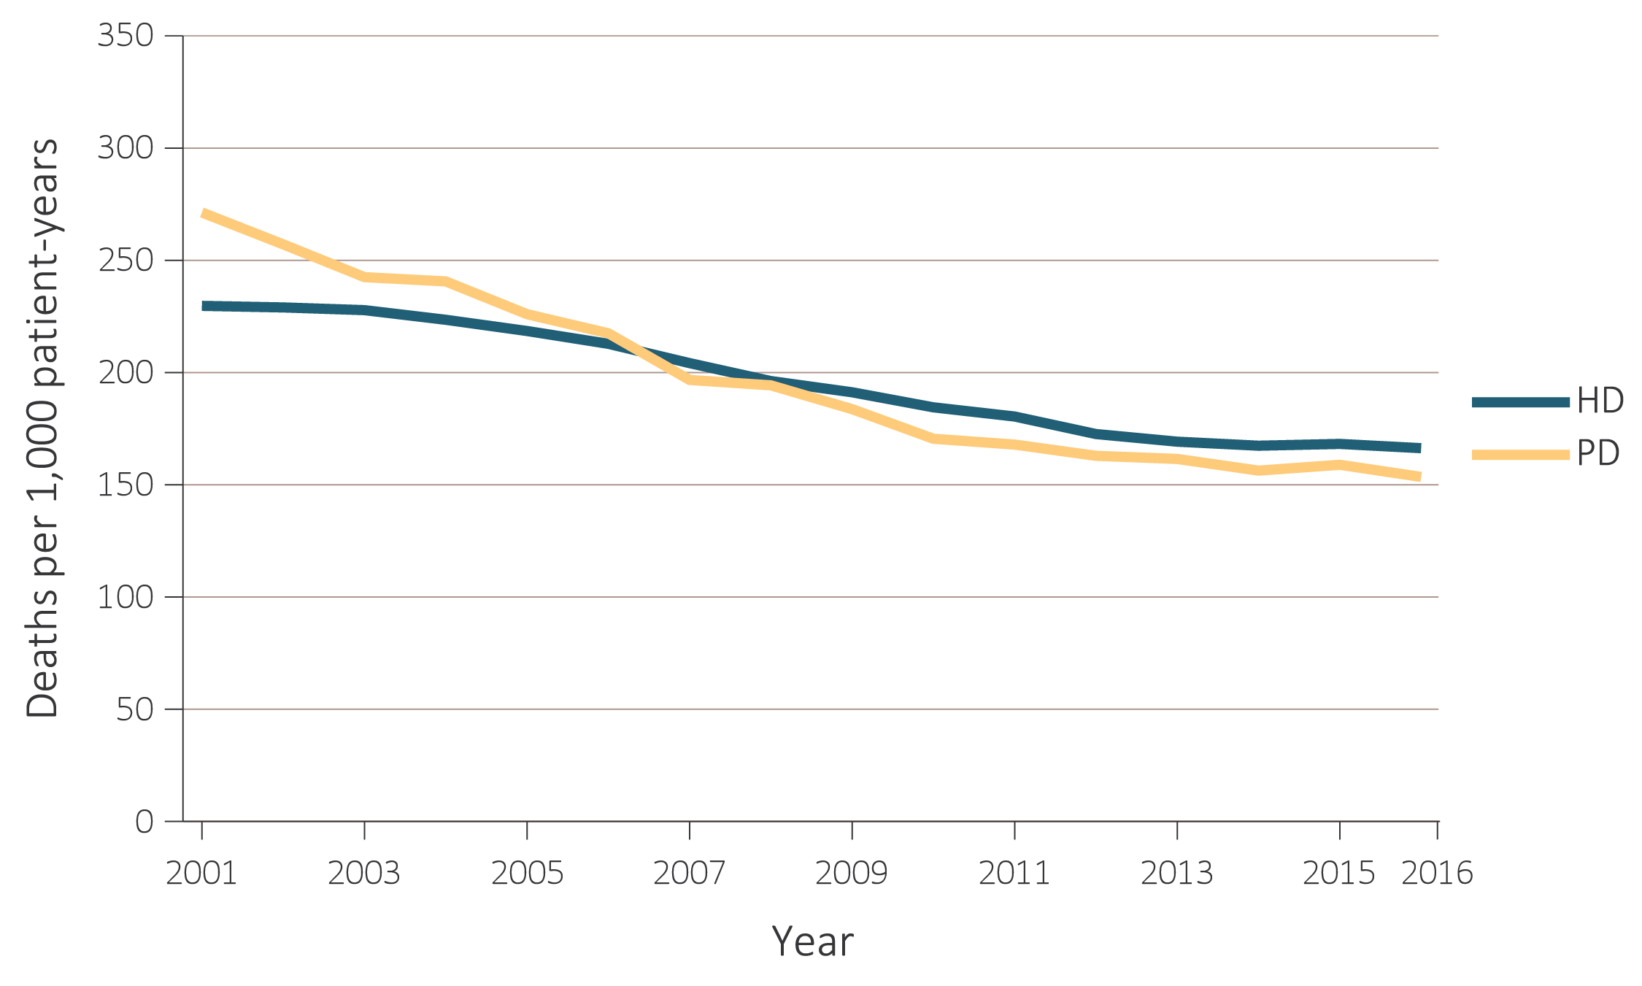
Mortality Trends PD vs. CHD
Adjusted for age, sex, race, ethnicity, primary diagnosis and vintage.
Reference population: period prevalent ESRD patients, 2011
2018 USRDS Annual Data Report Vol 2, Chapter 1, Fig 5.1
Dialysis Core Curriculum 2021

Slide 43
Adjusted Survival by Treatment
CHD vs. PD vs. Transplant
 | 3 months (%) | 12 months (%) | 24 months (%) | 36 months (%) | 60 months (%)
Hemodialysis
2003 | 91.0 | 74.8 | 61.8 | 51.4 | 36.6
2005 | 91.2 | 75.4 | 62.7 | 53.0 | 38.6
2007 | 91.6 | 76.3 | 64.2 | 54.6 | 40.0
2009 | 91.8 | 77.5 | 65.7 | 56.2 | 41.6
2011 | 92.1 | 78.3 | 66.8 | 57.4 | 42.0
Peritoneal dialysis
2003 | 96.3 | 83.9 | 69.0 | 57.7 | 42.9
2005 | 96.5 | 85.6 | 72.2 | 61.6 | 45.7
2007 | 96.9 | 87.5 | 74.8 | 64.5 | 48.8
2009 | 97.4 | 87.8 | 76.6 | 66.7 | 51.5
2011 | 97.7 | 89.7 | 79.0 | 69.5 | 52.1
Deceased-donor transplant
2003 | 95.7 | 89.9 | 84.5 | 79.5 | 69.2
2005 | 95.6 | 89.7 | 84.9 | 80.3 | 71.0
2007 | 96.7 | 92.2 | 88.1 | 83.7 | 73.3
2009 | 96.7 | 92.0 | 88.2 | 84.0 | 75.1
2011 | 97.1 | 93.9 | 90.4 | 86.4 | 76.8
Living-donor transplant
2003 | 98.1 | 95.3 | 91.3 | 86.9 | 77.9
2005 | 98.2 | 95.2 | 91.7 | 88.2 | 80.3
2007 | 99.0 | 97.0 | 94.3 | 91.0 | 83.5
2009 | 98.9 | 97.1 | 94.4 | 91.1 | 84.1
2011 | 98.9 | 96.3 | 94.3 | 91.2 | 84.1
Adjusted survival probabilities, from day one, in the ESRD population.
Reference population: incident ESRD patients, 2011. Adjusted for age, sex, race, Hispanic ethnicity, and primary diagnosis.
2018 USRDS Annual Data Report Vol 2 ESRD, Chapter 5, Table 5.3
Dialysis Core Curriculum 2021

Slide 44
Comprehensive ESRD Care (CEC) and ESCO Details
Dialysis clinics, nephrologists, and other providers joint venture to create the ESCO.
  Caveat: This is a new business; there would be infrastructure costs.
There are equity partners in the newly formed ESCO business.
  Caveat: At least one partner must be the nephrologists, and outside equity partners may not contribute to ESCO infrastructure costs.
Non-LDOs (less than 200 clinics) could participate in a one-sided track, where they participate in shared savings but have no risk if there are losses.
Performance year 1 until December 2016.
Model ran until 12/31/2020.
Must have had at least 350 patients to form an ESCO.
All patients in a participating unit are in the ESCO.
  Caveat: unless already in another Managed care project or ACO
Dialysis Core Curriculum 2021

Slide 45
Comprehensive ESRD Care (CEC)
ESRD Seamless Care Organization (ESCO)
Payment Year 1 CEC ESCO Report (Overview)
  All 13 ESCOs generated savings; 0 generated losses
  12 ESCOs’ savings totals surpassed the minimal savings rate, making them eligible for shared savings payments
  Total CEC model savings was over 5.3% of benchmark costs, or $75 million
  There were 16,085 total aligned patient years’ experience
  Net savings to Medicare was $23.9 million in Performance Year - 1
  Over $51 million in eligible shared savings paid to the 12 qualifying ESCOs
CMS.gov – CEC Financial and Quality Results Performance year 1
https://innovation.cms.gov/initiatives/comprehensive-ESRD-care
Dialysis Core Curriculum 2021

Slide 46
CEC ESCO Financial Report
(Medicare Comprehensive ESRD Care Model) Performance year 1 (10/15 – 12/16)
 | Total for All ESCOs | Total per patient
Total Aligned Beneficiary Years | 16,086
Total Benchmark Expenditures | $1,415,517,283 | $88,001
Total Actual Expenditures for Aligned Beneficiaries | $1,340,396,446 | $83,332
Total Benchmark Expenditures Minus Total Aligned Beneficiary Expenditures | $75,120,837 | $4,670
Total Benchmark Expenditures Minus Total Aligned Beneficiary Expenditures As a Percent of Total Benchmark | 5.31%
Earned Shared Savings Payments to ESCO | $51,151,304
Modified from: CMS.gov – CEC Financial and Quality Results Performance year 1
https://innovation.cms.gov/initiatives/comprehensive-ESRD-care
Dialysis Core Curriculum 2021

Slide 47
Based on These Observations, CMS Is Looking for New Ways to Adjust Payment for ESRD Care That:
summary
Award quality, and
Favor use of modalities that cost less and possibly have equal or better clinical outcomes
Dialysis Core Curriculum 2021

Slide 48

Potential for New Financial Incentives to Encourage Use of Home Dialysis: 2020 and Beyond
Dialysis Core Curriculum 2021

Slide 49
Executive Order on Advancing American Kidney Health
There are 3 broad policies:
Prevent kidney failure through better diagnosis, treatment, and incentives for preventive care
Increase patient choice through affordable alternative treatments for ESRD by encouraging higher-value care, educating patients on treatment alternatives, and encouraging the development of artificial kidneys
Increase access to kidney transplants by modernizing the organ recovery and transplantation systems
Expectations/Assumptions:
6-year term
Managing clinicians: Improve dialysis in the home setting by 3% each year
Facilities: Improve dialysis in the home setting by 1.5% each year
Result: Home dialysis usage in approximately 19% of overall dialysis population in selected geographic areas by 2026
Dialysis Core Curriculum 2021

Slide 50
Moving Forward in Executive Order (EO)
Attending physicians will either:
Be randomly assigned to participate in the mandatory part of the EO if their practice admits patients to a dialysis provider that is in a hospital region assigned to randomly participate, OR
Continue to bill and be paid as they did in 2019 if they do not practice in an area randomly assigned to the ETC portion, OR
Elect that their practice participate in one of the 4 voluntary models under EO.
Dialysis providers will either:
Be randomly assigned to participate in the mandatory part of the EO if they are located in a hospital region assigned to randomly participate, OR
Continue to bill and be paid as they did in 2019 if the do not practice in an area randomly assigned to the ETC portion, OR
Elect to be an equity partner with attending physician groups who elect to enroll in a voluntary model.
Dialysis Core Curriculum 2021

Slide 51
Advancing American Kidney Health Models
Basis of EO
Mandatory if Randomized
ESRD Treatment Choices (ETC) Model − nephrologists and providers
Voluntary
Kidney Care First (KCF) Model − nephrologists / nephrology practices only
Comprehensive Kidney Care Contracting (CKCC) Models
  Graduated
  Professional
  Global
Must include nephrologists / nephrology practices, but may also include
dialysis providers and transplant centers on an optional basis
Dialysis Core Curriculum 2021

Slide 52
Advancing American Kidney Health
Mandatory Model (ESRD Treatment Choices or ETC)
Mandatory participation for an estimated 50% of dialysis facilities and nephrology providers billing Medicare for ESRD services.
There will be 2 payment adjustors to facilitate use of home dialysis and transplantation.
  Home Dialysis Payment Adjustment (HDPA)
  Performance Payment Adjustment (PPA)
There will be waivers to facilitate modality education and CKD education.
Dialysis Core Curriculum 2021

Slide 53
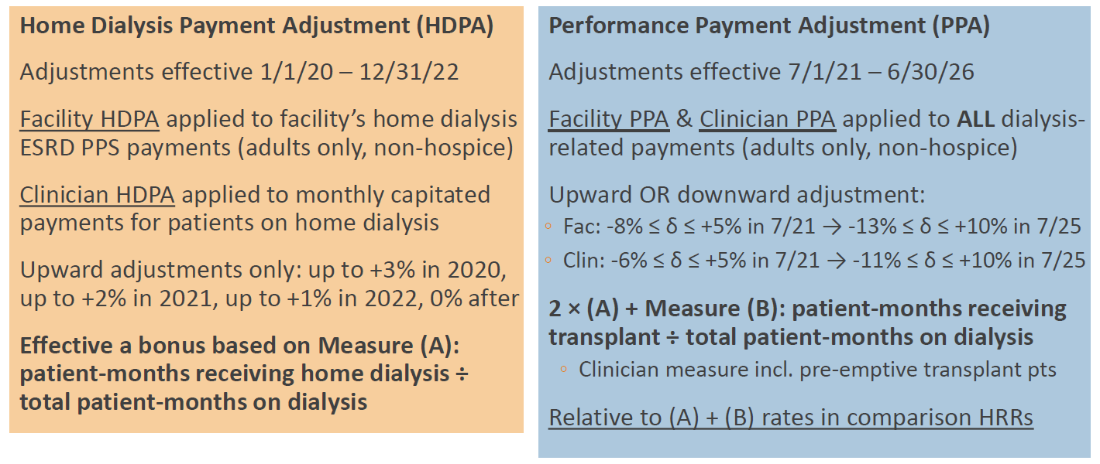
Advancing American Kidney Health
Summary of ESRD Treatment Choices – Adjustments HDPA and PPA
From NKF 6/10/19 summary of Executive order on AAKH 6/10/19, and Federal Register 07/18/2019, 42 CFR
Dialysis Core Curriculum 2021

Slide 54
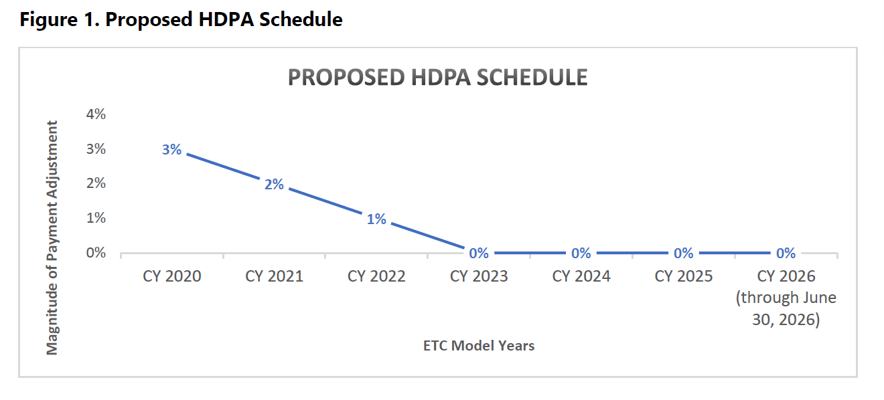
Advancing American Kidney Health
Mandatory Model (ETC) Physician MCP Adjustment
Modified from Table 11 -Federal Register 07/18/2019, 42 CFR Part 512 [CMS-5527-P]
Dialysis Core Curriculum 2021

Slide 55
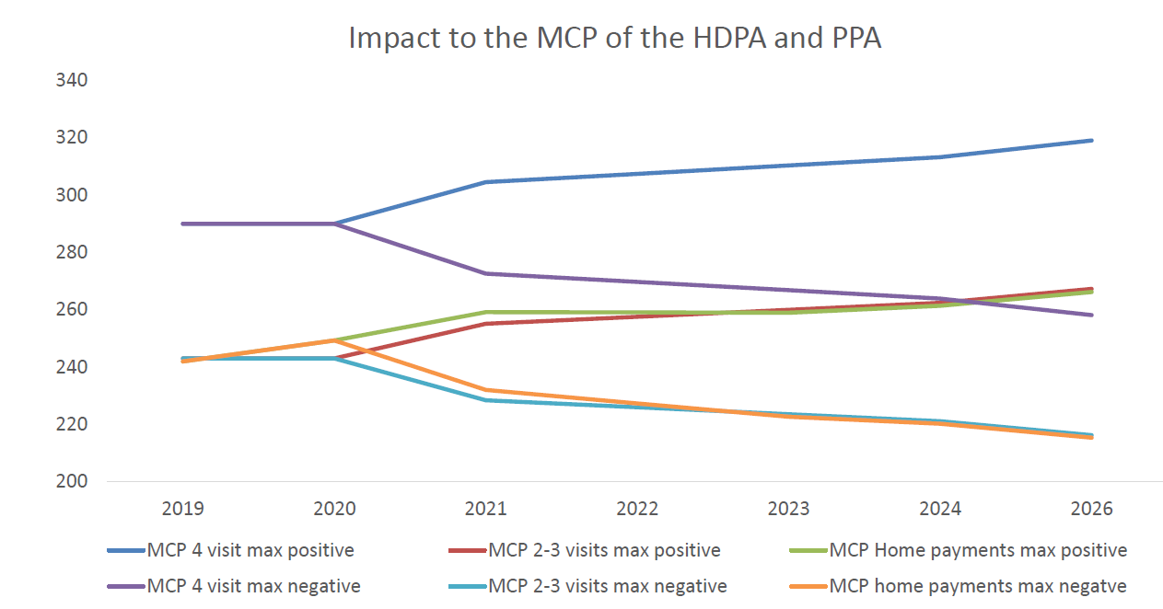
Potential MCP Adjustment Based on PPA in ETC
Managing clinicians will have their MCP adjusted.
Dollars
From: NKF Summary of AAKH initiative 07/18/2019 – Modified from CMS Physician fee schedule Search Tool 2017
and the HDPA and PPA tables (Tables 2 and 15) from the 7/10/19 Executive Order on AAKH
Dialysis Core Curriculum 2021

Slide 56
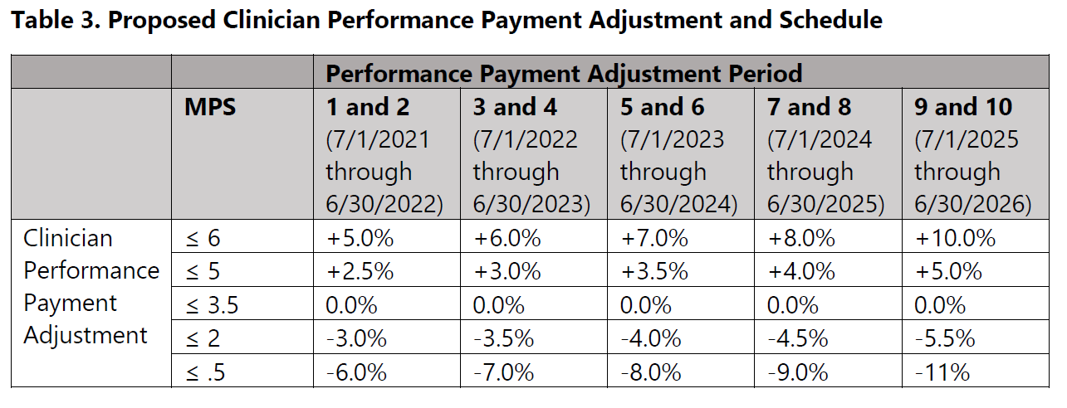
Proposed Physician MCP Payment Modifications Based on PPA in ETC Model
MPS = Modality Performance Score
Federal Register 07/18/2019, 42 CFR Part512 [CMS-5527-P] Table 2 512.380
Dialysis Core Curriculum 2021

Slide 57
PPA Metrics in ETC
As of 6/25/19, still to be determined.
Dialysis Core Curriculum 2021

Slide 58
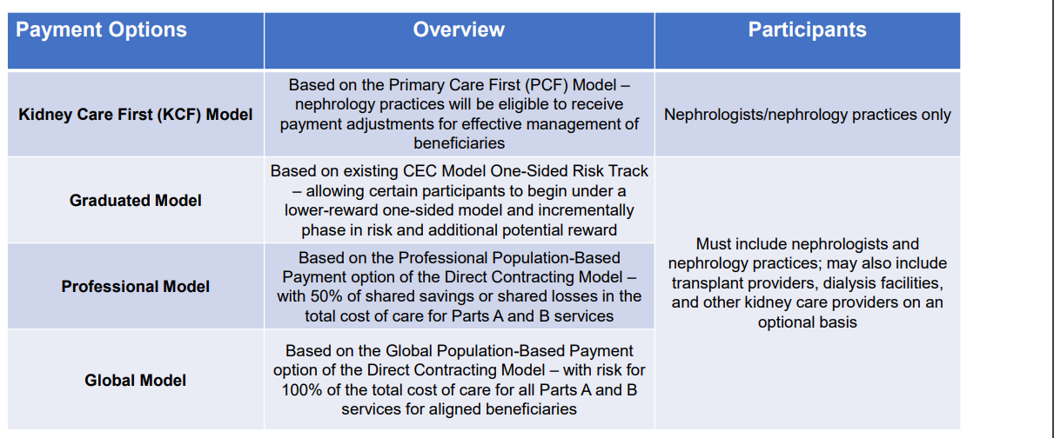
Advancing American Kidney Health
Voluntary Models
Modified From:
The Executive order on AAKH and the Federal Register 07/18/2019, 42 CFR part 512
Dialysis Core Curriculum 2021

Slide 59
Requirements for All CKCCs
To be in the CKCC model, you must form a Kidney Care Entity (KCE).
Must participate in periodic conference calls, meetings, and share resources with the CMS Innovation Center.
Each participant will be required to:
  Participate in targeted learning on Driver Diagrams.
  Develop and submit to CMS your individual Driver Diagram.
  Upon request, answer surveys and participate in interviews or engage with CMS to help identify learning needs.
  Participate in the dissemination of practices that show positive outcomes.
  Participate in one KCF or CCKF model learning activity every quarter.
  Share with CMS and others any state or local programs that compliment KCF and KCEs.
  Develop, track, and report to CMS your quality improvement efforts.
  Participate in in-person events in Baltimore and DC.
Dialysis Core Curriculum 2021

Slide 60
EO: Kidney Care First Model (KCF)
Potential Financial Incentives − Overview
KCF Physician Group Financial Incentives:
  Kidney Transplant Bonus (KTB)
  Adjusted Monthly Capitation Payment (AMCP)
  CKD Quarterly Capitation Payment (CKD QCP)
  Note: There will also be performance-related modifications to these payments.
Dialysis Core Curriculum 2021

Slide 61
EO: Kidney Care First Model (KCF)
Potential Financial Incentives – More Detailed
KCF Physician Group Financial Incentives:
Kidney Transplant Bonus (KTB):
  If transplanted and kidney working: Potential for $15,000 bonus if kidney functions 3 yrs
    1 yr = $2,500 bonus; 2 yrs = $5,000 bonus; 3 yrs = $7,500 bonus
Adjusted Monthly Capitation Payment (AMCP):
  “Adjusted” MCP is same for Home and CHD no matter how many times you see the patient
    Paid at about the current 2-3 Center HD visit rate
    This Prospective Payment (PP) is adjusted up or down based on performance metrics
CKD Quarterly Capitation Payment (CKD QCP):
  Nephrologist is paid a quarterly PP (about 1/3 of 2-3 visit MCP/mth or one MCP/qtr) to cover all services during that quarter
    Still submit CPT codes as in past
    CPT codes covered: 99201-205; 99211-215; 99345-355; 99495-496; 99497-498; 99490;G0402, G0438; G0439
Dialysis Core Curriculum 2021

Slide 62
EO: Kidney Care First Model (KCF)
Potential Financial Incentives – Potential Adjustments
Performance Based Adjustment (PBA):
The PBA is based on how the KCF does compared to their peers (the “relative” performance component) and than based on improvement (the “continuous” improvement component).
These adjustments will be based on:
  Quality gate, and
  Utilization measures
This PBA can result in the MCP of CKD payments being adjusted:
  Upwards as high as 30%, or
  Downwards as much as 20%
Dialysis Core Curriculum 2021

Slide 63
CKCC Voluntary Models
If nephrology group elects to participate, there will be potential shared savings for participating nephrologists based on final quality metrics and amount of savings that are achieved. The potential portion of savings (or losses) that the Kidney Contracting business entity can share is based on level of enrollment. (Graduated, professional, global model)
Final metrics still to be determined. (12/6/19)
Dialysis Core Curriculum 2021

Slide 64
ESRD Payments Summary
Current treatment of ESRD has saved and prolonged the lives of many Americans.
The ESRD program is a high dollar cost for Medicare, but there is a relatively small number of participants in this program.
CMS is looking at ways to reduce cost and continue to improve outcomes.
CMS believes one way to do this is to grow the percentage of patients on home dialysis and increase transplant rates.
The bundled payment with its associated QIP payment modifiers is the first recent attempt to control costs while improving outcomes.
Overall costs are still escalating.
Additional models such as the ESCO, and now the newly announced Executive Order on Advancing American Kidney Health, are likely to further modify payment to all players in this complex reimbursement system.
Dialysis Core Curriculum 2021

Slide 65
references
2018 Annual Data Report: Vol 2 ESRD
NKF Summary of the Advancing American Kidney Health initiative 07/18/2019
Part II HHS CMS 42 CFR parts 410, 413, 415: 9/29/09
Federal Register: Vol. 74; # 187; Sept 29, 2009. Proposed Rules
2018 Annual Data Report Volume 2 ESRD, Chapter 1, Fig 1.9
CMS.gov – CEC Financial and Quality Results Performance year 1; https://innovation.cms.gov/initiatives/comprehensive-ESRD-care
Federal Register 07/18/2019, 42 CFR Part512 [CMS-5527-P]
Dialysis Core Curriculum 2021

