Slide 1
Administrative Aspects of Operating Dialysis Units
Continuous Quality Improvement in Dialysis Units
Dialysis Core Curriculum 2021
Jay B. Wish, MD, FASN
Indiana University

Slide 2
Jay B. Wish
DISCLOSURES
Employer: Indiana University Health Physicians
Consultancy: Akebia, AstraZeneca, Vifor, Otsuka, Zydus, Rockwell Medical
Honoraria: Pfizer, Otsuka, Vifor, Keryx, Akebia, AstraZeneca, Rockwell Medical, Abbott
Scientific Advisor/Membership: JASN Editorial Board, CJASN Editorial Board, Nephrology News & Issues Editorial Board, Vifor, Akebia, AstraZeneca, Rockwell Medical, Medical Director of a DaVita dialysis facility
Speakers Bureau: Keryx, Pfizer
Dialysis Core Curriculum 2021

Slide 3
Learning Objectives
Discuss the principles of quality improvement (QI) and their application to health care
Identify the 7 basic tools of QI with examples of each
Describe the evolution of quality metrics as applied to the ESKD program
Analyze an example of the application of QI techniques to a real-world problem in a hemodialysis unit
Dialysis Core Curriculum 2021

Slide 4
Case Presentation
Introduction to QI
You are medical director at an urban hemodialysis facility. During your monthly quality assessment and performance improvement (QAPI) meeting, you are presented with data demonstrating a recent 3-month increase in bloodstream infections. Upon further inquiry, you discover that most but not all the affected patients have tunneled dialysis catheters (TDCs) and that most but not all of the pathogens are Staphylococcus aureus.
Dialysis Core Curriculum 2021

Slide 5
CQI Principles: Industrial Management Science
INTRODUCTION TO QI
Continuous Quality Improvement (CQI) originated in the industrial and management sciences systems theory or thinking – developed in system dynamics, provides a holistic perspective emphasizing feedback for greater self-regulation
Walter Shewhart, PhD – a physicist, he developed many quality methods and tools, father of “statistical quality control,” Plan Do Check Act (PDCA) cycle, and the “run chart”
W. Edward Deming, PhD – a statistician, he shared his expertise in statistical process control and quality methods to help Japan’s post-WWII economic recovery; also known for his “System of Profound Knowledge” and “14 Points For Management” that sought to understand and reduce variation
Total Quality Management (TQM) – a management approach that evolved from quality assurance methods in Japanese industry from the works of Philip B. Crosby, W. Edwards Deming, Armand V. Feigenbaum, Kaoru Ishikawa, and Joseph M. Juran; its principles emphasize customer-driven quality, top management leadership and commitment, continuous improvement, fast response, actions based on facts, employee participation, and a TQM culture
Deming WE: Out of the Crisis, Cambridge, MA, MIT Press, 2000
Dialysis Core Curriculum 2021

Slide 6
CQI Principles: Health Care Context
INTRODUCTION TO QI
Health Systems Research: Avedis Donabedian, MD, MPH – Donabedian transformed the approach to thinking about health systems. In his seminal paper, he introduced the paradigm for evaluating and monitoring the quality of health care through three interrelated (but distinct and not necessarily causal) aspects of the patient’s experience:
  Structure: attributes of care providers, settings, other contexts (e.g., facility attribute, physician training, and administrative attributes)
  Process: care provided or characteristics of its provision (e.g., prescription medication, ordering tests, and physician referrals)
  Outcome: a patient characteristic that is presumed to result from the care provided (e.g., death, hospitalization, and infection)
Of these three indicators, outcomes often remain the sole measure of quality. “Outcomes, by and large, remain the ultimate validation of the effectiveness and quality of medical care.”
But outcomes must always take context into account and cannot distinguish between efficacy and effectiveness.
Millbank Mem Fund Q 44(suppl):166–206, 1966
Dialysis Core Curriculum 2021

Slide 7
Quality and Accountability: Summary
Introduction TO QI
QC vs. QA vs. QI vs. PI Quality Control (QC): ensuring products/services are made/delivered to high standards, often through inspection, monitoring, recording
Quality Assurance (QA): ensuring the processes will produce high quality products/services, often through internal/external audits
Quality Improvement (QI): continuous process of identifying problems, examining solutions, and regularly monitoring solutions for improvement
Performance Improvement (PI): measuring output and modifying processes/procedures to increase output, efficiency, or effectiveness
Dual monitoring system for End-Stage Kidney Disease (ESKD) state survey agencies perform QA to require facilities meet minimum standards of operation to prevent harm (conditions of coverage)
ESKD Networks perform the QI function to improve processes intended to improve patient outcomes
Dialysis Core Curriculum 2021

Slide 8
Quality Improvement: Approach
INTRODUCTION TO QI
FOCUS-PDCA: an iterative management process
Find a process to improve
Organize a team of individuals who understand the process
Clarify current knowledge of the process (literature, policies, rules)
Understand the causes of variation in the process (special/root causes?)
Select the improvement that needs to take place
Plan how the improvement opportunity will be studied based on what needs to be done (Desired changes? Expected output/target/goals?)
Do the process improvement, data collection, data analysis (execute)
Check the results to observed vs expected; determine if the plan worked
Act by adapting/adjusting the plan if it did not work, or standardizing the change by writing a policy if it did work
Also known as the “Deming circle/cycle/wheel,” “Shewhart cycle,” “Plan, Do, Study, Act” (PDSA) cycle, or “Define, Measure, Analyze, Improve, Control” (DMAIC) in the Six Sigma programs
Deming WE: Out of the Crisis, Cambridge, MA, MIT Press, 2000
Dialysis Core Curriculum 2021

Slide 9
7 Basic Tools of QI: Ishikawa Diagram
INTRODUCTION TO QI
Also called fishbone diagram, cause-and-effect diagrams, or Fishikawa
Created by Kaoru Ishikawa to demonstrate causes of a certain event using causal diagrams in which each cause is a source of variation
The lines originating off the horizontal axis represent main causes, and lines branching off those represent subcauses – e.g., main causes in the service industry: surroundings, suppliers, systems, skills
Main causes in manufacturing: machine (technology), method (process), material (raw/consumables/information), man/mind power, measurement (inspection), milieu/Mother Nature (environment), management/money, maintenance
Commonly used in product design and quality defect prevention
Useful in structuring a brainstorming session
Dialysis Core Curriculum 2021

Slide 10
Ishikawa Diagram
INTRODUCTION TO QI
Adapted from https://esrdncc.org/en/fistula-first-catheter-last/
Dialysis Core Curriculum 2021

Slide 11
7 Basic Tools of QI: Check Sheet
INTRODUCTION TO QI
Simple document for collecting real-time, location-specific event data
Designed for quick, easy, efficient data recording using “checks”
Can be divided into regions with varying significance
Reading data involves observing the location and number of marks on sheet
Common types of check sheets:
  Classification–classifies trait such as a defect into categories
  Location–indicates location of a trait on a picture of a part or item
  Frequency–indicates presence or absence of a trait or combinations of traits
  Measurement scale–indicated by checking appropriate interval of measure
  Checklist–indicates completion of indicated tasks
Dialysis Core Curriculum 2021

Slide 12
Check Sheet
INTRODUCTION TO QI
Adapted from https://esrdncc.org/en/fistula-first-catheter-last/
Dialysis Core Curriculum 2021

Slide 13
Check Sheet
Introduction to QI
Transplantation Referral Process
Based on DaVita template
Dialysis Core Curriculum 2021

Slide 14
7 Basic Tools of QI: Control Chart
INTRODUCTION TO QI
Also called Shewhart charts, or process-behavior charts
Created by Walter Shewhart to differentiate natural variation in a process from significant changes, or common and special causes of variation
Control charts include points that represent a statistic (e.g., mean, proportion) of a quality characteristic taken from samples at different times; a center line representing the mean of the statistic (mean of means or proportions); and upper and lower control limits (“natural process limits”) indicating thresholds at which the process is statistically unlikely (3 standard errors from center line)
There are various types of control charts that may be best suited to the process being observed (quality characteristics, nonconformances, cumulative sums, fractions, and numbers)
Dialysis Core Curriculum 2021

Slide 15
Control Chart
introduction TO QI
Adapted from Qual Saf Health Care 17(Suppl 1): 13–32, 2008
Dialysis Core Curriculum 2021

Slide 16
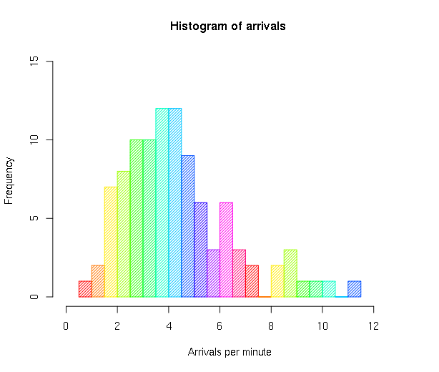
7 Basic Tools of QI: Plots
INTRODUCTION TO QI
Histogram: vertical bar chart displaying
variation and the distribution of the data
Adapted from Wikipedia.org: https://en.wikipedia.org/wiki/Histogram
Dialysis Core Curriculum 2021

Slide 17
7 Basic Tools of QI: Plots
INTRODUCTION TO QI
Pareto chart: plot that combines a bar graph (descending order) with a line graph (cumulative total); it displays distribution of items, ranking the frequency of problems based upon Juran’s Pareto principle (i.e., 80% of the effects arise from 20% of the possible causes)
Adapted from Wikipedia.org: https://en.wikipedia.org/wiki/Pareto_chart
Dialysis Core Curriculum 2021

Slide 18
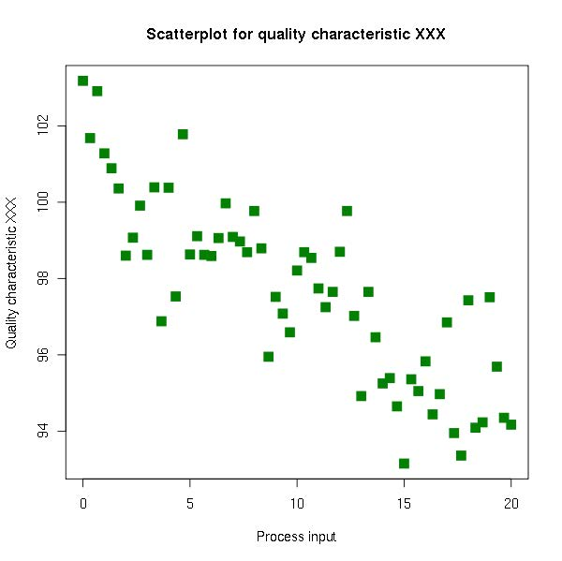
7 Basic Tools of QI: Plots
INTRODUCTION TO QI
Scatter diagram: plot to analyze possible relationships between 2 variables; it illustrates the degree of correlation (but not causation)
Adapted From wikipedia.org: https://en.wikipedia.org/wiki/Scatter_plot
Dialysis Core Curriculum 2021

Slide 19
7 Basic Tools of QI: Flowchart
INTRODUCTION TO QI
Diagram to represent an algorithm or process, demonstrating the steps through a system
Process operations (activity) are represented with boxes/rectangles, while decision points are represented by diamonds
The flow of control is represented by arrows connecting the figures
Most commonly used for identifying problems, but also used to analyze, design, document, or manage any process
Dialysis Core Curriculum 2021

Slide 20
7 Basic Tools of QI:
Flowchart
Introduction to qi
Modified From Fistula First
https://esrdncc.org/globalassets/ffcl/nw-11_avg-algorithm.pdf
Dialysis Core Curriculum 2021

Slide 21
Traditional Quality Domains in ESKD
Qi IN eskd
ESKD Process Measures | Comorbid Process Measures | Outcome Measures
Dialysis adequacy | Lipid management | Standardized mortality rate
Vascular access (fistula > graft > catheter) | Glycemic control | Standardized hospitalization rate
Target hemoglobin | Diabetic foot care | Standardized transplantation rate
Mineral metabolism control | Secondary cardiovascular protection | Quality-adjusted life years
Nutritional status | Adequate immunizations | Patient safety
Infection rates | Age-appropriate screening | Patient satisfaction
Adapted from Annu Rev Med 58:387-99, 2007
Dialysis Core Curriculum 2021

Slide 22
ESKD Quality Incentive Program (QIP)
Qi in ESKD
Instituted in 2012 as the first pay-for-performance (P4P) program in a Medicare prospective payment system (PPS)
Started with 3 metrics (hemoglobin, Kt/V, and vascular access) derived from Medicare claims, then expanded exponentially to include data derived from CROWNWeb, the electronic system for collecting facility-level quality data
2% of all Medicare payments to a facility at risk for an entire year (payment year); e.g., 2022
Based on data collected via claims and CROWNWeb 2 years before (performance year); e.g., 2020
Percentiles based on national norms from the year before that; e.g., 2019
Semin Dial 29(2):144-147, 2016
Dialysis Core Curriculum 2021

Slide 23
ESKD QIP Scoring and Payment Reduction Methodology (Payment Year 2022)
QI in eSKD
1 Patient & Family Engagement Measure
ICH CAHPS
4 Care Coordination Measures
Standardized Readmission Ratio (SRR)
Standardized Hospitalization Ratio (SHR)
Percentage of Prevalent Patients Waitlisted (PPPW)
Clinical Depression Screening and Follow-Up
6 Clinical Care Measures
Kt/V Dialysis Adequacy (all modalities)
Vascular Access Measure Topic (fistula, catheter)
Standardized Transfusion Ratio (STrR)
Hypercalcemia
Ultrafiltration Rate (UFR)
3 Patient Safety Measures
Blood stream infections
National Health Safety Network Dialysis Event Reporting
Medication Reconciliation
Weighting of Measures
Patient & Family Engagement: 15%
Care Coordination: 30%
Clinical Care: 40%
Patient Safety: 15%
ICH CAHPS – In-center Hemodialysis Consumer
Assessment of Healthcare Providers and Systems
https://www.cms.gov/Medicare/Quality-Initiatives-Patient-Assessment-Instruments/ESRDQIP/Downloads/ESRD-QIP-Summary-Payment-Years-2019-2024.pdf
Dialysis Core Curriculum 2021

Slide 24
Dialysis Facility Compare and 5-Star Rating
QIin ESKD
Data derived from Medicare claims and CROWNWeb
Updated the 3rd quarter of each year to include the previous calendar year
Publicly accessible website that allows consumers to compare facilities in a region
Metrics include bloodstream infection rate, adequacy of dialysis, vascular access, hypercalcemia, transplant wait listing, nutrition (pediatric only) and standardized ratios for blood transfusion, hospitalization, readmission, and mortality
Final score for 5-star quality rating uses complicated statistical methodology, as does the awarding of stars based on that final score
A separate 5-star rating is awarded based on the ICH-CAHPS patient satisfaction survey
ICH CAHPS – In-Center Hemodialysis
Consumer Assessment of Healthcare Providers and Systems
https://www.medicare.gov/dialysisfacilitycompare/
Dialysis Core Curriculum 2021

Slide 25
Case Presentation: A Problem Is Found
Case presentation
You are the medical director at an urban hemodialysis facility. During your monthly quality assessment and performance improvement (QAPI) meeting you are presented with data (a control chart) demonstrating a recent 3-month increase in bloodstream infections. Upon further inquiry, you discover that most but not all of the affected patients have tunneled dialysis catheters (TDCs) and that most but not all of the pathogens are Staphylococcus aureus. You appoint a team to investigate this problem including yourself, the head nurse, a dialysis technician, and a regional infection specialist from your dialysis organization.
Dialysis Core Curriculum 2021

Slide 26
Case Presentation: Plan
Case presentation
At the first meeting of the team, the group performs a root-cause analysis of the problem, creating an Ishikawa diagram of the “usual suspects” by category: people (staff and patients), policies/procedures, environment/equipment, and methods. A deeper dive into these categories reveals several issues: patients have not been adequately educated in the care of tunneled dialysis catheters; aseptic technique (handwashing and maintenance of clean/dirty areas by personnel) is inconsistent; the use of clear occlusive dressings at the catheter exit site has been waning due to poor inventory of the dressings; and previous discussions regarding the potential benefit of catheter lock solutions and antimicrobial catheter caps had been abandoned for no clear reason.
Dialysis Core Curriculum 2021

Slide 27
Case Presentation: Do
Case presentation
A QI project is initiated to address the “lowest hanging fruit” from the root cause analysis, namely patient education and staff behavior. Members of the team are assigned tasks (patient education, staff retraining, literature review, data collection, and reporting) with timelines for completion.
Dialysis Core Curriculum 2021

Slide 28
Case Presentation: Check
Case presentation
The team continues to meet monthly aside from the facility’s QAPI meeting. In three months, the bloodstream infection rate has decreased by 50%, but is still greater than it had been a year before. The medical director and facility administrator directly observe staff behavior and find few, if any, episodes of handwashing failure or clean/dirty cross-contamination. The head nurse interviews a random sample of patients with TDCs and finds that all know the basic principles of catheter care and avoidance of contamination. Nonetheless, a casual inspection of catheter exit sites finds that over 50% are still being dressed with gauze and not clear occlusive dressings. Discussion with the staff member responsible for ordering the clear dressings reveals he is unaware of their importance. A TDC reduction project, which had already been in place in the facility, is reinforced to all stakeholders.
Dialysis Core Curriculum 2021

Slide 29
Case Presentation: Act
Case Presentation
A regularly scheduled patient education program is implemented for patients with TDCs to reinforce proper catheter care strategies. Bimonthly team meetings of direct patient care staff are held to review infection reduction practices with monthly audits by the facility administrator and head nurse. The technician responsible for ordering clear occlusive TDC exit site dressings is counseled regarding the importance of adequate inventory of this item. Every patient with a TDC has a clear occlusive dressing and this is audited by the head nurse or her designate. The BSI rate has decreased to levels below 1 year ago and is continuing to decline. The medical director and corporate regional infection specialist have obtained budget approval for antimicrobial catheter caps to be used for every patient with TDCs.
Dialysis Core Curriculum 2021

Slide 30
QI: Pitfalls and Challenges
Concluding thoughts
Potential Pitfalls of P4P programs for ESRD
Weak evidence base for CPGs – reduces process-outcome link
“Tyranny of small numbers” – outliers not uncommon among relatively small patient panels per nephrologist and among small dialysis centers
Case-mix adjustment – often inadequate, little variation explained by MD
Feedback loop – frequent and timely feedback is needed to be effective
Spectrum of quality indicators – optimal panel not clear
Integrated data systems – absent for many, hindering data capture
Pediatric and other small facilities face additional challenges
Challenges of QI
Increasing quality requirements – but long history of experience in ESRD
Fear of change – needs to be removed prior to successful implementation
Costs for EHRs – substantial investment required but need likely inevitable
Success takes time – but improving quality can be viewed as a journey
Annu Rev Med 58: 387-399, 2007
Dialysis Core Curriculum 2021

Slide 31
Acknowledgement
We would like to thank Dr. Uptal D. Patel for his contribution to this presentation.
Dialysis Core Curriculum 2021

Slide 32
references
Deming WE: Out of the Crisis, Cambridge, MA, MIT Press, 2000
Donabedian A: Evaluating the Quality of Medical Care. Millbank Mem Fund Q 44(suppl):166–206, 1966
Adapted from ESRD National Coordinating Center: https://esrdncc.org/en/fistula-first-catheter-last/
Based on DaVita template
Ogrinc G, Mooney SE, Estrada C, Foster T, Goldmann D, Hall LW, et al: The SQUIRE (Standards for Quality Improvement Reporting Excellence) guidelines for quality improvement reporting: explanation and elaboration. Qual Saf Health Care 17 Suppl 1:i13-32, 2008
Wikipedia: Adapted from: https://en.wikipedia.org/wiki/Histogram
Wikipedia: Adapted from: https://en.wikipedia.org/wiki/Pareto_chart
Wikipedia: Adapted from: https://en.wikipedia.org/wiki/Scatter_plot
ESRD National Coordinating Center: https://esrdncc.org/globalassets/ffcl/nw-11_avg-algorithm.pdf
Himmelfarb J, Kliger AS: End-stage renal disease measures of quality. Annu Rev Med 58:387-99, 2007
Wanchoo R, Hazzan AD, Fishbane S: Update on the End-Stage Renal Disease Quality Incentive Program. Semin Dial 29(2):144-147, 2016
ICH CAHPS (In-center Hemodialysis Consumer, Assessment of Healthcare Providers and Systems): https://www.cms.gov/Medicare/Quality-Initiatives-Patient-Assessment-Instruments/ESRDQIP/Downloads/ESRD-QIP-Summary-Payment-Years-2019-2024.pdf
ICH CAHPS (In-Center Hemodialysis Consumer Assessment of Healthcare Providers and Systems): https://www.medicare.gov/dialysisfacilitycompare/
Wish JB: Quality, safety, accountability and medical director responsibilities. In Nissenson AR, Fine RN (eds): Handbook of Dialysis Therapy 5th edition, Elsevier, Philadelphia, 2017
Dialysis Core Curriculum 2021

