Slide 1
Initiation of Dialysis: ESRD
CKD Education and Modality Options for Patients
Dialysis Core Curriculum 2021
Jamie Alton Green, MD, MS
Geisinger Medical Center

Slide 2
Jamie Alton Green
Employer: Geisinger Medical Center
Dialysis Core Curriculum 2021

Slide 3
Learning Objectives
Describe risk prediction equations to estimate prognosis in CKD patients
Identify key components of pre-dialysis education
Explain decision aids to facilitate shared decisions making
Discuss effective communication skills for having difficult conversations
Dialysis Core Curriculum 2021

Slide 4
CKD to ESRD Transition
Over 100,000 patients transition from CKD to ESRD each year.
Treatment options differ with various advantages and disadvantages.
The right choice depends on each patient’s personal goals and values.
Patients report being completely unprepared for this decision, even when they have been under nephrology care for years.
Green and Boulware. ACKD 2016
Dialysis Core Curriculum 2021

Slide 5
Barriers
Disease trajectories are often unpredictable.
There is a lack of standardized patient education.
Providers are often unprepared to have these discussions.
Patient psychosocial factors may influence how they cope and prepare for treatment decisions.
Dialysis Core Curriculum 2021

Slide 6
Estimating Prognosis
Prognostic uncertainty serves as a barrier to timely discussions about treatment options.
Risk prediction models can be used to guide discussions about treatments options, initiate planning for RRT, or refer for palliative care.
Dialysis Core Curriculum 2021
Notes:
Uncertainty exists about which patients will progress to kidney failure and how well a patient will tolerate various RRT options. Disease trajectories are often variable, with some patients having non-progressive or slowly progressive disease and others experiencing rapid and unpredictable loss of kidney function. In some cases, GFR may actually improve. This uncertainty may serve as a barrier to timely discussions about prognosis and treatment options. In a survey of almost 600 patients with stage 4-5 CKD, more than 90% reported having had no discussion about prognosis with a doctor.

Slide 7
Who Is at Risk for Kidney Failure?
The kidney failure risk equation (KFRE) provides the 2- and 5-year probability of kidney failure for patients with CKD stages 3 to 5.
Validated in more than 30 countries, >700,000 individuals
https://kidneyfailurerisk.com
Tangri et al. JAMA 2016
Dialysis Core Curriculum 2021
Notes:
Validated risk prediction tools are available to help nephrology providers predict which patients will progress to ESRD. Risk prediction models can be used to guide discussions about treatments options, initiate planning for RRT, or refer for palliative care. The kidney failure risk equation (Tangri et al) provides the 2 and 5-year probability of kidney failure for patients with CKD stage 3 to 5. Different risk thresholds can be used to guide clinical decision-making rather than using eGFR alone, which may prevent unnecessary referrals and/or procedures in patients least likely to benefit. This risk equation has been validated in 31 multinational cohorts including more than 700,000 individuals.
Risk thresholds used in health systems include:
• 3-5 % over 5 years for referral to a kidney doctor
• 10 % over 2 years for team0based care (Kidney Doctor, Nurse, Dietician, Pharmacist)
• 20-40 % over 2 years for planning a transplant or fistula
The major limitation of the KFRE is that albuminuria results may not be routinely available.

Slide 8
Which Patients Are Unlikely to Benefit from Dialysis?
Advanced age
Multiple comorbidities
Low serum albumin
Frailty or limited mobility
Surprise question: “Would I be surprised if this patient died in the next year?” – “No”
Prognostic Tool
https://qxmd.com/calculate/
Cohen et al. CJASN 2010
Dialysis Core Curriculum 2021
Notes:
In certain patients with kidney failure, dialysis may not offer a survival or quality of life advantage over conservative care. In a study of 3,702 nursing home residents initiating treatment with dialysis, 58% of the sample died within the first year. Moreover, the initiation of dialysis was associated with a sharp and sustained decline in functional status even when adjusting for patient demographics and predialysis functional status trajectory (Kurella Tamura NEJM 2009).
Murtagh et al compared the survival of patients over age 75 treated with dialysis (n=52) versus conservative care (n=77). While the cumulative survival was lower in the conservative group compared with the dialysis group at one and two years (p<0.001), the survival advantage was lost in patients with high comorbidity, especially those with ischemic heart disease (NDT 2007). In addition, both the presence and degree of frailty have been independently associated with mortality (Alfaadhel CJASN 2015; Bao Arch Intern Med 2012; McAdams-DeMarco J Am Geriatr Soc 2013).
Tools are available to help nephrology care providers identify patients who may have a poor prognosis on dialysis and may benefit from early palliative care interventions. Use of the “surprise” question, “Would I be surprised if this patient died in the next year?” has been shown to be a strong predictor of early mortality (Moss CJASN 2008). An integrated 6-month prognostic tool has also been developed which includes the “surprise” question, age, serum albumin, dementia, and peripheral vascular disease (Cohen CJASN 2010). This tool was developing using a prevalent HD population.
A limitation of the Cohen calculator is that is relies on the surprise question which is subjective and may vary based on a provider’s training and knowledge of the patient.

Slide 9
Anderson et al. CJASN 2019
Dialysis Core Curriculum 2021
Notes:
A systematic review and meta-analysis identified validated prognostic indices with good discrimination to predict mortality for patients with ESKD starting dialysis. They excluded studies limited to prevalent dialysis patients, AKI, and studies excluding mortality in the first 1–3 months.
The Charlson comorbidity Index had the best discrimination performance. There was limited data on the performance of specific score cutoffs and risk thresholds that could inform clinical care. Many tools lacked external validation. Heterogeneity was high due to variable sample size, demographics, dialysis type, predictive window, predictive grouping, and predictors used. Most cohorts underrepresented patients of races and ethnicity other than white and Asian, limiting generalizability.
Online calculators are available for several of the indices:
• CCI (https://www.mdcalc.com/charlson-comorbidity-index-cci)
• REIN (https://qxmd.com/calculate/calculator_286/3-month-mortality-in-incident-elderly-esrd-patients)
• Thamer (http://www.pmidcalc.org/?sid=26123861&newtest=Y)
• Obi (www.DialysisScore.com)

Slide 10
Benefits of Predialysis Education
Prolonged time to dialysis
Improved survival
More likely to choose self-care modality
More likely to stay employed
Less likely to have an urgent start
More likely to get preemptive transplant
Wu et al. NDT 2009; Kurella et al. KI 2014; Manns et al. KI 2005; Shukla et al. PDI 2017; Hsu et al. PLoS One 2018
Dialysis Core Curriculum 2021
Notes:
There is increasing recognition of the benefits of predialysis education on patient outcomes. Predialysis education has been shown to prolong the time to dialysis by a median of 3-6 months and extend survival in CKD patients by approximately 2 years. Patients who receive predialysis education are more likely to choose self-care modalities, receive a preemptive transplant, and remain employed after starting dialysis. They are also less likely to have an urgent start and spend half as many days in the hospital during the first month of dialysis.

Slide 11
Medicare Improvement for Patients and Providers Act (MIPPA) 2008
Covers 6 educational sessions for CKD 4 Medicare beneficiaries
Individual and/or group formats
Content must include management of comorbidities, preventing complications, and RRT options
Must be taught by qualified person (physician, advance practitioner, clinical nurse specialist, etc.)
Must include outcomes assessments
www.cms.gov
Dialysis Core Curriculum 2021
Notes:
Policy: Section 152(b) of the Medicare Improvements for Patients and Providers Act (MIPPA) added KDE services as a Medicare Part B covered benefit for Medicare beneficiaries diagnosed with Stage IV CKD (severe decrease in GFR; GFR value of 15-29 ml/min/1.73 m2), who have received a referral from the physician managing the beneficiary’s kidney condition. The Centers for Medicare & Medicaid Services (CMS) published regulations implementing this provision at 42 CFR 410.48.
KDE services will be tailored to meet the needs of the individual beneficiary involved, designed to provide beneficiaries opportunities to actively participate in the choice of therapy, and provide comprehensive information regarding:
• Management of comorbidities, including for the purpose of delaying the need for dialysis;
• Prevention of uremic complications; and
• Each option for RRT (including HD and PD, at home and in-facility, dialysis access options, and transplantation)
Contractors will pay for KDE services that meet the following conditions:
• No more than 6 sessions of KDE services are provided in a beneficiary’s lifetime
• Sessions billed in increments of 1 hour (In order to bill for a session, a session must be at least 31 minutes in duration. A session that lasts at least 31 minutes, but less than 1 hour still constitutes 1 session.)
Sessions furnished either individually or in a group setting of 2 to 20 individuals, that need not all be Medicare beneficiaries, and
Furnished, upon the referral of the physician managing the beneficiary’s kidney condition, by a qualified person, meaning a:
• physician, physician’s assistant, nurse practitioner, or clinical nurse specialist;
• hospital, critical access hospital (CAH), comprehensive outpatient rehabilitation facility (CORF), home health agency (HHA), or hospice, that is located in a rural area; or
• hospital or CAH that is paid as if it were located in a rural area (hospitals and CAHs reclassified as rural under section 42 CFR 412.103).
https://www.cms.gov/Regulations-and-Guidance/Guidance/Transmittals/downloads/R1876CP.pdf

Slide 12
Dialysis Core Curriculum 2021
Notes:
A kidney disease lesson builder is available that meets the needs to deliver the kidney disease education services benefit under MIPPA.
https://www.niddk.nih.gov/health-information/communication-programs/nkdep/identify-manage-patients/kidney-disease-education-lesson-builder

Slide 13
Comprehensive RRT Options
Hemodialysis (in-center and home)
Peritoneal dialysis
Dialysis access options
Transplant (living and deceased donor)
Conservative Care
Dialysis Core Curriculum 2021
Notes:
Predialysis education should include comprehensive education including all forms of RRT including in-center and home dialysis options, transplant, and conservative care.

Slide 14
Courtesy of MEI (Dori Schatell)
Dialysis Core Curriculum 2021
Notes:
The non-profit Medical Education Institute, Inc., developed the Method to Assess Treatment Choices for Home Dialysis (MATCH-D) for Home Dialysis Central to help nephrologists and dialysis staff identify and assess candidates for home dialysis therapies (PD and HHD).

Slide 15
Courtesy of MEI (Dori Schatell)
Dialysis Core Curriculum 2021

Slide 16
Decision Aids
Help people become involved in decision making by making explicit the decision that needs to be made
Provide information about the options and outcomes
Help clarify personal values
Designed to complement, rather than replace, counseling from a health care provider
Dialysis Core Curriculum 2021
Notes:
A variety of decision aids exist to help patients engage in shared decision making about RRT treatment options.

Slide 17
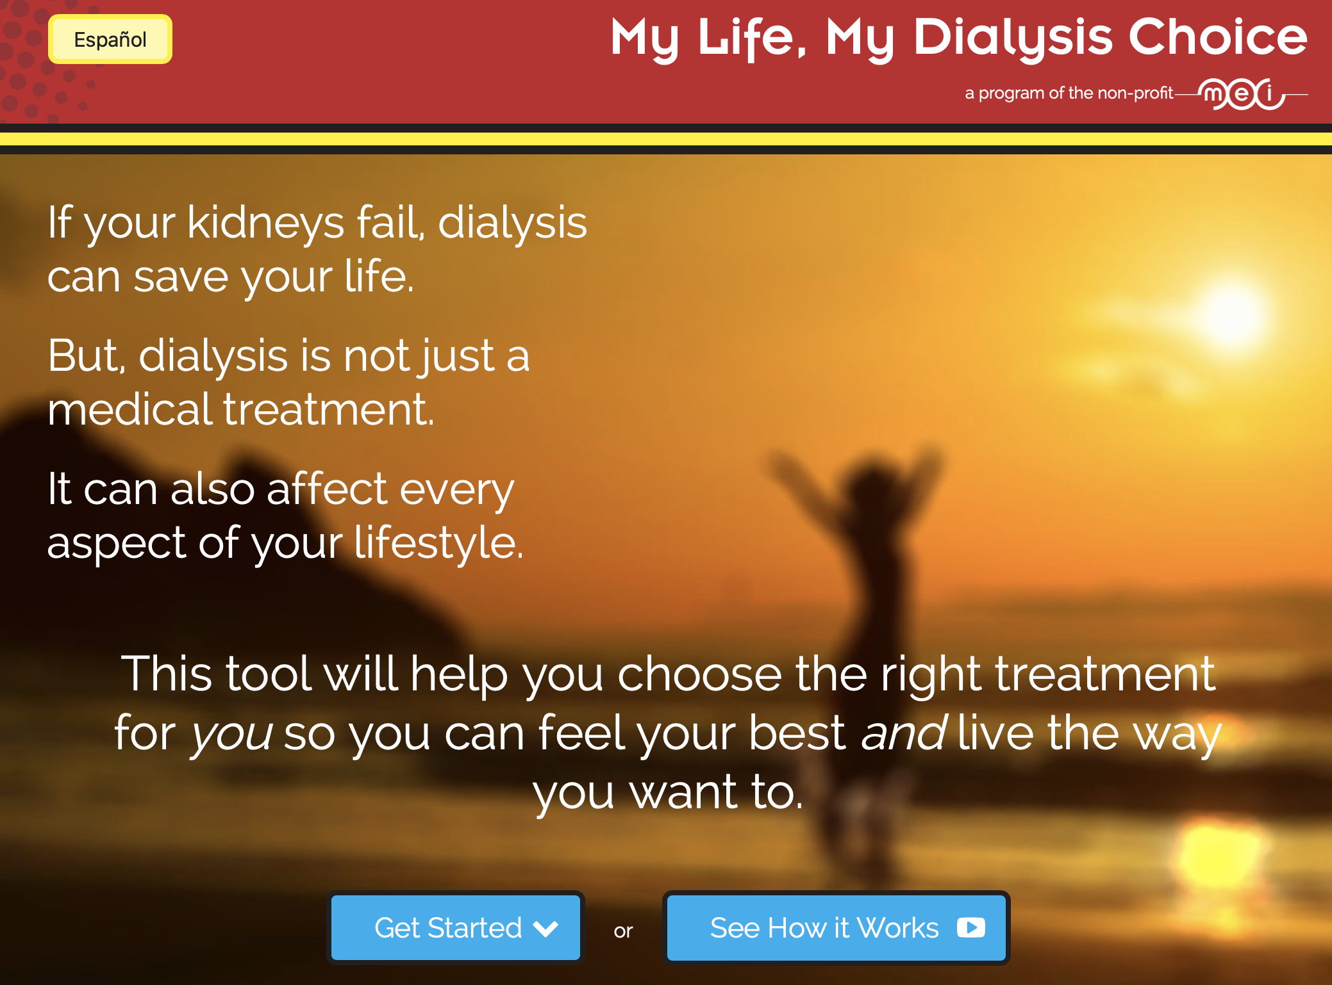
https://mydialysischoice.org
Courtesy of MEI (Dori Schatell)
Notes:
My Life, My Dialysis Choice decision aid was developed by the non-profit Medical Education Institute, Inc. (MEI).
It is available for free online at https://mydialysischoice.org.
It compares pros/cons of various forms of HD (standard, daily, nocturnal) and PD based on patient values. It does not include transplant or conservative care.

Slide 18
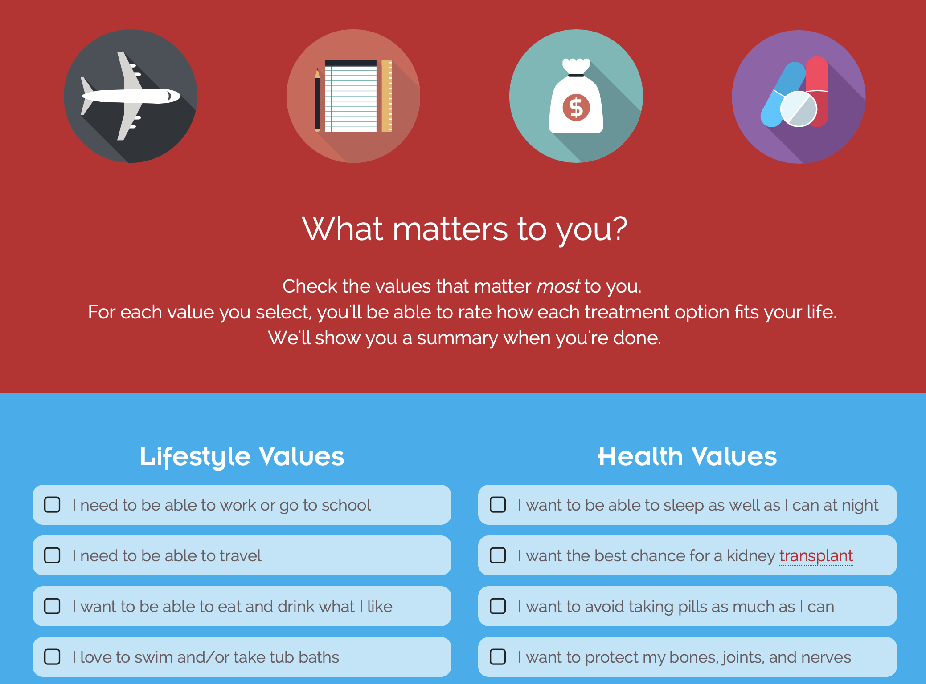
Courtesy of MEI (Dori Schatell)

Slide 19
Decisional Conflict: SURE Test
Légaré et al. Can Fam Physician 2010
Dialysis Core Curriculum 2021
Notes:
The decisional conflict scale (DCS) measures personal perceptions of:
• uncertainty in choosing options;
• modifiable factors contributing to uncertainty such as feeling uninformed, unclear about personal values and unsupported in decision making; and
• effective decision making (in full version) such as feeling the choice is informed, values-based, likely to be implemented, and expressing satisfaction with the choice.
Scores range from 0 [extremely high decisional conflict] to 4 [no decisional conflict]. A score of ≤ 3 indicates decisional conflict.

Slide 20
Communication Skills for Difficult Conversations
Discussing prognosis and RRT options can be challenging
Expectations, uncertainty, and emotions often get in the way
Effective communication skills exist and can be learned with practice
  Ask – Tell – Ask
  NURSE
Schell et al. CJASN 2013
Dialysis Core Curriculum 2021
Notes:
Patients often feel FEAR and DENIAL when they hear their kidneys are failing or that they might need dialysis.
Despite time pressures, the use of communication skills has actually been correlated with more efficient visits and less time for providers.

Slide 21
Ask – Tell – Ask
Ask (assess understanding) | “What have the doctors told you about your kidney function?”
Tell (provide information) | Use plain language, avoid medial jargon
Ask (check understanding) | “To make sure that I explained things well, can you tell me what you understand from what I just said?” “What questions do you have?”
Dialysis Core Curriculum 2021
Notes:
Ask-Tell-Ask is a patient-centered technique that is used to clarify a patient's understanding and perspective.
ASK
Assess patients understanding.
What have other doctors told you?
Provides information about the patient’s baseline level of understanding.
Ask permission to discuss the news.
Is it all right if we talk about your situation?
Patient should not feel forced to have conversation.
TELL
Tell the news using plain language.
Avoid medical jargon.
Provide the information in small pieces.
ASK
Confirm understanding.
Sometimes I don’t do a great job explaining everything. To help me make sure I am clear, could you tell me in your own words what you understand?
Ask patient or family if they have questions.
“What questions do you have?”
Video examples: https://www.niddk.nih.gov/health-information/communication-programs/nkdep/identify-manage-patients/professional-education/communicating-difficult-messages

Slide 22
Responding to Emotion: NURSE
Name | “You seem worried”
Understand | “I see why you are concerned about this”
Respect | “You have shown a lot of strength”
Support | “We will get through this together”
Explore | “Tell me more”
Dialysis Core Curriculum 2021
Notes:
Acknowledging emotion helps patients become ready to hear new information and engage in treatment decisions.

Slide 23
Case Presentation
A 70-year-old man presents to nephrology clinic for follow-up of CKD stage 3 due to diabetes. He was last seen 1 year ago. In the interim, he was hospitalized with chest pain and underwent PCI, so his missed his scheduled follow-up with you. He is now back to his usual activities of running his family business which requires him to work almost every day. The last time you saw him, his GFR was in the 30s, but it is now 25. His urine ACR is 3500 mg/g.
Dialysis Core Curriculum 2021

Slide 24
What Is His Risk of Kidney Failure in the Next 2 Years?
You go to https://kidneyfailurerisk.com to use the Kidney Failure Risk Equation.
Tangri et al. JAMA 2016
Dialysis Core Curriculum 2021
Notes:
You decide to break the news that his kidney function is worse and that it is time to begin learning about his treatment options.

Slide 25
Breaking the News
ASK: You begin by asking what he knows about his current level of kidney function. He says as far as he knows, nothing has changed since last year.
TELL:
  You tell him that unfortunately his kidney function is worse, and it’s time to begin learning about treatment options.
  He becomes TEARFUL and EMOTIONAL.
Dialysis Core Curriculum 2021

Slide 26
Responding to Emotion
You EXPLORE by asking him to tell you more about how he is feeling.
He tells you he is worried about his quality of life and not being able to work.
You offer a SUPPORT statement: “We will get through this together.”
He takes a deep breath and seems to be ready to hear more.
You are now able to talk with him about his options including home dialysis and transplant.
Dialysis Core Curriculum 2021

Slide 27
Referral for Education
ASK: You confirm understanding by asking him to explain to you in his own words what you have talked about.
When you ask, “What questions do you have?” – he says, “None for now.”
He accepts a referral for predialysis education which covers all kidney failure treatment options, including in-center hemodialysis, home hemodialysis, peritoneal dialysis, transplant, and conservative care.
Dialysis Core Curriculum 2021

Slide 28
Follow-Up Visit
You received a note from the nurse who taught his education that he scored a 2 on his SURE Test, meaning he still has some decisional conflict.
When you talk with the patient, he says he is interested in transplant. If dialysis is needed, he would like to do home peritoneal dialysis, but he has a dog at home and read online that means he cannot do PD.
Dialysis Core Curriculum 2021

Slide 29
Wrapping Up
You review the MATCH-D to determine his suitability for PD, and it appears he would be an excellent candidate for PD.
You discuss how to handle pets during connections, and he seems relieved.
He now feels confident in his decision.
You discuss next steps.
Dialysis Core Curriculum 2021

Slide 30
Summary
Prognostic tools are available to estimate prognosis in CKD patients.
Predialysis education has significant benefits for patients and is covered by MIPPA.
Decision aids can help patients clarify their personal values and facilitate shared decisions making conversations.
Effective communication skills exist for having difficult conversations and can be learned with practice.
Dialysis Core Curriculum 2021

Slide 31
REFERENCES
Green JA, Boulware LE: Patient Education and Support During CKD Transitions: When the Possible Becomes Probable. Adv Chronic Kidney Dis 23(4):231-9, 2016
Tangri N, Stevens LA, Griffith J, et al: A predictive model for progression of chronic kidney disease to kidney failure. JAMA 305(15), 1553-1559, 2011
Tangri N, Grams ME, Levey AS, et al: Multinational Assessment of Accuracy of Equations for Predicting Risk of Kidney Failure: A Meta-analysis. JAMA 315(2):1-11, 2016
Cohen LM, Ruthazer R, Moss AH, Germain MJ. Predicting six-month mortality for patients who are on maintenance hemodialysis. Clin J Am Soc Nephrol 5(1):72-79, 2010
Anderson RT, Cleek H, Pajouhi AS, et al: Prediction of Risk of Death for Patients Starting Dialysis. A Systematic Review and Meta-Analysis. Clin J Am Soc Nephrol14(8): 1213–1227, 2019
Couchoud CG, Beuscart JR, Aldigier JC, et al: Development of a risk stratification algorithm to improve patient-centered care and decision making for incident elderly patients with end-stage renal disease. Kidney Int 88(5): 1178-1186, 2015
Thamer M, Kaufman JS, Zhang Y, et al: Predicting Early Death Among Elderly Dialysis Patients: Development and Validation of a Risk Score to Assist Shared Decision Making for Dialysis Initiation. Am J Kidney Dis 66(6):1024-1032, 2015
Obi Y, Nguyen DV, Zhou H, et al: Development and Validation of Prediction Scores for Early Mortality at Transition to Dialysis. Mayo Clin Proc 93(9):1224-1235, 2018
Wu IW, Wang SY, Hsu KH, et al” Multidisciplinary predialysis education decreases the incidence of dialysis and reduces mortality--a controlled cohort study based on the NKF/DOQI guidelines. Nephrol Dial Transplant 24(11):3426-33, 2009
Kurella Tamura M, Li S, Chen SC, et al. Educational programs improve the preparation for dialysis and survival of patients with chronic kidney disease. Kidney Int 85(3):686-692, 2014
Dialysis Core Curriculum 2021

Slide 32
REFERENCES
Manns BJ, Taub K, Vanderstraeten C, et al. The impact of education on chronic kidney disease patients' plans to initiate dialysis with self-care dialysis: a randomized trial. Kidney Int 68(4):1777-1783, 2005
Shukla AM, Easom A, Singh M, Pandey R, Rotaru D, Wen X, Shah SV. Effects of a Comprehensive Predialysis Education Program on the Home Dialysis Therapies: A Retrospective Cohort Study. Perit Dial Int 37(5):542-547, 2017
Hsu CK, Lee CC, Chen YT, et al: Multidisciplinary predialysis education reduces incidence of peritonitis and subsequent death in peritoneal dialysis patients: 5-year cohort study. PLoS One 13(8):e0202781, 2018
Cankaya E, Cetinkaya R, Keles M, et al: Does a predialysis education program increase the number of pre-emptive renal transplantations? Transplant Proc 45(3):887-9, 2013
Rasgon S, Schwankovsky L, James-Rogers A, et al: An intervention for employment maintenance among blue-collar workers with end-stage renal disease. Am J Kidney Dis 22(3):403-412, 1993
Levin A, Lewis M, Mortiboy P, et al: Multidisciplinary predialysis programs: quantification and limitations of their impact on patient outcomes in two Canadian settings. Am J Kidney Dis 29(4):533-540, 1997
United States Centers for Medicare & Medicaid Services (CMS) Manual System. Coverage of Kidney Disease Patient Education Services. Published December 18, 2009. Accessed February 10, 2019. https://www.cms.gov/Regulations-and-Guidance/Guidance/Transmittals/downloads/R1876CP.pdf
Young HN, Chan MR, Yevzlin AS, et al: The rationale, implementation, and effect of the Medicare CKD education benefit. Am J Kidney Dis 57(3):381-386, 2011
The National Institute of Diabetes and Digestive and Kidney Diseases. Kidney Disease Education Lesson Builder. Accessed February 10, 2019. https://www.niddk.nih.gov/health-information/professionals/education-cme/kidney-disease-education-lesson-builder?dkrd=hisce0061.68
Dialysis Core Curriculum 2021

Slide 33
REFERENCES
The Medical Education Institute, Inc. Method to Assess Treatment Choices for Home Dialysis (MATCH-D), Version 4. Published March 15, 2013. Accessed February 10, 2019. https://homedialysis.org/match-d
The Medical Education Institute, Inc. My Life, My Dialysis Choice. Updated 2019. Accessed February 10, 2019. https://mydialysischoice.org
Légaré F, Kearing S, Clay K, et al: Are you SURE? Assessing patient decisional conflict with a 4-item screening test. Can Fam Physician 56(8):e308-14, 2010
Schell JO, Green JA, Tulsky JA, et al: Communication skills training for dialysis decision-making and end-of-life care in nephrology. Clin J Am Soc Nephrol 8(4):675-680, 2013
Schell JO, Arnold RM. NephroTalk: communication tools to enhance patient-centered care. Sem dialysis 25(6):611-616, 2012
Dialysis Core Curriculum 2021

